Slide 1
What is the minimal hardware support needed for an operating system (that can manage resources)?
Programs
Programs
Operating System
CPU
CPU
Memory
Memory

Slide 3
Content of the Course
Problem Sets 1-3: systems programming
Not in supervisor mode:
above the level of the “operating system”
Breaking into abstractions that are provided by OS or libraries
Classes: understanding more of what is going on underneath

Slide 4
highlight some projects from last year
Norvigtorious, uvagraph
IronKernel
Kiet’s

Slide 5
Introducing Rust
Truthiness vs. Control vs. Expressiveness

Slide 6
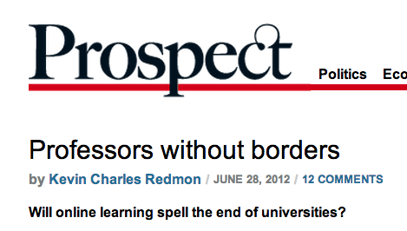
Teaching Philosophy
“I always felt, I was at Stanford, the world’s best university, and I was a great teacher,” he [Sebastian Thrun] said. “Having done this, I can’t teach at Stanford again. It’s impossible. I feel like there’s a red pill and a blue pill, and you can take the blue pill and go back to the classroom and lecture your 20 students. But I’ve taken the red pill. And I’ve seen wonderland.”
* * *
Not long ago, on a rainy Saturday morning, Professor Dave Evans and I hung out in bed while he tried to explain recursive functions (for the fourth time) and I worked on my homework. Or rather, I hung out in bed, and Evans, a computer science professor at the University of Virginia, hung out on my laptop screen, where I could—click—pause him midsentence and pour myself another cup of coffee.

Slide 7
What do you think my goals are in designing assignments?

Slide 8
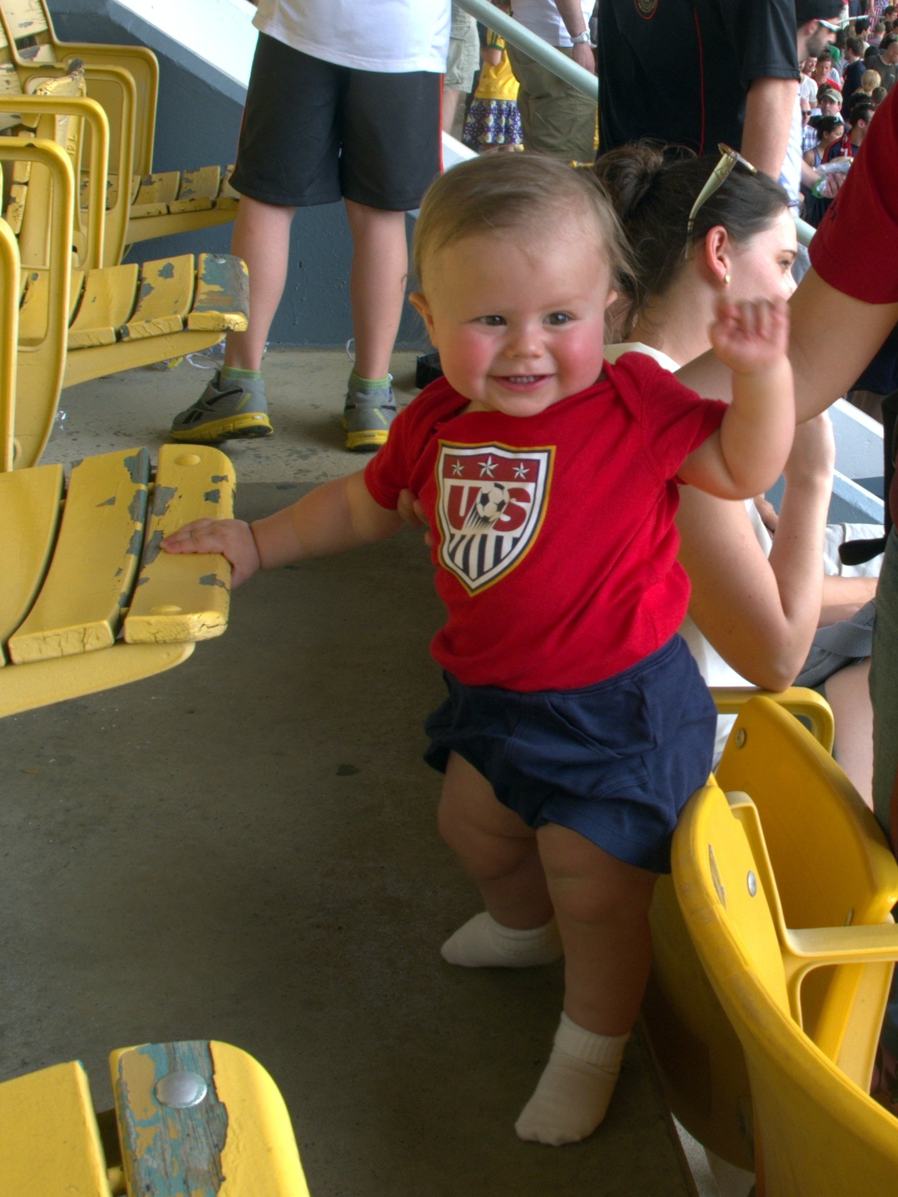
How much time should I spend on grading this semester?
Note: I mean just “grading” for the point of being able to assign appropriate grades to students. This doesn’t include time giving substantive “feedback”.

Slide 9
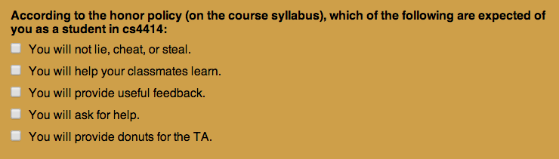
Course Honor Policy
5 people got it more wrong by omission (left out important things you should do)! If you are one of them and you want to stay in the class, read the syllabus more carefully and resubmit to correct your answer.

Slide 10

Course Honor Policy
3 people got it more wrong by addition. Those people definitely need to provide high quality donuts for the TAs! (This is encouraged for everyone, but optional if you didn’t check it as part of the honor policy.)

Slide 11
Plan for Projects
PS1: zhttpto web server
PS2: gash (learn about processes)
PS3: zhtta web server (learn about memory management, network protocols, performance)
PS4: something like DropBox (file systems, I/O, security)
PS2 Demo:
gash (“Good Auld Shell”)

Slide 12
cs4414 OS Definition
An operating system is a program that manages resources and provides abstractions.
Managing resources:

Slide 13
cs4414 OS Definition
An operating system is a program that manages resources and provides abstractions.
Managing resources:
How do you share processors, memory, and other hardware devices among programs?
Providing abstractions:
How do you provide programs with clean and easy to use interfaces to resources, without sacrificing (too much) efficiency and flexibility?

Slide 14
cs4414 OS Definition
An operating system is a program that manages resources and provides abstractions.
Managing resources:
How do you share processors, memory, and other hardware devices among programs?
Providing abstractions:
How do you provide programs with clean and easy to use interfaces to resources, without sacrificing (too much) efficiency and flexibility?

