Slide 1

Class 1: Introduction
cs4414 Spring 2014
rust-class.org
University of Virginia
David Evans

Slide 2
Plan for Today
What is an Operating System?
Course Overview
Introducing Rust

Slide 3
What is an Operating System?

Slide 4
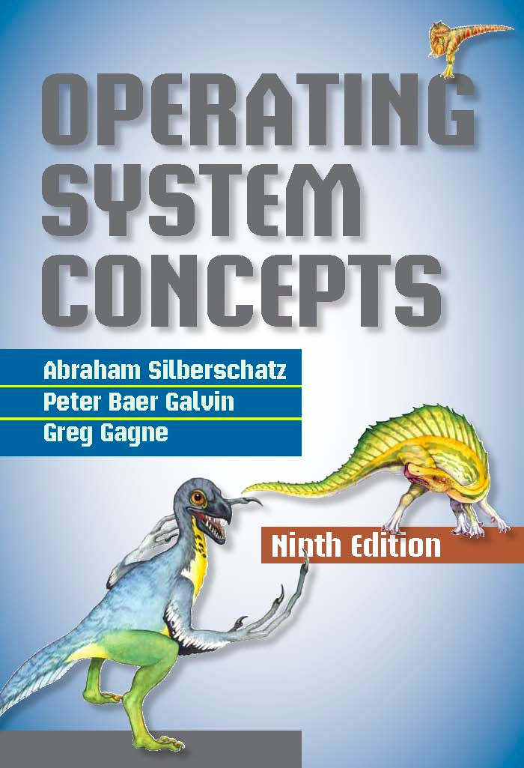
An operating system is a program that manages a computer’s hardware. It also provides a basis for application programs and acts as an intermediary between the computer user and the computer hardware. An amazing aspect of operating systems is how they vary in accomplishing these tasks. Mainframe operating systems are designed primarily to optimize utilization of hardware. Personal computer (PC) operating systems support complex games, business applications, and everything in between. Operating systems for mobile computers provide an environment in which a user can easily interface with the computer to execute programs. Thus, some operating systems are designed to be convenient, others to be efficient, and others to be some combination of the two.
$186.95

Slide 5
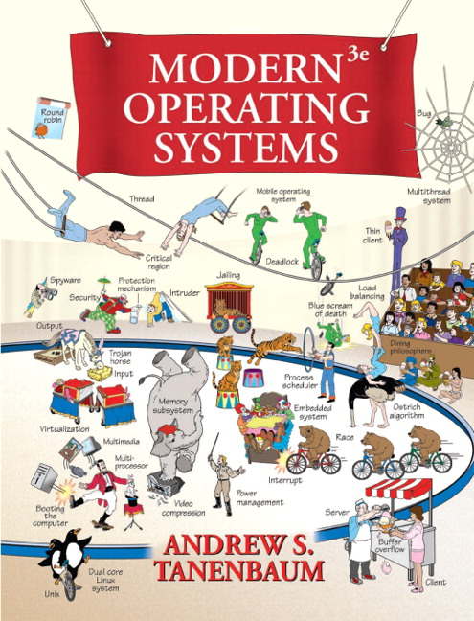
$186.00
It is hard to pin down what an operating system is other than saying it is the software that runs in kernel mode – and even that is not always true. Part of the problem is that operating systems perform two basically unrelated functions: providing application programmers (and application programs, naturally) a clean abstract set of resources instead of the messy hardware ones and managing these hardware resources.

Slide 6
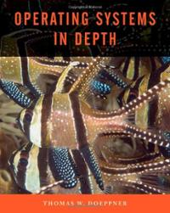
What’s an operating system? You might say it’s what’s between you and the hardware, but that would cover pretty much all software. So let’s say it’s the software that sites between your software and the hardware. But does that mean that the library you picked up from some web site is part of the operating system? We probably want our operating-system definition to be a bit less inclusive. So, let’s say that it’s that software that almost everything else depends upon. This is still vague, but then the term is used in a rather nebulous manner throughout the industry.
Perhaps we can do better by describing what an operating system is actually supposed to do. From a programmer’s point of view, operating systems provide useful abstractions of the underlying hardware facilities. Since many programs can use these facilities at once, the operating system is also responsible for managing how these facilities are shared.
$149.95

Slide 7
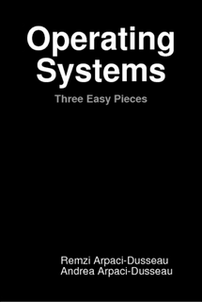
There is a body of software, in fact, that is responsible for making it easy to run programs (even allowing you to seemingly run many at the same time), allowing programs to share memory, enabling programs to interact with devices, and other fun stuff like that. That body of software is called the operating system, as it is in charge of making sure the system operates correctly and efficiently in an easy-to-use manner.
$0.00 ($29)

Slide 8
Do we like any of these definitions?

Slide 9
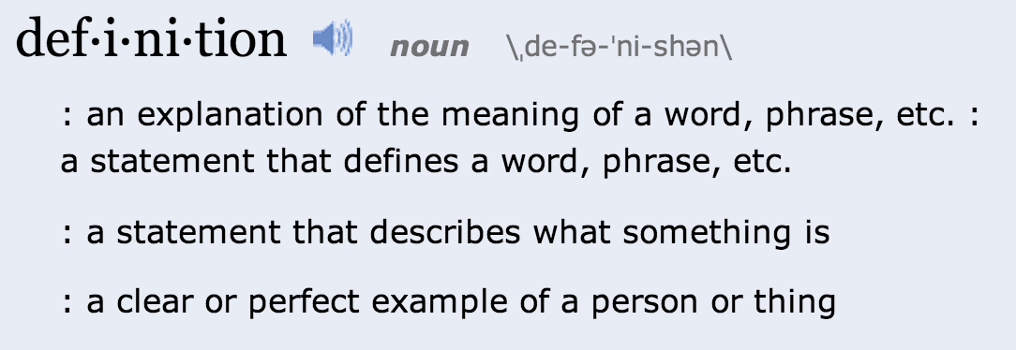
http://www.merriam-webster.com/dictionary/definition

Slide 10


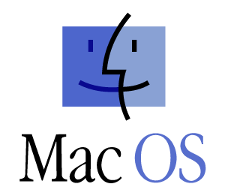
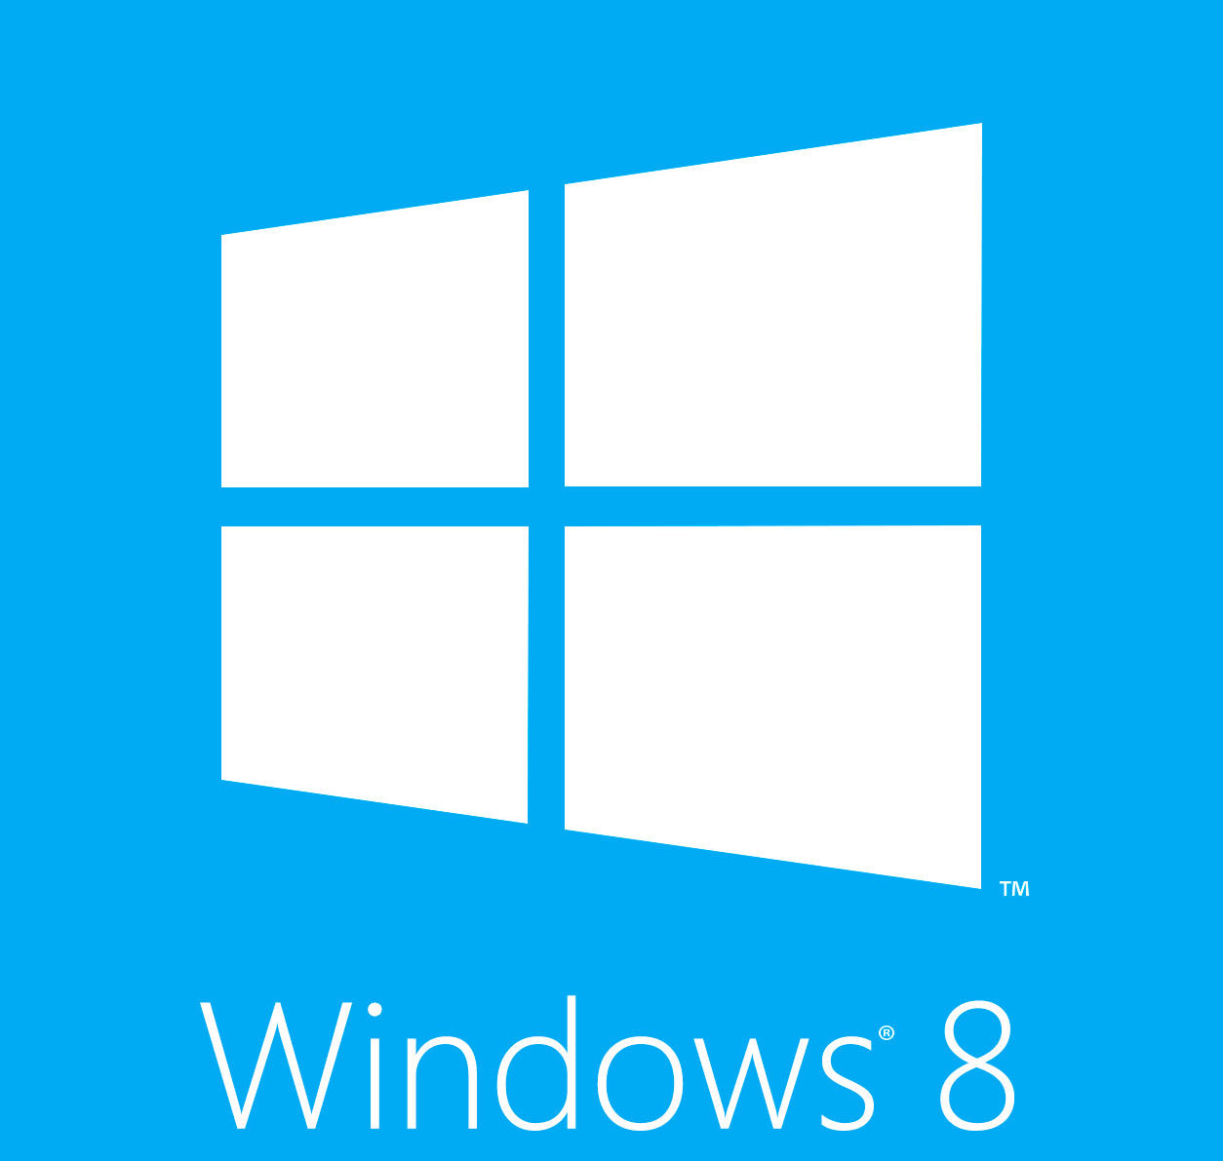
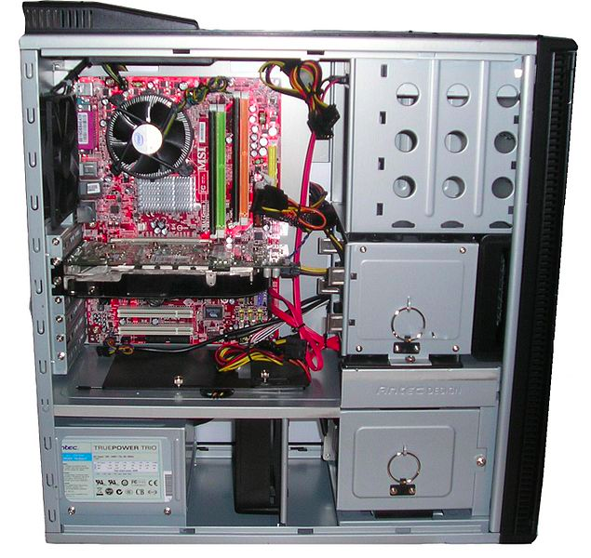

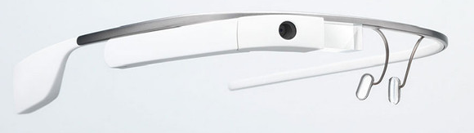
Simplistic View of Computing Systems
Applications
Operating System
Hardware

Slide 11
More Realistic View
Applications
Operating System
Hardware

Slide 12
cs4414 OS Definition
An operating system is a program that manages resources and provides abstractions.

Slide 13
Main Ideas in cs4414
Managing Resources
How do you share processors, memory, and hardware devices among programs?
Providing Abstractions
How do you provide programs with clean and easy to use interfaces to resources, without sacrificing (too much) efficiency and flexibility?

Slide 14
Does it have an Operating System?

Slide 15
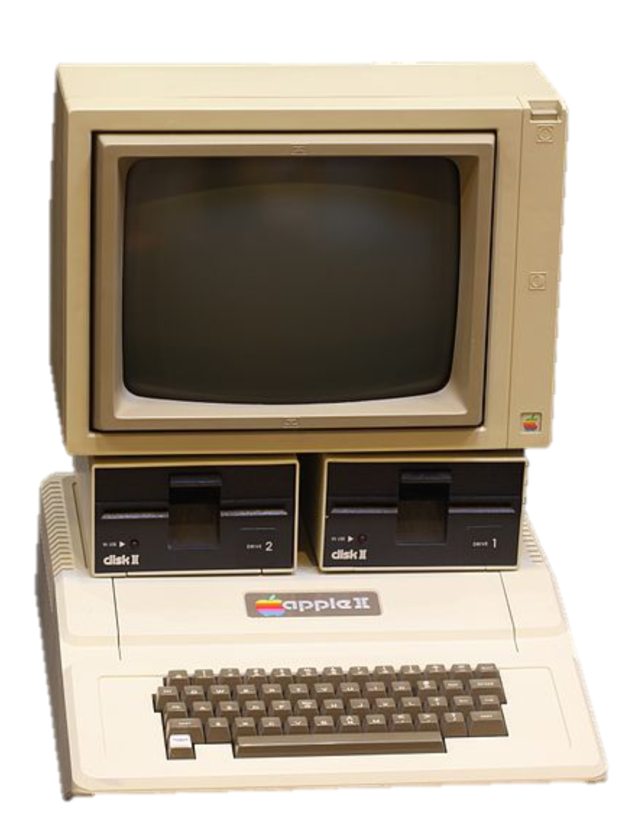
Apple II
1977

Slide 16
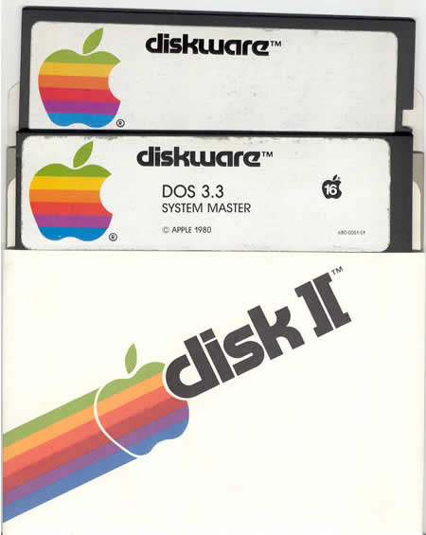

Slide 17
✖ Manage Resources
✔ Provide Abstractions

Slide 18
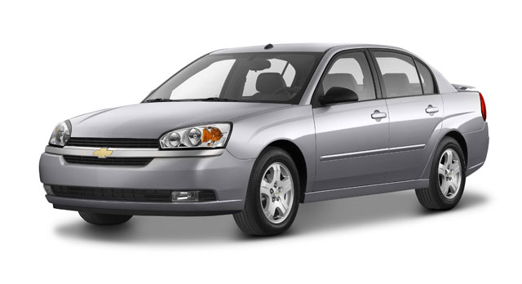

Slide 19
Not just one operating system, but dozens of them!

Slide 20
Does it have an Operating System?

Slide 22
Course Overview

Slide 23



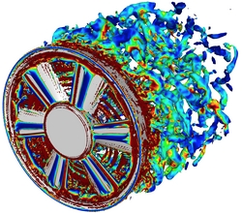


Minimizing Magic
Cool Computing Stuff
Its all magic!
Physics

Slide 24
Minimizing Magic
Cool Computing Stuff
Its all magic!
Four Years Studying Computing at an Elite Public University
Physics

Slide 25

Minimizing Magic
Cool Computing Stuff
Its all magic!
Its all understandable!
(and I can do magical things!)
Four Years Studying Computing at an Elite Public University
Physics

Slide 26
Minimizing Magic
Cool Computing Stuff
Its all magic!
cs1110
By the time you graduate, nothing should be “magic” other than how transistors work and NP-Completeness.
Physics

Slide 27
Minimizing Magic
Cool Computing Stuff
Its all magic!
cs3102
cs2110
cs1110
cs2150
cs3330
By the time you graduate, nothing should be “magic” other than how transistors work and NP-Completeness.
cs2150
cs2330
Physics

Slide 28
Minimizing Magic
Cool Computing Stuff
Its all magic!
cs4414
cs3102
cs2110
cs1110
cs2150
cs4414
cs3330
By the time you graduate, nothing should be “magic” other than how transistors work and NP-Completeness.
cs2150
cs4414
cs2330
Physics

Slide 29
Minimizing Magic
Cool Computing Stuff
Its all magic!
electives
cs4414
cs3102
cs2110
cs1110
cs4610
cs2150
cs4414
cs3330
By the time you graduate, nothing should be “magic” other than how transistors work and NP-Completeness.
cs2150
cs4414
cs2330
Physics

Slide 30
(Academic) Goal of the Class
Improve our understanding of how computers work.

Slide 31
(Academic) Goal of the Class
Improve our understanding of how computers work.
Not:

Slide 32
Why bother?
Better understanding of how computers work make you a better programmer which will help you build something cool, succeed in grad school, or get a more interesting job.
Better understanding of how computers work (and why) is intellectually, culturally, and scientifically interesting.

Slide 33
Why bother?
Better understanding of how computers work make you a better programmer which will help you build something cool, succeed in grad school, or get a more interesting job.
Better understanding of how computers work (and why) is intellectually, culturally, and scientifically interesting.

Slide 34
Why bother?
Better understanding of how computers work make you a better programmer which will help you build something cool, succeed in grad school, or get a more interesting job.
Better understanding of how computers work (and why) is intellectually, culturally, and scientifically interesting.

Slide 35
Why bother?
Better understanding of how computers work make you a better programmer which will help you build something cool, succeed in grad school, or get a more interesting job.
Better understanding of how computers work (and why) is intellectually, culturally, and scientifically interesting.
If these reasons don’t apply for you and you are only in this class because there is a bureaucratic requirement that you take it so some Dean will hand you a nice bit of paper in front of your parents, you should meet with me to figure out an alternative.

Slide 36
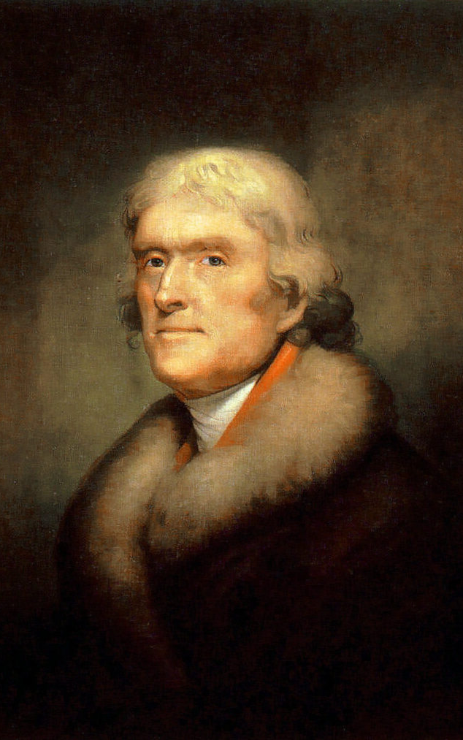
What Mr. Jefferson Wants

Slide 37
What Mr. Jefferson Wants
“We wish to establish in the upper country of Virginia, and more centrally for the State, a University on a plan so broad and liberal and modern, as to be worth patronizing with the public support, and be a temptation to the youth of other States to come and drink…”
TJ’s letter to Joseph Priestly, 1800
No Majors
No Degrees
No President

Slide 38
Note: this does not mean he wants you to be lazy:
:
Thomas Jefferson enrolled in the College of William and Mary on March 25, 1760, at the age of 16…
By the time he came to Williamsburg, the young scholar was proficient in the classics and able to read Greek and Latin authors in the original… He was instructed in natural philosophy (physics, metaphysics, and mathematics) and moral philosophy (rhetoric, logic, and ethics). A keen and diligent student, he displayed an avid curiosity in all fields and, according to family tradition, he frequently studied fifteen hours a day.
http://www.wm.edu/about/history/tjcollege/tjcollegelife/

Slide 39
What is my goal for lectures?
Convey some complex technical ideas
Teach you what you need to know to do the projects
Avoid being fired
Keep most of you awake for 75 minutes
Get you to laugh at dumb jokes

Slide 40
What is my goal for lectures?
Convey some complex technical ideas
Teach you what you need to know to do the projects
Avoid being fired
Keep most of you awake for 75 minutes
Get you to laugh at dumb jokes
Lectures are a horrible medium for learning complex ideas.
Better to read wikipedia.

Slide 41
What is my goal for lectures?
Convey some complex technical ideas
Teach you what you need to know to do the projects
Avoid being fired
Keep most of you awake for 75 minutes
Get you to laugh at dumb jokes
Lectures are a horrible medium for learning complex ideas.
Better to read wikipedia.
The point of the projects is to teach you things I want you to learn in the class (mostly by suggesting things you should learn on your own).

Slide 42
What is my goal for lectures?
Convey some complex technical ideas
Teach you what you need to know to do the projects
Avoid being fired
Keep most of you awake for 75 minutes
Get you to laugh at dumb jokes
Lectures are a horrible medium for learning complex ideas.
Better to read wikipedia.
The point of the projects is to teach you things I want you to learn in the class (mostly by suggesting things you should learn on your own).
I have tenure already

Slide 43
What is my goal for lectures?
Convey some complex technical ideas
Teach you what you need to know to do the projects
Avoid being fired
Keep most of you awake for 75 minutes
Get you to laugh at dumb jokes
Lectures are a horrible medium for learning complex ideas.
Better to read wikipedia.
The point of the projects is to teach you things I want you to learn in the class (mostly by suggesting things you should learn on your own).
I have tenure already
You probably should be getting more sleep!

Slide 44
What is my goal for lectures?
Convey some complex technical ideas
Teach you what you need to know to do the projects
Avoid being fired
Keep most of you awake for 75 minutes
Get you to laugh at dumb jokes
Lectures are a horrible medium for learning complex ideas.
Better to read wikipedia.
The point of the projects is to teach you things I want you to learn in the class (mostly by suggesting things you should learn on your own).
I have tenure already
You probably should be getting more sleep!
Monty Python is funnier (unless you are Kevin Redmon)

Slide 45
My Real Goal for Lectures
Provide context and meaning for the things you have or will later learn on your own.
(I also have an insidious goal for lectures, that I won’t tell you about until later…)

Slide 46
Course Assignments

Slide 47

The Problem Sets are Suggestions
If you have a better idea, convince me, and you should do that instead.

Slide 48
Plan for Projects
PS0 (Friday): Rust tutorial and course survey
PS1 (23 Jan): zhttpto web server
PS2 (9 Feb): gash (learn about processes)
PS3 (3 March): zhtta web server (learn about synchronization, memory management)
PS4 (2 April): hacking a (relatively simple) kernel

Slide 49
This generation of students got into “UVa” by doing exactly and precisely what teacher wants. If teacher is vague about what he wants, they work a lot harder to figure out what they want and whether or not it is good. The vaguer the directions, the more likely the opportunity for serendipity to happen. It drives them nuts!
Harvard Professor John Stilgoe
(on "60 Minutes", 4 January 2004)

Slide 50
Final Project
Final Project (29 April):
(almost*) anything you want!
* must be at least two of:
fun, technically interesting,
useful, relevant
Start thinking of ideas now – if you come up with something sufficiently worthwhile, can substitute for PS4/PS3/PS2/etc.

Slide 51
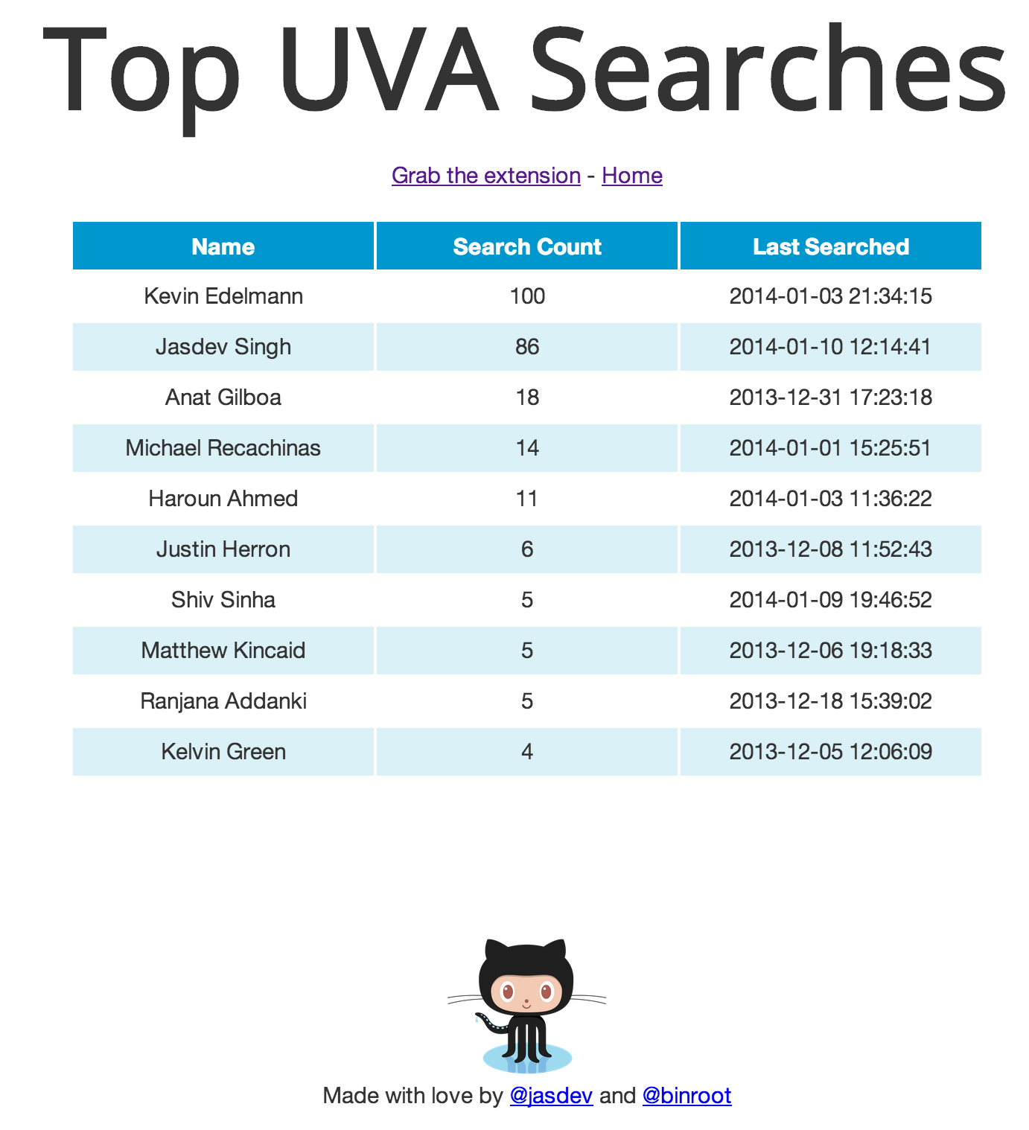
Some Examples
http://uvasear.ch/
Nishant Shukla
Jasdev Singh

Slide 52
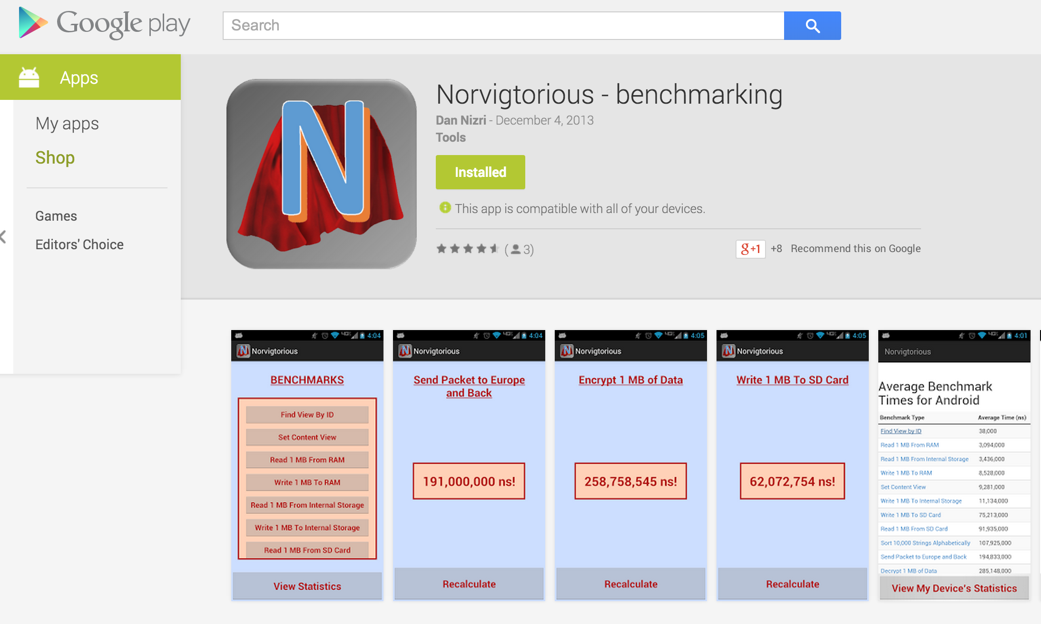
Norvigtorious
Alex Fabian
Daniel Nizri
Renee Seaman
Casey Silver

Slide 53

IronKernel
Kevin Broderick
Alex Lamana
Zeming Lin
John Stevans
Wil Thomason
We will use this for PS4!

Slide 54
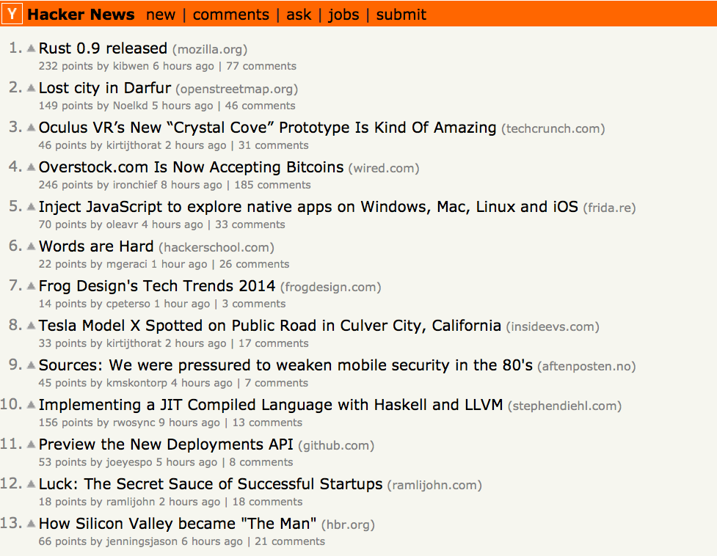

Slide 55
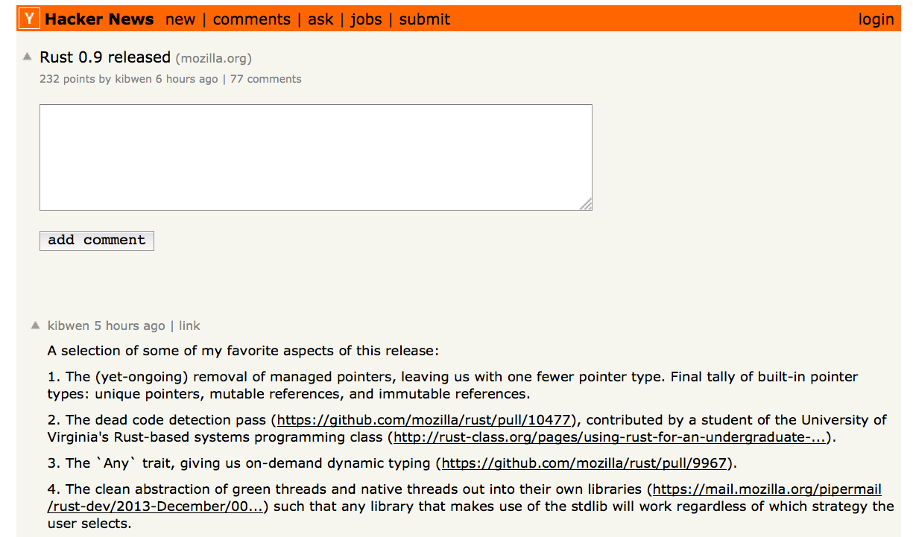

Slide 56
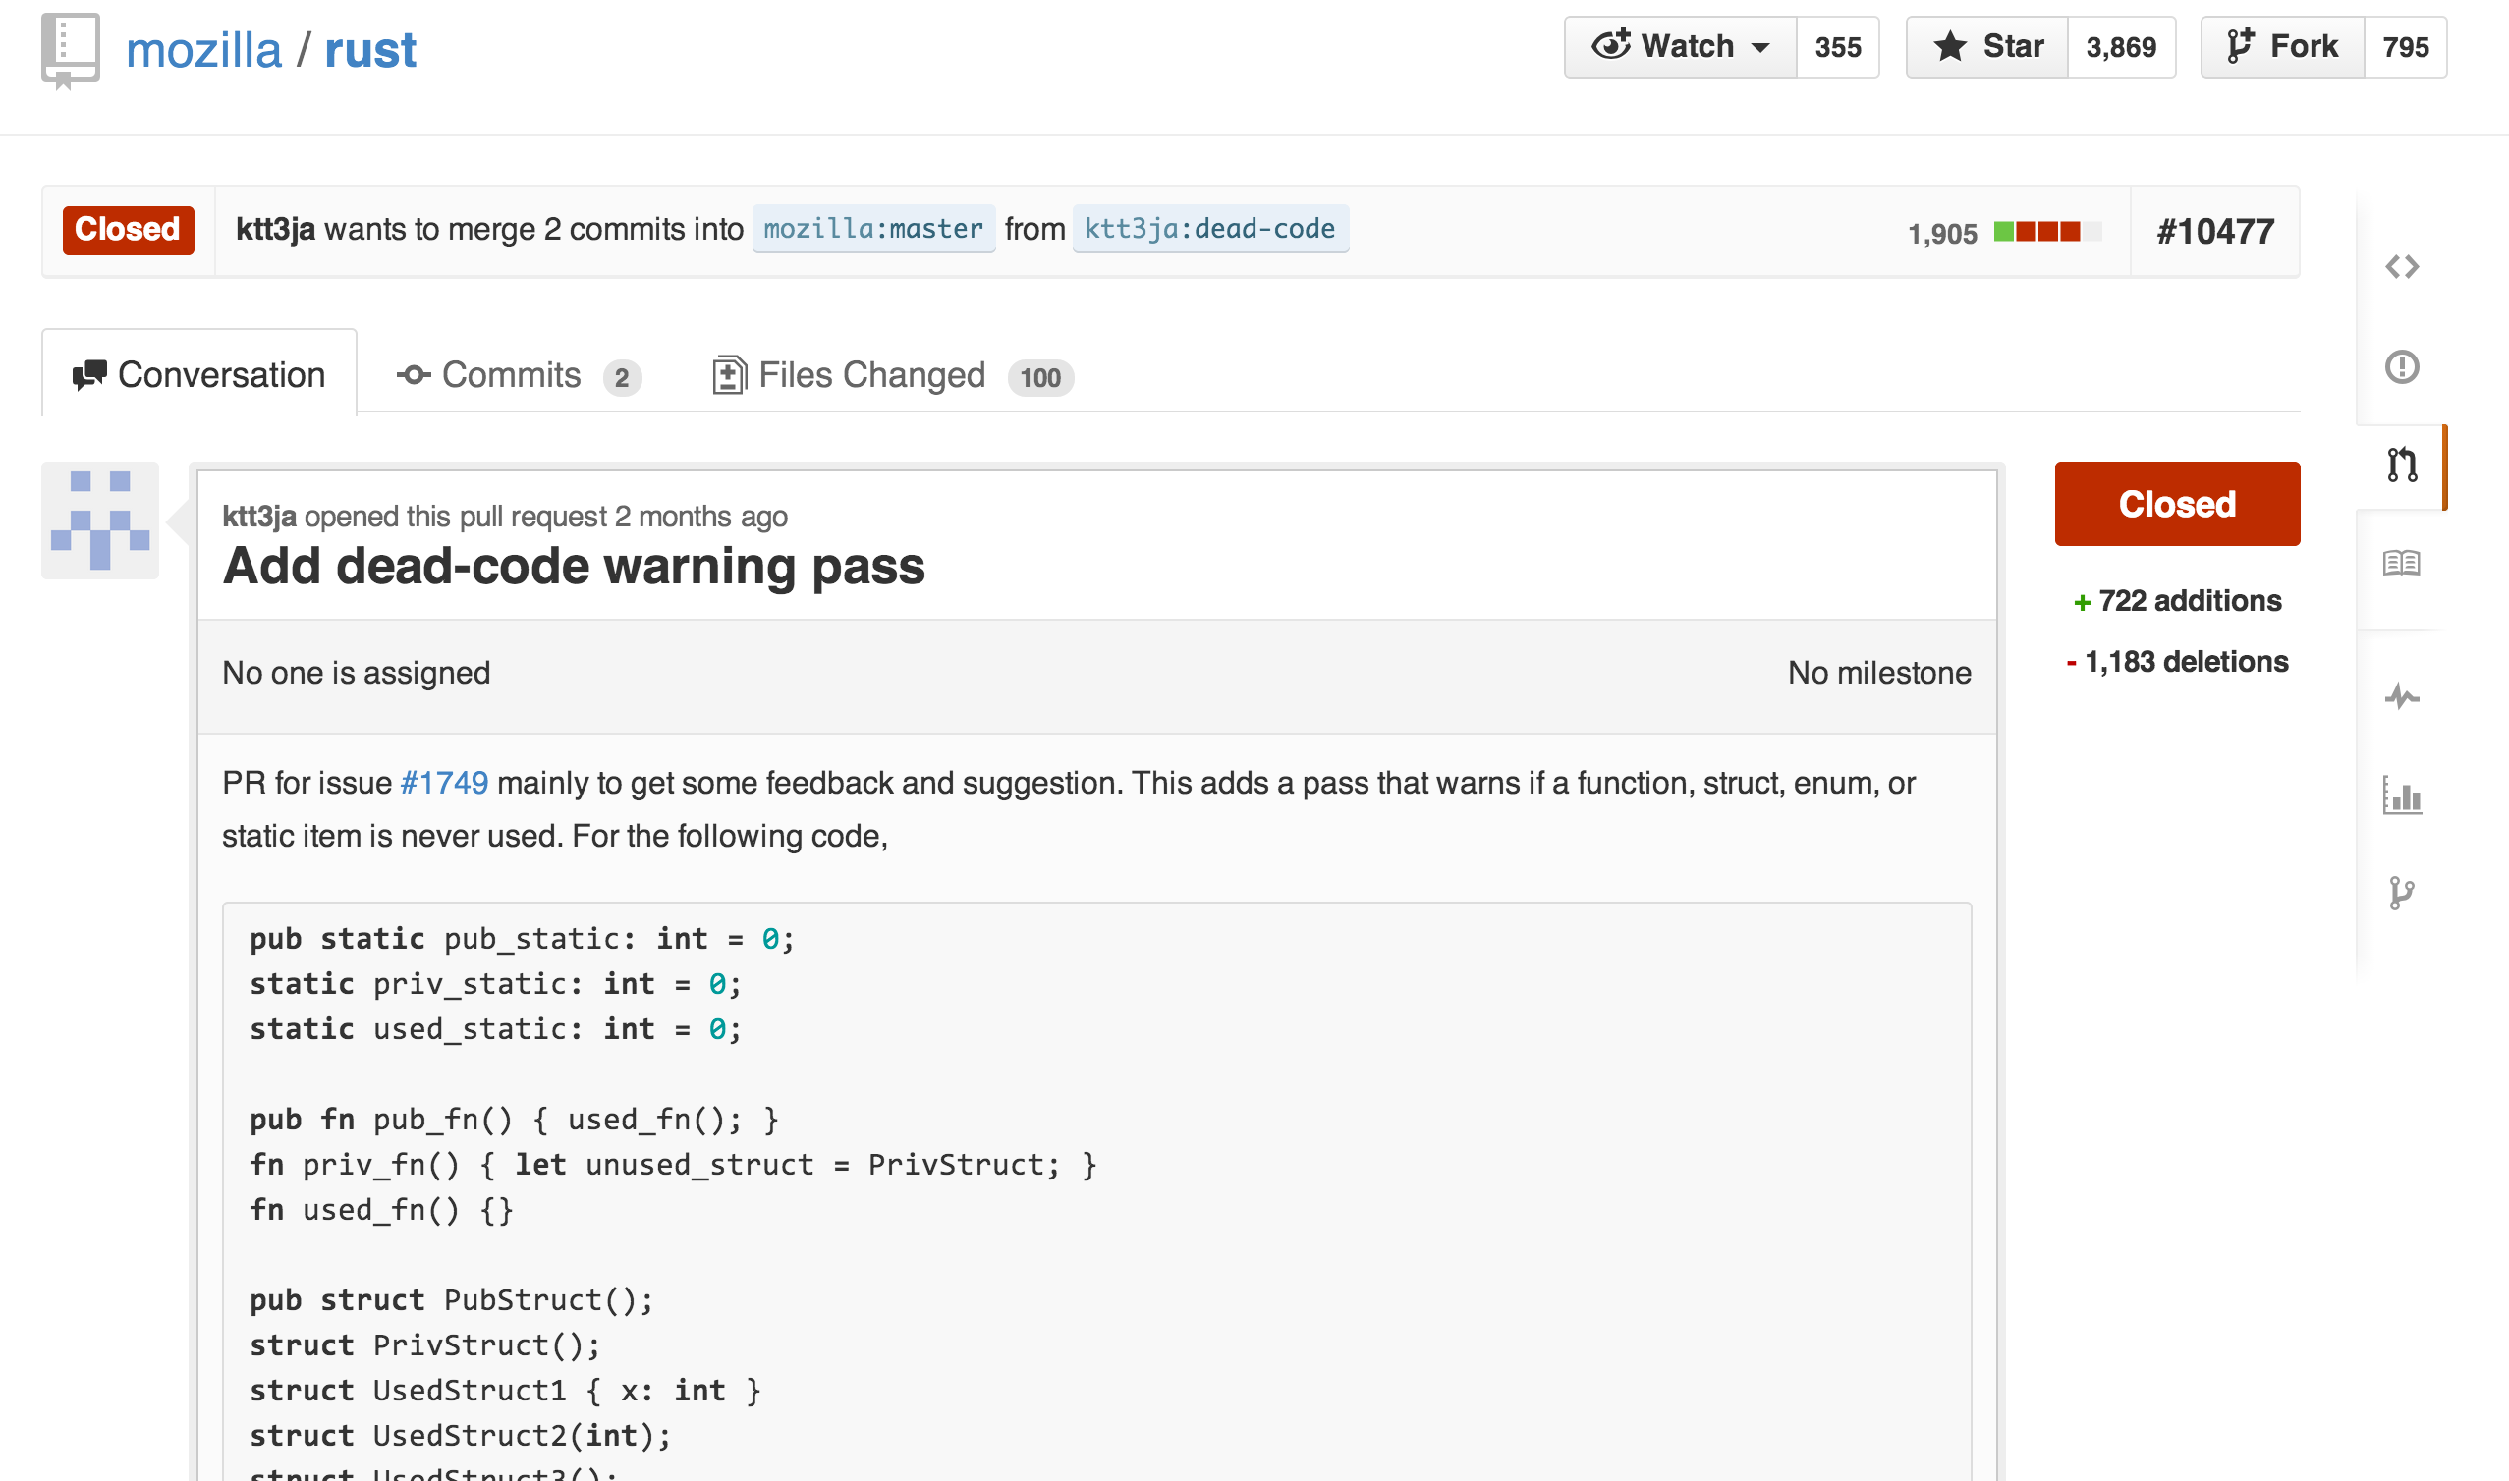
Kiet Tran

Slide 57

Why learn a new programming language?

Slide 58
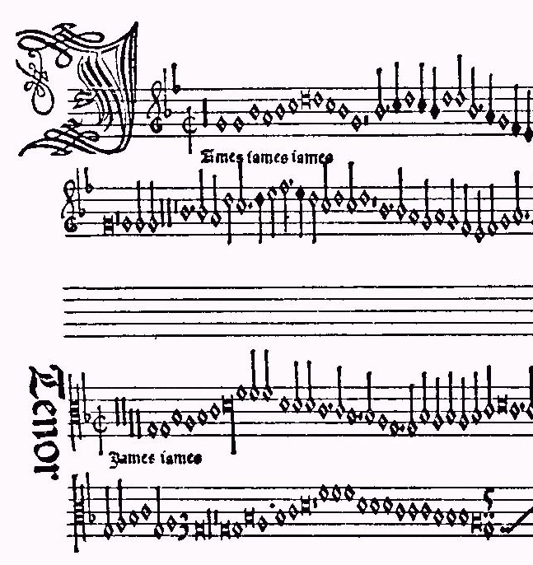
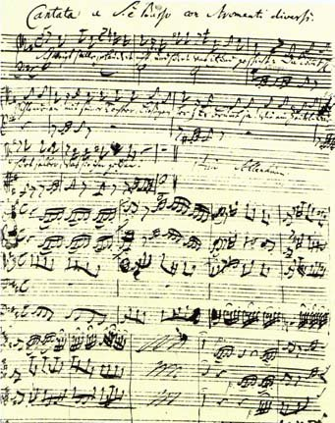
“Jamais Jamais Jamais” from Harmonice Musices Odhecaton A. (1501)
J S Bach, “Coffee Cantata”, BWV 211 (1732)
www.npj.com/homepage/teritowe/jsbhand.html

Slide 59
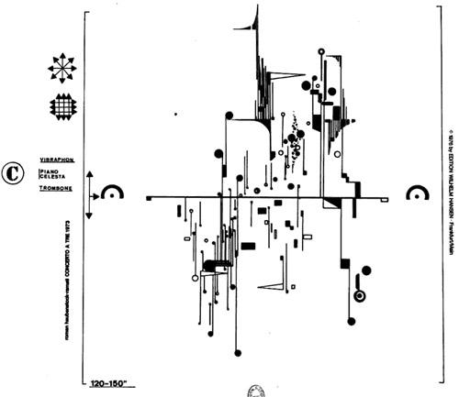
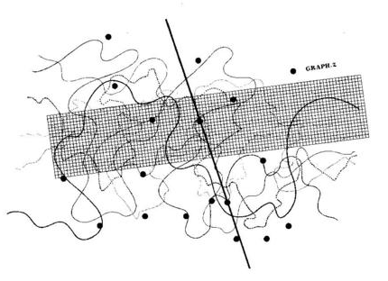
Modern Music Notation
Roman Haubenstock-Ramati, Concerto a Tre
John Cage, Fontana Mix
http://www.medienkunstnetz.de/works/fontana-mix/audio/1/

Slide 60
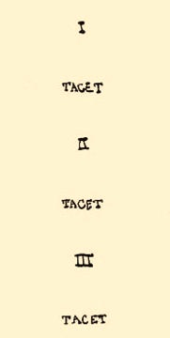

Slide 61
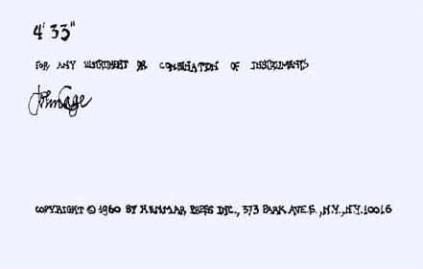
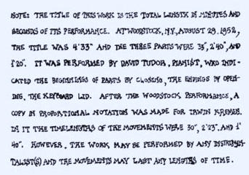

Slide 62
Thought and Action
Languages change the way we think
  BASIC: think about GOTO
  Algol, Python: think about assignments, control blocks
  Scheme, Haskell: think about procedures
  Java, C++: think about types, objects
Languages provide abstractions of machine resources
  Hide dangerous/confusing details: memory locations, instruction opcodes, number representations, calling conventions, etc.
  Hiding more increases simplicity, but limits control

Slide 63


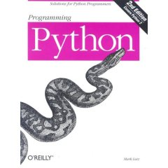

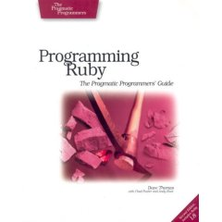
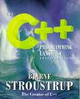
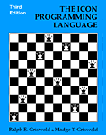

Why so many programming languages?

Slide 64
Fundamental Differences
All equivalently powerful!
  Universal languages: all capable of simulating each other
Fundamental differences
  Expressiveness: how easy it is to describe a computation
  Control: how much programmer can control machine
  “Truthiness”: likelihood program means programmer wants
  Safeness: impact of programmer mistakes
Difficult to achieve all of these at once

Slide 65
Fundamental Differences
All equivalently powerful!
  Universal languages: all capable of simulating each other
Fundamental differences
  Expressiveness: how easy it is to describe a computation
  Control: how much programmer can control machine
  “Truthiness”: likelihood program means programmer wants
  Safeness: impact of programmer mistakes
Difficult to achieve all of these at once

Slide 66
Fundamental Differences
All equivalently powerful!
  Universal languages: all capable of simulating each other
Fundamental differences
  Expressiveness: how easy it is to describe a computation
  Control: how much programmer can control machine
  “Truthiness”: likelihood program means programmer wants
  Safeness: minimize impact of programmer mistakes
Difficult to achieve all of these at once

Slide 67
Fundamental Differences
All equivalently powerful!
  Universal languages: all capable of simulating each other
Fundamental differences
  Expressiveness: how easy it is to describe a computation
  Control: how much programmer can control machine
  “Truthiness”: likelihood program means programmer wants
  Safeness: minimize impact of programmer mistakes
Difficult to achieve all of these at once
What do we want for systems programming?

Slide 68
Programming Language Design Space
high
Expressiveness
low
more mistake prone
less mistake prone
“Truthiness”

Slide 69
Programming Language Design Space
high
Scheme
(display “Hello!”)
Python
print ("Hello!")
Expressiveness
BASIC
strict typing,
static
C++
C
Java
Ada
low
Spec#
more mistake prone
less mistake prone
“Truthiness”

Slide 70
Programming Language Design Space
high
Control
low
very risky
fairly safe
Safety

Slide 71
Programming Language Design Space
high
C
Control
Java
Python
low
very risky
fairly safe
Safety

Slide 72

“a safe, concurrent, practical language”
Its design is oriented toward concerns of “programming in the large”, that is, of creating and maintaining boundaries – both abstract and operational – that preserve large-system integrity, availability and concurrency.
from http://www.rust-lang.org/
Rust
Advances in programming language design and compiler implementation make it possible to get both control and safety, and mostly get expressiveness and “truthiness” all at the same time!

Slide 73
Charge
Bring a laptop to use in Thursday’s class!
Do (or at least attempt) everything on the Class 1 notes Action Items before class Thursday
  Download and setup your computing environment for cs4414
  Setup your github account
Next class:
  Help getting everything working on your machine
  Help getting started with Rust (Rust tutorial)

