Slide 1
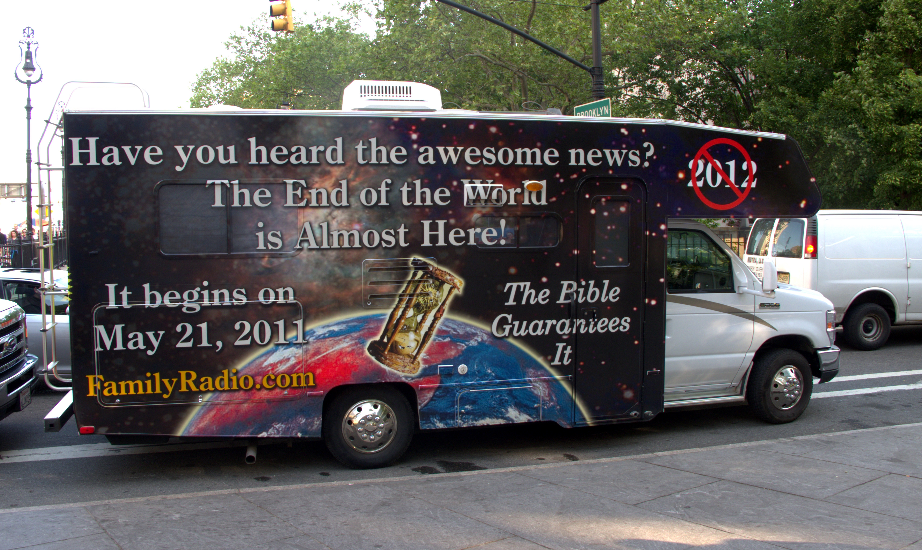
Class 10: Scheduling
cs4414 Fall 2013
University of Virginia
David Evans

Slide 2
Plan for Today
Scheduling Intro
Kernel Timer Winner!
Scheduling
Results of Performance Test
Shell Demos! (Stride Scheduled)
Evan Teague, Josh Lisko
Chris McFarland, Clarisse Abalos
Nishant Shukla, Jasdev Singh
Daniel Nizri, Alex Fabian
If you requested a demo, but weren’t selected the (undocumented) secondary tie-breaker was submission time (earlier is better) when multiple teams had similar extra features.

Slide 3
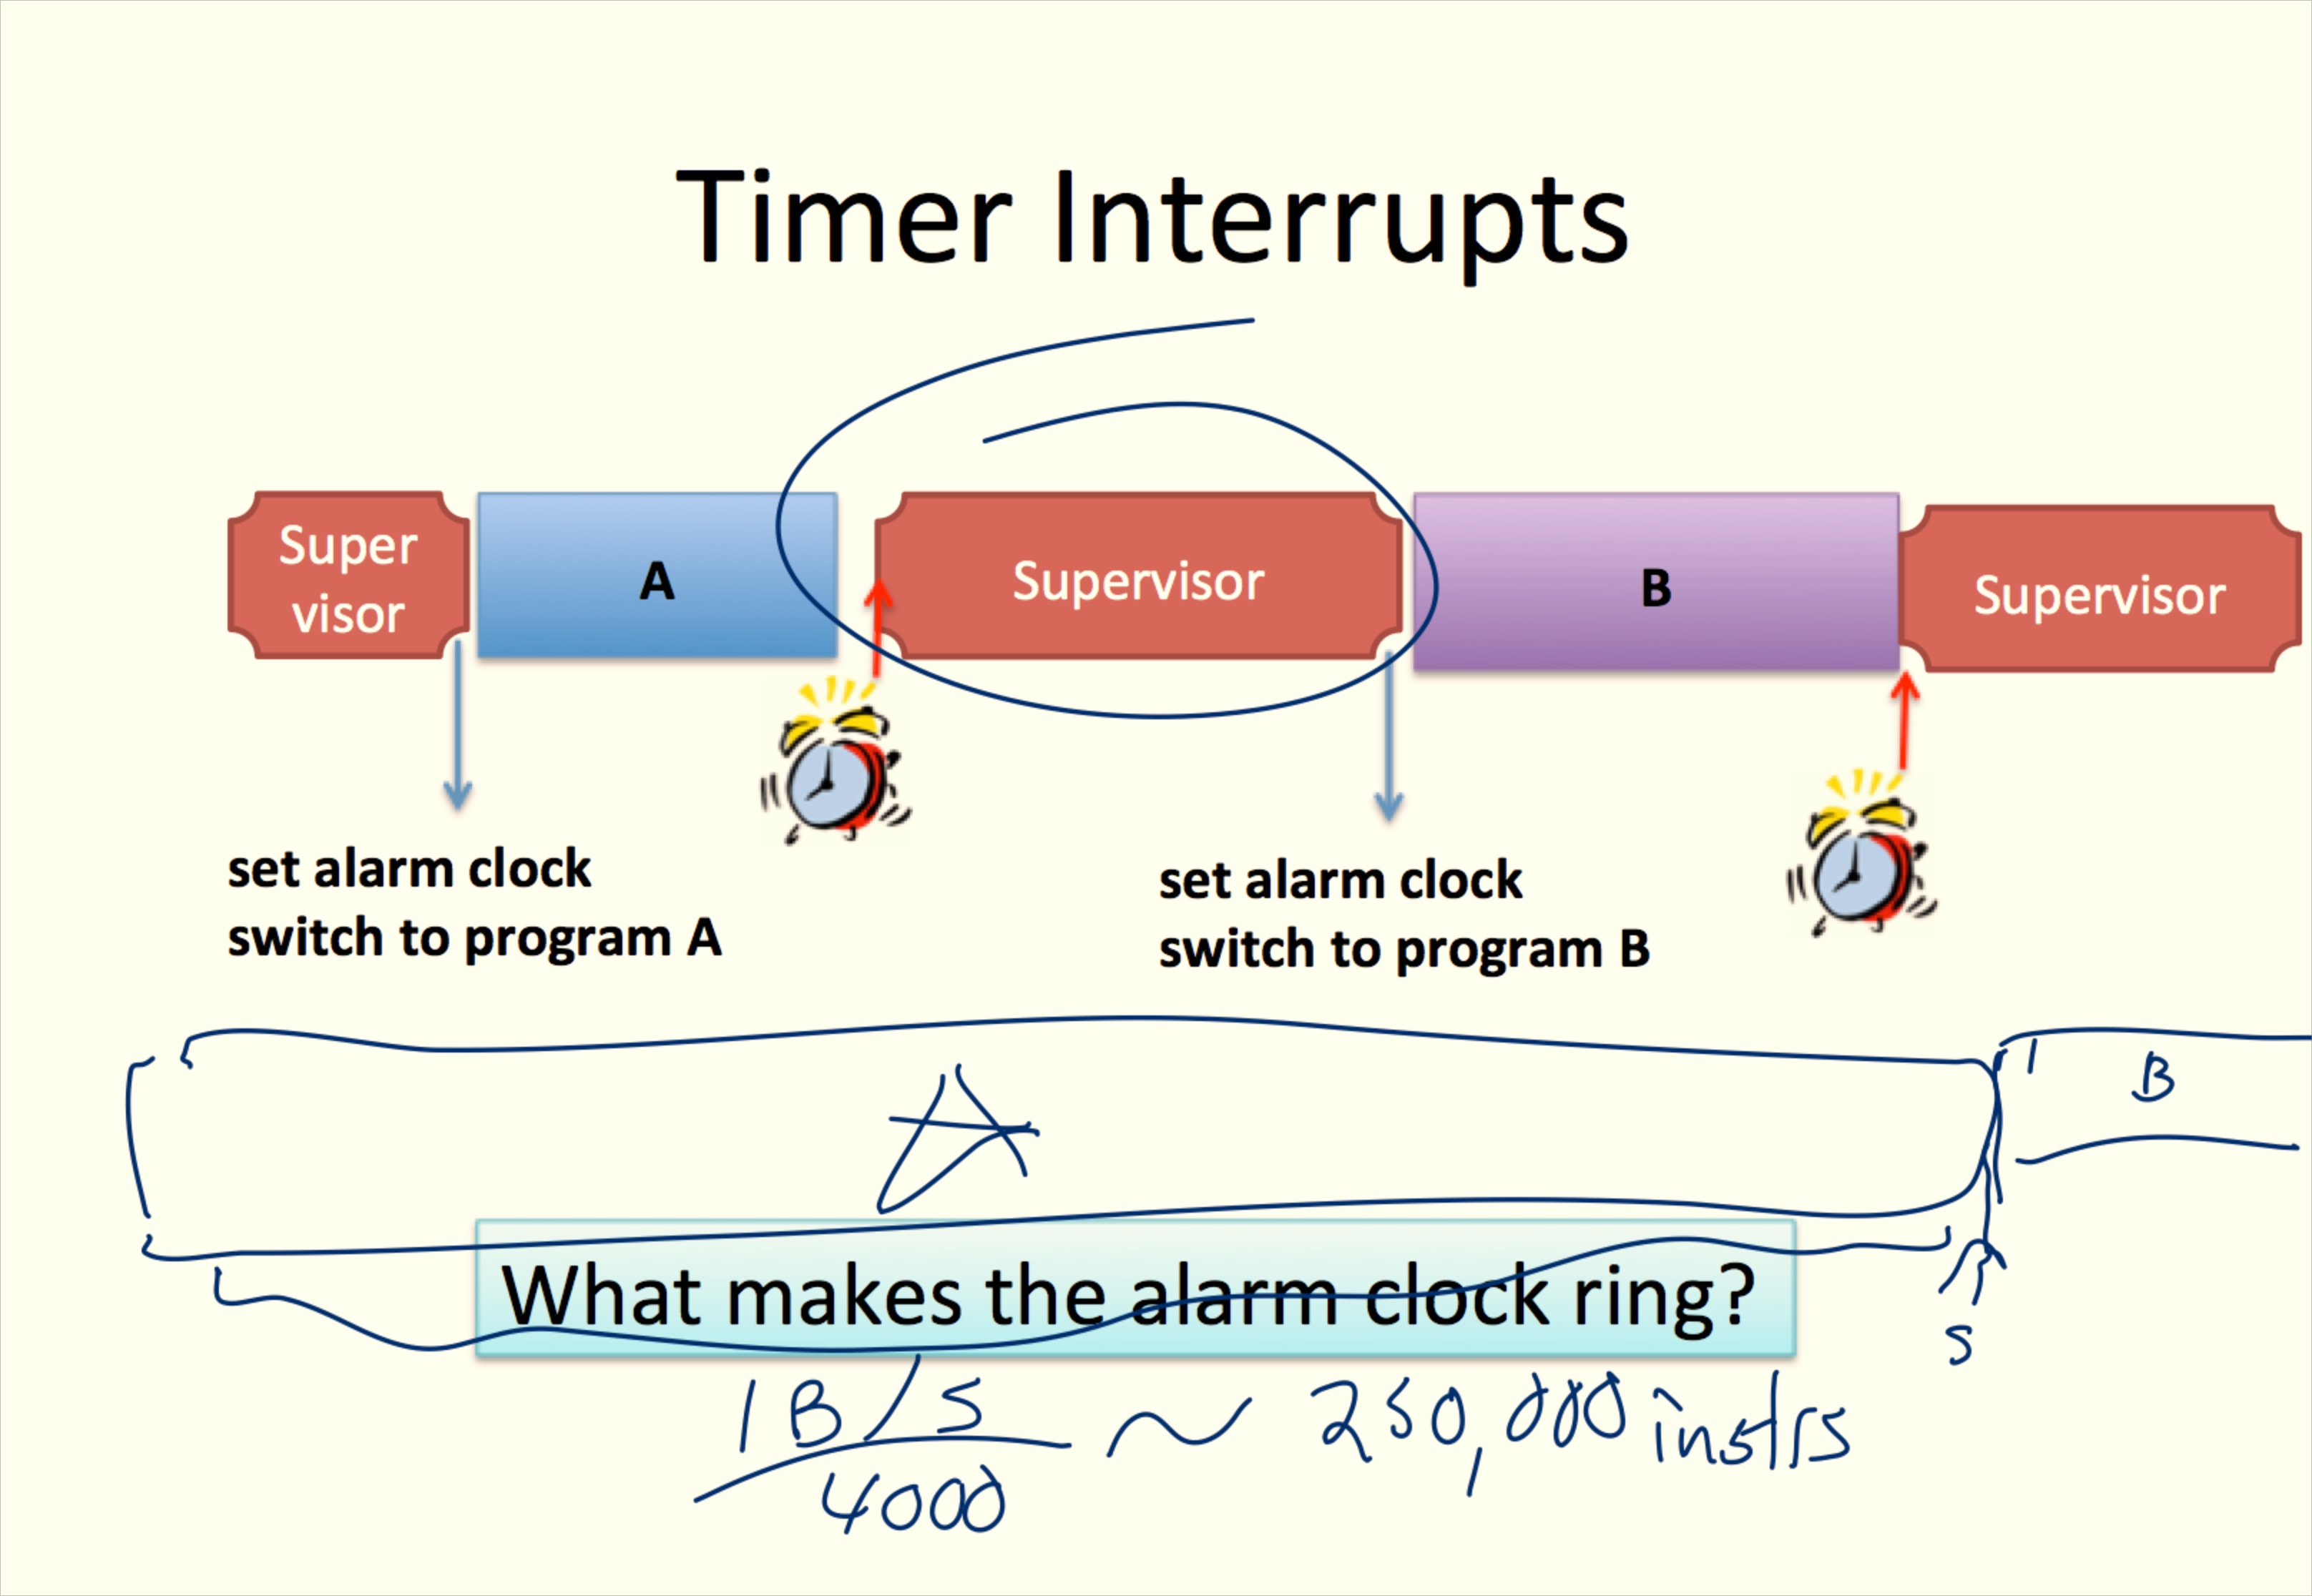
Remember from Class 4:
How should the supervisor decide which program to run?
How long should the alarm clock be set for?

Slide 4
Scheduler Desiderata
Go placidly amid the noise and haste, and remember what peace there may be in silence. As far as possible without surrender be on good terms with all persons. Speak your truth quietly and clearly; and listen to others, even the dull and the ignorant; they too have their story. Avoid loud and aggressive persons, they are vexations to the spirit. … Exercise caution in your business affairs; for the world is full of trickery. …And whether or not it is clear to you, no doubt the universe is unfolding as it should…whatever your labors and aspirations, in the noisy confusion of life keep peace with your soul. With all its sham, drudgery, and broken dreams, it is still a beautiful world. Be cheerful. Strive to be happy.
Max Ehrmann, “Desiderata” (1927)

Slide 5
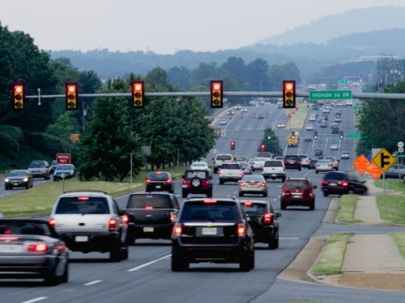
How well do traffic lights do?

Slide 6
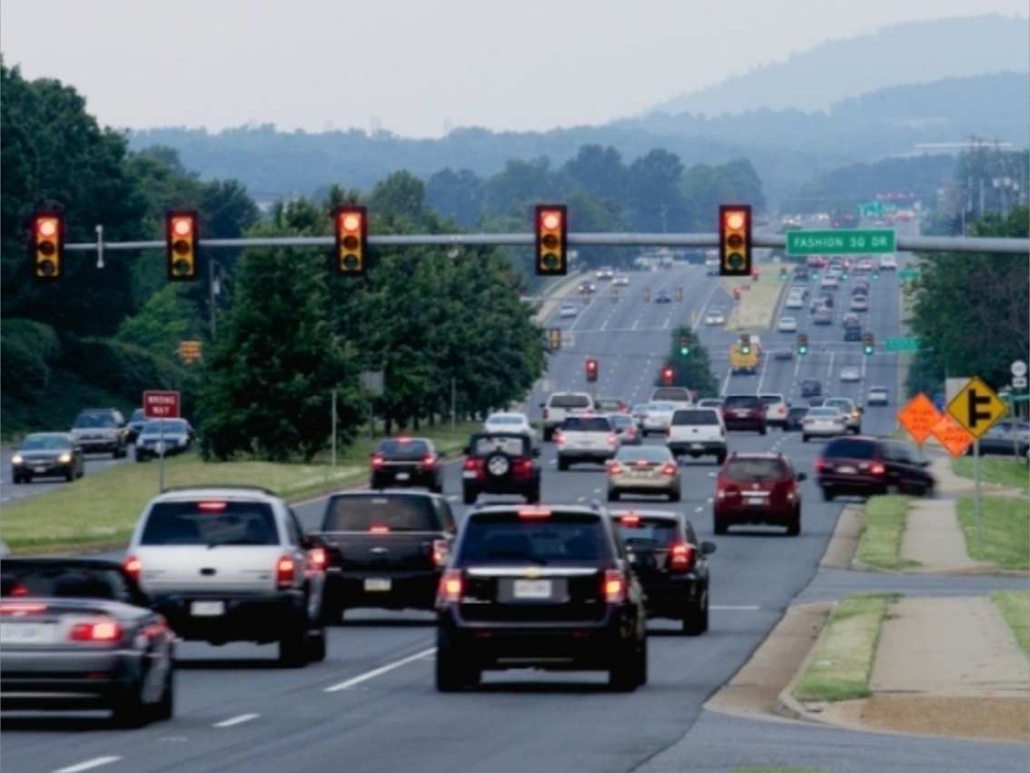
How well do traffic lights do?

Slide 7
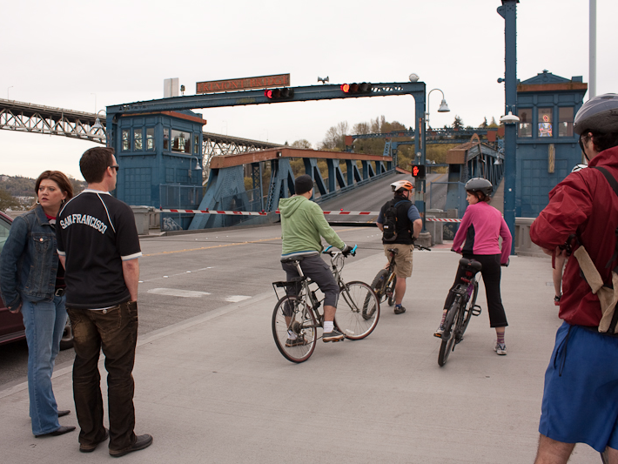
Kernel Timer: Wil Thomason

Slide 8


Midterm Exemption
vs.
“Dare and Do”
“To Dare is To Do” (Tottenham Hotspur FC)

Slide 9
About the Midterm
It is not meant to be painful or tedious!
A web form you will do outside of class (posted Thursday Oct 10, due Monday Oct 14)
Open resources except other humans
You should not be surprised if questions from the notes appear on the midterm
  It is fine (and encouraged!) to discuss those questions in the course forum before the midterm is posted

Slide 10
Scheduling Strategies
First Come, First Served (FIFO)
P1
P2
P3
(effectively: non-preemptive multi-processing)

Slide 11
Scheduling Strategies
First Come, First Served (FIFO)
P1
P2
P3
(effectively: non-preemptive multi-processing)
Round-Robin
P1
P2
P3
P1
P2
P3
P1
P3
P1
P3
Time Slice
Blocked
Each process gets to run for a set time slice, or until it finished or gets blocked.

Slide 12
Comparison
First Come, First Served
Round Robin

Slide 13
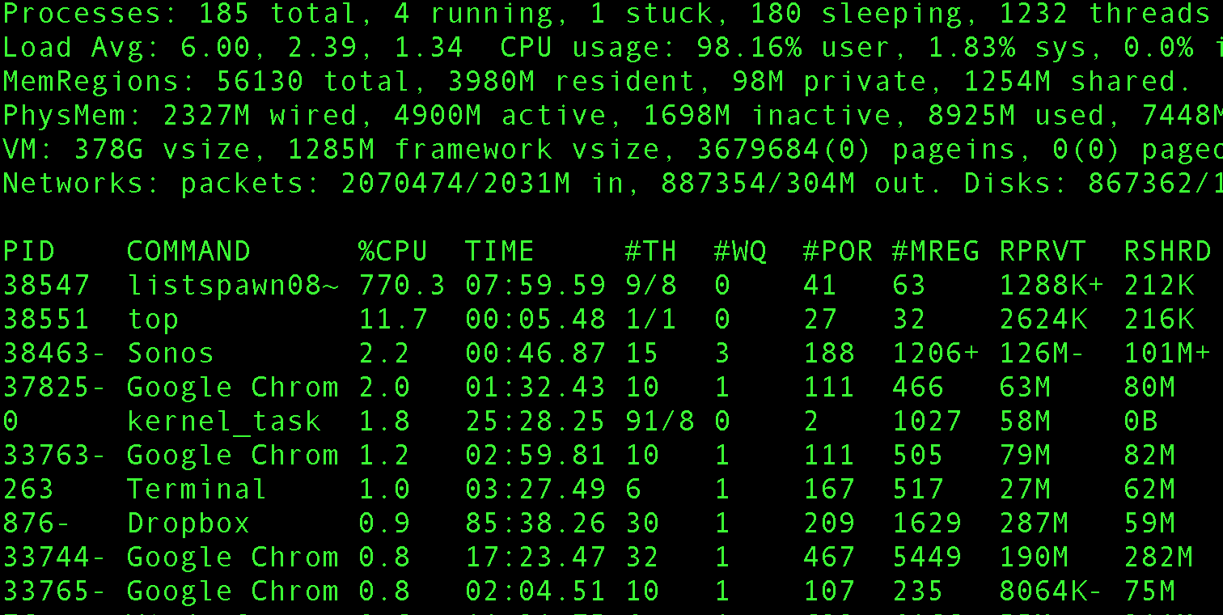
Which one is my laptop using?

Slide 14
Priorities
More important processes: “higher priority” (except Linux inverts priority values!)
  Highest priority = 0 (gets most preferential treatment)
  Lowest priority = 99 (highest number varies by Linux flavor)

Slide 15
$ ps -e -o uid,pid,pri,command | sort -n --key=3 (with some manual editing)
UID PID PRI COMMAND
222 48 4 /usr/sbin/netbiosd
501 1536 4 /System/Library/Frameworks/CoreServices.framework/Frameworks/Metadata.framework/Versions/A/Support/mdworker -s \
mdworker -c MDSImporterWorker -m com.apple.mdworker.shared
501 38470 4 /Applications/Preview.app/Contents/MacOS/Preview -psn_0_4777102
501 38921 4 /System/Library/Frameworks/CoreServices.framework/Frameworks/Metadata.framework/Versions/A/Support/mdworker -s \
mdworker-lsb -c MDSImporterWorker -m com.apple.mdworker.lsb
-2 36 23 /usr/libexec/warmd
0 1 31 /sbin/launchd
0 37965 31 /Library/DropboxHelperTools/Dropbox_u501/dbfseventsd
0 37966 31 /Library/DropboxHelperTools/Dropbox_u501/dbfseventsd
0 38871 31 /usr/sbin/ocspd
0 38923 31 ps -e -o uid,pid,pri,command
-2 1099 31 /sbin/launchd
  … many others at PRI=31 elided
501 38913 31 /bin/bash --noediting -i
501 38914 31 rust run listspawn.rs
501 38920 31 ./listspawn08~
501 38924 31 sort -n --key=3
0 11 33 /usr/libexec/UserEventAgent (System)
0 12 33 /usr/libexec/kextd
0 14 33 /usr/sbin/notifyd
0 15 33 /usr/sbin/securityd -i
Should I be happy?

Slide 16
Shell Demos!
Evan Teague and Josh Lisko
Chris McFarland and Clarisse Abalos

Slide 17
$ ps -e -o uid,pid,pri,command | sort -n --key=3 (with some manual editing)
UID PID PRI COMMAND
222 48 4 /usr/sbin/netbiosd
501 1536 4 /System/Library/Frameworks/CoreServices.framework/Frameworks/Metadata.framework/Versions/A/Support/mdworker -s \
mdworker -c MDSImporterWorker -m com.apple.mdworker.shared
501 38470 4 /Applications/Preview.app/Contents/MacOS/Preview -psn_0_4777102
501 38921 4 /System/Library/Frameworks/CoreServices.framework/Frameworks/Metadata.framework/Versions/A/Support/mdworker -s \
mdworker-lsb -c MDSImporterWorker -m com.apple.mdworker.lsb
-2 36 23 /usr/libexec/warmd
0 1 31 /sbin/launchd
0 37965 31 /Library/DropboxHelperTools/Dropbox_u501/dbfseventsd
0 37966 31 /Library/DropboxHelperTools/Dropbox_u501/dbfseventsd
0 38871 31 /usr/sbin/ocspd
0 38923 31 ps -e -o uid,pid,pri,command
-2 1099 31 /sbin/launchd
  … many others at PRI=31 elided
501 38913 31 /bin/bash --noediting -i
501 38914 31 rust run listspawn.rs
501 38920 31 ./listspawn08~
501 38924 31 sort -n --key=3
0 11 33 /usr/libexec/UserEventAgent (System)
0 12 33 /usr/libexec/kextd
0 14 33 /usr/sbin/notifyd
0 15 33 /usr/sbin/securityd -i
Should I be happy?

Slide 18
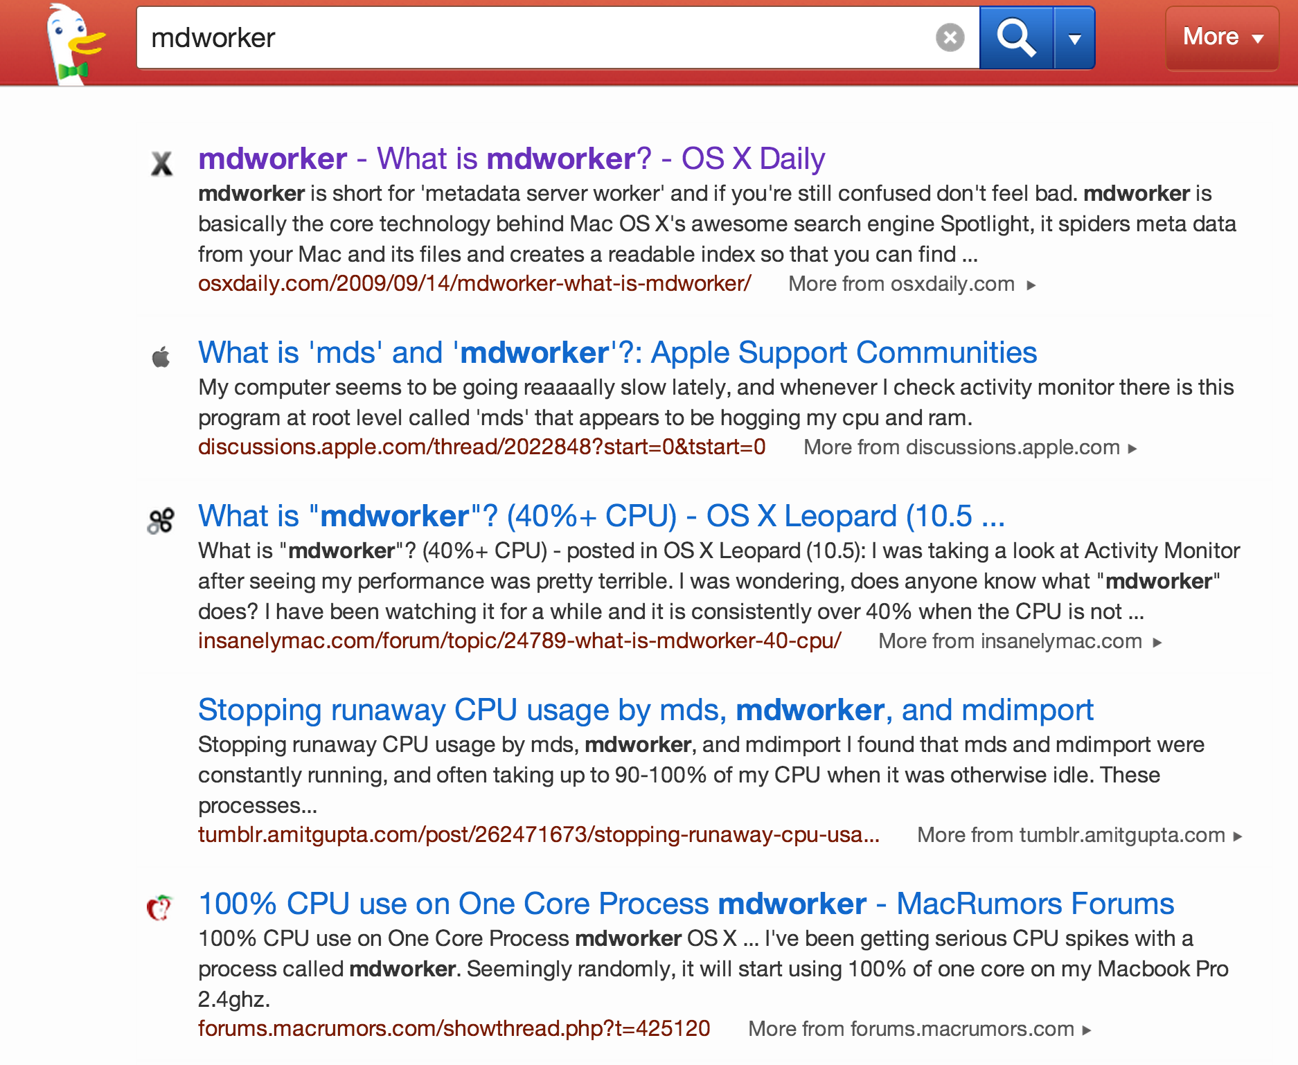

Slide 19
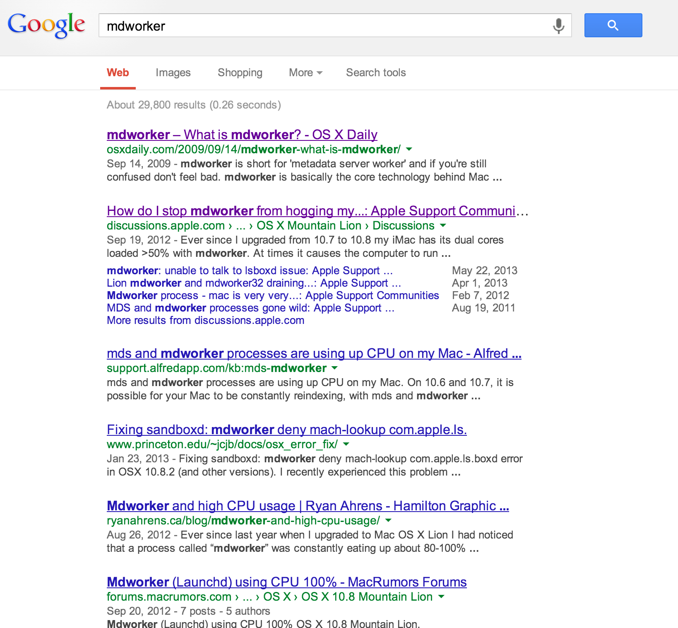
“mdworker is short for ‘metadata server worker’ and if you’re still confused don’t feel bad. mdworker is basically the core technology behind Mac OS X’s awesome search engine Spotlight, it spiders meta data from your Mac and its files and creates a readable index so that you can find things practically instantaneously via Spotlight (command-spacebar).”

Slide 20
Pre-emptive Priority Scheduling
Always run the highest priority process that is ready to run
Round-robin schedule among equally high, ready to run, highest-priority processes

Slide 21
Scheduler Queue

Slide 22
Shell Demos!
Nishant Shukla and Jasdev Singh
Daniel Nizri and Alex Fabian

Slide 23
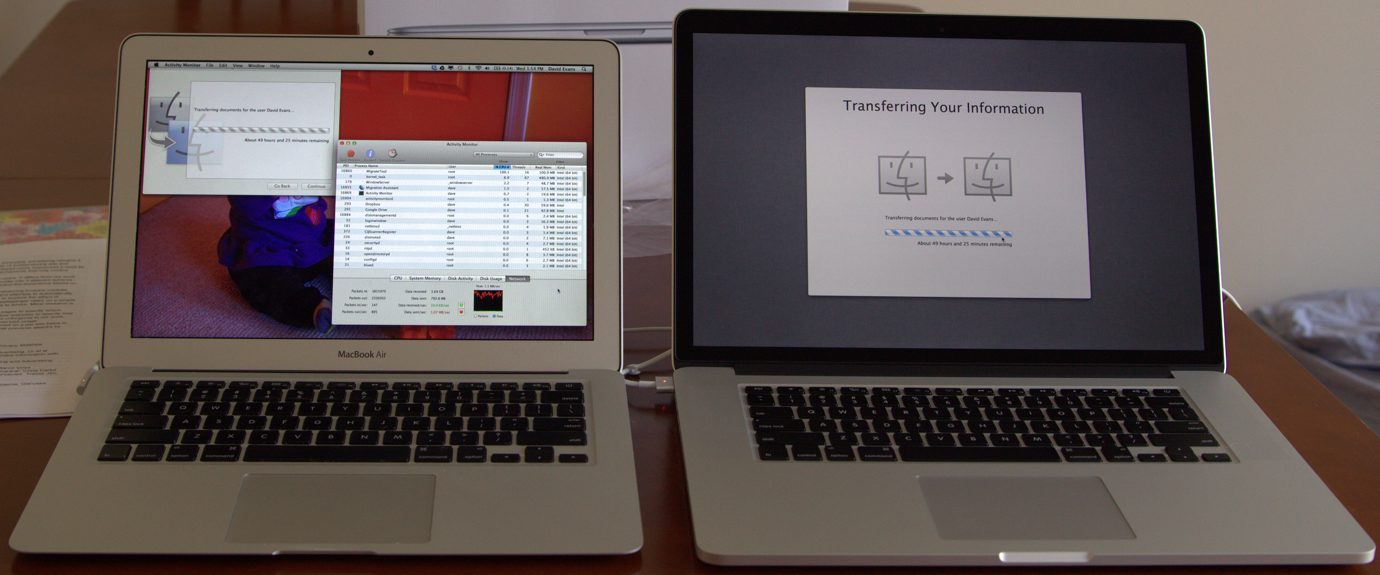
From Class 9: How much faster will my Rust mapping program be on my new machine?
60 seconds
(normalized time, running on 16-element list)
?
2011 MacBook Air
Intel i5-2557M
1.7 GHz, 2 cores (4 threads)
3 MB shared L3 cache
2013 MacBook Pro
Intel i7-3740QM
2.7 GHz, 4 cores (8 threads)
6MB shared L3 cache
both support “hyperthreading” (two threads per core)

Slide 24
impl Map for List {
fn mapr(&self, f: extern fn(int) -> int) -> List {
match(*self) {
None => None,
Some(ref node) => {
let (port, chan) : (Port<int>, Chan<int>) = stream();
let val = node.head;
do spawn {
chan.send(f(val));
}
let newtail = node.tail.mapr(f);
Some(~Node{ head: port.recv(), tail: newtail })
}
}
}
}

Slide 25
fn collatz_steps(n: int) -> int {
if n == 1 { 0 } else { 1 + collatz_steps(if n % 2 == 0 { n / 2 } else { 3*n + 1 }) }
}
fn find_collatz(k: int) -> int { // Minimum value, n, with Collatz stopping time >= k.
let mut n = 1;
while collatz_steps(n) < k { n += 1; }
n
}
fn test_list(n: int, x: int) -> List {
if n == 0 { None } else { Some(~Node{head: x, tail: test_list(n - 1, x + 1)}) }
}
fn main() {
let lst0 = test_list(16, 565);
println(lst0.to_str());
let lst1 = lst0.mapr(find_collatz);
println(lst1.to_str());
}
Formatted to fit on slide. Your code should have many more newlines than this!

Slide 26
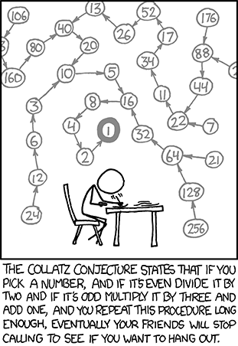
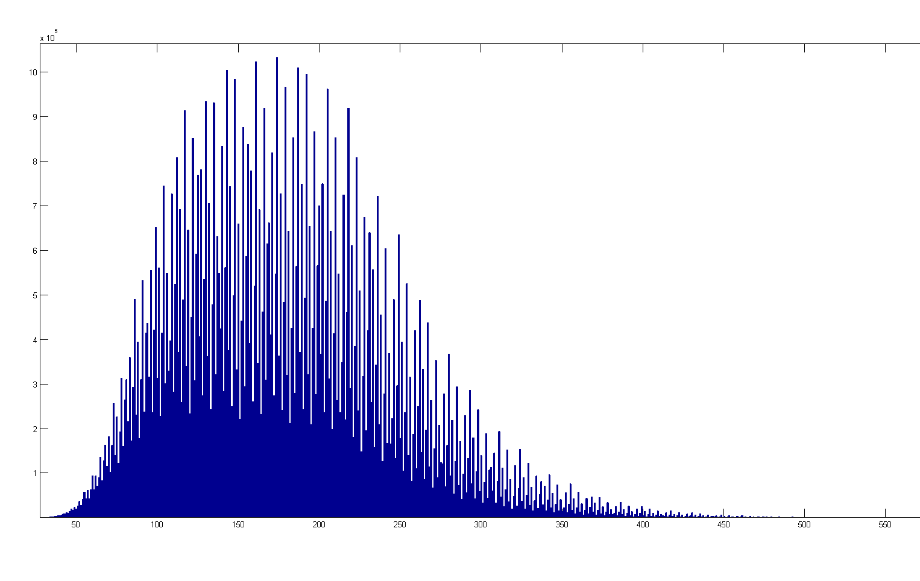
x 10⁵
Stopping Time distribution for 1-100 Million
http://en.wikipedia.org/wiki/File:CollatzStatistic100million.png

Slide 27
Results
Old MacBook Air
$ rustc listspawn.rs
$ time ./listspawn
[565, 566, 567, 568, 569, 570, 571, 572, 573, 574, 575, 576, 577, 578, 579, 580]
[3542887, 3542887, 3542887, 3542887, 3542887, 3542887, 3542887, 3542887, 3542887, 3542887, 3542887, 3542887, 3542887, 3542887, 3542887, 3542887]
real 0m58.843s
user 3m39.459s
sys 0m0.266s
New MacBook Pro
$ time ./listspawn
[565, 566, 567, 568, 569, 570, 571, 572, 573, 574, 575, 576, 577, 578, 579, 580]
[3542887, 3542887, 3542887, 3542887, 3542887, 3542887, 3542887, 3542887, 3542887, 3542887, 3542887, 3542887, 3542887, 3542887, 3542887, 3542887]
real 0m18.593s
user 2m17.990s
sys 0m0.120s

Slide 28
Checking Results
Old MacBook Air
$ time ./listspawn
real 0m58.843s
user 3m39.459s
sys 0m0.266s
$ !!
real 1m0.931s
user 3m47.609s
sys 0m0.291s
$ !!
real 0m57.967s
user 3m36.343s
sys 0m0.266s
New MacBook Pro
$ time ./listspawn
real 0m18.593s
user 2m17.990s
sys 0m0.120s
$ !!
real 0m18.757s
user 2m20.419s
sys 0m0.116s
$ !!
real 0m18.505s
user 2m18.653s
sys 0m0.130s
Median over three trials:
real = 58.8s (user 219.5s)
Median over three trials:
real = 18.6s (user 138.0s)

Slide 29

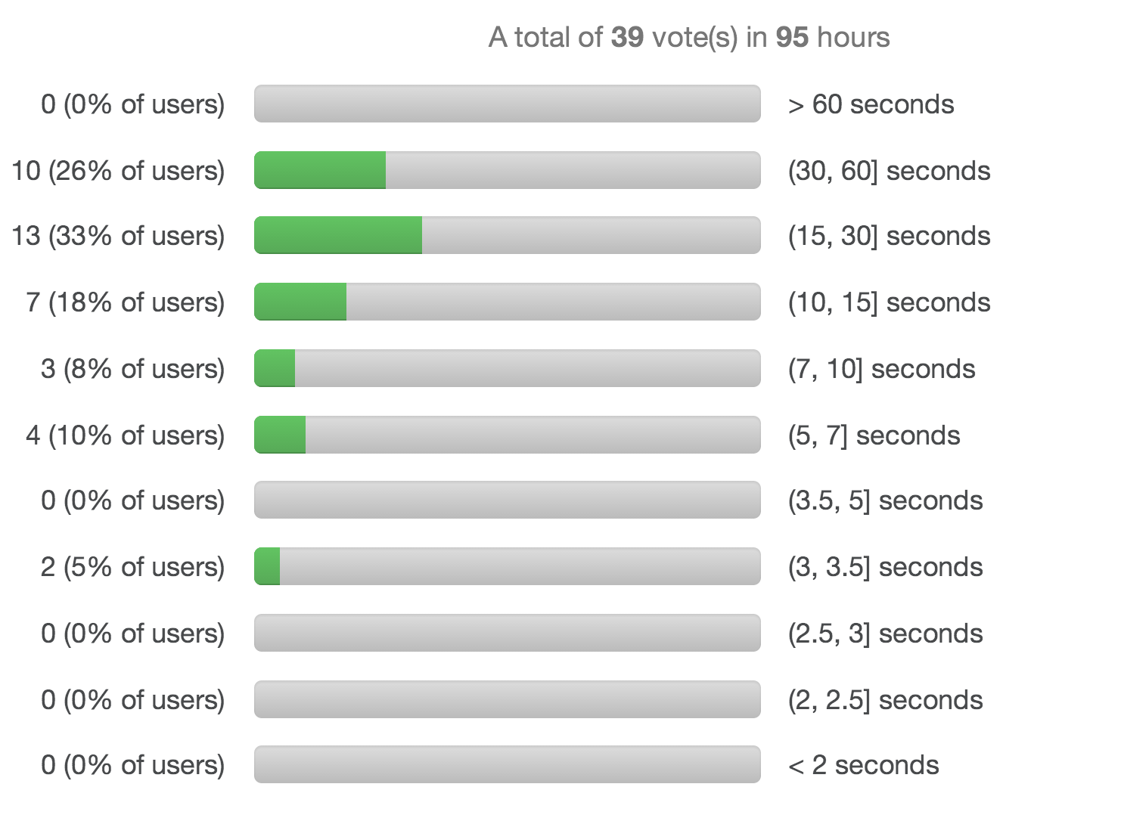
Median over three trials:
real = 18.6s (user 138.0s)

Slide 30
Does this make sense?
Old MacBook Air
1.7 GHz Processor
2 cores (4 hyperthreads)
New MacBook Pro
2.7 GHz Processor
4 cores (8 hyperthreads)
Median over three trials:
real = 58.8s (user 219.5s)
Median over three trials:
real = 18.6s (user 138.0s)
>>> 219.5 / 138.0
1.5905797101449275
>>> 58.8 / 18.6
3.1612903225806446
>>> (2.7 / 1.7) * 2
3.1764705882352944
Cycle speed increase: (2.7/1.7) = 1.59
Thread increase: 2

Slide 31
What sh-Ould I have done to make it faster?

Slide 32
-O >> $$
Old MacBook Air
$ rustc -O listspawn.rs
$ time ./listspawn
real 0m10.573s
user 0m36.498s
sys 0m0.127s
bash-3.2$ time ./listspawn
real 0m10.299s
user 0m36.545s
sys 0m0.119s
bash-3.2$ time ./listspawn
real 0m10.330s
user 0m36.555s
sys 0m0.112s
New MacBook Pro
$ time ./listspawn
real 0m2.975s
user 0m22.913s
sys 0m0.022s
$ time ./listspawn
real 0m2.922s
user 0m22.950s
sys 0m0.016s
$ time ./listspawn
real 0m2.982s
user 0m22.875s
sys 0m0.019s
Median over three trials:
-- real = 58.8s (user 219.5s)
-O real = 10.3s (user 36.5s)
Median over three trials:
-- real = 18.6s (user 138.0s)
-O real = 2.97s (user 22.91s)
predicted (2.7/1.7 * 2): 3.18 times faster
without: 3.16 times faster
with -O: 3.47 times faster

Slide 33
Open Midterm Exemption/HopperPatch Opportunities
Complete implementation of map_reduce function from Class 9 (must use all cores effectively and be able to do examples from MapReduce paper)
“Good Auld Shell” at UVa Football Game
[New!] Write a program that runs at least 20x faster on my new Mac than it does on my old Mac

Slide 34
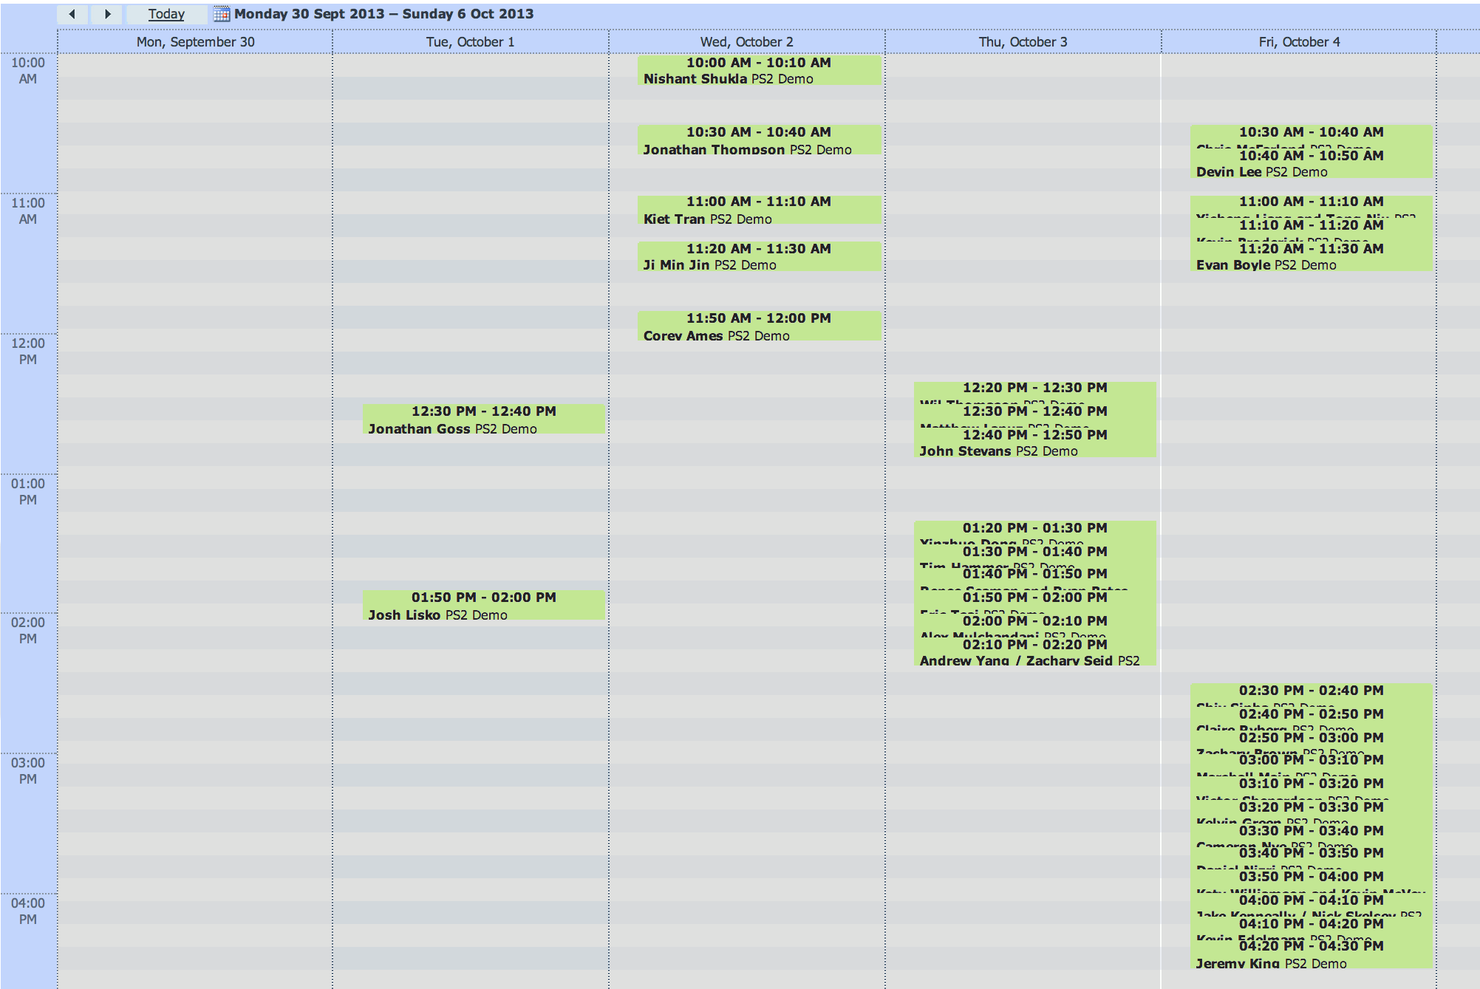
What algorithm did you use to schedule your PS2 demos?

