Slide 1
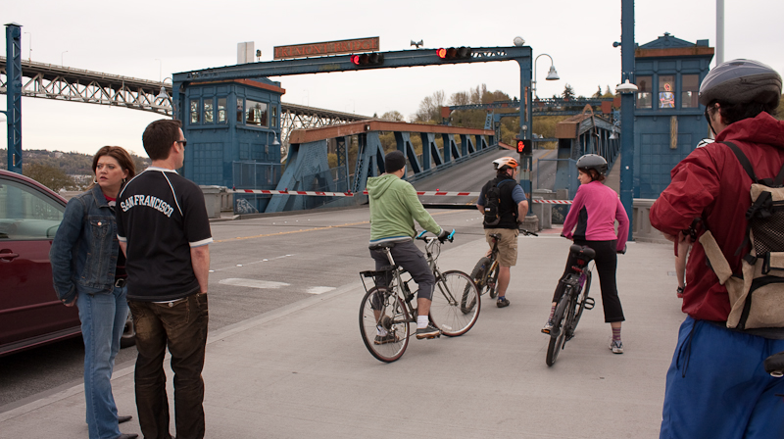
Class 10
Goto Failing, Sharing,
and Scheduling
Try this now: rust-class.org/ssl.html
cs4414 Fall 2013
David Evans

Slide 2


Plan for Today
Apple’s SSL Bug
Sharing Memory
Scheduling

Slide 3
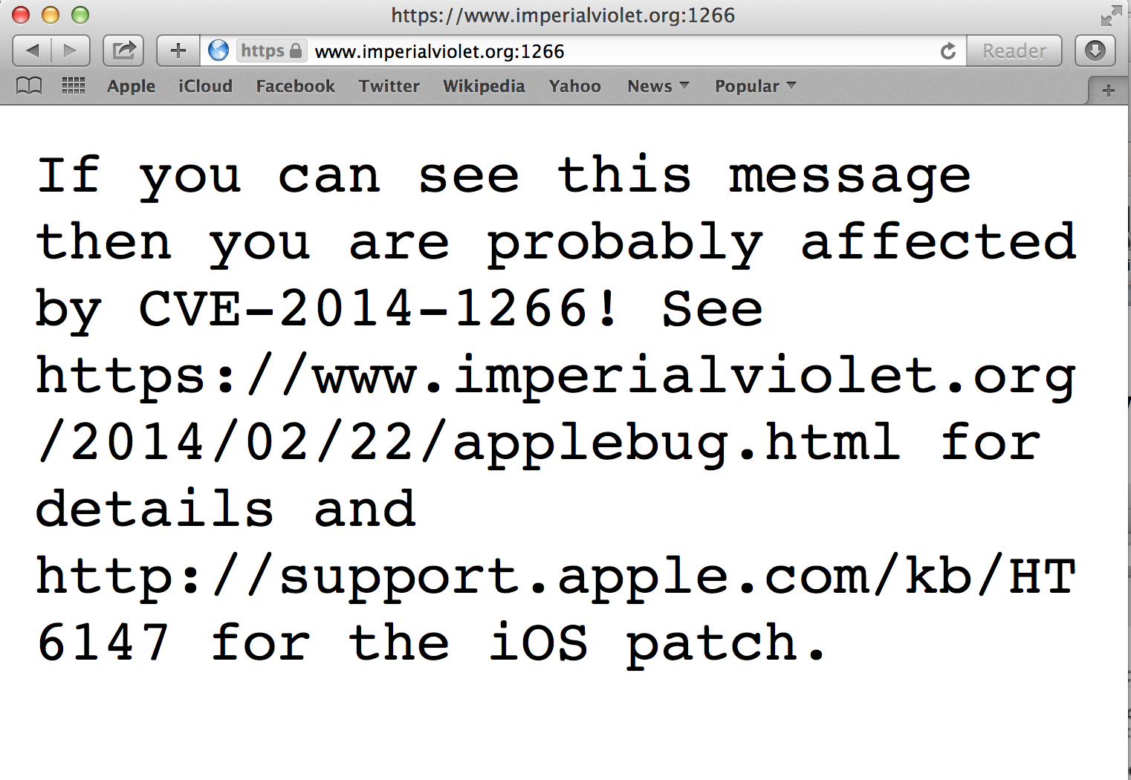
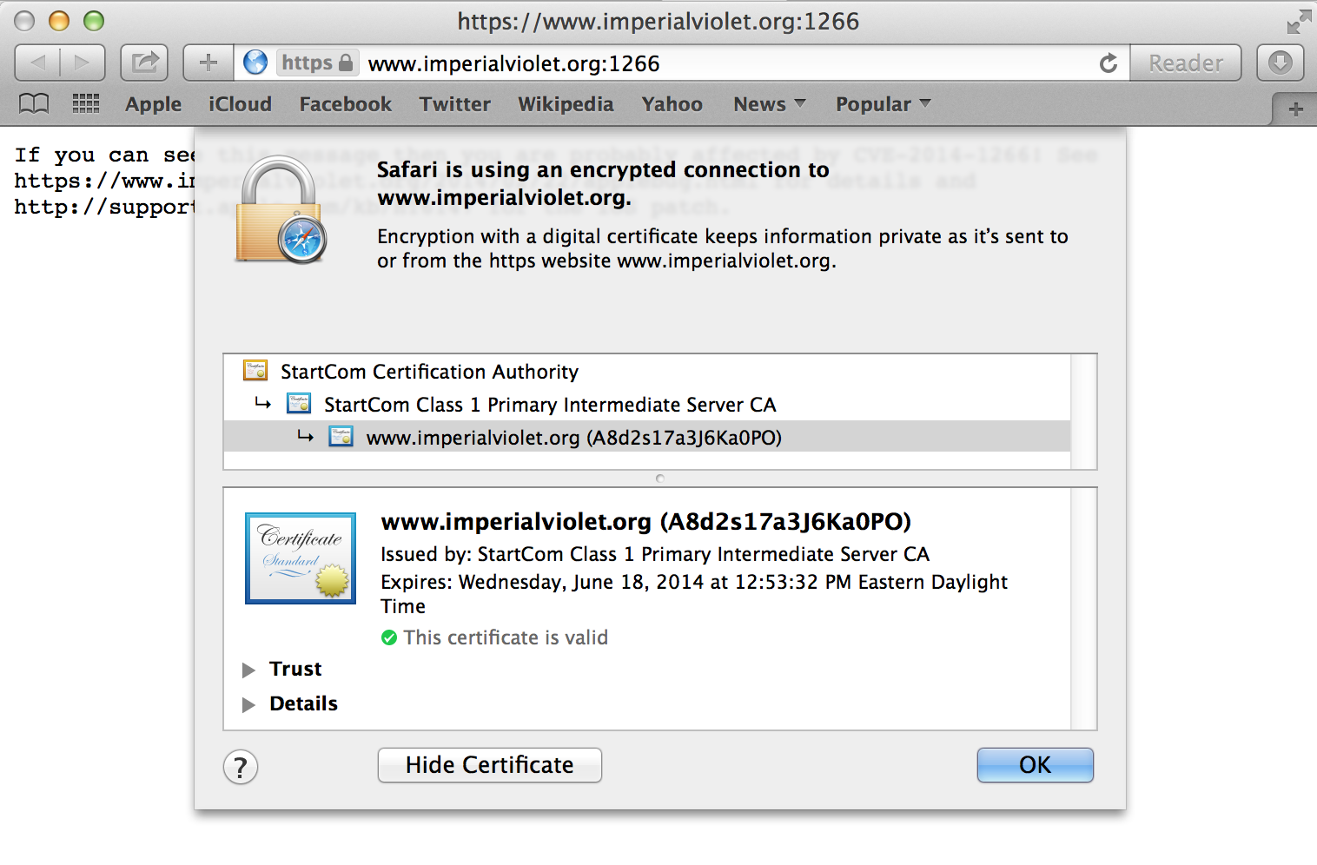
Try this now: rust-class.org/ssl.html

Slide 4
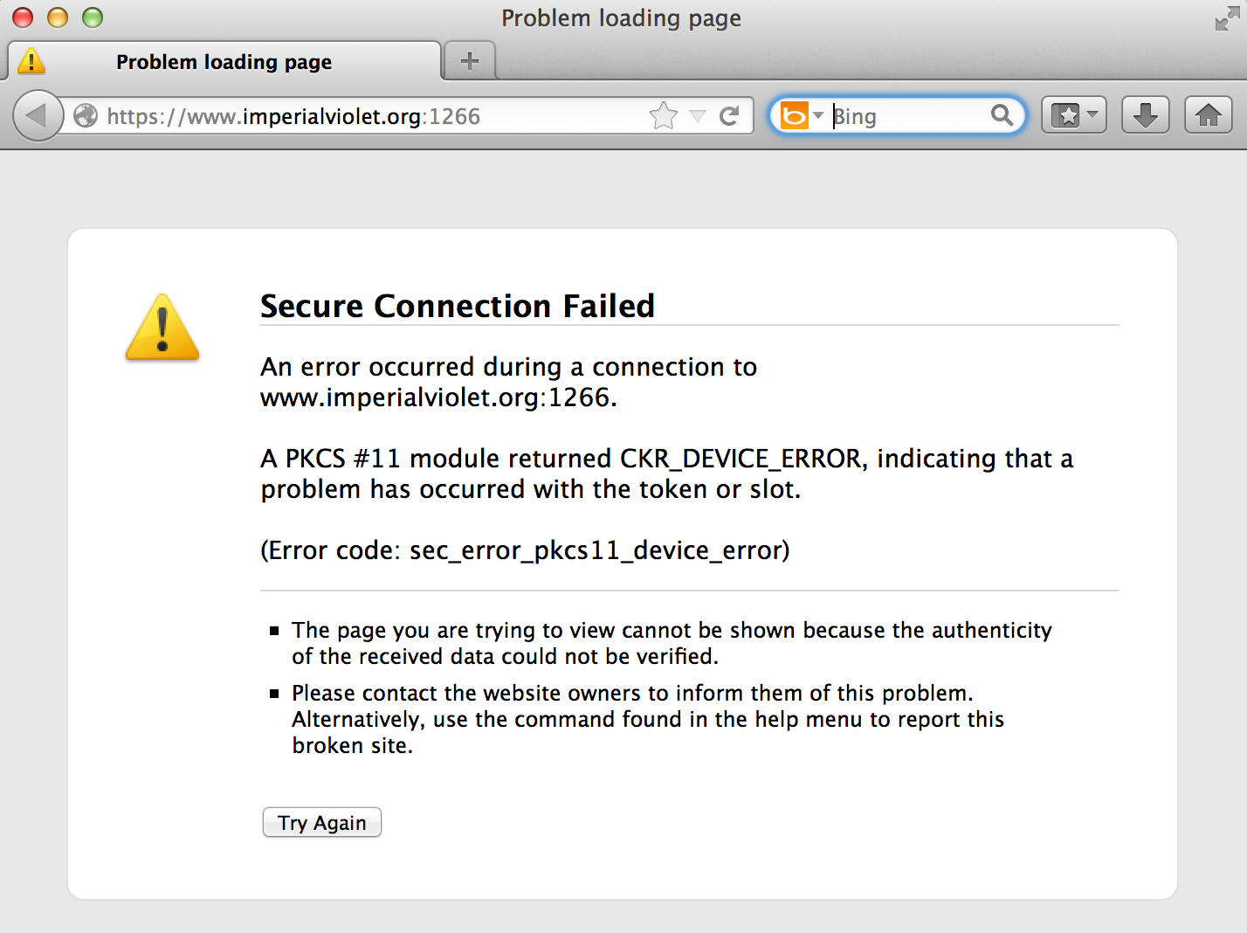
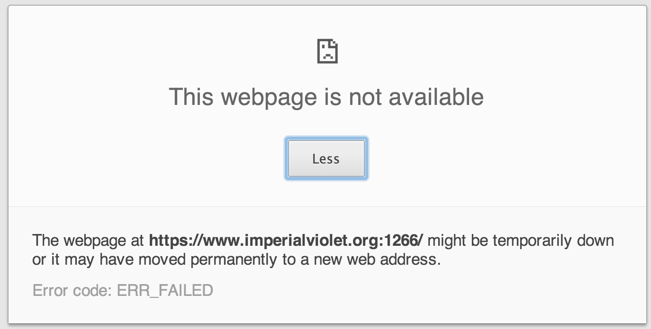

Slide 5
SSL/TLS Handshake Protocol
Client
Hello
Server
Verify Certificate using KU_{CA}
Check identity matches URL
Generate random K
KR_{CA}[Server Identity, KU_{S}]
Decryptusing KR_{S}
E_{KUS} (K)
Secure channel using K

Slide 6
SSL/TLS Handshake Protocol
Client
Hello
Server
Verify Certificate using KU_{CA}
Check identity matches URL
Generate random K
KR_{CA}[Server Identity, KU_{S}]
How did client get KU_{CA}?
Decryptusing KR_{S}
E_{KUS} (K)
Secure channel using K

Slide 7
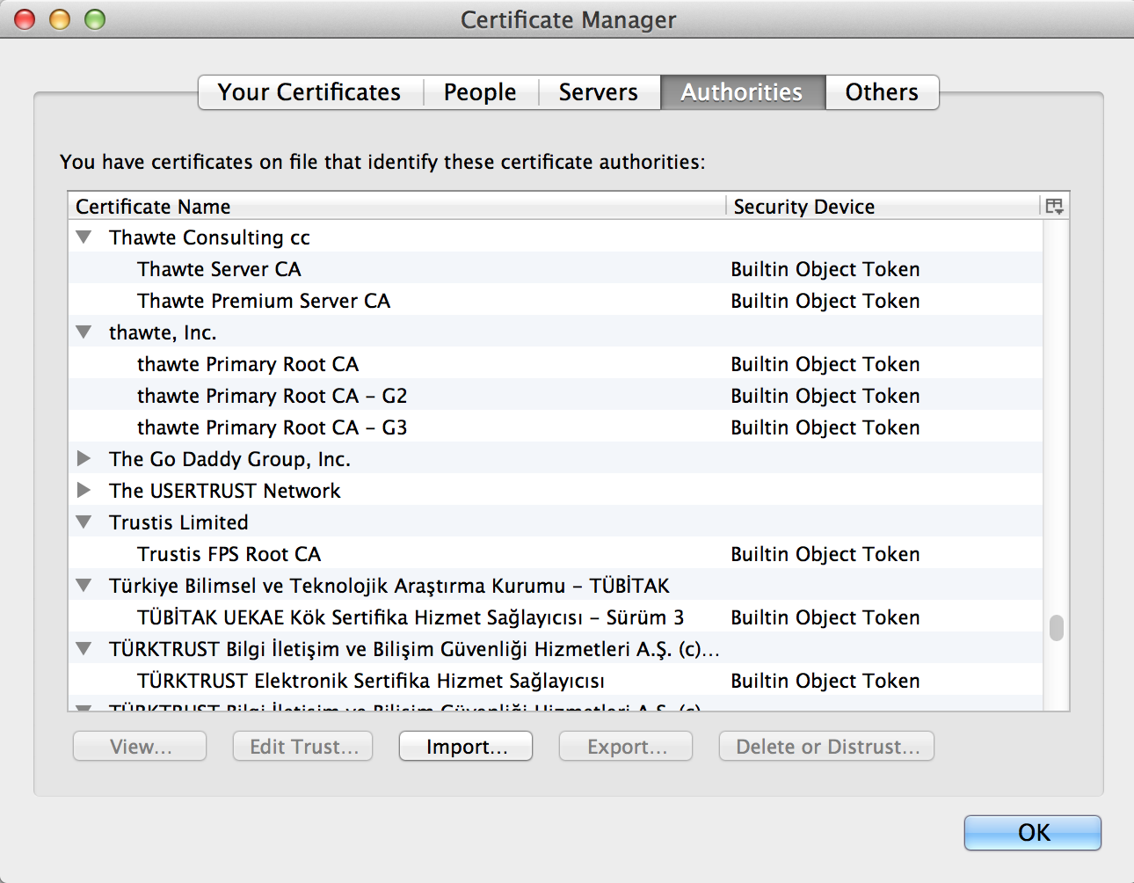

Slide 8
SSL/TLS Handshake Protocol
Client
Hello
Server
Verify Certificate using KU_{CA}
Check identity matches URL
Generate random K
KR_{CA}[Server Identity, KU_{S}]
Decryptusing KR_{S}
E_{KUS} (K)
Secure channel using K

Slide 9
Apple’s Implementation
static OSStatus
SSLVerifySignedServerKeyExchange(SSLContext *ctx, bool isRsa, SSLBuffer signedParams,
uint8_t *signature, UInt16 signatureLen)
{
OSStatus err;
SSLBuffer hashOut, hashCtx, clientRandom, serverRandom;
uint8_t hashes[SSL_SHA1_DIGEST_LEN + SSL_MD5_DIGEST_LEN];
SSLBuffer signedHashes;
uint8_t *dataToSign;
size_t dataToSignLen;
signedHashes.data = 0;
hashCtx.data = 0;
clientRandom.data = ctx->clientRandom;
clientRandom.length = SSL_CLIENT_SRVR_RAND_SIZE;
serverRandom.data = ctx->serverRandom;
serverRandom.length = SSL_CLIENT_SRVR_RAND_SIZE;
…
hashOut.data = hashes + SSL_MD5_DIGEST_LEN;
hashOut.length = SSL_SHA1_DIGEST_LEN;
if ((err = SSLFreeBuffer(&hashCtx)) != 0)
goto fail;
if ((err = ReadyHash(&SSLHashSHA1, &hashCtx)) != 0)
goto fail;
if ((err = SSLHashSHA1.update(&hashCtx, &clientRandom)) != 0)
goto fail;
if ((err = SSLHashSHA1.update(&hashCtx, &serverRandom)) != 0)
goto fail;
if ((err = SSLHashSHA1.update(&hashCtx, &signedParams)) != 0)
goto fail;
goto fail;
if ((err = SSLHashSHA1.final(&hashCtx, &hashOut)) != 0)
goto fail;
err = sslRawVerify(ctx,
ctx->peerPubKey,
dataToSign, /* plaintext */
dataToSignLen, /* plaintext length */
signature,
signatureLen);
if(err) {
sslErrorLog("SSLDecodeSignedServerKeyExchange: sslRawVerify "
"returned %d\n", (int)err);
goto fail;
}
fail:
SSLFreeBuffer(&signedHashes);
SSLFreeBuffer(&hashCtx);
return err;
}
[Link]

Slide 10
static OSStatus SSLVerifySignedServerKeyExchange(SSLContext *ctx, bool isRsa, SSLBuffer signedParams,
uint8_t *signature, UInt16 signatureLen)
{
…
if ((err = ReadyHash(&SSLHashSHA1, &hashCtx)) != 0)
goto fail;
if ((err = SSLHashSHA1.update(&hashCtx, &clientRandom)) != 0)
goto fail;
if ((err = SSLHashSHA1.update(&hashCtx, &serverRandom)) != 0)
goto fail;
if ((err = SSLHashSHA1.update(&hashCtx, &signedParams)) != 0)
goto fail;
goto fail;
if ((err = SSLHashSHA1.final(&hashCtx, &hashOut)) != 0)
goto fail;
err = sslRawVerify(ctx, ctx->peerPubKey, dataToSign, dataToSignLen, signature, signatureLen);
if(err) {
sslErrorLog("SSLDecodeSignedServerKeyExchange: sslRawVerify returned %d\n", (int)err);
goto fail;
}
fail:
SSLFreeBuffer(&signedHashes);
SSLFreeBuffer(&hashCtx);
return err;
}
Apple’s Implementation
(cleaned up and excerpted)

Slide 11
…
if ((err = SSLHashSHA1.update(&hashCtx, &serverRandom)) != 0)
goto fail;
if ((err = SSLHashSHA1.update(&hashCtx, &signedParams)) != 0)
goto fail;
goto fail;
if ((err = SSLHashSHA1.final(&hashCtx, &hashOut)) != 0)
goto fail;
err = sslRawVerify(ctx, ctx->peerPubKey, dataToSign, dataToSignLen, signature, signatureLen);
if(err) {
sslErrorLog("SSLDecodeSignedServerKeyExchange: sslRawVerify returned %d\n", (int)err);
goto fail;
}
fail:
SSLFreeBuffer(&signedHashes);
SSLFreeBuffer(&hashCtx);
return err;
}
Apple’s Implementation
(cleaned up and excerpted)

Slide 12
…
if ((err = SSLHashSHA1.update(&hashCtx, &serverRandom)) != 0)
goto fail;
if ((err = SSLHashSHA1.update(&hashCtx, &signedParams)) != 0)
goto fail;
goto fail;
if ((err = SSLHashSHA1.final(&hashCtx, &hashOut)) != 0)
goto fail;
err = sslRawVerify(ctx, ctx->peerPubKey, dataToSign, dataToSignLen,
signature, signatureLen);
if(err) {
sslErrorLog("SSLDecodeSignedServerKeyExchange: sslRawVerify returned %d\n", (int)err);
goto fail;
}
fail:
SSLFreeBuffer(&signedHashes);
SSLFreeBuffer(&hashCtx);
return err;
}
How should these kinds of mistakes be prevented?

Slide 13
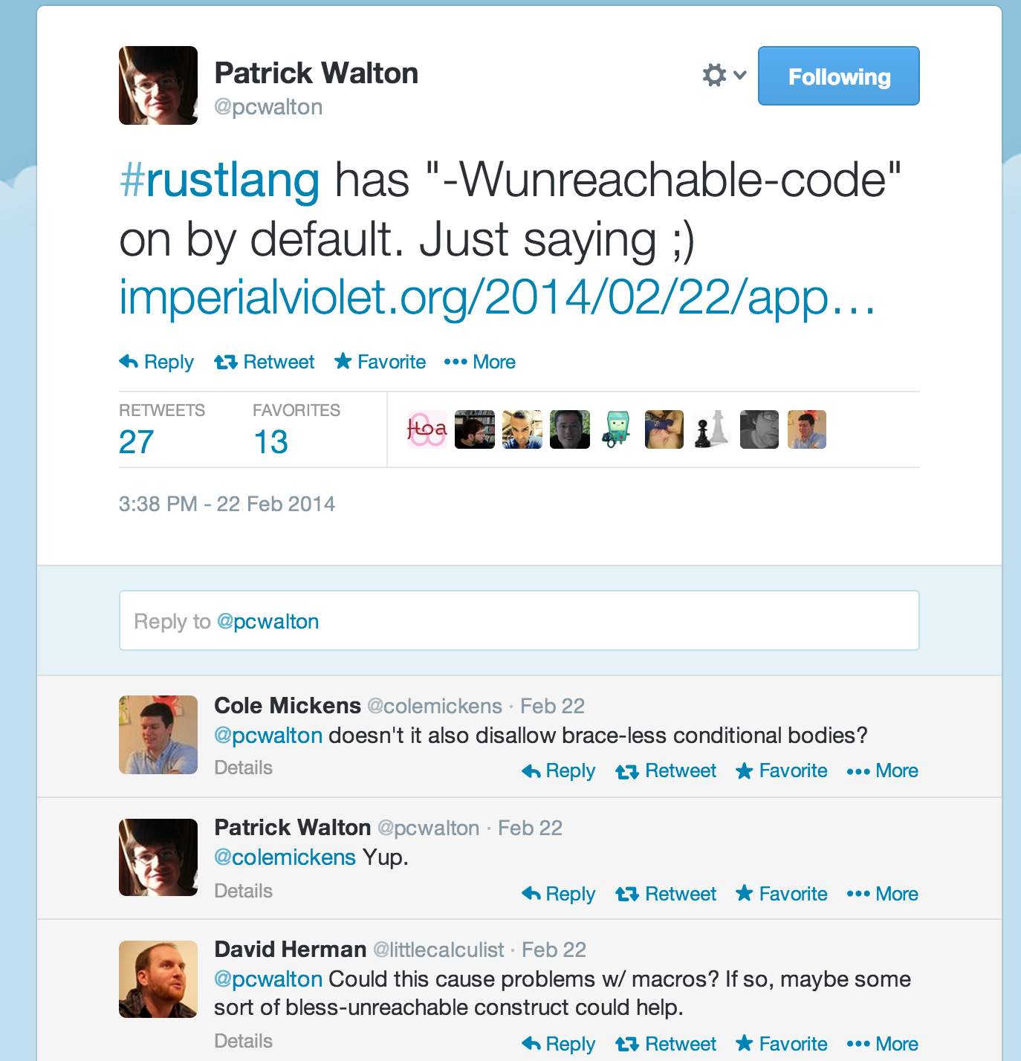
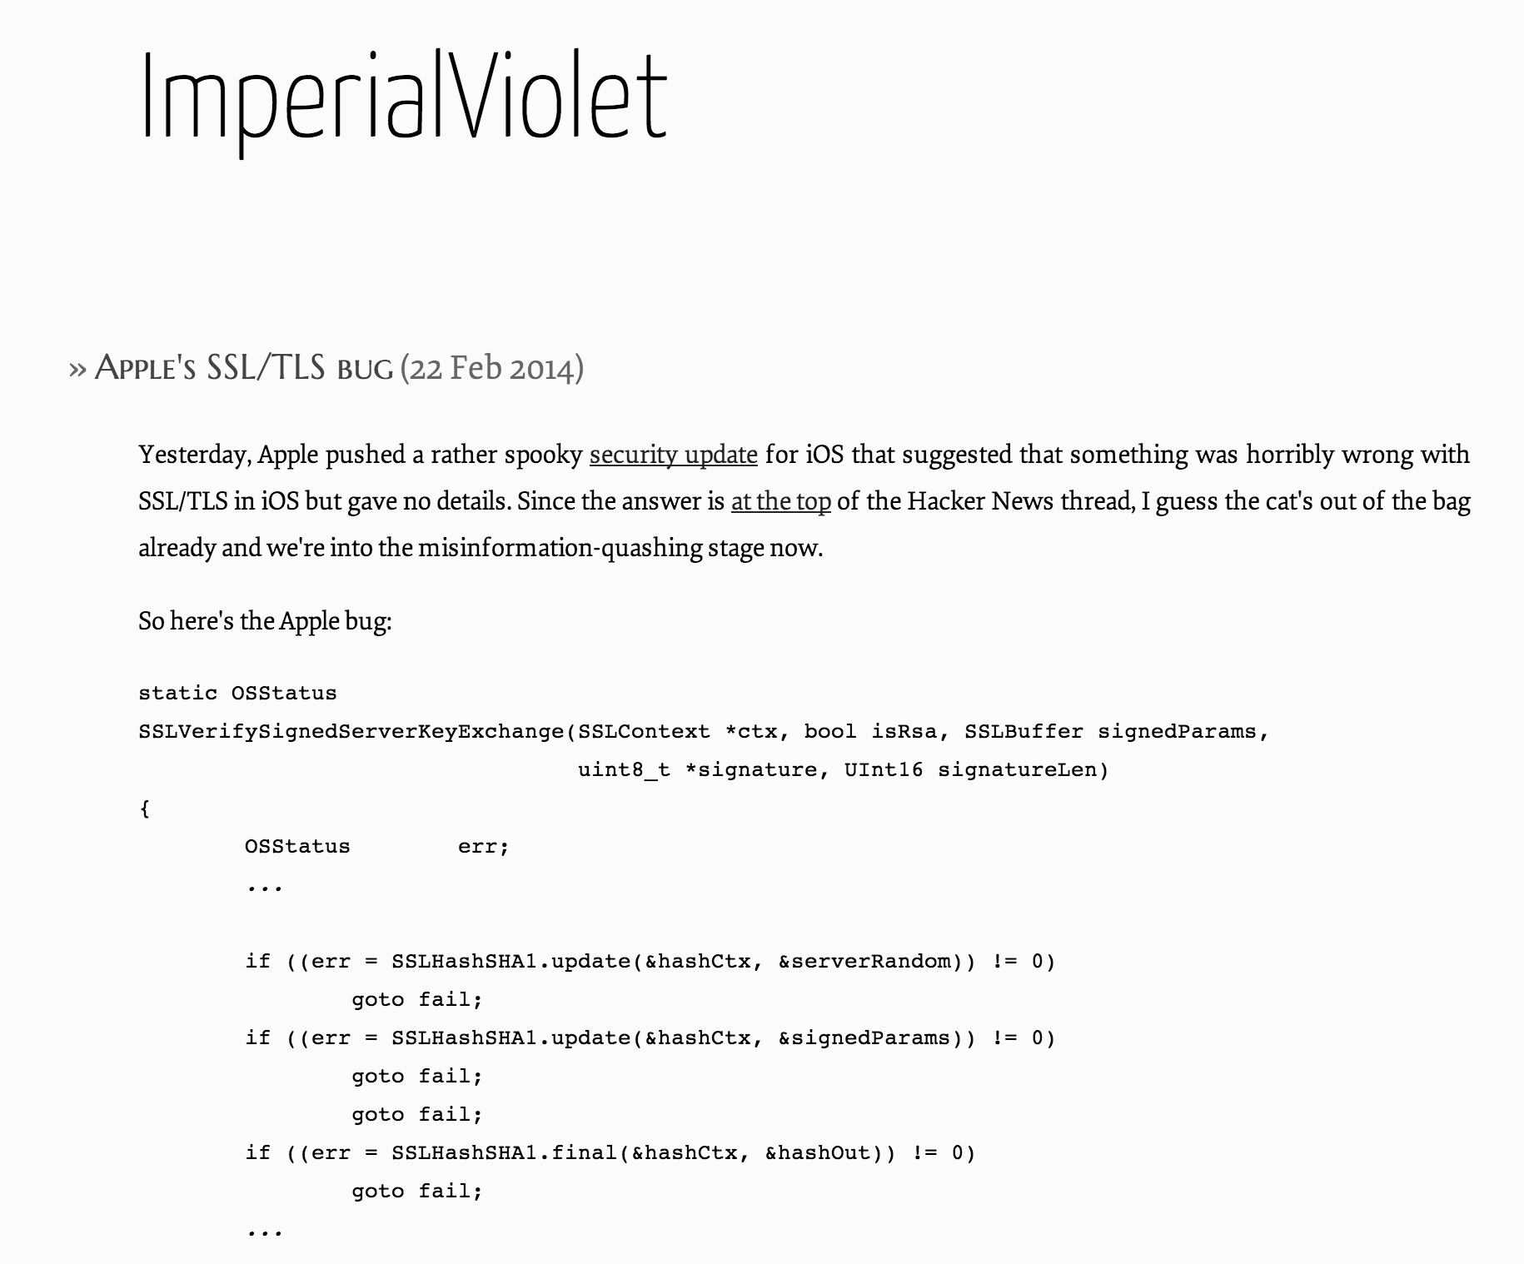

Slide 14
Theory Excursion
How hard is it for a compiler to provide unreachable code warnings?

Slide 15
Unreachable is Undecidable

Slide 16
Unreachable is Undecidable
fn halts(program: &str) {
execute(program);
println!(“Am I unreachable?”);
}
Compilers shouldn’t be constrained by theory!
Goal is to help programmers
Okay for warnings to be unsound and incomplete
(even okay for errors!)

Slide 17
My New
Theory of Computation Book!

Slide 18

plug book
A Tragicomic Tale of Combinatorics and Computability
for Curious Children of All Ages
Illustrations by Kim Dylla

Slide 19
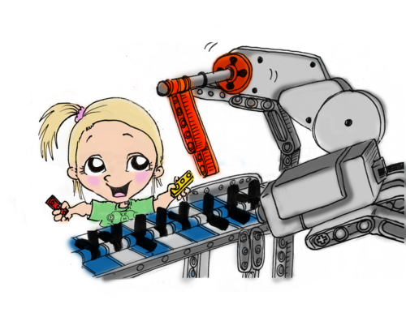
Sharing Memory in Tasks

Slide 20
Tasks
Class 7:
Thread
Own PC
Own stack, registers
Safely shared immutable memory
Safely independent own memory
fn spawn(f: proc ())
spawn( proc() {
println(“Get to work!”);
});
Task = Thread – unsafe memory sharing
or
Task = Process + safe memory sharing – cost of OS process

Slide 21
static mut count: uint = 0;
fn update_count() {
unsafe { count += 1; }
}
fn main() {
for _ in range(0u, 10) {
for _ in range(0u, 1000) {
update_count();
}
}
println!("Count: {:}", unsafe { count });
}

Slide 22
static mut count: uint = 0;
fn update_count() {
unsafe { count += 1; }
}
fn main() {
for _ in range(0u, 10) {
for _ in range(0u, 1000) {
update_count();
}
}
println!("Count: {:}", unsafe { count });
}
> rustc unsafe1.rs
> ./unsafe1
Count: 10000
> ./unsafe1
Count: 10000
> ./unsafe1
Count: 10000

Slide 23
static mut count: uint = 0;
fn update_count() {
unsafe { count += 1; }
}
fn main() {
for _ in range(0u, 10) {
spawn(proc() {
for _ in range(0u, 1000) {
update_count();
}
});
}
println!("Count: {:}", unsafe { count });
}
> rustc unsafe2.rs
> ./unsafe2
Count: 6955
> ./unsafe2
Count: 6473
> ./unsafe2
Count: 6367
> ./unsafe2
Count: 7557

Slide 24
static mut count: uint = 0;
fn update_count(id: uint) {
unsafe {
println!("Before update from {:}: {:}", id, count);
count += 1;
println!("After update from {:}: {:}", id, count);
}
}
fn main() {
for id in range(0u, 10) {
spawn(proc() {
for _ in range(0u, 1000) {
update_count(id);
}
});
}
println!("Count: {:}", unsafe { count });
}

Slide 25
static mut count: uint = 0;
fn update_count(id: uint) {
unsafe {
println!("Before update from {:}: {:}", id, count);
count += 1;
println!("After update from {:}: {:}", id, count);
}
}
fn main() {
for id in range(0u, 10) {
spawn(proc() {
for _ in range(0u, 1000) {
update_count(id);
}
});
}
println!("Count: {:}", unsafe { count });
}
> ./unsafe3
Before update from 0: 0
Before update from 1: 0
After update from 0: 1
Before update from 0: 1
After update from 0: 2
…
After update from 2: 81
Before update from 0: 81
After update from 3: 83
Before update from 2: After update from 5: 83
83
Before update from 3: 84
Before update from 6: 22
After update from 0: 84
…

Slide 26
static mut count: uint = 0;
fn update_count(id: uint) {
unsafe {
println!("Before update from {:}: {:}", id, count);
count += 1;
println!("After update from {:}: {:}", id, count);
}
}
fn main() {
for id in range(0u, 10) {
spawn(proc() {
for _ in range(0u, 1000) {
update_count(id);
}
});
}
println!("Count: {:}", unsafe { count });
}
…
Before update from 5: 6977
Before updCount: 6849
After update from 0: 6867
ate from 7: 6977
After update from 8: 6958
…
After update from 1: 9716
Before update from 1: 9716
After update from 1: 9717
Before update from 1: 9717
After update from 1: 9718
>

Slide 27
How atomic is count += 1?
fn update_count() {
unsafe { count += 1; }
}

Slide 28
__ZN12update_count19h86817af0b0797e96al4v0.0E:
.cfi_startproc
cmpq %gs:816, %rsp
ja LBB0_0
movabsq $16, %r10
movabsq $0, %r11
callq ___morestack
ret
LBB0_0:
pushq %rbp
Ltmp2:
.cfi_def_cfa_offset 16
Ltmp3:
.cfi_offset %rbp, -16
movq %rsp, %rbp
Ltmp4:
…
rustc -S unsafe2.rs
unsafe2.s

Slide 29
Ltmp4:
.cfi_def_cfa_register %rbp
pushq %rax
movq __ZN5count19hc6afed277fb1b6c3ah4v0.0E(%rip), %rax
addq $1, %rax
movq %rax, __ZN5count19hc6afed277fb1b6c3ah4v0.0E(%rip)
movq %rdi, -8(%rbp)
addq $8, %rsp
popq %rbp
ret
.cfi_endproc
unsafe2.s

Slide 30
rustc -O
fn update_count() {
unsafe { count += 1; }
}
fn main() {
for _ in range(0u, 10) {
spawn(proc() {
for _ in range(0u, 1000) {
update_count();
}
});
}
println!("Count: {:}", …);
}
> rustc unsafe2.rs
> ./unsafe2
Count: 7628
> ./unsafe2
Count: 6672
> rustc -O unsafe2.rs
> ./unsafe2
Count: 10000
> ./unsafe2
Count: 10000
> ./unsafe2
Count: 10000
> ./unsafe2
Count: 10000
> ./unsafe2
Count: 9000
__ZN4main4anon7expr_fn2agE:
.cfi_startproc
…
pushq %rbp
Ltmp15:
.cfi_def_cfa_offset 16
Ltmp16:
.cfi_offset %rbp, -16
movq %rsp, %rbp
Ltmp17:
.cfi_def_cfa_register %rbp
addq $1000, __ZN5count19hc6afed277v0.0E(%rip)
popq %rbp
ret
.cfi_endproc

Slide 31
ARCs
extra::arc provides:
Arc
wrapper for shared immutable state
MutexArc
mutable shared state
protected by mutual exclusion
RWArc
mutable shared state
protected by reader-writer lock
Automatically
Reference
Counted

Slide 32
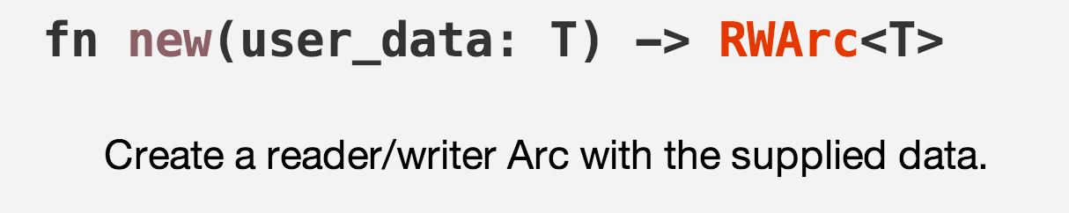
Creating an RWArc
let counter: RWArc<int> = RWArc::new(0);

Slide 33
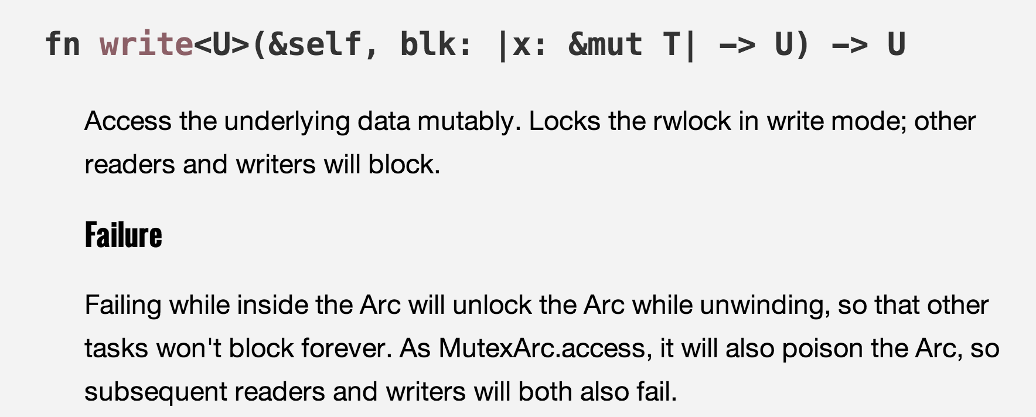
RWArc write

Slide 35
|count: &mut int|
fn update_count(counter: RWArc<int>) {
counter.write(|count| { *count += 1; });
}

Slide 36
extern mod extra;
use extra::arc::RWArc;
fn update_count(counter: RWArc<int>) {
counter.write(|count| { *count += 1; });
}
fn main() {
let counter: RWArc<int> = RWArc::new(0);
for _ in range(0, 10) {
let ccounter = counter.clone();
spawn(proc() {
for _ in range(0, 1000) { update_count(ccounter.clone()); }
});
}
counter.read(|count| { println!("Count: {:d}", *count); });
}

Slide 37
extern mod extra;
use extra::arc::RWArc;
fn update_count(counter: RWArc<int>) {
counter.write(|count| { *count += 1; });
}
fn main() {
let counter: RWArc<int> = RWArc::new(0);
for _ in range(0, 10) {
let ccounter = counter.clone();
spawn(proc() {
for _ in range(0, 1000) { update_count(ccounter.clone()); }
});
}
counter.read(|count| { println!("Count: {:d}", *count); });
}
What is the value printed for Count?
> ./rwarc1
Count: 1139
> ./rwarc1
Count: 1146
> ./rwarc1
Count: 1158

Slide 38
fn main() {
let counter: RWArc<int> = RWArc::new(0);
let running: RWArc<int> = RWArc::new(0);
for _ in range(0, 10) {
let ccounter = counter.clone();
running.write(|n| { *n += 1; });
let crunning = running.clone();
spawn(proc() {
for _ in range(0, 100) { update_count(ccounter.clone()); }
crunning.write(|n| { *n -= 1; });
});
}
while running.read(|n| { *n }) > 0 { ; }
counter.read(|count| { println!("Count: {:d}", *count); });
}

Slide 39
Scheduling

Slide 40
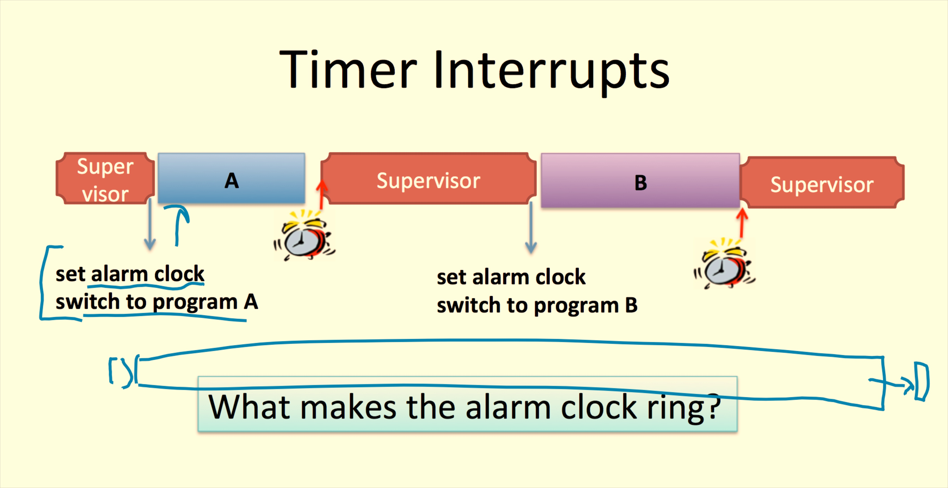
Remember from Class 4:
How should the supervisor decide which program to run?
How long should the alarm clock be set for?

Slide 41
Scheduler Desiderata
Go placidly amid the noise and haste, and remember what peace there may be in silence. As far as possible without surrender be on good terms with all persons. Speak your truth quietly and clearly; and listen to others, even the dull and the ignorant; they too have their story. Avoid loud and aggressive persons, they are vexations to the spirit. … Exercise caution in your business affairs; for the world is full of trickery. …And whether or not it is clear to you, no doubt the universe is unfolding as it should…whatever your labors and aspirations, in the noisy confusion of life keep peace with your soul. With all its sham, drudgery, and broken dreams, it is still a beautiful world. Be cheerful. Strive to be happy.
Max Ehrmann, “Desiderata” (1927)

Slide 42
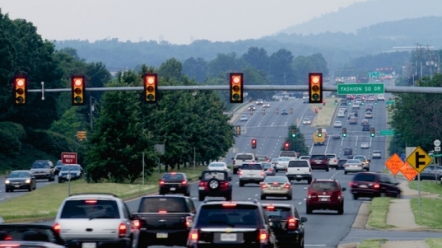
How well do traffic lights do?

Slide 43
How well do traffic lights do?

Slide 44
Scheduling Strategies
First Come, First Served (FIFO)
P1
P2
P3
(effectively: non-preemptive multi-processing)

Slide 45
First Come, First Served (FIFO)
P1
P2
P3
(effectively: non-preemptive multi-processing)
Round-Robin
P1
P2
P3
P1
P2
P3
P1
P3
P1
P3
Time Slice
Blocked
Each process gets to run for a set time slice, or until it finished or gets blocked.

Slide 46
Comparison
First Come, First Served
Round Robin

Slide 47
Which one is my laptop using?

Slide 48
Priorities
More important processes: “higher priority” (except Linux inverts priority values!)
  Highest priority = 0
  gets most preferential treatment
  Lowest priority = 99
  highest number varies by Linux flavor

Slide 49
High Priority Processes
ps -w -e -o pri,pid,pcpu,vsz,cputime,command
| sort -n -r --key=5 | sort --stable -n --key=1

Slide 50
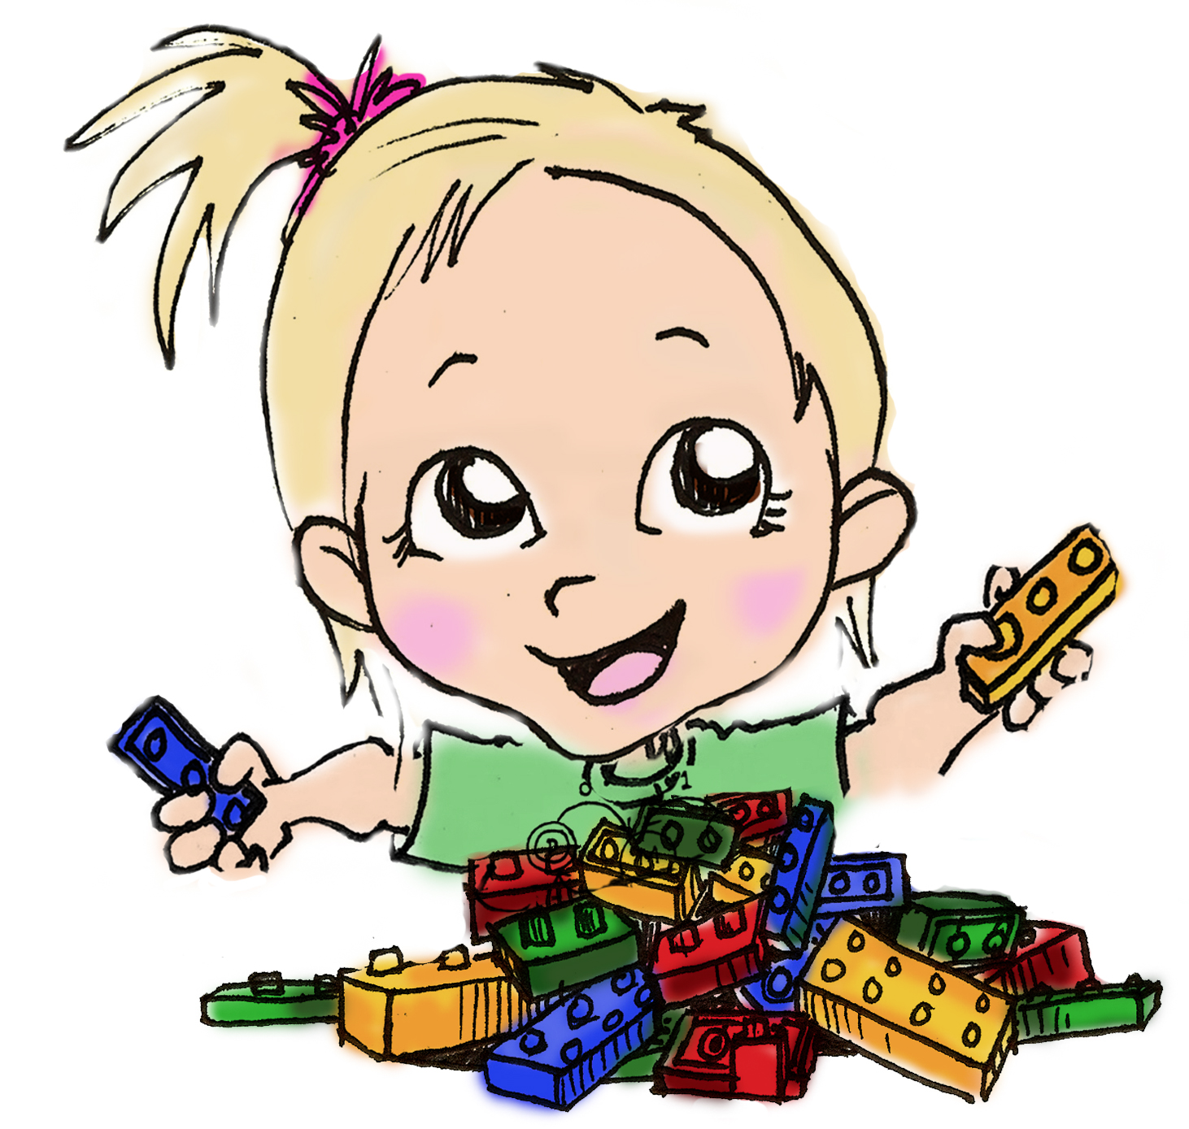
dori-mic.org
“If only I had this book when I was a young student, I might have done something useful with my life like discover a new complexity class instead of dropping out and wasting my life flipping pancakes, playing with basic blocks, and eradicating polo.”
Gill Bates,
Founder of Mic-Soft Corporation
MiniLEGO [FJNNO 2013]

