Slide 2
Charge
Next class: more advanced scheduling

Slide 3
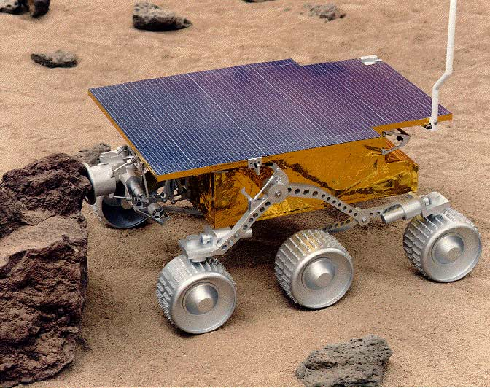
Mars Pathfinder (1997)

Slide 4

Pathfinder OS:
Pre-emptive Priority Scheduling
Always run the highest priority process that is ready to run
Round-robin schedule among equally high, ready to run, highest-priority processes
CPU
Shared Bus
Radio
Camera
Flash Memory
Actuators

Slide 5
Priority Inversion
Task 1 (scheduler) – highest priority (Priority = 1)
Task 2 (send data) – (Priority = 4)
Task 3 (science analysis) – lowest priority (Priority = 97)
CPU
Shared Bus
Radio
Camera
Flash Memory
Actuators

Slide 6
How should we solve priority inversion?

Slide 7
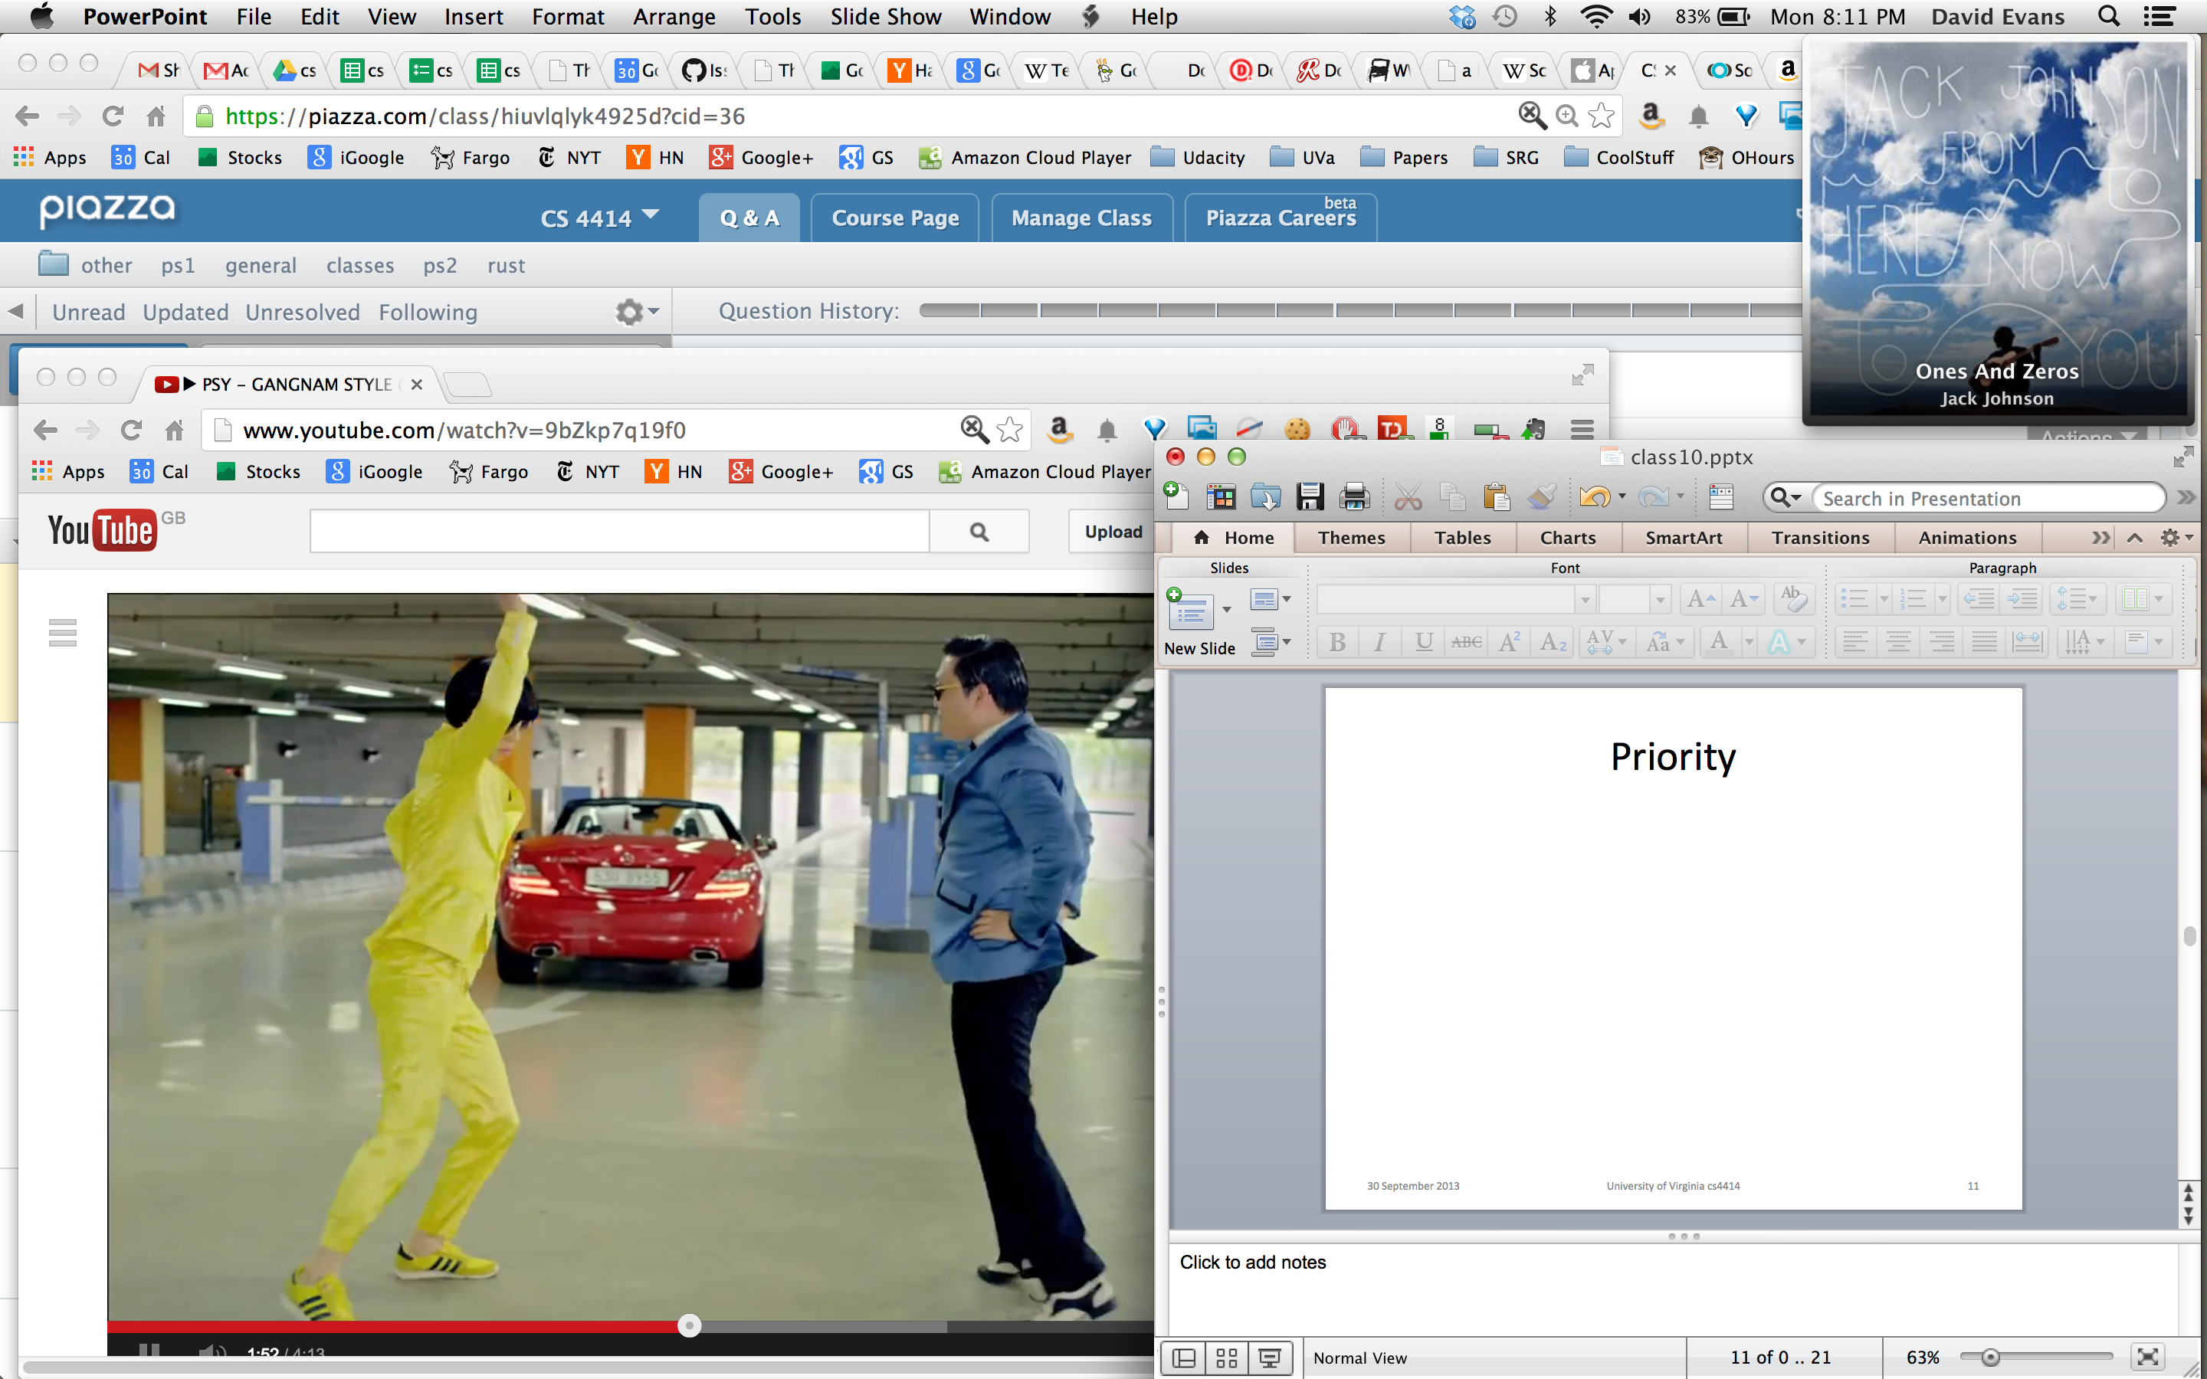
Priority

Slide 8
Kinds of Processes
“Compute-Bound”
P1
“I/O-Bound”
P2
P2
P2
wait for disk…
wait for network…
wait for user…
“Real Time”
P3
P3
P3
P3
need frame ^ need frame ^ need frame ^ need frame ^

Slide 9
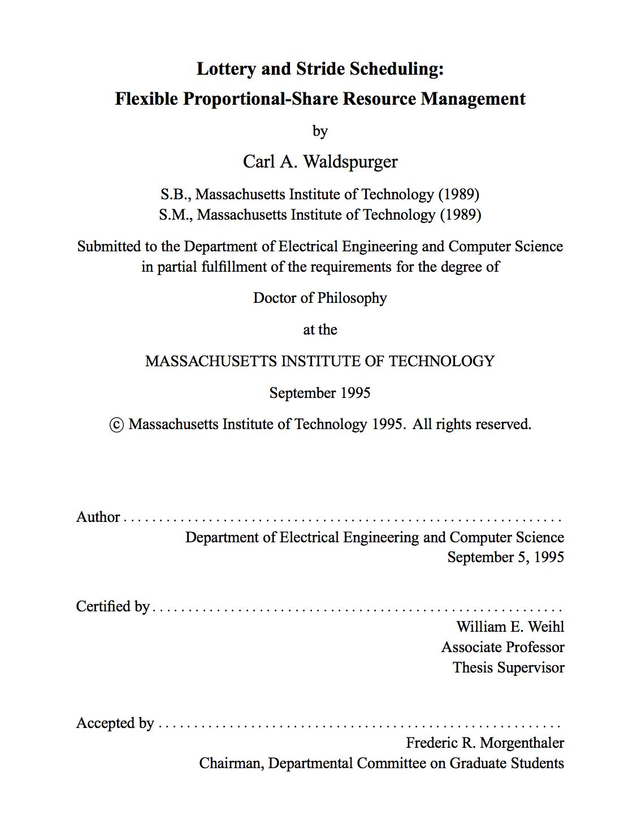

Carl Waldspurger

