Slide 1
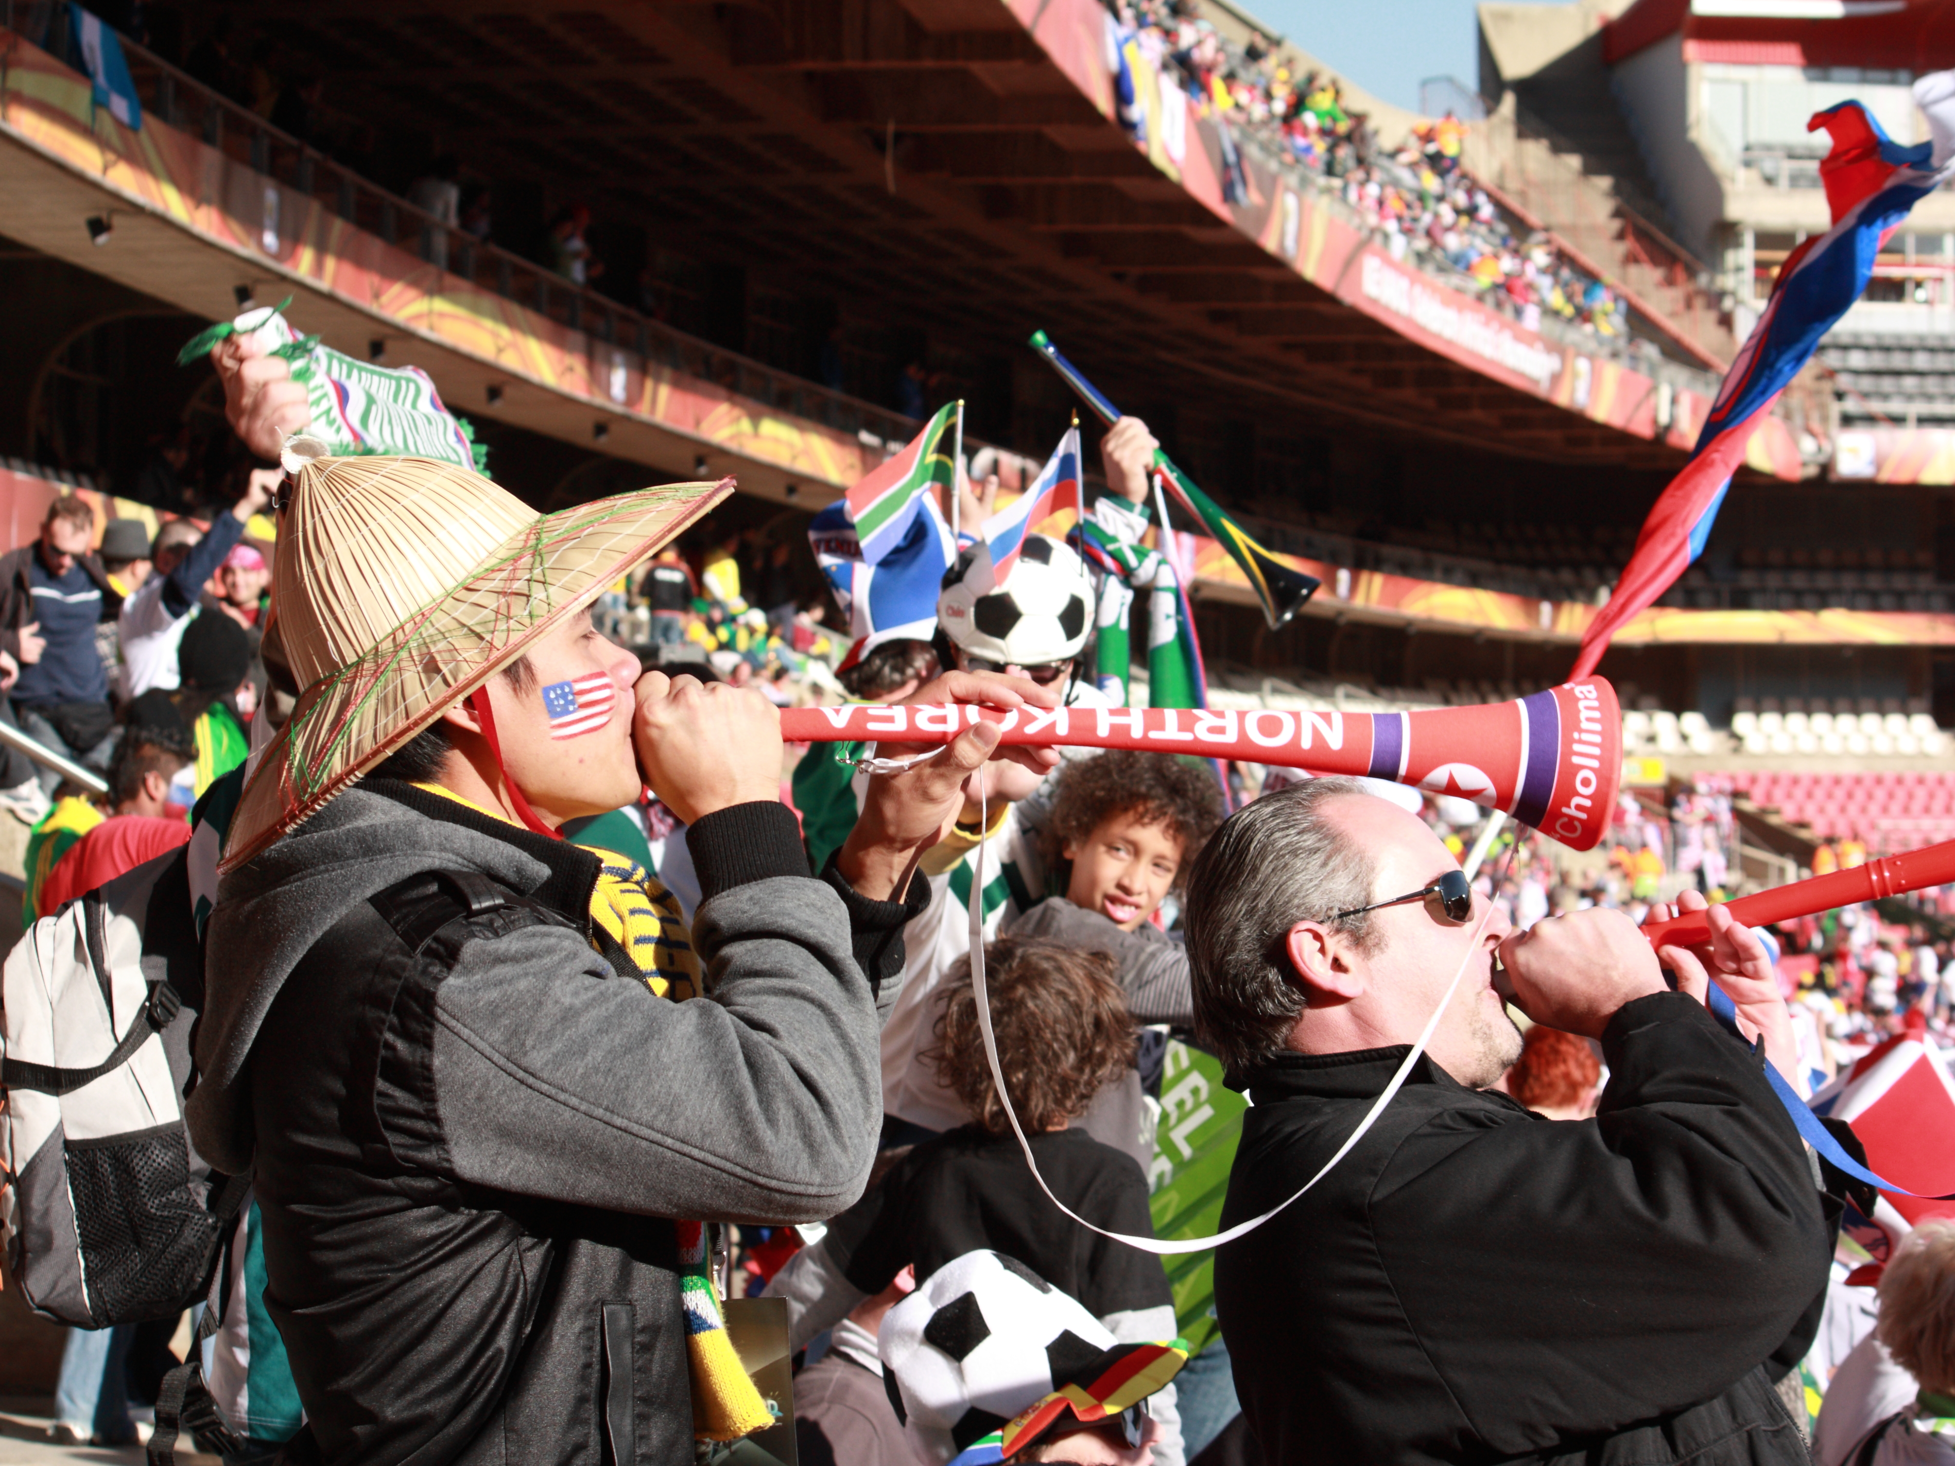
Class 12:
Synchronization
cs4414 Fall 2013
University of Virginia
David Evans

Slide 2
Plan for Today
First Three Files
Why Concurrency Is Hard
  Race Conditions
  Deadlocks
MapReduce!
Problem Set 3

Slide 3
When you create a new repo, what should the second file you add be?

Slide 4
Makefiles
Someone should be able to clone your repo and build it by doing: gash> make
Even if no one else ever clones your repo, you will be very happy to have this if you come back to it a few weeks later
The only excuse for not having a Makefile is if you use configure to create a platform-specific one (like rust does): ./configure; make && make install

Slide 5
Making Makefiles
# cs4414 Problem Set 3
all: zhtta
zhtta:
rustc zhtta.rs
Beware: awkward, quirky syntax:
<space><space><space><space><space> ≠ <tab>
# Suffix rules, putting all outputs into $(obj).
$(obj).$(TOOLSET)/%.o: $(srcdir)/%.c FORCE_DO_CMD
@$(call do_cmd,cc,1)
…
Complex projects have complex Makefiles:
but to build them, all you need to know is make

Slide 6
When you create a new repo, what should the third file you add be?
LICENSE

Slide 7
Permission is hereby granted, free of charge, to any person obtaining a copy of this software and associated documentation files (the "Software"), to deal in the Software without restriction, including without limitation the rights to use, copy, modify, merge, publish, distribute, sublicense, and/or sell copies of the Software, and to permit persons to whom the Software is furnished to do so, subject to the following conditions:
The above copyright notice and this permission notice shall be included in all copies or substantial portions of the Software.
THE SOFTWARE IS PROVIDED "AS IS", WITHOUT WARRANTY OF ANY KIND, EXPRESS OR IMPLIED, INCLUDING BUT NOT LIMITED TO THE WARRANTIES OF MERCHANTABILITY, FITNESS FOR A PARTICULAR PURPOSE AND NONINFRINGEMENT. IN NO EVENT SHALL THE AUTHORS OR COPYRIGHT HOLDERS BE LIABLE FOR ANY CLAIM, DAMAGES OR OTHER LIABILITY, WHETHER IN AN ACTION OF CONTRACT, TORT OR OTHERWISE, ARISING FROM, OUT OF OR IN CONNECTION WITH THE SOFTWARE OR THE USE OR OTHER DEALINGS IN THE SOFTWARE.
Include this part because you want others to contribute to and benefit from your code.
Include this part because you want to be protected if the government decides to use your zhtta to run healthcare.gov (but keep the ALLCAPS to ensure no one wastes time reading it).
This is the MIT License, taken from the Rust repo. Rust license is a more complicated (parts are MIT, parts are Apache).

Slide 8
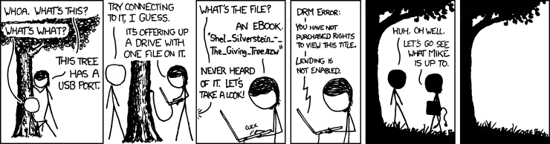
This work is licensed under a Creative Commons Attribution-NonCommercial 2.5 License.
This means that you are free to copy and reuse any of my drawings (noncommercially) as long as you tell people where they're from.
(Its from xkcd.com)

Slide 9
First File?
?
Makefile
LICENSE
(Note: you are not required to use a permissive LICENSE for code you write for this class, but anything you derive from our starting code must follow the LICENSE provided there.)
Can we start writing some code please!?!??

Slide 10
First File: README.md
README.md
Makefile
LICENSE
You may think this seems silly for small programs. But, every big, complex program started out as a small one. A few minutes setting up your repo will be worth it in the long run.
Now, start writing code… (or documentation!)

Slide 11
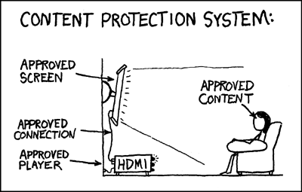
Synchronization
“You can use them freely (with some kind of link) in not-for-profit publications, and I’m also okay with people reprinting occasional comics (with clear attribution) in publications like books, blogs, newsletters, and presentations. If you’re not sure whether your use is noncommercial, feel free to email me and ask (if you’re not sure, it's probably okay).” (Detailed explanation of xkcd license.)

Slide 12
Scheduling Meetings
Bob
“When can you meet Friday?”
Alice
“When can you meet Friday?”
Colleen
“11am or 3pm”
“9am or 11am”
Selects and reserves 11am
Reserves 11am
for meeting
Reserves 11am
for meeting
“11am it is”
“11am it is.”

Slide 13
Partial Ordering of Events
Sequential programs give us a total ordering of events: everything happens in a determined (sequential) order
Concurrent programs give us a partial ordering of events: we know some things happen before other things, but other orderings are undetermined

Slide 14
Bob
“When can you meet Friday?”
Alice
“When can you meet Friday?”
Colleen
A1
A2
“11am or 3pm”
B1
“9am or 11am”
C1
A3
Selects and reserves 11am
A4
A5
Reserves 11am
for meeting
Reserves 11am
for meeting
“11am it is”
“11am it is.”
B2
C2

Slide 15
Race Condition
Race Condition: Behavior of a program depends on order of events
Data race: two threads read and write shared data in a way such that ordering of events changes resulting state
Time-of-check-to-time-of-use: thread 1 checks some property, thread 2 modifies it, thread 1 does something based on the out-of-date check

Slide 16
Bob
“When can you meet Friday?”
Alice
“When can you meet Friday?”
Colleen
A1
A2
“11am or 3pm”
B1
“9am or 11am”
C1
A3
Selects and reserves 11am
A4
A5
Reserves 11am
for meeting
Reserves 11am
for meeting
“11am it is”
“11am it is.”
B2
C2
Any race conditions here?

Slide 17
Bob
“When can you meet Friday?”
Alice
“When can you meet Friday?”
Colleen
Dave
“When can you meet Friday?”
A1
A2
“11am or 3pm”
“9am or 11am”
B1
“9am or 11am”
C1
D2
A3
Selects and reserves 11am
“Ok, 11am.”
Selects and reserves 11am
A4
A5
Reserves 11am
Reserves 11am
“11am it is”
“11am it is.”
B2
C2

Slide 18
Preventing Data Races
Use locks to impose ordering constraints
After responding to Alice, Coleen reserves all the times in response until she hears back

Slide 19
Bob
“When can you meet Friday?”
Alice
“When can you meet Friday?”
Colleen
Dave
“When can you meet Friday?”
A1
A2
“11am or 3pm”
“9am or 11am”
B1
D2
“Ok, 11am.”
Selects and reserves 11am
Reserves 11am
C1
“9am”
While Colleen’s calendar is locked, cannot allow Alice to read it!

Slide 20
Bob
“When can you meet Friday?”
Alice
“When can you meet Friday?”
Colleen
Dave
“When can you meet Friday?”
“Bob, when can you meet Friday?”
A1
A2
“11am or 3pm”
“9am or 11am”
B1

Slide 21
Deadlock
Deadlock: A group of threads are stuck because of resource dependencies
Thread A
Needs
Locks
Resource 2
Resource 1
Thread B
Locks
Needs

Slide 22
Why are threads hard?
Too few ordering constraints: race conditions
Too many ordering constraints: deadlocks
Hard/impossible to reason modularly
  If an object is accessible to multiple threads, need to think about what any of those threads could do at any time!
Testing is even more impossible than it is for sequential code: even if you test all the inputs, don’t know it will work if threads run in different order
Rust makes safe threads easy(er)!

Slide 23
Safe Rust Code
Is it possible to have a data race condition?
Is it possible to have a deadlock?

Slide 24
Multi-Rustic Map-Reduce
Alexander Lamana
Jasdev Singh
Nishant Shukla
William Thomason

Slide 25
Problem Set 3: Zhtta web server

Slide 26
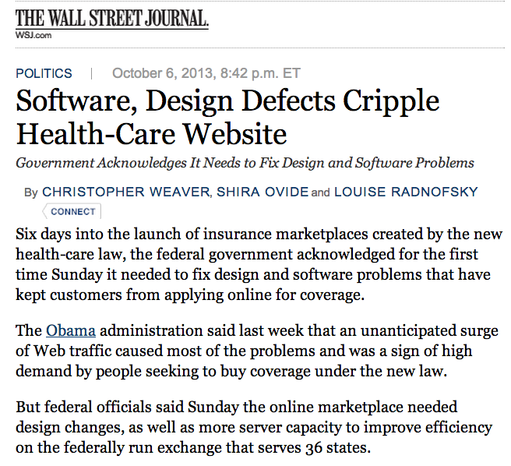
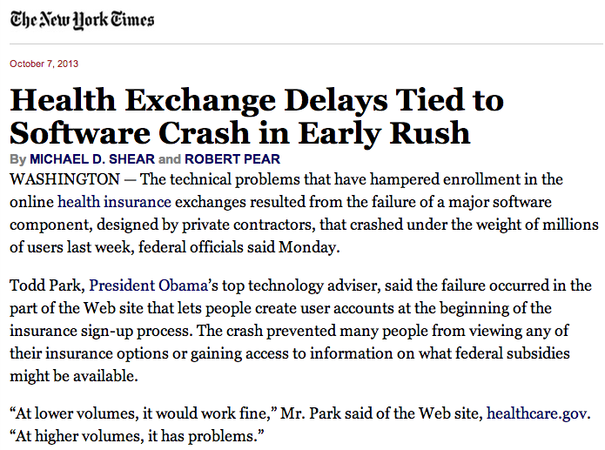
Yesterday’s Top Story

Slide 27
“In some cases, the Web site does not recognize users who established accounts before Oct. 1, when the online marketplaces opened for consumers to shop for insurance. Other users are prevented from establishing accounts. Some who successfully established a marketplace account received an e-mail asking them to verify their e-mail addresses, but the link provided did not work.” (NYT article)
Race condition, deadlock, or general crappiness?

Slide 28
“But because of the initial failures, other parts of the complex system have yet to be proved under the intense strain of real-world conditions. And outside experts said that White House officials should have spent more time tending to the computer code and technology of the Web site, rather than recruiting Hollywood celebrities to promote it.”
…
Those comments echoed similar criticism on sites across the Internet, where Web designers and developers speculated about the reasons for the ongoing problems at the Web site, healthcare.gov. One discussion on the popular Web site reddit.com was titled “How not to optimize a website.”

Slide 29
White House officials declined to identify the private contractors who had built the account creation function, citing a decision to keep that information private. They said the contractors had moved that part of the new system to beefed-up hardware and were busy rewriting the software code to make it more robust and efficient. In the past week, wait times have dropped by half, officials said.
Officials said they had also added staff members at call centers to provide customers an alternative to the online system. The Web site currently says that people “in a hurry” can apply faster at a government call center using a toll-free telephone number, (800) 318-2596. But an operator at the call center said Monday that he could not help because he, too, was “experiencing technical difficulties with the Web site.”

Slide 30
Ouch…what was today’s top story?

Slide 31
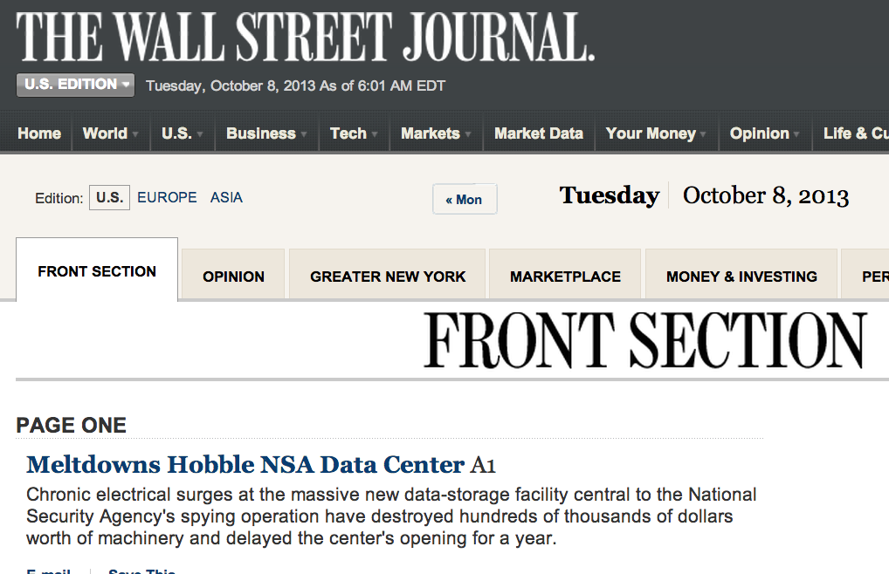

Slide 32
Mutual Exclusion

Slide 33
Dining Philosophers

