Slide 1

Class 12
Scheduling in Linux and Web Servers
cs4414 Fall 2013
David Evans

Slide 2
Plan for Today
Scheduling in Linux (2002-today)
Scheduling Web Services
Submitting PS3:
Schedule demo (sign up soon!)
Web submission form (11:59pm tomorrow)
Benchmark submission
Post-demo assessment (teammate evaluation)
leaderboard.html

Slide 3

Scheduling in Linux

Slide 4
Linux Scheduler before V2.6 (2002)
Three types of processes:
#define SCHED_OTHER 0
#define SCHED_FIFO 1
#define SCHED_RR 2
Not (fully) pre-emptive:
only user-level processes could be pre-empted
Select next process according to “goodness” function
Normal user processes
Non-pre-ementable
Real-time round-robin
Notes:
http://www.linuxjournal.com/article/3910

Slide 5
/* linux/kernel/sched.c
* This is the function that decides how desirable a process is.
* You can weigh different processes against each other depending
* on what CPU they've run on lately etc to try to handle cache
* and TLB miss penalties.
*
* Return values:
* -1000: never select this
* 0: out of time, recalculate counters (but it might still be selected)
* +ve: "goodness" value (the larger, the better)
* +1000: realtime process, select this.
*/
static inline int goodness(struct task_struct * p, int this_cpu, struct
mm_struct *this_mm)
{
int weight;
/*
* Realtime process, select the first one on the
* runqueue (taking priorities within processes
* into account).
*/
if (p->policy != SCHED_OTHER) {
weight = 1000 + p->rt_priority;
goto out;
}
/*
* Give the process a first-approximation goodness value
* according to the number of clock-ticks it has left.
*
* Don't do any other calculations if the time slice is
* over..
*/
weight = p->counter;
if (!weight)
goto out;
#ifdef __SMP__
/* Give a largish advantage to the same processor... */
/* (this is equivalent to penalizing other processors) */
if (p->processor == this_cpu)
weight += PROC_CHANGE_PENALTY;
#endif
/* .. and a slight advantage to the current MM */
if (p->mm == this_mm)
weight += 1;
weight += p->priority;
out:
return weight;
}
/* linux/kernel/sched.c
* This is the function that decides how desirable a process is.
* You can weigh different processes against each other depending
* on what CPU they've run on lately etc to try to handle cache
* and TLB miss penalties.
*
* Return values:
* -1000: never select this
* 0: out of time, recalculate counters (but it might still be selected)
* +ve: "goodness" value (the larger, the better)
* +1000: realtime process, select this.
*/
static inline int goodness(struct task_struct * p, int this_cpu,
struct mm_struct *this_mm)
{
…

Slide 6
static inline int goodness(struct task_struct * p, int this_cpu, struct mm_struct *this_mm)
{
int weight;
/* Realtime process, select the first one on the runqueue (taking priorities into account). */
if (p->policy != SCHED_OTHER) {
weight = 1000 + p->rt_priority;
goto out;
}
/* Give the process a first-approximation goodness value according to the number of clock-ticks it has left.
Don't do any other calculations if the time slice is over.. */
weight = p->counter;
if (!weight) goto out;
#ifdef __SMP__
/* Give a largish advantage to the same processor... (equivalent to penalizing other processors) */
if (p->processor == this_cpu) weight += PROC_CHANGE_PENALTY;
#endif
/* .. and a slight advantage to the current MM (memory segment) */
if (p->mm == this_mm) weight += 1;
weight += p->priority;
out:
return weight;
}
This is the whole goodness function from V2.5 scheduler (only edited formatting to fit on slide).

Slide 7
What is the running time of the
Linux 2.2-2.5 Scheduler?

Slide 8

What is the running time of the Linux 2.2-2.5 Scheduler?

Slide 9
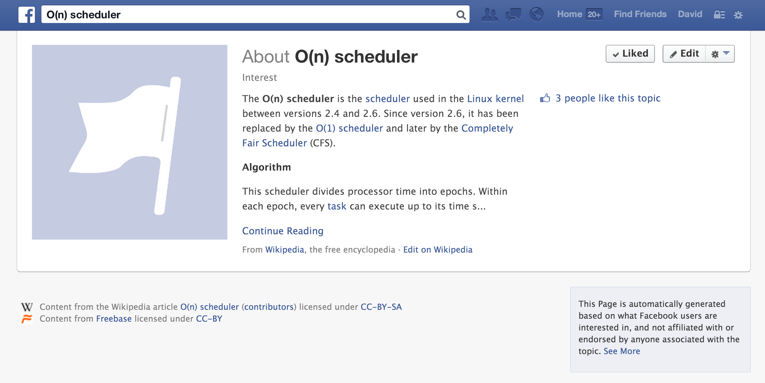

Slide 10
Linux 2.6 Scheduler (2003-2007)
140 different queues (for each processor)
  0-99 for “real time” processes
  100-139 for “normal” processes
Bit vector keeps track of which queues have ready to run process
Scheduler picks first process from highest priority queue with a ready process
  Given time quantum that scales with priority

Slide 11
Linux 2.6 Scheduler (2003-2007)
struct runqueue {
struct prioarray *active;
struct prioarray *expired;
struct prioarray arrays[2];
};
struct prioarray {
int nr_active; /* # Runnable */
unsigned long bitmap[5];
struct list_head queue[140];
};
140 different queues (for each processor)
  0-99 for “real time” processes
  100-139 for “normal” processes
Bit vector of ready-to-run
Scheduler picks first process from highest-priority queue with a ready process

Slide 12
What is the running time of the
Linux 2.6 Scheduler?

Slide 13
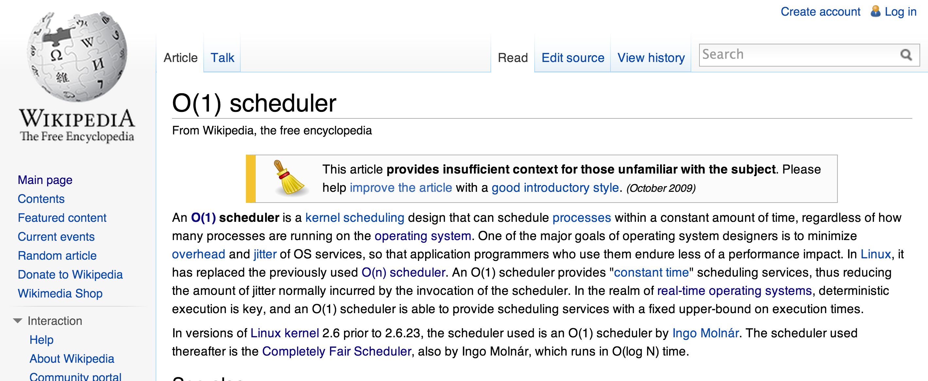
(Sadly, O(1) scheduler has no Facebook page.)

Slide 14
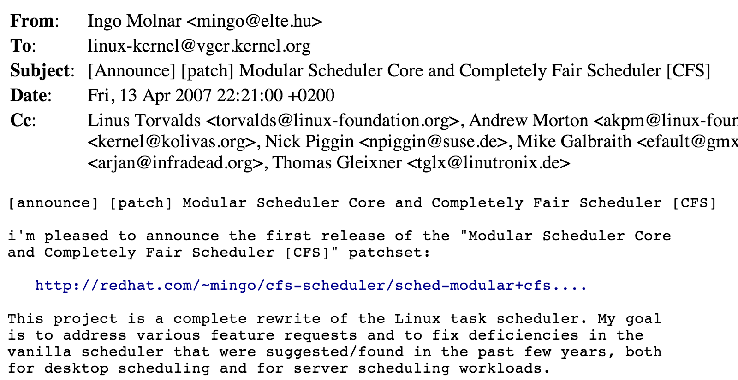
Linux V2.6.23+ Scheduler

Slide 15
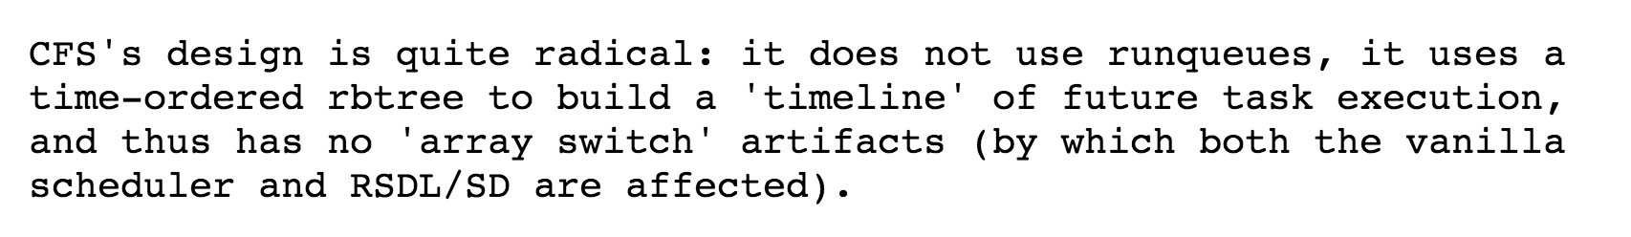
Rotating Staircase Deadline Scheduler
This is exactly stride scheduling (but with different terminology)!

Slide 16
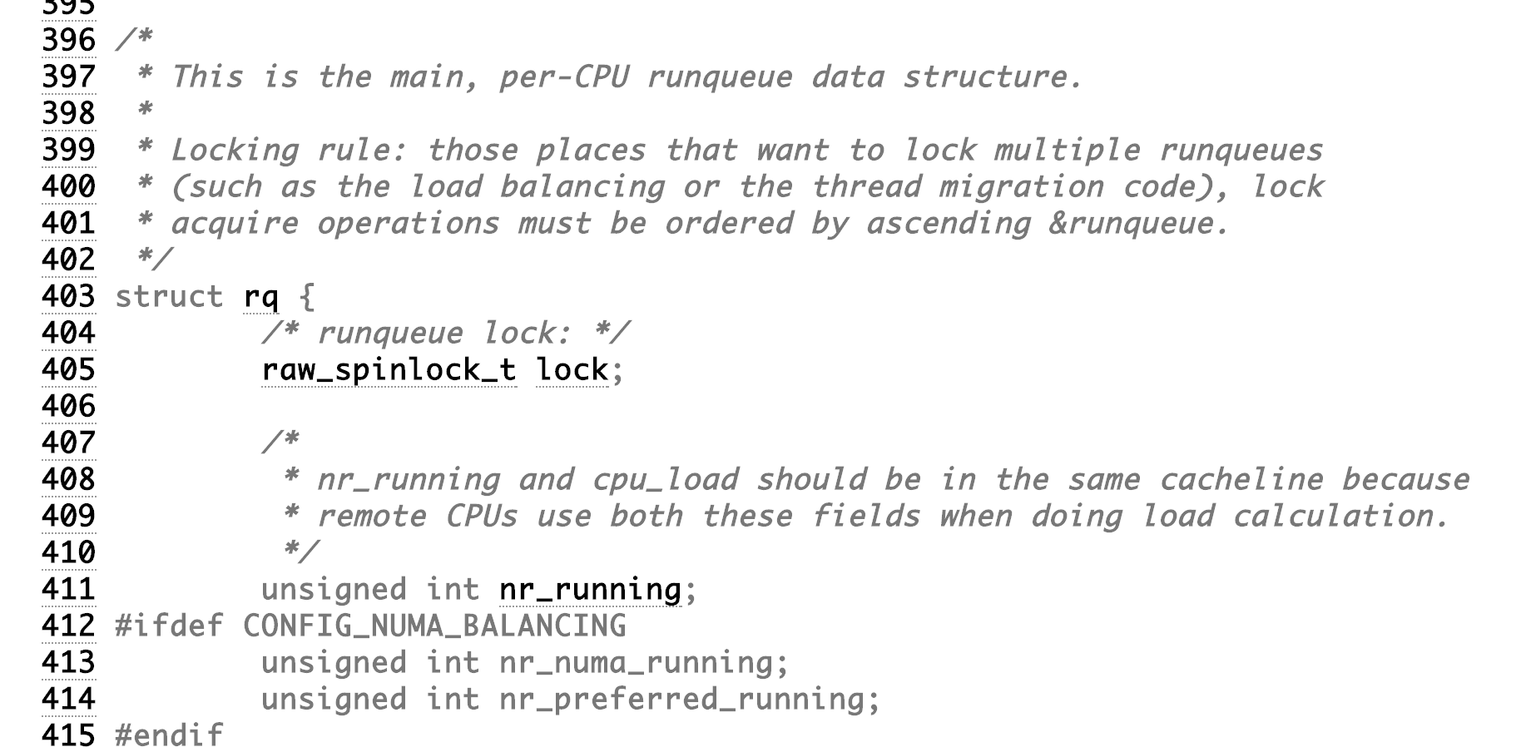
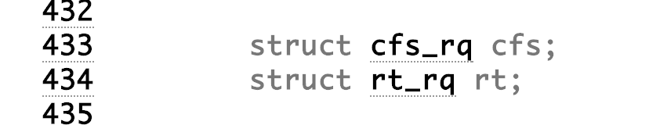

Slide 17
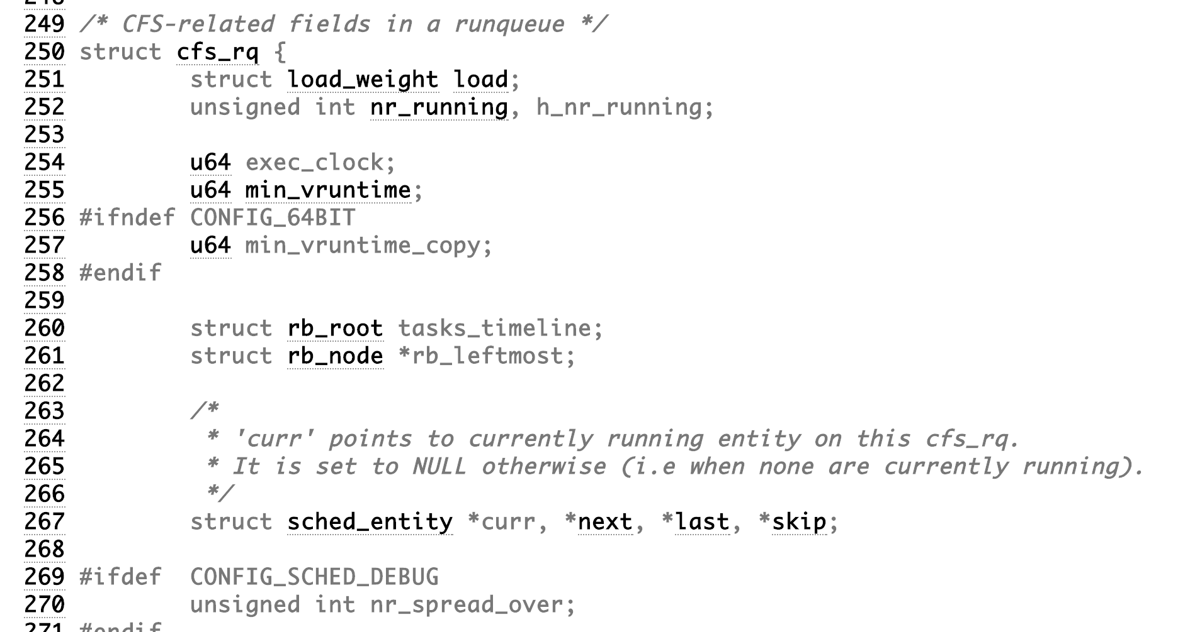

Slide 18
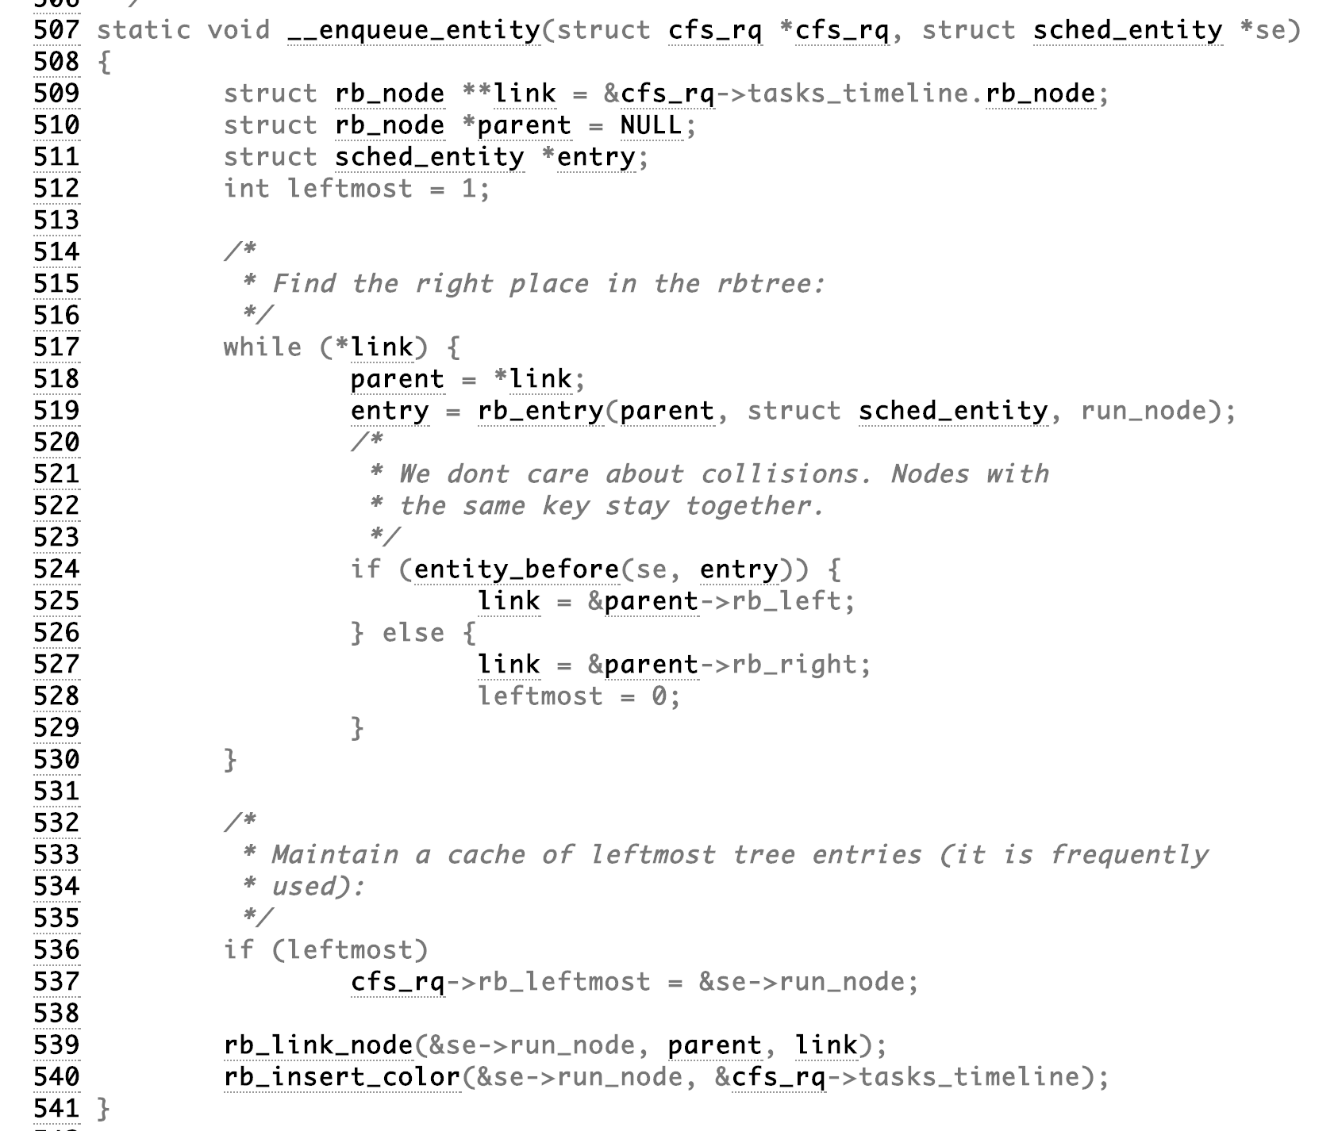

Slide 19
What is the running time of the
Linux 2.6.23+ Scheduler?

Slide 20
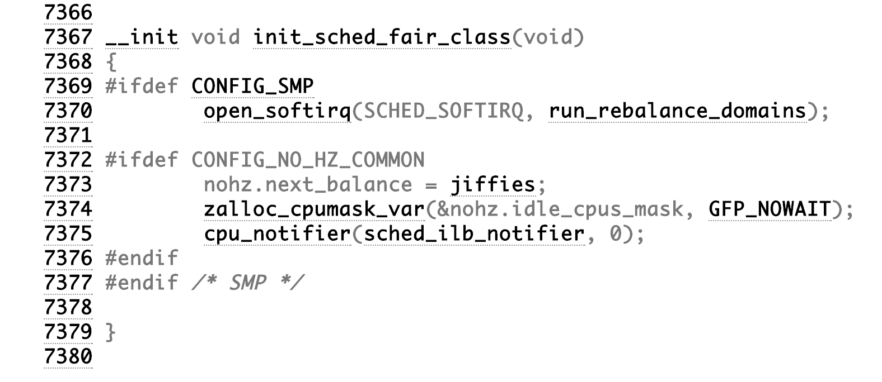
Linux/kernel/sched/fair.c

Slide 21
What is the running time of the
Linux 2.6.23+ Scheduler?
Not called the θ(log N) scheduler – by Linux 2.6.23 marketing
matters: “Completely Fair Scheduler”

Slide 22
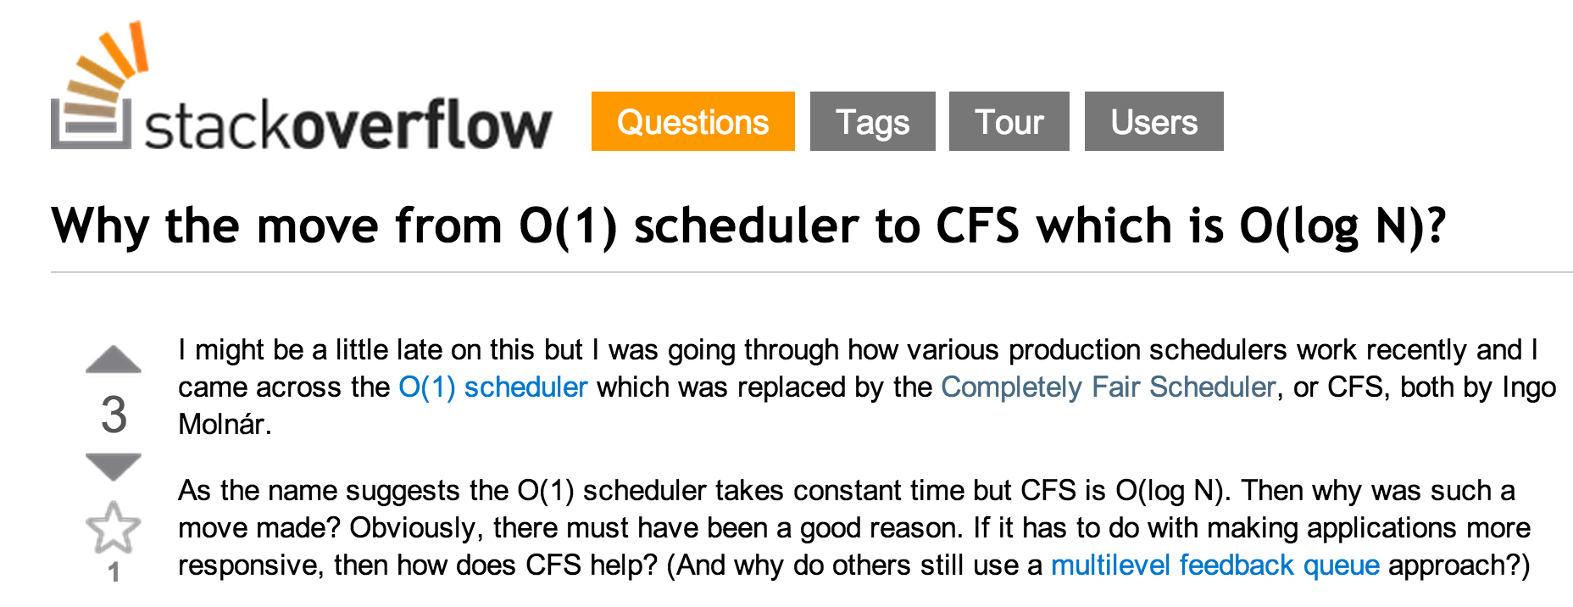
(In practice) What is log₂ N?

Slide 23
What resources should scheduler be maximizing utility of?

Slide 24
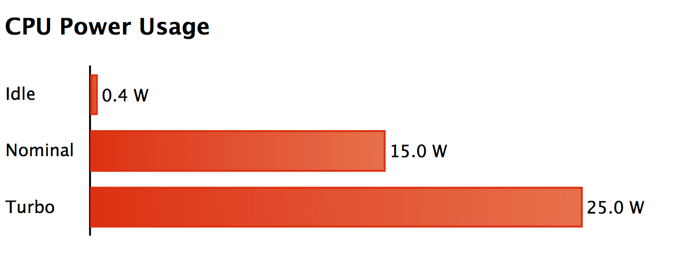
Key Resource: Energy!
Image from http://arstechnica.com/apple/2013/10/os-x-10-9/12/

Slide 25
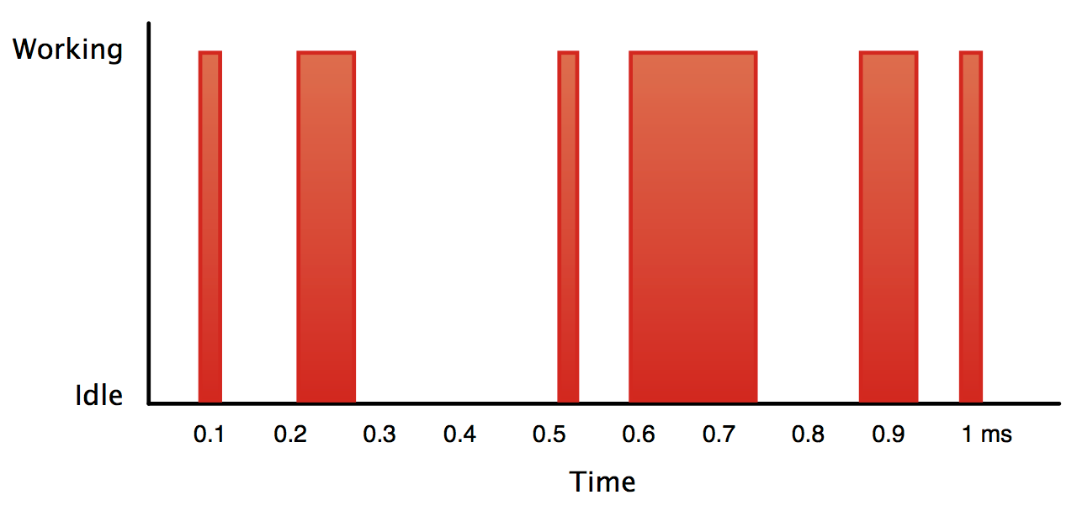
Image from http://arstechnica.com/apple/2013/10/os-x-10-9/12/

Slide 26
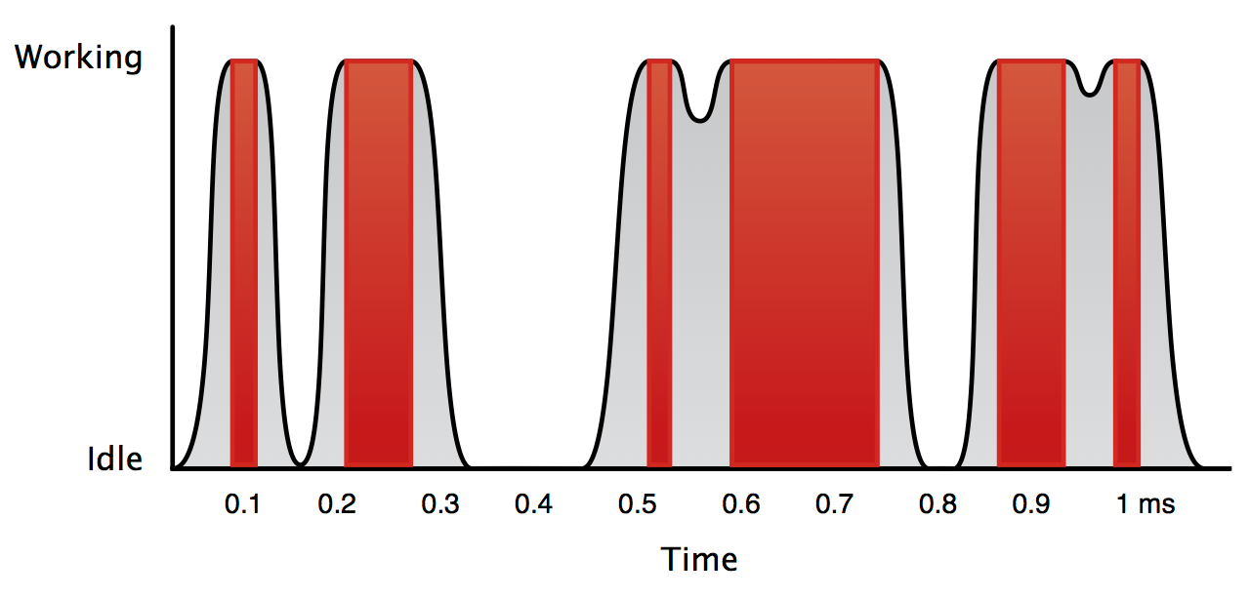
Image from http://arstechnica.com/apple/2013/10/os-x-10-9/12/

Slide 27
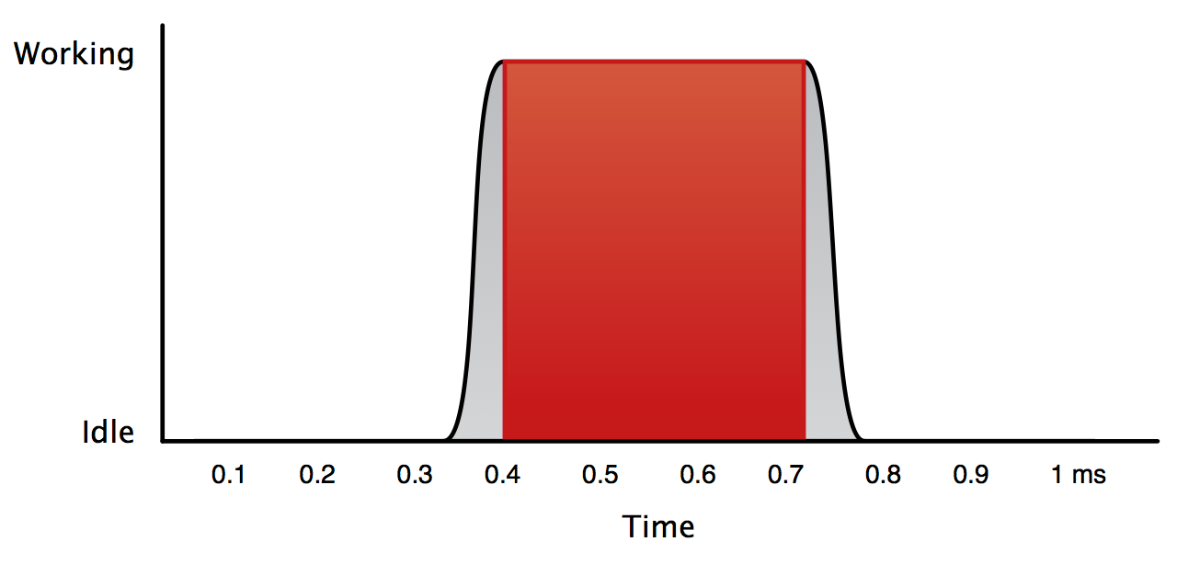
Image from http://arstechnica.com/apple/2013/10/os-x-10-9/12/

Slide 28
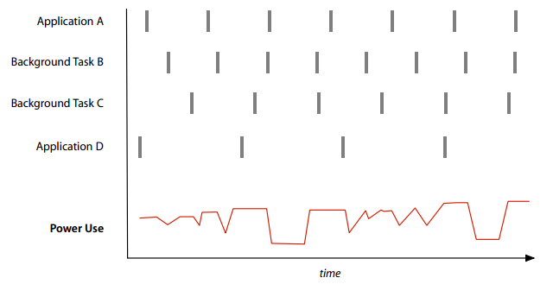
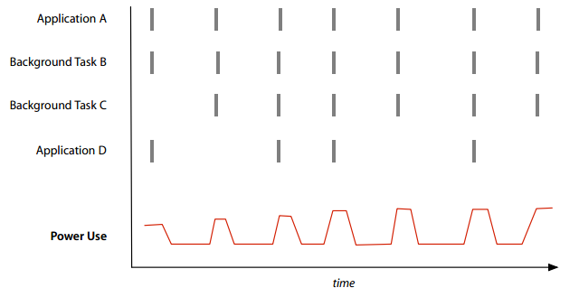
Timer Coalescing
Images from http://arstechnica.com/apple/2013/06/how-os-x-mavericks-works-its-power-saving-magic/

Slide 29
OS Schedulers Recap
Use Resources Well
Limit unnecessary switching, Save Energy
Low cost of scheduler itself
Make good decisions
Locally: pick the most important process
Globally: provide good system performance

Slide 30

Scheduling Web Servers

Slide 31
Web Server Overload!
healthcare.gov
Rate of incoming requests > Rate server can process requests

Slide 32
Solutions

Slide 33
Strategy 0:
Measure

Slide 34

“When the meetings ended at a CMS outpost in Herndon, Va., at about 7:00 p.m., the rescue squad already on the scene realized they had more work to do. One of the things that shocked Burt and Park’s team most—“among many jaw-dropping aspects of what we found,” as one put it—was that the people running HealthCare.gov had no “dashboard,” no quick way for engineers to measure what was going on at the website, such as how many people were using it, what the response times were for various click-throughs and where traffic was getting tied up. So late into the night of Oct. 18, Burt and the others spent about five hours coding and putting up a dashboard.”

Slide 35
Developer Benchmarks
Find bottlenecks: know what to spend time optimizing
Measure impact of changes
Predict what resources you will need to scale service
  Goal is a benchmark that represents the actual usage

Slide 36
Strategy 1:
Shrink and Simplify Your Content

Slide 37
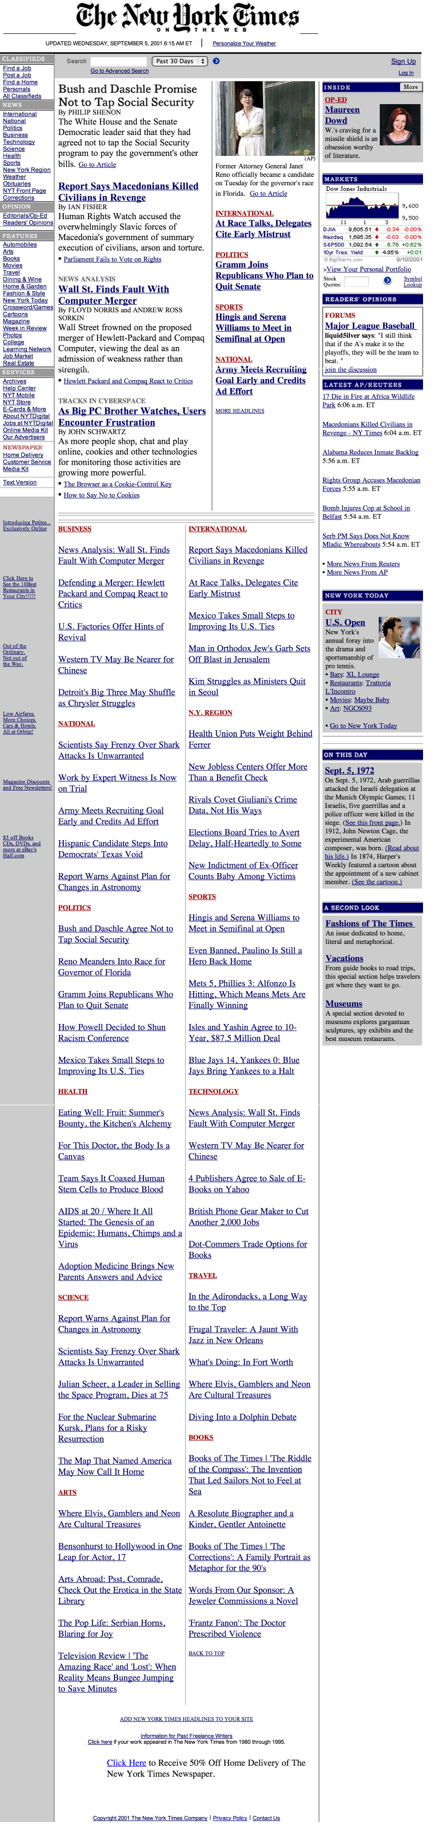

5 September 2001
11 September 2001
archive.org captures of New York Times (http://www.nytimes.com)

Slide 38
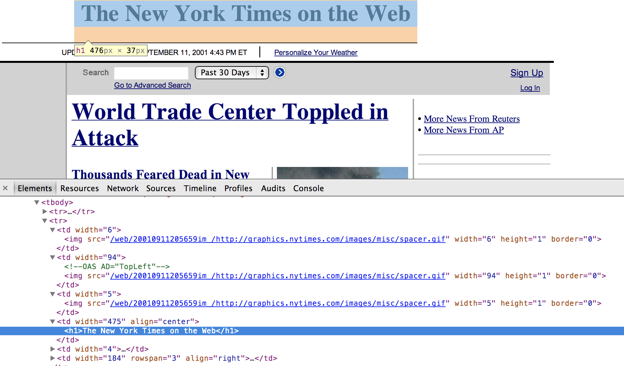

Slide 39
5 September 2001
11 September 2001

Slide 40
Strategy 2:
Cache to Save Effort

Slide 41
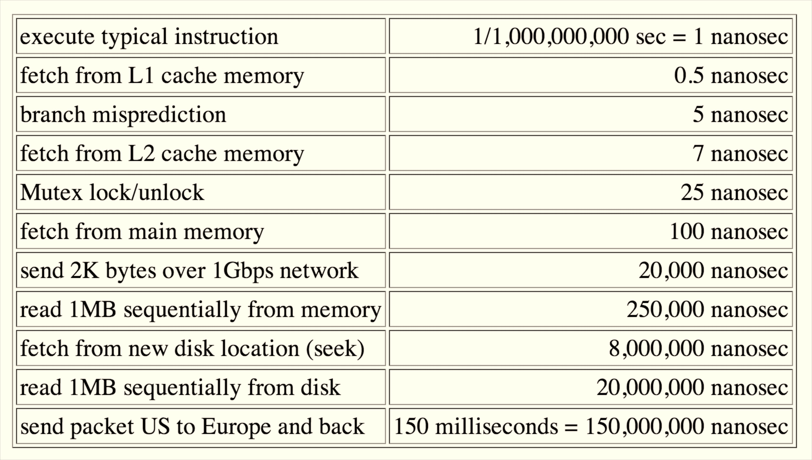
Norvig Numbers (2001)

Slide 42
“Looking over the dashboard that Park, Burt and the others had rigged up the prior Friday night, Abbott and the group discovered what they thought was the lowest-hanging fruit--a quick fix to an obvious mistake that could improve things immediately. HealthCare.gov had been constructed so that every time a user had to get information from the website's vast database, the website had to make what's called a query into that database. … The team began almost immediately to cache the data. The result was encouraging: the site's overall response time--the time it took a page to load--dropped on the evening of Oct. 22 from eight seconds to two. That was still terrible, of course, but it represented such an improvement that it cheered the engineers. They could see that HealthCare.gov could be saved instead of scrapped.”

Slide 43
Strategy 3:
Buy (or Rent) More Servers

Slide 44
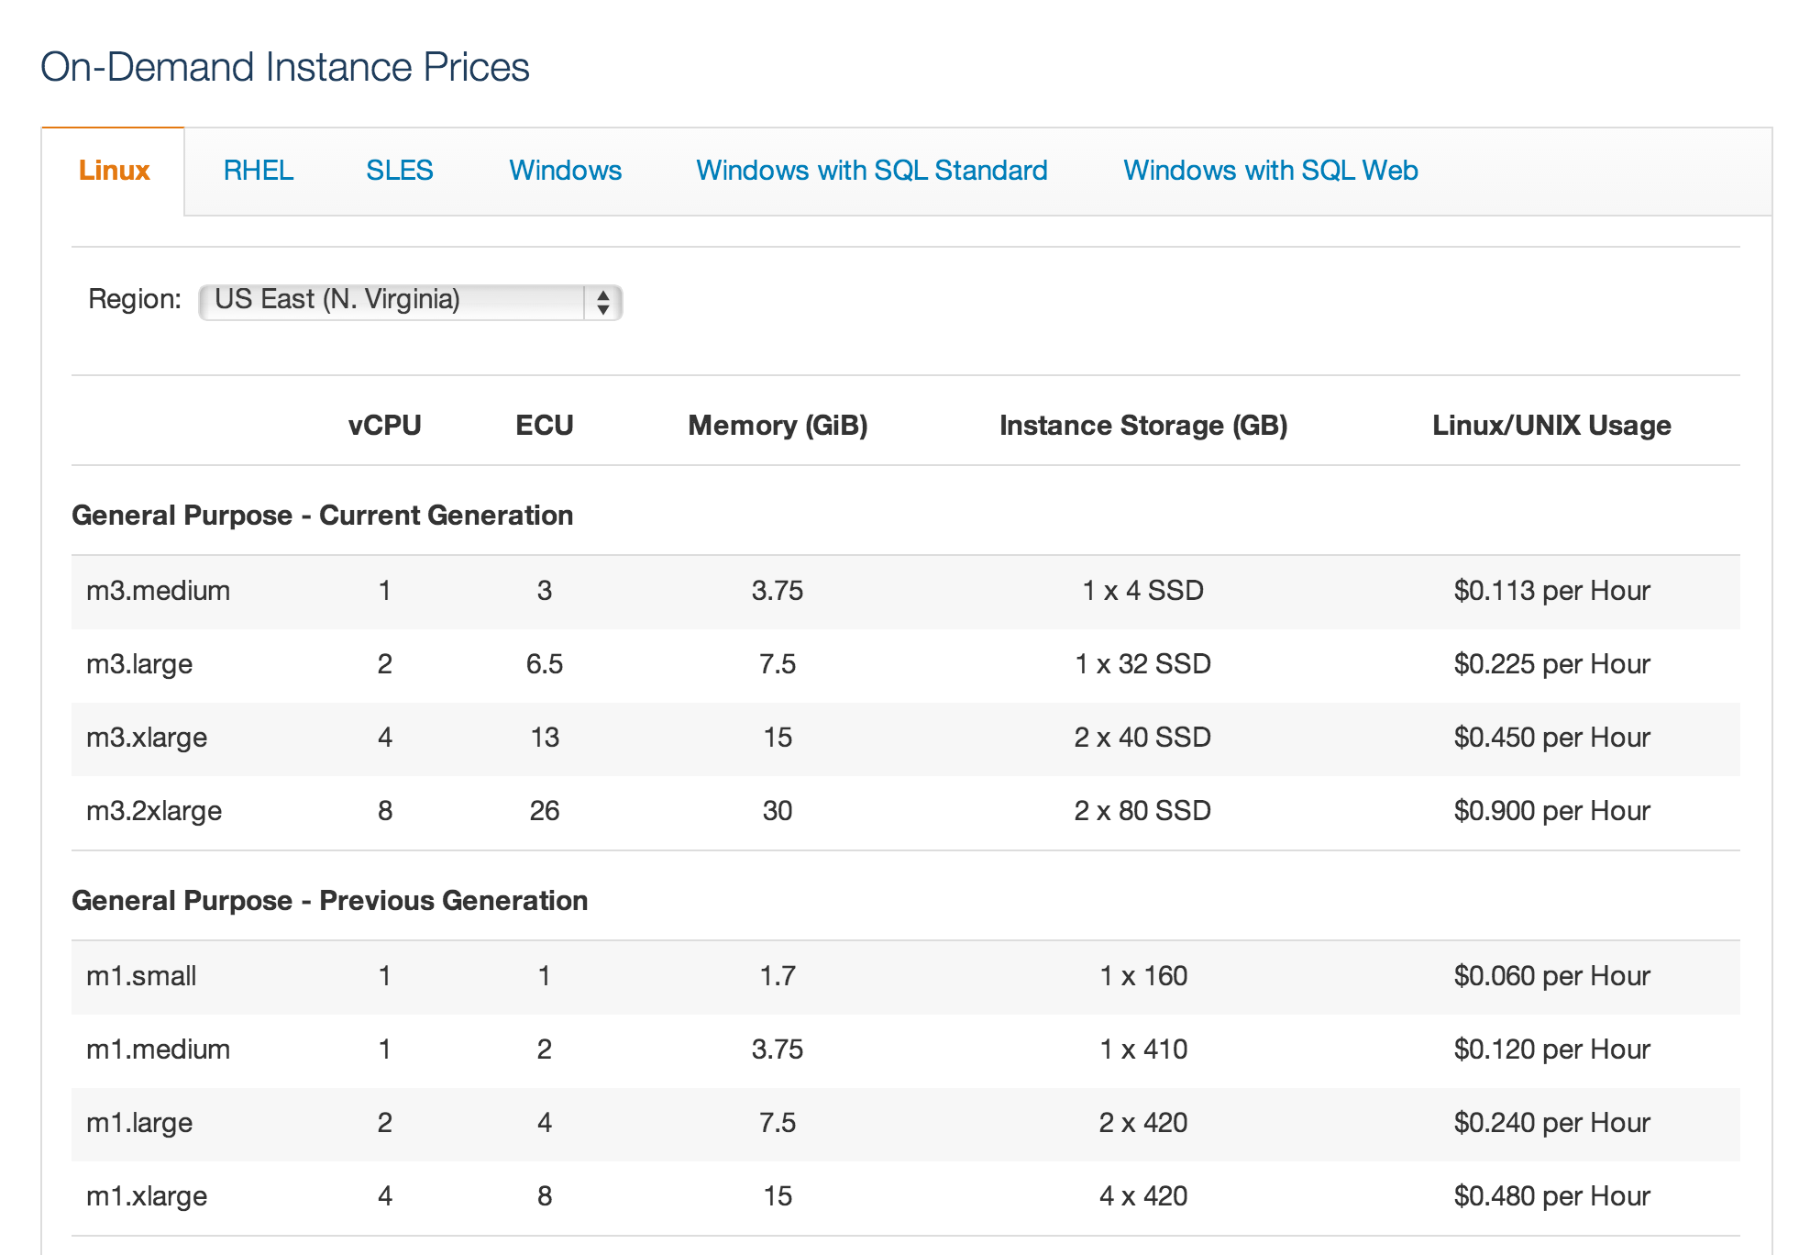

Amazon’s Elastic Compute Cloud
(EC2)

Slide 45
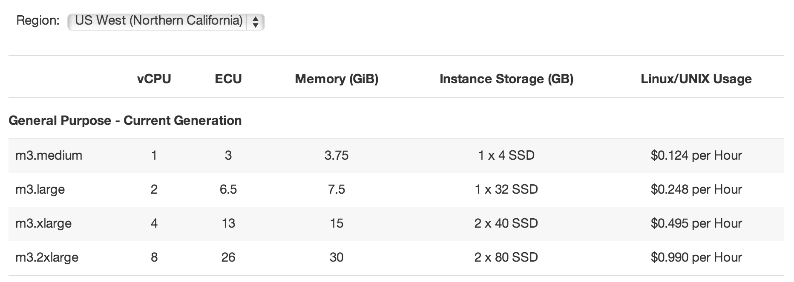
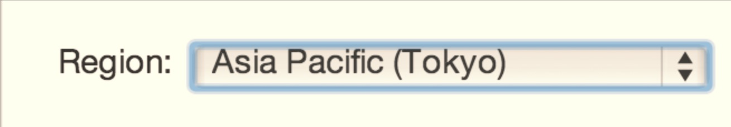
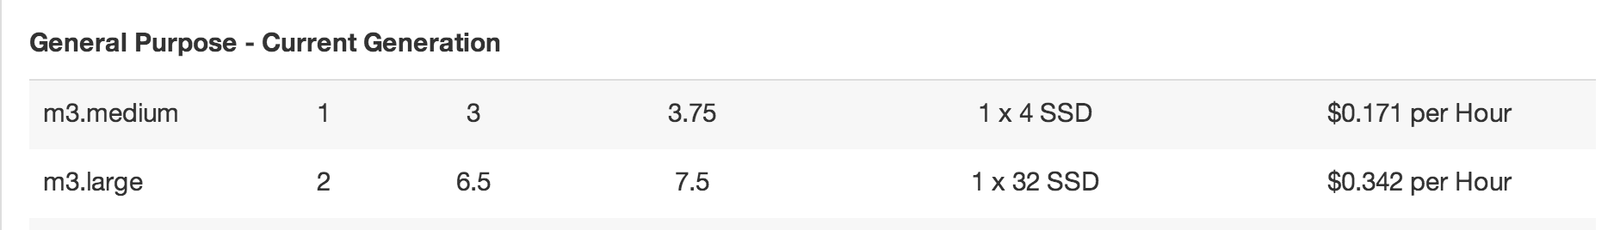

Slide 46
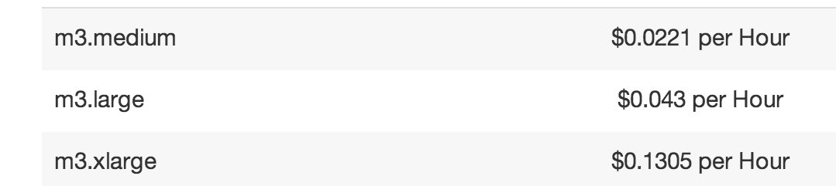
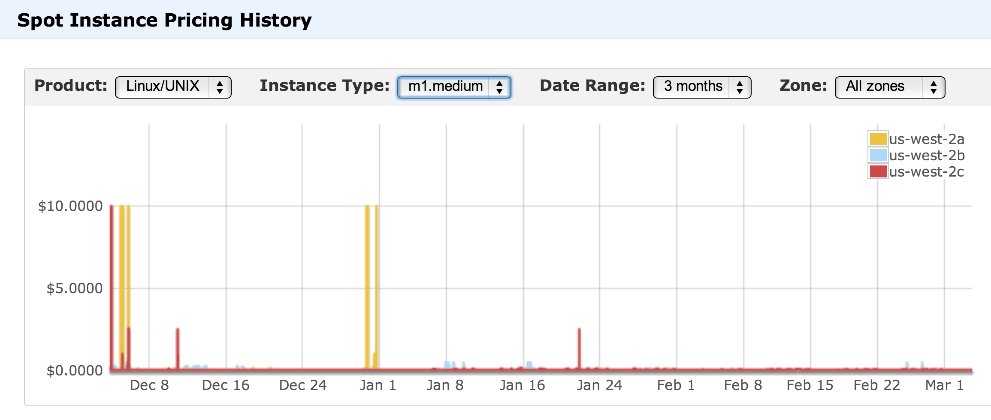

Slide 47
“A series of hardware upgrades had dramatically increased capacity; the system was now able to handle at least 50,000 simultaneous users and probably more. There had been more than 400 bug fixes. Uptimes had gone from an abysmal 43% at the beginning of November to 95%. And Kim and her team had knocked the error rate from 6% down to 0.5%. (By the end of January it would be below 0.5% and still dropping.)”

Slide 48
Using More Servers
Server 1
Dispatcher
Server 2
Server 3

Slide 49
Sharing State
Server 1
Dispatcher
Database
Server 2
Server 3

Slide 50
Distributed Database
Database
Server 1
Dispatcher
Database
Server 2
Database
Server 3
Database

Slide 51
Maintaining Consistency
Database
Server 1
Dispatcher
Database
Server 2
Database
Server 3
Database

Slide 52
Replication
  Reads are efficient
  Writes are complex and risky
Vertical Partitioning
  Split database by columns
Horizontal Partitioning (“Sharding”)
  Split database by rows
Give up on consistency and functionality
  “NoSQL” (e.g., Cassandra, MongoDB, BigTable)
Database
Server 1
Dispatcher
Database
Server 2
Database
Server 3
Database

Slide 53
Scalable Enough?
Database
Server 1
Dispatcher
Database
Server 2
Database
Server 3
Database

Slide 54
Distributed Denial-of-Service
Database
Server 1
Dispatcher
Database
Server 2
Database
Server 3
x 2000 machines
Database
Botnet

Slide 55
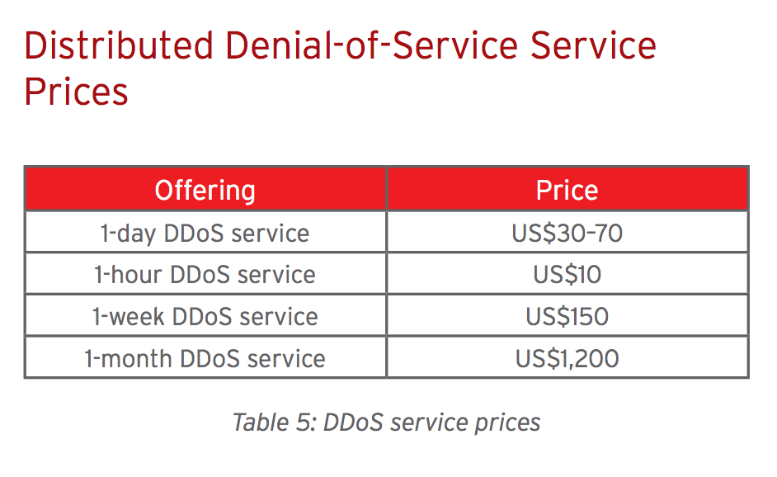

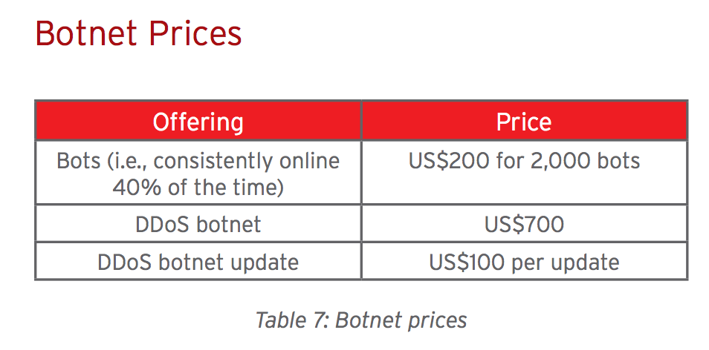
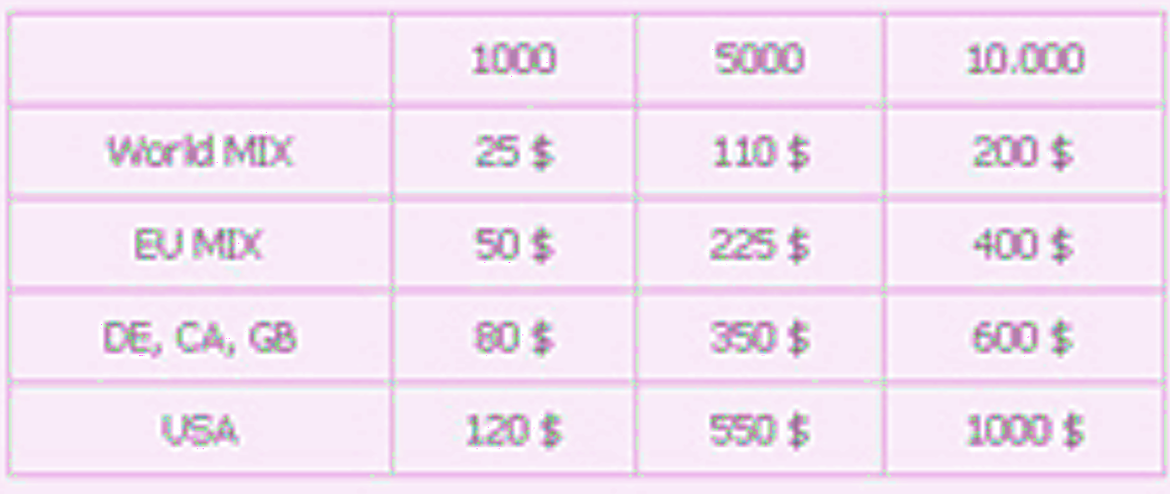

Slide 56


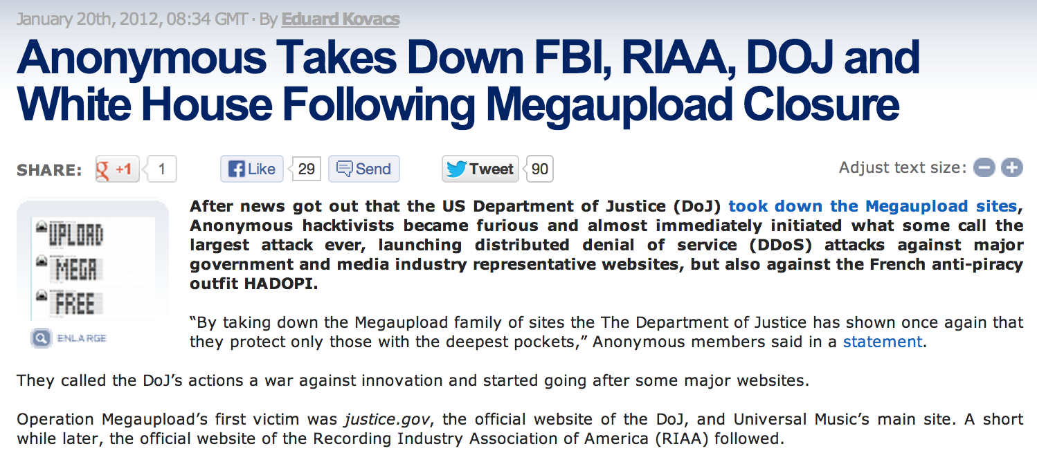
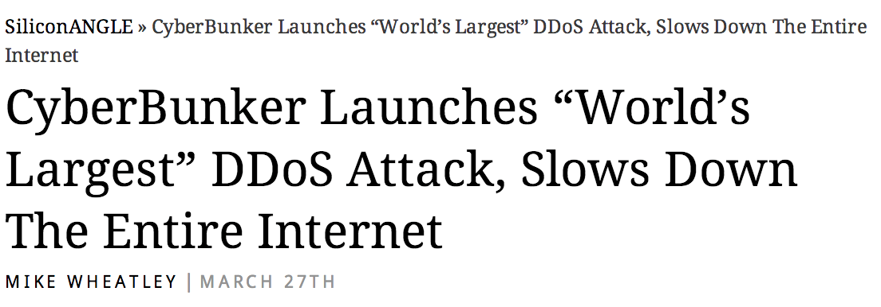
Example DDOS Attacks

Slide 57
Strategy 4:
Smarter Scheduling

Slide 58
What should the server’s goal be?

Slide 59
What is the bottleneck resource?
Zhtta
Disk (files)
Cache

Slide 60
Connecting to the Network
ISP Router
zhtta
Cache
Disk (files)

Slide 61
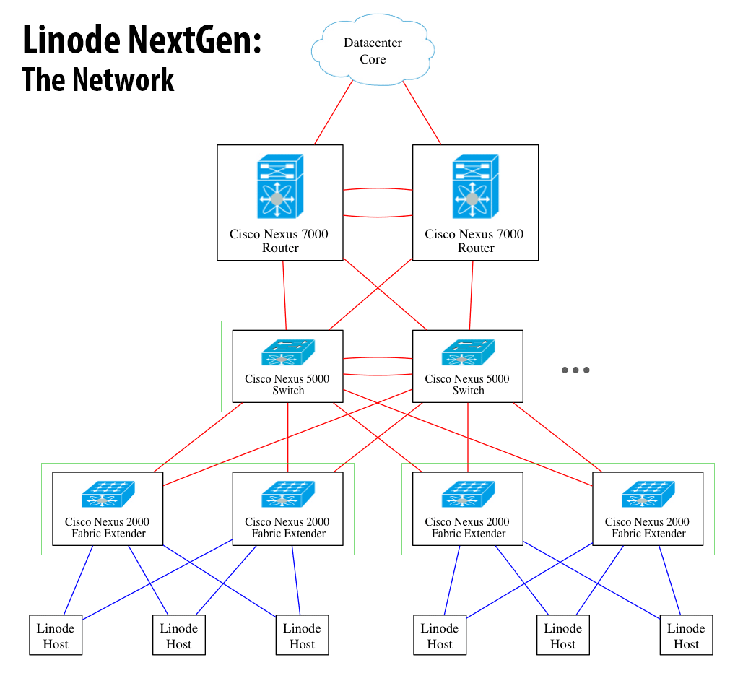
Cisco Nexus 7000 (~$100K)
48 Gb/s per slot x 10
10 Gb/s x 4 per switch
Your server
250 Mbits/s
$20/month

Slide 62
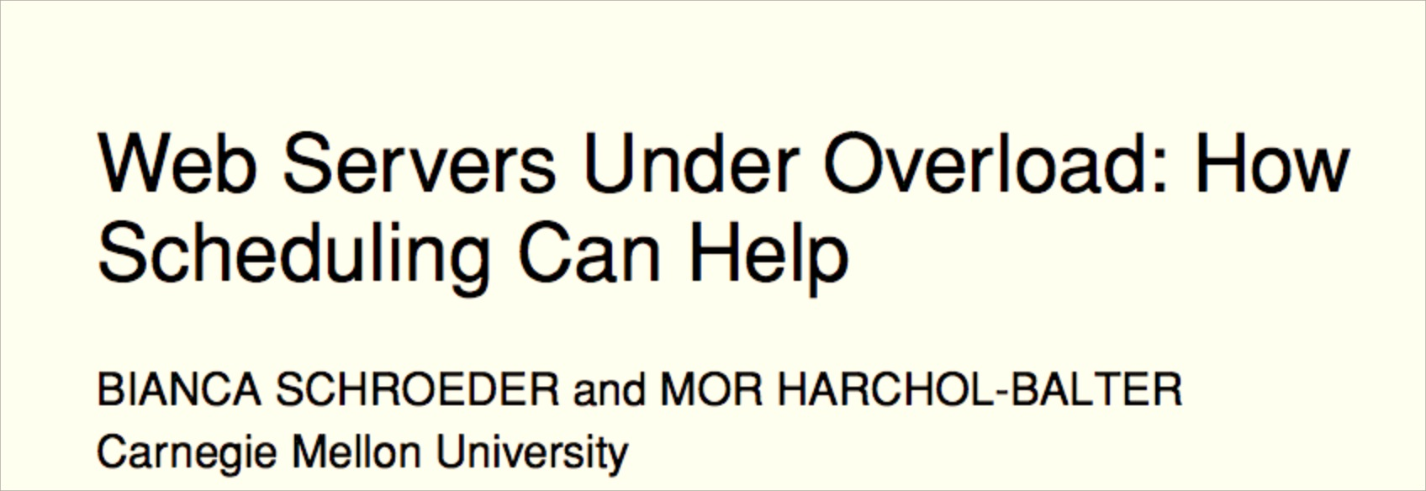

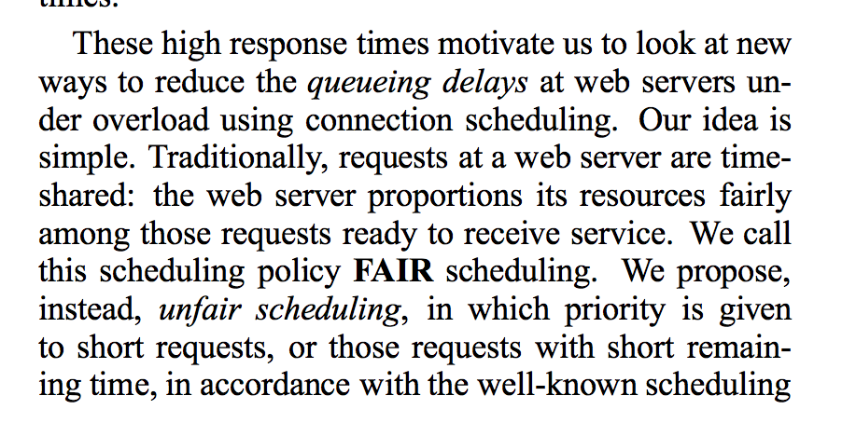
Shortest Remaining Processing Time-first

Slide 63
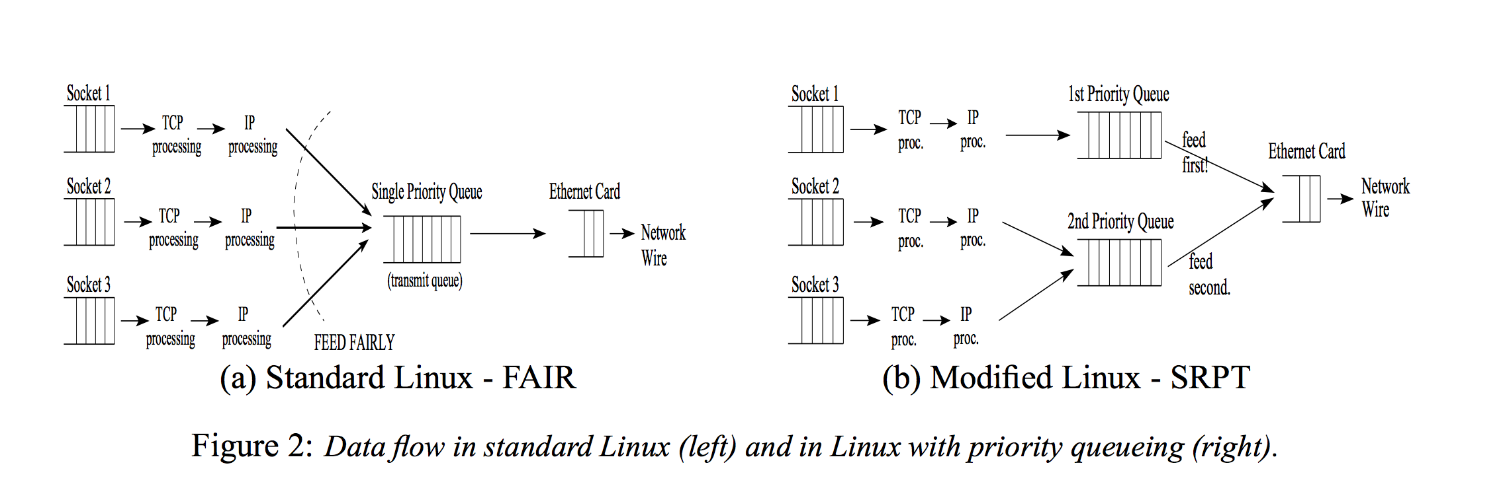
How close to this can you get for PS3?

Slide 64
Charge
Measurement (“dashboard”) is essential for improving performance
  Important to measure the right things!
Scheduling policies:
  Avoid wasting resources
  Make trade-offs that align with system goals
PS3 Due tomorrow (Wednesday) at 11:59pm
If you haven’t already scheduled your demo, do so now!

