Slide 1

Entering Ring Naught
Class 14
cs4414 Fall 2013
David Evans

Slide 2
Plan for Today
Review (Exam 1 Questions)
Milestones in Computing
Building a Kernel
Reminder: PS4 (part 1) is out now. If you want to have more time to work on your project idea instead of PS4, need to let me know this week.
Everyone should have received an email with the recorded results for PS2, PS3, and Exam 1.

Slide 3
Exam 2

Slide 4
Exam 2
Exam 2 will be out March 25
and due March 27 (12:25pm)

Slide 5
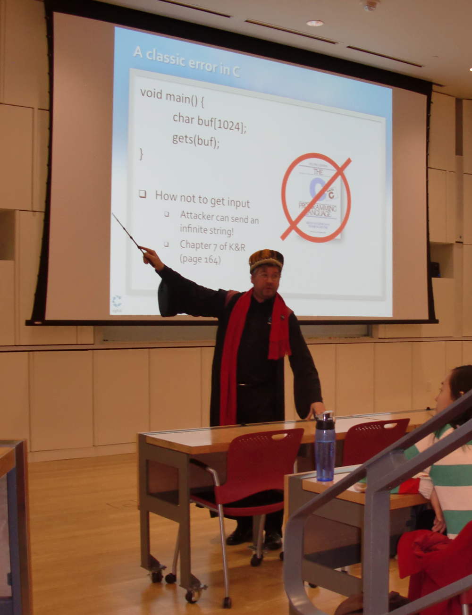
Talk After Class Today!
Cyber War, Cyber Peace,
Stones, and Glass Houses
Gary McGraw, CTO Cigital
2:00 PM
Rice Hall 130

Slide 6

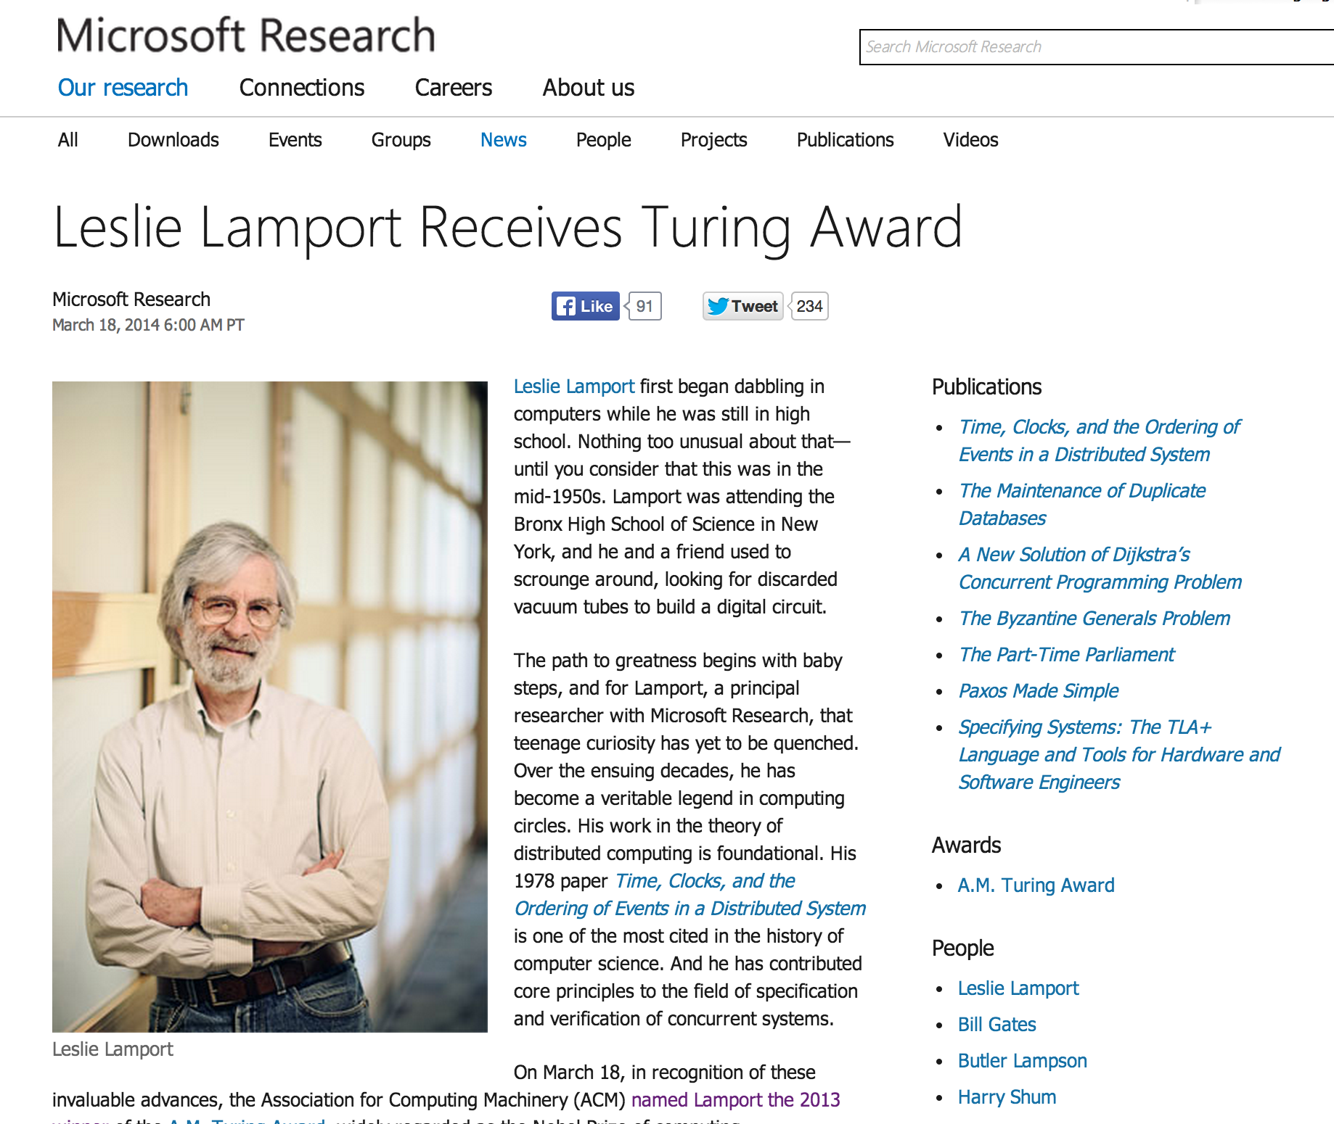

Slide 7
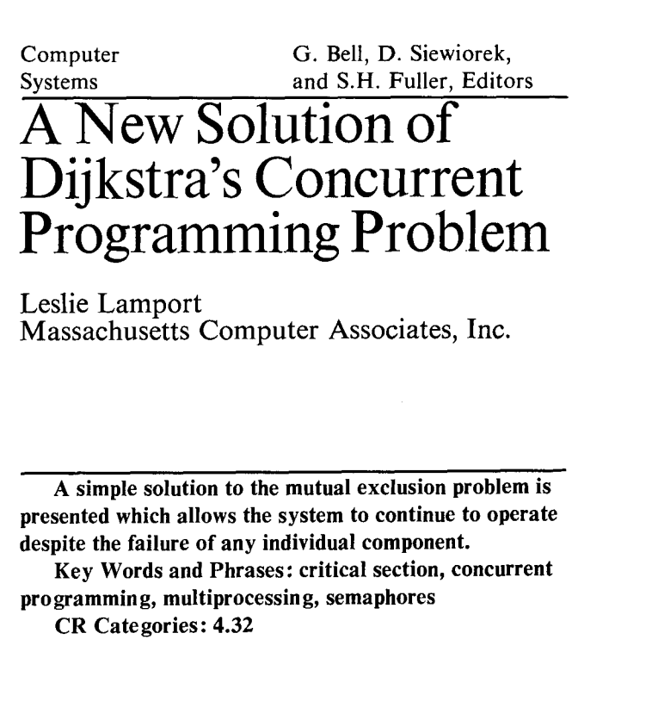
“What is significant about the bakery algorithm is that it implements mutual exclusion without relying on any lower-level mutual exclusion. Assuming that reads and writes of a memory location are atomic actions, as previous mutual exclusion algorithms had done, is tantamount to assuming mutually exclusive access to the location. So a mutual exclusion algorithm that assumes atomic reads and writes is assuming lower-level mutual exclusion. Such an algorithm cannot really be said to solve the mutual exclusion problem. Before the bakery algorithm, people believed that the mutual exclusion problem was unsolvable--that you could implement mutual exclusion only by using lower-level mutual exclusion.”
Communications of the ACM, August 1974 (2 pages)
We will explore this next Tuesday!

Slide 8
What are the advantages/disadvantages of hardware-based memory isolation over software-based memory isolation?

Slide 9
a[i] = x
mem.rs
Hardware Memory Isolation

Slide 10
a[i] = x
mem.rs
compiler
rustc
STR r0, [r1]
assembler
as
0100101101011…
mem
Hardware Memory Isolation

Slide 11
a[i] = x
mem.rs
process running code
compiler
rustc
STR r0, [r1]
assembler
as
loader
0100101101011…
mem
gash> mem
Hardware Memory Isolation

Slide 12
a[i] = x
mem.rs
process running code
compiler
rustc
STR r0, [r1]
WRITE 0x57283952, 0x413024
assembler
as
loader
0100101101011…
Segmentation Unit
Paging
Unit
Memory
Logical Address
Linear Address
Physical Address
mem
gash> mem
Hardware Memory Isolation

Slide 13
a[i] = x
mem.rs
process running code
compiler
rustc
STR r0, [r1]
WRITE 0x57283952, 0x413024
assembler
as
loader
0100101101011…
Segmentation Unit
Paging
Unit
Memory
Logical Address
Linear Address
Physical Address
mem
gash> mem
FAIL!
Hardware Memory Isolation

Slide 14
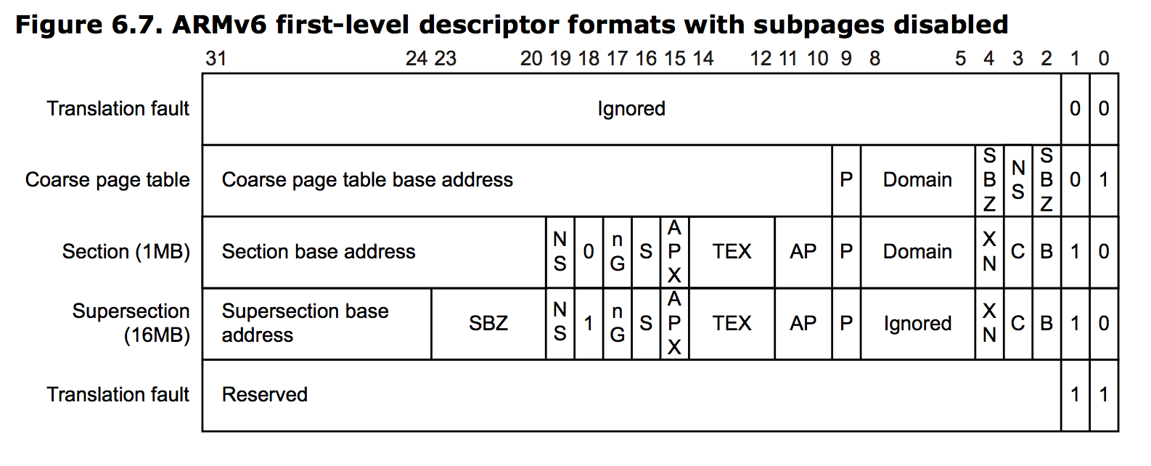
Hardware Memory Protection
Page Table
+ L1 Index

Slide 15
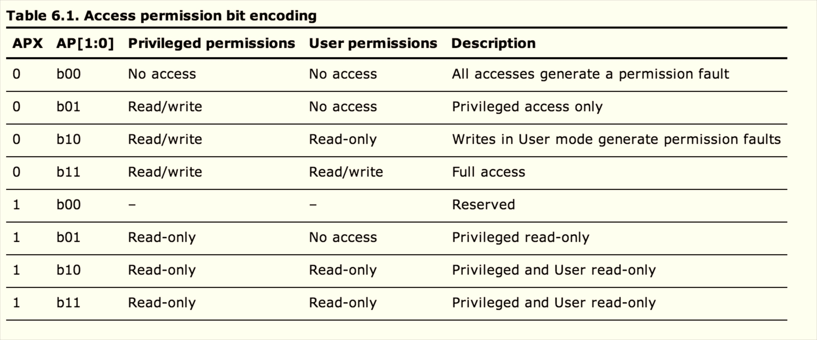

Slide 16
a[i] = x
mem.rs
process running code
compiler
rustc
STR r0, [r1]
WRITE 0x57283952, 0x413024
assembler
as
loader
0100101101011…
Segmentation Unit
Paging
Unit
Memory
Logical Address
Linear Address
Physical Address
mem
gash> mem
FAIL!
Software-Based Memory Isolation?

Slide 17
a[i] = x
mem.rs
process running code
compiler
rustc
…lots of code…
STR r0, [r1]
WRITE 0x57283952, 0x413024
assembler
loader
0100101101011…
Segmentation Unit
Paging
Unit
Memory
Logical Address
Linear Address
Physical Address
mem
gash> mem
Software-Based Memory Isolation

Slide 18
a[i] = x
mem.rs
process running code
compiler
rustc
…lots of code…
STR r0, [r1]
fn main() {
let mut a = [0, 1, 2, 3];
let i = 6;
a[i] = 7;
}
> rustc oob.rs
> ./oob
task '<main>' failed at 'index out of bounds: the len is 4 but the index is 6', oob.rs:5
WRITE 0x57283952, 0x413024
assembler
loader
0100101101011…
Segmentation Unit
Paging
Unit
Memory
Logical Address
Linear Address
Physical Address
mem
gash> mem
Software-Based Memory Isolation

Slide 19
Ltmp4:
…
movq $6, -40(%rbp)
movq -40(%rbp), %rcx
cmpq $4, %rcx
setae %dl
testb $1, %dl
movq %rdi, -48(%rbp)
movq %rax, -56(%rbp)
movq %rcx, -64(%rbp)
jne LBB0_2
movq -56(%rbp), %rax
movq -64(%rbp), %rcx
movq $7, (%rax,%rcx,8)
addq $64, %rsp
popq %rbp
ret
rustc -S oob.rs
LBB0_2:
leaq _str1253(%rip), %rsi
movabsq $5, %rdx
movabsq $4, %r8
movq -64(%rbp), %rcx
callq __ZN8unstable4lang17fail_bounds_check19h71a9f10808351b86aB4v0.9E
.cfi_endproc

Slide 20
a[i] = x
mem.rs
process running code
compiler
rustc
FAIL!
…lots of code…
STR r0, [r1]
jne LBB0_2
assembler
loader
0100101101011…
Segmentation Unit
Paging
Unit
Memory
Logical Address
Linear Address
Physical Address
mem
gash> mem
Software-Based Memory Isolation

Slide 21
a[i] = x
mem.rs
process running code
compiler
rustc
FAIL!
…lots of code…
STR r0, [r1]
jne LBB0_2
assembler
loader
What if you aren’t starting with source code in a type-safe language?
0100101101011…
Segmentation Unit
Paging
Unit
Memory
Logical Address
Linear Address
Physical Address
mem
gash> mem
Software-Based Memory Isolation

Slide 22
a[i] = x
mem.rs
process running code
compiler
rustc
FAIL!
transformer / loader
jne LBB0_2
STR r0, [r1]
loader
assembler
0100101101011…
Segmentation Unit
Paging
Unit
Memory
Logical Address
Linear Address
Physical Address
mem
gash> mem
Software-Based Memory Isolation

Slide 23


This is hard!

Slide 24
Which is more “expensive”?
Hardware-Based Memory Isolation
Transistors + wires
OS sets up page permissions, loads programs
Software-Based Memory Isolation
Trusted compiler/loader
Statically safe: no runtime cost!

Slide 25

Entering the Kernel
Photo: RDTaken

Slide 26
Hello World?
fn main() {
println("Hello?");
}

Slide 27
1. What’s the difference between a programming language and an operating system?

Slide 28

Image: flickr cc: Ruben Alexander

Slide 29


Slide 30
Which came first?
Early programming languages did not run on an Operating System
  Turing’s language, Church’s Lambda Calculus
  IPL/Lisp, FLOW-MATIC, etc.
Early operating systems were not written in programming languages

Slide 31
Programming Language
Operating System

Slide 32
Programming Language
Operating System
Mostly a precise way for humans to describe programs
Provides abstractions of (abstract) machine resources
Associated programs like compilers translate into a program for machines to execute
Modern programming languages usually depend on an underlying OS
A program that runs on some hardware
Provides abstractions for (real) machine resources
Manages sharing of machine resources
Modern operating systems are mostly implemented in C (arguably a programming language) and assembly

Slide 33
Kernel Programming in Rust
#[no_std];
fn main() {
println("Hello?");
}

Slide 34
Kernel Programming in Rust
#[no_std];
fn main() {
println("Hello?");
}
> rustc hello.rs
hello.rs:4:5: 4:12 error: unresolved name `println`.
hello.rs:4 println("Hello?");
^~~~~~~
error: aborting due to previous error

Slide 35
Printing is For The Weak!
#[no_std];
fn main() {
let mut a = [0, 1, 2, 3];
let i = 6;
a[i] = 7;
}

Slide 36
Main is For The Weak!
#[no_std];
fn main() {
let mut a = [0, 1, 2, 3];
let i = 6;
a[i] = 7;
}
> rustc oob1.rs
error: requires `start` lang_item

Slide 37
#[no_std];
#[start]
fn main(_: int, _: **u8) -> int {
let mut a = [0, 1, 2, 3];
let i = 6;
a[i] = 7;
}

Slide 38
#[no_std];
#[start]
fn main(_: int, _: **u8) -> int {
let mut a = [0, 1, 2, 3];
let i = 6;
a[i] = 7;
}
gash> rustc oob2.rs
oob2.rs:4:1: 9:2 error: not all control paths return a value
oob2.rs:4 fn main(_: int, _: **u8) -> int {
oob2.rs:5 let mut a = [0, 1, 2, 3];
oob2.rs:6 let i = 6;
oob2.rs:7
oob2.rs:8 a[i] = 7;
oob2.rs:9 }
error: aborting due to previous error

Slide 39
#[no_std];
#[start]
fn main(_: int, _: **u8) -> int {
let mut a = [0, 1, 2, 3];
let i = 6;
a[i] = 7;
return 0;
}

Slide 40
Ltmp4:
…
movq $6, -40(%rbp)
movq -40(%rbp), %rcx
cmpq $4, %rcx
setae %dl
testb $1, %dl
movq %rdi, -48(%rbp)
movq %rax, -56(%rbp)
movq %rcx, -64(%rbp)
jne LBB0_2
movq -56(%rbp), %rax
movq -64(%rbp), %rcx
movq $7, (%rax,%rcx,8)
addq $64, %rsp
popq %rbp
ret
rustc -S oob.rs
LBB0_2:
leaq _str1253(%rip), %rsi
movabsq $5, %rdx
movabsq $4, %r8
movq -64(%rbp), %rcx
callq __ZN8unstable4lang17fail_bounds_check19h71a9f10808351b86aB4v0.9E
.cfi_endproc

Slide 41
#[no_std];
#[start]
fn main(_: int, _: **u8) -> int {
let mut a = [0, 1, 2, 3];
let i = 6;
a[i] = 7;
return 0;
}
bash-3.2$ rustc oob3.rs
oob3.rs:8:5: 8:8 error: requires `fail_bounds_check` lang_item
oob3.rs:8 a[i] = 7;
^~~

Slide 42
#[no_std];
extern "rust-intrinsic" { fn abort() -> !; }
#[no_mangle] pub extern fn rust_stack_exhausted() {
unsafe { abort() }
}
#[lang="fail_bounds_check"]
pub fn fail_bounds_check(_: *i8, _: uint, _: uint, _: uint) {
unsafe { abort() }
}
#[start]
fn main(_: int, _: **u8) -> int {
let mut a = [0, 1, 2, 3];
let i = 6;
a[i] = 7;
return 0;
}

Slide 43
#[no_std];
extern "rust-intrinsic" { fn abort() -> !; }
#[no_mangle] pub extern fn rust_stack_exhausted() {
unsafe { abort() }
}
#[lang="fail_bounds_check"]
pub fn fail_bounds_check(_: *i8, _: uint, _: uint, _: uint) {
unsafe { abort() }
}
#[start]
fn main(_: int, _: **u8) -> int {
let mut a = [0, 1, 2, 3];
let i = 6;
a[i] = 7;
return 0;
}
gash> rustc oob4.rs
gash> ./oob4
Illegal instruction: 4

Slide 44
#[no_std];
extern "rust-intrinsic" { fn abort() -> !; }
#[no_mangle] pub extern fn rust_stack_exhausted() {
unsafe { abort() }
}
#[lang="fail_bounds_check"]
pub fn fail_bounds_check(_: *i8, _: uint, _: uint, _: uint) {
unsafe { abort() }
}
#[start]
fn main(_: int, _: **u8) -> int {
let mut a = [0, 1, 2, 3];
let i = 2;
a[i] = 7;
return 0;
}
gash> rustc oob5.rs
gash> ./oob5
gash>

Slide 45

IronKernel
Kevin Broderick, Alex Lamana, Zeming Lin, John Stevans, Wil Thomason

Slide 46
Building a Kernel
#[no_std]
Remove everything from Rust that depends on OS:
everything that uses system calls
rust-core
Library that doesn’t depend on OS.

Slide 47
core/option.rs
/// Convert from `Option<T>` to `Option<&T>`
pub fn as_ref<'a>(&'a self) -> Option<&'a T> {
match *self { Some(ref x) => Some(x), None => None }
}
/// Convert from `Option<T>` to `Option<&mut T>`
pub fn as_mut<'a>(&'a mut self) -> Option<&'a mut T> {
match *self { Some(ref mut x) => Some(x), None => None }
}
/// Return the value in an `Option` or call `abort` if it is `None`.
pub fn get(self) -> T {
match self { Some(x) => x, None => abort() }
}
/// Maps an `Option<T>` to `Option<U>` by applying a function to a contained value.
pub fn map<U>(self, f: |T| -> U) -> Option<U> {
match self { Some(x) => Some(f(x)), None => None }
}
/// Applies a function to the contained value or returns a default.
pub fn map_or<U>(self, def: U, f: |T| -> U) -> U {
match self { None => def, Some(t) => f(t) }
}
/// Take the value out of the option, leaving a `None` in its place.
#[inline(always)]
pub fn take(&mut self) -> Option<T> {
replace(self, None)
}
}
// Copyright 2014 The Rust Project Developers. See the COPYRIGHT
// file at the top-level directory of this distribution and at
// http://rust-lang.org/COPYRIGHT.
//
// Licensed under the Apache License, Version 2.0 <LICENSE-APACHE or
// http://www.apache.org/licenses/LICENSE-2.0> or the MIT license
// <LICENSE-MIT or http://opensource.org/licenses/MIT>, at your
// option. This file may not be copied, modified, or distributed
// except according to those terms.
use fail::abort;
use mem::replace;
pub enum Option<T> {
Some(T),
None
}
impl<T> Option<T> {
/// Returns true if the option contains a `Some` value
pub fn is_some(&self) -> bool {
match *self {
Some(_) => true,
None => false
}
}
Why does normal Option type need OS?

Slide 48
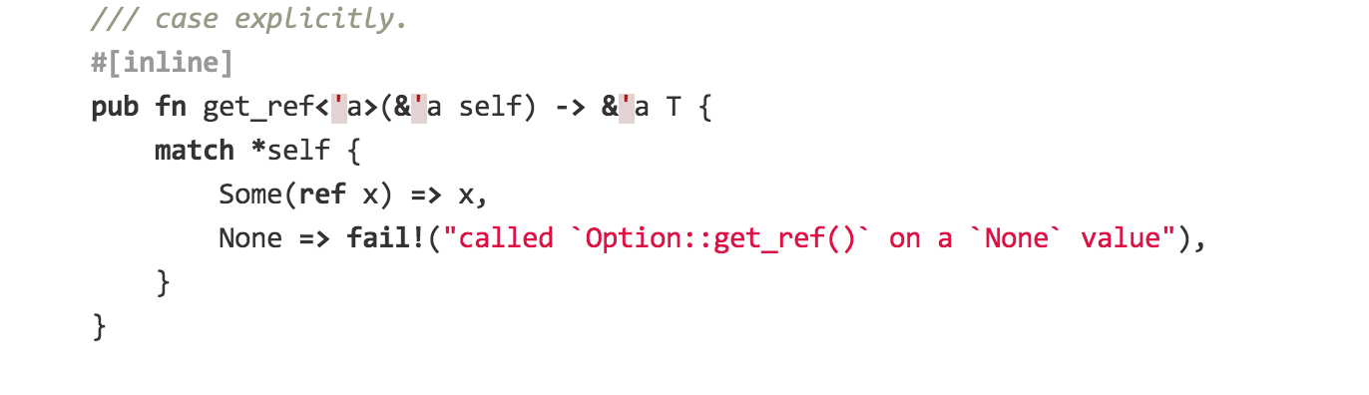
https://github.com/mozilla/rust/blob/master/src/libstd/option.rs
Almost all normal code relies on an underlying OS!

Slide 49
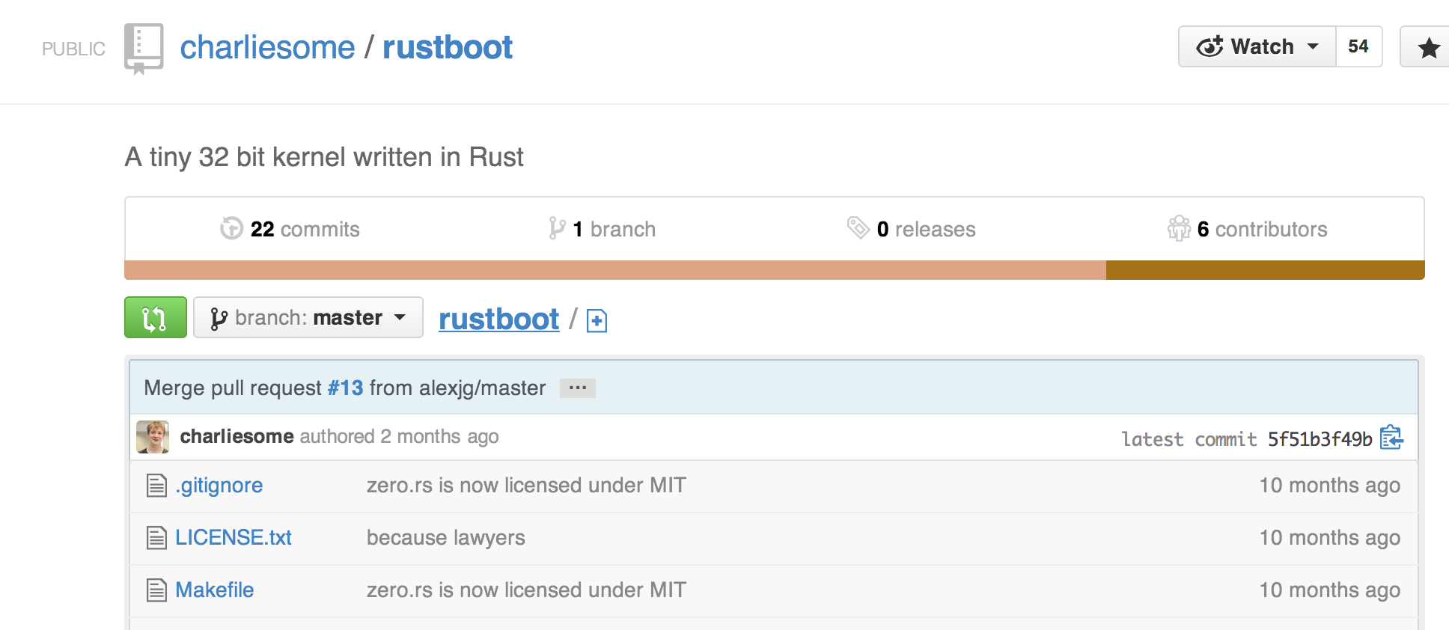
Building a Kernel
#[no_std]
Remove everything from Rust that depends on OS:
everything that uses system calls
rust-core
Library that doesn’t depend on OS.
rustboot

Slide 50
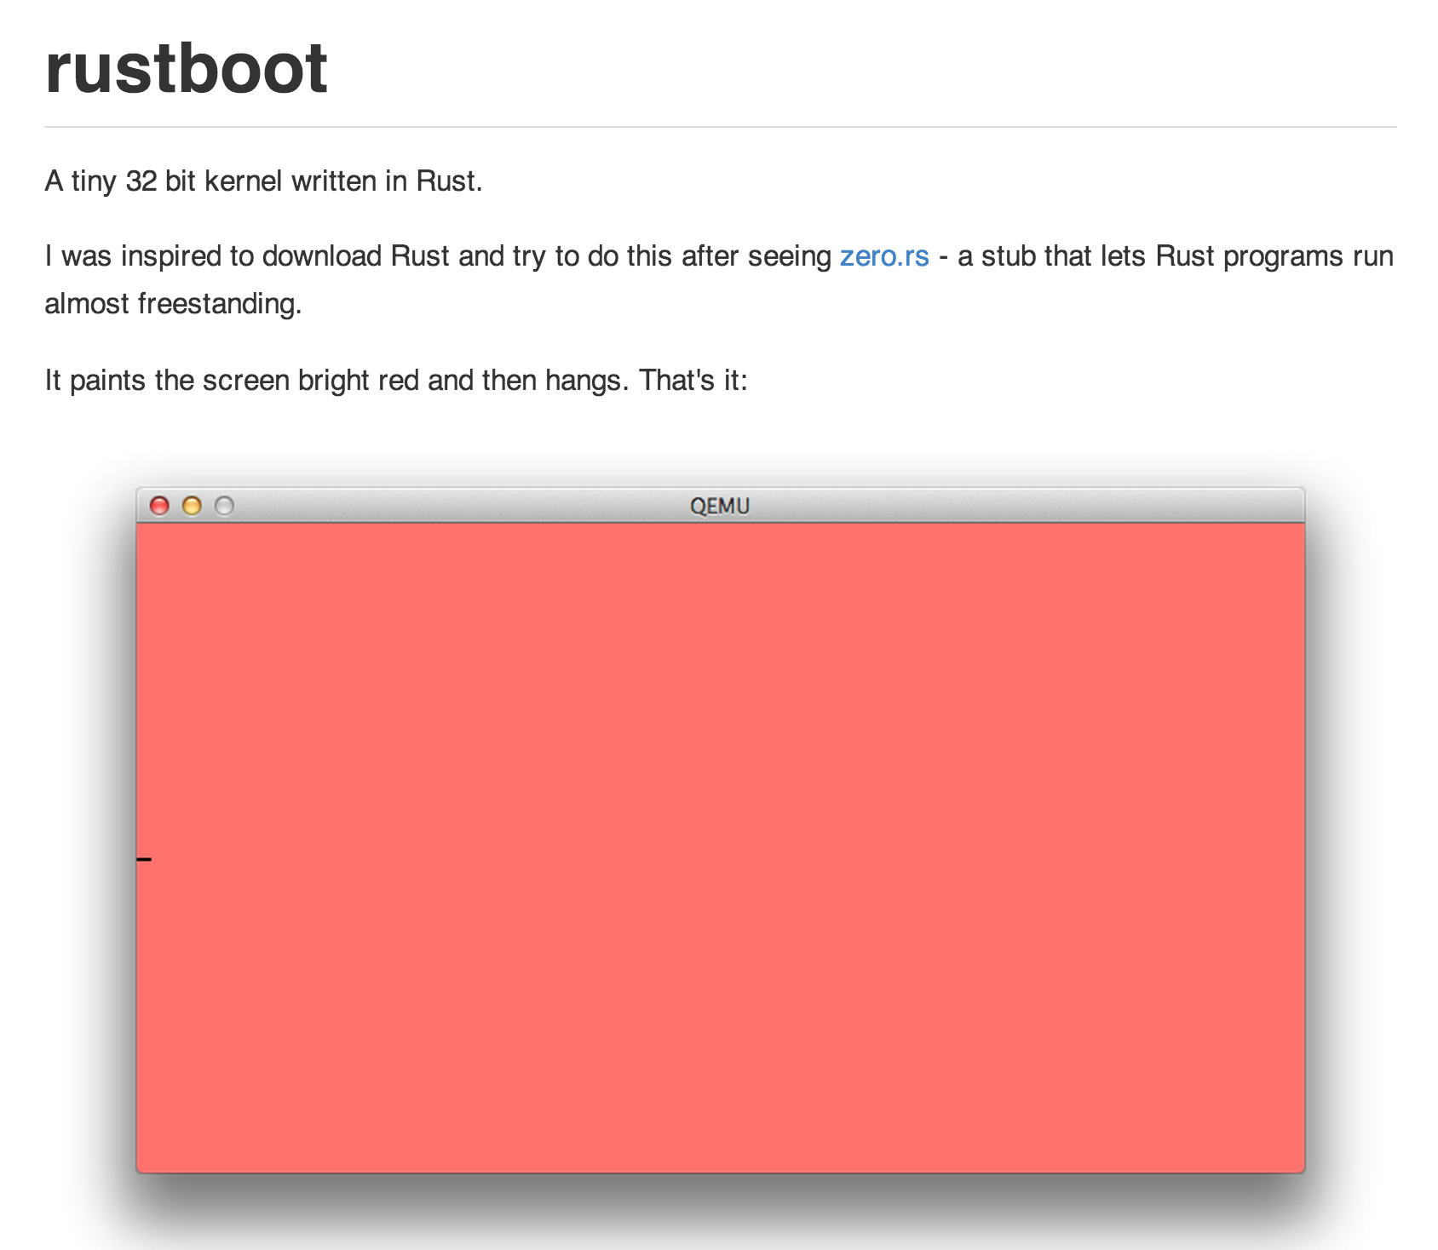

Slide 51
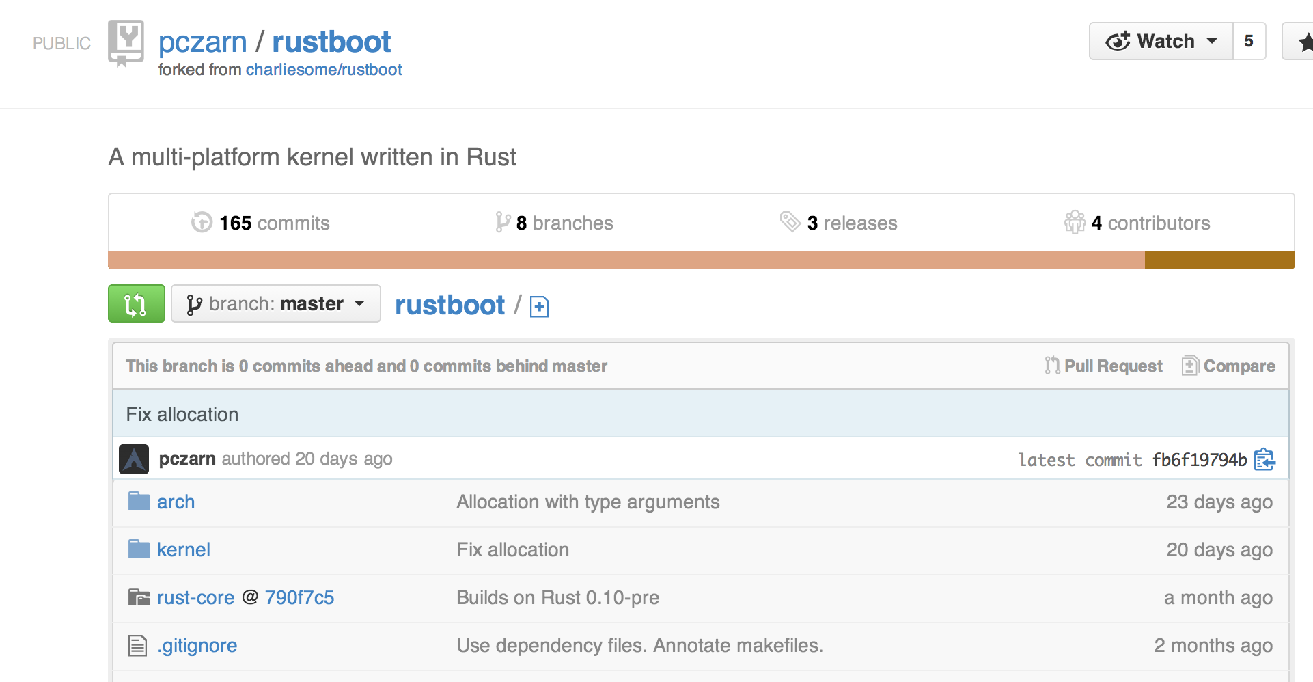

Slide 52
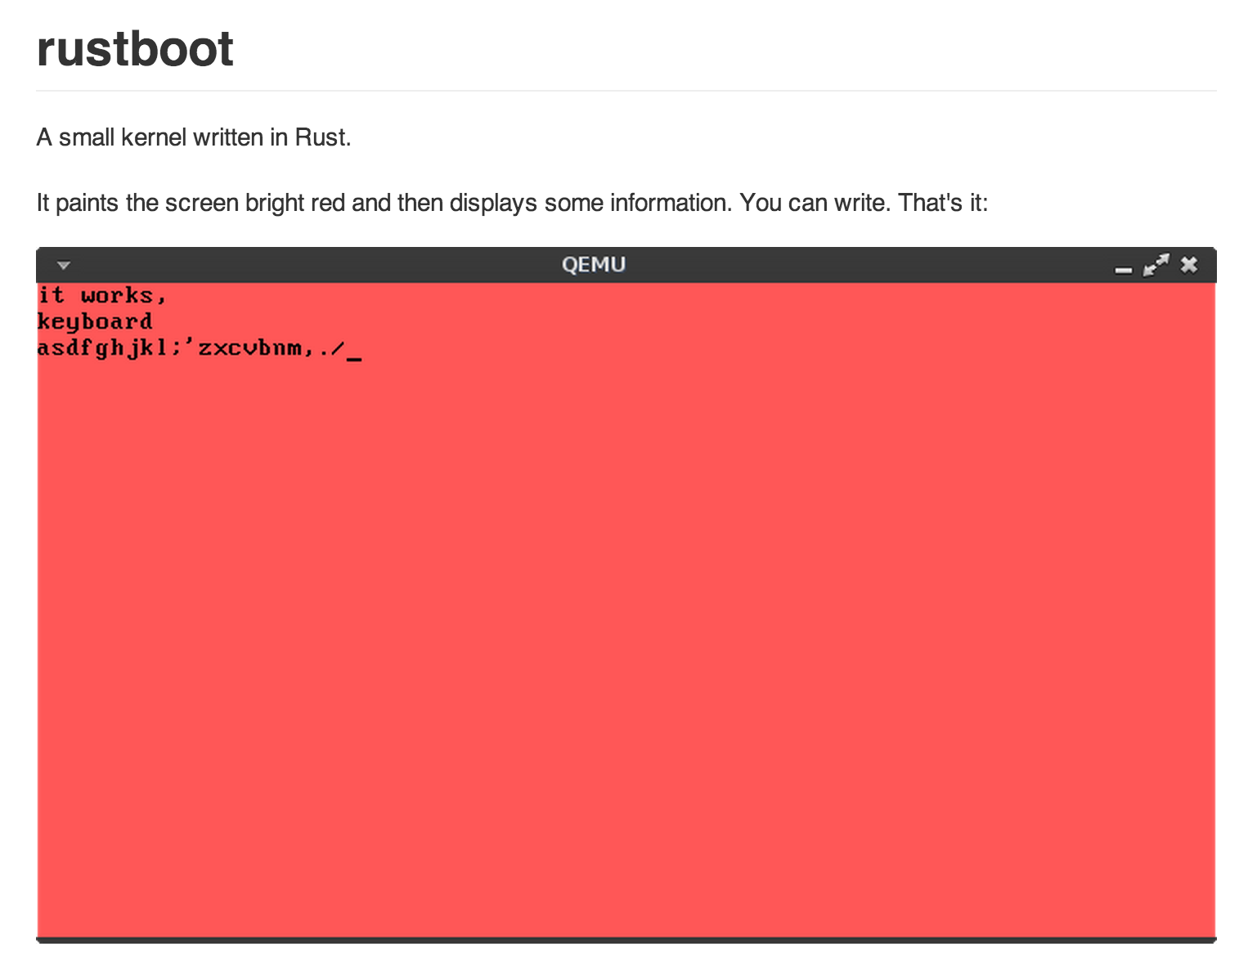

Slide 53
Building a Kernel
#[no_std]
Remove everything from Rust that depends on OS:
everything that uses system calls
rust-core
Library that doesn’t depend on OS.
rustboot
Boot!
IronKernel
32-bit ARM OS kernel that can print text on the screen (in many colors!), handle keyboard input (as long as you don’t press any “dangerous” keys

Slide 54

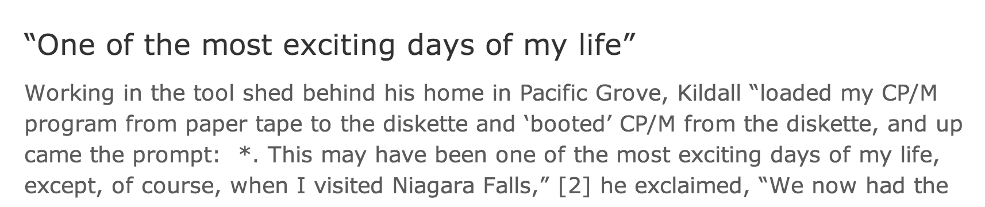
Photo: flickr cc:Randy OHC

Slide 55
Kernel Programming
editors, file system, network, compilers
Target Machine
(32-bit ARM)
Development Machine
(Ubuntu 64-bit x86 Linux)

Slide 56
Kernel Programming
editors, file system, network,
cross-compilers
ARM binary
Target Machine
(32-bit ARM)
Development Machine
(Ubuntu 64-bit x86 Linux)

Slide 57
Kernel Programming
editors, file system, network,
cross-compilers
ARM binary
QEMU: Emulator
(32-bit ARM)
Development Machine
(Ubuntu 64-bit x86 Linux)

Slide 58
mod.rs
rustc
How the kernel is built:
> rustc --emit-llvm mod.rs
> llc -march=arm -mcpu=arm926ej-s mod.bc
> arm-none-eabi-as mod.as
> objcopy mod.o …
mod.bc
llc
mod.s
arm-none-eabi-as
mod.o
assembler naming convention:
[processor]-[os]-[application binary interface]
objcopy
kernel.bin

Slide 59
mod.rs
rustc
How the kernel is built:
> rustc --emit-llvm mod.rs
> llc -march=arm -mcpu=arm926ej-s mod.bc
> arm-none-eabi-as mod.as
> objcopy mod.o …
mod.bc
Easy way: make run
llc
mod.s
arm-none-eabi-as
mod.o
assembler naming convention:
[processor]-[os]-[application binary interface]
objcopy
kernel.bin

Slide 60
IronKernel Demo

Slide 61
*((addr + (i * 4)) as * mut u32) = val

Slide 62

Form PS4 Teams while you are waiting for Gary’s talk!
A PS4 team can be
any 3 people.
Reminder: stay for Gary McGraw talk!

