Slide 1
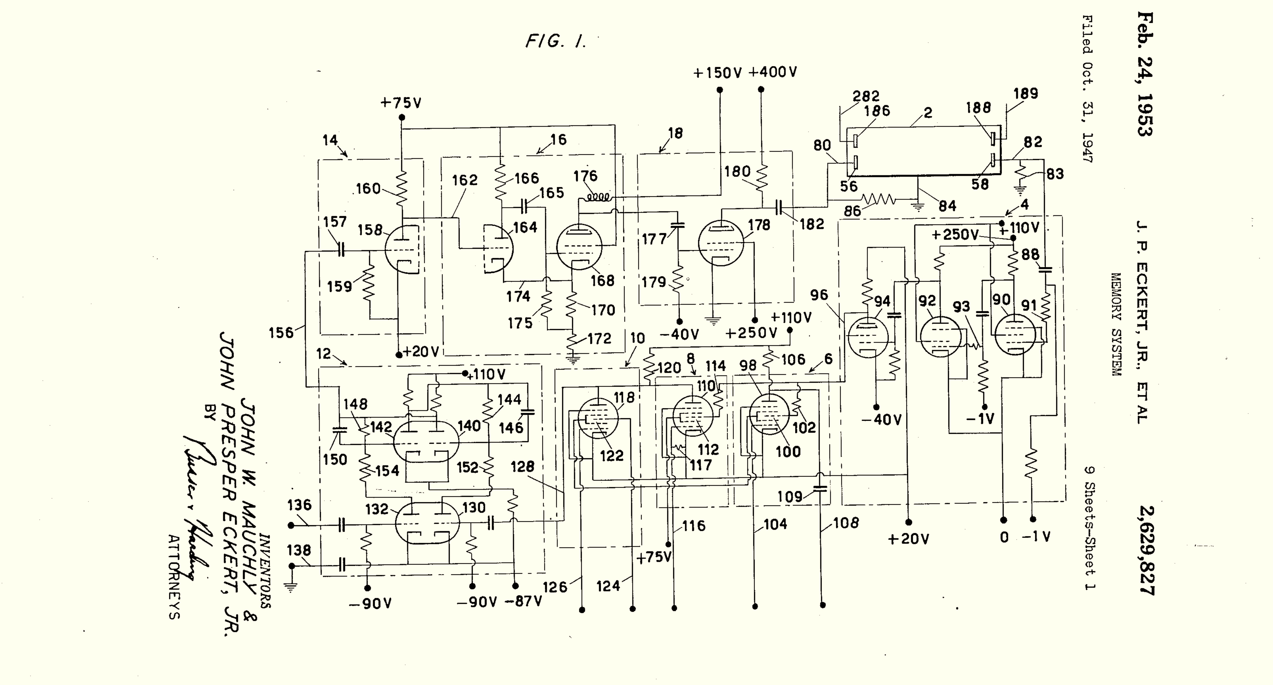
Class 16:
Storage
cs4414 Spring 2014
University of Virginia
David Evans

Slide 2
Plan for Today
Exam 2 is due at 11:59pm tonight.
PS4 is due 11:59pm Sunday, 6 April
Storage
File Systems

Slide 5
Why is storage complicated?

Slide 6
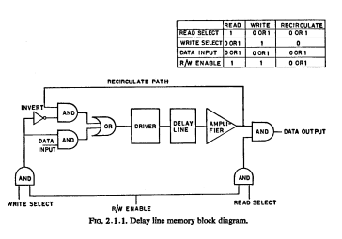
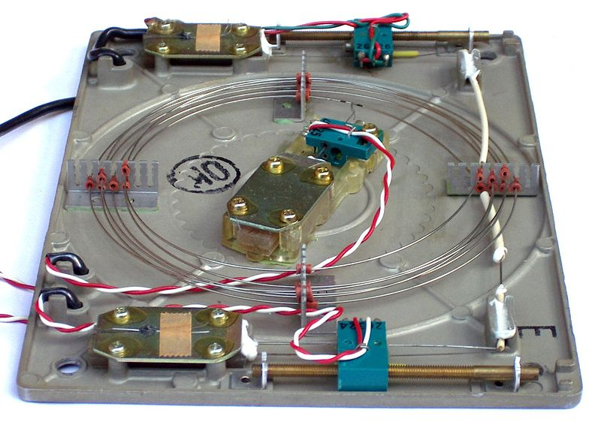
Delay Lines

Slide 7
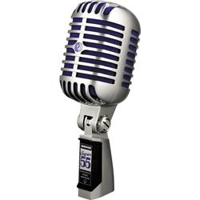

Mercury Delay Lines
0/1

Slide 8
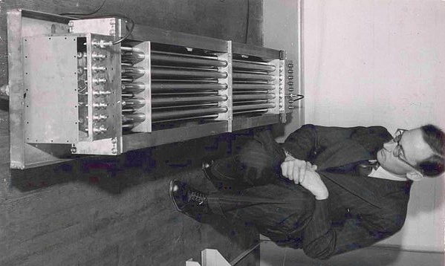

Slide 9
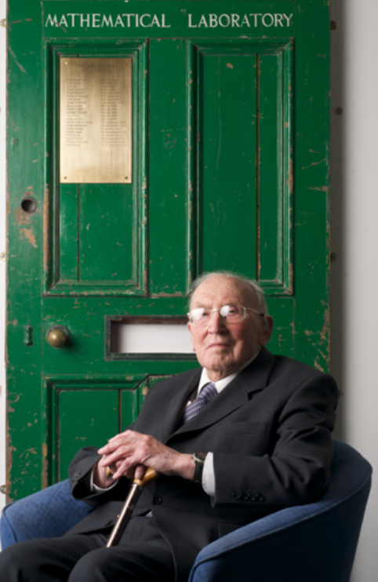
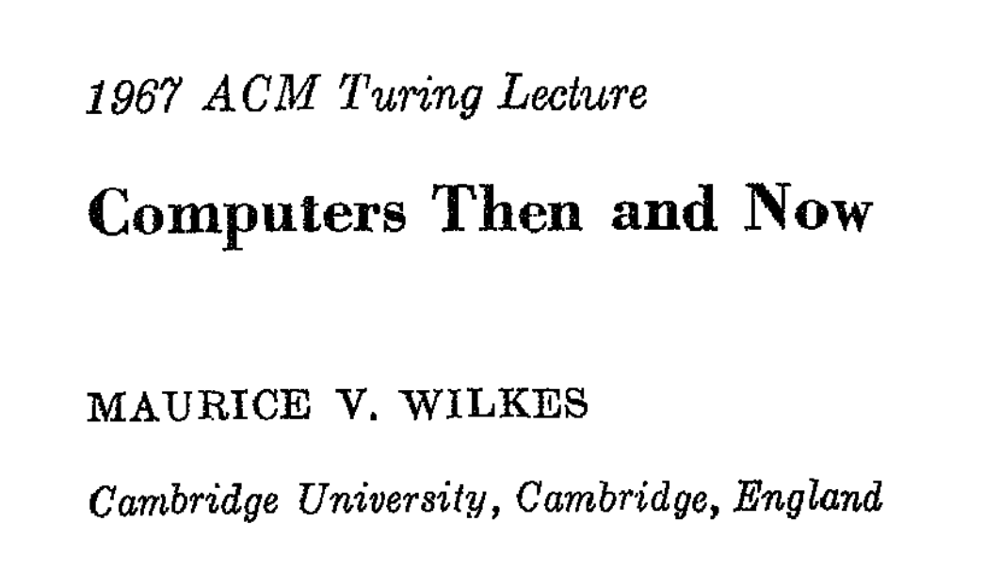

Slide 10
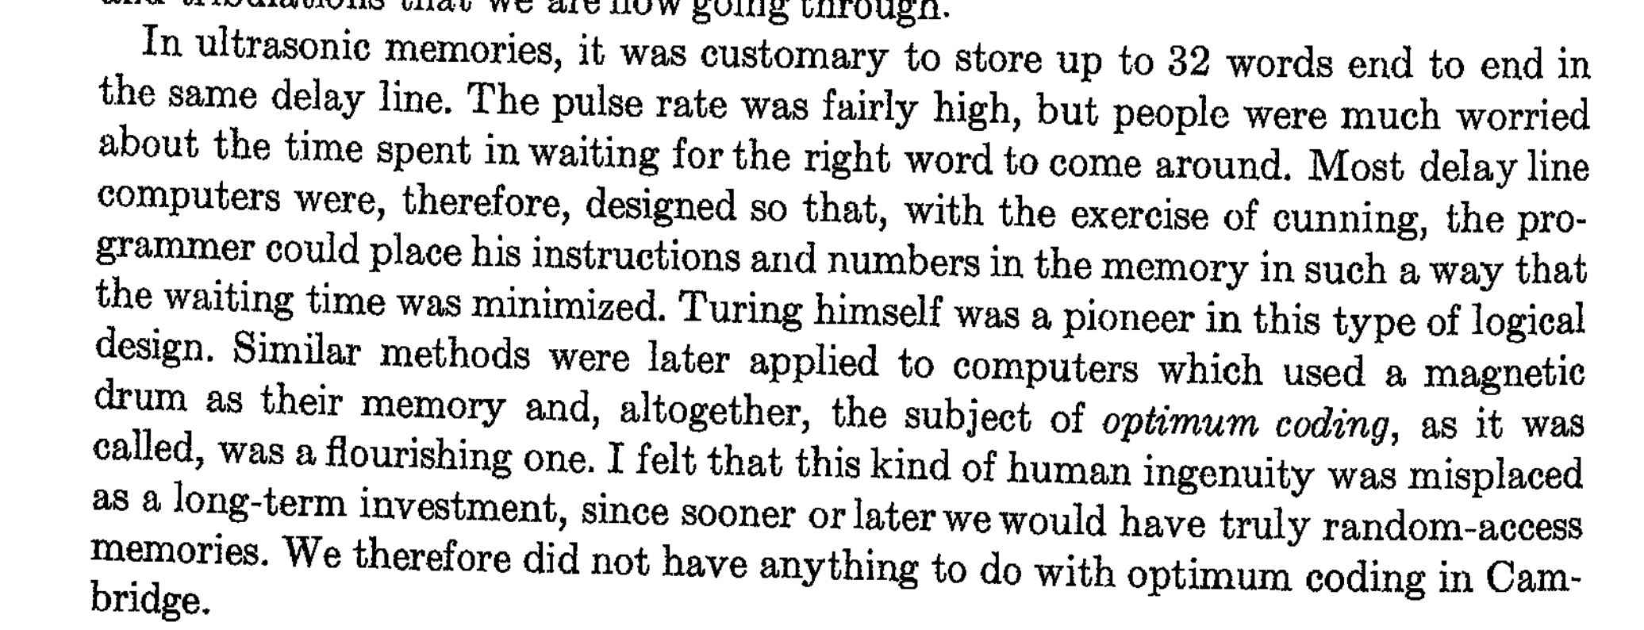

Slide 11
Why Mercury?
Speed of Sound
Air 343 m/s
Mercury 1450 m/s (40° C)
Water 1500 m/s (25° C)

Slide 12

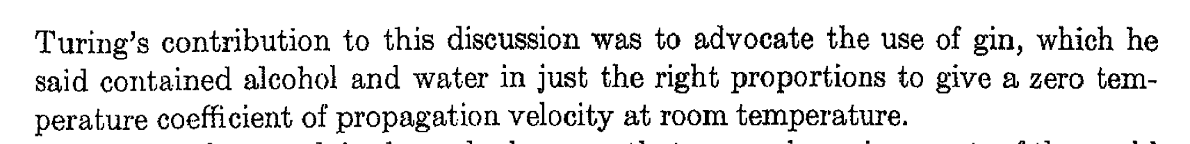
Why Mercury?
Speed of Sound
Air 343 m/s
Mercury 1450 m/s (40° C)
Water 1500 m/s (25° C)

Slide 13
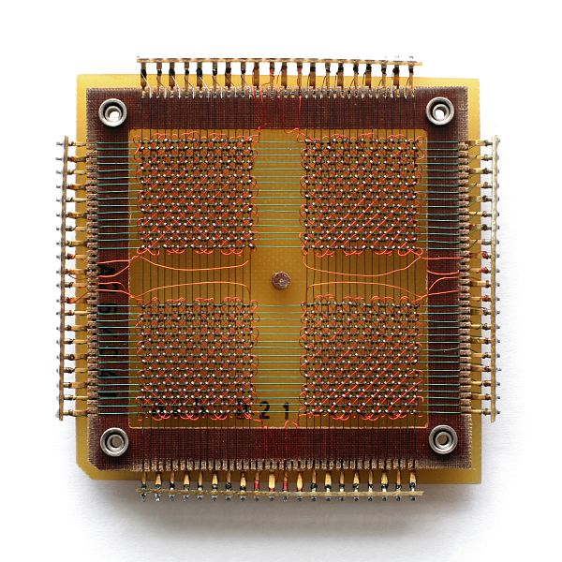
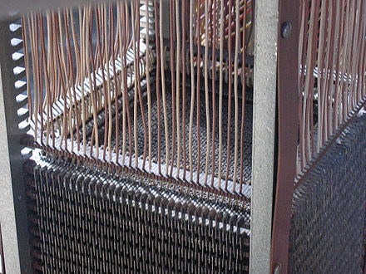
Magnetic Core Memory
MIT Project Whirlwind, 1951
2K 16-bit words
with “no waiting”!

Slide 14
SRAM
NOT
NOT

Slide 15
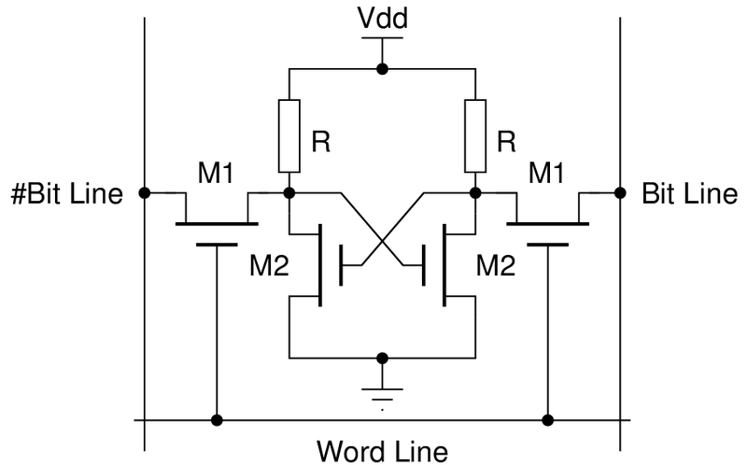
4-Transistor SRAM Bit

Slide 16
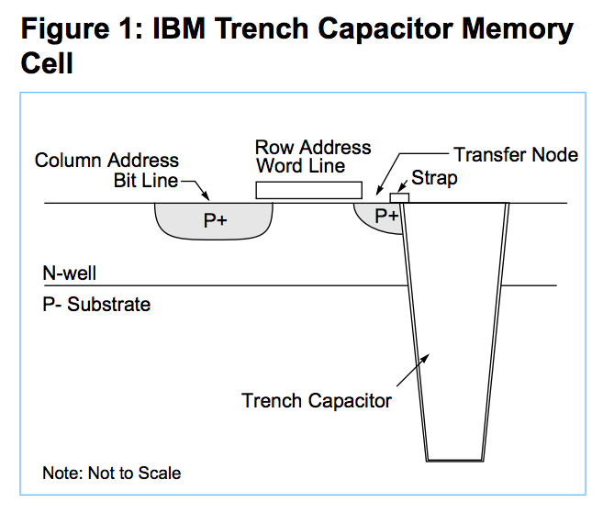
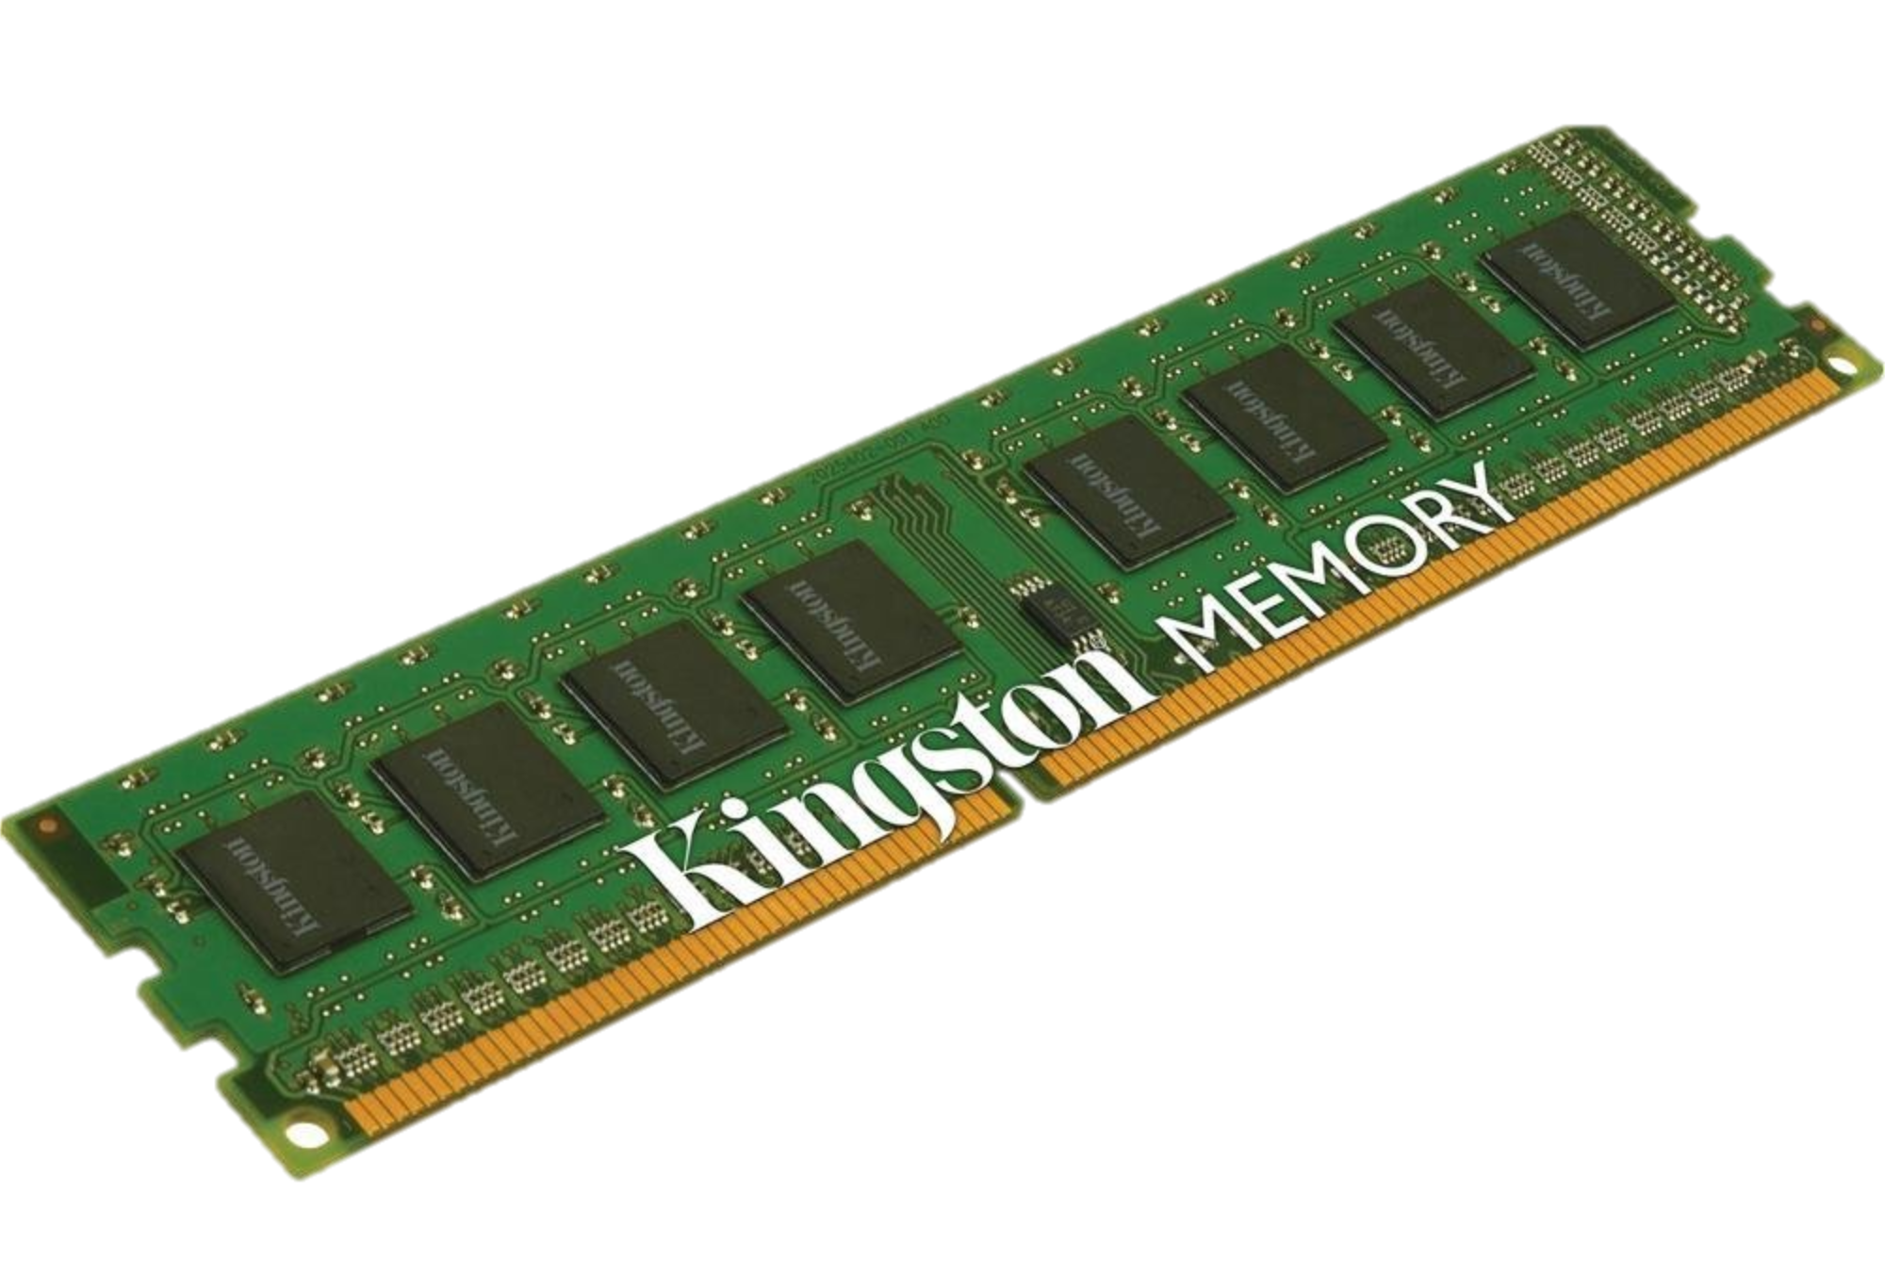
Modern
DRAM

Slide 17
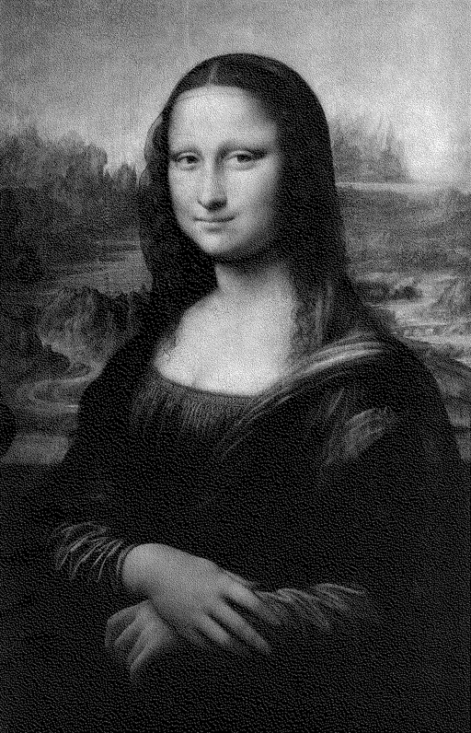
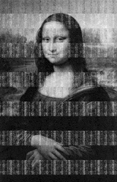

5 seconds
30 seconds
5 minutes

Slide 18
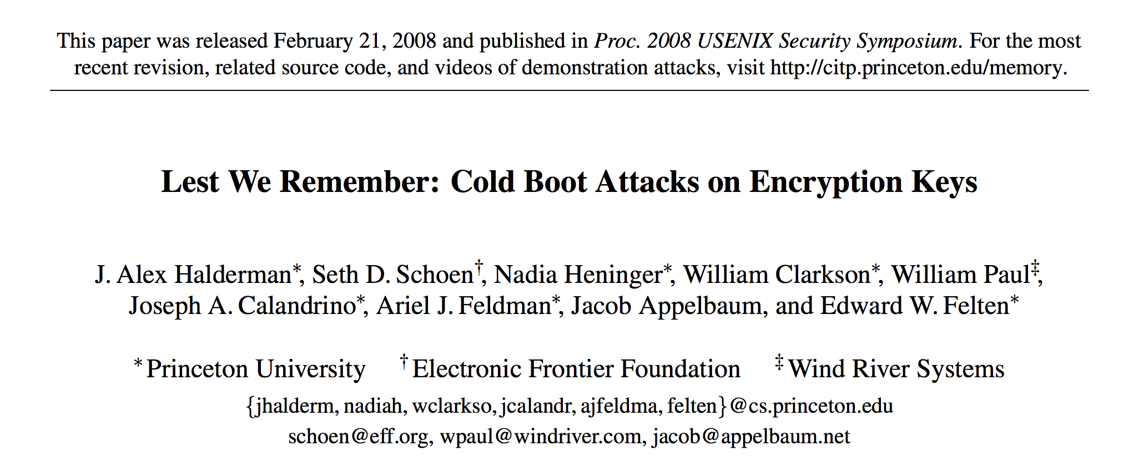
5 seconds
30 seconds
5 minutes

Slide 19
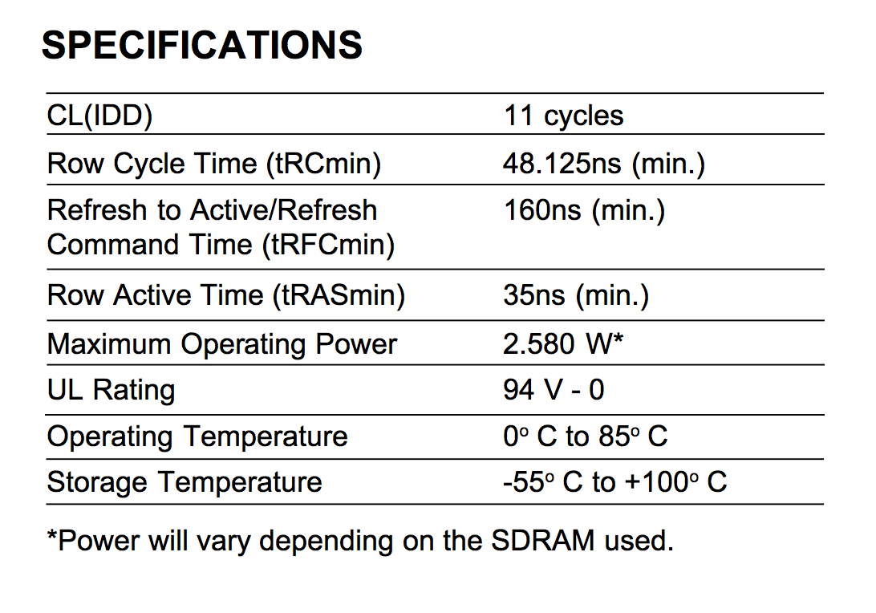
cycles (at 800MHz) to read a particular row = 13.75ns
= 185° F

Slide 20
Storage Systems
Device | Example | Time to Access | Cost per Bit
Mercury (Gin) Delay Line | UNIVAC (1951) | 220,000ns (average) | $ 0.38 (1968) (a bazillion n$)
DRAM | Kingston KVR16N11/4 4GB DDR3 ($40) | 13.75ns | 1.16 n$
UNIVAC 1968 (Core memory): $823,500 for 131 K 16-bit words

Slide 21
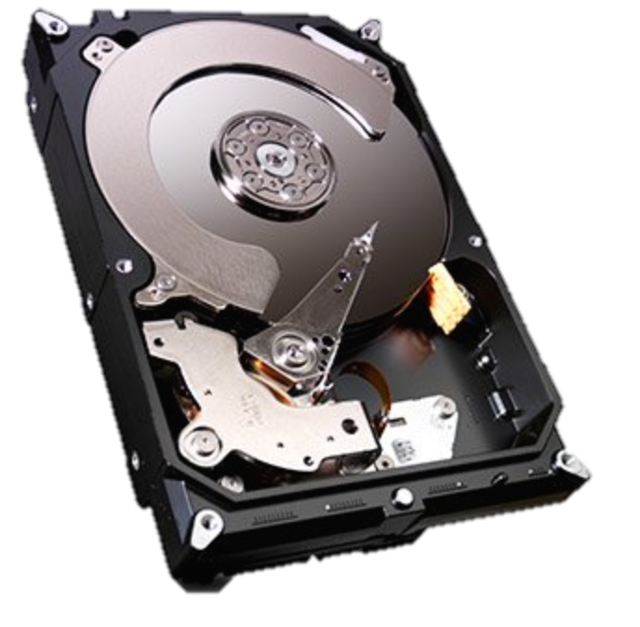
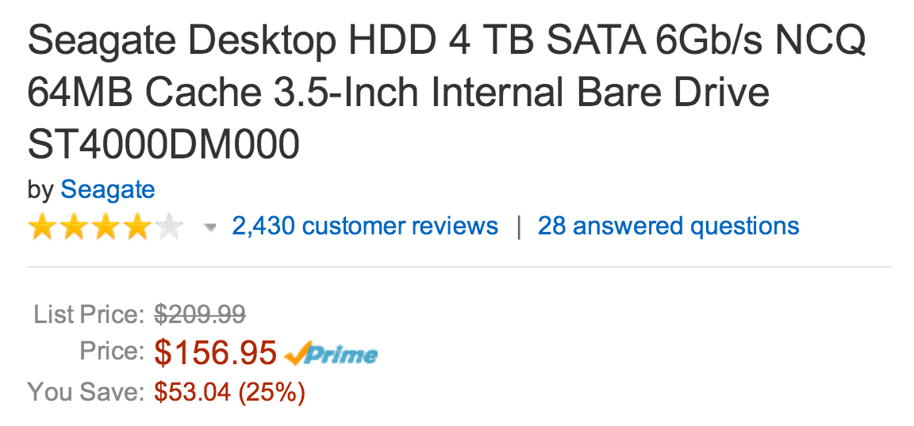
Cheaper, More Persistent Storage

Slide 22
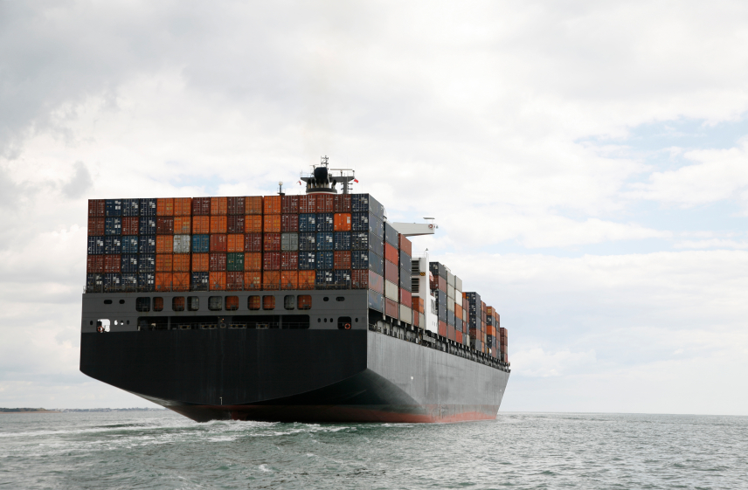
Review: what is the bandwidth of a storage container on an ocean liner full of these?

Slide 23
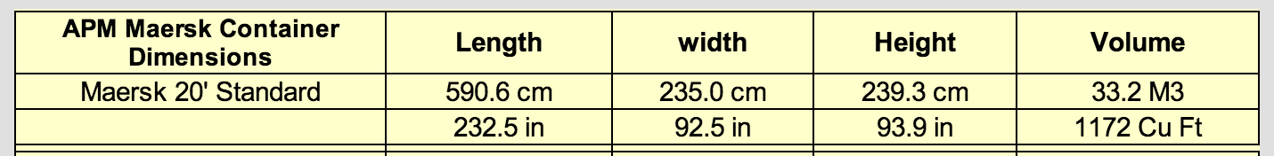
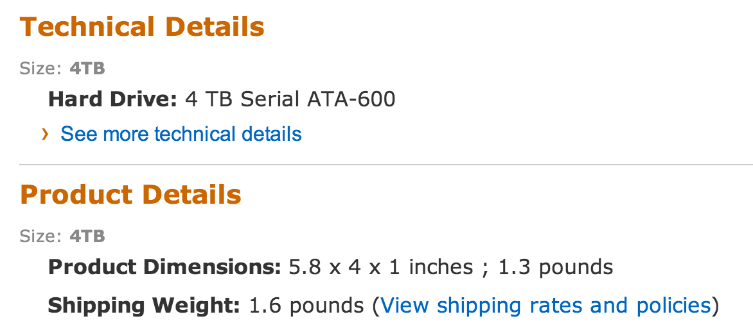

Slide 24
>>> drivevol = 5.8 * 4 * 1
>>> container = 232.5 * 92.5 * 93.9
>>> container / drivevol
87044.69288793104

Slide 25
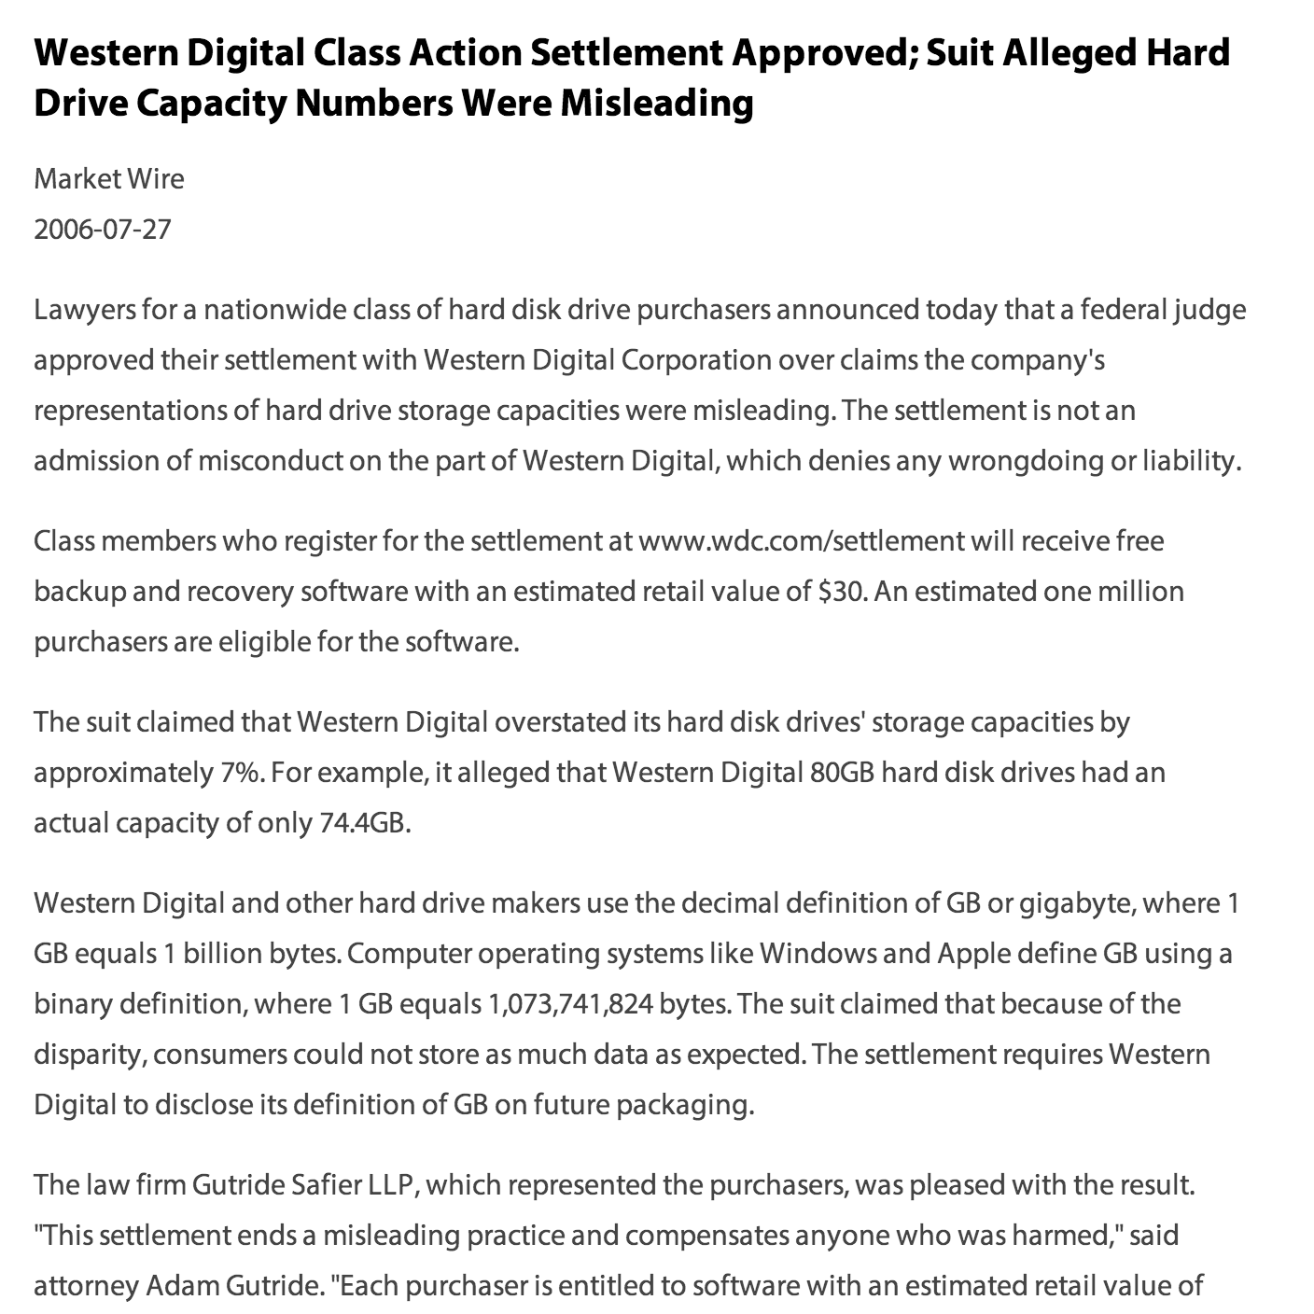
How big is a TB?

Slide 26
>>> drivevol = 5.8 * 4 * 1
>>> container = 232.5 * 92.5 * 93.9
>>> container / drivevol
87044.69288793104
>>> bpc = _ * 8 * 4 * 1024 * 1024 * 1024 * 1024
>>> bpc
3.0626128629270743e+18

Slide 27
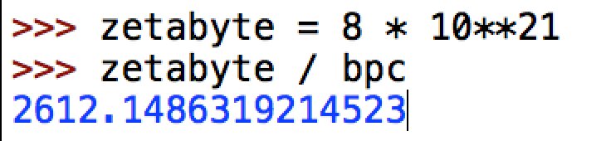
>>> drivevol = 5.8 * 4 * 1
>>> container = 232.5 * 92.5 * 93.9
>>> container / drivevol
87044.69288793104
>>> bpc = _ * 8 * 4 * 1024 * 1024 * 1024 * 1024
>>> bpc
3.0626128629270743e+18

Slide 28
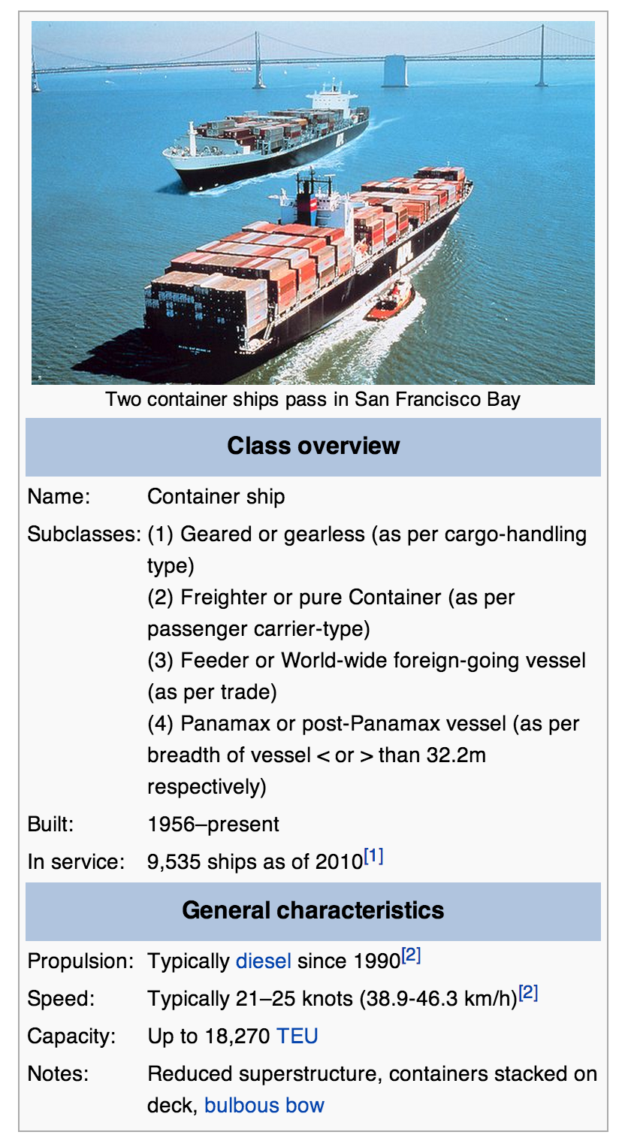
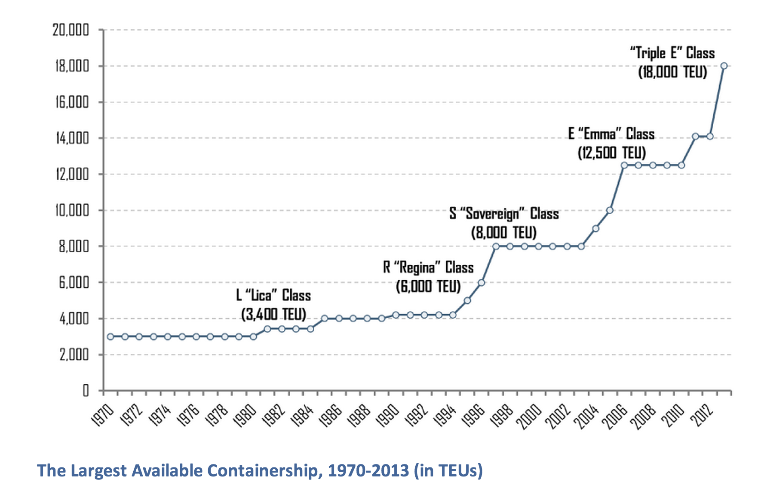

Slide 29
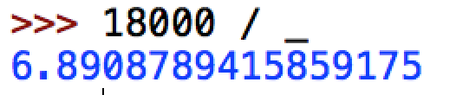
Bandwidth of container ship full of 4TB drives:
6.9 ZB at 40km/h

Slide 30
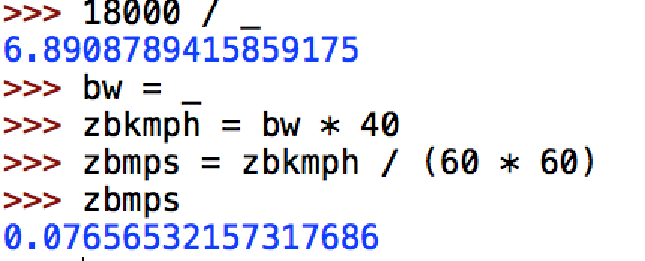
Bandwidth of container ship full of 4TB drives:
6.9 ZB at 40km/h

Slide 31
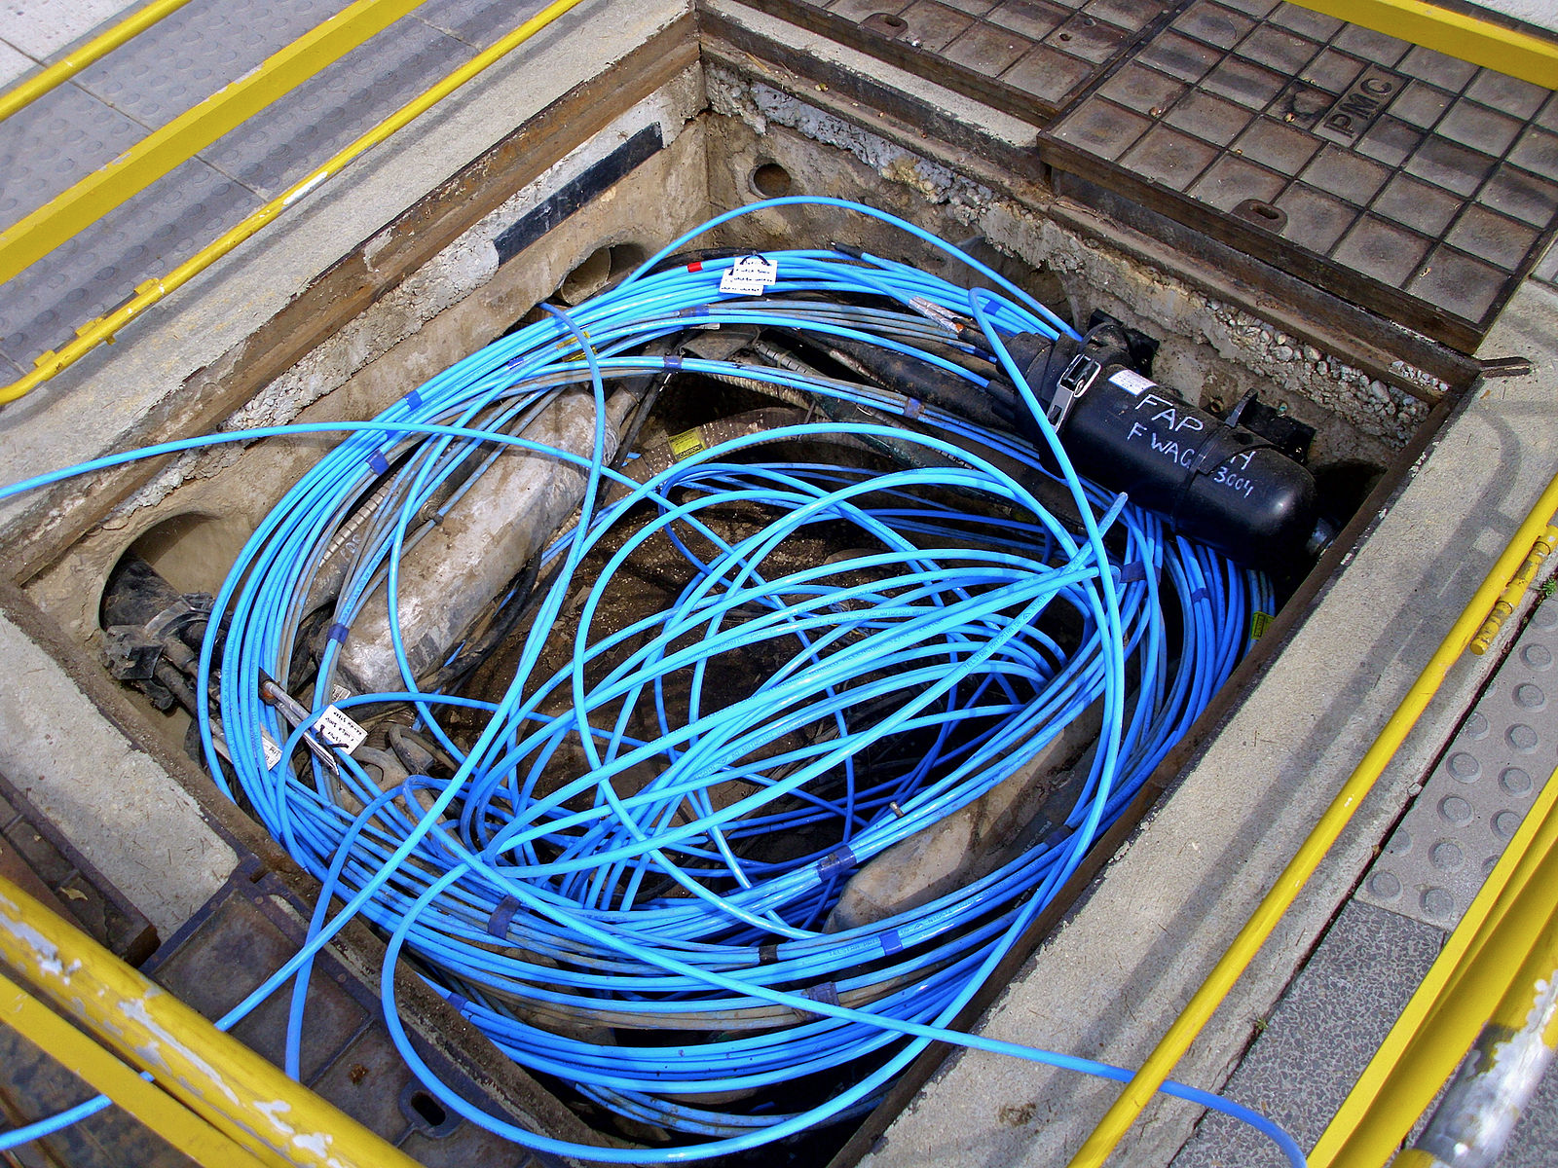
How does this compare to Gbit ethernet?

Slide 33
>>> gb = 1024 * 1024 * 1024
>>> speedoflight = 299792458 # mps
>>> gbmps = gb * speedoflight
>>> gbmps
321899700674363392
>>> ethernet_zbmps = gbmps / (8 * 10**21)
4.023746258429542e-05
>>> ship_zbmps / ethernet_zbmps
1902.8367261672238
Moral: Latency Matters!

Slide 34
Storage Systems
Device | Example | Time to Access | Cost per Bit
Mercury (Gin) Delay Line | UNIVAC (1951) | 220,000ns (average) | $ 0.38 (1968) (a bazillion n$)
DRAM | Kingston KVR16N11/4 4GB DDR3 ($40) | 13.75ns | 1.16 n$
Hard Drive | Seagate Desktop HDD 4 TB SATA 6Gb/s NCQ 64MB | ? | 0.0046 n$

Slide 35
Accessing a Hard Drive
“seek time”
~ 0.1ms
5900 rpm spindle
rotate time:
1/5900rpm ~ max 10ms

Slide 36

Passing the Drop Test

Slide 37
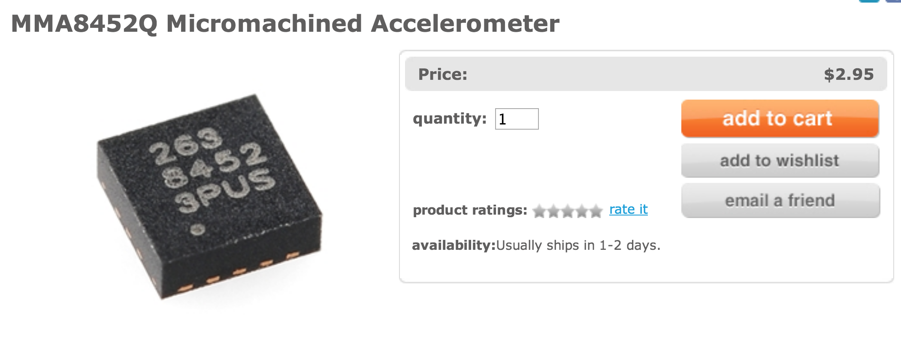
Passing the Drop Test

Slide 38
Storage Systems
Device | Example | Time to Access | Cost per Bit
Mercury (Gin) Delay Line | UNIVAC (1951) | 220,000ns (average) | $ 0.38 (1968) (a bazillion n$)
DRAM | Kingston KVR16N11/4 4GB DDR3 ($40) | 13.75ns | 1.16 n$
Hard Drive | Seagate Desktop HDD 4 TB SATA 6Gb/s NCQ 64MB | 5ms (ave) | 0.0046 n$

Slide 39
Storage Abstractions

Slide 40
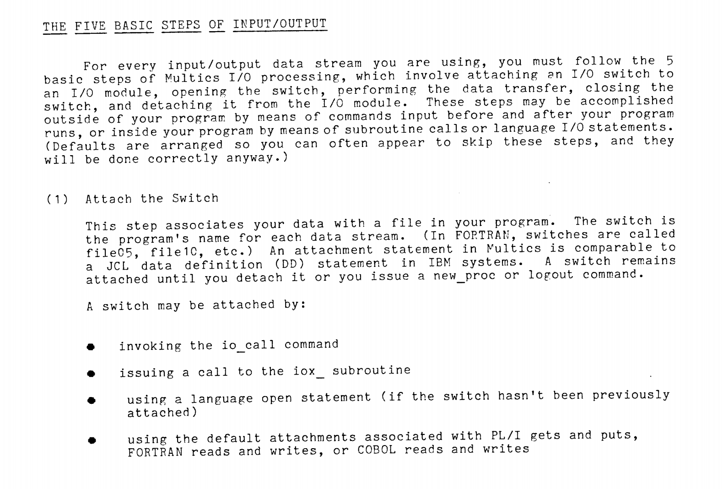

Slide 41
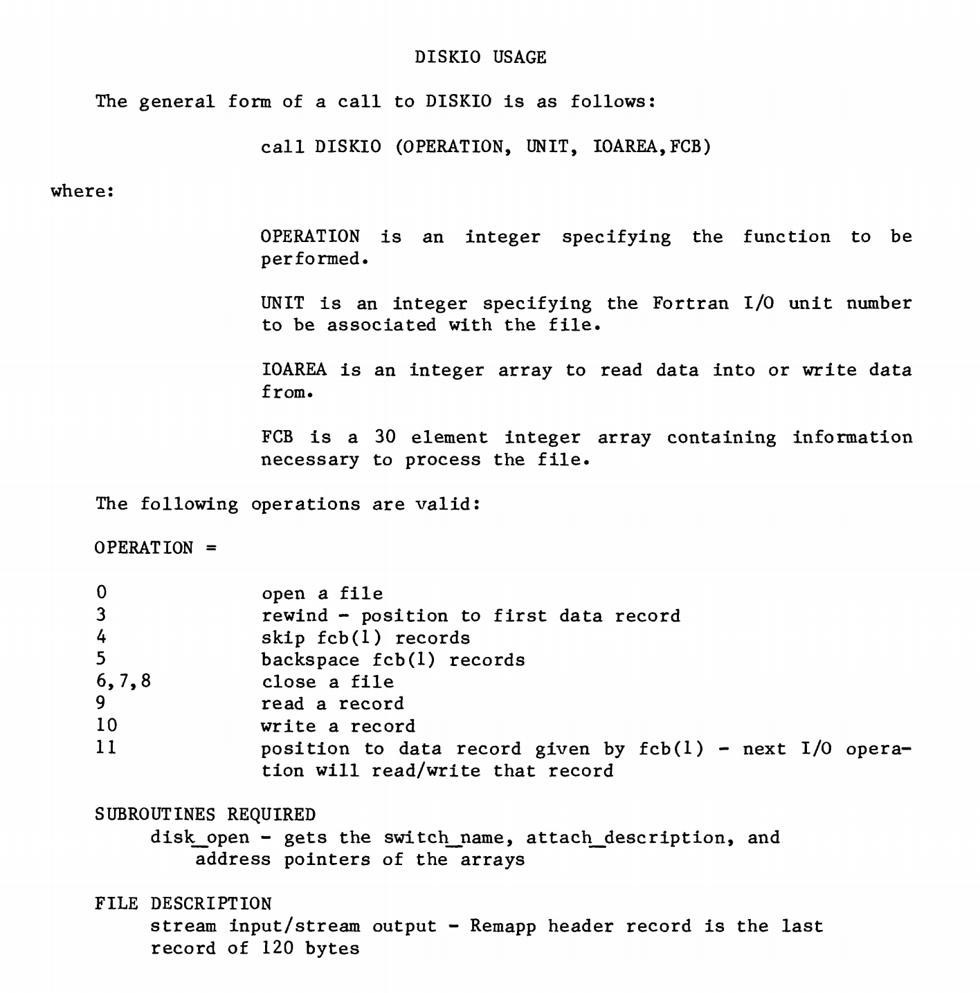
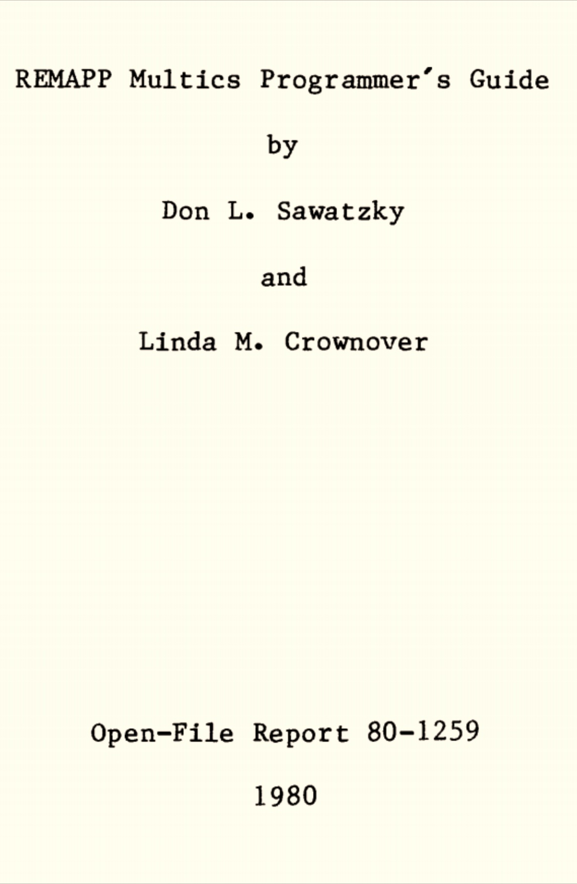

Slide 42
“Modern?” Storage Abstractions
Memory Location
File
Do we really need both?
What about: database, URI?

Slide 43

Unix File Abstraction

Slide 44
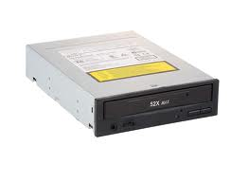

Which are files?
class16.pptx
/Users/dave/OS/classes/
OS-provided random numbers
the list of current interrupts

Slide 45
“Everything is a File”
class16.pptx
/mnt/cdrom
/Users/dave/OS/classes/
OS-provided random numbers
/dev/tty0
/dev/random

Slide 46
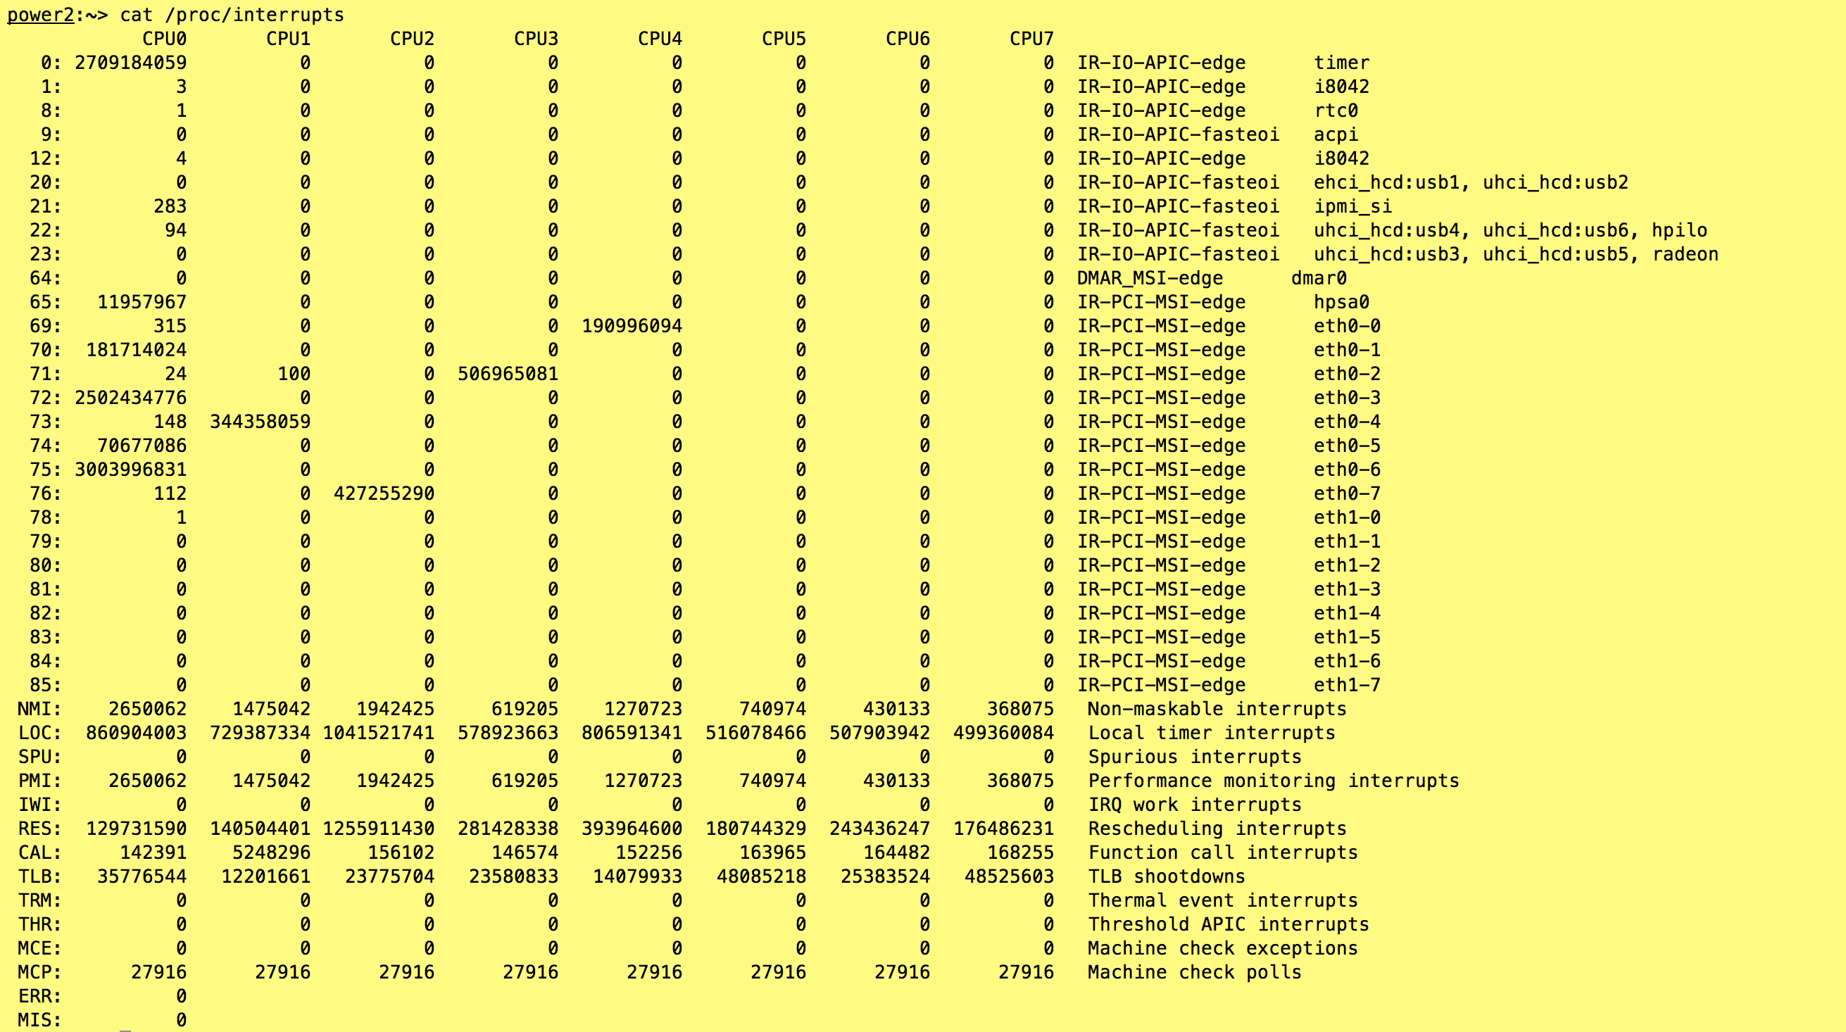
Note: this is on Ubuntu, not Mac OS X

Slide 47
inode represents a file
Size of File (bytes)
Device ID
User ID
Group ID
File Mode (permission bits)
Link count (number of hard links to node)
…
Diskmap

Slide 48
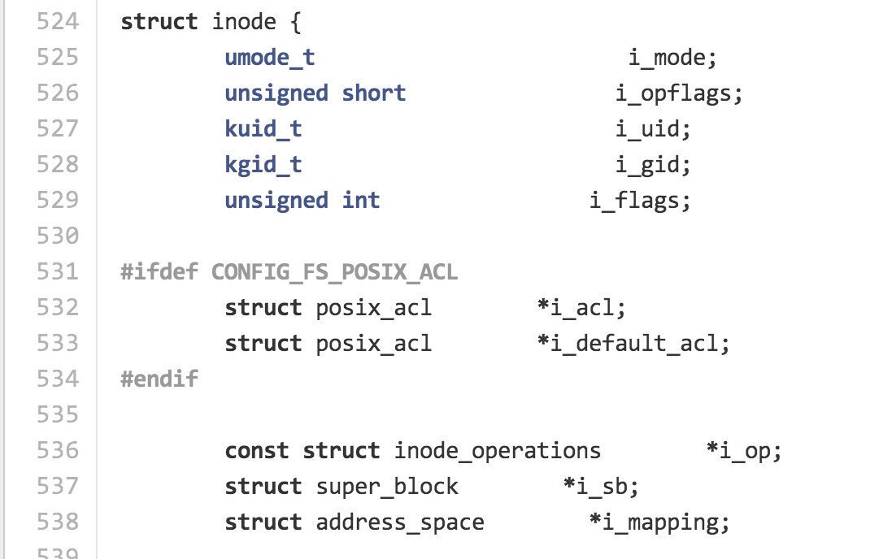
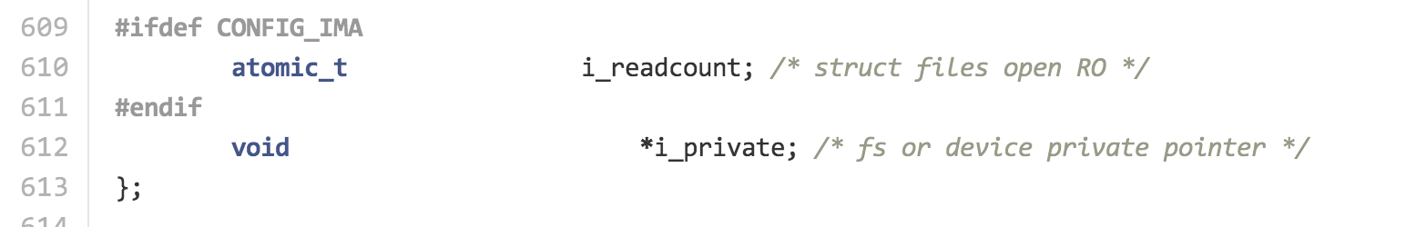
include/linux/fs.h

Slide 49
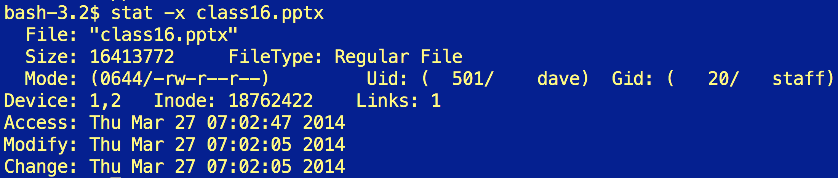
Size of File (bytes)
Device ID
User ID
Group ID
File Mode (permission bits)
Link count (number of hard links to node)
…
Diskmap
stat

Slide 50
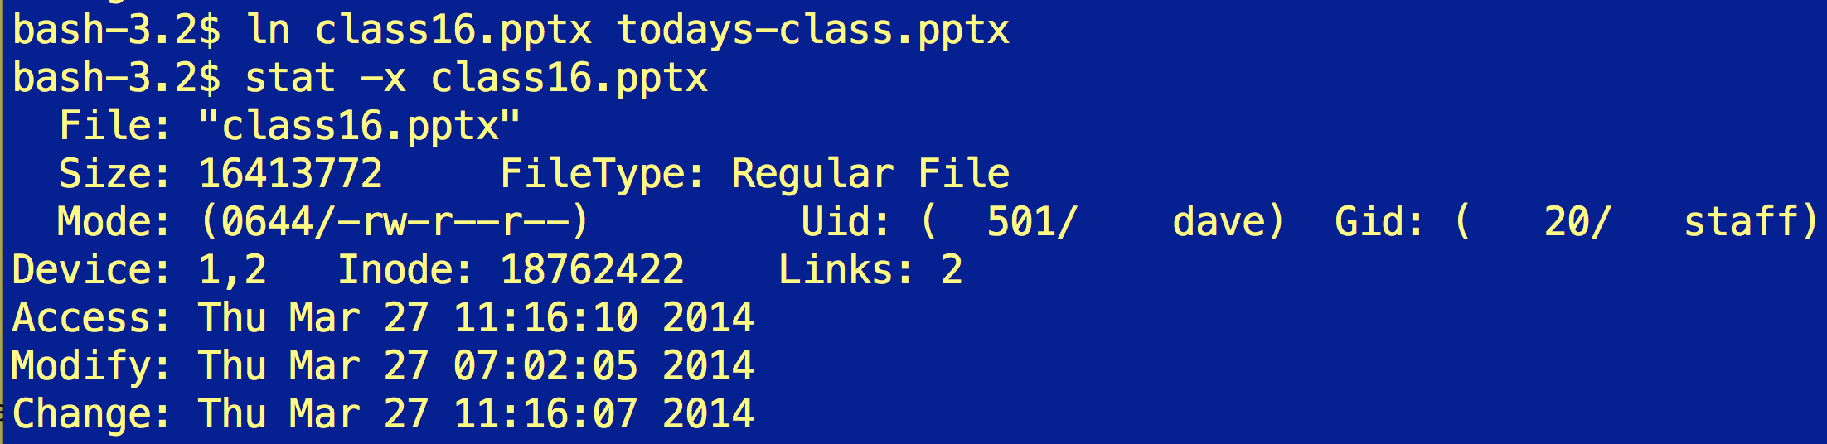

Slide 51
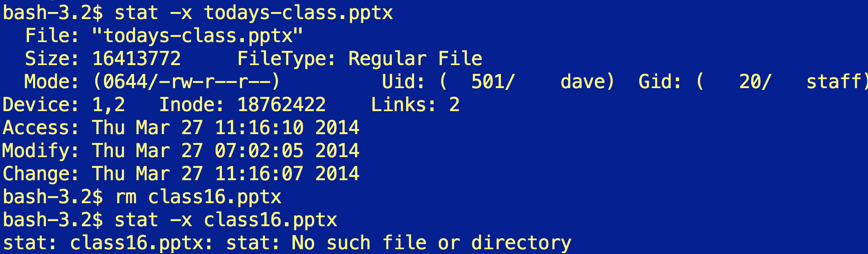

Slide 52
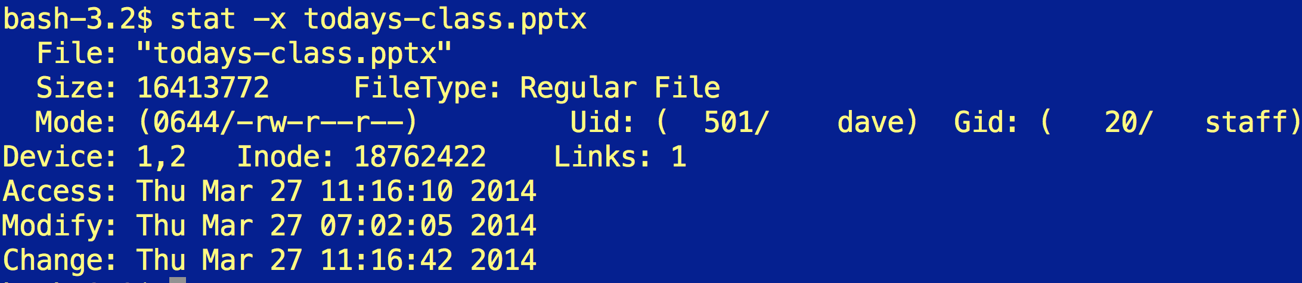

Slide 53
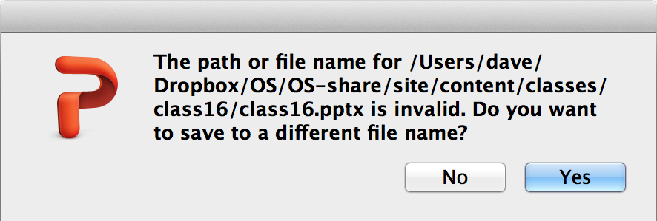
Removing a linked file like this is very confusing for PowerPoint…

Slide 54
Diskmap
(Unix System 5)
Size of File (bytes)
Device ID
User ID
Group ID
File Mode (permission bits)
Link count (number of hard links to node)
…
Diskmap
0
1
2
…
9
10
11
12
Disk Block (1K bytes)
Disk Block (1K bytes)
Disk Block (1K bytes)

Slide 55
Diskmap
(Unix System 5)
Disk Block (1K bytes)
Indirect
Disk Block (1K bytes)
Disk Block (1K bytes)
Disk Block (1K bytes)
0
1
2
…
9
10
11
12
4 bytes for each = 256 pointers
Disk Block (1K bytes)
Disk Block (1K bytes)
Disk Block (1K bytes)

Slide 56
Diskmap
(Unix System 5)
Disk Block (1K bytes)
Indirect
Disk Block (1K bytes)
Disk Block (1K bytes)
Disk Block (1K bytes)
0
1
2
…
9
10
11
12
4 bytes for each = 256 pointers
Indirect
Disk Block (1K bytes)
Double
Indirect
Disk Block
Indirect
Disk Block (1K bytes)
Disk Block (1K bytes)
Disk Block (1K bytes)
Disk Block (1K bytes)

Slide 57
Diskmap
(Unix System 5)
Disk Block (1K bytes)
Indirect
Disk Block (1K bytes)
Disk Block (1K bytes)
Disk Block (1K bytes)
0
1
2
…
9
10
11
12
4 bytes for each = 256 pointers
Indirect
Disk Block (1K bytes)
Double
Indirect
Disk Block
Indirect
Disk Block (1K bytes)
Disk Block (1K bytes)
Disk Block (1K bytes)
Disk Block (1K bytes)
How would you determine if your file system has this structure?

Slide 58
Diskmap
(Unix System 5)
Disk Block (1K bytes)
Indirect
Disk Block (1K bytes)
Disk Block (1K bytes)
Disk Block (1K bytes)
0
1
2
…
9
10
11
12
4 bytes for each = 256 pointers
Indirect
Disk Block (1K bytes)
Double
Indirect
Disk Block
Indirect
Disk Block (1K bytes)
Disk Block (1K bytes)
Disk Block (1K bytes)
Disk Block (1K bytes)
Disk Block (1K bytes)

Slide 59
Directories are Files Too!
Filename | Inode
. | 494211
.. | 494205
.DS_Store | 494212
class0 | 6565946
class1 | 6565826
class10 | 1467012
class11 | 2252968
… | …
class16 | 5649155
class2 | 494218
… | …
ls -ali

Slide 60
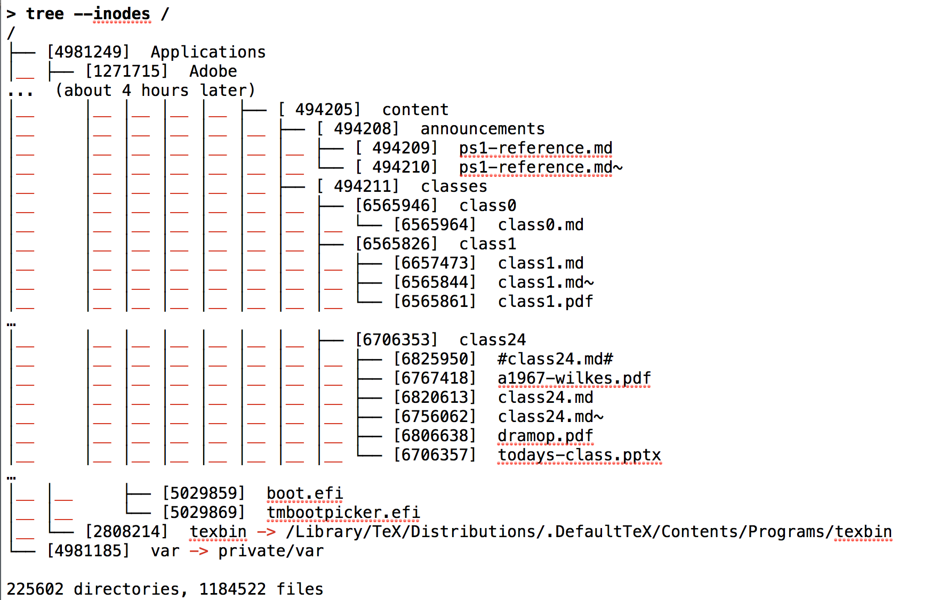
> brew install tree # needed on MacOS X, but builtin to most Unixes
(from last year’s class)

Slide 61
How do you create a new file?

Slide 62
Finding a Free Block
Data
I-List (inodes)
Superblock
Boot block
0
1
…
98
99
0
1
…
98
99
List of free disk blocks
Not to scale!

Slide 63
Finding a Free inode
Data
I-List (inodes)
Superblock
Boot block
0 | 0
1 | 1
2 | 0
3 | 0
… | …
Superblock keeps a cache of free inodes
Not to scale!

Slide 64
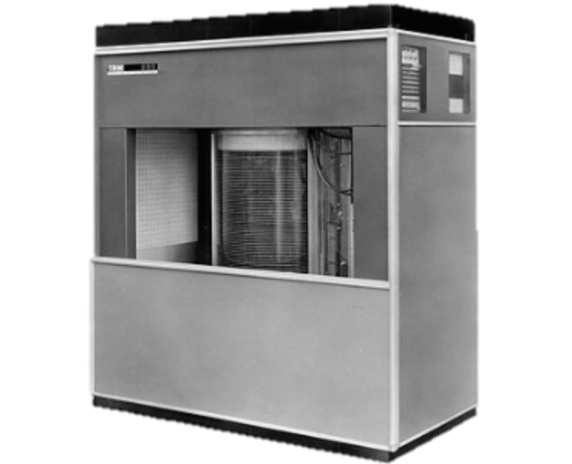
Modern File Systems
IBM 350 Disk Storage (1956)
118,000 in³, 5MB, 600ms seek
Seagate HDD (2013)
23 in³, 4TB (4M MB), 5ms seek

Slide 65
What should a modern file system do that Unix S5FS doesn’t?

Slide 67

Handling Failures
ZFS
Developed for Solaris, 2005
Now open source:
http://open-zfs.org/

Slide 68
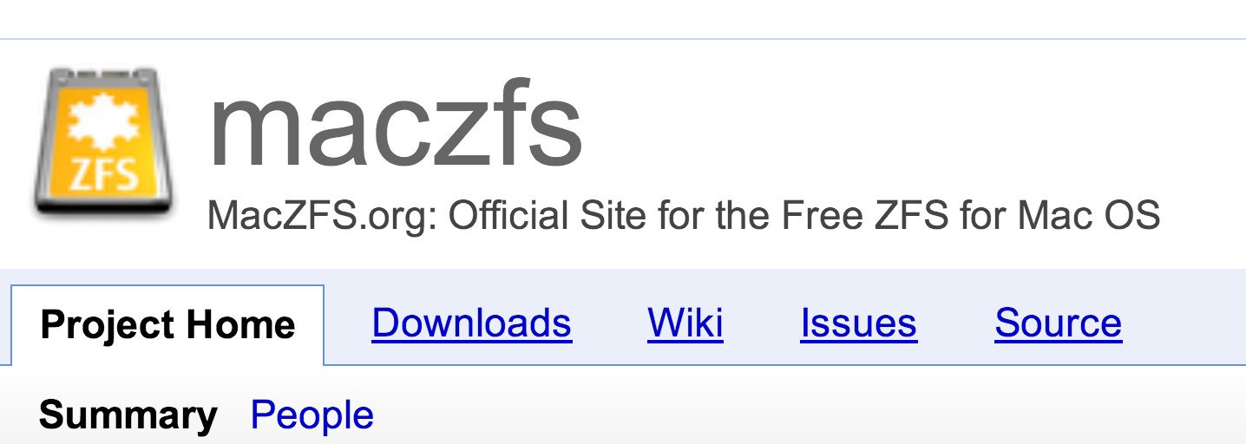
“MacZFS is free data storage and protection software for all Mac OS users. It’s for people who have Mac OS, who have any data, and who really like their data. Whether on a single-drive laptop or on a massive server, it’ll store your petabytes with ragingly redundant RAID reliability, and it’ll keep the bit-rotted bleeps and bloops out of your iTunes library.”

Slide 69
Block Checksums
Block | Checksum (SHA-256)
0 | 40a3dc…
1 | 2c5829d…
2 | 955d253…
… | …
0
1
2
…
9
10
11
12
Disk Block (1K bytes)
ZFS
How do you check the checksums?
S5FS

Slide 70
Hashing the Hashes
Hash(B1)
Hash(B2)
Hash(B3)
Hash(B4)
Block 1
Block 2
Block 3
Block 4

Slide 71

Merkle Tree
Ralph Merkle
Hash(B1)
Hash(B2)
Hash(B3)
Hash(B4)
Block 1
Block 2
Block 3
Block 4

Slide 72
Recovery
Copy 1
One Copy
Copy 2
Keep 2 copies of every block: if checksum fails for first copy read, try reading second copy.
copies = 2

Slide 73
Copy 1
For the truly paranoid…
One Copy
Copy 2
Copy 3
copies = 3

Slide 74
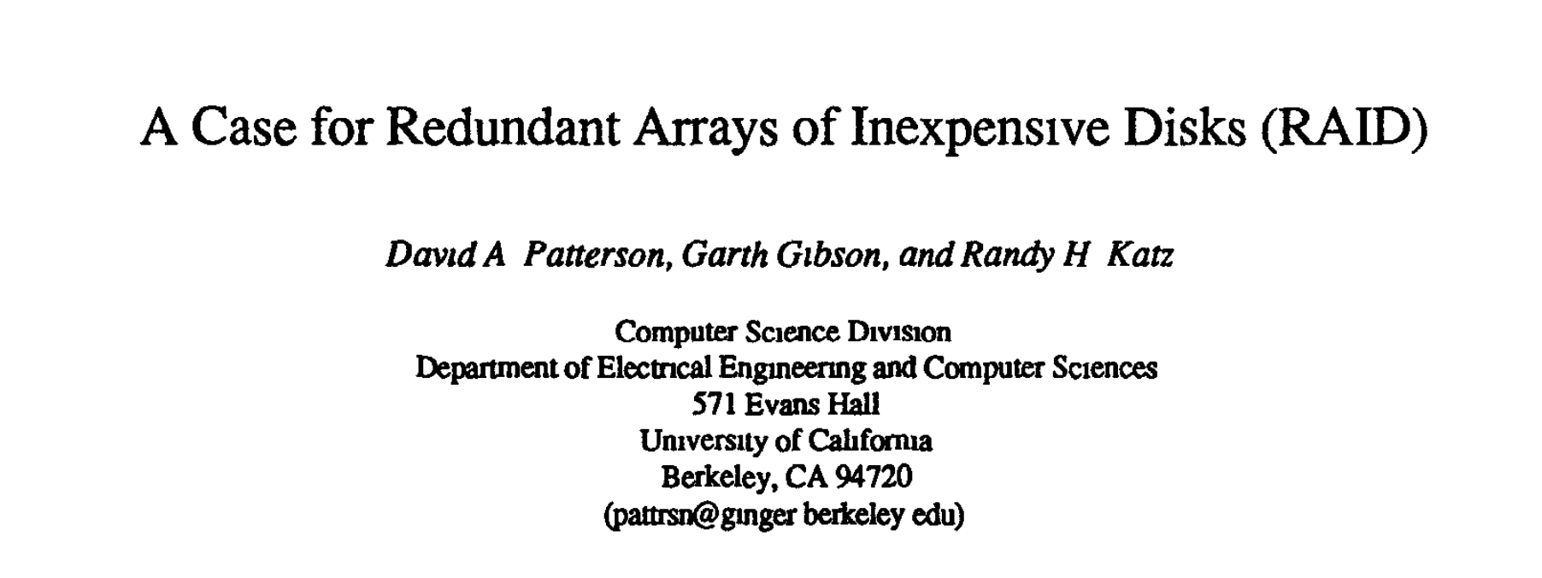

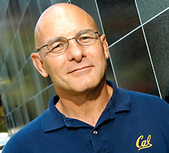
RAID
Redundant Arrays of Inexpensive Disks
For the fairly paranoid but cheap…
ACM SIGMOD 1988
whitehouse.gov

Slide 75
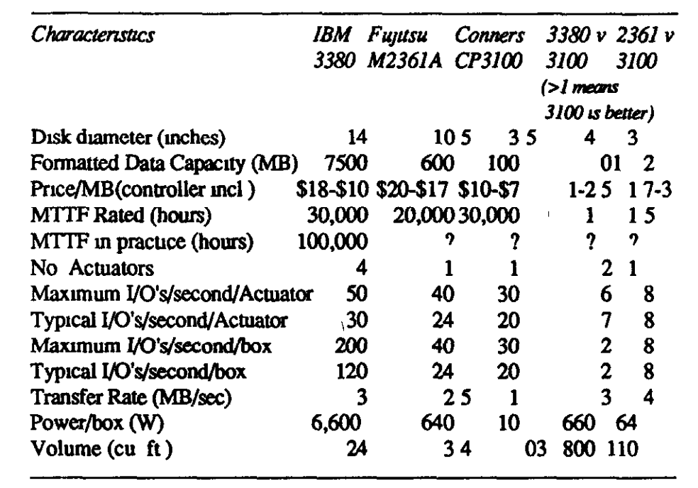
Case for RAID

Slide 76
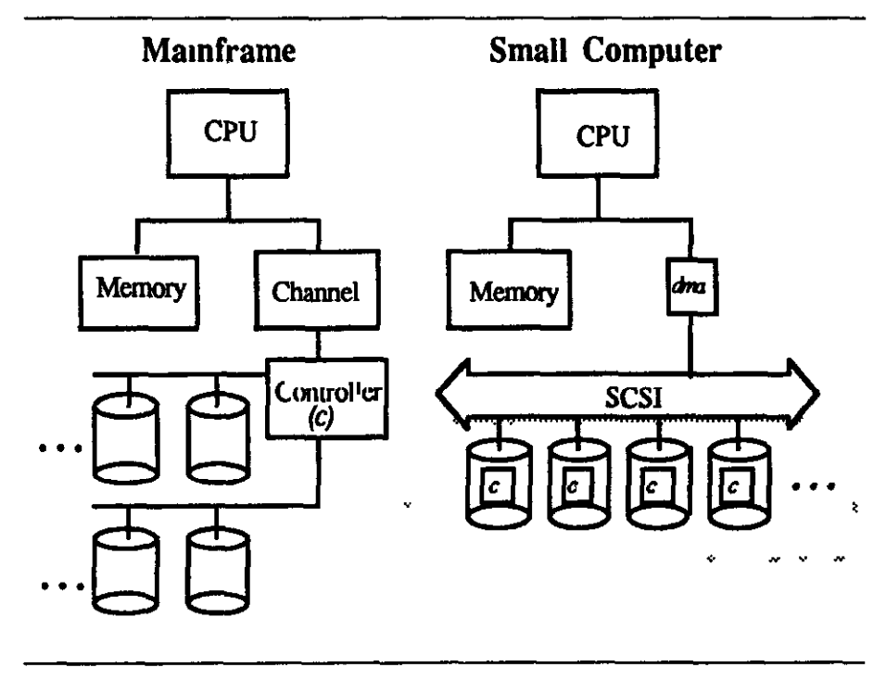

Slide 77

Redundancy

Slide 78


Slide 79
Improving Performance
Cache (64MB DRAM)
Adaptive Replacement Cache

Slide 80
Adaptive Replacement Cache
Accessed Again
Blocks in Cache
T1: Recent Cache Entries
T2: Frequently-Used Blocks
Size of T1 adapts
“Ghost” Entries
B1: Evicted from T1 (LRU)
B2: Evicted from T2 (LRU)
How should relative size of T1 and T2 be adjusted?

Slide 81
Adaptive Replacement Cache
Accessed Again
Blocks in Cache
T1: Recent Cache Entries
T2: Frequently-Used Blocks
Size of T1 adapts
“Ghost” Entries
B1: Evicted from T1 (LRU)
B2: Evicted from T2 (LRU)
Hit in B1: should increase size of T1, drop entry from T2 to B2
Hit in B2: should increase size of T2, drop entry from T1 to B1

Slide 82


IBM Almaden Research Center

Slide 83
Do you actually have a disk like this on your EC2 node/main computing device?
Cache (64MB DRAM)

Slide 84



Flash Memory
Solid State Drive

Slide 85
Storage Systems
Device | Example | Time to Access | Cost per Bit
Mercury (Gin) Delay Line | UNIVAC (1951) | 220,000ns (average) | $ 0.38 (1968) (a bazillion n$)
DRAM | Kingston KVR16N11/4 4GB DDR3 ($40) | 13.75ns | 1.16 n$
Hard Drive | Seagate Desktop HDD 4 TB SATA 6Gb/s NCQ 64MB | 5,000,000ns | 0.0046 n$
SSD | Samsung 500GB ($300) | ? | 0.075 n$

Slide 86



Slide 87


Slide 88


Slide 89
Summary: Storage Systems
Device | Example | Time to Access | Cost per Bit
Mercury (Gin) Delay Line | UNIVAC (1951) | 220,000ns (average) | $ 0.38 (1968) (a bazillion n$)
DRAM | Kingston KVR16N11/4 4GB DDR3 ($40) | 13.75ns | 1.16 n$
SSD | Samsung 500GB ($300) | ~10,000 ns (for random read) | 0.075 n$
Disk Drive | Seagate Desktop HDD 4 TB SATA 6Gb/s NCQ 64MB | 5,000,000ns | 0.0046 n$
Modern Hard Drive

Slide 90


Exam 2: Due at 11:59pm Tonight
Storage systems should be designed around hardware capabilities and workload
Today’s filesystems mostly designed around 1990s disks and 1960s workloads with lots of clever hacks to make them work okay on today’s hardware and workload.
More from Wilkes 1967

