Slide 1
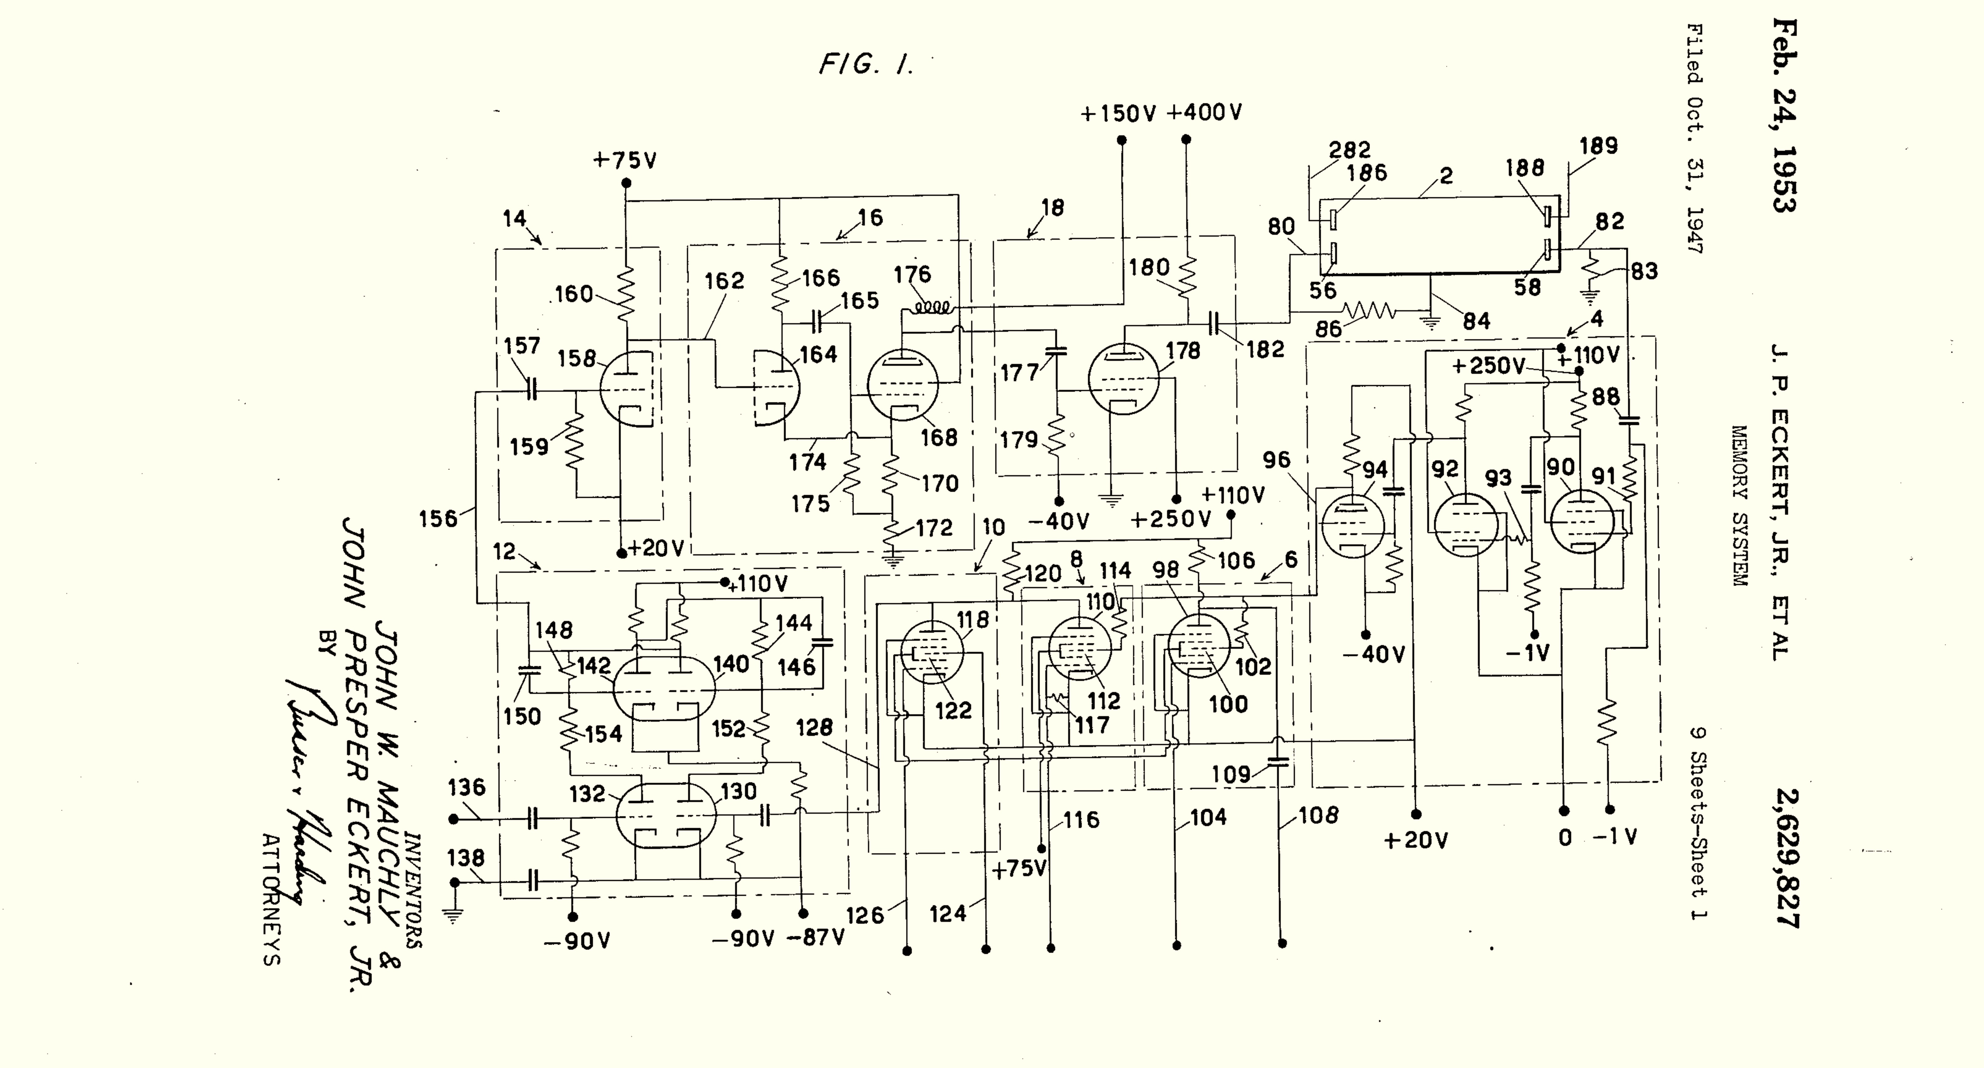
Class 16:
Storage
cs4414 Spring 2014
University of Virginia
David Evans

Slide 2
Plan for Today
Exam 2 is due at 11:59pm tonight.
PS4 is due 11:59pm Sunday, 6 April
Storage
File Systems

Slide 4
Why is storage complicated?

Slide 5
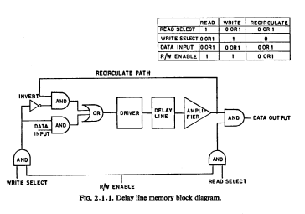
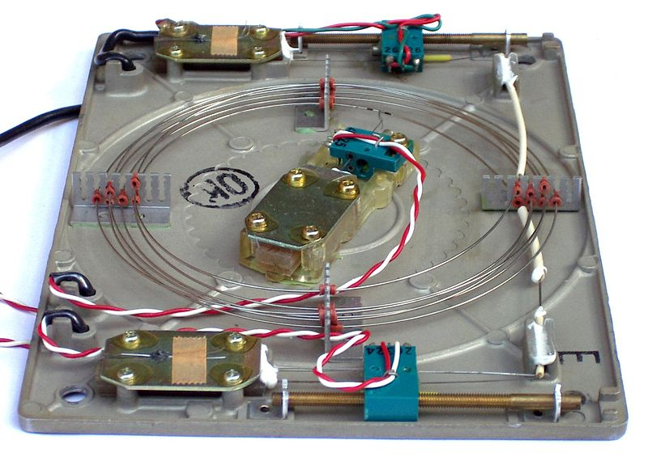
Delay Lines

Slide 6


Mercury Delay Lines
0/1

Slide 7
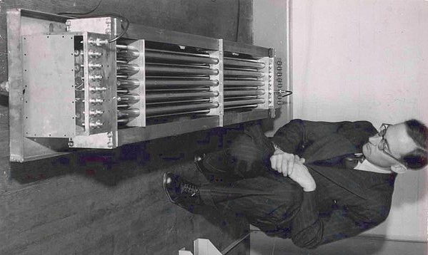

Slide 8
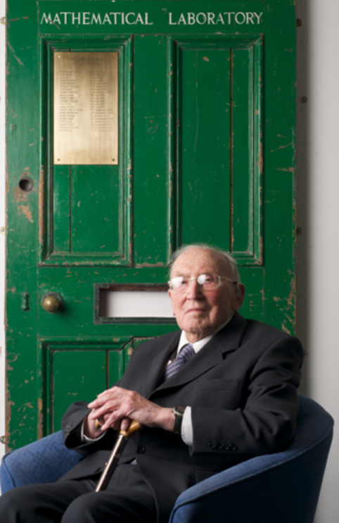
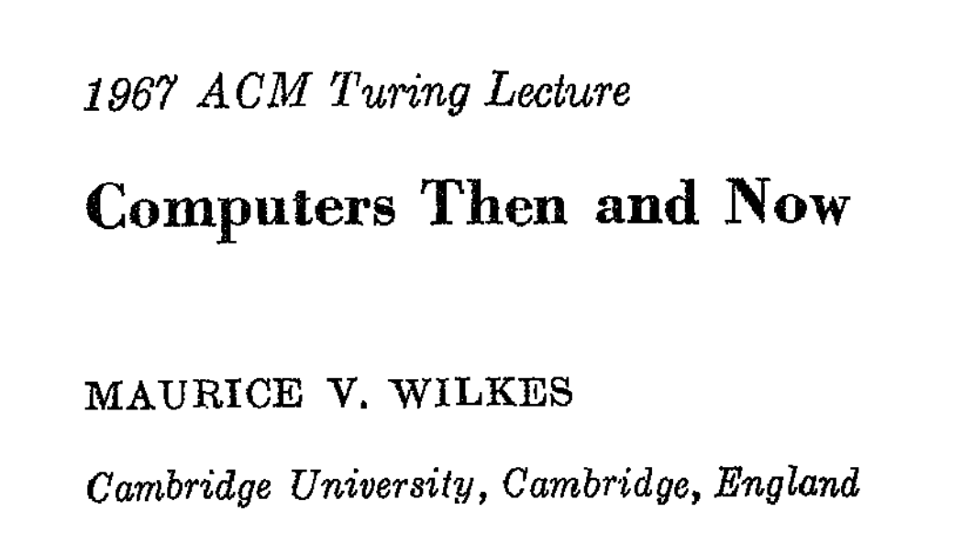

Slide 9
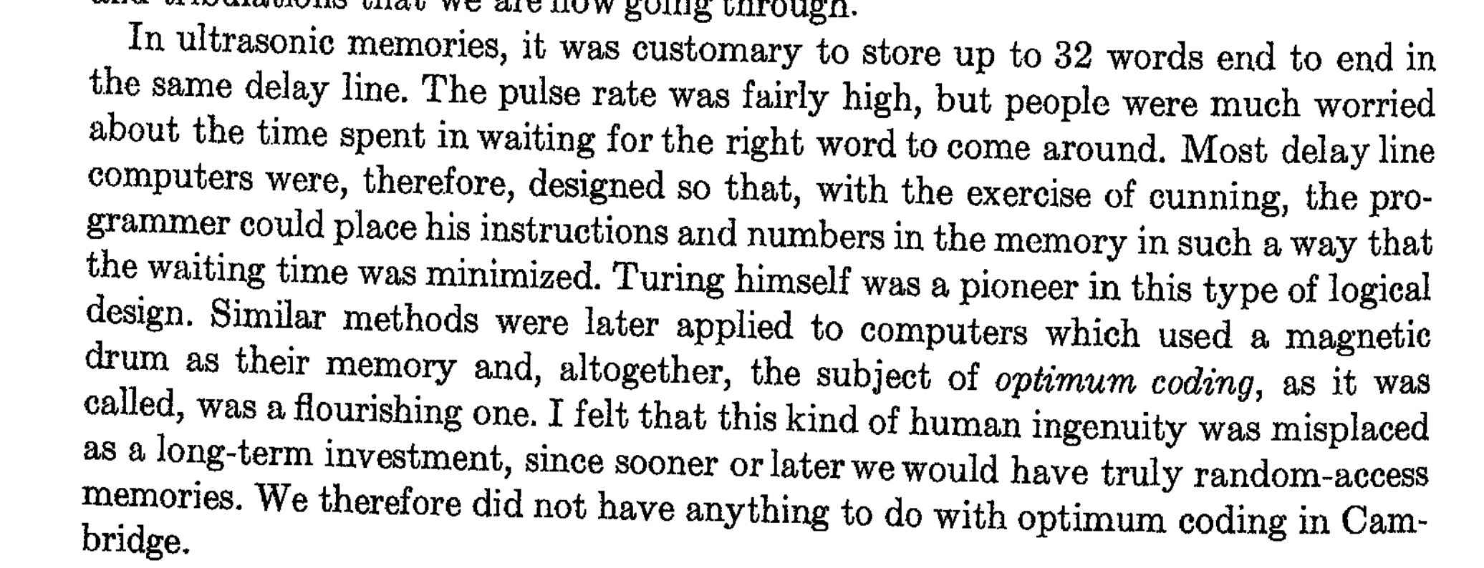

Slide 10
Why Mercury?
Speed of Sound
Air 343 m/s
Mercury 1450 m/s (40° C)
Water 1500 m/s (25° C)

Slide 11

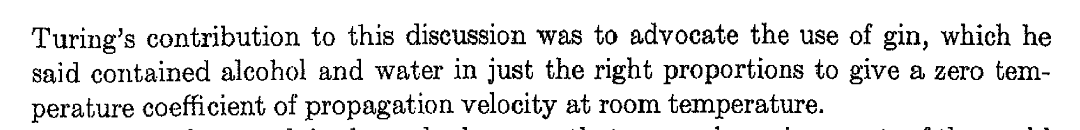
Why Mercury?
Speed of Sound
Air 343 m/s
Mercury 1450 m/s (40° C)
Water 1500 m/s (25° C)

Slide 12
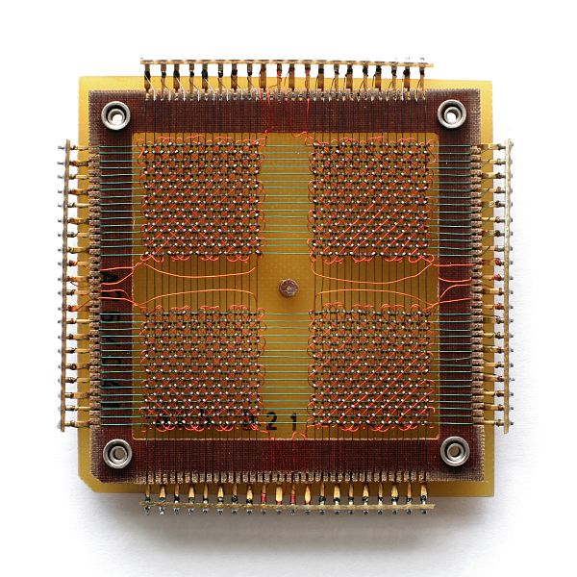
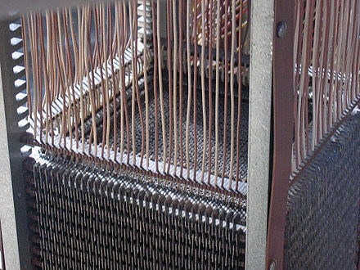
Magnetic Core Memory
MIT Project Whirlwind, 1951
2K 16-bit words
with “no waiting”!

Slide 13
SRAM
NOT
NOT

Slide 14
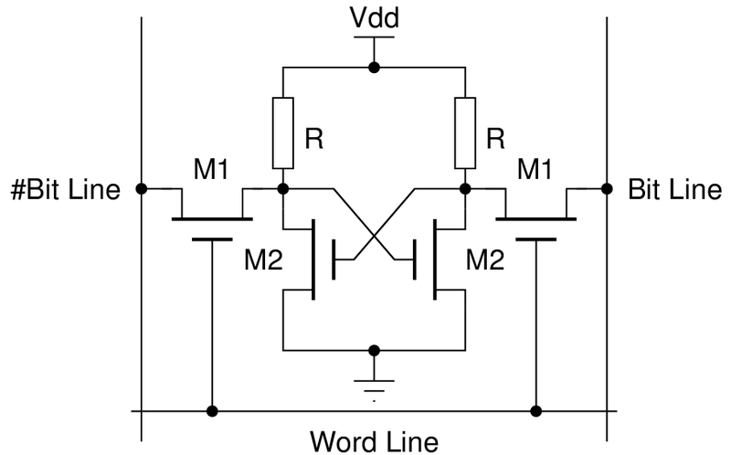
4-Transistor SRAM Bit

Slide 15
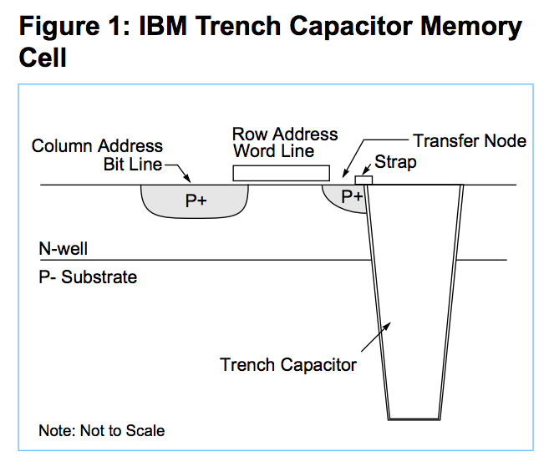
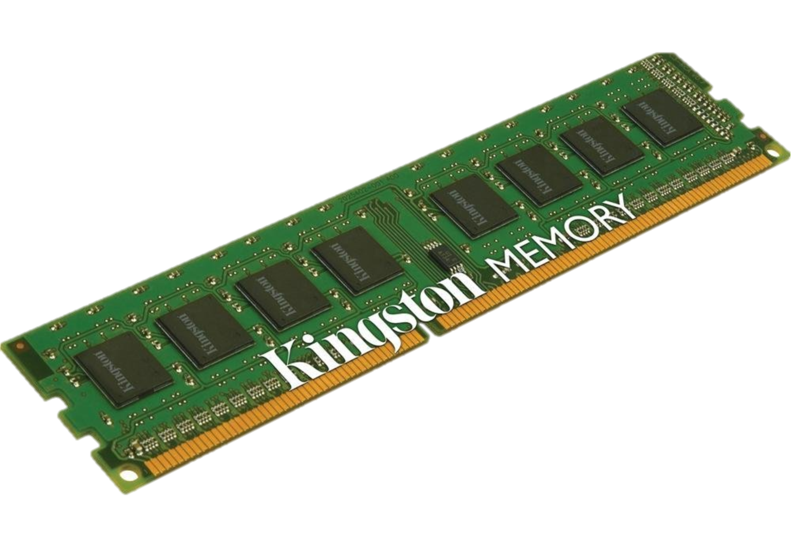
Modern
DRAM

Slide 16
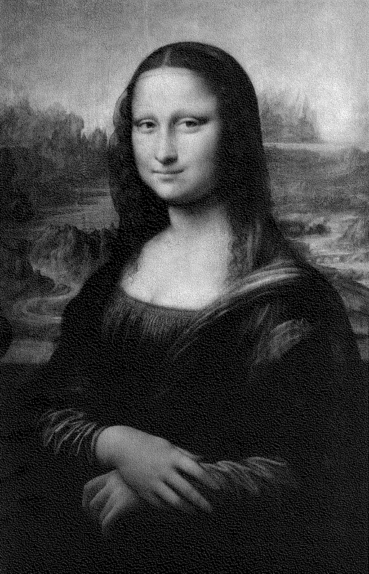


5 seconds
30 seconds
5 minutes

Slide 17
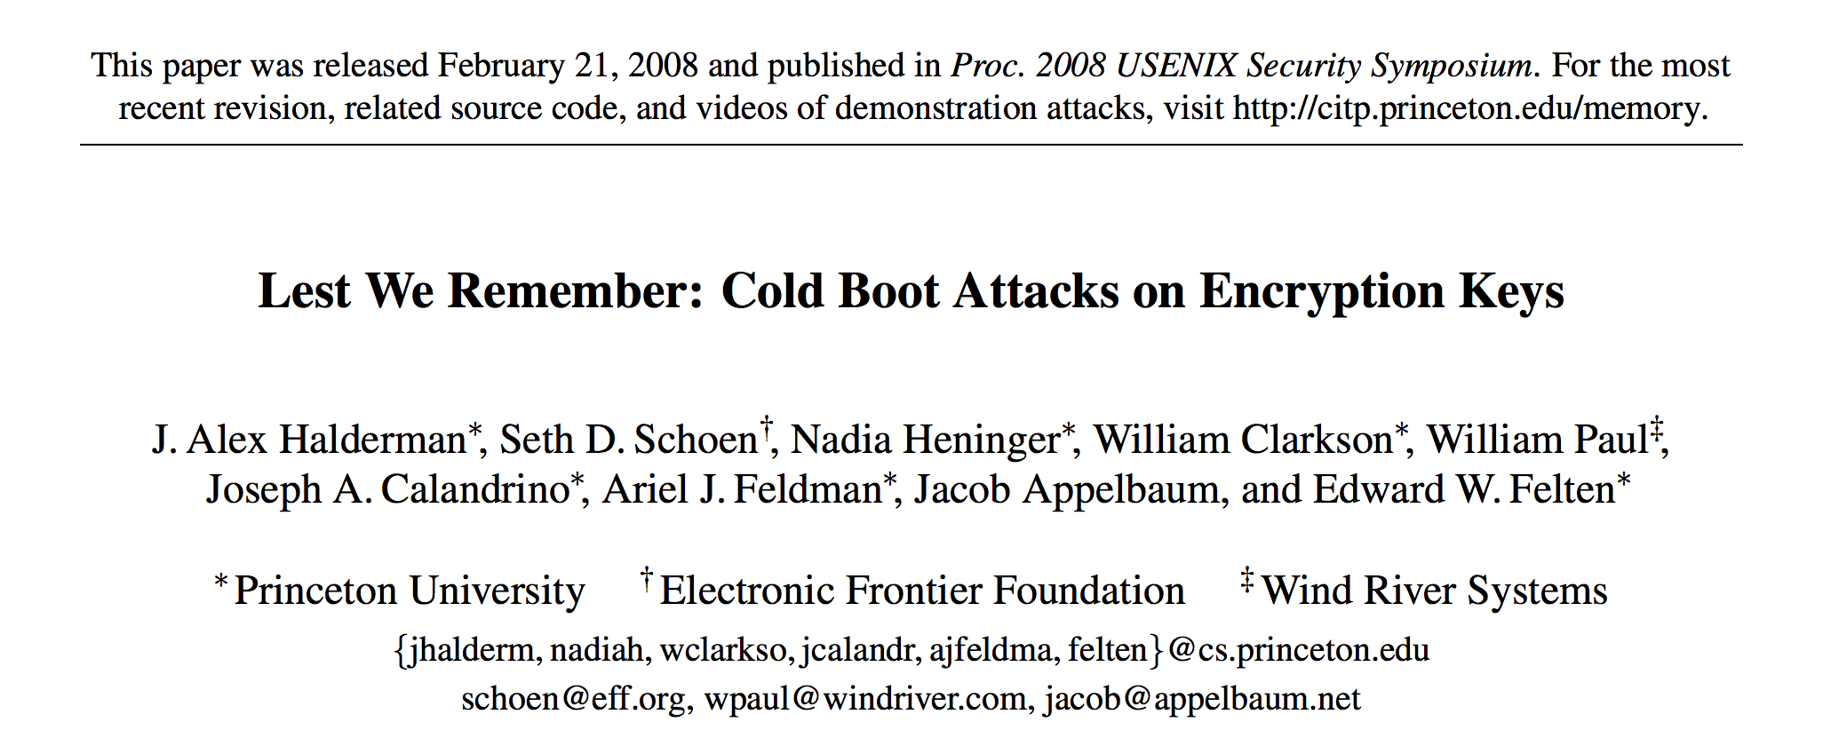
5 seconds
30 seconds
5 minutes

Slide 18
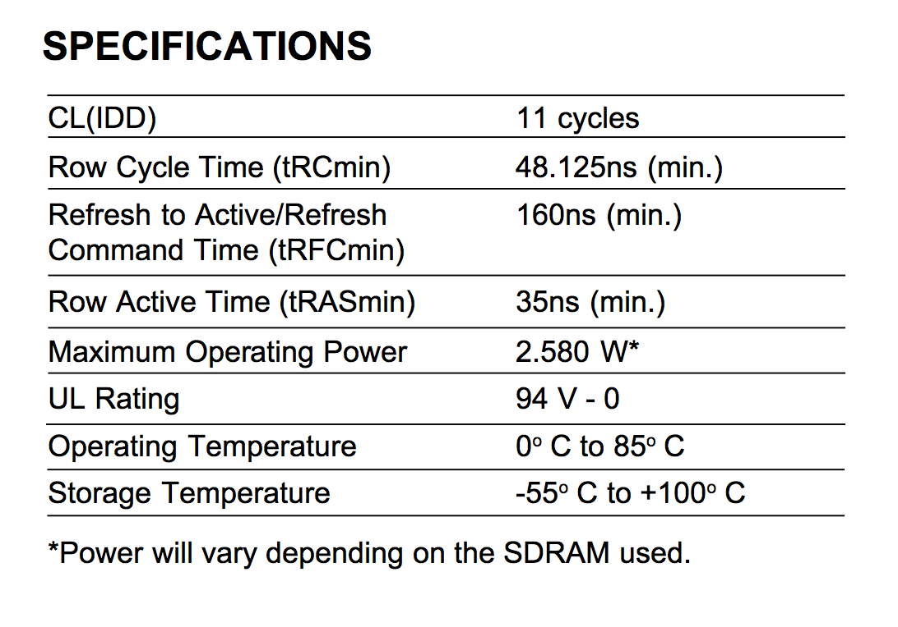
cycles (at 800MHz) to read a particular row = 13.75ns
= 185° F

Slide 19
Storage Systems
Device | Example | Time to Access | Cost per Bit
Mercury (Gin) Delay Line | UNIVAC (1951) | 220,000ns (average) | $ 0.38 (1968) (a bazillion n$)
DRAM | Kingston KVR16N11/4 4GB DDR3 ($40) | 13.75ns | 1.16 n$
UNIVAC 1968 (Core memory): $823,500 for 131 K 16-bit words

Slide 20
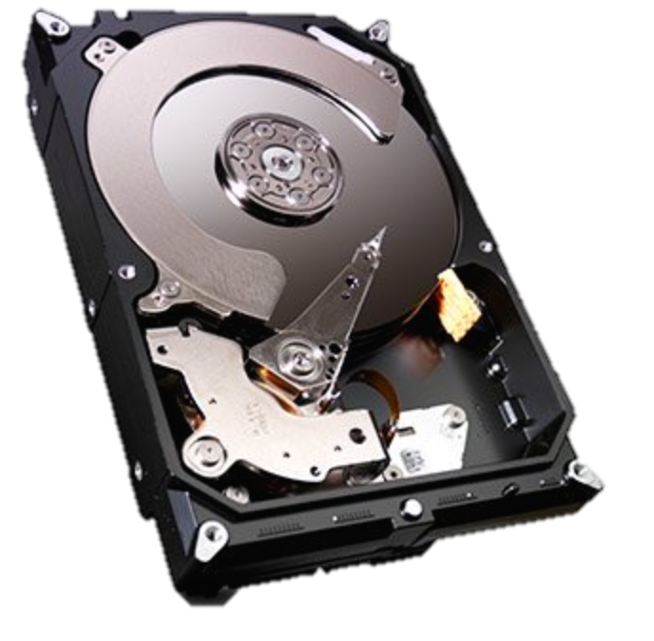
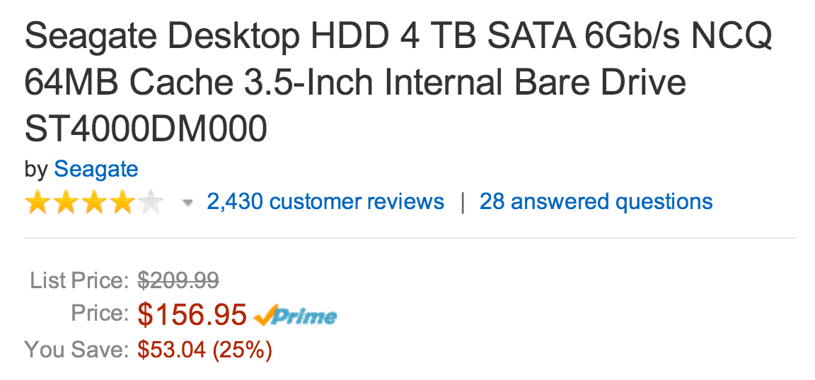
Cheaper, More Persistent Storage

Slide 21
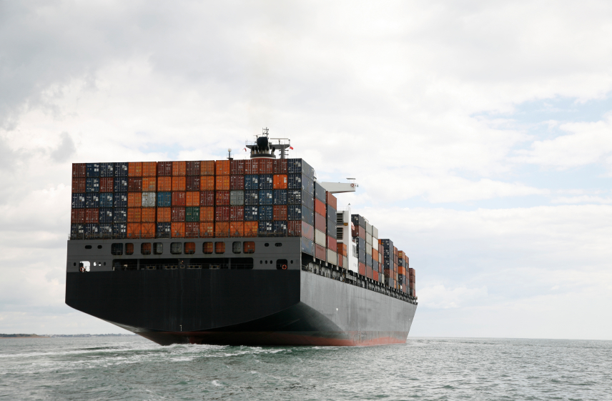
Review: what is the bandwidth of a storage container on an ocean liner full of these?

Slide 22
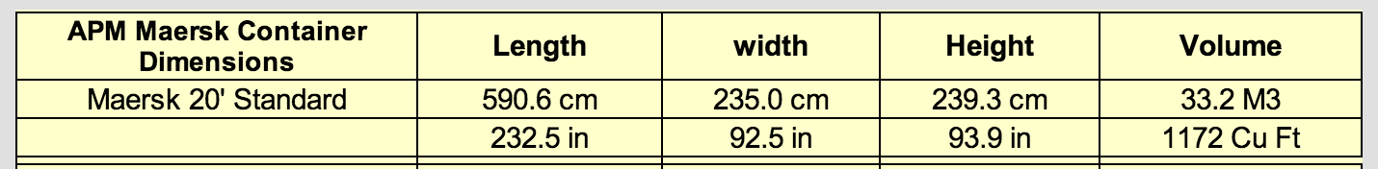
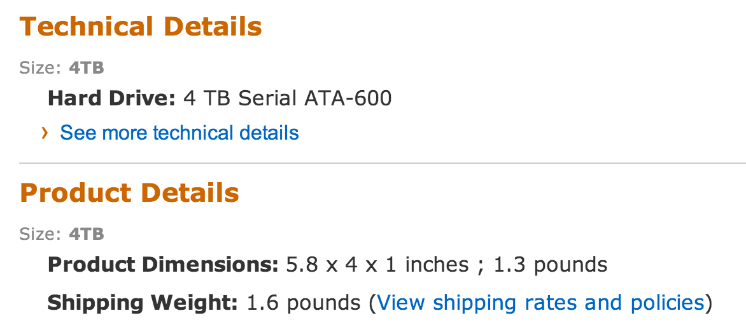

Slide 23
>>> drivevol = 5.8 * 4 * 1
>>> container = 232.5 * 92.5 * 93.9
>>> container / drivevol
87044.69288793104

Slide 24

How big is a TB?

Slide 25
>>> drivevol = 5.8 * 4 * 1
>>> container = 232.5 * 92.5 * 93.9
>>> container / drivevol
87044.69288793104
>>> bpc = _ * 8 * 4 * 1024 * 1024 * 1024 * 1024
>>> bpc
3.0626128629270743e+18

Slide 26
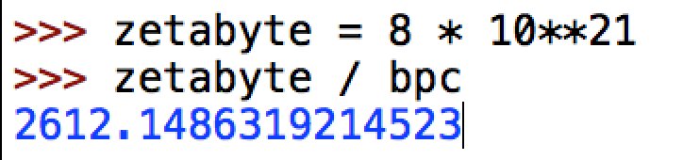
>>> drivevol = 5.8 * 4 * 1
>>> container = 232.5 * 92.5 * 93.9
>>> container / drivevol
87044.69288793104
>>> bpc = _ * 8 * 4 * 1024 * 1024 * 1024 * 1024
>>> bpc
3.0626128629270743e+18

Slide 27
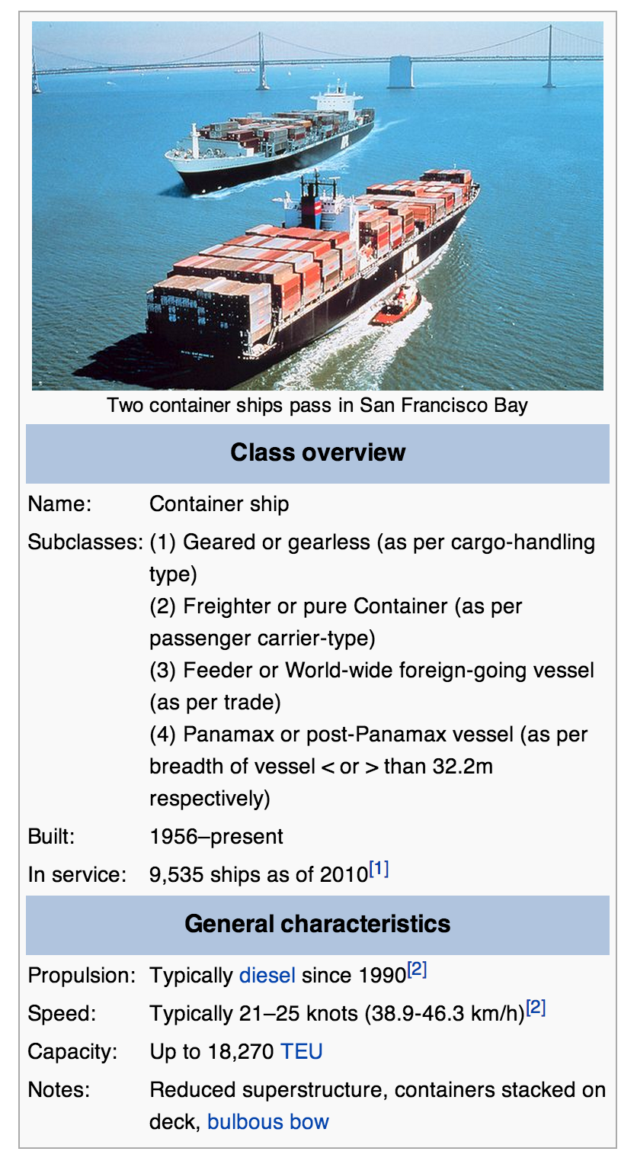
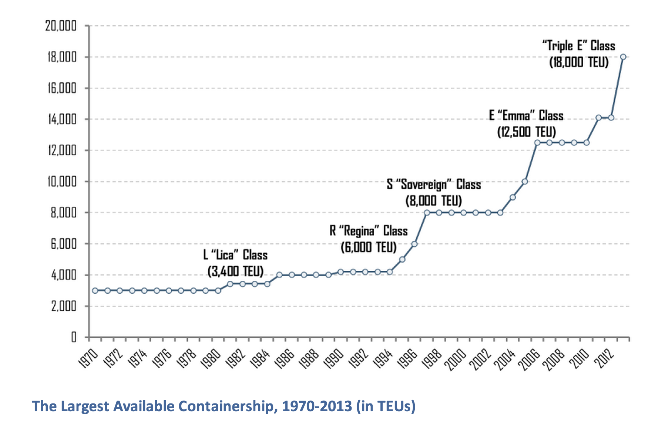

Slide 28
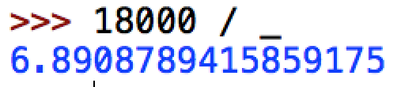
Bandwidth of container ship full of 4TB drives:
6.9 ZB at 40km/h

Slide 29
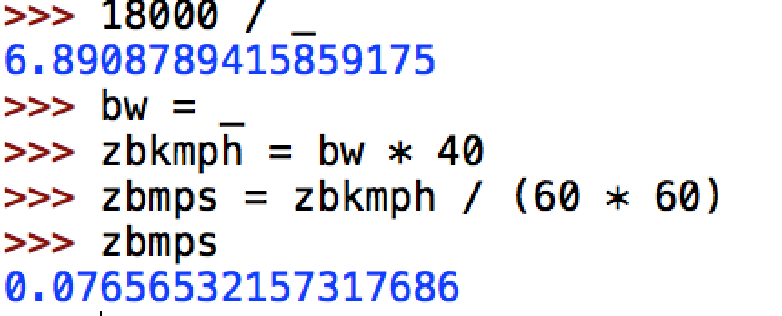
Bandwidth of container ship full of 4TB drives:
6.9 ZB at 40km/h

Slide 30
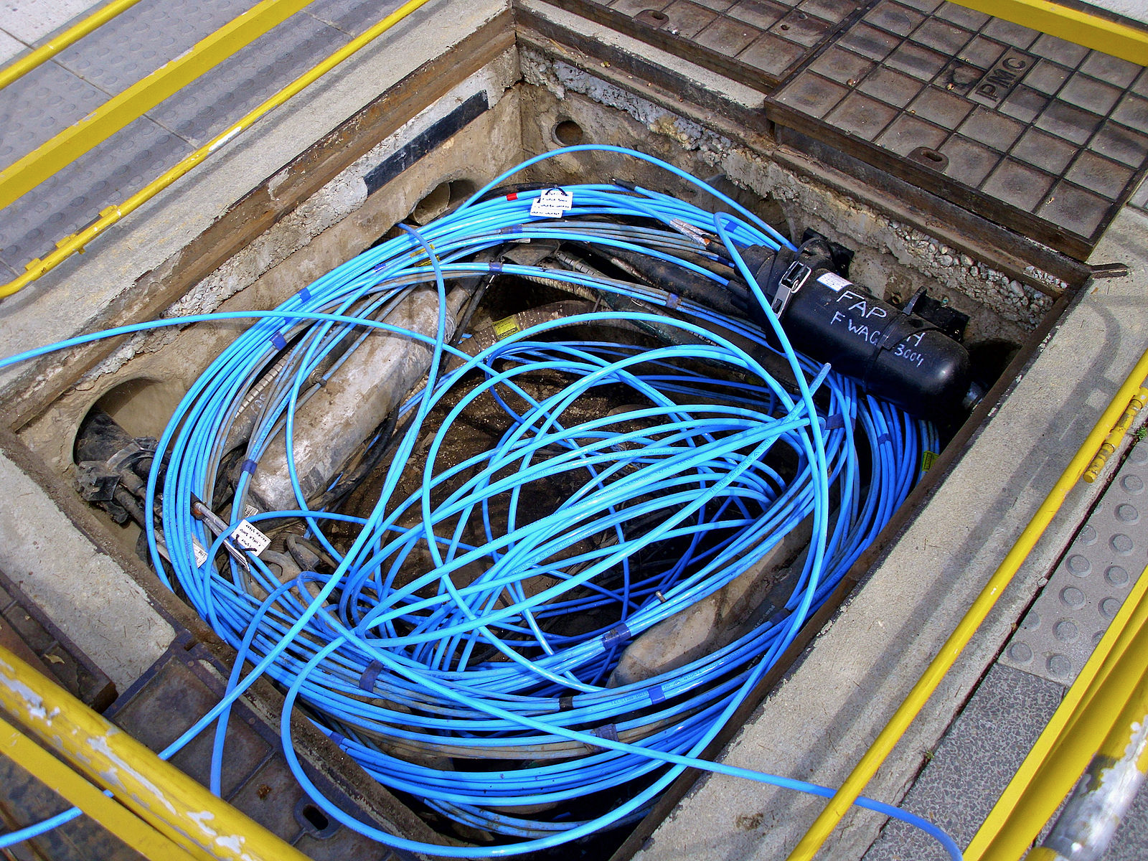
How does this compare to Gbit ethernet?

Slide 31
>>> gb = 1024 * 1024 * 1024
>>> speedoflight = 299792458 # mps
>>> gbmps = gb * speedoflight
>>> gbmps
321899700674363392
>>> ethernet_zbmps = gbmps / (8 * 10**21)
4.023746258429542e-05
>>> ship_zbmps / ethernet_zbmps
1902.8367261672238
Moral: Latency Matters!

Slide 32
Storage Systems
Device | Example | Time to Access | Cost per Bit
Mercury (Gin) Delay Line | UNIVAC (1951) | 220,000ns (average) | $ 0.38 (1968) (a bazillion n$)
DRAM | Kingston KVR16N11/4 4GB DDR3 ($40) | 13.75ns | 1.16 n$
Hard Drive | Seagate Desktop HDD 4 TB SATA 6Gb/s NCQ 64MB | ? | 0.0046 n$

Slide 33
Accessing a Hard Drive
“seek time”
~ 0.1ms
5900 rpm spindle
rotate time:
1/5900rpm ~ max 10ms

Slide 34

Passing the Drop Test

Slide 35
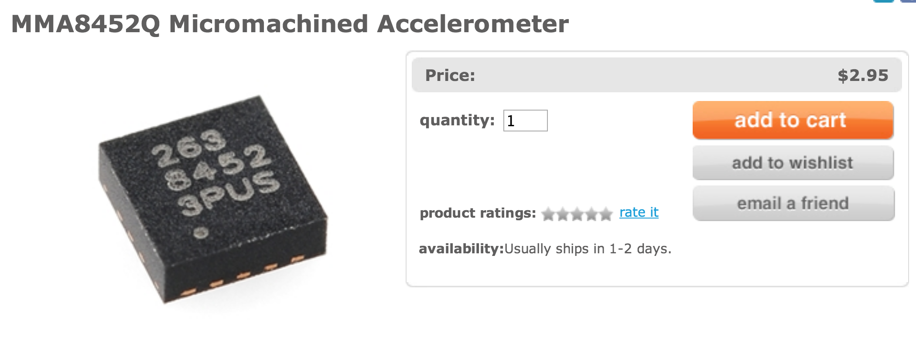
Passing the Drop Test

Slide 36
Storage Systems
Device | Example | Time to Access | Cost per Bit
Mercury (Gin) Delay Line | UNIVAC (1951) | 220,000ns (average) | $ 0.38 (1968) (a bazillion n$)
DRAM | Kingston KVR16N11/4 4GB DDR3 ($40) | 13.75ns | 1.16 n$
Hard Drive | Seagate Desktop HDD 4 TB SATA 6Gb/s NCQ 64MB | 5ms (ave) | 0.0046 n$

Slide 37
Storage Abstractions

Slide 38
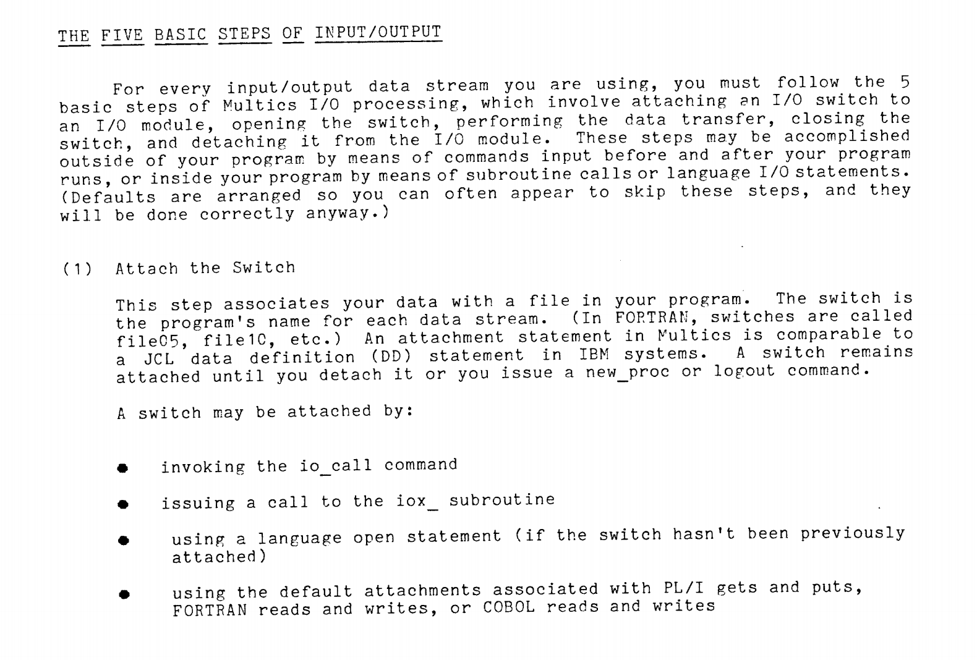

Slide 39
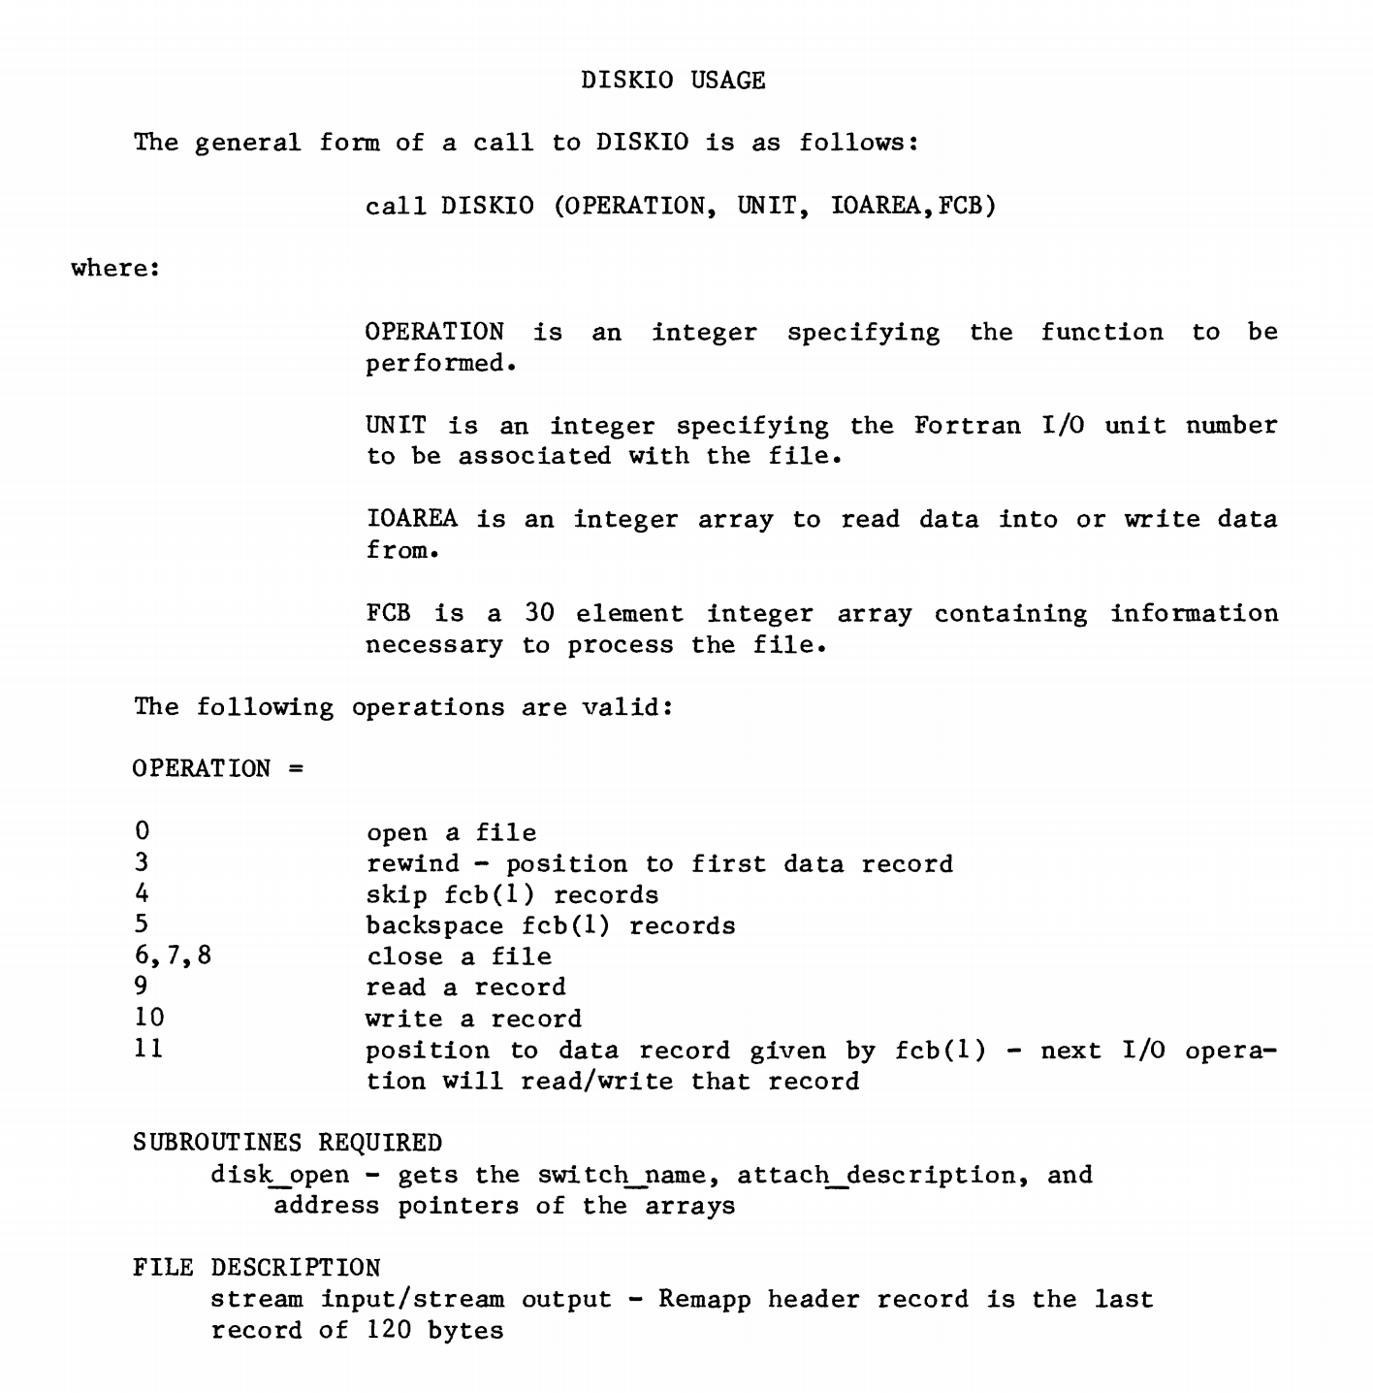
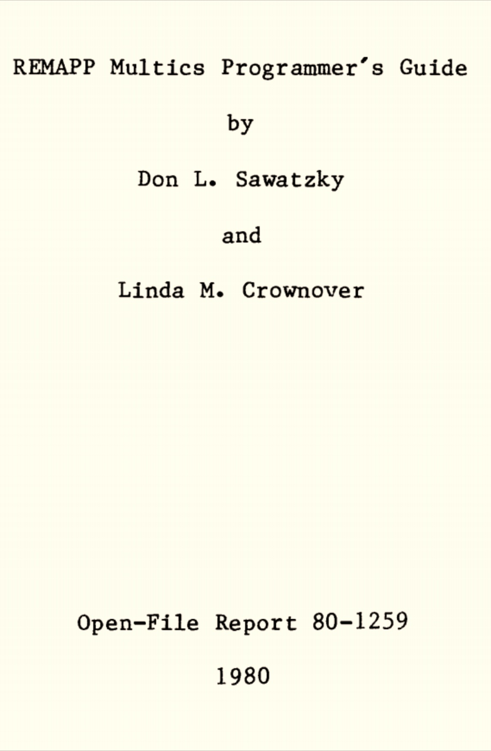

Slide 40
“Modern?” Storage Abstractions
Memory Location
File
Do we really need both?
What about: database, URI?

Slide 41

Unix File Abstraction

Slide 42
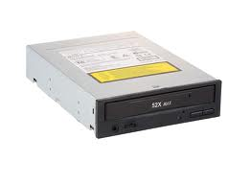

Which are files?
class16.pptx
/Users/dave/OS/classes/
OS-provided random numbers
the list of current interrupts

Slide 43
“Everything is a File”
class16.pptx
/mnt/cdrom
/Users/dave/OS/classes/
OS-provided random numbers
/dev/tty0
/dev/random

Slide 44
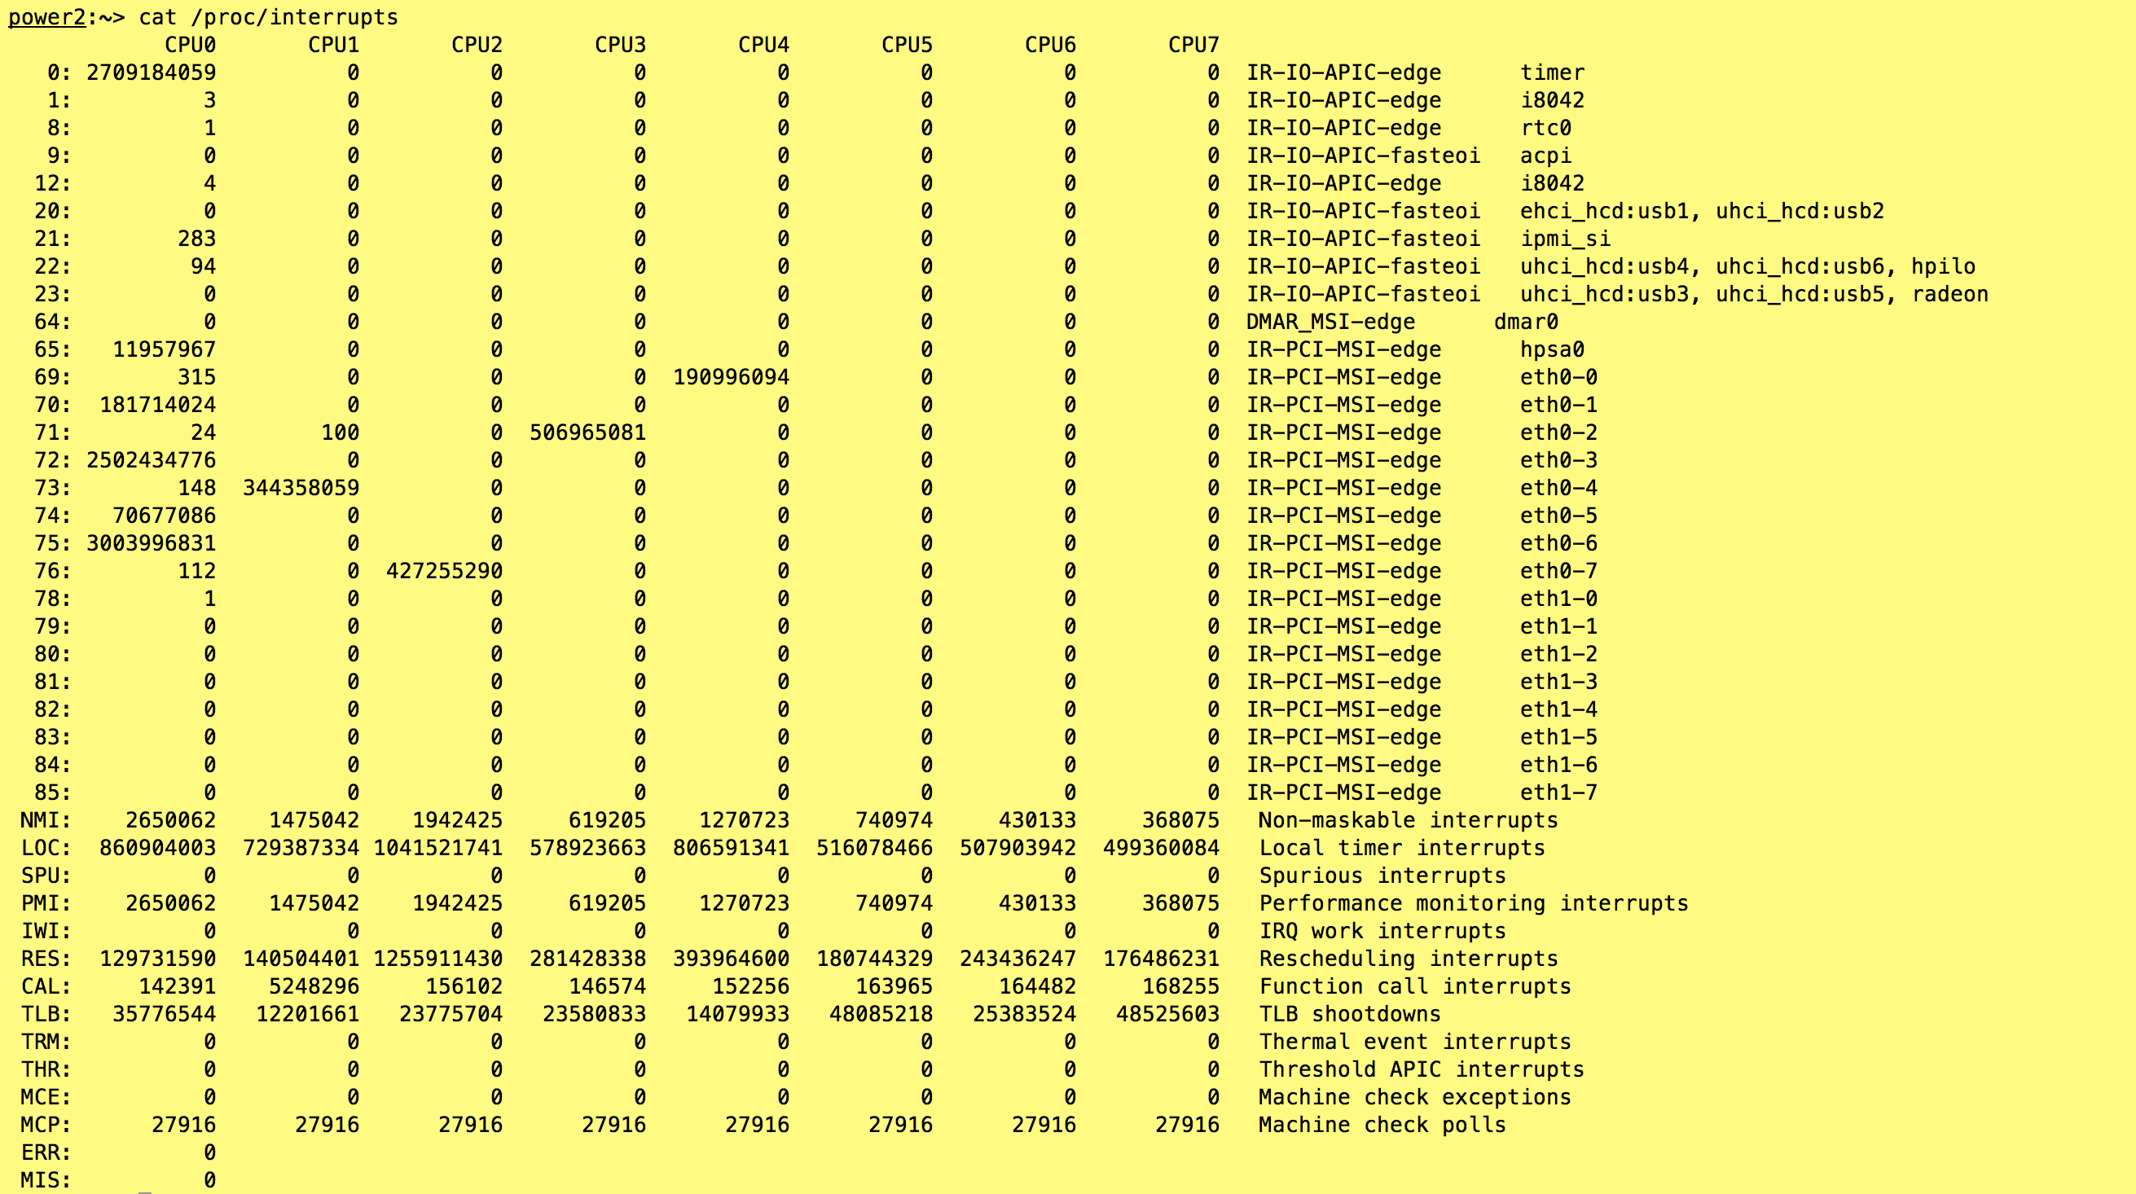
Note: this is on Ubuntu, not Mac OS X

Slide 45
inode represents a file
Size of File (bytes)
Device ID
User ID
Group ID
File Mode (permission bits)
Link count (number of hard links to node)
…
Diskmap

Slide 46
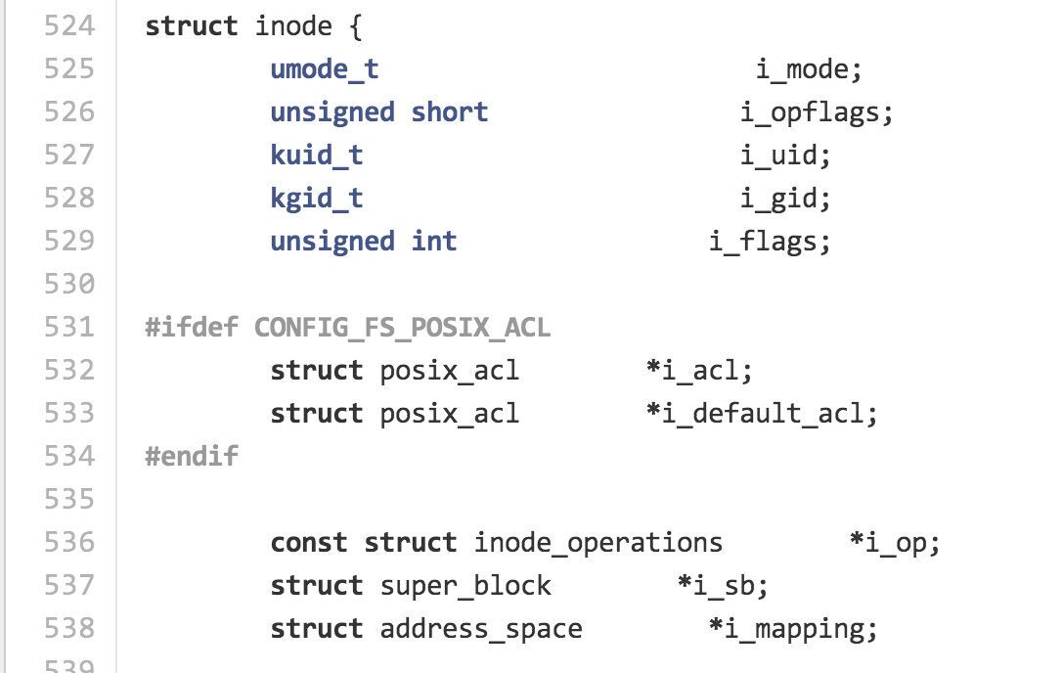
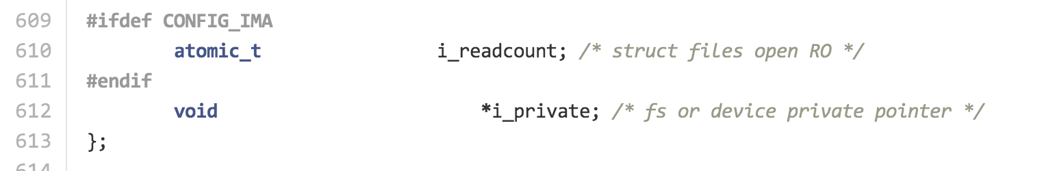
include/linux/fs.h

Slide 47
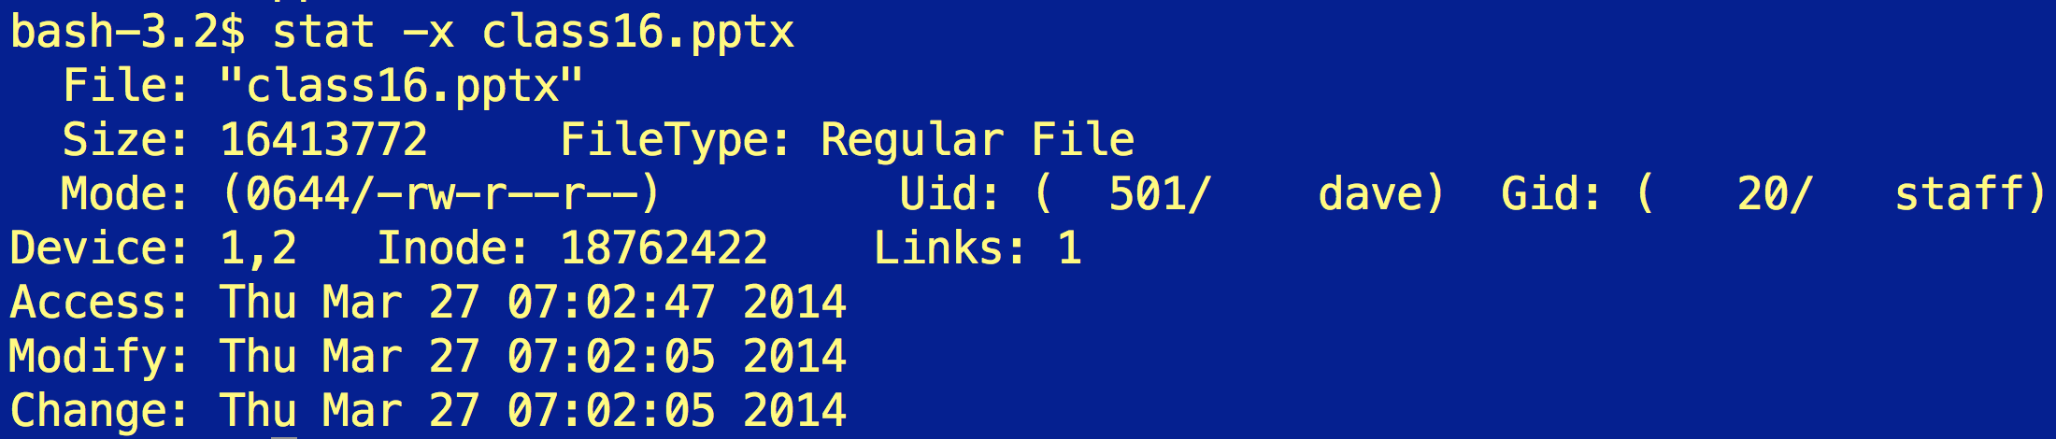
Size of File (bytes)
Device ID
User ID
Group ID
File Mode (permission bits)
Link count (number of hard links to node)
…
Diskmap
stat

Slide 48
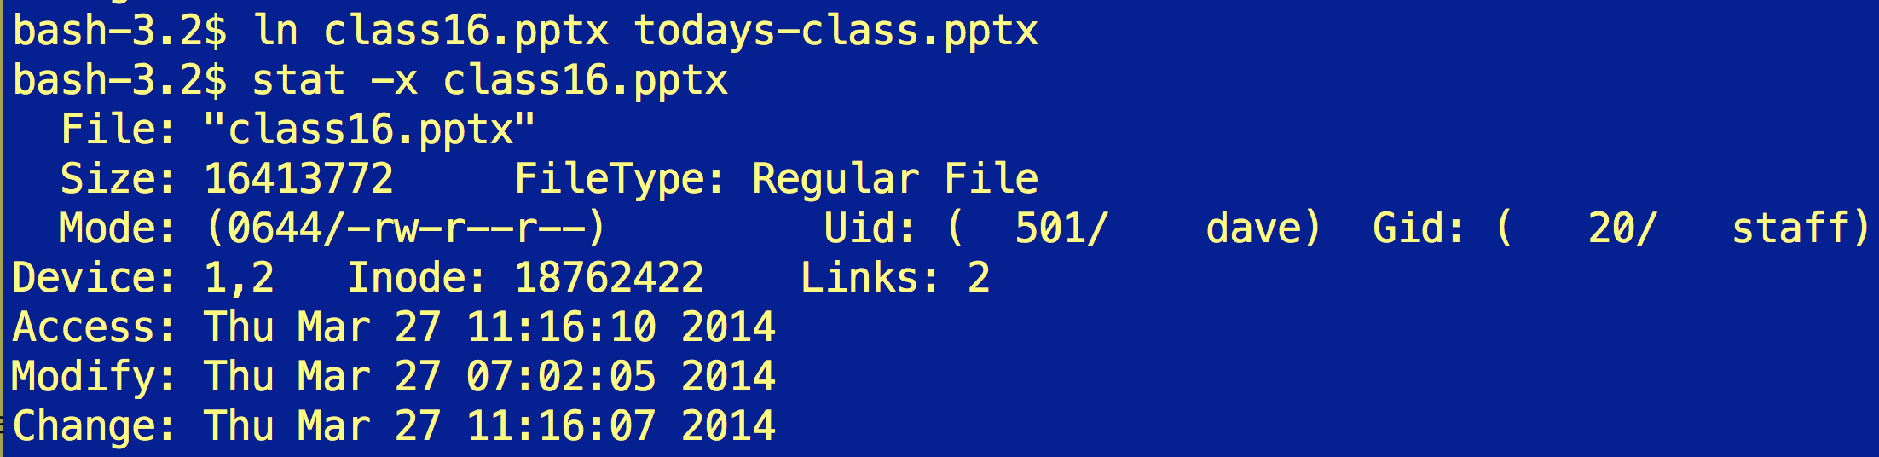

Slide 49
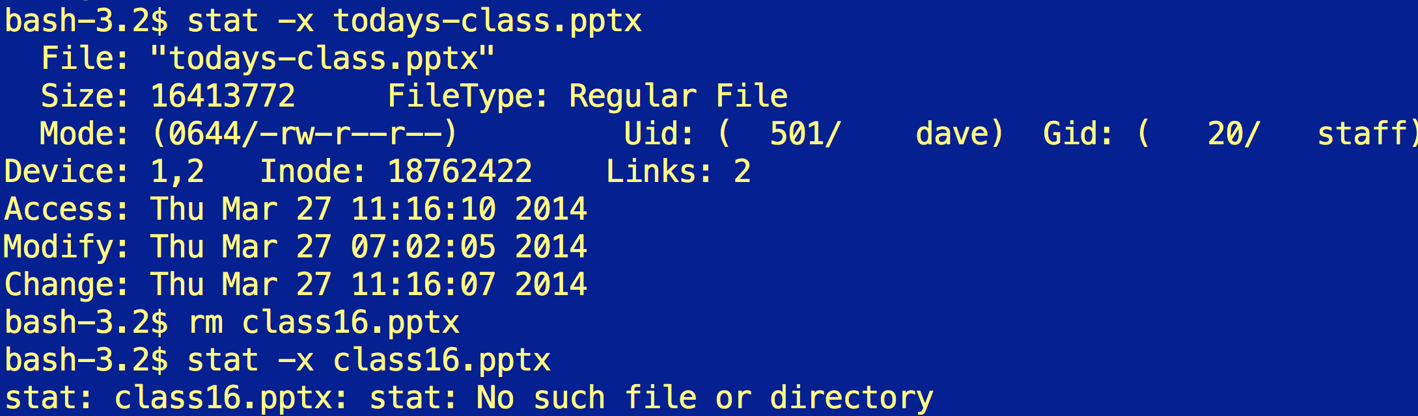

Slide 50
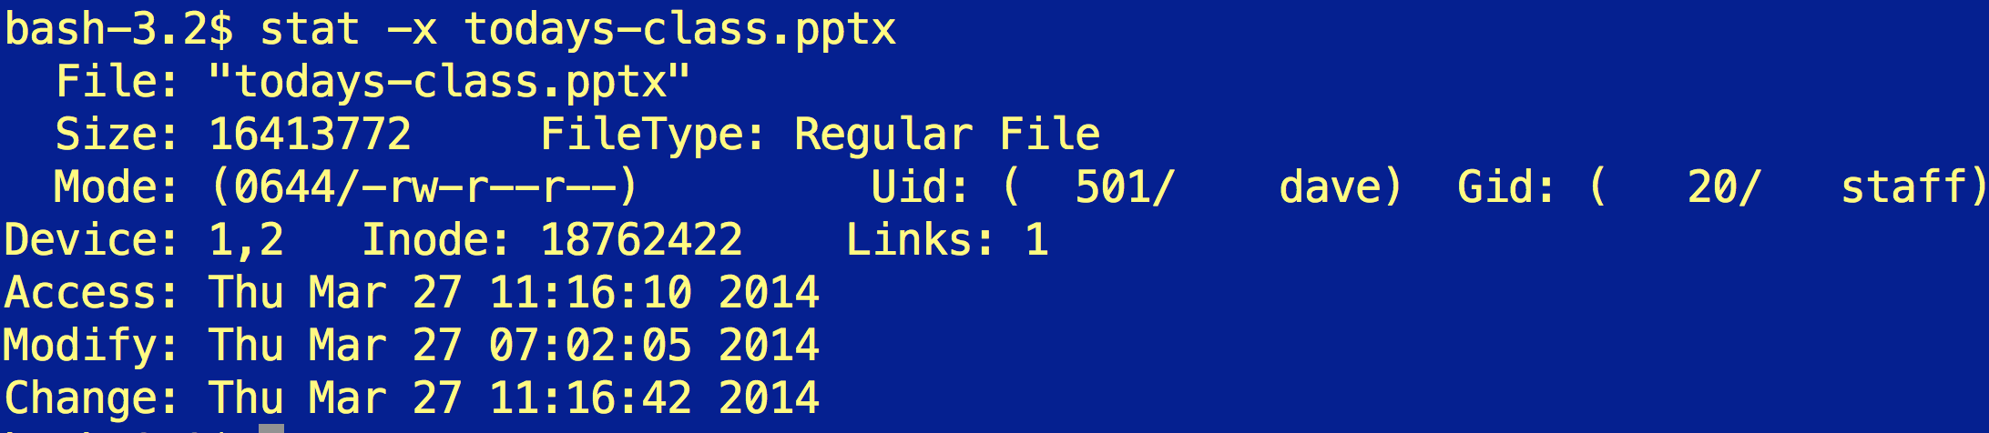

Slide 51
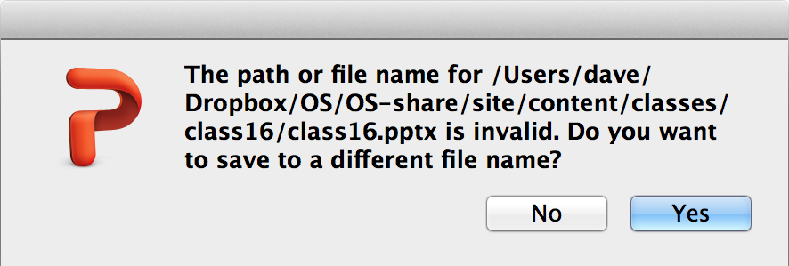
Removing a linked file like this is very confusing for PowerPoint…

Slide 52
Diskmap
(Unix System 5)
Size of File (bytes)
Device ID
User ID
Group ID
File Mode (permission bits)
Link count (number of hard links to node)
…
Diskmap
0
1
2
…
9
10
11
12
Disk Block (1K bytes)
Disk Block (1K bytes)
Disk Block (1K bytes)

Slide 53
Diskmap
(Unix System 5)
Disk Block (1K bytes)
Indirect
Disk Block (1K bytes)
Disk Block (1K bytes)
Disk Block (1K bytes)
0
1
2
…
9
10
11
12
4 bytes for each = 256 pointers
Disk Block (1K bytes)
Disk Block (1K bytes)
Disk Block (1K bytes)

Slide 54
Diskmap
(Unix System 5)
Disk Block (1K bytes)
Indirect
Disk Block (1K bytes)
Disk Block (1K bytes)
Disk Block (1K bytes)
0
1
2
…
9
10
11
12
4 bytes for each = 256 pointers
Indirect
Disk Block (1K bytes)
Double
Indirect
Disk Block
Indirect
Disk Block (1K bytes)
Disk Block (1K bytes)
Disk Block (1K bytes)
Disk Block (1K bytes)

Slide 55
Diskmap
(Unix System 5)
Disk Block (1K bytes)
Indirect
Disk Block (1K bytes)
Disk Block (1K bytes)
Disk Block (1K bytes)
0
1
2
…
9
10
11
12
4 bytes for each = 256 pointers
Indirect
Disk Block (1K bytes)
Double
Indirect
Disk Block
Indirect
Disk Block (1K bytes)
Disk Block (1K bytes)
Disk Block (1K bytes)
Disk Block (1K bytes)
How would you determine if your file system has this structure?

Slide 56
Diskmap
(Unix System 5)
Disk Block (1K bytes)
Indirect
Disk Block (1K bytes)
Disk Block (1K bytes)
Disk Block (1K bytes)
0
1
2
…
9
10
11
12
4 bytes for each = 256 pointers
Indirect
Disk Block (1K bytes)
Double
Indirect
Disk Block
Indirect
Disk Block (1K bytes)
Disk Block (1K bytes)
Disk Block (1K bytes)
Disk Block (1K bytes)
Disk Block (1K bytes)

Slide 57
Directories are Files Too!
Filename | Inode
. | 494211
.. | 494205
.DS_Store | 494212
class0 | 6565946
class1 | 6565826
class10 | 1467012
class11 | 2252968
… | …
class16 | 5649155
class2 | 494218
… | …
ls -ali

Slide 58
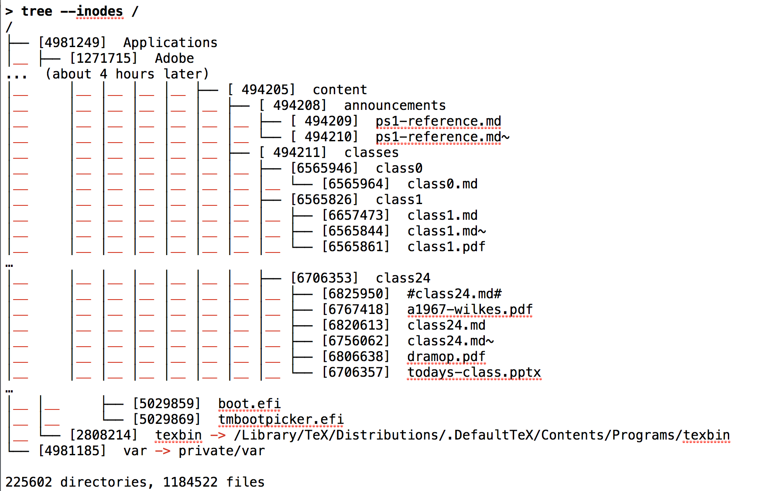
> brew install tree # needed on MacOS X, but builtin to most Unixes
(from last year’s class)

Slide 59
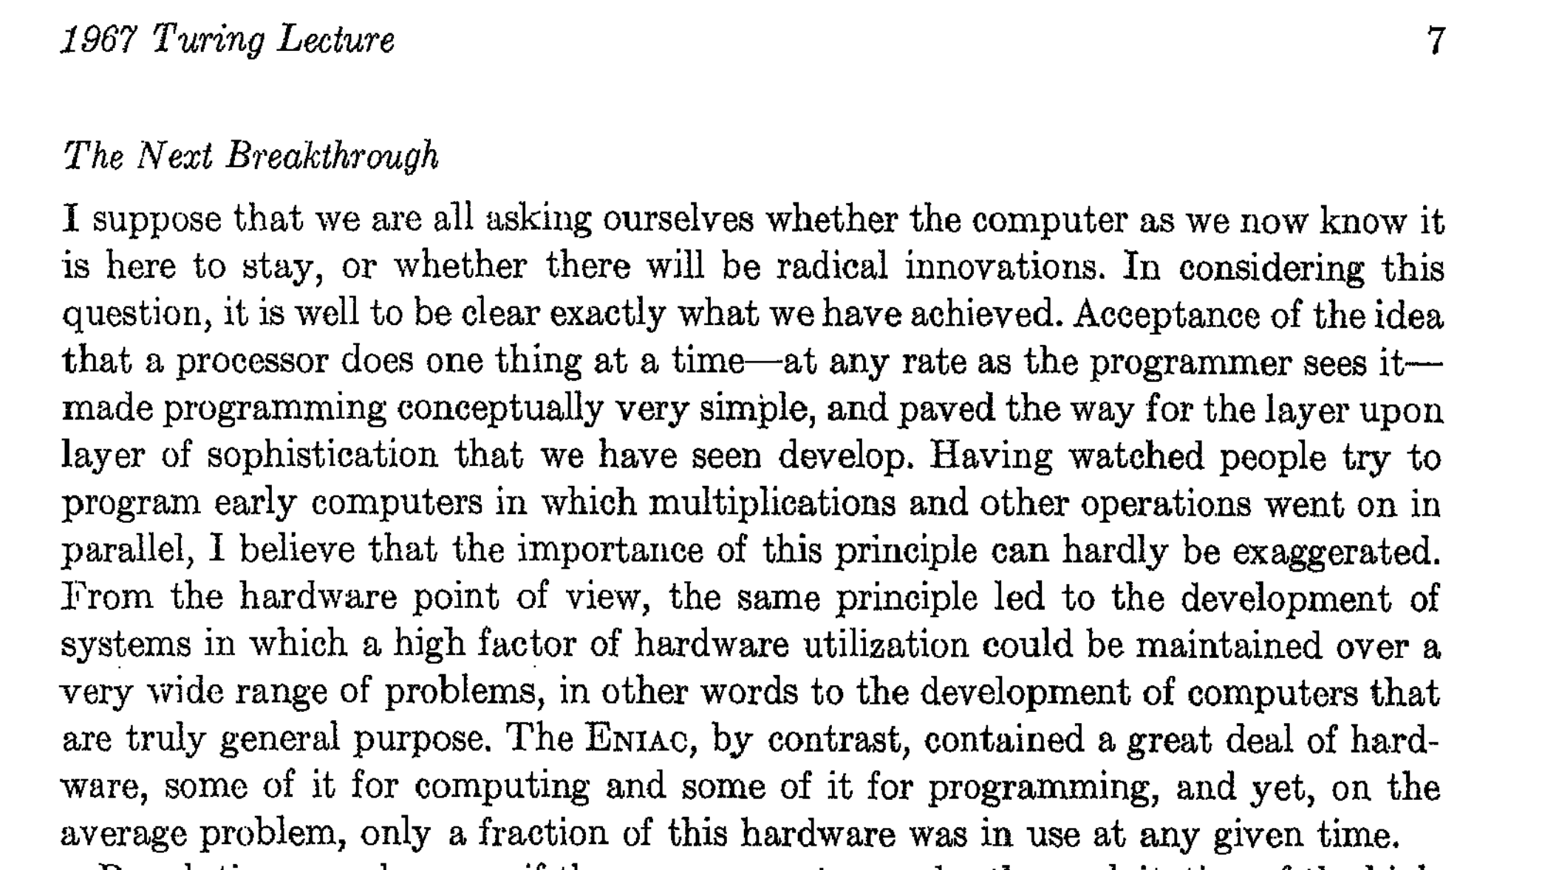
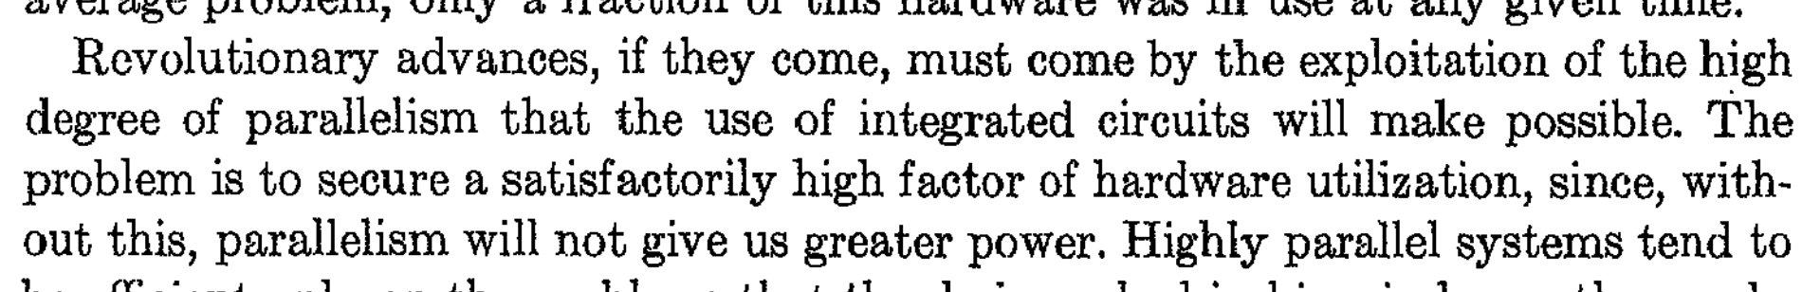
Exam 2: Due at 11:59pm Tonight
We’ll continue with file systems in the next class.
More from Wilkes 1967

