Slide 1
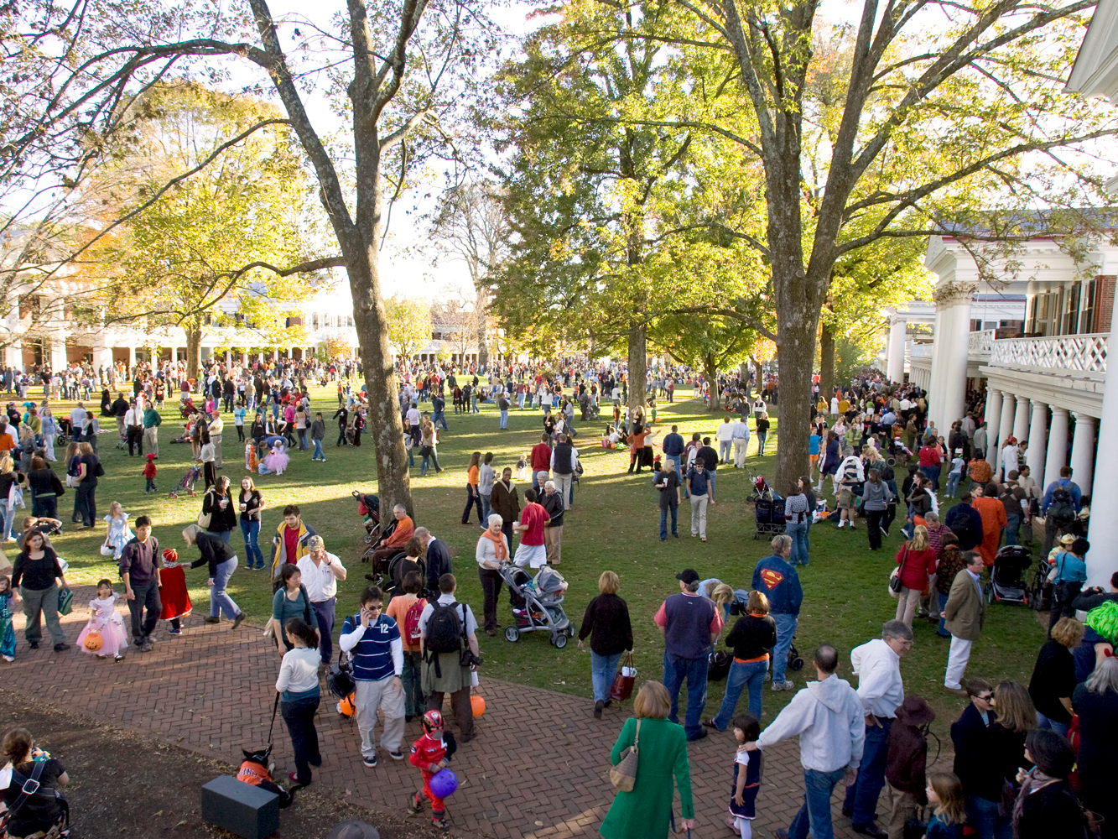
Class 29:
Inheritance
cs1120 Fall 2011
David Evans
31 October 2011
TexPoint fonts used in EMF.
Read the TexPoint manual before you delete this box.: AAAAAAAAA

Slide 2
Menu
Objects in Python
Inheritance
But first…
”Trick-or-Treat” Protocols!

Slide 3

“Trick or Treat”
Protocols

Slide 4
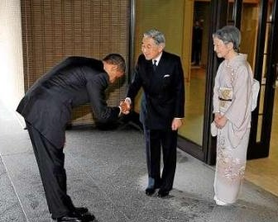
What’s a Protocol?
A protocol is an algorithm that involves two or more parties.

Slide 5
What’s an Algorithm?
An algorithm is a procedure that always finishes, and produces the correct output.
A procedure is a well defined sequence of steps that can be followed mechanically.

Slide 6
“Trick or Treat” Protocols
Two parties:
Tricker: initiates the protocol by demanding tribute
Victim: either pays tribute (usually in the form of sugary snack) or risks trick
Tricker must convince Victim that she poses a credible threat: prove she is a qualified tricker

Slide 7

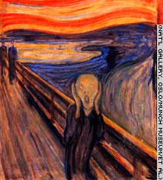

Trick-or-Treat
“Trick or Treat?”
Victim
“Prove it!”
Trickers?
“The magic word is: shazam!”
Any problems with this?

Slide 8

Authentication
How can the tricker prove their trickability, without allowing the victim to now impersonate a tricker?

Slide 9
One-Way Functions
f is a one-way function if it is a function y = f(x) that satisfies these two properties:
Invertible: there exists an f ⁻¹ such that,
for all x in range: f ⁻¹ (f (x)) = x
One-way: it is much, much, much easier to compute f (x) than to compute f ⁻¹ (y)

Slide 10
Example One-Way-ish Function: Factoring
Forward: given p and q are 200-digit prime numbers, output n = pq
Backward: given n, output (p, q)
Forward: (p, q) easy to calculate f (p, q).
Backward: given n = f (p, q): hard to find p and q.
Easy means we know is an algorithm with running time in O(N²) where N is number of digits
Hard means (we hope) the fastest possible procedure has running time in Ω(2^{N}) .

Slide 11
Is Factoring Hard?

Slide 12
Factors from Exam 1 (Solutions)
(define (factors n)
(list-reverse (factors-helper (- n 1) n)))
(define (factors-helper t n)
(if (< t 2) null
(if (is-divisible? n t)
(cons t (factors-helper (- t 1) n))
(factors-helper (- t 1) n))))

Slide 13
Factors
(define (factors n)
(list-reverse (factors-helper (- n 1) n)))
(define (factors-helper t n)
(if (< t 2) null
(if (is-divisible? n t)
(cons t (factors-helper (- t 1) n))
(factors-helper (- t 1) n))))

Slide 14
(define (factors n)
(list-reverse
(factors-helper (- n 1) n)))
(define (factors-helper t n)
(if (< t 2) null
(if (is-divisible? n t)
(cons t
(factors-helper (- t 1) n))
(factors-helper (- t 1) n))))
def factors(n):
res = []
for d in range(2, n):
if n % d == 0:
res.append(d)
return res

Slide 15
(define (factors n)
(list-reverse
(factors-helper (- n 1) n)))
(define (factors-helper t n)
(if (< t 2) null
(if (is-divisible? n t)
(cons t
(factors-helper (- t 1) n))
(factors-helper (- t 1) n))))
def factors(n):
res = []
for d in range(2, n):
if n % d == 0:
res.append(d)
return res
Assuming (aggressively!) that is-divisible? (or %) is constant time, running time is in Θ(V) where V is the value of n.
But, this is in Θ(2^{N}) where N is the size of n.

Slide 16
Does this prove that factoring is hard?

Slide 17
Best Known Factoring Algorithm
General Number Field Sieve: running time is in
where N is the number of bits in input.
Note: unless you have a big quantum computer! Then the running time is in

Slide 18
“Trick or Treat?”
“Prove it by factoring n = 2129024631825875754749788201627151749780670396327721627823338321538194 9984056495911366573853021918316783107387995317230889569230873441936471” ”
3398717423028438554530123627613875835633986495969597423490929302771479
* 6264200187401285096151654948264442219302037178623509019111660653946049
Checks the factors
multiple to produce n
Problems with this?

Slide 19
Tricker Needs to Solve
Trap-Door One-Way Function:
One-way function that can be quickly inverted, but only if you have a secret!

Slide 20
RSA Encryption System
E(M) = Me mod n
D(C) = C^{d} mod n
n = pq p, q are prime
d is relatively prime to (p – 1)(q – 1)
ed ≡ 1 (mod (p – 1)(q – 1))
d is the trap-door secret:
if you have it, you can invert Me mod n

Slide 21
“Trick or Treat?”
“Prove it by producing D(x)”
D(x) = C^{d} mod n
Checks that
D(x)^{e} mod n = x
How does victim know e and n?

Slide 22
“Trick or Treat?”
“What is your Ticker ID No?”
“tricker@virginia.edu”
Help me verify
“tricker@virginia.edu”
Trickers
Bureau
e_{T@V}, n_{T@V}
Challenge: x
D(x) = C^{dT@V} mod n_{T@V}
Checks that
^{D(x)eT@V} mod n_{T@V} = x
How does victim know e and n?

Slide 23
Except on Halloween, this is called a
public-key challenge-response
authentication protocol.

Slide 24
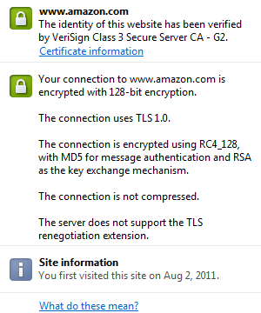

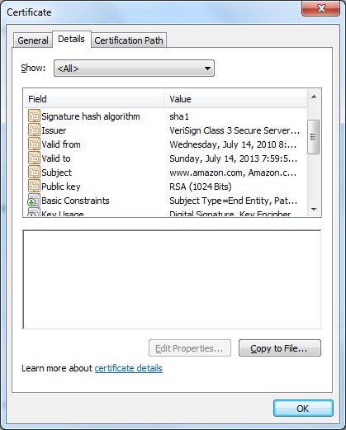
On the web, it is called “TLS” or “SSL” and the “Tricker’s Bureau” is called a “Certificate Authority”.

Slide 25
Do One-Way Functions Exist?
This is the most important open question in Computer Science (and Mathematics)!
Same question as:
Are they problems where it is hard to find a solution, but easy to check it?
Can a computer that can always guess right between two choices better than one that can’t?
Is the class of problems that a Turing Machine can solve in polynomial time (O(n^{k})) smaller than the class of problems an always-guessing-right TM can solve in polynomial time? (P = NP)

Slide 26
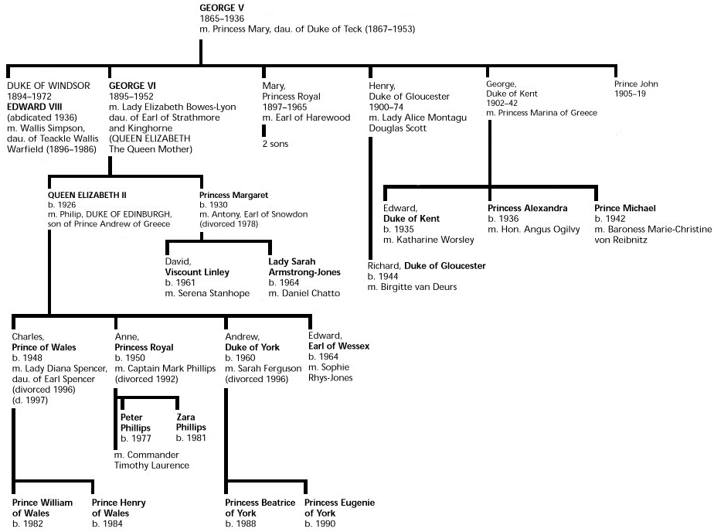
Inheritance

Slide 27
Making a Dog
class Dog:
def bark(self):
print "wuff wuff wuff wuff"
spot = Dog()

Slide 28

There are many kinds of Dogs…
class Dog:
def __init__(self, n):
self.name = n
def bark(self):
print “wuff wuff wuff wuff”
class TalkingDog (Dog):
def speak(self, stuff):
print stuff

Slide 29
Subclasses
ClassDefinition ::= class SubClassName ( SuperClassName ) :
FunctionDefinitions
class TalkingDog (Dog):
def speak(self, stuff):
print stuff
TalkingDog is a subclass of Dog.
Dog is the superclass of TalkingDog.

Slide 30
Every Dog has its Day
class Dog:
def __init__(self, n):
self.name = n
def bark(self):
print “wuff wuff wuff wuff”
>>> bo = Dog('Bo')
>>> scooby = TalkingDog('Scooby Doo')
>>> scooby.speak('Ta-da!')
Ta-da!
>>> bo.speak('Ta-da!')
Traceback (most recent call last):
File "<pyshell#11>", line 1, in <module>
bo.speak('Ta-da!')
AttributeError: Dog instance has no attribute 'speak‘
>>> scooby.bark()
wuff wuff wuff wuff
class TalkingDog (Dog):
def speak(self, stuff):
print stuff

Slide 31
Speaking about Inheritance
  Inheritance is using the definition of one class to define another class.
  TalkingDog inherits from Dog.
  TalkingDog is a subclass of Dog.
  The superclass of TalkingDog is Dog.
Dog
TalkingDog
These all mean the same thing.

Slide 32
PS6
Make an adventure game programming with objects:
Many objects in our game have similar properties and behaviors, so we use inheritance to reuse implementations.

Slide 33
PS6 Classes
SimObject
PhysicalObject
Place
MobileObject
OwnableObject
Person
Student
PoliceOfficer

Slide 34
class SimObject:
def __init__(self, name):
self.name = name
def note(self, msg):
print "%s: %s" % (self, msg)
SimObject
PhysicalObject
Place
class PhysicalObject (SimObject):
def __init__(self, name):
SimObject.__init__(self, name)
self.location = None
def install(self, loc):
self.note ("Installing at " + str(loc))
self.location = loc
loc.add_thing(self)
MobileObject
OwnableObject
Person
class MobileObject (PhysicalObject):
def change_location(self, loc):
self.location.remove_thing(self)
loc.add_thing(self)
self.location = loc
Student
PoliceOfficer

Slide 35
SimObject
class MobileObject (PhysicalObject):
def change_location(self, loc):
self.location.remove_thing(self)
loc.add_thing(self)
self.location = loc
PhysicalObject
Place
MobileObject
OwnableObject
Person
class OwnableObject (MobileObject):
def __init__(self, name):
MobileObject.__init__(self, name)
self.owner = None
def is_ownable(self): return True
Student
PoliceOfficer

Slide 36
PS6 Objects
SimObject
PhysicalObject
Place
MobileObject
Place(‘Noodles Hall’)
An object that is an instance of the Place class.
OwnableObject
Person
Student
PoliceOfficer
aph = Student(‘Alyssa P. Hacker’)

Slide 37
Does the “real world” have inheritance hierarchies like this, or only the fake world of Charlottansville?

Slide 38
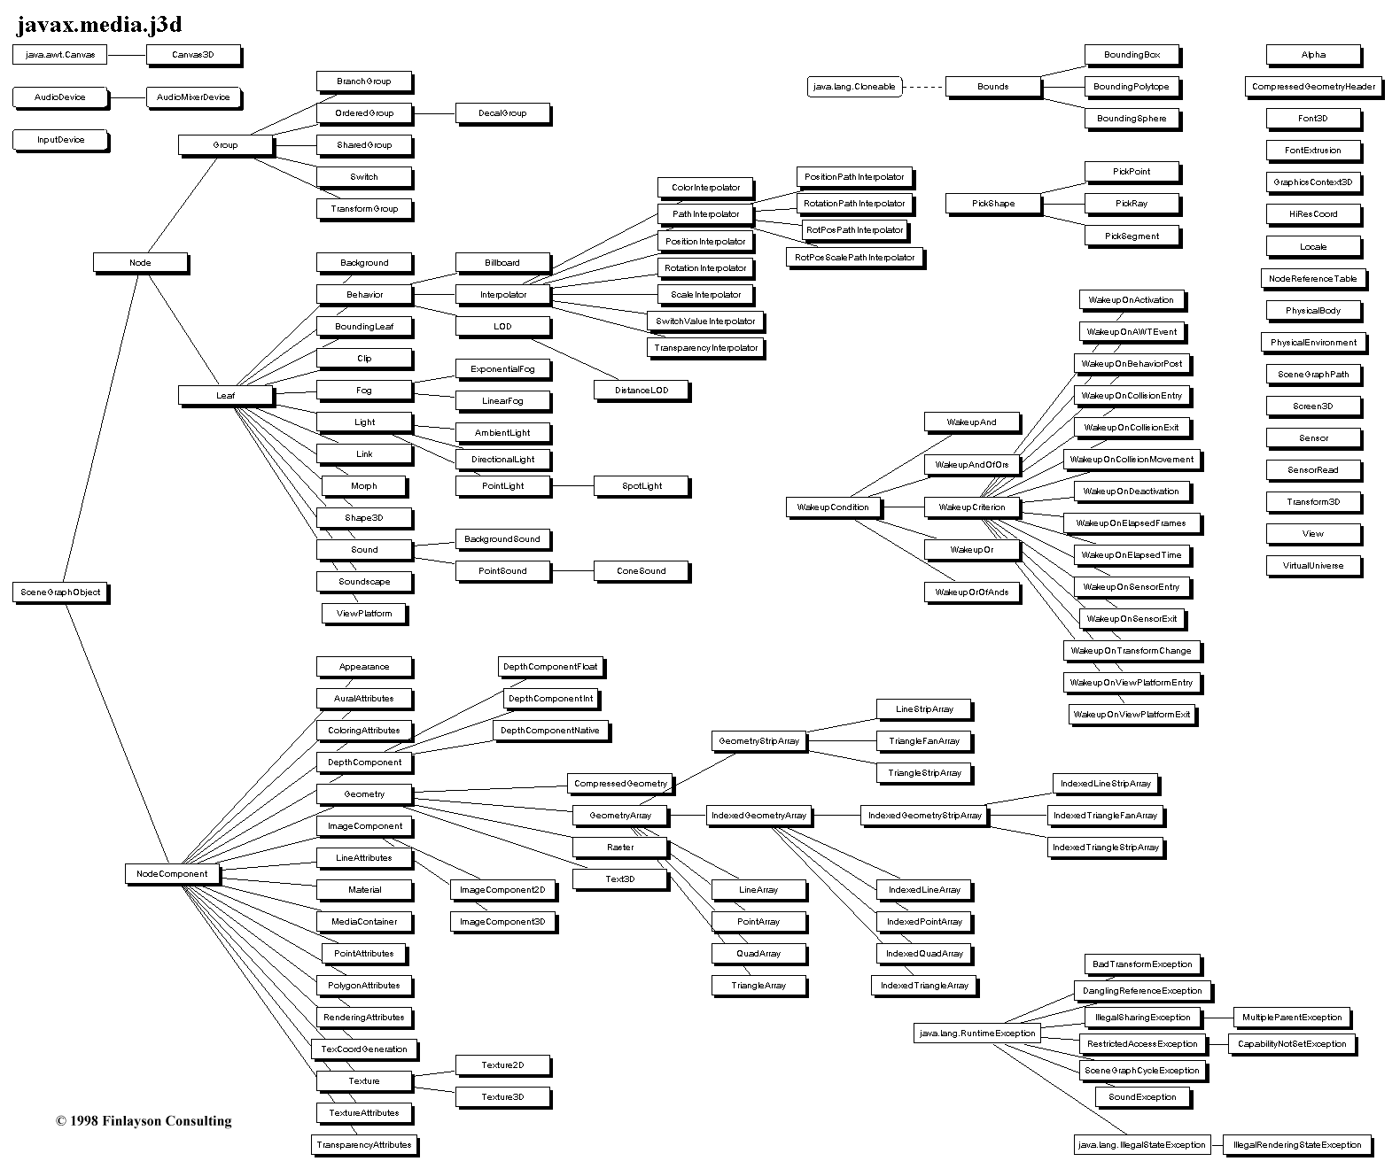
PathInterpolator
RotationPathInterpolator
Interpolator
Node
Selector
Leaf
SceneGraphObject
Not at all uncommon to have
class hierarchies like this!
Java 3D Class Hierarchy Diagram
http://java.sun.com/products/java-media/3D/collateral/j3dclass.html

Slide 39
Summary
Try not to make any kids cry by asking them to factor large numbers!
An object packages state and procedures.
A class provides procedures for making and manipulating a type of object.
The procedures for manipulating objects are called methods. We invoke a method on an object.
Inheritance allows one class to refine and reuse the behavior of another.
Wednesday: Excursion on Exponential Growth
  Please ready Tyson essay before class Wednesday!

