Slide 1
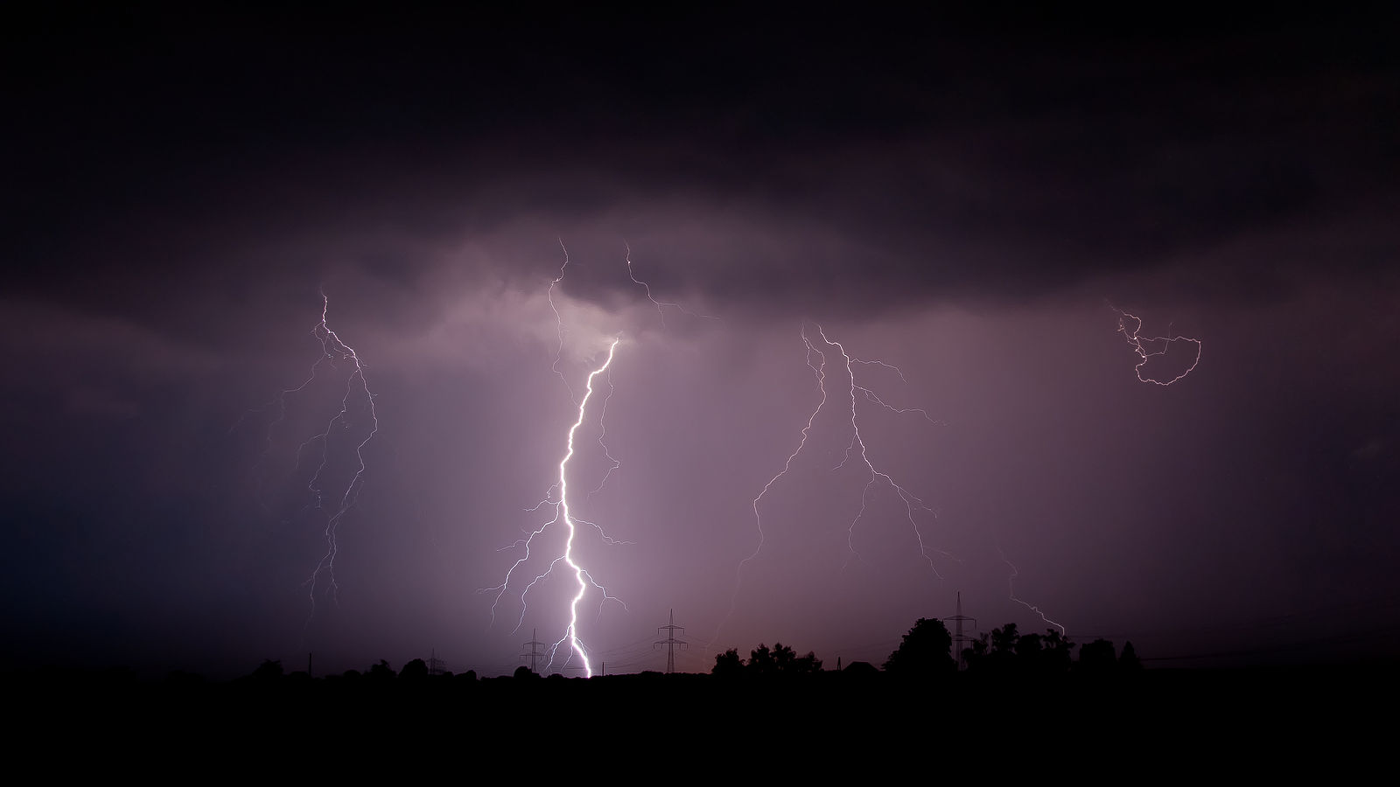
Class 17:
Flash!
cs4414 Spring 2014
University of Virginia
David Evans
Image: Mathias Krumbholz (wikipedia commons)

Slide 2
Plan for Today
Recap: Unix System 5 File System
Creating a File
Better File Systems: ZFS, RAID
Flash Memory
PS4 is due 11:59pm Sunday, 6 April

Slide 3
Diskmap
(Unix System 5)
Disk Block (1K bytes)
Indirect
Disk Block (1K bytes)
Disk Block (1K bytes)
Disk Block (1K bytes)
0
1
2
…
9
10
11
12
4 bytes for each = 256 pointers
Indirect
Disk Block (1K bytes)
Double
Indirect
Disk Block
Indirect
Disk Block (1K bytes)
Disk Block (1K bytes)
Disk Block (1K bytes)
Disk Block (1K bytes)
Disk Block (1K bytes)

Slide 4
Directories are Files Too!
Filename | Inode
. | 494211
.. | 494205
.DS_Store | 494212
class0 | 6565946
class1 | 6565826
class10 | 1467012
class11 | 2252968
… | …
class16 | 5649155
class2 | 494218
… | …
ls -ali

Slide 5
How do you create a new file?

Slide 6
Finding a Free Block
Data
I-List (inodes)
Superblock
Boot block
0
1
…
98
99
0
1
…
98
99
List of free disk blocks
Not to scale!

Slide 7
Finding a Free inode
Data
I-List (inodes)
Superblock
Boot block
0 | 0
1 | 1
2 | 0
3 | 0
… | …
Superblock keeps a cache of free inodes
Not to scale!

Slide 8
Finding a Free inode
Data
I-List (inodes)
Superblock
Boot block
Lots more to do!
Need to select disk blocks, update directory, etc. Read the OSTEP chapter.
0 | 0
1 | 1
2 | 0
3 | 0
… | …
Superblock keeps a cache of free inodes
Not to scale!

Slide 9
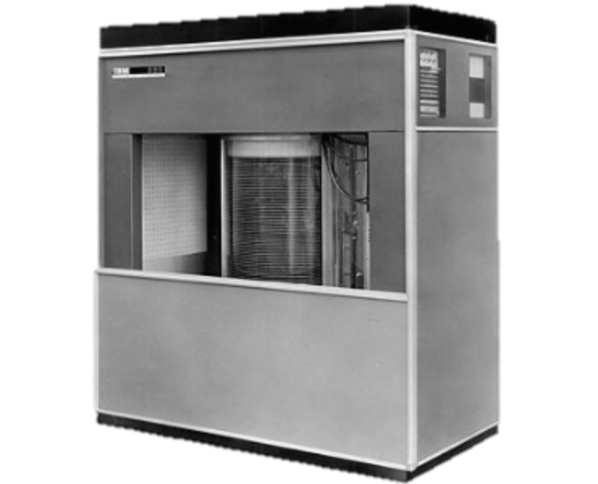
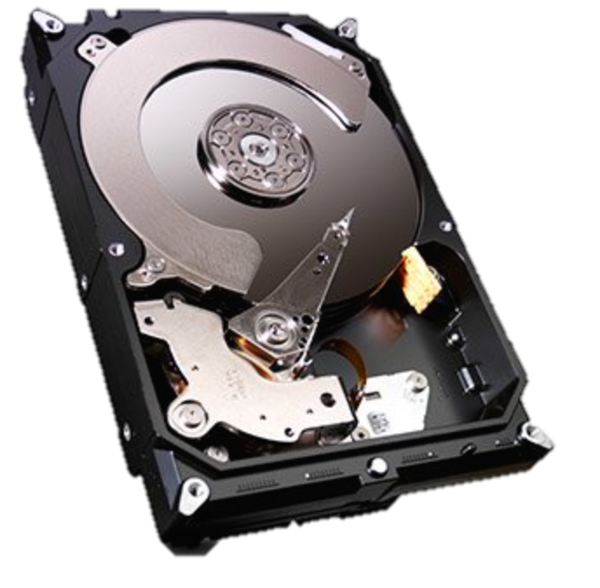
Modern File Systems
IBM 350 Disk Storage (1956)
118,000 in³, 5MB, 600ms seek
Seagate HDD (2013)
23 in³, 4TB (4M MB), 5ms seek

Slide 10
What should a modern file system do that Unix S5FS doesn’t?

Slide 12

ZFS
Developed for Solaris, 2005
Now open source:
http://open-zfs.org/

Slide 13
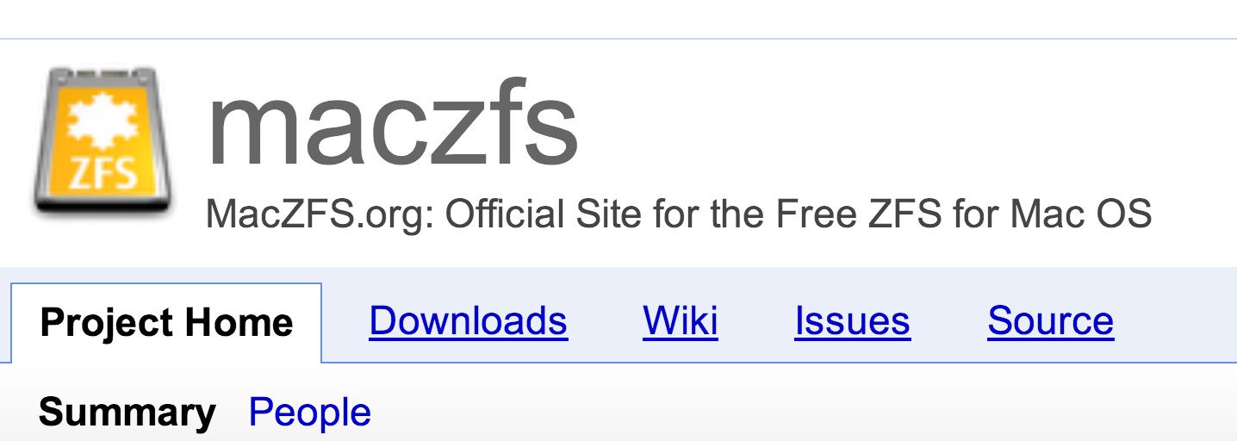
“MacZFS is free data storage and protection software for all Mac OS users. It’s for people who have Mac OS, who have any data, and who really like their data. Whether on a single-drive laptop or on a massive server, it’ll store your petabytes with ragingly redundant RAID reliability, and it’ll keep the bit-rotted bleeps and bloops out of your iTunes library.”

Slide 14
Handling Failures

Slide 15
Block Checksums
Block | Checksum (SHA-256)
0 | 40a3dc…
1 | 2c5829d…
2 | 955d253…
… | …
0
1
2
…
9
10
11
12
Disk Block (1K bytes)
ZFS
How do you check the checksums?
S5FS

Slide 16
Hashing the Hashes
Hash(B1)
Hash(B2)
Hash(B3)
Hash(B4)
Block 1
Block 2
Block 3
Block 4

Slide 17

Merkle Tree
Ralph Merkle
Hash(B1)
Hash(B2)
Hash(B3)
Hash(B4)
Block 1
Block 2
Block 3
Block 4

Slide 18
Recovery
Copy 1
One Copy
Copy 2
Keep 2 copies of every block: if checksum fails for first copy read, try reading second copy.
copies = 2

Slide 19
Copy 1
For the truly paranoid…
One Copy
Copy 2
Copy 3
copies = 3

Slide 20
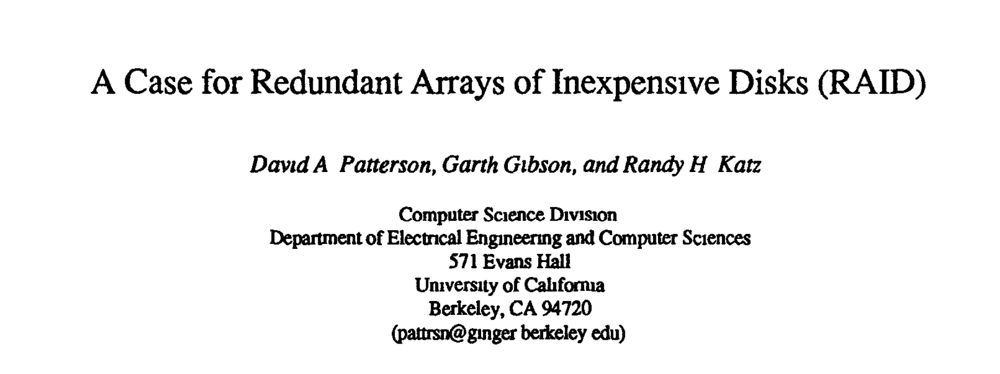


RAID
Redundant Arrays of Inexpensive Disks
For the fairly paranoid but cheap…
ACM SIGMOD 1988
whitehouse.gov

Slide 21
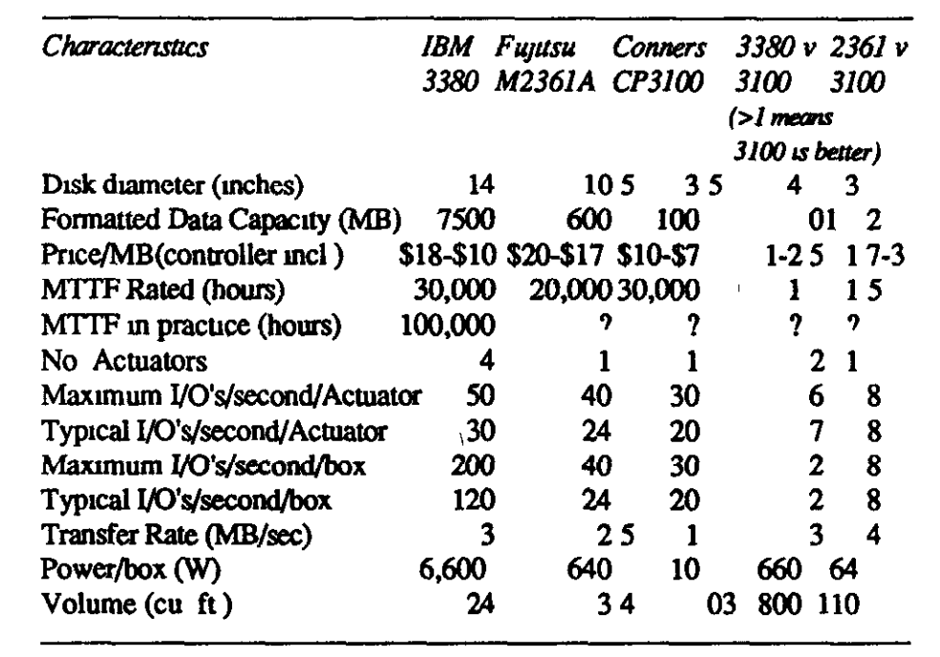
Case for RAID

Slide 22
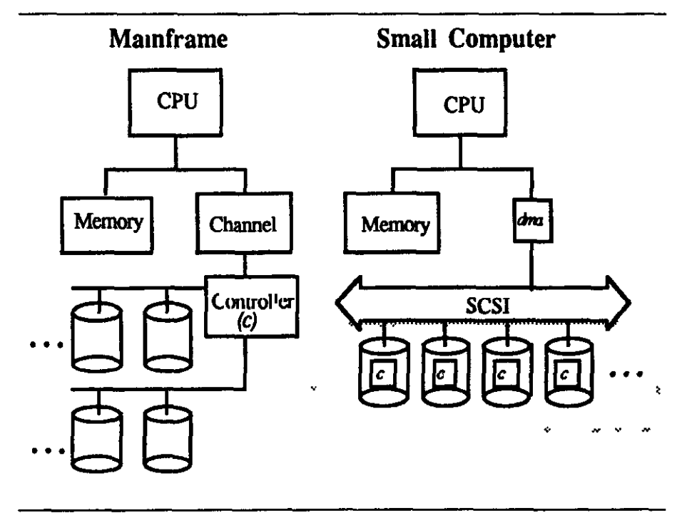

Slide 23
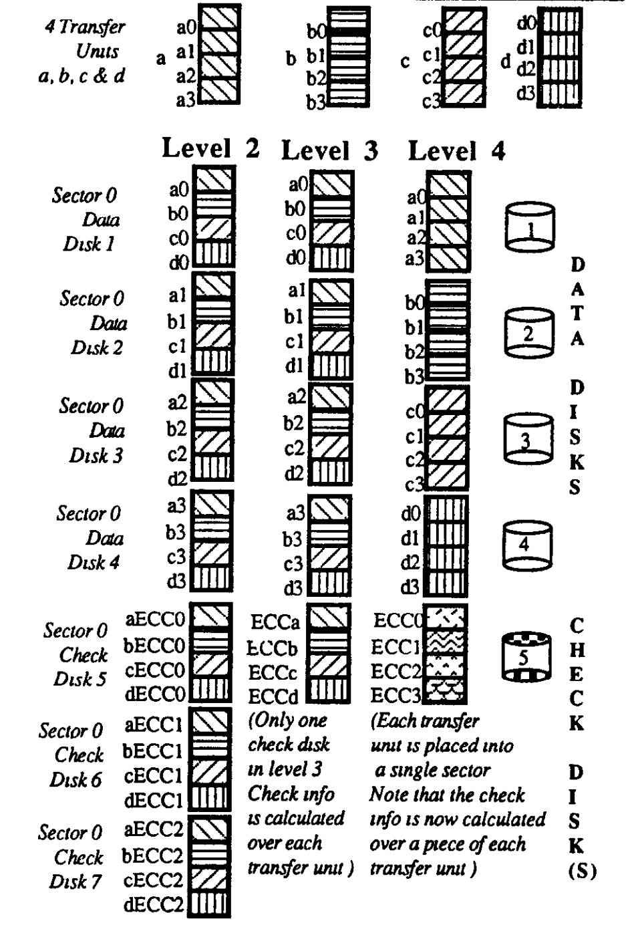
Redundancy

Slide 24
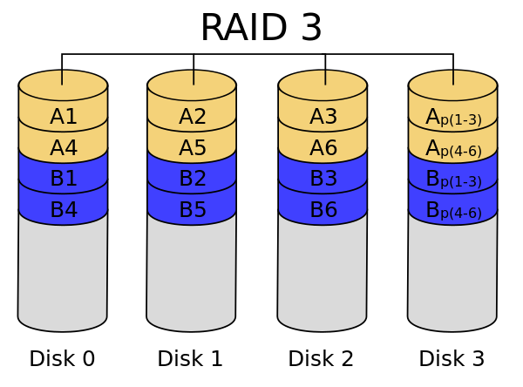

Slide 25
Improving Performance
Cache (64MB DRAM)
Adaptive Replacement Cache

Slide 26
Adaptive Replacement Cache
Accessed Again
Blocks in Cache
T1: Recent Cache Entries
T2: Frequently-Used Blocks
Size of T1 adapts
“Ghost” Entries
B1: Evicted from T1 (LRU)
B2: Evicted from T2 (LRU)
How should relative size of T1 and T2 be adjusted?

Slide 27
Adaptive Replacement Cache
Accessed Again
Blocks in Cache
T1: Recent Cache Entries
T2: Frequently-Used Blocks
Size of T1 adapts
“Ghost” Entries
B1: Evicted from T1 (LRU)
B2: Evicted from T2 (LRU)
Hit in B1: should increase size of T1, drop entry from T2 to B2
Hit in B2: should increase size of T2, drop entry from T1 to B1

Slide 28
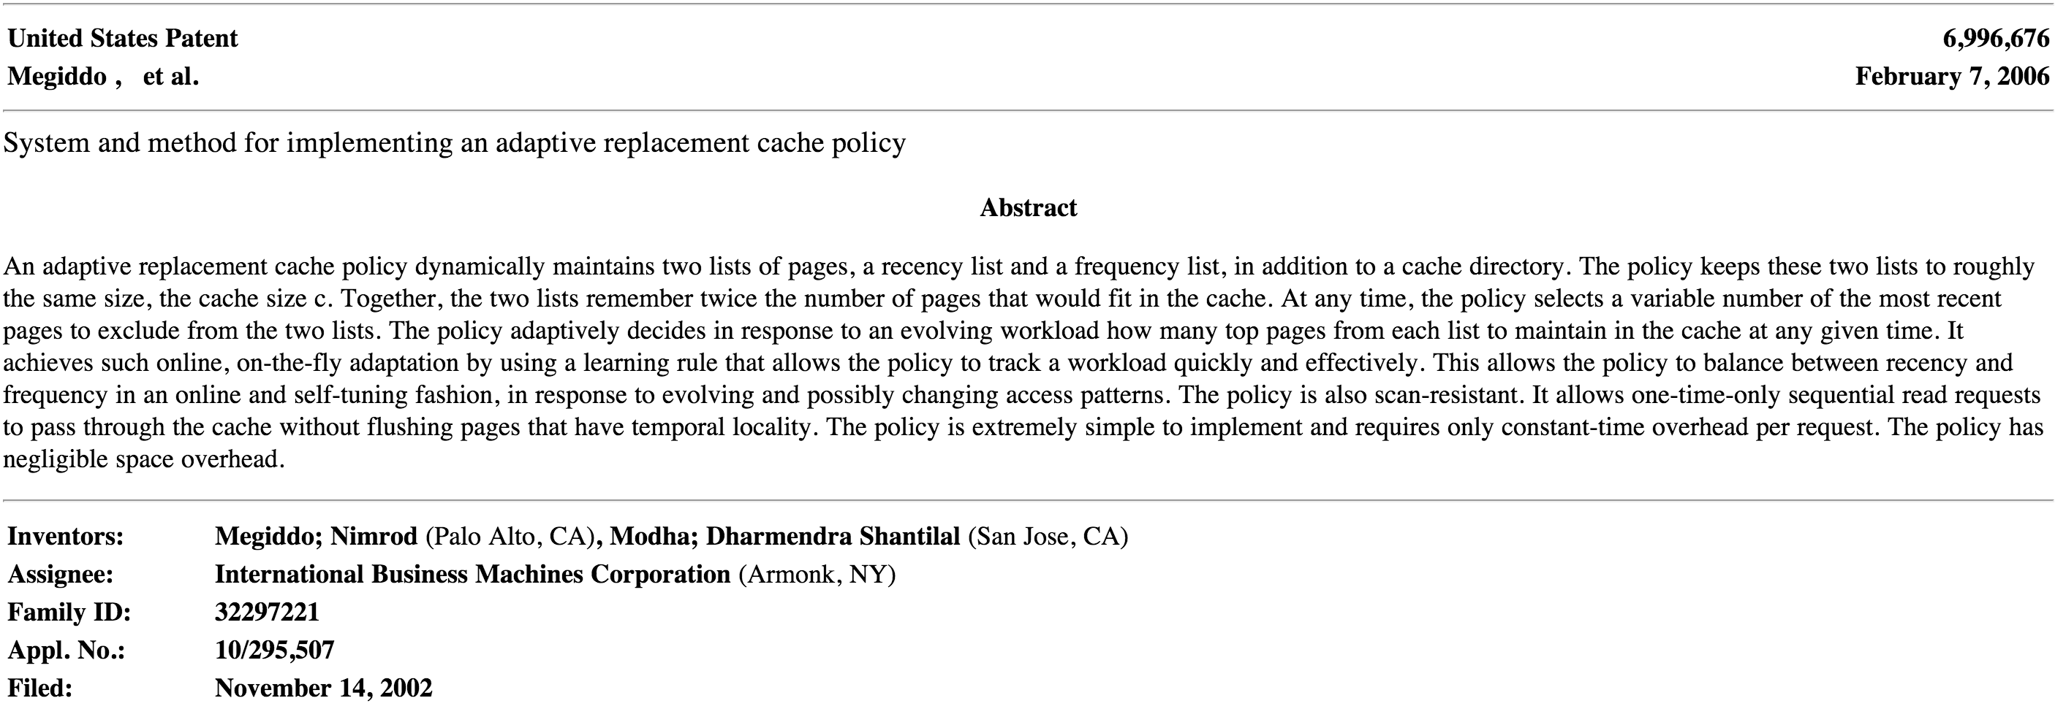
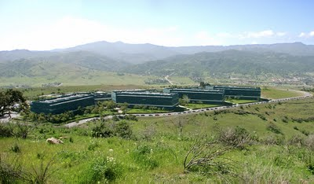
IBM Almaden Research Center

Slide 29
Do you actually have a disk like this on your EC2 node/main computing device?
Cache (64MB DRAM)

Slide 30
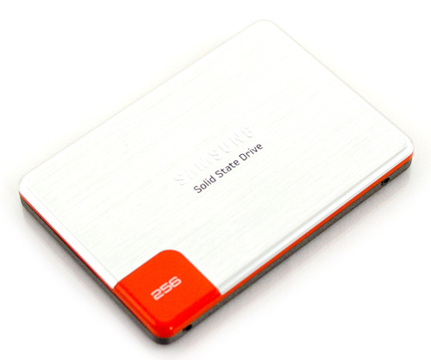
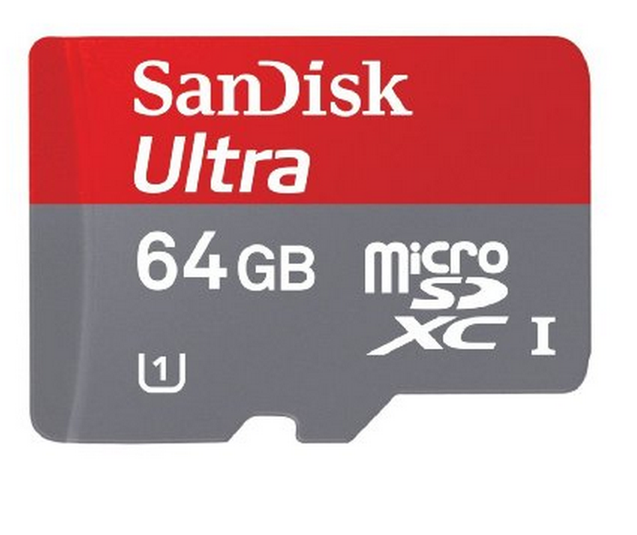

Flash Memory
Solid State Drive

Slide 31

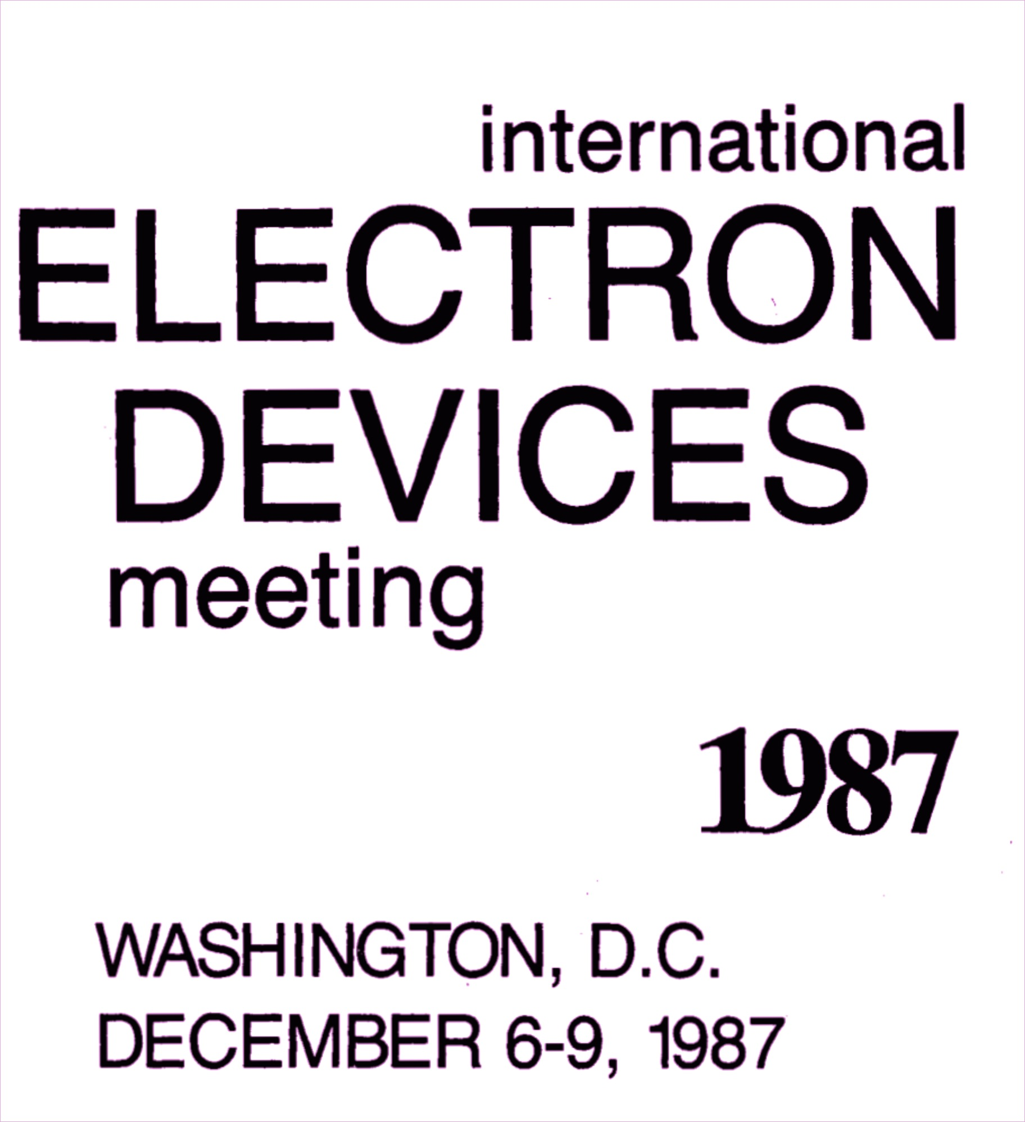
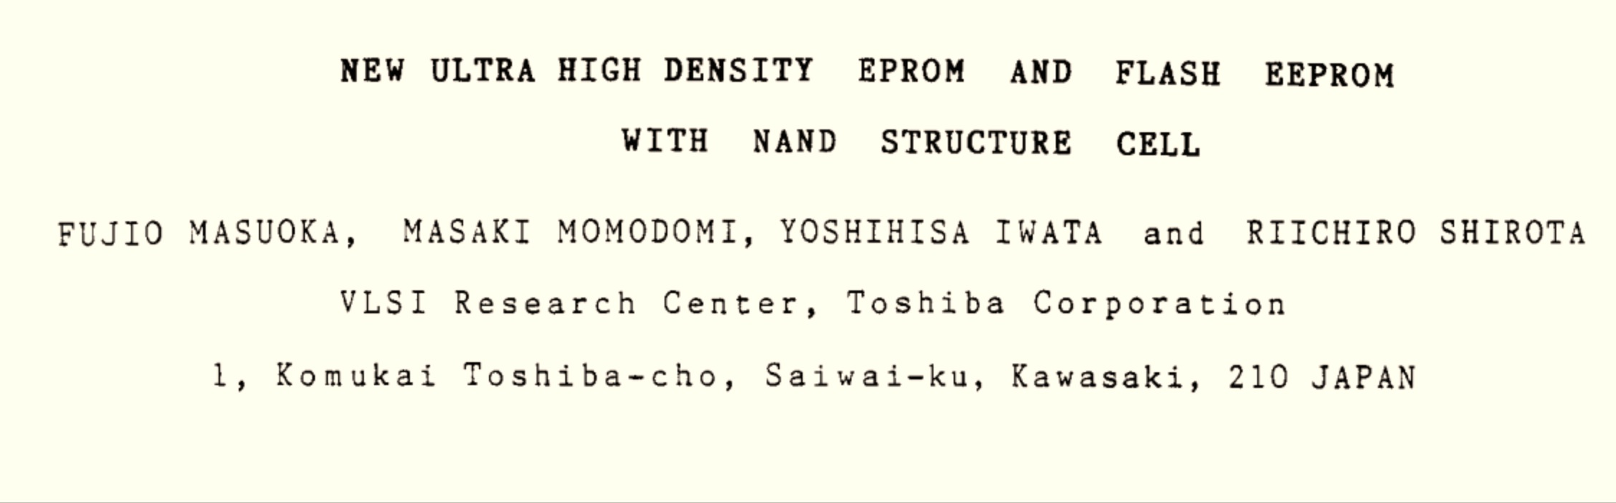
Fujio Masuoka

Slide 32
How NAND Flash Works
Word Line
Control gate
Oxide Layer
stores electrons
Floating gate
Drain
Source
1
Bit Line
Uncharged State
Adapted from http://computer.howstuffworks.com/flash-memory1.htm

Slide 33
How NAND Flash Works
Word Line
Control gate
----------------------------------------
Oxide Layer
stores electrons
Floating gate
Drain
Source
0
Bit Line
Charged State
Adapted from http://computer.howstuffworks.com/flash-memory1.htm

Slide 34
Flash Memory
Non-volatile
preserves state without any power
Solid State
no moving parts larger than electrons
Fast (compared to disk)
random read time ~10,000ns

Slide 35
Summary: Storage Systems
Device | Example | Time to Access | Cost per Bit
Mercury (Gin) Delay Line | UNIVAC (1951) | 220,000ns (average) | $ 0.38 (1968) (a bazillion n$)
DRAM | Kingston KVR16N11/4 4GB DDR3 ($40) | 13.75ns | 1.16 n$
SSD | Samsung 500GB ($300) | ~10,000 ns (for random read) | 0.075 n$
Disk Drive | Seagate Desktop HDD 4 TB SATA 6Gb/s NCQ 64MB | 5,000,000ns | 0.0046 n$

Slide 36
Challenges of Flash
Writing (1 ➔ 0) is expensive
Erasing (0 ➔ 1) is super expensive:
Apply electric field to release charge
Can only erase a full block (often 128K) at a time
Cells wear out after 10,000-1M erasings
Reading disturbs nearby cells
Cannot read same cell too many times
But: no seek time – time to access every cell is the same!

Slide 37
How should we design a file system for flash memory?

Slide 38
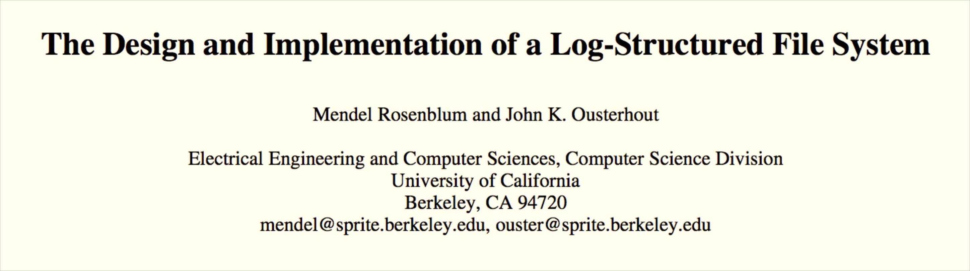


UVa Mathematics (1984)
Berkeley CS PhD
Stanford Professor

Slide 39
Log-Structured File System
Disk
File 1
File 2
Updated
File 1
Write sequentially: never overwrite data
April Fool’s? What’s wrong with this picture?

Slide 40
Where does the meta-data go?
Disk
Block 0
Block 1
Block 2
Inode A

Slide 41
When should we do the writes?
Disk
Block 0
Block 1
Block 2
Inode A

Slide 42
When should we do the writes?
Disk
Block 0
Block 1
Block 2
Inode A
Block 3
Block 4
Block 5
In-Memory Buffer
Block 6
Block 7
Inode B

Slide 43
When should we do the writes?
Disk
Block 0
Block 1
Block 2
Inode A
Block 3
Block 4
Block 5
In-Memory Buffer
Block 6
Block 7
Inode B

Slide 44
Updating a File
Disk
Block 0
Block 1
Block 2
Inode A
Block 3
Block 4
Block 5
Block 6
Block 7
Disk, continued
Block 7
Inode B
Suppose the contents of Block 1 are modified?

Slide 45
Updating a File
Disk
Block 0
Block 1
Block 2
Inode A
Block 3
Block 4
Block 5
Block 6
Block 7
Disk, continued
Block 7
Inode B
Block 1 - update

Slide 46
Updating a File
Disk
Block 0
Block 1
Block 2
Inode A
Block 3
Block 4
Block 5
Block 6
Block 7
Disk, continued
Block 7
Inode B
Block 1 - update
Inode A’

Slide 47
Finding an Inode
Disk
Block 0
Block 1
Block 2
Inode A
Block 3
Block 4
Block 5
Block 6
Block 7
Disk, continued
Block 7
Inode B
Block 1 - update
Inode A’

Slide 48
Recap: how did we do this for S5FS?
Filename | Inode
. | 494211
.. | 494205
.DS_Store | 494212
class0 | 6565946
class1 | 6565826
… | …
class16 | 5649155
class2 | 494218
… | …

Slide 49
Recap: how did we do this for S5FS?
Filename | Inode
. | 494211
.. | 494205
.DS_Store | 494212
class0 | 6565946
class1 | 6565826
… | …
class16 | 5649155
class2 | 494218
… | …

Slide 50
Finding an Inode
Disk
Block 0
Block 1
Block 2
Inode A
Block 3
Block 4
Block 5
Block 6
Block 7
Disk, continued
Block 7
Inode B
Block 1 - update
Inode A’

Slide 51
imap
0
1
2
Pointer to most recent version of inode.
Disk
Block 0
Block 1
Block 2
Inode A
Block 3
Block 4
Block 5
Block 6
Block 7
Disk, continued
Block 7
Inode B
Block 1 - update
Inode A’

Slide 52
imap
0
1
2
Pointer to most recent version of inode.
Disk
Block 0
Block 1
Block 2
Inode A
Block 3
Block 4
Block 5
Block 6
Block 7
Where should we store the imap?
Disk, continued
Block 7
Inode B
Block 1 - update
Inode A’

Slide 53
imap
0
1
2
Pointer to most recent version of inode.
Disk
Block 0
Block 1
Block 2
Inode A
Block 3
Block 4
Block 5
Block 6
Block 7
At the end of each write! (when necessary) – its small (4 bytes * number of inodes), and sequential writes are cheap!
Disk, continued
Block 7
Inode B
Block 1 - update
Inode A’

Slide 54
Disk
Block 0
Block 1
Block 2
Inode A
Block 3
Block 4
Block 5
Block 6
Block 7
Disk, continued
Block 7
Inode B
Block 1 - update
Inode A’
imap
Block 8
Block 0 - update
Inode A’
Block 5 - update
Inode B’
imap
…
Won’t the disk fill up with lots of old junk?

Slide 55
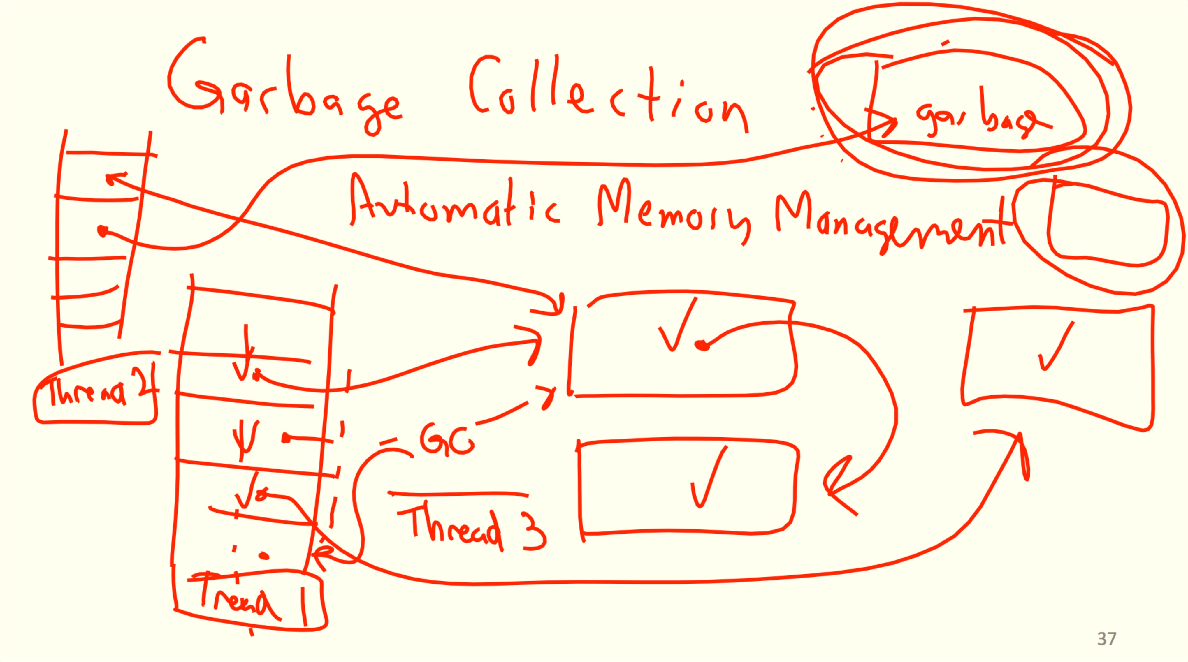
Class 8:

Slide 56
Garbage Collection in LSFS
Block 0
Block 1
Block 2
Inode A
Block 3
Block 4
Block 5
Block 6
Block 7
Disk, continued
Block 7
Inode B
Block 1 - update
Inode A’
imap
Block 8
Block 0 - update
Inode A’
Block 5 - update
Inode B’
imap
…

Slide 57
Garbage Collection in LSFS
Segment
Block 0
Block 1
Block 2
Inode A
Block 3
Block 4
Block 5
Block 6
Block 7
Disk, continued
Block 7
Inode B
Block 1 - update
Inode A’
imap
Block 8
Block 0 - update
Inode A’
Block 5 - update
Inode B’
imap
…

Slide 58
Garbage Collection in LSFS
Segment
Block 0
Block 1
Block 2
Inode A
Block 3
Block 4
Block 5
Block 6
Block 7
Disk, continued
Block 7
Inode B
Block 1 - update
Inode A’
imap
Block 8
Block 0 - update
Inode A’
Block 5 - update
Inode B’
imap
…

Slide 59
Garbage Collection in LSFS
Segment
Block 6
Block 7
A full clean segment!
Block 7
Inode B
Block 1 - update
Inode A’
imap
Block 8
Block 0 - update
Inode A’
Block 5 - update
Inode B’
imap
…
Block 2
Block 3
Block 4
Inode A’
Inode B’
imap
…

Slide 60
SOSP 1991
1987

Slide 61
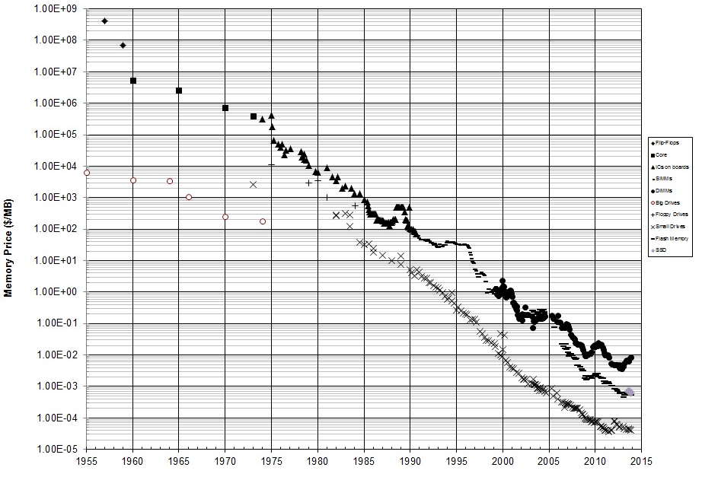
http://www.jcmit.com/flash2013.htm
2003: $0.25/MB
2006: $0.02/MB
2010: $0.002/MB
2013: $0.0005/MB
< $1/GB

Slide 62
Differences with Flash
No need for sequential writes
  Just need to find unused blocks
Can do 1 ➔ 0 rewrites!
Maintain a bitmap of used blocks at fixed block
Lots of complexities:
Bits wear out, read disruption, etc.
Who should deal with those complexities?

Slide 63
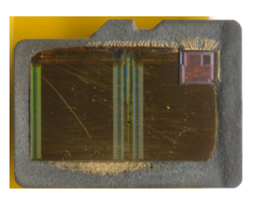
Andrew “bunnie” Huang
2GB microSD card

Slide 64
Andrew “bunnie” Huang
ARM Processor!
2GB microSD card

Slide 65
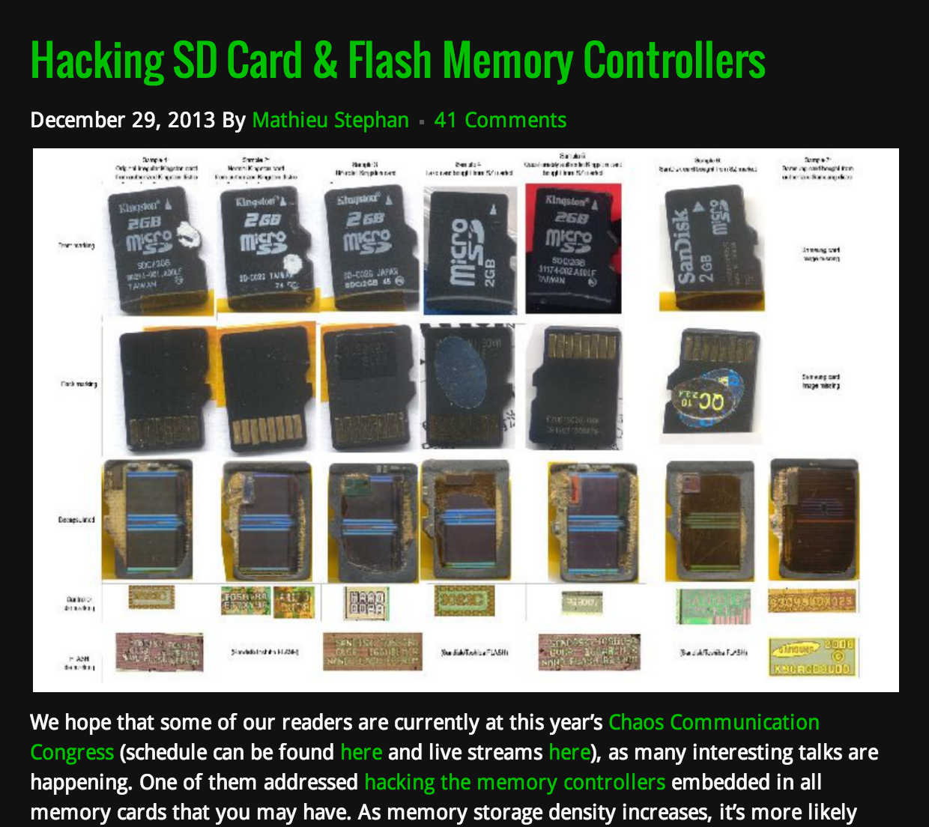
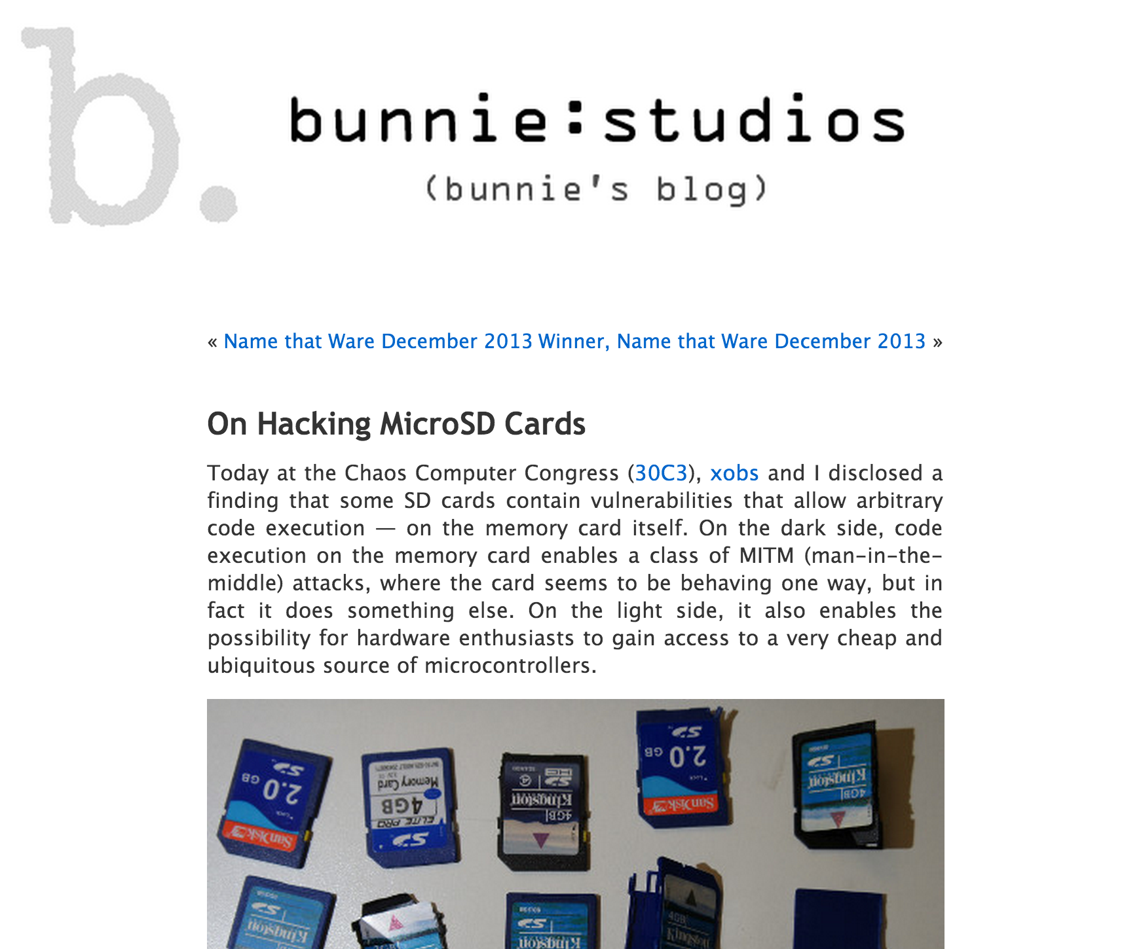

Slide 66
Summary: Storage Systems
Device | Example | Time to Access | Cost per Bit
Mercury (Gin) Delay Line | UNIVAC (1951) | 220,000ns (average) | $ 0.38 (1968) (a bazillion n$)
DRAM | Kingston KVR16N11/4 4GB DDR3 ($40) | 13.75ns | 1.16 n$
SSD | Samsung 500GB ($300) | ~10,000 ns (for random read) | 0.075 n$
Disk Drive | Seagate Desktop HDD 4 TB SATA 6Gb/s NCQ 64MB | 5,000,000ns | 0.0046 n$
Modern Hard Drive

Slide 67
Relevance to PS4?
Not expected to implement any of this – a very simple filesystem in memory is fine (but feel free to surprise us!)
Your filesystem is in memory: no need to deal with complexities of interfacing with persistent media (but doing this could be a good post-PS4 project!).

Slide 68

FlashKernel?
PS4 Due Sunday, 11:59pm
by shamserg

