Slide 1
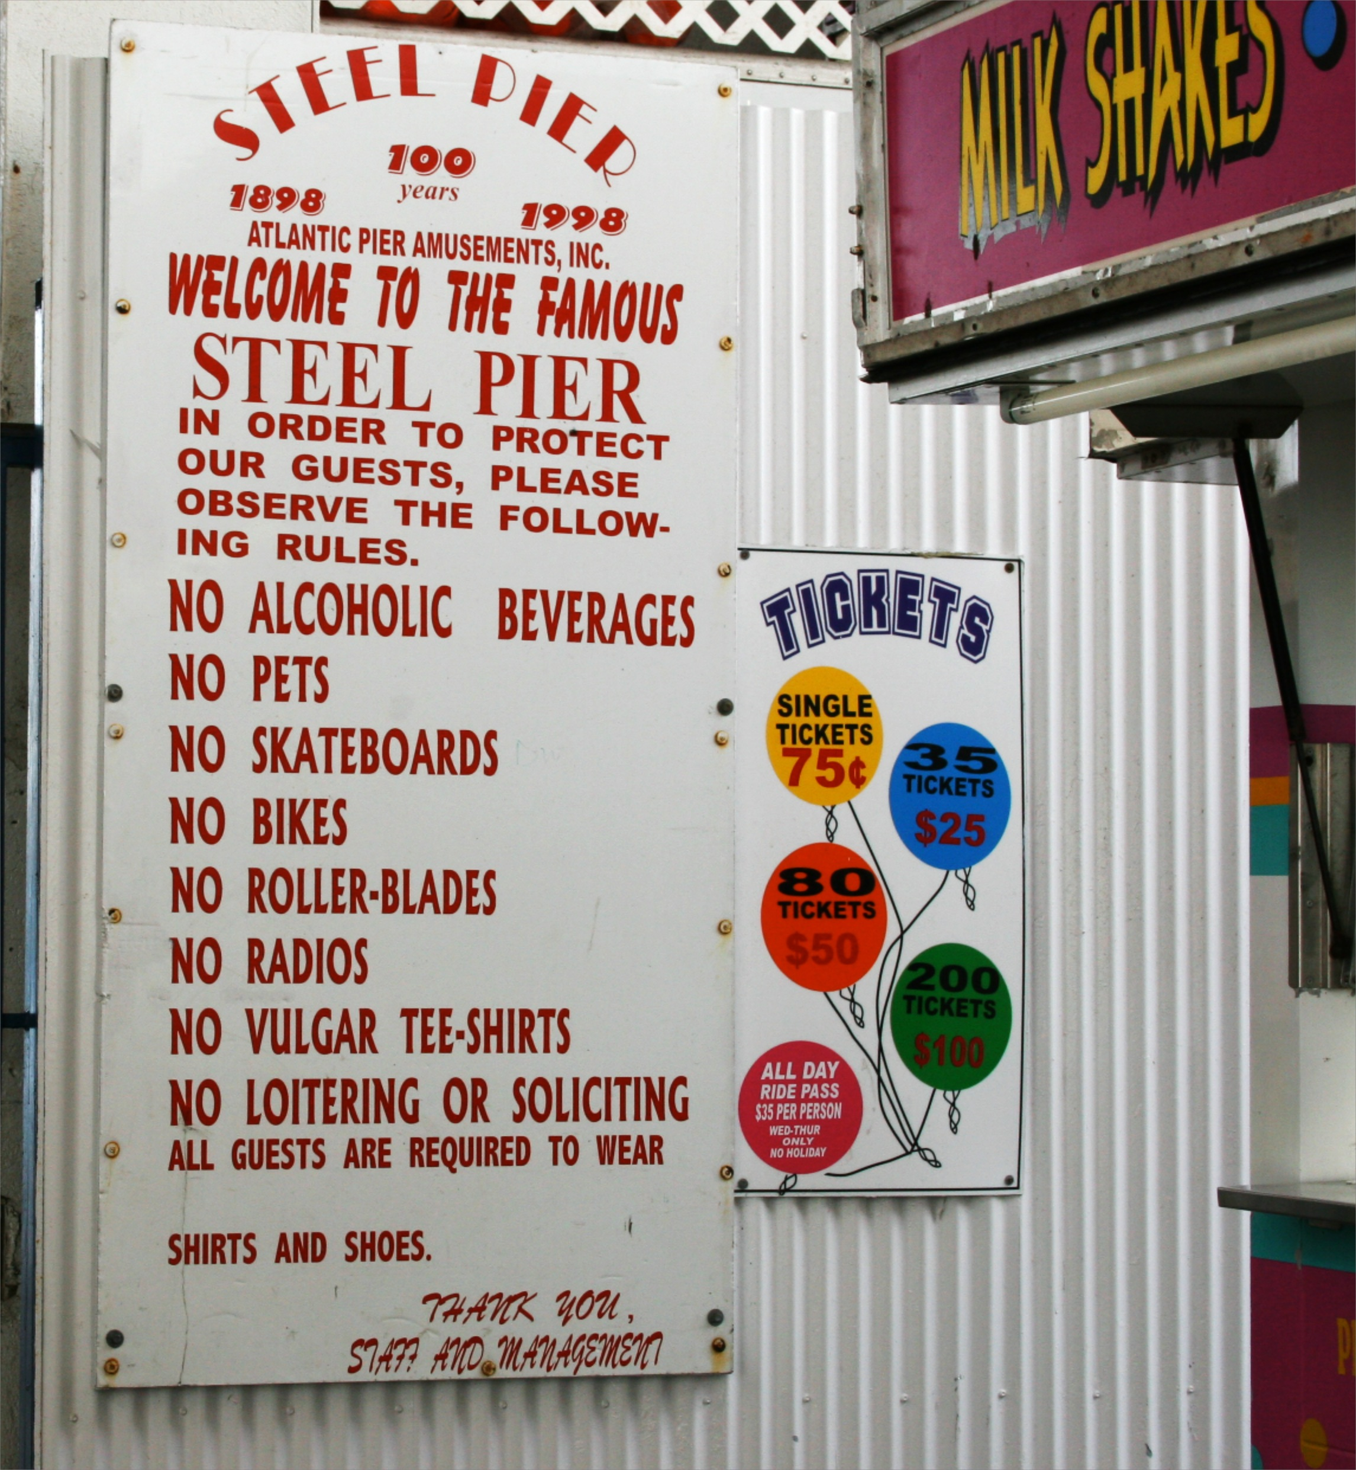
Class 16:
Access Control
cs4414 Fall 2013
University of Virginia
David Evans

Slide 2
Plan for Today
Plan for Rest of Semester
Starting Security

Slide 3
Plan for Remainder of Course
28 October: Due: PS3: Zhtta Web Server
29 October: Security
31 October: Guest: Karsten Nohl
4 Nov: Due: Project Proposals
5-7 Nov: Lower-Level OS (Processes, Virtual Memory)
11 Nov: Due: Norvig Numbers Contribution Expected
12-14 Nov: Storage
18 Nov: Due: Project Design Reviews
19-22 Nov: Virtual Machines, Micro/Exo-Kernels
26 Nov: Guest: Tom Pinckney
28 Nov: Thanksgiving Break
3 Dec: Wrap-Up
5 Dec: Due: Project Demos

Slide 4
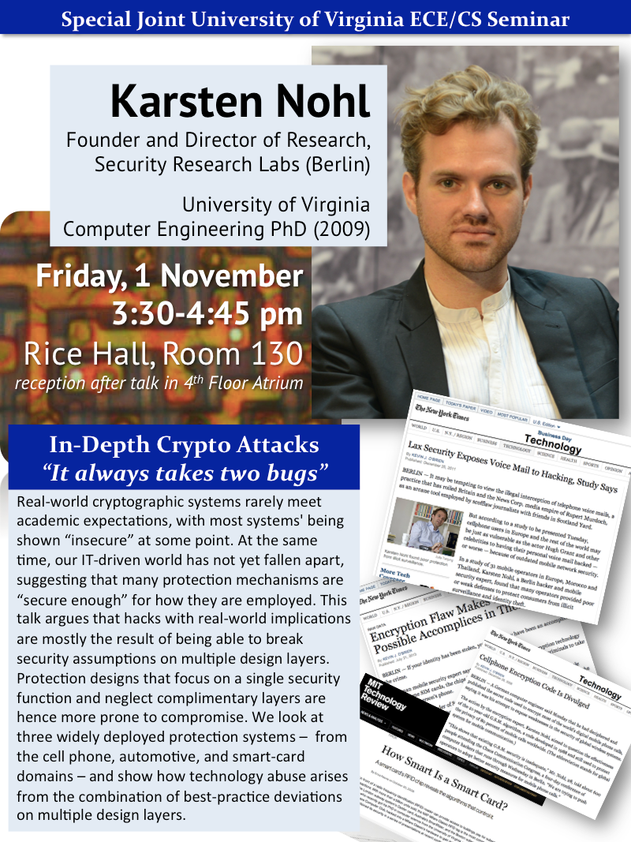
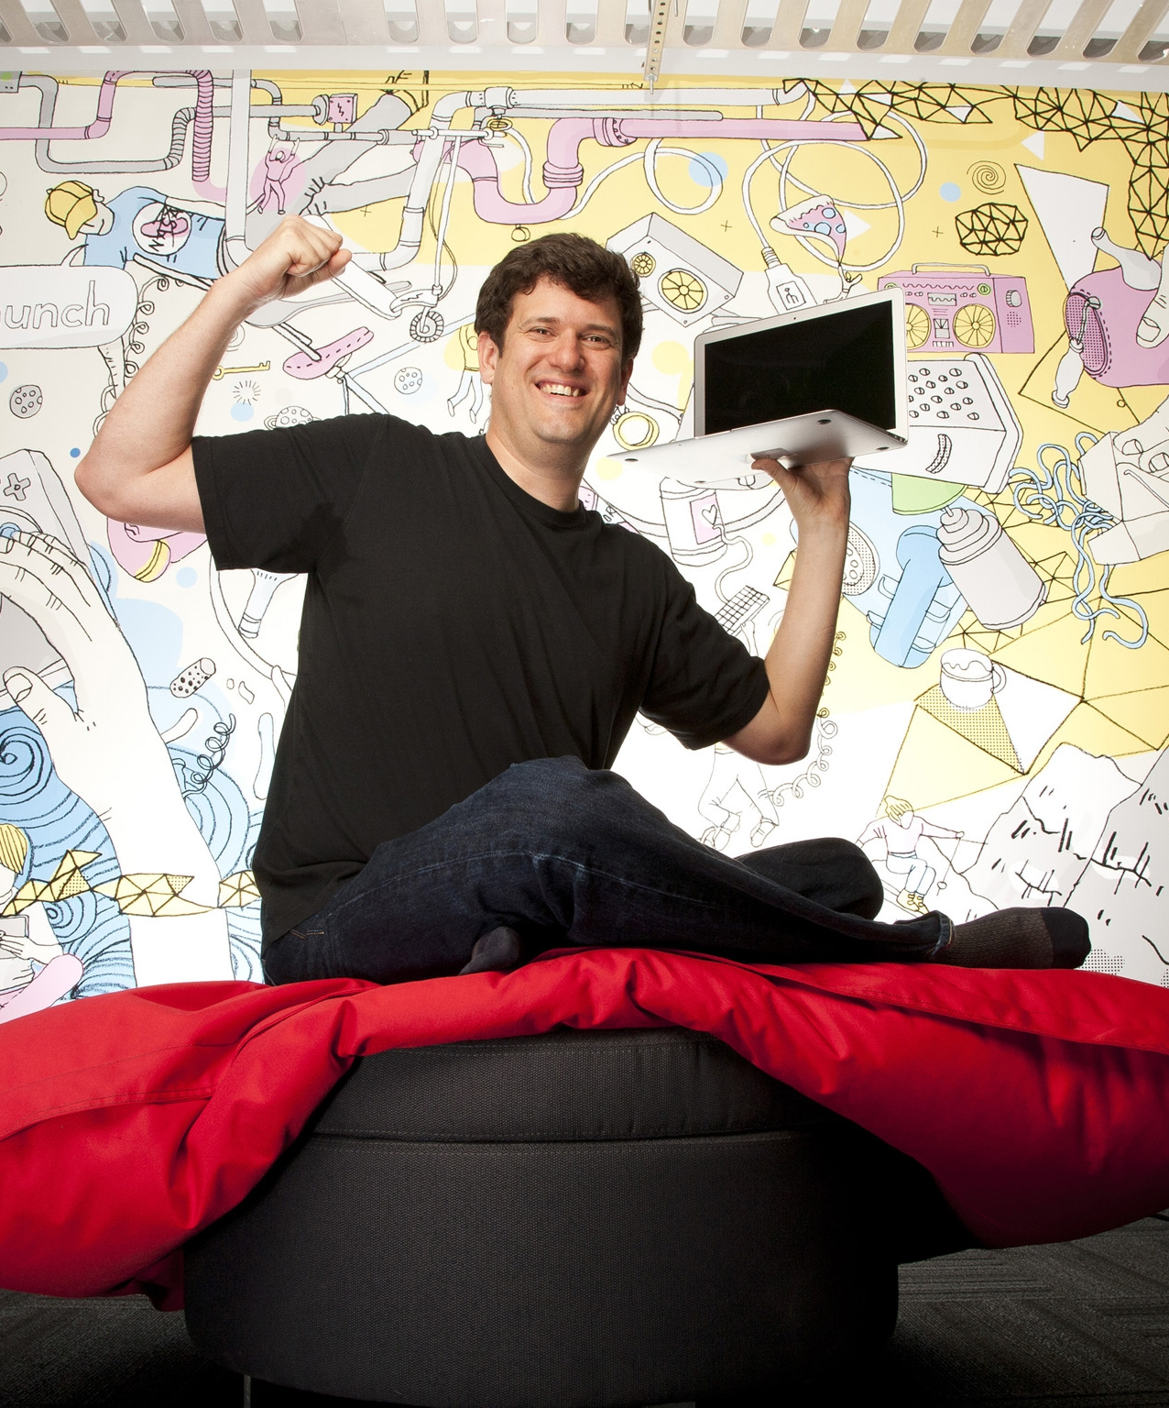




Karsten Nohl, Oct 31
Tom Pinckney, Nov 26

Slide 5
Project
4 Nov: Due: Project Proposals
18 Nov: Due: Project Design Reviews
5 Dec: Due: Project Demos
Do something that is
  fun (for you to do, and others to see)
  relevant (to the class)
  technically interesting (to you and me)
  useful (at least to you, hopefully to many)
You probably can’t maximize all of these! It is okay to sacrifice one or two of them to increase others. A good project should be strong on at least 2 of these, which is much better than being mediocre of all four.

Slide 6
Project Teams
Anyone you want
Size: 1-65+ people (recommended: 2-5)
Okay to include people not in class “Impressiveness” should scale as sqrt(N)
(N = # of teammates in class)
Choose your teammates carefully and manage it well.

Slide 7
Project Grading
A Do something you are proud of
A- Do something you find satisfactory
B+ Do something you find not embarrassing
<=B Do something embarrassing
* (and that I think its reasonable for you to be proud of)
* (and that I think it is okay for you to find satisfactory)
* (and that I think is okay for you to not find embarrassing)

Slide 8
“A+” Projects
A+ Do something I am impressed by
    I will help you get into grad school, find a high-paying interesting job, and/or give you a low-paying interesting job.
A++ Do something I am super impressed by
    I will get Tom Pinckney to help you find a high-paying super-interesting job.
A+++ Do something I am way super impressed by
    I will get Sebastian Thrun to help you find a high-paying super-interesting job.

Slide 9
Ideas for Projects
Some interesting systems-level program
Some contribution to Rust
Some contribution to computing
Doesn’t have to be a program…
Growing list of suggestions will be posted on course site…but don’t limit yourself to these.

Slide 10
Examples
Do something that is
  fun (for you to do, and others to see)
  relevant (to the class)
  technically interesting (to you and me)
  useful (at least to you, hopefully to many)
usefulness
interestingness
“funness”
“relevantness”

Slide 11
Example: cs3102 PS7
http://www.youtube.com/watch?v=GSIodz9GWxc
Assignment

Slide 12
Remaining Content
28 October: Due: PS3: Zhtta Web Server
29 October: Security
31 October: Guest: Karsten Nohl
4 Nov: Due: Project Proposals
5-7 Nov: Lower-Level OS (Processes, Virtual Memory)
11 Nov: Due: Norvig Numbers Contribution Expected
12-14 Nov: Storage
18 Nov: Due: Project Design Reviews
19-22 Nov: Virtual Machines, Micro/Exo-Kernels
26 Nov: Guest: Tom Pinckney
28 Nov: Thanksgiving Break
3 Dec: Wrap-Up
5 Dec: Due: Project Demos

Slide 13



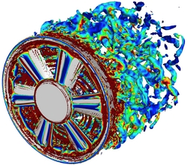



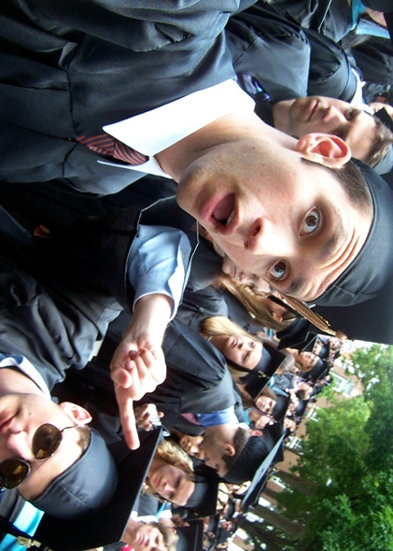
Minimizing Magic
Cool Computing Stuff
Its all magic!
Its all understandable!
(and I can do something cooler)
Four Years Studying Computing at an Elite Public University
(click for article)
Physics

Slide 14
Minimizing Magic
Cool Computing Stuff
Its all magic!
electives
cs4414
cs3102
cs2110
cs1110
cs4610
cs2150
cs4414
cs3330
By the time you graduate, nothing should be “magic” other than how transistors work and NP-Completeness.
cs2150
cs4414
cs2330
Physics

Slide 15
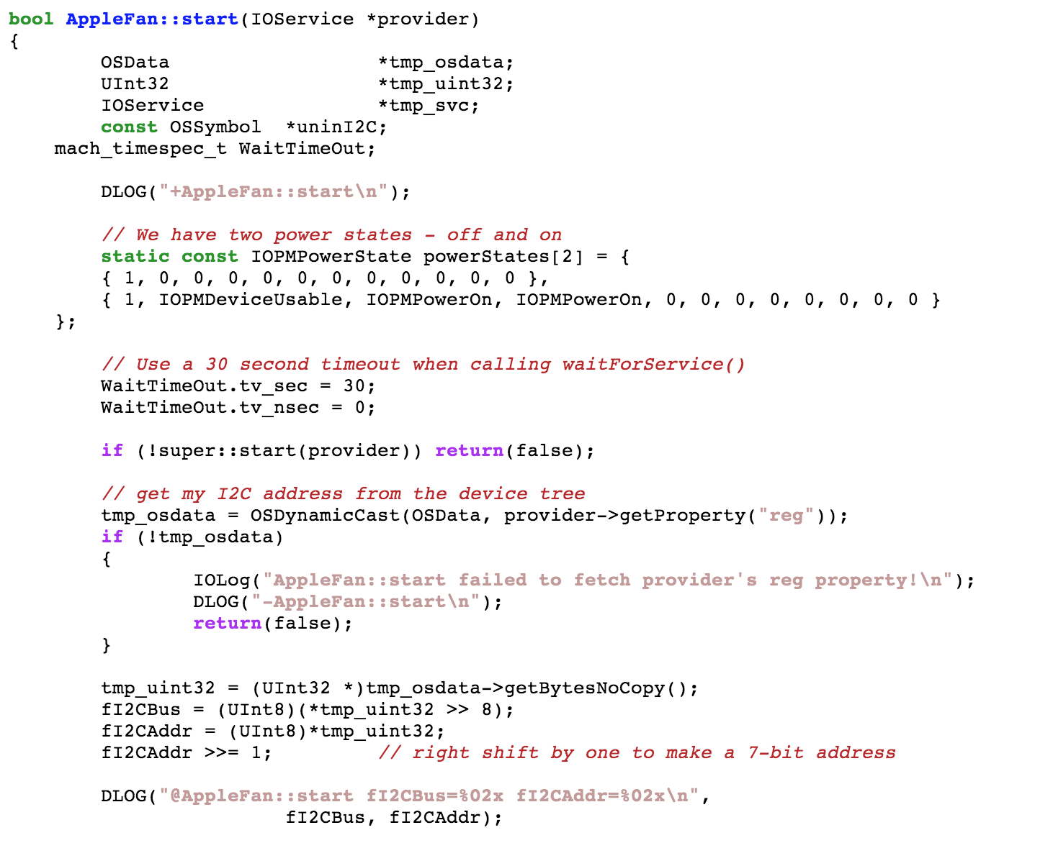
http://opensource.apple.com/source/AppleFan/AppleFan-110.3.1/AppleFan.cpp

Slide 16
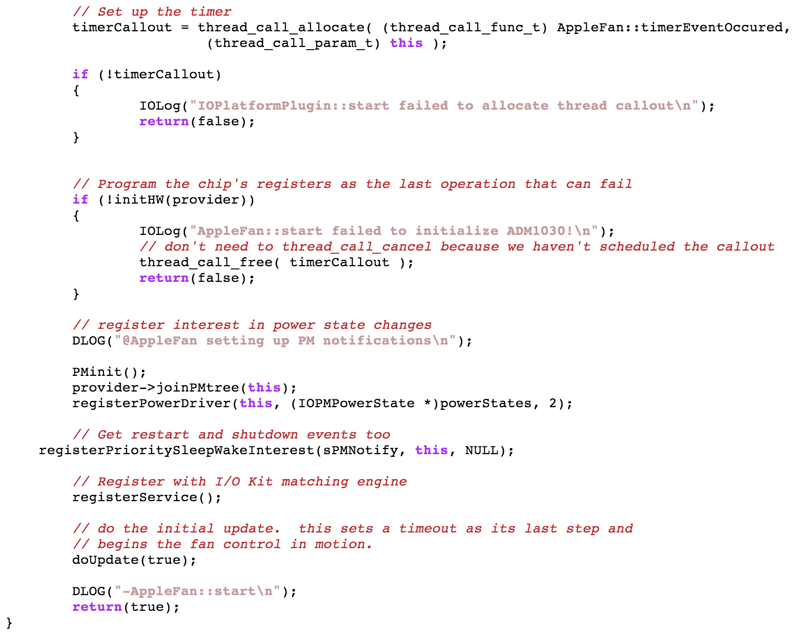

Slide 17
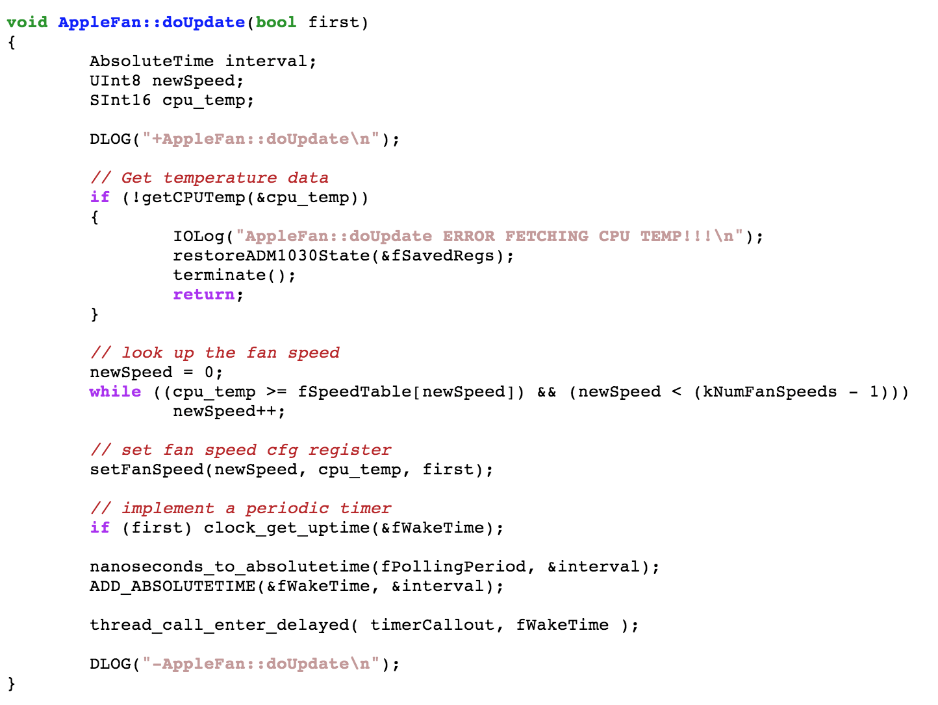

Slide 18
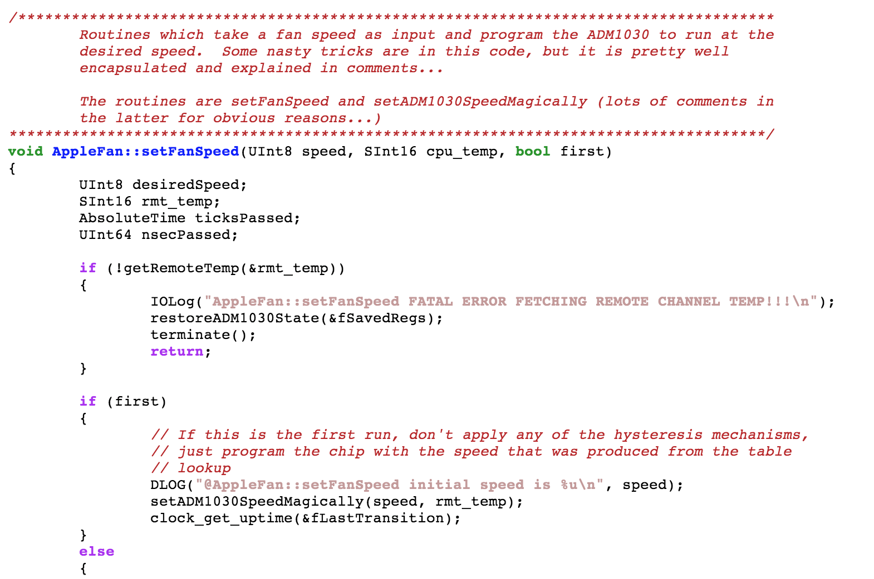

Slide 19
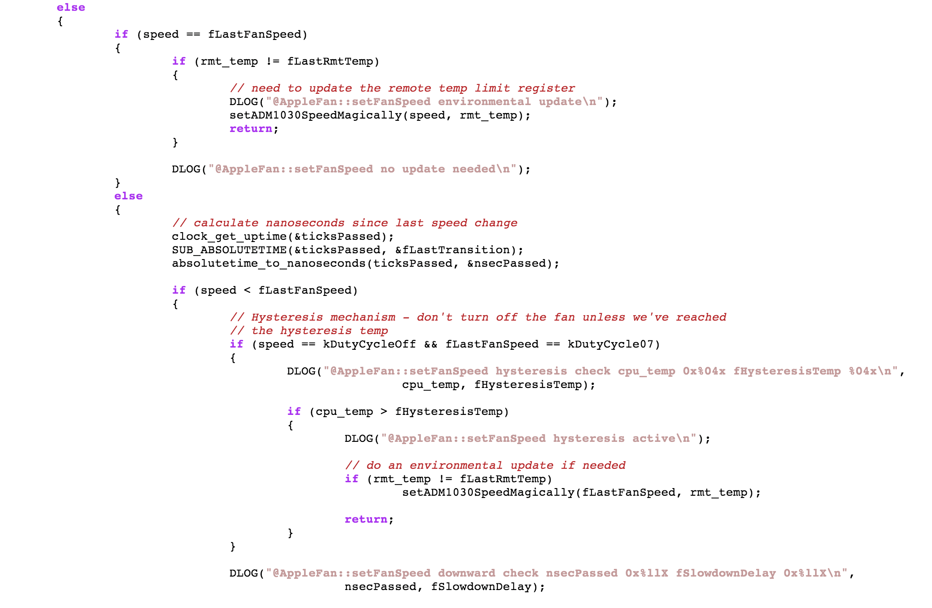

Slide 20
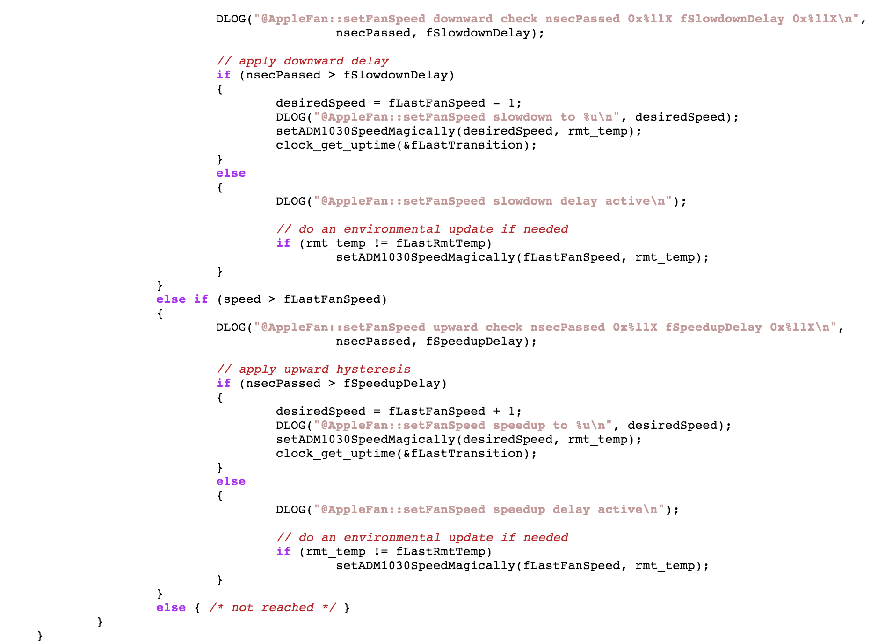

Slide 21
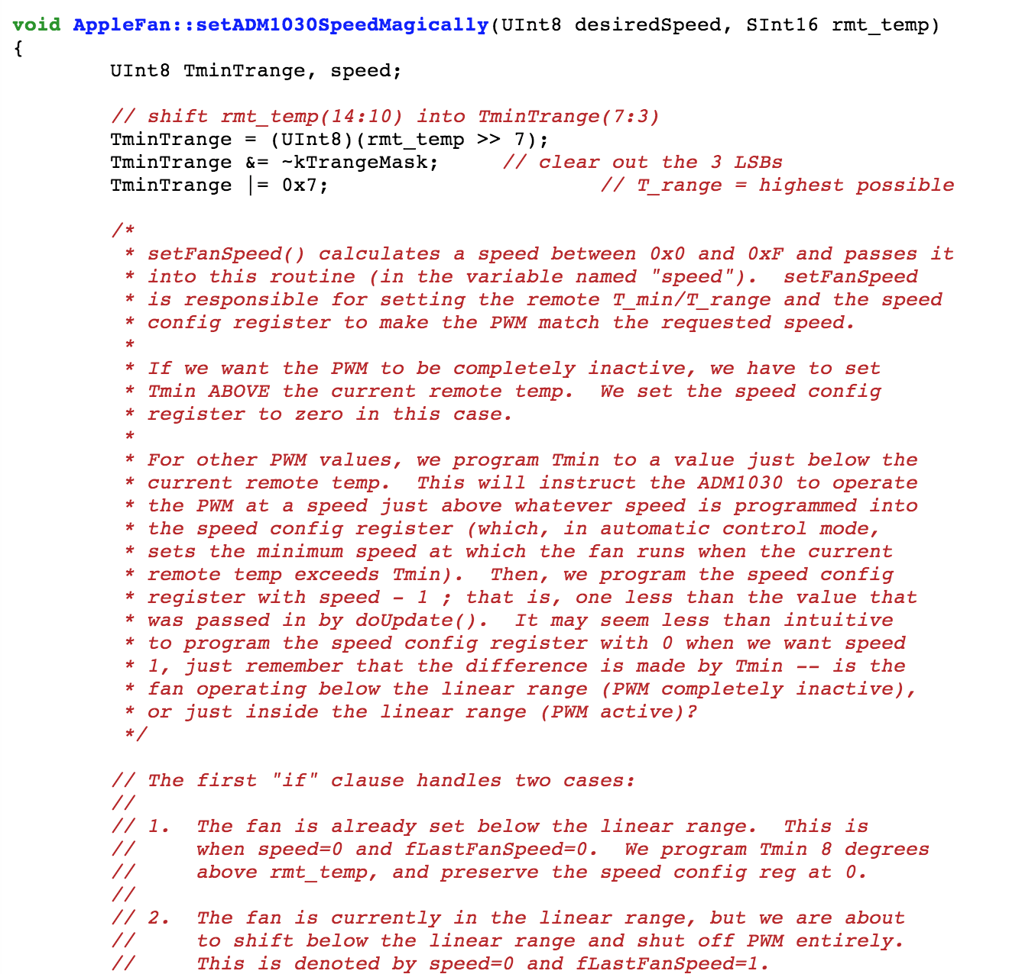

Slide 23
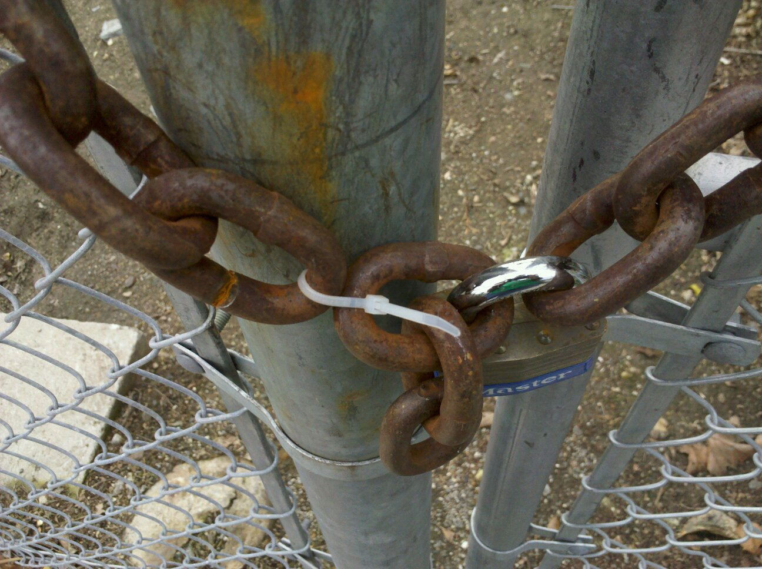
Security

Slide 24
What’s wrong with zhttpo (V 0.2)?
…
stream.read(buf);
let request_str = str::from_utf8(buf);
let req_group : ~[&str]= request_str.splitn_iter(' ', 3).collect();
if req_group.len() > 2 {
let path = req_group[1];
…
let file_path = &os::getcwd().push(path);
if !os::path_exists(file_path) || os::path_is_dir(file_path) {
…
else {
match io::read_whole_file(file_path) {
Ok(file_data) => {
stream.write(file_data);
}
…

Slide 25
Why Might Letting Anyone Read Any File on your Machine Be a Bad Idea?
LMGTFY

Slide 26
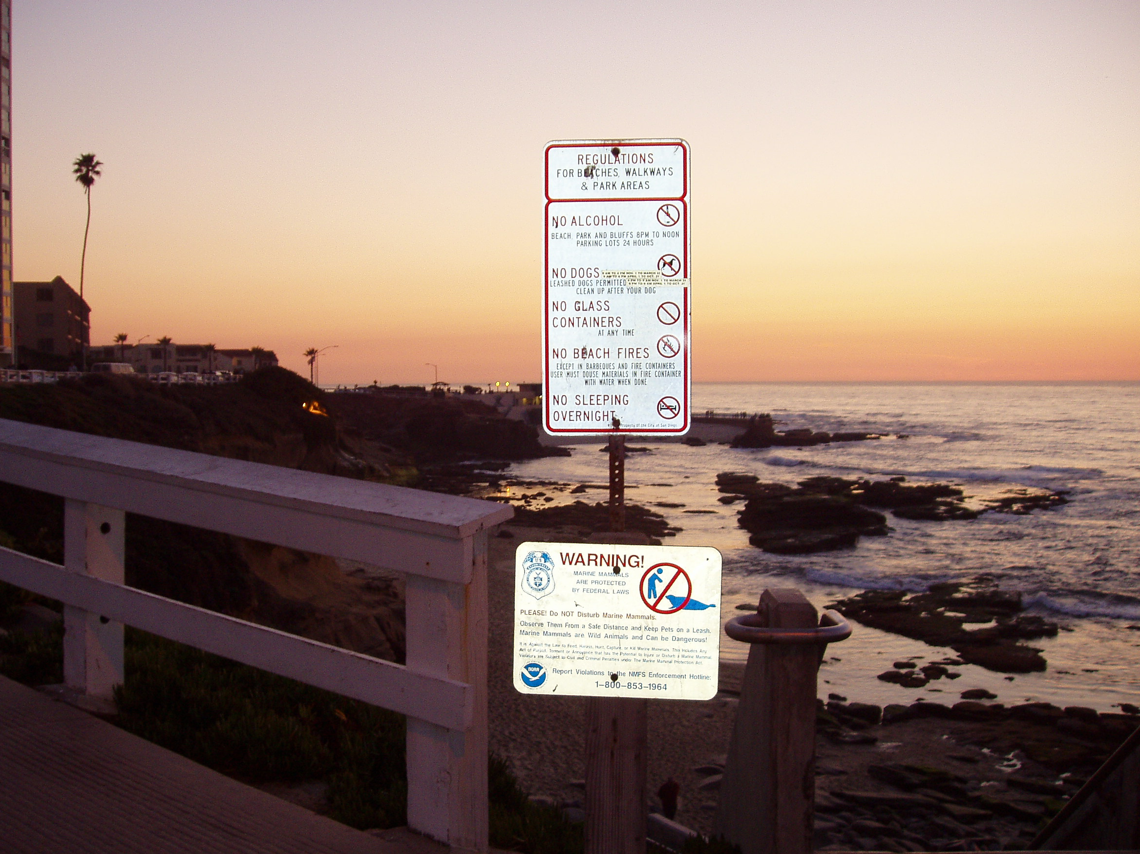
This is serious: actually trying the passwords would be wrong and criminal*.
* Just because someone “broadcasts” their password or uses laughable security, doesn’t mean the FBI considers it “authorized” access. Whether it is you or Google that is breaking the law in this case is unclear.

Slide 27
What’s wrong with Zhtta (V 0.3)?
…
stream.read(buf);
let request_str = str::from_utf8(buf);
let req_group : ~[&str]= request_str.splitn_iter(' ', 3).collect();
if req_group.len() > 2 {
let path = req_group[1];
…
let file_path = ~os::getcwd().push(path.replace("/../", ""));
if !os::path_exists(file_path) || os::path_is_dir(file_path) {
…
else {
match io::read_whole_file(file_path) {
Ok(file_data) => {
stream.write(file_data);
}
…
http://rust-class.org/./.././wp-config.php

Slide 28
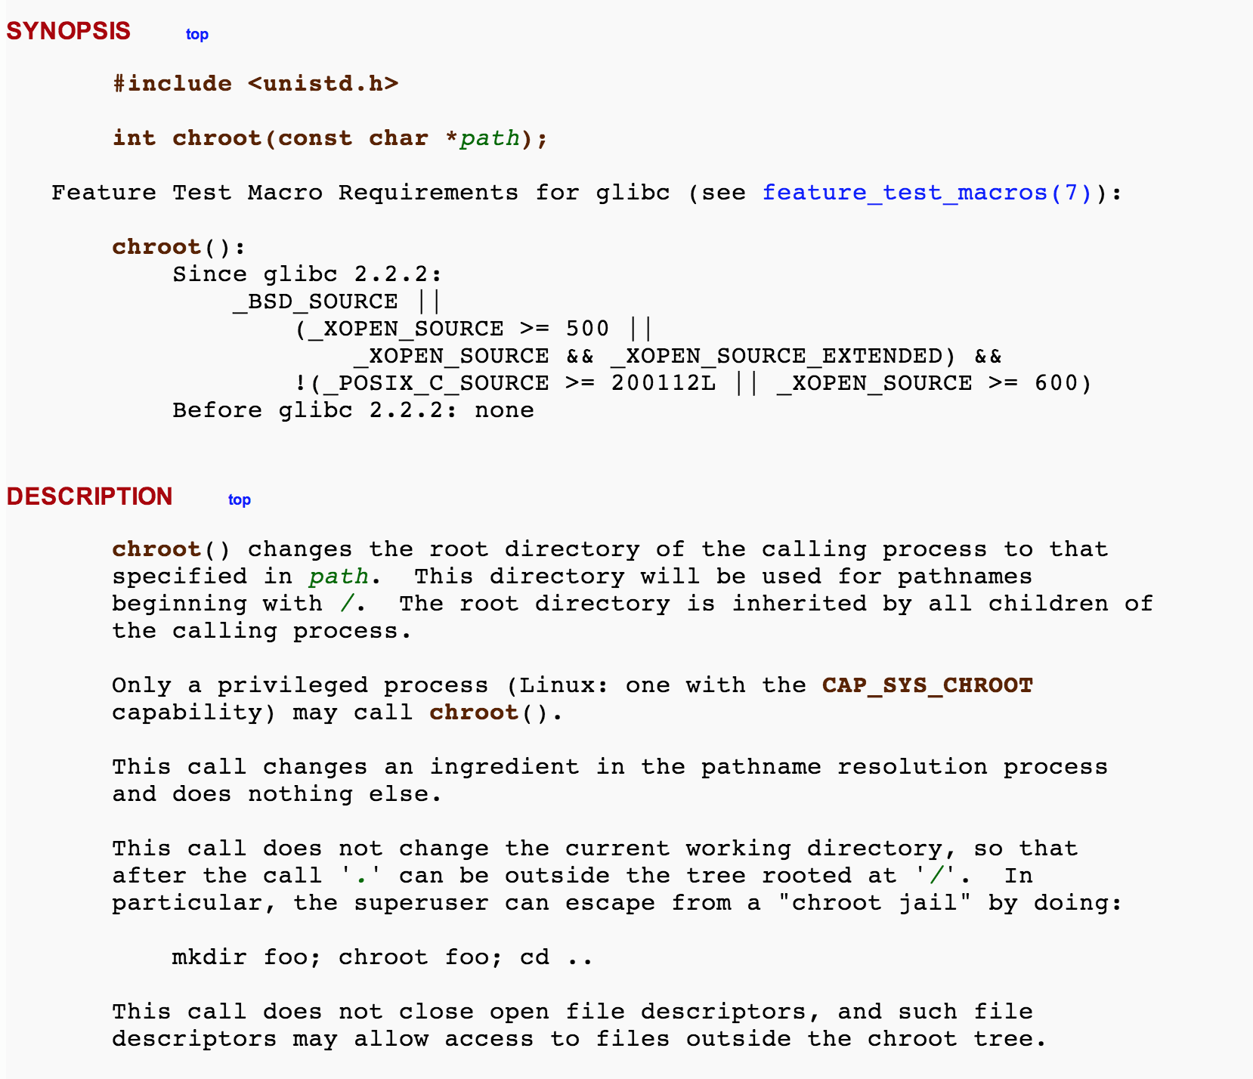
Unix (Sort-of) “Solution”

Slide 29
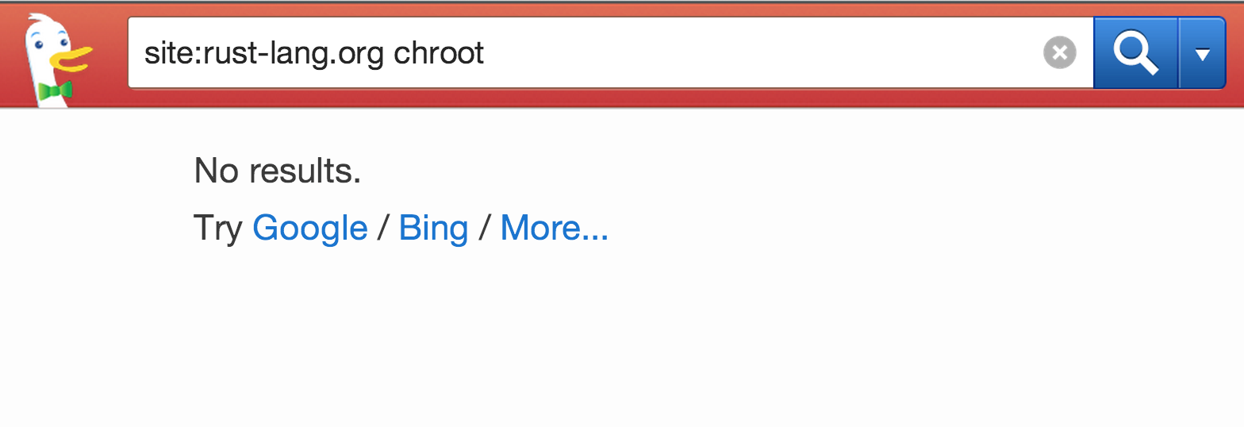
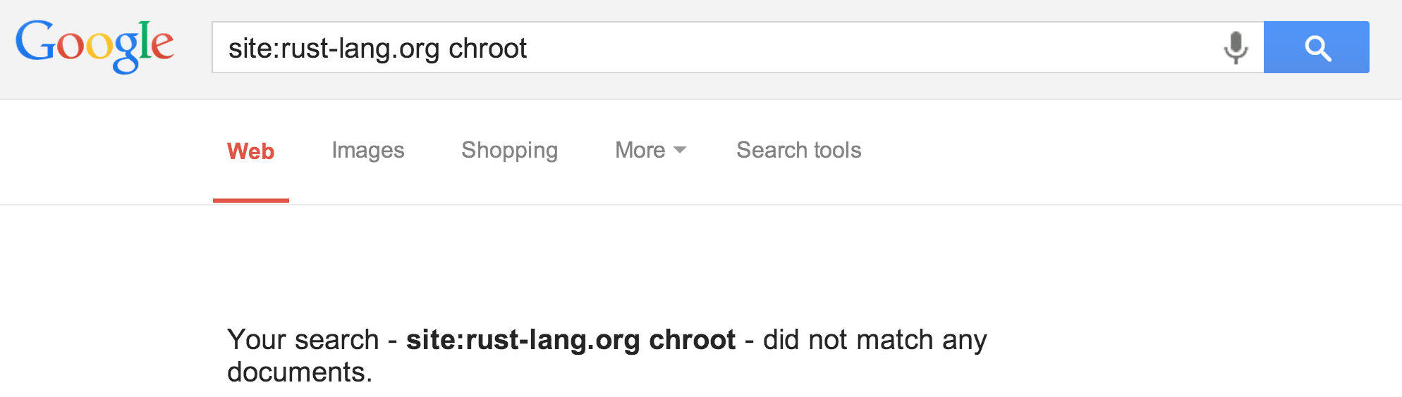

Slide 30
Apache’s (Partial) Solution
in httpd.conf:
DocumentRoot /home/evans/htdocs/
Apache will only serve files in DocumentRoot’s subtree.

Slide 31
Apache’s (Partial) Solution
in httpd.conf:
DocumentRoot /home/evans/htdocs/
<Directory />
Options FollowSymLinks
</Directory>
Opps! Now it will follow symlinks inside DocumentRoot subtree to anywhere…

Slide 32
Apache’s (Further) Solution
in httpd.conf:
User #-1
Apache starts running as root (uid = 0) to be able to listen on port 80, which is default web port.
By default, switches to run as uid = -1 (“nobody”) when processing requests.

Slide 33
bash-3.2$ ps aux | grep httpd
dave 20926 0.0 0.0 2423356 208 p0 R+ 10:15PM 0:00.00 grep httpd
_www 20923 0.0 0.0 2437400 700 ?? S 10:15PM 0:00.00 httpd
root 20922 0.0 0.0 2437400 2376 ?? Ss 10:15PM 0:00.05 httpd
# after one request
bash-3.2$ !ps
ps aux | grep httpd
dave 20934 0.0 0.0 2432768 620 p0 S+ 10:16PM 0:00.00 grep httpd
_www 20932 0.0 0.0 2437400 700 ?? S 10:16PM 0:00.00 httpd
_www 20931 0.0 0.0 2437400 700 ?? S 10:16PM 0:00.00 httpd
_www 20930 0.0 0.0 2437400 896 ?? S 10:16PM 0:00.00 httpd
_www 20923 0.0 0.0 2437400 1800 ?? S 10:15PM 0:00.01 httpd
root 20922 0.0 0.0 2437400 2376 ?? Ss 10:15PM 0:00.05 httpd

Slide 34
Changing Users
int setuid(uid_t uid);
real user id (ruid) = owner of the process
effective user id (euid) = ID used in access control decisions
saved user id (suid) = previous user ID that may be restored

Slide 35
Using setuid
httpd
euid: 0 (root)
pid_t handler = fork();
if (handler == 0) {
setuid(-1);
…
}
HTTP GET ./../../../user/dave/secrets.txt
handler
fopen(pathname, ‘r’)
Error: secrets.txt not readable to user nobody

Slide 36
Using setuid
httpd
euid: 0 (root)
pid_t handler = fork();
if (handler == 0) {
setuid(-1);
…
}
HTTP GET ./../../../user/dave/secrets.txt
Principle of Least Privilege
Running code should have as little power as possible to get the job done.
handler
fopen(pathname, ‘r’)
Error: secrets.txt not readable to user nobody

Slide 37
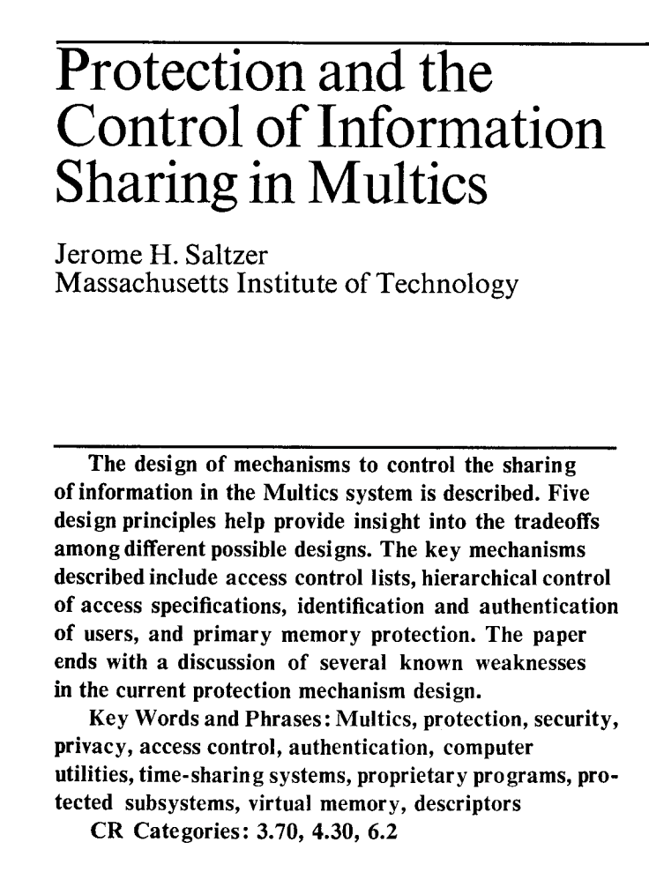
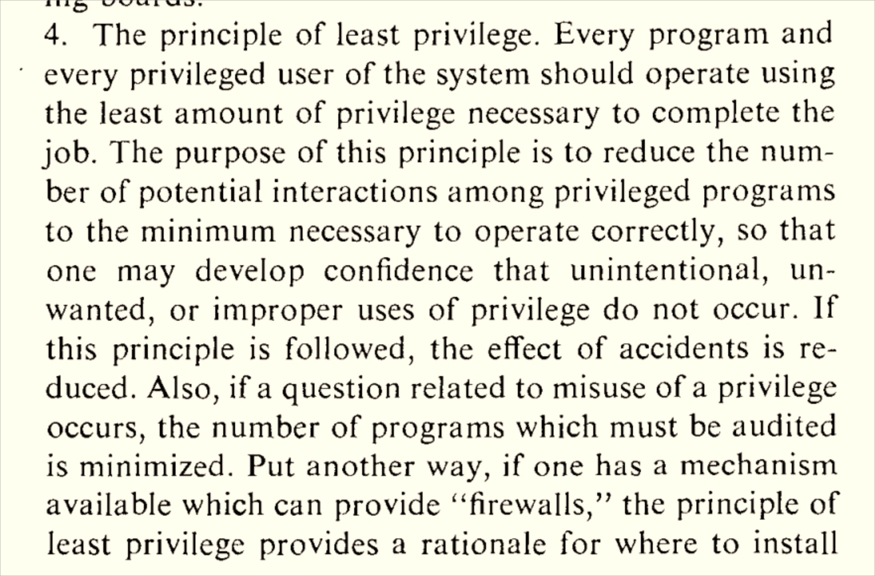

Slide 38
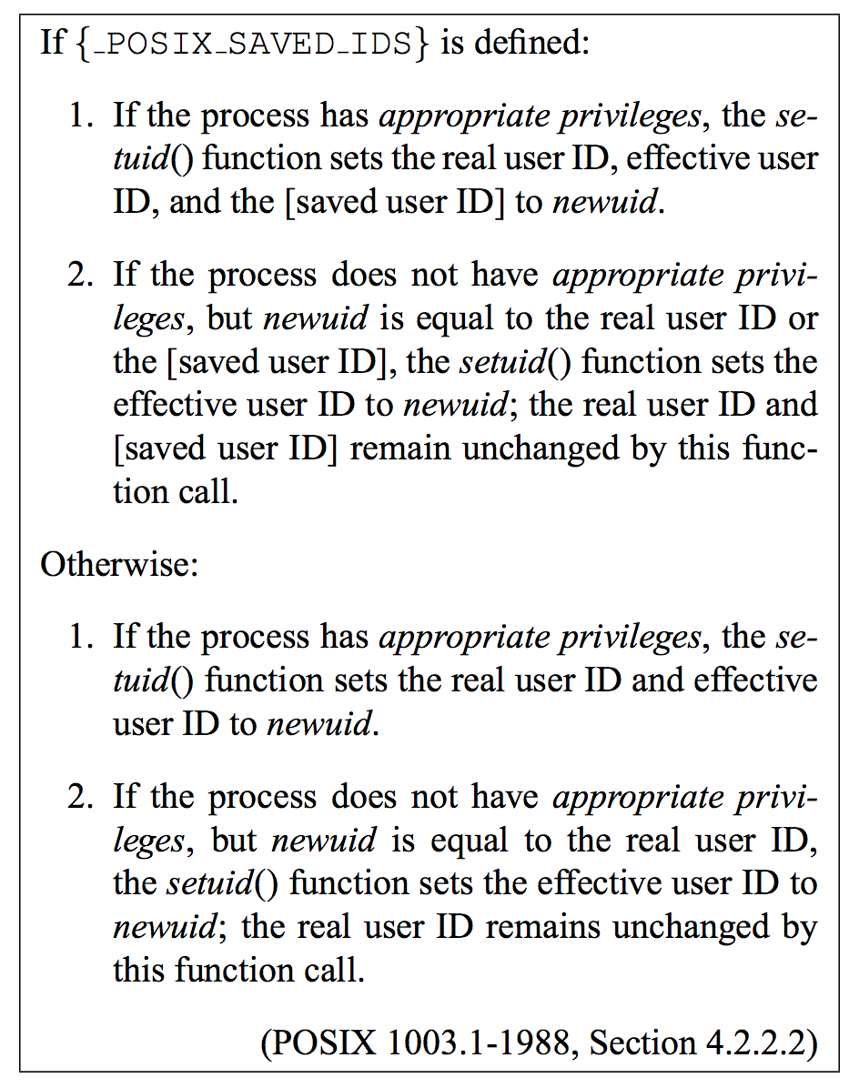
POSIX Spec for setuid

Slide 39
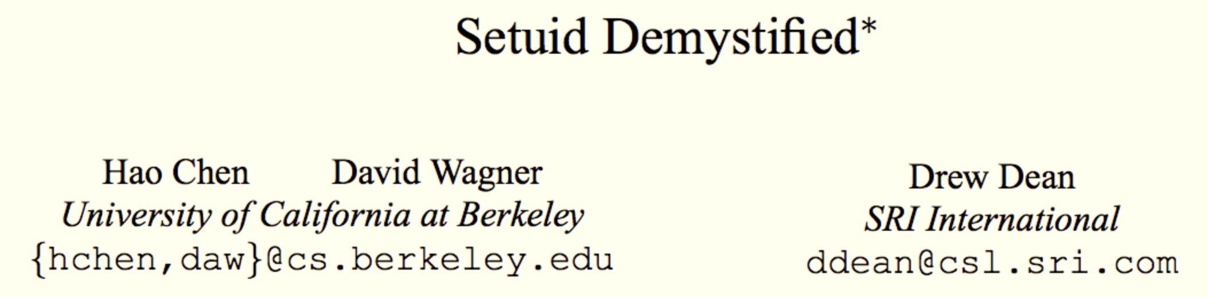
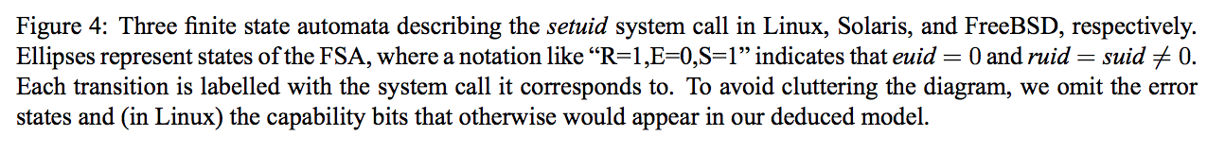
USENIX Security 2002

Slide 40
Example: cs3102 PS7
http://www.youtube.com/watch?v=PeRRF3jrHbQ
Assignment

Slide 41
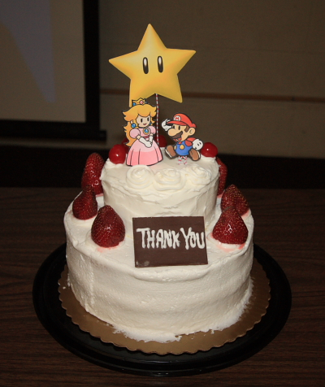
I’m showing you examples because I want you to be open-minded, not because I want everyone to make silly movies or bake cakes (but too many cakes is always better than no cakes).

Slide 42
Access Control
gash> ls -l secrets.txt
-rw------- 1 dave staff 37 Oct 23 23:15 secrets.txt
How does the OS know whether or not the (effective) user can read a file?

Slide 43
Access Control Matrix
Users | Files
 | /alice/www/index.html | /dave/secrets.txt | /alice/secrets.txt
root | read, write | read, write | read, write
dave | read | read, write | -
www | read | - | -

Slide 44
Reference Monitor
httpd
euid: 0 (root)
fopen(pathname, ‘r’)
HTTP GET ./../../../user/dave/secrets.txt
OS Kernel
Reference Monitor
handler
secrets.txt

Slide 45
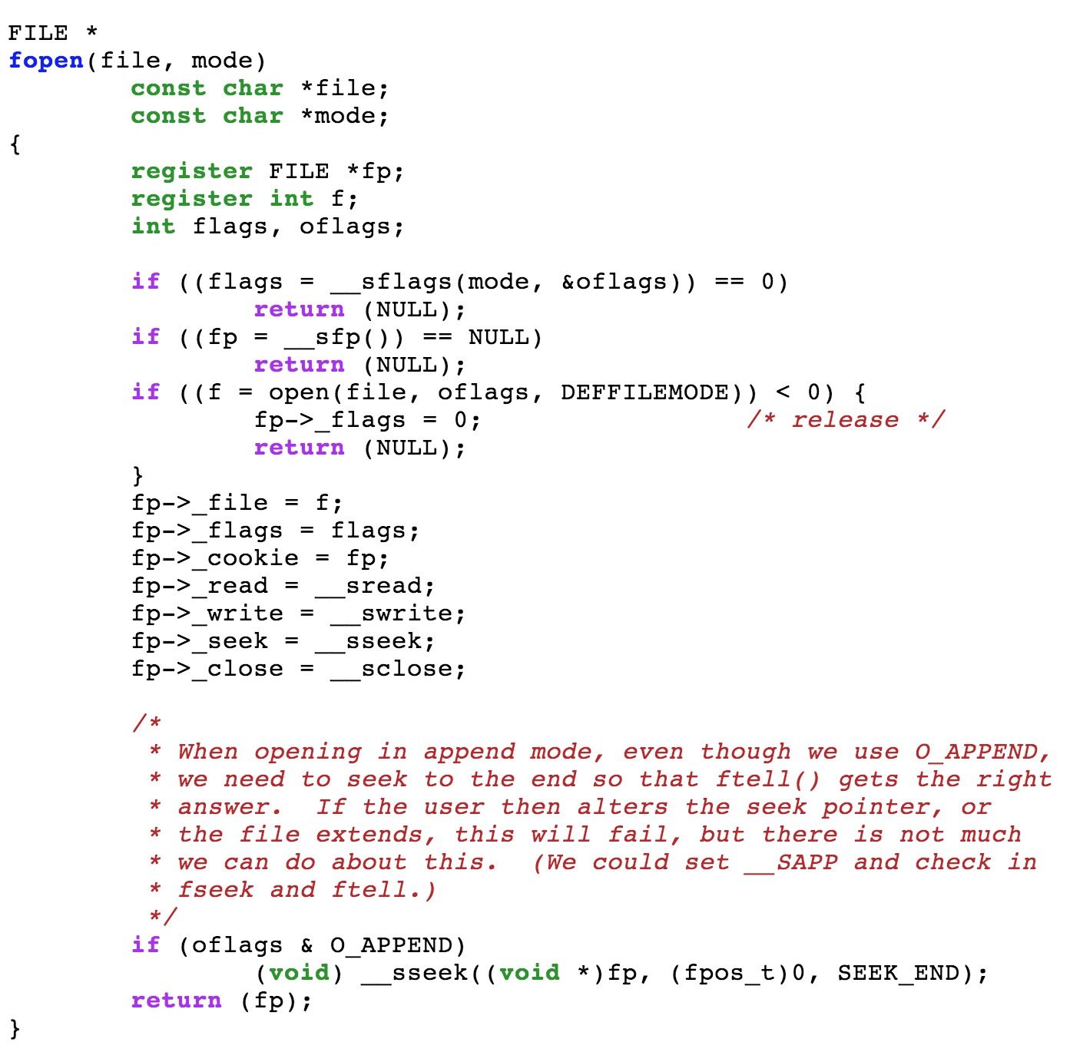
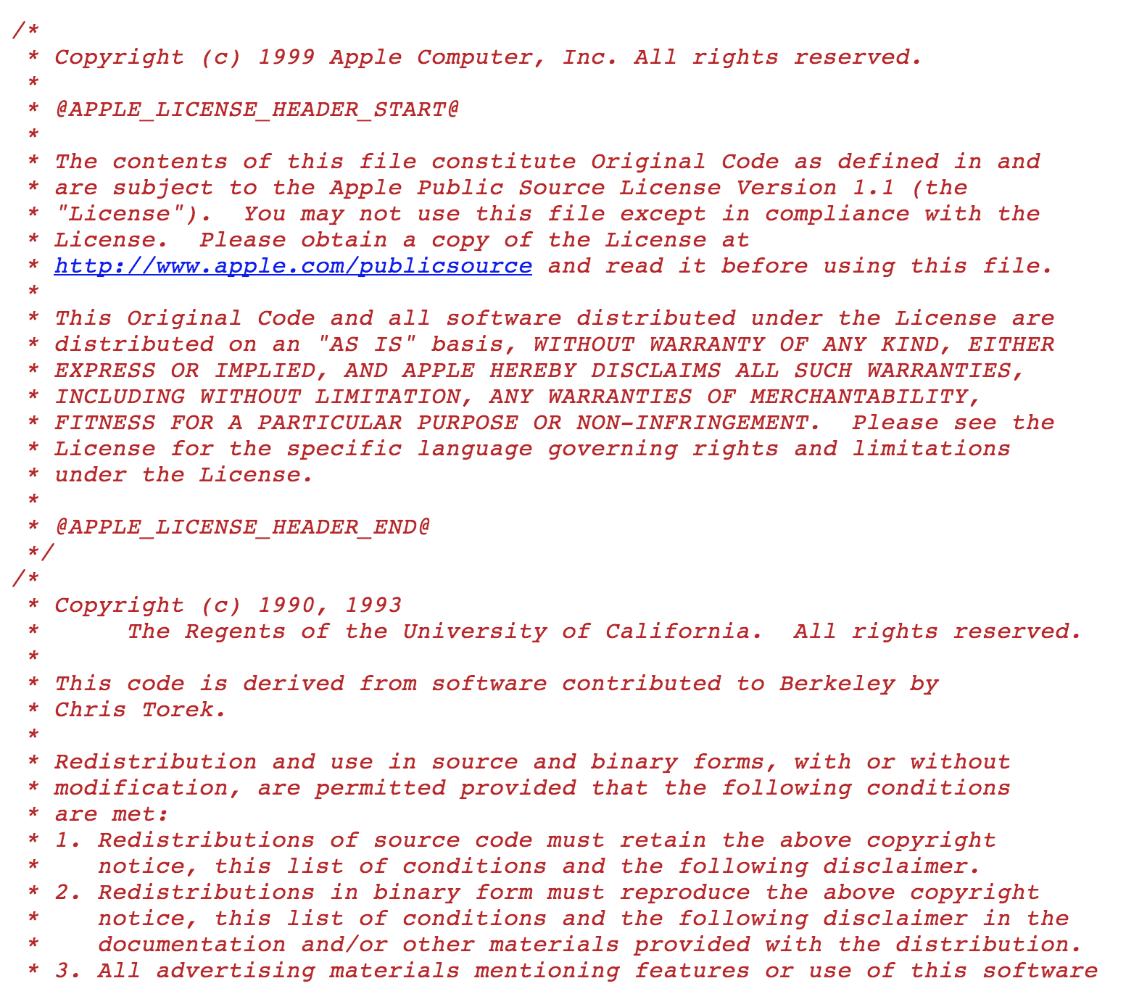
http://opensource.apple.com/source/Libc/Libc-167/stdio.subproj/fopen.c

Slide 46
Charge
PS3 is due Monday! Sign up for demo time.
Continue (start ☹) thinking about ideas for your project and recruiting teammates.

