Slide 1
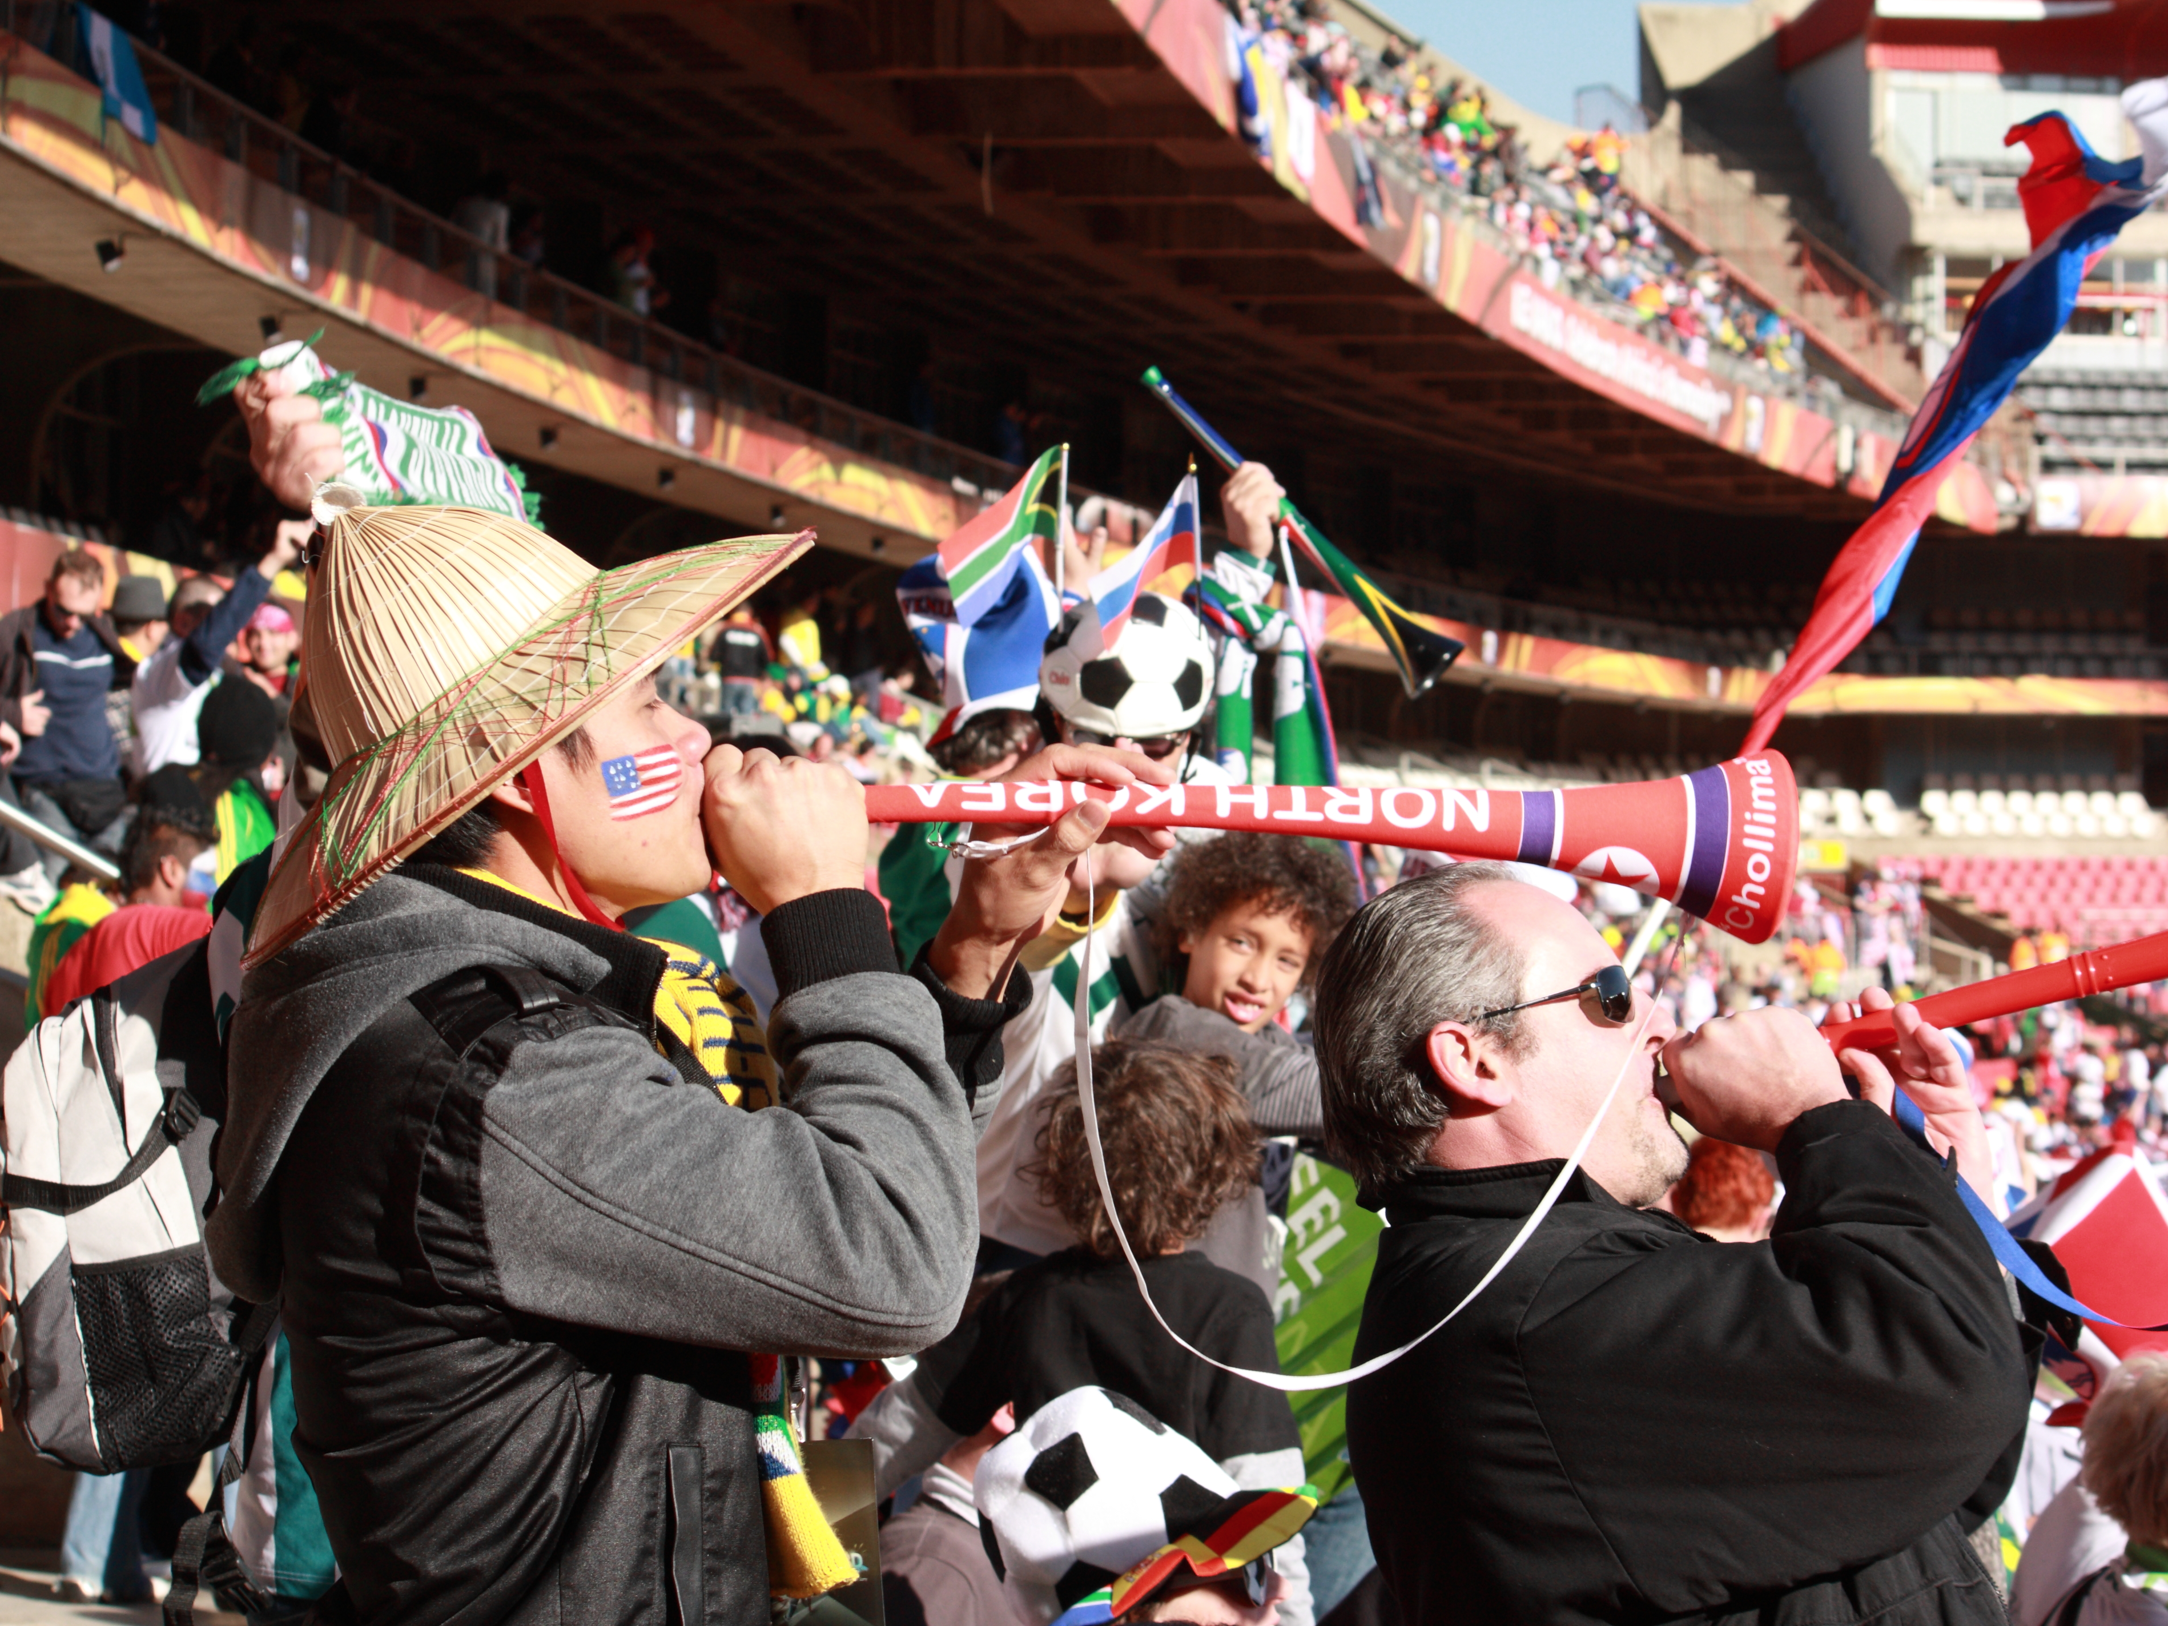
Class 19:
Synchronization
cs4414 Spring 2014
University of Virginia
David Evans

Slide 2
Plan for Today
PS4 Postmortem (?)
Yesterday’s SSL Bug
Projects
Synchronization
Due this week:
After your demo: PS4 Assessment
By 11:59pm Thursday: Project Idea

Slide 3

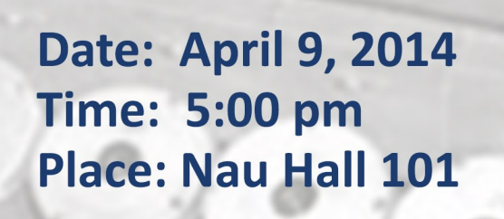
Public Talk this Wednesday!

Slide 4

PS4
There is nothing magic going on in the kernel.
Memory Protection is Really Valuable!
Problem 1: 32 out of 32 teams
Problem 2: 31 / 32
Problem 3: 31 / 32 (upside-down)
Problem 4: 28 / 32 (echoing)
Problem 5: 26 (note: 4 teams doing projects)
Problem 6: 14 (file system)
Problem 7: 13 (file system commands)
Problem 8: 21 (memory allocator fix)
Problem 9: 26 (interesting improvement)

Slide 5
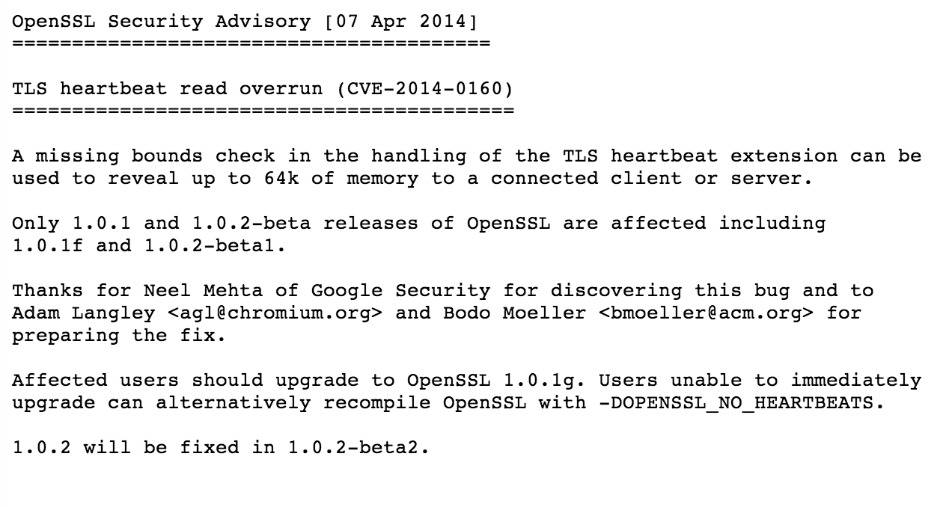
Yesterday’s SSL Bug
HT: Dan Truong

Slide 6
int
dtls1_process_heartbeat(SSL *s)
{
unsigned char *p = &s->s3->rrec.data[0], *pl;
unsigned short hbtype;
unsigned int payload;
unsigned int padding = 16; /* Use minimum padding */
/* Read type and payload length first */
hbtype = *p++;
n2s(p, payload);
pl = p;
…
if (hbtype == TLS1_HB_REQUEST)
{
unsigned char *buffer, *bp;
int r;
/* Allocate memory for the response, size is 1 byte
* message type, plus 2 bytes payload length, plus
* payload, plus padding
*/
buffer = OPENSSL_malloc(1 + 2 + payload + padding);
bp = buffer;
/* Enter response type, length and copy payload */
*bp++ = TLS1_HB_RESPONSE;
s2n(payload, bp);
memcpy(bp, pl, payload);
bp += payload;
/* Random padding */
RAND_pseudo_bytes(bp, padding);
r = dtls1_write_bytes(s, TLS1_RT_HEARTBEAT, buffer,
3 + payload + padding);
if (r >= 0 && s->msg_callback)
s->msg_callback(1, s->version, TLS1_RT_HEARTBEAT,
buffer, 3 + payload + padding,
s, s->msg_callback_arg);
OPENSSL_free(buffer);
if (r < 0)
return r;
}
...

Slide 7
int dtls1_process_heartbeat(SSL *s) {
unsigned char *p = &s->s3->rrec.data[0], *pl;
unsigned int payload;
unsigned int padding = 16; /* Use minimum padding */
/* Read type and payload length first */
hbtype = *p++;
n2s(p, payload);
pl = p;
…
buffer = OPENSSL_malloc(1 + 2 + payload + padding);
bp = buffer;
*bp++ = TLS1_HB_RESPONSE;
s2n(payload, bp);
memcpy(bp, pl, payload);
bp += payload;
RAND_pseudo_bytes(bp, padding);
r = dtls1_write_bytes(s, TLS1_RT_HEARTBEAT, buffer,
3 + payload + padding);

Slide 8
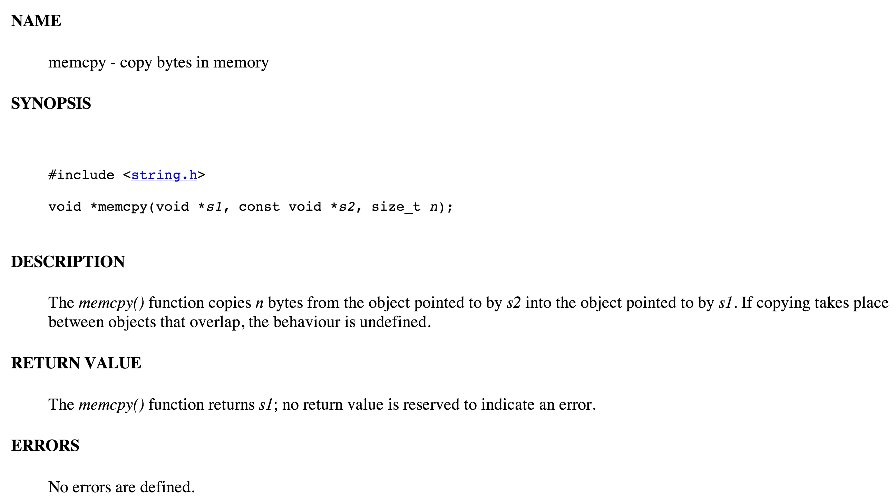
int dtls1_process_heartbeat(SSL *s) {
unsigned char *p = &s->s3->rrec.data[0], *pl;
unsigned int payload;
unsigned int padding = 16; /* Use minimum padding */
/* Read type and payload length first */
hbtype = *p++;
n2s(p, payload);
pl = p;
…
buffer = OPENSSL_malloc(1 + 2 + payload + padding);
bp = buffer;
*bp++ = TLS1_HB_RESPONSE;
s2n(payload, bp);
memcpy(bp, pl, payload);
bp += payload;
RAND_pseudo_bytes(bp, padding);
r = dtls1_write_bytes(s, TLS1_RT_HEARTBEAT, buffer,
3 + payload + padding);

Slide 9
int dtls1_process_heartbeat(SSL *s) {
unsigned char *p = &s->s3->rrec.data[0], *pl;
unsigned int payload;
unsigned int padding = 16; /* Use minimum padding */
/* Read type and payload length first */
hbtype = *p++;
n2s(p, payload);
pl = p;
…
buffer = OPENSSL_malloc(1 + 2 + payload + padding);
bp = buffer;
*bp++ = TLS1_HB_RESPONSE;
s2n(payload, bp);
memcpy(bp, pl, payload);
bp += payload;
RAND_pseudo_bytes(bp, padding);
r = dtls1_write_bytes(s, TLS1_RT_HEARTBEAT, buffer,
3 + payload + padding);
typedef struct ssl3_record_st
{
int type; /* type of record */
unsigned int length; /* How many bytes available */
unsigned int off; /* read/write offset into 'buf' */
unsigned char *data; /* pointer to the record data */
unsigned char *input; /* where the decode bytes are */
unsigned char *comp; /* only used with decompression - malloc()ed */
unsigned long epoch; /* epoch number, needed by DTLS1 */
unsigned char seq_num[8]; /* sequence number, needed by DTLS1 */
} SSL3_RECORD;

Slide 10
int dtls1_process_heartbeat(SSL *s) {
unsigned char *p = &s->s3->rrec.data[0], *pl;
unsigned int payload;
unsigned int padding = 16; /* Use minimum padding */
/* Read type and payload length first */
hbtype = *p++;
n2s(p, payload);
pl = p;
…
buffer = OPENSSL_malloc(1 + 2 + payload + padding);
bp = buffer;
*bp++ = TLS1_HB_RESPONSE;
s2n(payload, bp);
memcpy(bp, pl, payload);
bp += payload;
RAND_pseudo_bytes(bp, padding);
r = dtls1_write_bytes(s, TLS1_RT_HEARTBEAT, buffer,
3 + payload + padding);
data
0: type
1: length (1)
2: length (2)
3: …
n2s copies two bytes into 16-bit int:
payload = p[0:1]
s2n copies 16-bit int into two bytes:
bp[0:1] = payload

Slide 11
int dtls1_process_heartbeat(SSL *s) {
unsigned char *p = &s->s3->rrec.data[0], *pl;
unsigned int payload;
unsigned int padding = 16; /* Use minimum padding */
/* Read type and payload length first */
hbtype = *p++;
n2s(p, payload);
pl = p;
…
buffer = OPENSSL_malloc(1 + 2 + payload + padding);
bp = buffer;
*bp++ = TLS1_HB_RESPONSE;
s2n(payload, bp);
memcpy(bp, pl, payload);
bp += payload;
RAND_pseudo_bytes(bp, padding);
r = dtls1_write_bytes(s, TLS1_RT_HEARTBEAT, buffer,
3 + payload + padding);
data
0: type
1: length (1)
2: length (2)
3: …
n2s copies two bytes into 16-bit int:
payload = p[0:1]
User controls size
of s3->rrec->data,
and value of payload!
Can read up to 64K-2 bytes
beyond allocated object…

Slide 12
int dtls1_process_heartbeat(SSL *s) {
unsigned char *p = &s->s3->rrec.data[0], *pl;
unsigned int payload;
unsigned int padding = 16; /* Use minimum padding */
/* Read type and payload length first */
hbtype = *p++;
n2s(p, payload);
pl = p;
…
buffer = OPENSSL_malloc(1 + 2 + payload + padding);
bp = buffer;
*bp++ = TLS1_HB_RESPONSE;
s2n(payload, bp);
memcpy(bp, pl, payload);
bp += payload;
RAND_pseudo_bytes(bp, padding);
r = dtls1_write_bytes(s, TLS1_RT_HEARTBEAT, buffer,
3 + payload + padding);
if (1 + 2 + 16 > s->s3->rrec.length)
return 0; /* silently discard */
if (1 + 2 + payload + 16 > s->s3->rrec.length)
return 0; /* silently discard per RFC 6520 sec. 4 */
unsigned int write_length = 1 /* heartbeat type */ +
2 /* heartbeat length */ +
payload + padding;
if (write_length > SSL3_RT_MAX_PLAIN_LENGTH)
return 0;
buffer = OPENSSL_malloc(write_length);

Slide 13
int dtls1_process_heartbeat(SSL *s) {
unsigned char *p = &s->s3->rrec.data[0], *pl;
unsigned int payload;
unsigned int padding = 16; /* Use minimum padding */
/* Read type and payload length first */
hbtype = *p++;
n2s(p, payload);
pl = p;
…
buffer = OPENSSL_malloc(1 + 2 + payload + padding);
bp = buffer;
*bp++ = TLS1_HB_RESPONSE;
s2n(payload, bp);
memcpy(bp, pl, payload);
bp += payload;
RAND_pseudo_bytes(bp, padding);
r = dtls1_write_bytes(s, TLS1_RT_HEARTBEAT, buffer,
3 + payload + padding);
if (1 + 2 + 16 > s->s3->rrec.length)
return 0; /* silently discard */
Yuck, yuck, yuck!
Even after such a bug, the OpenSSL maintainers still haven’t learned…
if (1 + 2 + payload + 16 > s->s3->rrec.length)
return 0; /* silently discard per RFC 6520 sec. 4 */
unsigned int write_length = 1 /* heartbeat type */ +
2 /* heartbeat length */ +
payload + padding;
if (write_length > SSL3_RT_MAX_PLAIN_LENGTH)
return 0;
buffer = OPENSSL_malloc(write_length);

Slide 14
Project
Do something that is
  fun (for you to do, and others to see)
  relevant (to the class)
  technically interesting (to you and me)
  useful (at least to you, hopefully to many)
You probably can’t maximize all of these! It is okay to sacrifice one or two of them to increase others. A good project should be strong on at least 2 of these, which is much better than being mediocre of all four.

Slide 15
Project Teams
Anyone you want
Size: 1-110 (7B) people (recommended: 2-5)
Okay to include people not in class “Impressiveness” should scale as sqrt(N)
(N = # of teammates in class)
Choose your teammates carefully and manage it well.

Slide 16
Project Grading
A Do something you are proud of
A- Do something you find satisfactory
B+ Do something you find not embarrassing
<=B Do something embarrassing
* (and that I think its reasonable for you to be proud of)
* (and that I think it is okay for you to find satisfactory)
* (and that I think is okay for you to not find embarrassing)

Slide 17
“A+” Projects
A+ Do something I am impressed by
    I will help you get into grad school, find a high-paying interesting job, or give you a low-paying interesting job.

Slide 18
Ideas for Projects
Doesn’t have to use Rust
Doesn’t have to be a program
Extensions to IronKernel
Run a user-level process; Flash drive file system
Concurrency mechanisms; Networking stack
Some interesting systems-level program
Some contribution to Rust
Some contribution to computing (e.g., SafeSSL?)

Slide 19
Project Schedule
Due Thursday: Project Ideas
16-21 Apr: Project Design Reviews
24 & 29 Apr: Project Presentations

Slide 20
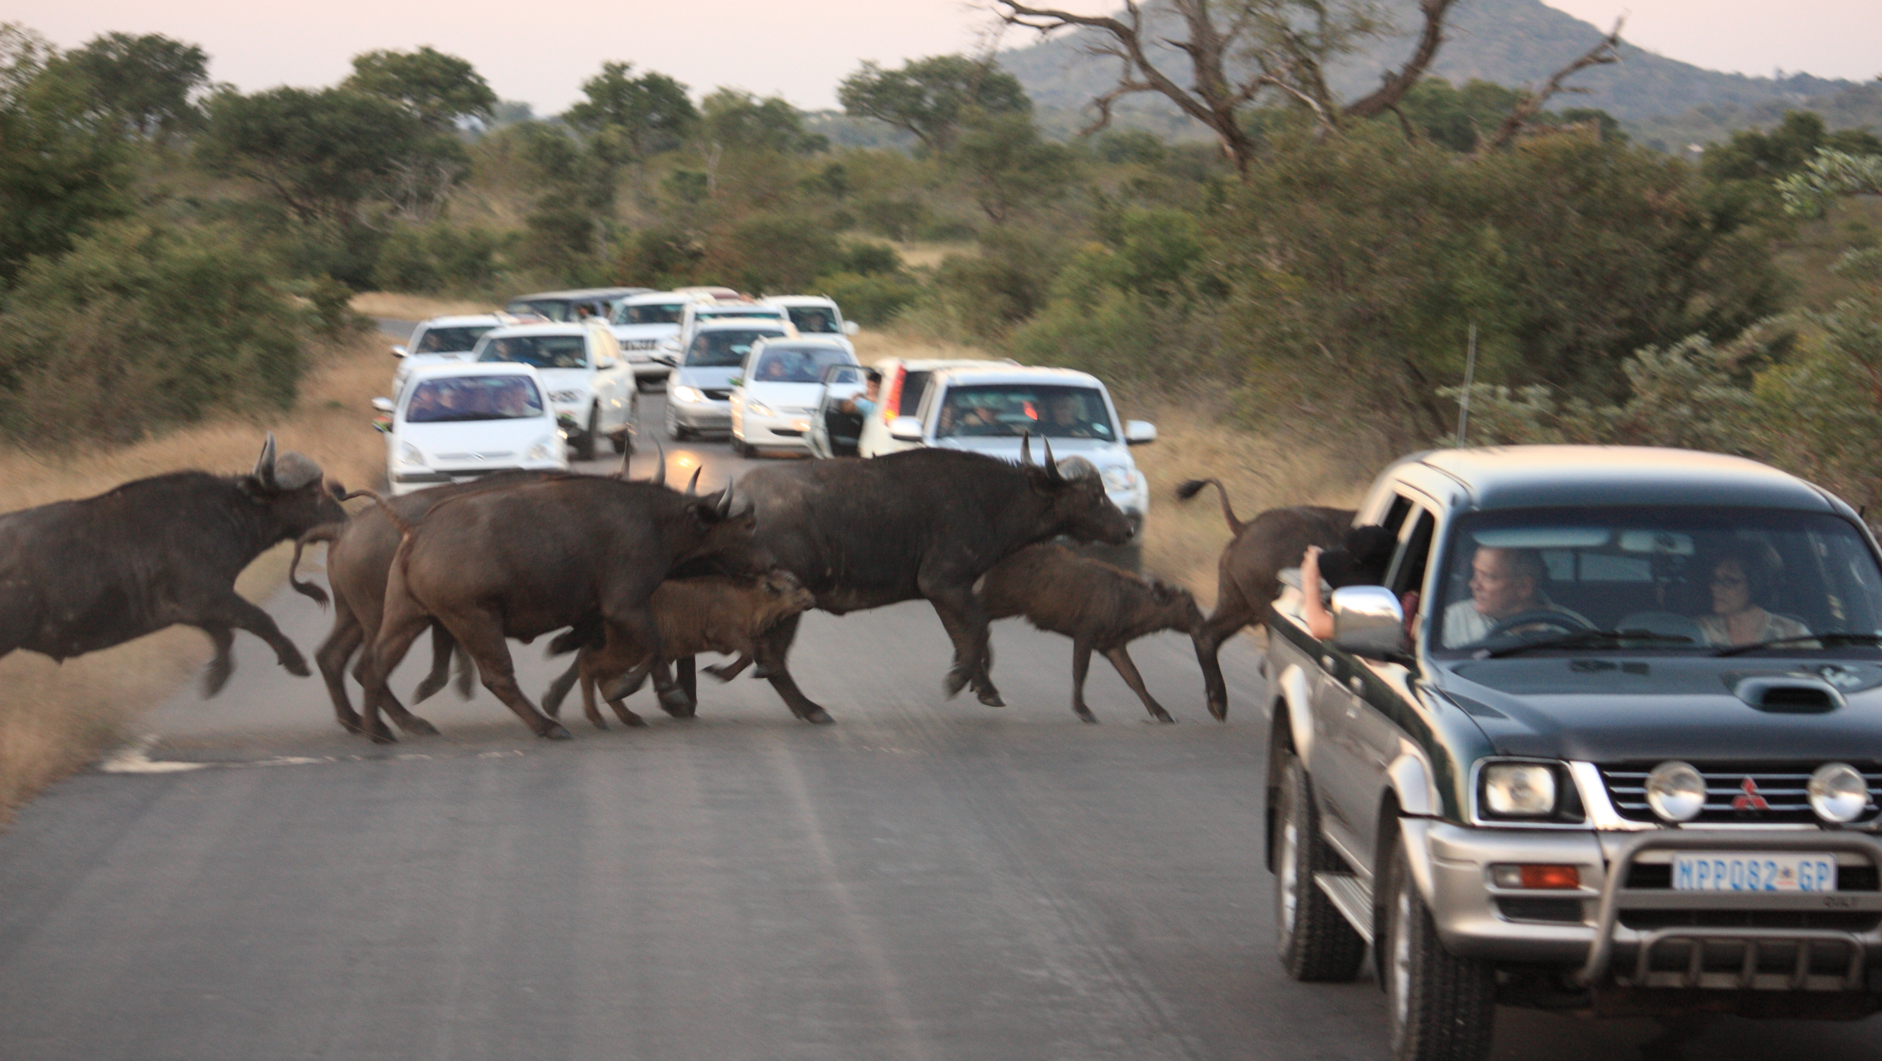
Synchronization

Slide 21
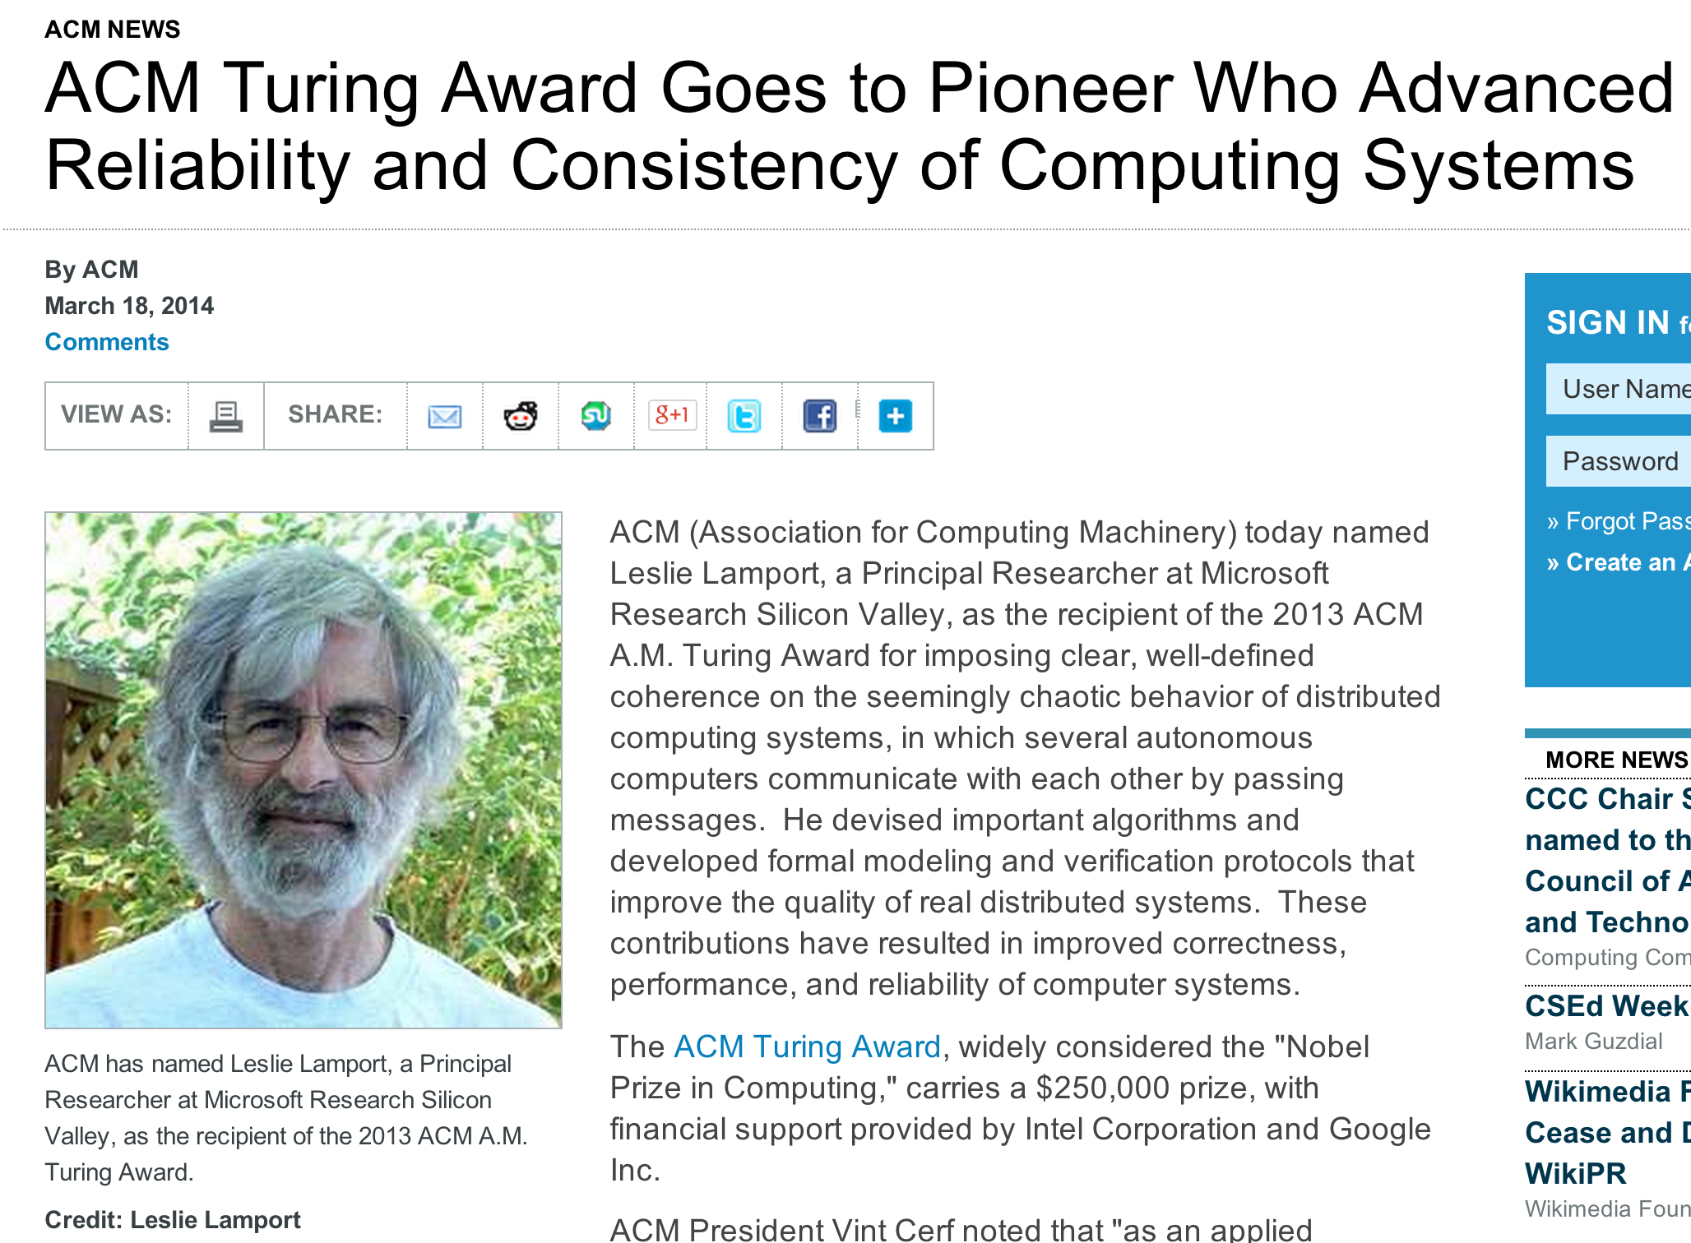
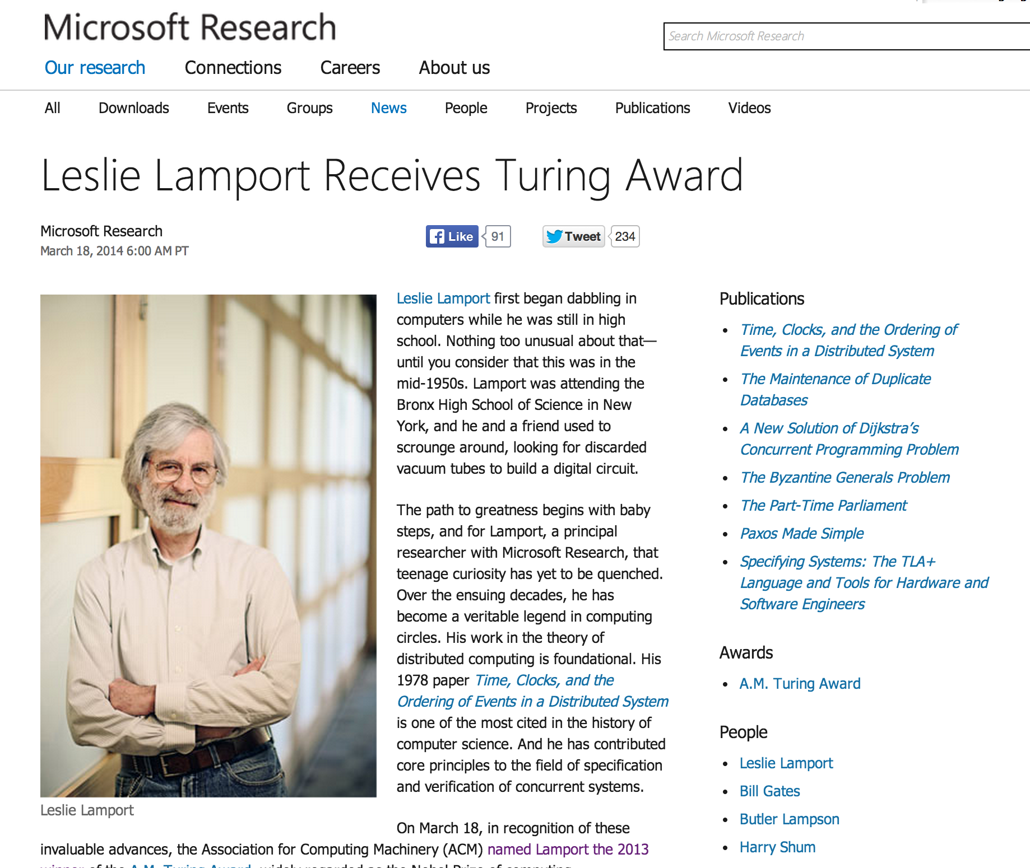
Class 14

Slide 22
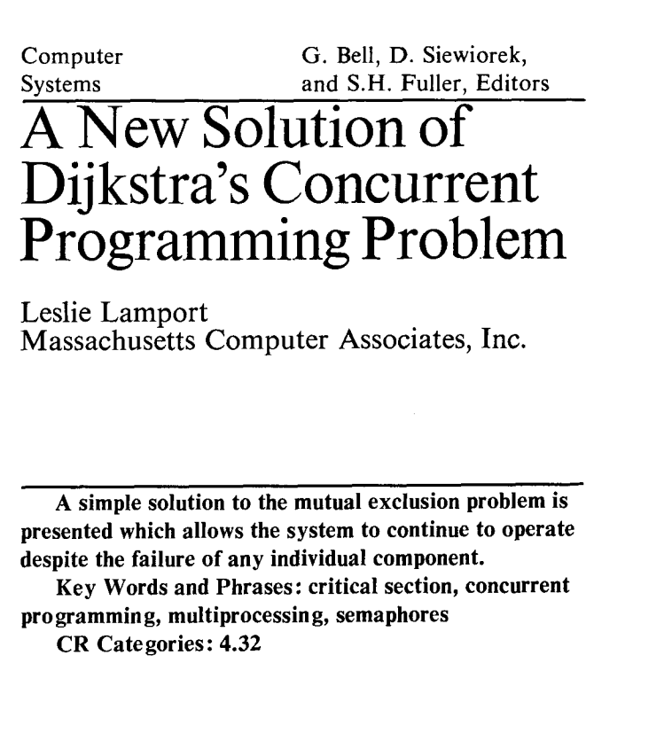
Class 14
“What is significant about the bakery algorithm is that it implements mutual exclusion without relying on any lower-level mutual exclusion. Assuming that reads and writes of a memory location are atomic actions, as previous mutual exclusion algorithms had done, is tantamount to assuming mutually exclusive access to the location. So a mutual exclusion algorithm that assumes atomic reads and writes is assuming lower-level mutual exclusion. Such an algorithm cannot really be said to solve the mutual exclusion problem. Before the bakery algorithm, people believed that the mutual exclusion problem was unsolvable--that you could implement mutual exclusion only by using lower-level mutual exclusion.”
Communications of the ACM, August 1974 (2 pages)
We will explore this next Tuesday!

Slide 23
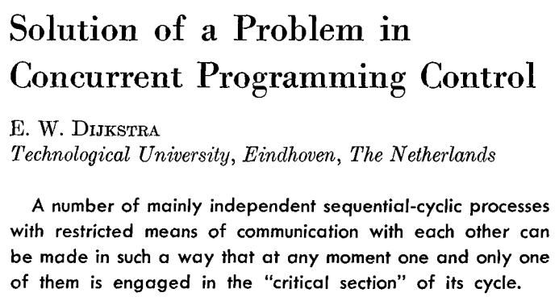
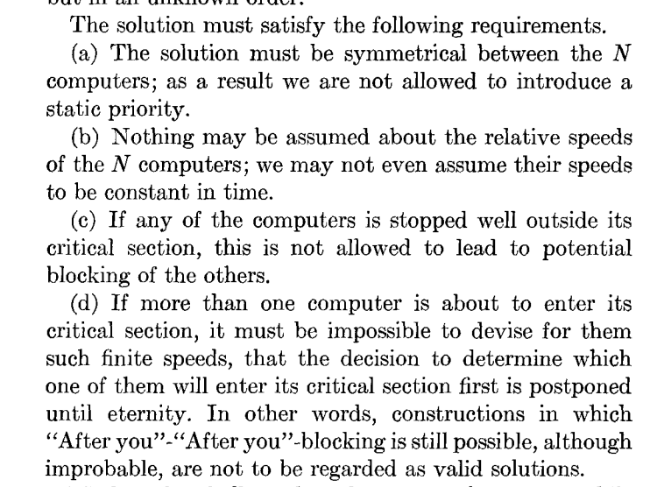

Edsger Dijkstra (1930-2002)

Slide 24
Dijkstra’s Problem
N independent threads
Program:
loop {
non-critical {
…
}
critical {
…
}
}
T1
T2
T3
T4
T5
Shared Memory (atomic read and write)

Slide 25
N independent threads
T1
T2
T3
T4
T5
Program:
loop {
non-critical {
…
}
critical {
…
}
}
Shared Memory (atomic read and write)
Requirements:
Only one thread may be in the critical section at any time.
Each must eventually be able to enter its critical section.
Must be symmetrical (all run same program).
Cannot make any assumptions about speed of threads.

Slide 26
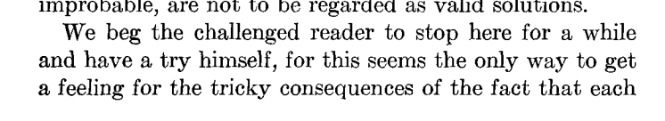
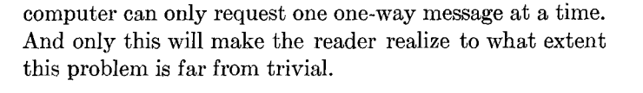
herself,

Slide 27
N independent threads
T1
T2
T3
T4
T5
Program:
loop {
non-critical {
…
}
critical {
…
}
}
Shared Memory (atomic read and write)
Requirements:
Only one thread may be in the critical section at any time.
Each must eventually be able to enter its critical section.
Must be symmetrical (all run same program).
Cannot make any assumptions about speed of threads.

Slide 28

How does UVaCollab solve mutual exclusion problem?
“UVaCollab is an advanced web-based course and collaboration environment”

Slide 29


Slide 31
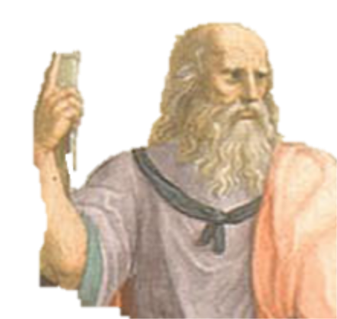



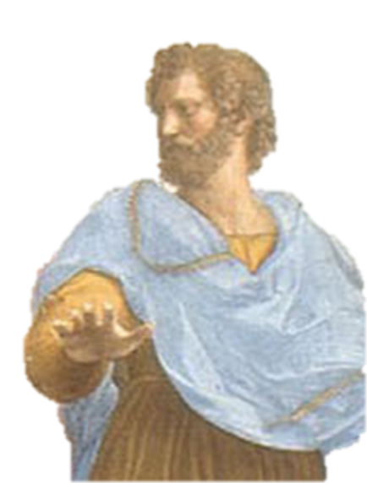
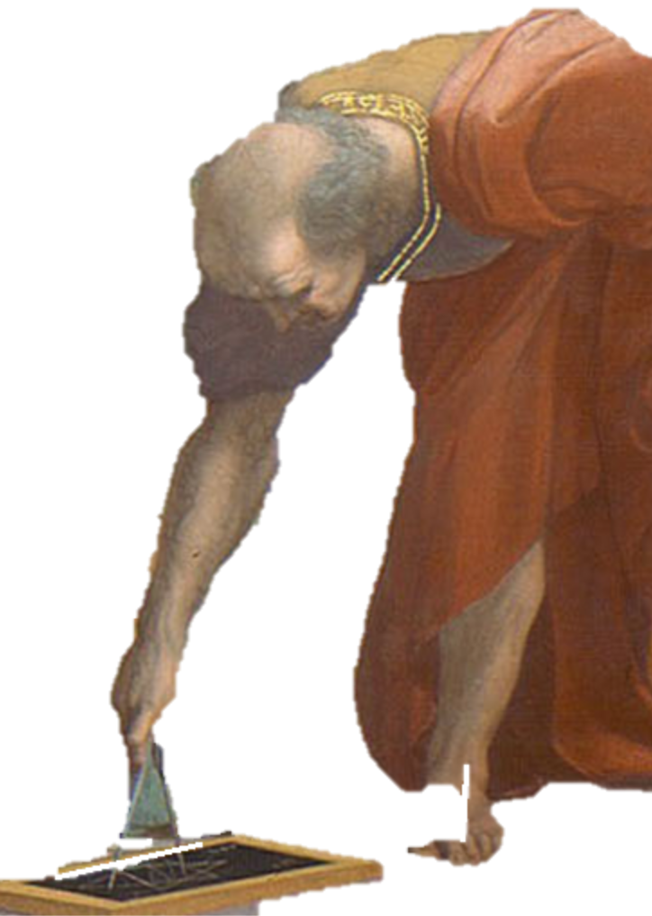
Charge
Think about how to solve this without atomic read/writes
Project ideas due by Thursday (11:59pm)
Submit PS4 Assessment

