Slide 1
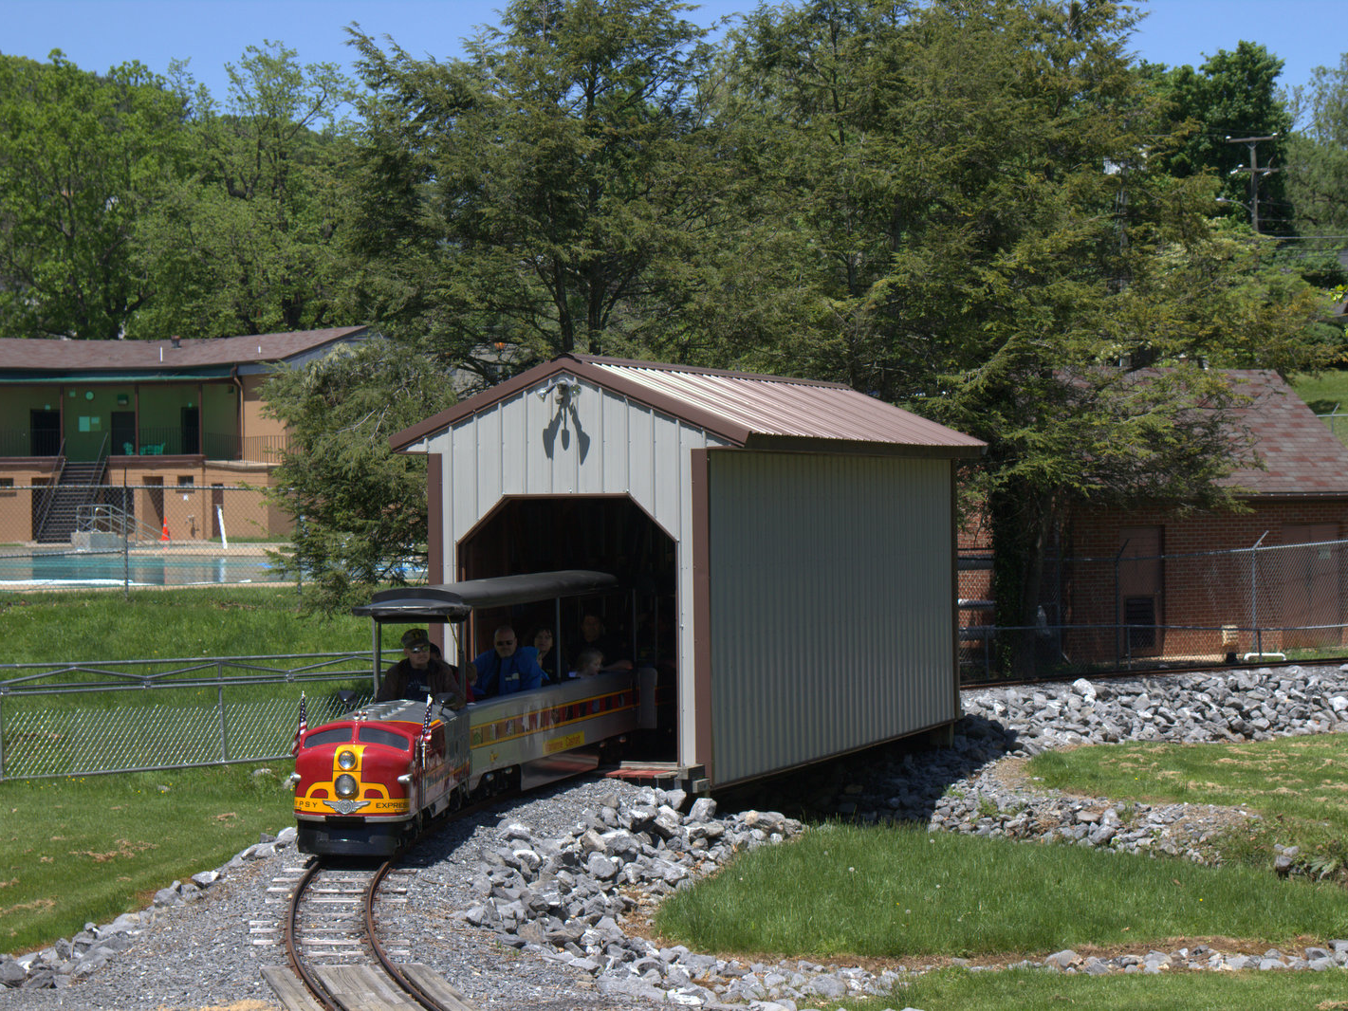
Class 2:
First Ride on Rust
cs4414 Fall 2013
University of Virginia
David Evans

Slide 2
Menu
Recap last week, syllabus questions
Overview of Rust (and why we are using it)
Brief history of Computing Systems
Some Rust constructs (for PS1)

Slide 3
Why learn a new programming language?

Slide 4
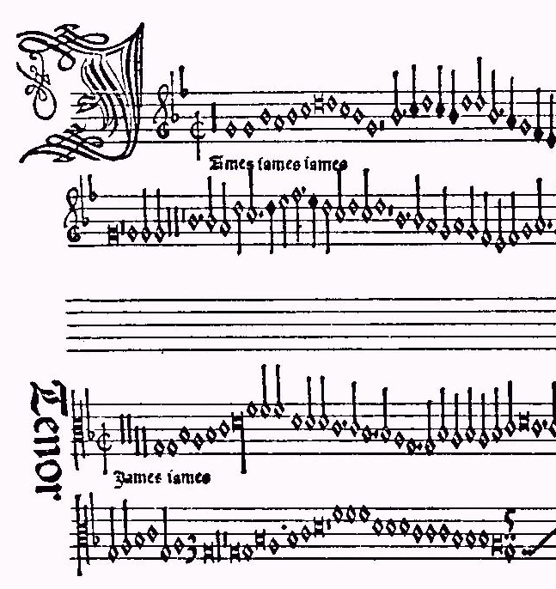
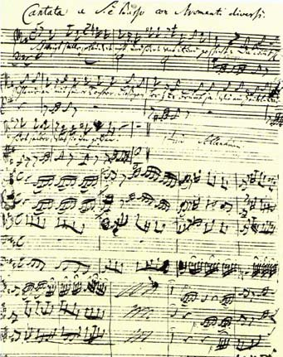
“Jamais Jamais Jamais” from Harmonice Musices Odhecaton A. (1501)
J S Bach, “Coffee Cantata”, BWV 211 (1732)
www.npj.com/homepage/teritowe/jsbhand.html

Slide 5
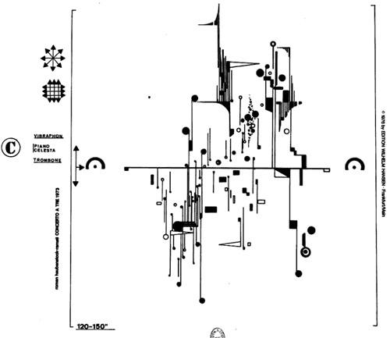
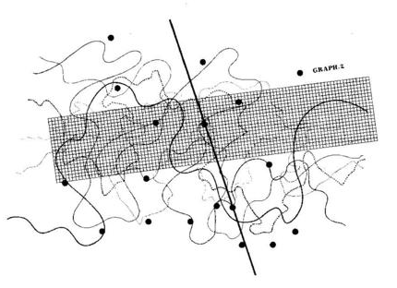
Modern Music Notation
Roman Haubenstock-Ramati, Concerto a Tre
John Cage, Fontana Mix
http://www.medienkunstnetz.de/works/fontana-mix/audio/1/

Slide 6
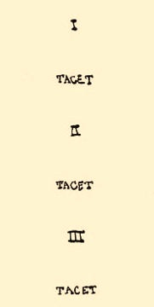
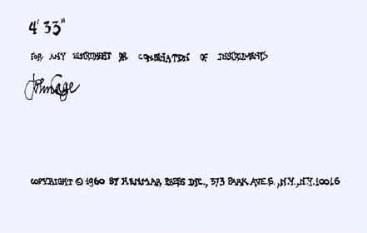
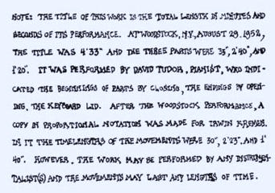

Slide 7
Thought and Action
Languages change the way we think
  BASIC: think about GOTO
  Algol, Python: think about assignments, control blocks
  Scheme, Haskell: think about procedures
  Java, C++: think about types, objects
Languages provide abstractions of machine resources
  Hide dangerous/confusing details: memory locations, instruction opcodes, number representations, calling conventions, etc.
  Hiding more increases simplicity, but limits expressiveness
What do we want for systems programming?

Slide 8


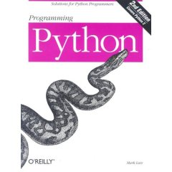

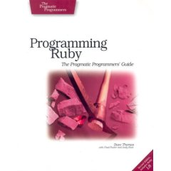
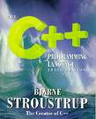


Why so many programming languages?

Slide 9
Fundamental Differences
All equivalently powerful!
  Universal languages: all capable of simulating each other
Fundamental differences
  Expressiveness: how easy it is to describe a computation
  “Truthiness”: likelihood that a program means what a programmer things it means
  Safeness: impact of programmer mistakes
There is a fundamental conflict between expressiveness and truthiness/safeness

Slide 10
Programming Language Design Space
high
Scheme
(display “Hello!”)
Python
print ("Hello!")
Expressiveness
BASIC
C++
strict typing,
static
C
Java
Ada
low
Spec#
more mistake prone
less mistake prone
“Truthiness”

Slide 11

“a safe, concurrent, practical language”
Its design is oriented toward concerns of “programming in the large”, that is, of creating and maintaining boundaries – both abstract and operational – that preserve large-system integrity, availability and concurrency.
from http://www.rust-lang.org/
Rust

Slide 12
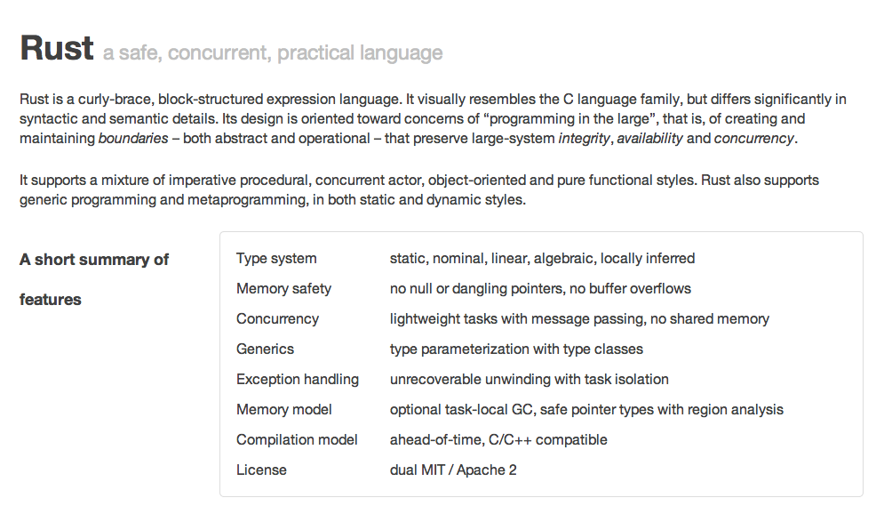
http://www.rust-lang.org/

Slide 13
fn max(a: int, b: int) -> int {
if a > b {
a
} else {
b
}
}
fn main() {
println(fmt!("Max: %?", max(3, 4)));
}

Slide 14
Expressions and Statements
Java/C++
Rust
IfStatement ::=
if (Expression)
Statement_{True}
[ else
Statement_{False}
]
IfExpression ::=
if Expression Block
[ else Block ]
Block ::= { [Statement* Expr] }
Expression ::= Block
Statement ::= Expression ;
Simplified: see http://static.rust-lang.org/doc/0.7/rust.html#if-expressions for full grammar.
Warning: “(looking for consistency in the manual's grammar is bad: it's entirely wrong in many places.)”

Slide 15
Quiz
IfExpression ::=
if Expression Block
[ else Block ]
Block ::= { [Statement* Expr] }
Expression ::= Block
fn max(a: int, b: int) -> int {
if { } { a } else { b }
}
Syntax Error
Type Error
Run-time Error

Slide 16
Quiz
IfExpression ::=
if Expression Block
[ else Block ]
Block ::= { [Statement* Expr] }
Expression ::= Block
fn max(a: int, b: int) -> int {
if { } { a } else { b }
}
$ rustc block.rs
block.rs:2:7: 2:10 error: mismatched types: expected `bool` but found `()` (expected bool but found ())
block.rs:2 if { } {
^~~

Slide 17
(Trick) Quiz
IfExpression ::=
if Expression Block
[ else Block ]
Block ::= { [Statement* Expr] }
Expression ::= Block
fn max(a: int, b: int) -> int {
if { let x = 4414; x = x + a; x > b + 4414 } { a }
else { b }
}
Syntax Error
Type Error
Run-time Error

Slide 18
(Trick) Quiz
IfExpression ::=
if Expression Block
[ else Block ]
Block ::= { [Statement* Expr] }
Expression ::= Block
fn max(a: int, b: int) -> int {
if { let x = 4414; x = x + a; x > b + 4414 } { a }
else { b }
}
“Variables” are invariable…unless declared with mut.
$ rustc block.rs
block.rs:2:23: 2:24 error: re-assignment of immutable variable `x`
block.rs:2 if { let x = 4414; x = x + a; x > b + 4414 } {
^

Slide 19
Quiz
IfExpression ::=
if Expression Block
[ else Block ]
Block ::= { [Statement* Expr] }
Expression ::= Block
fn max(a: int, b: int) -> int {
if { let mut x = 4414; x = x + a; x > b + 4414 } { a }
else { b }
}
$ rust run block.rs
Max: 5

Slide 20
Quiz
IfExpression ::=
if Expression Block
[ else Block ]
Block ::= { [Statement* Expr] }
Expression ::= Block
Statement ::= Expression ;
fn max(a: int, b: int) -> int {
if a > b { a } else { b; }
}
fn main() {
println(fmt!("Max: %?", max(5, 4)));
}

Slide 21
Quiz
The semi-colon makes it a statement – no value
fn max(a: int, b: int) -> int {
if a > b { a } else { b; }
}
fn main() {
println(fmt!("Max: %?", max(5, 4)));
}
block.rs:2:24: 2:30 error: mismatched types: expected `int` but found `()` (expected int but found ())
block.rs:2 if a > b { a } else { b; }
^~~~~~

Slide 22
Higher-Order Functions
Java
Rust
Java 8 (March 2014)
| <parameters> | Block
Scheme
(define (make-adder a)
(lambda (n)
(+ a n)))

Slide 23
Define a function, make_adder(int), that takes an integer as input and returns a function that takes and int and returns the sum of the original and input int.
make_adder(3)(1) => 4
let increment = make_adder(1);

Slide 24
fn make_adder(a : int) -> ~fn(int) -> int {
|b| { a + b }
}

Slide 25
Define a function, ntimes, that takes as inputs a function f (int -> int) and an integer n, and returns a function that applies f n-times.
fn double(a: int) -> int { a * 2 }
fn main() {
let quadruple = ntimes(double, 2);
println(fmt!("quad: %?", quadruple(2)));
}

Slide 26
fn ntimes(f: extern fn(int) -> int, times: int) -> ~fn(int) -> int {
|x| { if times == 0 { x } else { ntimes(f, times - 1)(f(x)) } }
}

Slide 27
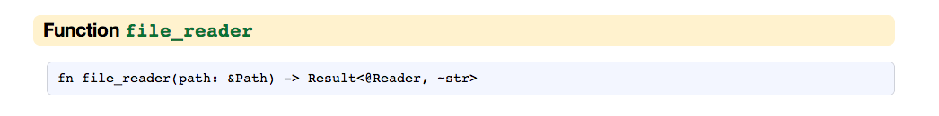
Reading a File
http://static.rust-lang.org/doc/0.7/std/io.html#function-file_reader
This isn’t an excerpt! This is all the documentation there is in the Rust manual.

Slide 28

Arrgh! What to do?
Image: credit unknown

Slide 29

“Baby” programmer (cs1xxx)

Slide 30

Give up in disgust!

Slide 31

cs4414 Student
“Professional Amateur
Programmer”

Slide 32
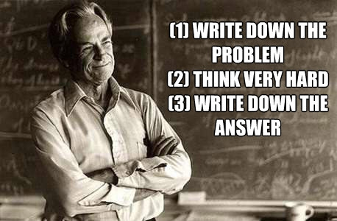
Solving Programming Mysteries
http://www.smellsfunny.com/view.php?fid=17557

Slide 33
Solving Programming Mysteries
DuckDuckGo (or Google) is your friend!

Slide 34
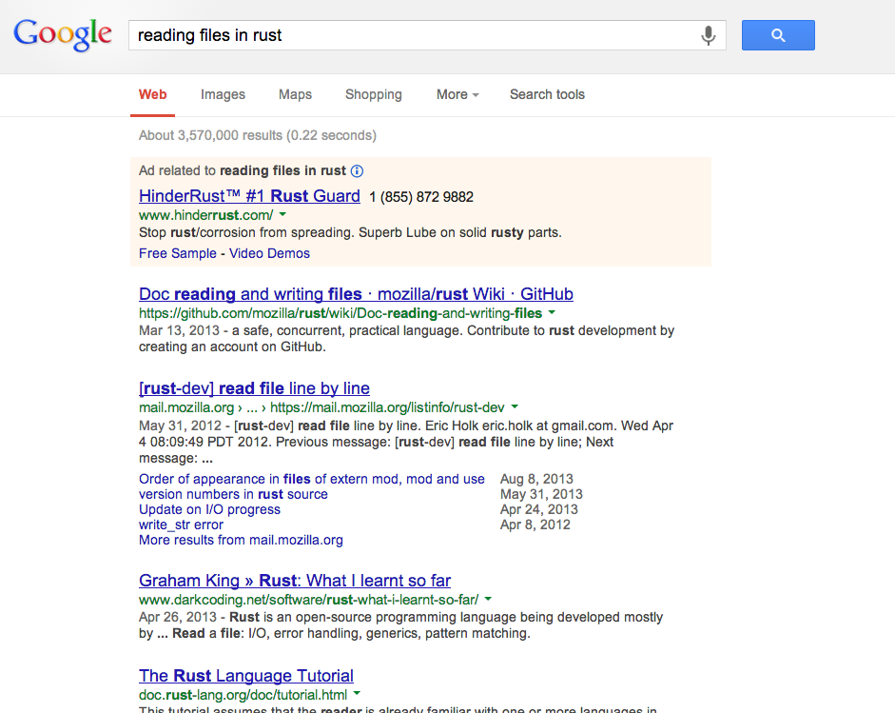
Caveats:
HinderRust will probably not help at all
Rust 0.7 is quite different from Rust 0.3
Easy to get lost in lots of details
Top-ranked result is not always the best solution
Dangerous to “cut-and-paste” code you don’t understand!

Slide 35
Solving Programming Mysteries
DuckDuckGo (or Google) is your friend!
stackoverflow [rust]

Slide 36
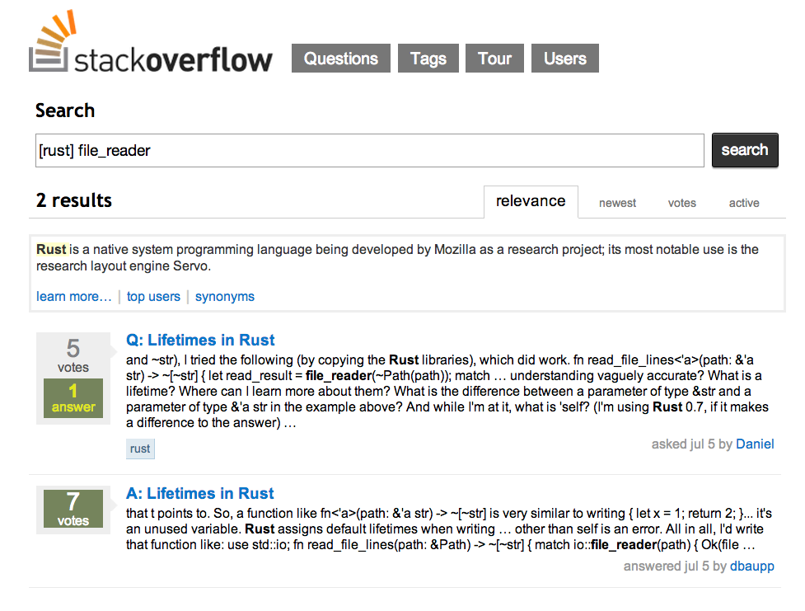
Questions tagged with rust: 116
Questions tagged with java: 468,140

Slide 37
Solving Programming Mysteries
DuckDuckGo (or Google) is your friend!
stackoverflow [rust]
Experiment!

Slide 38
fn main() {
let filereader = std::io::file_reader(~std::path::Path("test.txt"));
}
$ rustc experiment.rs
experiment.rs:6:8: 6:18 warning: unused variable: `filereader` [-W unused-variable (default)]
experiment.rs:6 let filereader = std::io::file_reader(~std::path::Path("test.txt"));
^~~~~~~~~~
fn main() {
let filereader = std::io::file_reader(~std::path::Path("test.txt"));
println(fmt!("Reader: %?", filereader));
}
$ rust run experiment.rs
Reader: Err(~"error opening test.txt")
$ echo ‘hello’ > test.txt
$ rust run experiment.rs
warning: no debug symbols in executable (-arch x86_64)
Reader: Ok()

Slide 39
Solving Programming Mysteries
DuckDuckGo (or Google) is your friend!
stackoverflow [rust]
Experiment!
Ask for help:
  Course Piazza forum
  IRC
If you figure something useful out that is not well documented, document it! course forum post, “blog” post

Slide 40
Back to Reading Files
Result<T, U> : enumerated type:
Ok(T)
Err(U)
Result<@Reader, ~str>

Slide 41
match expression
fn load_file(pathname : ~str) -> ~[~str] {
let filereader : Result<@Reader, ~str> =
io::file_reader(~path::Path(pathname));
match filereader {
Ok(reader) => reader.read_lines(),
Err(msg) => fail!("Cannot open file: " + msg),
}
}
How does this compare to the “Java” way?

Slide 42
match
match filereader {
Ok(reader) => reader.read_lines(),
}
compile-time completeness
cat.rs:9:4: 11:5 error: non-exhaustive patterns: Err not covered
current =
match current {
current if current % 2 == 0 => current / 2,
_ => 3 * current + 1
};
match predicates can be arbitrary expressions
_ (like default in C switch)

Slide 43
Why NOT to use Rust

Slide 44
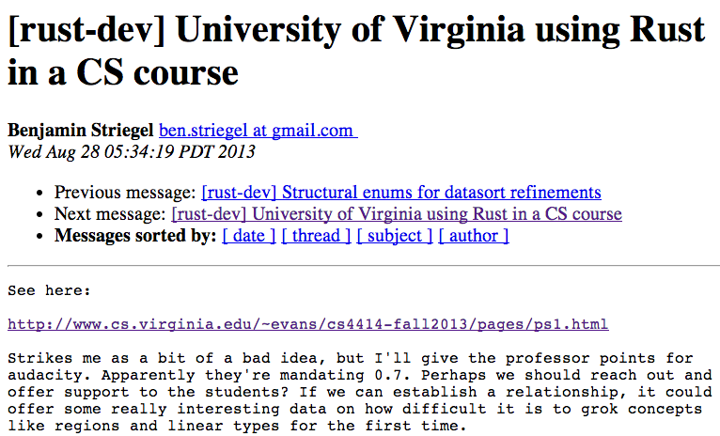
https://mail.mozilla.org/pipermail/rust-dev/2013-August/005409.html

Slide 45
https://github.com/graydon/rust/wiki
This is a very preliminary work in progress. No supported releases yet nor defined release schedule / plans. Caveat emptor. It will crash. It will change syntax and semantics. It will eat your laundry. Use at your own risk. Etc.
Originally posted: 15 Dec 2011 (but still there today)

Slide 46
Rust or Bust?
Rust
Bust (C)
☹ Immature, Unstable
Poorly documented
Few open source projects (except Servo)
Not in high employer demand
No other courses
Mature, Stable
Hundreds of books, etc.
Lots of open source projects (incl. Linux)
Popular for interview questions
Nearly all OS courses

Slide 47
Rust or Bust?
Rust
Bust (C)
Benefits from past 30 years of language and compiler research
Suffers from maintaining backwards compatibility with language stripped down to fit in ~9 KB

Slide 48

Dennis Ritchie
PDP-11
~4KB of memory
Ken Thompson
PDP-11

Slide 49

“I call it my billion-dollar mistake.” (Sir Tony Hoare)
int main(int argc, char **argv) {
char *s = (char *) malloc (MY_SIZE);
*s = 'a';
return 0;
}
Note: Sir Tony invented null references in 1964 (before C), and said this in 2009 (back when an American billion dollars was still real money). See a great talk here:
http://www.infoq.com/presentations/Null-References-The-Billion-Dollar-Mistake-Tony-Hoare
He designed compiler to check every reference is safe (but null and bounds checking), but C removed them as too expensive.
$ gcc -Wall null.c
$ ./a.out
Segmentation fault (core dumped)
Photo: Bertrand Meyer

Slide 50
Rust or Bust?
Rust
Bust (C)
Benefits from past 30 years of language and compiler research
Chance to influence a new, exciting, fast-evolving language
Some really cool features for memory management and concurrency
FUN!
Suffers from maintaining backwards compatibility
C++0x standard process began in 1998, released in 2011, over 40 meetings
Lots of complexity, but not designed for safety
Boring, Annoying

Slide 51
Diving In: zhttpo.rs
// zhttpto.rs
// ...
extern mod extra;
use extra::uv;
use extra::{net_ip, net_tcp};
use std::str;
static BACKLOG: uint = 5;
static PORT: uint = 4414;
static IPV4_LOOPBACK: &'static str = "127.0.0.1";
fn new_connection_callback(new_conn :net_tcp::TcpNewConnection, _killch: std::comm::SharedChan<Option<extra::net_tcp::TcpErrData>>)
{
...
Comments similar to C++
Dependency on an external “crate” (compilation unit)
Import into namespace:
uv = “extra::uv”
global “variables” (no mut, so they are constants)

Slide 52
main
fn main() {
net_tcp::listen(net_ip::v4::parse_addr(IPV4_LOOPBACK), PORT, BACKLOG,
&uv::global_loop::get(),
|_chan| { println(fmt!("Listening on tcp port %u ...", PORT)); },
new_connection_callback);
}

Slide 53
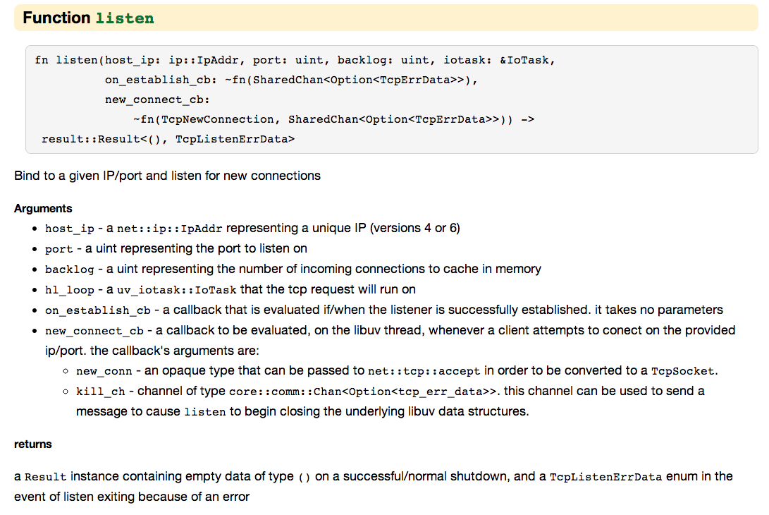
http://static.rust-lang.org/doc/std/net_tcp.html#function-listen

Slide 54
fn main() {
net_tcp::listen(net_ip::v4::parse_addr(IPV4_LOOPBACK), PORT, BACKLOG,
&uv::global_loop::get(),
|_chan| { println(fmt!("Listening on tcp port %u ...", PORT)); },
new_connection_callback);
}
on_establish_cb: ~fn(SharedChan<Option<TcpErrData>>)
a callback that is evaluated if/when the listener is successfully established. it takes no parameters
new_connect_cb - a callback to be evaluated, on the libuv thread, whenever a client attempts to connect on the provided ip/port. the callback’s arguments are: …

Slide 55
fn new_connection_callback(new_conn : net_tcp::TcpNewConnection,
_killch : std::comm::SharedChan<…>)
{
do spawn {
let accept_result = extra::net_tcp::accept(new_conn);
match accept_result {
Err(err) => { println(fmt!("Connection error: %?", err)); },
Ok(sock) => {
let peer_addr: ~str = net_ip::format_addr(&sock.get_peer_addr());
println(fmt!("Received connection from: %s", peer_addr));
let read_result = net_tcp::read(&sock, 0u);
match read_result {
Err(err) => { println(fmt!("Receive error: %?", err)); },
Ok(bytes) => {
let request_str = str::from_bytes(bytes.slice(0, bytes.len() - 1));
println(fmt!("Request received:\n%s", request_str));
let response: ~str = ~
"HTTP/1.1 …”;
net_tcp::write(&sock, response.as_bytes_with_null_consume());
},
};
} } }; }

Slide 56
Charge
You should be making progress on PS1 now: you know everything you need to finish it
  Take advantage of Piazza forum and IRC for any strange Rustiness you encounter
Next class: processes!

Slide 57
Ways to Learn New Languages
Read the compiler source code
Read the reference manual
Go through a (well designed!) tutorial
Read a good book with lots of exercises
Dive right into a complex program and try to modify it
Find a mentor who is a language expert

