Slide 1

Class 20:
Mutual Exclusion
Reminder: Project Ideas are due by 11:59pm tonight!
cs4414 Spring 2014
University of Virginia
David Evans

Slide 2
Plan for Today
Recap: Dijkstra’s Mutual Exclusion Problem
Why Obvious Solutions Fail
Practical Solutions with Modern Processors
Dijkstra’s Solution
Lamport’s Solution
Reminder: Project Ideas are due by 11:59pm tonight!

Slide 3



Slide 4
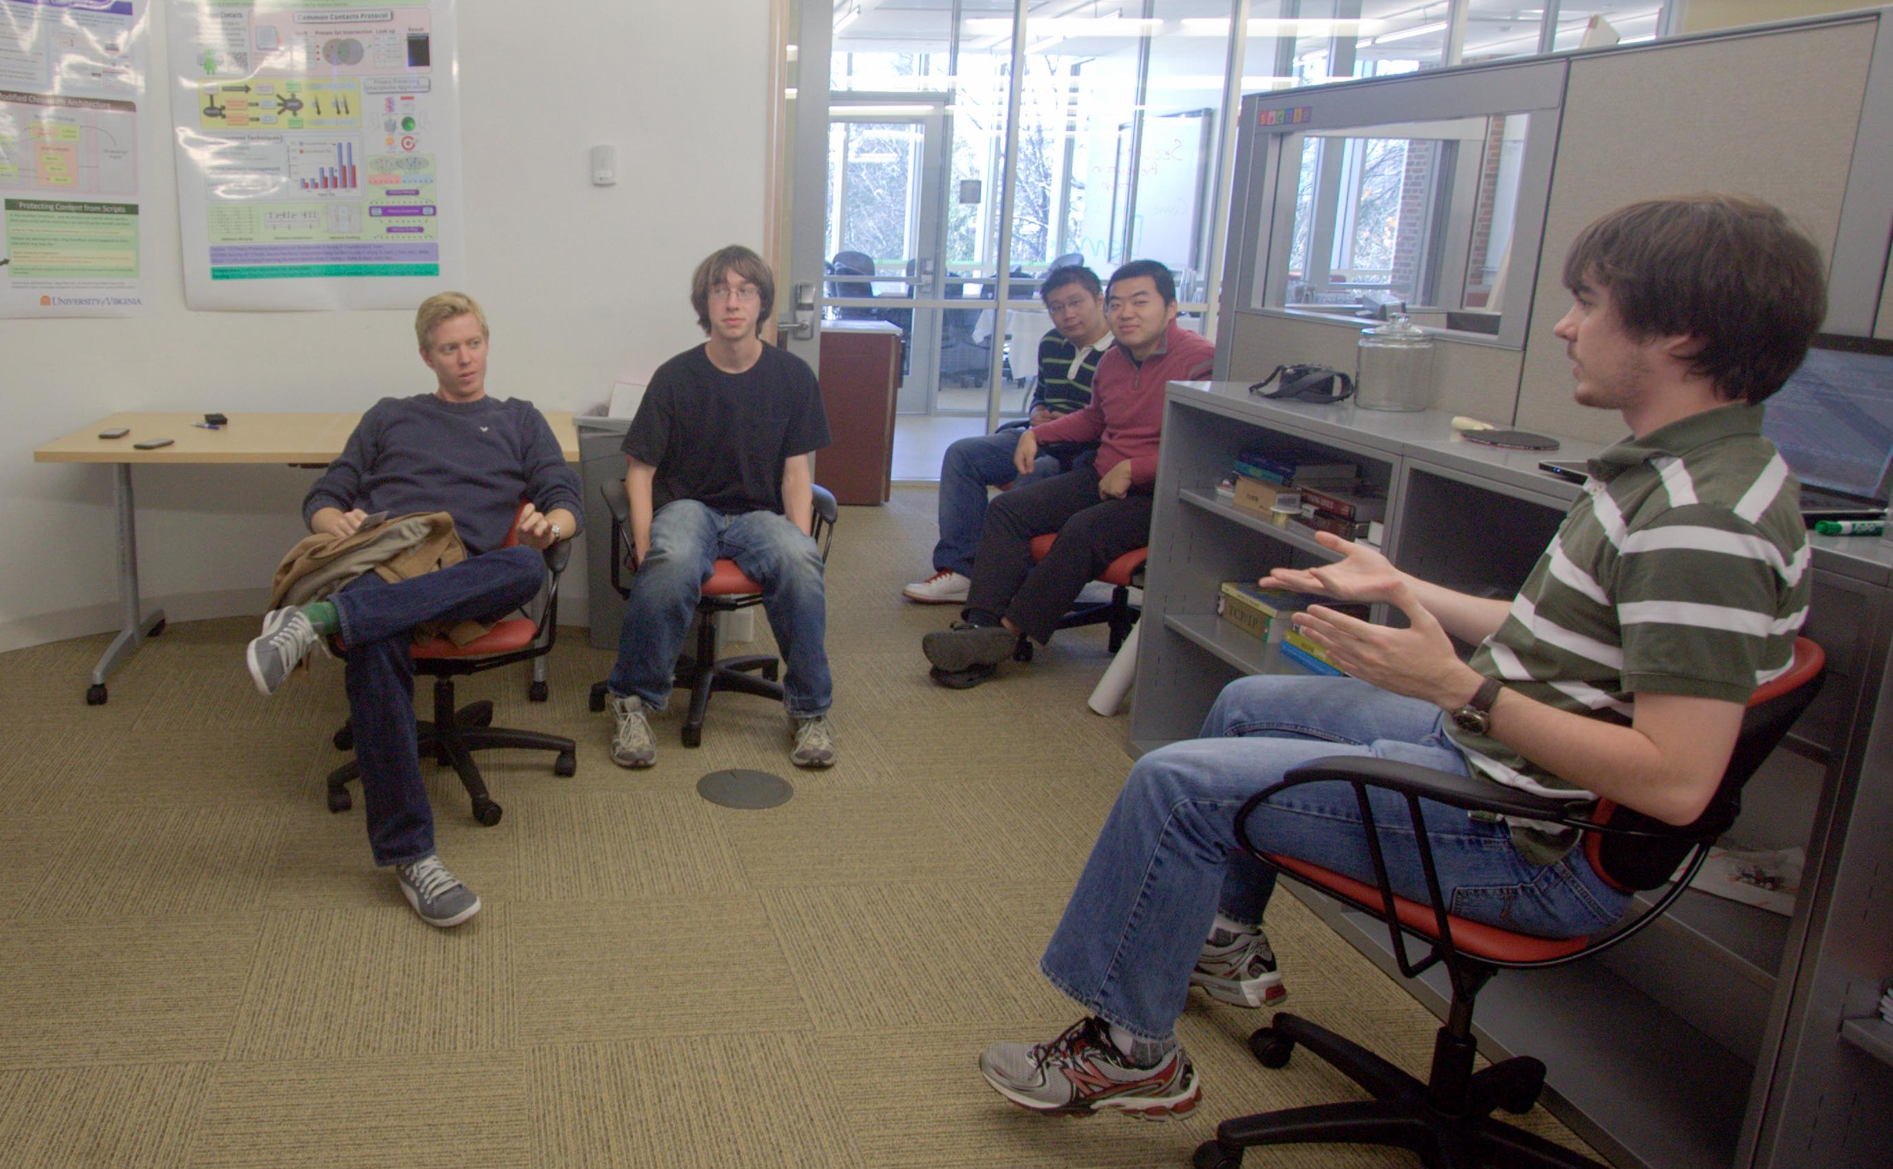
Projects Update
Class 20 / Segment 1
cs4414 Spring 2014
David Evans

Slide 5
N independent threads
T1
T2
T3
T4
T5
Program:
loop {
non-critical {
…
}
critical {
…
}
}
Shared Memory (atomic read and write)
Requirements:
Only one thread may be in the critical section at any time.
Each must eventually be able to enter its critical section.
Must be symmetrical (all run same program).
Cannot make any assumptions about speed of threads.

Slide 6
Clever “Cheating” Solution
T1
T2
T3
Initially, turn = 1
loop {
if turn == i:
critical_section;
turn = i + 1;
}
Shared Memory
turn:

Slide 7
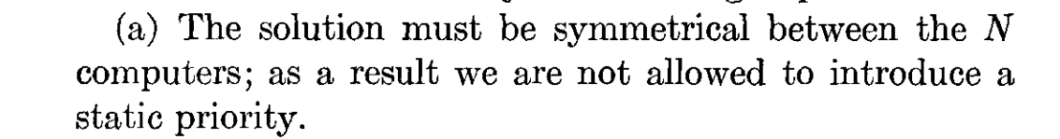
Initially, turn = 1
loop {
if turn == i:
critical_section;
turn = i + 1;
}

Slide 8
Attempted Solution
T1
T2
T3
loop {
if not lock:
lock = true;
critical_section;
lock = false;
}
Shared Memory
lock:

Slide 9
Attempted Fix
T1
T2
T3
loop {
if lock == 0:
lock = i;
if lock == i:
critical_section;
lock = 0;
}
Shared Memory
lock:

Slide 10
Attempted Fix of Fix
loop {
if lock1 == 0:
lock1 = i;
if lock1 == i:
if lock2 == 0:
lock2 = i;
if lock2 == i:
critical_section;
lock2 = 0;
lock1 = 0;
}
T1
T2
T3
Shared Memory
lock1:
lock2:

Slide 11
Attempted Fix of Fix of Fix …
loop {
if lock1 == 0:
lock1 = i;
if lock1 == i:
if lock2 == 0:
lock2 = i;
if lock2 == i:
critical_section;
lock2 = 0;
lock1 = 0;
}
T1
T2
T3
Shared Memory
lock1:
lock2:
Do we need to see why 3-locks still breaks?

Slide 12
Easy (Kernel Cheating) Solution
Uniprocessor
loop {
non-critical;
disable interrupts
critical_section;
enable interrupts
}
T1
T2
T3
Shared Memory

Slide 13
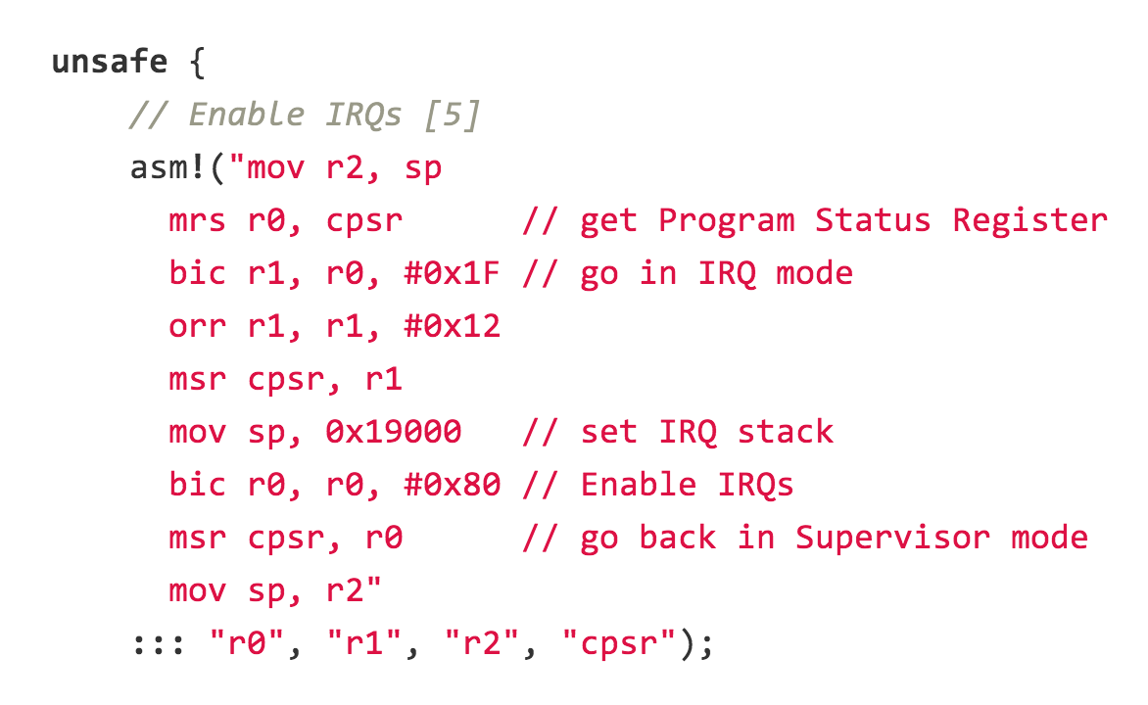
ironkernel: arch/arm/cpu/interrupt.rs

Slide 14
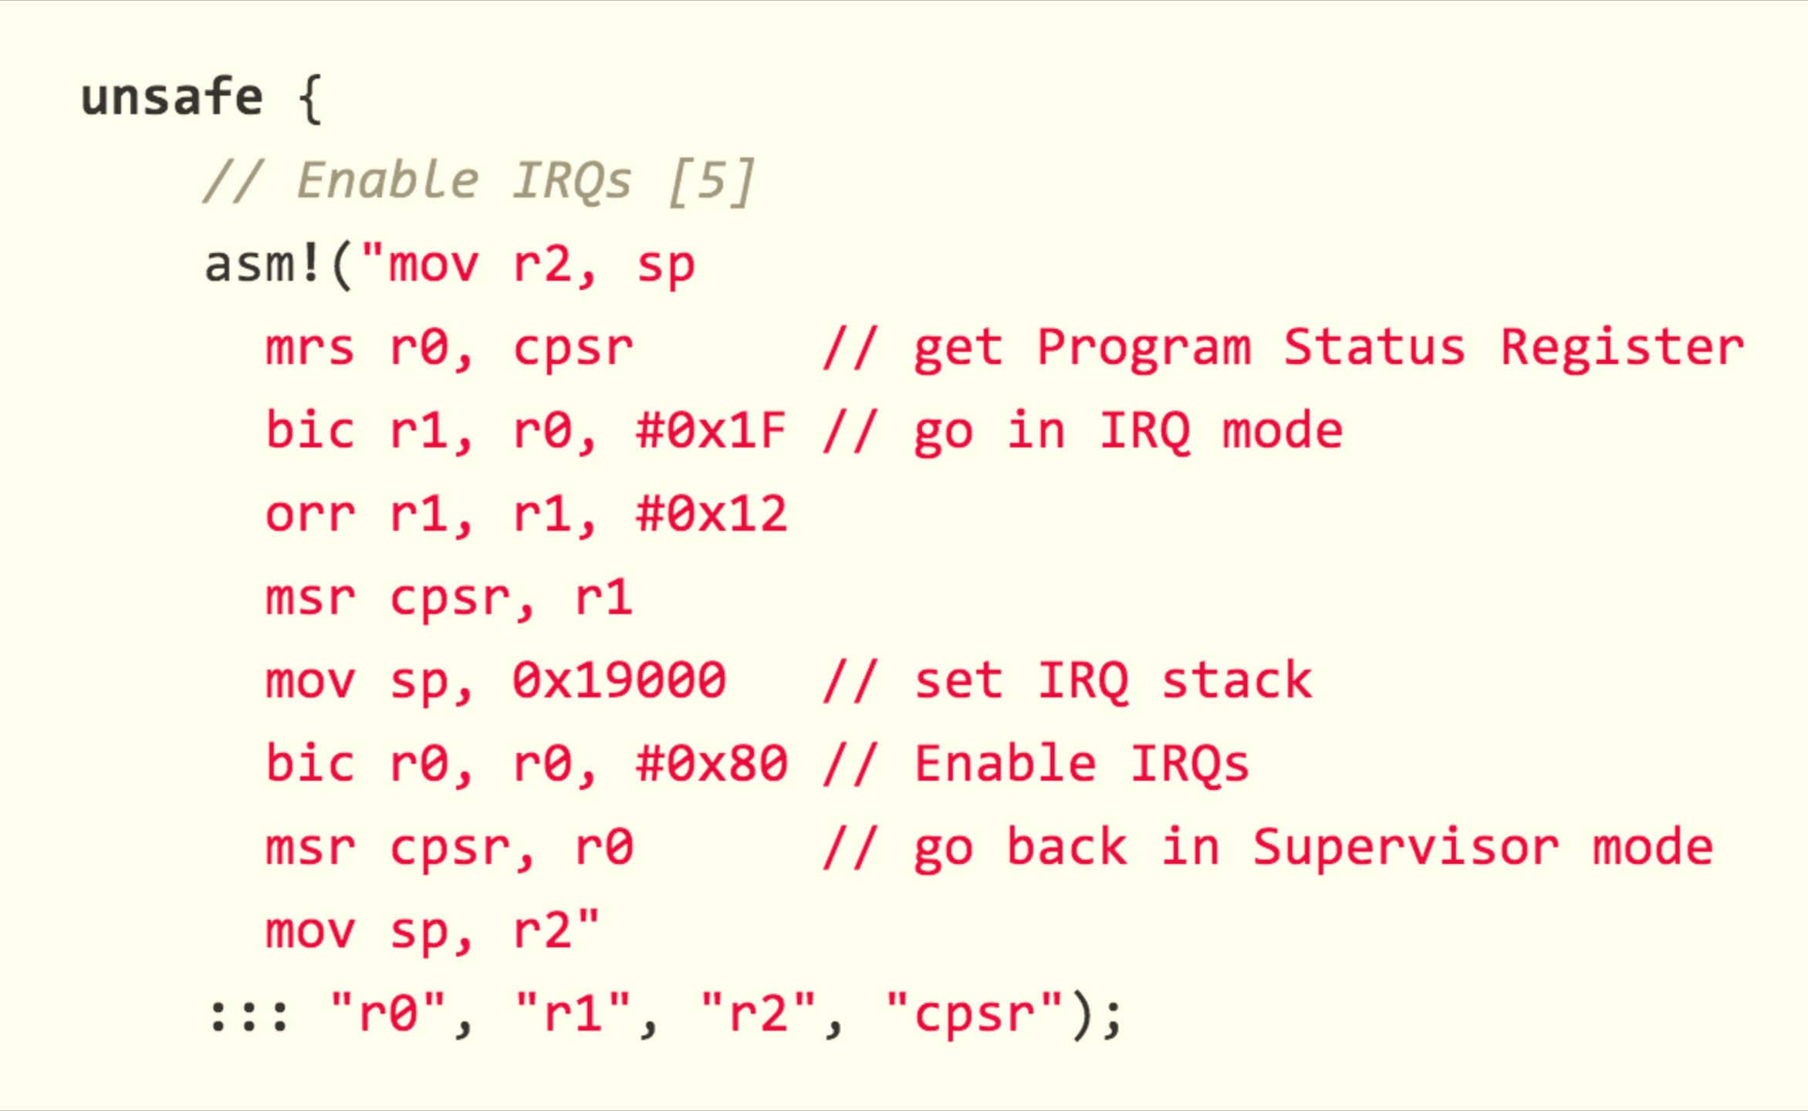
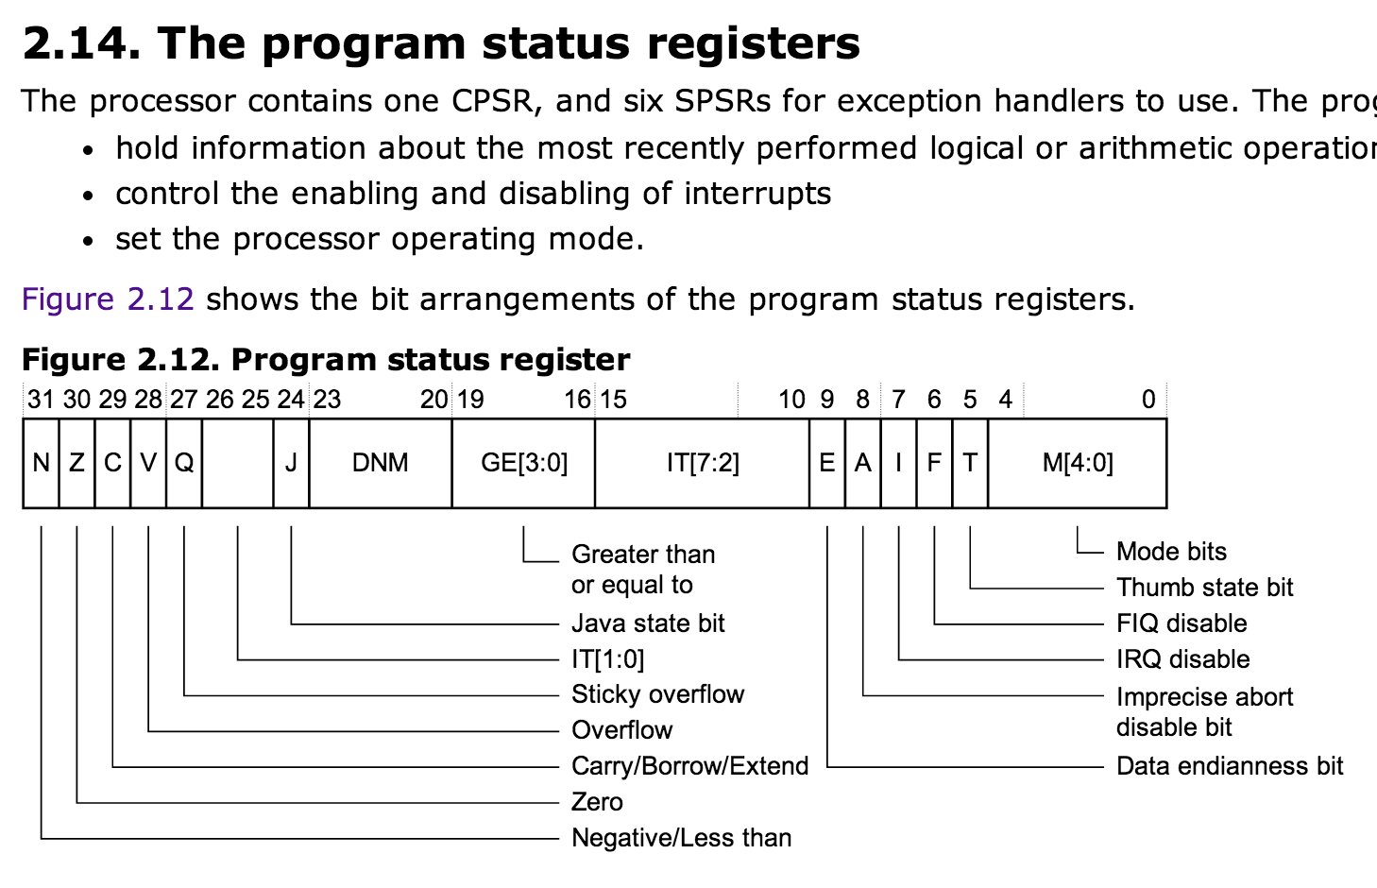
ironkernel: arch/arm/cpu/interrupt.rs
CPSR: Current Program Status Register

Slide 15
Easy (Kernel Cheating) Solution
loop {
non-critical;
disable interrupts
critical_section;
enable interrupts
}
Uniprocessor
T1
T2
T3
Shared Memory
How well does this solution work for modern kernels?

Slide 16
Easy (Cheating) Solution
T1
T2
T3
Shared Memory
(with atomic read/write/test&set)
lock:
test_and_set(v)
returns current value of v
sets value of v to true

Slide 17
Easy (Cheating) Solution
T1
T2
T3
loop {
if not test_and_set(lock):
critical_section;
lock = false;
}
Shared Memory
(with atomic read/write/test&set)
lock:
test_and_set(v)
returns current value of v
sets value of v to true

Slide 18
Does your processor provide such an instruction?

Slide 19
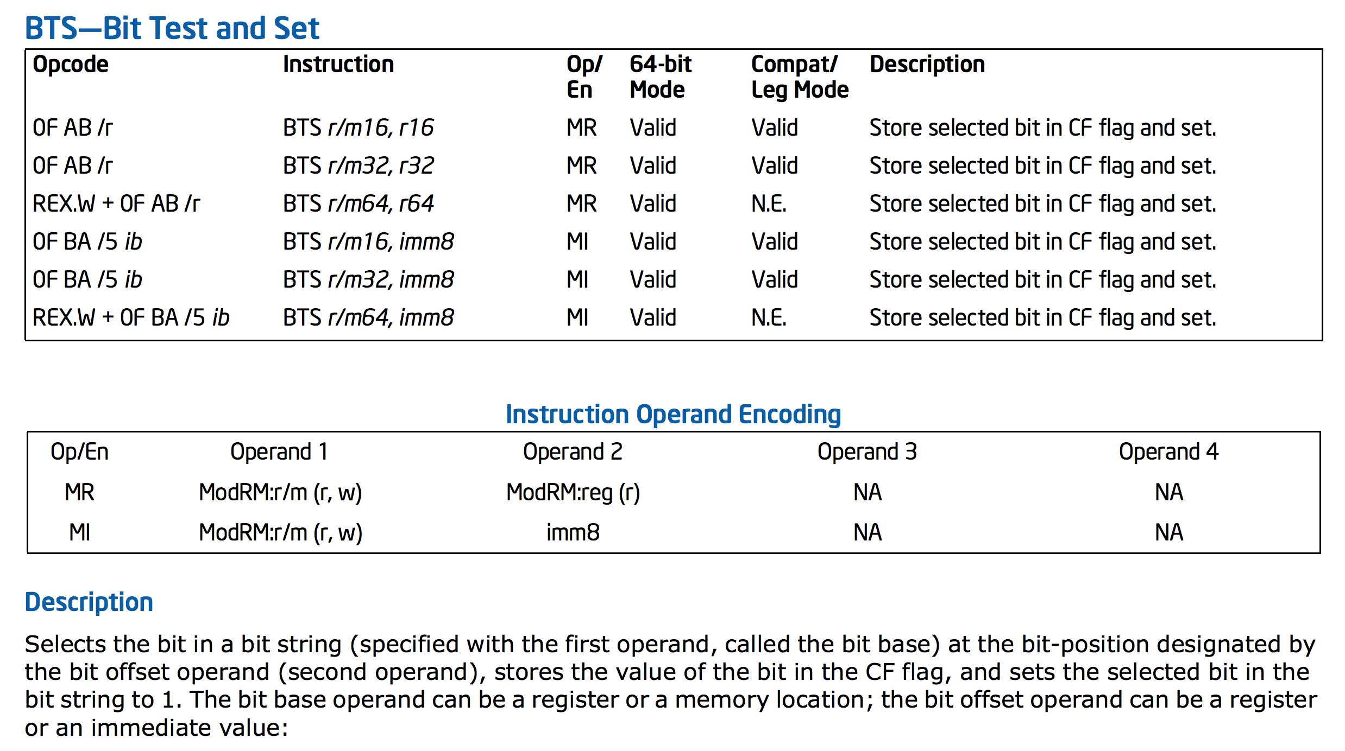
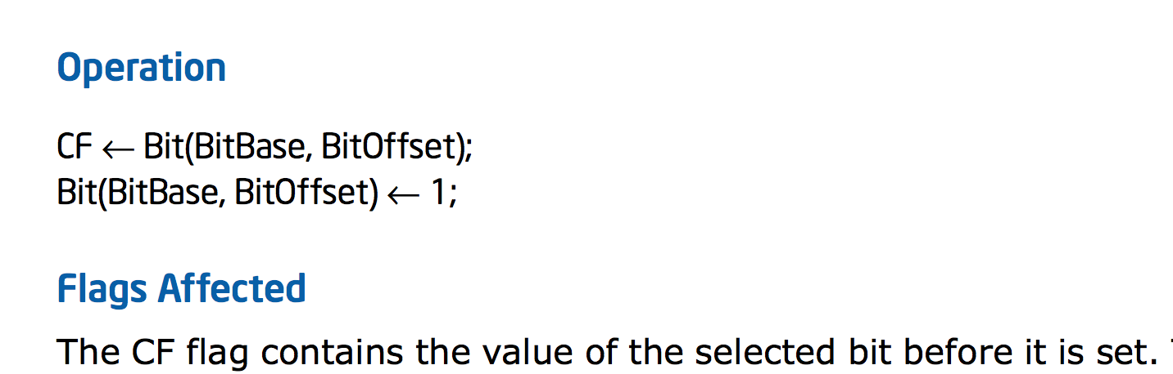
Intel x86

Slide 20
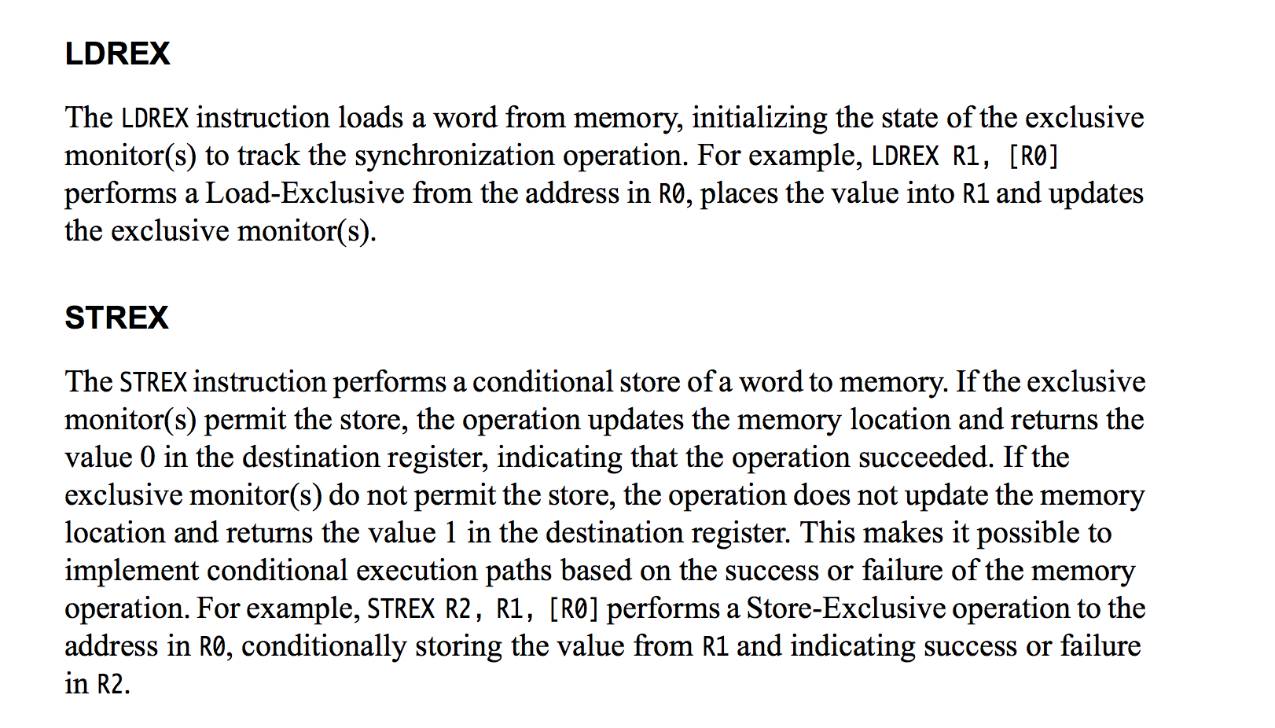
ARMv7

Slide 21
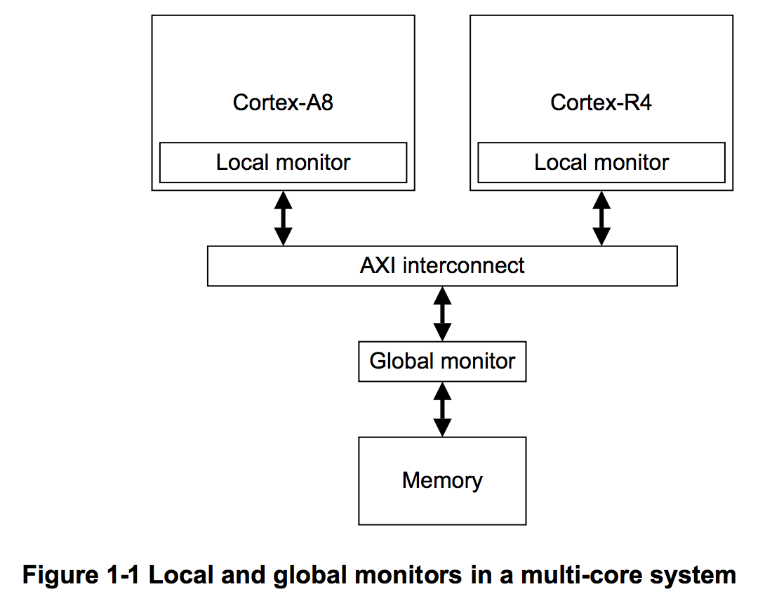
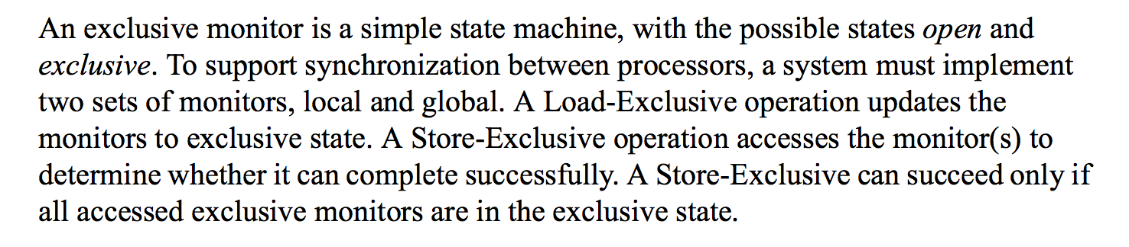

Slide 22
Implementing a Mutex Lock
LDREX <dest> <location>
<dest> = <location>
Sets monitor on <location> in Exclusive state
STREX <success> <value> <location>
  Conditionally store <value> into exclusive <location>.
  If permitted, <success> = 1 and <location> = <value>.
  If not, <success> = 0 and <location> value unchanged.
Context switch clears monitor (Open) state.
lock_mutex(lock);
critical
unlock_mutex(lock);

Slide 23
LDREX <dest> <location>
<dest> = <location>
Sets monitor on <location> in Exclusive state
STREX <success> <value> <location>
  Conditionally store <value> into exclusive <location>.
  If permitted, <success> = 1 and <location> = <value>.
  If not, <success> = 0 and <location> value unchanged.
lock_mutex(lock);
critical
unlock_mutex(lock);
lock_mutex(lock):
try_again:
LDREX R2, [lock]
if R2 goto try_again
STREX R2, 1, [lock]
if not R2 goto try_again
unlock_mutex(lock):
STR [lock], 0

Slide 24
lock_mutex(lock);
critical
unlock_mutex(lock);
What if you care about energy?
lock_mutex(lock):
try_again:
LDREX R2, [lock]
if R2 goto try_again
STREX R2, 1, [lock]
if not R2 goto try_again
unlock_mutex(lock):
STR [lock], 0

Slide 25
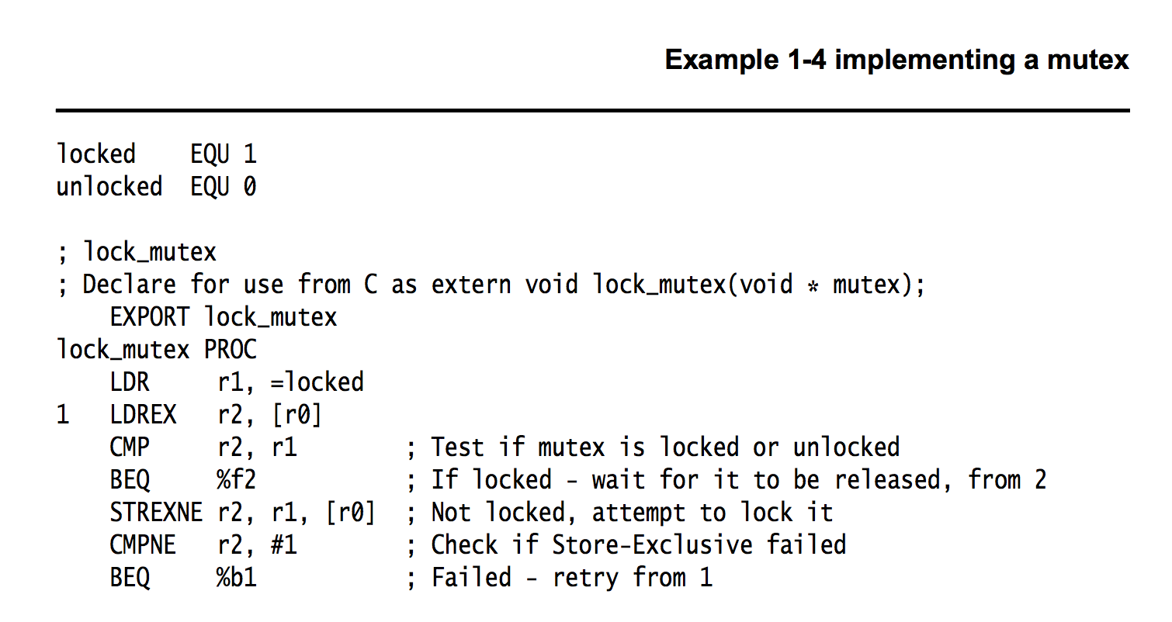
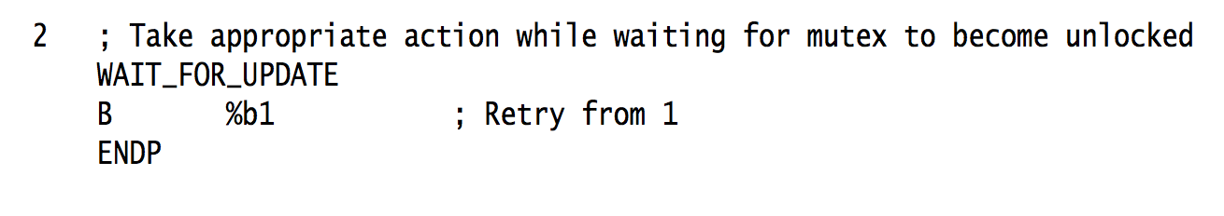

Slide 26
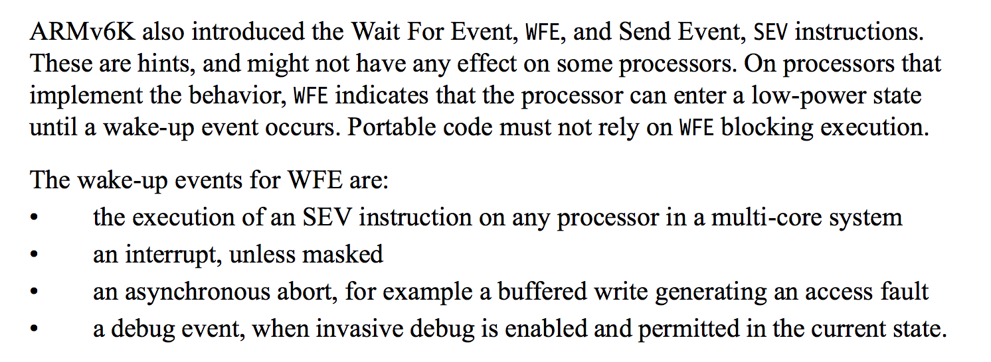
WFE and WFI do not provide synchronization! Just hints to the processor to save energy.

Slide 27
ARMv7
Why two instructions like this instead of one?

Slide 28
T1
T2
T3
T4
T5
Program:
loop {
non-critical {
…
}
critical {
…
}
}
Shared Memory (atomic read and write)
no special combined atomic operations (e.g., test-and-set, LDREX/STREX)
Requirements:
Only one thread may be in the critical section at any time.
Each must eventually be able to enter its critical section.
Must be symmetrical (all run same program).
Cannot make any assumptions about speed of threads.

Slide 29

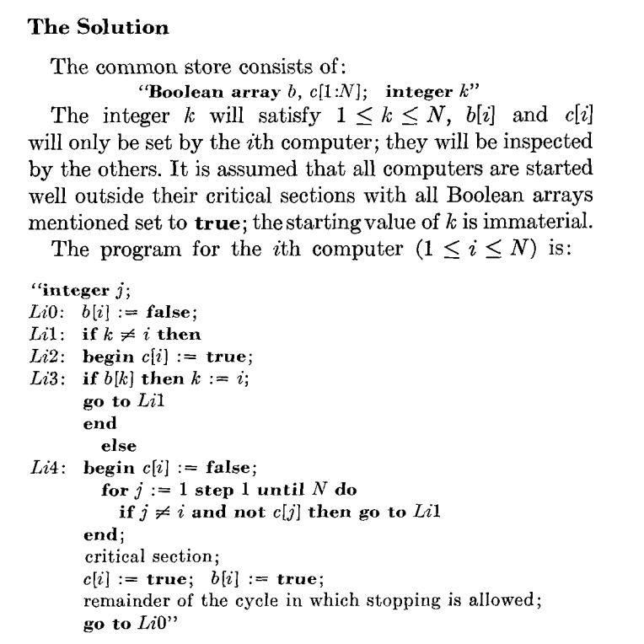
1965
Dijkstra (1973)
From Edgar Daylight’s collection:
http://www.dijkstrascry.com/node/59

Slide 30
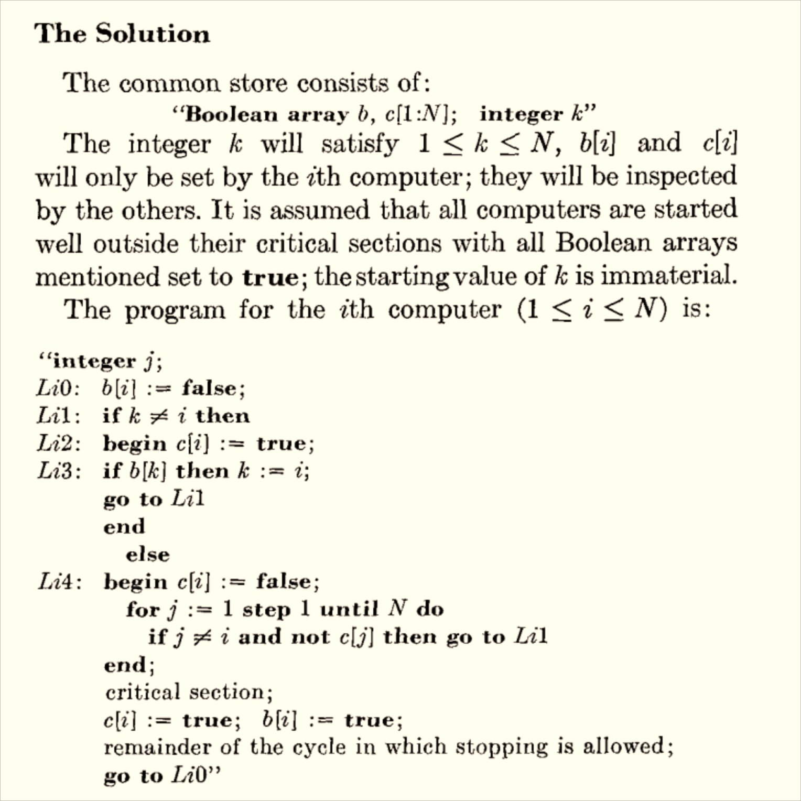
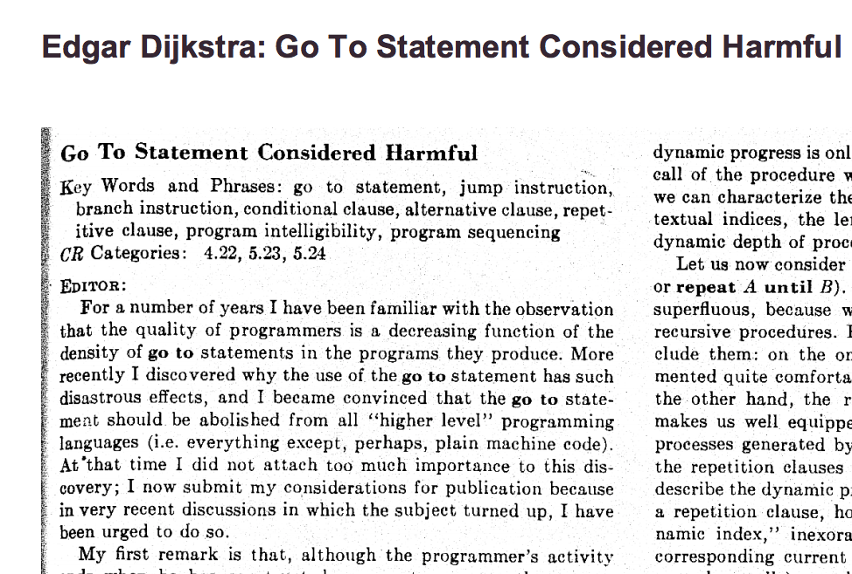

Slide 31
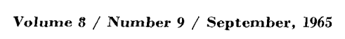
Program for Processor i
loop {
b[i] := false
L1: if k != i
c[i] := true
if b[k]
k := i
goto L1
else:
c[i] := false
for j in [1, …, N]:
if j != i and not c[j]:
goto L1
critical section;
c[i] := true
b[i] := true
}
Initialization
b[1:N] = [true, true, …]
c[1:N] = [true, true, …]
k = choose([1..N])

Slide 32
Program for Processor i
loop {
b[i] := false
L1: if k != i
c[i] := true
if b[k]:
k := i
goto L1
else:
c[i] := false
for j in [1, …, N]:
if j != i and not c[j]:
goto L1
critical section;
c[i] := true
b[i] := true
}
Safety: only one program can be in critical section

Slide 33
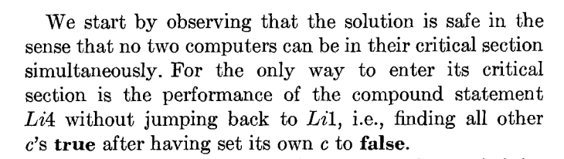
Program for Processor i
loop {
b[i] := false
L1: if k != i
c[i] := true
if b[k]:
k := i
goto L1
else:
c[i] := false;
L4: for j in [1, …, N]:
if j != i and not c[j]:
goto L1
critical section;
c[i] := true
b[i] := true
}
How do we know none of the c[.]’s changed during the loop?

Slide 34
Charge
Think about Dijkstra’s Solution:
How does it guarantee mutual exclusion?
How does it guarantee liveness?
Submit Project Idea by 11:59pm Tonight

