Slide 1

Class 20:
Mutual Exclusion
Reminder: Project Ideas are due by 11:59pm tonight!
cs4414 Spring 2014
University of Virginia
David Evans

Slide 2
Plan for Today
Recap: Dijkstra’s Mutual Exclusion Problem
Why Obvious Solutions Fail
Practical Solutions with Modern Processors
Dijkstra’s Solution
Lamport’s Solution
Reminder: Project Ideas are due by 11:59pm tonight!

Slide 3



Slide 4
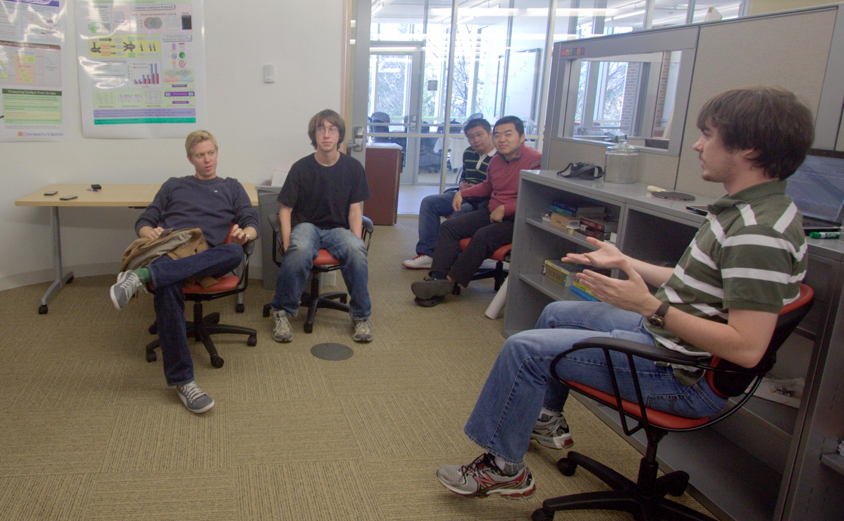


Final Keynote (Sunday):
Steve Huffman

Slide 5
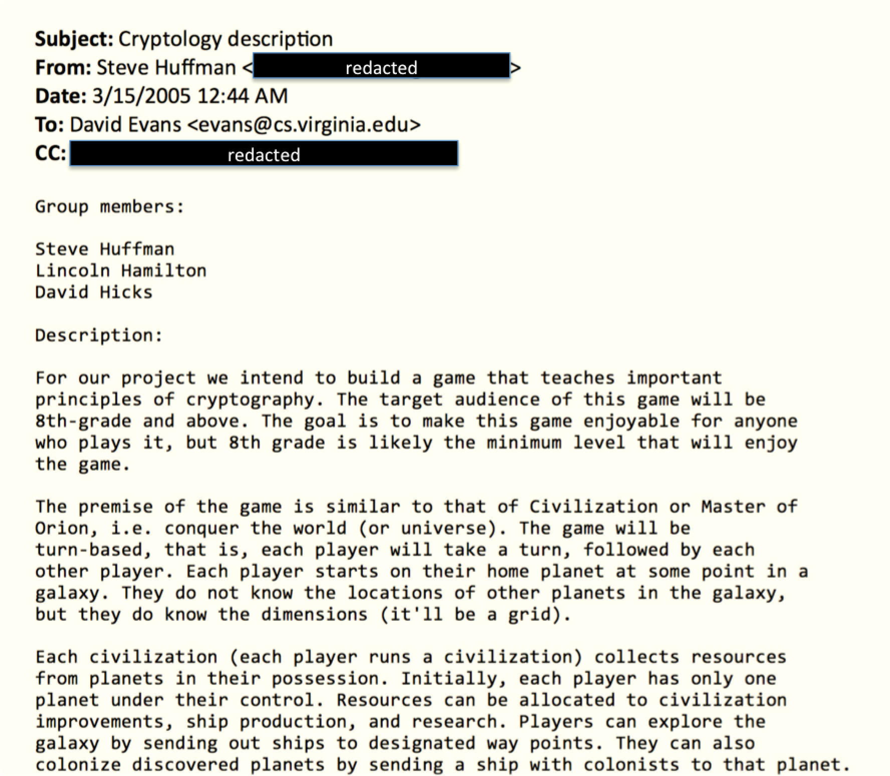

Slide 6
Decoy Project!

Slide 7
Lessons for your Project Submissions:
Don’t submit something I will think is a decoy project! (Too late for that here)
Don’t do something that involves breaking into my house.
Do do something creative and unexpected.

Slide 8
N independent threads
T1
T2
T3
T4
T5
Program:
loop {
non-critical {
…
}
critical {
…
}
}
Shared Memory (atomic read and write)
Requirements:
Only one thread may be in the critical section at any time.
Each must eventually be able to enter its critical section.
Must be symmetrical (all run same program).
Cannot make any assumptions about speed of threads.

Slide 9
Clever “Cheating” Solution
T1
T2
T3
Initially, turn = 1
loop {
if turn == i:
critical_section;
turn = i + 1;
}
Shared Memory
turn:

Slide 10
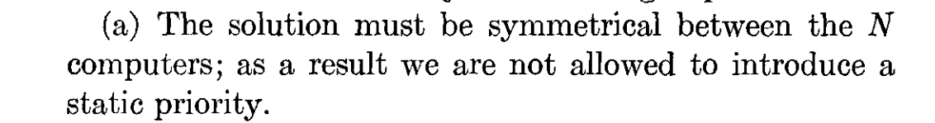
Initially, turn = 1
loop {
if turn == i:
critical_section;
turn = i + 1;
}

Slide 11
Attempted Solution
T1
T2
T3
loop {
if not lock:
lock = true;
critical_section;
lock = false;
}
Shared Memory
lock:

Slide 12
Attempted Fix
T1
T2
T3
loop {
if lock == 0:
lock = i;
if lock == i:
critical_section;
lock = 0;
}
Shared Memory
lock:

Slide 13
Attempted Fix of Fix
loop {
if lock1 == 0:
lock1 = i;
if lock1 == i:
if lock2 == 0:
lock2 = i;
if lock2 == i:
critical_section;
lock2 = 0;
lock1 = 0;
}
T1
T2
T3
Shared Memory
lock1:
lock2:

Slide 14
Attempted Fix of Fix of Fix …
loop {
if lock1 == 0:
lock1 = i;
if lock1 == i:
if lock2 == 0:
lock2 = i;
if lock2 == i:
critical_section;
lock2 = 0;
lock1 = 0;
}
T1
T2
T3
Shared Memory
lock1:
lock2:
Do we need to see why 3-locks still breaks?

Slide 15
Easy (Kernel Cheating) Solution
Uniprocessor
loop {
non-critical;
disable interrupts
critical_section;
enable interrupts
}
T1
T2
T3
Shared Memory

Slide 16
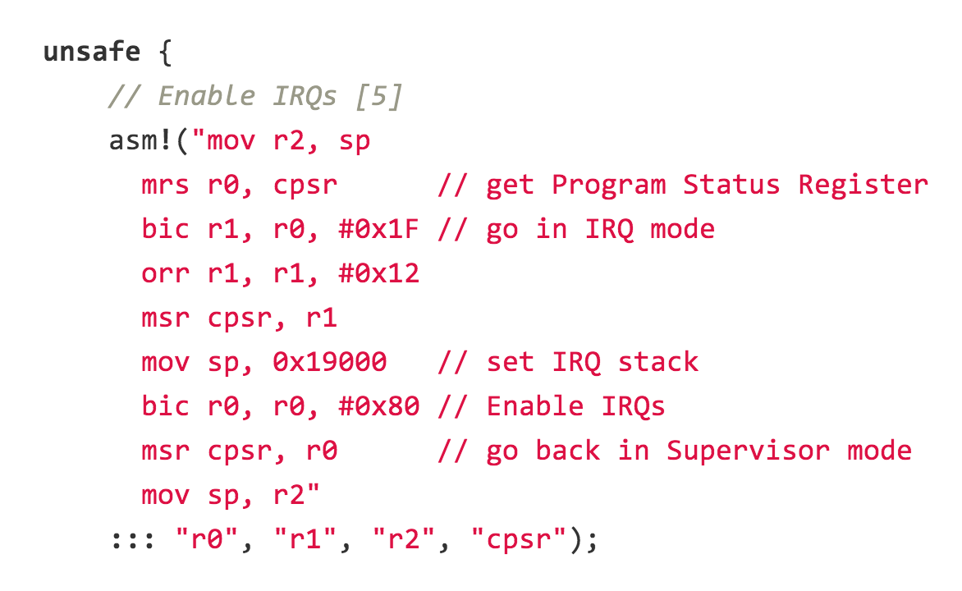
ironkernel: arch/arm/cpu/interrupt.rs

Slide 17
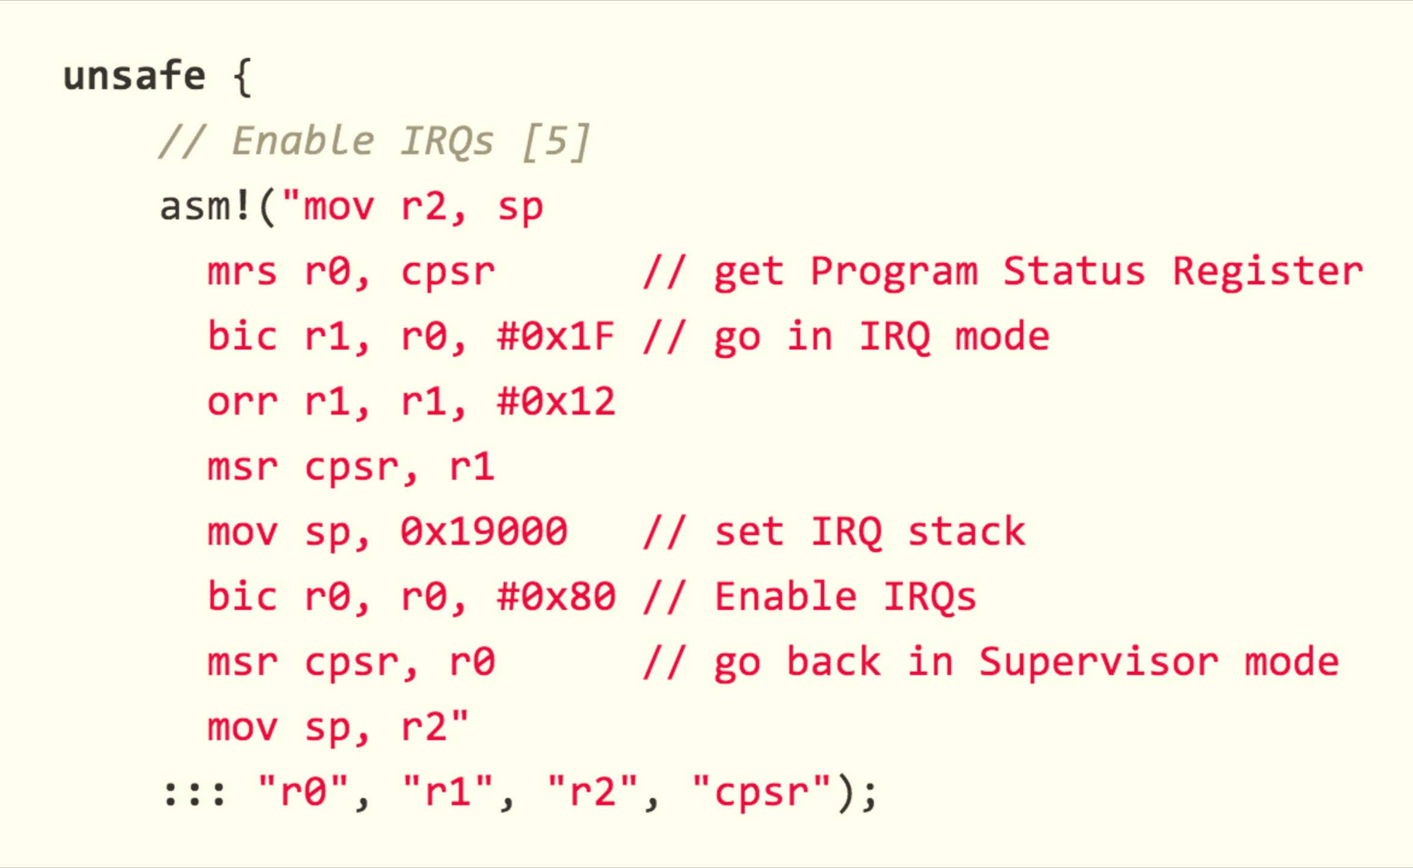
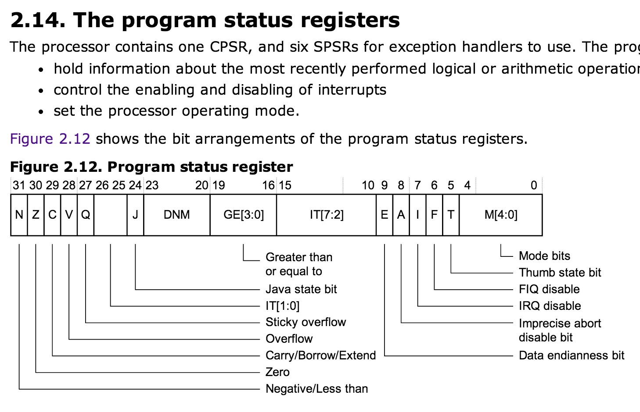
ironkernel: arch/arm/cpu/interrupt.rs
CPSR: Current Program Status Register

Slide 18
Easy (Kernel Cheating) Solution
loop {
non-critical;
disable interrupts
critical_section;
enable interrupts
}
Uniprocessor
T1
T2
T3
Shared Memory
How well does this solution work for modern kernels?

Slide 19
Easy (Cheating) Solution
T1
T2
T3
Shared Memory
(with atomic read/write/test&set)
lock:
test_and_set(v)
returns current value of v
sets value of v to true

Slide 20
Easy (Cheating) Solution
T1
T2
T3
loop {
if not test_and_set(lock):
critical_section;
lock = false;
}
Shared Memory
(with atomic read/write/test&set)
lock:
test_and_set(v)
returns current value of v
sets value of v to true

Slide 21
Does your processor provide such an instruction?

Slide 22
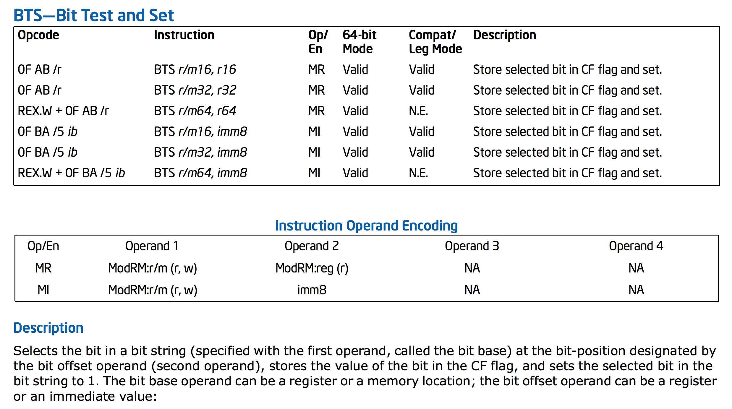
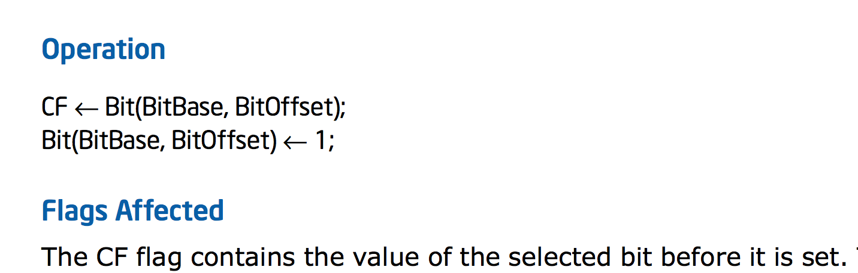
Intel x86

Slide 23
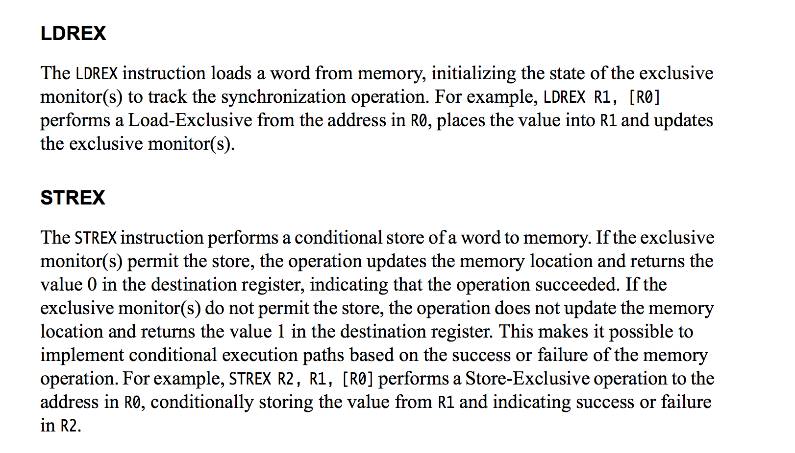
ARMv7

Slide 24
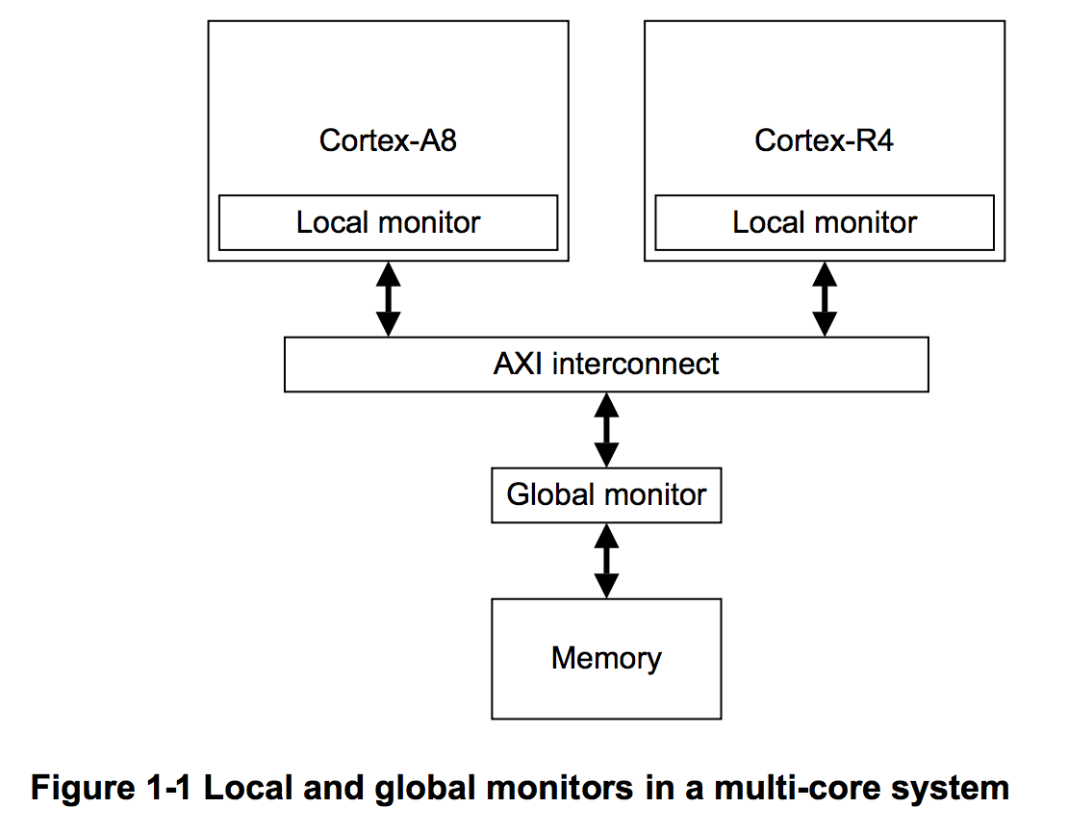
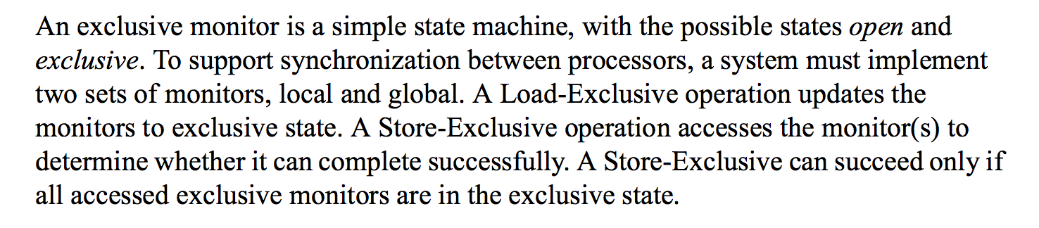

Slide 25
Implementing a Mutex Lock
LDREX <dest> <location>
<dest> = <location>
Sets monitor on <location> in Exclusive state
STREX <success> <value> <location>
  Conditionally store <value> into exclusive <location>.
  If permitted, <success> = 1 and <location> = <value>.
  If not, <success> = 0 and <location> value unchanged.
Context switch clears monitor (Open) state.
lock_mutex(lock);
critical
unlock_mutex(lock);

Slide 26
LDREX <dest> <location>
<dest> = <location>
Sets monitor on <location> in Exclusive state
STREX <success> <value> <location>
  Conditionally store <value> into exclusive <location>.
  If permitted, <success> = 1 and <location> = <value>.
  If not, <success> = 0 and <location> value unchanged.
lock_mutex(lock);
critical
unlock_mutex(lock);
lock_mutex(lock):
try_again:
LDREX R2, [lock]
if R2 goto try_again
STREX R2, 1, [lock]
if not R2 goto try_again
unlock_mutex(lock):
STR [lock], 0

Slide 27
lock_mutex(lock);
critical
unlock_mutex(lock);
What if you care about energy?
lock_mutex(lock):
try_again:
LDREX R2, [lock]
if R2 goto try_again
STREX R2, 1, [lock]
if not R2 goto try_again
unlock_mutex(lock):
STR [lock], 0

Slide 28
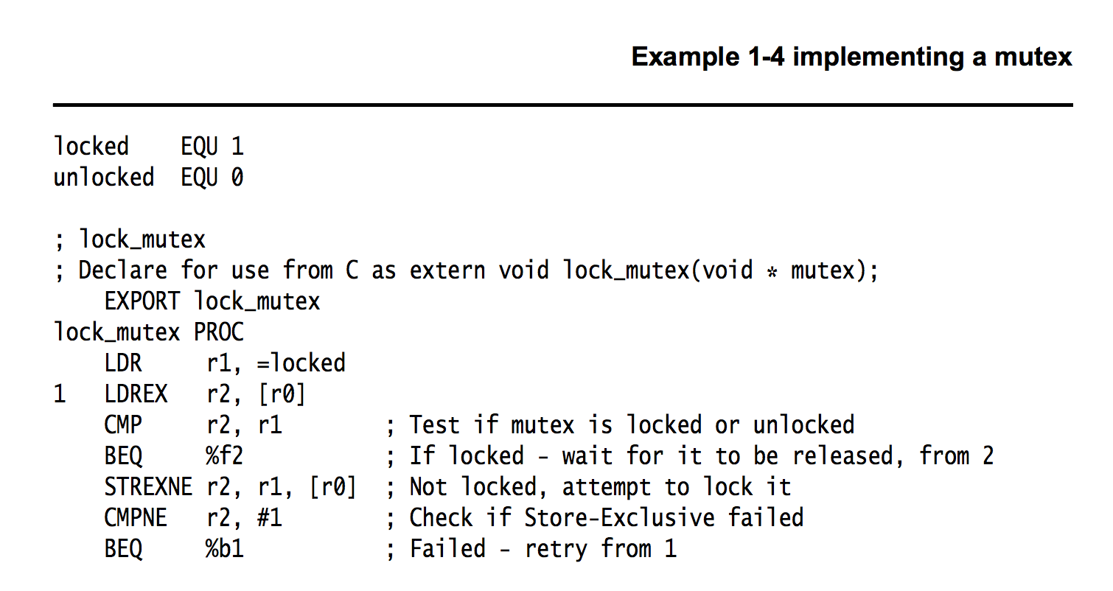
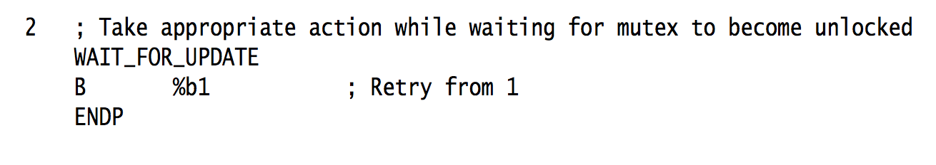

Slide 29
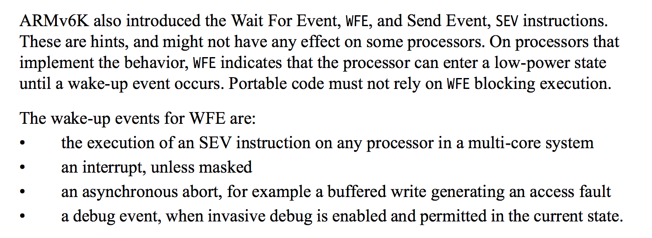
WFE and WFI do not provide synchronization! Just hints to the processor to save energy.

Slide 30
ARMv7
Why two instructions like this instead of one?

Slide 31
T1
T2
T3
T4
T5
Program:
loop {
non-critical {
…
}
critical {
…
}
}
Shared Memory (atomic read and write)
no special combined atomic operations (e.g., test-and-set, LDREX/STREX)
Requirements:
Only one thread may be in the critical section at any time.
Each must eventually be able to enter its critical section.
Must be symmetrical (all run same program).
Cannot make any assumptions about speed of threads.

Slide 32

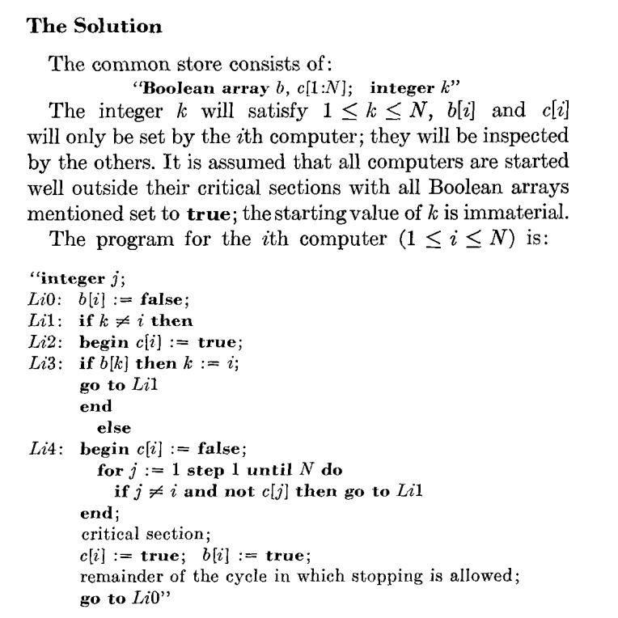
1965
Dijkstra (1973)
From Edgar Daylight’s collection:
http://www.dijkstrascry.com/node/59

Slide 33
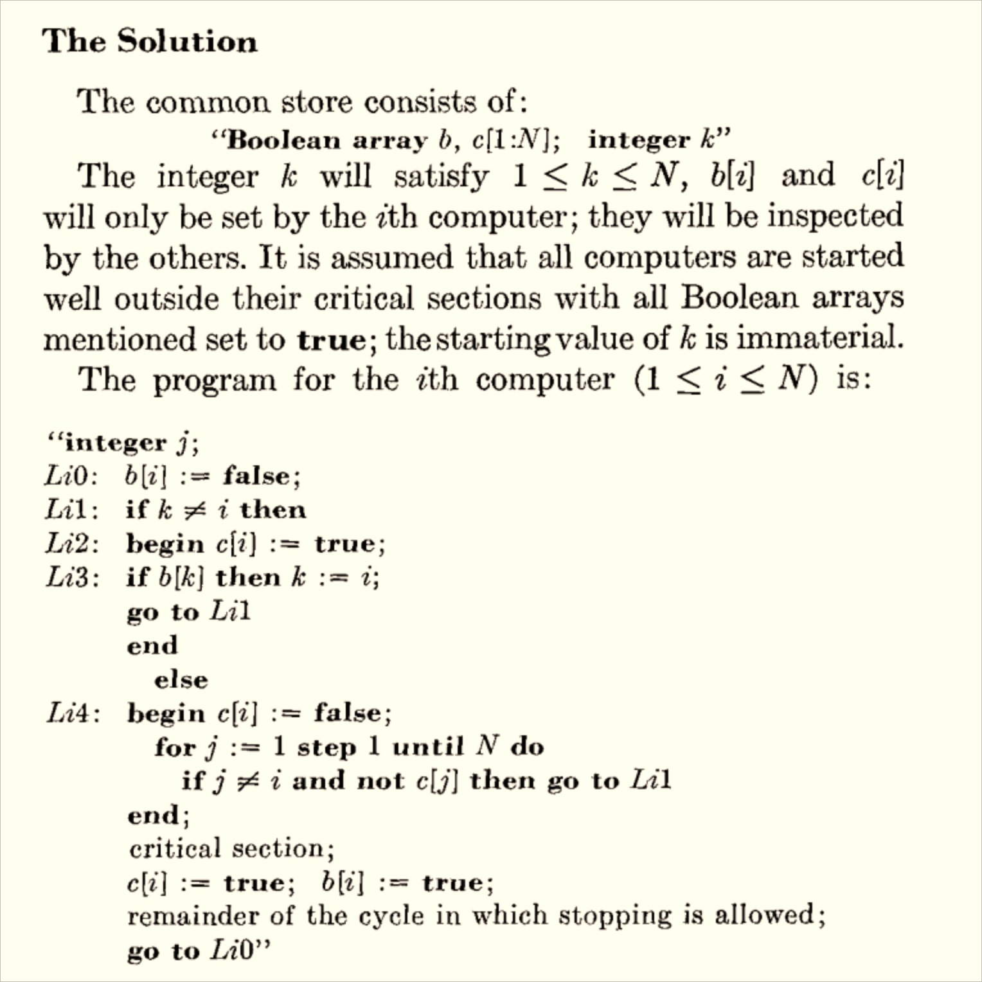
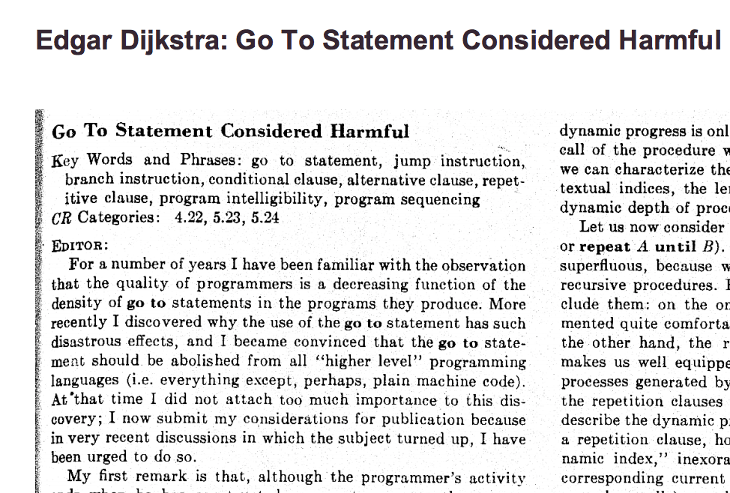

Slide 34
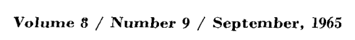
Program for Processor i
loop {
b[i] := false
L1: if k != i
c[i] := true
if b[k]
k := i
goto L1
else:
c[i] := false
for j in [1, …, N]:
if j != i and not c[j]:
goto L1
critical section;
c[i] := true
b[i] := true
}
Initialization
b[1:N] = [true, true, …]
c[1:N] = [true, true, …]
k = choose([1..N])

Slide 35
Program for Processor i
loop {
b[i] := false
L1: if k != i
c[i] := true
if b[k]:
k := i
goto L1
else:
c[i] := false
for j in [1, …, N]:
if j != i and not c[j]:
goto L1
critical section;
c[i] := true
b[i] := true
}
Safety: only one program can be in critical section

Slide 36
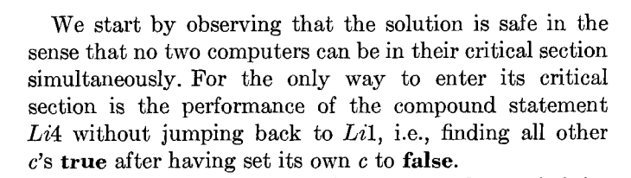
Program for Processor i
loop {
b[i] := false
L1: if k != i
c[i] := true
if b[k]:
k := i
goto L1
else:
c[i] := false;
L4: for j in [1, …, N]:
if j != i and not c[j]:
goto L1
critical section;
c[i] := true
b[i] := true
}
How do we know none of the c[.]’s changed during the loop?

Slide 37
Program for Processor i
loop {
1 b[i] := false
2 L1: if k != i
3 c[i] := true
4 if b[k]:
5 k := i
6 goto L1
7 else:
8 c[i] := false
9 for j in [1, …, N]:
10 if j != i and not c[j]:
11 goto L1
12 critical section;
13 c[i] := true
14 b[i] := true
}

Slide 38
Program for Processor i
loop {
1 b[i] := false
2 L1: if k != i
3 c[i] := true
4 if b[k]:
5 k := i
6 goto L1
7 else:
8 c[i] := false
9 for j in [1, …, N]:
10 if j != i and not c[j]:
11 goto L1
12 critical section;
13 c[i] := true
14 b[i] := true
}

Slide 39
Program for Processor i
loop {
b[i] := false
L1: if k != i:
c[i] := true
if b[k]:
k := i
goto L1
else:
c[i] := false;
L4: for j in [1, …, N]:
if j != i and not c[j]:
goto L1
critical section;
c[i] := true
b[i] := true
}
How do we know none of the c[.]’s changed during the loop?

Slide 40
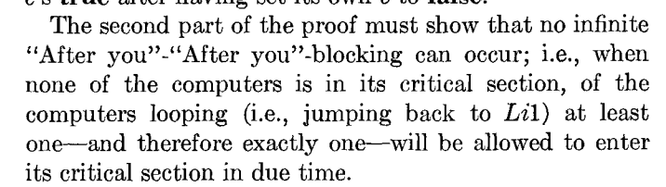
Program for Processor i
loop {
b[i] := false
L1: if k != i
c[i] := true
if b[k]:
k := i
goto L1
else:
c[i] := false;
L4: for j in [1, …, N]:
if j != i and not c[j]:
goto L1
critical section;
c[i] := true
b[i] := true
}

Slide 41
Program for Processor i
loop {
b[i] := false
L1: if k != i
c[i] := true
if b[k]:
k := i
goto L1
else:
c[i] := false;
L4: for j in [1, …, N]:
if j != i and not c[j]:
goto L1
critical section;
c[i] := true
b[i] := true
}
Liveness: makes progress

Slide 42
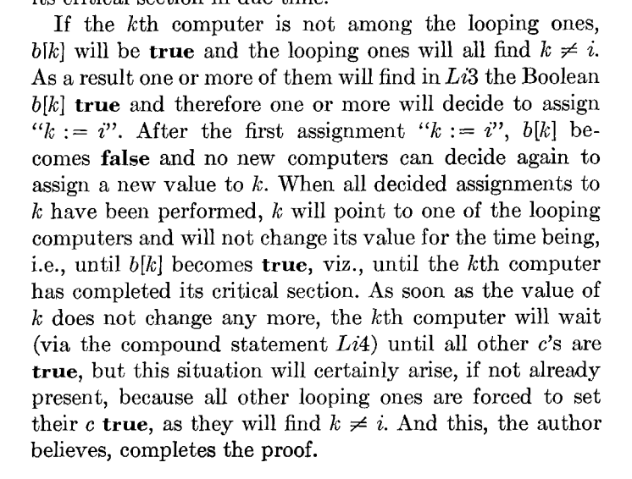
Program for Processor i
loop {
b[i] := false
L1: if k != i
c[i] := true
L3: if b[k]:
k := i
goto L1
else:
c[i] := false;
L4: for j in [1, …, N]:
if j != i and not c[j]:
goto L1
critical section;
c[i] := true
b[i] := true
}
Liveness Proof

Slide 44
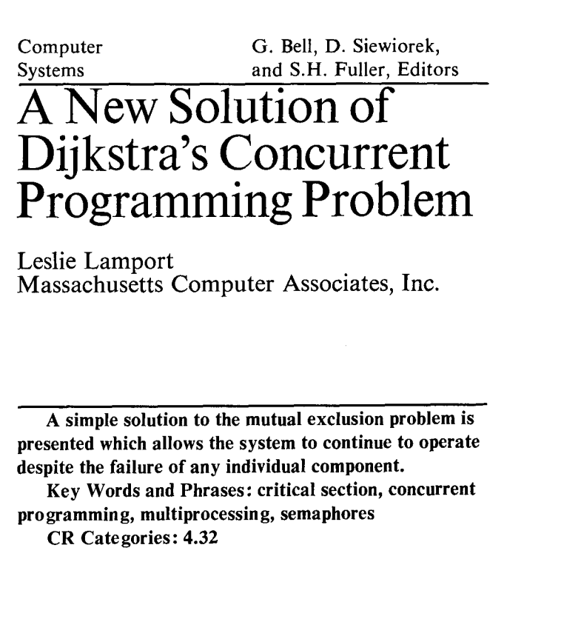

Communications of the ACM, August 1974 (2 pages)

Slide 45
“What is significant about the bakery algorithm is that it implements mutual exclusion without relying on any lower-level mutual exclusion. Assuming that reads and writes of a memory location are atomic actions, as previous mutual exclusion algorithms had done, is tantamount to assuming mutually exclusive access to the location. So a mutual exclusion algorithm that assumes atomic reads and writes is assuming lower-level mutual exclusion. Such an algorithm cannot really be said to solve the mutual exclusion problem. Before the bakery algorithm, people believed that the mutual exclusion problem was unsolvable--that you could implement mutual exclusion only by using lower-level mutual exclusion.”
Communications of the ACM, August 1974 (2 pages)

Slide 46
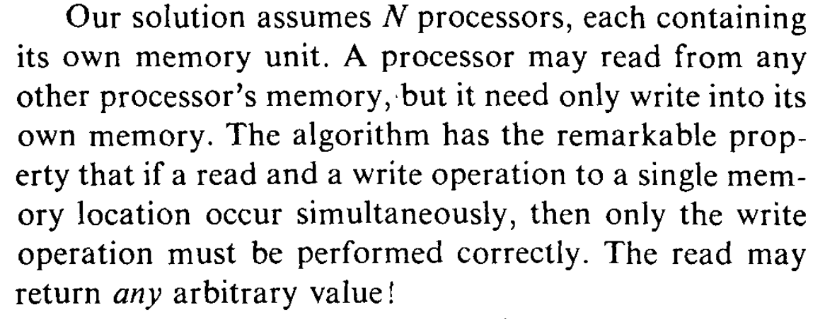

Slide 47

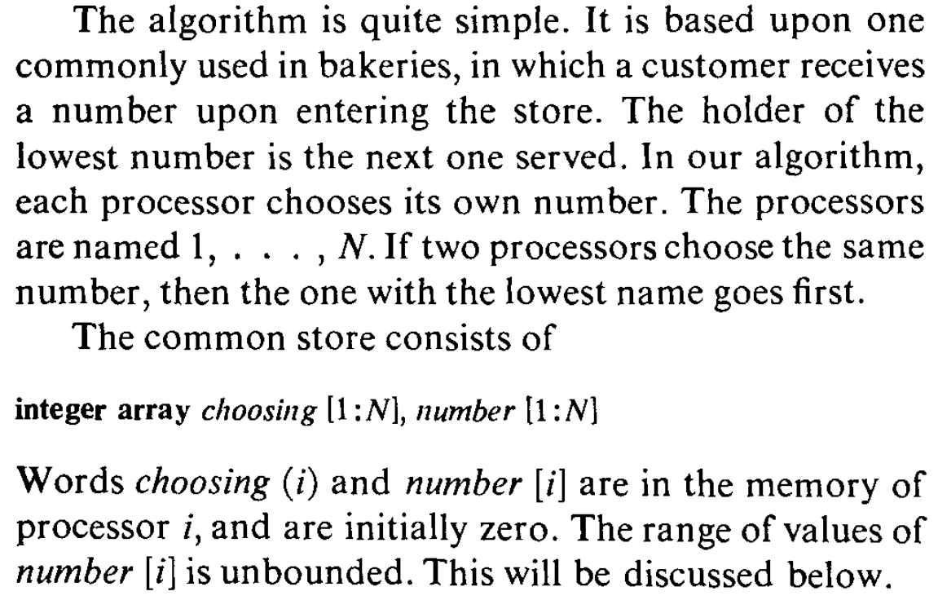

Slide 48
N independent threads
T1
T2
T3
T4
T5
Program:
loop {
non-critical {
…
}
critical {
…
}
}
Shared Memory (no exclusion!)
Requirements:
Only one thread may be in the critical section at any time.
Each must eventually be able to enter its critical section.
Must be symmetrical (all run same program).
Cannot make any assumptions about speed of threads.
Only writes are guaranteed (when simultaneous).

Slide 50
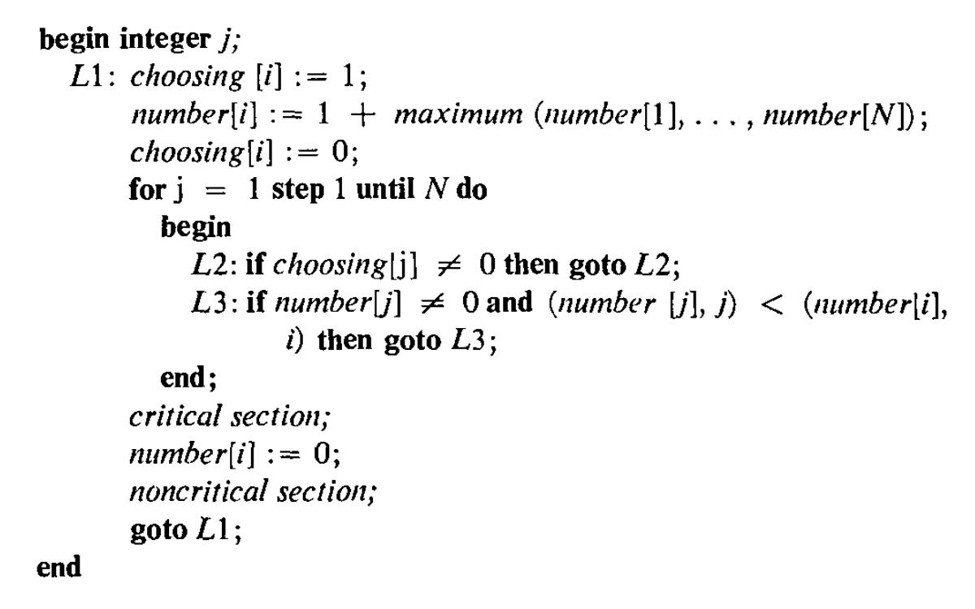
Processor number: i

Slide 51
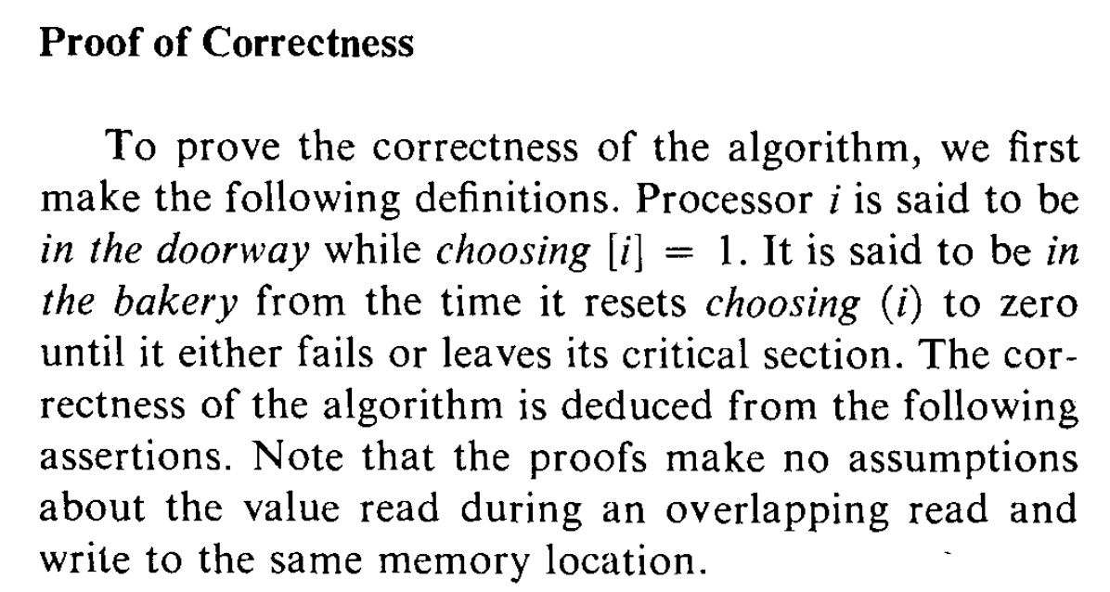

Slide 52
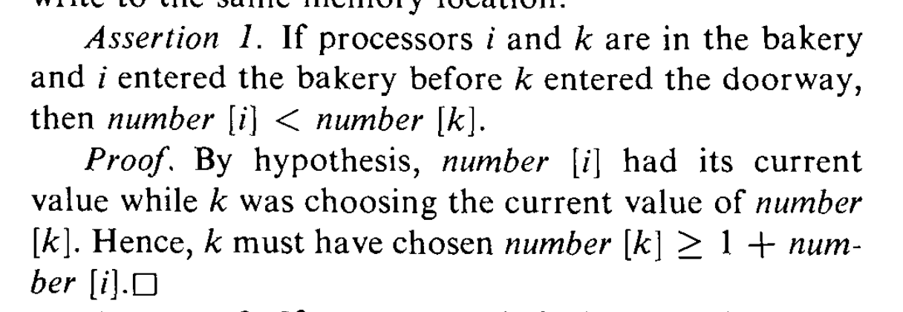
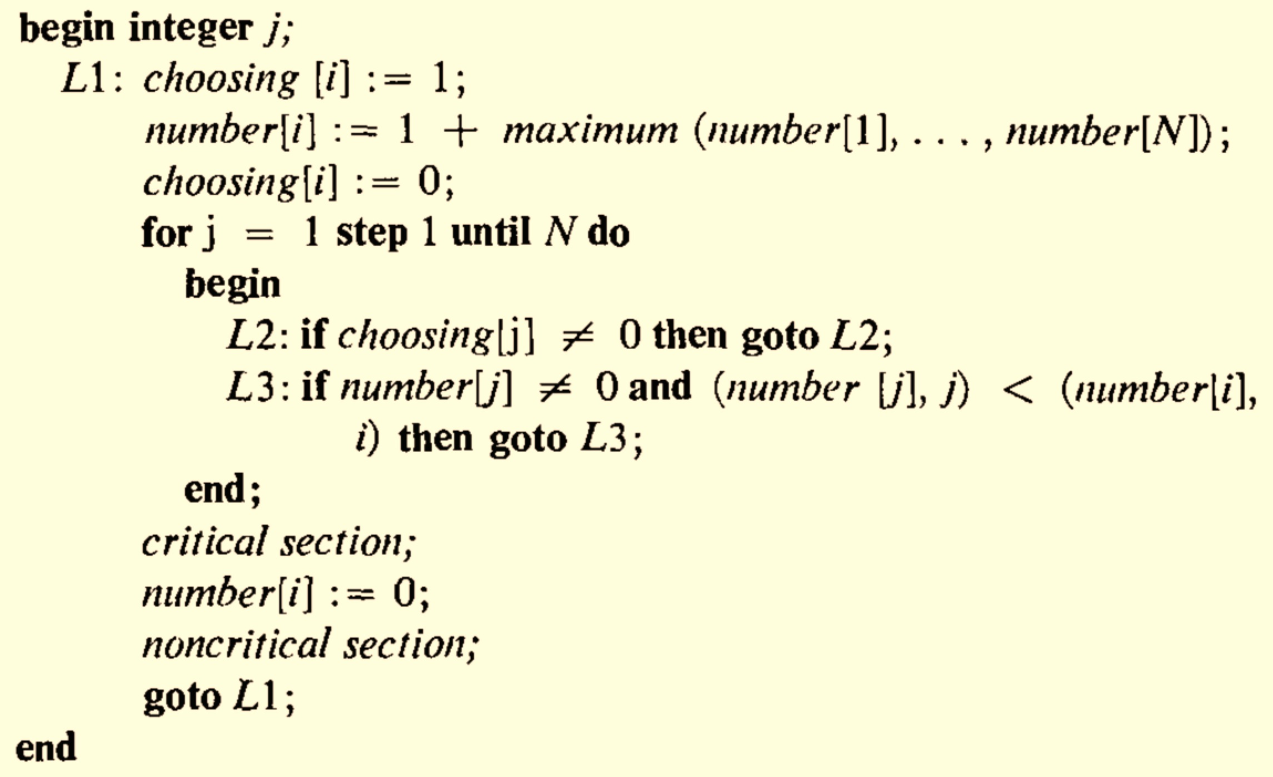

Slide 54
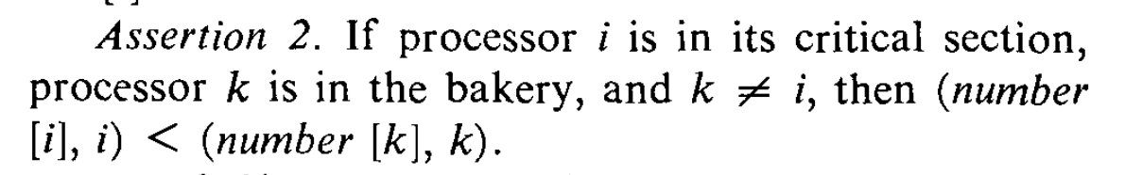

Slide 55
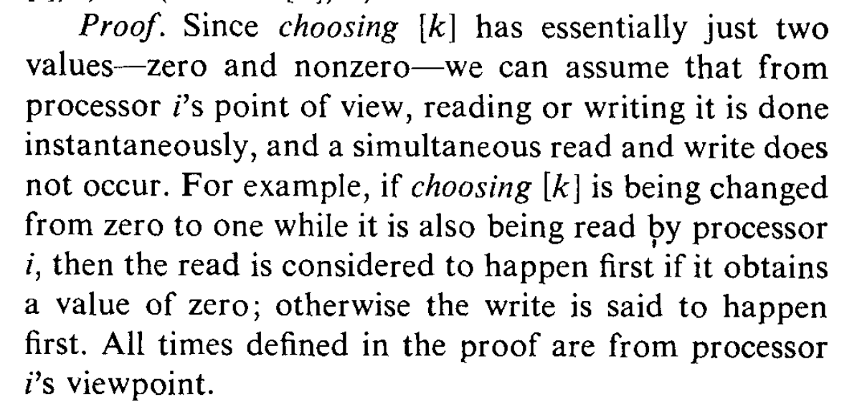

Slide 56
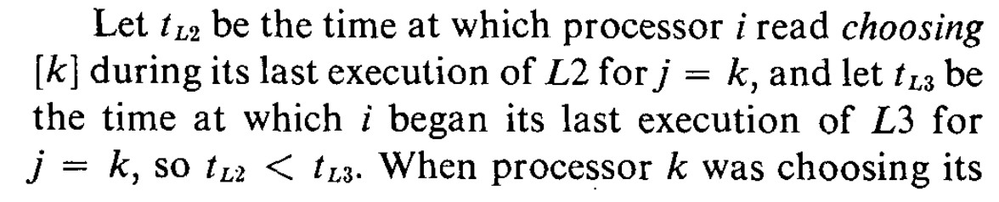
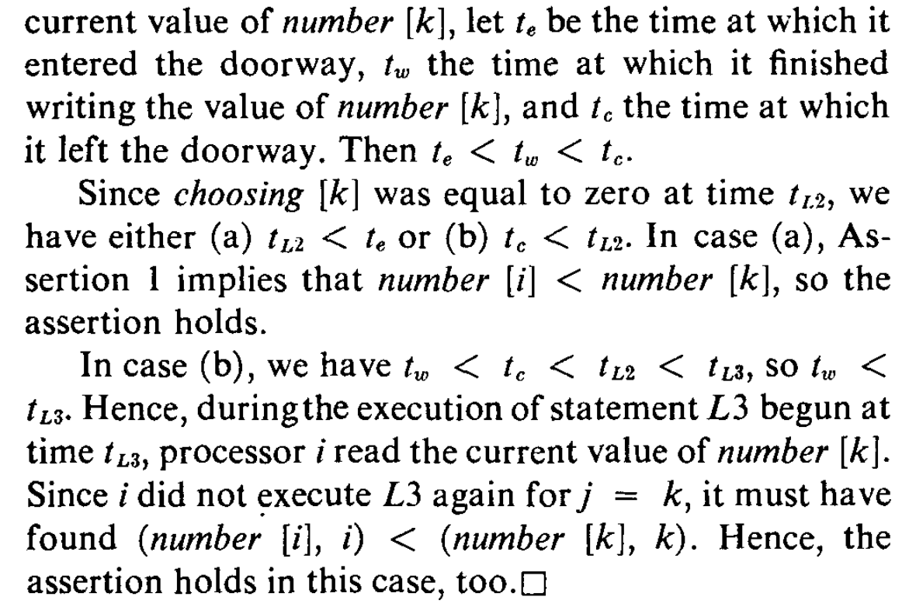

Slide 58
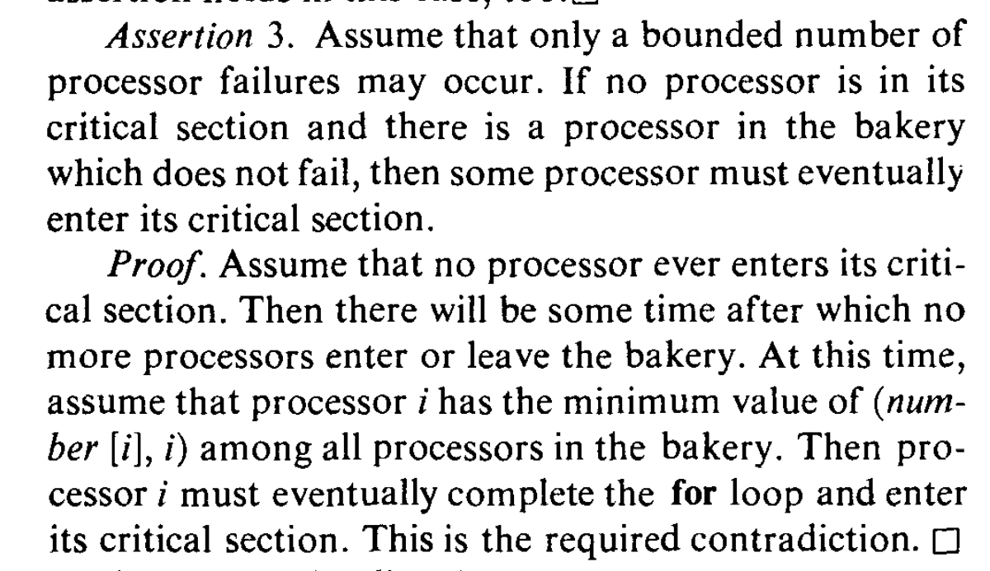

Slide 59
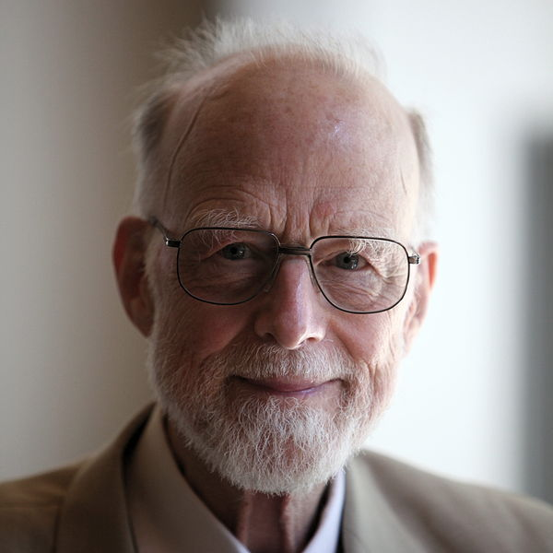
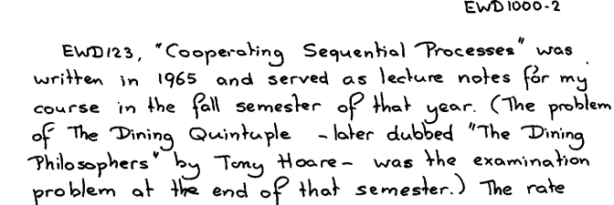
Sir Tony Hoare (born 1934)

Slide 60






Slide 61
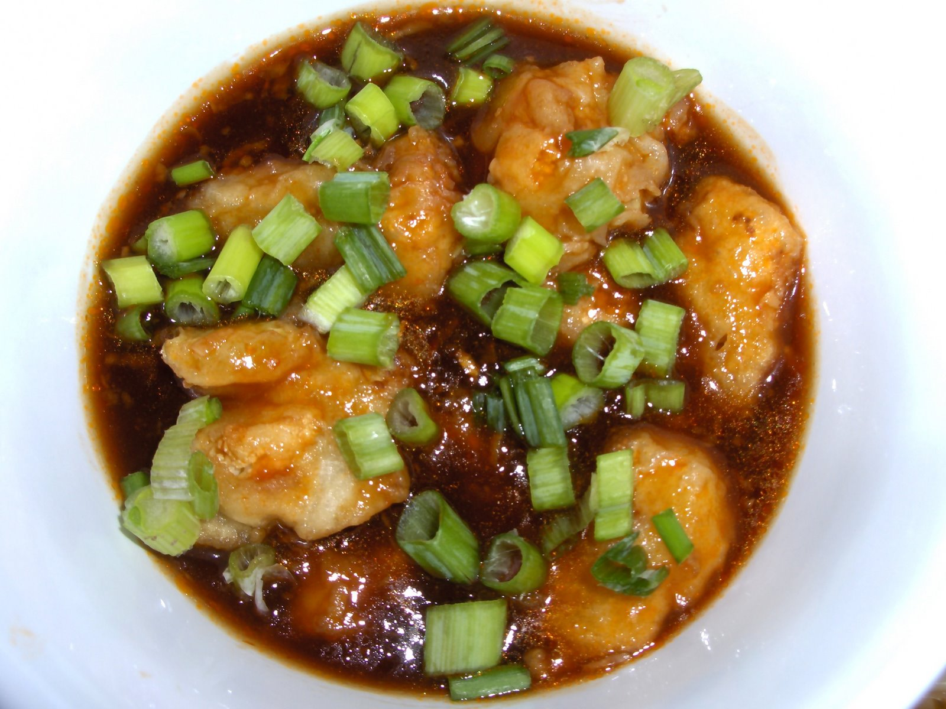
Plato
Heraclitus
Socrates
Euclid
Aristotle

Slide 62
5 Dining Philosophers
5 Chopsticks (one between each pair)
Need 2 chopsticks to eat

Slide 63
No (extra) communication No deadlock
No starvation
Fair
Charge
Think about the philosophers for next class
Project ideas due by 11:59pm tonight
Remember to submit PS4 Assessment

Slide 64
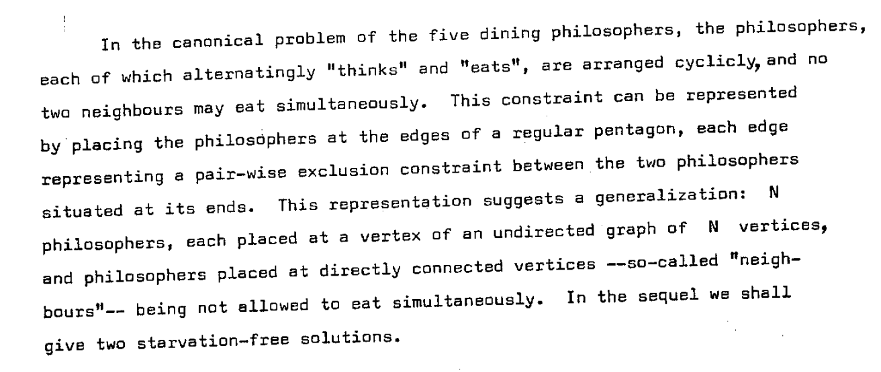
Djikstra’s (Hygenic) Version EWD625
Is this equivalent to the shared chopsticks?

Slide 66
Solution Desiderata
No communication required
No deadlock
No starvation: everyone gets to eat eventually
Fair: each philosopher has equal likelihood of
getting to eat

Slide 67
Could all the philosophers starve?

Slide 68
Dijkstra’s Solution (Idea)
Number the chopsticks, always grab lower-numbered stick first
  Does it matter how the chopsticks are numbered?

Slide 69
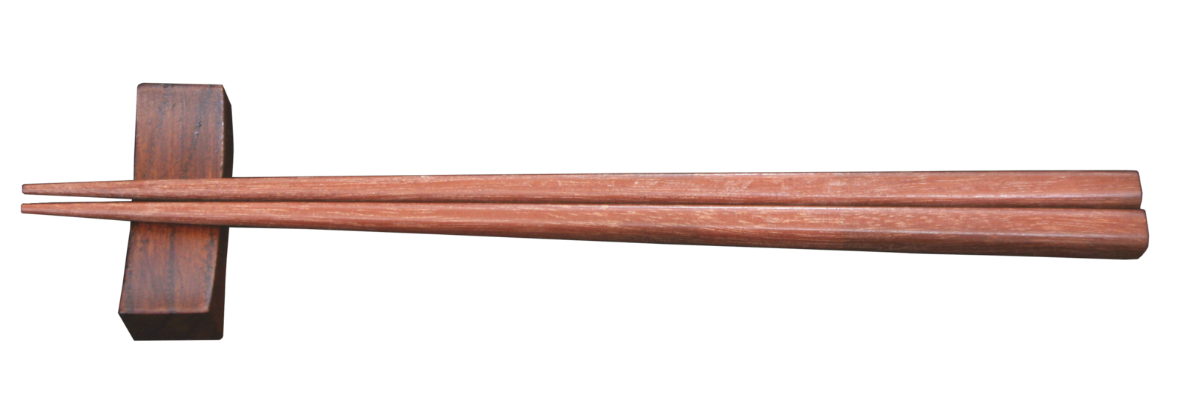
The Real Idea was to
“Invent the Chopstick”
Binary Semaphore
Lock that can be held by up to one process
http://commons.wikimedia.org/wiki/File:Chopstick.png

Slide 70
type Semaphore = Option<uint> ; // either None (available) or owner
static mut count: uint = 0; // protected by lock
static mut lock: Semaphore = None;
fn grab_lock(id: uint) {
while (lock.is_some()) { ; } // wait for lock
lock = Some(id);
}
fn release_lock() { lock = None; }
fn update_count(id: uint) {
grab_lock(id);
count += 1;
println(fmt!("Count updated by %?: %?", id, count));
release_lock();
}
fn main() {
for num in range(0u, 10) {
do spawn { for _ in range(0u, 1000)
{ update_count(num); }
} } }

Slide 71
type Semaphore = Option<uint> ; // either None (available) or owner
static mut count: uint = 0; // protected by lock
static mut lock: Semaphore = None;
fn grab_lock(id: uint) {
while (lock.is_some()) { ; } // wait for lock
lock = Some(id);
}
fn release_lock() { lock = None; }
fn update_count(id: uint) {
grab_lock(id);
count += 1;
println(fmt!("Count updated by %?: %?", id, count));
release_lock();
}
fn main() {
for num in range(0u, 10) {
do spawn { for _ in range(0u, 1000) { update_count(num); } } } }
FAIL! This is unsafe:
semaphore.rs:9:11: 9:15 error: use of mutable static requires unsafe function or block
semaphore.rs:9 while (lock.is_some()) {
…

Slide 72
type Semaphore = Option<uint> ; // either None (available) or owner
static mut count: uint = 0; // protected by lock
static mut lock: Semaphore = None;
fn grab_lock(id: uint) {
unsafe {
while (lock.is_some()) { ; }
lock = Some(id);
} }
fn release_lock() { unsafe { lock = None; } }
fn update_count(id: uint) {
unsafe {
grab_lock(id);
count += 1;
println(fmt!("Count updated by %?: %?", id, count));
release_lock();
}
}
fn main() {
for num in range(0u, 10) {
do spawn {
for _ in range(0u, 1000) {
update_count(num);
}
}
}
}
What will the final count be?

Slide 73
gash> ./semaphore > run1.txt
gash> ./semaphore > run2.txt
gash> ./semaphore > run3.txt
gash> tail -1 run1.txt
Count updated by 8u: 9968u
gash> tail -1 run2.txt
Count updated by 9u: 9951u
gash> tail -1 run3.txt
Count updated by 9u: 9950u

Slide 74
type Semaphore = Option<uint> ; // either None (available) or owner
static mut count: uint = 0; // protected by lock
static mut lock: Semaphore = None;
fn grab_lock(id: uint) {
unsafe {
while (lock.is_some()) { ; }
lock = Some(id);
} }
fn release_lock() { unsafe { lock = None; } }
fn update_count(id: uint) {
unsafe {
grab_lock(id);
count += 1;
println(fmt!("Count updated by %?: %?", id, count));
release_lock();
}
}
fn main() {
for num in range(0u, 10) {
do spawn {
for _ in range(0u, 1000) {
update_count(num);
}
}
}
}

Slide 75
Djikstra’s (Hygenic) Version EWD625
Is this equivalent to the shared chopsticks?

Slide 77
Solution Desiderata
No communication required
No deadlock
No starvation: everyone gets to eat eventually
Fair: each philosopher has equal likelihood of
getting to eat

Slide 78
Could all the philosophers starve?

Slide 79
Dijkstra’s Solution (Idea)
Number the chopsticks, always grab lower-numbered stick first
  Does it matter how the chopsticks are numbered?

Slide 80
The Real Idea was to
“Invent the Chopstick”
Binary Semaphore
Lock that can be held by up to one process
http://commons.wikimedia.org/wiki/File:Chopstick.png

Slide 81
type Semaphore = Option<uint> ; // either None (available) or owner
static mut count: uint = 0; // protected by lock
static mut lock: Semaphore = None;
fn grab_lock(id: uint) {
while (lock.is_some()) { ; } // wait for lock
lock = Some(id);
}
fn release_lock() { lock = None; }
fn update_count(id: uint) {
grab_lock(id);
count += 1;
println(fmt!("Count updated by %?: %?", id, count));
release_lock();
}
fn main() {
for num in range(0u, 10) {
do spawn { for _ in range(0u, 1000)
{ update_count(num); }
} } }

Slide 82
type Semaphore = Option<uint> ; // either None (available) or owner
static mut count: uint = 0; // protected by lock
static mut lock: Semaphore = None;
fn grab_lock(id: uint) {
while (lock.is_some()) { ; } // wait for lock
lock = Some(id);
}
fn release_lock() { lock = None; }
fn update_count(id: uint) {
grab_lock(id);
count += 1;
println(fmt!("Count updated by %?: %?", id, count));
release_lock();
}
fn main() {
for num in range(0u, 10) {
do spawn { for _ in range(0u, 1000) { update_count(num); } } } }
FAIL! This is unsafe:
semaphore.rs:9:11: 9:15 error: use of mutable static requires unsafe function or block
semaphore.rs:9 while (lock.is_some()) {
…

Slide 83
type Semaphore = Option<uint> ; // either None (available) or owner
static mut count: uint = 0; // protected by lock
static mut lock: Semaphore = None;
fn grab_lock(id: uint) {
unsafe {
while (lock.is_some()) { ; }
lock = Some(id);
} }
fn release_lock() { unsafe { lock = None; } }
fn update_count(id: uint) {
unsafe {
grab_lock(id);
count += 1;
println(fmt!("Count updated by %?: %?", id, count));
release_lock();
}
}
fn main() {
for num in range(0u, 10) {
do spawn {
for _ in range(0u, 1000) {
update_count(num);
}
}
}
}
What will the final count be?

Slide 84
gash> ./semaphore > run1.txt
gash> ./semaphore > run2.txt
gash> ./semaphore > run3.txt
gash> tail -1 run1.txt
Count updated by 8u: 9968u
gash> tail -1 run2.txt
Count updated by 9u: 9951u
gash> tail -1 run3.txt
Count updated by 9u: 9950u

Slide 85
type Semaphore = Option<uint> ; // either None (available) or owner
static mut count: uint = 0; // protected by lock
static mut lock: Semaphore = None;
fn grab_lock(id: uint) {
unsafe {
while (lock.is_some()) { ; }
lock = Some(id);
} }
fn release_lock() { unsafe { lock = None; } }
fn update_count(id: uint) {
unsafe {
grab_lock(id);
count += 1;
println(fmt!("Count updated by %?: %?", id, count));
release_lock();
}
}
fn main() {
for num in range(0u, 10) {
do spawn {
for _ in range(0u, 1000) {
update_count(num);
}
}
}
}

Slide 86
fn update_count(id: uint) {
unsafe {
grab_lock(id);
assert!(match lock { None => false,
Some(lockee) => lockee == id});
count += 1;
println(fmt!("Count updated by %?: %?", id, count));
release_lock();
}
}
Count updated by 1u: 710u
Count updated by 2u: 710u
Count updated by 1u: 711u
Count updated by 2u: 713uCount updated by 1u: 713u
Count updated by 2u: 714u
Count updated by 2u: 715u
task <unnamed> failed at 'assertion failed: match lock { None => false, Some(lockee) => \
lockee == id }', semaphore.rs:26
Count updated by 2u: 716u
Count updated by 2u: 717u

Slide 87
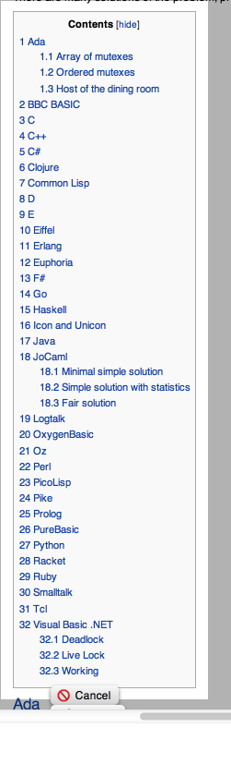
http://rosettacode.org/wiki/Dining_philosophers

Slide 88

Class 14

Slide 89
Class 14
“What is significant about the bakery algorithm is that it implements mutual exclusion without relying on any lower-level mutual exclusion. Assuming that reads and writes of a memory location are atomic actions, as previous mutual exclusion algorithms had done, is tantamount to assuming mutually exclusive access to the location. So a mutual exclusion algorithm that assumes atomic reads and writes is assuming lower-level mutual exclusion. Such an algorithm cannot really be said to solve the mutual exclusion problem. Before the bakery algorithm, people believed that the mutual exclusion problem was unsolvable--that you could implement mutual exclusion only by using lower-level mutual exclusion.”
Communications of the ACM, August 1974 (2 pages)
We will explore this next Tuesday!

Slide 90
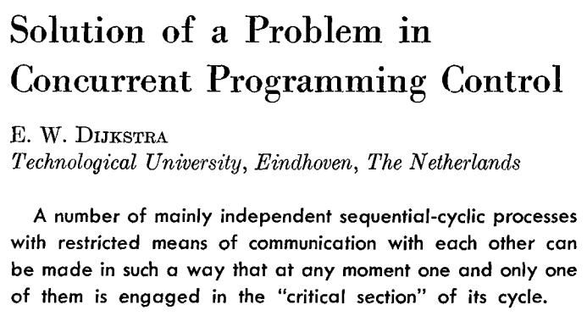
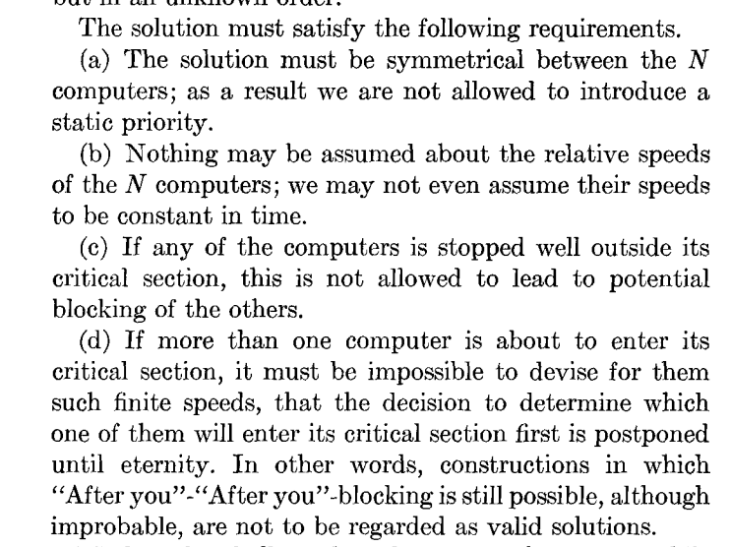

Edsger Dijkstra (1930-2002)

Slide 91
Dijkstra’s Problem
N independent threads
Program:
loop {
non-critical {
…
}
critical {
…
}
}
T1
T2
T3
T4
T5
Shared Memory (atomic read and write)

Slide 92
N independent threads
T1
T2
T3
T4
T5
Program:
loop {
non-critical {
…
}
critical {
…
}
}
Shared Memory (atomic read and write)
Requirements:
Only one thread may be in the critical section at any time.
Each must eventually be able to enter its critical section.
Must be symmetrical (all run same program).
Cannot make any assumptions about speed of threads.

Slide 93
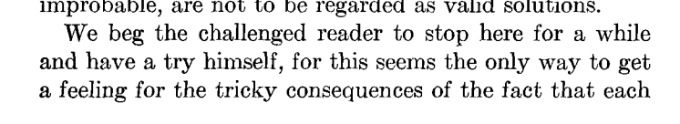
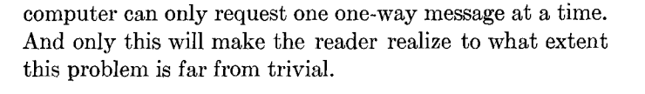

Slide 94
fn update_count(id: uint) {
unsafe {
grab_lock(id);
assert!(match lock { None => false,
Some(lockee) => lockee == id});
count += 1;
println(fmt!("Count updated by %?: %?", id, count));
release_lock();
}
}
Count updated by 1u: 710u
Count updated by 2u: 710u
Count updated by 1u: 711u
Count updated by 2u: 713uCount updated by 1u: 713u
Count updated by 2u: 714u
Count updated by 2u: 715u
task <unnamed> failed at 'assertion failed: match lock { None => false, Some(lockee) => \
lockee == id }', semaphore.rs:26
Count updated by 2u: 716u
Count updated by 2u: 717u

Slide 95
http://rosettacode.org/wiki/Dining_philosophers

