Slide 1

Class 20:
Bakers and Philosophers
Reminder: Project Ideas are due by 11:59pm tonight!
cs4414 Spring 2014
University of Virginia
David Evans

Slide 2
Plan for Today
Recap: Dijkstra’s Mutual Exclusion Problem
Why Obvious Solutions Fail
Dijkstra’s Solution
Lamport’s Solution
Dining Philosophers
Reminder: Project Ideas are due by 11:59pm tonight!

Slide 3
N independent threads
T1
T2
T3
T4
T5
Program:
loop {
non-critical {
…
}
critical {
…
}
}
Shared Memory (atomic read and write)
Requirements:
Only one thread may be in the critical section at any time.
Each must eventually be able to enter its critical section.
Must be symmetrical (all run same program).
Cannot make any assumptions about speed of threads.

Slide 4
Attempted Solution
T1
T2
T3
loop {
if not lock:
lock = true;
critical_section;
lock = false;
}
Shared Memory
lock:

Slide 5
Attempted Fix
T1
T2
T3
loop {
if lock == 0:
lock = i;
if lock == i:
critical_section;
lock = 0;
}
Shared Memory
lock:

Slide 6
Attempted Fix of Fix
loop {
if lock1 == 0:
lock1 = i;
if lock1 == i:
if lock2 == 0:
lock2 = i;
if lock2 == i:
critical_section;
lock2 = 0;
lock1 = 0;
}
T1
T2
T3
Shared Memory
lock1:
lock2:

Slide 7
Attempted Fix of Fix of Fix …
loop {
if lock1 == 0:
lock1 = i;
if lock1 == i:
if lock2 == 0:
lock2 = i;
if lock2 == i:
critical_section;
lock2 = 0;
lock1 = 0;
}
T1
T2
T3
Shared Memory
lock1:
lock2:
Do we need to see why 3-locks still breaks?

Slide 8
Easy (Cheating) Solution
T1
T2
T3
Shared Memory
(with atomic read/write/test&set)
lock:
test_and_set(v)
returns current value of v
sets value of v to true

Slide 9
Easy (Cheating) Solution
T1
T2
T3
loop {
if not test_and_set(lock):
critical_section;
lock = false;
}
Shared Memory
(with atomic read/write/test&set)
lock:
test_and_set(v)
returns current value of v
sets value of v to true

Slide 10
Does your processor provide such an instruction?

Slide 11
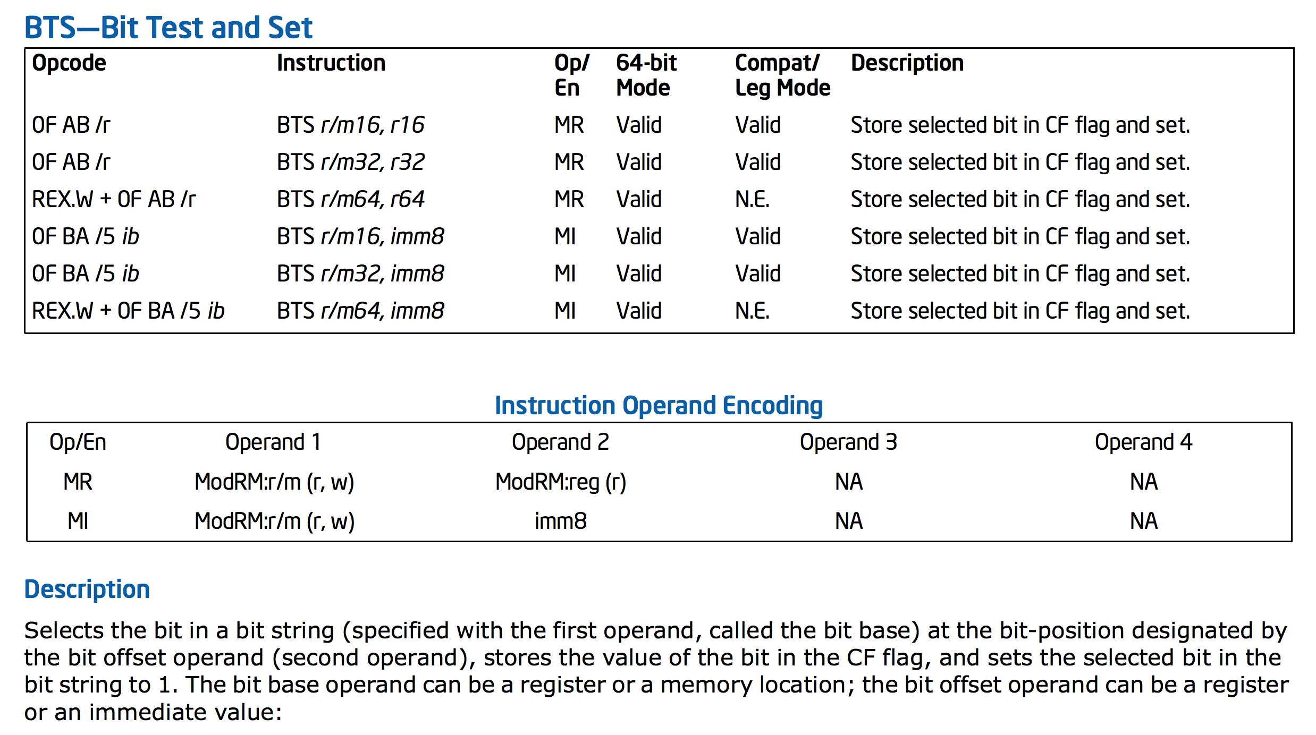
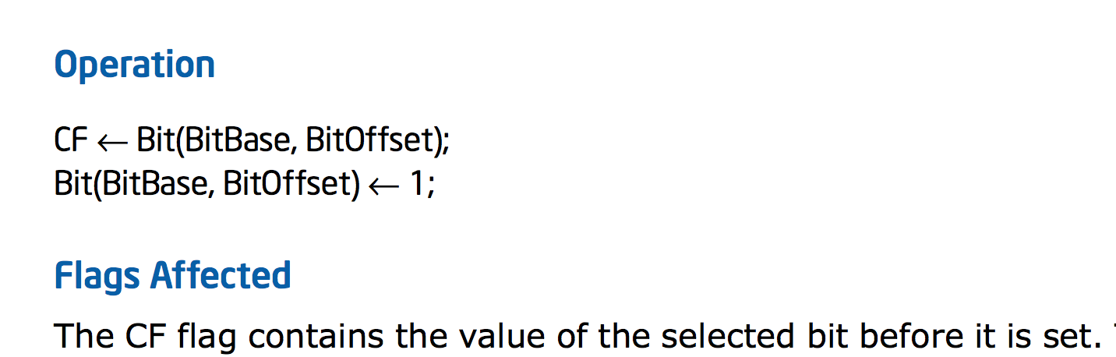
Intel x86

Slide 12
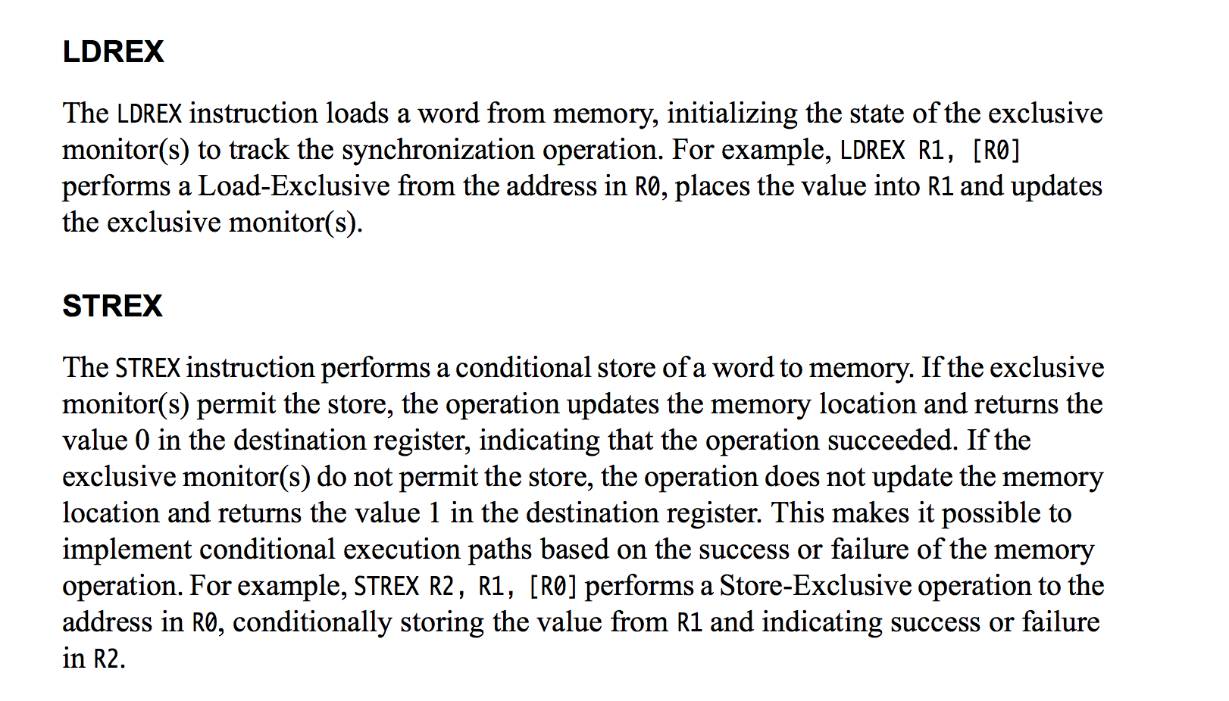
ARMv7

Slide 13
T1
T2
T3
T4
T5
Program:
loop {
non-critical {
…
}
critical {
…
}
}
Shared Memory (atomic read and write)
but no combined atomic operation (e.g., test-and-set)
Requirements:
Only one thread may be in the critical section at any time.
Each must eventually be able to enter its critical section.
Must be symmetrical (all run same program).
Cannot make any assumptions about speed of threads.

Slide 14
Clever “Cheating” Solution
T1
T2
T3
Initially, turn = 1
loop {
if turn == i:
critical_section;
turn = i + 1;
}
Shared Memory
turn:

Slide 15
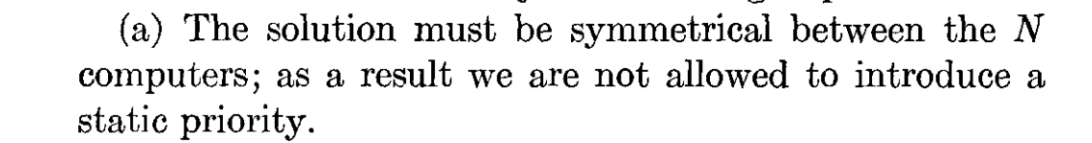
Initially, turn = 1
loop {
if turn == i:
critical_section;
turn = i + 1;
}

Slide 16

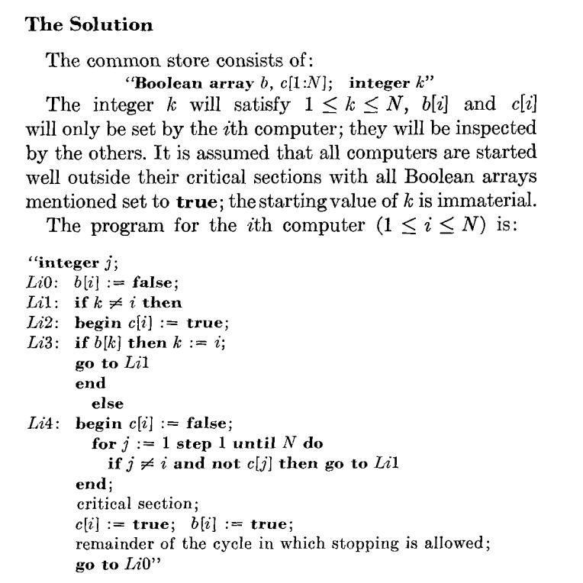
1965
Dijkstra (1973)
From Edgar Daylight’s collection:
http://www.dijkstrascry.com/node/59

Slide 17
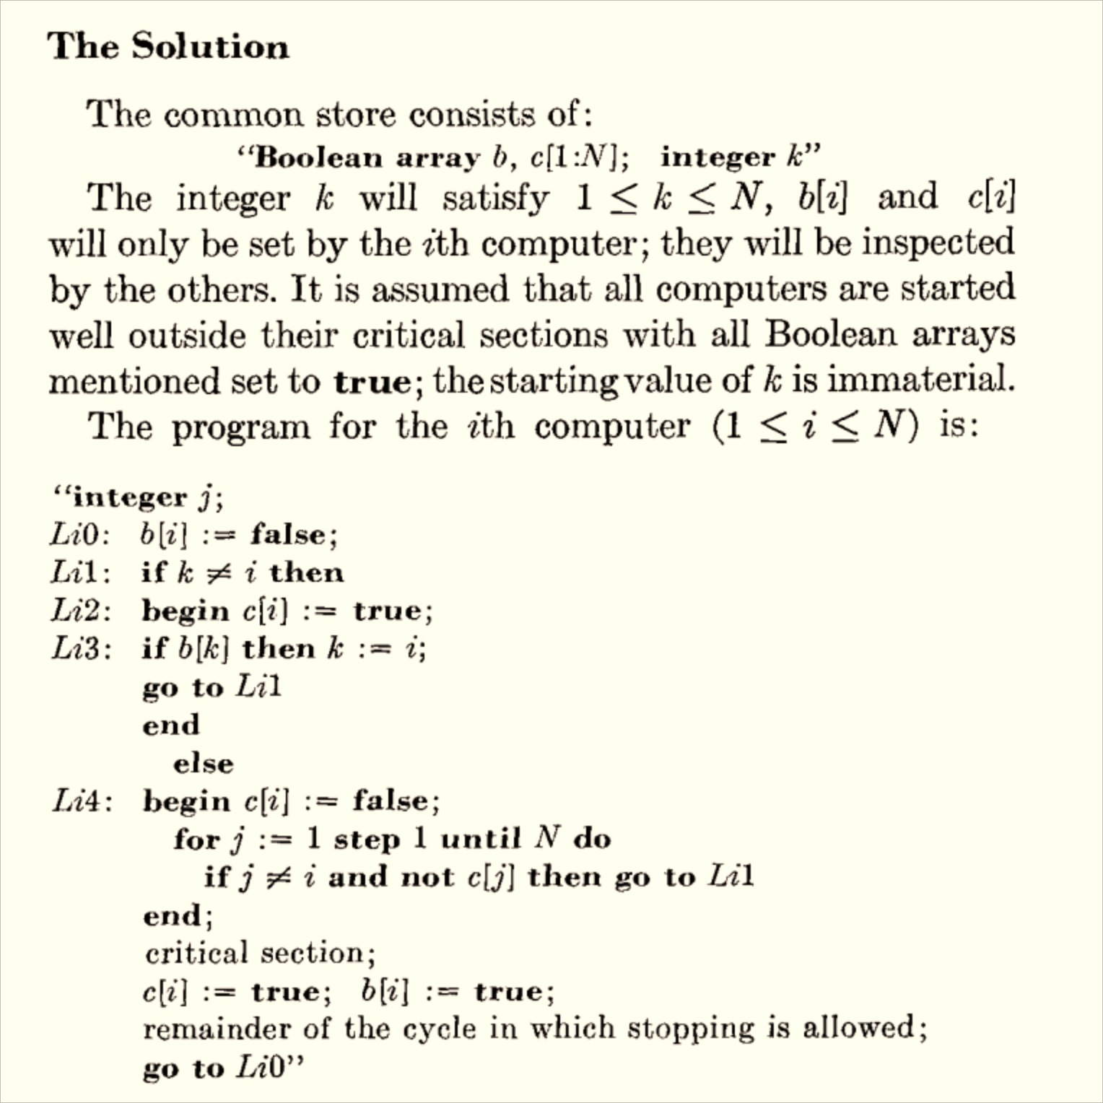
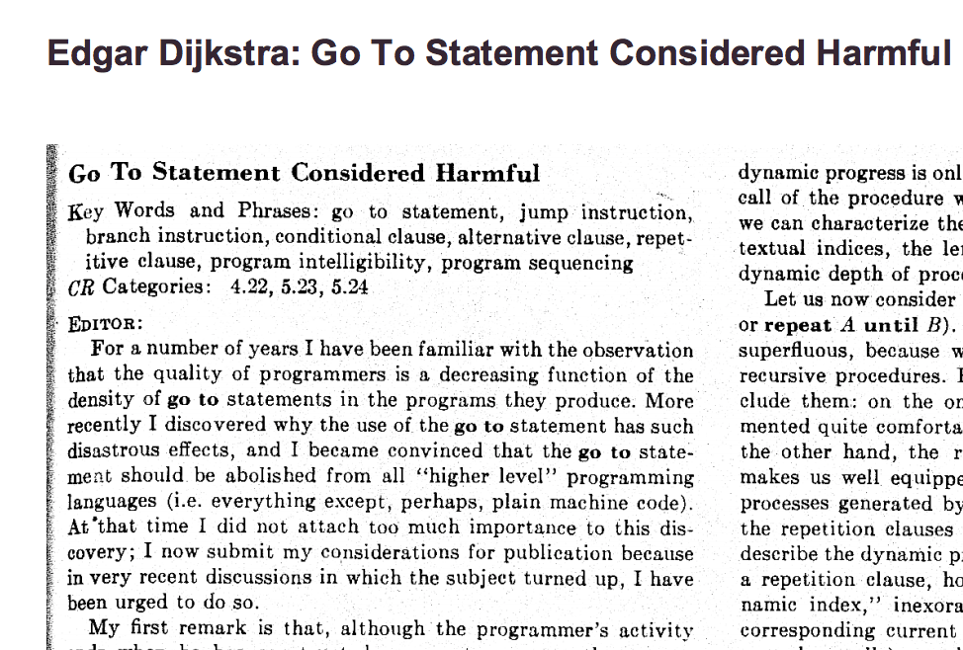

Slide 18
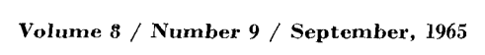
Program for Processor i
loop {
b[i] := false
L1: if k != i
c[i] := true
if b[k]
k := i
goto L1
else:
c[i] := false
for j in [1, …, N]:
if j != i and not c[j]:
goto L1
critical section;
c[i] := true
b[i] := true
}
Initialization
b[1:N] = [true, true, …]
c[1:N] = [true, true, …]
k = choose([1..N])

Slide 19
Program for Processor i
loop {
b[i] := false
L1: if k != i
c[i] := true
if b[k]:
k := i
goto L1
else:
c[i] := false
for j in [1, …, N]:
if j != i and not c[j]:
goto L1
critical section;
c[i] := true
b[i] := true
}
Safety: only one program can be in critical section

Slide 20
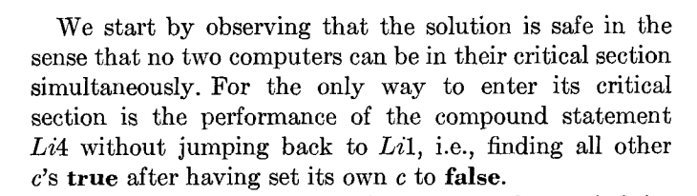
Program for Processor i
loop {
b[i] := false
L1: if k != i
c[i] := true
if b[k]:
k := i
goto L1
else:
c[i] := false;
L4: for j in [1, …, N]:
if j != i and not c[j]:
goto L1
critical section;
c[i] := true
b[i] := true
}
How do we know none of the c[.]’s changed during the loop?

Slide 21
Program for Processor i
loop {
b[i] := false
L1: if k != i:
c[i] := true
if b[k]:
k := i
goto L1
else:
c[i] := false;
L4: for j in [1, …, N]:
if j != i and not c[j]:
goto L1
critical section;
c[i] := true
b[i] := true
}
How do we know none of the c[.]’s changed during the loop?

Slide 22
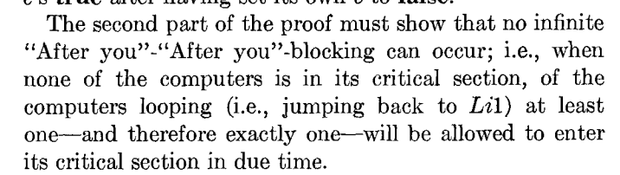
Program for Processor i
loop {
b[i] := false
L1: if k != i
c[i] := true
if b[k]:
k := i
goto L1
else:
c[i] := false;
L4: for j in [1, …, N]:
if j != i and not c[j]:
goto L1
critical section;
c[i] := true
b[i] := true
}

Slide 23
Program for Processor i
loop {
b[i] := false
L1: if k != i
c[i] := true
if b[k]:
k := i
goto L1
else:
c[i] := false;
L4: for j in [1, …, N]:
if j != i and not c[j]:
goto L1
critical section;
c[i] := true
b[i] := true
}
Liveness: makes progress

Slide 24
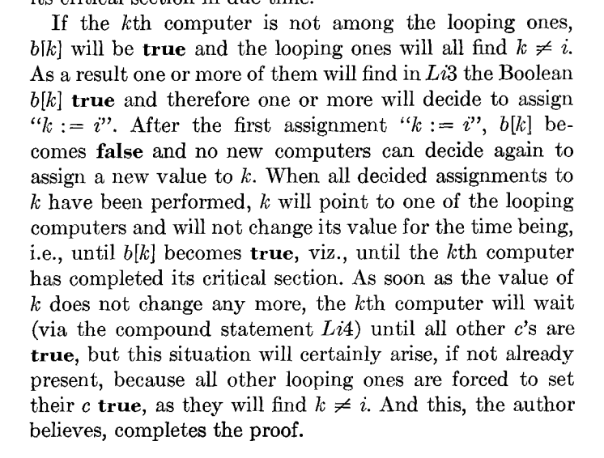
Program for Processor i
loop {
b[i] := false
L1: if k != i
c[i] := true
L3: if b[k]:
k := i
goto L1
else:
c[i] := false;
L4: for j in [1, …, N]:
if j != i and not c[j]:
goto L1
critical section;
c[i] := true
b[i] := true
}
Liveness Proof

Slide 27
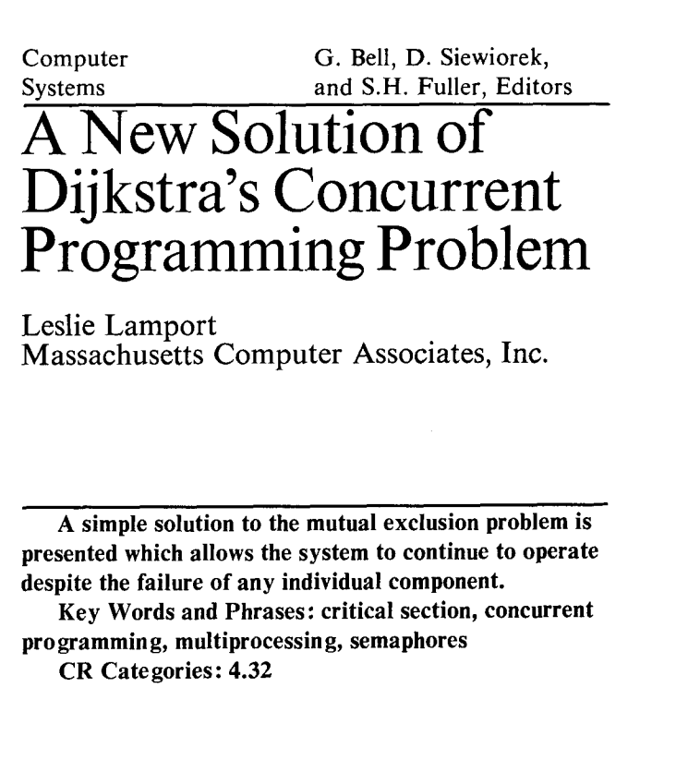

Communications of the ACM, August 1974 (2 pages)

Slide 28
“What is significant about the bakery algorithm is that it implements mutual exclusion without relying on any lower-level mutual exclusion. Assuming that reads and writes of a memory location are atomic actions, as previous mutual exclusion algorithms had done, is tantamount to assuming mutually exclusive access to the location. So a mutual exclusion algorithm that assumes atomic reads and writes is assuming lower-level mutual exclusion. Such an algorithm cannot really be said to solve the mutual exclusion problem. Before the bakery algorithm, people believed that the mutual exclusion problem was unsolvable--that you could implement mutual exclusion only by using lower-level mutual exclusion.”
Communications of the ACM, August 1974 (2 pages)

Slide 29
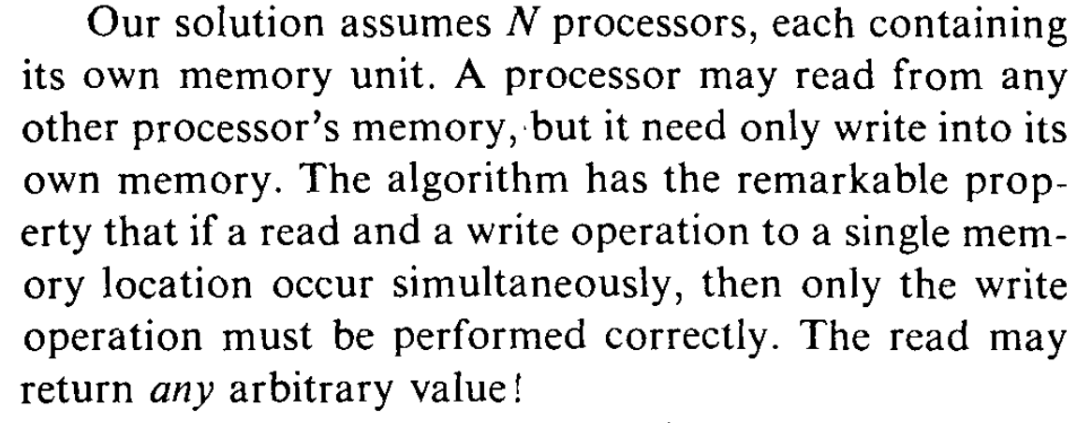

Slide 30

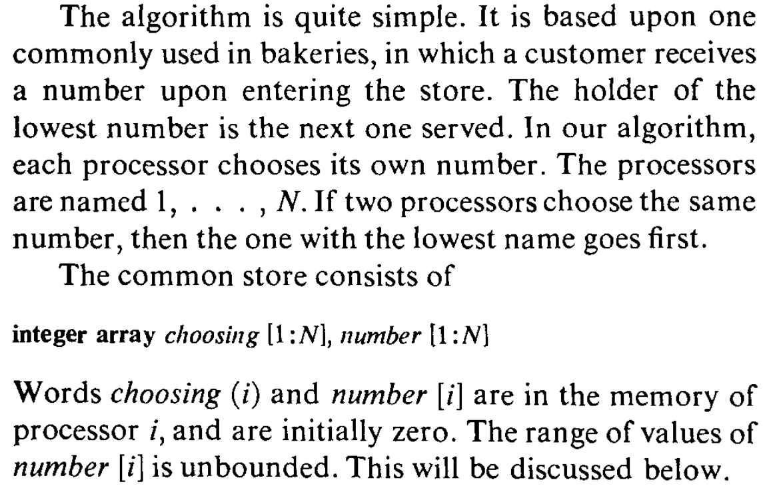

Slide 31
N independent threads
T1
T2
T3
T4
T5
Program:
loop {
non-critical {
…
}
critical {
…
}
}
Shared Memory (no exclusion!)
Requirements:
Only one thread may be in the critical section at any time.
Each must eventually be able to enter its critical section.
Must be symmetrical (all run same program).
Cannot make any assumptions about speed of threads.
Only writes are guaranteed (when simultaneous).

Slide 33
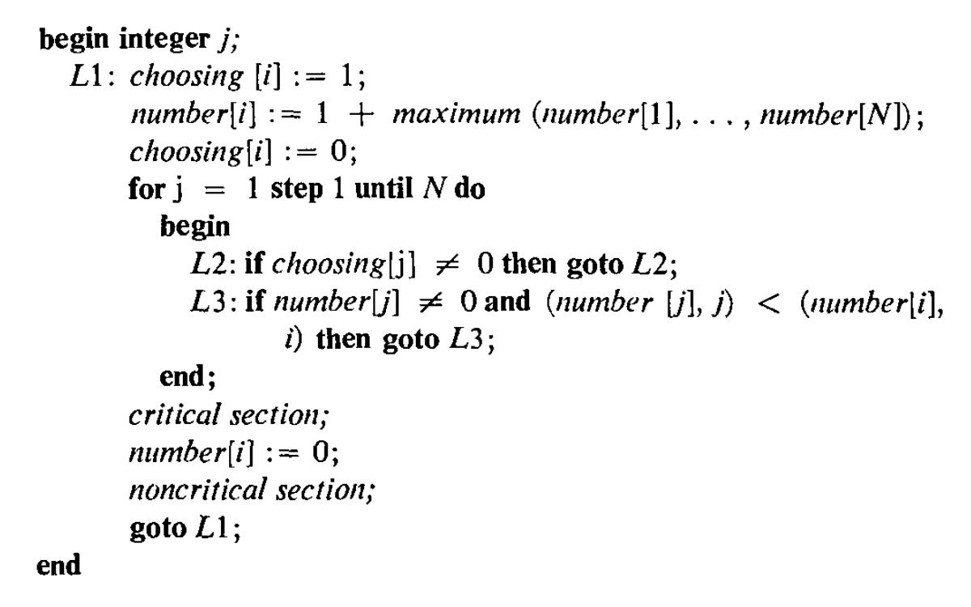
Processor number: i

Slide 34
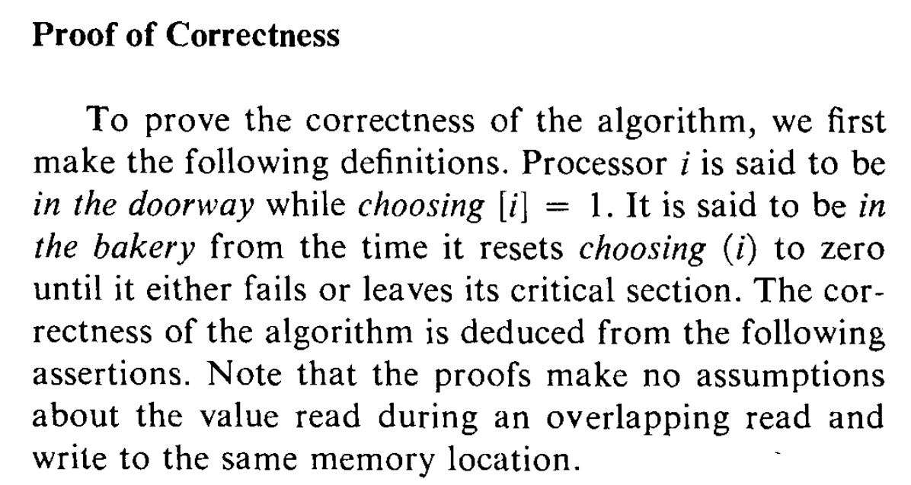

Slide 35
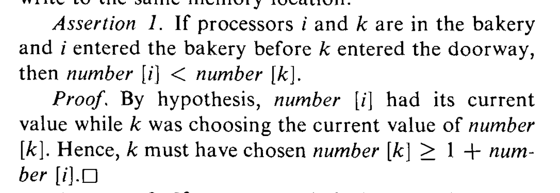
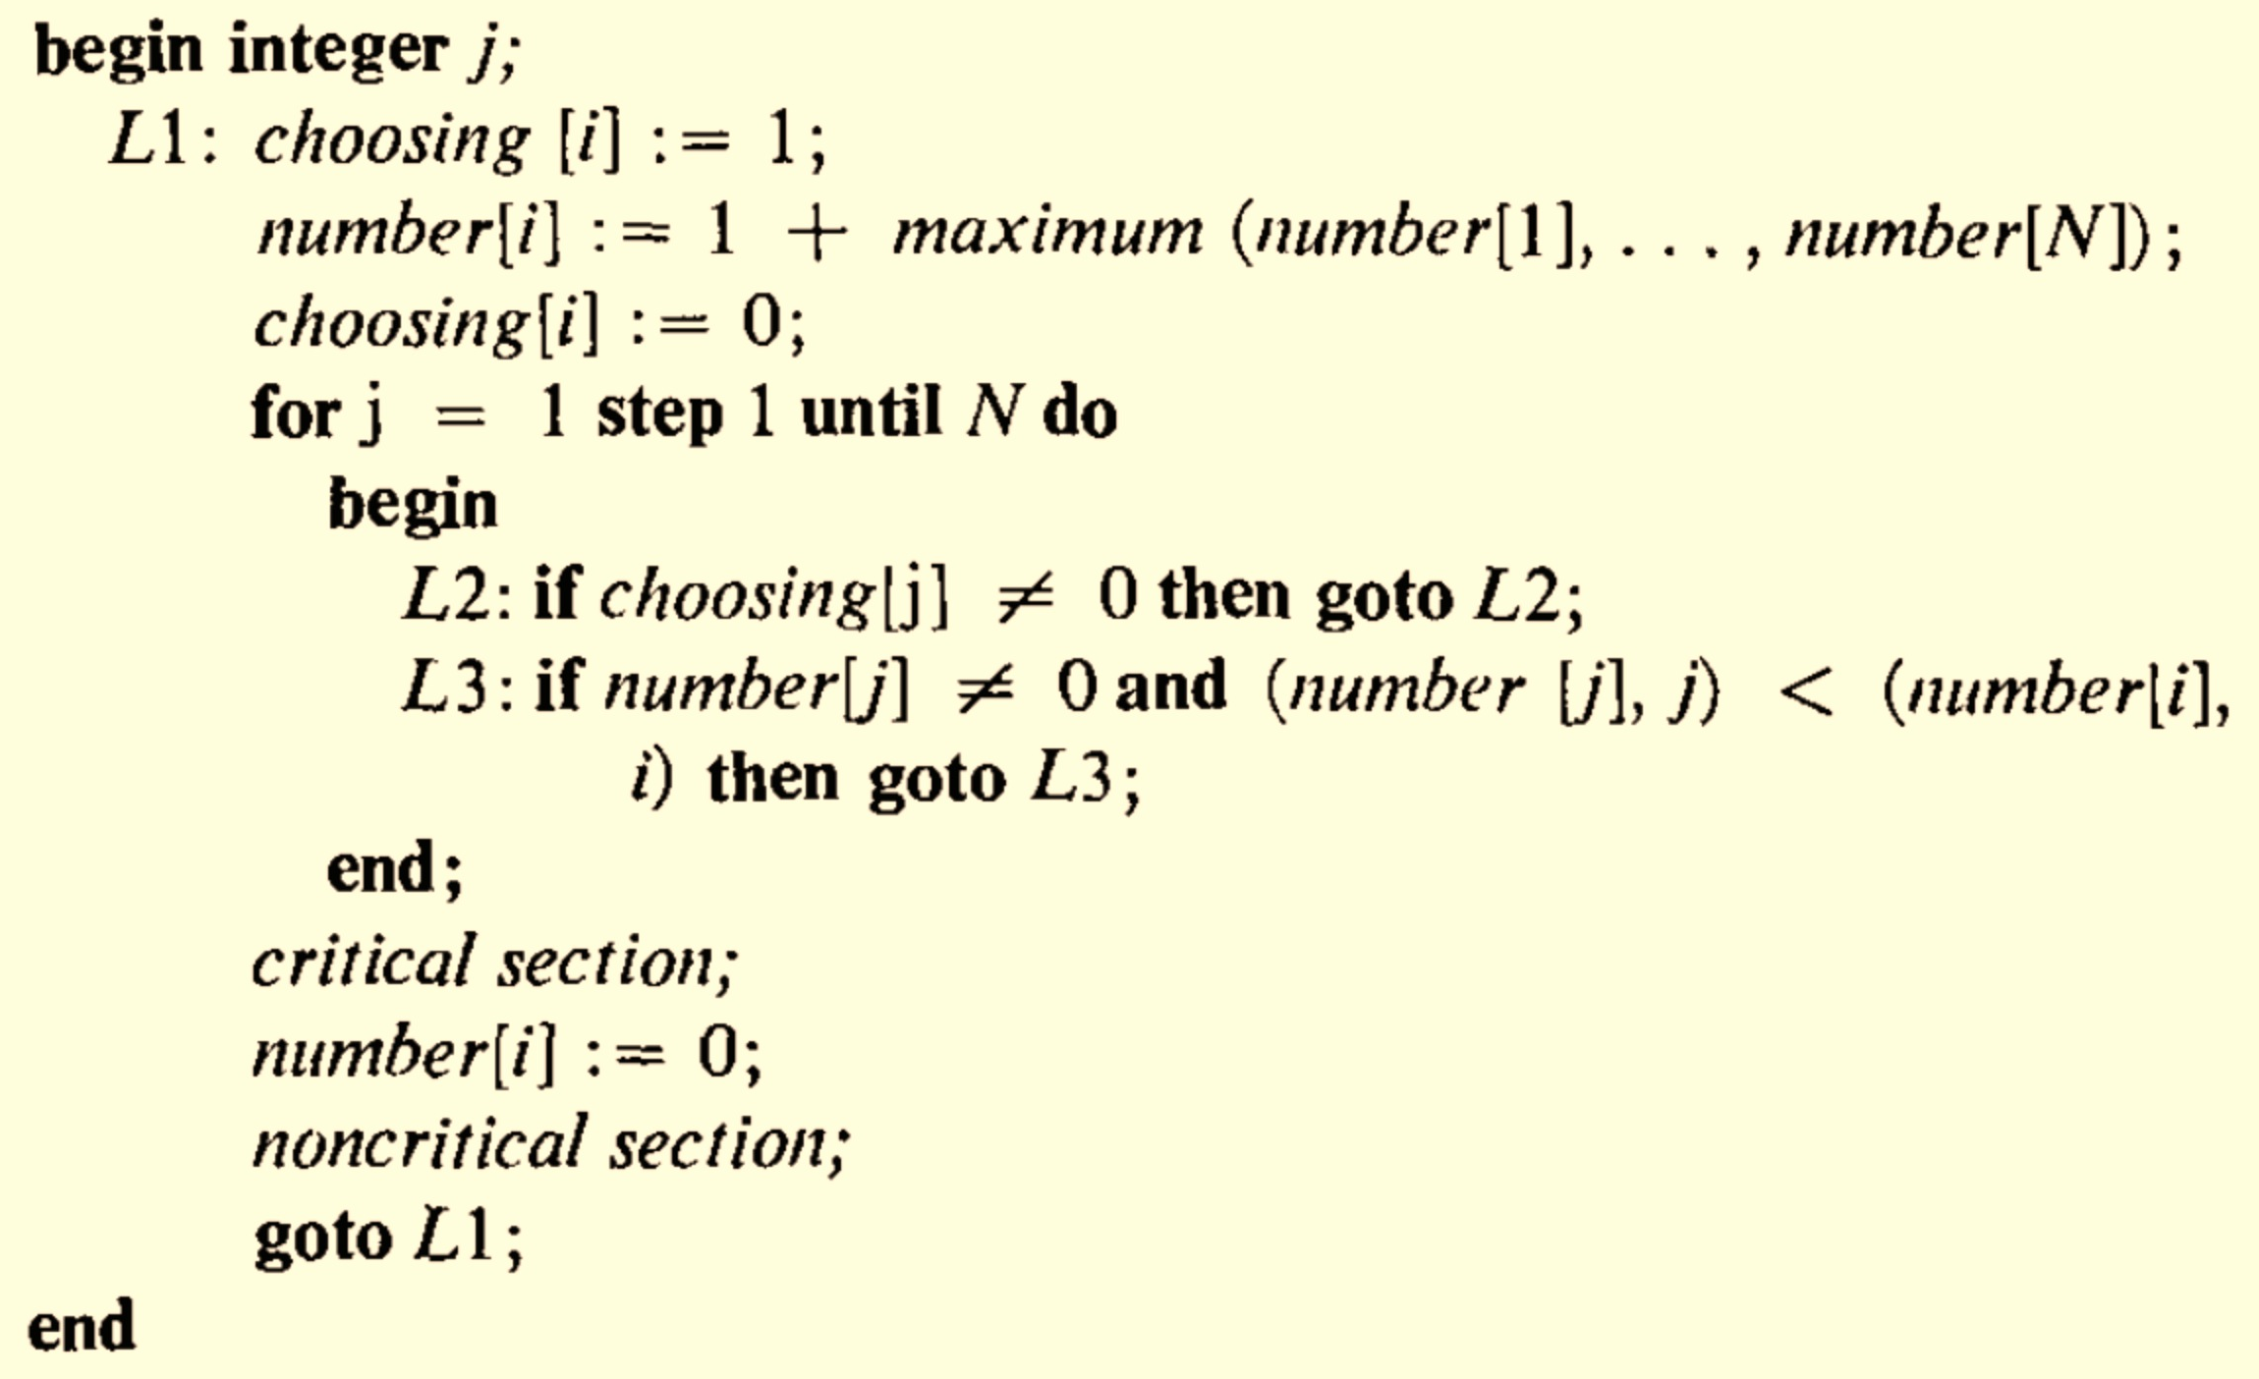

Slide 37
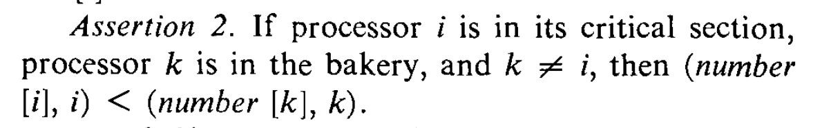

Slide 38
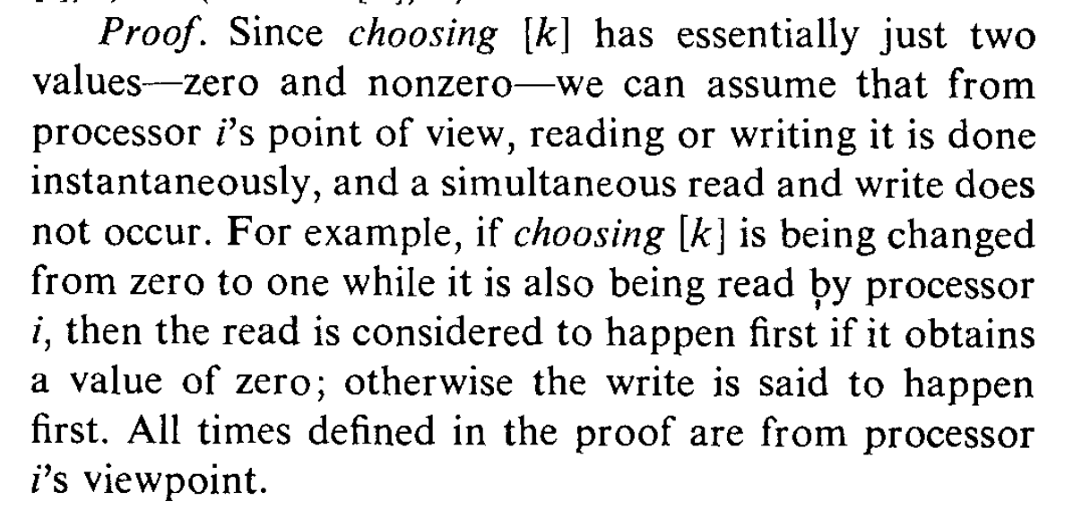

Slide 39
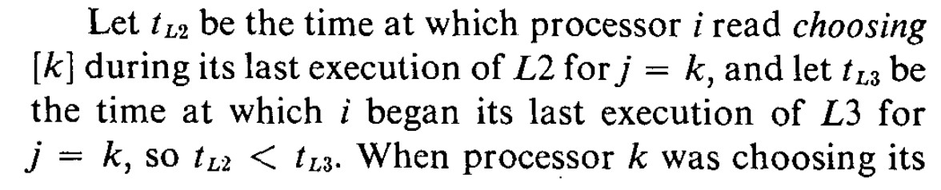
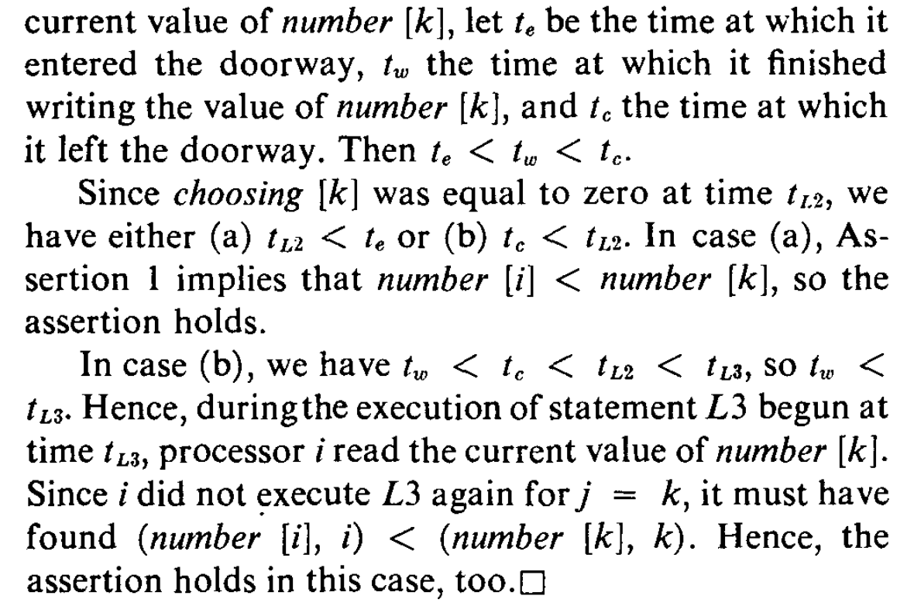

Slide 41
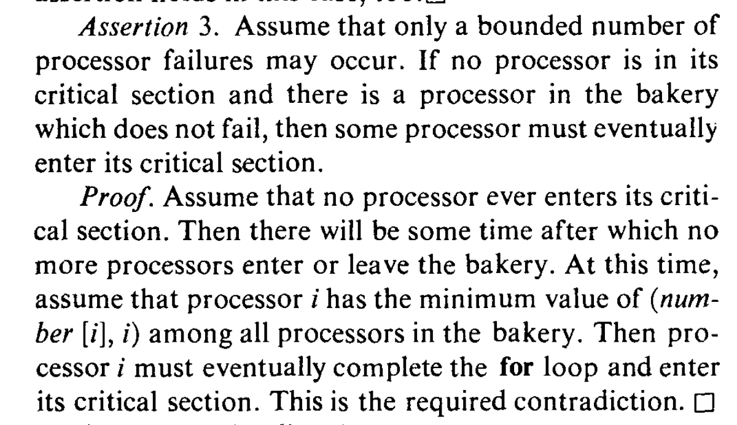

Slide 42
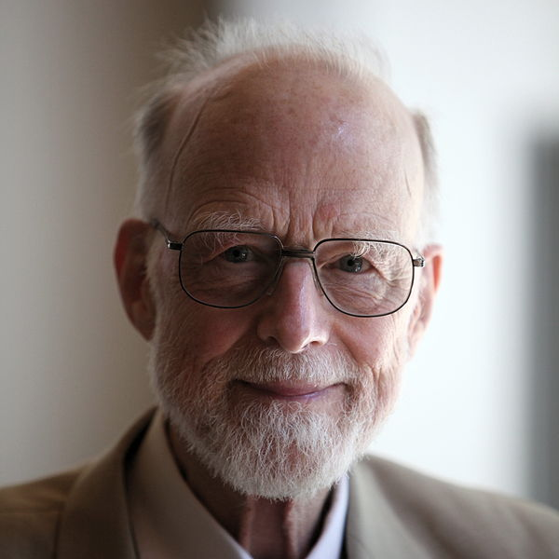
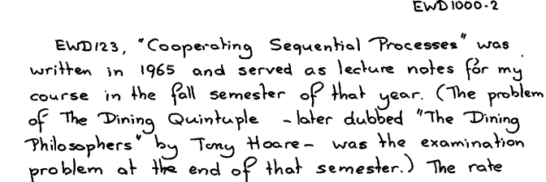
Sir Tony Hoare (born 1934)

Slide 43






Slide 44
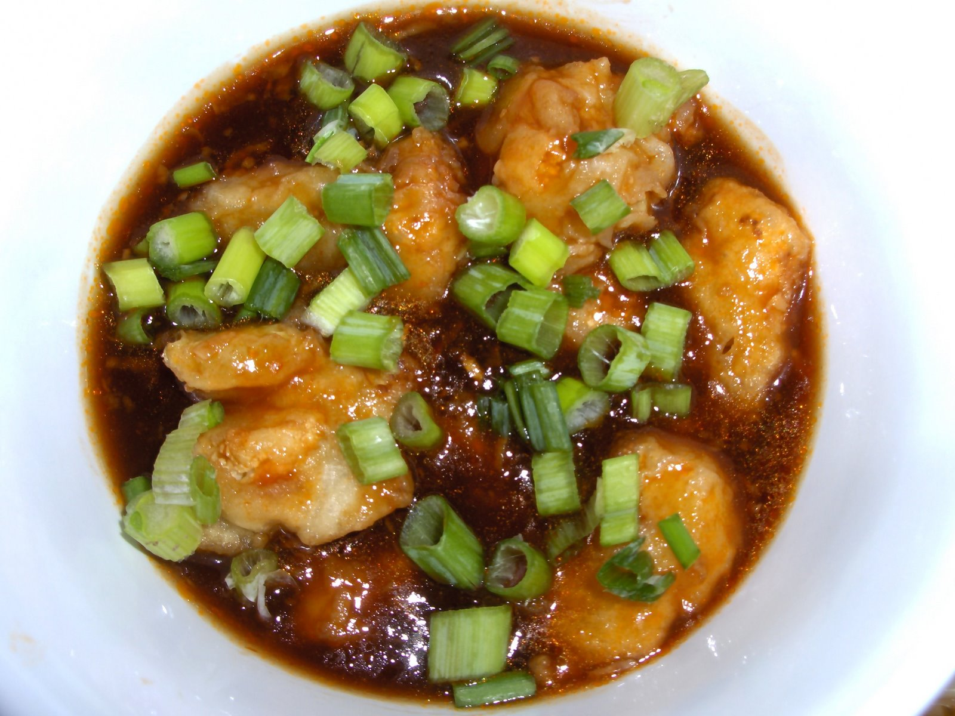
Plato
Heraclitus
Socrates
Euclid
Aristotle

Slide 45
5 Dining Philosophers
5 Chopsticks (one between each pair)
Need 2 chopsticks to eat

Slide 46
No (extra) communication No deadlock
No starvation
Fair
Charge
Think about the philosophers for next class
Project ideas due by 11:59pm tonight
Submit PS4 Assessment

Slide 47
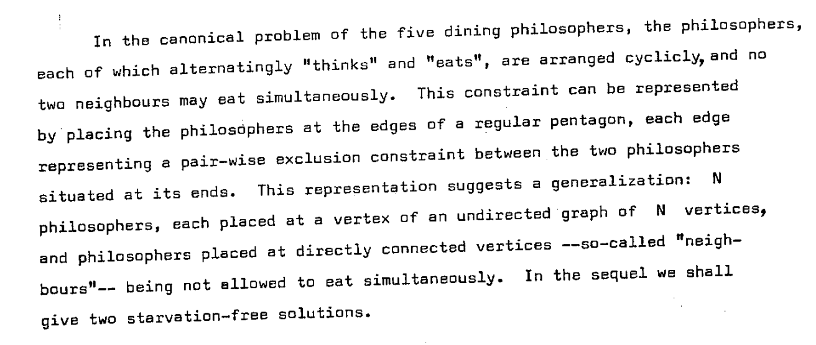
Djikstra’s (Hygenic) Version EWD625
Is this equivalent to the shared chopsticks?

Slide 49
Solution Desiderata
No communication required
No deadlock
No starvation: everyone gets to eat eventually
Fair: each philosopher has equal likelihood of
getting to eat

Slide 50
Could all the philosophers starve?

Slide 51
Dijkstra’s Solution (Idea)
Number the chopsticks, always grab lower-numbered stick first
  Does it matter how the chopsticks are numbered?

Slide 52
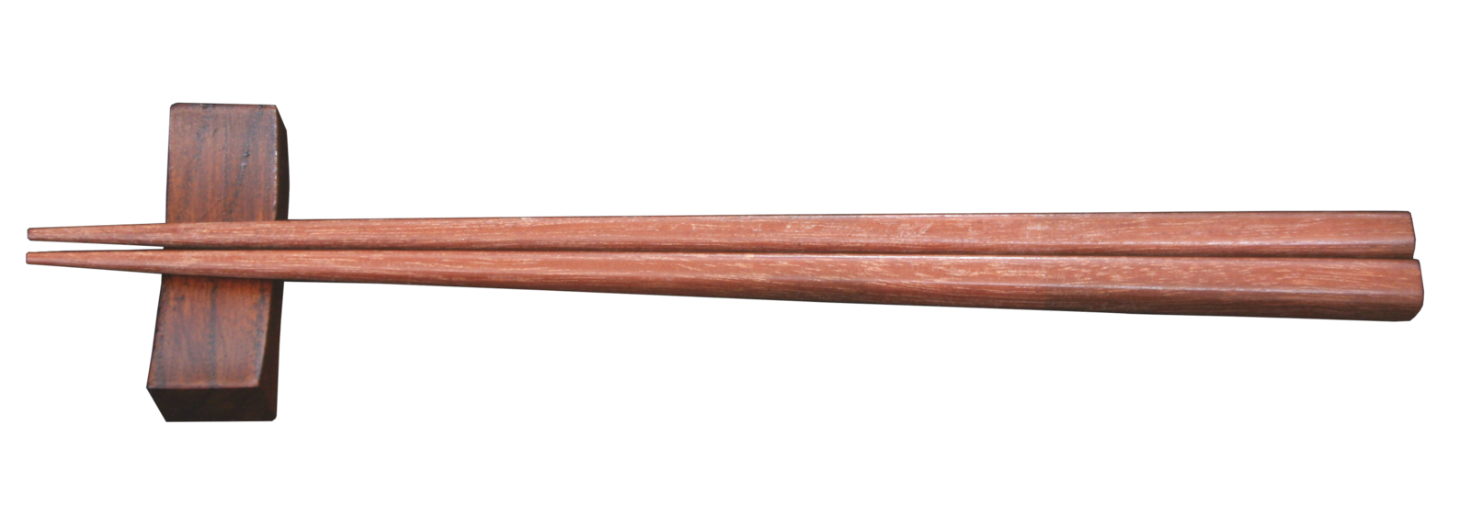
The Real Idea was to
“Invent the Chopstick”
Binary Semaphore
Lock that can be held by up to one process
http://commons.wikimedia.org/wiki/File:Chopstick.png

Slide 53
type Semaphore = Option<uint> ; // either None (available) or owner
static mut count: uint = 0; // protected by lock
static mut lock: Semaphore = None;
fn grab_lock(id: uint) {
while (lock.is_some()) { ; } // wait for lock
lock = Some(id);
}
fn release_lock() { lock = None; }
fn update_count(id: uint) {
grab_lock(id);
count += 1;
println(fmt!("Count updated by %?: %?", id, count));
release_lock();
}
fn main() {
for num in range(0u, 10) {
do spawn { for _ in range(0u, 1000)
{ update_count(num); }
} } }

Slide 54
type Semaphore = Option<uint> ; // either None (available) or owner
static mut count: uint = 0; // protected by lock
static mut lock: Semaphore = None;
fn grab_lock(id: uint) {
while (lock.is_some()) { ; } // wait for lock
lock = Some(id);
}
fn release_lock() { lock = None; }
fn update_count(id: uint) {
grab_lock(id);
count += 1;
println(fmt!("Count updated by %?: %?", id, count));
release_lock();
}
fn main() {
for num in range(0u, 10) {
do spawn { for _ in range(0u, 1000) { update_count(num); } } } }
FAIL! This is unsafe:
semaphore.rs:9:11: 9:15 error: use of mutable static requires unsafe function or block
semaphore.rs:9 while (lock.is_some()) {
…

Slide 55
type Semaphore = Option<uint> ; // either None (available) or owner
static mut count: uint = 0; // protected by lock
static mut lock: Semaphore = None;
fn grab_lock(id: uint) {
unsafe {
while (lock.is_some()) { ; }
lock = Some(id);
} }
fn release_lock() { unsafe { lock = None; } }
fn update_count(id: uint) {
unsafe {
grab_lock(id);
count += 1;
println(fmt!("Count updated by %?: %?", id, count));
release_lock();
}
}
fn main() {
for num in range(0u, 10) {
do spawn {
for _ in range(0u, 1000) {
update_count(num);
}
}
}
}
What will the final count be?

Slide 56
gash> ./semaphore > run1.txt
gash> ./semaphore > run2.txt
gash> ./semaphore > run3.txt
gash> tail -1 run1.txt
Count updated by 8u: 9968u
gash> tail -1 run2.txt
Count updated by 9u: 9951u
gash> tail -1 run3.txt
Count updated by 9u: 9950u

Slide 57
type Semaphore = Option<uint> ; // either None (available) or owner
static mut count: uint = 0; // protected by lock
static mut lock: Semaphore = None;
fn grab_lock(id: uint) {
unsafe {
while (lock.is_some()) { ; }
lock = Some(id);
} }
fn release_lock() { unsafe { lock = None; } }
fn update_count(id: uint) {
unsafe {
grab_lock(id);
count += 1;
println(fmt!("Count updated by %?: %?", id, count));
release_lock();
}
}
fn main() {
for num in range(0u, 10) {
do spawn {
for _ in range(0u, 1000) {
update_count(num);
}
}
}
}

Slide 58
Djikstra’s (Hygenic) Version EWD625
Is this equivalent to the shared chopsticks?

Slide 60
Solution Desiderata
No communication required
No deadlock
No starvation: everyone gets to eat eventually
Fair: each philosopher has equal likelihood of
getting to eat

Slide 61
Could all the philosophers starve?

Slide 62
Dijkstra’s Solution (Idea)
Number the chopsticks, always grab lower-numbered stick first
  Does it matter how the chopsticks are numbered?

Slide 63
The Real Idea was to
“Invent the Chopstick”
Binary Semaphore
Lock that can be held by up to one process
http://commons.wikimedia.org/wiki/File:Chopstick.png

Slide 64
type Semaphore = Option<uint> ; // either None (available) or owner
static mut count: uint = 0; // protected by lock
static mut lock: Semaphore = None;
fn grab_lock(id: uint) {
while (lock.is_some()) { ; } // wait for lock
lock = Some(id);
}
fn release_lock() { lock = None; }
fn update_count(id: uint) {
grab_lock(id);
count += 1;
println(fmt!("Count updated by %?: %?", id, count));
release_lock();
}
fn main() {
for num in range(0u, 10) {
do spawn { for _ in range(0u, 1000)
{ update_count(num); }
} } }

Slide 65
type Semaphore = Option<uint> ; // either None (available) or owner
static mut count: uint = 0; // protected by lock
static mut lock: Semaphore = None;
fn grab_lock(id: uint) {
while (lock.is_some()) { ; } // wait for lock
lock = Some(id);
}
fn release_lock() { lock = None; }
fn update_count(id: uint) {
grab_lock(id);
count += 1;
println(fmt!("Count updated by %?: %?", id, count));
release_lock();
}
fn main() {
for num in range(0u, 10) {
do spawn { for _ in range(0u, 1000) { update_count(num); } } } }
FAIL! This is unsafe:
semaphore.rs:9:11: 9:15 error: use of mutable static requires unsafe function or block
semaphore.rs:9 while (lock.is_some()) {
…

Slide 66
type Semaphore = Option<uint> ; // either None (available) or owner
static mut count: uint = 0; // protected by lock
static mut lock: Semaphore = None;
fn grab_lock(id: uint) {
unsafe {
while (lock.is_some()) { ; }
lock = Some(id);
} }
fn release_lock() { unsafe { lock = None; } }
fn update_count(id: uint) {
unsafe {
grab_lock(id);
count += 1;
println(fmt!("Count updated by %?: %?", id, count));
release_lock();
}
}
fn main() {
for num in range(0u, 10) {
do spawn {
for _ in range(0u, 1000) {
update_count(num);
}
}
}
}
What will the final count be?

Slide 67
gash> ./semaphore > run1.txt
gash> ./semaphore > run2.txt
gash> ./semaphore > run3.txt
gash> tail -1 run1.txt
Count updated by 8u: 9968u
gash> tail -1 run2.txt
Count updated by 9u: 9951u
gash> tail -1 run3.txt
Count updated by 9u: 9950u

Slide 68
type Semaphore = Option<uint> ; // either None (available) or owner
static mut count: uint = 0; // protected by lock
static mut lock: Semaphore = None;
fn grab_lock(id: uint) {
unsafe {
while (lock.is_some()) { ; }
lock = Some(id);
} }
fn release_lock() { unsafe { lock = None; } }
fn update_count(id: uint) {
unsafe {
grab_lock(id);
count += 1;
println(fmt!("Count updated by %?: %?", id, count));
release_lock();
}
}
fn main() {
for num in range(0u, 10) {
do spawn {
for _ in range(0u, 1000) {
update_count(num);
}
}
}
}

Slide 69
fn update_count(id: uint) {
unsafe {
grab_lock(id);
assert!(match lock { None => false,
Some(lockee) => lockee == id});
count += 1;
println(fmt!("Count updated by %?: %?", id, count));
release_lock();
}
}
Count updated by 1u: 710u
Count updated by 2u: 710u
Count updated by 1u: 711u
Count updated by 2u: 713uCount updated by 1u: 713u
Count updated by 2u: 714u
Count updated by 2u: 715u
task <unnamed> failed at 'assertion failed: match lock { None => false, Some(lockee) => \
lockee == id }', semaphore.rs:26
Count updated by 2u: 716u
Count updated by 2u: 717u

Slide 70
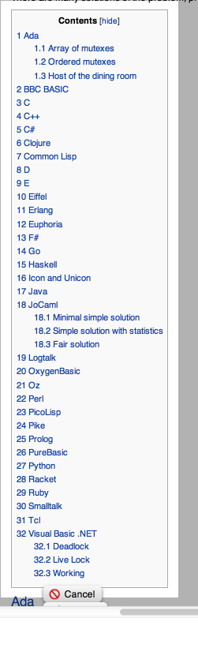
http://rosettacode.org/wiki/Dining_philosophers

Slide 71

Class 14

Slide 72
Class 14
“What is significant about the bakery algorithm is that it implements mutual exclusion without relying on any lower-level mutual exclusion. Assuming that reads and writes of a memory location are atomic actions, as previous mutual exclusion algorithms had done, is tantamount to assuming mutually exclusive access to the location. So a mutual exclusion algorithm that assumes atomic reads and writes is assuming lower-level mutual exclusion. Such an algorithm cannot really be said to solve the mutual exclusion problem. Before the bakery algorithm, people believed that the mutual exclusion problem was unsolvable--that you could implement mutual exclusion only by using lower-level mutual exclusion.”
Communications of the ACM, August 1974 (2 pages)
We will explore this next Tuesday!

Slide 73
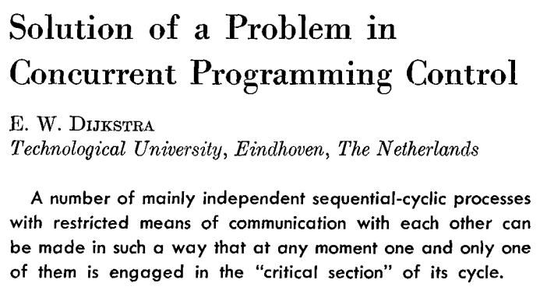
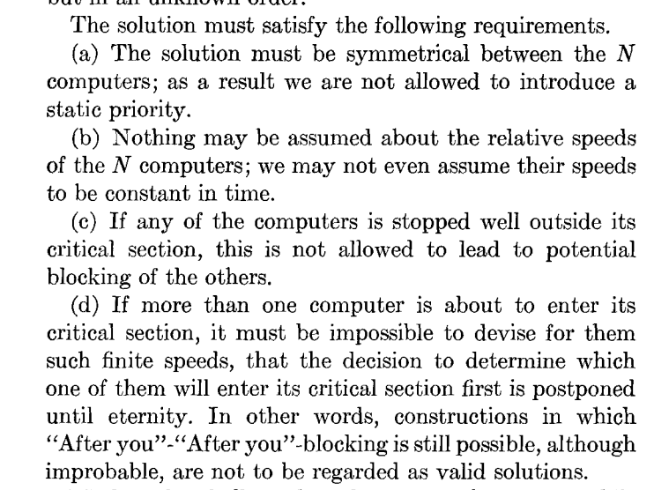

Edsger Dijkstra (1930-2002)

Slide 74
Dijkstra’s Problem
N independent threads
Program:
loop {
non-critical {
…
}
critical {
…
}
}
T1
T2
T3
T4
T5
Shared Memory (atomic read and write)

Slide 75
N independent threads
T1
T2
T3
T4
T5
Program:
loop {
non-critical {
…
}
critical {
…
}
}
Shared Memory (atomic read and write)
Requirements:
Only one thread may be in the critical section at any time.
Each must eventually be able to enter its critical section.
Must be symmetrical (all run same program).
Cannot make any assumptions about speed of threads.

Slide 76
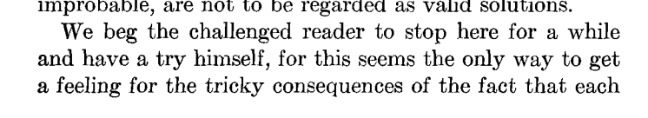
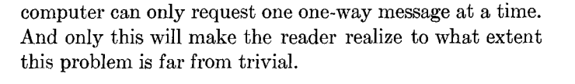

Slide 77
fn update_count(id: uint) {
unsafe {
grab_lock(id);
assert!(match lock { None => false,
Some(lockee) => lockee == id});
count += 1;
println(fmt!("Count updated by %?: %?", id, count));
release_lock();
}
}
Count updated by 1u: 710u
Count updated by 2u: 710u
Count updated by 1u: 711u
Count updated by 2u: 713uCount updated by 1u: 713u
Count updated by 2u: 714u
Count updated by 2u: 715u
task <unnamed> failed at 'assertion failed: match lock { None => false, Some(lockee) => \
lockee == id }', semaphore.rs:26
Count updated by 2u: 716u
Count updated by 2u: 717u

Slide 78
http://rosettacode.org/wiki/Dining_philosophers

