Slide 1
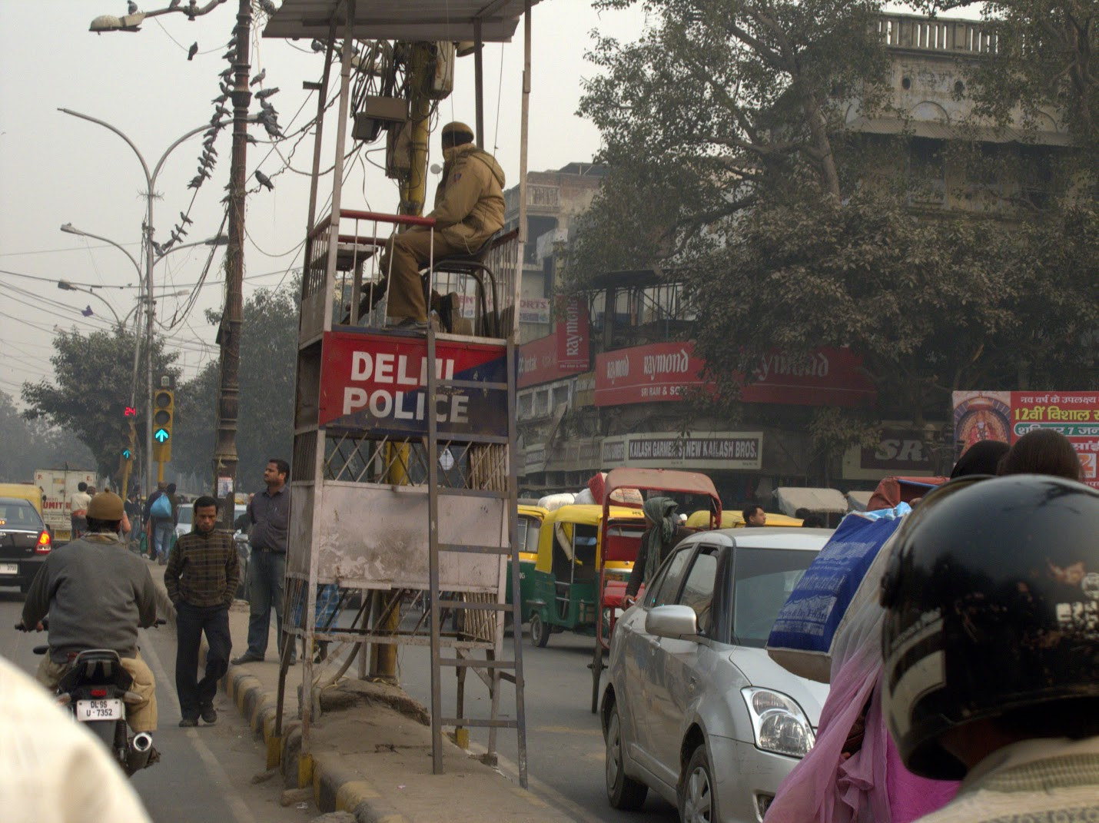
Class 21:
Making a Process
(Virtual Memory)
cs4414 Fall 2013
University of Virginia
David Evans

Slide 2
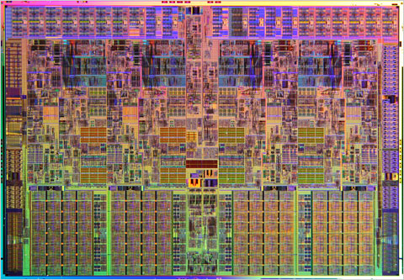
Recap: Last Week
run::Process::new(program, argv, options)
Rust Runtime
spawn_process_os(prog, args, env, dir, in_fd, …)
fork()
int 0x80
libc: fork()
jumps into kernel code
sets supervisor mode
linux kernel: fork syscall

Slide 3
Plan for This Week
How the Kernel Makes a Process
  Virtual Memory
Thursday: diving into fork.c

Slide 4
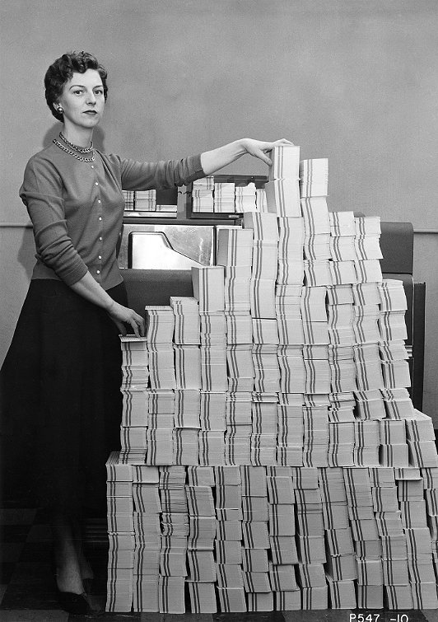
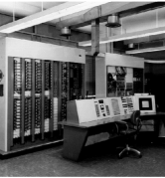

Batch Processing
From Class 3:
Program
Computer Center
Your Program Runs
Output: Invalid Operation
Charge: $174.32

Slide 5

Process Abstraction
Provide each program with the illusion that it owns the whole machine.
The best example of this way to do things is Linux, which is an operating system, which is a program that keeps track of other programs in a computer and gives each its due in space and time.
Guy Steele, “How to Grow a Language”
HT: Anonymous for posting link in Piazza forum

Slide 6
Memory Isolation
Process 1 should only be able to access Memory Space 1
Process 2 should only be able to access Memory Space 2
Memory Space 1
Memory Space 2

Slide 7
Software-Based Memory Isolation
Original Code
“Sandboxed” Code
…
movq %rax, -8(%rbp)
…
…
movq -8(%rbp),%rdx
andq %rdx,%rgx
movq %rax, %rdx
…
Safe Loader
Assumes %rdx is reserved and %rgx is protected and holds a mask for the memory segment

Slide 8
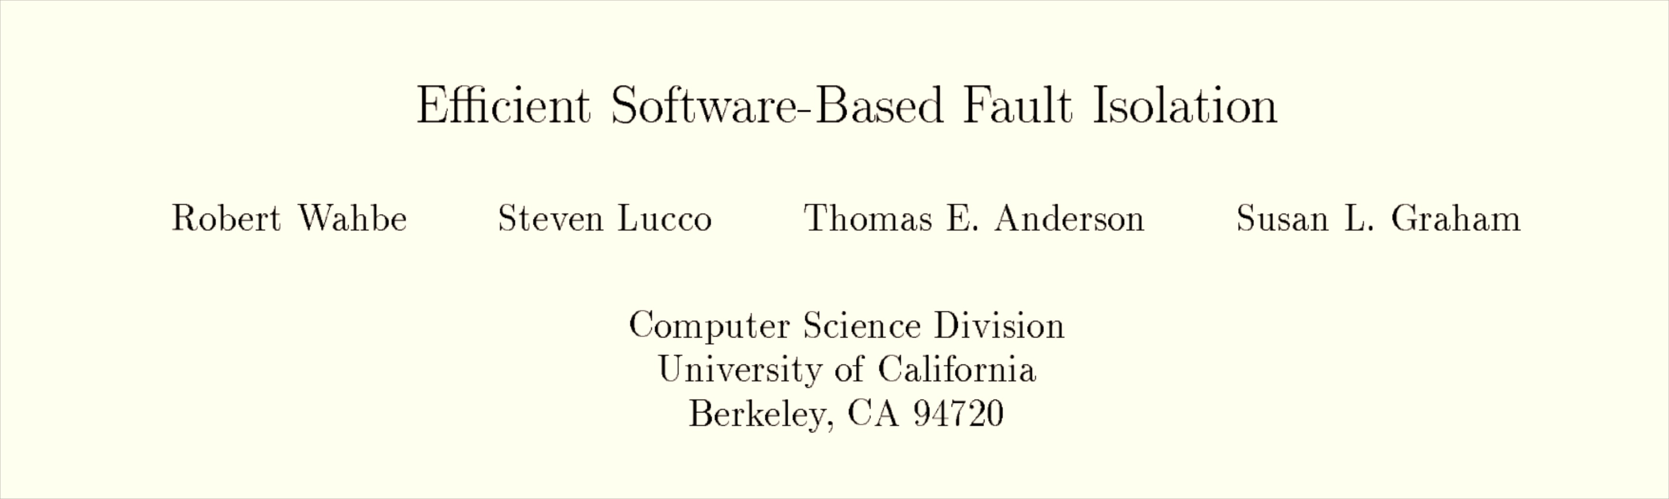
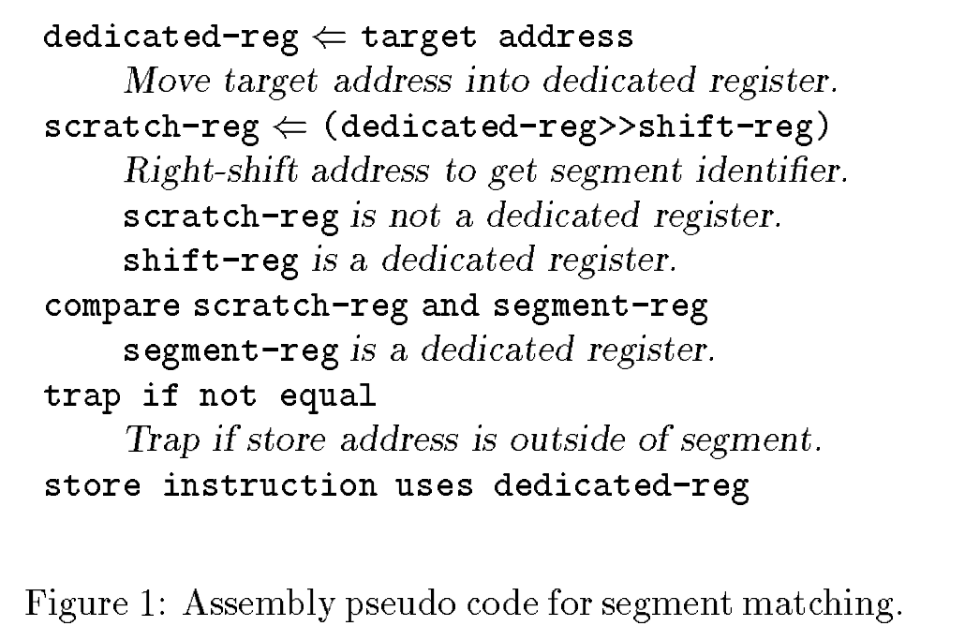
SOSP 1993
SOSP 1993

Slide 9
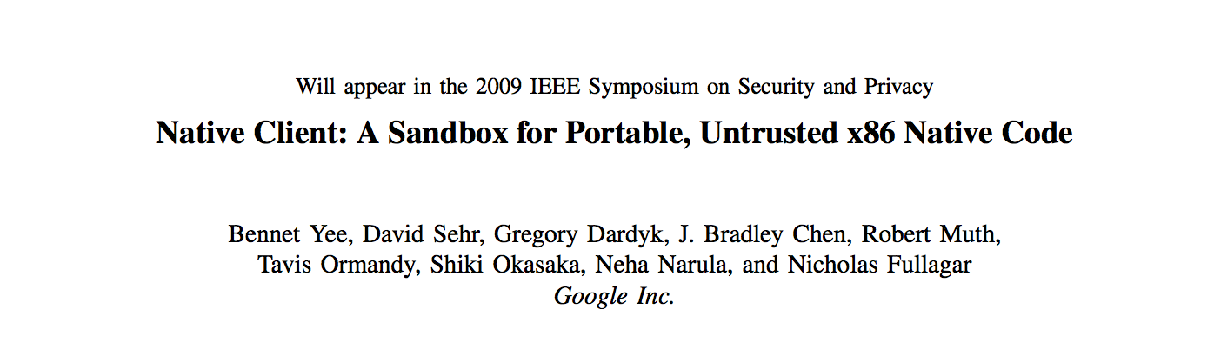
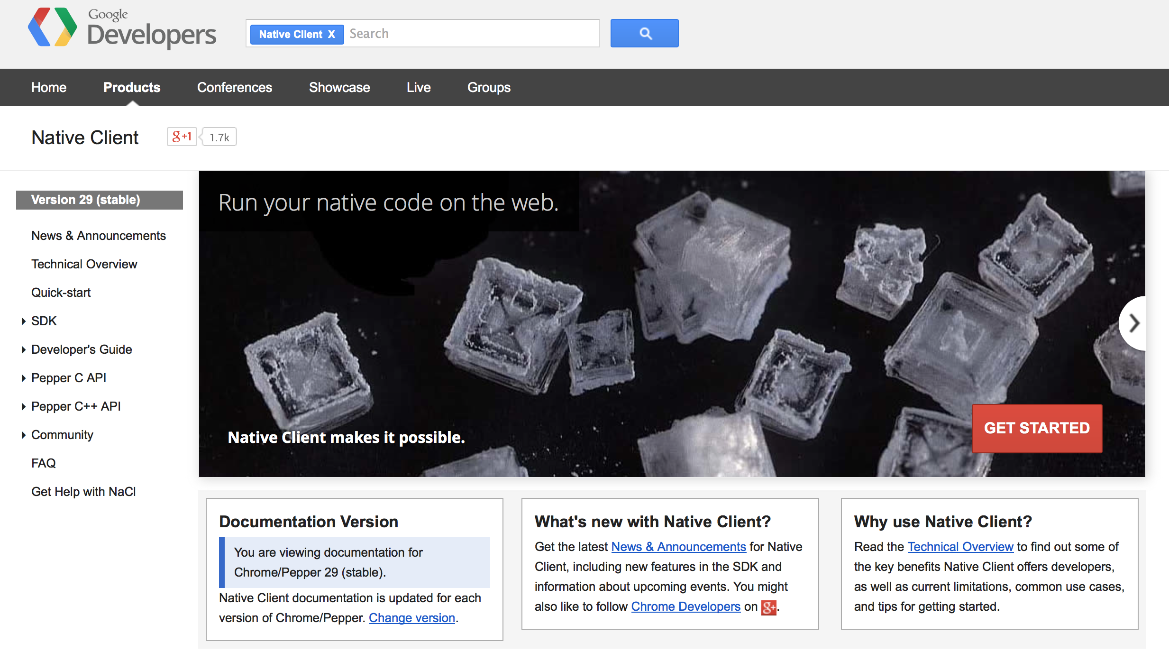


Slide 10
Hardware-Based Memory Isolation
Original Code
Running Code
…
movq %rax, -8(%rbp)
…
…
movq %rax, -8(%rbp)
…
Memory Space 1
Memory Space 2

Slide 11
Virtual Memory
address in Process P
Virtual Memory Mapping
physical address owned by Process P
User-level processes cannot access physical memory directly: all memory addresses created by process P are virtual addresses, mapped into physical addresses owned by process P

Slide 12
Getting Into the Details…

Slide 13

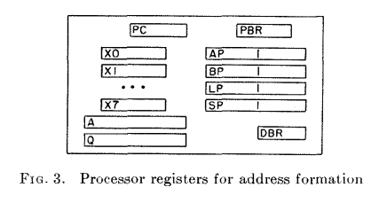
SOSP 1967
Procedure Base Register:
segment number of executing procedure
Argument Pointer
Base Pointer
Linkage Pointer
Stack Pointer
Descriptor Base Register

Slide 14
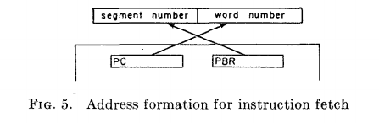
Generating an Address
18 bits
18 bits
2¹⁸ = 262144

Slide 15
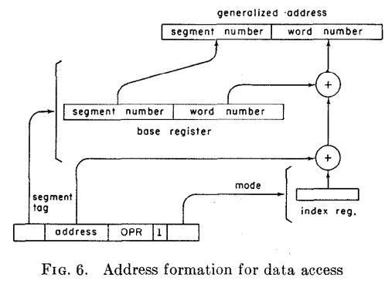
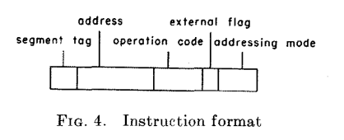
Addressing Mode selects:
Argument Pointer
Base Pointer
Linkage Pointer
Stack Pointer

Slide 16
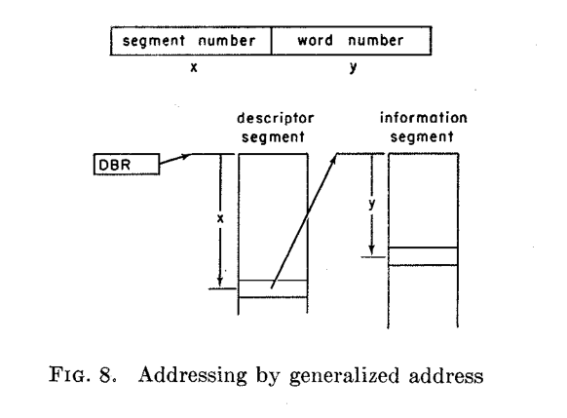
Descriptor Base Register
What does MULTICS need to do to switch processes?

Slide 17
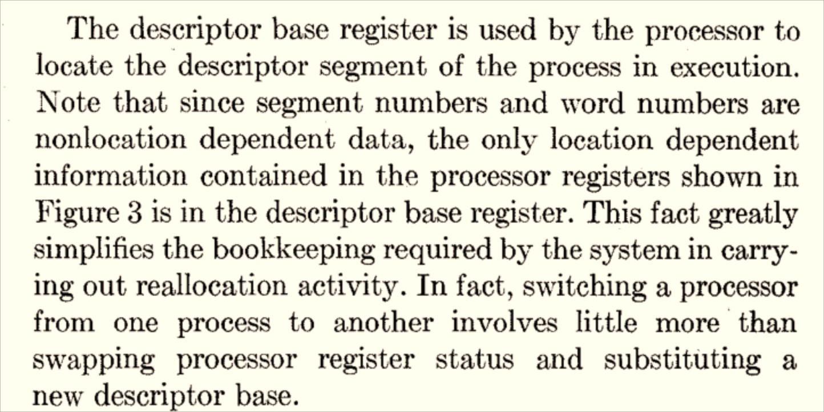

Slide 18
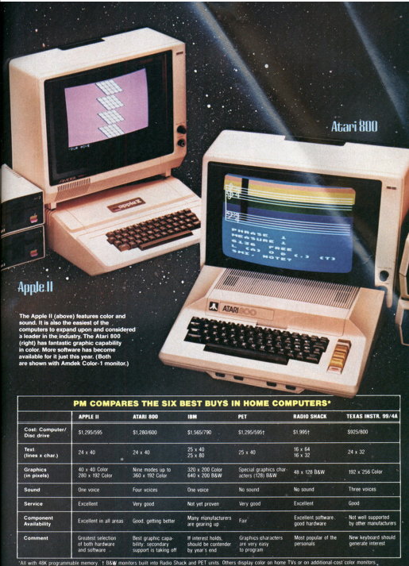
1982
"It used to be that programs were easy to copy and change. But manufacturers began to lose money as many people made copies of software and gave them to their friends. Now, many manufacturers have figured out how to 'copy-protect' discs. A copy-protected disc–like a cartridge–can’t be copied or changed. To our mind this is a disaster: Most people learn programming by changing programs to fit their own needs. This capability of customization is what makes computers so attractive. New ways of copy protection will probably be found soon. Until then, a computer owner may have to put up with being 'locked out' of his own machine.”
Popular Mechanics, January 1982

Slide 19
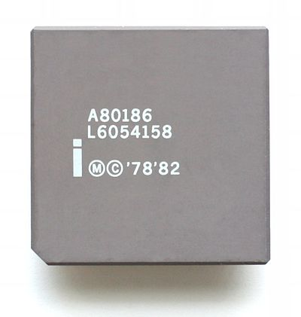
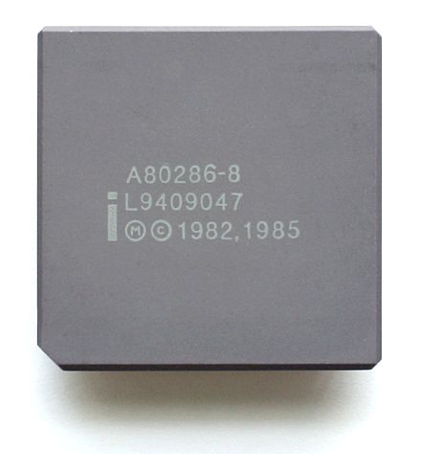
Intel 80186
Intel 80286
First x86 Processor with Virtual Memory Support
“Protected Mode”

Slide 20
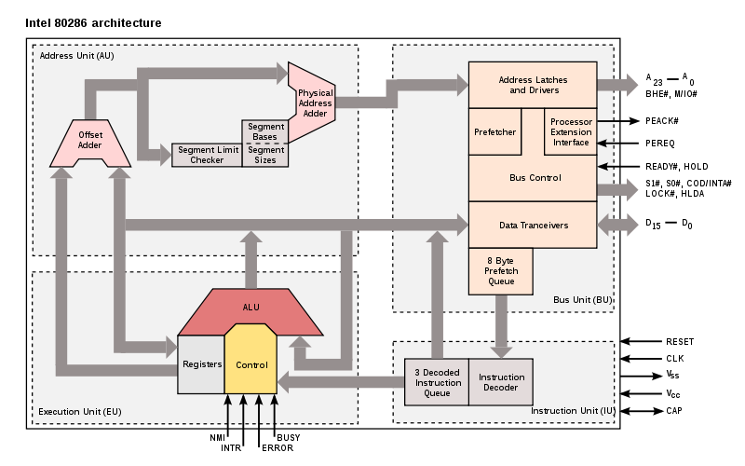
http://en.wikipedia.org/wiki/File:Intel_i80286_arch.svg

Slide 21
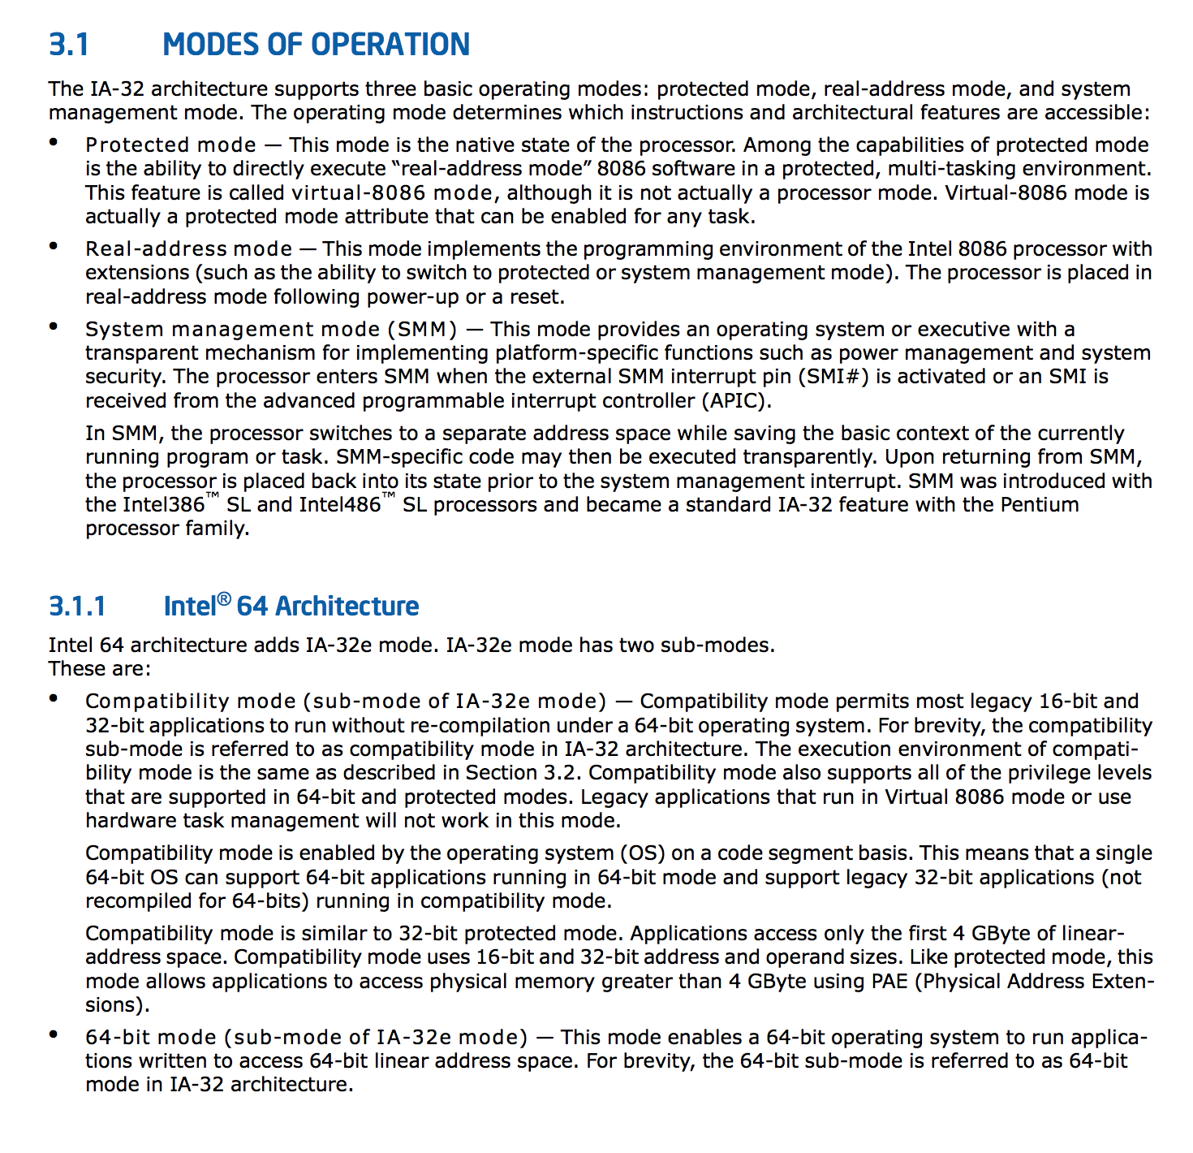
Five x86-64 Processor Modes
Real Mode: pretend to be an 8086
20-bit direct-access address space
Protected Mode: “native state”
System Management Mode: platform-specific power management and security (separate address space)
Compatibility Mode: pretend to be x86-32
IA-32e/64-bit Mode: run applications in 64-bit address space
“For brevity, the 64-bit sub-mode is referred to as 64-bit mode in IA-32 architecture.”

Slide 22
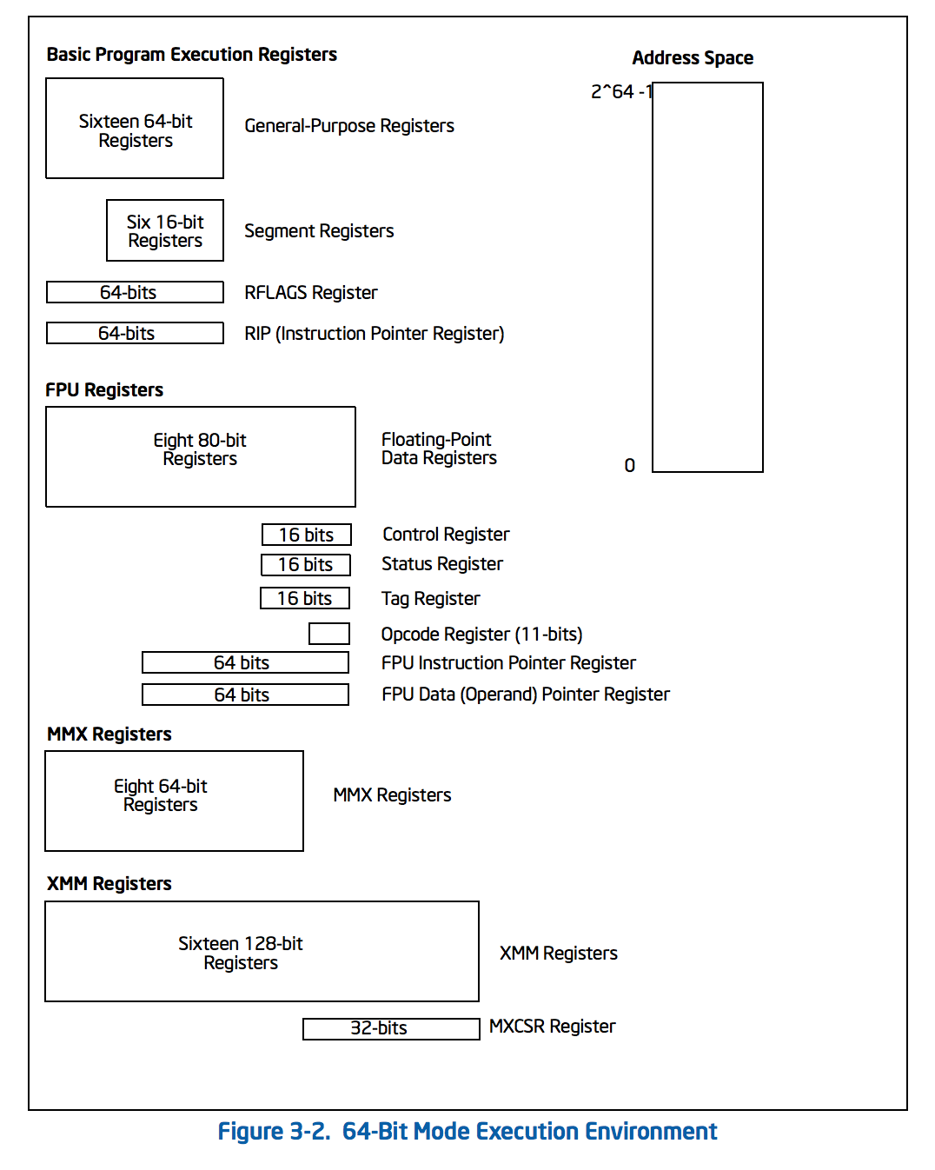
Protected State (can only be modified by the kernel):
RFLAGS (includes EFLAGS)
Includes I/O Privilege Level
Control Registers
CR0 bit 0: controls if processor is in protected mode
CR3: page directory base register

Slide 23
Address Translation
Segmentation Unit
Paging
Unit
Memory
Logical Address
Linear Address
Physical Address

Slide 24
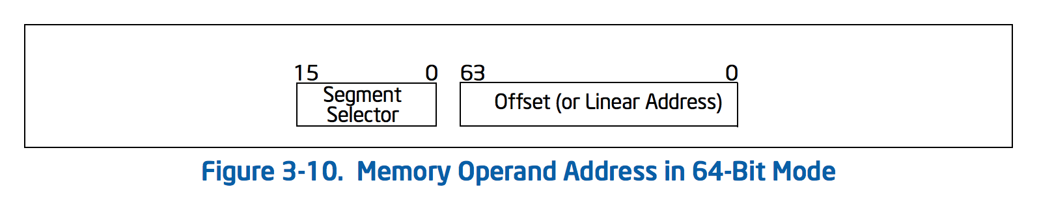
Accessing Memory
16 bits to select segment, 16- 32- or 64- bits to select offset
Actual addressable space for user-level process in Unix:
2⁴⁷ bytes = 128TiB

Slide 25
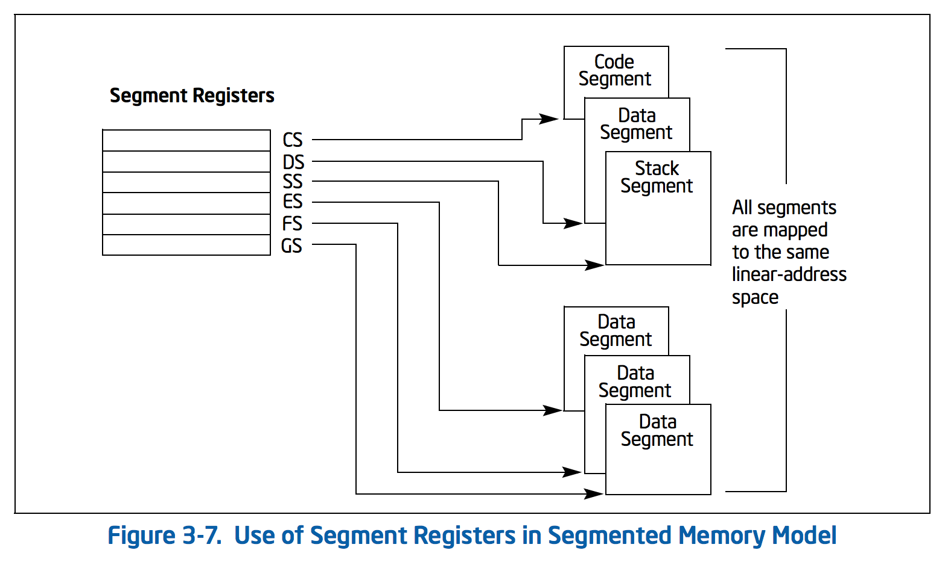
Computing the Linear Address
Segmentation Unit
Paging
Unit
Memory
Logical Address
Linear Address
Physical Address
Segment selection is inferred from instruction type
Logical (“General”, “Virtual”) Address
Segment Selector
Offset

Slide 26
Fetching an Instruction
EIP
Instruction Pointer (Offset)
32 bits
CS
Code Segment
16 bits
13 bits
1
2
Table Index
Ring
Global or Local Table
Only Kernel can write to Segment Registers

Slide 27
Segmentation Tables
Global Descriptor Table (GDT)
limit
linear address space
0-2⁶⁴ - 1
base address
Segments can overlap!
13 bits – up to 8192 entries

Slide 28
Segmentation Tables
Global Descriptor Table (GDT)
Local Descriptor Table
(per process)
How does the processor find the GDT/LDT?
13 bits – up to 8192 entries

Slide 29
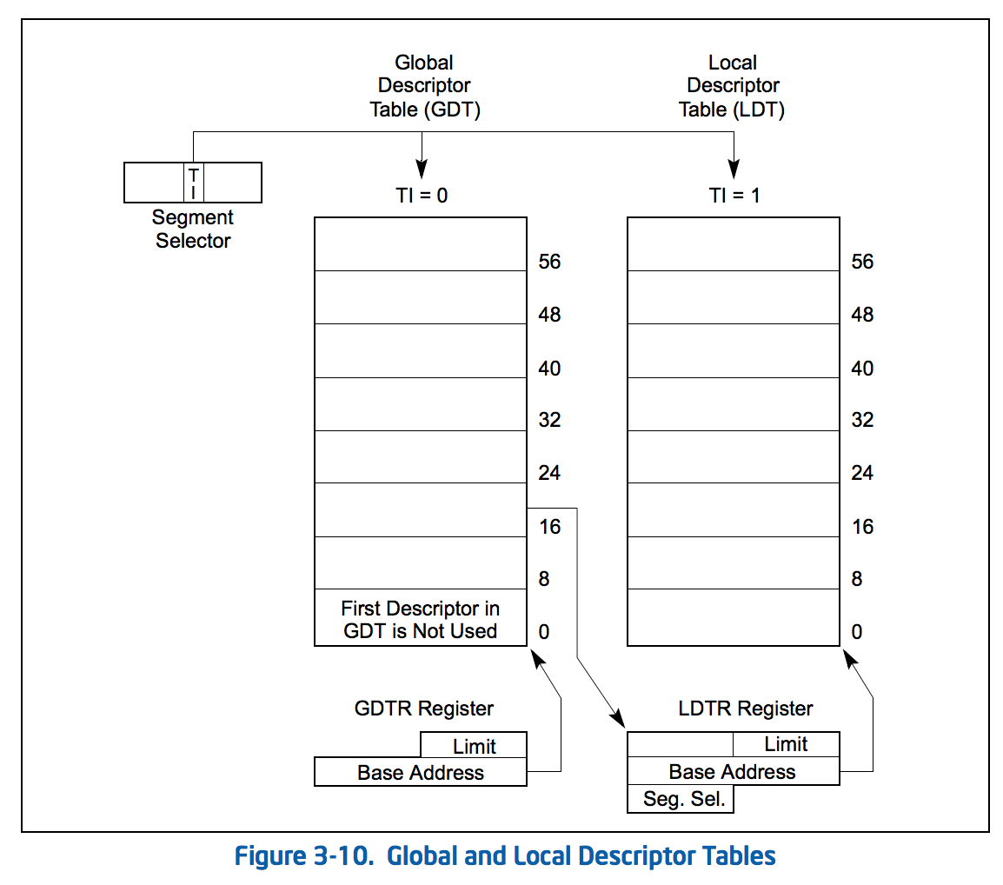
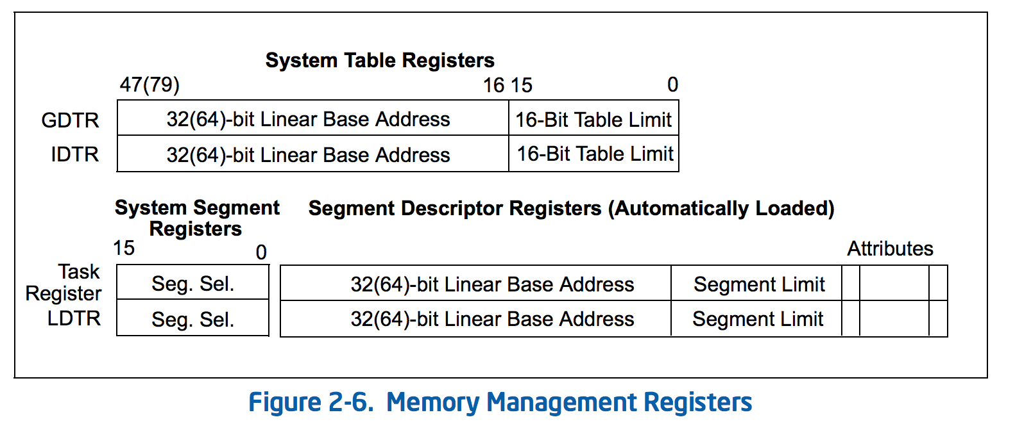
The GDT and LDT are just data structures in memory!
Special registers store their locations

Slide 30
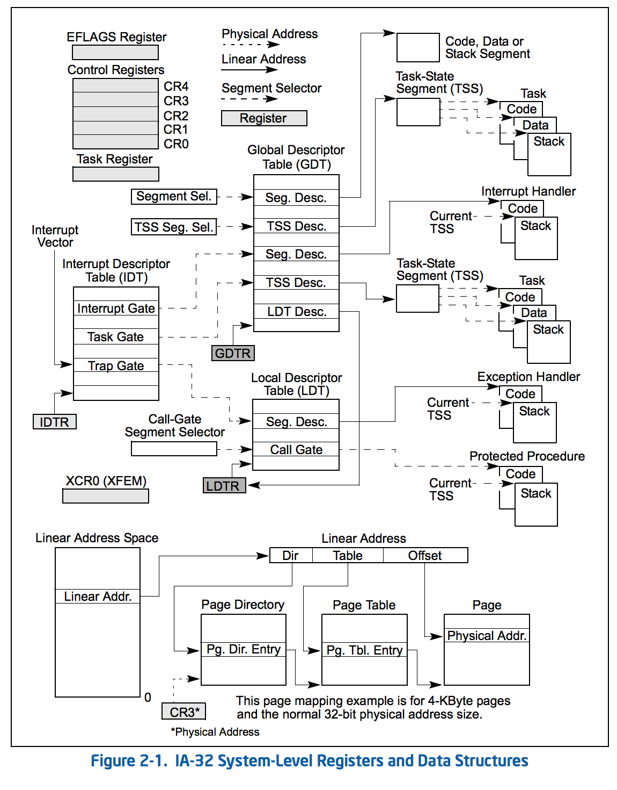
Segmentation Unit
Paging
Unit
Memory
Logical Address
Linear Address
Physical Address

Slide 31
Paging
Segmentation Unit
Logical Address
Linear Address
2⁶⁴ linear addresses
What would it cost to have 2⁶⁴ bytes of RAM?

Slide 32
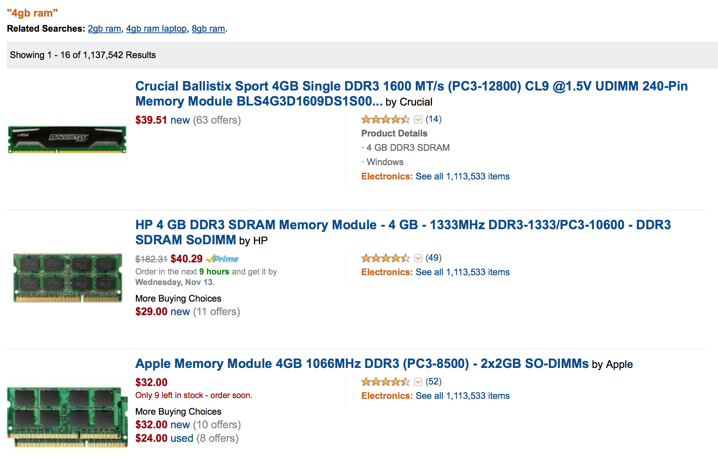
$10 per 1GB = 2³⁰ bytes
2⁶⁴ bytes = $10 * 2³⁴
$172B ~ ½ Google’s Market Cap

Slide 33
Paging
Segmentation Unit
Paging
Unit
Memory
Logical Address
Linear Address
Physical Address
We don’t need to store the whole address space in memory!
Most of it is unused, and we can store rarely-used parts on the disk.

Slide 34
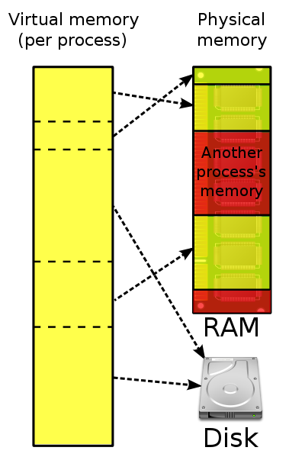
Paging
Unit
Memory
Linear Address
Physical Address
Image from Wikipedia

Slide 35
Overview (Intel 386)
Physical Memory
32-bit linear address
CR3
Dir
Page
Offset
10 bits
(1K tables)
10 bits
(1K entries)
12 bits
(4K pages)
Page Directory
Page Table
Page Entry
Page + Offset
CR3+Dir

Slide 36
Page Table Entries
Physical Memory
CR3
Page Table
Page Entry
Page Directory
20 bits: physical address of page
12 bits: flags
user/kernel page
write permission
present
Page + Offset

Slide 37
386 Checkup
Physical Memory
32-bit linear address
CR3
Dir
Page
Offset
10 bits
(1K tables)
10 bits
(1K entries)
12 bits
(4K pages)
Page Directory
Page Table
20 bits addr / 12 bits flags
Page + Offset
CR3+Dir
How many pages do we need to store the page table?

Slide 38
How slow is this???!
Segmentation Unit
Paging
Unit
Memory
Logical Address
Linear Address
Physical Address
Dir
Page
Offset
Physical Memory
GDTR
CR3
Page Directory
Page Table
Global Descriptor Table

Slide 39
Translation Lookaside Buffer (Cache)
Segmentation Unit
Paging
Unit
Memory
Logical Address
Linear Address
Physical Address
Dir
Page
Offset
Physical Memory
GDTR
CR3
Page Directory
Page Table
Global Descriptor Table

Slide 40
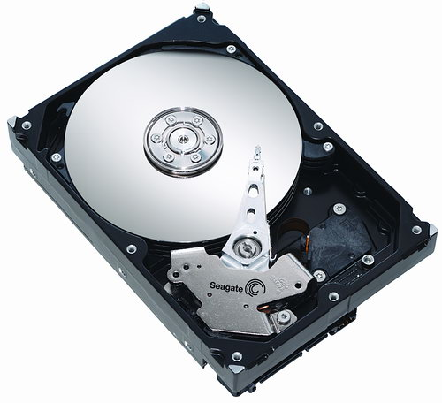
Page Fault
Physical Memory
CR3
Page Table
Page Entry
Page Directory
20 bits: physical address of page
12 bits: flags
user/kernel page
write permission
present

Slide 41
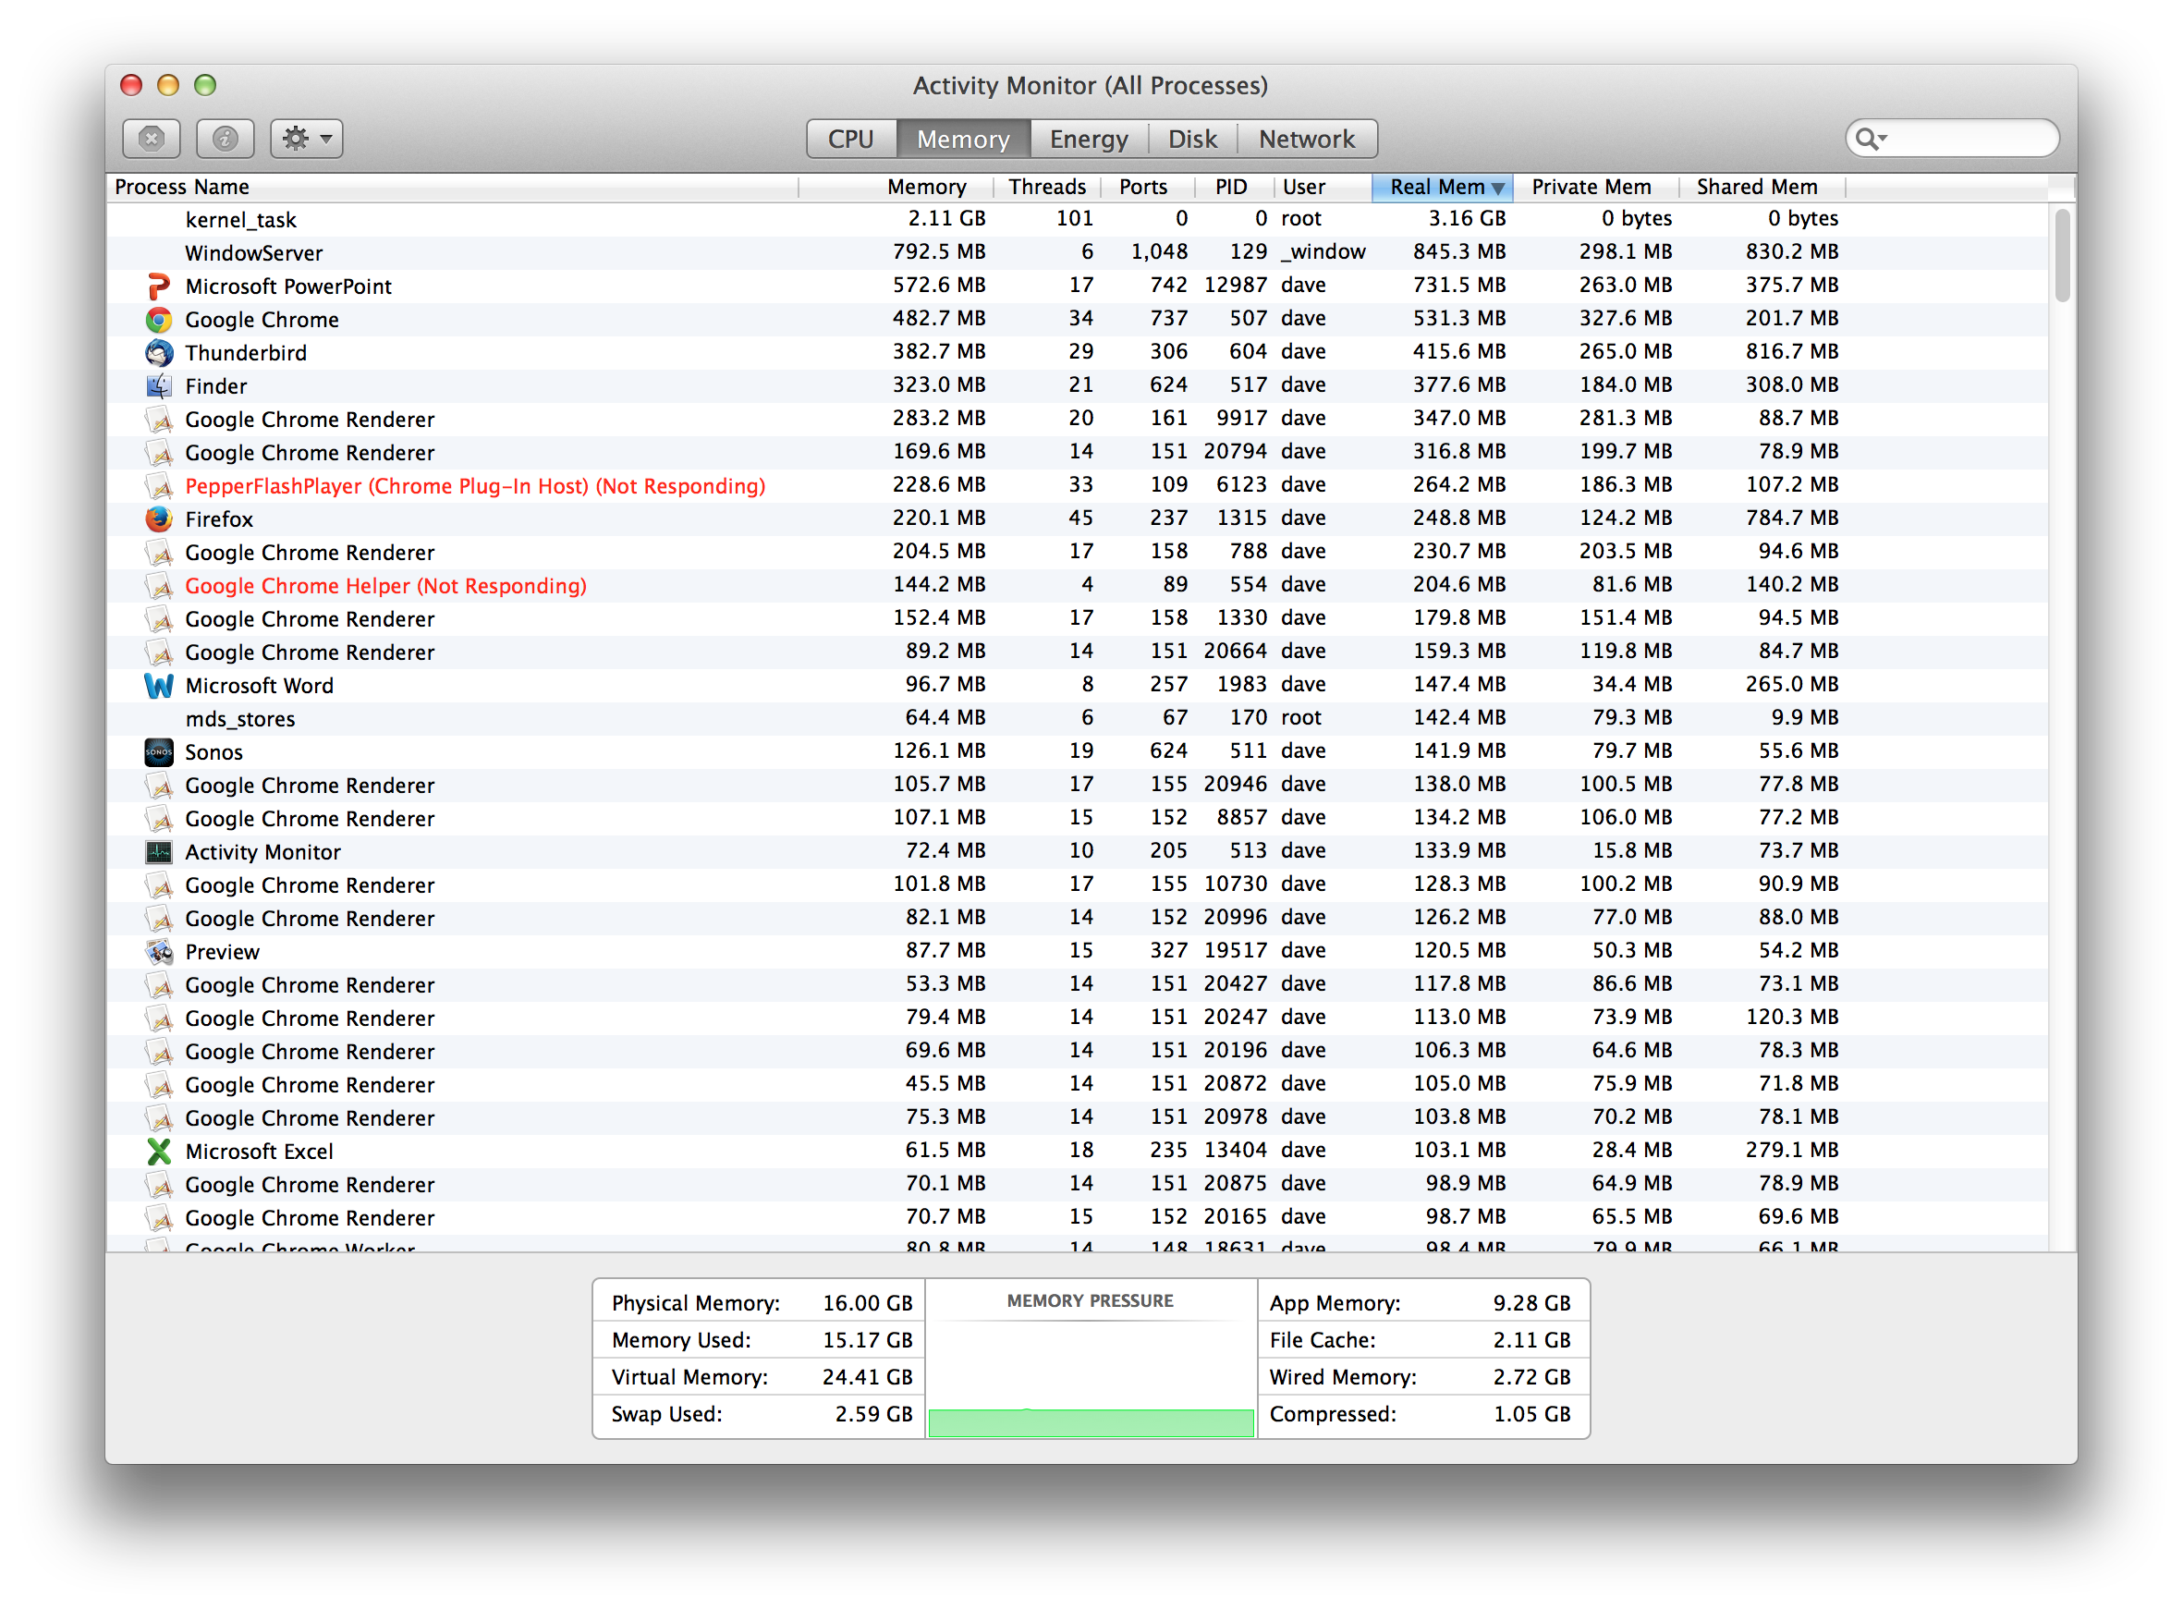
How common are page faults?

Slide 42
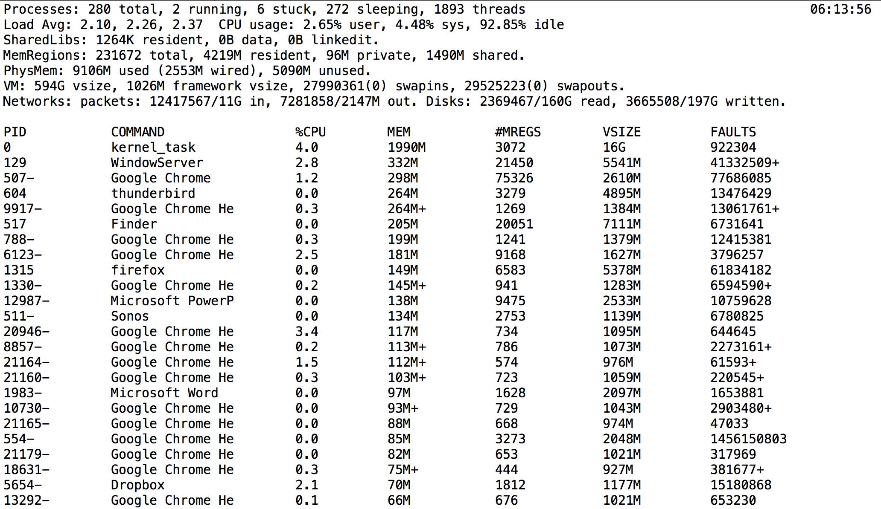
top -o mem -stats pid,command,cpu,mem,mregion,vsize,faults

Slide 43
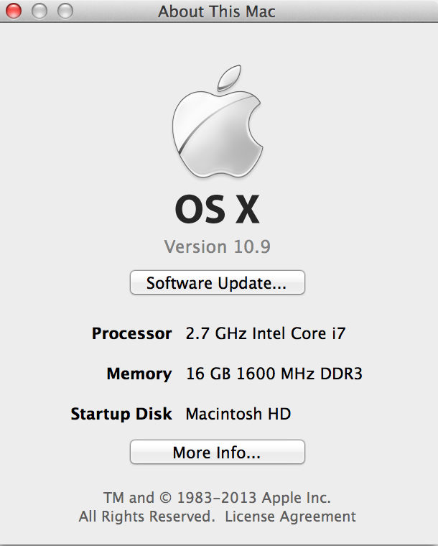
Physical Memory:
9106M used (2553M “wired” – cannot be paged out)
+ 5090M unused
= 14196M
where is my missing ~2GB???!
Virtual Memory: 594G (total)
top -o mem -stats pid,command,cpu,mem,mregion,vsize,faults

Slide 44
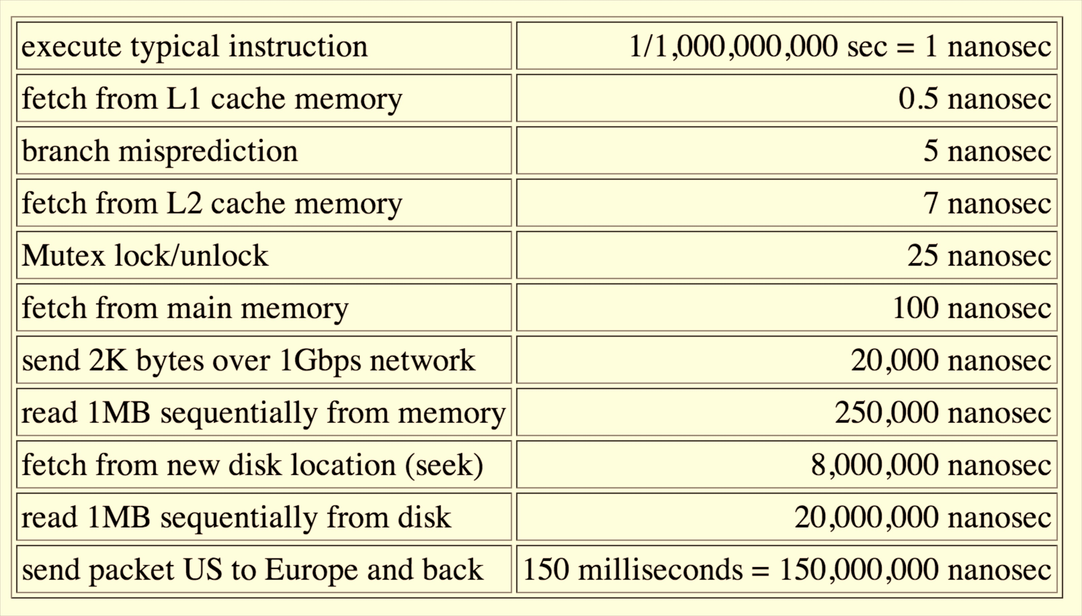
How expensive is a page fault?

Slide 45
#include <stdio.h>
#include <stdlib.h>
int main(int argc, char **argv) {
char *s = (char *) malloc (1);
int i = 0;
while (1) {
printf("%d: %x\n", i, s[i]);
i += 4;
}
}
What will this program do?
> ./a.out
0: 0
4: 0
8: 0
12: 0
…1033872: 0
1033876: 0
1033880: 0
1033884: 0
Segmentation fault: 11

Slide 46
Charge
Make progress on your projects: everyone should have a clear idea what you are doing now
Will post more details on next deliverable (design reviews) soon
Challenge: write a program that takes N as an input and produces (nearly) exactly N page faults.

