Slide 1
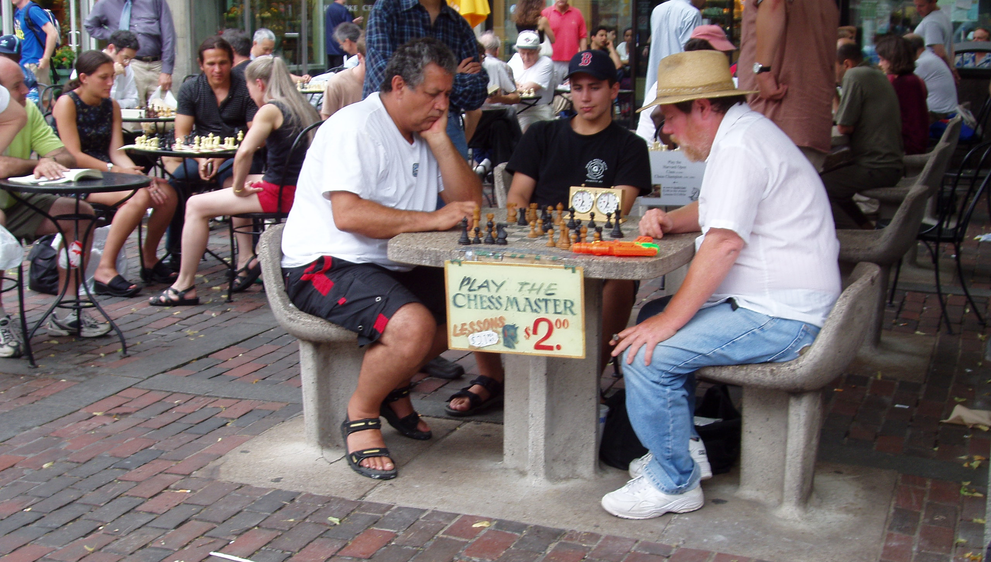
Class 21:
Bakers and Philosophers
cs4414 Spring 2014
University of Virginia
David Evans

Slide 2
Plan for Today
Dijkstra’s Mutual Exclusion Solution
Lamport’s Solution
Dining Philosophers
Reminder: Everyone should have scheduled a project progress meeting!

Slide 3
Project Update
Every team should have a progress/review meeting scheduled
  Discuss what you have done so far and plans to finish
Project submission:
  Web form (including link to github repo or other web content): accepted without penalty until Monday, 5 May (11:59pm)
  Option of either:
    In-class presentation/demo (April 24 or April 29)
    Formal written report (due April 29, 11:59pm)
    Something else
You have until Monday (Apr 21) to submit a form with your preferences, but priority will be given to earlier submissions!
No final exam, unless your project is embarrassing. Then you’ll have a chance to make up for it by doing a final exam.

Slide 4
Why so much on mutual exclusion?

Slide 5
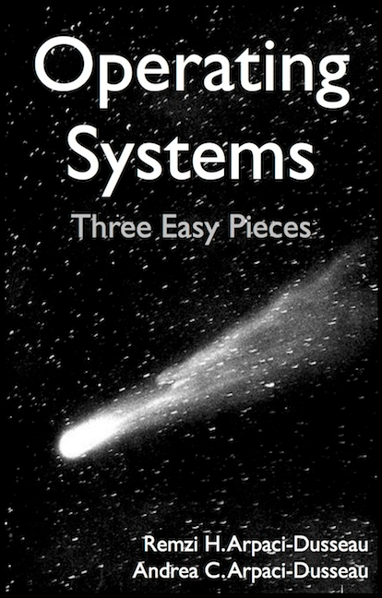
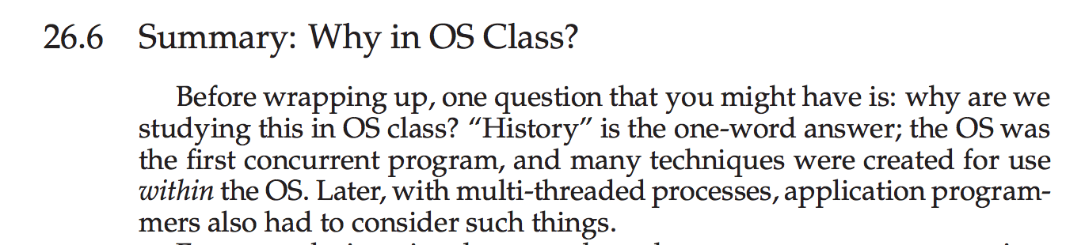

Slide 6
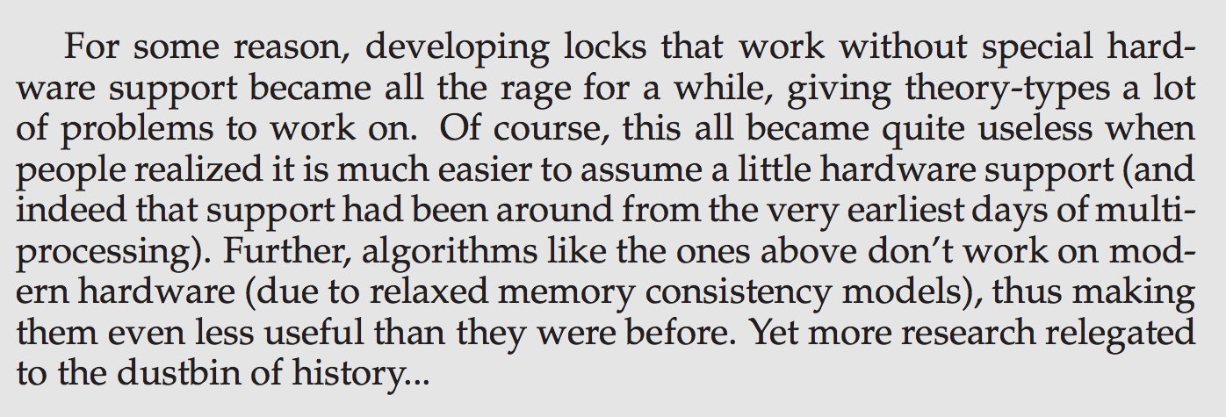

Slide 7
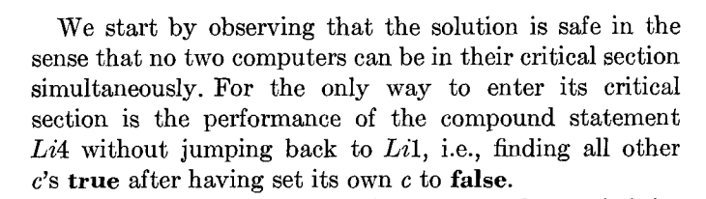
Where we got last class:
Program for Processor i
loop {
b[i] := false
L1: if k != i
c[i] := true
if b[k]:
k := i
goto L1
else:
c[i] := false;
L4: for j in [1, …, N]:
if j != i and not c[j]:
goto L1
critical section;
c[i] := true
b[i] := true
}
How do we know none of the c[.]’s changed during the loop?

Slide 8
Program for Processor i
loop {
1: b[i] := false
2: if k != i:
3: c[i] := true
4: if b[k]:
5: k := i
6: goto L2
else:
7: c[i] := false;
8: for j in [1, …, N]:
9: if j != i and not c[j]:
10: goto L2
11: critical section;
12: c[i] := true
13: b[i] := true
}
How do we know none of the c[.]’s changed during the loop?

Slide 9
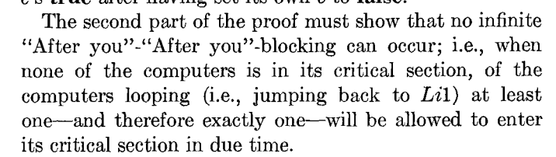
Program for Processor i
loop {
b[i] := false
L1: if k != i
c[i] := true
if b[k]:
k := i
goto L1
else:
c[i] := false;
L4: for j in [1, …, N]:
if j != i and not c[j]:
goto L1
critical section;
c[i] := true
b[i] := true
}

Slide 10
Program for Processor i
loop {
1: b[i] := false
2: if k != i:
3: c[i] := true
4: if b[k]:
5: k := i
6: goto L2
else:
7: c[i] := false;
8: for j in [1, …, N]:
9: if j != i and not c[j]:
10: goto L2
11: critical section;
12: c[i] := true
13: b[i] := true
}
Liveness: makes progress

Slide 11
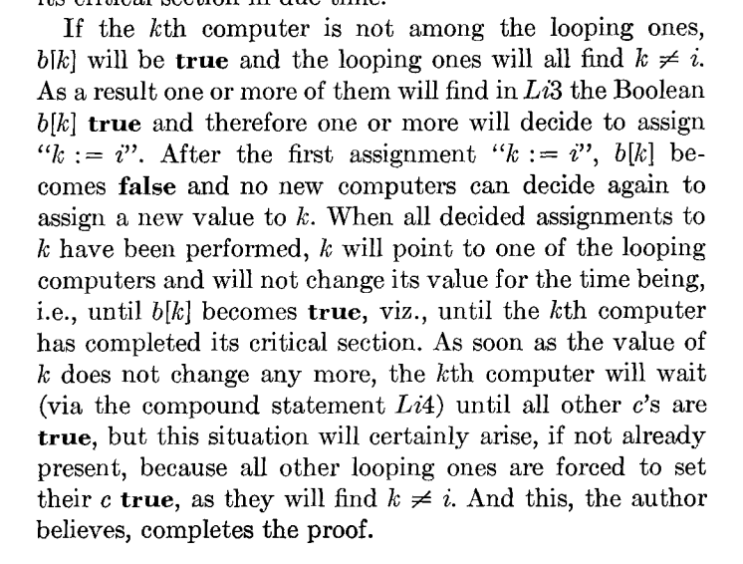
Program for Processor i
loop {
b[i] := false
L1: if k != i
c[i] := true
L3: if b[k]:
k := i
goto L1
else:
c[i] := false;
L4: for j in [1, …, N]:
if j != i and not c[j]:
goto L1
critical section;
c[i] := true
b[i] := true
}
Liveness Proof

Slide 13
Assumptions?
Program for Processor i
loop {
b[i] := false
L1: if k != i
c[i] := true
L3: if b[k]:
k := i
goto L1
else:
c[i] := false;
L4: for j in [1, …, N]:
if j != i and not c[j]:
goto L1
critical section;
c[i] := true
b[i] := true
}

Slide 14
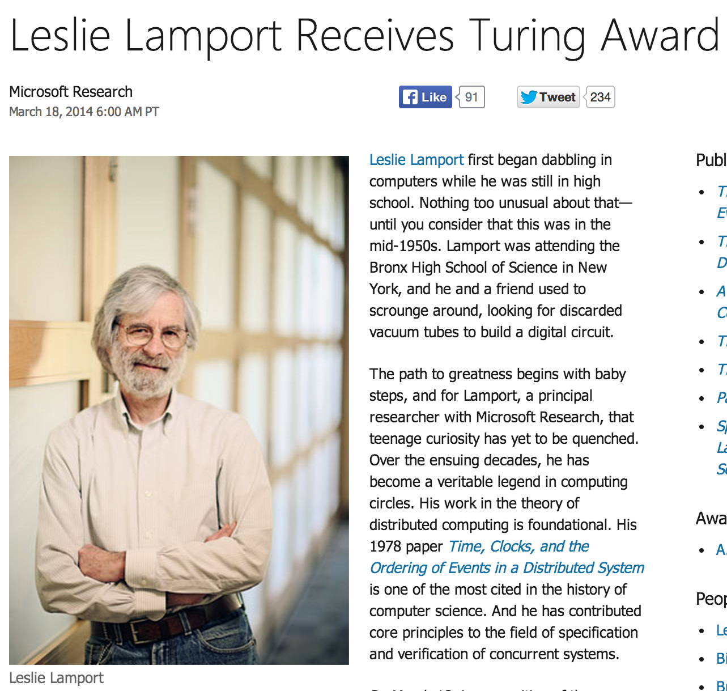
“When I was at Compass, I read a paper in Communications of the ACM about a mutual-exclusion algorithm,” Lamport recalls. “It was the first time I had seen the mutual-exclusion problem, and I looked at it and said, ‘Well, that doesn’t seem very difficult.’”

Slide 15
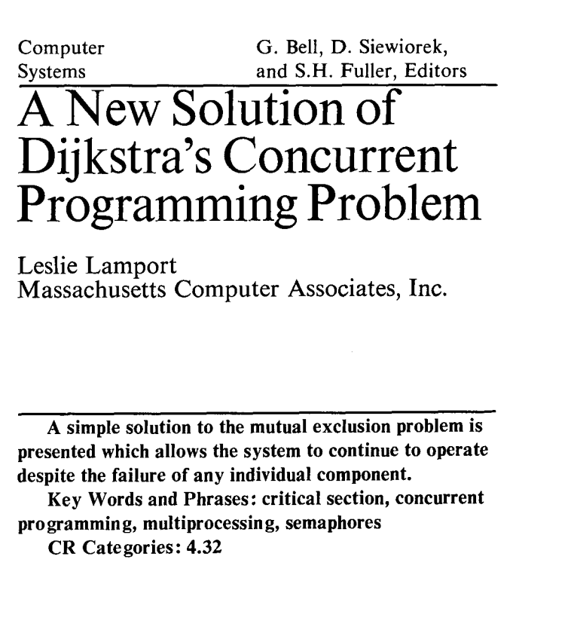
“What is significant about the bakery algorithm is that it implements mutual exclusion without relying on any lower-level mutual exclusion. Assuming that reads and writes of a memory location are atomic actions, as previous mutual exclusion algorithms had done, is tantamount to assuming mutually exclusive access to the location. So a mutual exclusion algorithm that assumes atomic reads and writes is assuming lower-level mutual exclusion. Such an algorithm cannot really be said to solve the mutual exclusion problem. Before the bakery algorithm, people believed that the mutual exclusion problem was unsolvable--that you could implement mutual exclusion only by using lower-level mutual exclusion.”
Communications of the ACM, August 1974 (2 pages)

Slide 16
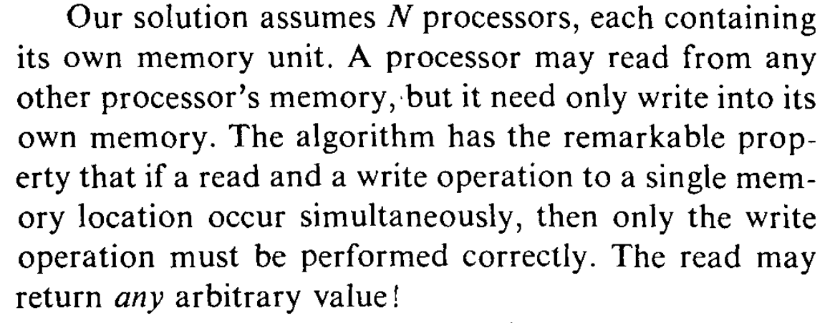

Slide 17

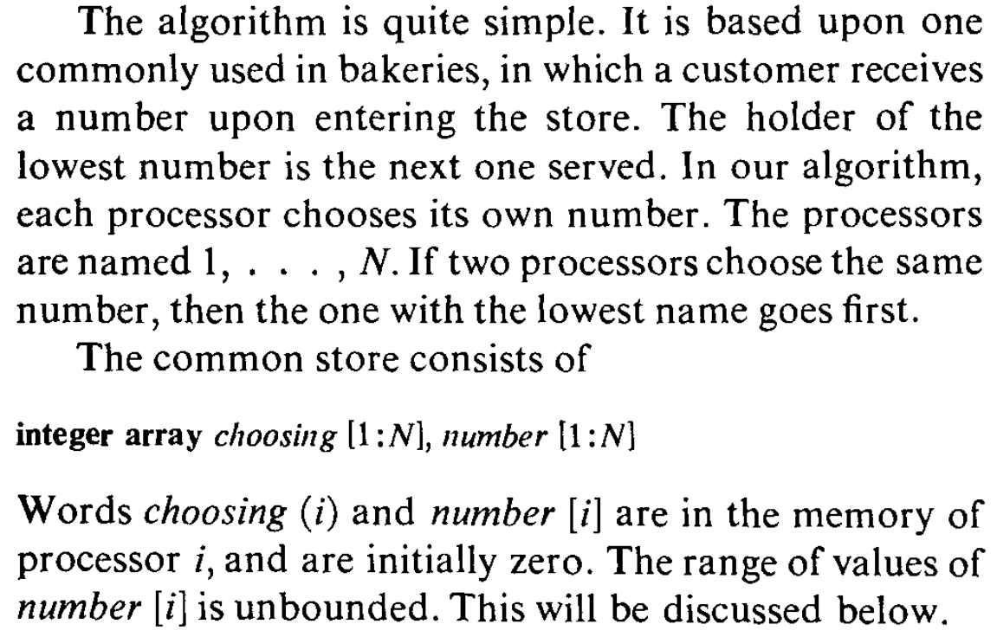

Slide 18
N independent threads
T1
T2
T3
T4
T5
Program:
loop {
non-critical {
…
}
critical {
…
}
}
Shared Memory (no exclusion!)
Requirements:
Only one thread may be in the critical section at any time.
Each must eventually be able to enter its critical section.
Must be symmetrical (all run same program).
Cannot make any assumptions about speed of threads.
Only writes are guaranteed (when simultaneous).

Slide 19
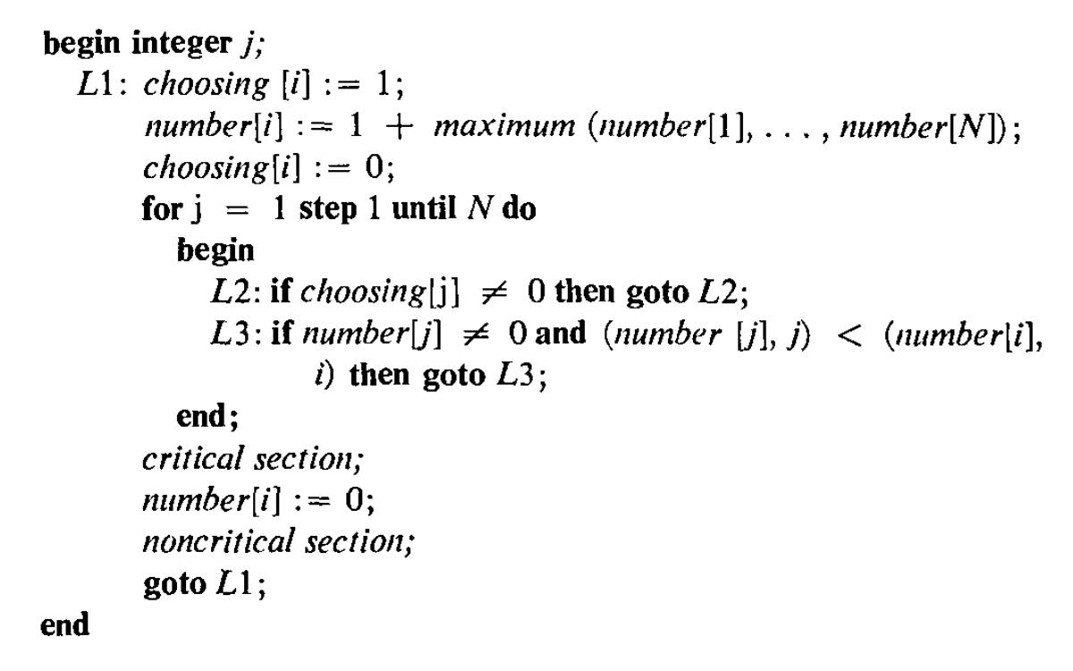
Processor number: i

Slide 20
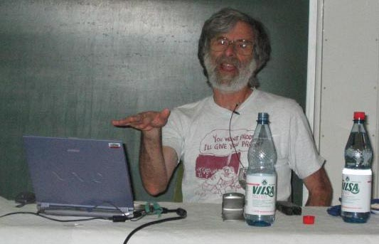
If the write changes the value from 0 to 1, a concurrent read could obtain the value 7456 (assuming that 7456 is a value that could be in the memory location). The algorithm still works. I didn't try to devise an algorithm with this property. I discovered that the bakery algorithm had this property after writing a proof of its correctness and noticing that the proof did not depend on what value is returned by a read that overlaps a write.

Slide 21
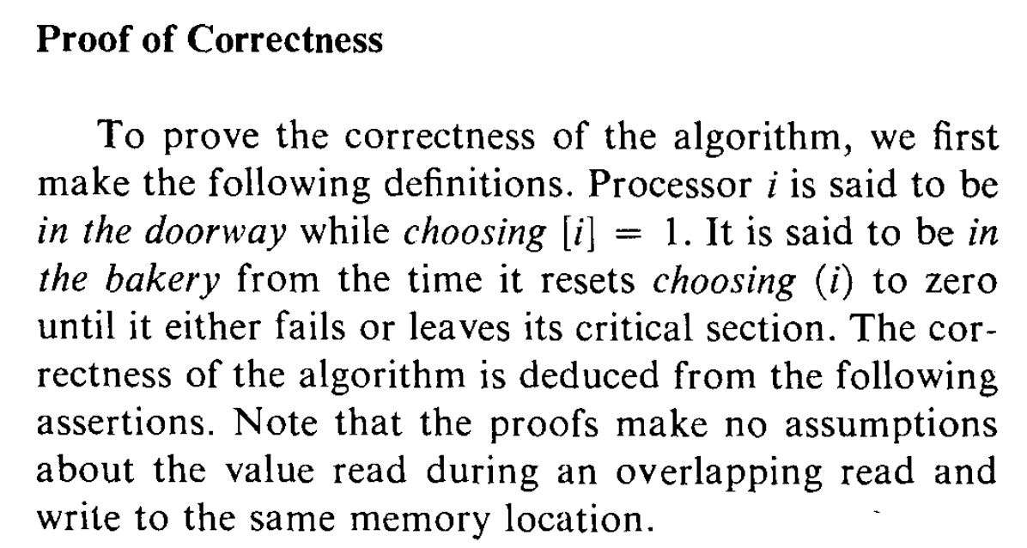

Slide 22
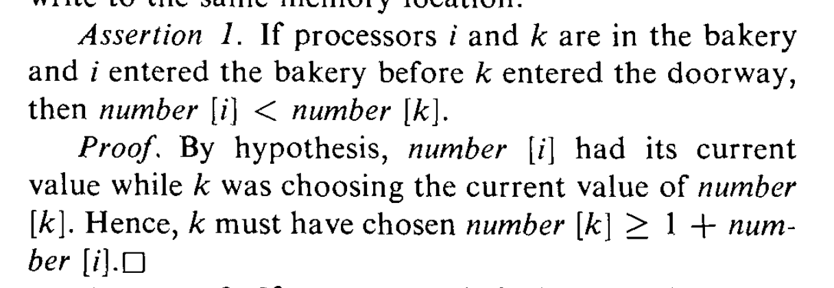
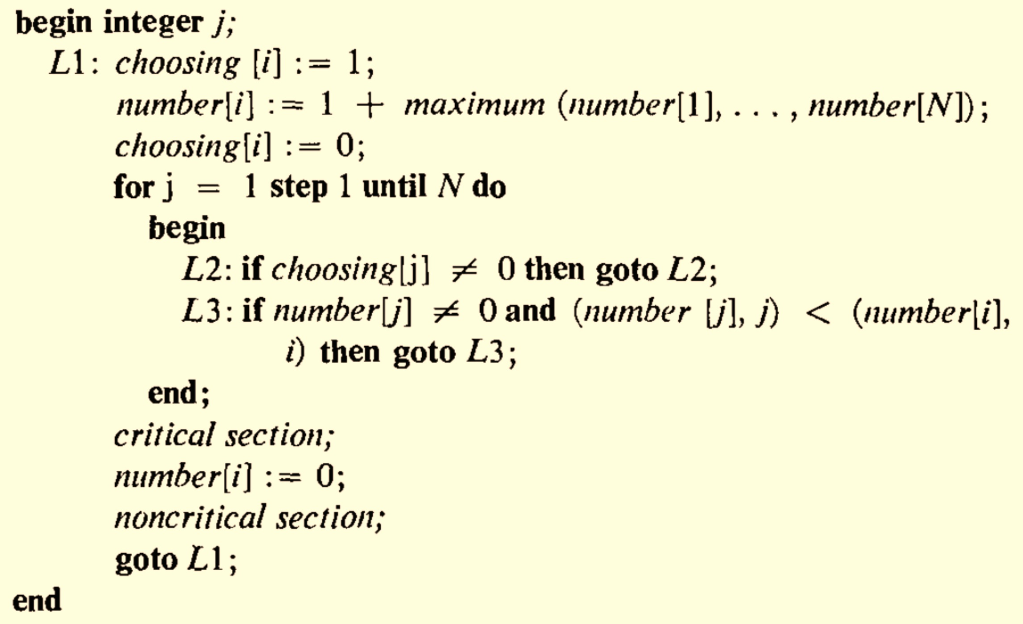

Slide 23
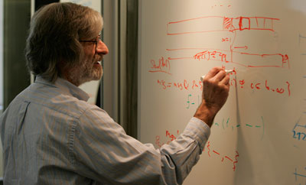

Slide 24
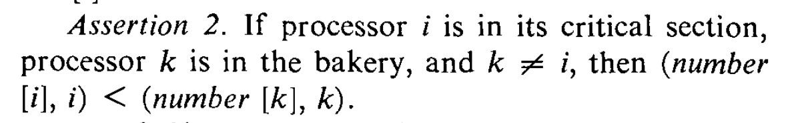
How could number[i] = number[k]?

Slide 26
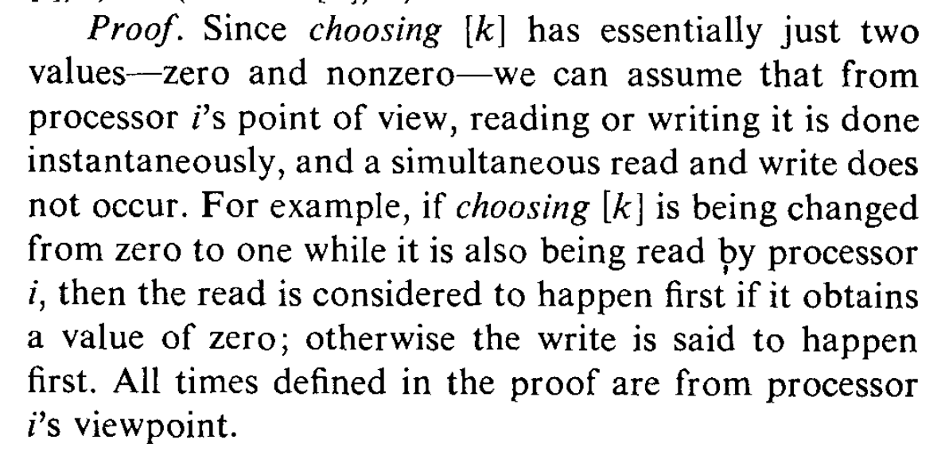

Slide 28
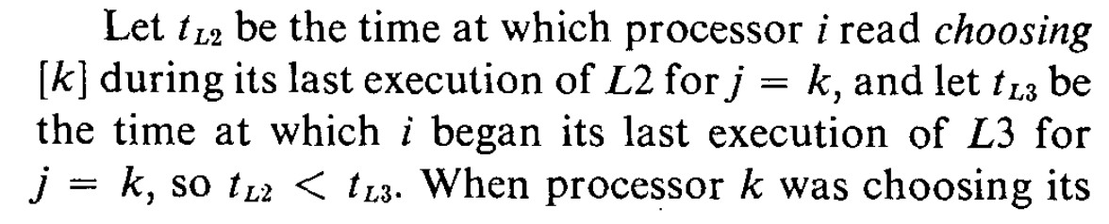
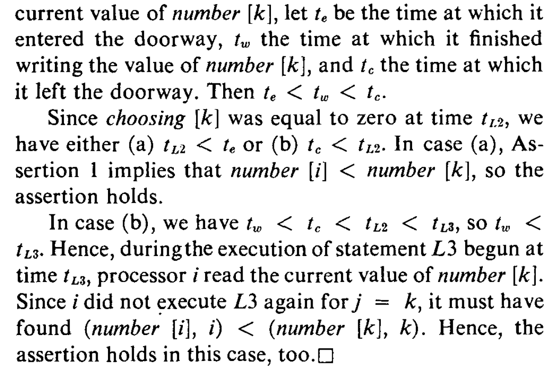

Slide 29
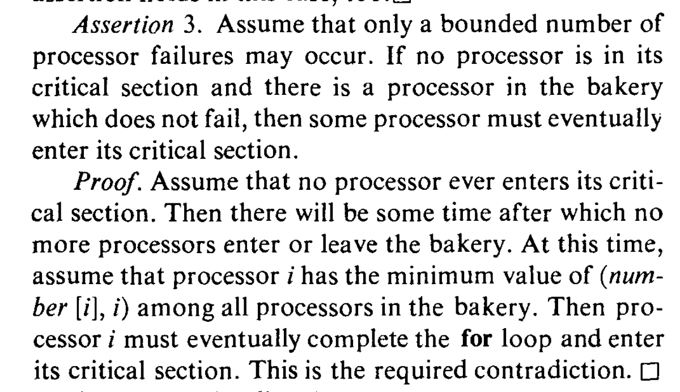

Slide 30
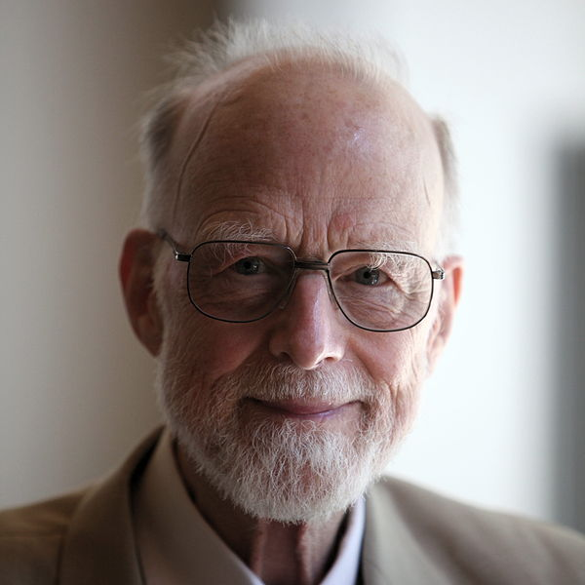
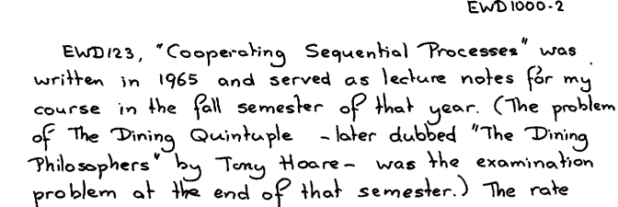
Sir Tony Hoare (born 1934)

Slide 31






Slide 32
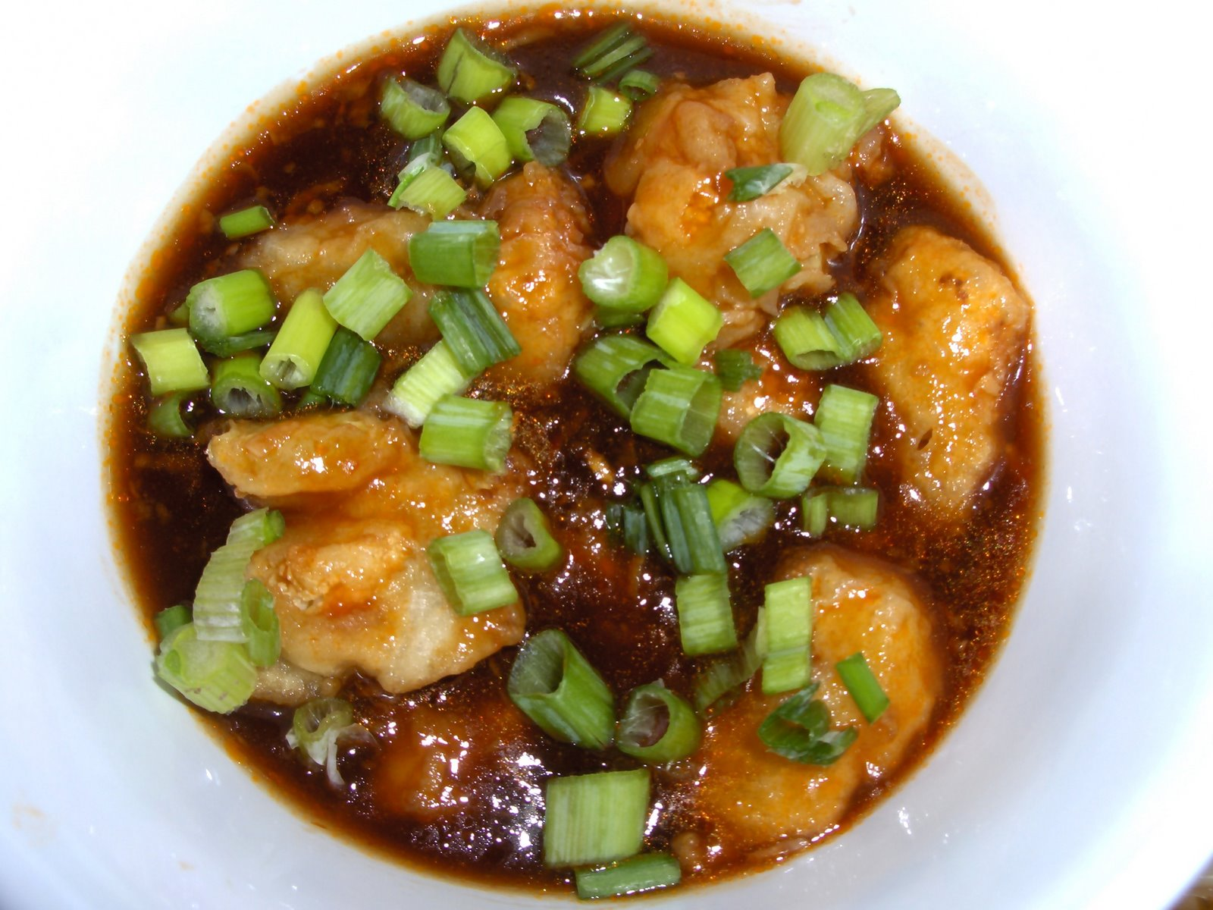
Plato
Heraclitus
Socrates
Euclid
Aristotle

Slide 33
5 Dining Philosophers
5 Chopsticks (one between each pair)
Need 2 chopsticks to eat

Slide 34
Could all the philosophers starve?

Slide 35
No (extra) communication No deadlock
No starvation
Fair

Slide 36
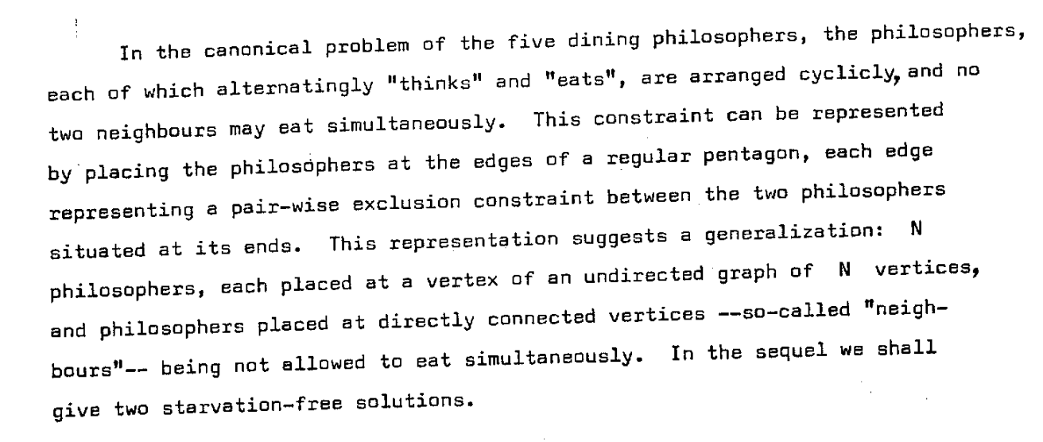
Djikstra’s (Hygenic) Version EWD625
Is this equivalent to the shared chopsticks?

Slide 38
Solution Desiderata
No communication required
No deadlock
No starvation: everyone gets to eat eventually
Fair: each philosopher has equal likelihood of
getting to eat

Slide 39
Dijkstra’s Solution (Idea)
Number the chopsticks
Always grab lower-numbered stick first
  Does it matter how the chopsticks are numbered?

Slide 40
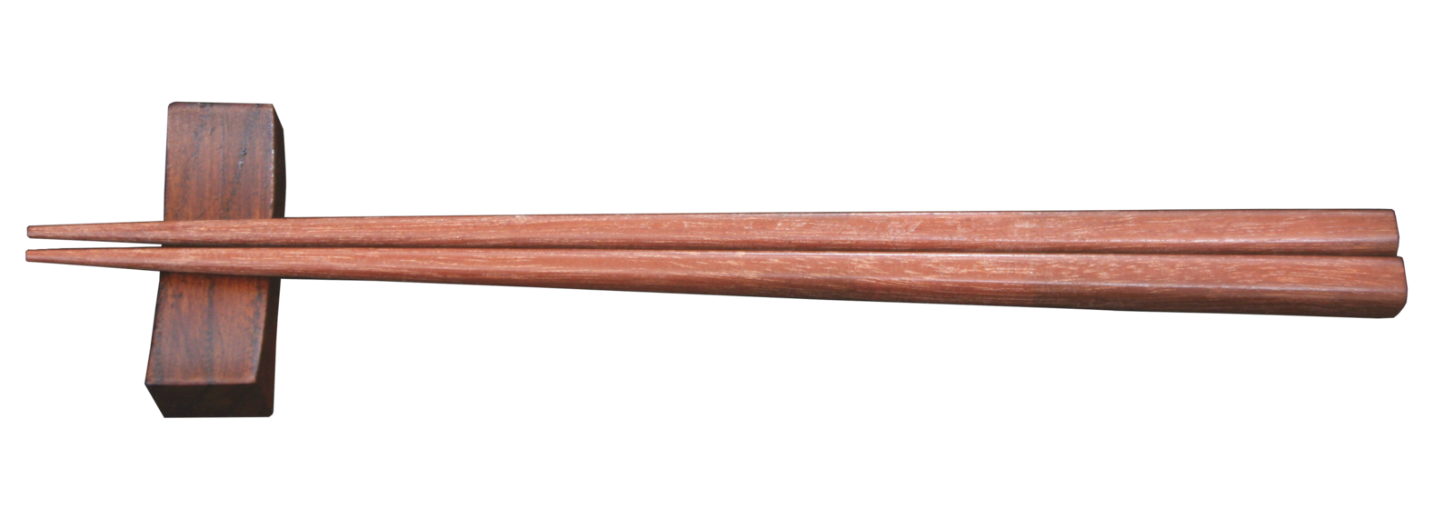
The Real Idea was to
“Invent the Chopstick”
Binary Semaphore
Lock that can be held by up to one process
http://commons.wikimedia.org/wiki/File:Chopstick.png

Slide 41
Charge
Many more interesting problems and solutions in distributed algorithms:
Consensus
Leader election
Reliable broadcast
…
Next class:
Microkernels, Exokernels, and “Zepto”-kernels
Hardware solutions only help when all threads are running on the same processor

