Slide 1
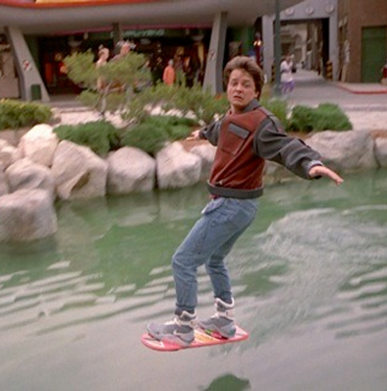
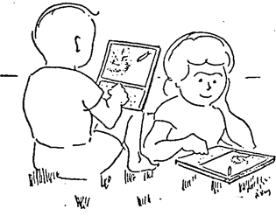
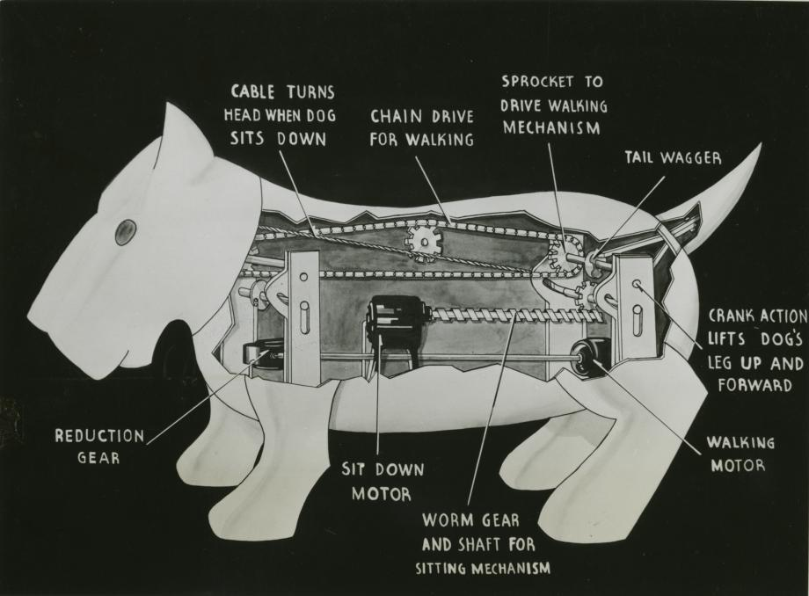
Class 23:
Invent the Future
Alan Kay’s Dynabook (1972)
Operating Systems
in 2029
cs4414 Spring 2014
University of Virginia
David Evans
Back to the Future II
(1989, set in 2015)
Mechanical Dog (1939)

Slide 2
This Week in cs4414
Today: What will happen in the next 15 years
Thursday: Project Presentations
Next Tuesday: Project Presentations
Note: teams presenting next Tuesday will get 4 minutes each: prepare a focused presentation
Presenting on Thursday – up to 15 minutes each
Archibald Elliott, Esteban Amas, Chun Wang, Nathan Typanski, Michael Peterson
Matt Pearson-Beck, Jeff Principe, Richard Knoll, Arjun Shankar, Tanya Art, Brian Whitlow
Loren Fryxell
Emily Seibert, Kevin Hoffman, Kristen Felsing
Jay Ashe, Matt Bloom, Steph Colen, Axel Tarnvik

Slide 3
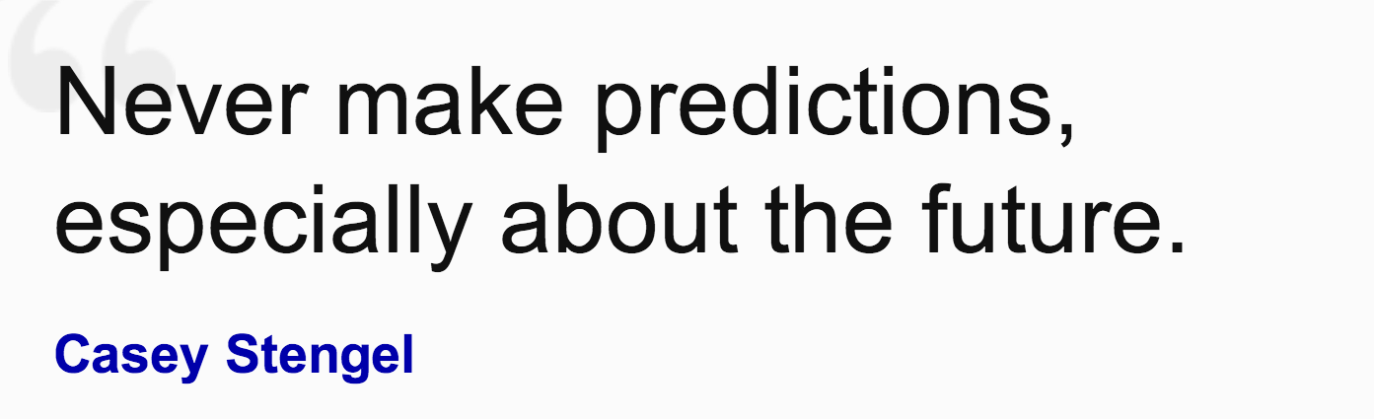
Prediction is very difficult, especially about the future.
Neils Bohr
Det er svært at spå, især om fremtiden.
Robert Storm Petersen

Slide 4
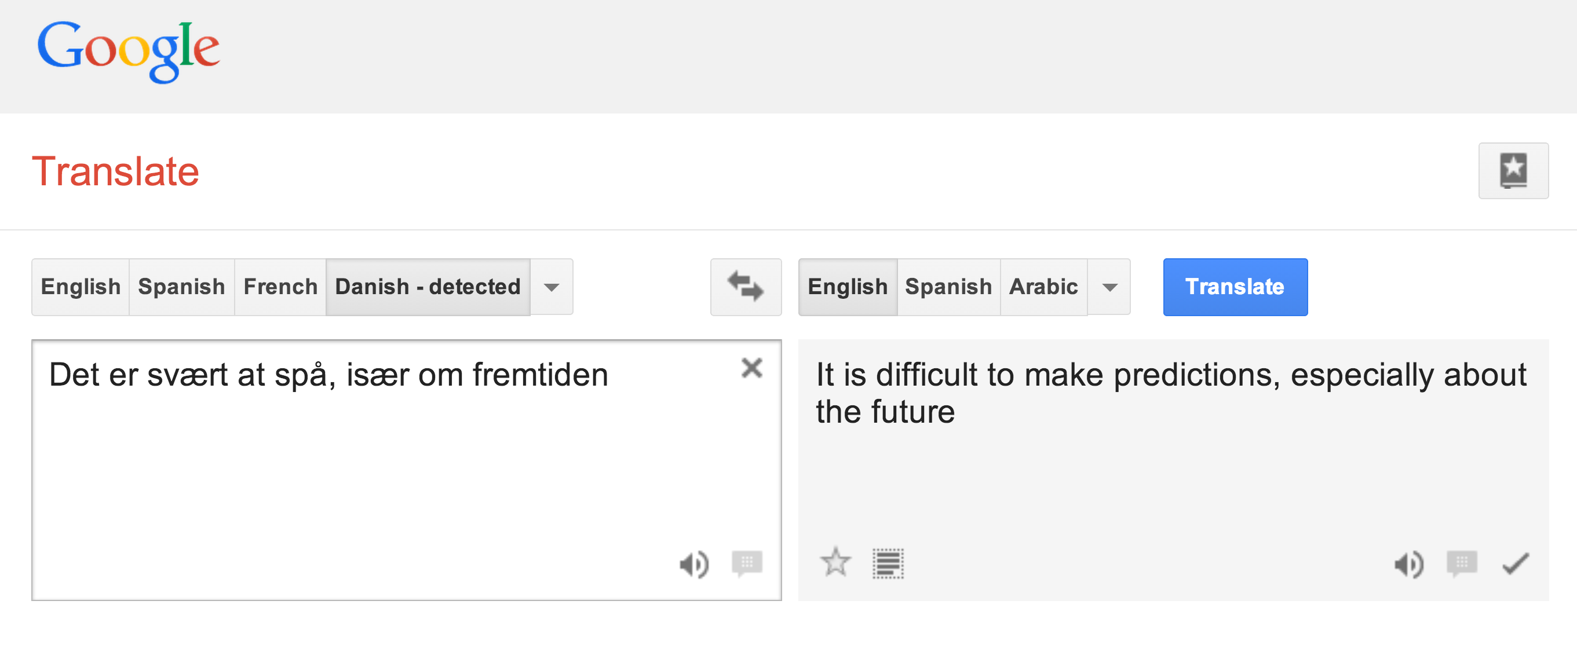
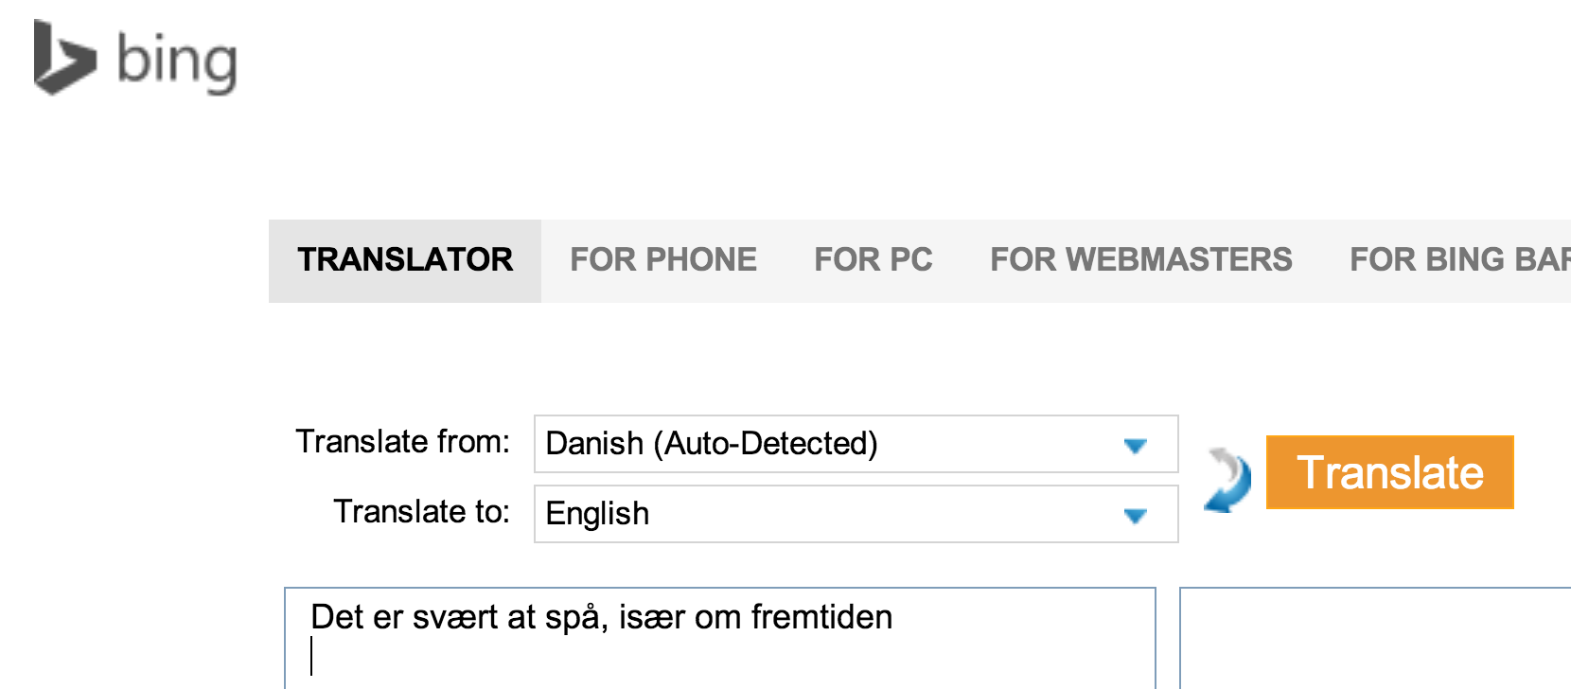
It is difficult to predict, especially about the future

Slide 5
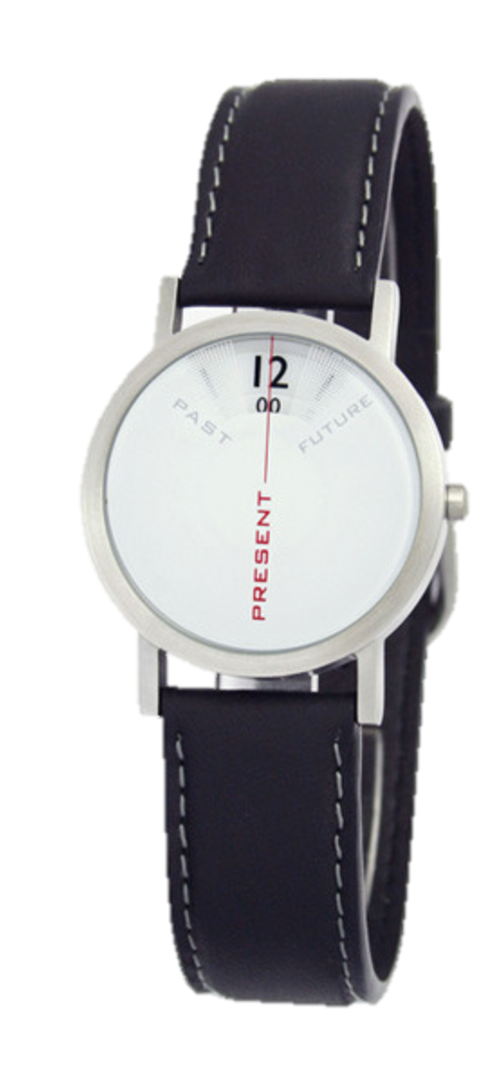
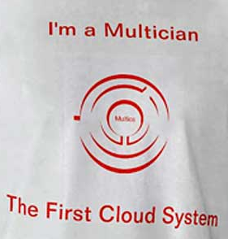
Past and Future

Slide 6
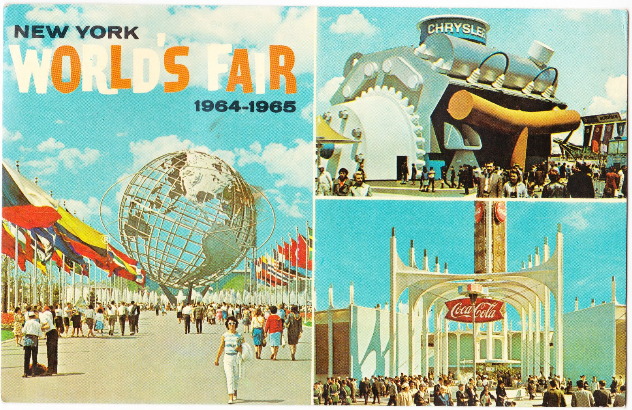

Slide 7
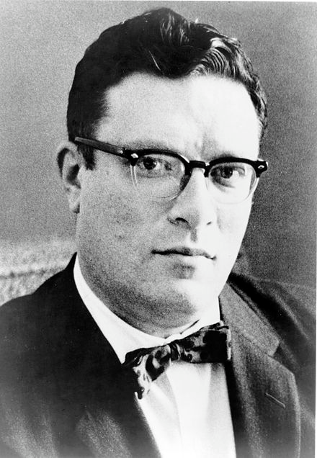
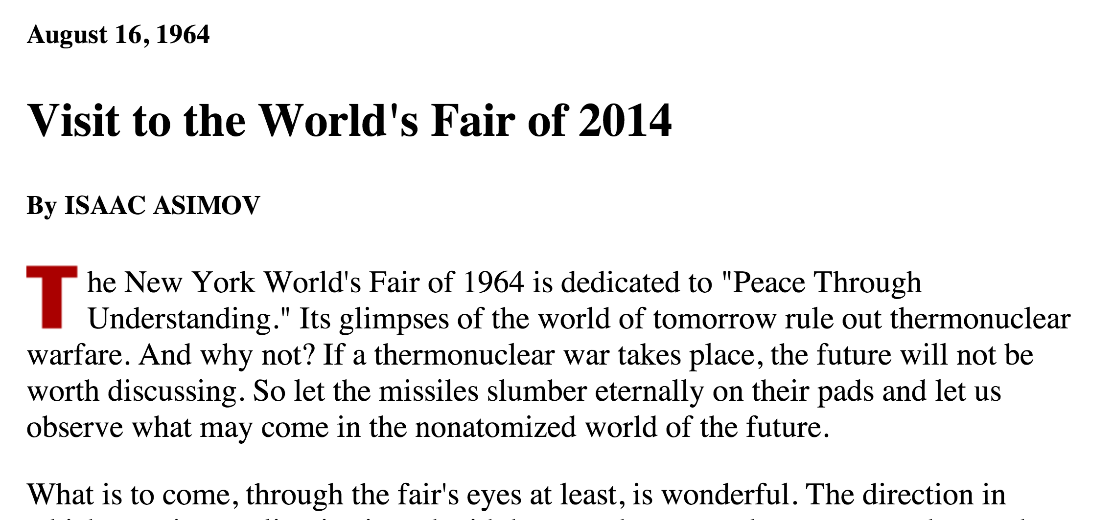
Isaac Asimov
(1919-1992)

Slide 8
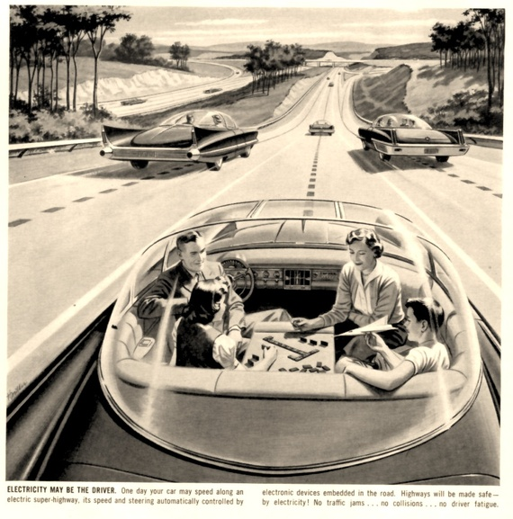
“Much effort will be put into the designing of vehicles with “Robot-brains” - vehicles that can be set for particular destinations and that will then proceed there without interference by the slow reflexes of a human driver. I suspect one of the major attractions of the 2014 fair will be rides on small roboticized cars which will maneuver in crowds at the two-foot level, neatly and automatically avoiding each other.”

Slide 9
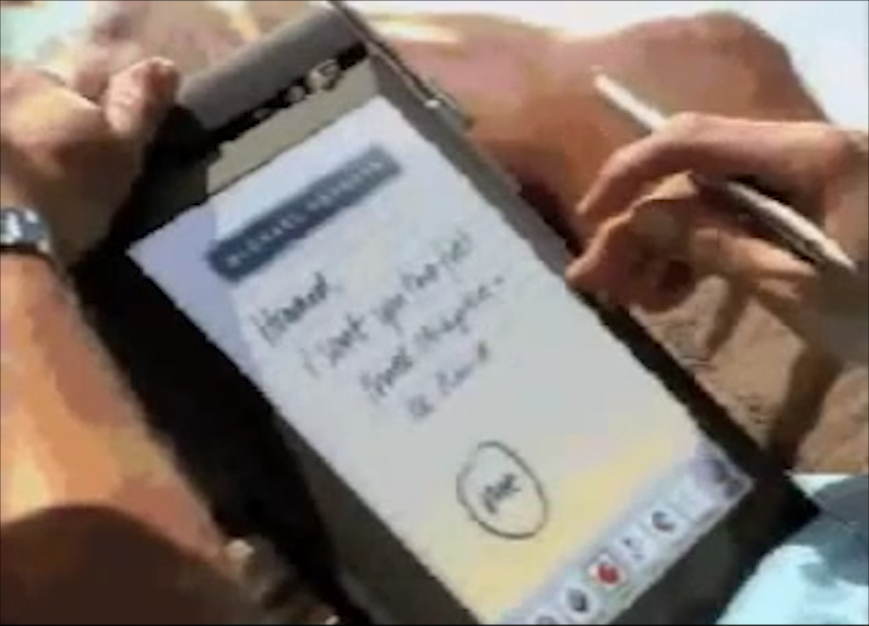
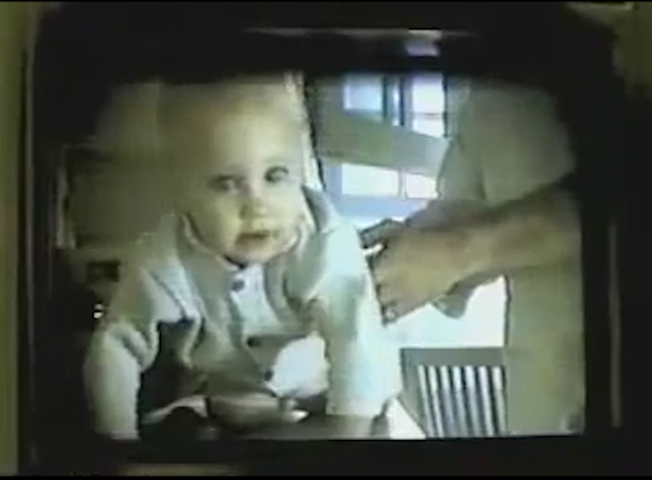
AT&T’s
“You Will”
(1993-4)

Slide 10


Slide 11
Commerce
renewed your driver’s license at a cash machine
bought concert tickets from a cash machine
checked out of a supermarket a whole cart at a time
sent someone a fax from the beach
Travel
crossed the country without directions
paid a toll without slowing down
Media Consumption
borrowed a book from thousands of miles away
watched the movie you wanted to the minute you wanted to
Communication
tucked your baby in from a phone booth
put your heads together when you’re not together
attended a meeting in your bare feet
Security
opened doors with your voice
kept an eye on your home when you’re not
carried your medical history in your wallet
Agents
conducted business in a language you don’t understand
had an assistant who lived in your computer
Education
learned special things from faraway places
had a classmate who is thousands of miles away
fixed your car with a television

Slide 12
Commerce
78 responses from class
renewed your driver’s license at a cash machine (13%)
bought concert tickets from a cash machine (37%)
checked out of a supermarket a whole cart at a time (13%)
sent someone a fax from the beach (31%)
Travel
crossed the country without directions (72%)
paid a toll without slowing down (64%)
Media Consumption
borrowed a book from thousands of miles away (79%)
watched the movie you wanted to the minute you wanted to (96%)
Communication
tucked your baby in from a phone booth (10%)
put heads together when not together (87%)
attended a meeting in your bare feet (71%)
Security
opened doors with your voice (6%)
kept eye on your home when you’re not (20%)
carried your medical history in your wallet (20%)
Agents
conducted business in a language you don’t understand (17%)
had an assistant who lived in your computer (68%)
Education
learned special things from faraway places (92%)
had a classmate thousands of miles away (74%)
fixed your car with a television (18%)

Slide 13
Commerce
S2014; F2013
renewed your driver’s license at a cash machine (13; 16)
bought concert tickets from a cash machine (37; 56)
checked out of a supermarket a whole cart at a time (13; 11)
sent someone a fax from the beach (31; 44)
Travel
crossed the country without directions (72; 82)
paid a toll without slowing down (64; 64)
Media Consumption
borrowed a book from thousands of miles away (79; 73)
watched movie you wanted to the minute you wanted to (96; 98)
Communication
tucked baby in from a phone booth (10; 58)
put heads together when not together (87; 84)
attended a meeting in your bare feet (71; 67)
Security
opened doors with your voice (6; 18)
kept eye on your home when you’re not (20; 24)
carried your medical history in wallet (20; 20)
Agents
conducted business in a language you don’t understand (17; 13)
had an assistant who lived in your computer (68; 56)
Education
learned special things from faraway places (92; 87)
had a classmate thousands of miles away (74; 73)
fixed your car with a television (18; 29)

Slide 14
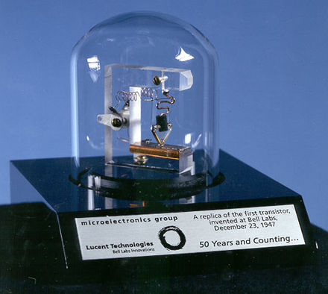
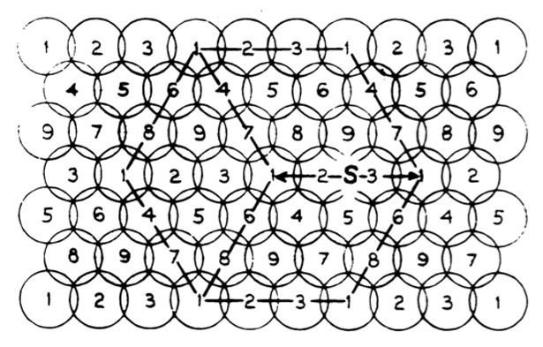
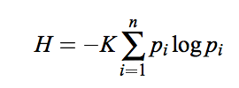
Prediction #1
Amazon, Facebook, Google, and Microsoft combined will contribute less valuable technological innovation to society in 1990-2030 than Bell Labs did in 1944-1949.
information theory,
cryptography (1945)
cellular telephony (1947)
transistor (1947)

Slide 15
Commerce
S2014; F2013
renewed your driver’s license at a cash machine (13; 16)
bought concert tickets from a cash machine (37; 56)
checked out of a supermarket a whole cart at a time (13; 11)
sent someone a fax from the beach (31; 44)
Travel
crossed the country without directions (72; 82)
paid a toll without slowing down (64; 64)
Media Consumption
borrowed a book from thousands of miles away (79; 73)
watched movie you wanted to the minute you wanted to (96; 98)
Communication
tucked baby in from a phone booth (10; 58)
put heads together when not together (87; 84)
attended a meeting in your bare feet (71; 67)
Security
opened doors with your voice (6; 18)
kept eye on your home when you’re not (20; 24)
carried your medical history in wallet (20; 20)
Agents
conducted business in a language you don’t understand (17; 13)
had an assistant who lived in your computer (68; 56)
Education
learned special things from faraway places (92; 87)
had a classmate thousands of miles away (74; 73)
fixed your car with a television (18; 29)

Slide 16
Commerce
S2014; F2013
renewed your driver’s license at a cash machine (13; 16)
bought concert tickets from a cash machine (37; 56)
checked out of a supermarket a whole cart at a time (13; 11)
sent someone a fax from the beach (31; 44)
Travel
crossed the country without directions (72; 82)
paid a toll without slowing down (64; 64)
Media Consumption
borrowed a book from thousands of miles away (79; 73)
watched movie you wanted to the minute you wanted to (96; 98)
Communication
tucked baby in from a phone booth (10; 58)
put heads together when not together (87; 84)
attended a meeting in your bare feet (71; 67)
Security
opened doors with your voice (6; 18)
kept eye on your home when you’re not (20; 24)
carried your medical history in wallet (20; 20)
Agents
conducted business in a language you don’t understand (17; 13)
had an assistant who lived in your computer (68; 56)
Education
learned special things from faraway places (92; 87)
had a classmate thousands of miles away (74; 73)
fixed your car with a television (18; 29)

Slide 17

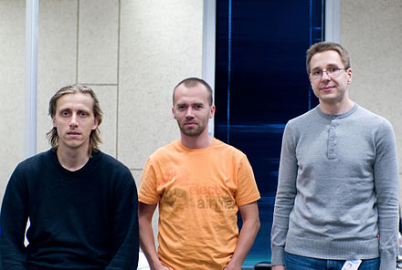
Commerce
S2014; F2013
renewed your driver’s license at a cash machine (13; 16)
bought concert tickets from a cash machine (37; 56)
checked out of a supermarket a whole cart at a time (13; 11)
sent someone a fax from the beach (31; 44)
Travel
crossed the country without directions (72; 82)
paid a toll without slowing down (64; 64)
Media Consumption
borrowed a book from thousands of miles away (79; 73)
watched movie you wanted to the minute you wanted to (96; 98)
Communication
First Release 2003
tucked baby in from a phone booth (10; 58)
put heads together when not together (87; 84)
attended a meeting in your bare feet (71; 67)
Security
opened doors with your voice (6; 18)
kept eye on your home when you’re not (20; 24)
carried your medical history in wallet (20; 20)
Agents
Created by Ahti Heinla, Priit Kasesalu, Jaan Tallinn
(3rd years at U. of Tartu in 1994); Janus Friis (HS dropout), Niklas Zennström
conducted business in a language you don’t understand (17; 13)
had an assistant who lived in your computer (68; 56)
Education
learned special things from faraway places (92; 87)
had a classmate thousands of miles away (74; 73)
fixed your car with a television (18; 29)

Slide 18
Commerce
S2014; F2013
renewed your driver’s license at a cash machine (13; 16)
bought concert tickets from a cash machine (37; 56)
checked out of a supermarket a whole cart at a time (13; 11)
sent someone a fax from the beach (31; 44)
Travel
crossed the country without directions (72; 82)
paid a toll without slowing down (64; 64)
Media Consumption
borrowed a book from thousands of miles away (79; 73)
watched movie you wanted to the minute you wanted to (96; 98)
Communication
tucked baby in from a phone booth (10; 58)
put heads together when not together (87; 84)
attended a meeting in your bare feet (71; 67)
Security
opened doors with your voice (6; 18)
kept eye on your home when you’re not (20; 24)
carried your medical history in wallet (20; 20)
Agents
conducted business in a language you don’t understand (17; 13)
had an assistant who lived in your computer (68; 56)
Education
learned special things from faraway places (92; 87)
had a classmate thousands of miles away (74; 73)
fixed your car with a television (18; 29)

Slide 19
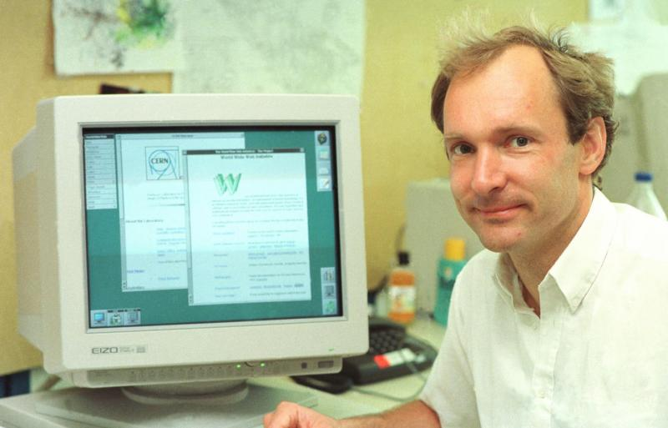
Commerce
S2014; F2013
renewed your driver’s license at a cash machine (13; 16)
bought concert tickets from a cash machine (37; 56)
checked out of a supermarket a whole cart at a time (13; 11)
sent someone a fax from the beach (31; 44)
Travel
crossed the country without directions (72; 82)
paid a toll without slowing down (64; 64)
Media Consumption
borrowed a book from thousands of miles away (79; 73)
watched movie you wanted to the minute you wanted to (96; 98)
Communication
tucked baby in from a phone booth (10; 58)
put heads together when not together (87; 84)
attended a meeting in your bare feet (71; 67)
Security
opened doors with your voice (6; 18)
kept eye on your home when you’re not (20; 24)
carried your medical history in wallet (20; 20)
Agents
conducted business in a language you don’t understand (17; 13)
had an assistant who lived in your computer (68; 56)
Education
learned special things from faraway places (92; 87)
had a classmate thousands of miles away (74; 73)
fixed your car with a television (18; 29)
Sir Tim Berners-Lee
First WWW Prototype at CERN 1990

Slide 20
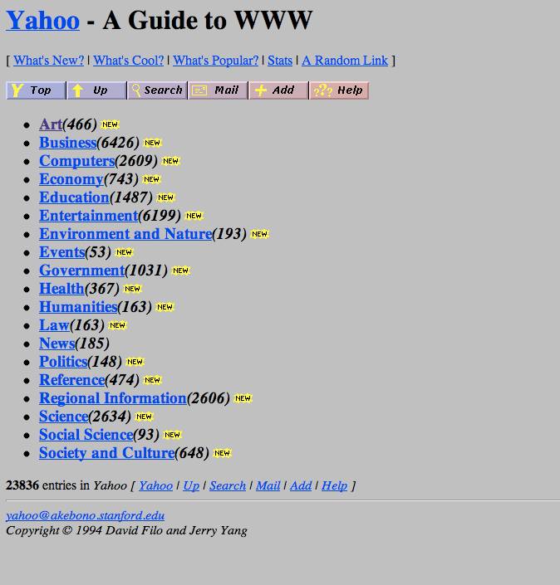
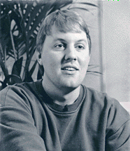
David Filo and Jerry Yang
Students at Stanford
Yahoo 1994
Marc Andreesen
Student at U. Illinois
NCSA Mosaic released in 1993

Slide 21
Commerce
S2014; F2013
renewed your driver’s license at a cash machine (13; 16)
bought concert tickets from a cash machine (37; 56)
checked out of a supermarket a whole cart at a time (13; 11)
sent someone a fax from the beach (31; 44)
Travel
crossed the country without directions (72; 82)
paid a toll without slowing down (64; 64)
Media Consumption
borrowed a book from thousands of miles away (79; 73)
watched movie you wanted to the minute you wanted to (96; 98)
Communication
tucked baby in from a phone booth (10; 58)
put heads together when not together (87; 84)
attended a meeting in your bare feet (71; 67)
Security
opened doors with your voice (6; 18)
kept eye on your home when you’re not (20; 24)
carried your medical history in wallet (20; 20)
Agents
conducted business in a language you don’t understand (17; 13)
had an assistant who lived in your computer (68; 56)
Education
learned special things from faraway places (92; 87)
had a classmate thousands of miles away (74; 73)
fixed your car with a television (18; 29)

Slide 22
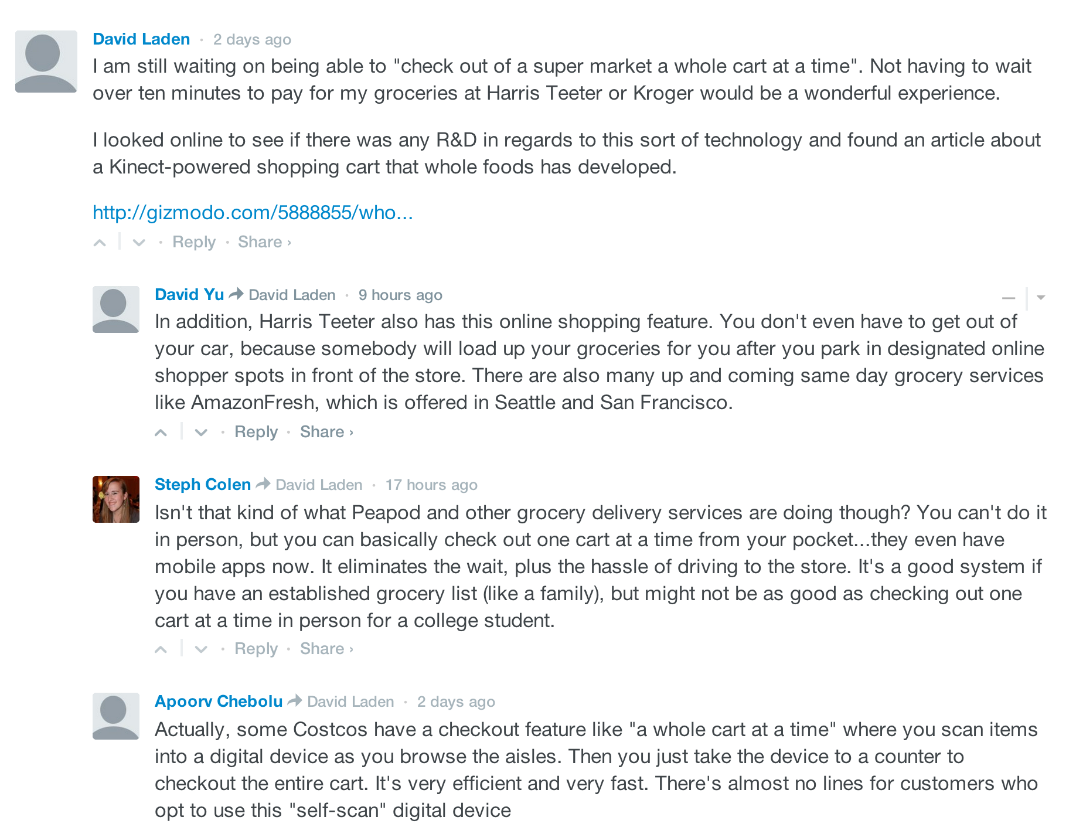
Commerce
S2014; F2013
renewed your driver’s license at a cash machine (13; 16)
bought concert tickets from a cash machine (37; 56)
checked out of a supermarket a whole cart at a time (13; 11)
sent someone a fax from the beach (31; 44)
Travel
crossed the country without directions (72; 82)
paid a toll without slowing down (64; 64)
Media Consumption
borrowed a book from thousands of miles away (79; 73)
watched movie you wanted to the minute you wanted to (96; 98)
Communication
tucked baby in from a phone booth (10; 58)
put heads together when not together (87; 84)
attended a meeting in your bare feet (71; 67)
Security
opened doors with your voice (6; 18)
kept eye on your home when you’re not (20; 24)
carried your medical history in wallet (20; 20)
Agents
conducted business in a language you don’t understand (17; 13)
had an assistant who lived in your computer (68; 56)
Education
learned special things from faraway places (92; 87)
had a classmate thousands of miles away (74; 73)
fixed your car with a television (18; 29)

Slide 23
Commerce
S2014; F2013
renewed your driver’s license at a cash machine (13; 16)
bought concert tickets from a cash machine (37; 56)
checked out of a supermarket a whole cart at a time (13; 11)
sent someone a fax from the beach (31; 44)
Travel
crossed the country without directions (72; 82)
paid a toll without slowing down (64; 64)
Media Consumption
borrowed a book from thousands of miles away (79; 73)
watched movie you wanted to the minute you wanted to (96; 98)
Communication
tucked baby in from a phone booth (10; 58)
put heads together when not together (87; 84)
attended a meeting in your bare feet (71; 67)
Security
opened doors with your voice (6; 18)
kept eye on your home when you’re not (20; 24)
carried your medical history in wallet (20; 20)
Agents
conducted business in a language you don’t understand (17; 13)
had an assistant who lived in your computer (68; 56)
Education
learned special things from faraway places (92; 87)
had a classmate thousands of miles away (74; 73)
fixed your car with a television (18; 29)

Slide 24
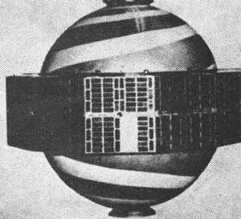
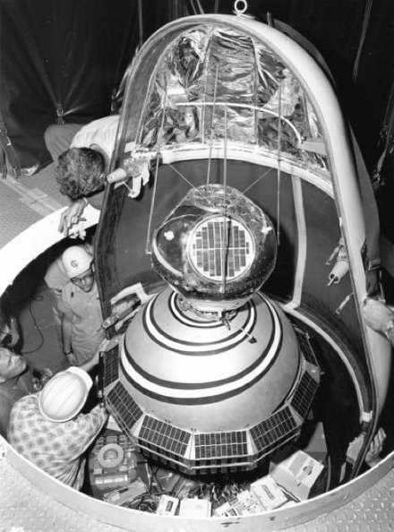
TRANSIT/NAVSAT (1964)
Probably first satellite that could be reprogrammed!
48 bytes of working memory

Slide 25
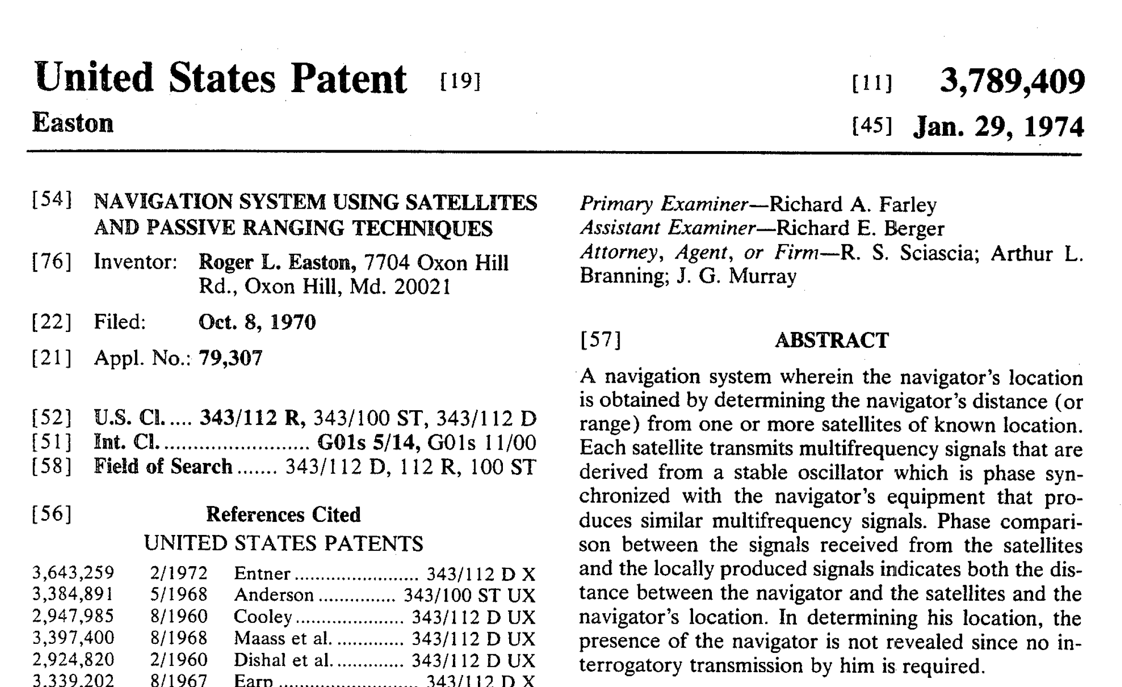
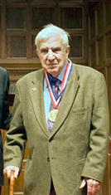

Slide 26
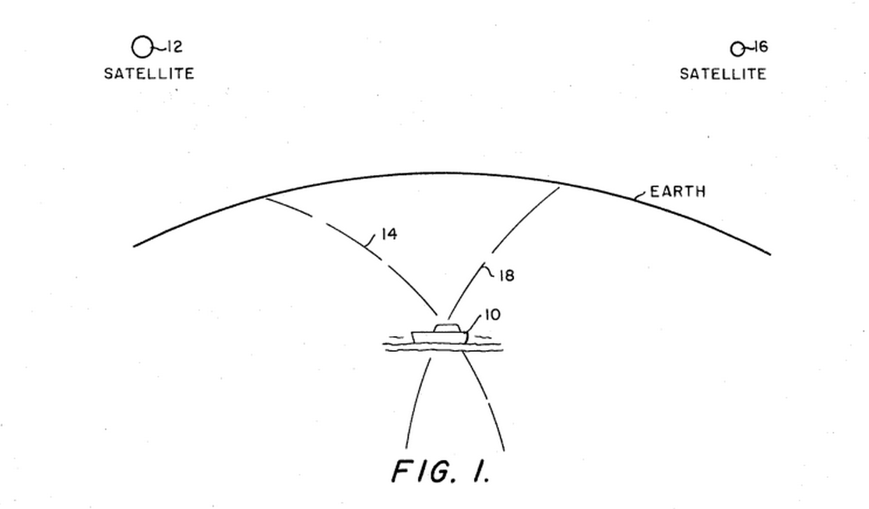

Slide 27
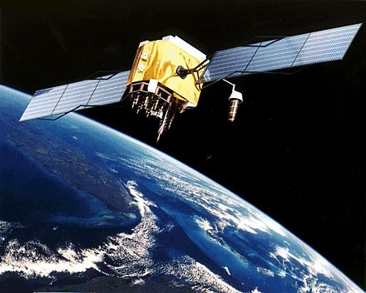
GPS (10 sats): used in 1990-1 Gulf War
First Garmin: $2500
GPS (24 sats) Operational 1995
1996: Dual-Use Directive

Slide 28
Commerce
S2014; F2013
renewed your driver’s license at a cash machine (13; 16)
bought concert tickets from a cash machine (37; 56)
checked out of a supermarket a whole cart at a time (13; 11)
sent someone a fax from the beach (31; 44)
Travel
crossed the country without directions (72; 82)
paid a toll without slowing down (64; 64)
Media Consumption
borrowed a book from thousands of miles away (79; 73)
watched movie you wanted to the minute you wanted to (96; 98)
Communication
tucked baby in from a phone booth (10; 58)
put heads together when not together (87; 84)
attended a meeting in your bare feet (71; 67)
Security
opened doors with your voice (6; 18)
kept eye on your home when you’re not (20; 24)
carried your medical history in wallet (20; 20)
Agents
conducted business in a language you don’t understand (17; 13)
had an assistant who lived in your computer (68; 56)
Education
learned special things from faraway places (92; 87)
had a classmate thousands of miles away (74; 73)
fixed your car with a television (18; 29)

Slide 29
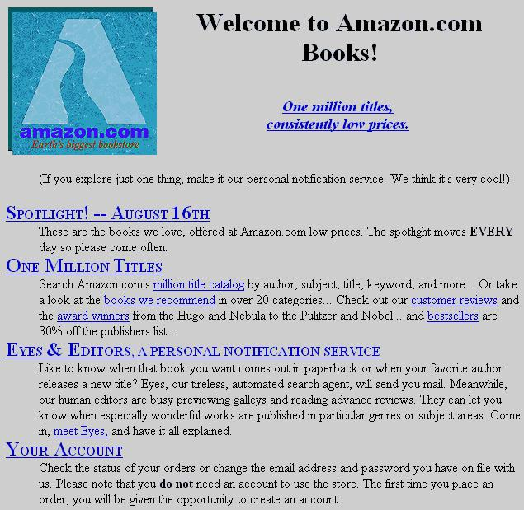
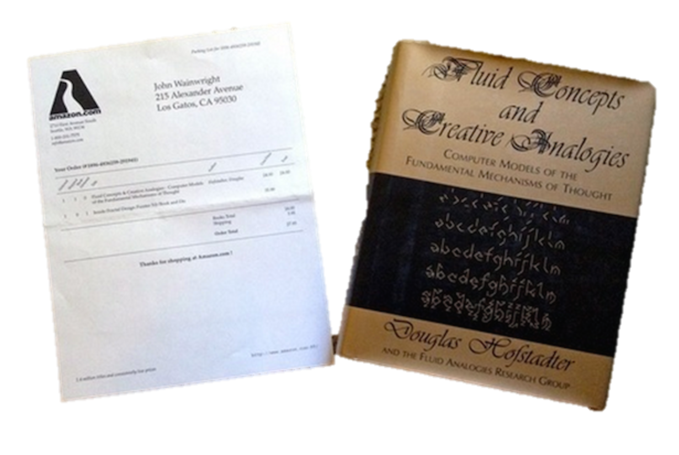
amazon.com opens: July 1995

Slide 30
Commerce
S2014; F2013
renewed your driver’s license at a cash machine (13; 16)
bought concert tickets from a cash machine (37; 56)
checked out of a supermarket a whole cart at a time (13; 11)
sent someone a fax from the beach (31; 44)
Travel
crossed the country without directions (72; 82)
paid a toll without slowing down (64; 64)
Media Consumption
borrowed a book from thousands of miles away (79; 73)
watched movie you wanted to the minute you wanted to (96; 98)
Communication
tucked baby in from a phone booth (10; 58)
put heads together when not together (87; 84)
attended a meeting in your bare feet (71; 67)
Security
opened doors with your voice (6; 18)
kept eye on your home when you’re not (20; 24)
carried your medical history in wallet (20; 20)
Agents
conducted business in a language you don’t understand (17; 13)
had an assistant who lived in your computer (68; 56)
Education
learned special things from faraway places (92; 87)
had a classmate thousands of miles away (74; 73)
fixed your car with a television (18; 29)

Slide 31

Cost to sequence genome
“Moore’s Law”
Predicting steady technology improvement is easy!

Slide 32
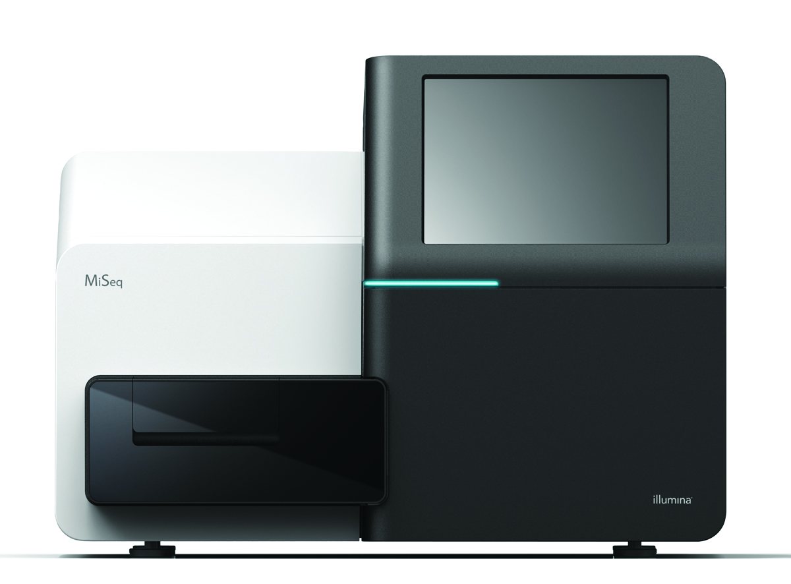
Cost to sequence genome
“Moore’s Law”

Slide 33
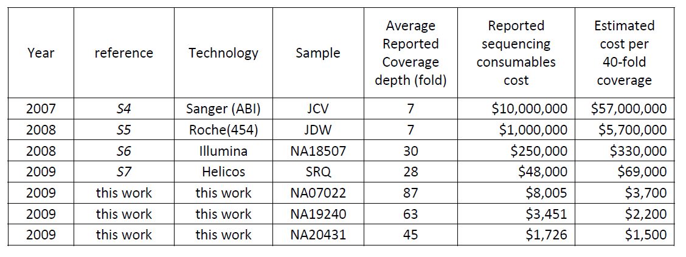
Human Genome Sequencing Using Unchained Base Reads on Self-Assembling DNA Nanoarrays. Radoje Drmanac, Andrew B. Sparks, Matthew J. Callow, Aaron L. Halpern, Norman L. Burns, Bahram G. Kermani, Paolo Carnevali, Igor Nazarenko, Geoffrey B. Nilsen, George Yeung, Fredrik Dahl, Andres Fernandez, Bryan Staker, Krishna P. Pant, Jonathan Baccash, Adam P. Borcherding, Anushka Brownley, Ryan Cedeno, Linsu Chen, Dan Chernikoff, Alex Cheung, Razvan Chirita, Benjamin Curson, Jessica C. Ebert, Coleen R. Hacker, Robert Hartlage, Brian Hauser, Steve Huang, Yuan Jiang, Vitali Karpinchyk, Mark Koenig, Calvin Kong, Tom Landers, Catherine Le, Jia Liu, Celeste E. McBride, Matt Morenzoni, Robert E. Morey, Karl Mutch, Helena Perazich, Kimberly Perry, Brock A. Peters, Joe Peterson, Charit L. Pethiyagoda, Kaliprasad Pothuraju, Claudia Richter, Abraham M. Rosenbaum, Shaunak Roy, Jay Shafto, Uladzislau Sharanhovich, Karen W. Shannon, Conrad G. Sheppy, Michel Sun, Joseph V. Thakuria, Anne Tran, Dylan Vu, Alexander Wait Zaranek, Xiaodi Wu, Snezana Drmanac, Arnold R. Oliphant, William C. Banyai, Bruce Martin, Dennis G. Ballinger, George M. Church, Clifford A. Reid. Science, January 2010.

Slide 34
Human Genome Sequencing Using Unchained Base Reads on Self-Assembling DNA Nanoarrays. Radoje Drmanac, Andrew B. Sparks, Matthew J. Callow, Aaron L. Halpern, Norman L. Burns, Bahram G. Kermani, Paolo Carnevali, Igor Nazarenko, Geoffrey B. Nilsen, George Yeung, Fredrik Dahl, Andres Fernandez, Bryan Staker, Krishna P. Pant, Jonathan Baccash, Adam P. Borcherding, Anushka Brownley, Ryan Cedeno, Linsu Chen, Dan Chernikoff, Alex Cheung, Razvan Chirita, Benjamin Curson, Jessica C. Ebert, Coleen R. Hacker, Robert Hartlage, Brian Hauser, Steve Huang, Yuan Jiang, Vitali Karpinchyk, Mark Koenig, Calvin Kong, Tom Landers, Catherine Le, Jia Liu, Celeste E. McBride, Matt Morenzoni, Robert E. Morey, Karl Mutch, Helena Perazich, Kimberly Perry, Brock A. Peters, Joe Peterson, Charit L. Pethiyagoda, Kaliprasad Pothuraju, Claudia Richter, Abraham M. Rosenbaum, Shaunak Roy, Jay Shafto, Uladzislau Sharanhovich, Karen W. Shannon, Conrad G. Sheppy, Michel Sun, Joseph V. Thakuria, Anne Tran, Dylan Vu, Alexander Wait Zaranek, Xiaodi Wu, Snezana Drmanac, Arnold R. Oliphant, William C. Banyai, Bruce Martin, Dennis G. Ballinger, George M. Church, Clifford A. Reid. Science, January 2010.

Slide 35
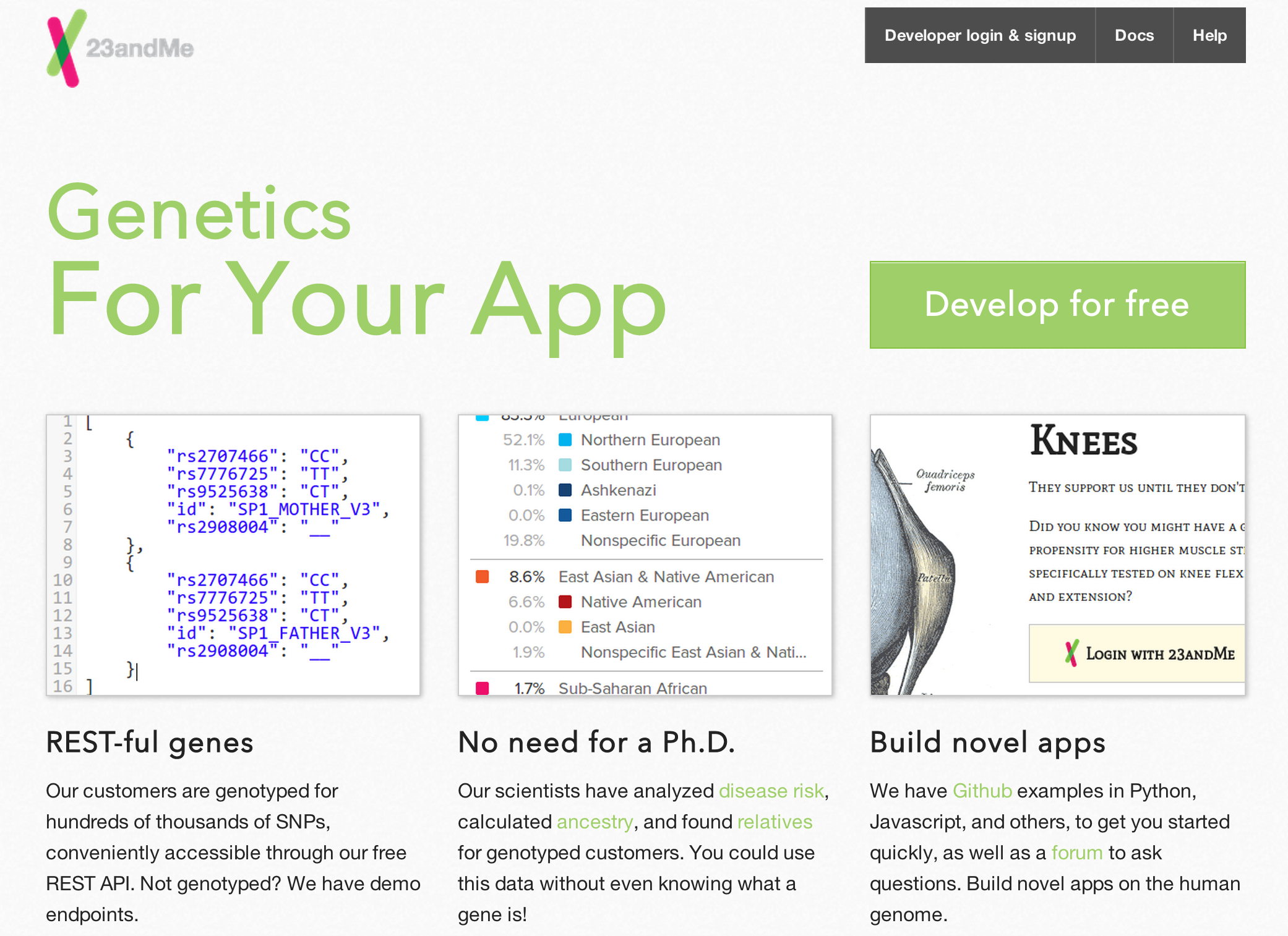

Slide 36
Commerce
S2014; F2013
renewed your driver’s license at a cash machine (13; 16)
bought concert tickets from a cash machine (37; 56)
checked out of a supermarket a whole cart at a time (13; 11)
sent someone a fax from the beach (31; 44)
Travel
crossed the country without directions (72; 82)
paid a toll without slowing down (64; 64)
Media Consumption
borrowed a book from thousands of miles away (79; 73)
watched movie you wanted to the minute you wanted to (96; 98)
Communication
tucked baby in from a phone booth (10; 58)
put heads together when not together (87; 84)
attended a meeting in your bare feet (71; 67)
Security
opened doors with your voice (6; 18)
kept eye on your home when you’re not (20; 24)
carried your medical history in wallet (20; 20)
Agents
conducted business in a language you don’t understand (17; 13)
had an assistant who lived in your computer (68; 56)
Education
learned special things from faraway places (92; 87)
had a classmate thousands of miles away (74; 73)
fixed your car with a television (18; 29)

Slide 37
Prediction #2
Within 15 years, at least 95% of the world’s adult population will have done everything on the “You Will” list (or something comparable but much better).
Note: this implies end to world poverty!

Slide 38
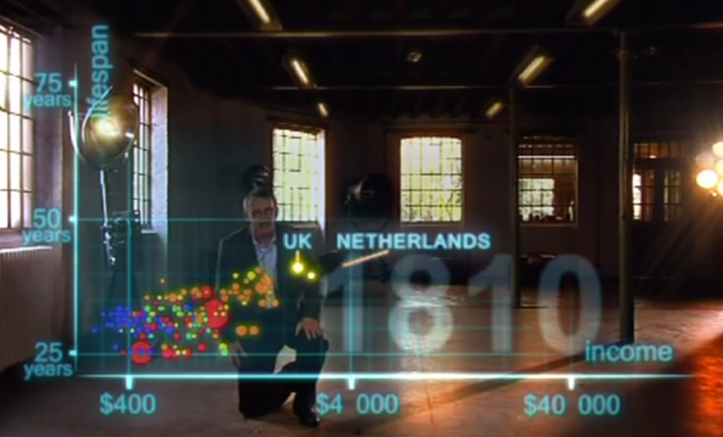
Hans Rosling

Slide 39
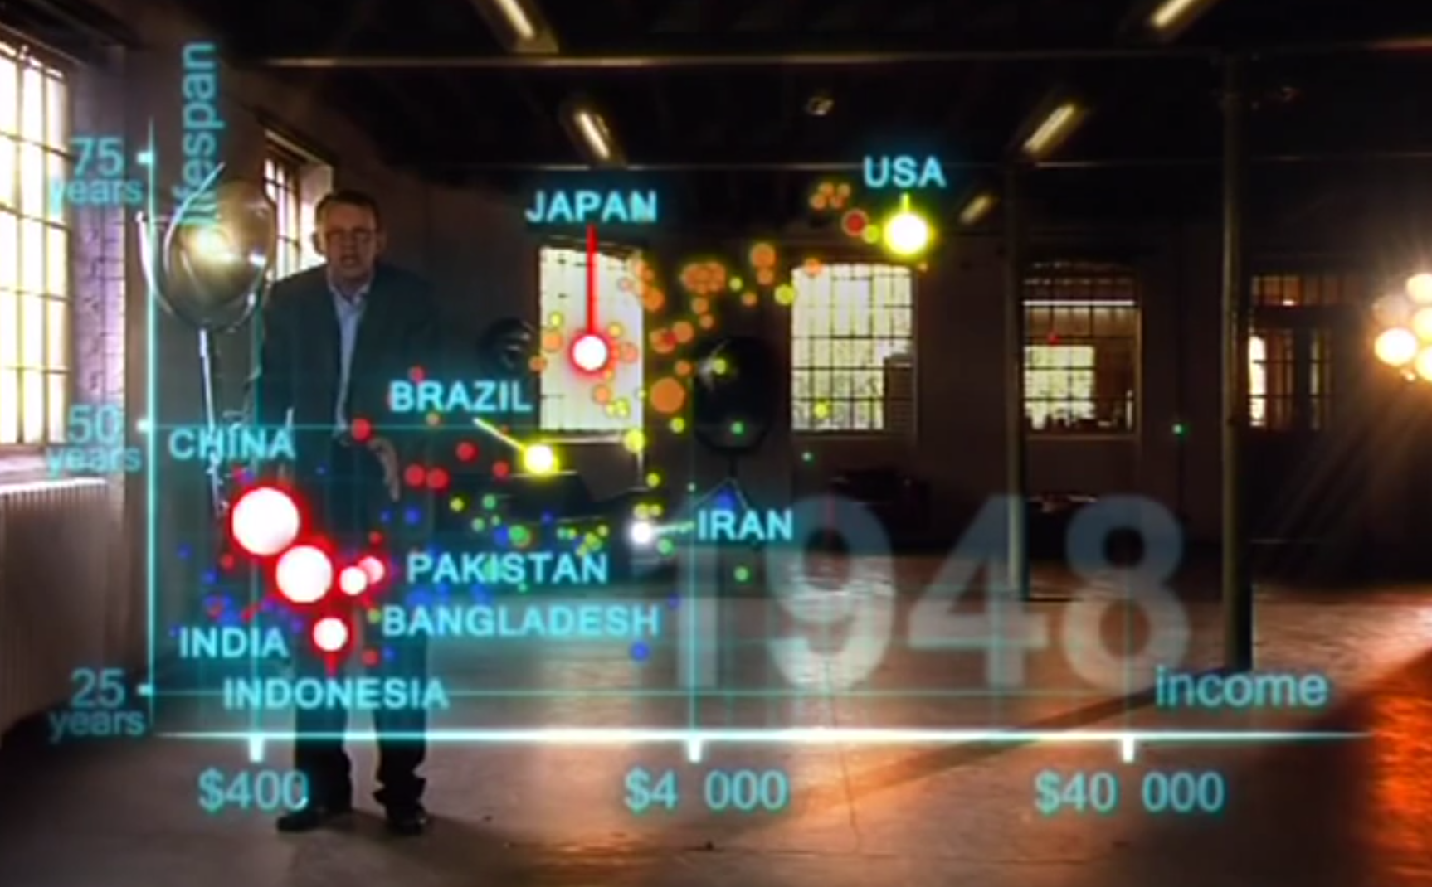
1948

Slide 40
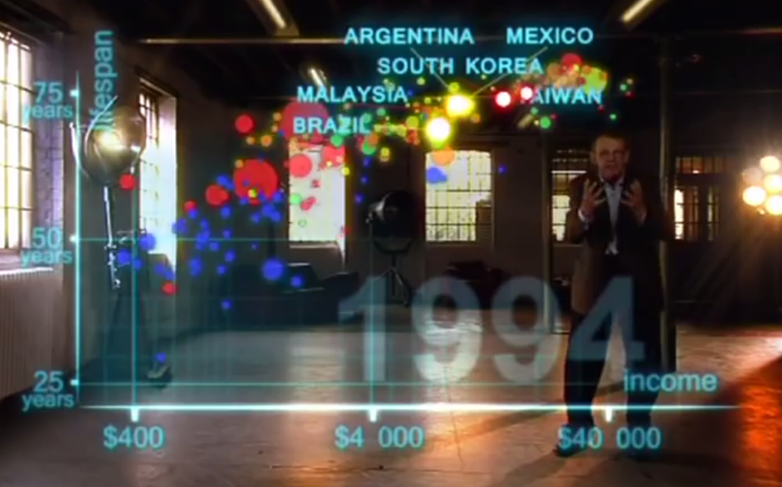
1994

Slide 41
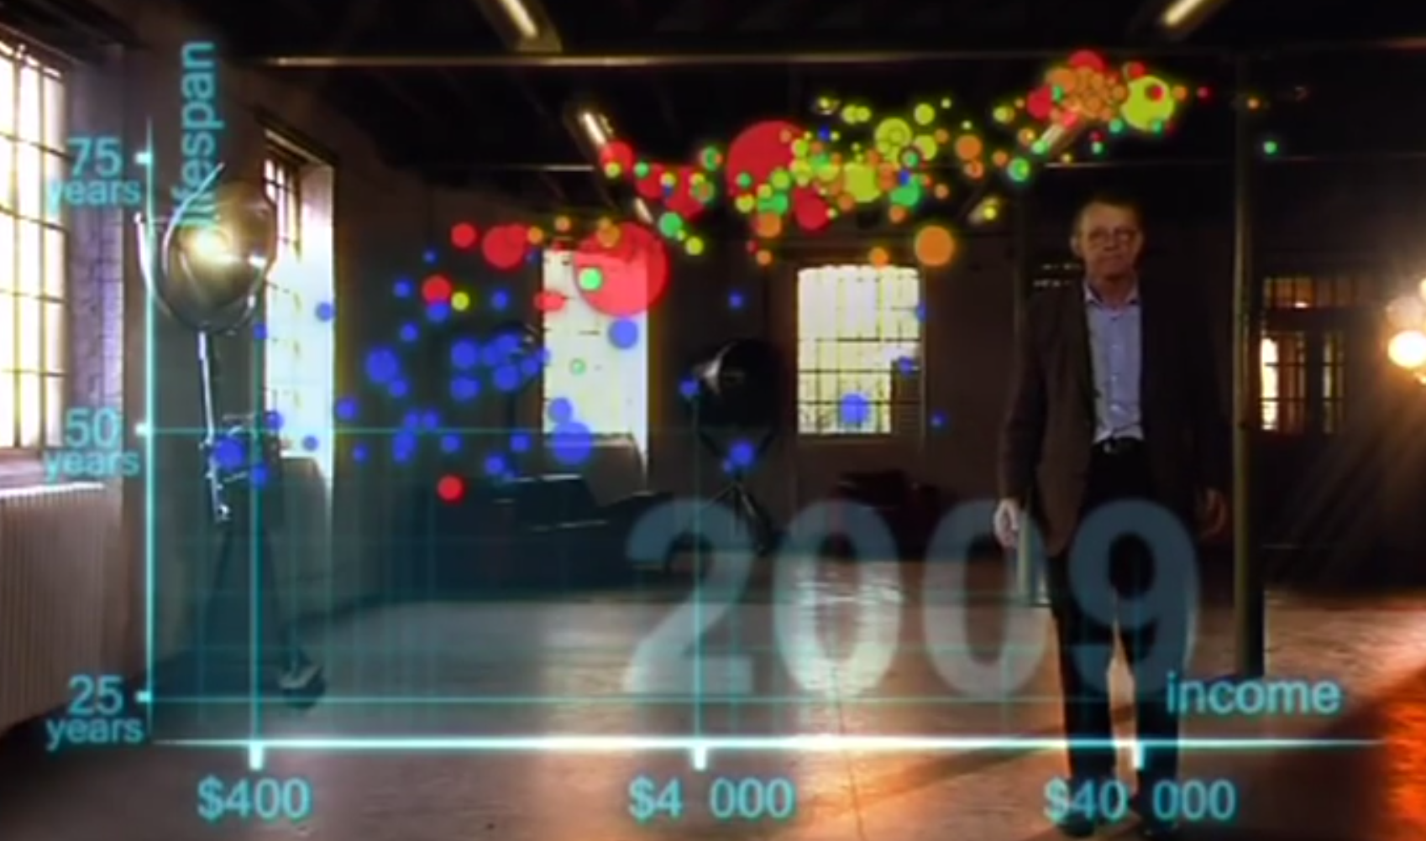

Slide 42
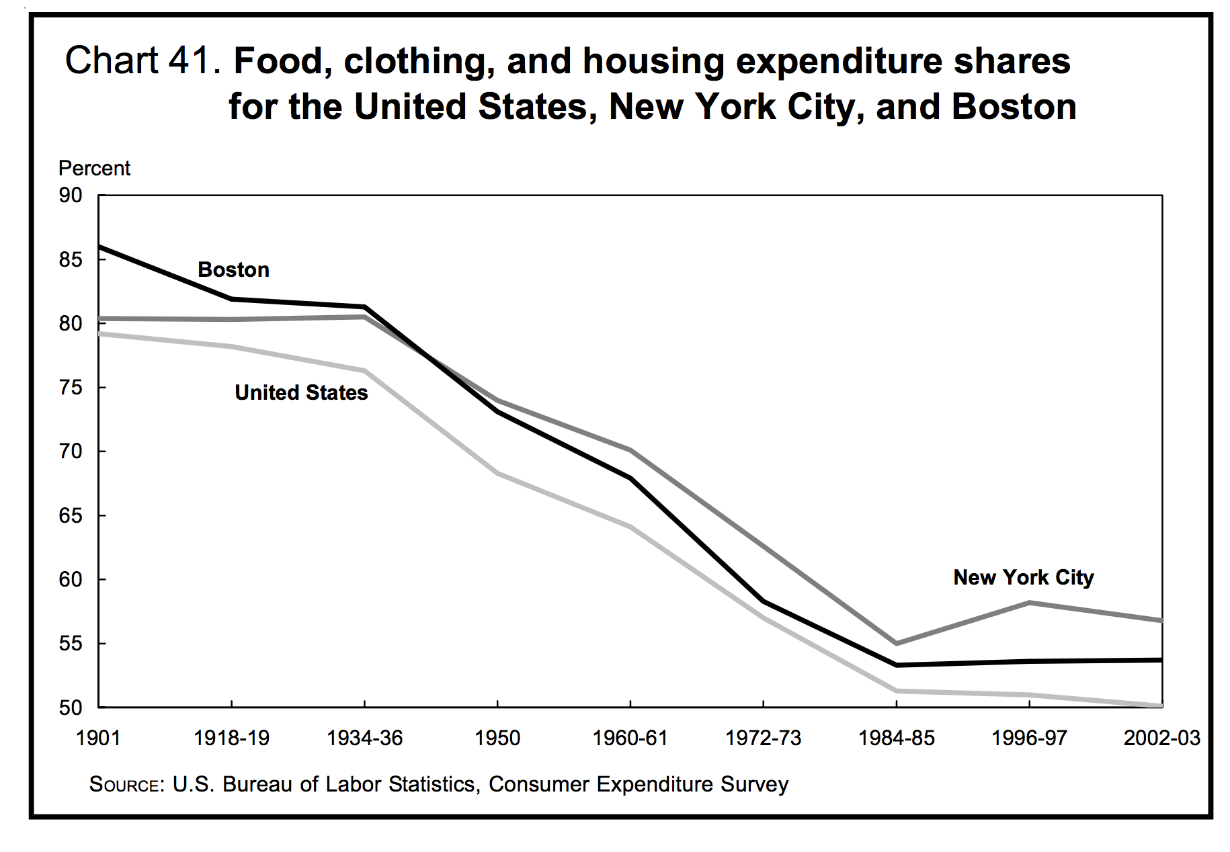

Slide 43
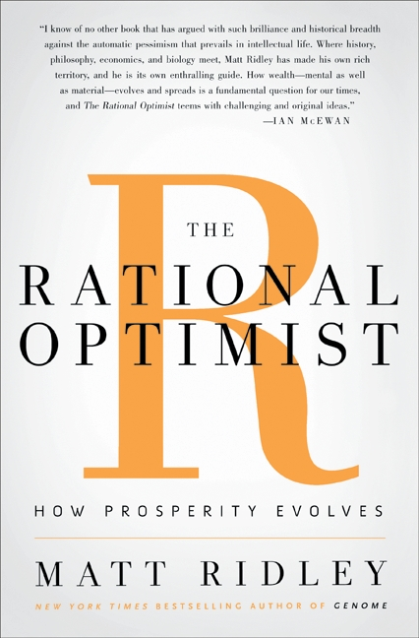
“Today, of Americans officially designated as ‘poor’, 99 percent have electricity, running water, flush toilets, and a refrigerator; 95 percent have a television, 88 percent a telephone, 71 percent a car and 70 percent air conditioning. Cornelius Vanderbilt had none of these.”

Slide 44
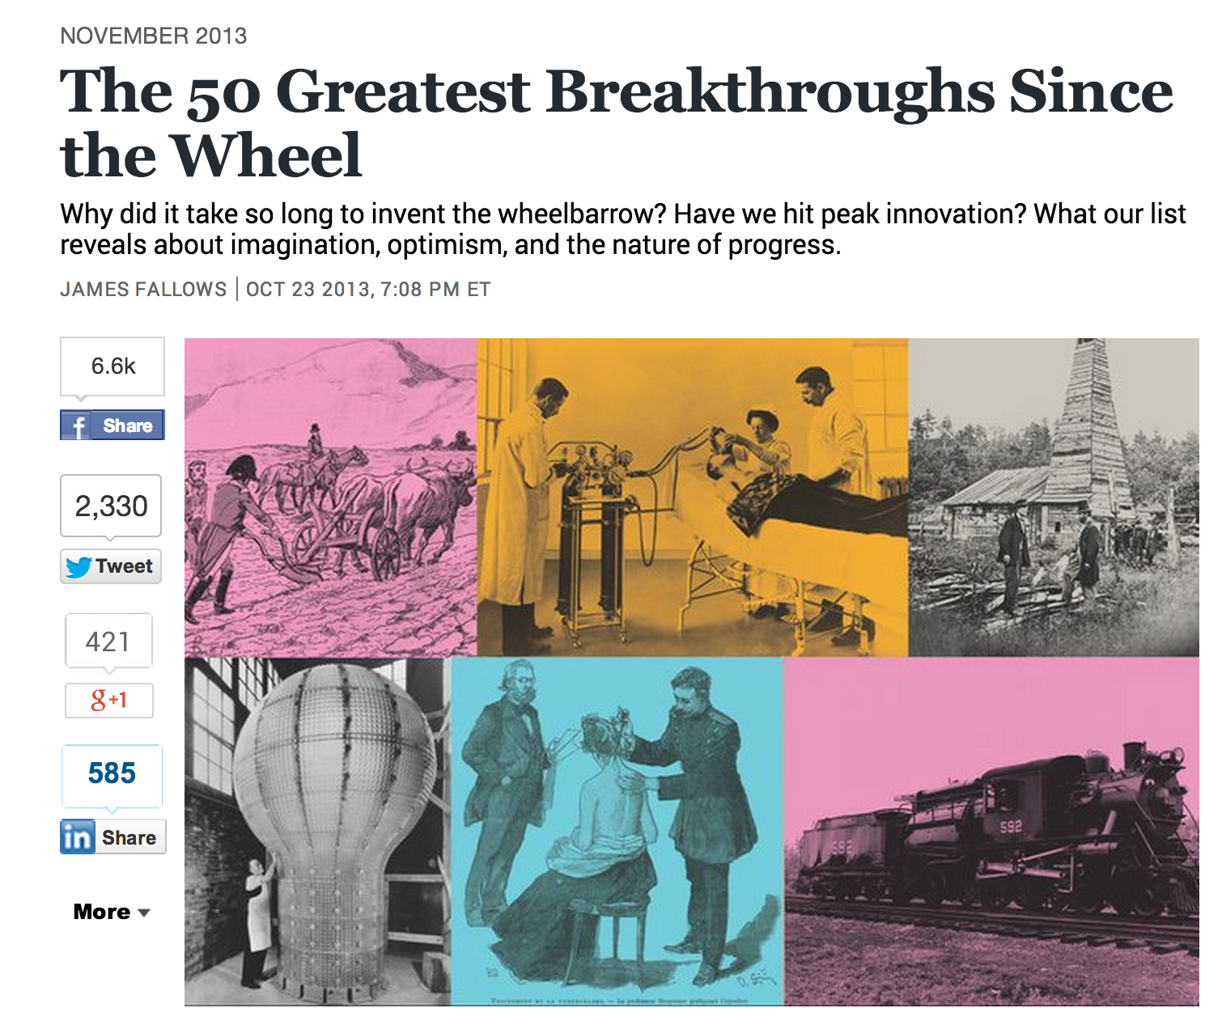
Pace of Progress

Slide 45


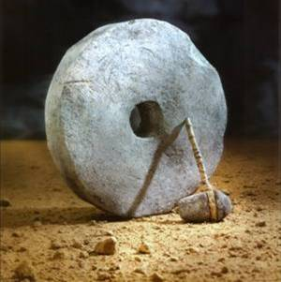
Year of Invention
Rank on List
S ::= NP V
NP ::= N and NP
Cooking (-400 000)
Language (-300 000)
Wheel (~4000 BC)

Slide 46
Last Millennium

Slide 47
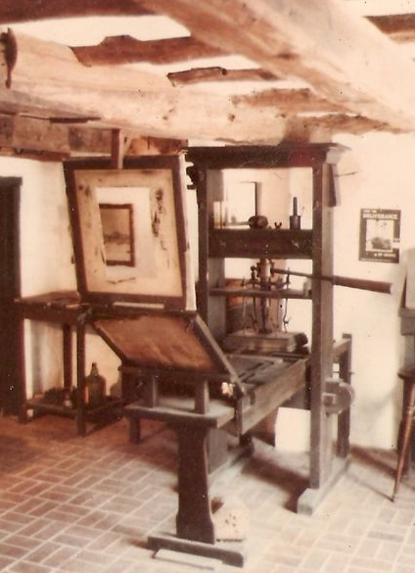
Last Millennium
#1: Printing Press

Slide 48
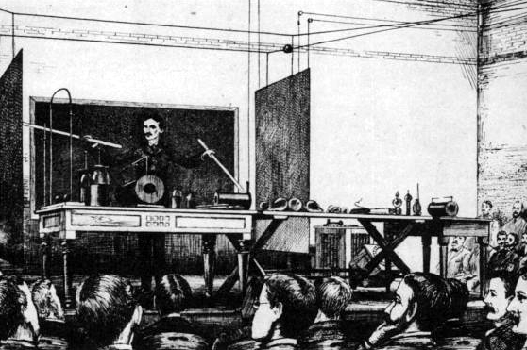
Last Millennium
#1: Printing Press
#2: Electricity
Nikola Tesla

Slide 49
Last Millennium
#1: Printing Press
#2: Electricity
#4: Semiconductor
#9: Internet
#16: Personal Computer

Slide 50
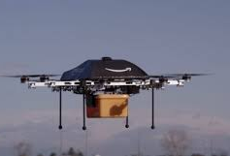
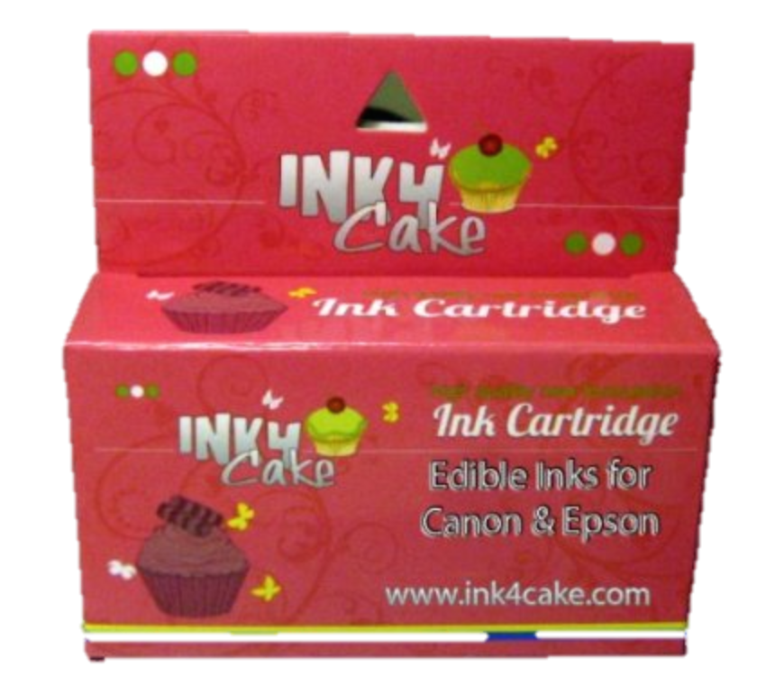
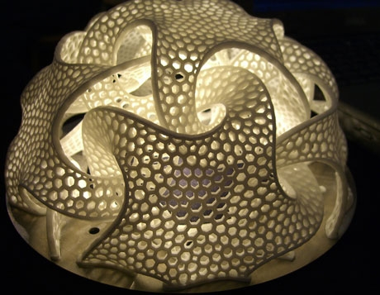

Prediction #3
Over the next 15 years, there will be inventions that change the world at least as much as the semiconductor, personal computer, and Internet did over the last 30.
Drone delivery?
Printing food?
3D fabrication?
AI?

Slide 51
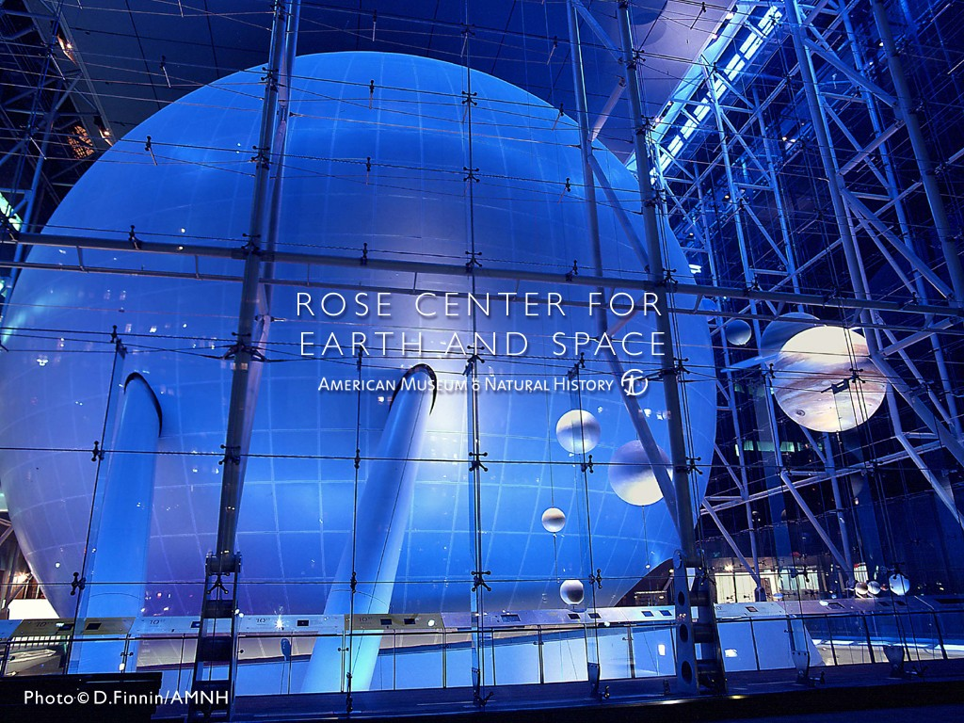
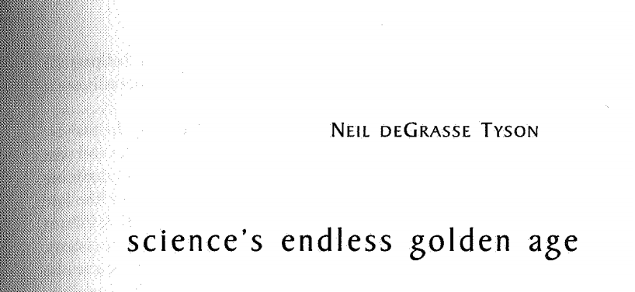
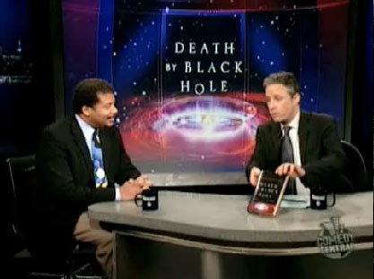

Slide 52
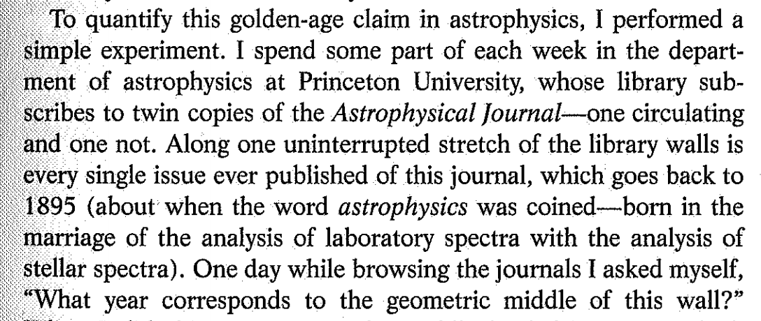


Slide 53
“If you’re going to use your computer to simulate some phenomenon in the universe, then it only becomes interesting if you change the scale of that phenomenon by at least a factor of 10. … For a 3D simulation, an increase by a factor of 10 in each of the three dimensions increases your volume by a factor of 1000.”
What is the asymptotic running time for simulating the universe?

Slide 54
Astrophysics and Moore’s Law
Simulating universe is Θ(n³)
  Moore’s “law”: computing power doubles every 18 months
Tyson: to understand something new about universe, need to scale by 10x
How long does it take to know twice as much about the universe?

Slide 55


Slide 56




Slide 57

15 years ≈1000x computing power
≈ double understanding
“There’s an unwritten rule in astrophysics: your computer simulation must end before you die.”
Neil deGrasse Tyson
Will there be any mystery left in the Universe when you die?

Slide 58

Only two things are infinite, the universe and human stupidity, and I'm not sure about the former.
Albert Einstein

Slide 59
The Endless Golden Age
Golden Age – period in which knowledge/quality of something improves exponentially
At any point in history, half of what is known was discovered in the previous 15 years!
  Moore’s law today, but other advances previously (and tomorrow): telescopes, photocopiers, clocks, agriculture, drone delivery, personal assistant, etc.
Accumulating 4% per year => doubling every 15 years
Accumulating 4% per month => 1000x every 15 years

Slide 60

“Any physical quantity that’s growing exponentially predicts a disaster, you simply can’t go beyond certain major limits.”
Gordon Moore (2007)
Log scale: straight line = exponential curve!
Koomey’s Law:Assessing Trends in the Electrical Efficiency of Computation Over Time

Slide 61

An analysis of the history of technology shows that technological change is exponential, contrary to the common-sense 'intuitive linear' view. So we won't experience 100 years of progress in the 21st century-it will be more like 20,000 years of progress… Within a few decades, machine intelligence will surpass human intelligence, leading to the Singularity — technological change so rapid and profound it represents a rupture in the fabric of human history. The implications include the merger of biological and non-biological intelligence, immortal software-based humans, and ultra-high levels of intelligence that expand outward in the universe at the speed of light.
Ray Kurzweil

Slide 62


Slide 63
Sustainability is a very depressing goal for a scientist/engineer – we should be striving for progress!
share what we have with the rest of the world (by lowering costs)
invent new things that improve the quality, interconnectedness, and length of human life

Slide 64
Golden Ages or
Golden Catastrophes?

Slide 65

Reverend Thomas Robert Malthus, Essay on the Principle of Population, 1798

Slide 66

The great and unlooked for discoveries that have taken place of late years in natural philosophy, the increasing diffusion of general knowledge from the extension of the art of printing, the ardent and unshackled spirit of inquiry that prevails throughout the lettered and even unlettered world, … have all concurred to lead many able men into the opinion that we were touching on a period big with the most important changes, changes that would in some measure be decisive of the future fate of mankind.

Slide 67
I think I may fairly make two postulata.
  First, that food is necessary to the existence of man.
  Secondly, that the passion between the sexes is necessary and will remain….
Assuming then my postulata, I say, that the power of population is indefinitely greater than the power in the earth to produce subsistence. Population, when unchecked, increases in a geometrical ratio. Subsistence increases only in an arithmetical ratio.
Food per person = Θ(n) / Θ(k^{n}) approaches 0

Slide 68

Malthus’ Fallacy?

Slide 69
He forgot how he started:
“The great and unlooked for discoveries that have taken place of late years in natural philosophy, the increasing diffusion of general knowledge from the extension of the art of printing, the ardent and unshackled spirit of inquiry that prevails throughout the lettered and even unlettered world…”

Slide 70
Golden Age of Food Production
Agriculture is an “endless golden age” field
production from the same land increases 2%/year
Increasing knowledge of farming, weather forecasting, plant domestication, preservatives, genetic engineering, pest repellants, distribution channels, etc.

Slide 71


1906: < 1,000 pounds per acre
2006: 10,000 pounds per acre
Michael Pollan’s The Omnivore’s Dilemma

Slide 72

Corn Yield
Note: Log axis!
http://www.agbioforum.org/v2n1/v2n1a10-ruttan.htm

Slide 73

https://www.wolframalpha.com/input/?i=corn+yield+china+vs.+us

Slide 74
The 2014 fair will feature an Algae Bar at which “mock-turkey” and “pseudosteak” will be served. It won’t be bad at all (if you can dig up those premium prices), but there will be considerable psychological resistance to such an innovation.

Slide 75


Green Revolution
Norman Borlaug (1914-2009)

Slide 76
At a time when doom-sayers were hopping around saying everyone was going to starve, Norman was working. He moved to Mexico and lived among the people there until he figured out how to improve the output of the farmers. So that saved a million lives. Then he packed up his family and moved to India, where in spite of a war with Pakistan, he managed to introduce new wheat strains that quadrupled their food output. So that saved another million. You get it? But he wasn’t done. He did the same thing with a new rice in China. He’s doing the same thing in Africa - as much of Africa as he’s allowed to visit. When he won the Nobel Prize in 1970, they said he had saved a billion people. That's BILLION! BUH! And most of them were a different race from him. Norman is the greatest human being, and you probably never heard of him.”
Penn Jillette (Penn & Teller)

Slide 77
I think I may fairly make two postulata.
  First, that food is necessary to the existence of man.
  Secondly, that the passion between the sexes is necessary and will remain….
Assuming then my postulata, I say, that the power of population is indefinitely greater than the power in the earth to produce subsistence. Population, when unchecked, increases in a geometrical ratio. Subsistence increases only in an arithmetical ratio.
What about his other postulate?

Slide 78
Well, the earth’s population is now about 3,000,000,000 and is doubling every 40 years. If this rate of doubling goes unchecked, then a World-Manhattan is coming in just 500 years. All earth will be a single choked Manhattan by A.D. 2450 and society will collapse long before that!
There are only two general ways of preventing this: (1) raise the death rate; (2) lower the birth rate. Undoubtedly, the world of 2014 will have agreed on the latter method.

Slide 79
“In 2014, there is every likelihood that the world population will be 6,500,000,000 and the population of the United States will be 350,000,000. Boston-to-Washington, the most crowded area of its size on the earth, will have become a single city with a population of over 40,000,000.”

Slide 80

“In 2014, there is every likelihood that the world population will be 6,500,000,000 and the population of the United States will be 350,000,000.”

Slide 81


Advances in science (birth control), medicine (higher life expectancy), education, and societal and political changes (e.g., regulation in China) have reduced k (it is < 1 in many countries now!)

Slide 82

Upcoming Malthusian Catastrophes?
http://ourfiniteworld.com/2012/03/12/world-energy-consumption-since-1820-in-charts/

Slide 83



Slide 84
“Cornucopian View”
Few resources are really finite
All scientific things have endless golden ages
Knowledge accumulates
Knowledge makes it easier to acquire more
(We hope) Human ingenuity and economics and politics will continue solve problems before they become catastrophes

Slide 85


Prediction #4
The vast majority of jobs people have today will be automated, and the fraction of the world’s population who can produce something of economic value (i.e., that cannot be done better and cheaper by machines) will plummet.
Automated Mall Cop
Automated Warehouse

Slide 86


Will the elimination of tedious human work cause mass riots or mass rejoicing?
Luddites, 1812

Slide 87
Are Software Engineers Safe?
 | Year Founded | Employees | Revenues
Instagram | 2010 | 13
Twitter | 2006 | 2000 | $0.3B
Facebook | 2004 | 5800 | $1.2B
Google | 1998 | 46000 | $50B
eBay | 1995 | 27700 | $14B
Microsoft | 1975 | 100518 | $78B
HP | 1939 | 331800 | $120B
IBM | 1911 | 435000 | $104B

Slide 88
Even so, mankind will suffer badly from the disease of boredom, a disease spreading more widely each year and growing in intensity. This will have serious mental, emotional and sociological consequences, and I dare say that psychiatry will be far and away the most important medical specialty in 2014. The lucky few who can be involved in creative work of any sort will be the true elite of mankind, for they alone will do more than serve a machine.
Indeed, the most somber speculation I can make about A.D. 2014 is that in a society of enforced leisure, the most glorious single word in the vocabulary will have become work!

Slide 89

America will always do the right thing
but only after exhausting all other options.
Winston Churchill
Charles Vest’s slide idea!

Slide 90

Charge
The best way to predict the future is to invent it.
— Alan Kay

