Slide 1
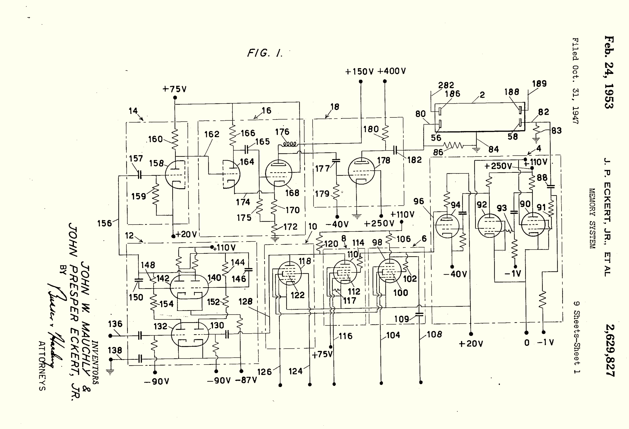
Class 24:
Storage
cs4414 Fall 2013
University of Virginia
David Evans

Slide 2

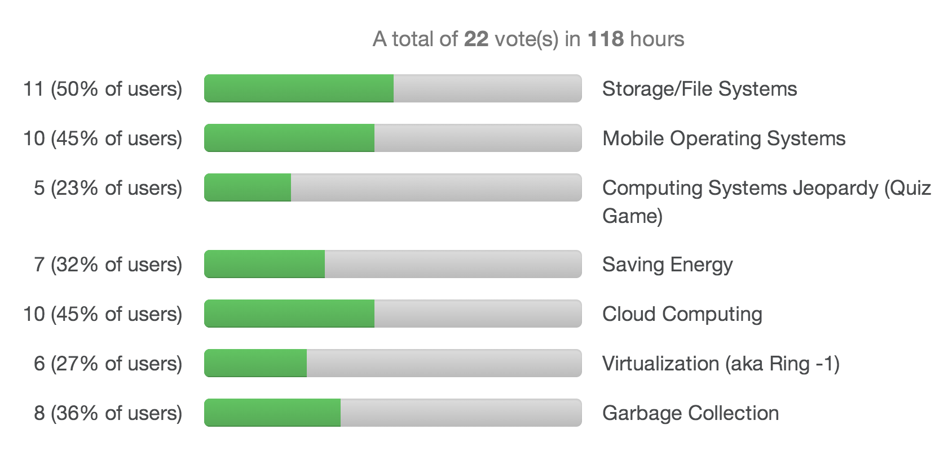

Slide 3
Why is storage complicated?

Slide 4
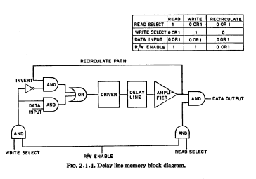
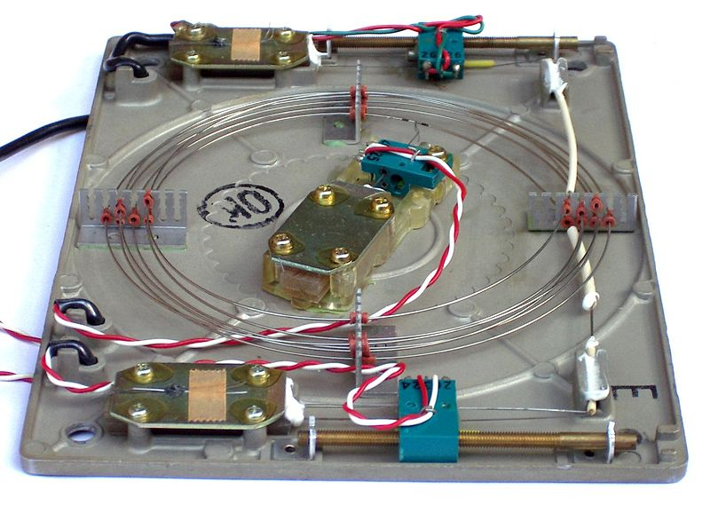
Delay Lines

Slide 5
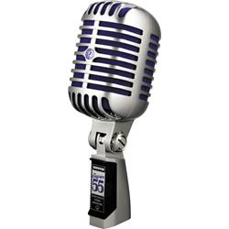

Mercury Delay Lines
0/1

Slide 6
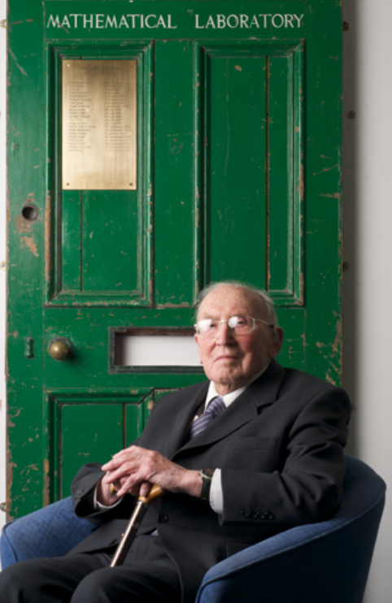
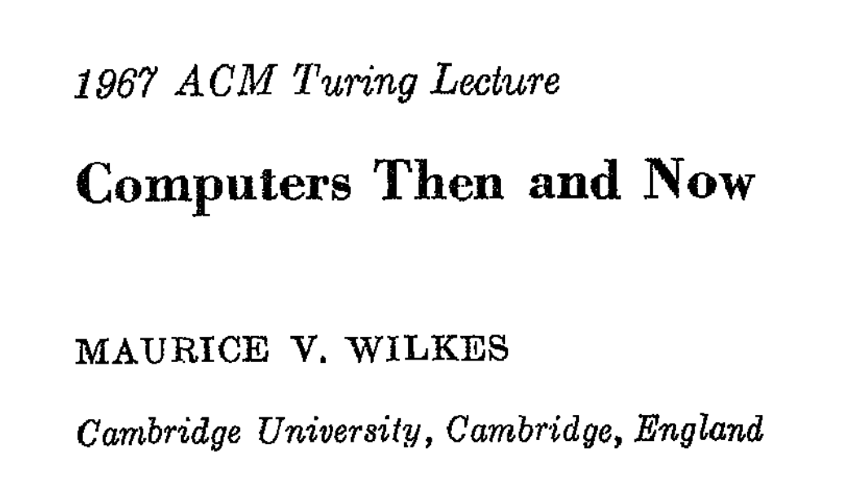

Slide 7
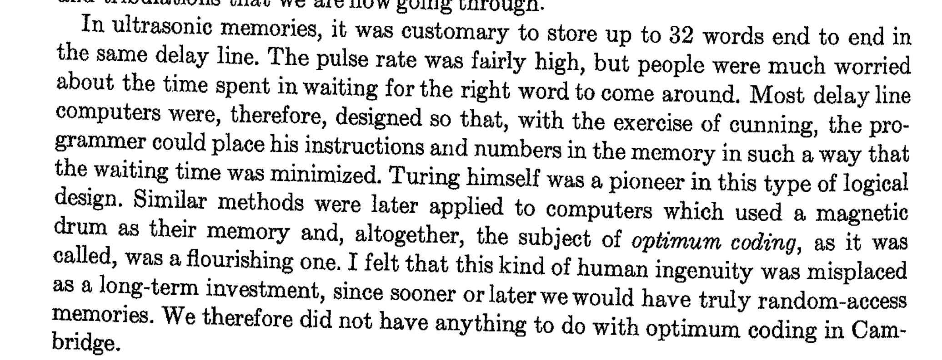
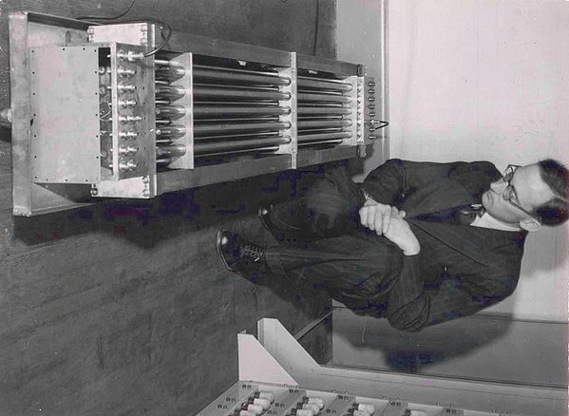

Slide 8

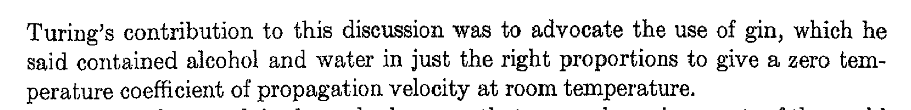
Why Mercury?
Speed of Sound
Air 343 m/s
Mercury 1450 m/s (40° C)
Water 1500 m/s (25° C)
0/1

Slide 9
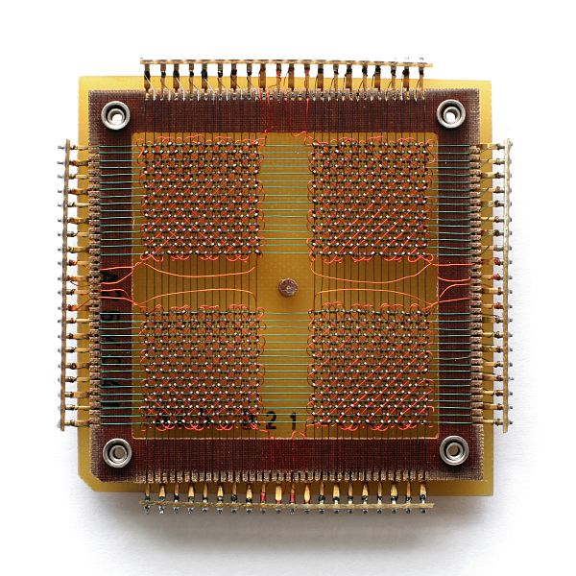
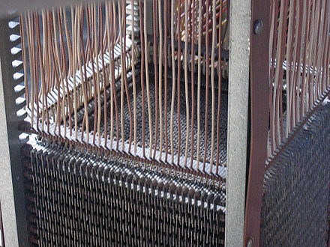
Magnetic Core Memory
MIT Project Whirlwind, 1951
2K 16-bit words
with “no waiting”!

Slide 10
SRAM
NOT
NOT

Slide 11
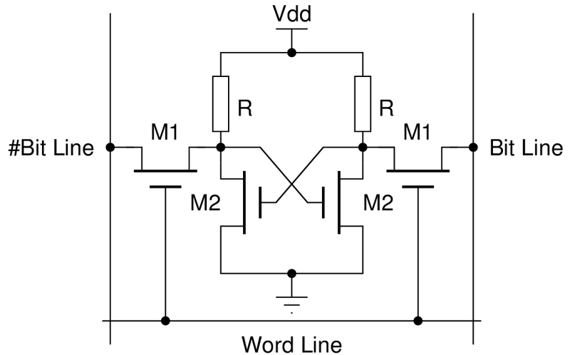
Four-Transistor SRAM Bit

Slide 12
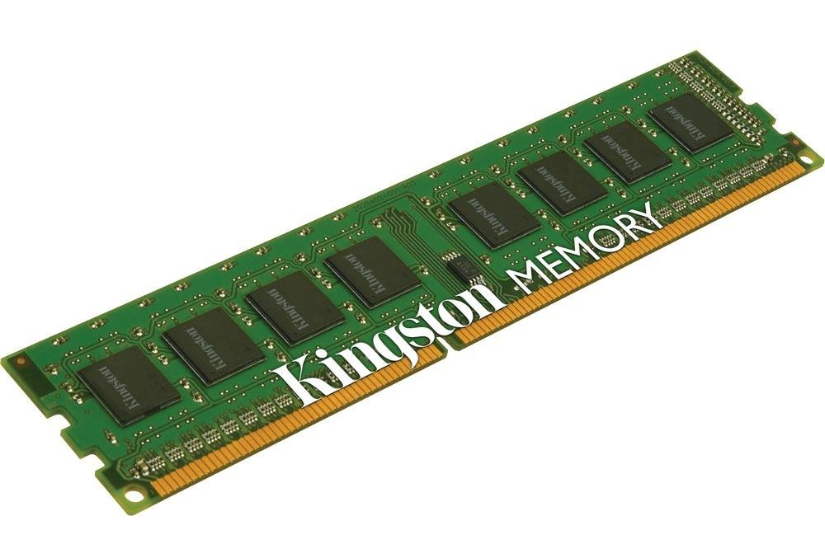
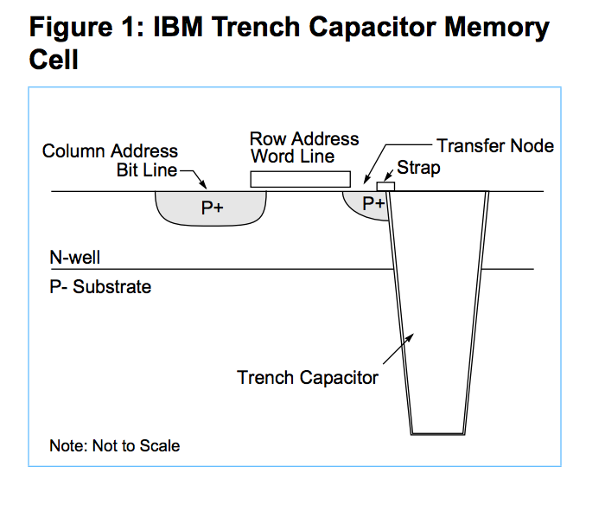
Modern DRAM

Slide 13
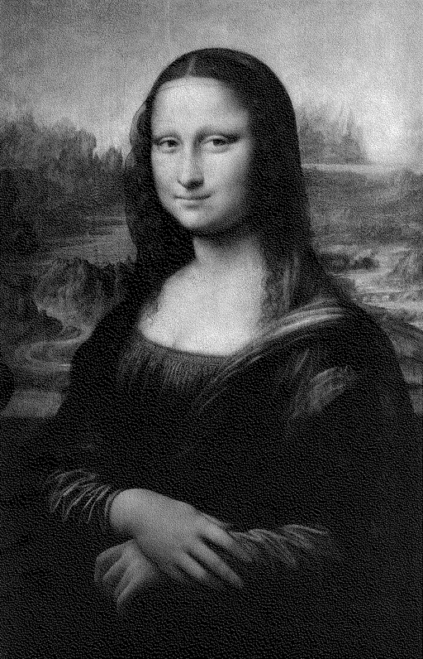
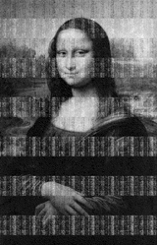

After Turning off Power
5 seconds
30 seconds
5 minutes

Slide 14
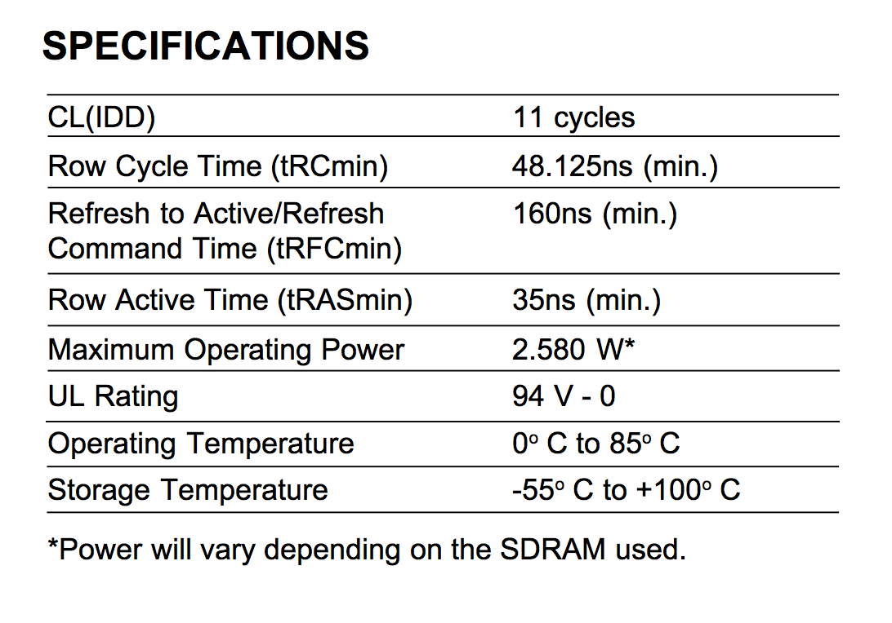
cycles (at 800MHz) to read a particular row = 13.75ns
= 185° F

Slide 15
Storage Systems
Device | Example | Time to Access | Cost per Bit
Mercury (Gin) Delay Line | UNIVAC (1951) | 220,000ns (average) | $ 0.38 (1968) (a bazillion n$)
DRAM | Kingston KVR16N11/4 4GB DDR3 ($40) | 13.75ns | 1.16 n$
UNIVAC 1968 (Core memory): $823,500 for 131 K 16-bit words

Slide 16
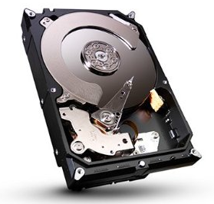
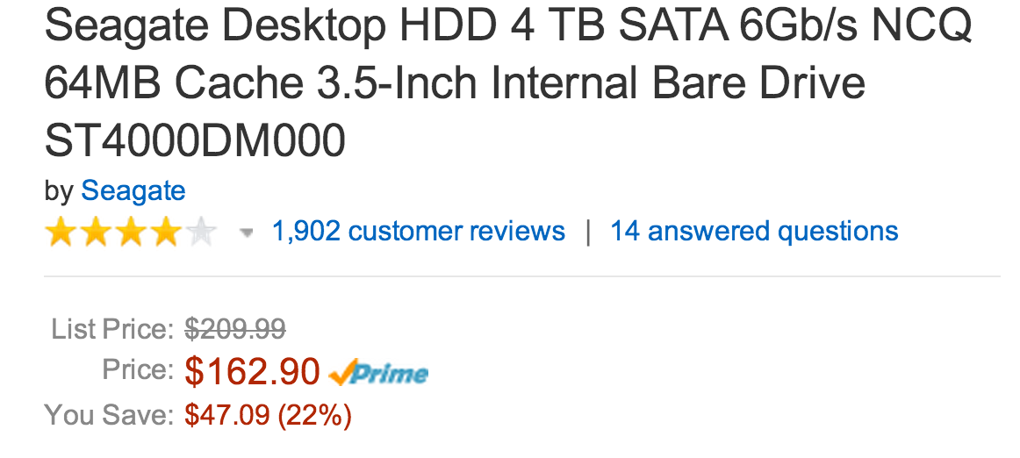
Cheaper, More Persistent Storage

Slide 17
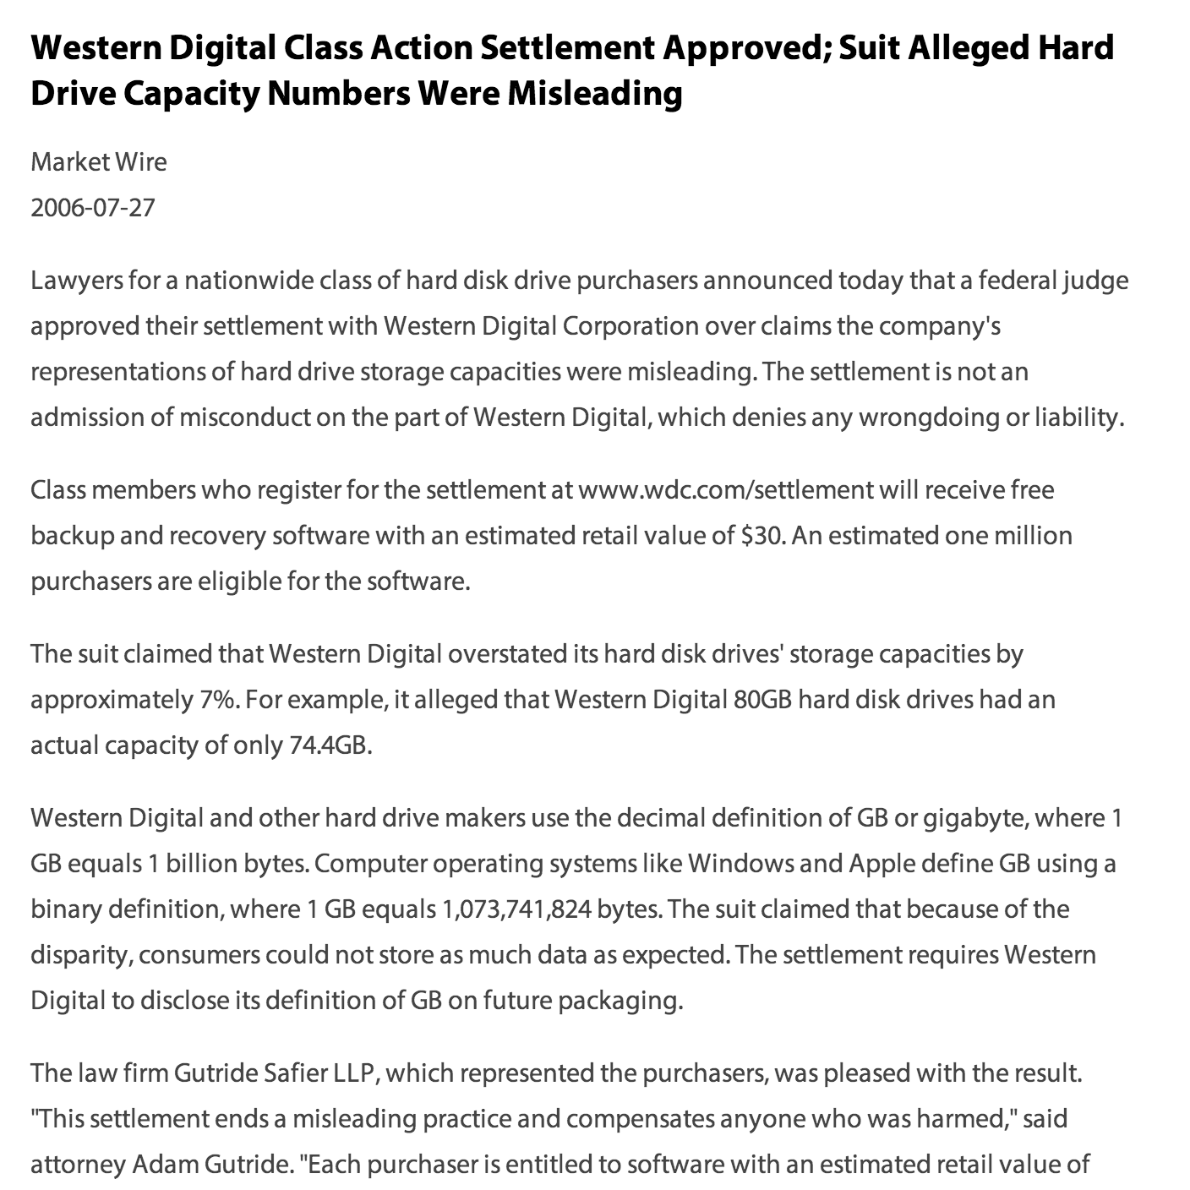
How big is a TB?

Slide 18
Storage Systems
Device | Example | Time to Access | Cost per Bit
Mercury (Gin) Delay Line | UNIVAC (1951) | 220,000ns (average) | $ 0.38 (1968) (a bazillion n$)
DRAM | Kingston KVR16N11/4 4GB DDR3 ($40) | 13.75ns | 1.16 n$
Hard Drive | Seagate Desktop HDD 4 TB SATA 6Gb/s NCQ 64MB | ? | 0.0046 n$

Slide 19
Accessing a Hard Drive
“seek time”
~ 0.1ms
rotate time:
1/5900rpm ~ max 10ms
5900 rpm spindle

Slide 20

Passing the Drop Test

Slide 21
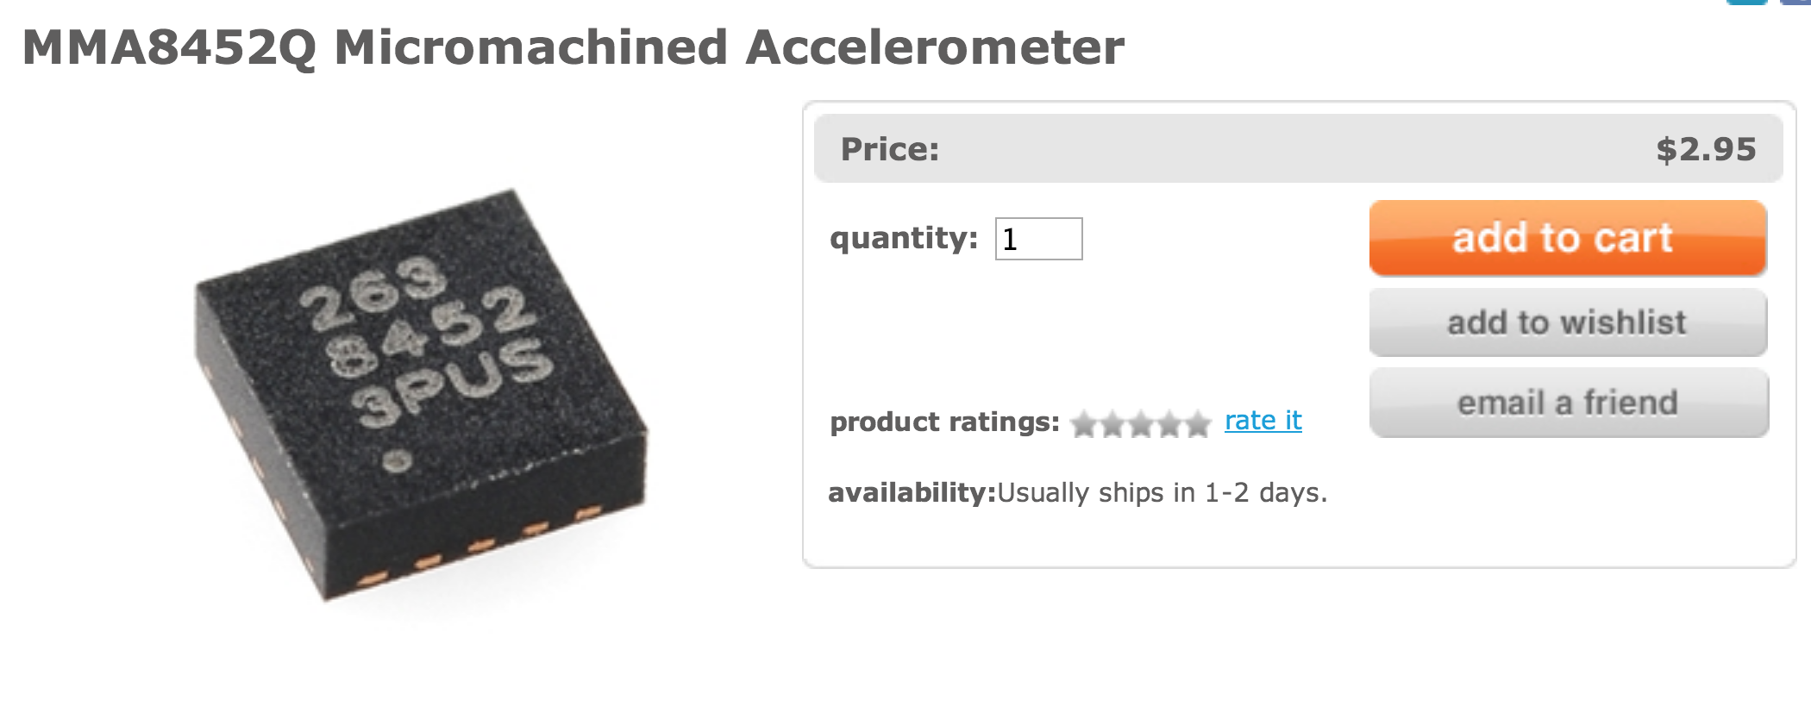
Passing the Drop Test

Slide 22
Storage Systems
Device | Example | Time to Access | Cost per Bit
Mercury (Gin) Delay Line | UNIVAC (1951) | 220,000ns (average) | $ 0.38 (1968) (a bazillion n$)
DRAM | Kingston KVR16N11/4 4GB DDR3 ($40) | 13.75ns | 1.16 n$
Hard Drive | Seagate Desktop HDD 4 TB SATA 6Gb/s NCQ 64MB | 5ms (ave) | 0.0046 n$

Slide 23
Storage Abstractions

Slide 24
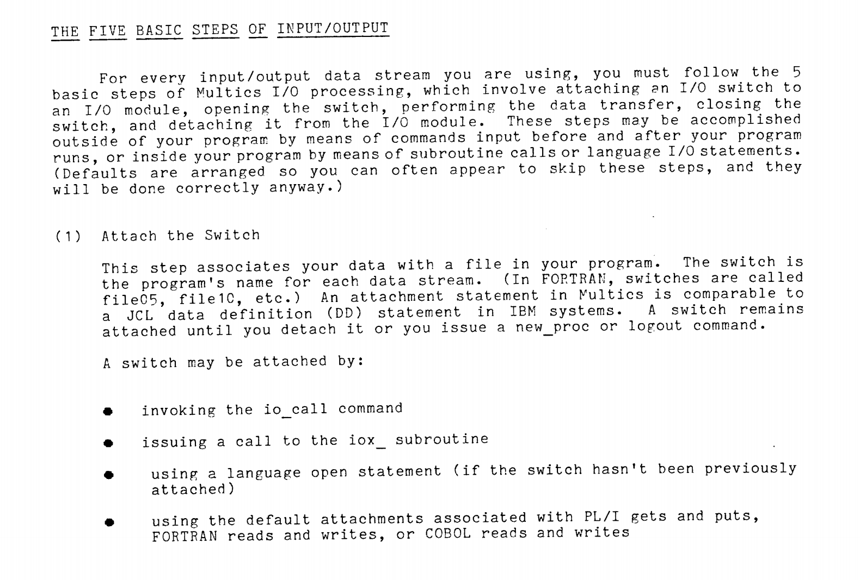

Slide 25
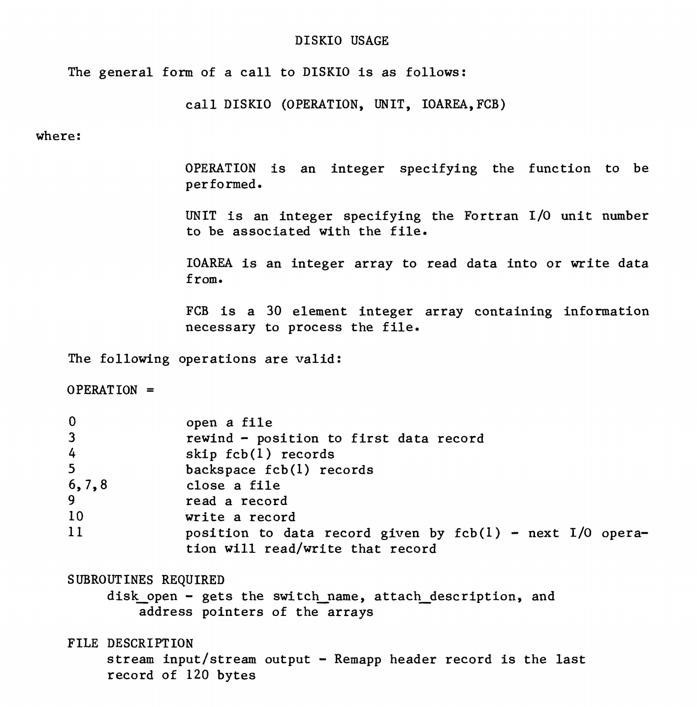
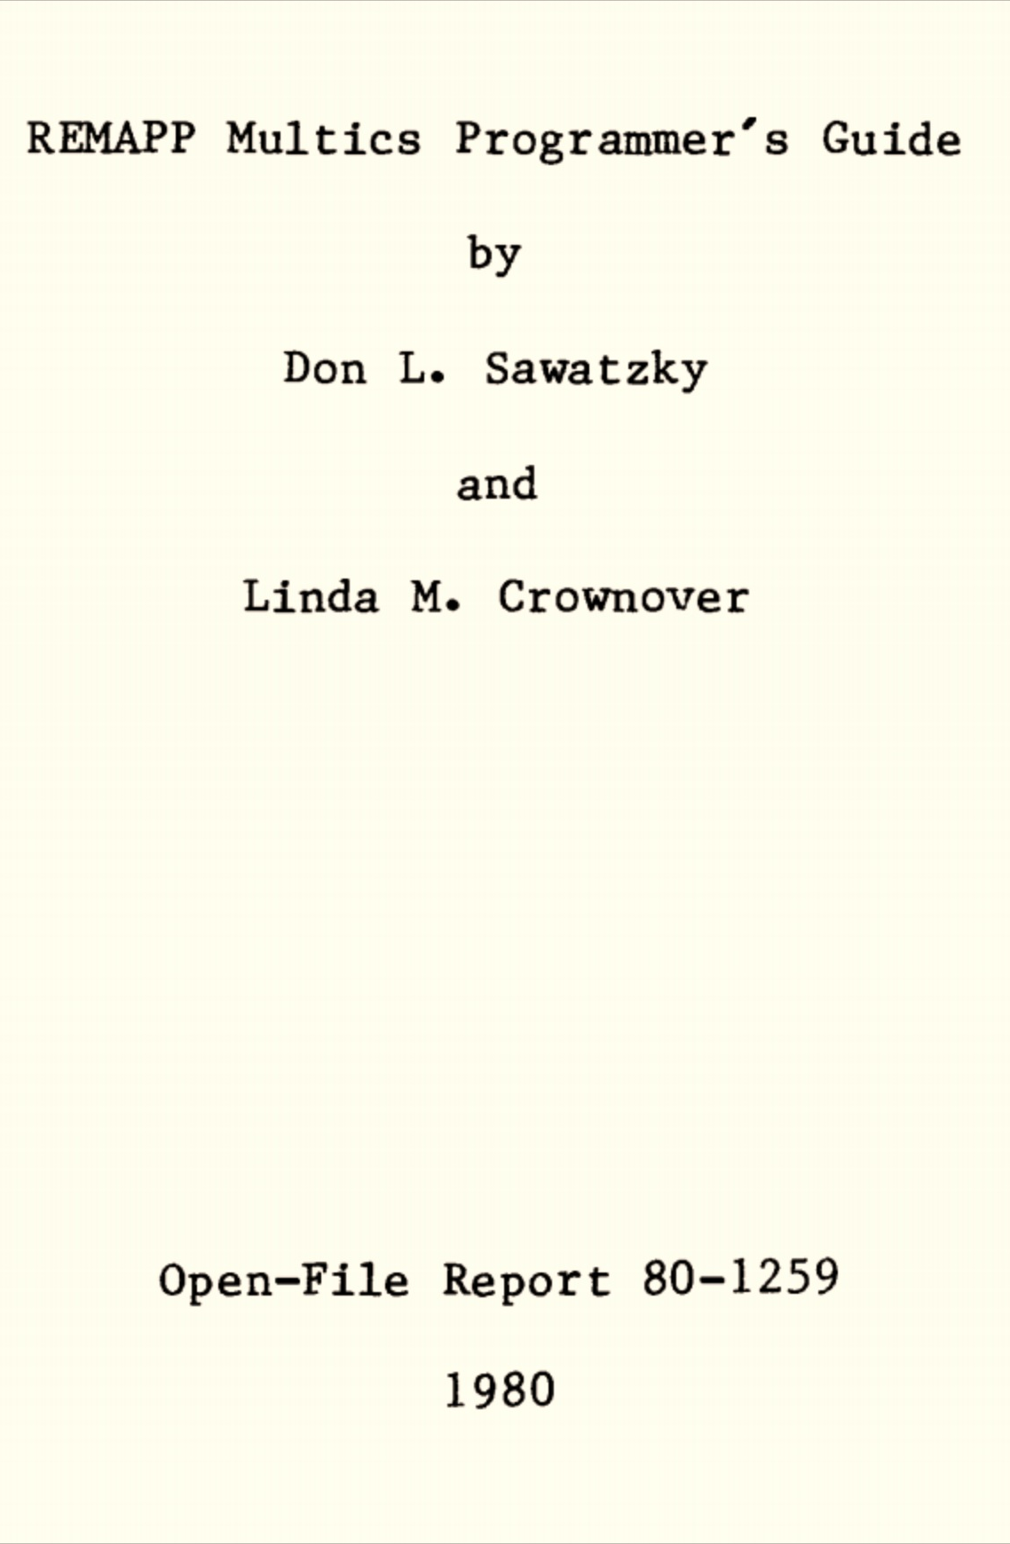

Slide 26
Storage Abstractions
Memory Location
File
Do we really need both?
What about: database, URI?

Slide 27
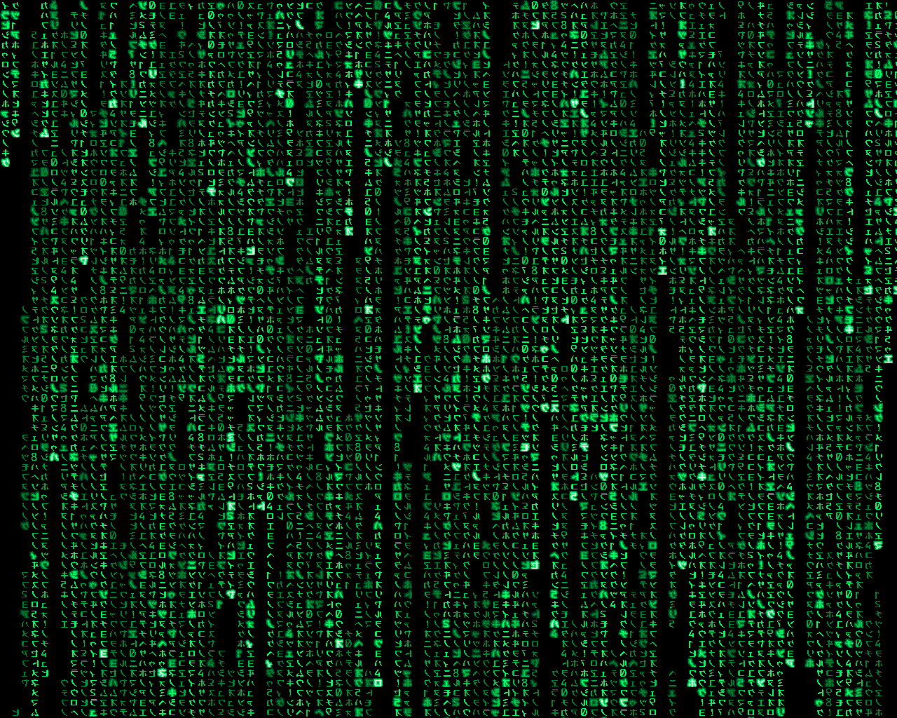
Unix File Abstraction

Slide 28
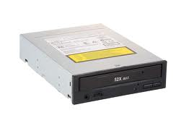

Which are files?
class24.pptx
/Users/dave/OS/classes/
OS-provided random numbers

Slide 29
“Everything is a File”
class24.pptx
/mnt/cdrom
/Users/dave/OS/classes/
OS-provided random numbers
/dev/tty0
/dev/random

Slide 30
inode represents a file
Size of File (bytes)
Device ID
User ID
Group ID
File Mode (permission bits)
Link count (number of hard links to node)
…
Diskmap

Slide 31
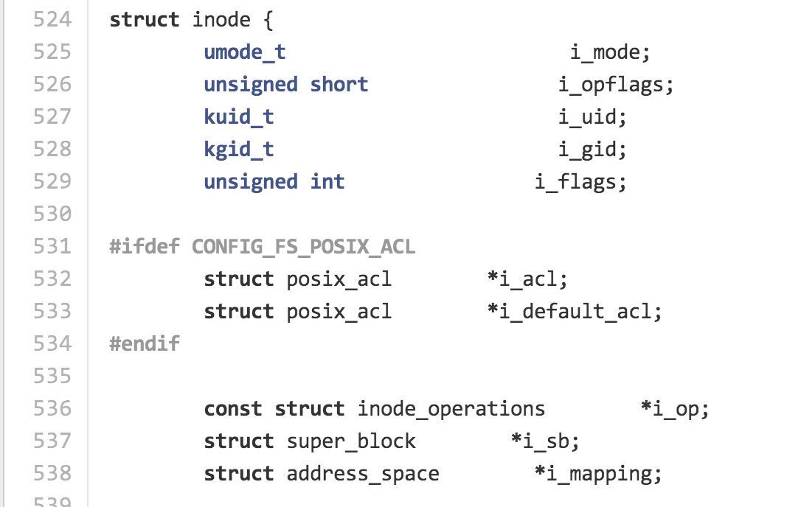
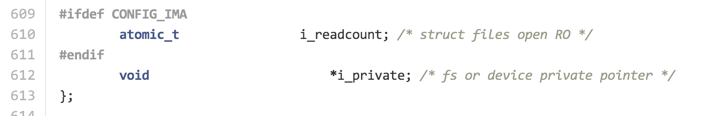
include/linux/fs.h

Slide 32
Size of File (bytes)
Device ID
User ID
Group ID
File Mode (permission bits)
Link count (number of hard links to node)
…
Diskmap
stat
> stat -x class24.pptx
File: "class24.pptx"
Size: 5855495 FileType: Regular File
Mode: (0644/-rw-r--r--) Uid: ( 501/ dave) Gid: ( 20/ staff)
Device: 1,2 Inode: 6706357 Links: 1
Access: Wed Nov 20 15:00:41 2013
Modify: Wed Nov 20 14:23:13 2013
Change: Wed Nov 20 14:23:13 2013

Slide 33
> ln class24.pptx todays-class.pptx
> stat -x class24.pptx
File: "class24.pptx"
Size: 5855495 FileType: Regular File
Mode: (0644/-rw-r--r--) Uid: ( 501/ dave) Gid: ( 20/ staff)
Device: 1,2 Inode: 6706357 Links: 2
Access: ..
> stat -x todays-class.pptx
File: "todays-class.pptx"
Size: 5855495 FileType: Regular File
Mode: (0644/-rw-r--r--) Uid: ( 501/ dave) Gid: ( 20/ staff)
Device: 1,2 Inode: 6706357 Links: 2
> rm class24.pptx
> stat -x class24.pptx
stat: class24.pptx: stat: No such file or directory
> stat -x todays-class.pptx
File: "todays-class.pptx"
Size: 5855495 FileType: Regular File
Mode: (0644/-rw-r--r--) Uid: ( 501/ dave) Gid: ( 20/ staff)
Device: 1,2 Inode: 6706357 Links: 1

Slide 34
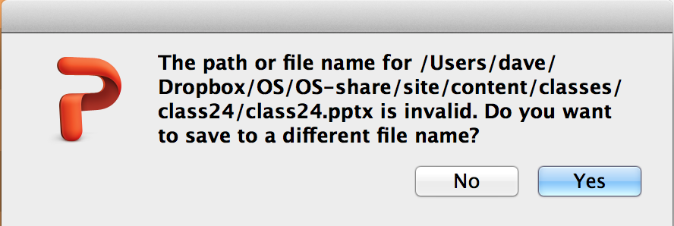
Removing a linked file like this is very confusing for PowerPoint…

Slide 35
Diskmap
(Unix System 5)
Size of File (bytes)
Device ID
User ID
Group ID
File Mode (permission bits)
Link count (number of hard links to node)
…
Diskmap
0
1
2
…
9
10
11
12
Disk Block (1K bytes)
Disk Block (1K bytes)
Disk Block (1K bytes)

Slide 36
Diskmap
(Unix System 5)
Disk Block (1K bytes)
Indirect
Disk Block (1K bytes)
Disk Block (1K bytes)
Disk Block (1K bytes)
0
1
2
…
9
10
11
12
4 bytes for each = 256 pointers
Disk Block (1K bytes)
Disk Block (1K bytes)
Disk Block (1K bytes)

Slide 37
Diskmap
(Unix System 5)
Disk Block (1K bytes)
Indirect
Disk Block (1K bytes)
Disk Block (1K bytes)
Disk Block (1K bytes)
0
1
2
…
9
10
11
12
4 bytes for each = 256 pointers
Indirect
Disk Block (1K bytes)
Double
Indirect
Disk Block
Indirect
Disk Block (1K bytes)
Disk Block (1K bytes)
Disk Block (1K bytes)
Disk Block (1K bytes)

Slide 38
Diskmap
(Unix System 5)
Disk Block (1K bytes)
Indirect
Disk Block (1K bytes)
Disk Block (1K bytes)
Disk Block (1K bytes)
0
1
2
…
9
10
11
12
4 bytes for each = 256 pointers
Indirect
Disk Block (1K bytes)
Double
Indirect
Disk Block
Indirect
Disk Block (1K bytes)
Disk Block (1K bytes)
Disk Block (1K bytes)
Disk Block (1K bytes)
How would you determine if your file system has this structure?

Slide 39
Diskmap
(Unix System 5)
Disk Block (1K bytes)
Indirect
Disk Block (1K bytes)
Disk Block (1K bytes)
Disk Block (1K bytes)
0
1
2
…
9
10
11
12
4 bytes for each = 256 pointers
Indirect
Disk Block (1K bytes)
Double
Indirect
Disk Block
Indirect
Disk Block (1K bytes)
Disk Block (1K bytes)
Disk Block (1K bytes)
Disk Block (1K bytes)
Disk Block (1K bytes)

Slide 40
Directories are Files Too!
Filename | Inode
. | 494211
.. | 494205
.DS_Store | 494212
class0 | 6565946
class1 | 6565826
class10 | 1467012
class11 | 2252968
… | …
class19 | 5649155
class2 | 494218
… | …
ls -ali

Slide 41
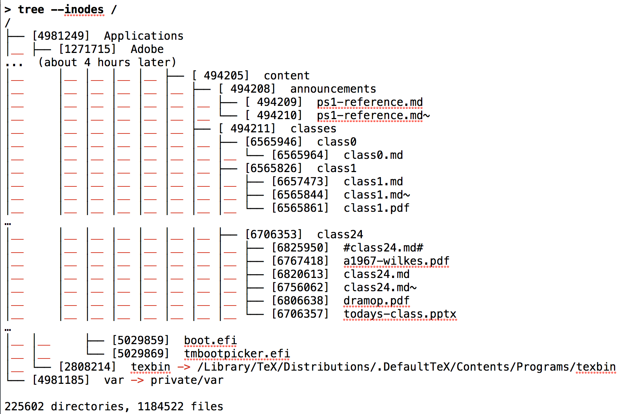
> brew install tree # needed on MacOS X, but builtin to most Unixes

Slide 42
How to create a new file?

Slide 43
Finding a Free Block
Data
I-List (inodes)
Superblock
Boot block
0
1
…
98
99
0
1
…
98
99
List of free disk blocks
Not to scale!

Slide 44
Finding a Free inode
Data
I-List (inodes)
Superblock
Boot block
0 | 0
1 | 1
2 | 0
3 | 0
… | …
Superblock keeps a cache of free inodes
Not to scale!

Slide 45
Modern File Systems

Slide 46
What should a modern file system do that Unix S5FS doesn’t?

Slide 47
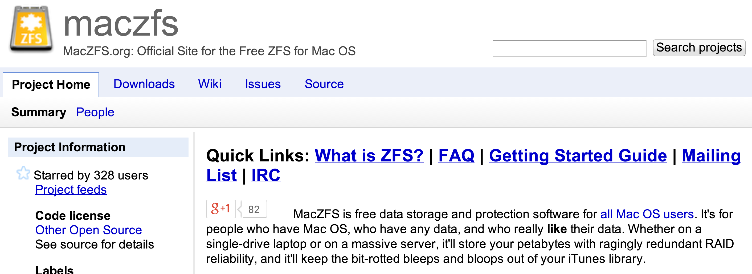
Handling Failures
ZFS
Developed for Solaris, 2005
Now open source:
http://open-zfs.org/
“MacZFS is free data storage and protection software for all Mac OS users. It's for people who have Mac OS, who have any data, and who really like their data. Whether on a single-drive laptop or on a massive server, it'll store your petabytes with ragingly redundant RAID reliability, and it'll keep the bit-rotted bleeps and bloops out of your iTunes library.”

Slide 48
Block Checksums
Block | Checksum (SHA-256)
0 | 40a3dc…
1 | 2c5829d…
2 | 955d253…
… | …
0
1
2
…
9
10
11
12
Disk Block (1K bytes)
ZFS
How do you check the checksums?
S5FS

Slide 49
Hashing the Hashes
Hash(B1)
Hash(B2)
Hash(B2)
Hash(B2)
Block 1
Block 2
Block 3
Block 4

Slide 50

Merkle Tree
Ralph Merkle
Hash(B1)
Hash(B2)
Hash(B2)
Hash(B2)
Block 1
Block 2
Block 3
Block 4

Slide 51
Recovery
Copy 1
One Copy
Copy 2
Keep 2 copies of every block: if checksum fails for first copy read, try reading second copy.
copies = 2

Slide 52
Copy 1
For the truly paranoid…
One Copy
Copy 2
Copy 3
copies = 3

Slide 53
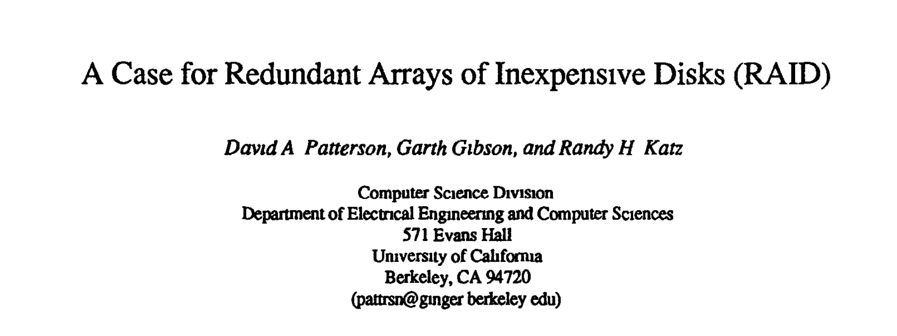


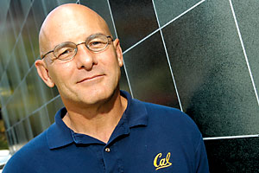

RAID
For the fairly paranoid but cheap…
Redundant Arrays of Inexpensive Disks
ACM SIGMOD 1988
whitehouse.gov

Slide 54
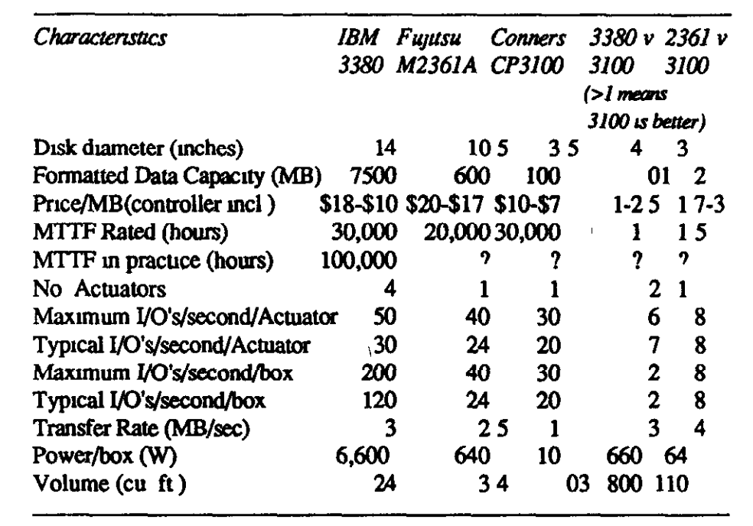
Case for RAID

Slide 55
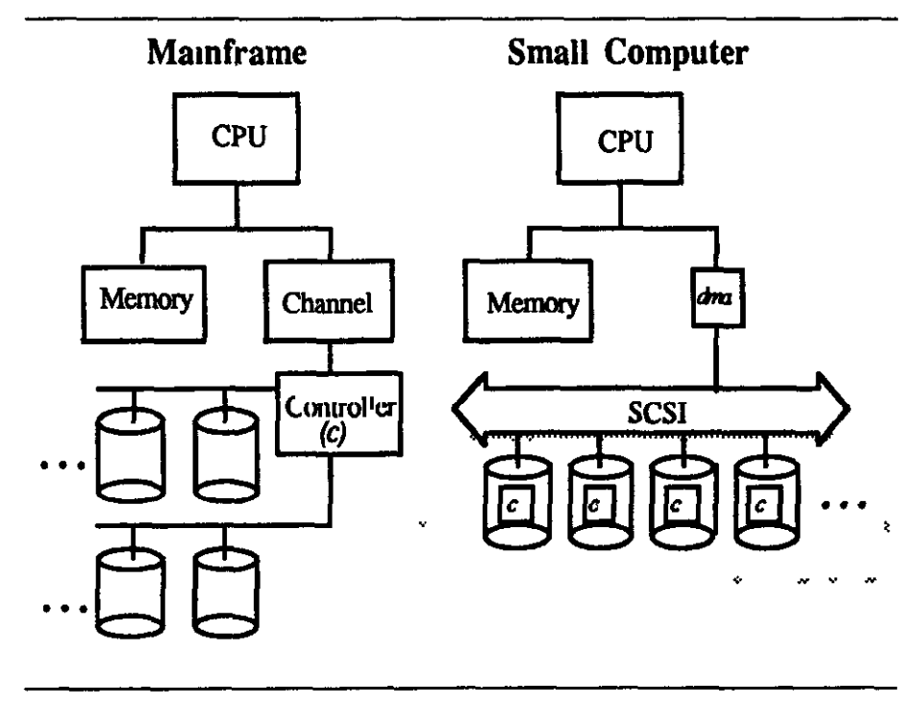

Slide 56
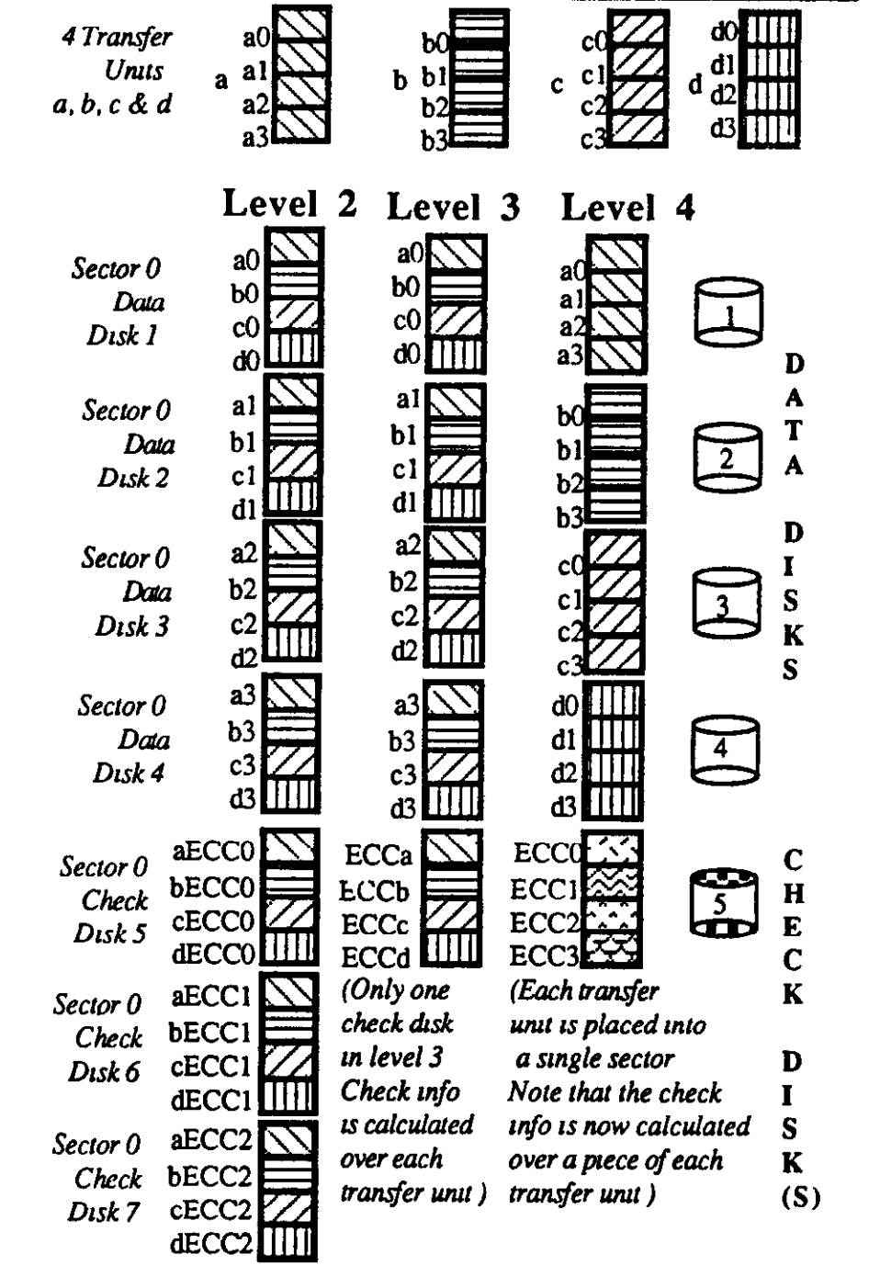
Redundancy

Slide 57
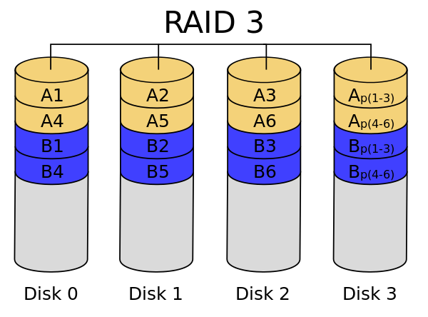

Slide 58
Improving Performance
Cache (64MB DRAM)
Adaptive Replacement Cache

Slide 59
Adaptive Replacement Cache
Accessed Again
Blocks in Cache
T1: Recent Cache Entries
T2: Frequently-Used Blocks
Size of T1 adapts
“Ghost” Entries
B1: Evicted from T1 (LRU)
B2: Evicted from T2 (LRU)
How should relative size of T1 and T2 be adjusted?

Slide 60
Adaptive Replacement Cache
Accessed Again
Blocks in Cache
T1: Recent Cache Entries
T2: Frequently-Used Blocks
Size of T1 adapts
“Ghost” Entries
B1: Evicted from T1 (LRU)
B2: Evicted from T2 (LRU)
Hit in B1: should increase size of T1, drop entry from T2 to B2
Hit in B2: should increase size of T2, drop entry from T1 to B1

Slide 61
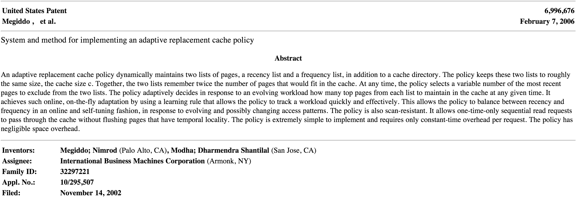
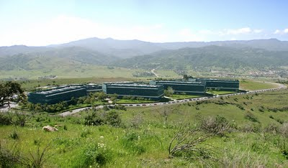
IBM Almaden Research Center

Slide 62
Do you actually have a disk like this on your main computing device?
Cache (64MB DRAM)

Slide 63
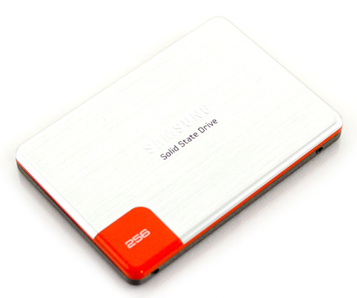
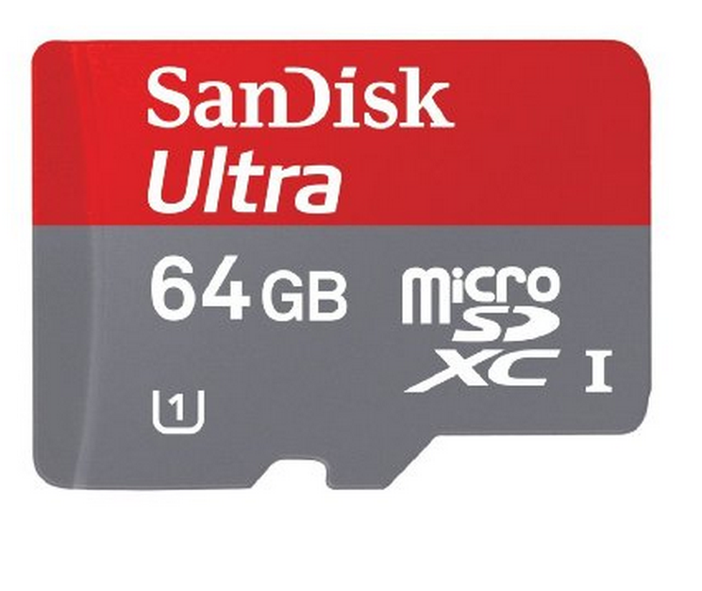

Flash Memory
Solid State Drive

Slide 64
Storage Systems
Device | Example | Time to Access | Cost per Bit
Mercury (Gin) Delay Line | UNIVAC (1951) | 220,000ns (average) | $ 0.38 (1968) (a bazillion n$)
DRAM | Kingston KVR16N11/4 4GB DDR3 ($40) | 13.75ns | 1.16 n$
Hard Drive | Seagate Desktop HDD 4 TB SATA 6Gb/s NCQ 64MB | 5,000,000ns | 0.0046 n$
SSD | Samsung 500GB ($300) | ? | 0.075 n$

Slide 65
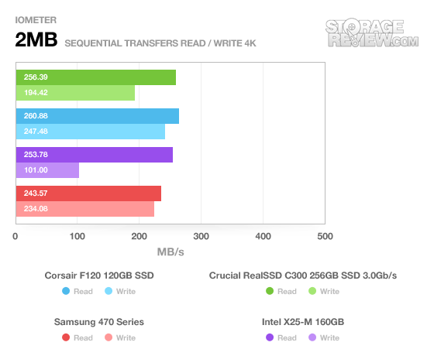
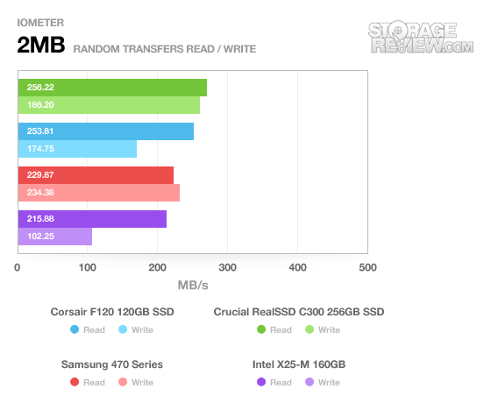

Slide 66
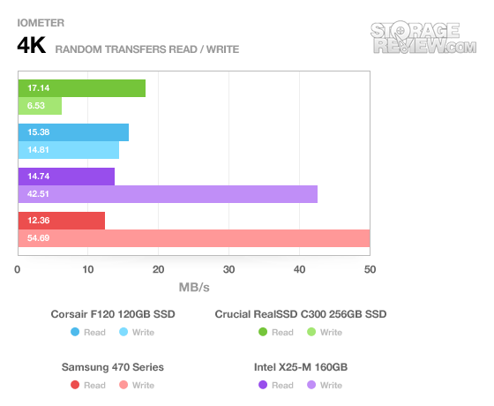

Slide 67
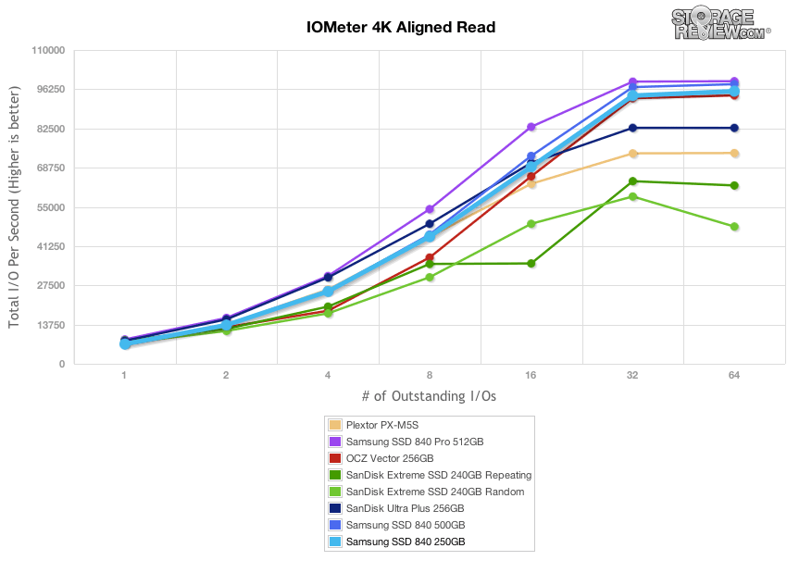

Slide 68
Storage Systems
Device | Example | Time to Access | Cost per Bit
Mercury (Gin) Delay Line | UNIVAC (1951) | 220,000ns (average) | $ 0.38 (1968) (a bazillion n$)
DRAM | Kingston KVR16N11/4 4GB DDR3 ($40) | 13.75ns | 1.16 n$
SSD | Samsung 500GB ($300) | ~10,000 ns (for random read) | 0.075 n$
Disk Drive | Seagate Desktop HDD 4 TB SATA 6Gb/s NCQ 64MB | 5,000,000ns | 0.0046 n$
Modern Hard Drive

Slide 69
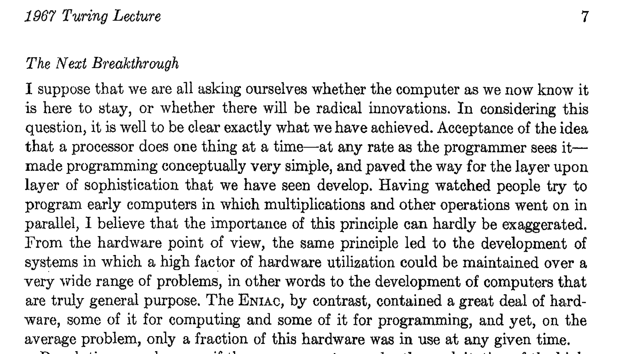
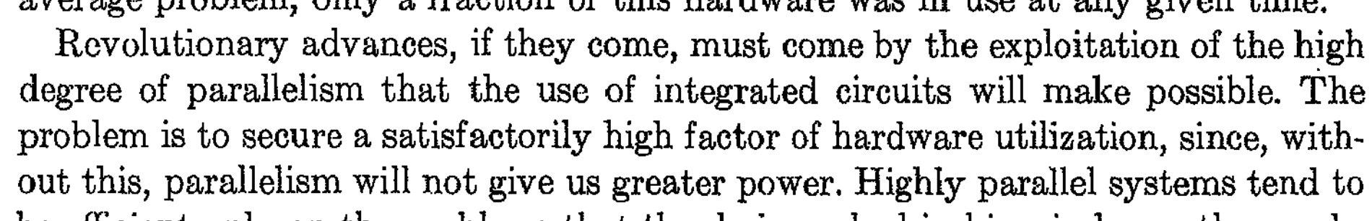
Charge
Storage systems should be designed around hardware capabilities and workload
  Today’s OSes mostly use filesystems designed around 1990s disks and 1960s workloads!
  But, with lots of clever hacks to make them work okay on today’s hardware and workloads
More from Wilkes 1967:

