Slide 1
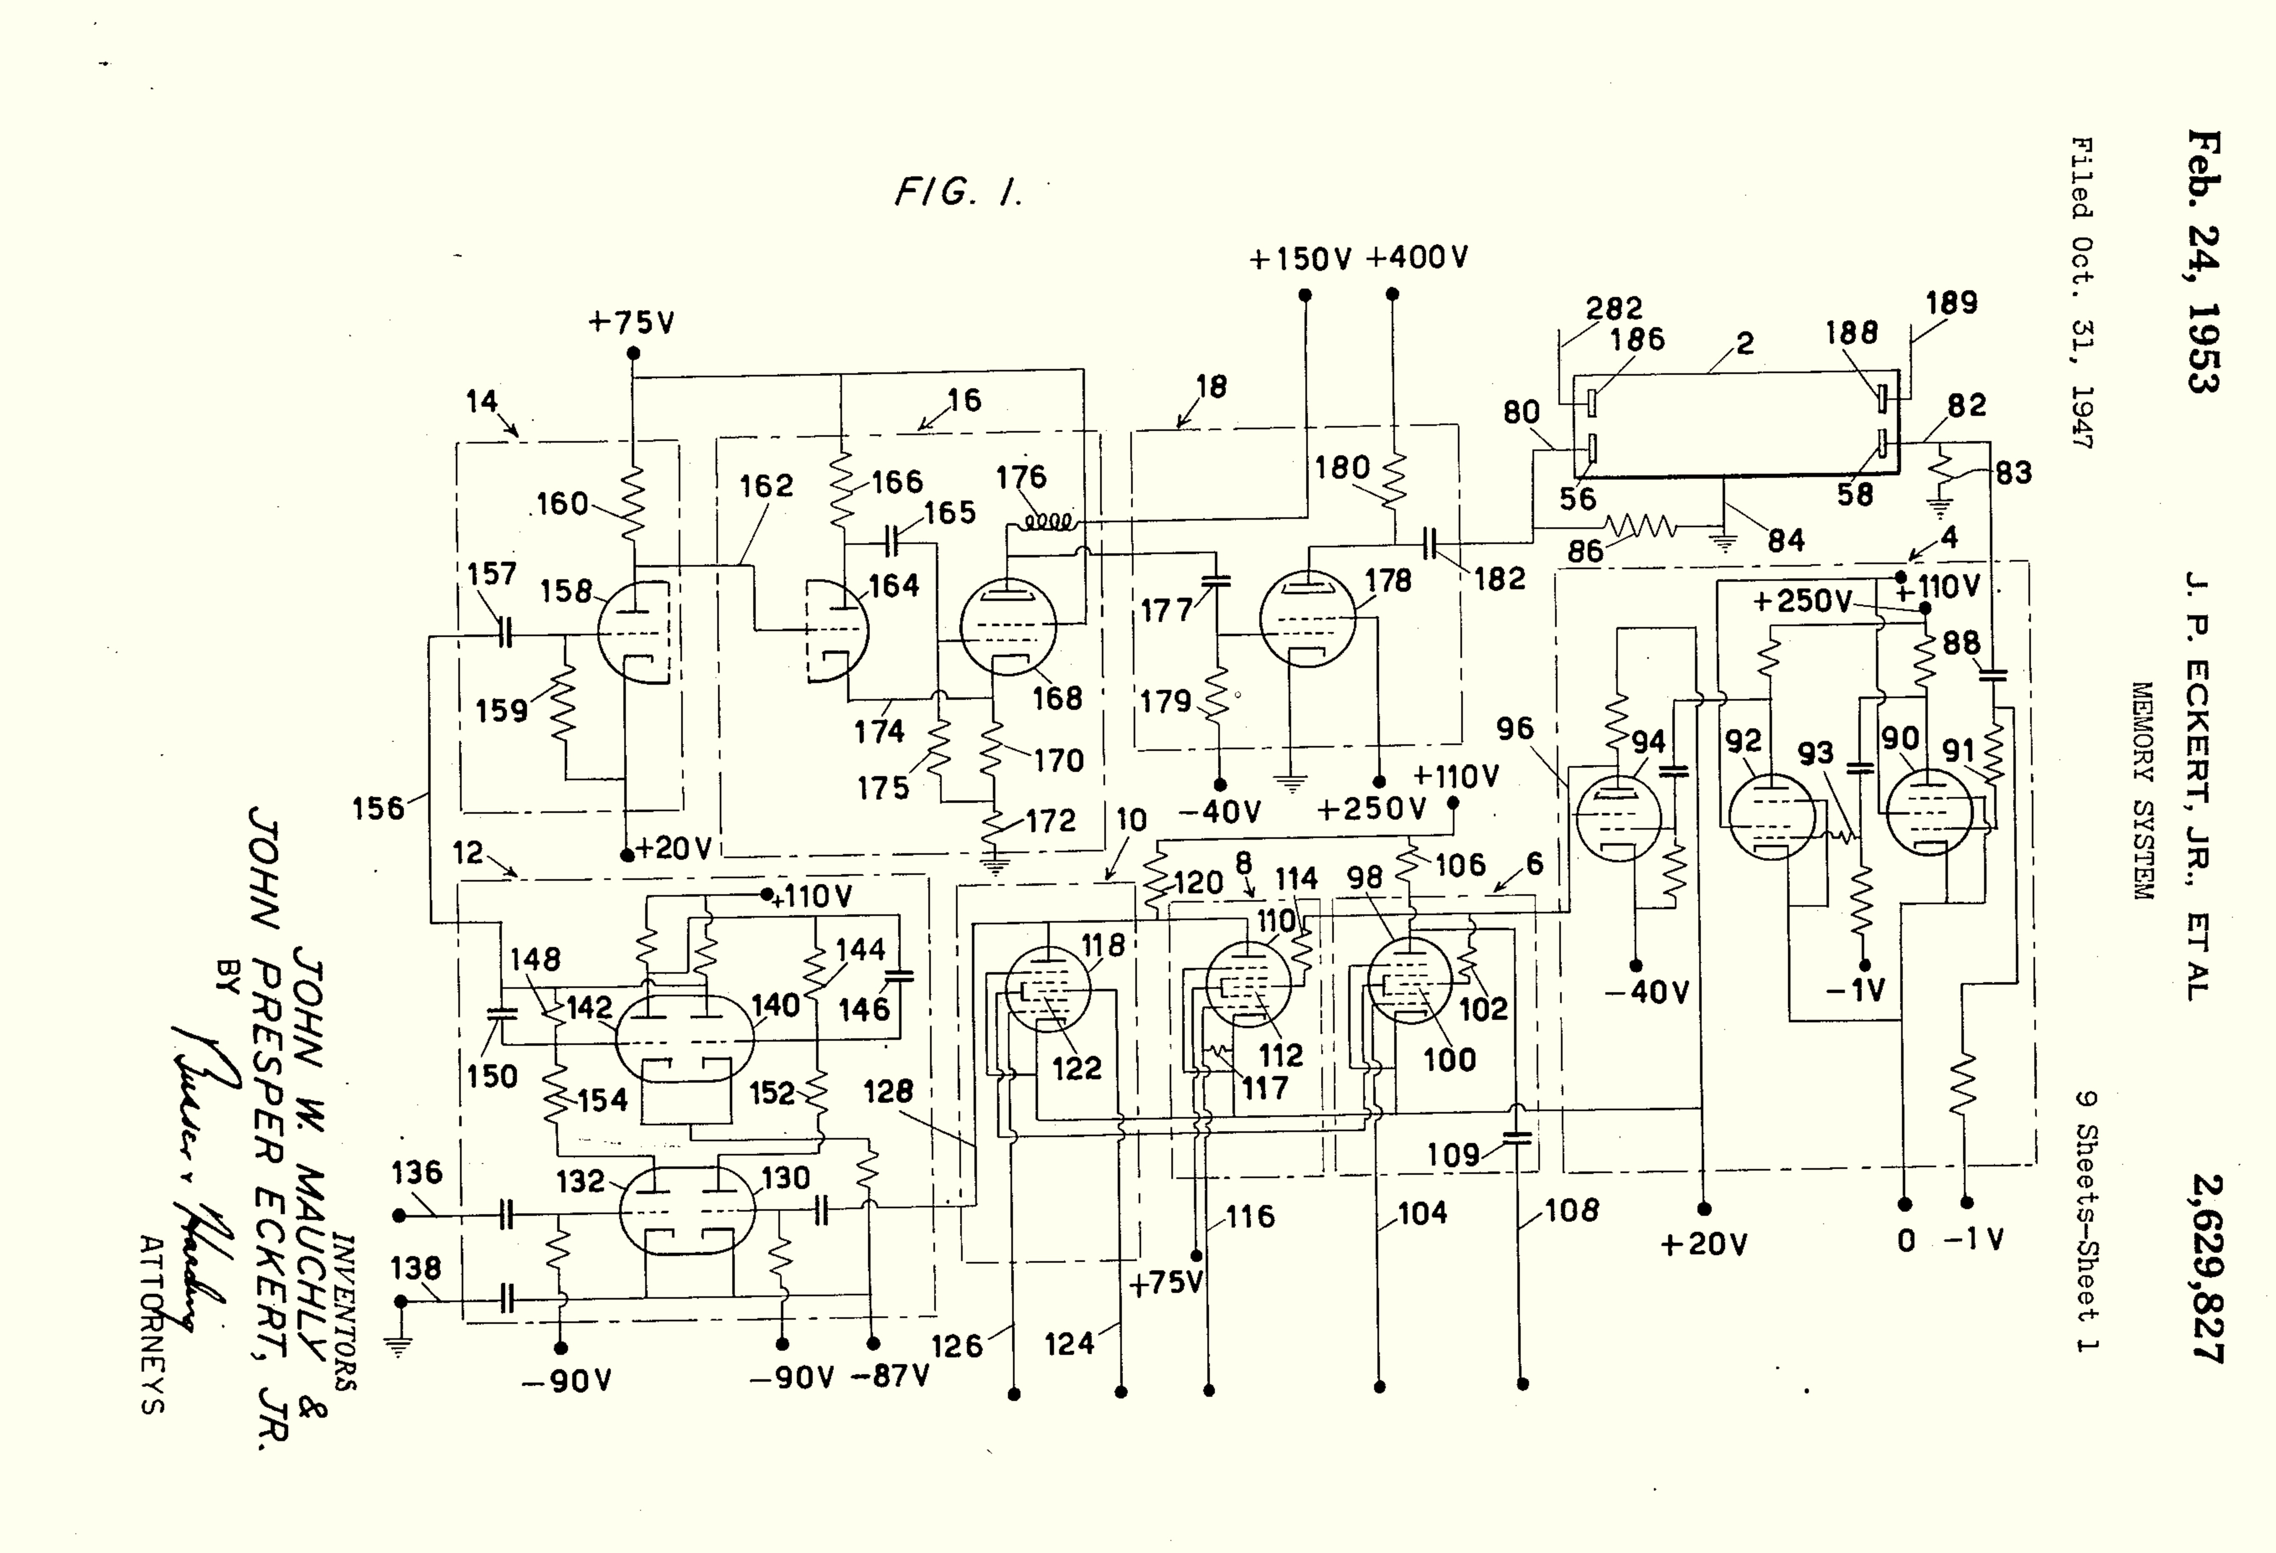
Class 24:
Storage
cs4414 Fall 2013
University of Virginia
David Evans

Slide 2
Why is storage complicated?

Slide 3
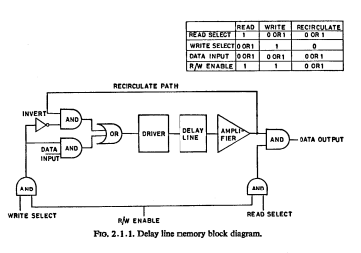
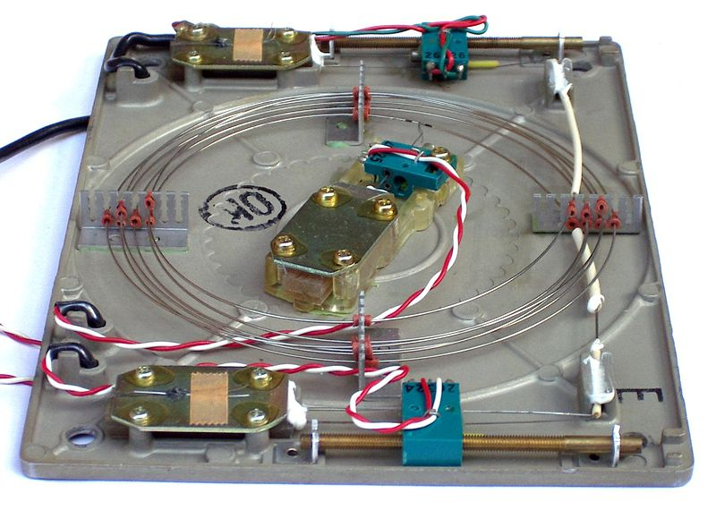
Delay Lines

Slide 4
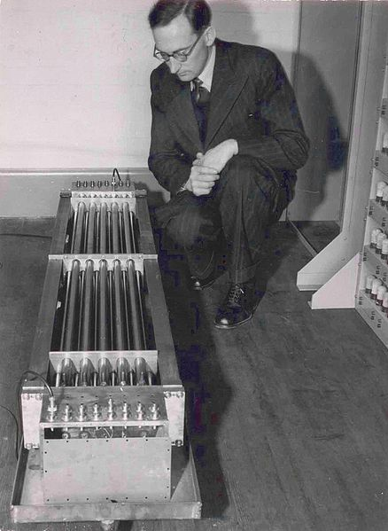
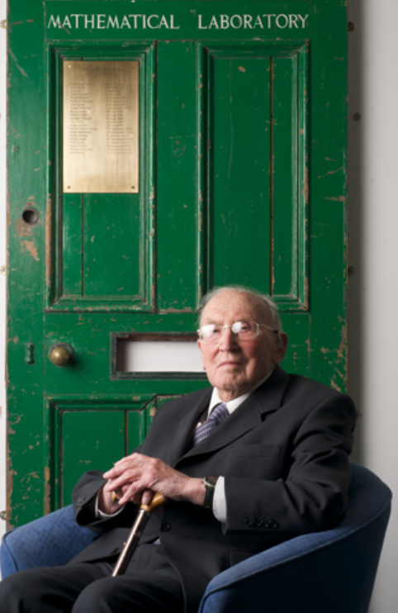
I do not imagine that many of the Turing lecturers who will follow me will be people who were acquainted with Alan Turing. … Although a mathematician, Turing took quite an interest in the engineering side of computer design… Turing’s contribution to this discussion was to advocate the use of gin, which he said contained alcohol and water in just the right proportions …
Sir Maurice Wilkes (1913-2010), Computers Then and Now
(1967 Turing Award Lecture)
flickr: rolandeva

Slide 5
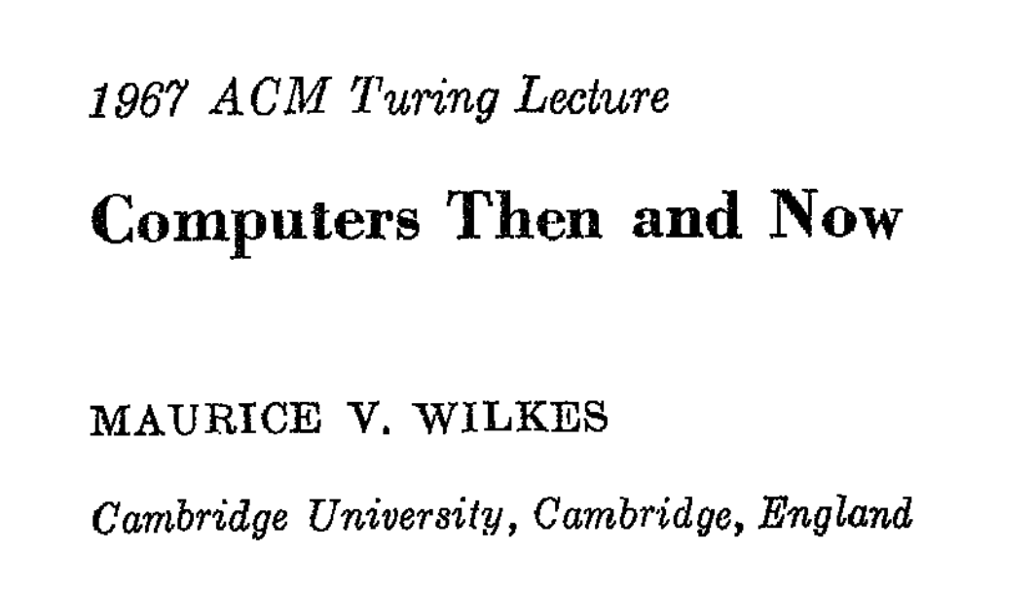
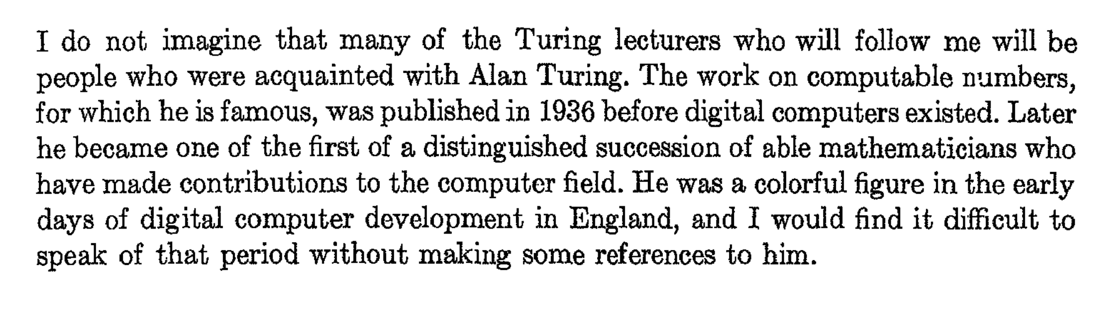

Slide 6
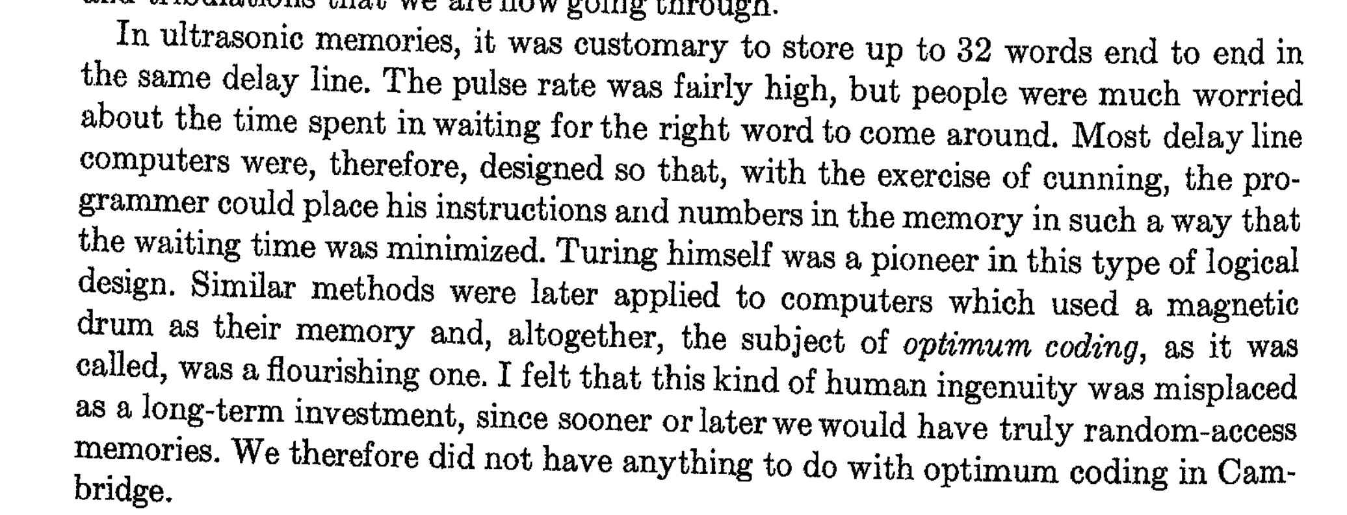

Slide 7
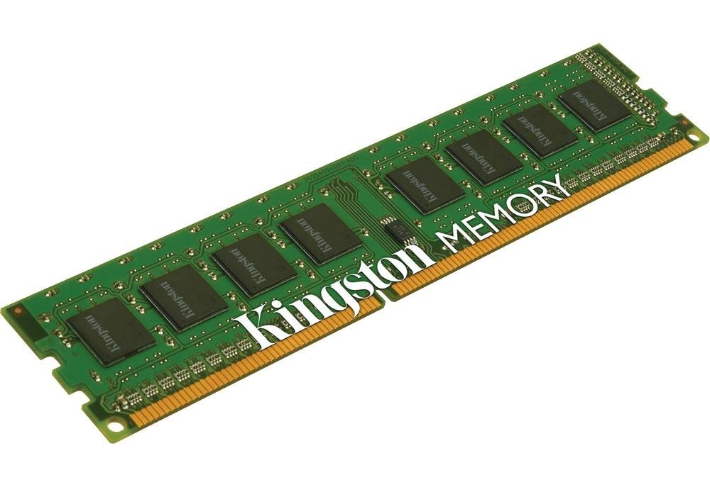
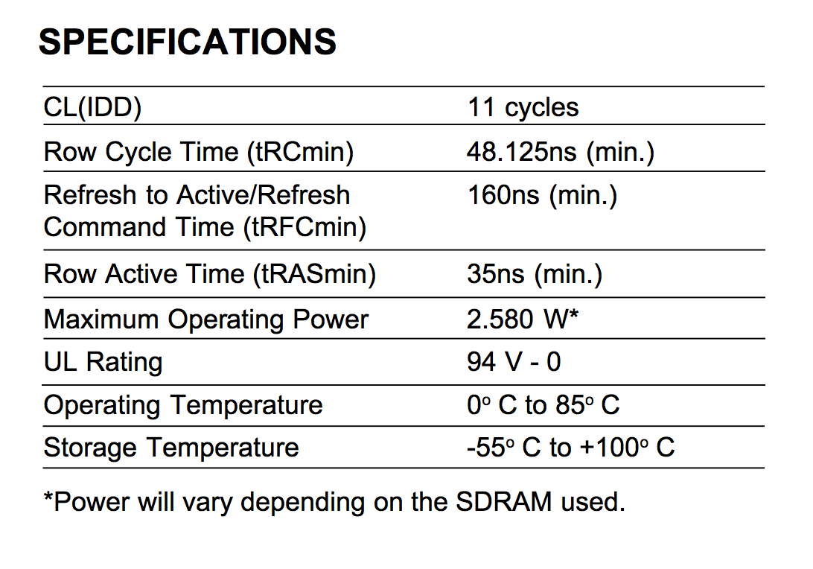
cycles (at 800MHz) to read a particular row = 13.75ns
= 185° F

Slide 8
Storage Systems
Device | Example | Time to Access | Power Consumption | Cost per Bit
DRAM | Kingston KVR16N11/4 4GB DDR3 ($40) | 13.75ns

Slide 9
Storage Abstractions
Memory Location
File
Do we really need both?
What about: database, URI?

Slide 10
Storage “Abstractions”
File abstract: array of bytes
can be accessed arbitrarily
live forever
Before files:
application programs needed to worry about records, block sizes, etc.
Physical disk: collection of sectors, each is fixed size (512 bytes)

Slide 11
Storage Abstractions
Memory Location
File
Do we really need both?
What about: database, URI?

