Slide 2
The Real Golden Rule?
Why do fields like astrophysics, medicine, biology and computer science have “endless golden ages”, but fields like
  music (1775-1825)
  rock n’ roll (1962-1973)*
  philosophy (400BC-350BC?)
  art (1875-1925?)
  soccer (1950-1966)
  baseball (1925-1950?)
  movies (1920-1940?)
  have short golden ages?
* or whatever was popular when you were 16.

Slide 3
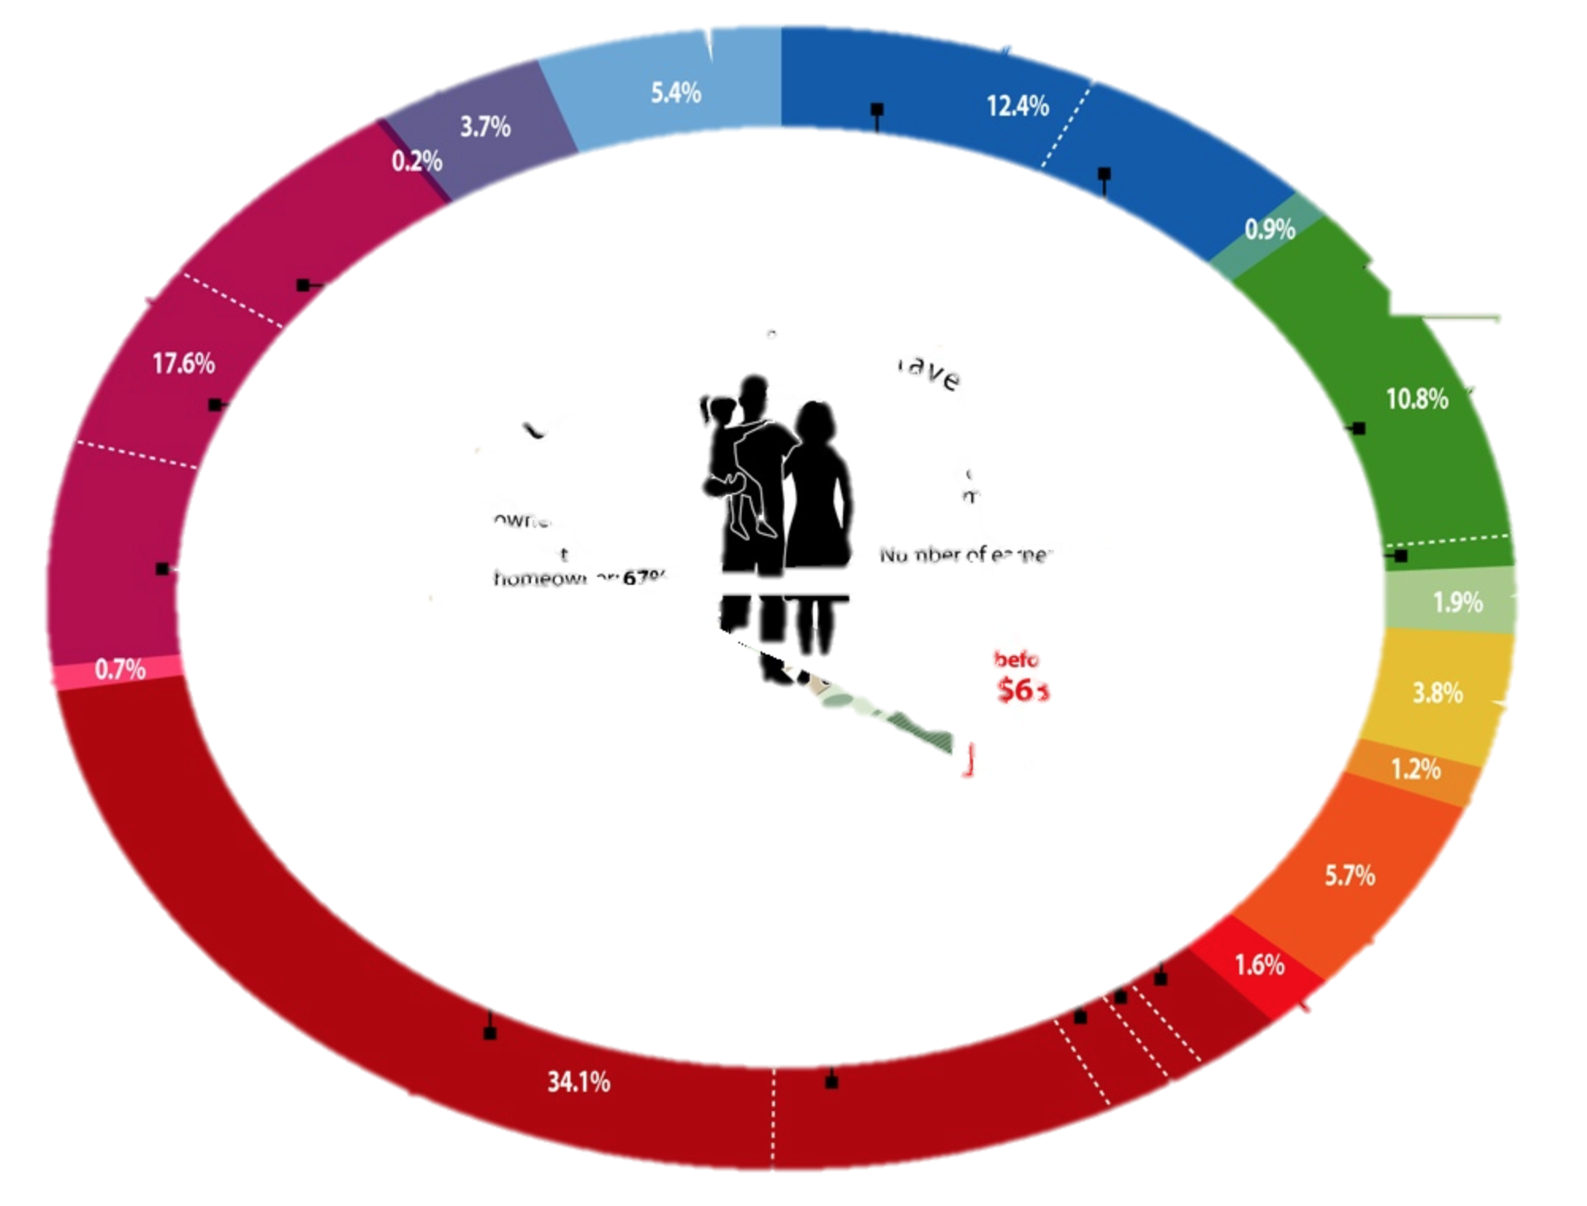
U.S Consumer Spending (consumer unit ~ household)
Average Annual Expenditures: $49.6K (pre-tax income: $63K)
housing

Slide 4
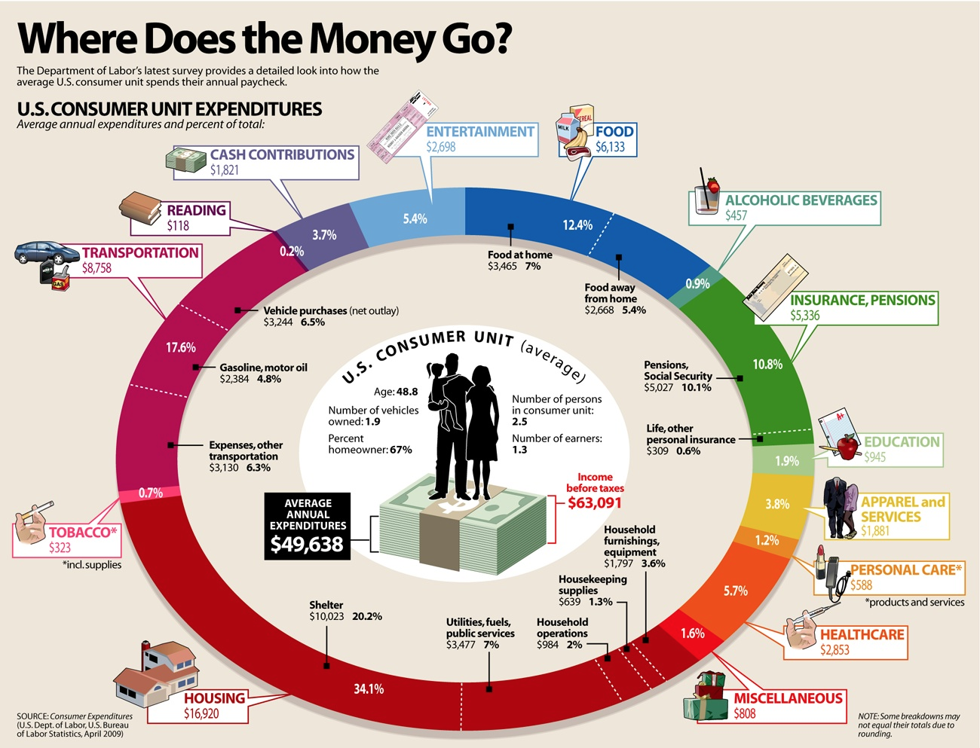

Slide 5
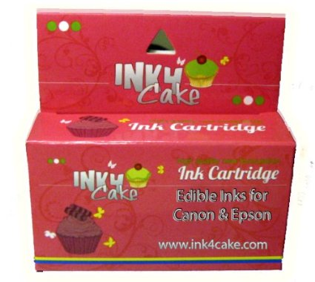
Software Fabrication

Slide 6
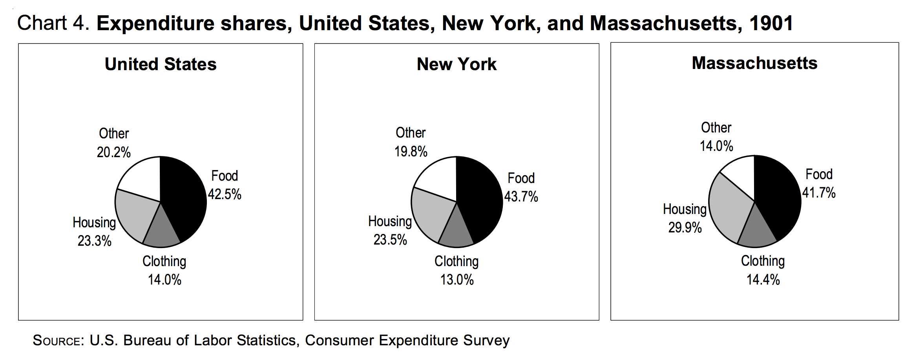
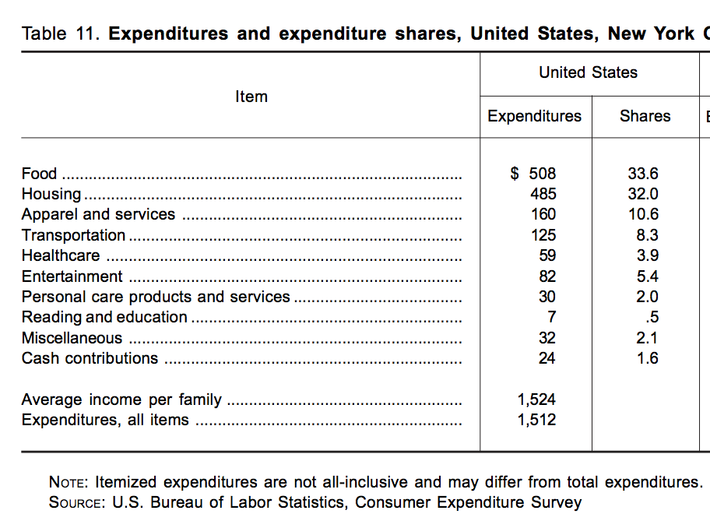
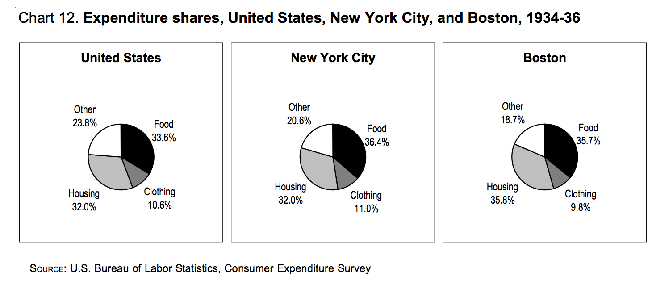

Slide 7
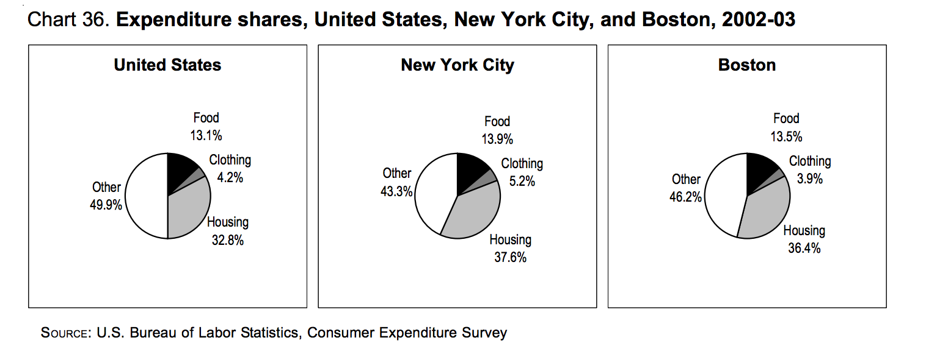

Slide 8
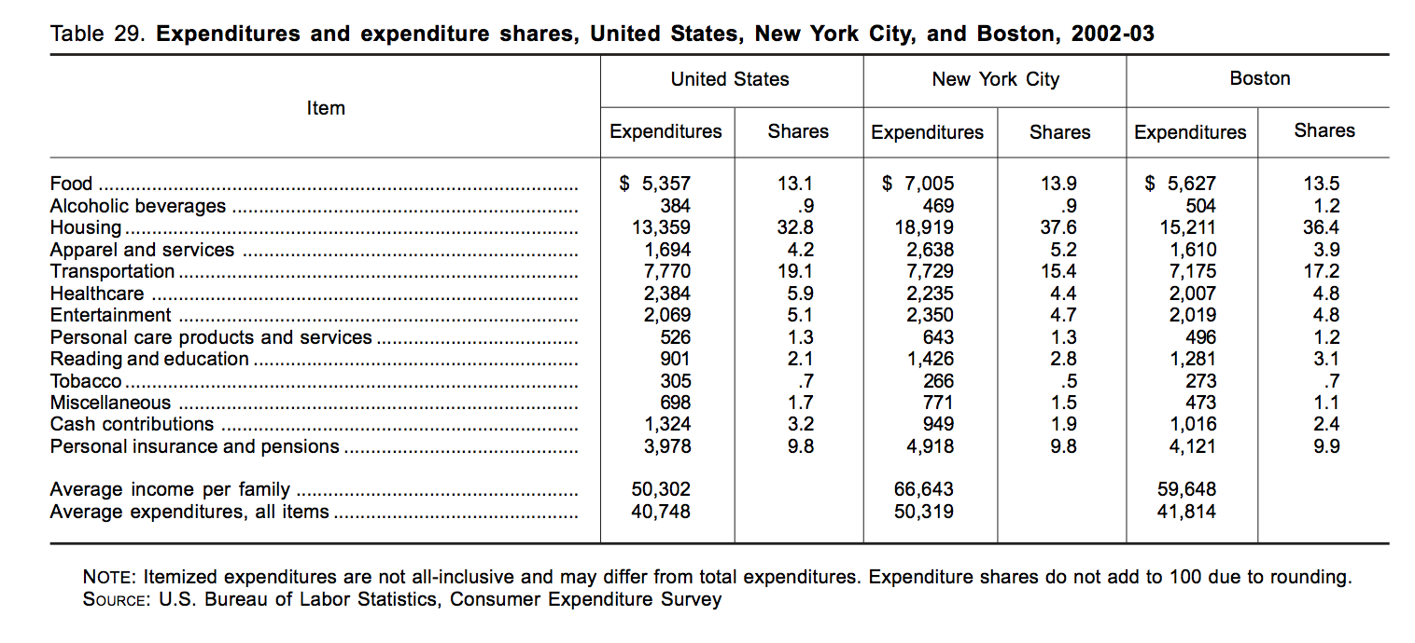
http://www.bls.gov/opub/uscs/report991.pdf

Slide 9
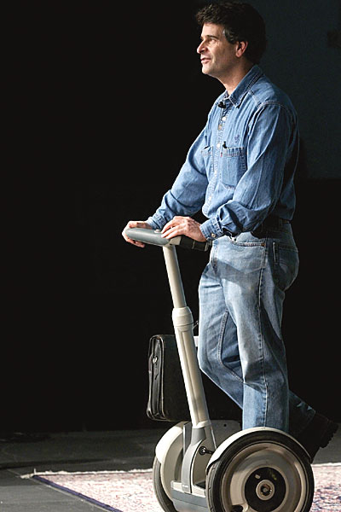
ACM1: Beyond Cyberspace (2001)
Neil de Grasse Tyson: "Awash in Data, Awash in Discoveries: Defining the Golden Age of Science“
Alan Kay: "The Computer Revolution Hasn't Happened Yet" (Vice President and Disney Fellow, Walt Disney Imagineering)
Dean Kamen: "Engineering the Future Depends on Future Engineers" (President and Owner, DEKA Research & Development Corporation and Founder of FIRST)
Rice Hall Dedication Speaker!
Friday, Nov 18, 3pm: “The Future Belongs to the Innovators”

Slide 10
Simulating the Universe
Work scales linearly with volume of simulation: scales cubically with scale
Θ(n³)
When we double the scale of the simulation, the work octuples! (Just like oceanography octopi simulations)

Slide 11
Orders of Growth
simulating
universe

Slide 12
Orders of Growth
simulating
universe

Slide 13
Orders of Growth
factors
2^{n}
simulating
universe

Slide 14
Endless/Short Golden Ages
Endless golden age: at any point in history, the amount known is twice what was known 15 years ago
  Continuous exponential growth: Θ(k^{n})
    k is some constant (e.g., 1.04), n is number of years
Short golden age: knowledge doubles during a short, “golden” period, but only improves linearly most of the time
  Mostly linear growth: Θ(n)
    n is number of years

Slide 15
Goal-den age
Average Goals per Game, FIFA World Cups
Changed goalkeeper
passback rule

Slide 16
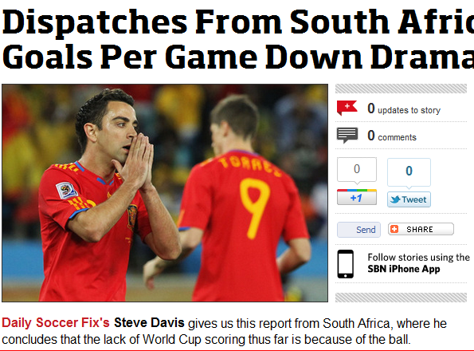

Slide 17
Computing Power 1969-2011
(in Apollo Control Computer Units)

Slide 18
Computing Power 1969-1990
(in Apollo Control Computer Units)

Slide 19
Computing Power 2008-2050?
30 years from now?!
Human brain:
~100 Billion neurons
100 Trillion connections
Brain simulator today (IBM Blue Brain):
10,000 neurons
30 Million connections
2011 = 1 computing unit

