Slide 1
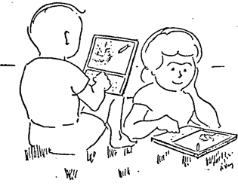
Class 26:
Inventing the Future
Alan Kay’s Dynabook (1972)
cs4414 Fall 2013
University of Virginia
David Evans

Slide 2
This Week in cs4414
Today: What will happen in the next 15 years
Tomorrow (4:59pm Wednesday):
team project submission due
link, well-written description
if you want to demo Thursday
if you want extension to submit final project
Thursday’s class: Project Demos
Friday (11:49pm): Individual Submissions Due
includes evaluation of your project teammates

Slide 3
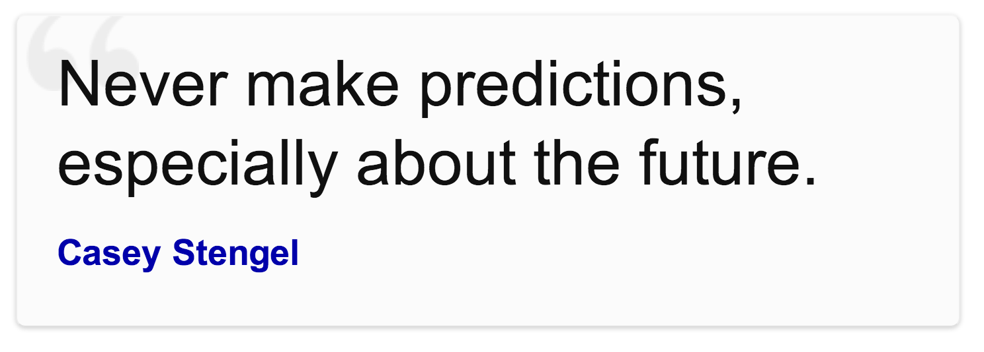
Prediction is very difficult, especially about the future.
Neils Bohr
Det er svært at spå, især om fremtiden.
Robert Storm Petersen

Slide 4
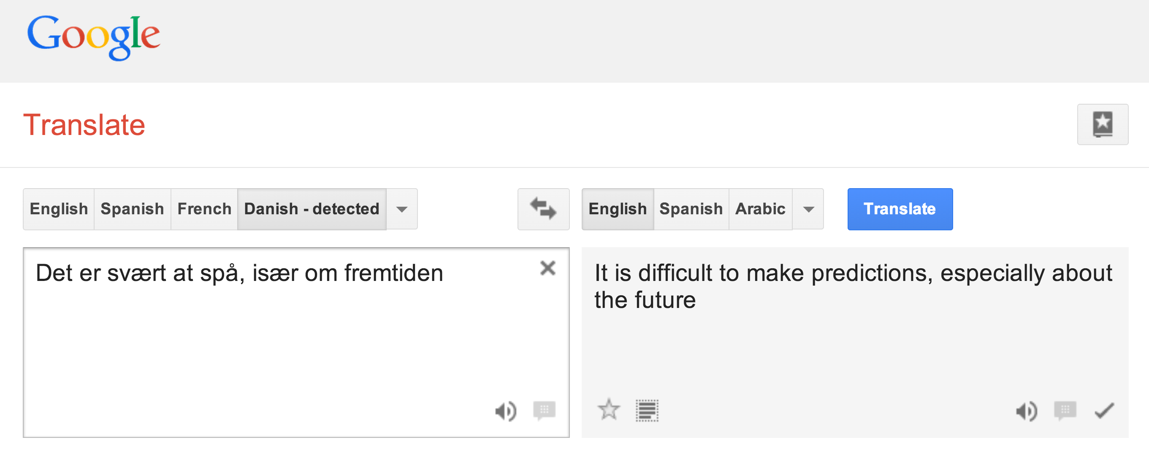
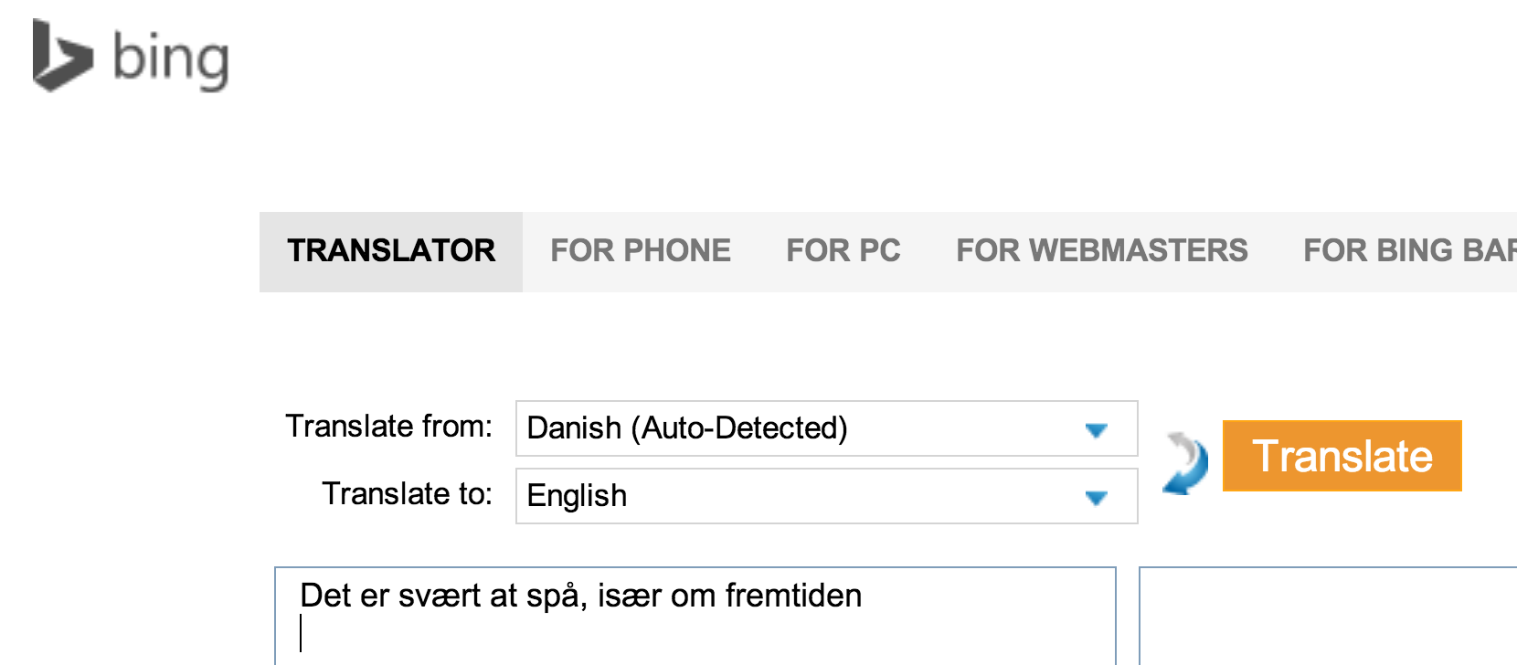
It is difficult to predict, especially about the future

Slide 5
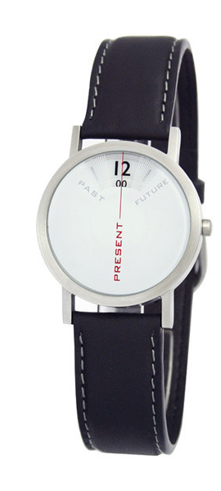
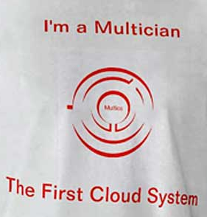
Past and Future

Slide 6
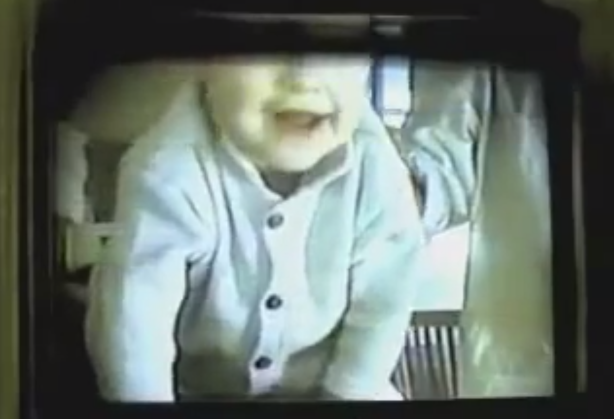

AT&T’s “You Will” (1993-4)

Slide 7
Commerce
renewed your driver’s license at a cash machine
bought concert tickets from a cash machine
checked out of a supermarket a whole cart at a time
sent someone a fax from the beach
Travel
crossed the country without asking for directions
paid a toll without slowing down
Media Consumption
borrowed a book from thousands of miles away
watched the movie you wanted to the minute you wanted to
Video Chat
tucked your baby in from a phone booth
put your heads together when you’re not together
attended a meeting in your bare feet
Security
opened doors with the sound of your voice
kept an eye on your home when you’re not at home
carried your medical history in your wallet
Agents
conducted business in a language you don’t understand
had an assistant who lived in your computer
Education
learned special things from faraway places
had a classmate who is thousands of miles away
fixed your car with a television

Slide 8
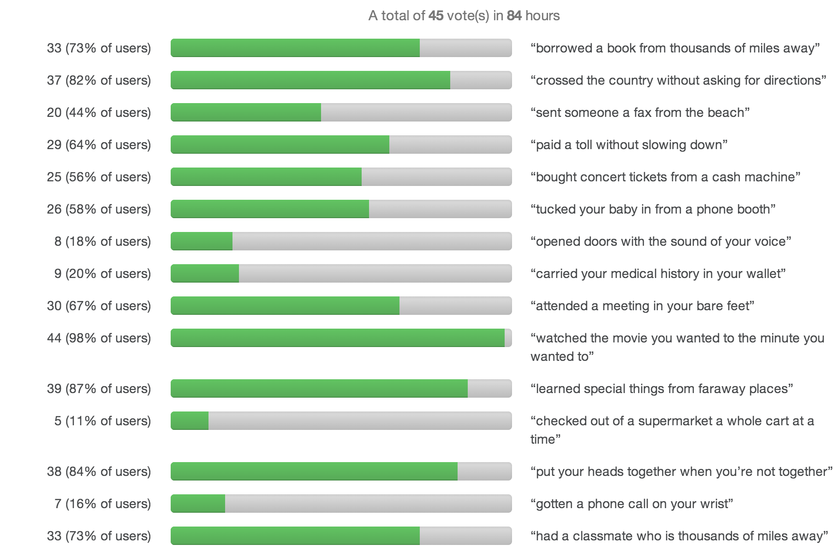
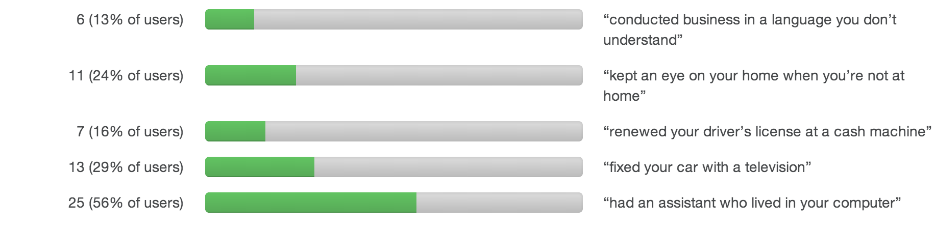

Slide 9
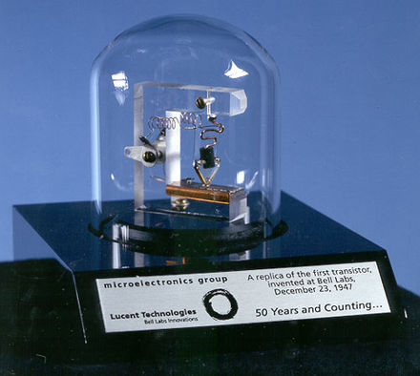
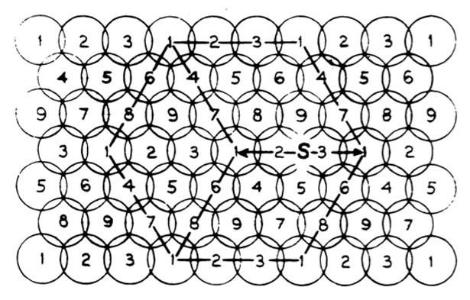
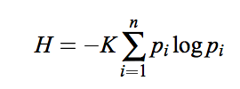
Prediction #1
Amazon, Facebook, Google, and Microsoft combined will contribute less valuable technological innovation to society in 1990-2030 than Bell Labs did in 1940-1980.
information theory,
cryptography (1945)
transistor (1947)
cellular telephony (1947)

Slide 10
Commerce
renewed your driver’s license at a cash machine
bought concert tickets from a cash machine
checked out of a supermarket a whole cart at a time
sent someone a fax from the beach
Travel
crossed the country without asking for directions
paid a toll without slowing down
Media Consumption
borrowed a book from thousands of miles away
watched the movie you wanted to the minute you wanted to
Video Chat
tucked your baby in from a phone booth
put your heads together when you’re not together
attended a meeting in your bare feet
Security
opened doors with the sound of your voice
kept an eye on your home when you’re not at home
carried your medical history in your wallet
Agents
conducted business in a language you don’t understand
had an assistant who lived in your computer
Education
learned special things from faraway places
had a classmate who is thousands of miles away
fixed your car with a television

Slide 11

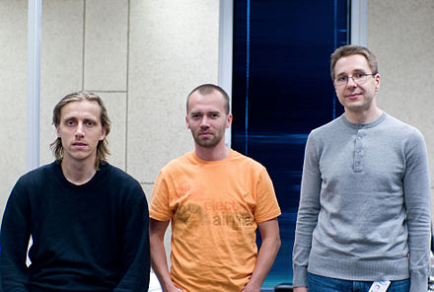
Commerce
renewed your driver’s license at a cash machine
bought concert tickets from a cash machine
checked out of a supermarket a whole cart at a time
sent someone a fax from the beach
Travel
crossed the country without asking for directions
paid a toll without slowing down
Media Consumption
borrowed a book from thousands of miles away
watched the movie you wanted to the minute you wanted to
Video Chat
tucked your baby in from a phone booth
put your heads together when you’re not together
attended a meeting in your bare feet
Security
opened doors with the sound of your voice
kept an eye on your home when you’re not at home
carried your medical history in your wallet
First Release 2003
Created by Ahti Heinla , Priit Kasesalu, and Jaan Tallinn (3rd year at University of Tartu in 1994)
Agents
conducted business in a language you don’t understand
had an assistant who lived in your computer
Education
learned special things from faraway places
had a classmate who is thousands of miles away
fixed your car with a television

Slide 12
Commerce
renewed your driver’s license at a cash machine
bought concert tickets from a cash machine
checked out of a supermarket a whole cart at a time
sent someone a fax from the beach
Travel
crossed the country without asking for directions
paid a toll without slowing down
Media Consumption
borrowed a book from thousands of miles away
watched the movie you wanted to the minute you wanted to
Video Chat
tucked your baby in from a phone booth
put your heads together when you’re not together
attended a meeting in your bare feet
Security
opened doors with the sound of your voice
kept an eye on your home when you’re not at home
carried your medical history in your wallet
Agents
conducted business in a language you don’t understand
had an assistant who lived in your computer
Education
learned special things from faraway places
had a classmate who is thousands of miles away
fixed your car with a television

Slide 13
Commerce
renewed your driver’s license at a cash machine
bought concert tickets from a cash machine
checked out of a supermarket a whole cart at a time
sent someone a fax from the beach
Travel
crossed the country without asking for directions
paid a toll without slowing down
Media Consumption
borrowed a book from thousands of miles away
watched the movie you wanted to the minute you wanted to
Video Chat
tucked your baby in from a phone booth
put your heads together when you’re not together
attended a meeting in your bare feet
Security
opened doors with the sound of your voice
kept an eye on your home when you’re not at home
carried your medical history in your wallet
Agents
conducted business in a language you don’t understand
had an assistant who lived in your computer
Education
learned special things from faraway places
had a classmate who is thousands of miles away
fixed your car with a television

Slide 14
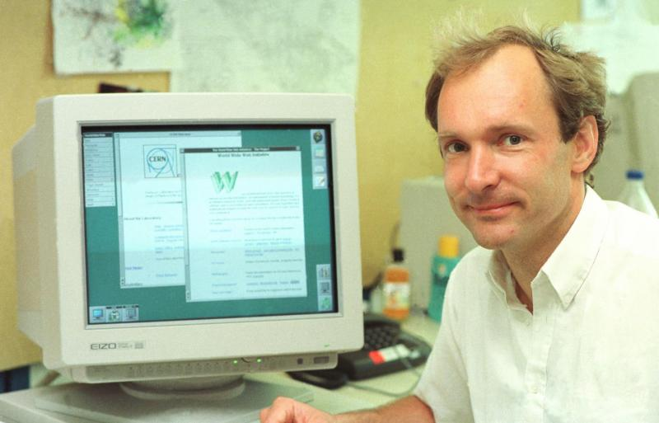
Commerce
renewed your driver’s license at a cash machine
bought concert tickets from a cash machine
checked out of a supermarket a whole cart at a time
sent someone a fax from the beach
Travel
crossed the country without asking for directions
paid a toll without slowing down
Media Consumption
Sir Tim Berners-Lee
First WWW Prototype at CERN 1990
borrowed a book from thousands of miles away
watched the movie you wanted to the minute you wanted to
Video Chat
tucked your baby in from a phone booth
put your heads together when you’re not together
attended a meeting in your bare feet
Security
opened doors with the sound of your voice
kept an eye on your home when you’re not at home
carried your medical history in your wallet
Agents
conducted business in a language you don’t understand
had an assistant who lived in your computer
Education
learned special things from faraway places
had a classmate who is thousands of miles away
fixed your car with a television

Slide 15
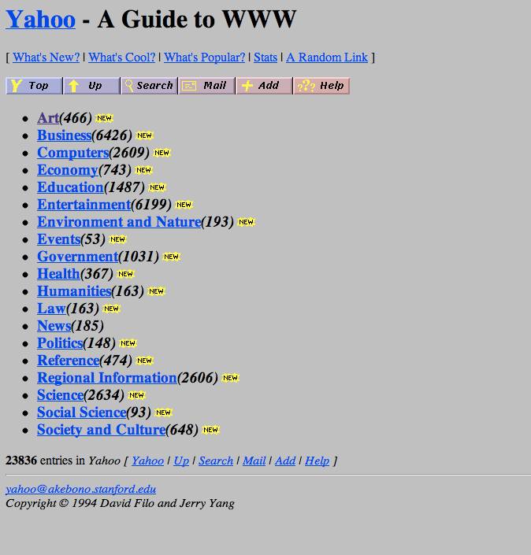
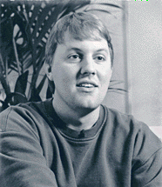
Commerce
renewed your driver’s license at a cash machine
bought concert tickets from a cash machine
checked out of a supermarket a whole cart at a time
sent someone a fax from the beach
Travel
crossed the country without asking for directions
paid a toll without slowing down
Media Consumption
borrowed a book from thousands of miles away
watched the movie you wanted to the minute you wanted to
Video Chat
tucked your baby in from a phone booth
put your heads together when you’re not together
attended a meeting in your bare feet
Security
opened doors with the sound of your voice
kept an eye on your home when you’re not at home
carried your medical history in your wallet
Marc Andreesen
Student at U. Illinois
NCSA Mosaic released in 1993
Agents
conducted business in a language you don’t understand
had an assistant who lived in your computer
Education
learned special things from faraway places
had a classmate who is thousands of miles away
fixed your car with a television
David Filo and Jerry Yang
Students at Stanford
Yahoo 1994

Slide 16
Commerce
renewed your driver’s license at a cash machine
bought concert tickets from a cash machine
checked out of a supermarket a whole cart at a time
sent someone a fax from the beach
Travel
crossed the country without asking for directions
paid a toll without slowing down
Media Consumption
borrowed a book from thousands of miles away
watched the movie you wanted to the minute you wanted to
Video Chat
tucked your baby in from a phone booth
put your heads together when you’re not together
attended a meeting in your bare feet
Security
opened doors with the sound of your voice
kept an eye on your home when you’re not at home
carried your medical history in your wallet
Agents
conducted business in a language you don’t understand
had an assistant who lived in your computer
Education
learned special things from faraway places
had a classmate who is thousands of miles away
fixed your car with a television

Slide 17
Commerce
renewed your driver’s license at a cash machine
bought concert tickets from a cash machine
checked out of a supermarket a whole cart at a time
sent someone a fax from the beach
Travel
crossed the country without asking for directions
paid a toll without slowing down
Media Consumption
borrowed a book from thousands of miles away
watched the movie you wanted to the minute you wanted to
Video Chat
tucked your baby in from a phone booth
put your heads together when you’re not together
attended a meeting in your bare feet
Security
opened doors with the sound of your voice
kept an eye on your home when you’re not at home
carried your medical history in your wallet
Agents
conducted business in a language you don’t understand
had an assistant who lived in your computer
Education
learned special things from faraway places
had a classmate who is thousands of miles away
fixed your car with a television

Slide 18
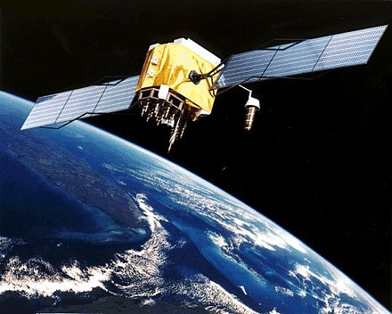
Commerce
renewed your driver’s license at a cash machine
bought concert tickets from a cash machine
checked out of a supermarket a whole cart at a time
sent someone a fax from the beach
Travel
crossed the country without asking for directions
paid a toll without slowing down
Media Consumption
borrowed a book from thousands of miles away
watched the movie you wanted to the minute you wanted to
Video Chat
tucked your baby in from a phone booth
put your heads together when you’re not together
attended a meeting in your bare feet
Security
opened doors with the sound of your voice
kept an eye on your home when you’re not at home
carried your medical history in your wallet
GPS (10 sats): used in 1990-1 Gulf War
First Garmin: $2500
GPS (24 sats) Operational 1995
1996: Dual-Use Directive
Agents
conducted business in a language you don’t understand
had an assistant who lived in your computer
Education
learned special things from faraway places
had a classmate who is thousands of miles away
fixed your car with a television

Slide 19
Commerce
renewed your driver’s license at a cash machine
bought concert tickets from a cash machine
checked out of a supermarket a whole cart at a time
sent someone a fax from the beach
Travel
crossed the country without asking for directions
paid a toll without slowing down
Media Consumption
borrowed a book from thousands of miles away
watched the movie you wanted to the minute you wanted to
Video Chat
tucked your baby in from a phone booth
put your heads together when you’re not together
attended a meeting in your bare feet
Security
opened doors with the sound of your voice
kept an eye on your home when you’re not at home
carried your medical history in your wallet
Agents
conducted business in a language you don’t understand
had an assistant who lived in your computer
Education
learned special things from faraway places
had a classmate who is thousands of miles away
fixed your car with a television

Slide 20
Commerce
renewed your driver’s license at a cash machine
bought concert tickets from a cash machine
checked out of a supermarket a whole cart at a time
sent someone a fax from the beach
Travel
crossed the country without asking for directions
paid a toll without slowing down
Media Consumption
borrowed a book from thousands of miles away
watched the movie you wanted to the minute you wanted to
Video Chat
tucked your baby in from a phone booth
put your heads together when you’re not together
attended a meeting in your bare feet
Security
opened doors with the sound of your voice
kept an eye on your home when you’re not at home
carried your medical history in your wallet
Agents
conducted business in a language you don’t understand
had an assistant who lived in your computer
Education
learned special things from faraway places
had a classmate who is thousands of miles away
fixed your car with a television

Slide 21
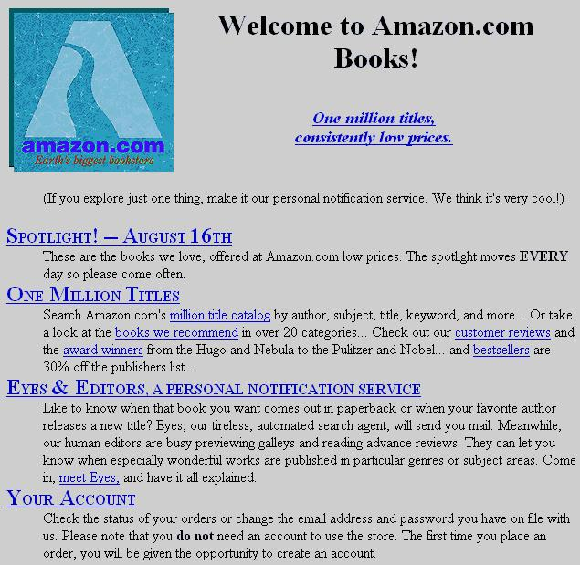
Commerce
renewed your driver’s license at a cash machine
bought concert tickets from a cash machine
checked out of a supermarket a whole cart at a time
sent someone a fax from the beach
Travel
crossed the country without asking for directions
paid a toll without slowing down
Media Consumption
borrowed a book from thousands of miles away
watched the movie you wanted to the minute you wanted to
Video Chat
tucked your baby in from a phone booth
put your heads together when you’re not together
attended a meeting in your bare feet
Security
opened doors with the sound of your voice
kept an eye on your home when you’re not at home
carried your medical history in your wallet
Agents
conducted business in a language you don’t understand
had an assistant who lived in your computer
Education
learned special things from faraway places
had a classmate who is thousands of miles away
fixed your car with a television
amazon.com opens: July 1995

Slide 22
Commerce
renewed your driver’s license at a cash machine
bought concert tickets from a cash machine
checked out of a supermarket a whole cart at a time
sent someone a fax from the beach
Travel
crossed the country without asking for directions
paid a toll without slowing down
Media Consumption
borrowed a book from thousands of miles away
watched the movie you wanted to the minute you wanted to
Video Chat
tucked your baby in from a phone booth
put your heads together when you’re not together
attended a meeting in your bare feet
Security
opened doors with the sound of your voice
kept an eye on your home when you’re not at home
carried your medical history in your wallet
Agents
conducted business in a language you don’t understand
had an assistant who lived in your computer
Education
learned special things from faraway places
had a classmate who is thousands of miles away
fixed your car with a television

Slide 23
Commerce
renewed your driver’s license at a cash machine
bought concert tickets from a cash machine
checked out of a supermarket a whole cart at a time
sent someone a fax from the beach
Travel
crossed the country without asking for directions
paid a toll without slowing down
Media Consumption
borrowed a book from thousands of miles away
watched the movie you wanted to the minute you wanted to
Video Chat
tucked your baby in from a phone booth
put your heads together when you’re not together
attended a meeting in your bare feet
Security
opened doors with the sound of your voice
kept an eye on your home when you’re not at home
carried your medical history in your wallet
Agents
conducted business in a language you don’t understand
had an assistant who lived in your computer
Education
learned special things from faraway places
had a classmate who is thousands of miles away
fixed your car with a television

Slide 24
Commerce
renewed your driver’s license at a cash machine
bought concert tickets from a cash machine
checked out of a supermarket a whole cart at a time
sent someone a fax from the beach
Travel
crossed the country without asking for directions
paid a toll without slowing down
Media Consumption
borrowed a book from thousands of miles away
watched the movie you wanted to the minute you wanted to
Video Chat
tucked your baby in from a phone booth
put your heads together when you’re not together
attended a meeting in your bare feet
Security
opened doors with the sound of your voice
kept an eye on your home when you’re not at home
carried your medical history in your wallet
Agents
conducted business in a language you don’t understand
had an assistant who lived in your computer
Education
learned special things from faraway places
had a classmate who is thousands of miles away
fixed your car with a television

Slide 25
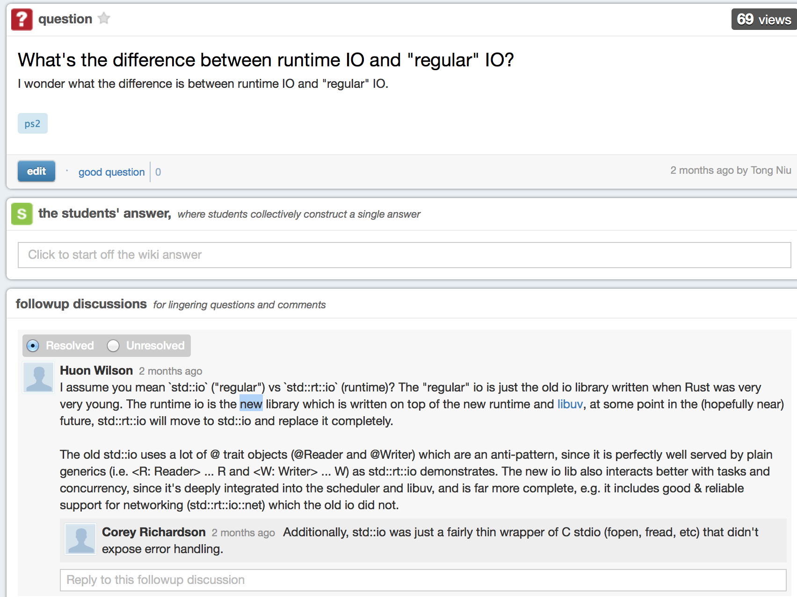
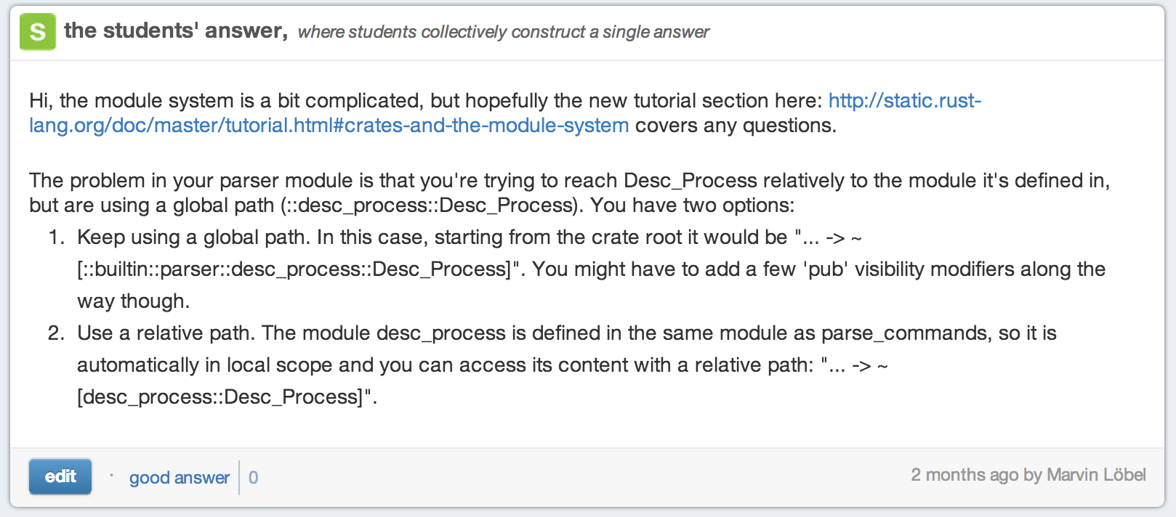
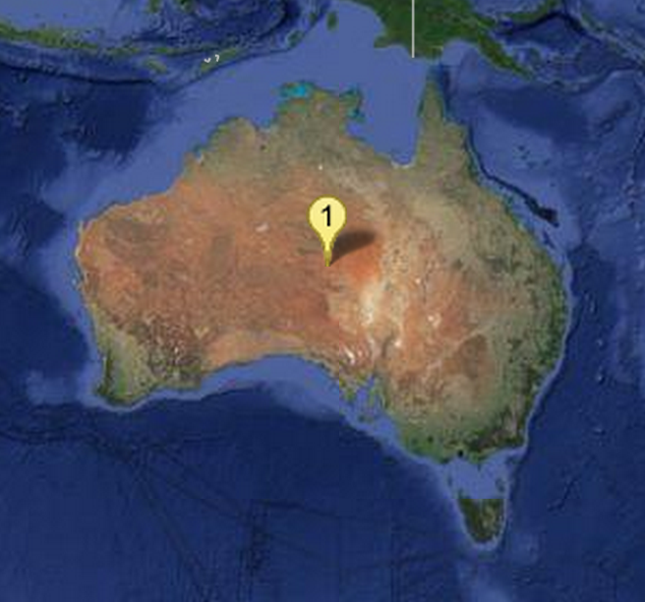
Commerce
renewed your driver’s license at a cash machine
bought concert tickets from a cash machine
checked out of a supermarket a whole cart at a time
sent someone a fax from the beach
Travel
crossed the country without asking for directions
paid a toll without slowing down
Media Consumption
borrowed a book from thousands of miles away
watched the movie you wanted to the minute you wanted to
Video Chat
tucked your baby in from a phone booth
put your heads together when you’re not together
attended a meeting in your bare feet
Security
opened doors with the sound of your voice
kept an eye on your home when you’re not at home
carried your medical history in your wallet
Agents
conducted business in a language you don’t understand
had an assistant who lived in your computer
Education
learned special things from faraway places
had a classmate who is thousands of miles away
fixed your car with a television

Slide 26
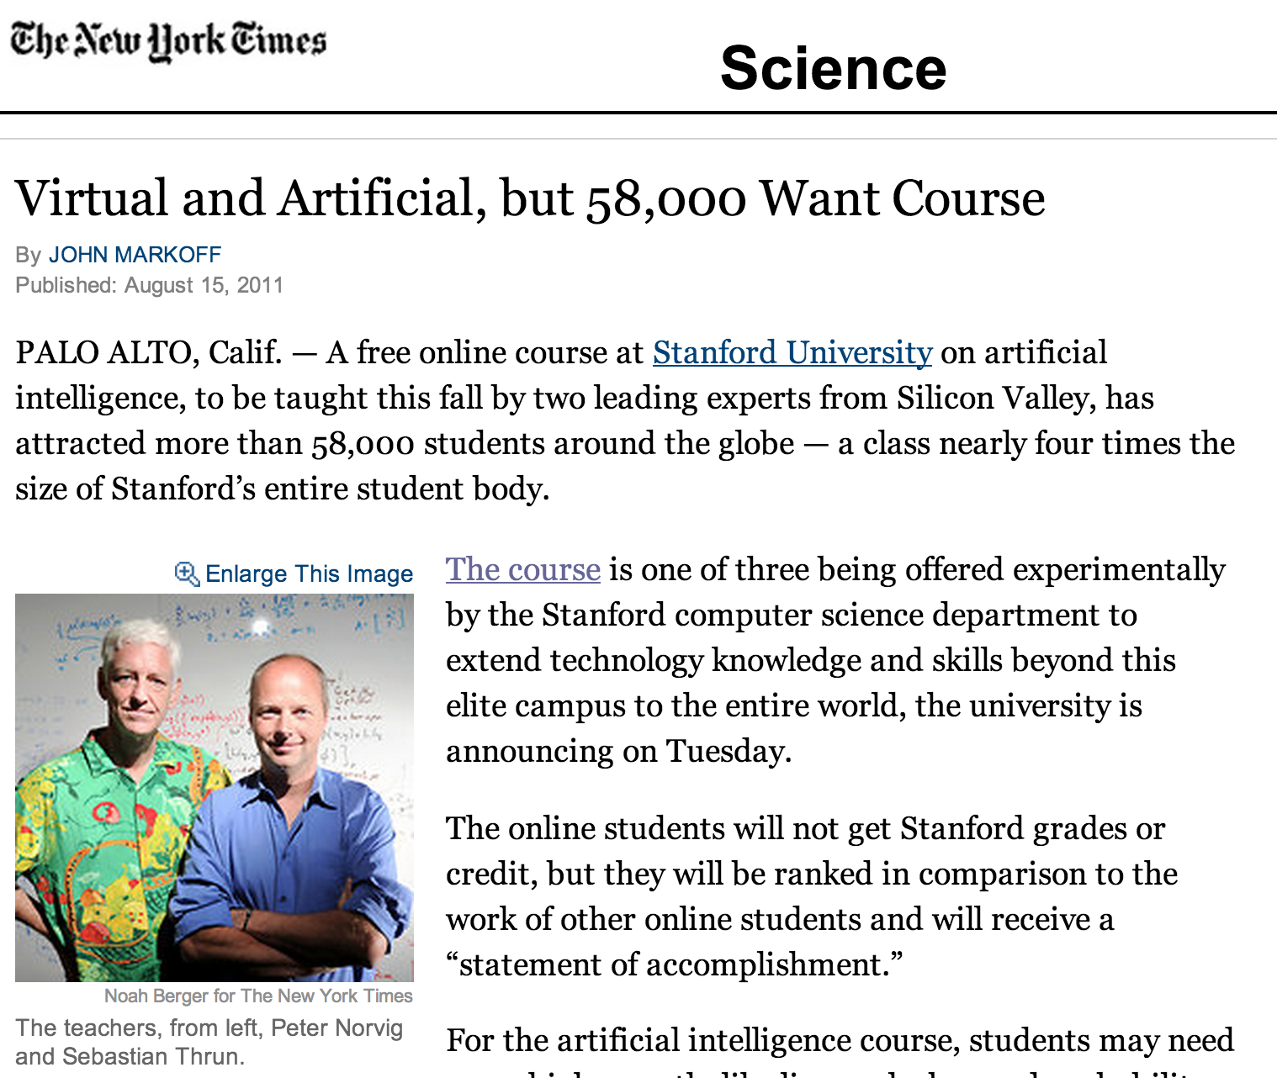
Commerce
renewed your driver’s license at a cash machine
bought concert tickets from a cash machine
checked out of a supermarket a whole cart at a time
sent someone a fax from the beach
August 2011
Travel
crossed the country without asking for directions
paid a toll without slowing down
Media Consumption
borrowed a book from thousands of miles away
watched the movie you wanted to the minute you wanted to
Video Chat
tucked your baby in from a phone booth
put your heads together when you’re not together
attended a meeting in your bare feet
Security
opened doors with the sound of your voice
kept an eye on your home when you’re not at home
carried your medical history in your wallet
Agents
conducted business in a language you don’t understand
had an assistant who lived in your computer
Education
learned special things from faraway places
had a classmate who is thousands of miles away
fixed your car with a television

Slide 27
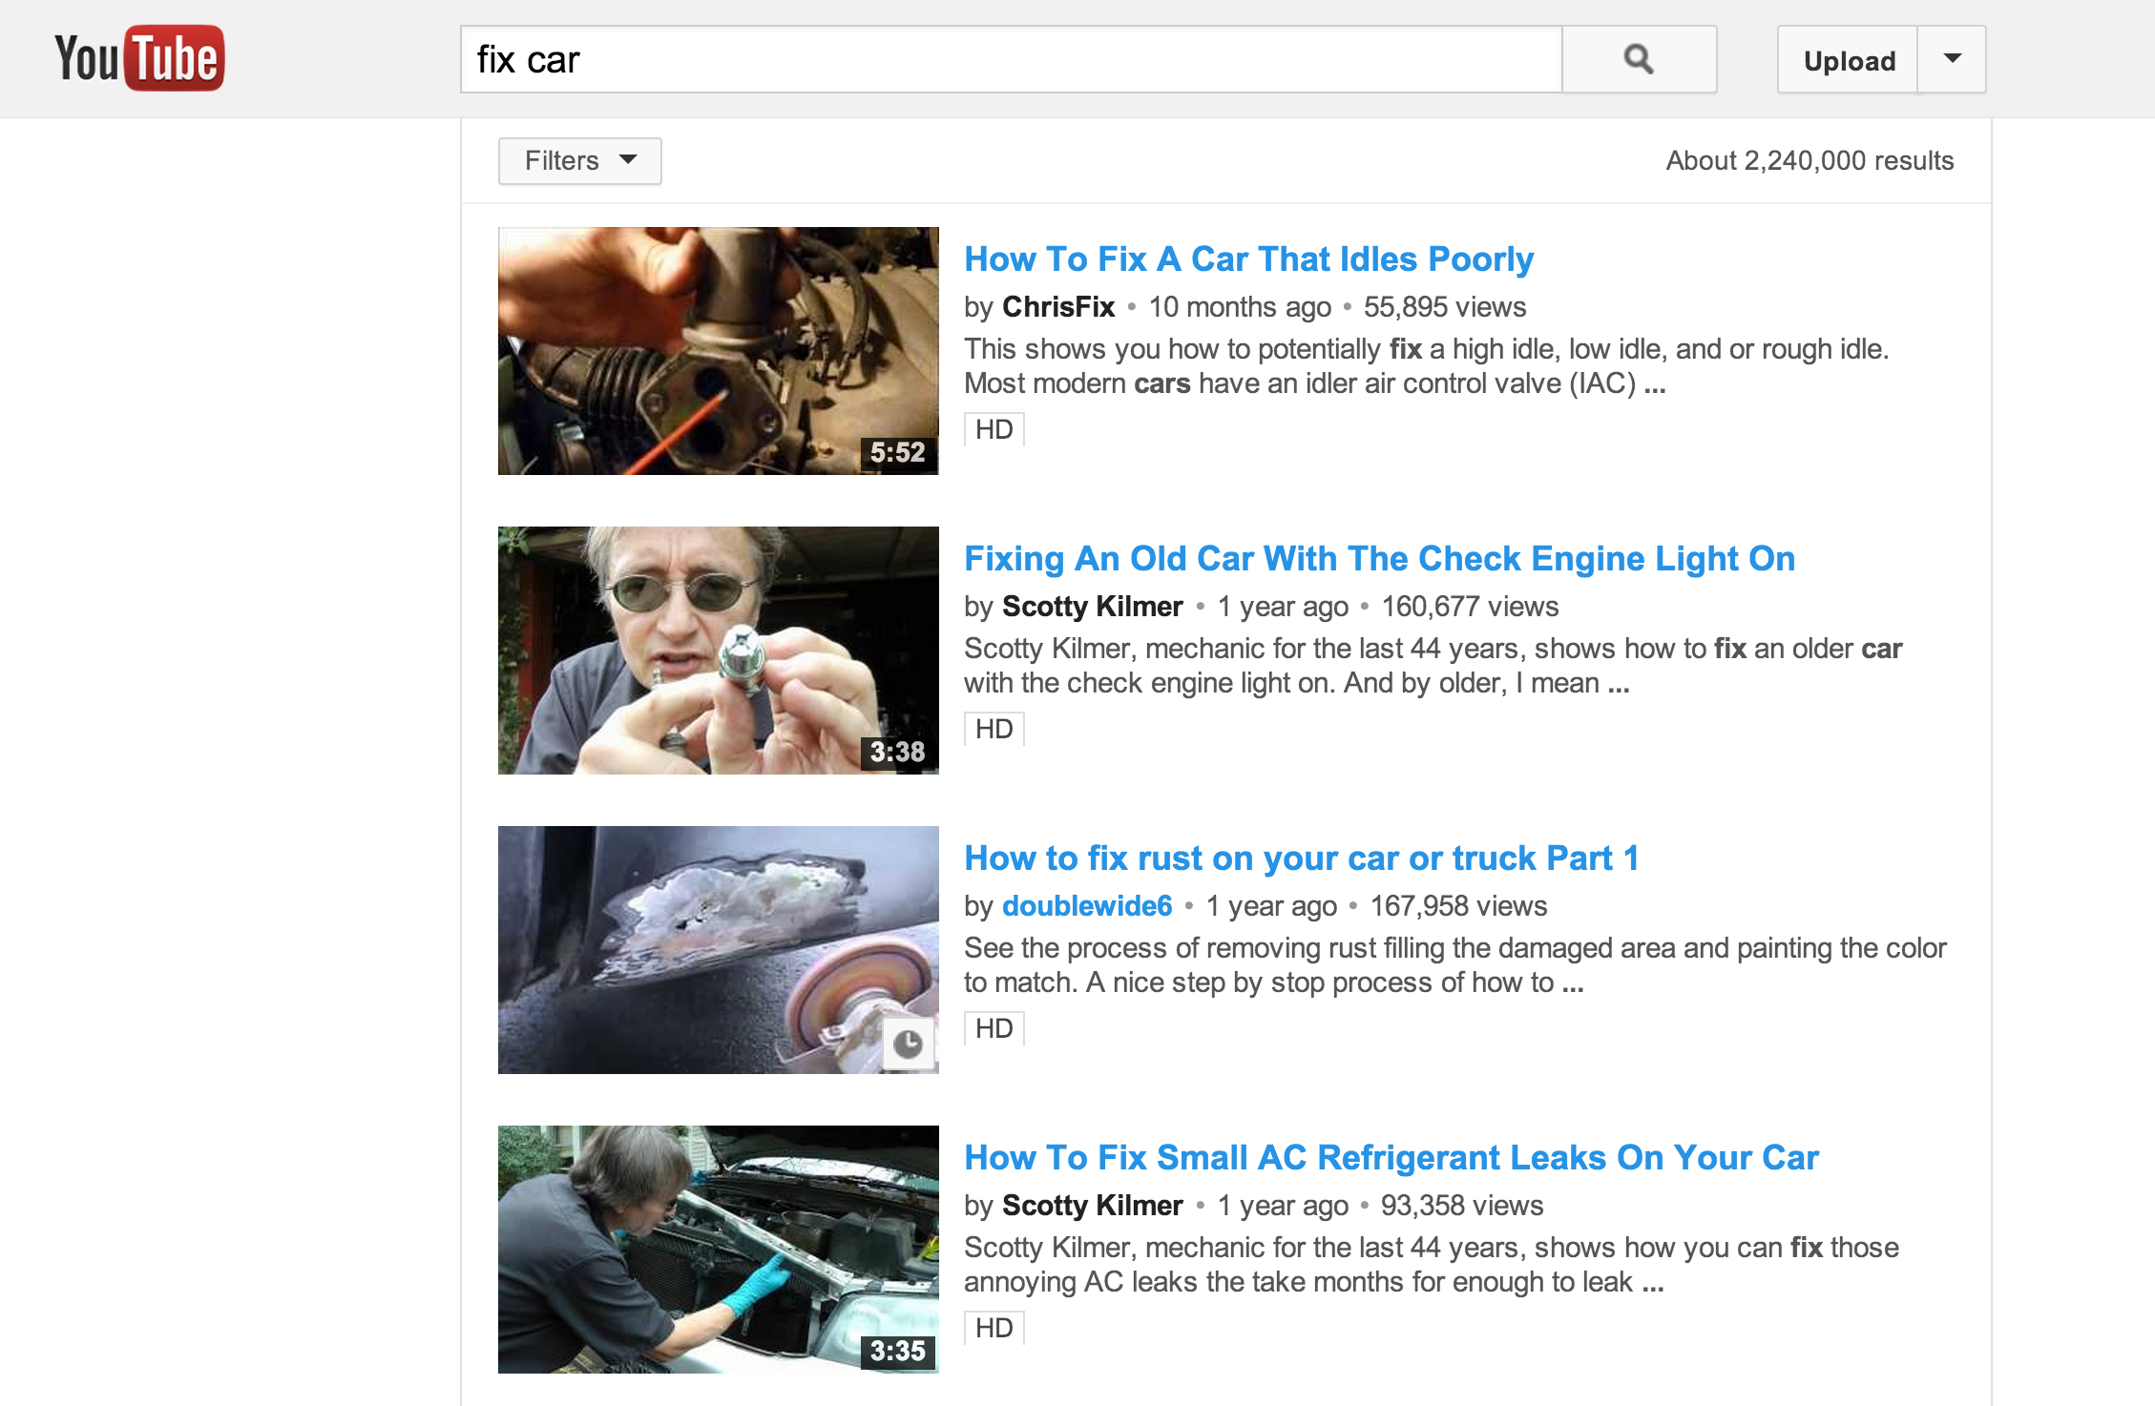
Commerce
renewed your driver’s license at a cash machine
bought concert tickets from a cash machine
checked out of a supermarket a whole cart at a time
sent someone a fax from the beach
August 2011
Travel
crossed the country without asking for directions
paid a toll without slowing down
Media Consumption
borrowed a book from thousands of miles away
watched the movie you wanted to the minute you wanted to
Video Chat
tucked your baby in from a phone booth
put your heads together when you’re not together
attended a meeting in your bare feet
Security
opened doors with the sound of your voice
kept an eye on your home when you’re not at home
carried your medical history in your wallet
Agents
conducted business in a language you don’t understand
had an assistant who lived in your computer
Education
learned special things from faraway places
had a classmate who is thousands of miles away
fixed your car with a television

Slide 28
Commerce
renewed your driver’s license at a cash machine
bought concert tickets from a cash machine
checked out of a supermarket a whole cart at a time
sent someone a fax from the beach
Travel
crossed the country without asking for directions
paid a toll without slowing down
Media Consumption
borrowed a book from thousands of miles away
watched the movie you wanted to the minute you wanted to
Video Chat
tucked your baby in from a phone booth
put your heads together when you’re not together
attended a meeting in your bare feet
Security
opened doors with the sound of your voice
kept an eye on your home when you’re not at home
carried your medical history in your wallet
Agents
conducted business in a language you don’t understand
had an assistant who lived in your computer
Education
learned special things from faraway places
had a classmate who is thousands of miles away
fixed your car with a television

Slide 29
Commerce
renewed your driver’s license at a cash machine
bought concert tickets from a cash machine
checked out of a supermarket a whole cart at a time
sent someone a fax from the beach
Travel
crossed the country without asking for directions
paid a toll without slowing down
Media Consumption
borrowed a book from thousands of miles away
watched the movie you wanted to the minute you wanted to
Video Chat
tucked your baby in from a phone booth
put your heads together when you’re not together
attended a meeting in your bare feet
Security
opened doors with the sound of your voice
kept an eye on your home when you’re not at home
carried your medical history in your wallet
Agents
conducted business in a language you don’t understand
had an assistant who lived in your computer
Education
learned special things from faraway places
had a classmate who is thousands of miles away
fixed your car with a television

Slide 30

Cost to sequence human genome
Moore’s Law prediction
(halve every 18 months)
Predicting steady technology improvement is easy!

Slide 31
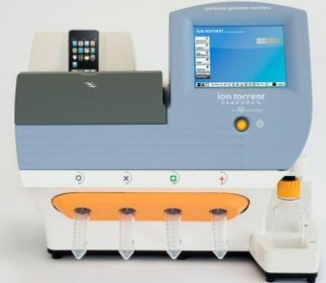
Cost to sequence human genome
Moore’s Law prediction
(halve every 18 months)
Ion torrent Personal Genome Machine

Slide 32
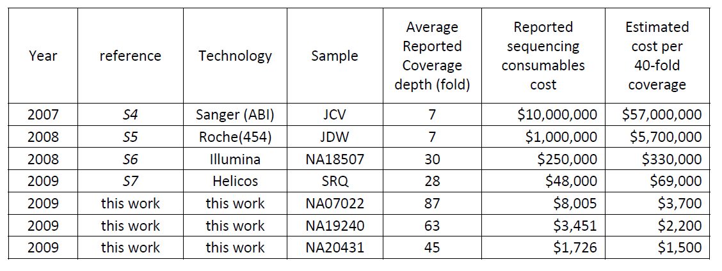
Human Genome Sequencing Using Unchained Base Reads on Self-Assembling DNA Nanoarrays. Radoje Drmanac, Andrew B. Sparks, Matthew J. Callow, Aaron L. Halpern, Norman L. Burns, Bahram G. Kermani, Paolo Carnevali, Igor Nazarenko, Geoffrey B. Nilsen, George Yeung, Fredrik Dahl, Andres Fernandez, Bryan Staker, Krishna P. Pant, Jonathan Baccash, Adam P. Borcherding, Anushka Brownley, Ryan Cedeno, Linsu Chen, Dan Chernikoff, Alex Cheung, Razvan Chirita, Benjamin Curson, Jessica C. Ebert, Coleen R. Hacker, Robert Hartlage, Brian Hauser, Steve Huang, Yuan Jiang, Vitali Karpinchyk, Mark Koenig, Calvin Kong, Tom Landers, Catherine Le, Jia Liu, Celeste E. McBride, Matt Morenzoni, Robert E. Morey, Karl Mutch, Helena Perazich, Kimberly Perry, Brock A. Peters, Joe Peterson, Charit L. Pethiyagoda, Kaliprasad Pothuraju, Claudia Richter, Abraham M. Rosenbaum, Shaunak Roy, Jay Shafto, Uladzislau Sharanhovich, Karen W. Shannon, Conrad G. Sheppy, Michel Sun, Joseph V. Thakuria, Anne Tran, Dylan Vu, Alexander Wait Zaranek, Xiaodi Wu, Snezana Drmanac, Arnold R. Oliphant, William C. Banyai, Bruce Martin, Dennis G. Ballinger, George M. Church, Clifford A. Reid. Science, January 2010.

Slide 33
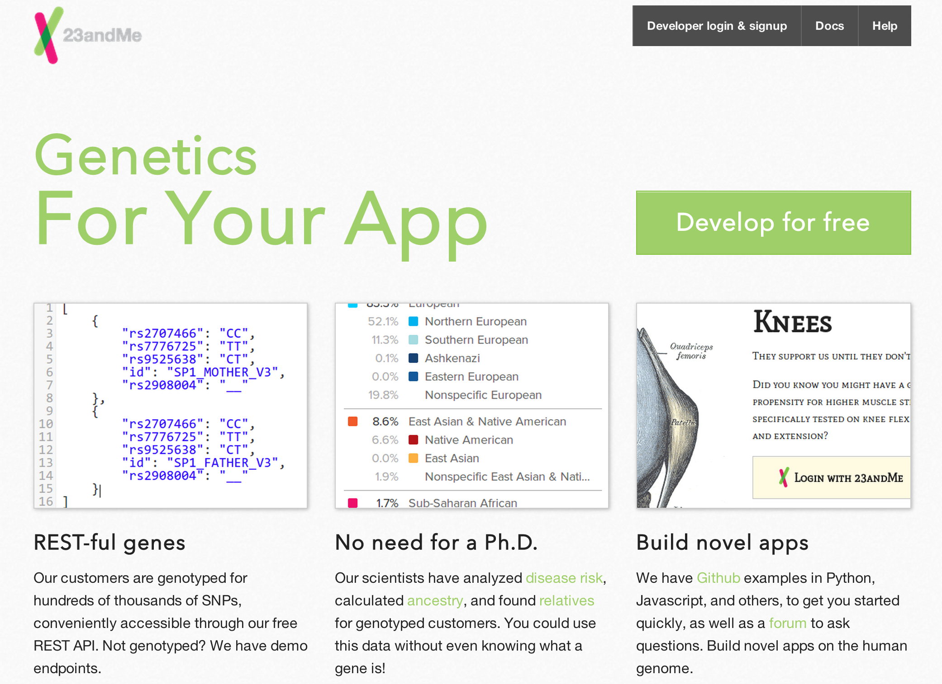

Slide 34
Commerce
renewed your driver’s license at a cash machine
bought concert tickets from a cash machine
checked out of a supermarket a whole cart at a time
sent someone a fax from the beach
Travel
crossed the country without asking for directions
paid a toll without slowing down
Media Consumption
borrowed a book from thousands of miles away
watched the movie you wanted to the minute you wanted to
Video Chat
tucked your baby in from a phone booth
put your heads together when you’re not together
attended a meeting in your bare feet
Security
opened doors with the sound of your voice
kept an eye on your home when you’re not at home
carried your medical history in your wallet
Agents
conducted business in a language you don’t understand
had an assistant who lived in your computer
Education
learned special things from faraway places
had a classmate who is thousands of miles away
fixed your car with a television

Slide 35
Prediction #2
Within 15 years, at least 95% of the world’s adult population will have done everything on the “You Will” list (or something comparable but much better).
Note: this implies end to world poverty!

Slide 36
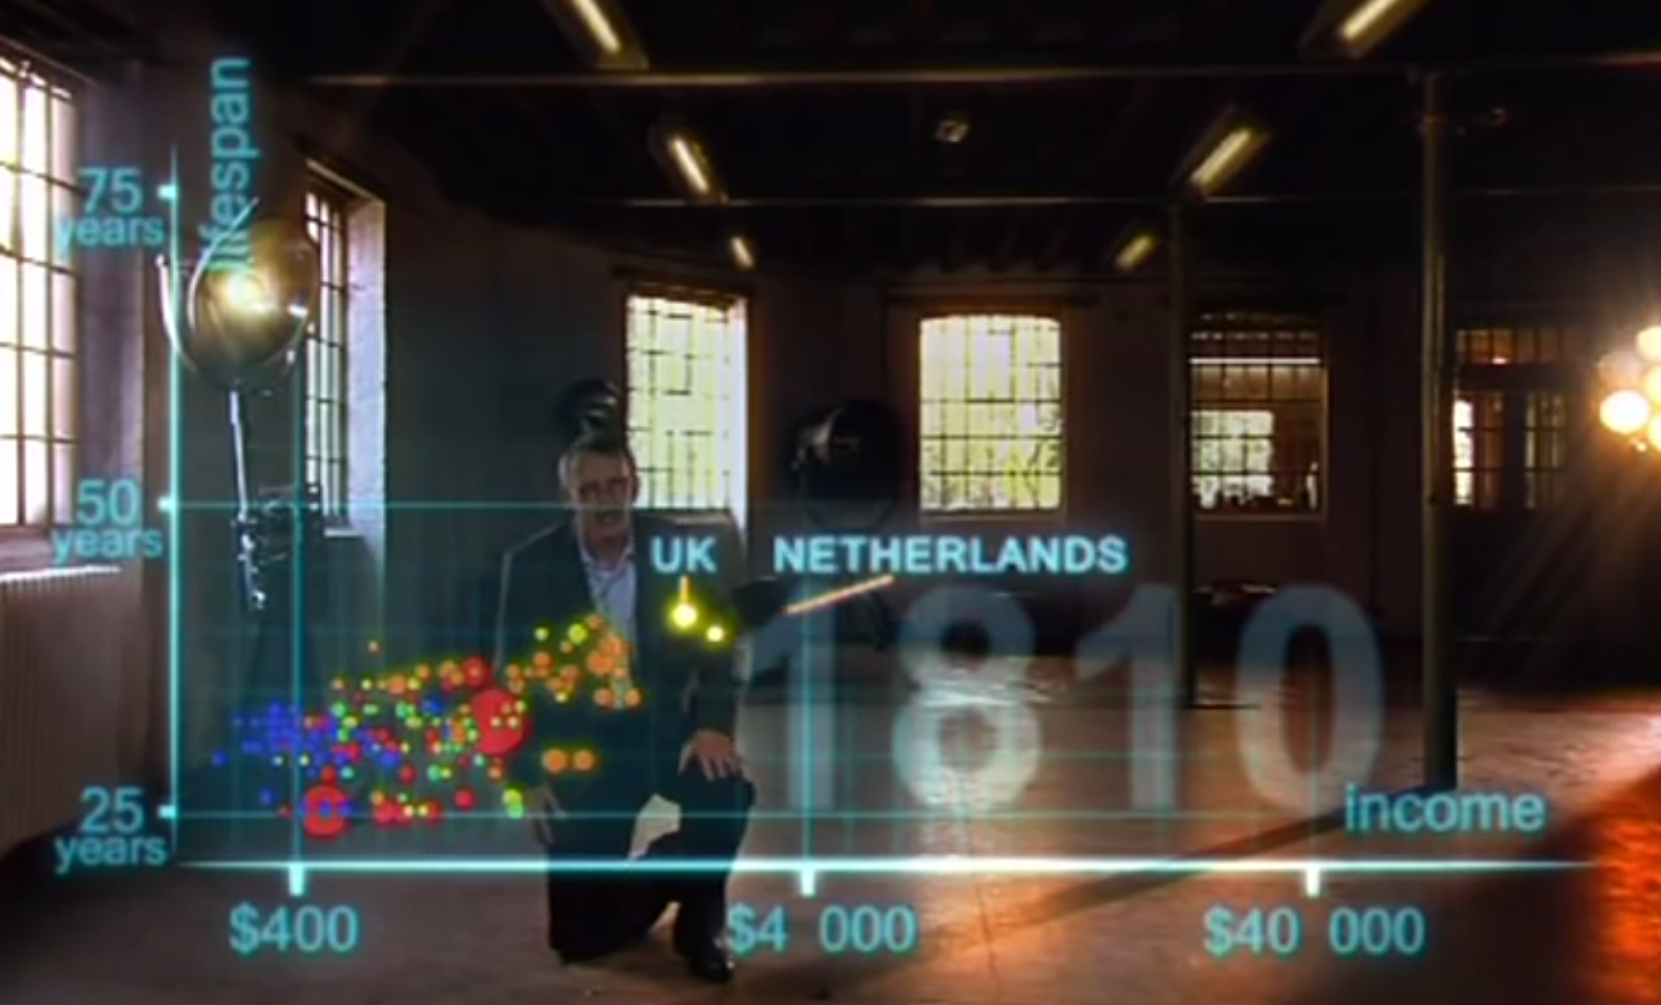

Slide 37
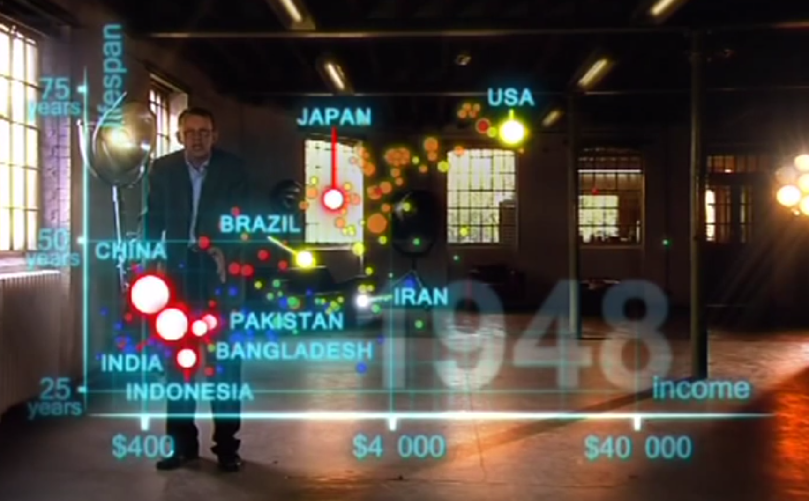
1948

Slide 38
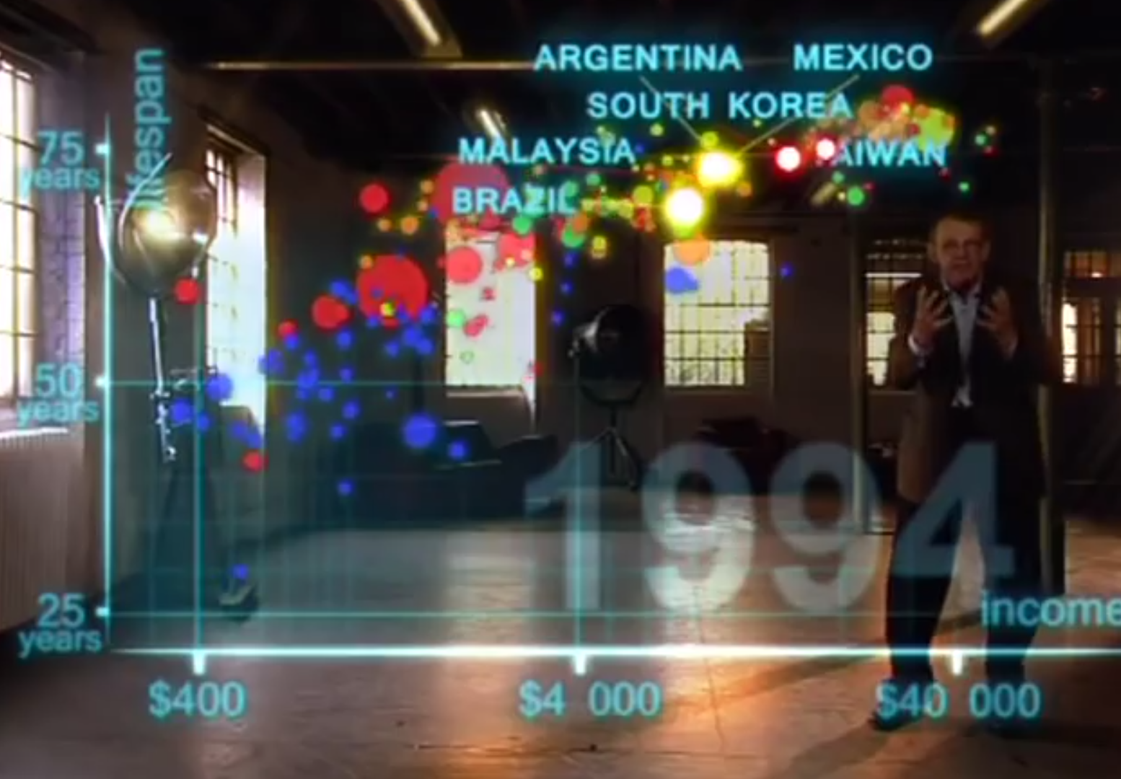
1994

Slide 39
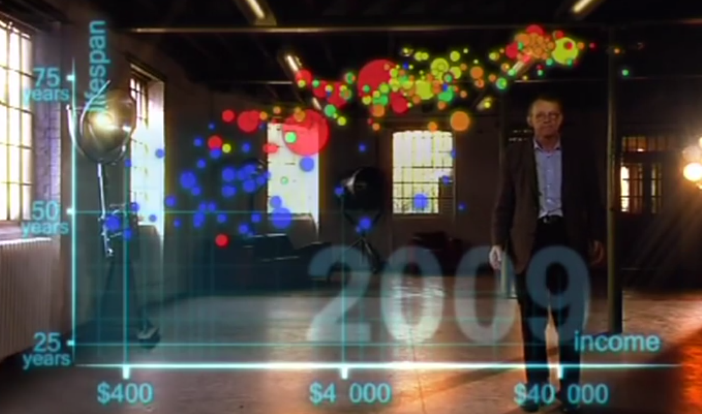

Slide 40
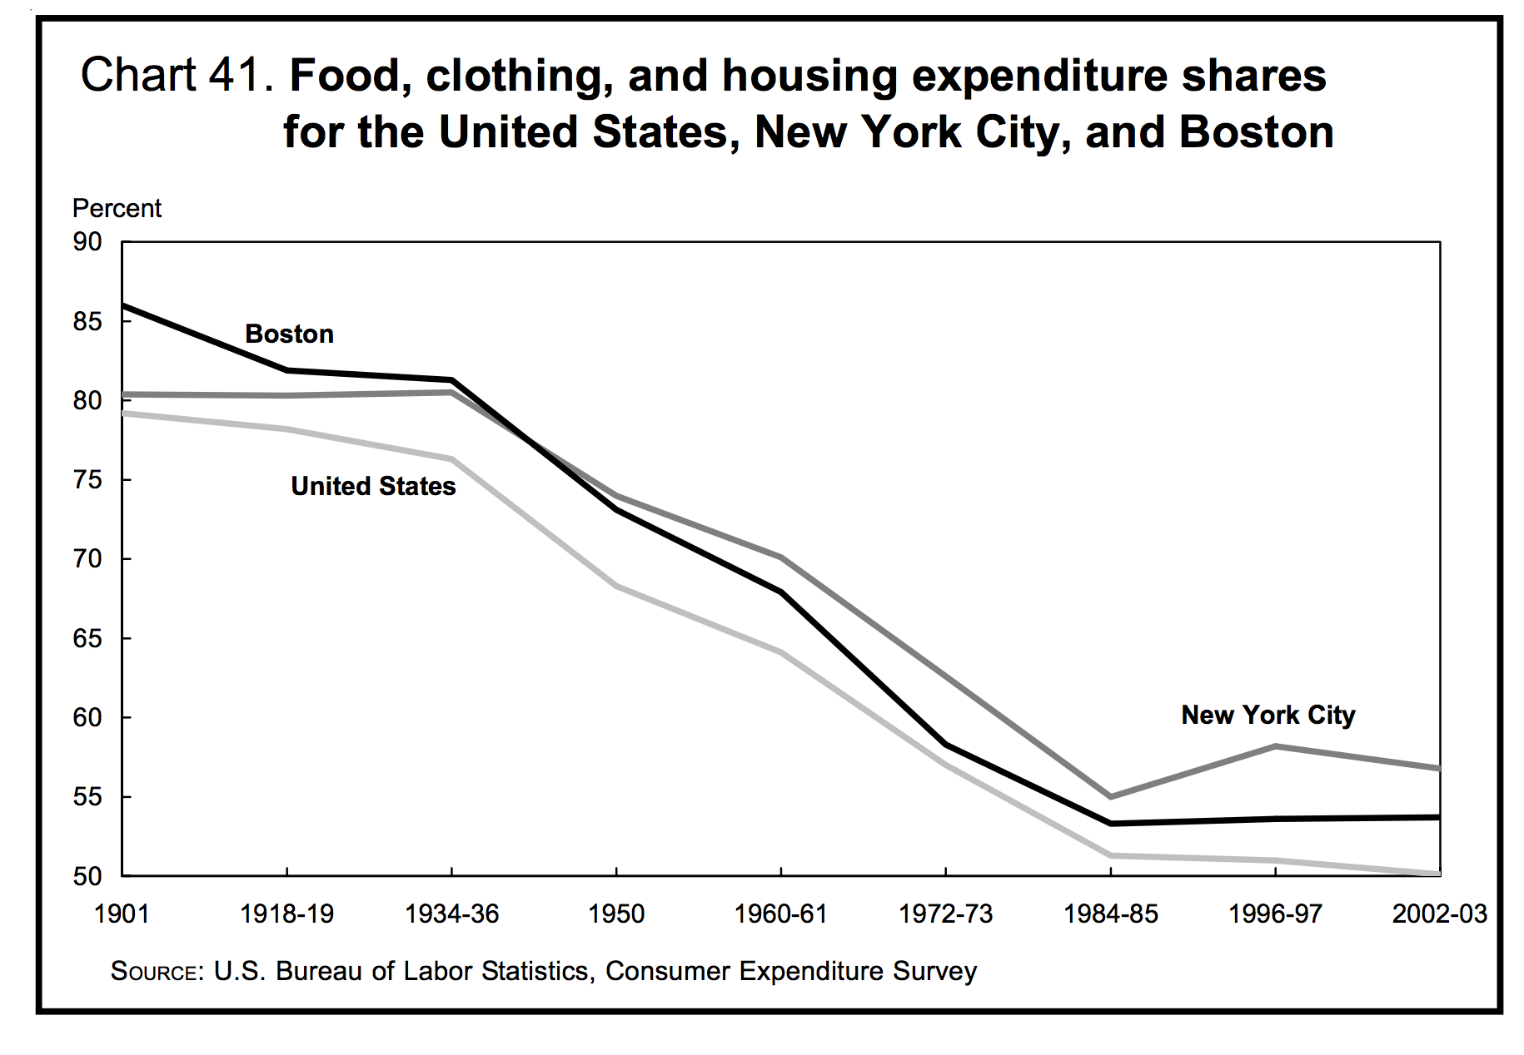

Slide 41

“Today, of Americans officially designated as ‘poor’, 99 percent have electricity, running water, flush toilets, and a refrigerator; 95 percent have a television, 88 percent a telephone, 71 percent a car and 70 percent air conditioning. Cornelius Vanderbilt had none of these.” Matt Ridley

Slide 42
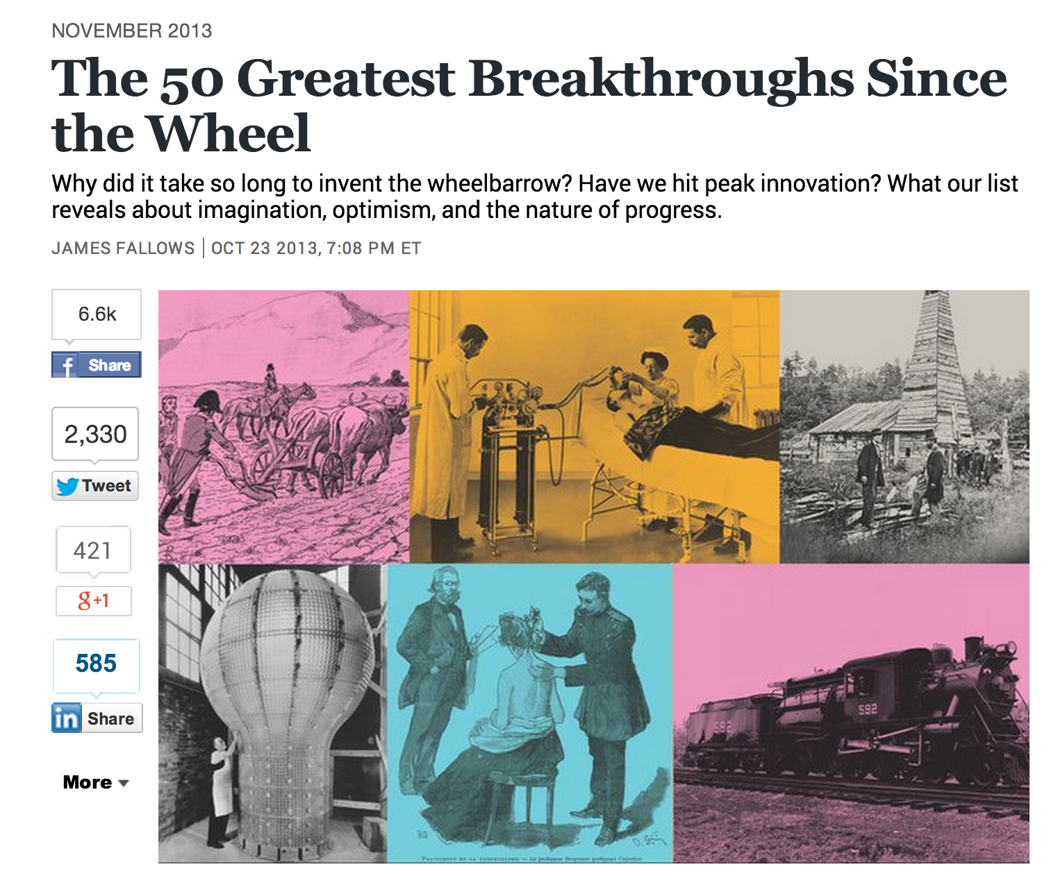
Pace of Progress

Slide 43


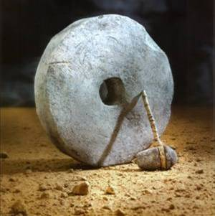
Year of Invention
Rank on List
S ::= NP V
NP ::= N and NP
Cooking (-400 000)
Language (-300 000)
Wheel (~4000 BC)

Slide 44
Last Millennium

Slide 45
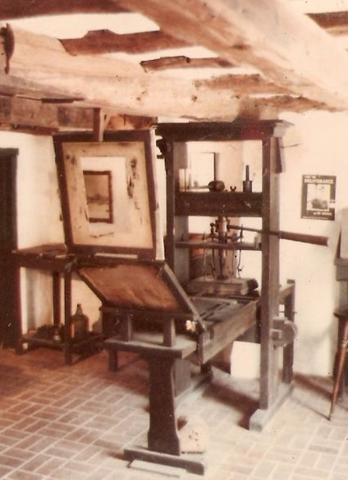
Last Millennium
#1: Printing Press

Slide 46
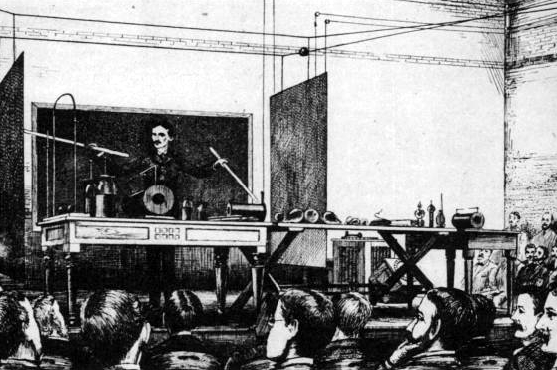
Last Millennium
#1: Printing Press
#2: Electricity
Nikola Tesla

Slide 47
Last Millennium
#1: Printing Press
#2: Electricity
#4: Semiconductor
#9: Internet
#16: Personal Computer

Slide 48
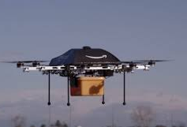
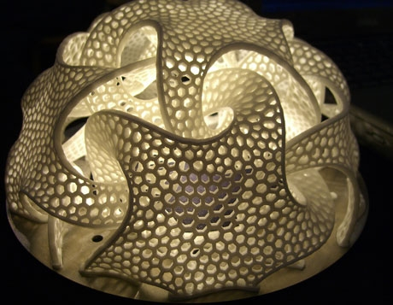

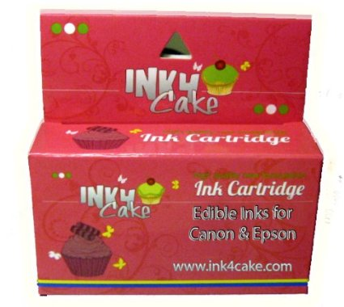
Prediction #3
Over the next 15 years, there will be inventions that change the world at least as much as the semiconductor, personal computer, and Internet did over the last 30.
Drone delivery?
3D fabrication?
Printing food?
AI?

Slide 49
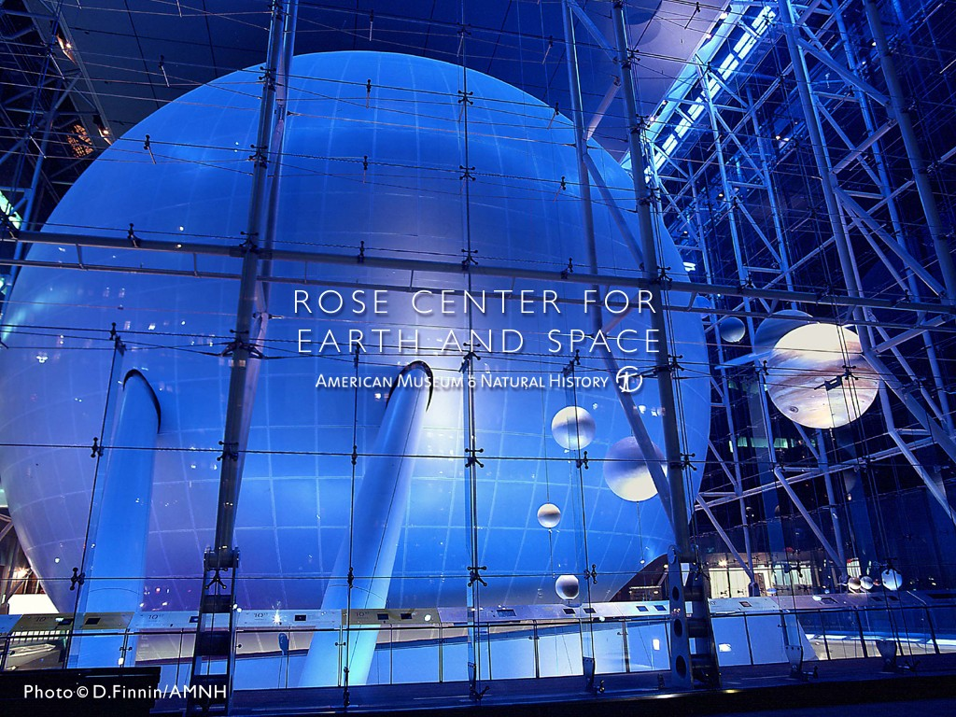
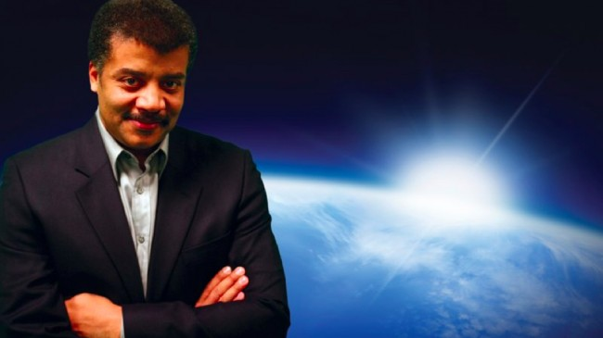
Science’s Endless
Golden Age
Neil deGrasse Tyson

Slide 50
“If you’re going to use your computer to simulate some phenomenon in the universe, then it only becomes interesting if you change the scale of that phenomenon by at least a factor of 10. … For a 3D simulation, an increase by a factor of 10 in each of the three dimensions increases your volume by a factor of 1000.”
What is the asymptotic running time for simulating the universe?

Slide 51
Astrophysics and Moore’s Law
Simulating universe is Θ(n³)
Moore’s “law”: computing power doubles every 18 months
Dr. Tyson: to understand something new about the universe, need to scale by 10x
How long does it take to know twice as much about the universe?

Slide 52
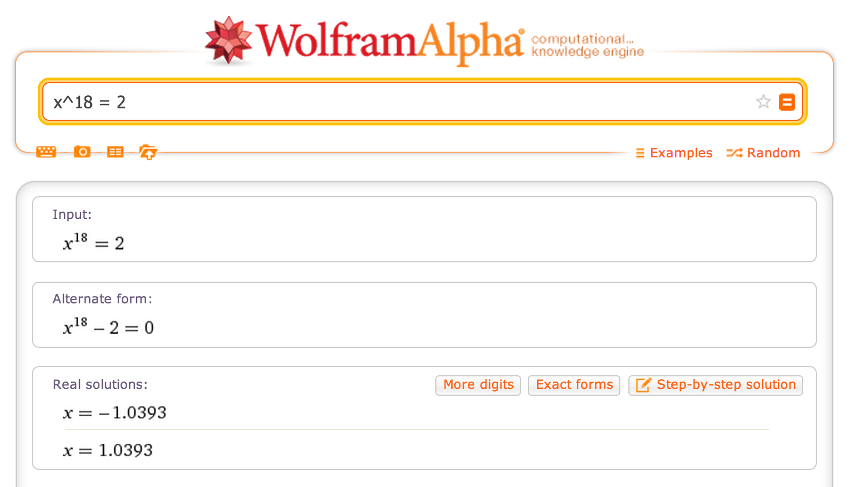

Slide 53
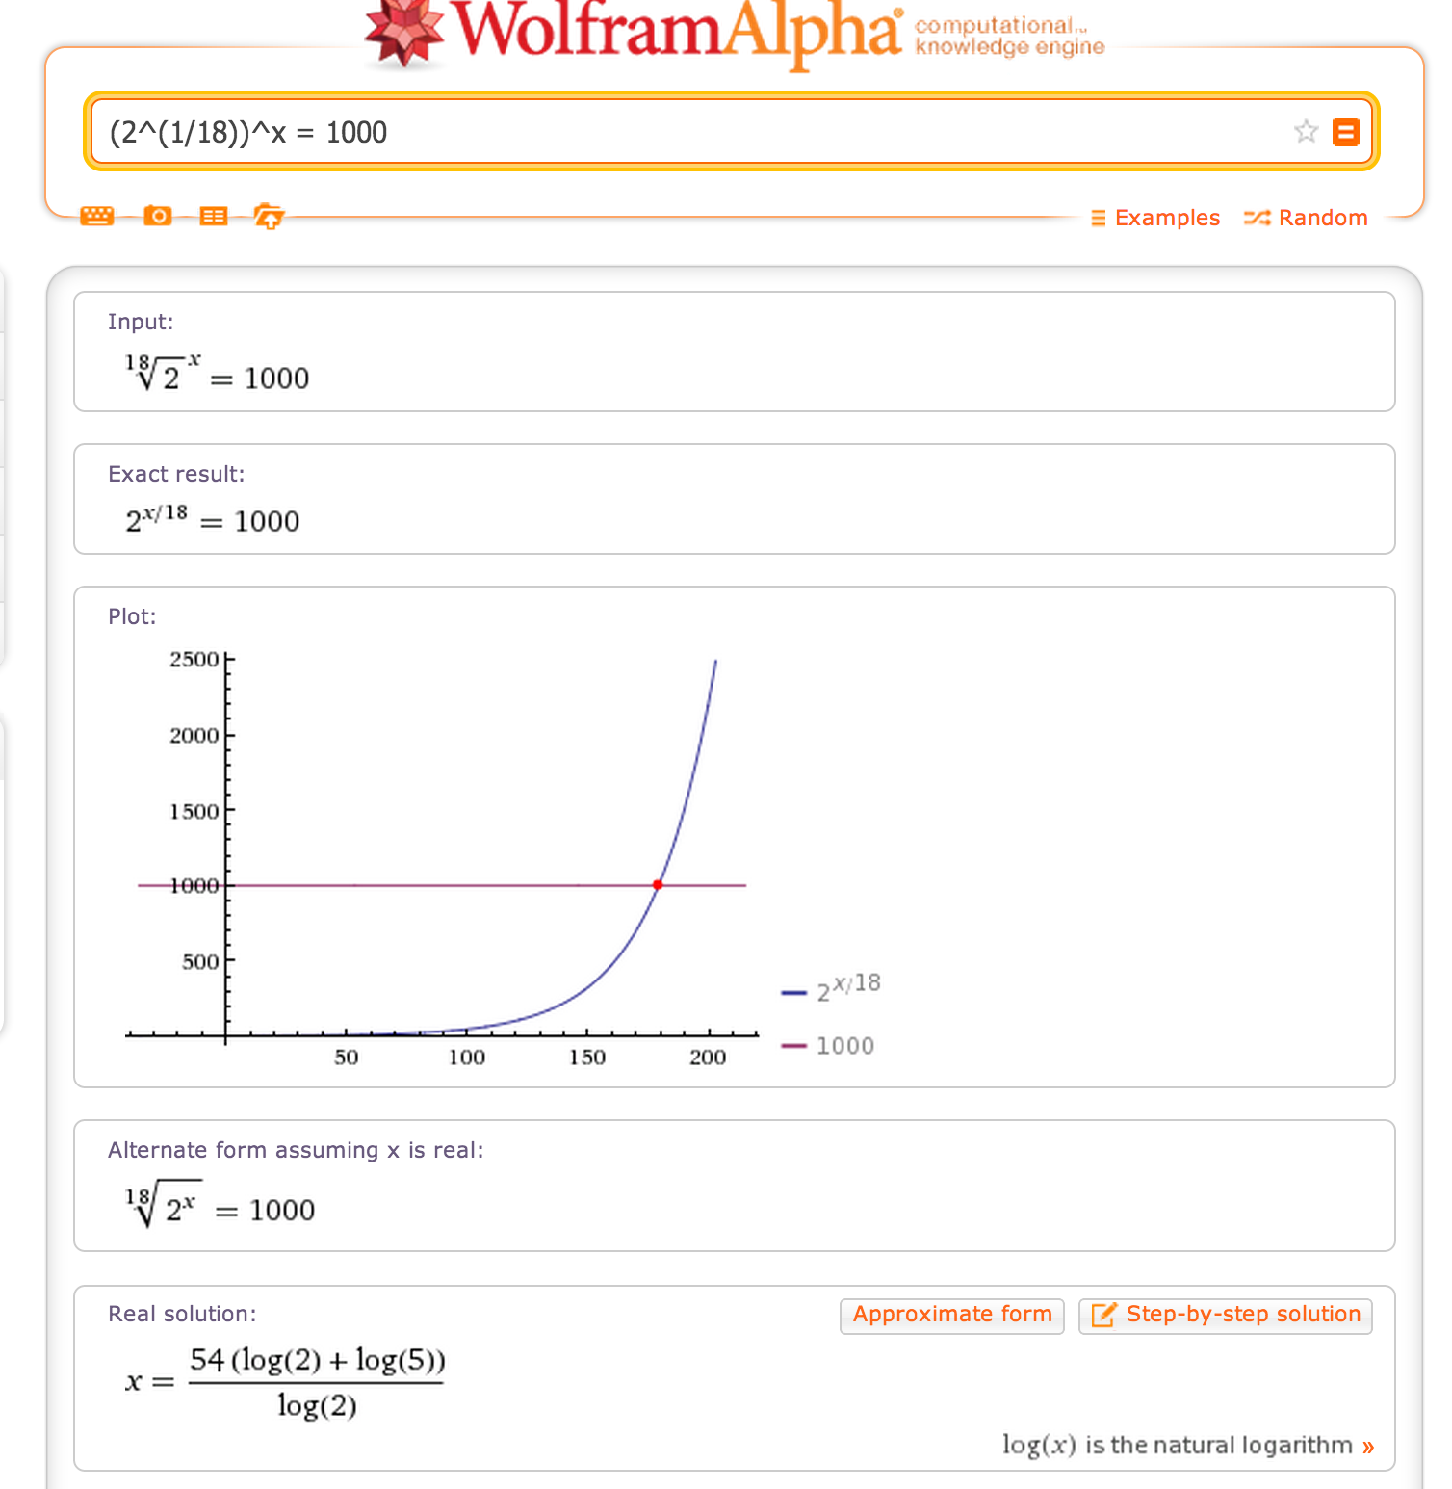
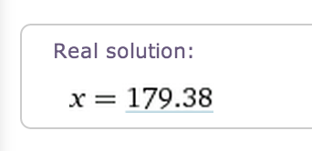
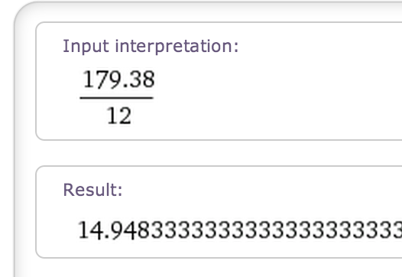

Slide 54
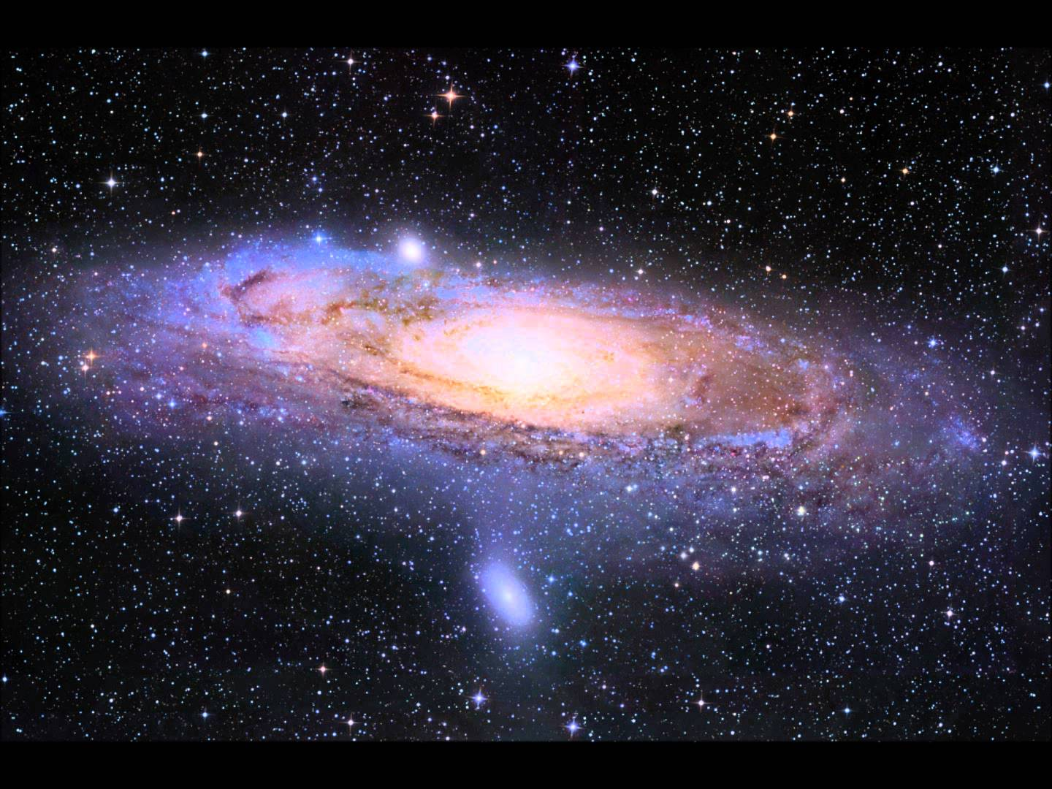
15 years ≈1000x computing power
≈ double understanding
“There’s an unwritten rule in astrophysics: your computer simulation must end before you die.”
Neil deGrasse Tyson
Will there be any mystery left in the Universe when you die?

Slide 55
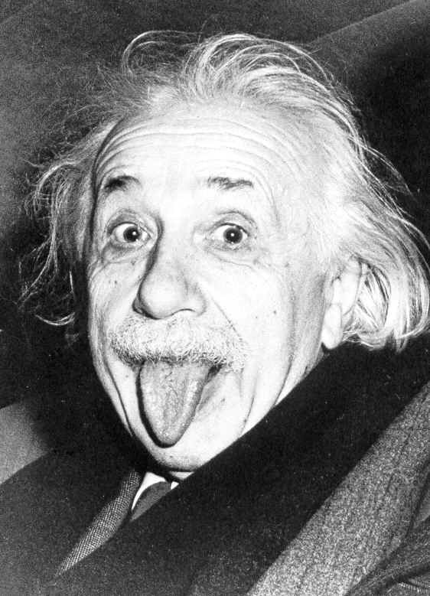
Only two things are infinite, the universe and human stupidity, and I'm not sure about the former.
Albert Einstein

Slide 56
The Endless Golden Age
Golden Age – period in which knowledge/quality of something improves exponentially
At any point in history, half of what is known about astrophysics was discovered in the previous 15 years!
  Moore’s law today, but other advances previously (and tomorrow): telescopes, photocopiers, clocks, agriculture, drone delivery, personal assistant, etc.
Accumulating 4% per year => doubling every 15 years!

Slide 57
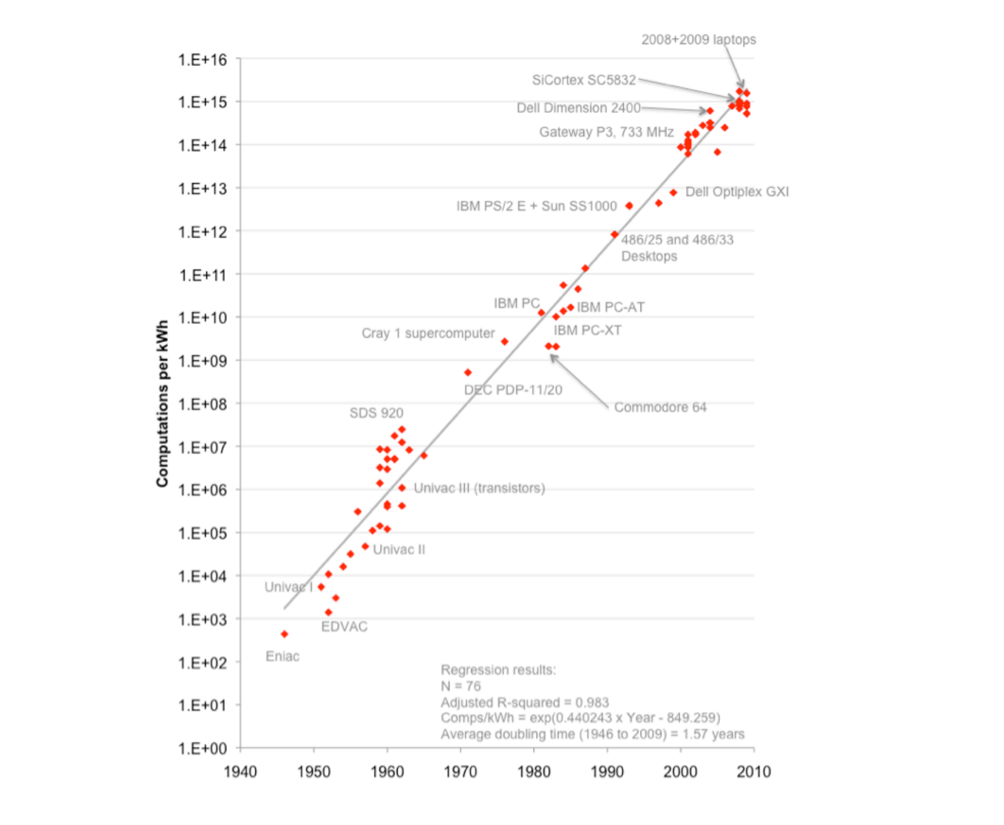
“Any physical quantity that’s growing exponentially predicts a disaster, you simply can’t go beyond certain major limits.”
Gordon Moore (2007)
Log scale: straight line = exponential curve!
Koomey’s Law:Assessing Trends in the Electrical Efficiency of Computation Over Time

Slide 58

An analysis of the history of technology shows that technological change is exponential, contrary to the common-sense 'intuitive linear' view. So we won't experience 100 years of progress in the 21st century-it will be more like 20,000 years of progress (at today’s rate)... Within a few decades, machine intelligence will surpass human intelligence, leading to the Singularity — technological change so rapid and profound it represents a rupture in the fabric of human history. The implications include the merger of biological and non-biological intelligence, immortal software-based humans, and ultra-high levels of intelligence that expand outward in the universe at the speed of light.
Ray Kurzweil

Slide 59


Slide 60
Sustainability is a very depressing goal for a scientist/engineer – we should be striving for progress!
share what we have with the rest of the world (by lowering costs)
invent new things that improve the quality, interconnectedness, and length of human life

Slide 61
Golden Ages or
Golden Catastrophes?

Slide 62
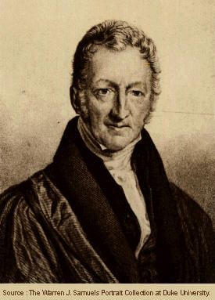
Reverend Thomas Robert Malthus, Essay on the Principle of Population, 1798

Slide 63
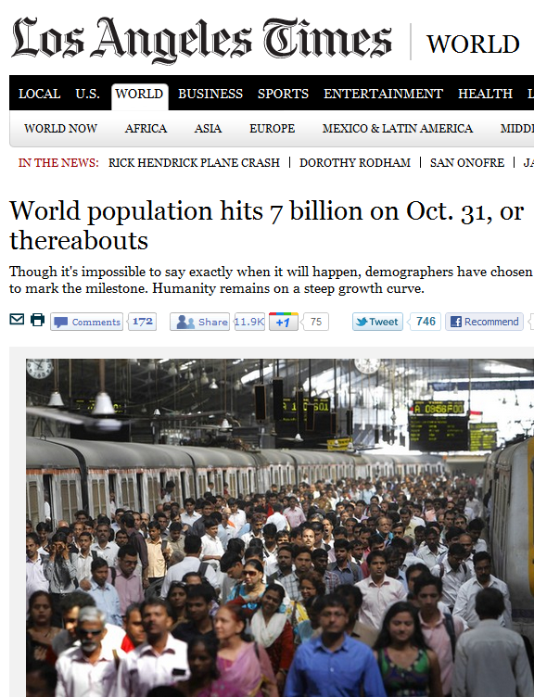
The great and unlooked for discoveries that have taken place of late years in natural philosophy, the increasing diffusion of general knowledge from the extension of the art of printing, the ardent and unshackled spirit of inquiry that prevails throughout the lettered and even unlettered world, … have all concurred to lead many able men into the opinion that we were touching on a period big with the most important changes, changes that would in some measure be decisive of the future fate of mankind.”

Slide 64
I think I may fairly make two postulata.
  First, that food is necessary to the existence of man.
  Secondly, that the passion between the sexes is necessary and will remain….
Assuming then my postulata, I say, that the power of population is indefinitely greater than the power in the earth to produce subsistence. Population, when unchecked, increases in a geometrical ratio. Subsistence increases only in an arithmetical ratio.
Food per person = Θ(n) / Θ(k^{n}) approaches 0

Slide 65
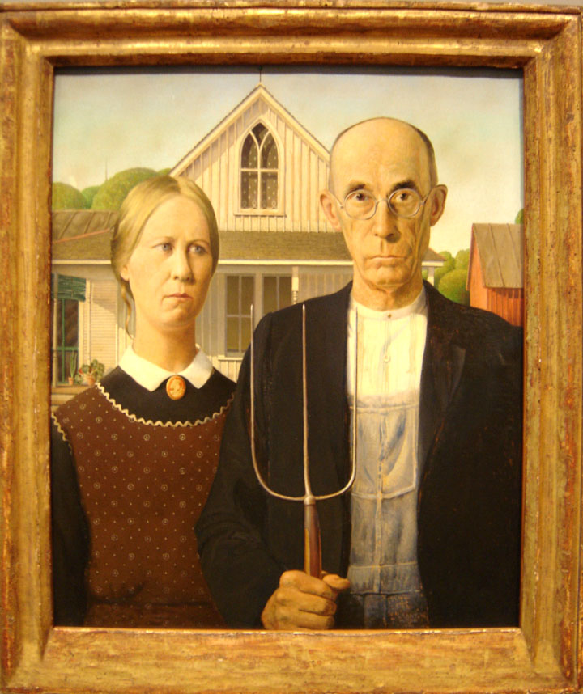
Malthus’ Fallacy?

Slide 66
Malthus’ Fallacy
He forgot how he started:
The great and unlooked for discoveries that have taken place of late years in natural philosophy, the increasing diffusion of general knowledge from the extension of the art of printing, the ardent and unshackled spirit of inquiry that prevails throughout the lettered and even unlettered world…

Slide 67
Golden Age of Food Production
Agriculture is an “endless golden age” field: production from the same land increases as ~ Θ(1.02^{n})
Increasing knowledge of farming, weather forecasting, plant domestication, genetic engineering, pest repellants, distribution channels, preservatives, etc.

Slide 68


Growing Corn
1906: < 1,000 pounds per acre
2006: 10,000 pounds per acre
Michael Pollan’s The Omnivore’s Dilemma

Slide 69

Corn Yield
Note: Log axis!
http://www.agbioforum.org/v2n1/v2n1a10-ruttan.htm

Slide 70


https://www.wolframalpha.com/input/?i=corn+yield+china+vs.+us

Slide 71


Green Revolution
Norman Borlaug (1914-2009)

Slide 72
“At a time when doom-sayers were hopping around saying everyone was going to starve, Norman was working. He moved to Mexico and lived among the people there until he figured out how to improve the output of the farmers. So that saved a million lives. Then he packed up his family and moved to India, where in spite of a war with Pakistan, he managed to introduce new wheat strains that quadrupled their food output. So that saved another million. You get it? But he wasn't done. He did the same thing with a new rice in China. He's doing the same thing in Africa -- as much of Africa as he's allowed to visit. When he won the Nobel Prize in 1970, they said he had saved a billion people. That's BILLION! BUH! That's Carl Sagan BILLION with a "B"! And most of them were a different race from him. Norman is the greatest human being, and you probably never heard of him.”
Penn Jillette (Penn & Teller)

Slide 73


Malthus was wrong about #2 Also
Advances in science (birth control), medicine (higher life expectancy), education, and societal and political changes (e.g., regulation in China) have reduced k (it is < 1 in many countries now!)

Slide 74

Upcoming Malthusian Catastrophes?
http://ourfiniteworld.com/2012/03/12/world-energy-consumption-since-1820-in-charts/

Slide 75




Slide 76
“Cornucopian View”
Few resources are really finite
All scientific things have endless golden ages
Knowledge accumulates
Knowledge makes it easier to acquire more
(We hope) Human ingenuity and economics and politics will continue solve problems before they become catastrophes
  No one will sell the last gallon of gas for $3

Slide 77


Prediction #4
The vast majority of jobs people have today will be automated, and the fraction of the world’s population who can produce something of economic value (i.e., that cannot be done better and cheaper by machines) will plummet.
Automated Mall Cop
Automated Warehouse

Slide 78


Will the elimination of tedious human work cause mass riots or mass rejoicing?
Luddites, 1812

Slide 79

Charles Vest’s slide idea!
America will always do the right thing
but only after exhausting all other options.
Winston Churchill

Slide 80

Charge
The best way to predict the future is to invent it.
— Alan Kay
Project submissions by 4:59pm tomorrow!

