Slide 1
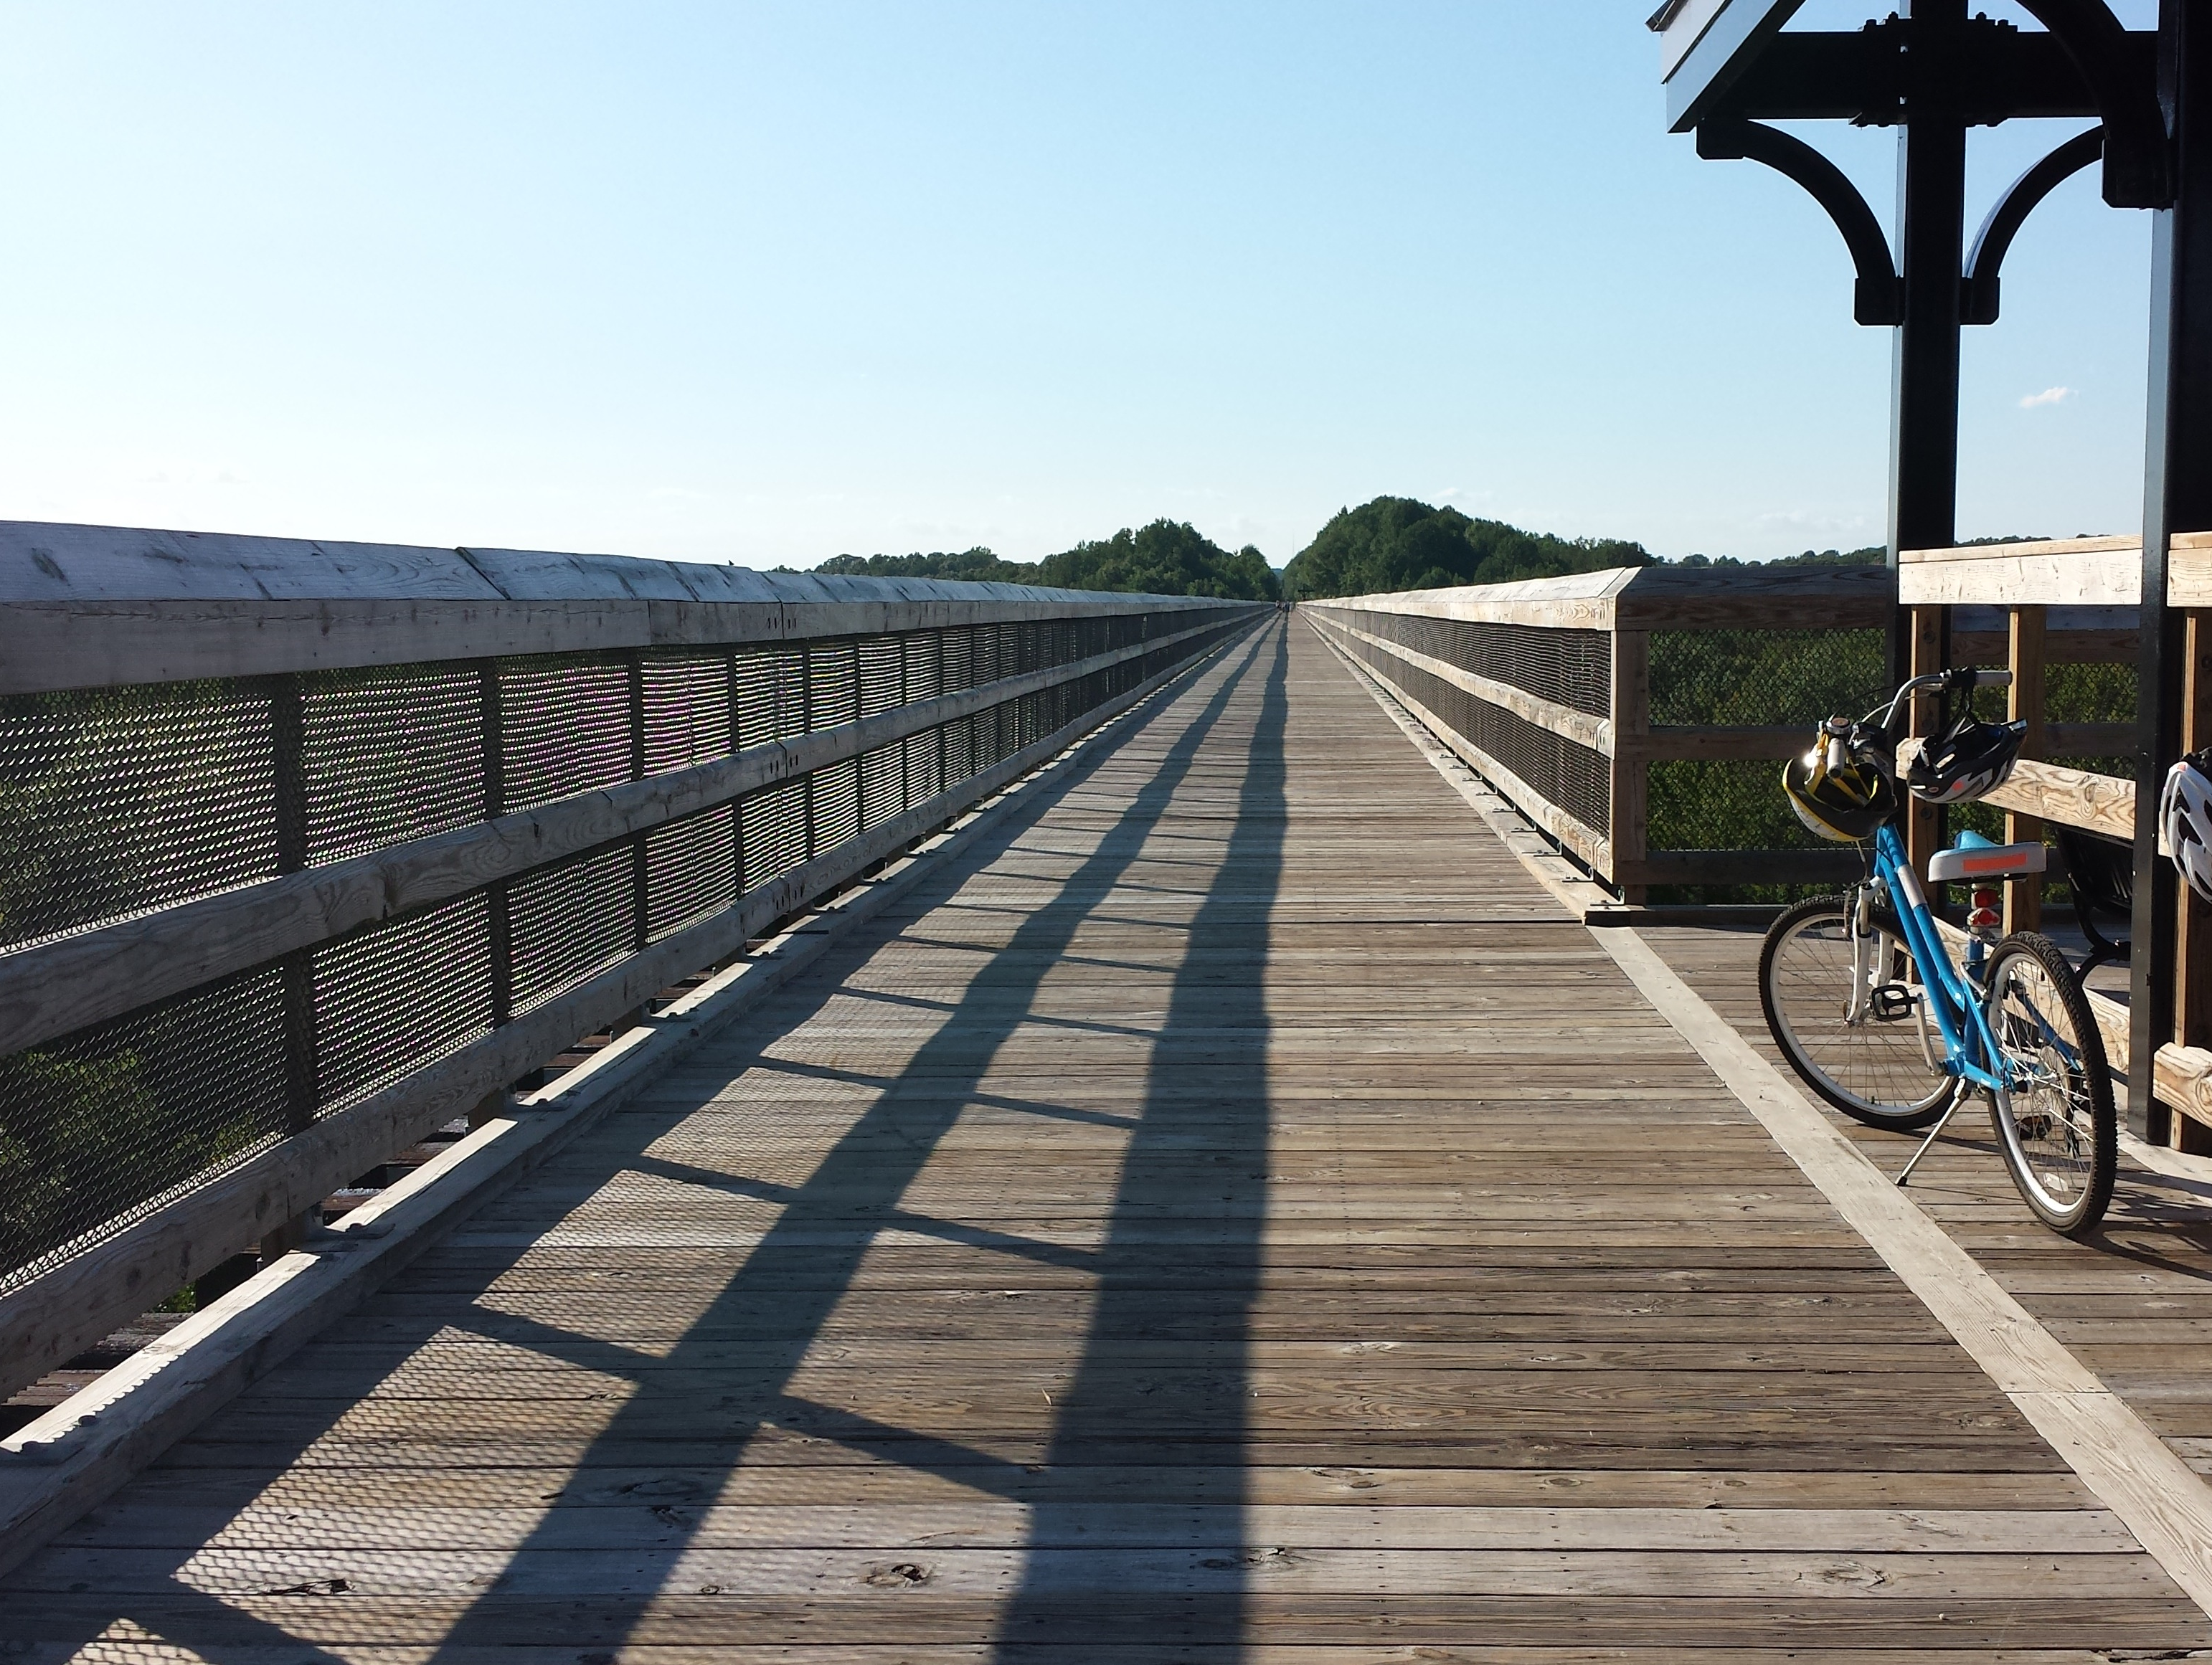
Class 3: Zero to a Billion in 4.86 Years
(War, Peace, and Operating Systems)
cs4414 Fall 2013
University of Virginia
David Evans

Slide 2
Today’s Class
Brief history of operating systems
Two prevailing technical themes:
  kernel
  process
PS1 is due Sunday, 11:59pm

Slide 3
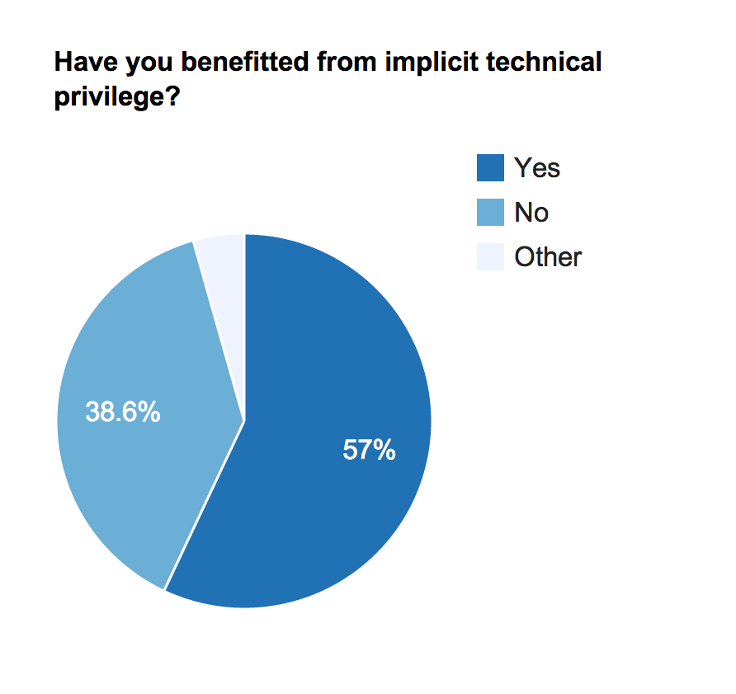
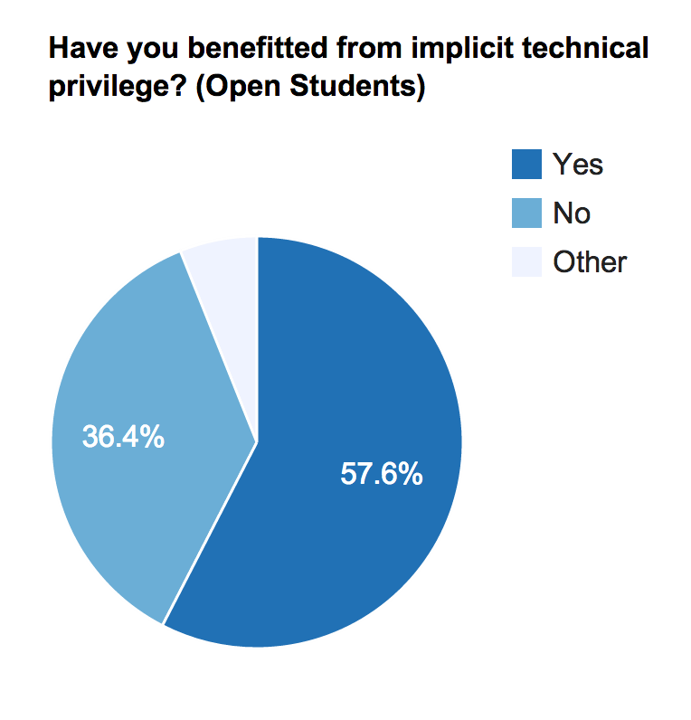

Slide 4
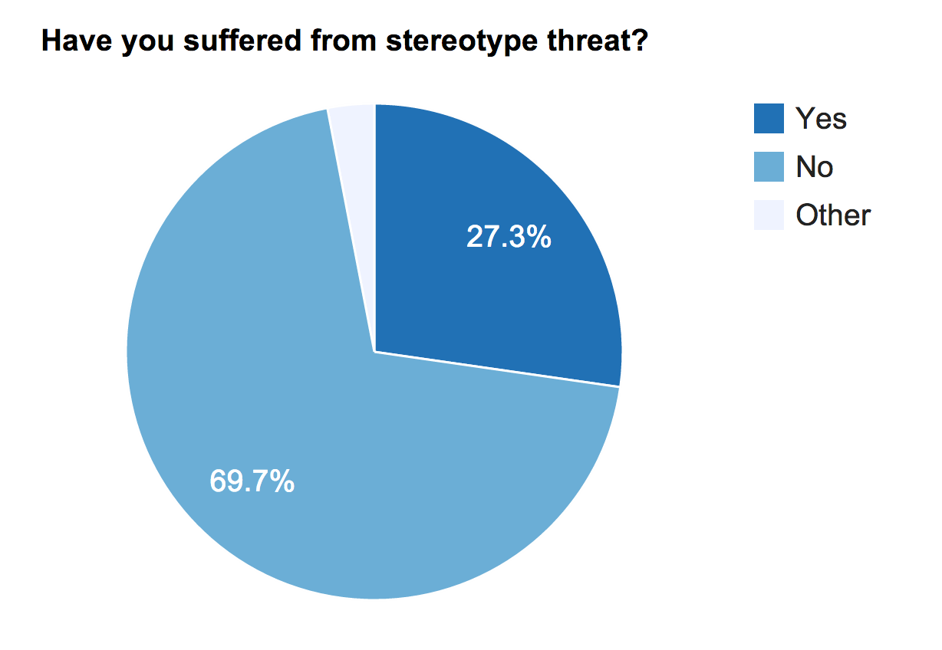
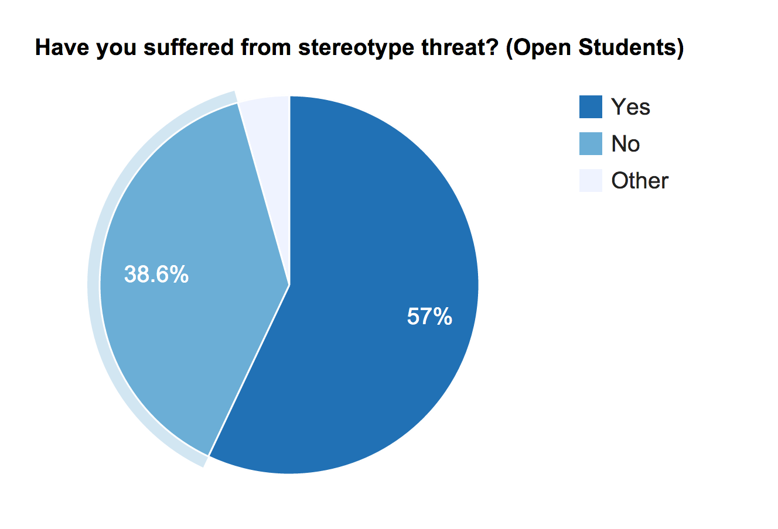
Selected responses and comments will be posted on course site later today

Slide 5
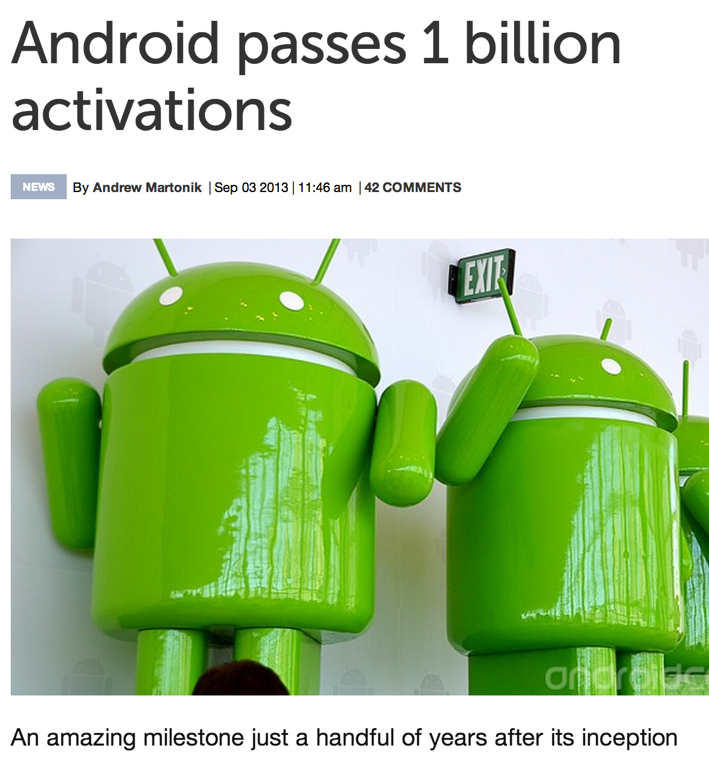
September 2013:
Billionth Android Activation

Slide 6
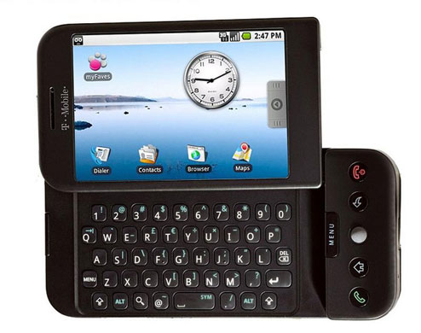
5.25 years ago…
“The long-awaited HTC Dream, the first commercial handset running Google’s Android operating system, will be coming to T-Mobile as the G1 for $179 on October 22nd. Featuring a 3-inch touchscreen, internet navigation buttons and a full QWERTY keypad, the smartphone market has finally broken free of Symbian, Windows Mobile and the sweet clutches of fruit companies.”
Mark Wilson, 23 Sept 2008

Slide 7
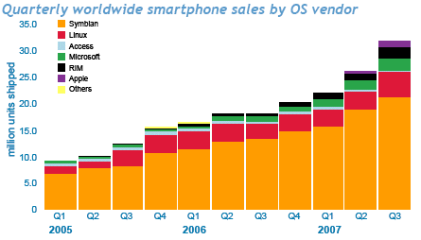
http://www.mobilephonedevelopment.com/archives/507

Slide 8
1 000 000 000
Android Activations
Oct 2008
Sept 2013

Slide 9

about 13.8 Billion years ago…

Slide 10
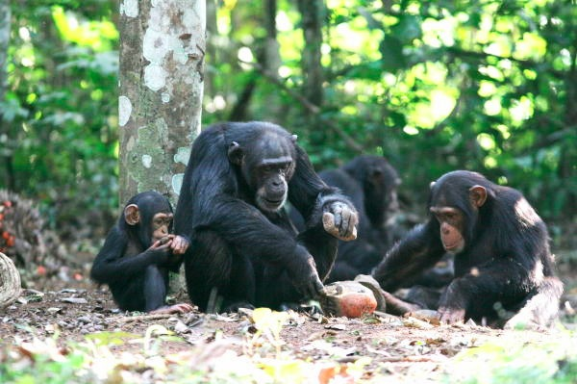
Chimpanzees (∼5 million years ago):
Using tools to amplify physical abilities
Working in teams
Altruistic behavior
Notes:
Image: http://mindclockwork.com/ape-intelligence-can-monkeys-be-as-clever-as-humans/

Slide 11
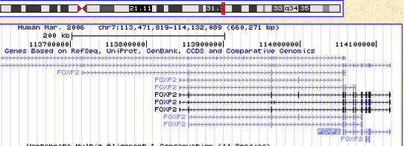
about 300,000 years ago…
Mutations to the FOXP2 gene enable development of brains that can handle recursive language
S ::= NP V
NP ::= N and NP
Caveat: This is speculative…best current theory.

Slide 12
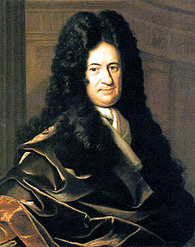
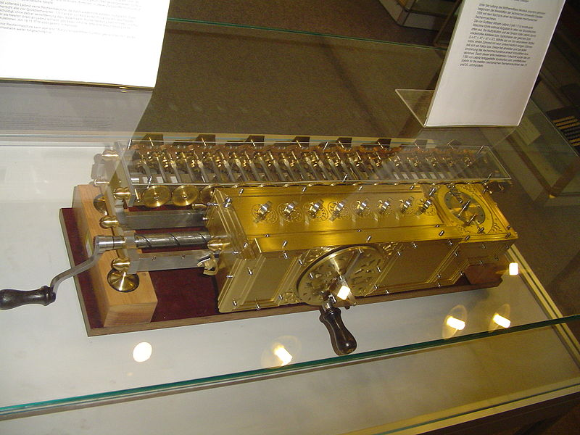
1679
Digital Mechanical Calculator: +, -, *, /
Gottfried Wilhelm Leibniz

Slide 13
...a general method in which all truths of reason would be reduced to a kind of calculation. At the same time, this would be a sort of universal language or script, but infinitely different from all those imagined previously, because its symbols and words would direct the reason, and errors – except those of fact - would be mere mistakes in calculation…
Gottfried Wilhelm Leibniz

Slide 14
Gottfried Wilhelm Leibniz (Universitat Altdorf, 1666) who advised:
Jacob Bernoulli (Universitdt Basel, 1684) who advised:
Johann Bernoulli (Universitdt Basel, 1694) who advised:
Leonhard Euler (Universitat Basel, 1726) who advised:
Joseph Louis Lagrange who advised:
Simeon Denis Poisson who advised:
Michel Chasles (Ecole Polytechnique, 1814) who advised:
H. A. (Hubert Anson) Newton (Yale, 1850) who advised:
E. H. Moore (Yale, 1885) who advised:
Oswald Veblen (U. of Chicago, 1903) who advised:
Philip Franklin (Princeton 1921) who advised:
Alan Perlis (MIT Math PhD 1950) who advised:
Jerry Feldman (CMU Math 1966) who advised:
Jim Horning (Stanford CS PhD 1969) who advised:
John Guttag (U. of Toronto CS PhD 1975) who advised:
David Evans (MIT CS PhD 2000)
my academic great-great-great-great-great-great-great-great-great-great-great-great-great-great-great-grandparent!
http://www.cs.virginia.edu/evans/academic-roots.html

Slide 15
1 000 000 000
Android Activations
Programmable Machines
Recursive Language
Tools
Altruism
Universe
S ::= NP V O
NP ::= N and NP
-13.8B
-5M
-300K
1679
2008
2013

Slide 16
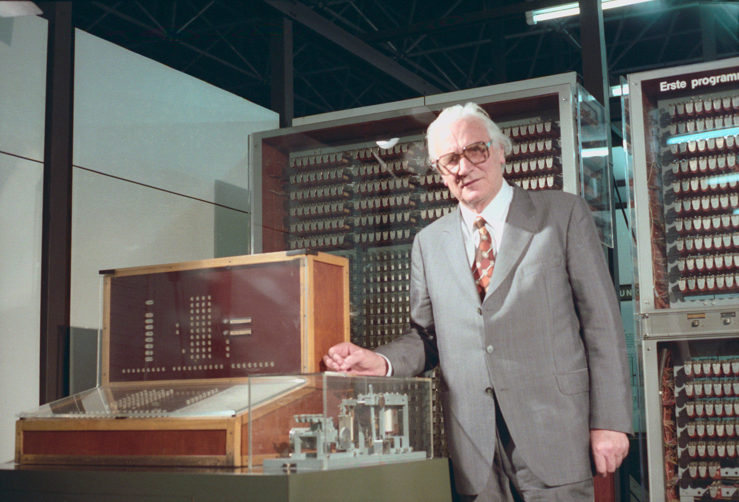
Z3 (Operational 1941)
First working (bounded) universal machine
Konrad Zuse (1910-1995)

Slide 17
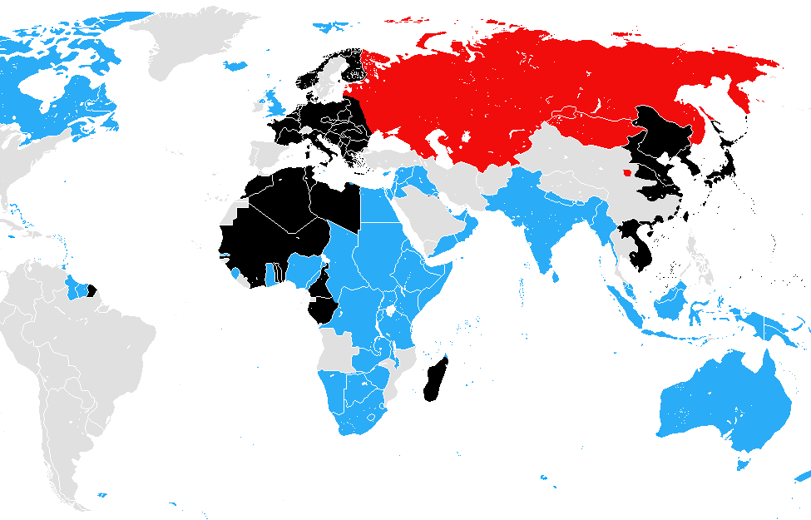
The World in July 1941
Black: Axis
Red: Soviet (pact with Nazis)
Grey: Neutral
Blue: Anti-Nazis
http://commons.wikimedia.org/wiki/File:Ww2_allied_axis_1941_jul.png

Slide 18
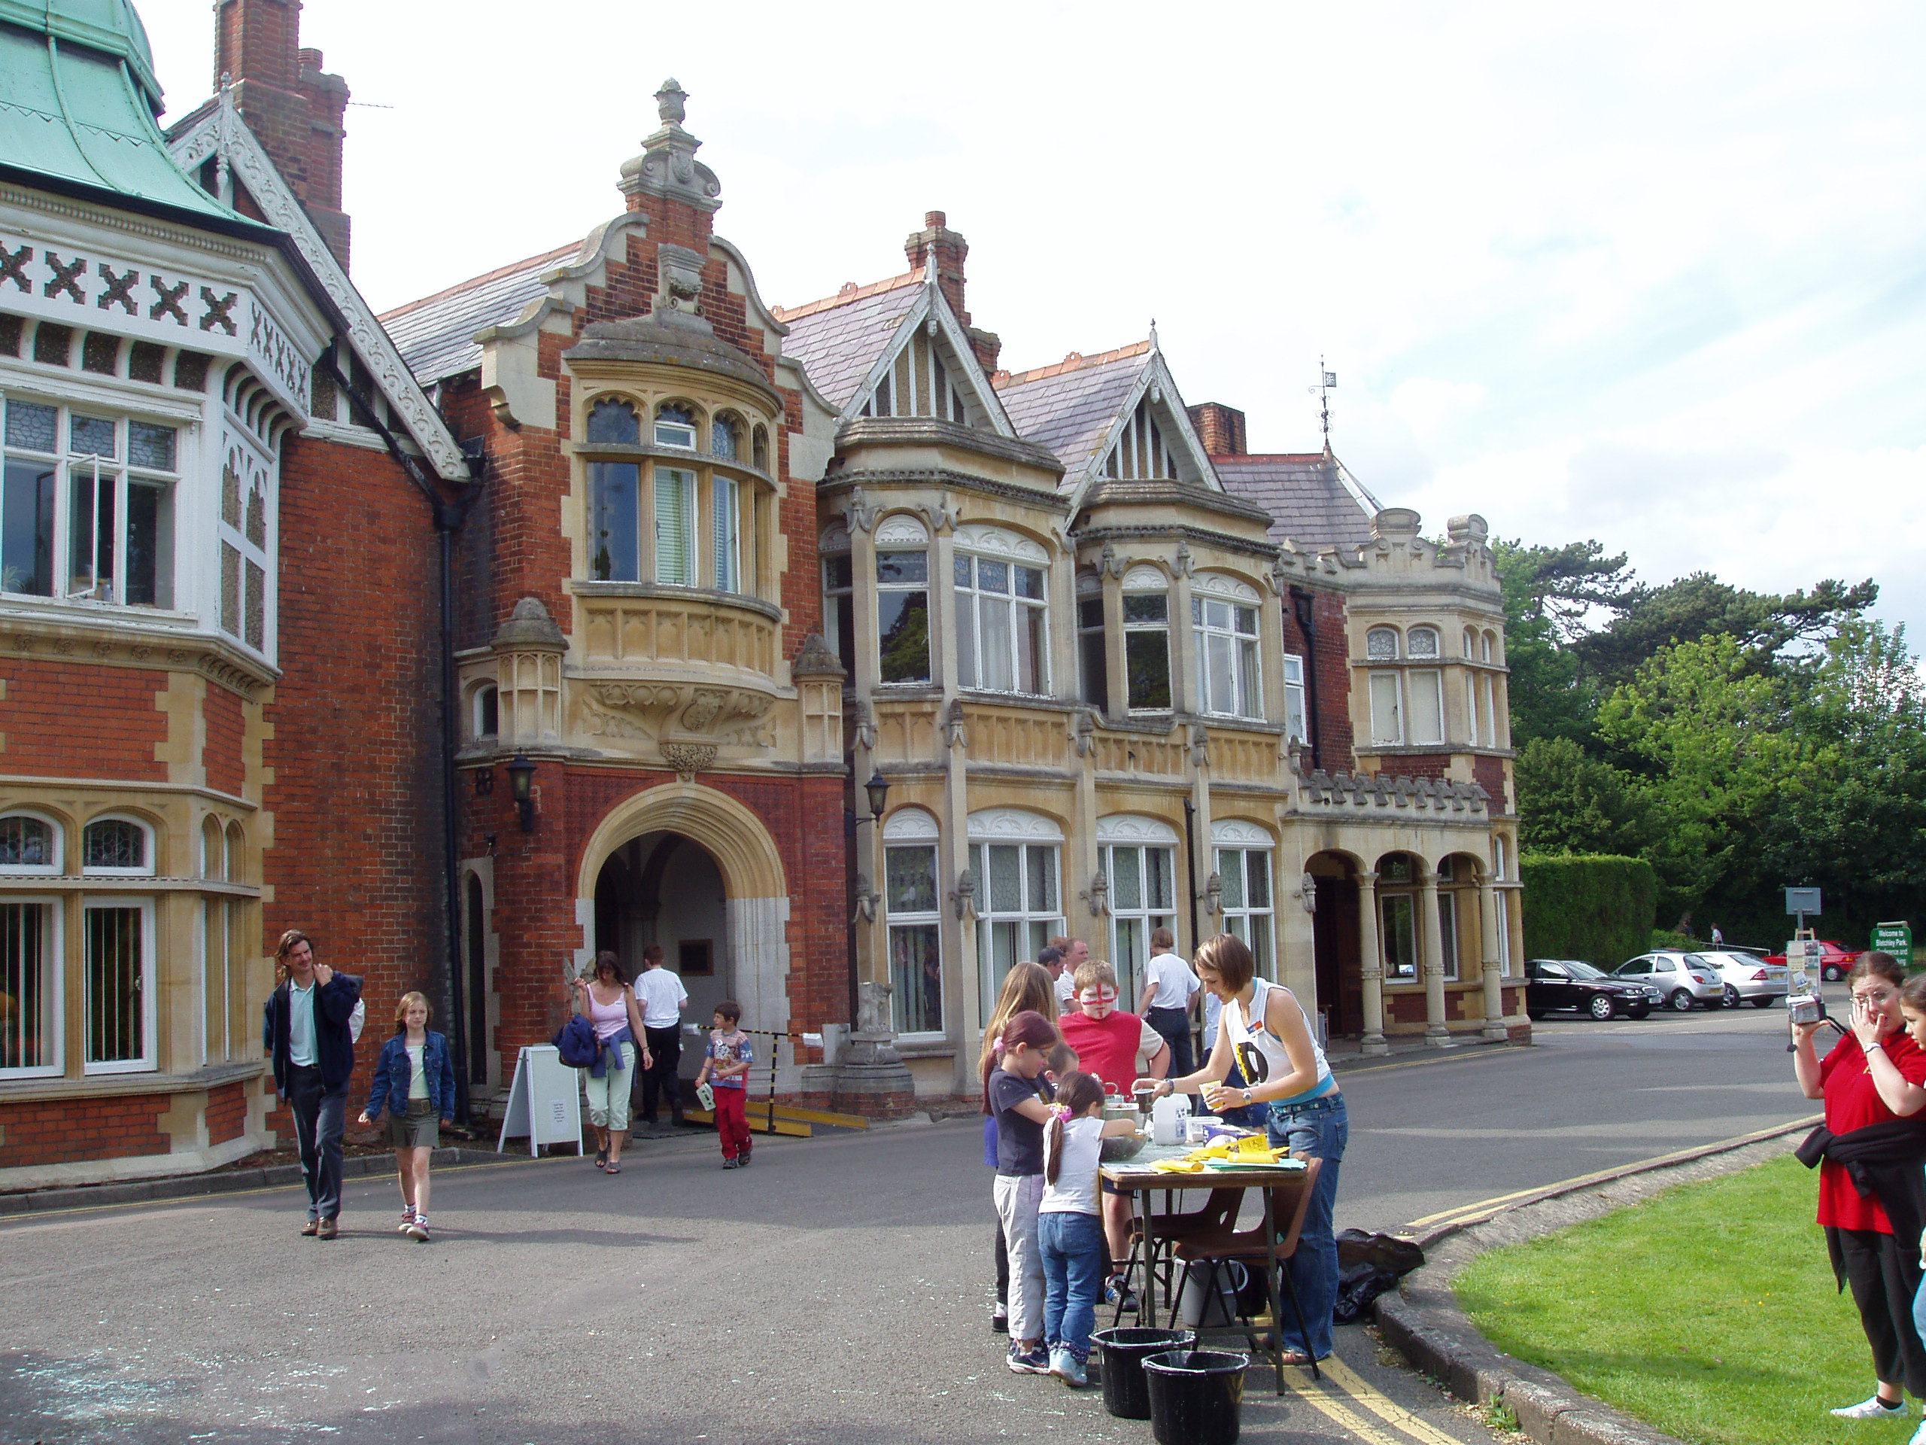

Slide 19

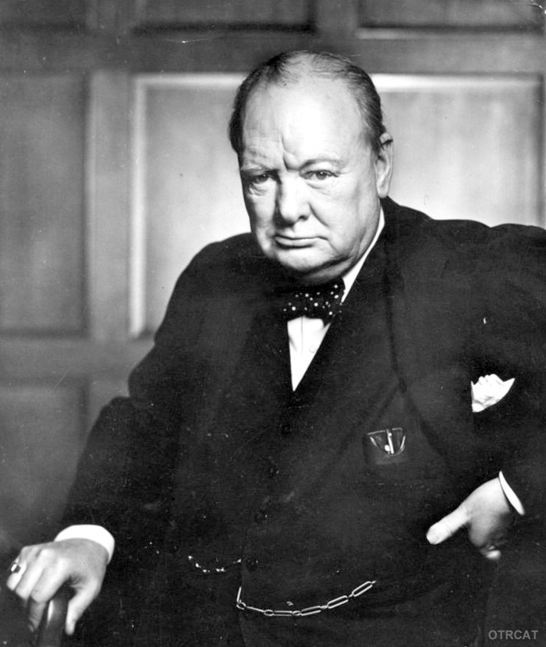
21st October 1941
Dear Prime Minister,
Some weeks ago you paid us the honour of a visit, and we believe that you regard our work as important. … it seems to us that we have met with unnecessary impediments. …The cumulative effect, however, has been to drive us to the conviction that the importance of the work is not being impressed with sufficient force upon those outside authorities with whom we have to deal.
A.M. Turing (+ 3 others)
Winston Churchill

Slide 20
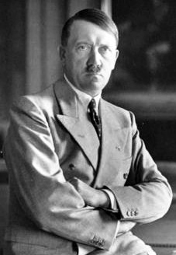
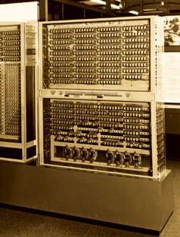
“Strategically Unimportant”
Konrad Zuse Z3

Slide 21
Most Important Decision of WWII?
21st October 1941
Dear Prime Minister,
Some weeks ago you paid us the honour of a visit, and we believe that you regard our work as important. … it seems to us that we have met with unnecessary impediments. …The cumulative effect, however, has been to drive us to the conviction that the importance of the work is not being impressed with sufficient force upon those outside authorities with whom we have to deal.
A.M. Turing (+ 3 others)
ACTION
THIS DAY
Winston Churchill

Slide 22
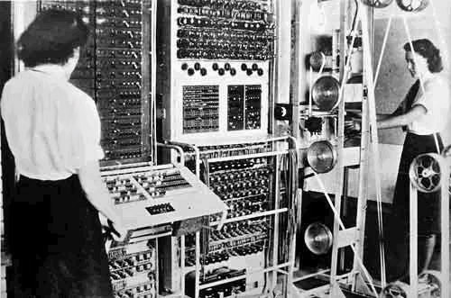
Colossus (1943)
Bletchley Park

Slide 23
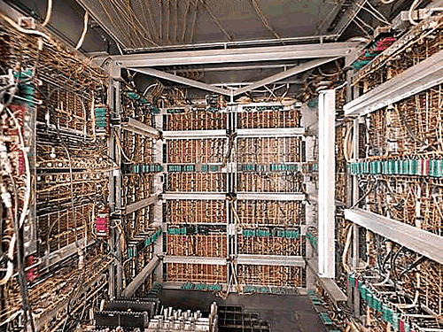
1 000 000 000
Android Activations
Practical Universal Machines
Programmable Machines
Tools
Altruism
Recursive Language
Universe
S ::= NP V O
NP ::= N and NP
-13.8B
-5M
-300K
1679
1945
2008
2013

Slide 24
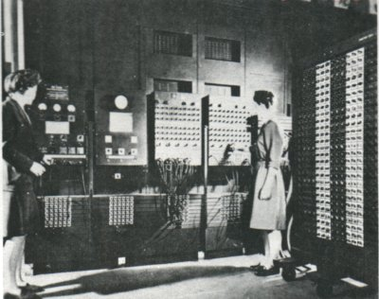
Do we have Operating Systems yet?
ENIAC (1946)

Slide 26
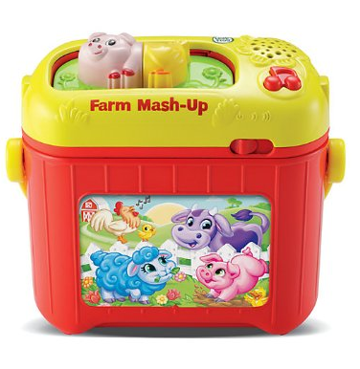

Slide 27
Directions for Getting 6
Choose any regular accumulator (ie. Accumulator #9).
Direct the Initiating Pulse to terminal 5i.
The initiating pulse is produced by the initiating unit's Io terminal each time the Eniac is started. This terminal is usually, by default, plugged into Program Line 1-1 (described later). Simply connect a program cable from Program Line 1-1 to terminal 5i on this Accumulator.
Set the Repeat Switch for Program Control 5 to 6.
Set the Operation Switch for Program Control 5 to ADD .
Set the Clear-Correct switch to C.
Turn on and clear the Eniac.
Normally, when the Eniac is first started, a clearing process is begun. If the Eniac had been previously started, or if there are random neons illuminated in the accumulators, the “Initial Clear” button of the Initiating device can be pressed.
Press the “Initiating Pulse Switch” that is located on the Initiating device.
Stand back.

Slide 28
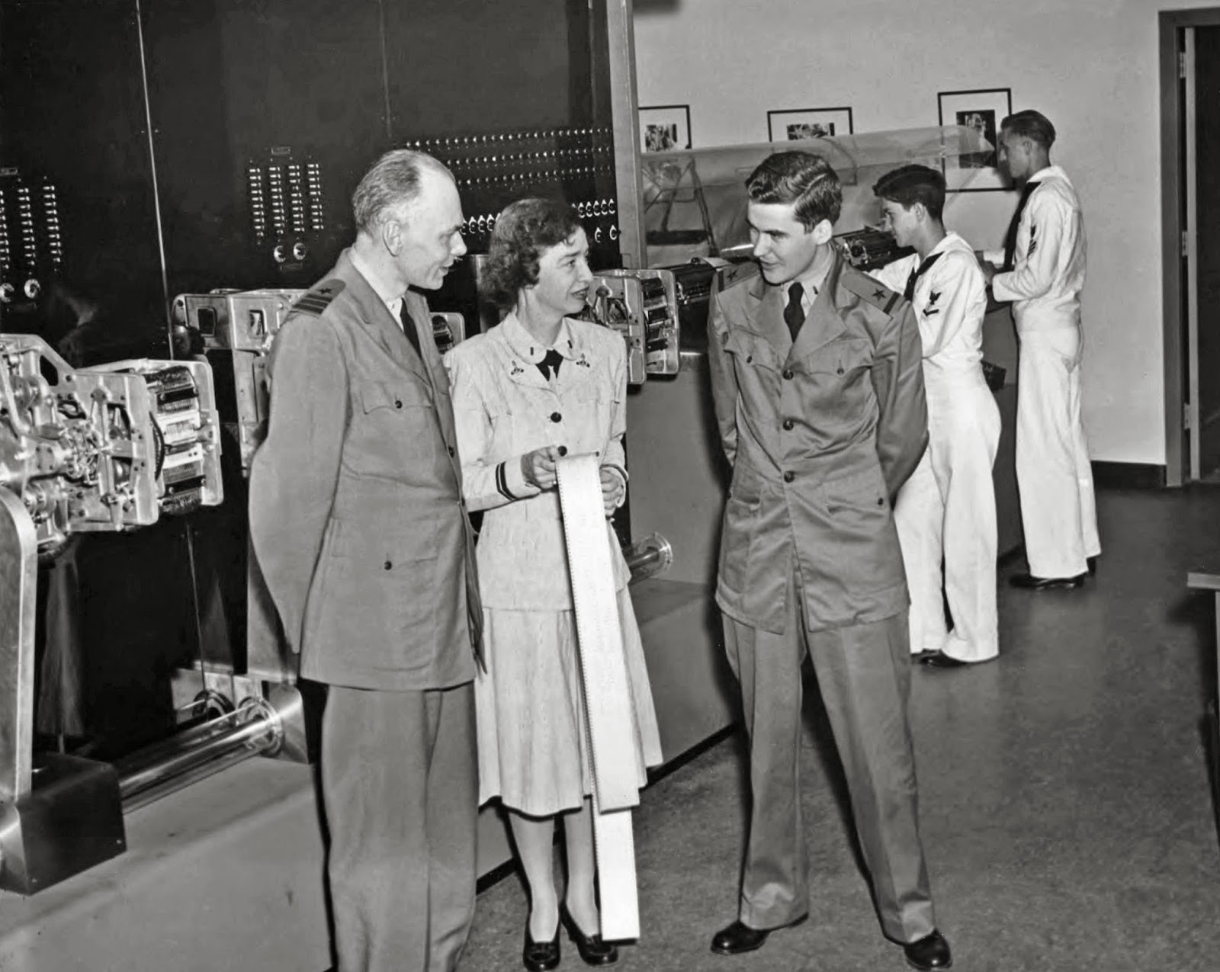
Admiral Grace Hopper
(1906-1992)

Slide 29
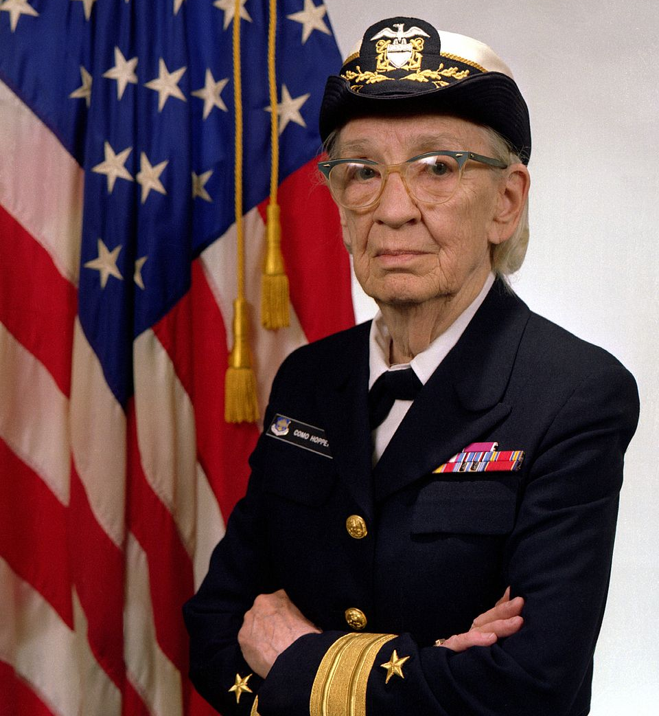
“Nobody believed that I had a running compiler and nobody would touch it. They told me computers could only do arithmetic.”

Slide 30


Slide 31
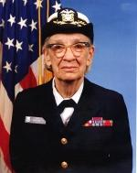
1 000 000 000
Android Activations
Practical Universal Machines
Abstractions
Programmable Machines
Tools
Altruism
Recursive Language
Universe
S ::= NP V O
NP ::= N and NP
-13.8B
-5M
-300K
1679
1945
1950s
2008
2013

Slide 32
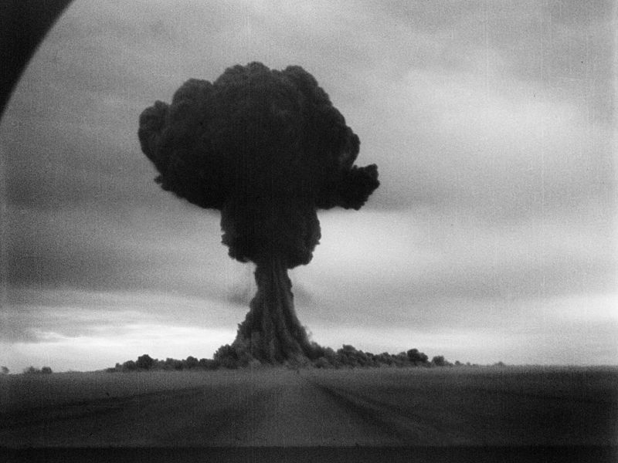
August 29, 1949
First Soviet Atomic Test

Slide 33
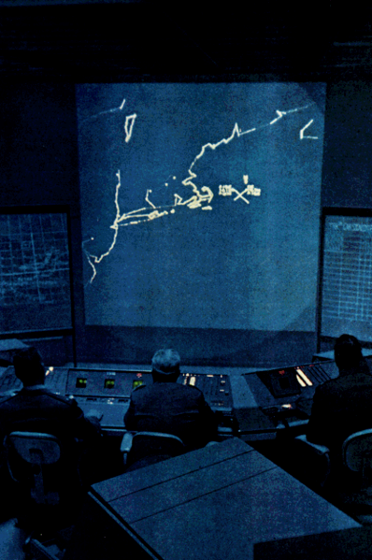
Semi-Automatic Ground Environment (SAGE)
MIT/IBM, 1950-1982
Coordinate radar stations in real-time to track incoming bombers
Total cost: ∼$55B
(> Manhattan Project)

Slide 34
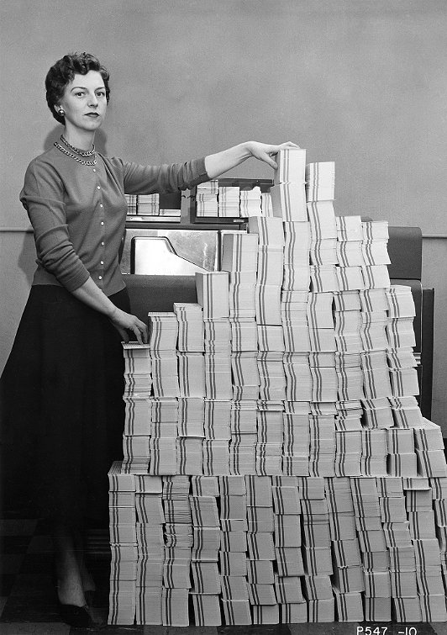
Control program for SAGE
(62500 cards ∼ 5MB)
Image: Computer History Museum

Slide 35
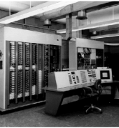
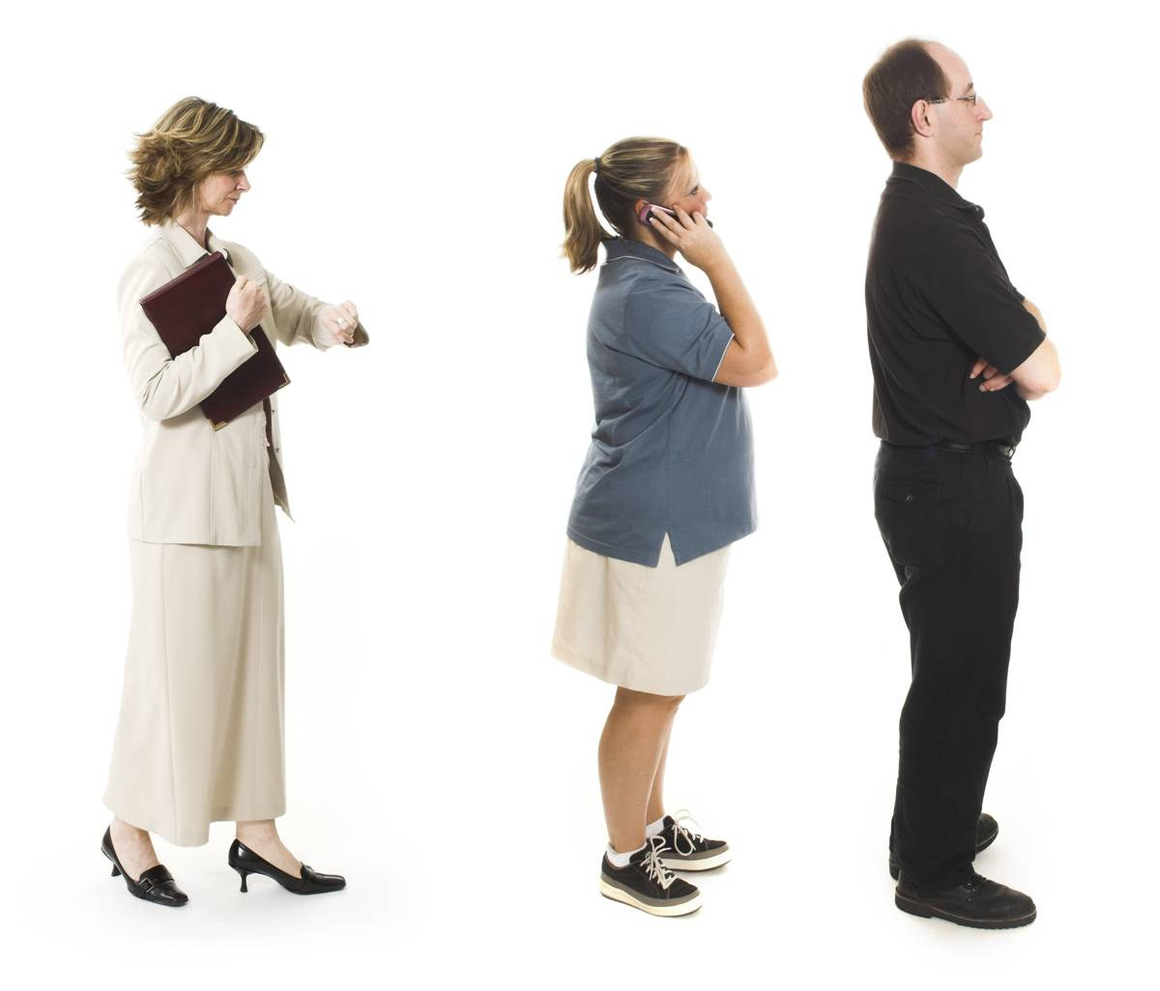
Batch Processing
Program
Computer Center
Your Program Runs
Output: Invalid Operation
Charge: $174.32

Slide 36
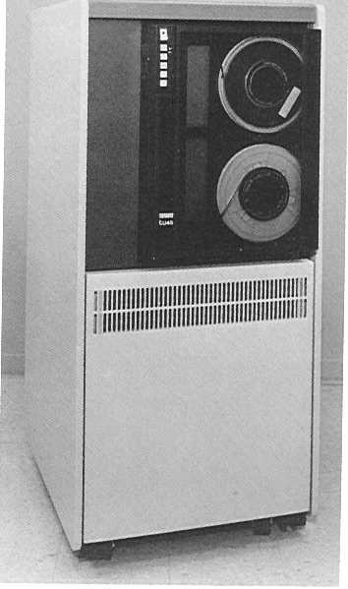
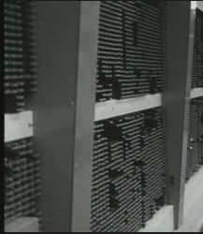
Reading data is slow
Processing is (relatively) fast

Slide 37
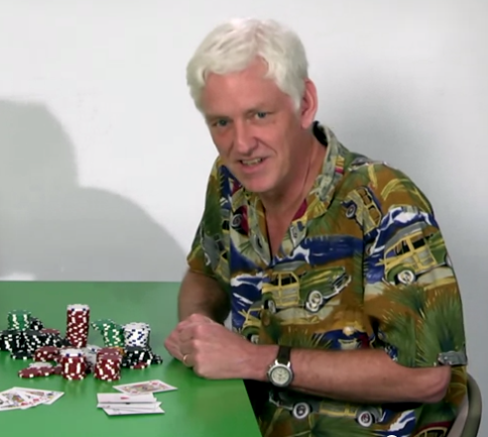
Peter Norvig’s Numbers Every Programmer Should Know
execute typical instruction 1 ns
fetch from main memory 100 ns
read 1MB sequentially from memory 250,000 ns
fetch from new disk location (seek) 8,000,000 ns
send packet US to Europe and back 150,000,000 ns
These are from 2001 (and several more numbers) – try Norvigtorious app for up-to-date numbers.
(Please don’t click the picture link!)

Slide 38
Multiprograming
A
Program A
B
Program B
A
Program C
C

Slide 39
Making Multiprogramming Work
A
Goal: allow multiple programs to share one machine, but other programs shouldn’t break my program
B
A
C

Slide 40
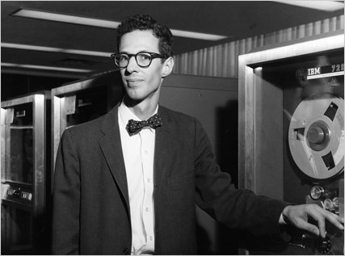
MULTICS
Multiplexed Information and Computing Service
1964-(2000)
MIT, GE/Honeywell
(Bell Labs < 1969)
Fernando Corbató

Slide 41
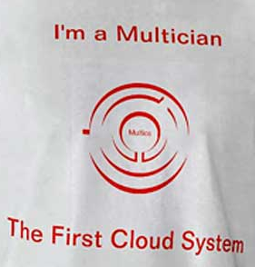
MULTICS
Process abstraction
Virtual memory
Dynamic linking
Hierarchical file system
Entirely programmed in
high-level language
Multi-level security
On-line reconfiguration
Which of these is true for the OS running on your laptop today?

Slide 42
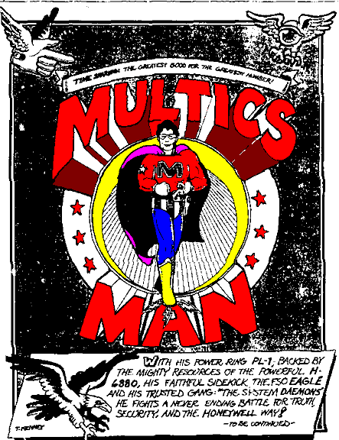
1 000 000 000
Android Activations
“(post?) Modern OS”
Practical Universal Machines
Abstractions
Programmable Machines
Tools
Altruism
Recursive Language
Universe
S ::= NP V O
NP ::= N and NP
-13.8B
-5M
-300K
1679
1945
1950s
1969
2008
2013

Slide 43
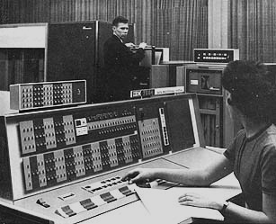
IBM 704 (1969)
∼144 KB
$3.5 Million

Slide 44
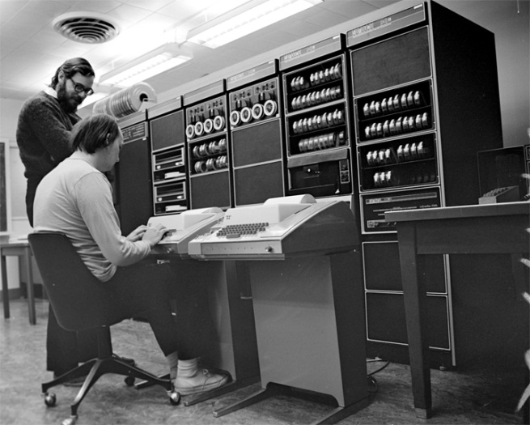
Bell Labs 1969
Ken Thompson
PDP-7
∼8KB
$72,000
Dennis Ritchie
Later picture: PDP-11

Slide 45
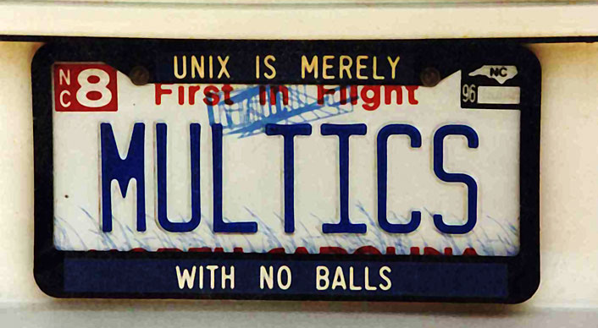
UNIX

Slide 46
MULTICS
UNIX
Process abstraction
Virtual memory
Dynamic linking
Hierarchical file system
Entirely programmed in high-level language (PL/1)
Multi-level security
On-line reconfiguration
Runs on machines costing $Ms
Code controlled by GE/etc.

Slide 47
MULTICS
UNIX
Process abstraction
Virtual memory
Dynamic linking
Hierarchical file system
Entirely programmed in high-level language (PL/1)
Multi-level security
On-line reconfiguration
Process abstraction
(Not Really)
(Not Really)
Yes
Assembly; had to simplify B to fit into machine (C)
No security (until later)
Reboot
Runs on machines costing $Ms
Code controlled by GE/etc.
Runs on machines costing $10Ks
Source code available to universities, classroom use permitted
1956 Anti-Trust Settlement: AT&T was not allowed to enter computer business!

Slide 48
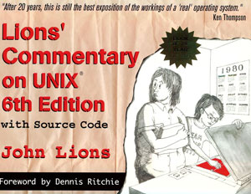
1976 book

Slide 49
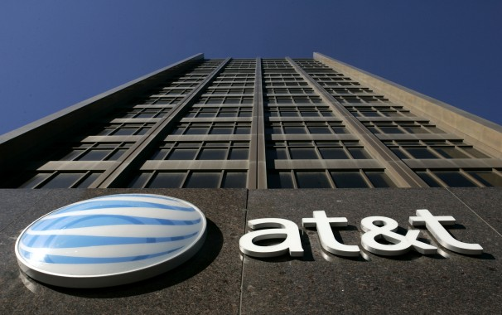

Slide 50
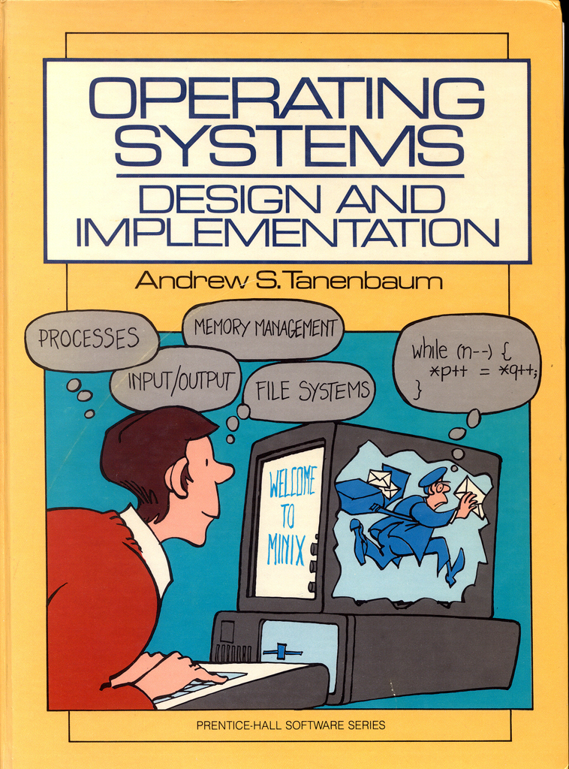
1987: Andy Tanenbaum
  Includes source code for Minix (“toy” Unix)

Slide 51
From: torv...@klaava.Helsinki.FI (Linus Benedict Torvalds)
Newsgroups: comp.os.minix
Subject: What would you like to see most in minix?
Summary: small poll for my new operating system
Keywords: 386, preferences
Date: 25 Aug 91 20:57:08 GMT
Hello everybody out there using minix -
I'm doing a (free) operating system (just a hobby, won't be big and professional like gnu) for 386(486) AT clones. This has been brewing since april, and is starting to get ready. I'd like any feedback on things people like/dislike in minix, as my OS resembles it somewhat (same physical layout of the file-system (due to practical reasons) among other things).
I've currently ported bash(1.08) and gcc(1.40), and things seem to work. This implies that I'll get something practical within a few months, and I'd like to know what features most people would want. Any suggestions are welcome, but I won't promise I'll implement them :-)
Linus (torv...@kruuna.helsinki.fi)
PS. Yes - it's free of any minix code, and it has a multi-threaded fs. It is NOT protable (uses 386 task switching etc), and it probably never will support anything other than AT-harddisks, as that's all I have :-(.

Slide 52
From: torv...@klaava.Helsinki.FI (Linus Benedict Torvalds)
Newsgroups: comp.os.minix
Subject: Re: LINUX is obsolete
Date: 31 Jan 92 10:33:23 GMT
…
>I still maintain the point that designing a monolithic kernel in 1991 is
>a fundamental error. Be thankful you are not my student. You would
>not get a high grade for such a design :-)
Well, I probably won't get too good grades even without you: I had an
argument (completely unrelated - not even pertaining to OS's) with the
person here at the university that teaches OS design. I wonder when
I'll learn :)
…
Andy Tanenbaum

Slide 53
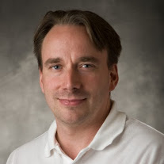
Really, I’m not out to destroy Microsoft. That will just be a completely unintentional side effect.
Linus Torvalds,
28 Sept 2003
(New York Times)

Slide 54

1 000 000 000
Android Activations
Open Source OS, runs on cheap machines
Practical Universal Machines
Abstractions
Modern OS
Programmable Machines
Tools
Altruism
Recursive Language
Universe
S ::= NP V O
NP ::= N and NP
-13.8B
-5M
-300K
1679
1945
1950s
1969
1993
2008
2013

Slide 55
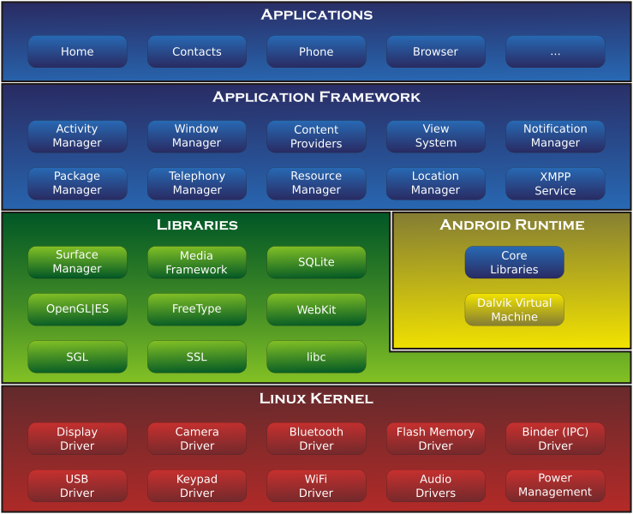

Android
https://en.wikipedia.org/wiki/File:Android-System-Architecture.svg

Slide 56
1 000 000 000
Android Activations
Open Source OS, runs on cheap machines
Cheaper, faster, low-energy processors, Internet, web, $$$
Practical Universal Machines
Abstractions
Modern OS
Programmable Machines
Tools
Altruism
Recursive Language
Universe
S ::= NP V O
NP ::= N and NP
-13.8B
-5M
-300K
1679
1945
1950s
1969
1993
2008
2013

Slide 57
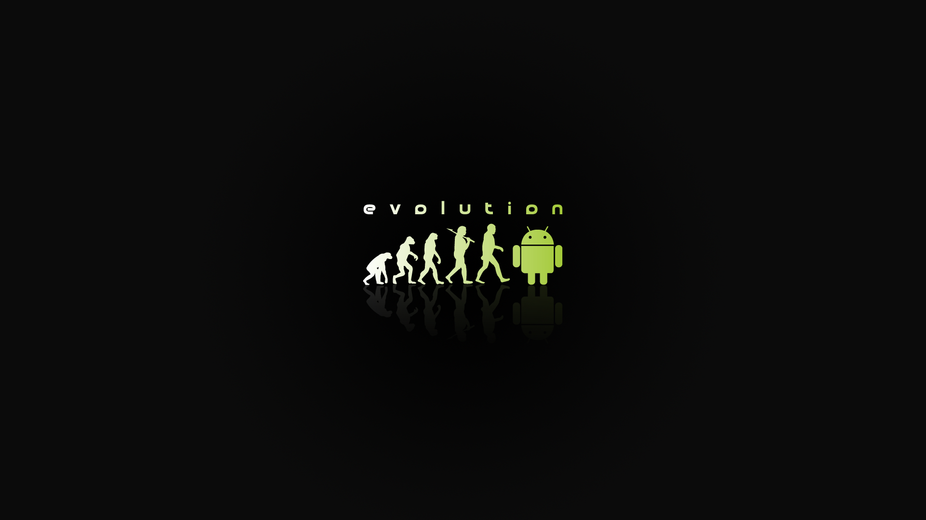
http://ranpict.com/android-evolution-wallpaper.html

Slide 58
How long for the next Billion?

Slide 59
Charge
It’s a very exciting time in operating systems!
  Bet: Five years from now, there will be a billion computing devices running an operating system we haven’t heard of yet
PS1 is due Sunday

