Slide 1
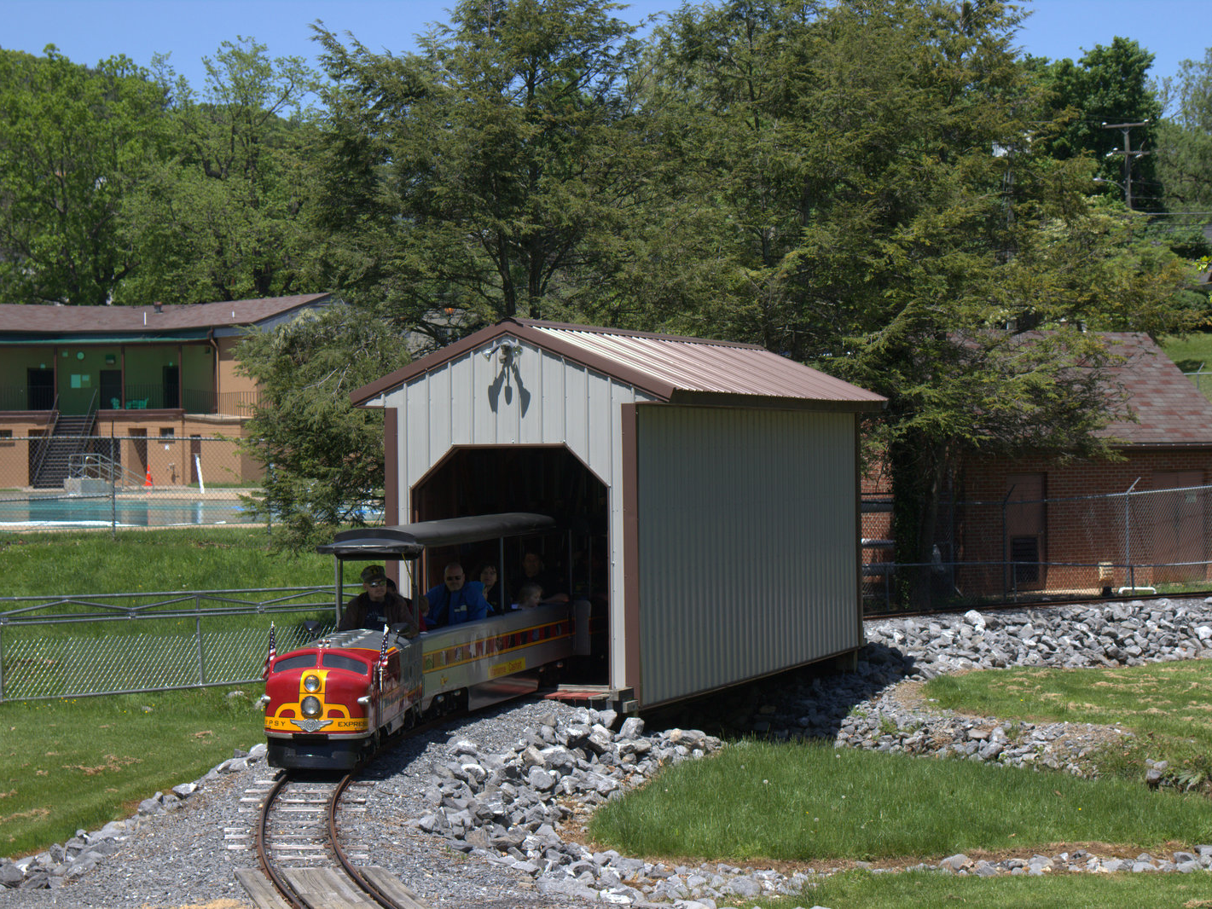
Class 4:
Once Upon a Process
cs4414 Fall 2013
University of Virginia
David Evans

Slide 2
Plan for Today
Administrative Things
Communication, Grading, Recording
Learning Rust
How to Share a Processor

Slide 3
Human⇔Human Communication
IRC: quick and dirty
#cs4414: want an immediate response/conversation
#rust: try here if you have a Rust language question/problem
Web: rust-class.org
Page-specific forums (e.g., PS1, Class 1 notes)
General forums
easiest for others to see, best for longer questions/responses
Email: evans@virginia.edu
Use for things that don’t fit into other channels
Notify me if you asked something on web but didn’t get a response
Anything that you want to keep private

Slide 4
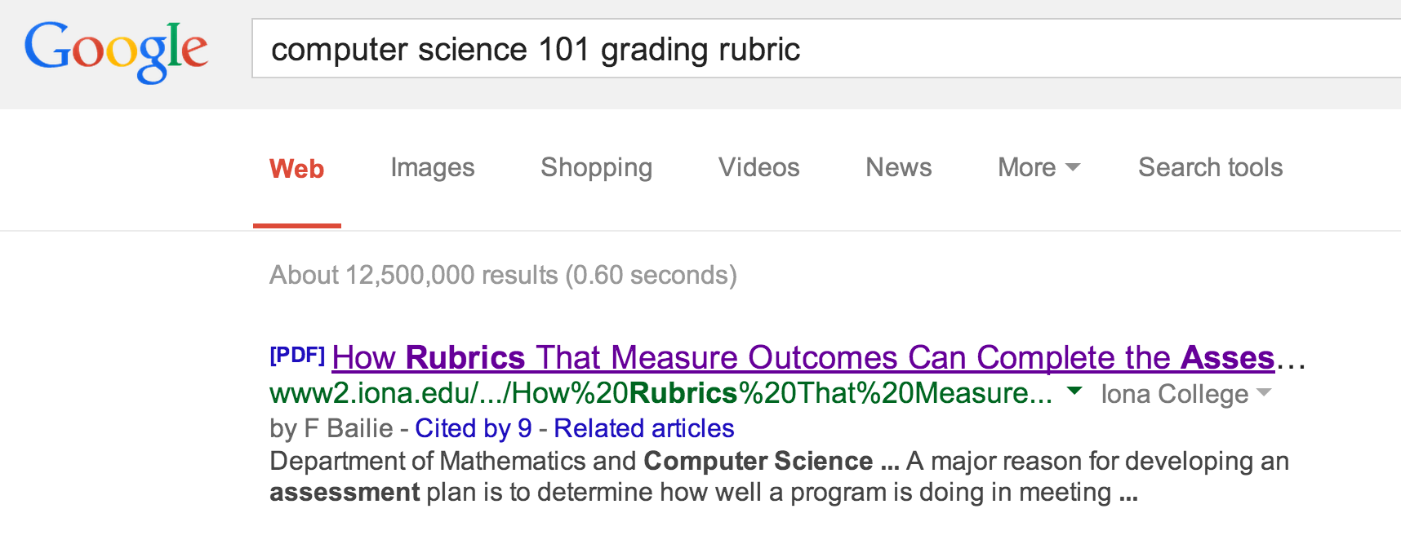
Grading
Don’t be stressed!

Slide 5
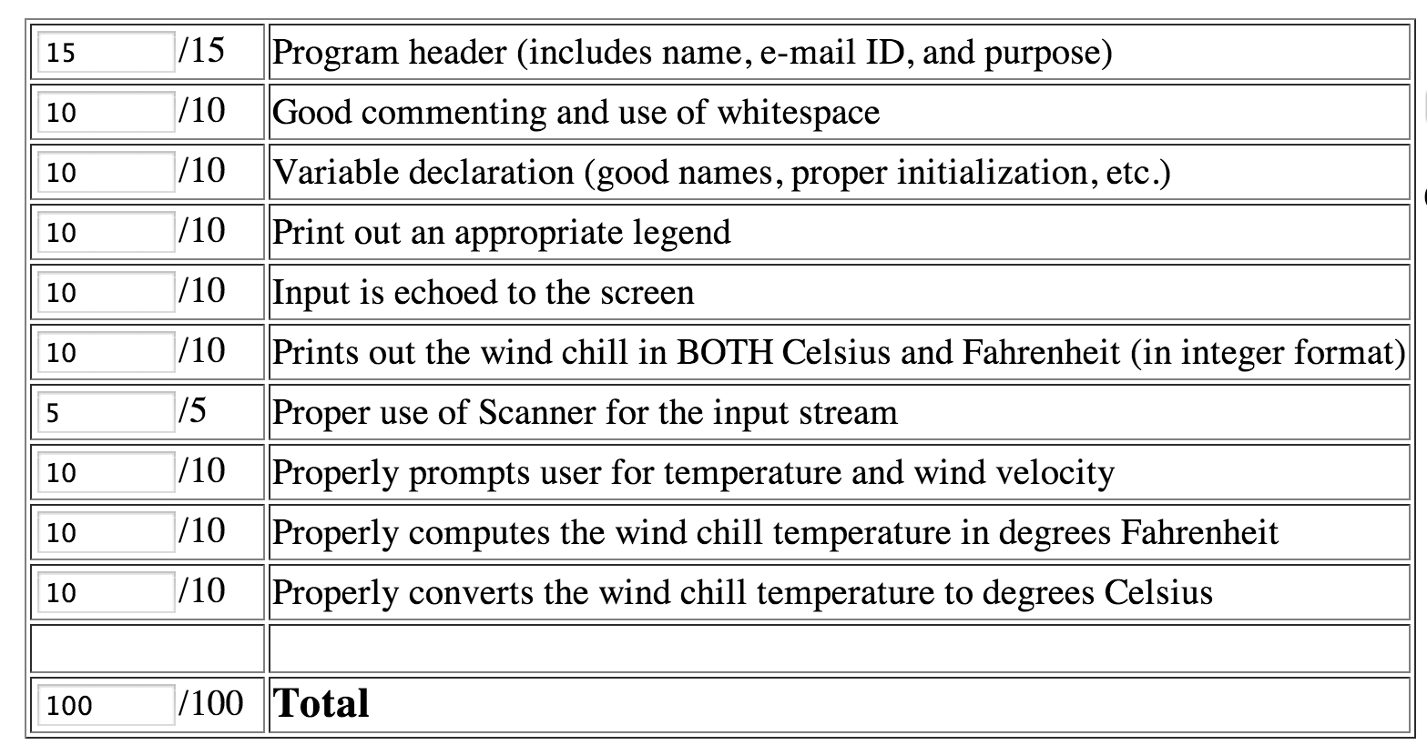
cs4414
1
/ 1
Your program works.

Slide 6
For Future Problem Sets
Auto-grader
  You’ll be able to confirm that your code behaves as expected before submitting (and can try as many times as you want)
Demos
  You’ll show your program working
  All team members will answer questions about design decisions, concepts, how to extend, etc.
Teammate Ratings

Slide 7
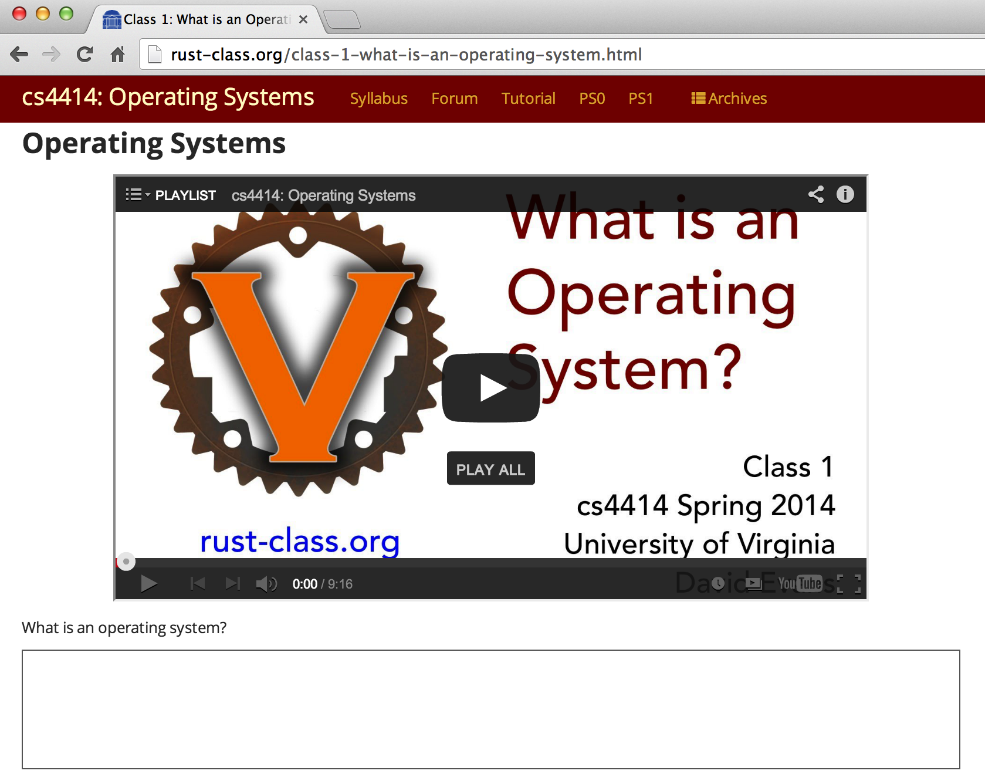
Recording Classes
Can’t promise to record everything
Recordings will be (somewhat) edited
Press the button in front of you unless you want to be recorded

Slide 8

Questions

Slide 9

Some Rusty Things

Slide 10
Expressions and Statements
Java/C++
Rust
IfStatement ::=
if (Expression)
Statement_{True}
[ else
Statement_{False}
]
IfExpression ::=
if Expression Block
[ else Block ]
Block ::= { [Statement* Expr] }
Expression ::= Block
Statement ::= Expression ;
Simplified: static.rust-lang.org/doc/master/rust.html#if-expressions.
Warning: “(looking for consistency in the manual's grammar is bad: it's entirely wrong in many places.)”

Slide 11
Quiz
IfExpression ::=
if Expression Block
[ else Block ]
Block ::= { [Statement* Expr] }
Expression ::= Block
fn max(a: int, b: int) -> int {
if { } { a } else { b }
}
Syntax Error
Type Error
Run-time Error

Slide 12
Quiz
IfExpression ::=
if Expression Block
[ else Block ]
Block ::= { [Statement* Expr] }
Expression ::= Block
fn max(a: int, b: int) -> int {
if { } { a } else { b }
}
If you get bad error messages from rustc,
report them to Kiet!
$ rustc block.rs
block.rs:2:7: 2:10 error: mismatched types: expected `bool` but found `()` (expected bool but found ())
block.rs:2 if { } {
^~~

Slide 13
(Trick) Quiz
IfExpression ::=
if Expression Block
[ else Block ]
Block ::= { [Statement* Expr] }
Expression ::= Block
fn max(a: int, b: int) -> int {
if { let x = 4414; x = x + a; x > b + 4414 } { a }
else { b }
}
Syntax Error
Type Error
Run-time Error

Slide 14
(Trick) Quiz
IfExpression ::=
if Expression Block
[ else Block ]
Block ::= { [Statement* Expr] }
Expression ::= Block
fn max(a: int, b: int) -> int {
if { let x = 4414; x = x + a; x > b + 4414 } { a }
else { b }
}
“Variables” are invariable…unless declared with mut.
$ rustc block.rs
block.rs:2:23: 2:24 error: re-assignment of immutable variable `x`
block.rs:2 if { let x = 4414; x = x + a; x > b + 4414 } {
^

Slide 15
Quiz
IfExpression ::=
if Expression Block
[ else Block ]
Block ::= { [Statement* Expr] }
Expression ::= Block
fn max(a: int, b: int) -> int {
if { let mut x = 4414; x = x + a; x > b + 4414 } { a }
else { b }
}
$ rust run block.rs
Max: 5

Slide 16
Quiz
IfExpression ::=
if Expression Block
[ else Block ]
Block ::= { [Statement* Expr] }
Expression ::= Block
Statement ::= Expression ;
fn max(a: int, b: int) -> int {
if a > b { a } else { b; }
}
fn main() {
println(fmt!("Max: %?", max(5, 4)));
}

Slide 17
Quiz
The semi-colon makes it a statement – no value
fn max(a: int, b: int) -> int {
if a > b { a } else { b; }
}
fn main() {
println(fmt!("Max: %?", max(5, 4)));
}
block.rs:2:24: 2:30 error: mismatched types: expected `int` but found `()` (expected int but found ())
block.rs:2 if a > b { a } else { b; }
^~~~~~

Slide 18
Higher-Order Functions
Java
Rust
Java 8 (March 2014)
| <parameters> | Block
Scheme
proc(<parameters>) Block
(define (make-adder a)
(lambda (n)
(+ a n)))

Slide 19
Define a function, make_adder(int), that takes an integer as input and returns a function that takes and int and returns the sum of the original and input int.
make_adder(3)(1) => 4
let increment = make_adder(1);

Slide 20
fn make_adder(a: int) -> (fn(int) -> int) {
fn(b: int) { a + b }
}
fn main() {
let increment = make_adder(1);
println!("result: {:x}", increment(2));
}
Limitation: we can only use increment once!

Slide 21
Define a function, ntimes, that takes as inputs a function f (int -> int) and an integer n, and returns a function that applies f n-times.
fn double(a: int) -> int { a * 2 }
fn main() {
let quadruple = ntimes(double, 2);
println(fmt!("quad: %?", quadruple(2)));
}

Slide 22
fn double(a: int) -> int { a * 2 }
fn ntimes(f: proc(int) -> int, times: int) -> proc(int) -> int {
proc(x: int) {
match times {
0 => { x }
_ => { ntimes(f, times - 1)(f(x))}
}
}
}
fn main() {
let quadruple = ntimes(double, 2);
println!("quad: {:d}", quadruple(2));
}

Slide 23
fn double(a: int) -> int { a * 2 }
fn ntimes(f: proc(int) -> int, times: int) -> proc(int) -> int {
proc(x: int) {
match times {
0 => { x }
_ => { ntimes(f, times - 1)(f(x))}
}
}
}
fn main() {
let quadruple = ntimes(double, 2);
println!("quad: {:d}", quadruple(2));
}
bash-3.2$ rustc ntimes.rs
bash-3.2$ ./ntimes
Segmentation fault: 11
Note: when a C/C++ program gives a “Segmentation fault”, 99.9999% of the time it is the programmers “fault”. When a Rust program (that doesn’t use unsafe) does, 100% of the time it is Rust’s fault.

Slide 24
https://github.com/graydon/rust/wiki
This is a very preliminary work in progress. No supported releases yet nor defined release schedule / plans. Caveat emptor. It will crash. It will change syntax and semantics. It will eat your laundry. Use at your own risk. Etc.
Originally posted: 15 Dec 2011
(but still there today, 28 Jan 2014)

Slide 25
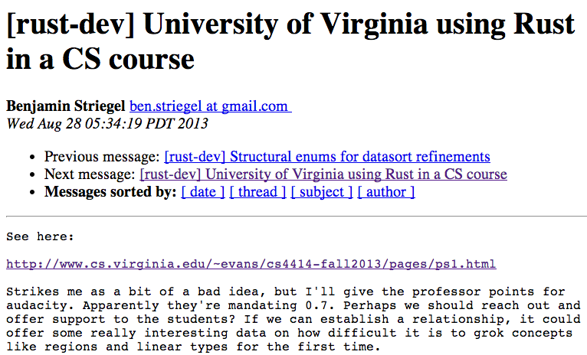
https://mail.mozilla.org/pipermail/rust-dev/2013-August/005409.html

Slide 26
Rust or Bust?
Rust
Bust (C)
Benefits from past 30 years of language and compiler research
Chance to influence a new, exciting, fast-evolving language
Some really cool features for memory management and concurrency
FUN!
Suffers from maintaining backwards compatibility
C++0x standard process began in 1998, released in 2011, over 40 meetings
Lots of complexity, but not designed for safety
Boring, Annoying

Slide 27
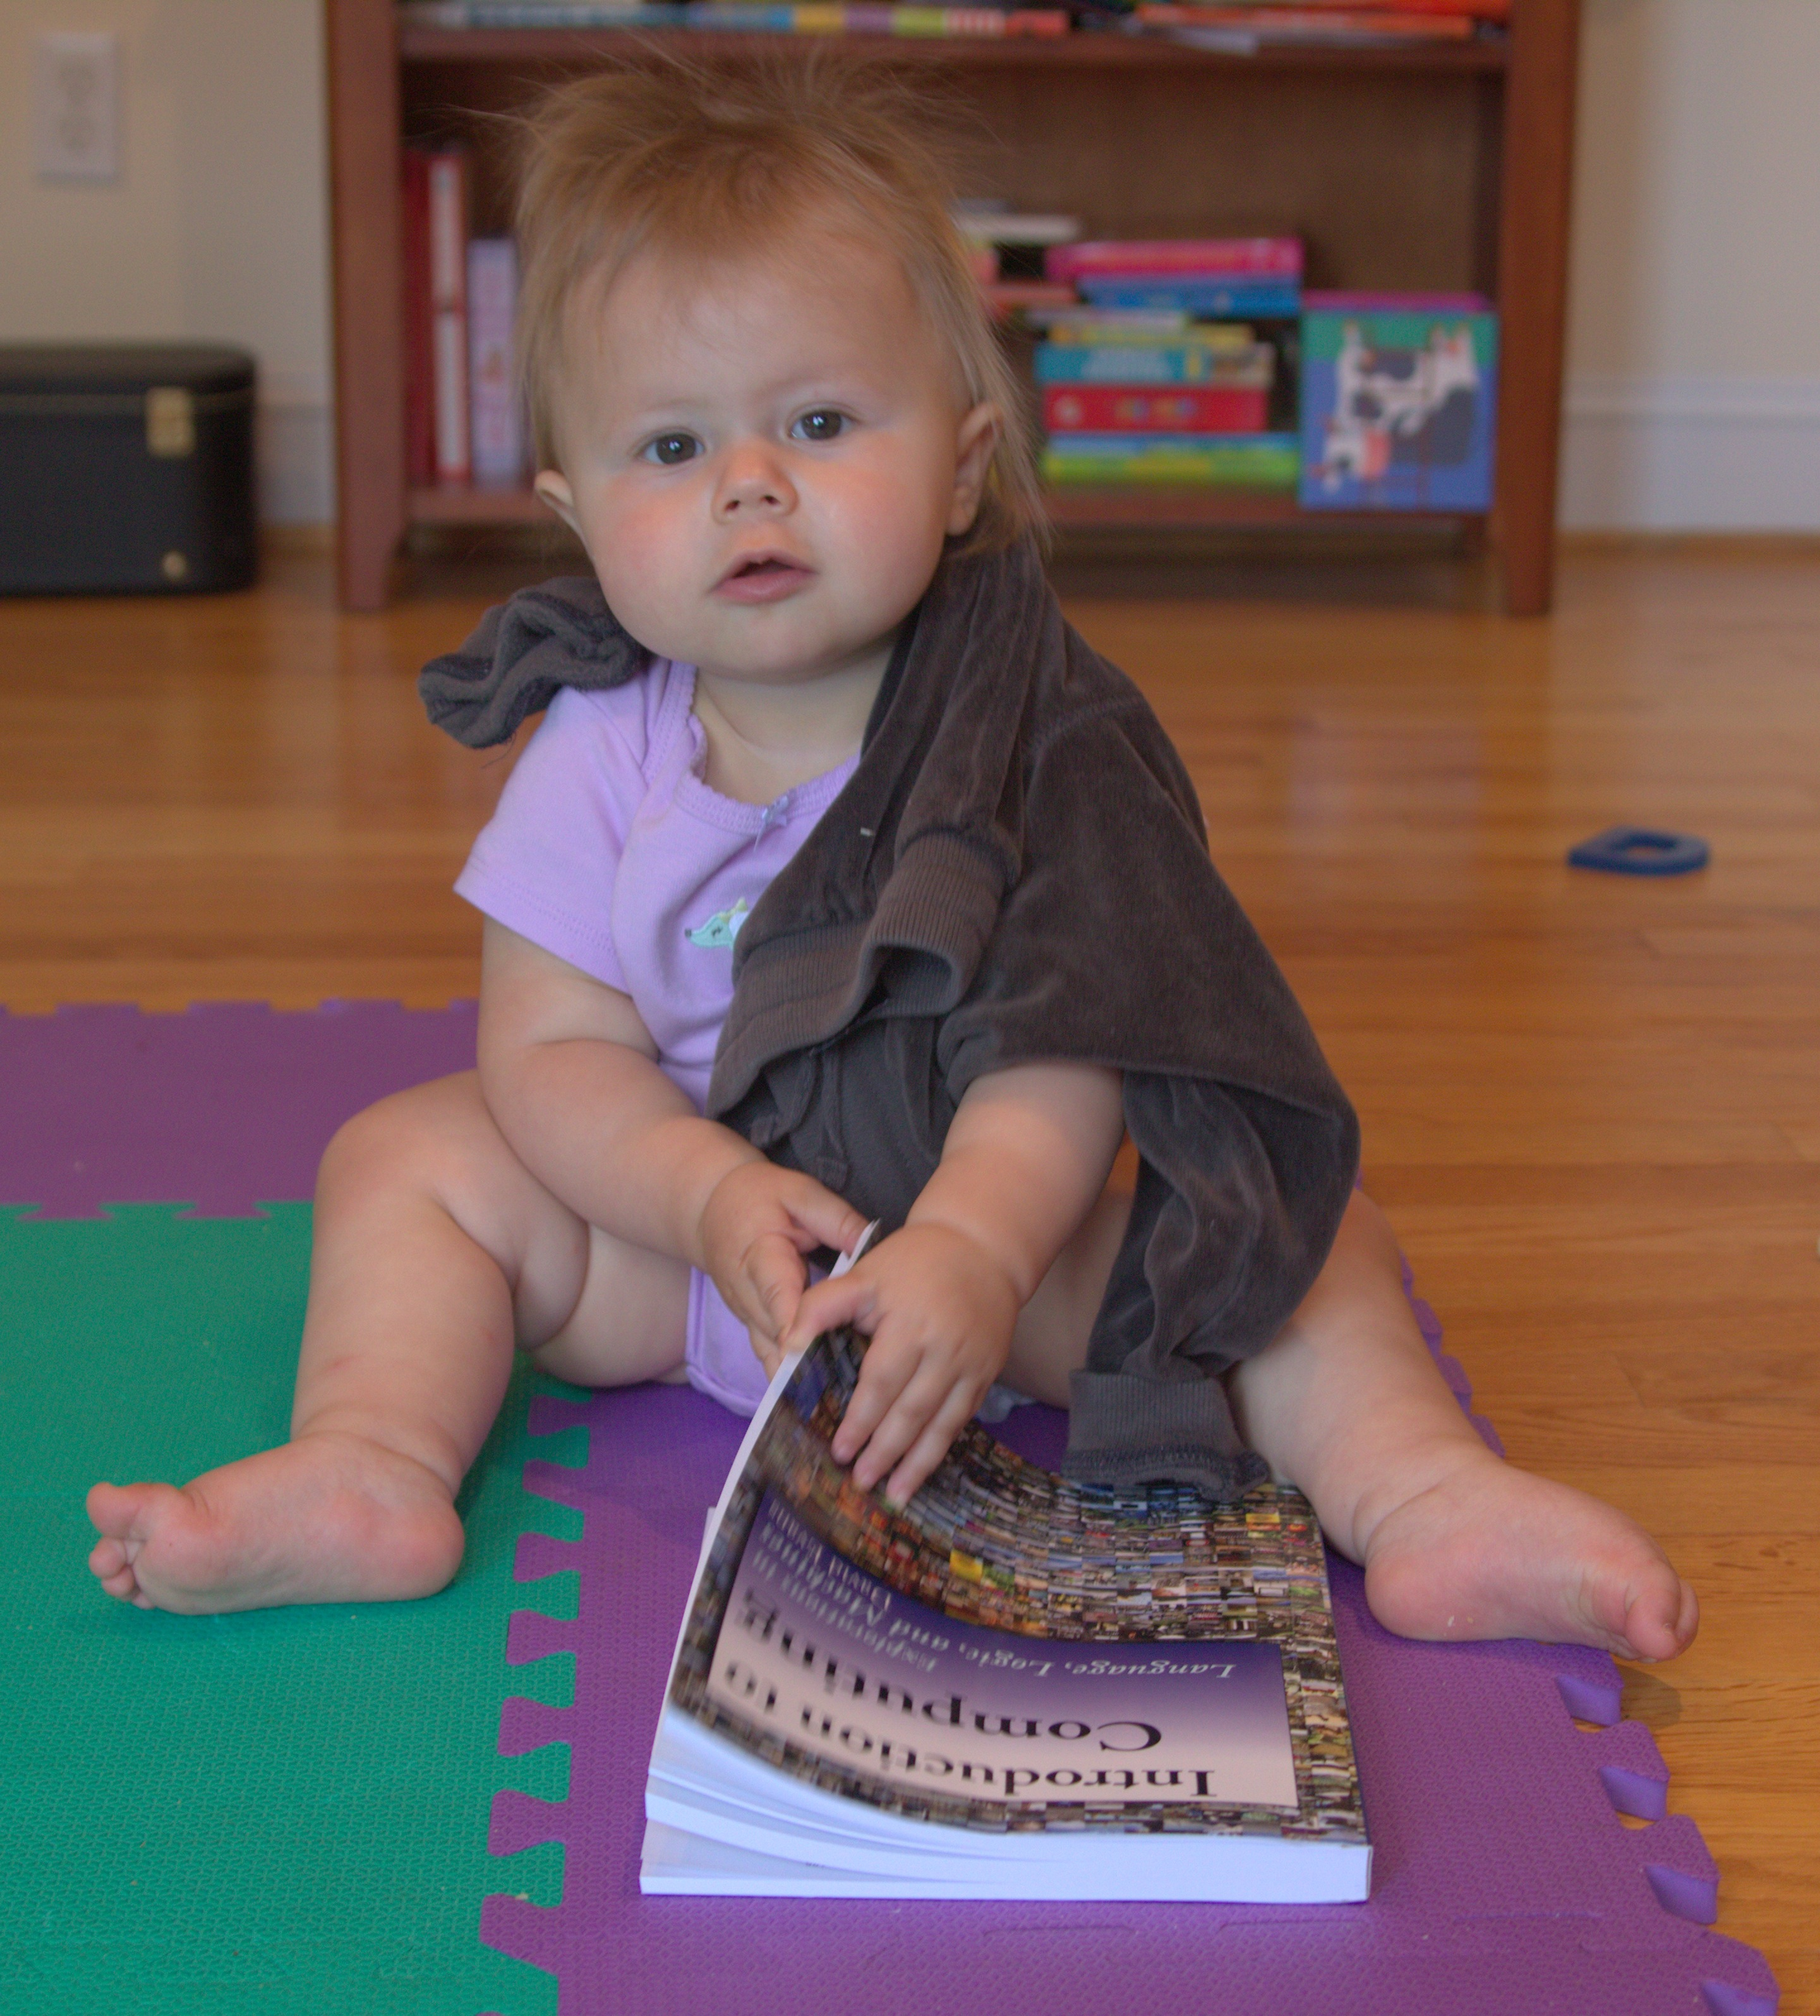
“Baby” programmer (cs1xxx)

Slide 28
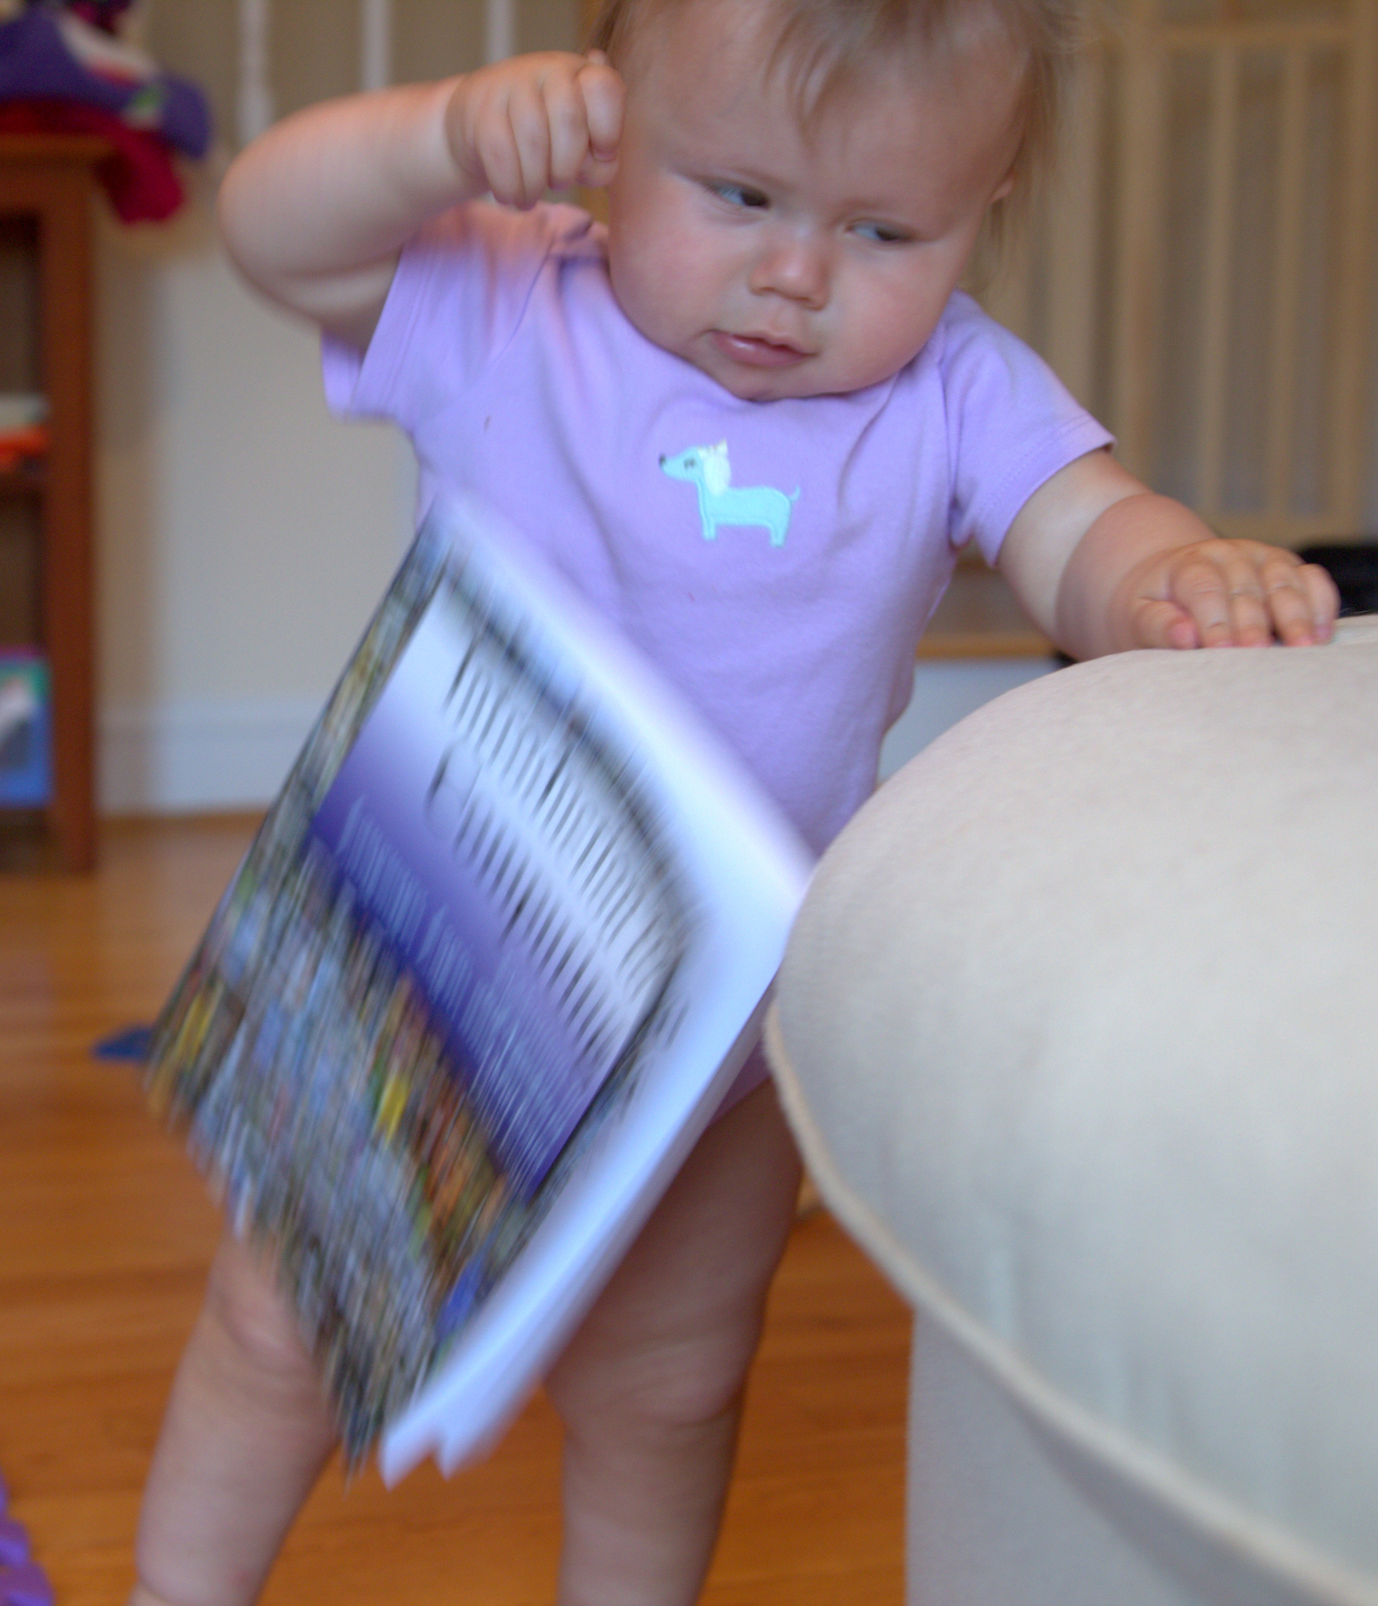
Give up in disgust!

Slide 29

cs4414 Student
“Professional Amateur
Programmer”

Slide 30
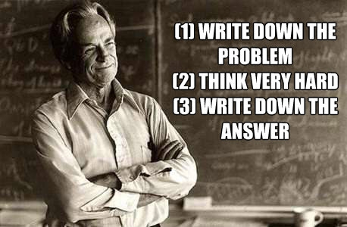
Solving Programming Mysteries
http://www.smellsfunny.com/view.php?fid=17557

Slide 31
Solving Programming Mysteries
DuckDuckGo (or Google) is your friend!
stackoverflow [rust]
Experiment!
Ask for help:
  IRC
  rust-class.org
If you figure something useful out that is not well documented, document it: course forum comment, “blog” post

Slide 32
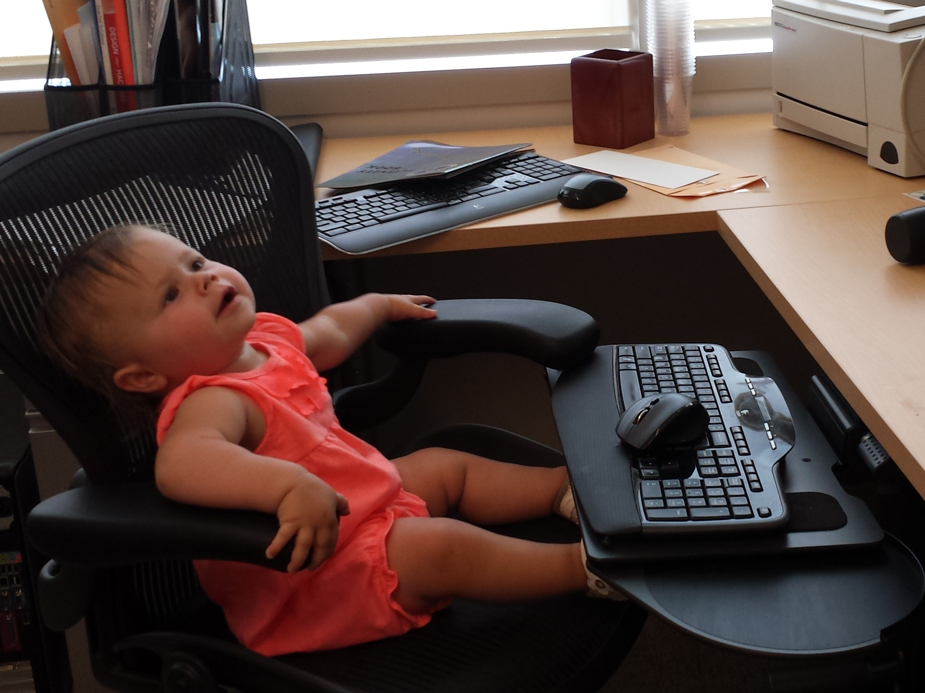
Instead of whinging about how bad the Rust documentation for strings is….

Slide 33
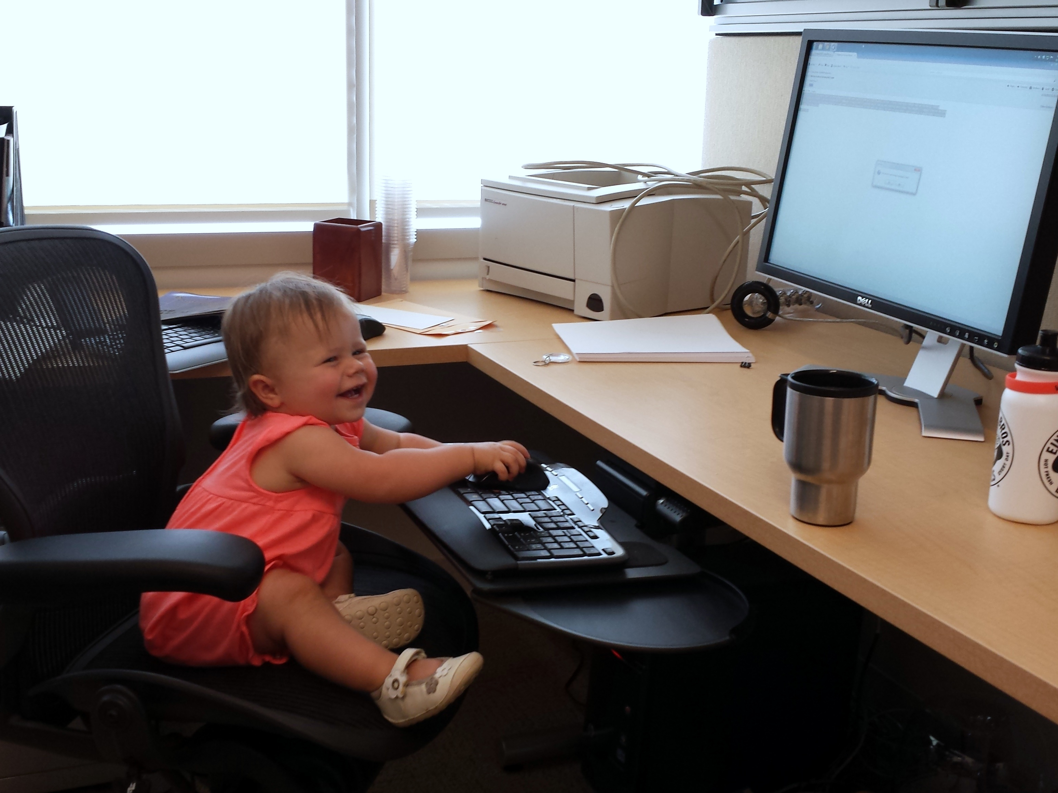
Be happy! You can be the first to write one!
STRINGS IN RUST

Slide 34
Be happy! You can be the first to write one!
STRINGS IN RUST
Note: last semester’s students had much less documentation, and an even more buggy compiler, but still survived! (And some did contribute to writing the tutorials and improving the compiler you are using now.)

Slide 35
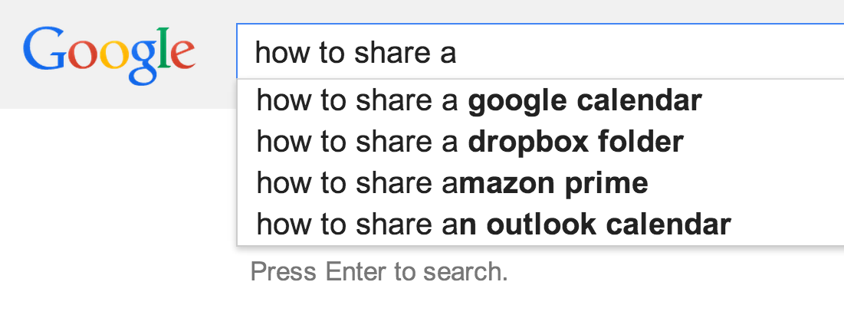
How can several programs share a processor?

Slide 36
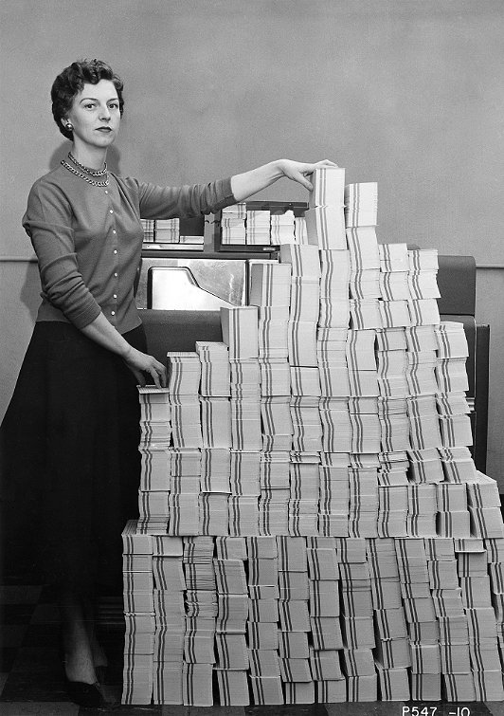
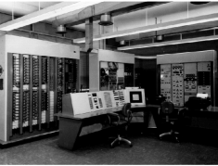

Recap:
Last Class
Batch Processing
Program
Computer Center
Your Program Runs
A
Program A
B
Program B
A
Multiprogramming
Program C
C

Slide 37
Kinds of Processor-Sharing
Multiprogramming
User program X runs until it gets stuck, then supervisor program takes over.
Non-preemptive multi-tasking
User program X runs until it decides to let the supervisor program run.
Preemptive multi-tasking
User program X runs until the (approximately) supervisor decides to let another program run.

Slide 38
Non-preemptive
Preemptive

Slide 39

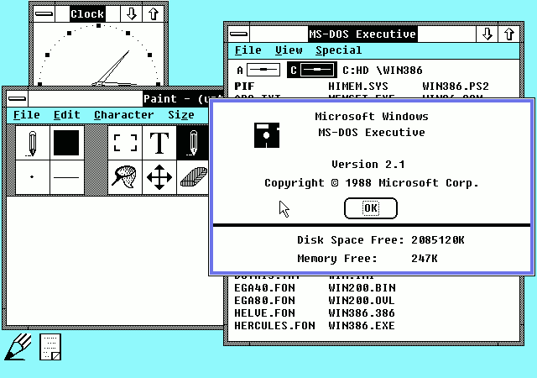
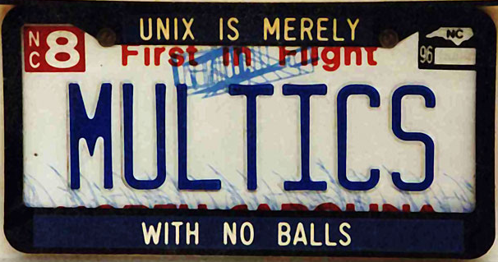

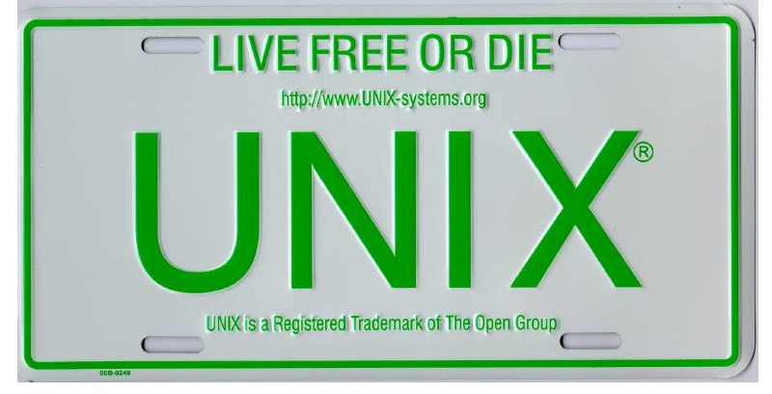

Which have preemptive multitasking?
Microsoft Windows 2.1x
1988
PowerMac G5
(Mac OS 9)
2006
MULTICS (1969)
MacBook Air
(Mac OS X)
2011
UNIX (1975)

Slide 40
Which have preemptive multitasking?
Microsoft Windows 2.1x
1988
PowerMac G5
(Mac OS 9)
2006
MULTICS (1969)
MacBook Air
(Mac OS X)
2011
UNIX (1975)

Slide 41
How could I prove it?
Mac OS X
40

Slide 42
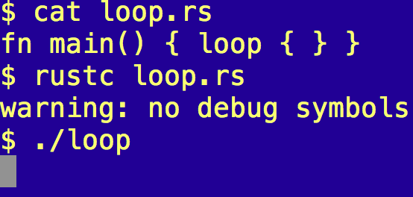
One-line Proof

Slide 43
Which are result of preemptive multitasking?
A computer running Mac OS X crashes less than one running Mac OS 9
A computer running Mac OS X needs fewer hard reboots than one running Mac OS 9
When you watch your favorite Eminem video for the 50th time, the video still (occasionally) jitters
Your zhttpto server can handle more than one request at a time

Slide 44
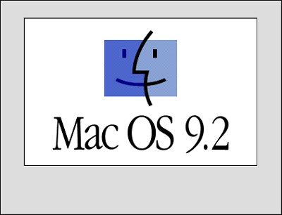
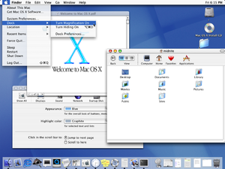
Mac OS 9.2.2
5 Dec 2001
Mac OS X (Cheetah)
24 March 2001
How did Apple add preemptive multitasking to Mac OS?

Slide 45

(The answer is probably not in this movie.)
http://www.youtube.com/watch?v=YsWBJ_usRck&t=2m18s

Slide 46

“Once you make them talk, they won’t be inanimate anymore.”
Steve Jobs (as quoted by Sorkin earlier in interview)

Slide 47
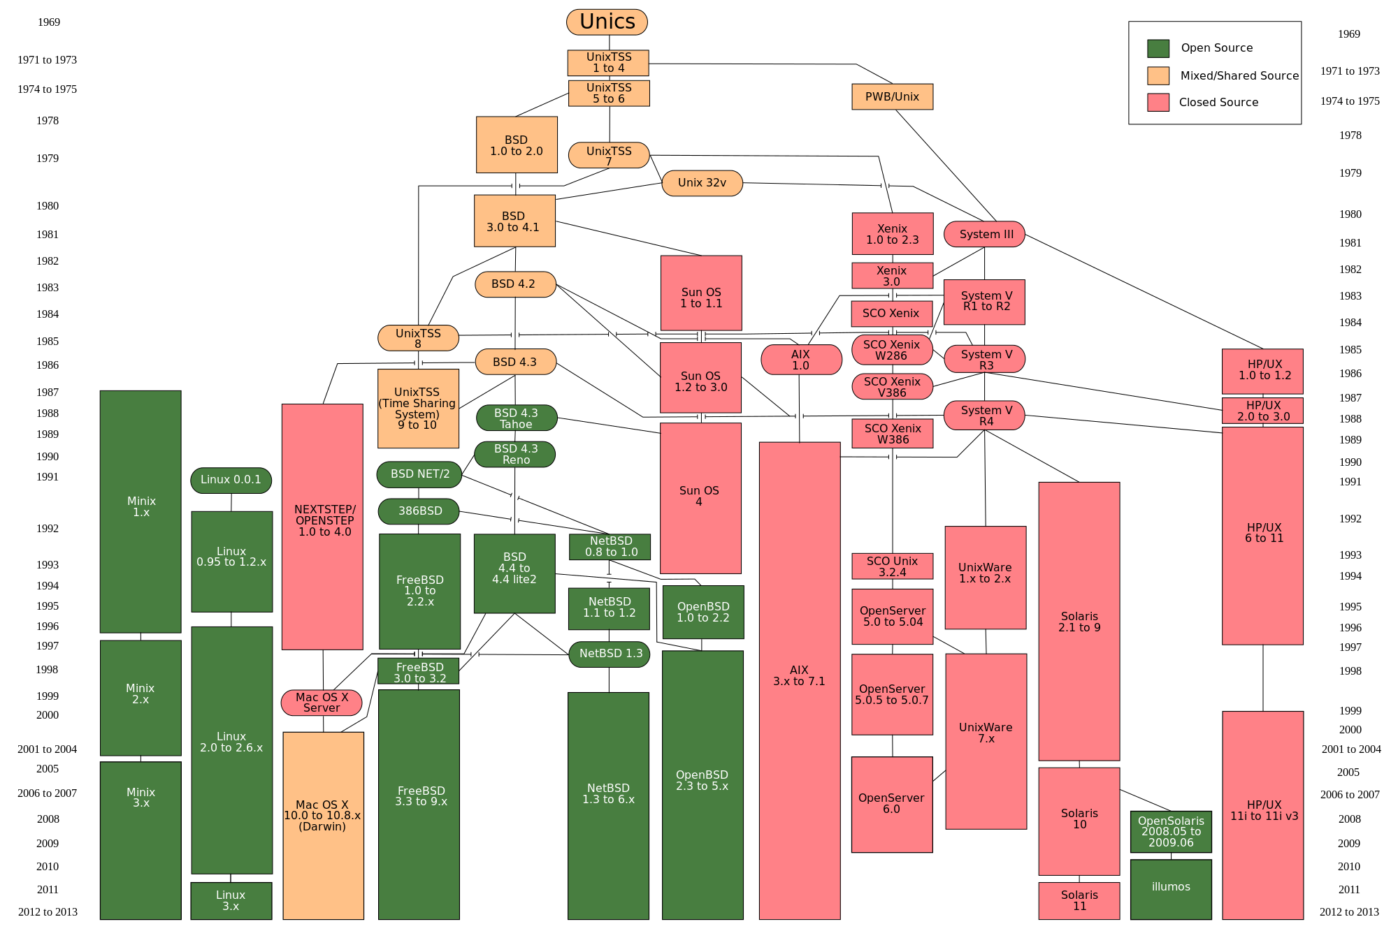
https://upload.wikimedia.org/wikipedia/commons/7/77/Unix_history-simple.svg

Slide 49
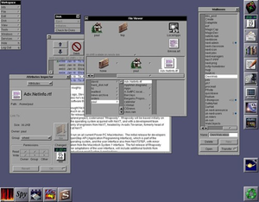
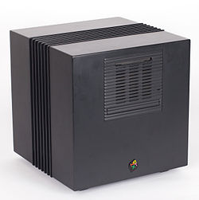

Slide 50
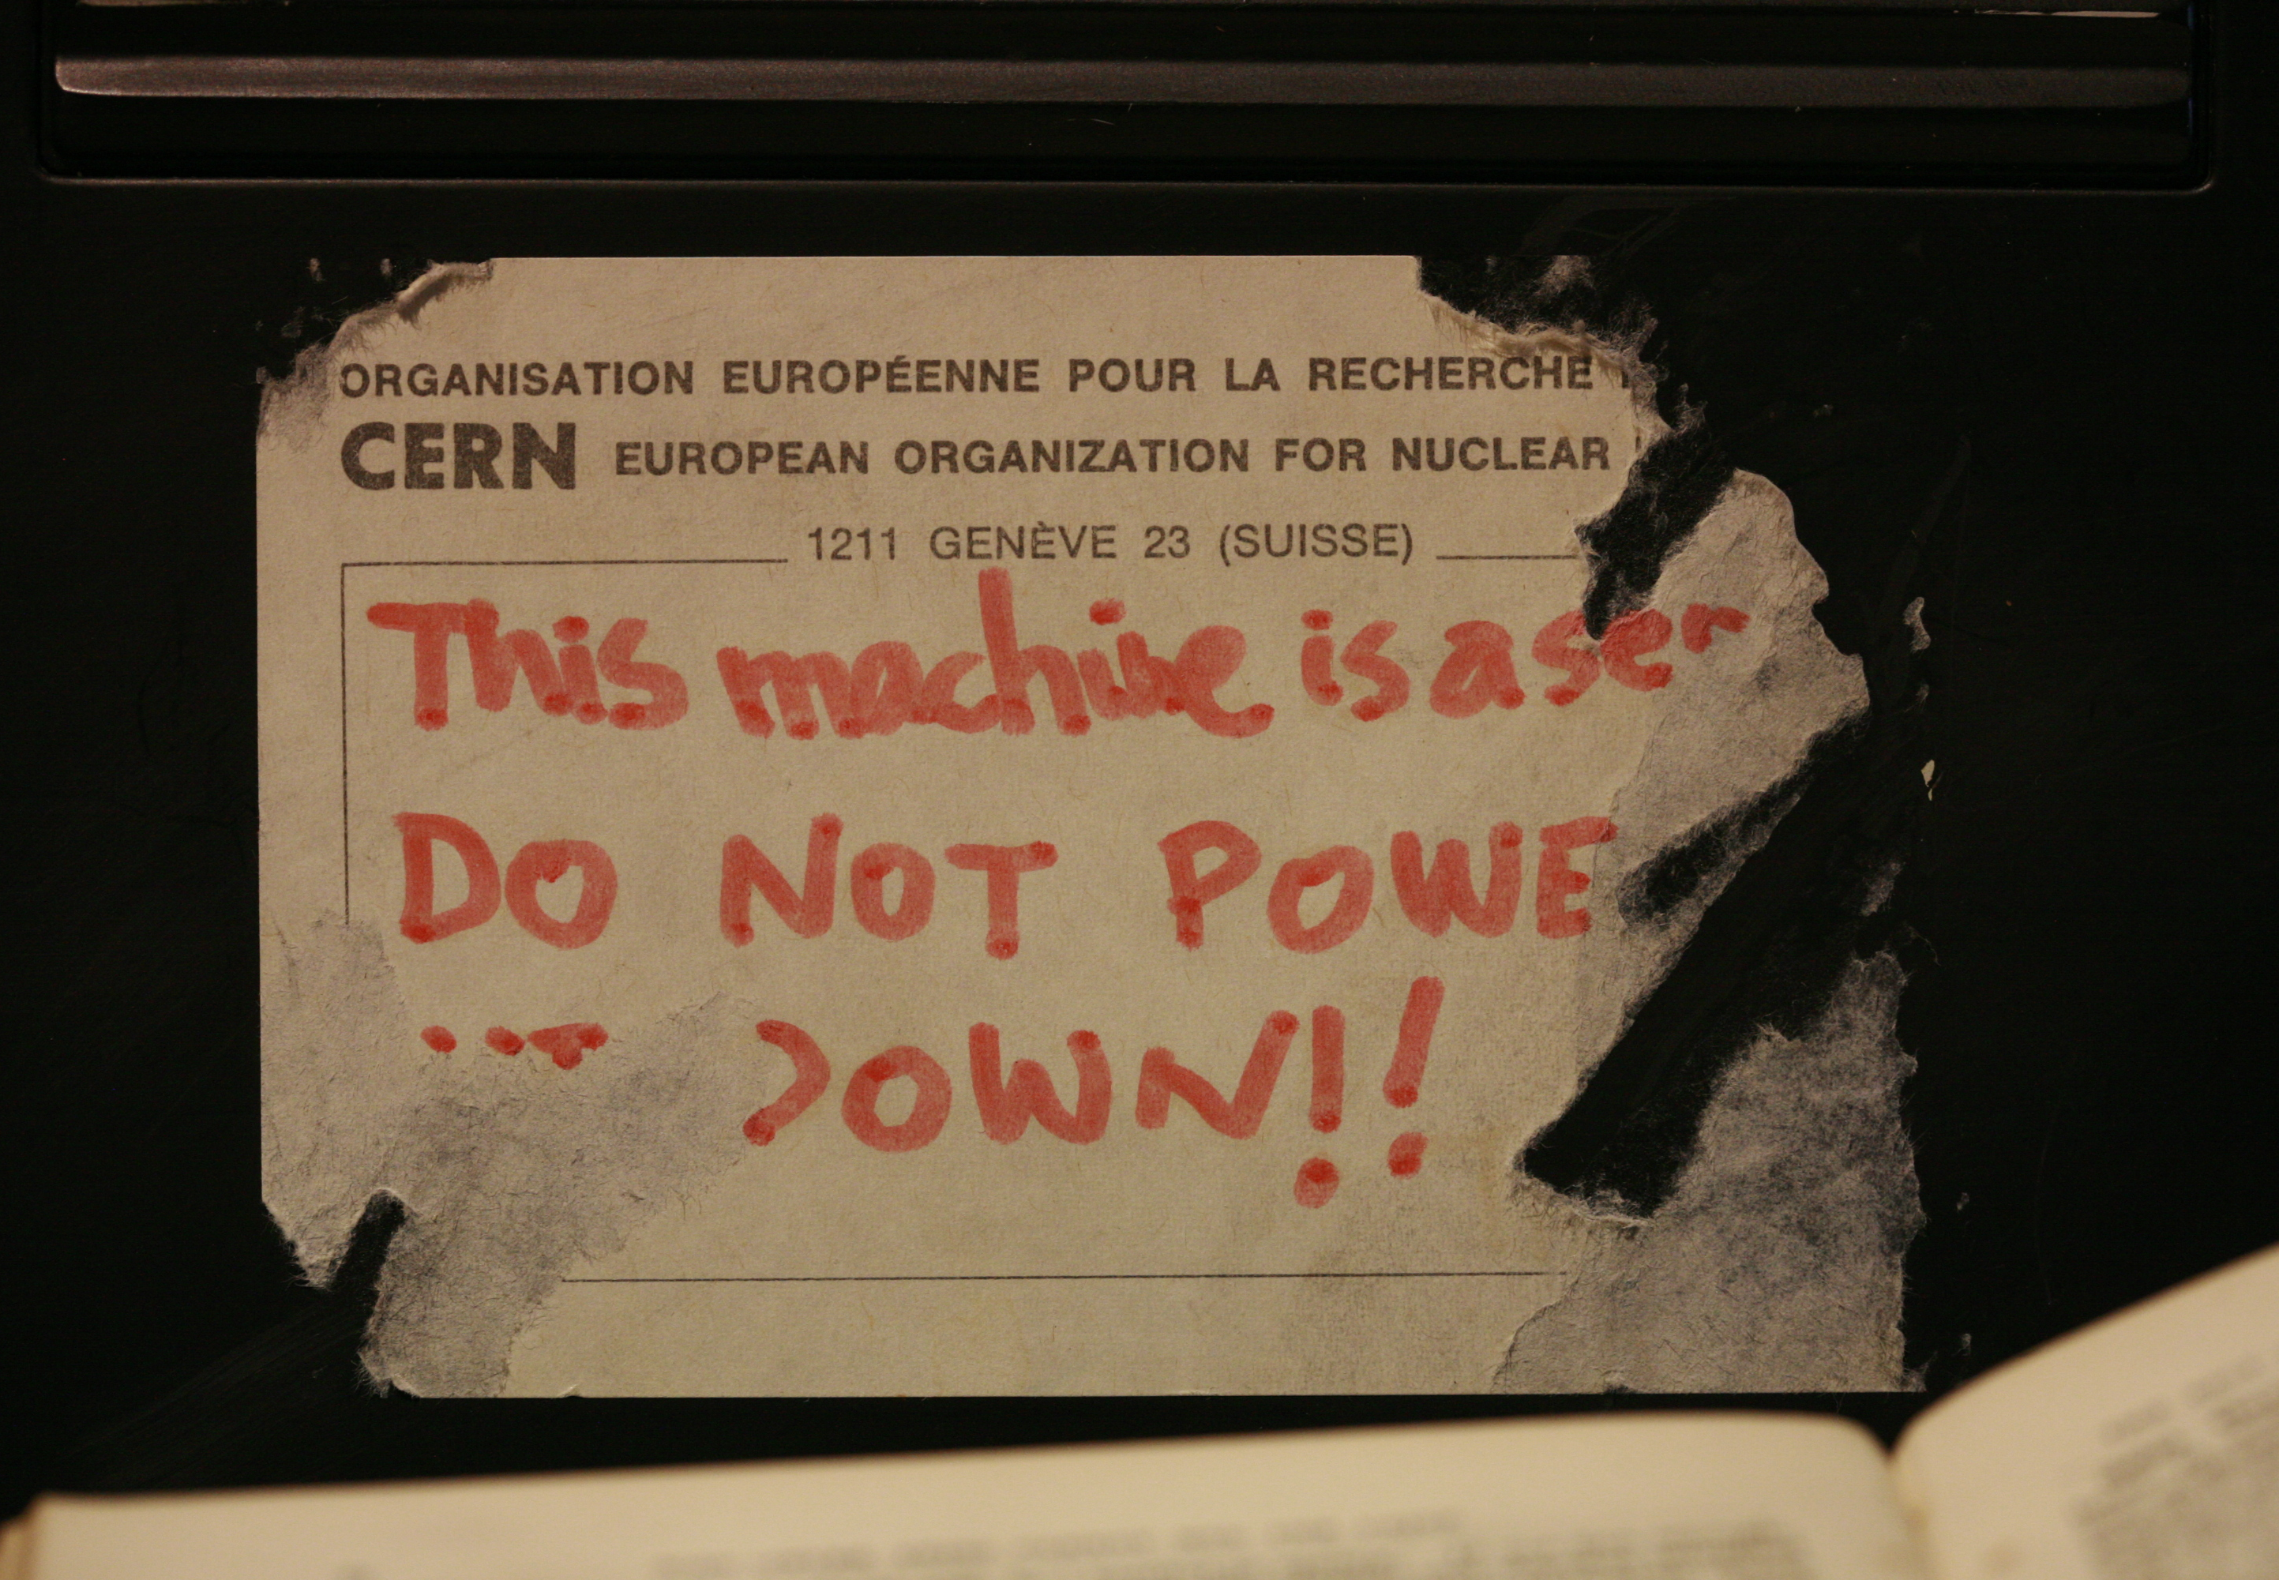

Slide 51
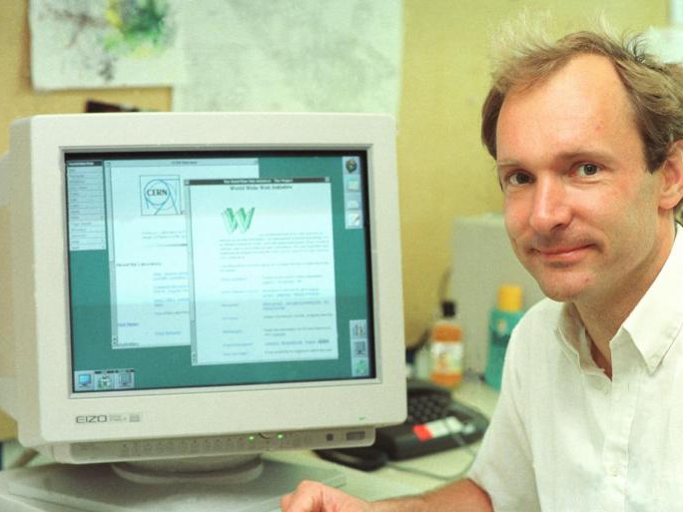
Tim Berners Lee finishing PS1 24 years early!

Slide 52
MULTICS
Code (carries license)
“Ideas” (no license, possible patent lawsuits)
Unix
BSD
Minix
NextStep
FreeBSD
Linux
Mac OS X
Android
iOS

Slide 53
How can preemptive multitasking even be possible?!?
Preemptive multi-tasking
User program X runs until the supervisor decides to let another program run.

Slide 54
Preemptive (?) Multitasking
A
Program A
Supervisor
B
Program B
Supervisor
Program C
A
Supervisor
A

Slide 55


Slide 56
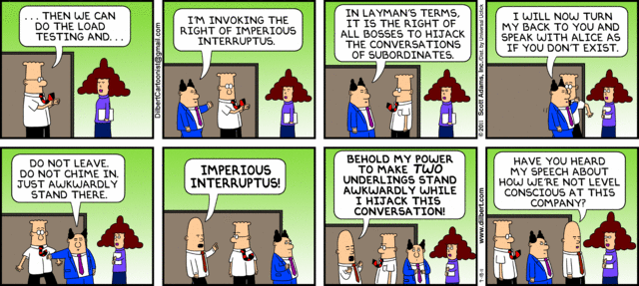

Slide 57

Interrupts
How frequently should the supervisor’s alarm clock (“kernel timer interrupt”) go off to check on the workers?

Slide 58
My MacBook (Ubuntu)
timer.c is a 50-line C program from
http://www.advenage.com/topics/linux-timer-interrupt-frequency.php (link on notes)
bash-3.2$ uname -a
Darwin Davids-MacBook-Air-2.local 11.4.2 Darwin Kernel Version 11.4.2: Thu Aug 23 16:25:48 PDT 2012; root:xnu-1699.32.7~1/RELEASE_X86_64 x86_64
bash-3.2$ gcc timer.c ; ./a.out
kernel timer interrupt frequency is approx. 4016 Hz or higher
Rust version by Wil Thomason

Slide 59
Timer Interrupts
Supervisor
A
Supervisor
B
Supervisor
set alarm clock
switch to program A
set alarm clock
switch to program B
What makes the alarm clock ring?

Slide 60
Who interrupts the supervisor?

Slide 61
The supervisor’s supervisor!
a.k.a. Hypervisor

Slide 62

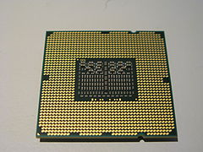
Support for hypervisor added to Intel x86 in 2005 (VT-x)

Slide 63
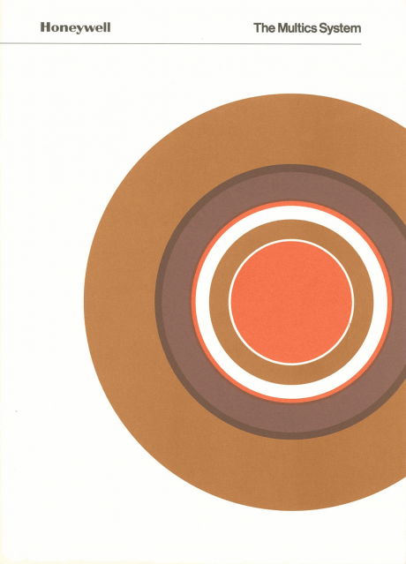
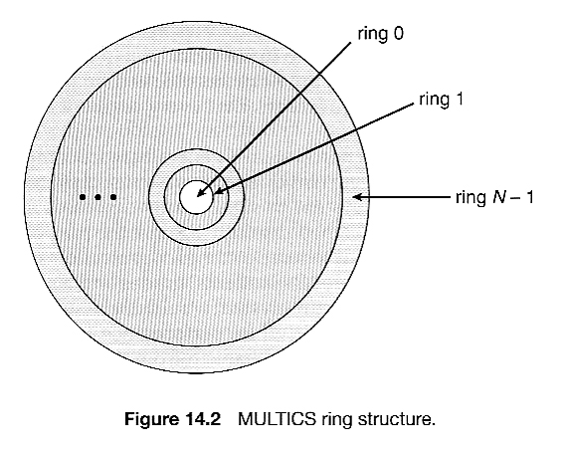
More general (quite similar) idea in MULTICS (but with 8-levels of supervision in hardware by 1975)

Slide 64
Charge
Tutorial Part 3 and Problem Set 2 will be posted later today
  PS2 is due February 9
  Longer and more challenging than PS1, don’t wait to get started
Read the Process API and Direct Execution sections of the OSTEP book

