Slide 1
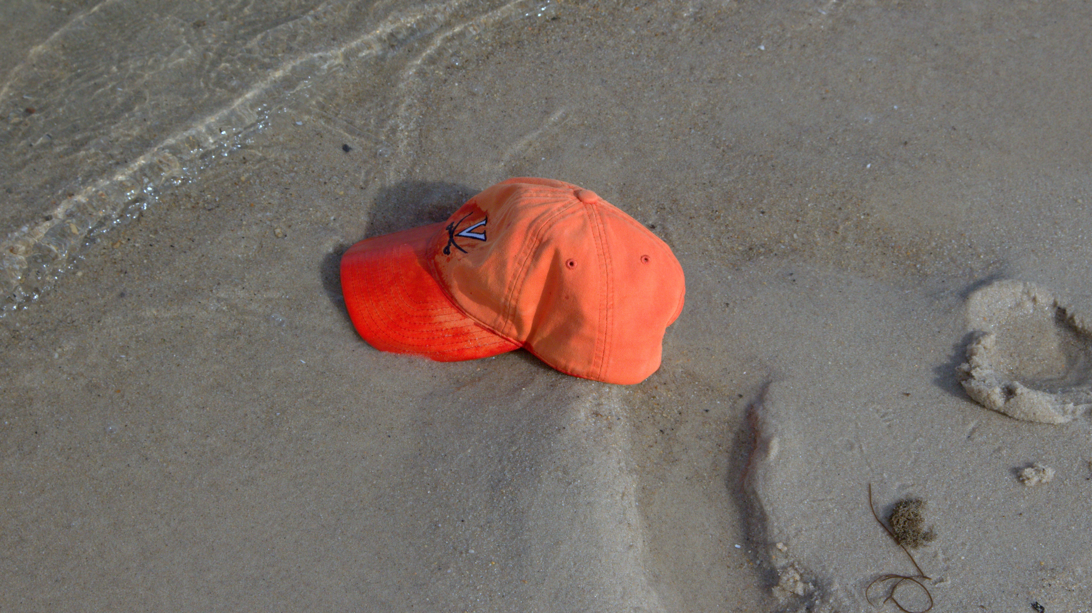
Class 5
Good Auld
SHell
cs4414 Fall 2013
University of Virginia
David Evans

Slide 2
Plan for Today
Kernel Privileges
How VirtualBox Really Works
Browser Processes
Demo PS2
Shell, Pipes, Redirects

Slide 3
Kernel Privileges
What can the kernel (supervisor) do that user-level programs cannot?

Slide 4
Kernel Privileges
What can the kernel (supervisor) do that user-level programs cannot?
Handle interrupts
Execute privileged instructions
What instructions are privileged?

Slide 5
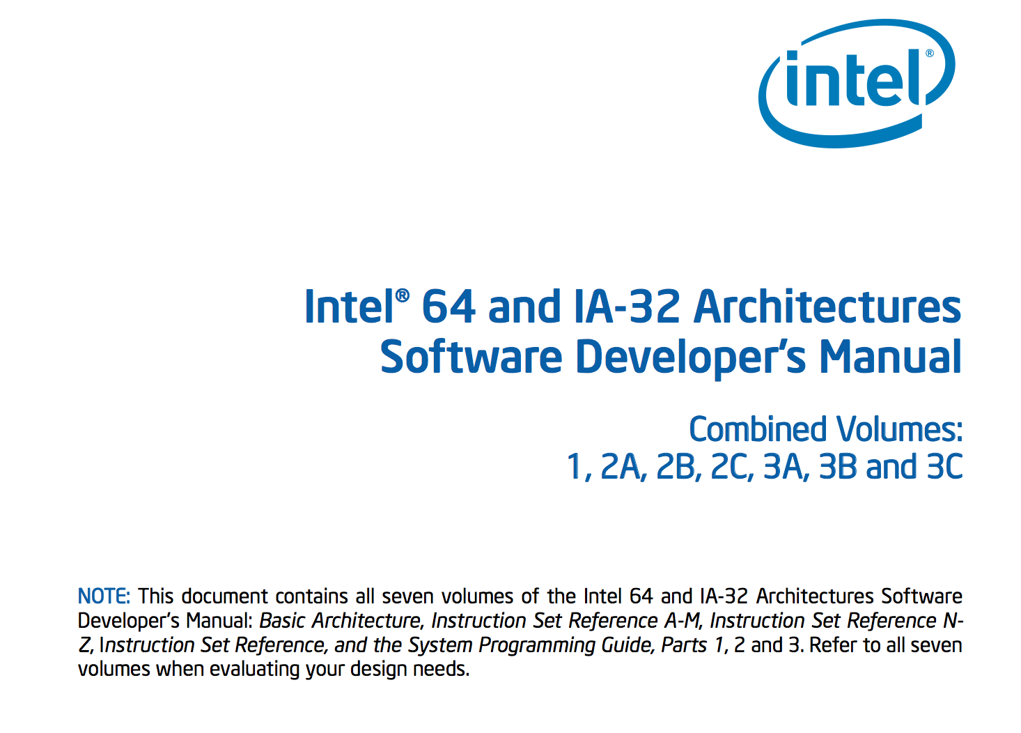

Slide 6
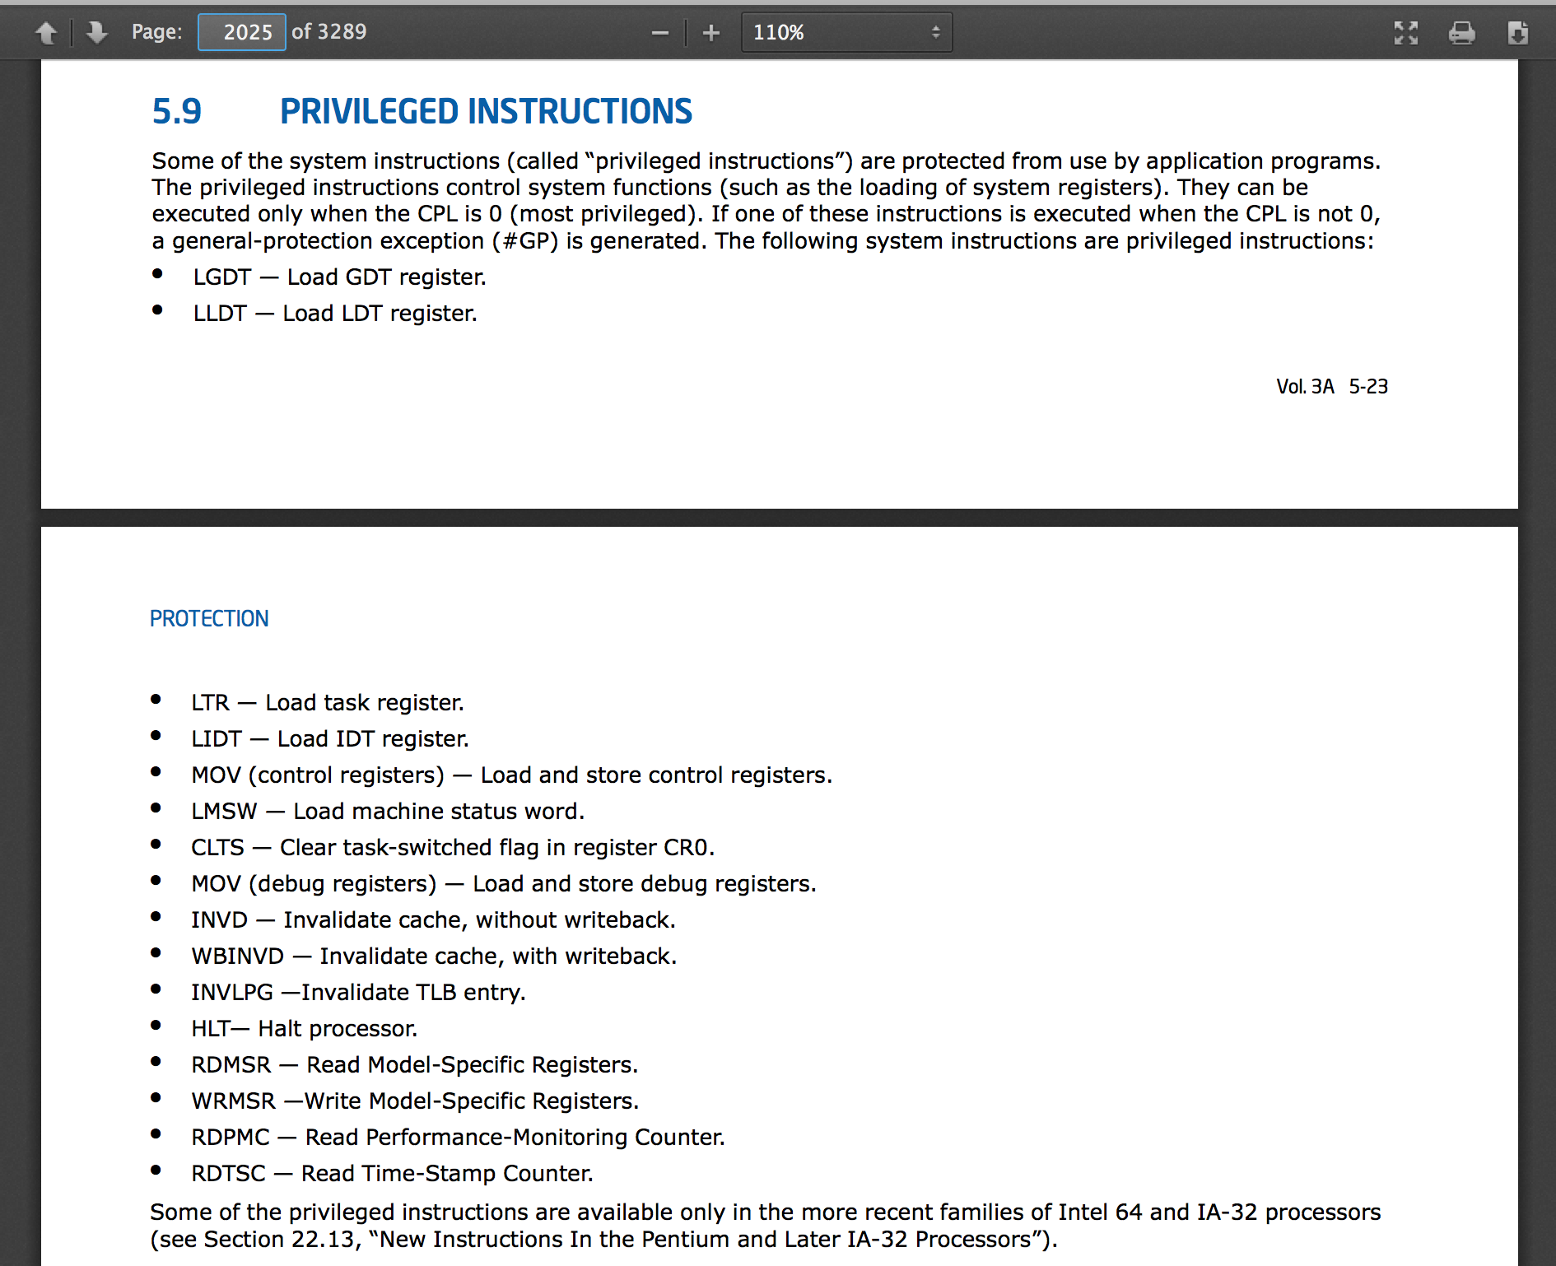

Slide 7
GDT: Global Descriptor Table
LDT: Local Descriptor Table
Control memory segments
MOV (control registers)
What is in control registers (CR0)?

Slide 8
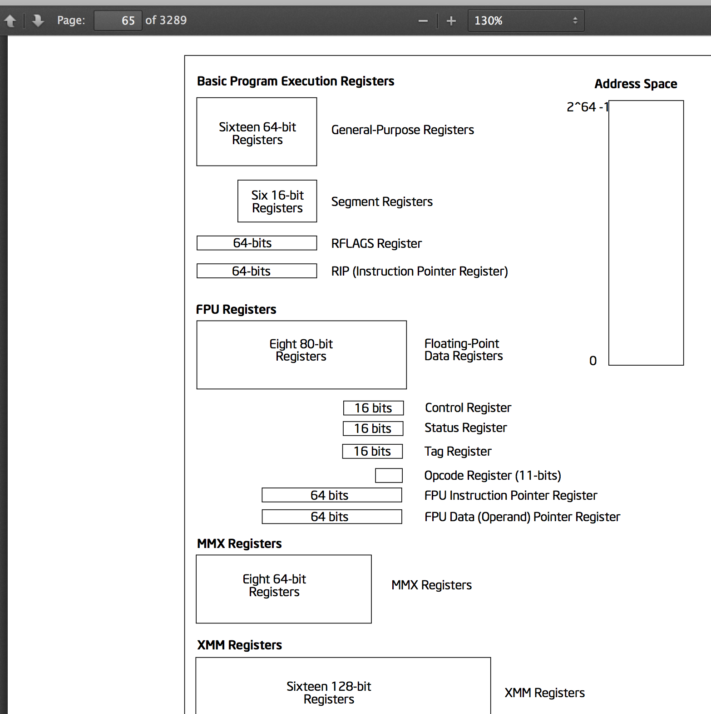

Slide 9
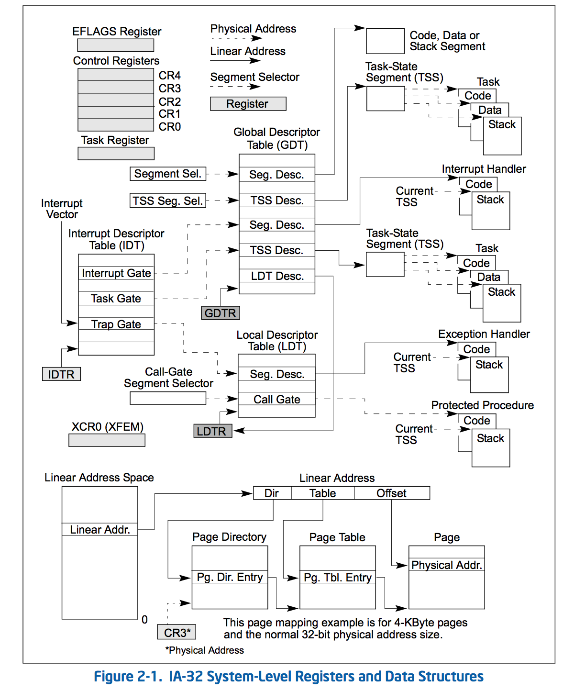

Slide 10
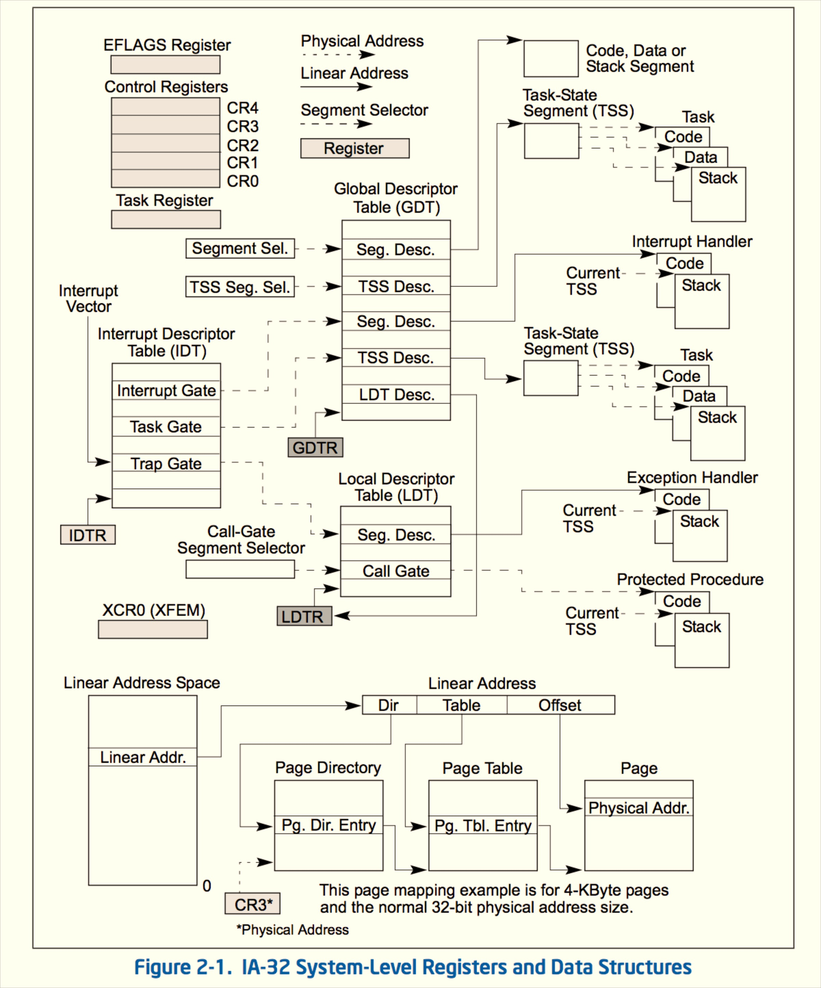
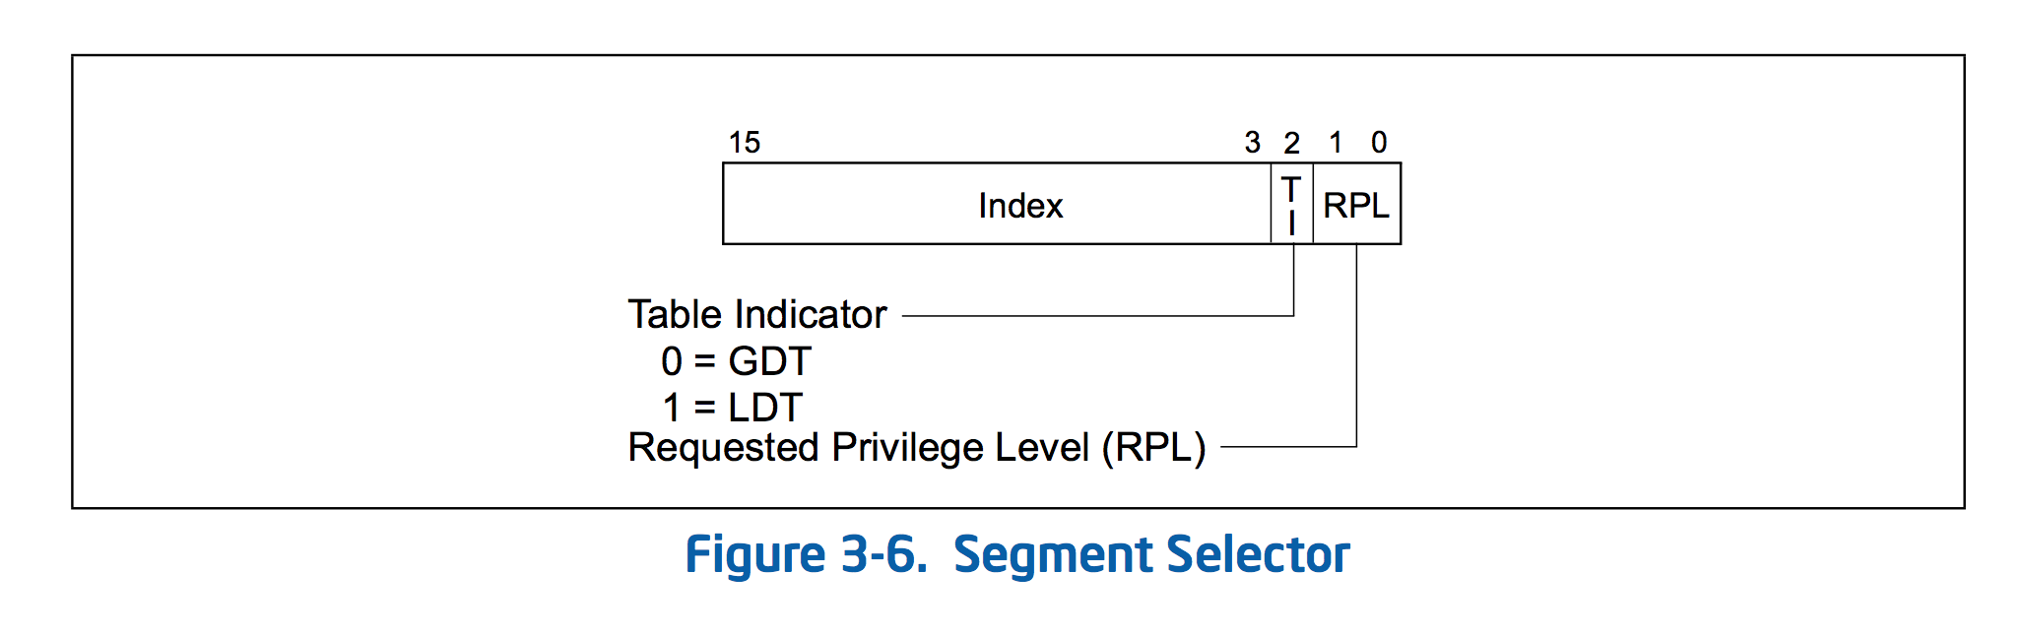

Slide 11
x86 Protection Rings
Ring 3
Rings 1 and 2:
device drivers
Ring 0
There’s nothing magic here: just 2 bits in a register that determine what instructions can execute!

Slide 12
Kernel Privileges
What can the kernel (supervisor) do that user-level programs cannot?
Handle interrupts
Execute privileged instructions
What happens when a user-level program attempts a privileged instruction?

Slide 13


Slide 14
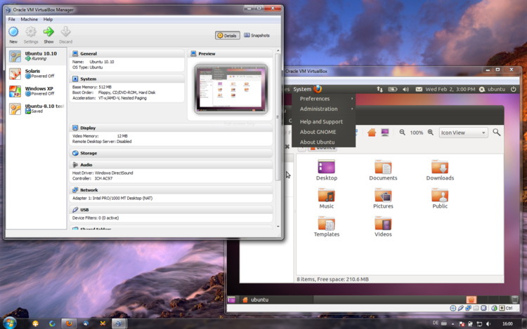
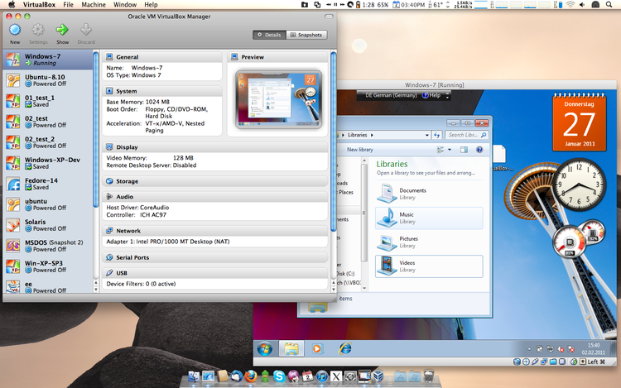
Ubuntu
Windows
Windows
Mac OS X

Slide 15
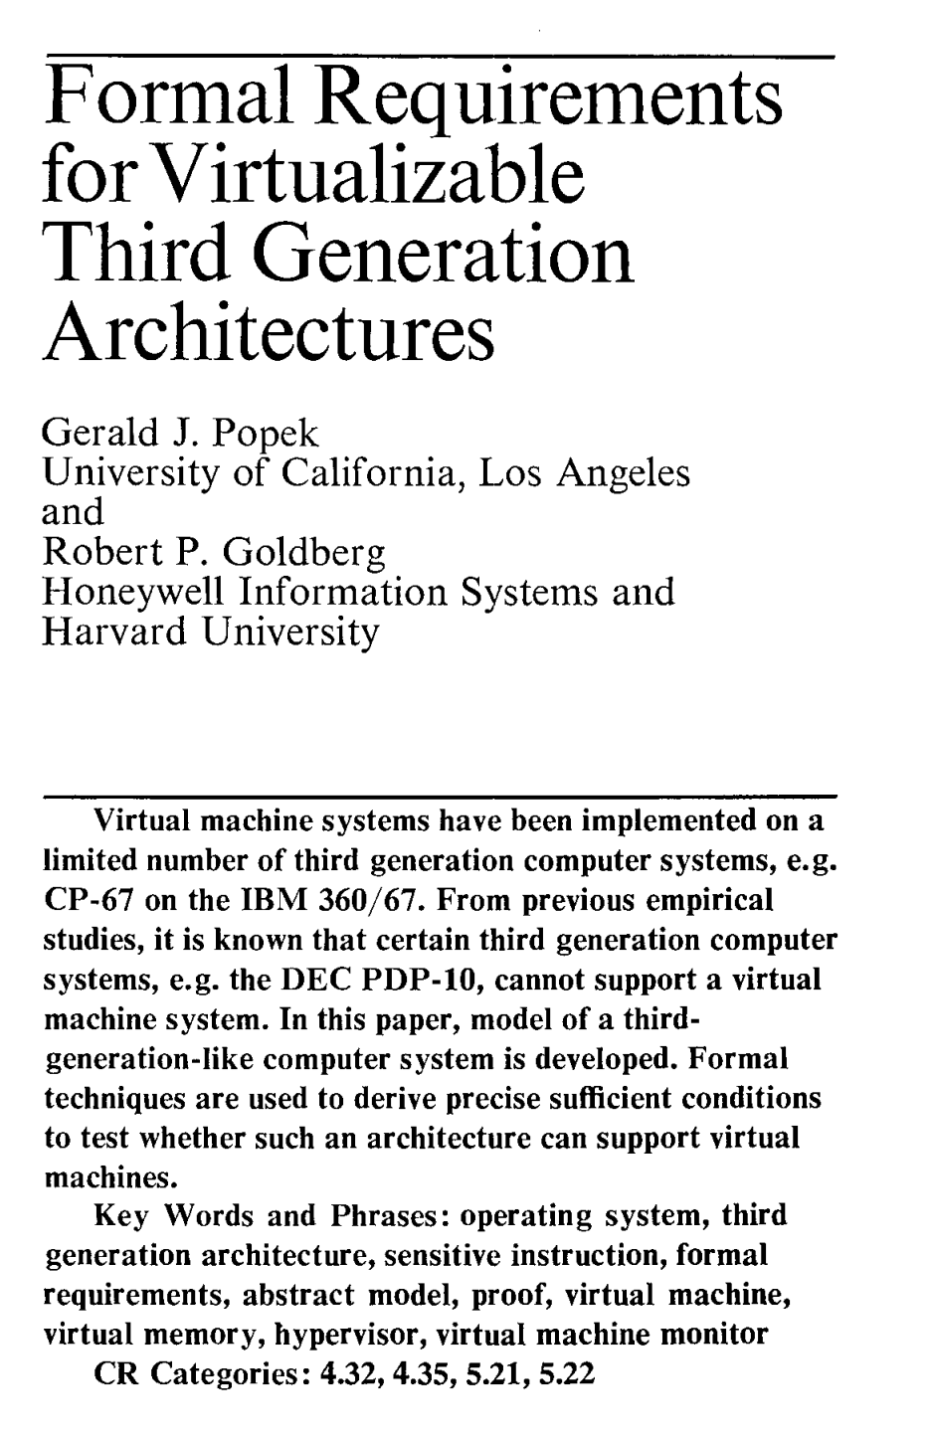
“Trap-and-Emulate”
Early Virtual Machines (1960-2005)
1. Guest OS (running at user-level) attempts privileged instruction
2. Traps to host OS
3. Host OS trap handler switches to virtualization program (VMM)
4. VMM emulates privileged instruction in virtual environment
SOSP 1973

Slide 16
Hardware-Assisted Virtualization
VT-x (Intel) and AMD-V (2005/2006)
vmrun
Enter “Guest mode”
Hardware-support for data structures for VM
exit
Return to “Host mode”
Saves guest state in hardware data structures

Slide 17
How many processes should a browser create?
Challenge for PS2 Exercise 1: what is the fewest number of processes you can have running on your machine?

Slide 18
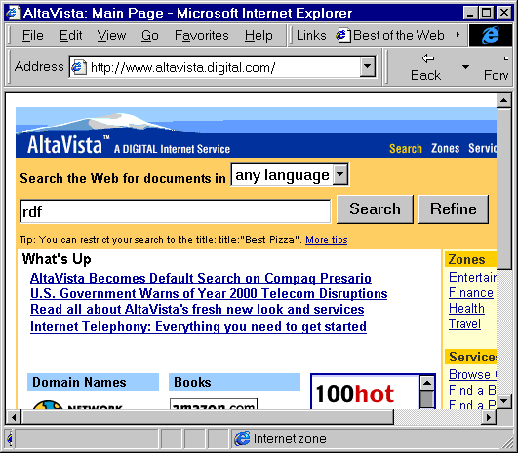
1990’s answer: 1 processes waste memory and CPU which are expensive and limited

Slide 19
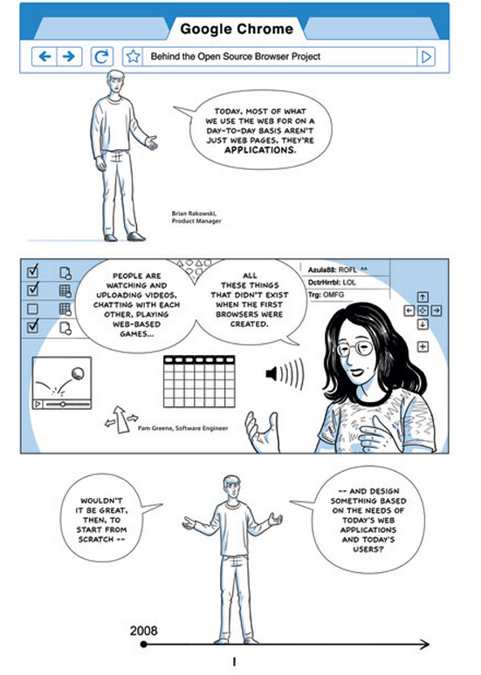
2000s answer:
http://www.google.com/googlebooks/chrome/

Slide 20
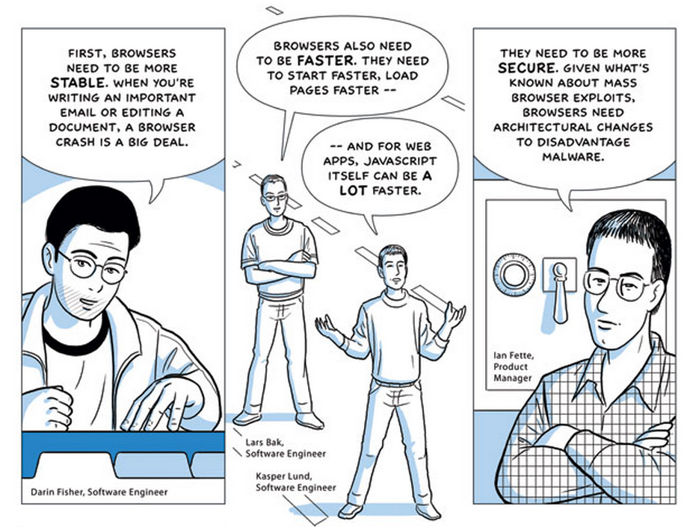

Slide 21
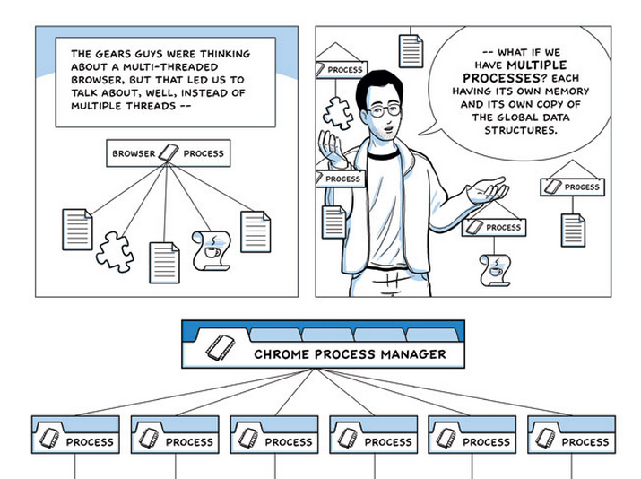

Slide 22
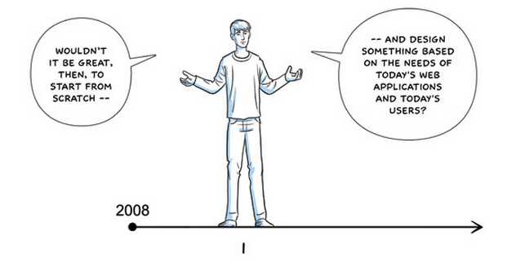

Slide 23
What should the 2010s answer be?

Slide 24
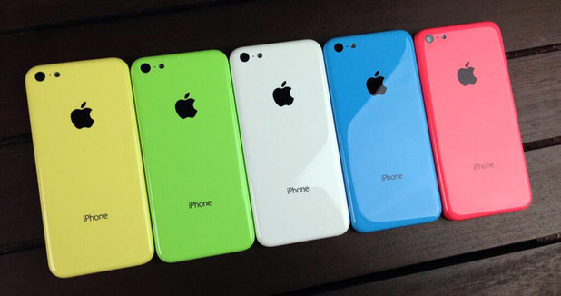
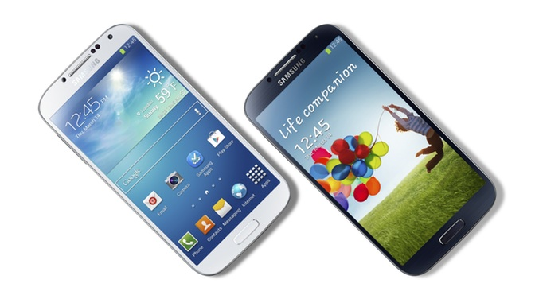
Apple iPhone 5C
Five colors, 2 cores!
Samsung Galaxy S4
Only two colors, but 4-8 cores!
(+ loads of GPU cores)
Note: the colors vs. cores tradeoff can probably be overcome by good engineering, but addressing the energy vs. cores tradeoffs require some theoretical advances also.

Slide 25
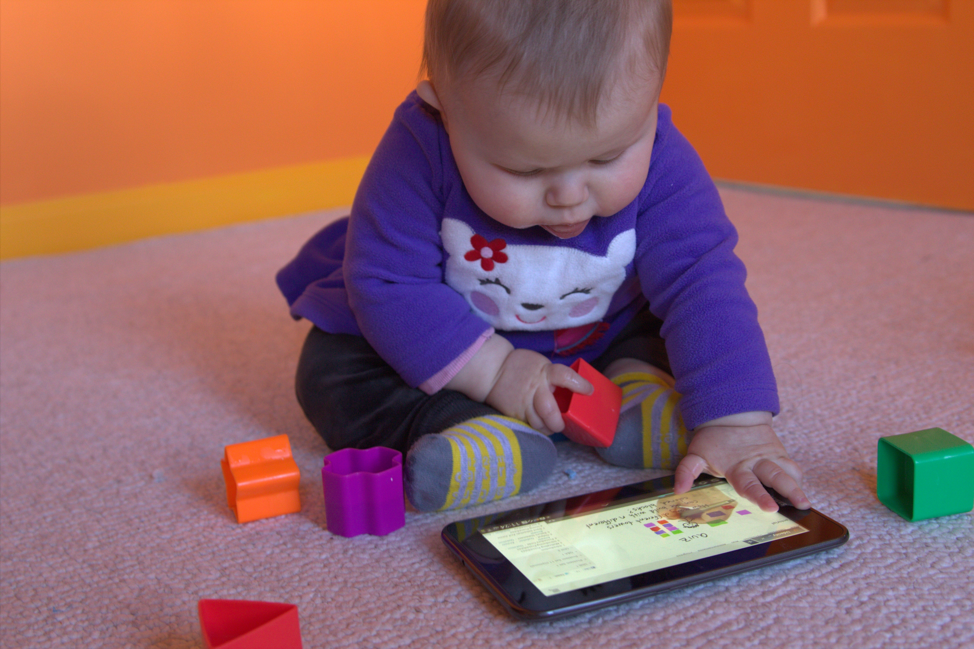
Humans should not be getting bored and grumpy waiting for their browser to render a page while cores are sitting idle!

Slide 26
“Start from Scratch” but constrained by using programming tools developed in the 1960s

Slide 27
2010s answer:
A modern browser should have enough threads to efficiently use all the machine resources available to provide human users with a good browsing experience!

Slide 28
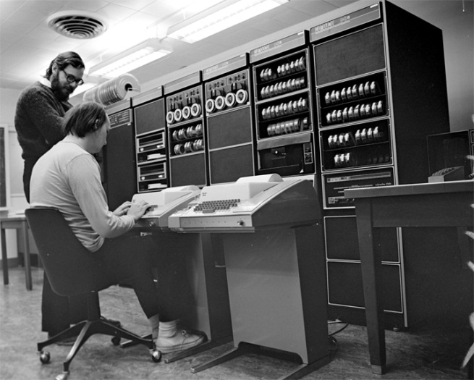
Unfortunately, it is not (humanly) possible to build such a browser (in a way that will also be secure, robust, and reliable) using languages whose primary design goal was to fit on a 4K machine.

Slide 29

Why do Rust stickers have gears on them?
Servo: the main reason Rust is being developed is so Mozilla can build a better browser!

Slide 30
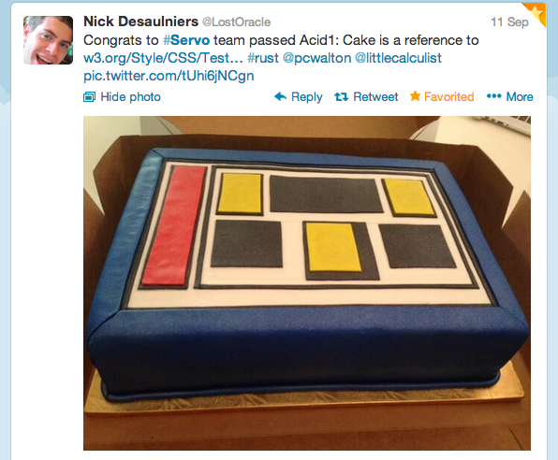
Really starting from scratch is really hard…
this is why getting Servo to the point where it can render a static page is cake-worthy!

Slide 31
PS2: The Good Auld SHell
gash> echo ‘Wha-hoo-wa!’
gash> !!
gash> traceroute 128.143.22.36
gash> id -p ray
gash> !!
gash> fsck; !mount -u VA!

Slide 34
Charge
Get started on PS2
  You must work with one
  other person
Examine the processes running on your computer, have fun killing them (but backup your work first!)
  If you don’t have a teammate, stay after class and find one!

