Slide 1

Class 5:
She Cells C Shells by the Rust Shore
cs4414 Fall 2013
University of Virginia
David Evans

Slide 2
Plan for Today
Correct course vacation policy
My teaching philosophy + overview of class (i.e., what you missed the first day)
Comments on Surveys, PS1
PS2 Demo (Purnam & Weilin)
PS2 Code Overview

Slide 3
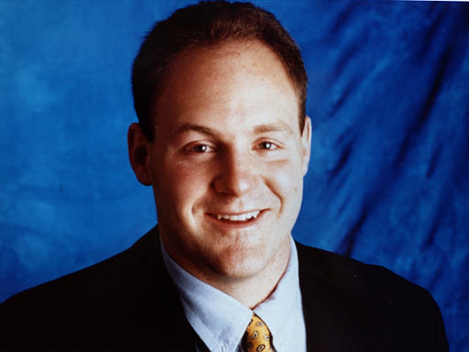
Daniel Lewin
14 May 1970 –
11 September 2001

Slide 4
0
Consistent Distributed Hashing
1
½

Slide 5
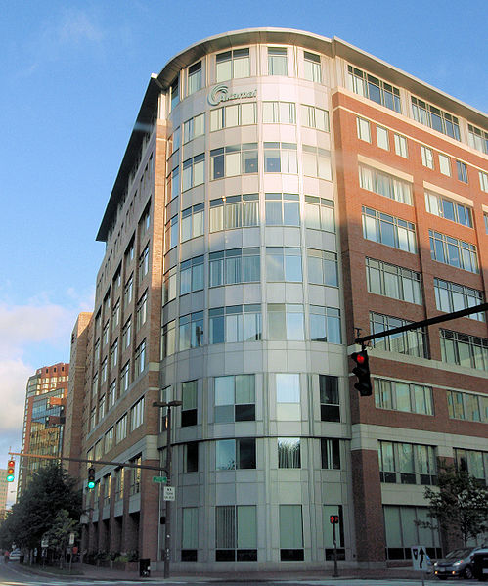

Akamai Headquarters, Cambridge, MA

Slide 6









“High-quality images and video became powerful assets in building the Victoria’s Secret brand.” (Akamai Inc.’s case study [2000])
(until a few years ago)
If you use any of these, your packets arrive faster because of Danny’s algorithms.

Slide 7





Updated (Non-US-Centric)
Course Vacation Policy
birth
parentage
marriage
UVa coach

Slide 8

+ Your Own Countries
To cheer up any Mexicans, you could still get a vacation day on Nov 21!

Slide 9
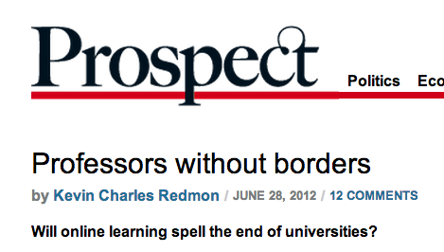
Teaching Philosophy
“I always felt, I was at Stanford, the world’s best university, and I was a great teacher,” he [Sebastian Thrun] said. “Having done this, I can’t teach at Stanford again. It’s impossible. I feel like there’s a red pill and a blue pill, and you can take the blue pill and go back to the classroom and lecture your 20 students. But I’ve taken the red pill. And I’ve seen wonderland.”
* * *
Not long ago, on a rainy Saturday morning, Professor Dave Evans and I hung out in bed while he tried to explain recursive functions (for the fourth time) and I worked on my homework. Or rather, I hung out in bed, and Evans, a computer science professor at the University of Virginia, hung out on my laptop screen, where I could—click—pause him midsentence and pour myself another cup of coffee.

Slide 10
What is my goal for lectures?
Convey some complex technical ideas
Teach you what you need to know to do the projects
Avoid being fired
Keep most of you awake for 75 minutes
Get you to laugh at dumb jokes

Slide 11
What is my goal for lectures?
Convey some complex technical ideas
Teach you what you need to know to do the projects
Avoid being fired
Keep most of you awake for 75 minutes
Get you to laugh at dumb jokes
Lectures are a horrible medium for learning complex ideas.
Better to read wikipedia.
The point of the projects is to teach you things I want you to learn in the class (mostly by suggesting things you should learn on your own).
I have tenure already
You probably should be getting more sleep!
Monty Python is funnier (unless you are Kevin Redmon)

Slide 12
My Real Goal for Lectures
Provide context/meaning/inspiration for the things you have or will later learn on your own.
My Insidious Goal for Lectures
Take advantage of huge opportunity to convey my values to (semi-)captive impressionable young people.

Slide 13
(Academic) Goal of the Class
Improve our understanding of how computers work.

Slide 14
Why bother?
Better understanding of how computers work make you a better programmer which will help you build something cool, succeed in grad school, or get a more interesting job.
Better understanding of how computers work (and why) is intellectually, culturally, and scientifically interesting.
If these reasons don’t apply for you and you are only in this class because there is a bureaucratic requirement that you take it so some Dean will hand you a nice bit of paper in front of your parents, you should meet with me to figure out an alternative.

Slide 15
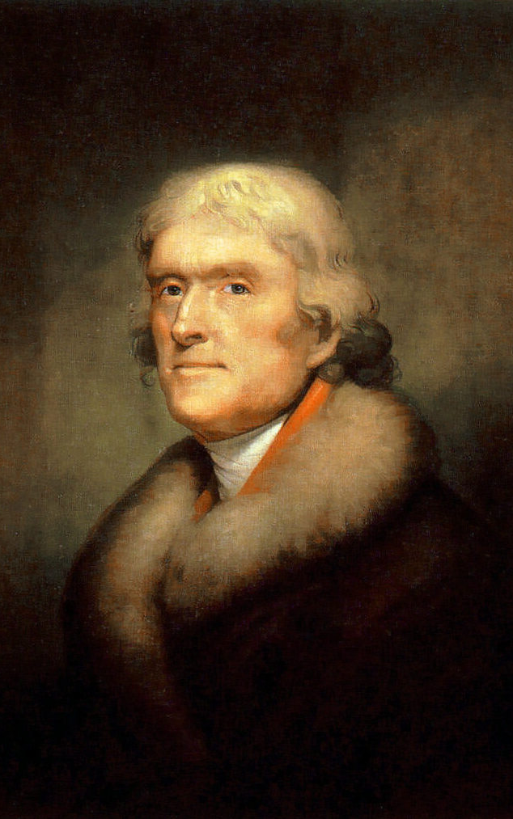
What Mr. Jefferson Wants
“We wish to establish in the upper country of Virginia, and more centrally for the State, a University on a plan so broad and liberal and modern, as to be worth patronizing with the public support, and be a temptation to the youth of other States to come and drink of the cup of knowledge and fraternize with us.”
TJ’s letter to Joseph Priestly, 1800
No Majors
No Degrees
No President

Slide 16
Note: this does not mean he wants you to be lazy:
:
Thomas Jefferson enrolled in the College of William and Mary on March 25, 1760, at the age of 16…
By the time he came to Williamsburg, the young scholar was proficient in the classics and able to read Greek and Latin authors in the original… He was instructed in natural philosophy (physics, metaphysics, and mathematics) and moral philosophy (rhetoric, logic, and ethics). A keen and diligent student, he displayed an avid curiosity in all fields and, according to family tradition, he frequently studied fifteen hours a day.
http://www.wm.edu/about/history/tjcollege/tjcollegelife/

Slide 17
What do you think my goals are in designing assignments?

Slide 18
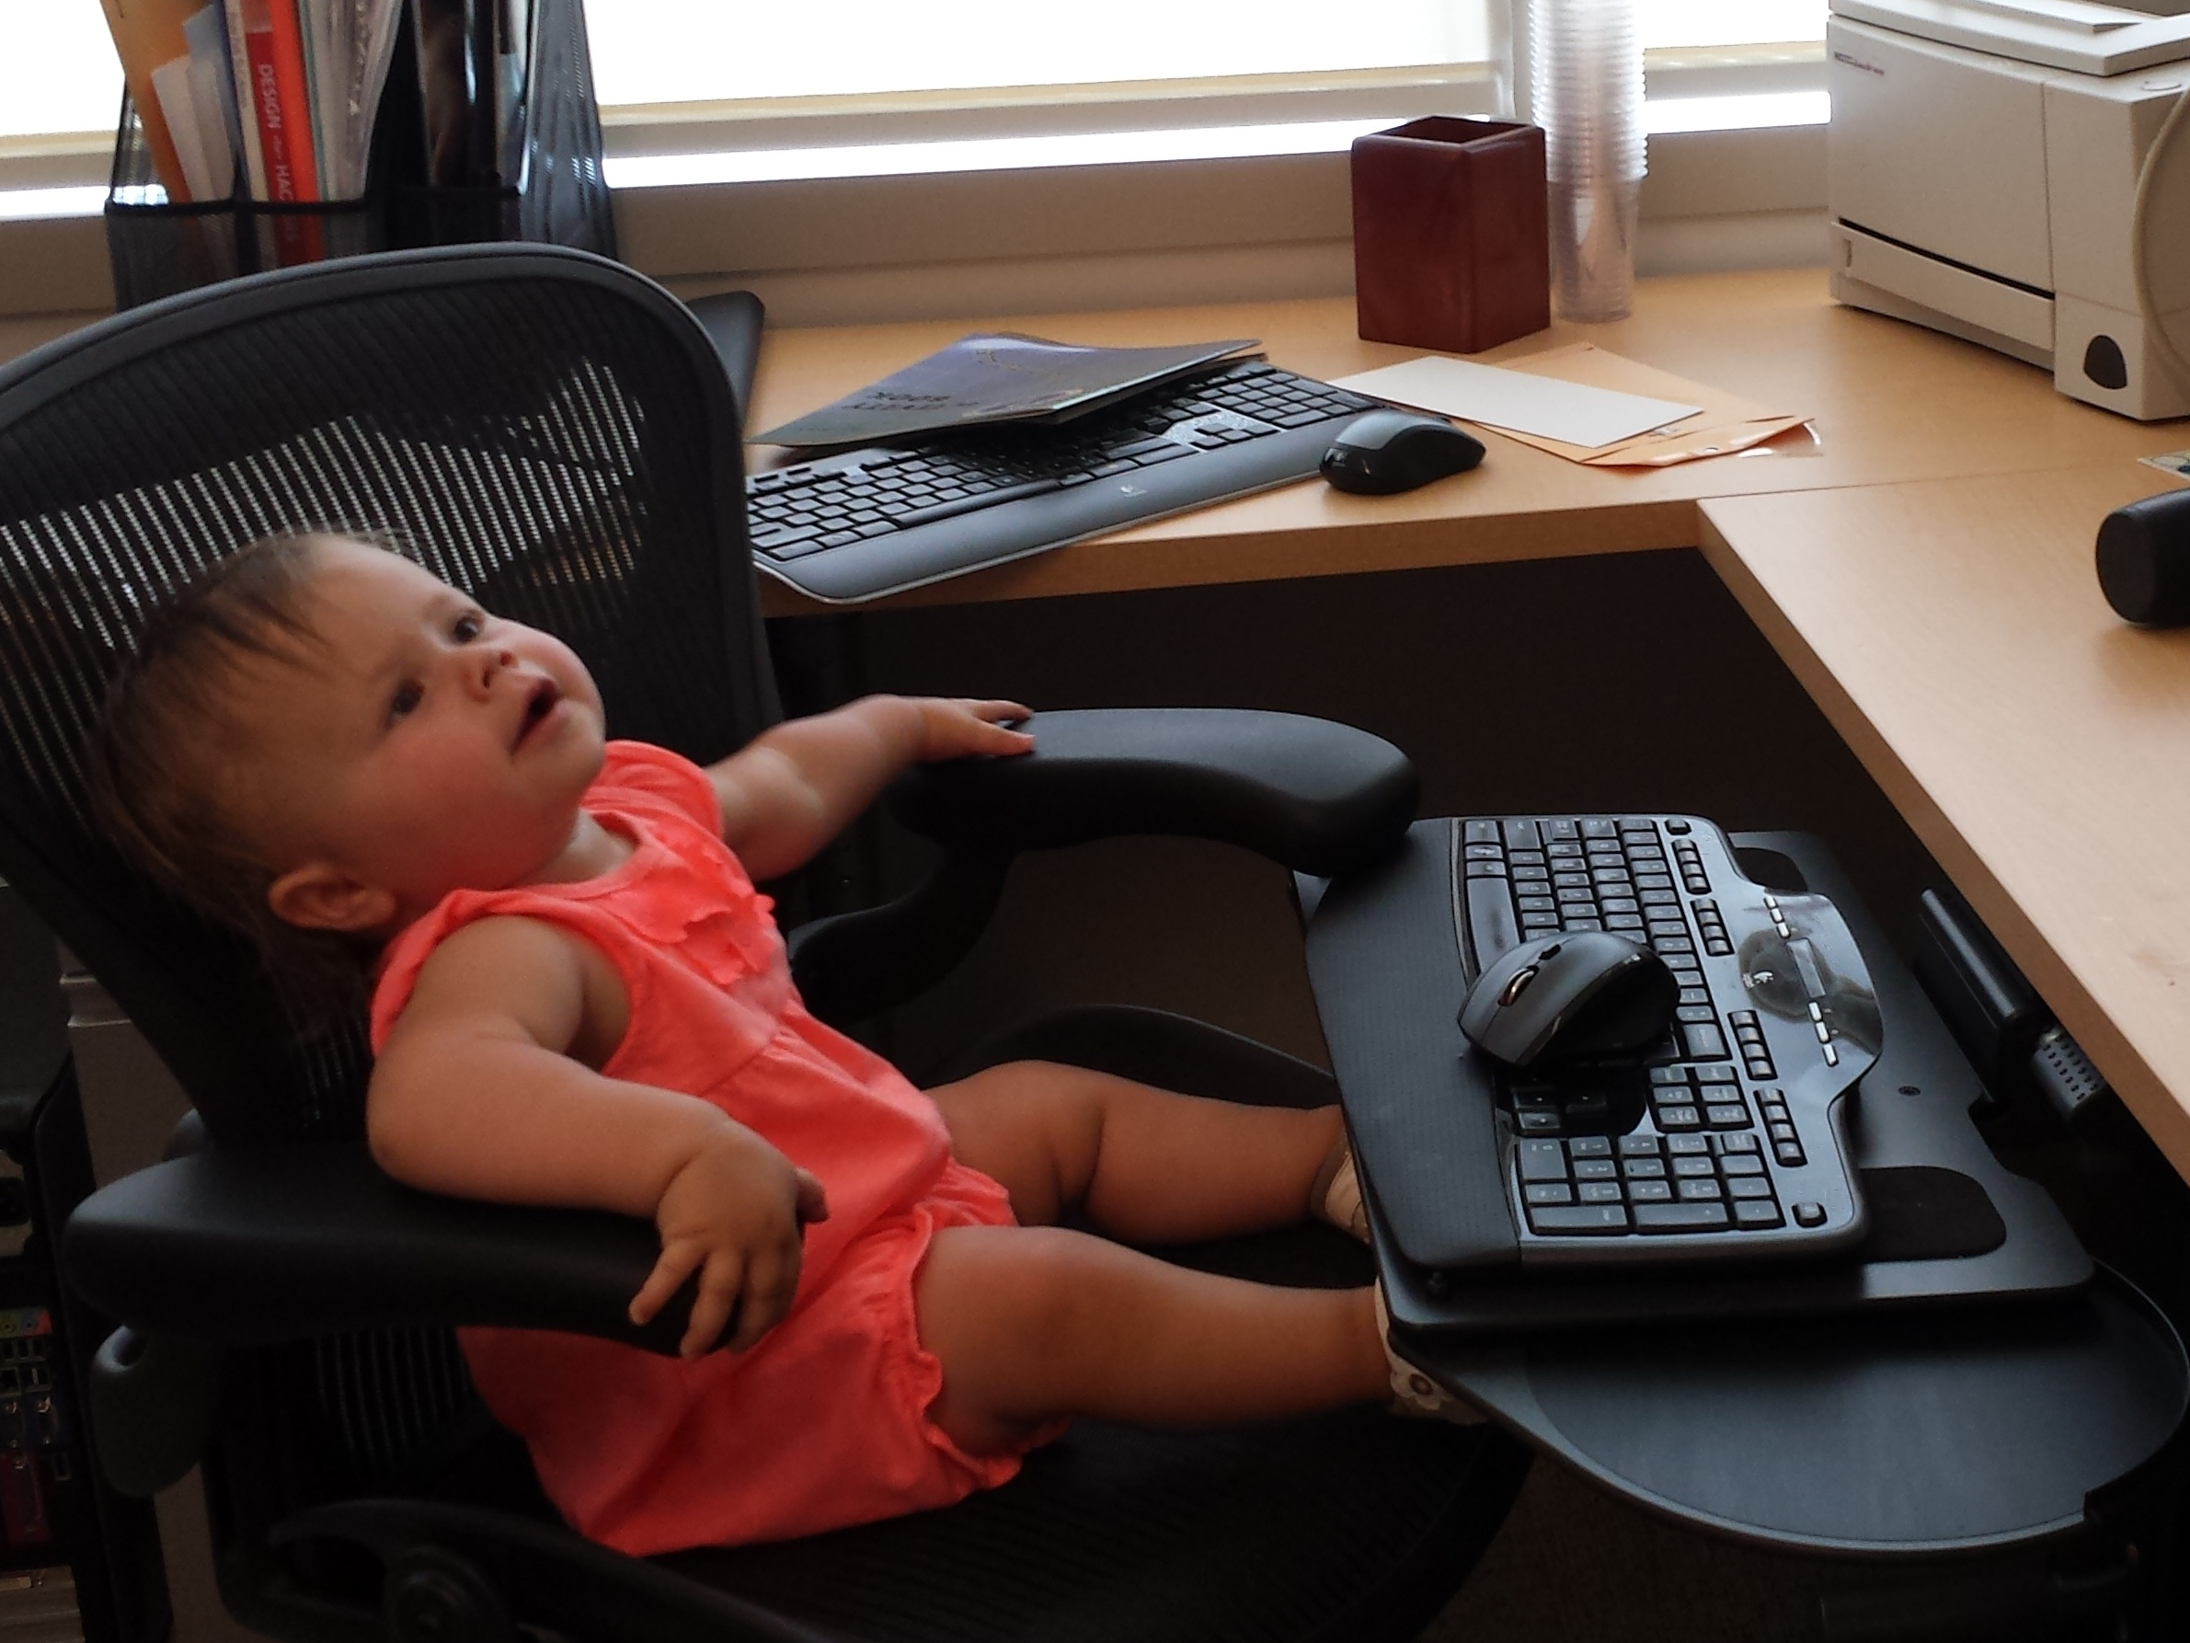
Instead of whinging about how bad the Rust documentation for strings is….

Slide 19
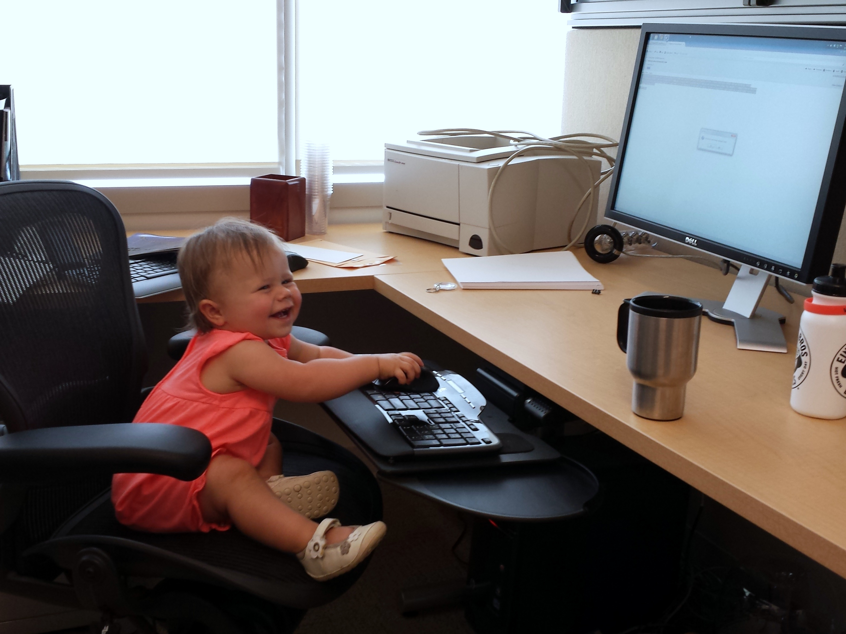
Be happy! You can be the first to write one!
STRINGS IN RUST

Slide 20
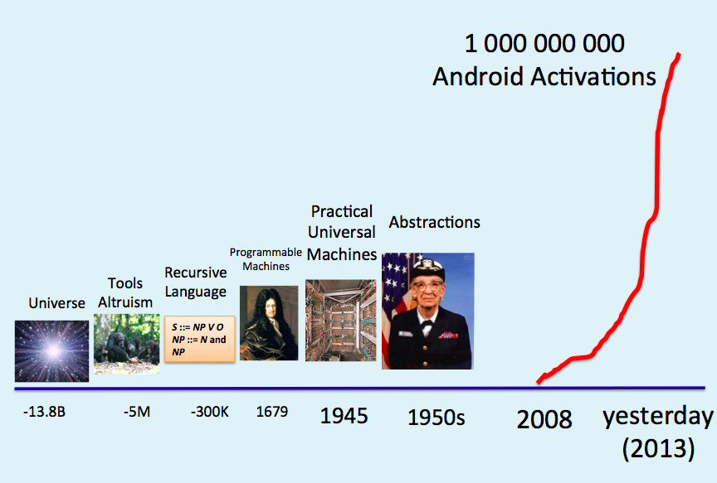
Remember Class 3?
From: torv...@klaava.Helsinki.FI (Linus Benedict Torvalds)
Subject: What would you like to see most in minix?
Summary: small poll for my new operating system
Date: 25 Aug 91 20:57:08 GMT
Hello everybody out there using minix -
I'm doing a (free) operating system (just a hobby, won't be big and professional like gnu) for 386(486) AT clones. This has been brewing since april, and is starting to get ready. …
Its not always about being best. Sometimes being first counts for a lot!
12 September 2013
University of Virginia cs4414
19

Slide 21
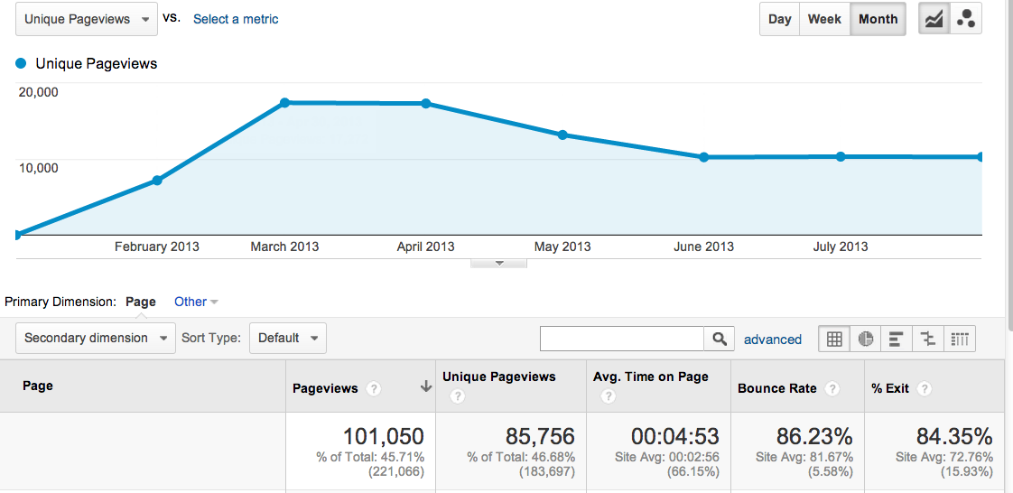
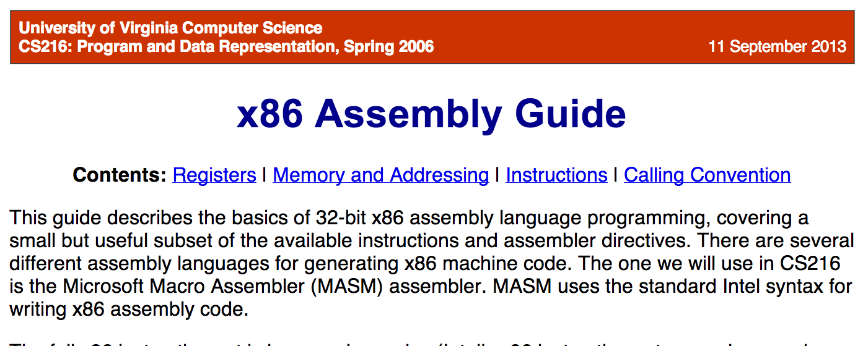
101K page views in 6 months * 4:53/view = 493 460 minutes
http://www.cs.virginia.edu/evans/cs216/guides/x86.html

Slide 22
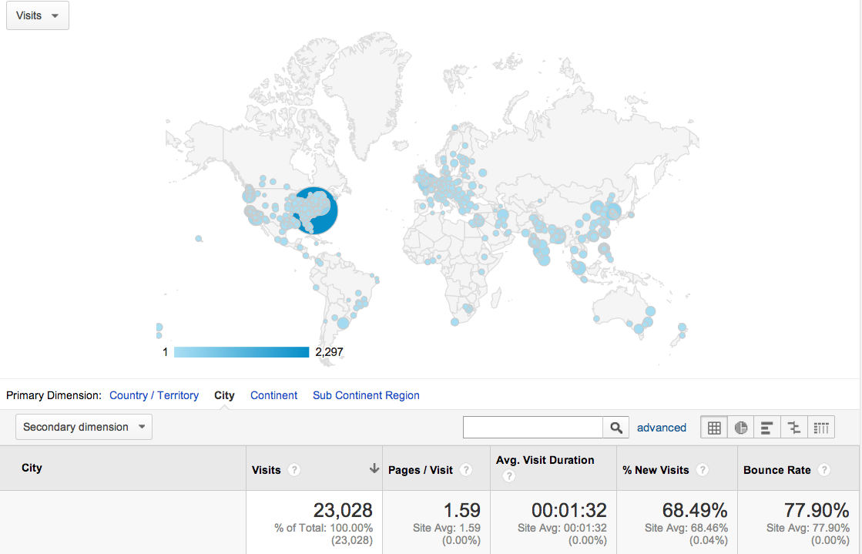

Slide 23
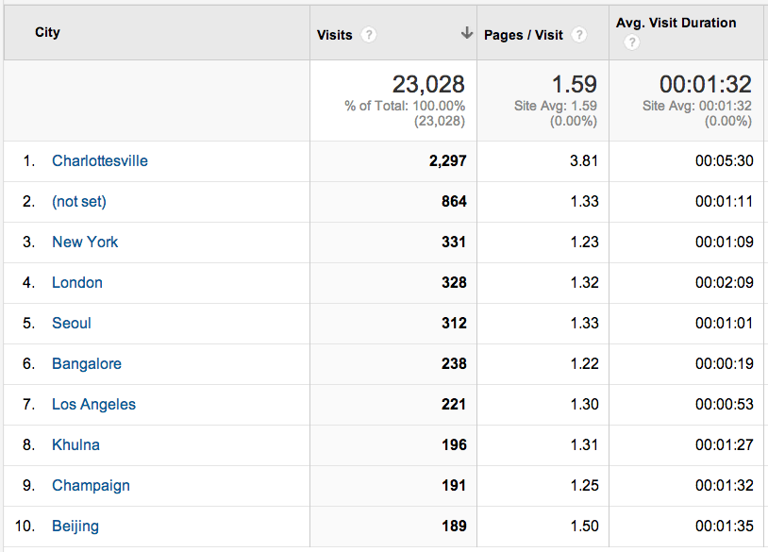
/cs4414-fall2013/

Slide 24

Date: Thu, 12 Sep 2013 09:35:16 +0200 [3:30am this morning our time]
From: Jordi Boggiano <email hidden@....be>
To: evans@cs.virginia.edu
Heya,
It came to someone's attention that you seemed to encourage people to write new docs for rust in your http://www.cs.virginia.edu/~evans/cs4414/ course. We figured someone should let you know that an effort is under way for rust 0.8, so that nobody wastes time on it. The current preview can be seen on my site at http://seld.be/rustdoc/ - it's targetting master and we can’t really build it for 0.7 due to language changes, but hopefully within a few weeks it will land as the new official doc for upcoming version. Better search is coming and a few final additions are still needed.
Cheers
--
Jordi Boggiano
@seldaek - http://nelm.io/jordi
Belgium

Slide 25

The Problem Sets are Suggestions
If you have a better idea, convince me, and you should do that instead.

Slide 26
Plan for Projects
PS1: zhttpto web server
PS2: shell (learn about processes)
PS3: zhtta web server (learn about memory management, network protocols, performance)
PS4: something like DropBox (file systems, I/O, security)
zepto = 10⁻²¹
zetta = 10⁺²¹
(Note: The actual relative difficulty is less than 10⁴².)

Slide 27
This generation of students got into “UVa” by doing exactly and precisely what teacher wants. If teacher is vague about what he wants, they work a lot harder to figure out what they want and whether or not it is good. The vaguer the directions, the more likely the opportunity for serendipity to happen. It drives them nuts!
Harvard Professor John Stilgoe
(on "60 Minutes", 4 January 2004)
PS5: anything you want
(no concrete suggestion)

Slide 28

How much time should I need to spend on grading this semester?
Note: I mean just “grading” for the point of being able to assign appropriate grades to students. This doesn’t include time giving substantive “feedback”.

Slide 29
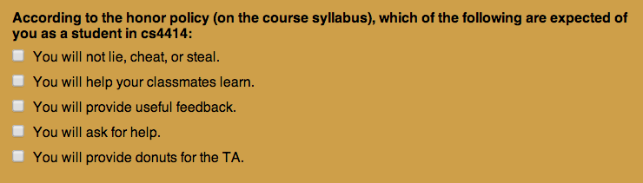
Course Honor Policy
5 people got it more wrong by omission (left out important things you should do)! If you are one of them and you want to stay in the class, read the syllabus more carefully and resubmit to correct your answer.

Slide 30

Course Honor Policy
3 people got it more wrong by addition. Those people definitely need to provide high quality donuts for the TAs! (This is encouraged for everyone, but optional if you didn’t check it as part of the honor policy.)

Slide 31
Plan for Projects
PS1: zhttpto web server
PS2: gash (learn about processes)
PS3: zhtta web server (learn about memory management, network protocols, performance)
PS4: something like DropBox (file systems, I/O, security)
PS2 Demo:
gash (“Good Auld Shell”)

Slide 32
Charge
In true Danny form, he fought back against the terrorists in an effort to defend the stewardesses and the cockpit. To this day, those of us who knew him well can’t figure out how only five terrorists managed to overpower him. During his short life, Danny made extraordinary contributions to the internet and to computer science through his work in algorithms and complexity theory. The impact of his work will be felt throughout the hi-tech industry for many years to come.
Tom Leighton
(full speech linked from class notes)
PS2 is much longer and harder than PS1.
Don’t wait until next week to get started!

