Slide 1
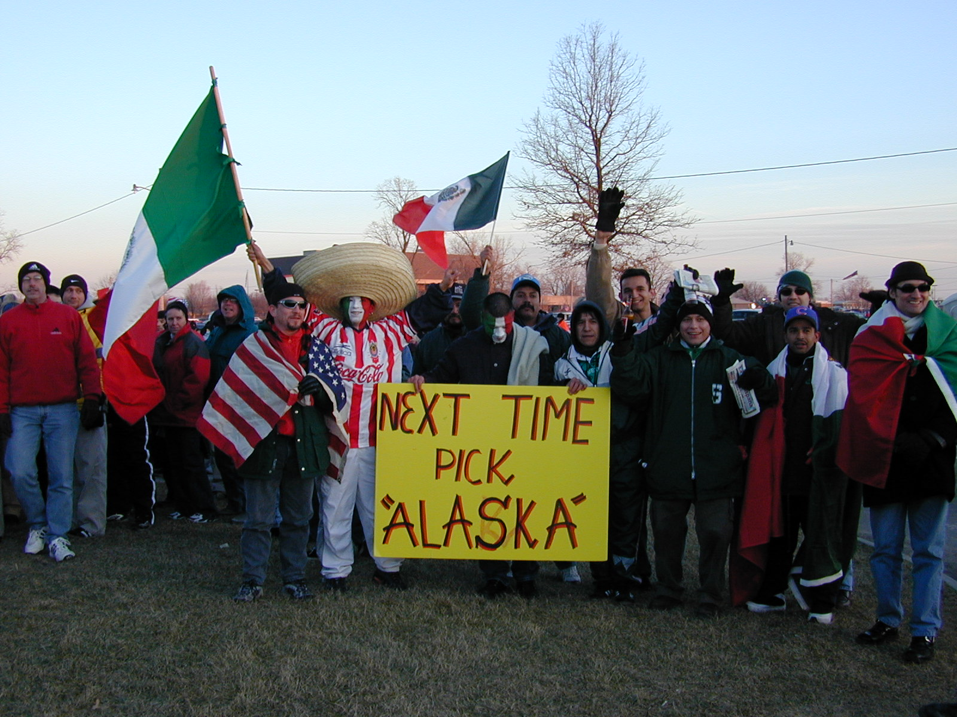
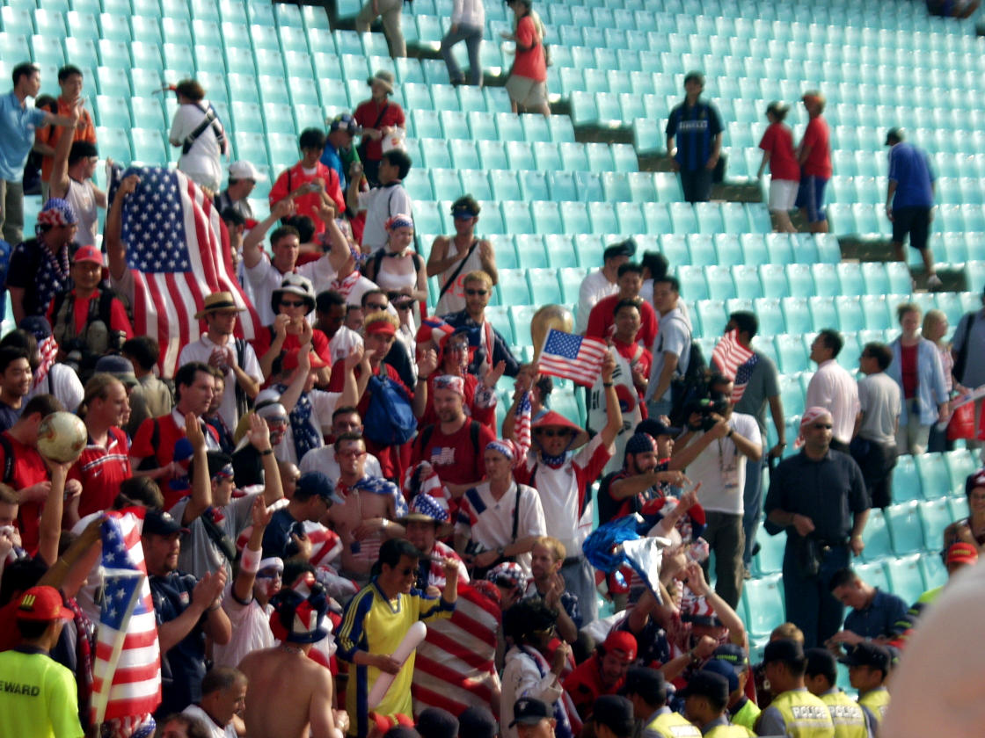
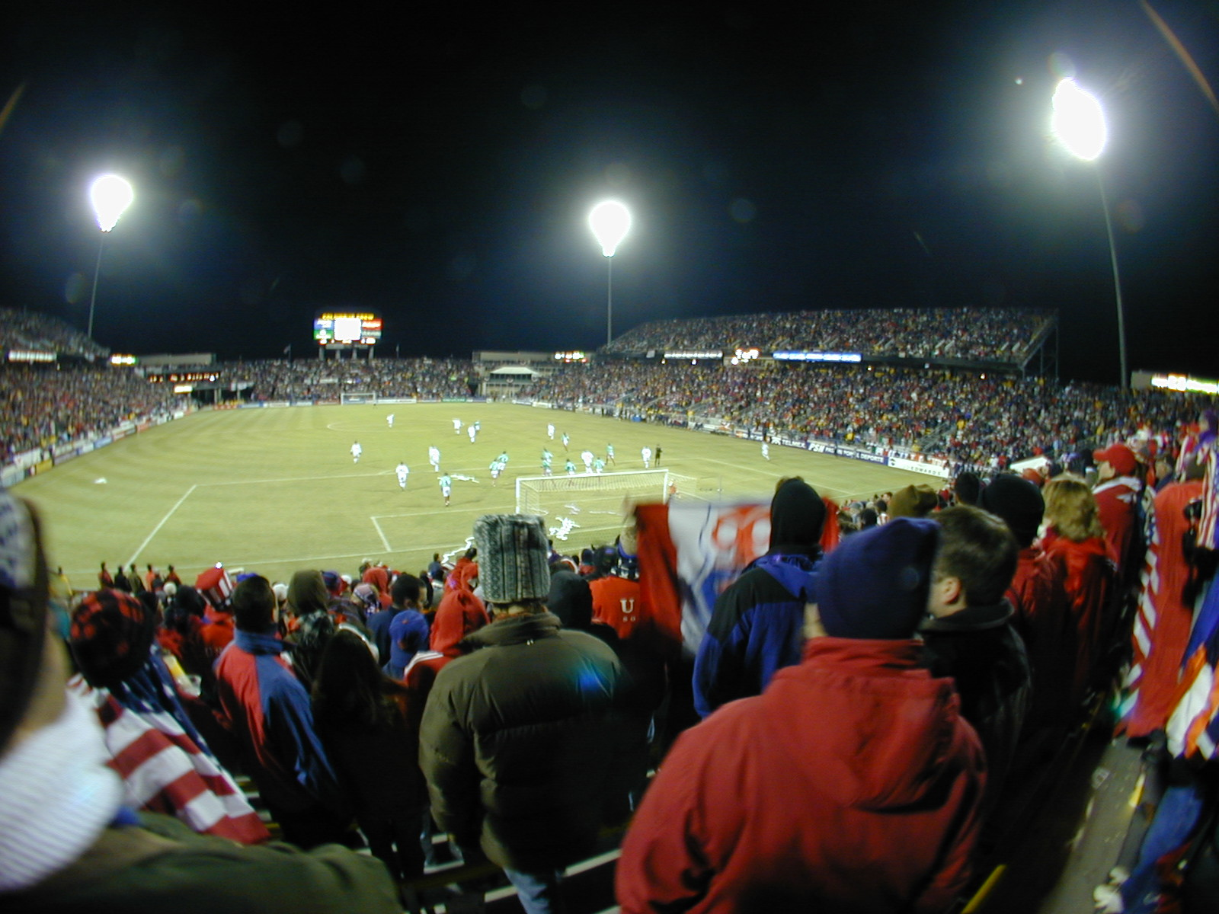
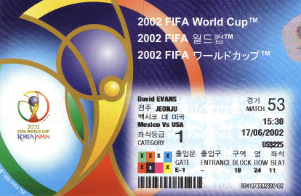
Class 2-0:
Once Upon a Process
Columbus, 28 Feb 2001
Jeonju, 17 June 2002
cs4414 Fall 2013
University of Virginia
David Evans

Slide 2
Today’s Main Question
How can several programs share a processor?

Slide 3
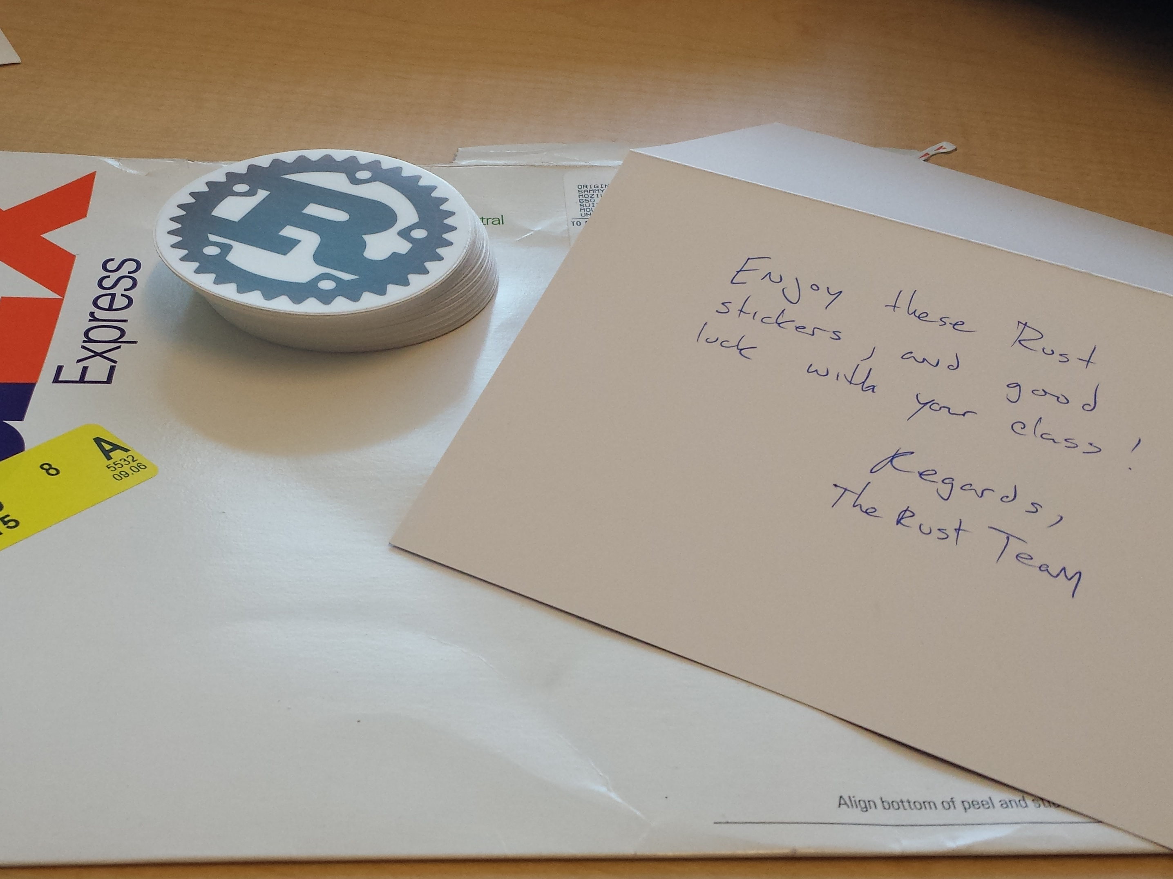

Slide 4
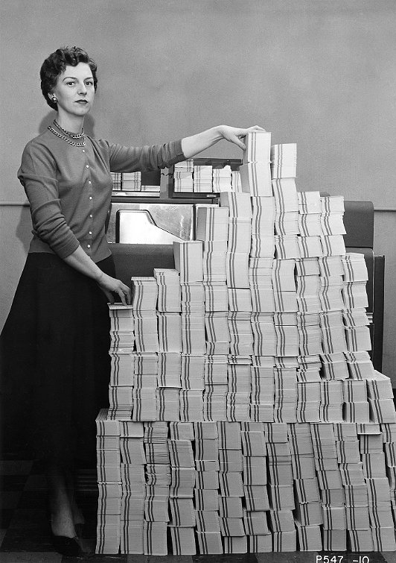
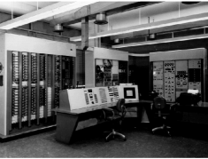
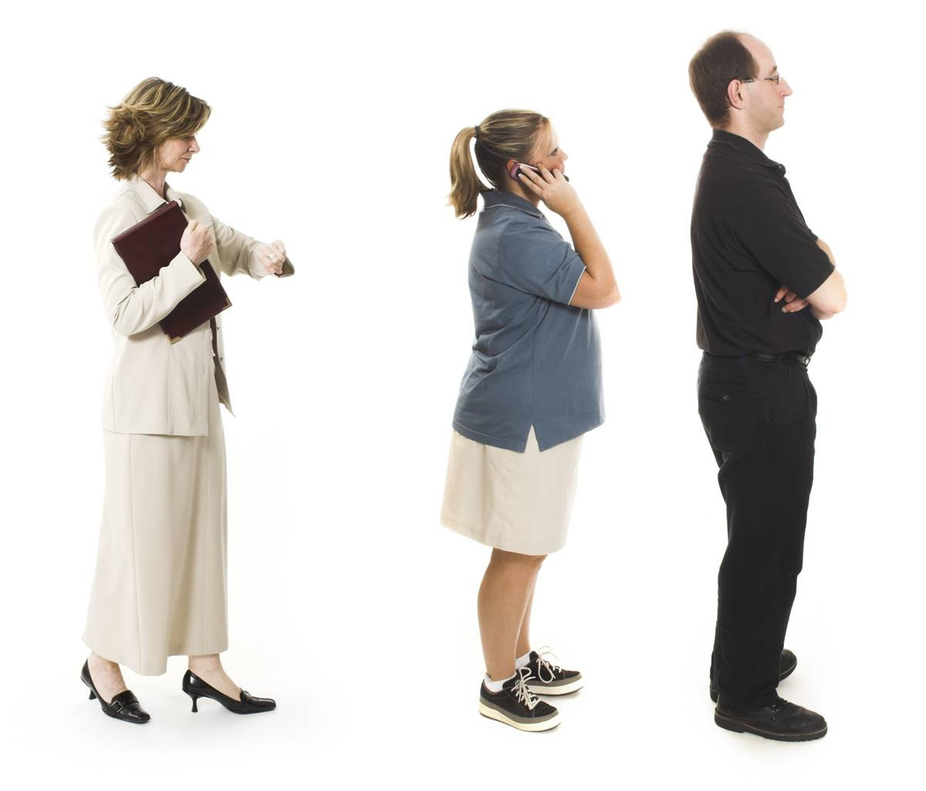
Recap:
Last Class
Batch Processing
Program
Computer Center
Your Program Runs
A
Program A
B
Program B
A
Multiprogramming
Program C
C

Slide 5
Kinds of Processor-Sharing
Multiprogramming
User program X runs until it gets stuck, then supervisor program takes over.
Non-preemptive multi-tasking
User program X runs until it decides to let the supervisor program run.
Preemptive multi-tasking
User program X runs until the (approximately) supervisor decides to let another program run.

Slide 6
Non-preemptive
Preemptive

Slide 7

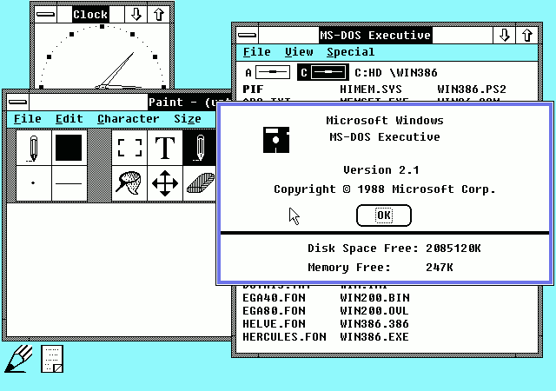
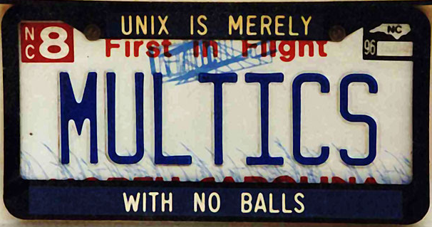
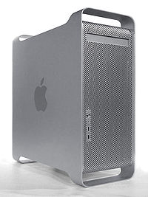
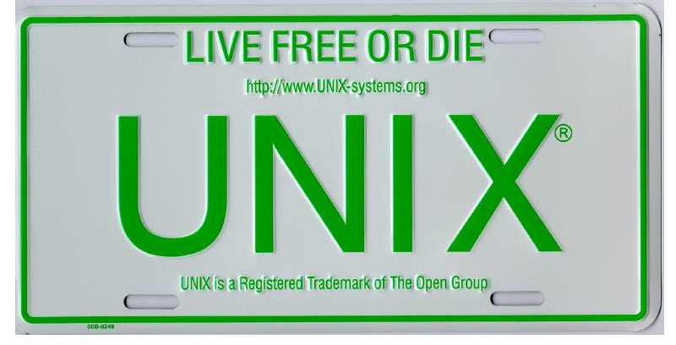
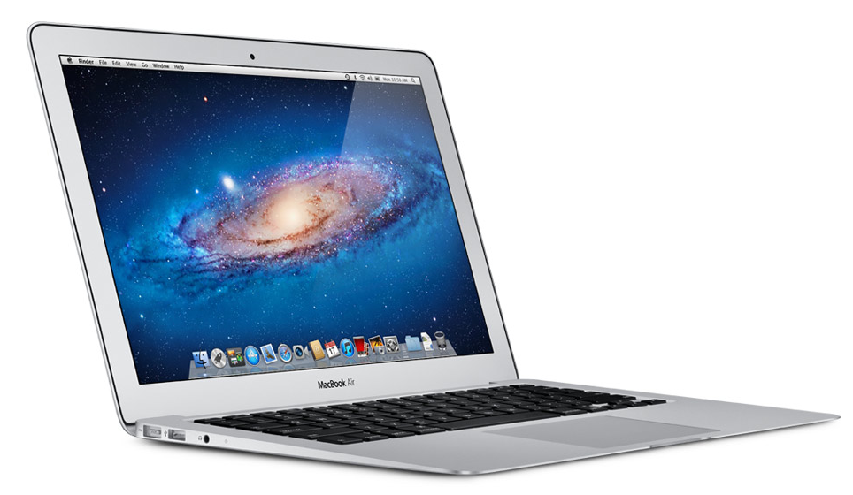
Which have preemptive multitasking?
Microsoft Windows 2.1x
1988
PowerMac G5
(Mac OS 9)
2006
MULTICS (1969)
MacBook Air
(Mac OS X)
2011
UNIX (1975)

Slide 8
Which have preemptive multitasking?
Microsoft Windows 2.1x
1988
PowerMac G5
(Mac OS 9)
2006
MULTICS (1969)
MacBook Air
(Mac OS X)
2011
UNIX (1975)

Slide 9
How could I prove it?

Slide 10
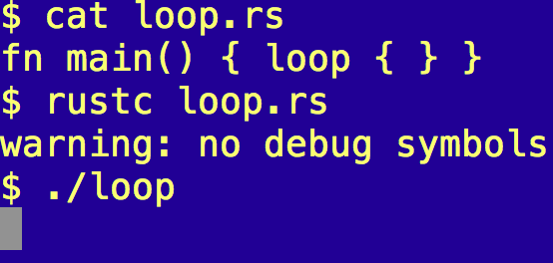
One-line Proof

Slide 11
Quiz
Which are results of preemptive multitasking?
A computer running Mac OS X crashes less than one running Mac OS 9
A computer running Mac OS X needs fewer hard reboots than one running Mac OS 9
When you watch Gangnam Style even for the 50th time, the video jitters
A Senator can play poker on an iPhone during an important hearing

Slide 12
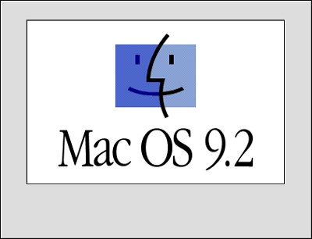
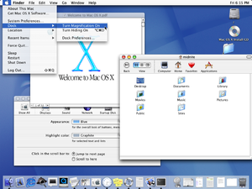
Mac OS 9.2.2
5 Dec 2001
Mac OS X (Cheetah)
24 March 2001
How did Apple add preemptive multitasking to Mac OS?

Slide 13
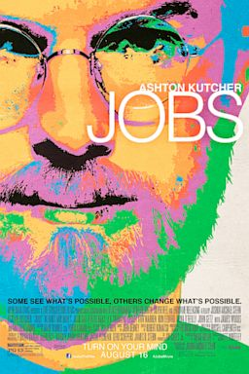
(The answer is probably not in this movie.)
http://www.youtube.com/watch?v=YsWBJ_usRck&t=2m18s

Slide 14

“Once you make them talk, they won’t be inanimate anymore.”
Steve Jobs (as quoted by Sorkin earlier in interview)

Slide 15
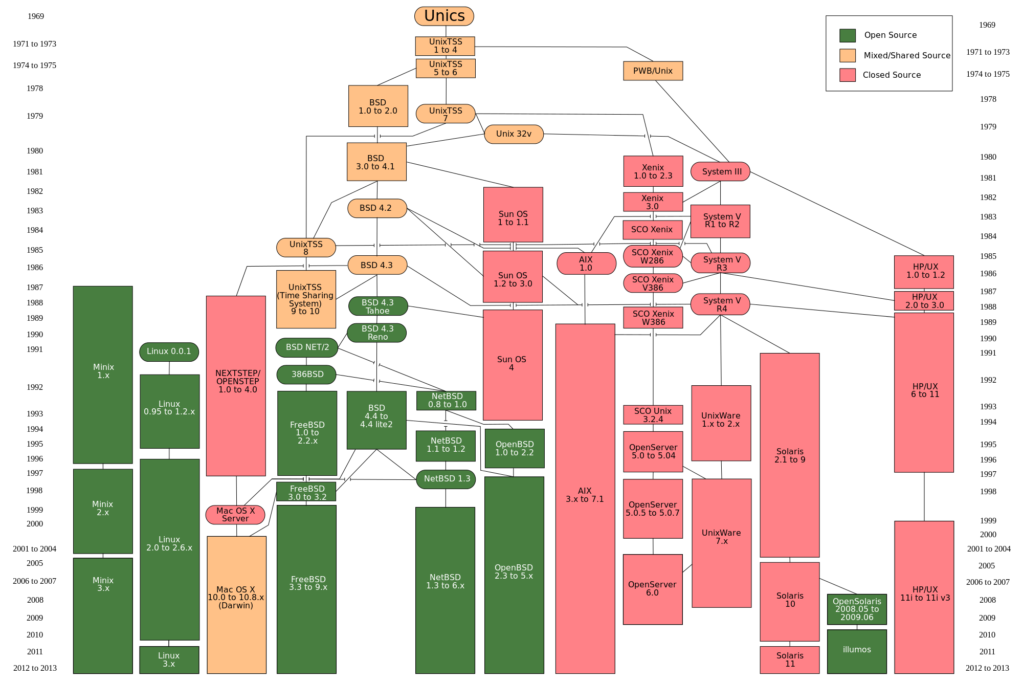
https://upload.wikimedia.org/wikipedia/commons/7/77/Unix_history-simple.svg

Slide 17
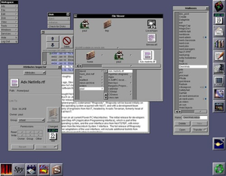
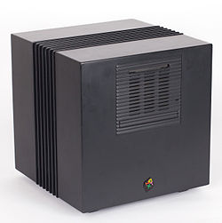

Slide 18
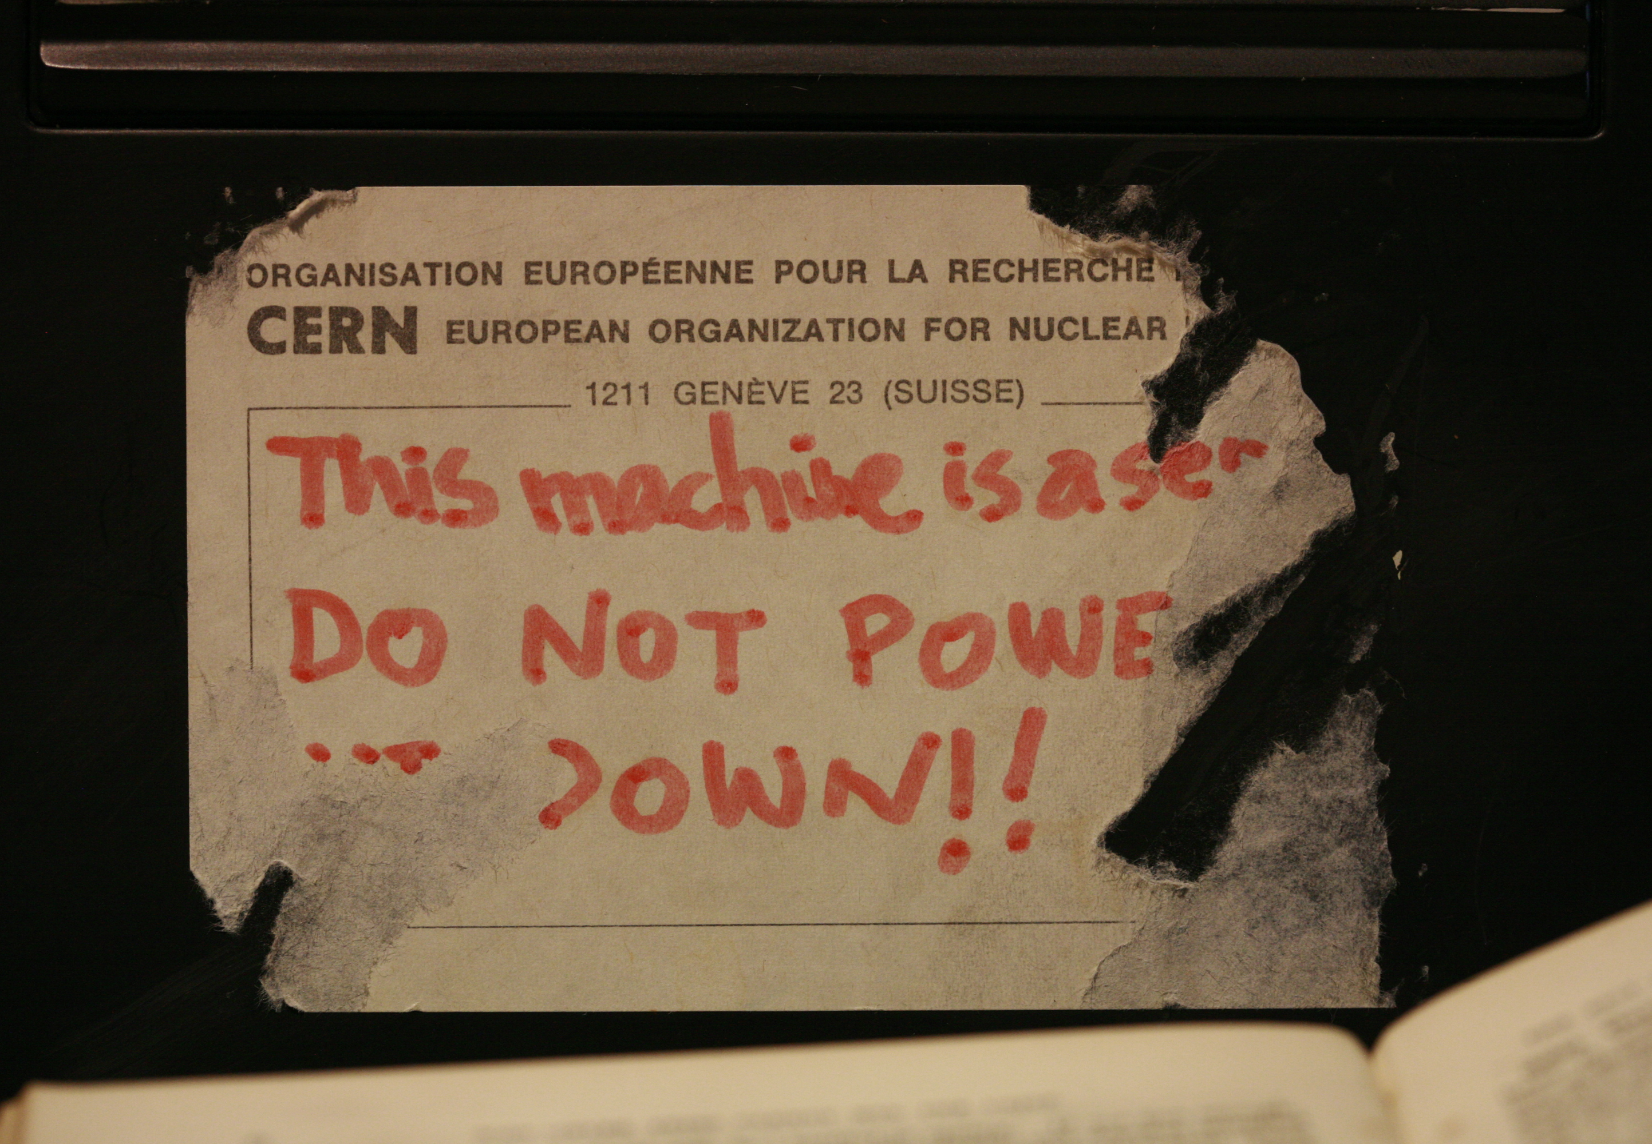

Slide 19
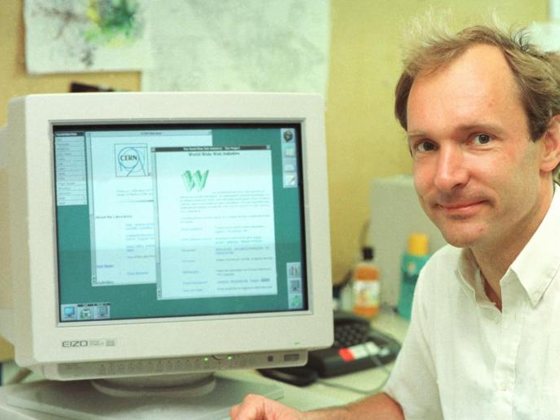
Tim Berners Lee finishing PS1 23 years early!

Slide 20
MULTICS
Code (carries license)
“Ideas” (no license, possible patent lawsuits)
Unix
BSD
Minix
NextStep
FreeBSD
Linux
Mac OS X
Android
iOS

Slide 21


Slide 22
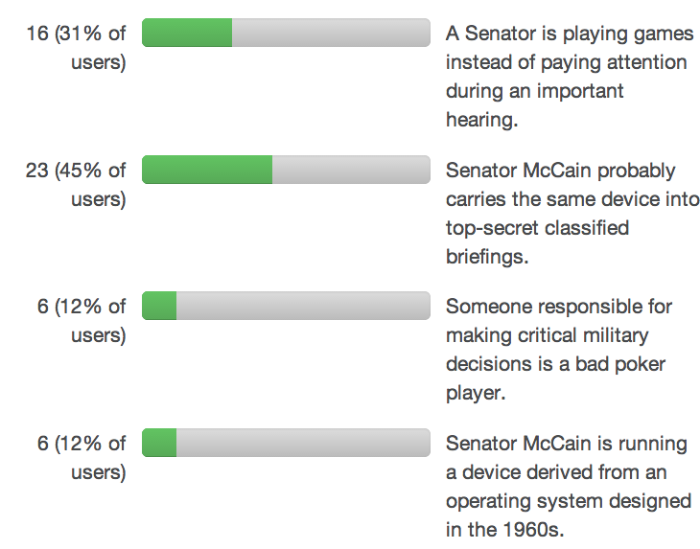

Slide 23

I am not making this up (really)!:
http://www.pkr.com/en/community/news-events/pkr-for-iphone/
Non-Malicious
Developers
Senator’s Phone

Slide 24
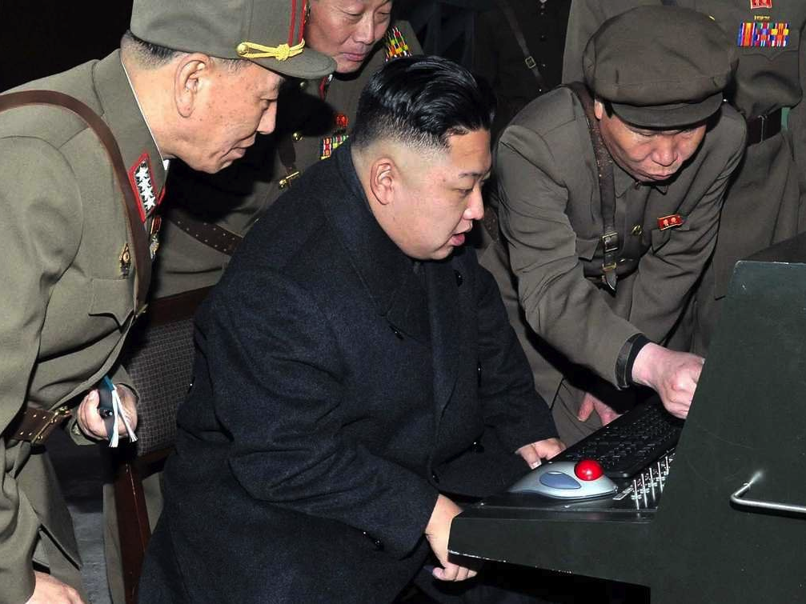
So, which API do I use to turn on his microphone?

Slide 25
(This one is speculative…)
Malicious
Developers
PRK
Senator’s Phone
senate hearing

Slide 26
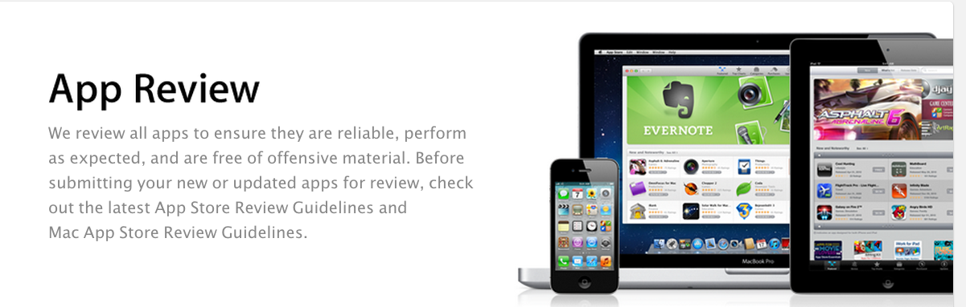

Actually just a little harder…
Malicious
Developers

Slide 27
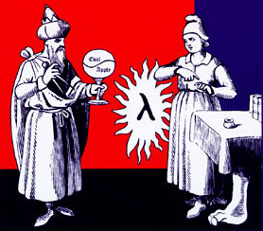

Is “App Review” Possible?
Possibly Malicious PRK Poker App
Some program execution turns on the microphone!
Ok! Never turns on microphone.

Slide 28
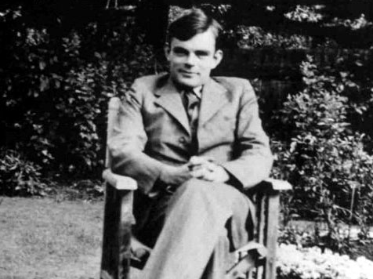
Not on my machine, muchachas!

Slide 29
What Seems To Be Possible
Possibly Malicious PRK Poker App
Some program execution turns on the microphone!
Ok! Never turns on microphone.
Not sure…let’s send it to NSA just in case.

Slide 31
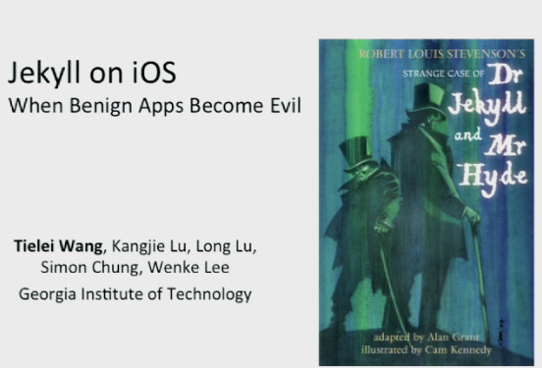
USENIX Security 2013 (click picture for talk video)

Slide 32
What Is Actually Possible
Possibly Malicious PRK Poker App
Some program execution turns on the microphone!
Ok! Never turns on microphone.
Not sure…let’s send it to NSA just in case.

Slide 33
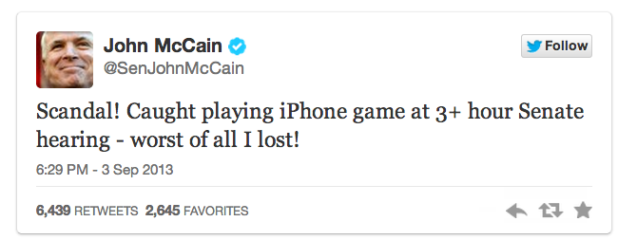
The Good News!
May have been posted by malicious app, not US senator.

Slide 34
How can preemptive multitasking even be possible?!?
More bad news…?
Preemptive multi-tasking
User program X runs until the supervisor decides to let another program run.

Slide 35
Preemptive (?) Multitasking
A
Program A
Supervisor
B
Program B
Supervisor
Program C
A
Supervisor
A

Slide 36


Slide 37
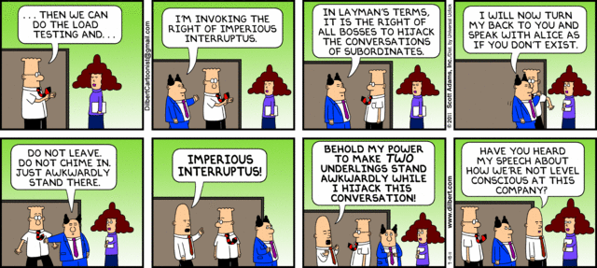

Slide 38

Interrupts
How frequently should the supervisor’s alarm clock (“kernel timer interrupt”) go off to check on the workers?

Slide 39
My MacBook (Ubuntu)
timer.c is a 50-line C program from
http://www.advenage.com/topics/linux-timer-interrupt-frequency.php (link on notes)
bash-3.2$ uname -a
Darwin Davids-MacBook-Air-2.local 11.4.2 Darwin Kernel Version 11.4.2: Thu Aug 23 16:25:48 PDT 2012; root:xnu-1699.32.7~1/RELEASE_X86_64 x86_64
bash-3.2$ gcc timer.c ; ./a.out
kernel timer interrupt frequency is approx. 4016 Hz or higher
Midterm exemption opportunity:
make a Rust version (and convince me it is accurate)

Slide 40
Timer Interrupts
Supervisor
A
Supervisor
B
Supervisor
set alarm clock
switch to program A
set alarm clock
switch to program B
What makes the alarm clock ring?

Slide 41
Who interrupts the supervisor?

Slide 42
The supervisor’s supervisor!
a.k.a. Hypervisor

Slide 43

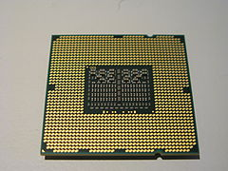
Support for hypervisor added to Intel x86 in 2005 (VT-x)

Slide 44
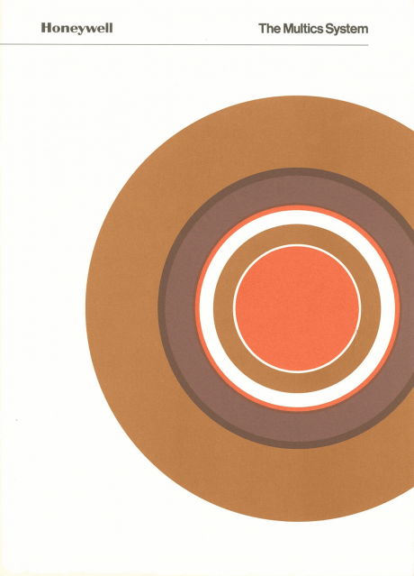
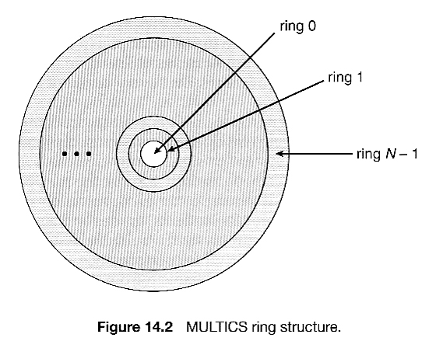
More general (quite similar) idea in MULTICS (but with 8-levels of supervision in hardware by 1975)

Slide 45
PS2: The Good Ole Shell
$ echo ‘Wha-hoo-wa!’
$ !!
$ traceroute 128.143.22.36
$ id -p ray
$ !!
$ fsck; !mount -u VA!

