Slide 1
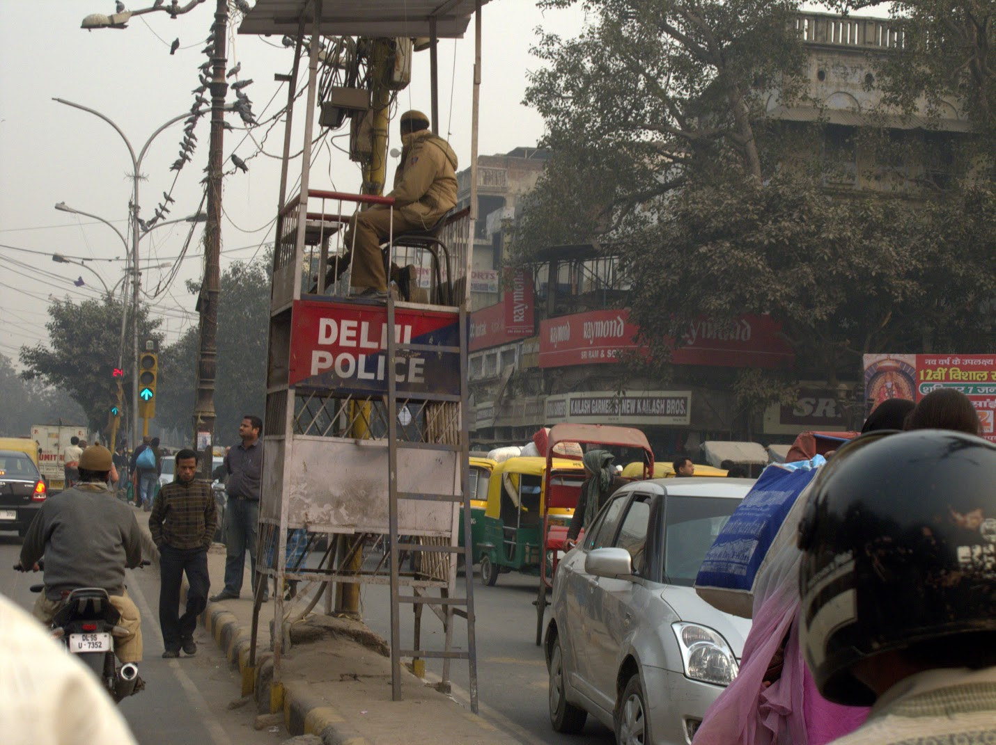
Class 6
Making a Process
(Virtualizing Memory)
cs4414 Fall 2013
University of Virginia
David Evans

Slide 2
Plan for Today
Anti-Gnashing Gashing Tips
How the Kernel Makes a Process:
Virtual Memory
Exam 1 is out after class Tuesday (Feb 11) due 11:59pm Thursday (Feb 13) – open resources, most questions will be taken from notes
PS2 is Due Sunday

Slide 3

Today’s OS News
He started his career as a member of the technology staff at Sun Microsystems. In 1992, he joined Microsoft. He was on his way to get a master’s degree in business when the Microsoft job offer came. The company was building an operating system that ultimately would be known as Windows NT, and needed team members who understood UNIX and 32-bit operating systems, he says. Nadella wanted to complete his master’s degree and take the Microsoft job. He did both.

Slide 4
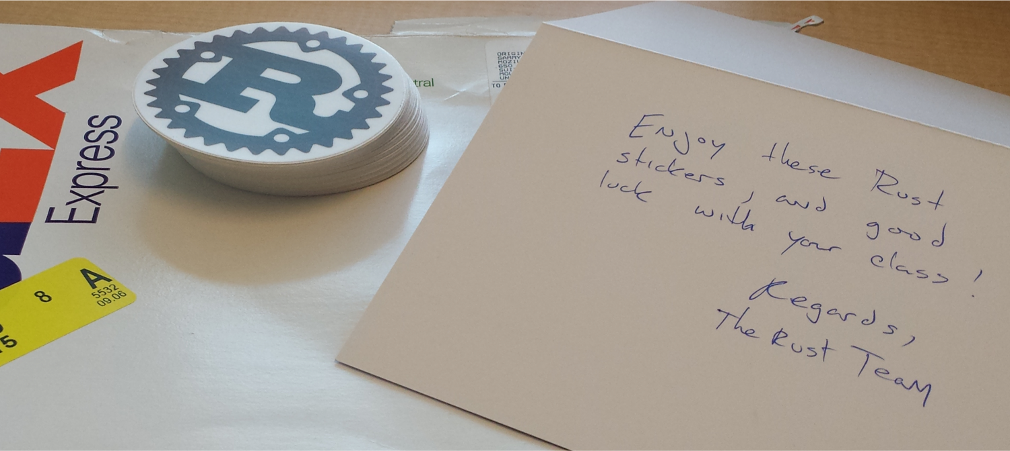
PS1 Stickers!
Muntaser Ahmed
Benjamin Foster

Slide 5
Today’s Experiment!
What should we do to make things better?
“Please excuse the paradox, but stop listening to young white males like me. Other people deserve a voice.”

Slide 6
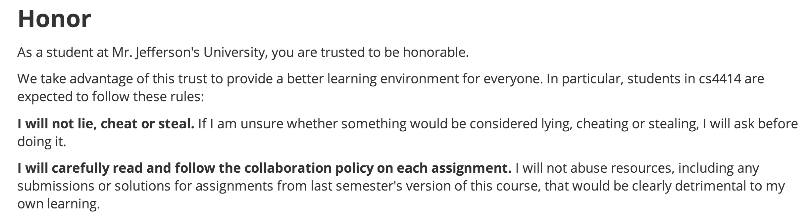
Honor Policy
Remember the honor policy: don’t abuse solutions from last semester
  They are easy to find, but viewing them at all is abuse.

Slide 7
Foreground Processes
main gash thread
run_command(p)
main gash thread

Slide 8
Background Processes
main gash thread
new task
run_command(p)
spawn(…)
main gash thread

Slide 9
Parsing Commands
Not our main focus
The main tests will be fairly simple, but you should definitely be able to handle
ifconfig | grep "flags" | tail
command := program
command := command &
command := command < file
command := command > file
command := command | command
program := valid program name
file := valid pathname

Slide 10
Weilin’s Most Evil Test
curl "http://rust-class.org/pages/ps2.html" | sed "s/[^a-zA-Z ]/ /g" | tr "A-Z " "a-z\n"| grep "[a-z]" | sort -u
curl "http://rust-class.org/pages/ps2.html"
| sed "s/[^a-zA-Z ]/ /g" | tr "A-Z " "a-z\n"
| grep "[a-z]" | sort -u
Rust Sticker* if you can handle this one!
*: while supplies last!

Slide 11
Handling Signals
main gash thread
run_command(p)
Process P

Slide 12

Handling Signals
gash Process
Child Process
main gash thread
Process P
run_command(p)
Ctrl-C

Slide 13
main gash thread
Process P
run_command(p)
Ctrl-C
Kernel

Slide 14
main gash thread
Process P
run_command(p)
signal handler
Ctrl-C
Kernel
SIGINT

Slide 15
main gash thread
Process P
run_command(p)
signal handler
Ctrl-C
Kernel
SIGINT

Slide 16
Handling Signals
Jumping around code like this is inherently unsafe: you will need to use libc functions and unsafe
use std::io::signal::{Listener, Interrupt};
use std::libc::funcs::posix88::signal;
…
unsafe { signal::kill(fgpid, libc::SIGINT); }

Slide 17
How the Kernel Makes a Process

Slide 18
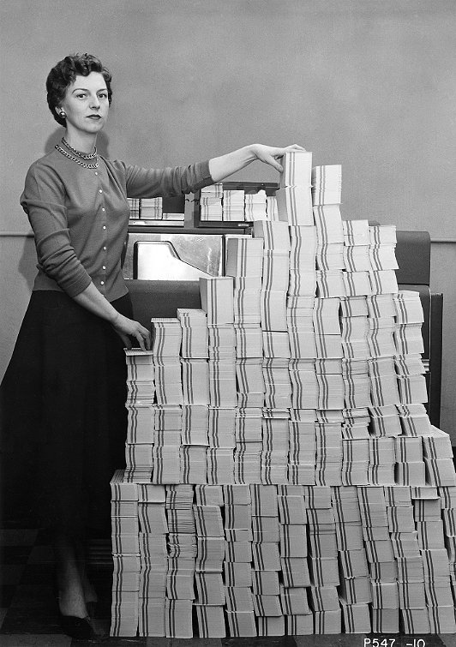
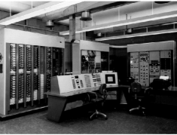

Batch Processing
From Class 3:
Program
Computer Center
Your Program Runs
Output: Invalid Operation
Charge: $174.32

Slide 19

Process Abstraction
Provide each program with the illusion that it owns the whole machine.
The best example of this way to do things is Linux, which is an operating system, which is a program that keeps track of other programs in a computer and gives each its due in space and time.
Guy Steele, “How to Grow a Language”

Slide 20
Memory Isolation
Process 1 should only be able to access Memory Space 1
Process 2 should only be able to access Memory Space 2
Memory Space 1
Memory Space 2
Physical memory
Do we need special hardware support do provide memory isolation?

Slide 21
Software-Based Memory Isolation
Original Code
“Sandboxed” Code
…
movq %rax, -8(%rbp)
…
…
movq -8(%rbp),%rdx
andq %rdx,%rgx
movq %rax, %rdx
…
Safe Loader
Assumes %rdx is reserved and %rgx is protected and holds a mask for the memory segment

Slide 22
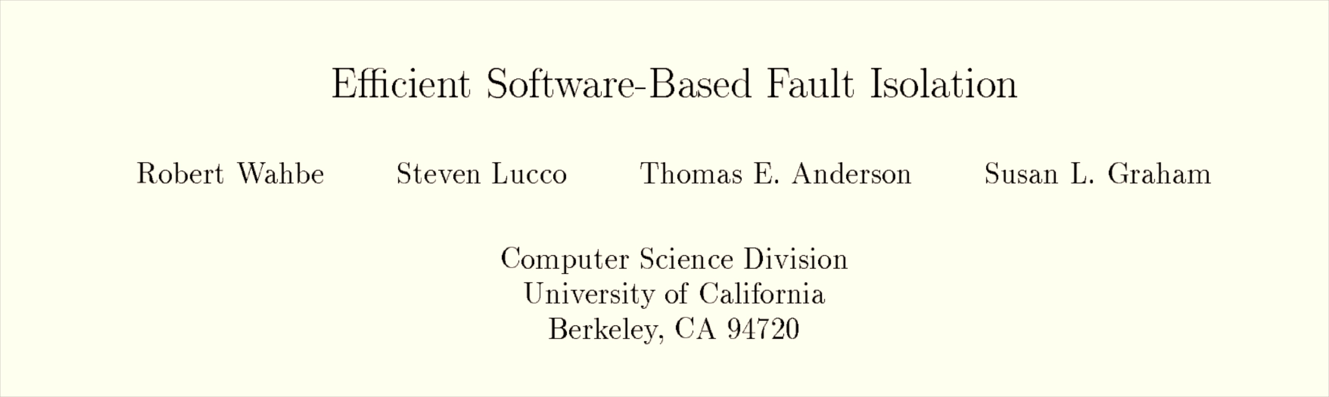
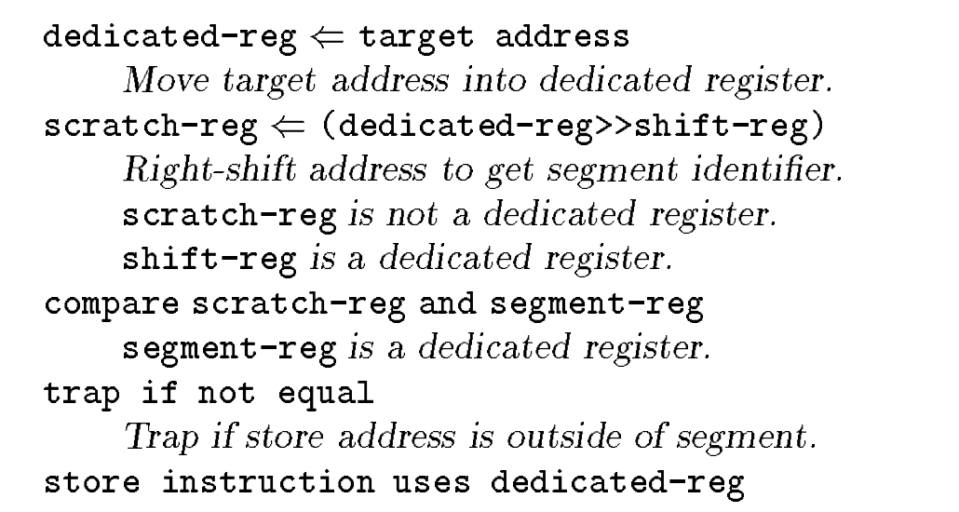
SOSP 1993

Slide 23
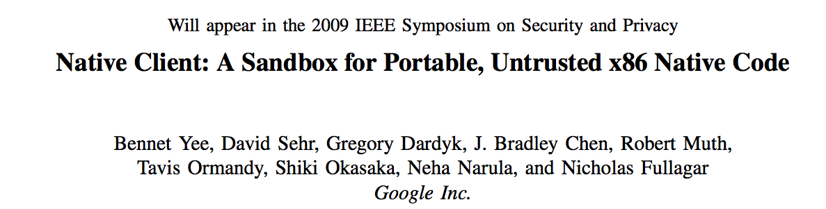



Slide 24
Hardware-Based Memory Isolation
Original Code
Running Code
…
movq %rax, -8(%rbp)
…
…
movq %rax, -8(%rbp)
…
Loader
Memory Space 1
Memory Space 2

Slide 25
Virtual Memory
address in Process P
Virtual Memory Mapping
physical address owned by Process P
User-level processes cannot access physical memory directly: all memory addresses created by process P are virtual addresses, mapped into physical addresses owned by process P

Slide 26
Virtual Memory
address in Process P
Virtual Memory Mapping
physical address owned by Process P
Who controls the virtual memory mapping?

Slide 27
Getting Into the Details…

Slide 28

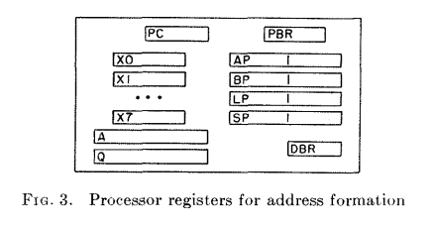
SOSP 1967
Procedure Base Register:
segment number of executing procedure
Argument Pointer
Base Pointer
Linkage Pointer
Stack Pointer
Descriptor Base Register

Slide 29
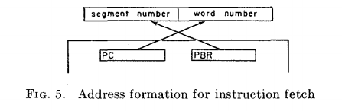
Generating an Address
18 bits
18 bits
2¹⁸ = 262144

Slide 30
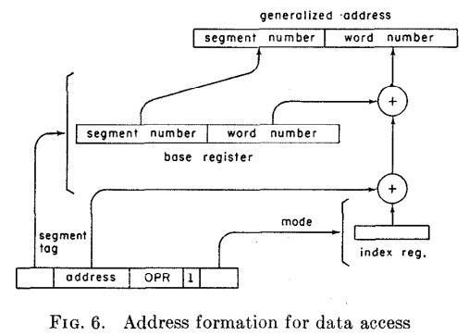
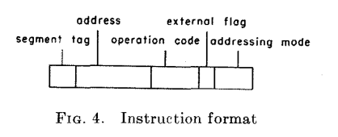
Addressing Mode selects:
Argument Pointer
Base Pointer
Linkage Pointer
Stack Pointer

Slide 31
Addressing Mode selects:
Argument Pointer
Base Pointer
Linkage Pointer
Stack Pointer

Slide 32
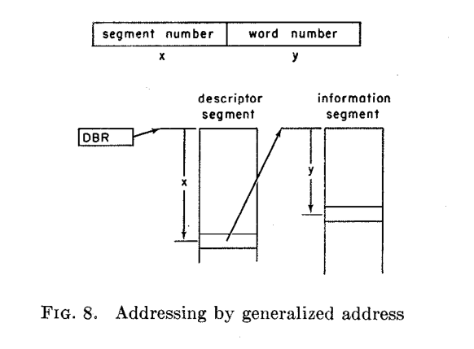
What does the MULTICS kernel do to switch processes?

Slide 33
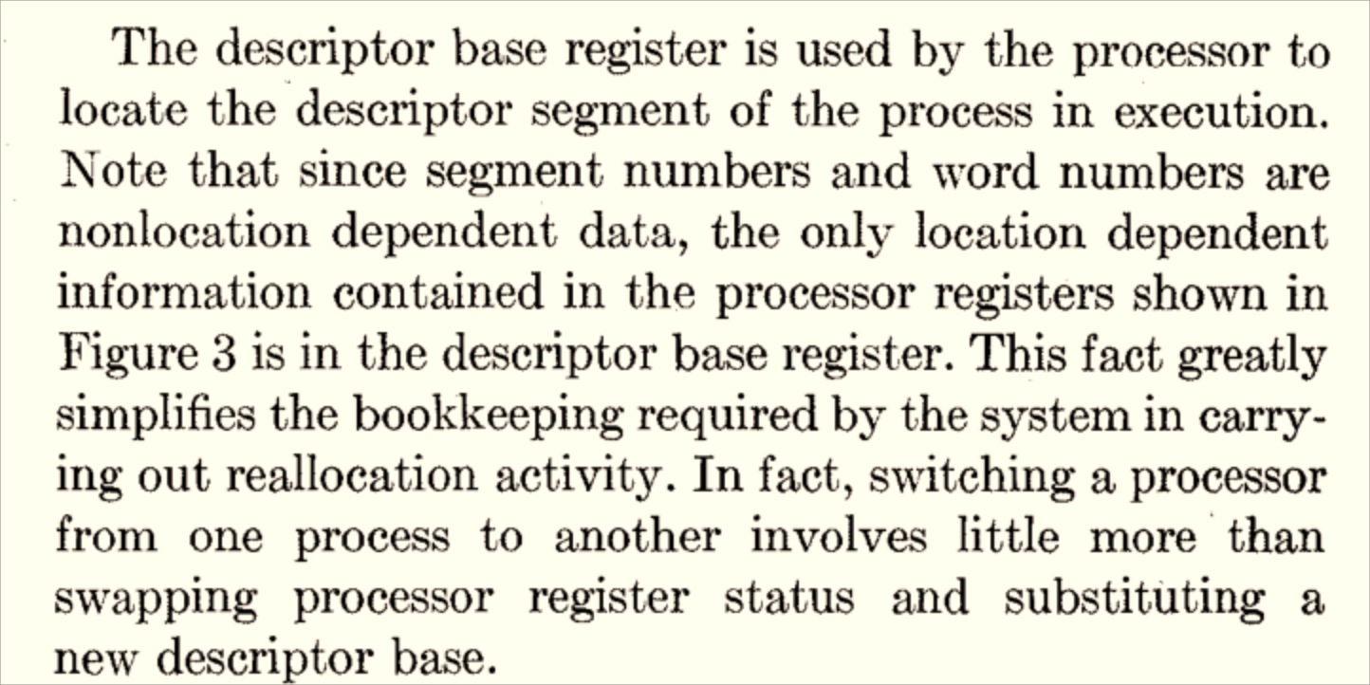

Slide 34
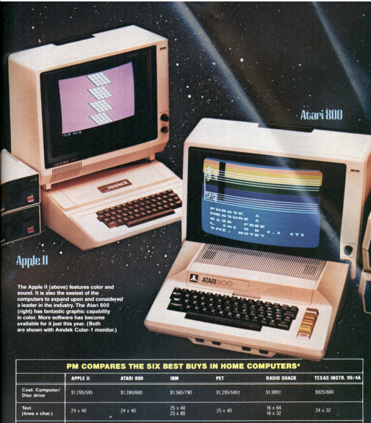
1982
“It used to be that programs were easy to copy and change. But manufacturers began to lose money as many people made copies of software and gave them to their friends. Now, many manufacturers have figured out how to 'copy-protect' discs. To our mind this is a disaster: Most people learn programming by changing programs to fit their own needs. This capability of customization is what makes computers so attractive. New ways of copy protection will probably be found soon. Until then, a computer owner may have to put up with being 'locked out' of his (sic) own machine.”
Popular Mechanics, January 1982

Slide 35
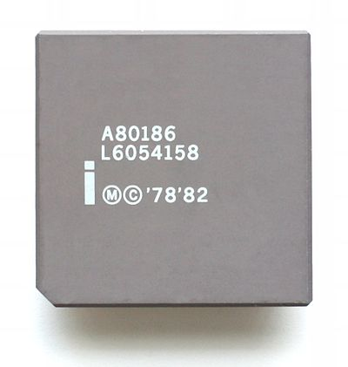
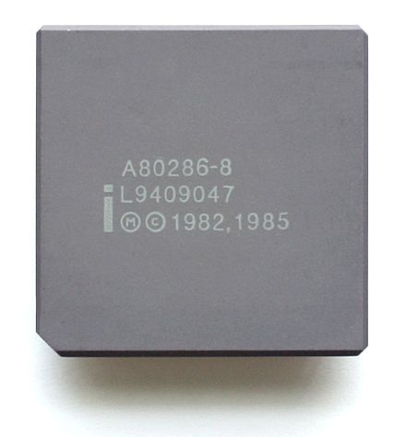
Intel 80186
Intel 80286
First x86 Processor with Virtual Memory Support
“Protected Mode”

Slide 36
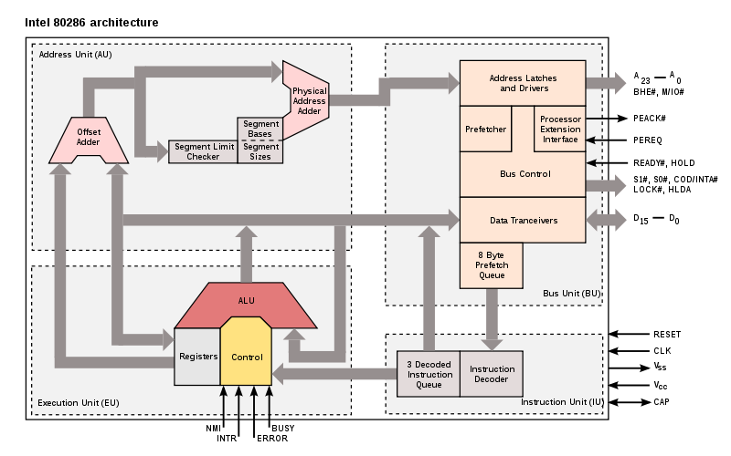
http://en.wikipedia.org/wiki/File:Intel_i80286_arch.svg

Slide 37
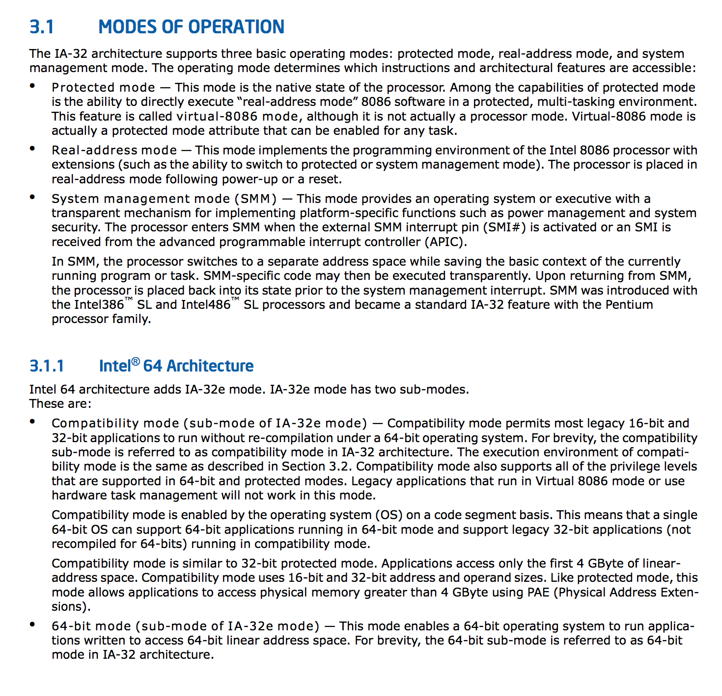
Five x86-64 Processor Modes
Real Mode: pretend to be an 8086
20-bit direct-access address space
Protected Mode: “native state”
System Management Mode: platform-specific power management and security (separate address space)
Compatibility Mode: pretend to be x86-32
IA-32e/64-bit Mode: run applications in 64-bit address space
“For brevity, the 64-bit sub-mode is referred to as 64-bit mode in IA-32 architecture.”

Slide 38
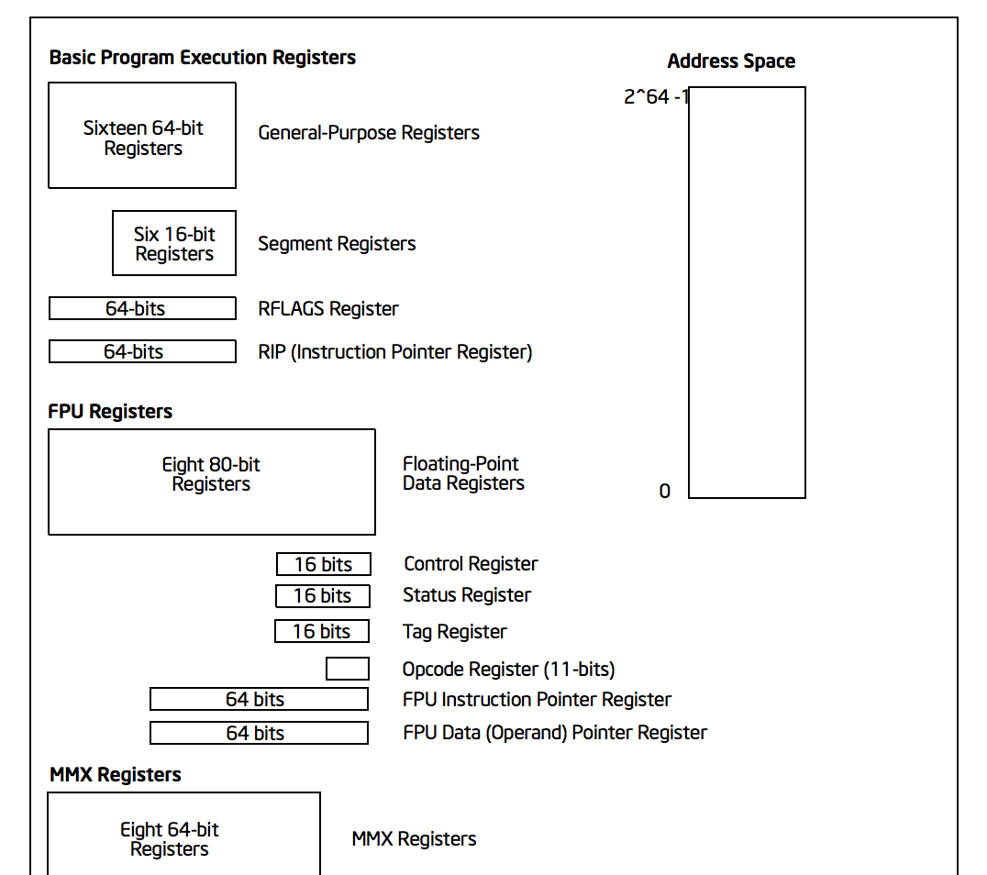
Protected State
(can only be modified by the kernel):
RFLAGS (includes EFLAGS)
Includes I/O Privilege Level
Control Registers
CR0 bit 0: controls if processor is in protected mode
CR3: page directory base register

Slide 39
Address Translation
Segmentation Unit
Paging
Unit
Memory
Logical Address
Linear Address
Physical Address

Slide 40
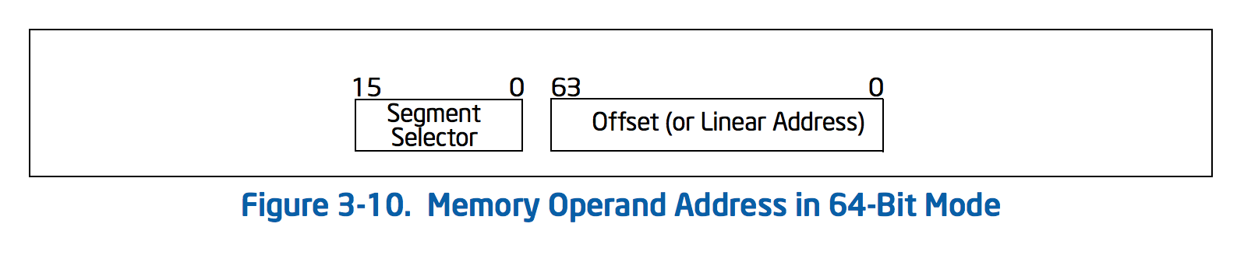
Accessing Memory
16 bits to select segment, 16- 32- or 64- bits to select offset
Actual addressable space for user-level process in Unix:
2⁴⁷ bytes = 128TiB

Slide 41
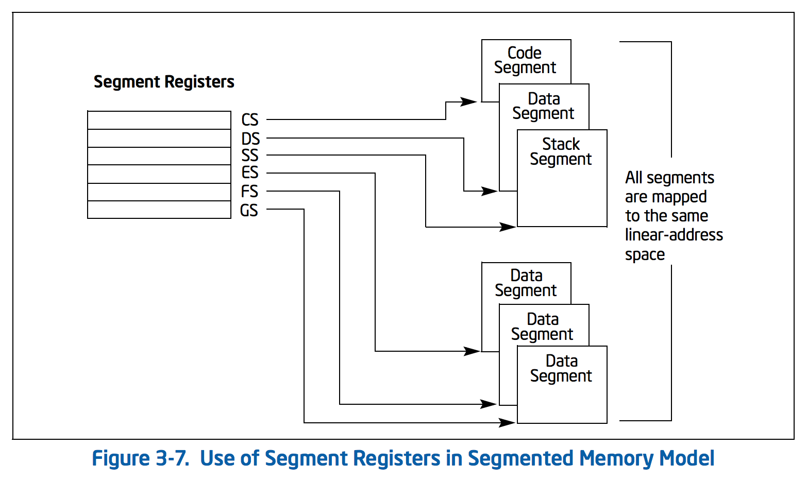
Computing the Linear Address
Segmentation Unit
Paging
Unit
Memory
Logical Address
Linear Address
Physical Address
Segment selection is inferred from instruction type
Logical (“General”, “Virtual”) Address
Segment Selector
Offset

Slide 42
Fetching an Instruction
EIP
Instruction Pointer (Offset)
32 bits
CS
Code Segment
16 bits
13 bits
1
2
Table Index
Ring
Global or
Local Table
Only Kernel can write to Segment Registers

Slide 43
Segmentation Tables
Global Descriptor Table (GDT)
limit
linear address space
0-2⁶⁴ - 1
base address
Segments can overlap!
13 bits – up to 8192 entries

Slide 44
Segmentation Tables
Global Descriptor Table (GDT)
Local Descriptor Table
(per process)
13 bits – up to 8192 entries
How does the processor find the GDT/LDT?

Slide 45
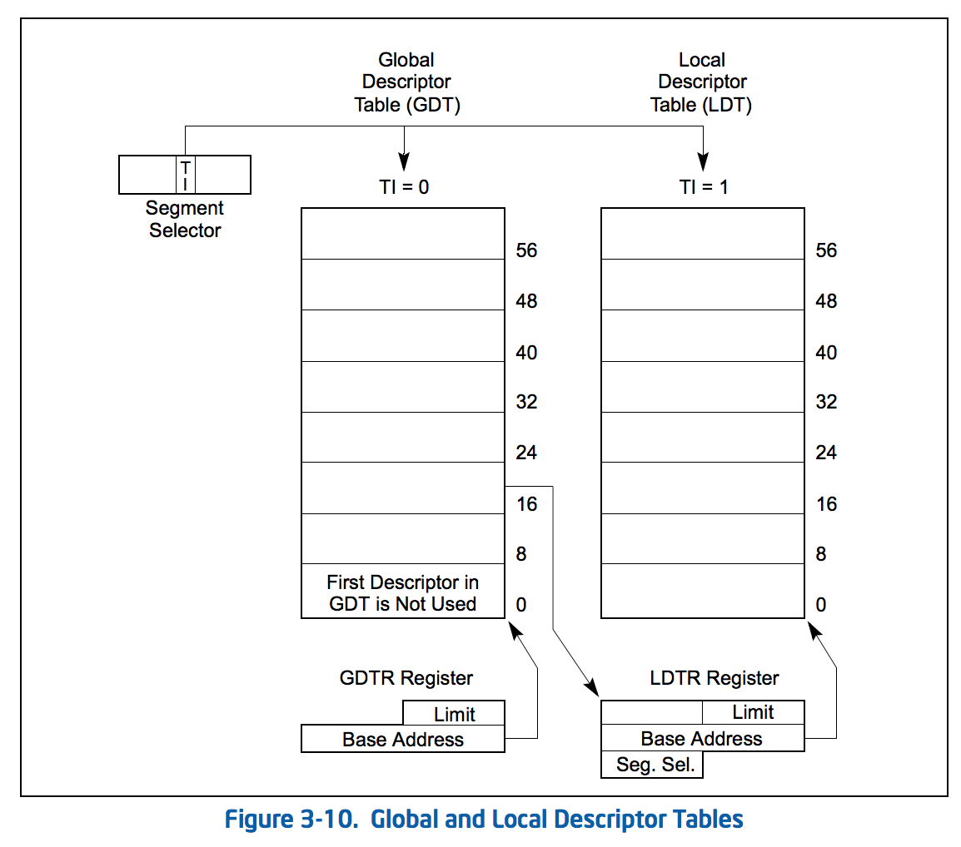
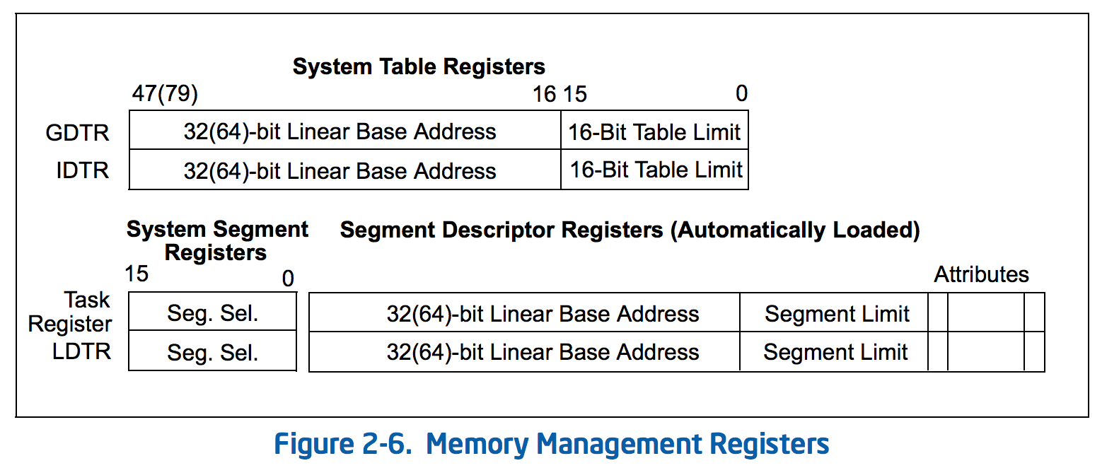
The GDT and LDT are just data structures in memory!
Special registers store their locations

Slide 46
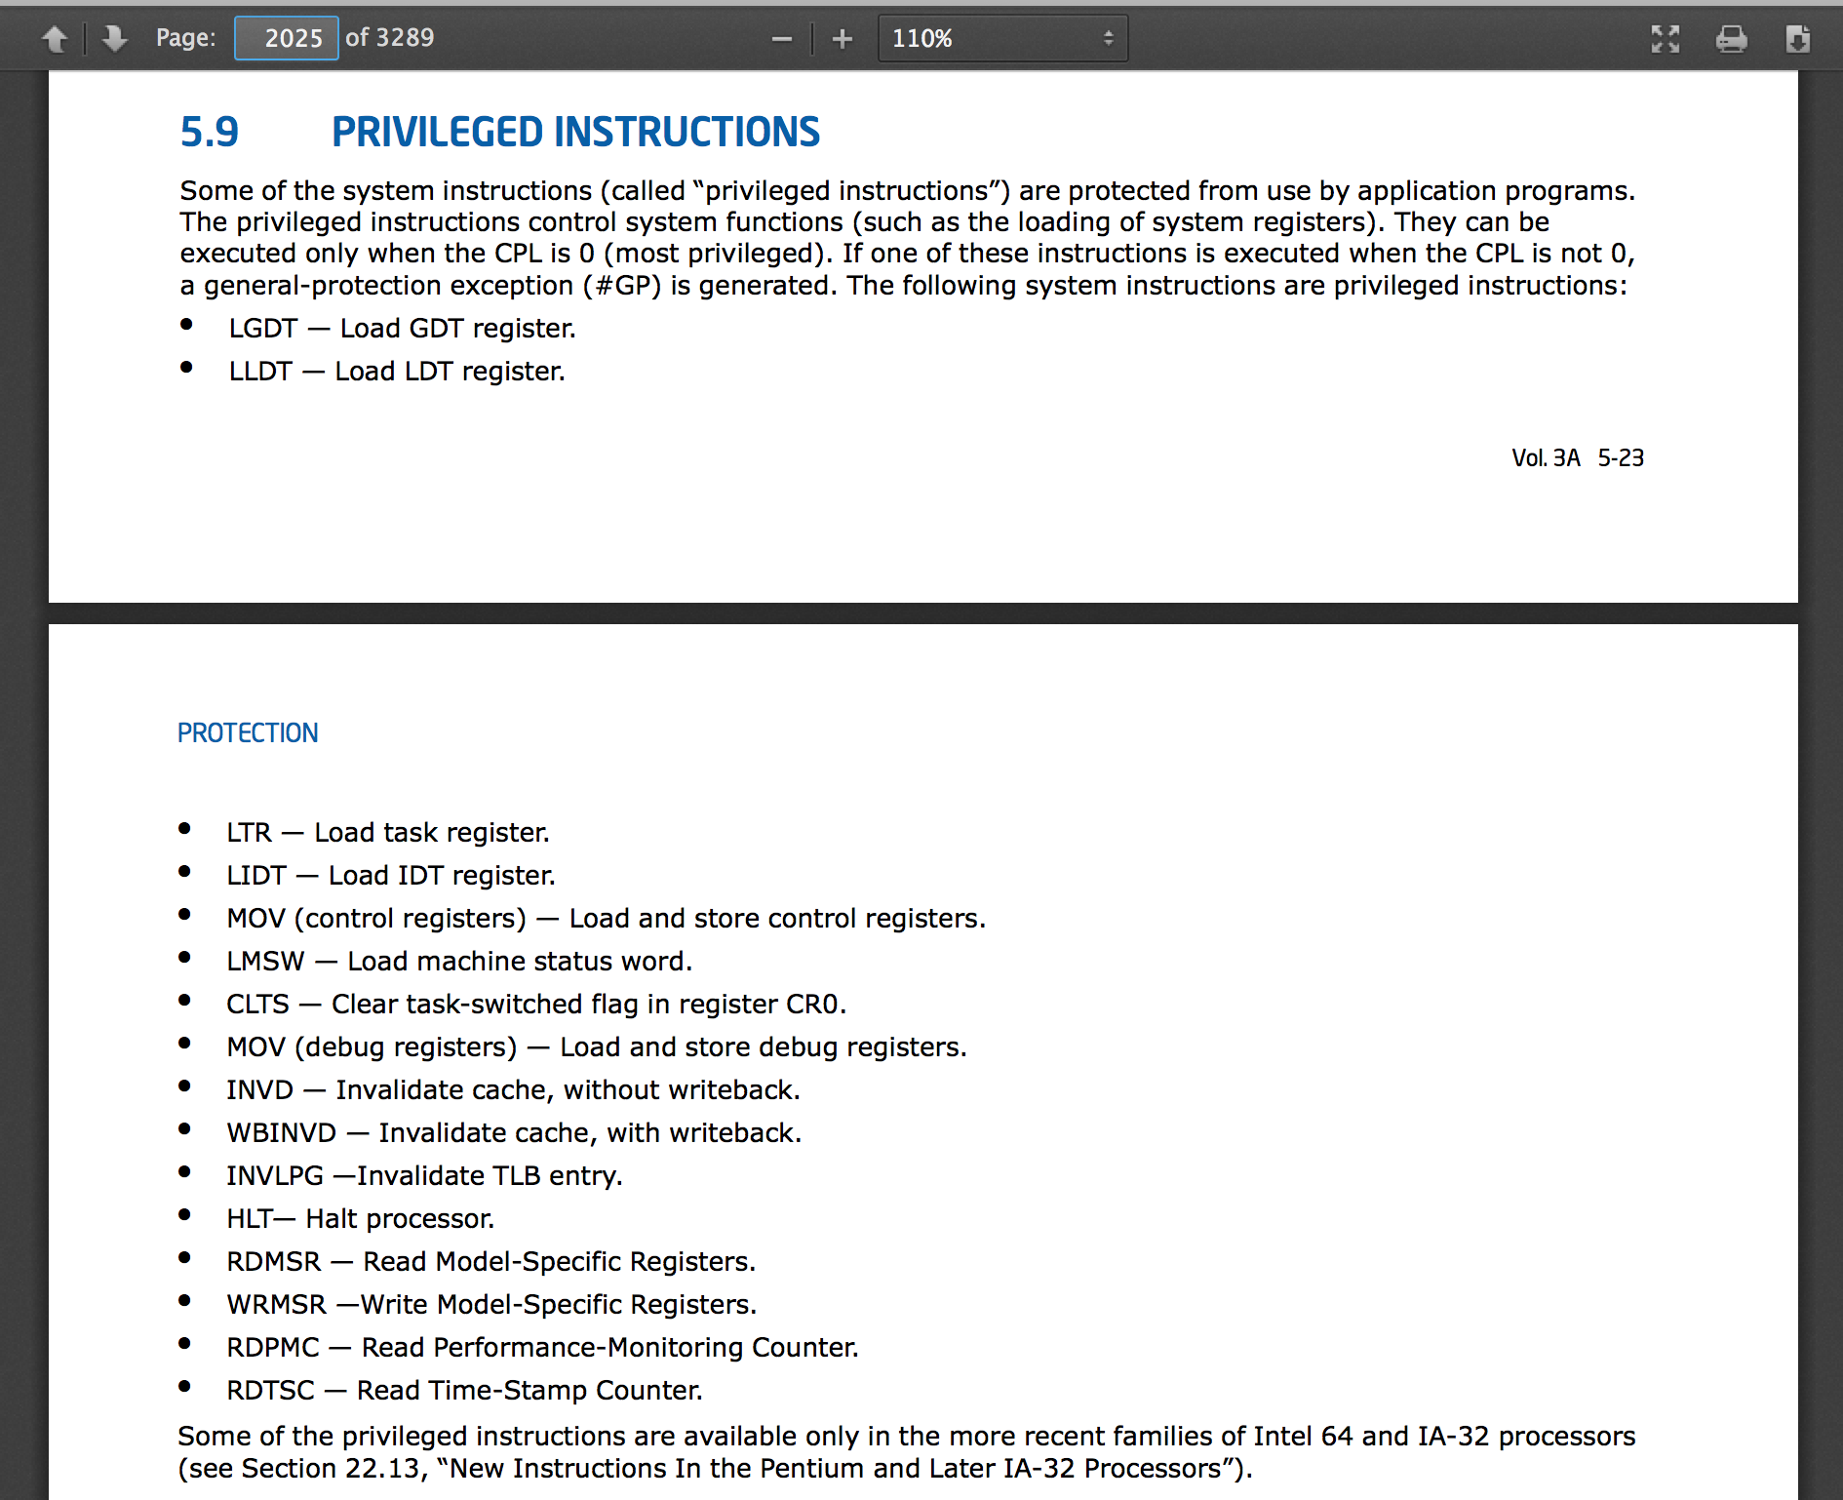
from Class 5

Slide 47
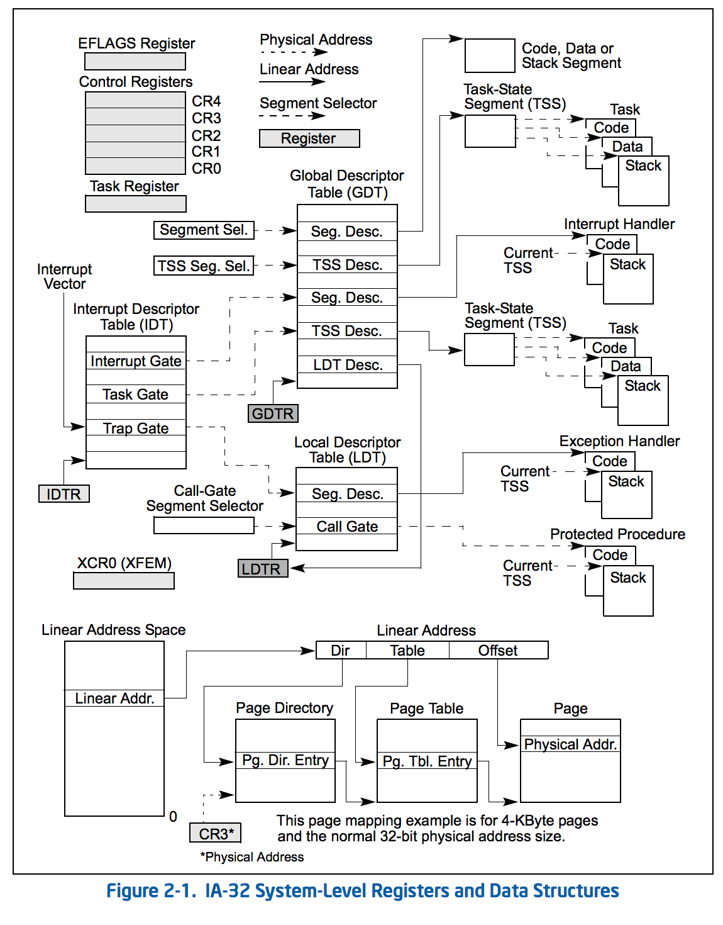
`
Segmentation Unit
Paging
Unit
Memory
Logical Address
Linear Address
Physical Address

Slide 48
Paging
Segmentation Unit
Logical Address
Linear Address
2⁶⁴ linear addresses
What would it cost to have 2⁶⁴ bytes of RAM?

Slide 49
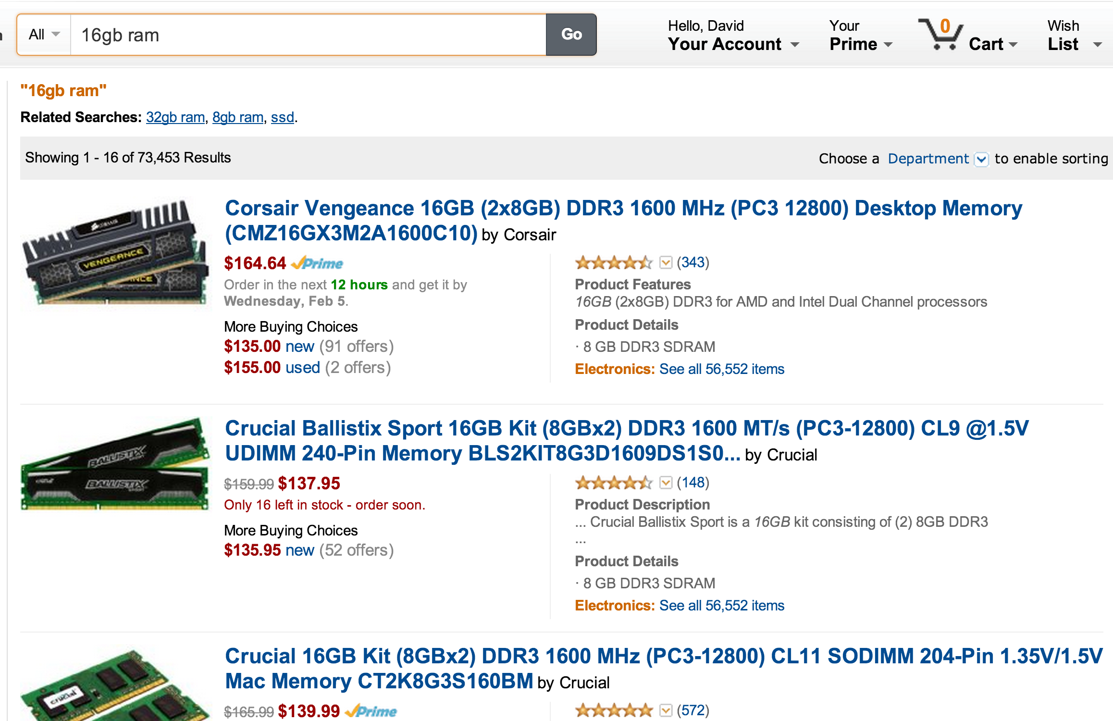
$10 per 1GB = 2³⁰ bytes
2⁶⁴ bytes = $10 * 2³⁴
$172B
∼ Apple’s 2013 revenue
∼ US federal spending for 18 days

Slide 50
Paging
Segmentation Unit
Paging
Unit
Memory
Logical Address
Linear Address
Physical Address
We don’t need to store the whole address space in memory!
Most of it is unused: store rarely-used parts on the disk.

Slide 51
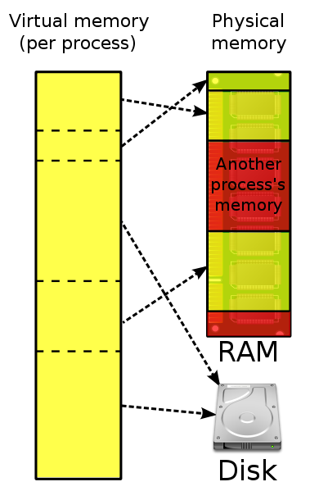
Paging
Unit
Memory
Linear Address
Physical Address
Image from Wikipedia

Slide 52
Overview (Intel 386)
Physical Memory
32-bit linear address
CR3
Dir
Page
Offset
10 bits
(1K tables)
10 bits
(1K entries)
12 bits
(4K pages)
Page Directory
Page Table
Page Entry
Page + Offset
CR3+Dir

Slide 53
Page Table Entries
Physical Memory
CR3
Page Table
Page Entry
Page Directory
20 bits: physical address
12 bits: flags
user/kernel page
write permission
present
Page + Offset

Slide 54
386 Checkup
32-bit linear address
Dir
Page
Offset
Physical Memory
10 bits
(1K tables)
10 bits
(1K entries)
12 bits
(4K pages)
CR3
Page Directory
Page Table
20 bits addr / 12 bits flags
Page + Offset
How many pages do we need to store the page table?

Slide 55
How slow is this???!
Segmentation Unit
Paging
Unit
Memory
Logical Address
Linear Address
Physical Address
Dir
Page
Offset
Physical Memory
GDTR
CR3
Page Directory
Page Table
20 bits addr / 12 bits flags
Global Descriptor Table
Page + Offset

Slide 56
Translation Lookaside Buffer (Cache)
Segmentation Unit
Paging
Unit
Memory
Logical Address
Linear Address
Physical Address
Dir
Page
Offset
Physical Memory
GDTR
CR3
Page Directory
Page Table
20 bits addr / 12 bits flags
Global Descriptor Table
Page + Offset

Slide 57
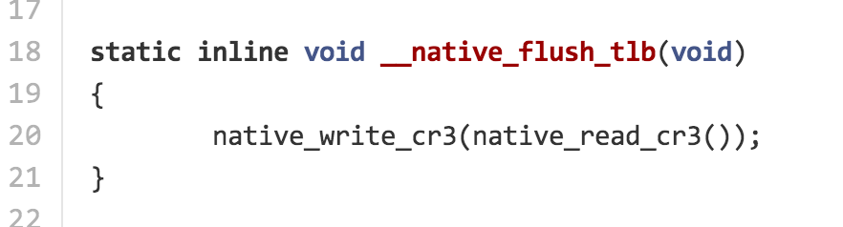
My Favorite Statement in the Linux Kernel Code!

Slide 58
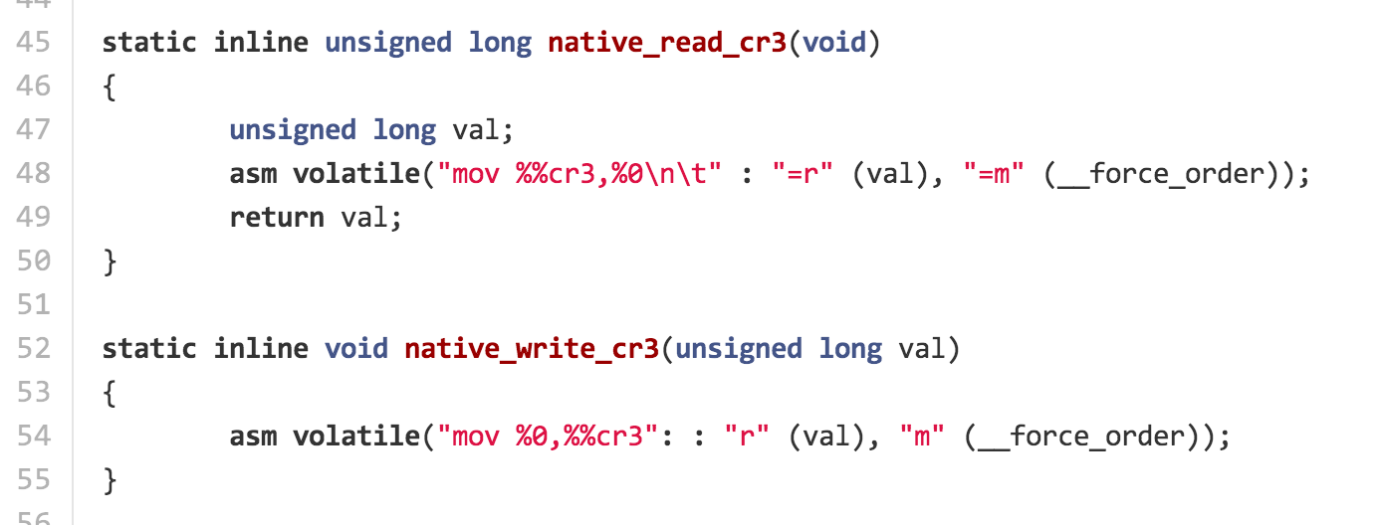
arch/x86/include/asm/tlbflush.h
arch/x86/include/asm/special_insns.h

Slide 59
Translation Lookaside Buffer (Cache)
Segmentation Unit
Paging
Unit
Memory
Logical Address
Linear Address
Physical Address
Dir
Page
Offset
flush cache!
Physical Memory
GDTR
CR3
Page Directory
Page Table
20 bits addr / 12 bits flags
Global Descriptor Table
Page + Offset

Slide 60
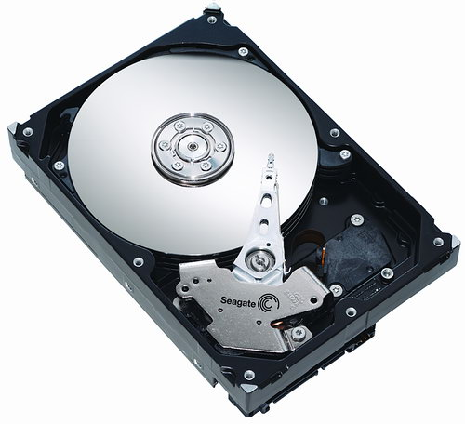
Page Fault
Physical Memory
CR3
Page Table
Page Entry
Page Directory
20 bits: physical address
12 bits: flags
user/kernel page
write permission
present

Slide 61
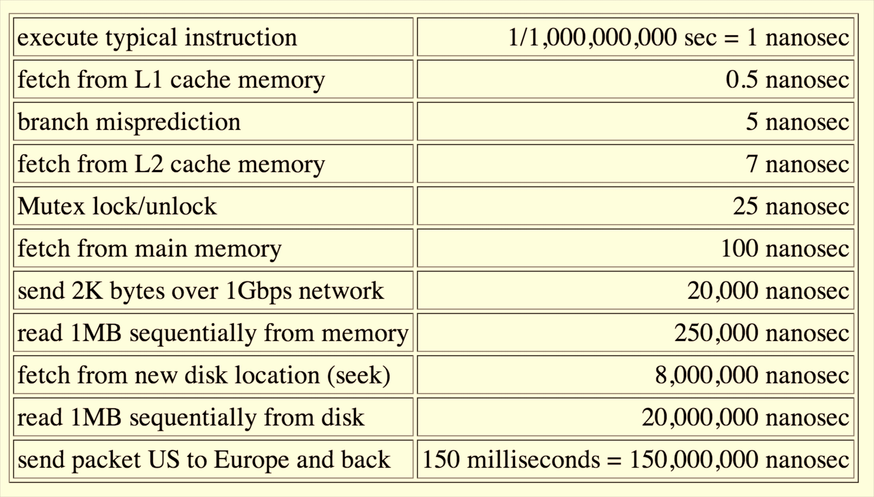
How expensive is a page fault?

Slide 62
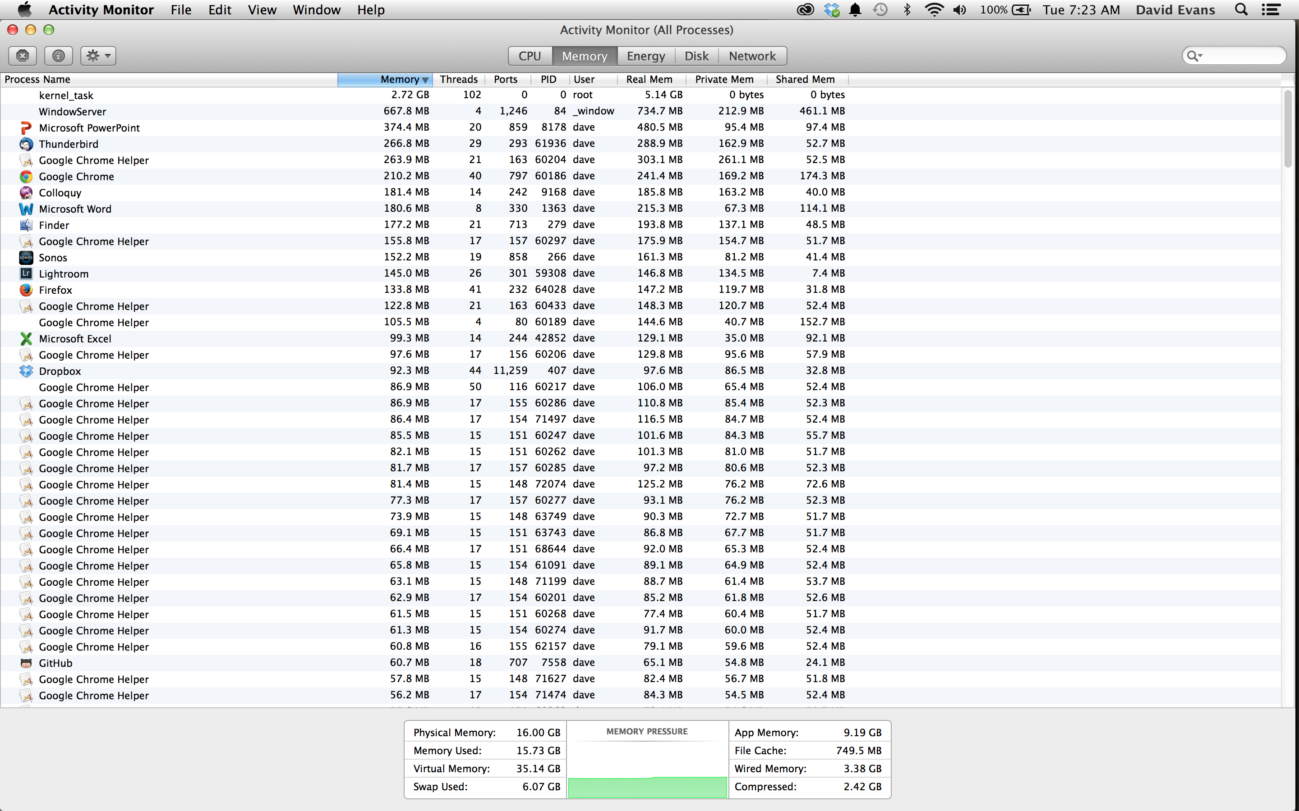
How common are page faults?

Slide 63
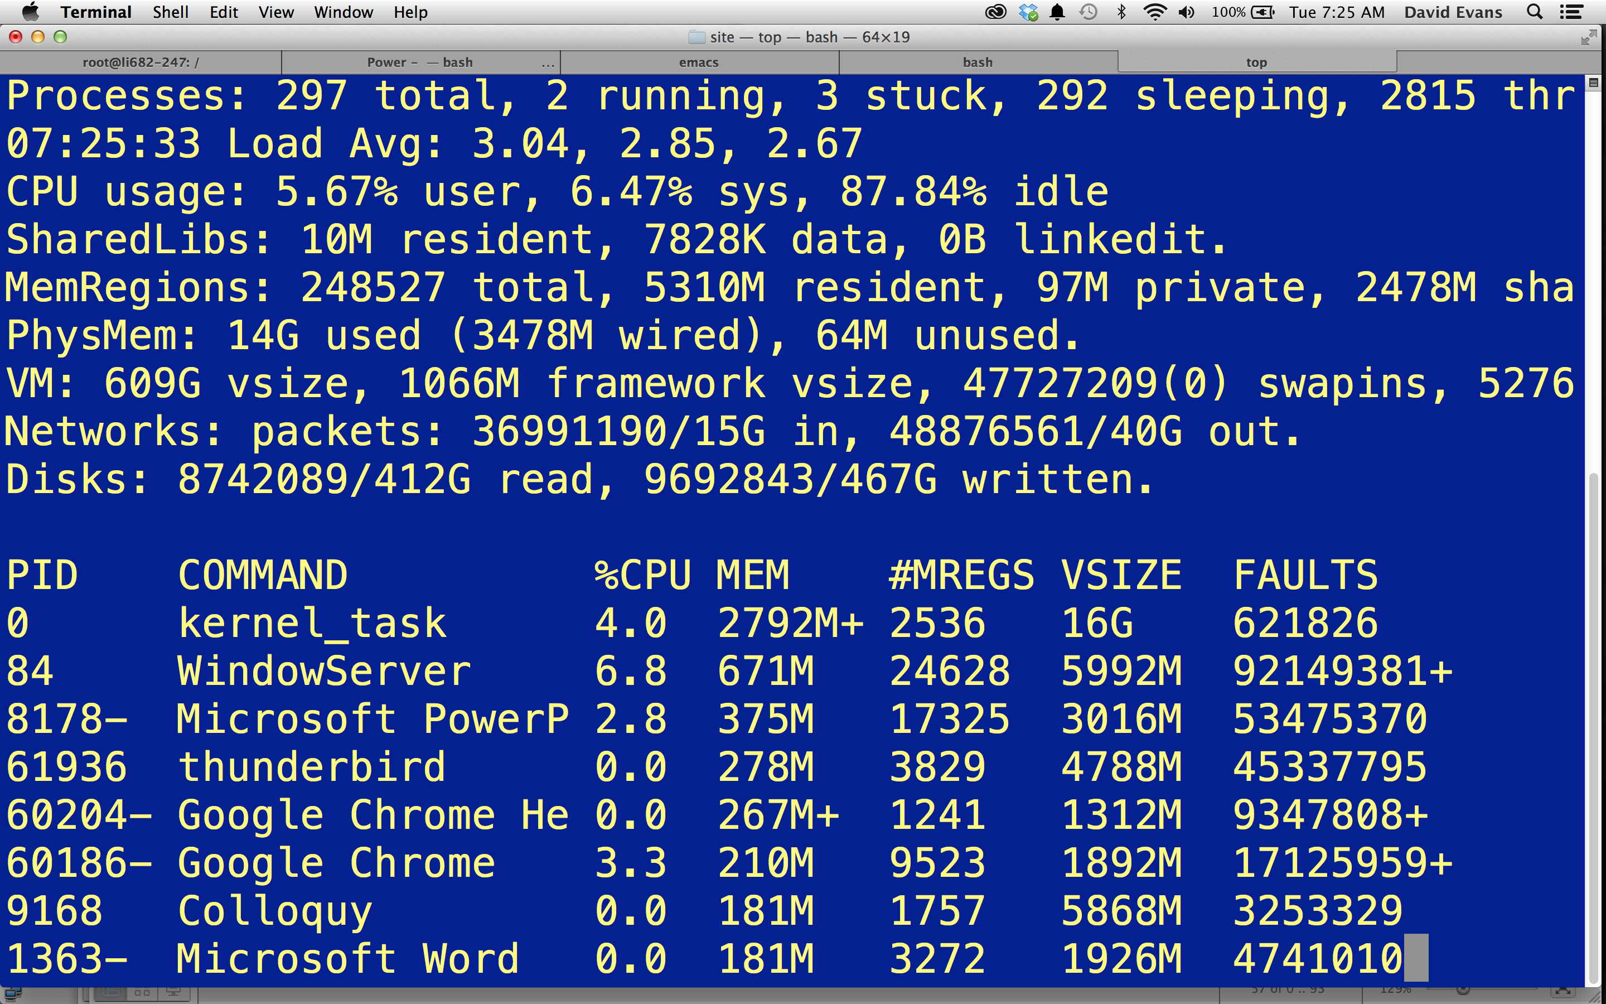
top -o mem -stats pid,command,cpu,mem,mregion,vsize,faults

Slide 64
#include <stdio.h>
#include <stdlib.h>
int main(int argc, char **argv) {
char *s = (char *) malloc (1);
int i = 0;
while (1) {
printf("%d: %x\n", i, s[i]);
i += 4;
}
}
What will this program do?

Slide 65
#include <stdio.h>
#include <stdlib.h>
int main(int argc, char **argv) {
char *s = (char *) malloc (1);
int i = 0;
while (1) {
printf("%d: %x\n", i, s[i]);
i += 4;
}
}
What will this program do?
> ./a.out
0: 0
4: 0
8: 0
12: 0
…
1033876: 0
1033880: 0
1033884: 0
Segmentation fault: 11

Slide 66
Charge
Examine the memory use of processes running on your computer
Problem Set 2 is due Sunday, 9 February
Sign-up for your PS2 demo now/soon!

