Slide 1
What Dave was doing when you were being born/learning to crawl…

Slide 2
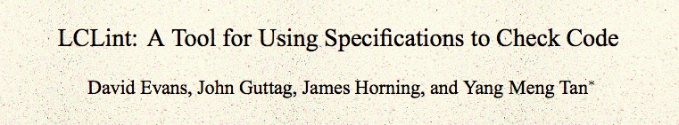
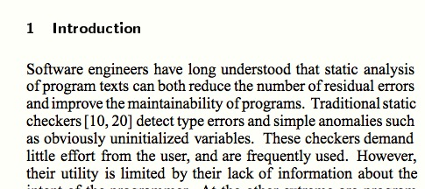
ACM Foundations in Software Engineering, 1994

Slide 3
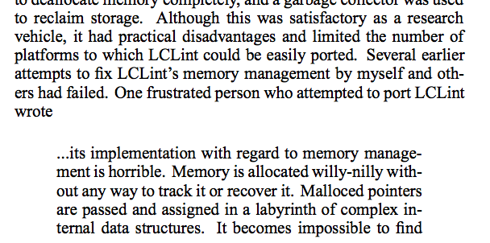
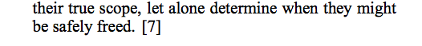
comp.os.linux post, August 1994

Slide 4
C Memory Management
MALLOC(3) BSD Library Functions Manual
SYNOPSIS
...
void free(void *ptr);
void *malloc(size_t size);
...
DESCRIPTION
The malloc(), calloc(), valloc(), realloc(), and reallocf() functions allocate memory. The allocated memory is aligned such that it can be used for any data type, …. The free() function frees allocations that were created via the preceding allocation functions.

Slide 5
# include <stdlib.h>
# include <stdio.h>
int main(int _argc, char **_argv) {
int *x = (int *) malloc (sizeof(*x));
*x = 4414;
printf("x = %d\n", *x);
return 0;
}
gash> gcc -Wall toofree.c
gash> ./a.out
x = 4414

Slide 6
# include <stdlib.h>
# include <stdio.h>
int main(int _argc, char **_argv) {
int *x = (int *) malloc (sizeof(*x));
*x = 4414;
free(x);
printf("x = %d\n", *x);
return 0;
}
gash> gcc -Wall toofree.c
gash> ./a.out
x = 4414

Slide 7
int main(int _argc, char **_argv) {
int *x = (int *) malloc (sizeof(*x));
*x = 4414;
free(x);
free(x);
printf("x = %d\n", *x);
return 0;
}
Note: this is what happens to happen on my computer, but the C behavior is undefined. It would be “correct” for a C program like this to do absolutely anything!
gash> gcc -Wall toofree.c
gash> ./a.out
a.out(23685) malloc: *** error for object 0x10a1008d0: pointer being freed was not allocated
*** set a breakpoint in malloc_error_break to debug
Abort trap: 6

Slide 8
This gets tricky…
(from locale.h)
struct lconv
{
char *decimal_point;
char *thousands_sep;
char *grouping;
char *int_curr_symbol;
char *currency_symbol;
… } ;
// in my code…
struct lconv *local = localeconv (void);
…
free(local->decimal_point); // ?
free(local); // ?

Slide 9
Should we really care?

Slide 10
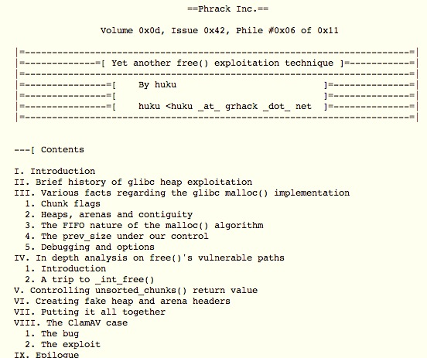
November 2009

Slide 11
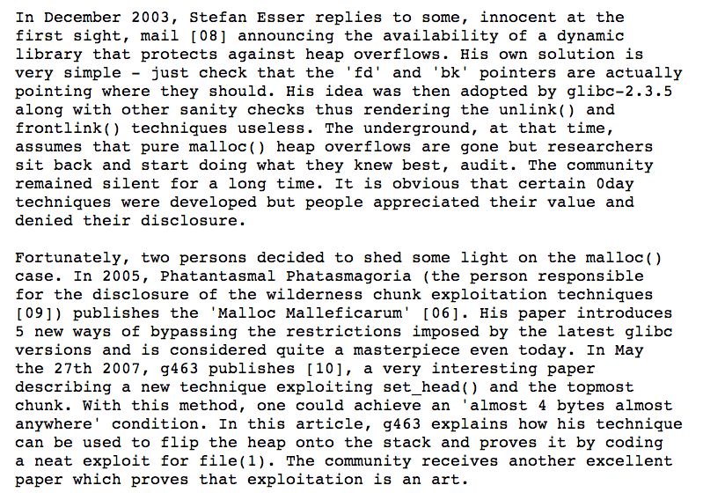

Slide 13
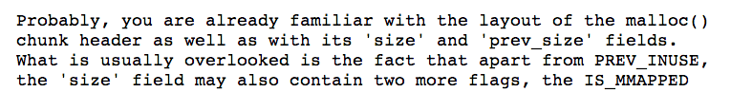
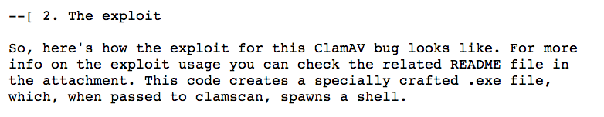
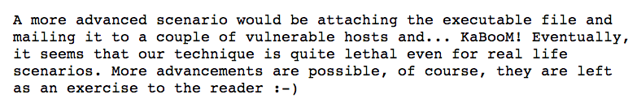

Slide 14
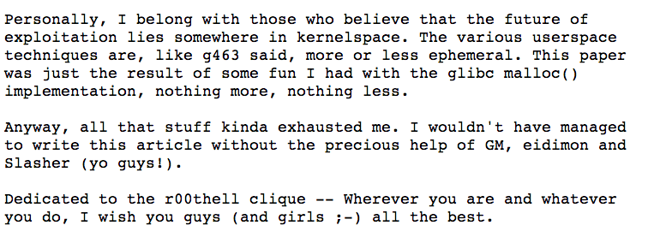
http://www.phrack.org/issues.html?issue=61&id=6

Slide 15
(Why) Doesn’t C++ solve this?
new = malloc
delete = free

Slide 16
Doesn’t Java solve this?

Slide 18
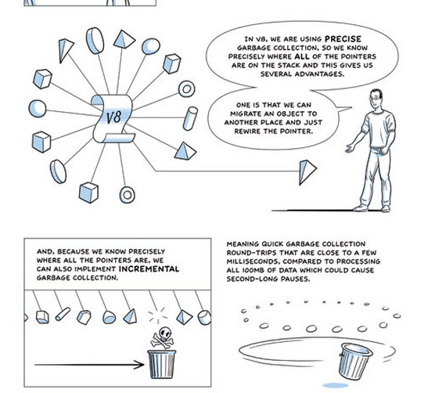
(Advanced “comic book” version of GC)

Slide 19
Getting back to my story…
comp.os.linux post, August 1994

Slide 20
“Willy-Nilly” Memory Management
Systematic Memory Management

Slide 21
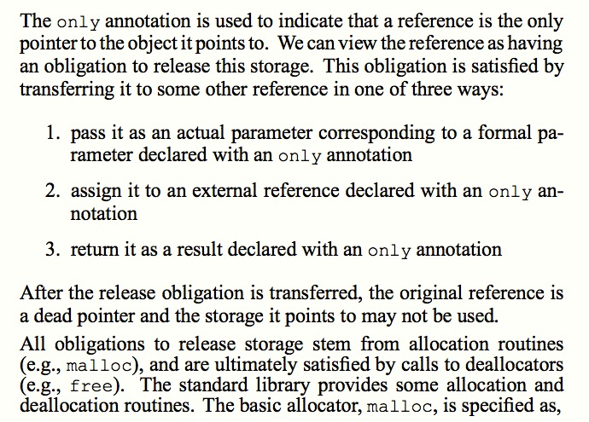
Static Detection of Dynamic Memory Errors, David Evans, PLDI May 1996

Slide 22
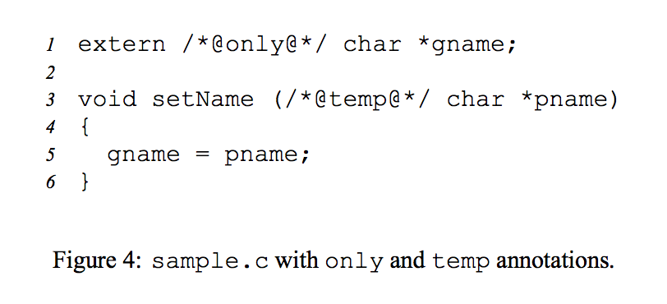
Static Detection of Dynamic Memory Errors, David Evans, PLDI May 1996

Slide 23
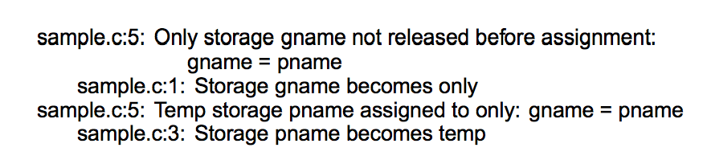
Static Detection of Dynamic Memory Errors, David Evans, PLDI May 1996
Note: these are “compile-time” errors (just produced by a separate tool).

Slide 24

Annotations?
Where we are going, we don’t need annotations!

Slide 25
A box is a reference to a heap allocation holding another value. There are two kinds of boxes: managed boxes and owned boxes.
An owned box type or value is constructed by the prefix tilde sigil ~.
Rust Manual, Section 9.1.4
extern /*@only@*/ char *gname;
void setName(/*@temp@*/ char *pname) {
gname = pname;
}

Slide 26
A box is a reference to a heap allocation holding another value. There are two kinds of boxes: managed boxes and owned boxes.
An owned box type or value is constructed by the prefix tilde sigil ~.
Rust Manual, Section 9.1.4
extern /*@only@*/ char *gname;
void setName(/*@temp@*/ char *pname) {
gname = pname;
}
static gname : ~str = ~"";
fn set_name(pname : &str) {
gname = pname;
}
[Note: we can’t really have a global, owned string like this in Rust.]

Slide 27
extern /*@only@*/ char *gname;
void setName(/*@temp@*/ char *pname) {
gname = pname;
}
gash> splint sample.c
sample.c:5: Only storage gname not released before assignment:
gname = pname
sample.c:1: Storage gname becomes only
sample.c:5: Temp storage pname assigned to only: gname = pname
sample.c:3: Storage pname becomes temp
static gname : ~str = ~"Where we're going, we don't need roads!”;
fn set_name(pname : &str) {
gname = pname;
}
gash> rustc sample.rs
sample.rs:4:12: 4:17 error: mismatched types: expected `~str` but found `&str`
(str storage differs: expected ~ but found &)
sample.rs:4 gname = pname;

Slide 28
static gname : ~str = ~"annotations";
fn set_name(pname : ~str) {
gname = pname;
}
fn main() {
set_name("roads");
}
gash> rustc sample2.rs
sample2.rs:8:13: 8:20 error: mismatched types: expected `~str` but found `&'static str` (str storage differs: expected ~ but found &'static )
sample2.rs:8 set_name("roads");

Slide 29
fn set_name(gname : &mut ~str, pname : ~str) {
*gname = pname;
}
fn main() {
let mut gname : ~str = ~"annotations";
println(fmt!("gname = %s", gname));
set_name(&mut gname, ~"frees");
println(fmt!("gname = %s", gname));
}
gash> rust run good.rs
gname = annotations
gname = frees

Slide 30
fn set_name(gname : &mut ~str, pname : ~str) {
*gname = pname;
}
Why doesn’t Rust complain about the missing free?

Slide 31
free()s?
Where we are going, we don’t need free()s!

Slide 32
Charge
Managing memory safely and explicitly gets really complicated since we often do want to share objects. We’ll talk about pointer types Rust provides for more complex sharing next class.
PS2 is due Sunday, 9 February
You can use any language you want for this, but if your submission has any double-free vulnerabilities, buffer overflow vulnerabilities, or memory leaks you get a -10 on this assignment.

Slide 33
What Dave was doing when you were being born/learning to crawl…

Slide 34
ACM Foundations in Software Engineering, 1994

Slide 35
comp.os.linux post, August 1994

Slide 36
C Memory Management
MALLOC(3) BSD Library Functions Manual
SYNOPSIS
...
void free(void *ptr);
void *malloc(size_t size);
...
DESCRIPTION
The malloc(), calloc(), valloc(), realloc(), and reallocf() functions allocate memory. The allocated memory is aligned such that it can be used for any data type, …. The free() function frees allocations that were created via the preceding allocation functions.

Slide 37
# include <stdlib.h>
# include <stdio.h>
int main(int _argc, char **_argv) {
int *x = (int *) malloc (sizeof(*x));
*x = 4414;
printf("x = %d\n", *x);
return 0;
}
gash> gcc -Wall toofree.c
gash> ./a.out
x = 4414

Slide 38
# include <stdlib.h>
# include <stdio.h>
int main(int _argc, char **_argv) {
int *x = (int *) malloc (sizeof(*x));
*x = 4414;
free(x);
printf("x = %d\n", *x);
return 0;
}
gash> gcc -Wall toofree.c
gash> ./a.out
x = 4414

Slide 39
int main(int _argc, char **_argv) {
int *x = (int *) malloc (sizeof(*x));
*x = 4414;
free(x);
free(x);
printf("x = %d\n", *x);
return 0;
}
Note: this is what happens to happen on my computer, but the C behavior is undefined. It would be “correct” for a C program like this to do absolutely anything!
gash> gcc -Wall toofree.c
gash> ./a.out
a.out(23685) malloc: *** error for object 0x10a1008d0: pointer being freed was not allocated
*** set a breakpoint in malloc_error_break to debug
Abort trap: 6

Slide 40
This gets tricky…
(from locale.h)
struct lconv
{
char *decimal_point;
char *thousands_sep;
char *grouping;
char *int_curr_symbol;
char *currency_symbol;
… } ;
// in my code…
struct lconv *local = localeconv (void);
…
free(local->decimal_point); // ?
free(local); // ?

Slide 41
Should we really care?

Slide 42
November 2009

Slide 46
http://www.phrack.org/issues.html?issue=61&id=6

Slide 47
(Why) Doesn’t C++ solve this?
new = malloc
delete = free

Slide 48
Doesn’t Java solve this?

Slide 50
(Advanced “comic book” version of GC)

Slide 51
Getting back to my story…

Slide 52
“Willy-Nilly” Memory Management
Systematic Memory Management

Slide 53
Static Detection of Dynamic Memory Errors, David Evans, PLDI May 1996

Slide 54
Static Detection of Dynamic Memory Errors, David Evans, PLDI May 1996

Slide 55
Static Detection of Dynamic Memory Errors, David Evans, PLDI May 1996
Note: these are “compile-time” errors (just produced by a separate tool).

Slide 56
Annotations?
Where we are going, we don’t need annotations!

Slide 57
A box is a reference to a heap allocation holding another value. There are two kinds of boxes: managed boxes and owned boxes.
An owned box type or value is constructed by the prefix tilde sigil ~.
Rust Manual, Section 9.1.4
extern /*@only@*/ char *gname;
void setName(/*@temp@*/ char *pname) {
gname = pname;
}

Slide 58
A box is a reference to a heap allocation holding another value. There are two kinds of boxes: managed boxes and owned boxes.
An owned box type or value is constructed by the prefix tilde sigil ~.
Rust Manual, Section 9.1.4
extern /*@only@*/ char *gname;
void setName(/*@temp@*/ char *pname) {
gname = pname;
}
static gname : ~str = ~"";
fn set_name(pname : &str) {
gname = pname;
}
[Note: we can’t really have a global, owned string like this in Rust.]

Slide 59
extern /*@only@*/ char *gname;
void setName(/*@temp@*/ char *pname) {
gname = pname;
}
gash> splint sample.c
sample.c:5: Only storage gname not released before assignment:
gname = pname
sample.c:1: Storage gname becomes only
sample.c:5: Temp storage pname assigned to only: gname = pname
sample.c:3: Storage pname becomes temp
static gname : ~str = ~"Where we're going, we don't need roads!”;
fn set_name(pname : &str) {
gname = pname;
}
gash> rustc sample.rs
sample.rs:4:12: 4:17 error: mismatched types: expected `~str` but found `&str`
(str storage differs: expected ~ but found &)
sample.rs:4 gname = pname;

Slide 60
static gname : ~str = ~"annotations";
fn set_name(pname : ~str) {
gname = pname;
}
fn main() {
set_name("roads");
}
gash> rustc sample2.rs
sample2.rs:8:13: 8:20 error: mismatched types: expected `~str` but found `&'static str` (str storage differs: expected ~ but found &'static )
sample2.rs:8 set_name("roads");

Slide 61
fn set_name(gname : &mut ~str, pname : ~str) {
*gname = pname;
}
fn main() {
let mut gname : ~str = ~"annotations";
println(fmt!("gname = %s", gname));
set_name(&mut gname, ~"frees");
println(fmt!("gname = %s", gname));
}
gash> rust run good.rs
gname = annotations
gname = frees

Slide 62
fn set_name(gname : &mut ~str, pname : ~str) {
*gname = pname;
}
Why doesn’t Rust complain about the missing free?

Slide 63
free()s?
Where we are going, we don’t need free()s!

Slide 64
Managing memory safely and explicitly gets really complicated since we often do want to share objects. We’ll talk about pointer types Rust provides for more complex sharing next class.
PS2 is due Sunday, 9 February
You can use any language you want for this, but if your submission has any double-free vulnerabilities, buffer overflow vulnerabilities, or memory leaks you get a -10 on this assignment.

Slide 65
Charge

