Slide 1

Class 7:
What the &~#@<!?
(Pointers in Rust)
cs4414 Fall 2013
University of Virginia
David Evans

Slide 2
Plan for Today
Some early comments on PS2 (how many processes?)
Explicit vs. implicit memory management
Pointers in Rust
Notes for today will be posted later today.

Slide 3
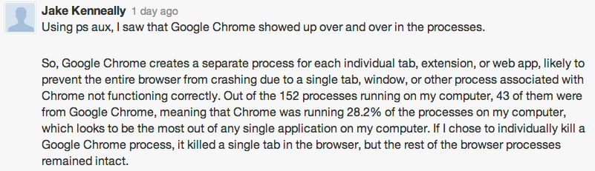
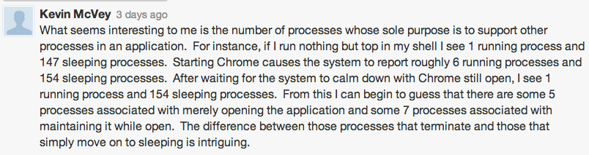

Slide 4
How many processes should a browser create?
New challenge for Exercise 1 & 2: what is the fewest number of processes you can have running on your machine?

Slide 5

1990’s answer:
1 process since processes waste memory and CPU which are expensive and limited

Slide 6
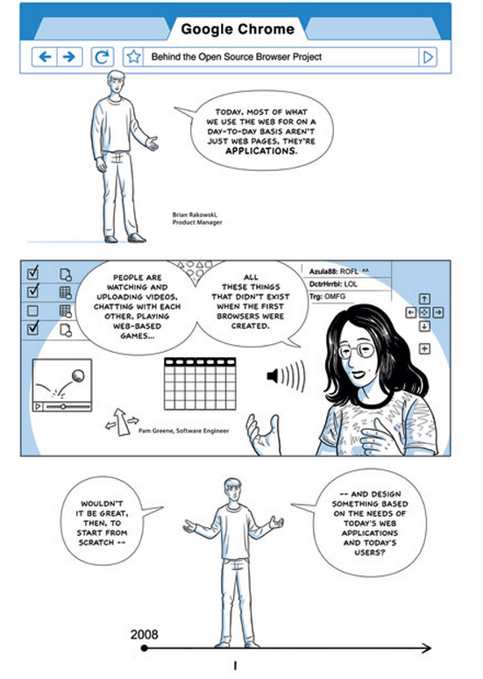
2000s answer:
http://www.google.com/googlebooks/chrome/

Slide 7
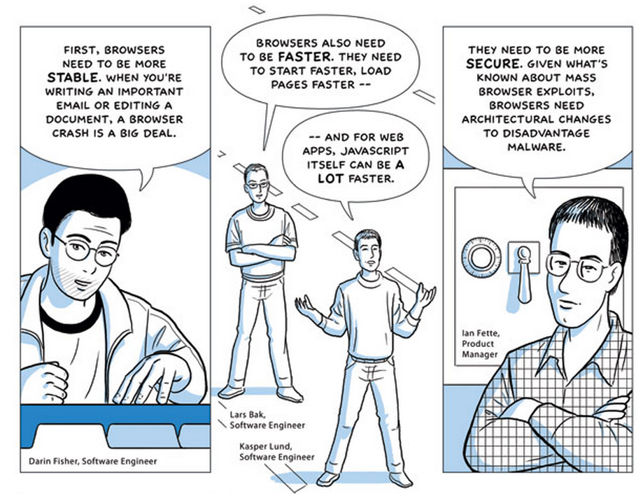

Slide 8
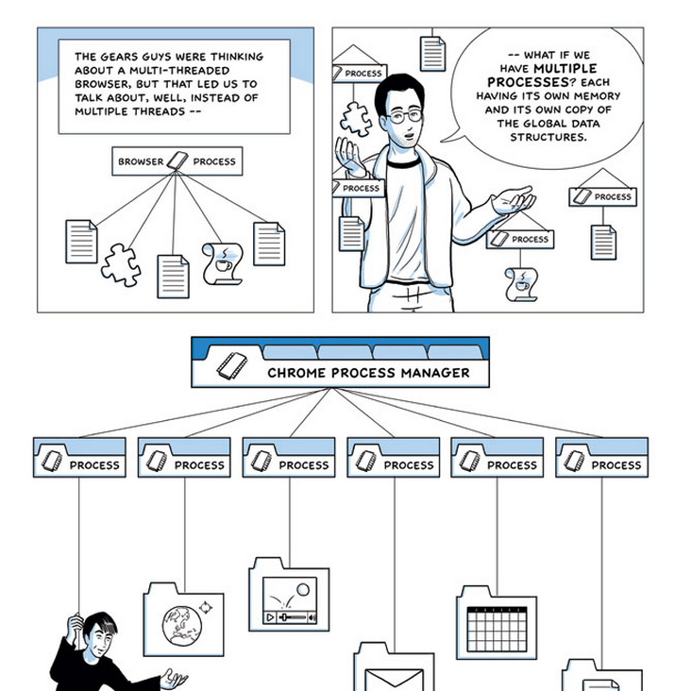

Slide 9
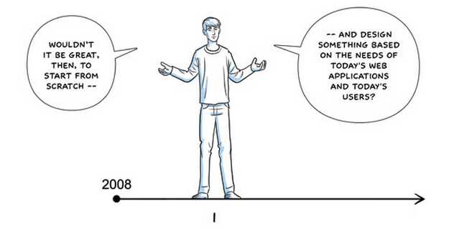
“Start from Scratch” = start from scratch constrained by using programming tools and methods developed in the 1960s

Slide 10
What should the 2010s answer be?

Slide 11
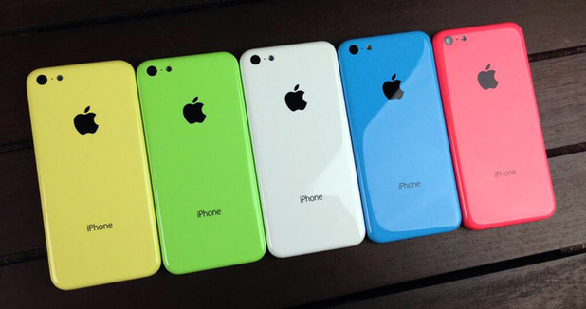

Apple iPhone 5C
Five colors, 2 cores!
Samsung Galaxy S4
Only two colors, but 4-8 cores!
(+ loads of GPU cores)
Note: the colors vs. cores tradeoff can probably be overcome by good engineering, but addressing the energy vs. cores tradeoffs require some theoretical advances also.

Slide 12

Humans should not be getting bored and grumpy waiting for their browser to render a page while cores are sitting idle!

Slide 13
“Start from Scratch” = start from scratch constrained by using programming tools and methods developed in the 1960s

Slide 14

2010s answer:
A modern browser should have enough processes to efficiently use all the machine resources available to provide human users with a good browsing experience!
Unfortunately, it is not (humanly) possible to build such a browser (in a way that will also be secure, robust, and reliable) using languages whose primary design goal was to fit on a 4K machine.

Slide 15

Why do our Rust stickers have a gear on them?
Servo: the main reason Rust is being developed is so Mozilla can build a better browser!

Slide 16
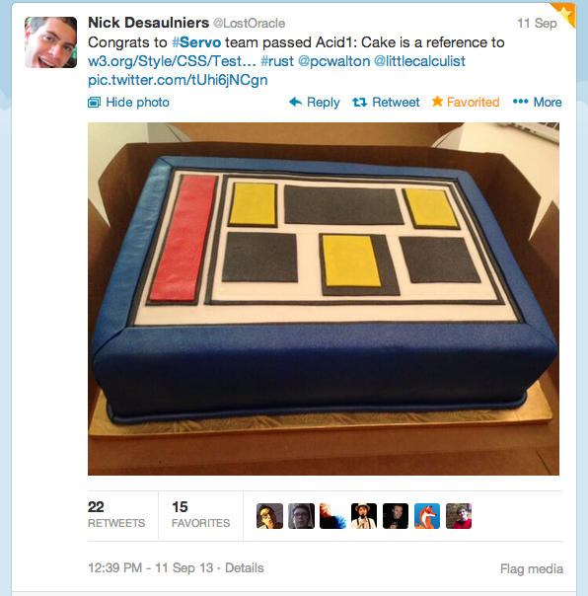
Really starting from scratch is really hard…
this is why getting Servo to the point where it can render a static page is cake-worthy!

Slide 17
What Dave was doing when you were learning to crawl…

Slide 18
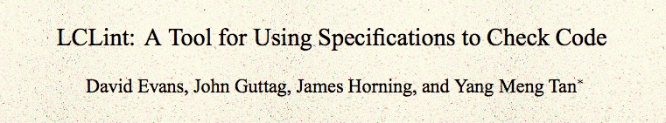
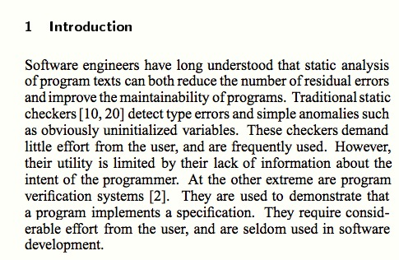
ACM Foundations in Software Engineering, 1994

Slide 19
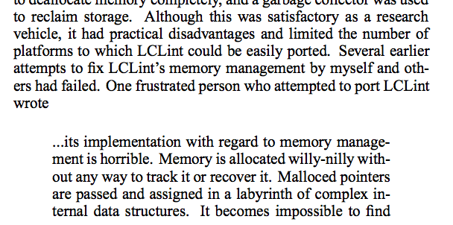
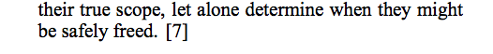
comp.os.linux post, August 1994

Slide 20
Memory management in C
$ man malloc # on my Macbook Air
MALLOC(3) BSD Library Functions Manual
SYNOPSIS
...
void free(void *ptr);
void *malloc(size_t size);
...
DESCRIPTION
The malloc(), calloc(), valloc(), realloc(), and reallocf() functions allocate memory. The allocated memory is aligned such that it can be used for any data type, …. The free() function frees allocations that were created via the preceding allocation functions.
The malloc() function allocates size bytes of memory and returns a pointer to the allocated memory.

Slide 21
# include <stdlib.h>
# include <stdio.h>
int main(int _argc, char **_argv) {
int *x = (int *) malloc (sizeof(*x));
*x = 4414;
printf("x = %d\n", *x);
return 0;
}
gash> gcc -Wall toofree.c
gash> ./a.out
x = 4414

Slide 22
# include <stdlib.h>
# include <stdio.h>
int main(int _argc, char **_argv) {
int *x = (int *) malloc (sizeof(*x));
*x = 4414;
free(x);
printf("x = %d\n", *x);
return 0;
}
gash> gcc -Wall toofree.c
gash> ./a.out
x = 4414

Slide 23
# include <stdlib.h>
# include <stdio.h>
int main(int _argc, char **_argv) {
int *x = (int *) malloc (sizeof(*x));
*x = 4414;
free(x);
free(x);
printf("x = %d\n", *x);
return 0;
}
Note: this is what happens to happen on my computer, but the C behavior is undefined. It would be “correct” for a C program like this to do absolutely anything!
gash> gcc -Wall toofree.c
gash> ./a.out
a.out(23685) malloc: *** error for object 0x10a1008d0: pointer being freed was not allocated
*** set a breakpoint in malloc_error_break to debug
Abort trap: 6

Slide 24
This gets tricky…
(from locale.h)
struct lconv
{
char *decimal_point;
char *thousands_sep;
char *grouping;
char *int_curr_symbol;
char *currency_symbol;
… } ;
// in my code…
struct lconv *local = localeconv (void);
…
free(local->decimal_point); // ?
free(local); // ?

Slide 25
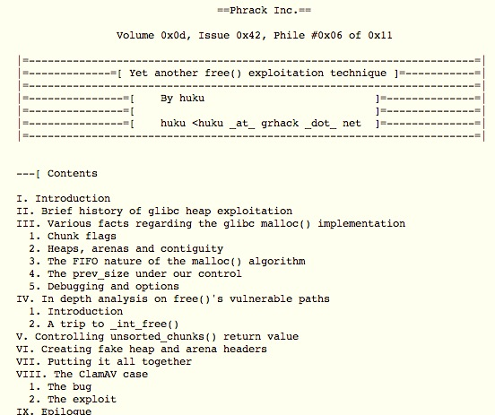
Should we really care?
November 2009

Slide 26
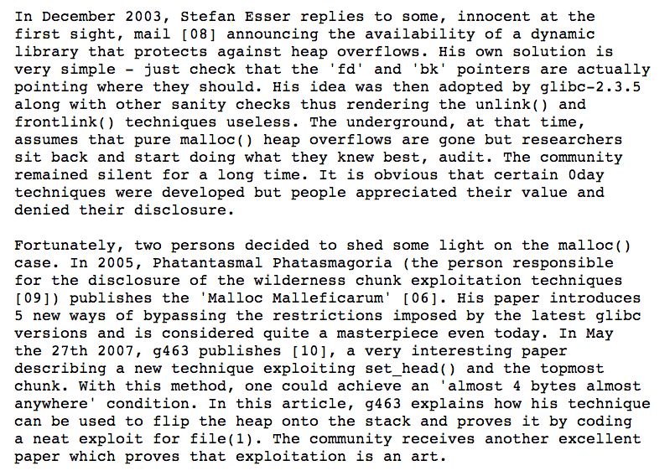

Slide 27
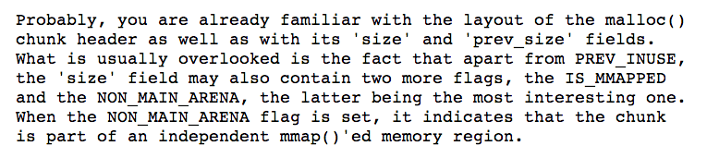
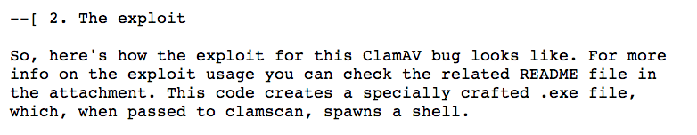
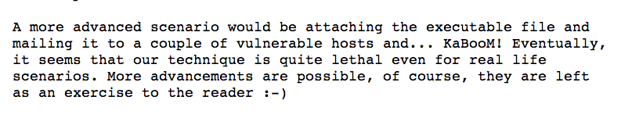

Slide 28
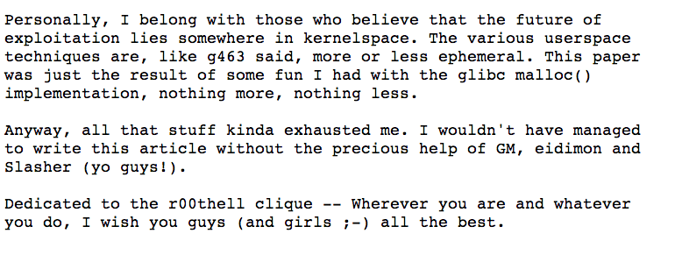
http://www.phrack.org/issues.html?issue=61&id=6

Slide 29
(Why) Doesn’t C++ solve this?
new = malloc
delete = free

Slide 30
Doesn’t Java solve this?

Slide 32
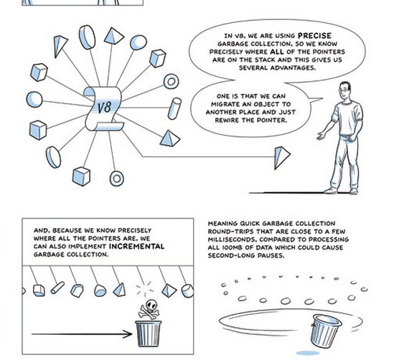
(Advanced “comic book” version of GC)

Slide 33
Getting back to my story…

Slide 34
“Willy-Nilly” Memory Management
Systematic Memory Management

Slide 35
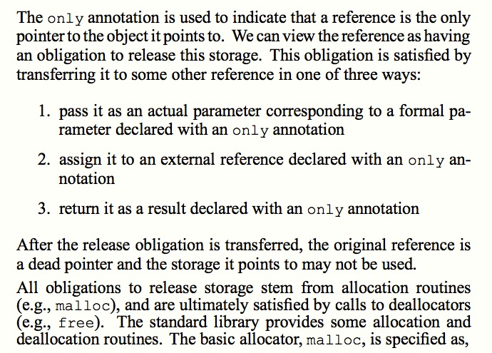
Static Detection of Dynamic Memory Errors, David Evans, PLDI May 1996

Slide 36
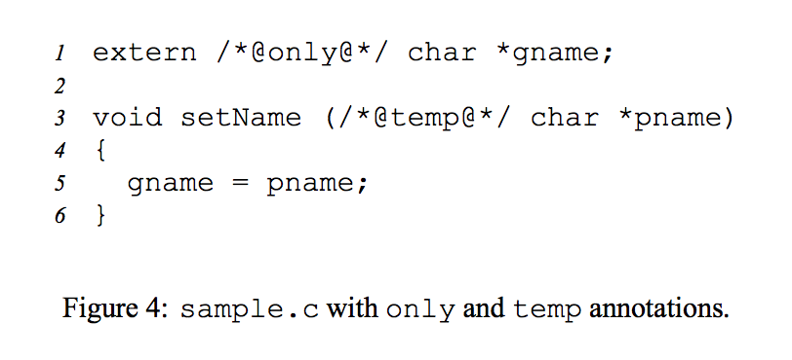
Static Detection of Dynamic Memory Errors, David Evans, PLDI May 1996

Slide 37
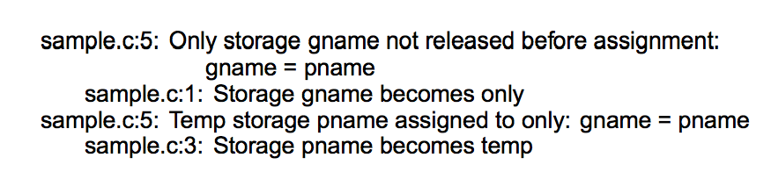
Static Detection of Dynamic Memory Errors, David Evans, PLDI May 1996
Note: these are “compile-time” errors (just produced by a separate tool).

Slide 38

Annotations?
Where we are going, we don’t need annotations!

Slide 39
A box is a reference to a heap allocation holding another value. There are two kinds of boxes: managed boxes and owned boxes.
An owned box type or value is constructed by the prefix tilde sigil ~.
Rust Manual, Section 9.1.4
extern /*@only@*/ char *gname;
void setName(/*@temp@*/ char *pname) {
gname = pname;
}

Slide 40
A box is a reference to a heap allocation holding another value. There are two kinds of boxes: managed boxes and owned boxes.
An owned box type or value is constructed by the prefix tilde sigil ~.
Rust Manual, Section 9.1.4
extern /*@only@*/ char *gname;
void setName(/*@temp@*/ char *pname) {
gname = pname;
}
static gname : ~str = ~"";
fn set_name(pname : &str) {
gname = pname;
}
[Note: we can’t really have a global, owned string like this in Rust.]

Slide 41
extern /*@only@*/ char *gname;
void setName(/*@temp@*/ char *pname) {
gname = pname;
}
gash> splint sample.c
sample.c:5: Only storage gname not released before assignment:
gname = pname
sample.c:1: Storage gname becomes only
sample.c:5: Temp storage pname assigned to only: gname = pname
sample.c:3: Storage pname becomes temp
static gname : ~str = ~"Where we're going, we don't need roads!”;
fn set_name(pname : &str) {
gname = pname;
}
gash> rustc sample.rs
sample.rs:4:12: 4:17 error: mismatched types: expected `~str` but found `&str`
(str storage differs: expected ~ but found &)
sample.rs:4 gname = pname;

Slide 42
static gname : ~str = ~"annotations";
fn set_name(pname : ~str) {
gname = pname;
}
fn main() {
set_name("roads");
}
gash> rustc sample2.rs
sample2.rs:8:13: 8:20 error: mismatched types: expected `~str` but found `&'static str` (str storage differs: expected ~ but found &'static )
sample2.rs:8 set_name("roads");

Slide 43
fn set_name(gname : &mut ~str, pname : ~str) {
*gname = pname;
}
fn main() {
let mut gname : ~str = ~"annotations";
println(fmt!("gname = %s", gname));
set_name(&mut gname, ~"frees");
println(fmt!("gname = %s", gname));
}
gash> rust run good.rs
gname = annotations
gname = frees

Slide 44
fn set_name(gname : &mut ~str, pname : ~str) {
*gname = pname;
}
Why doesn’t Rust complain about the missing free?

Slide 45
Free()s?
Where we are going, we don’t need free()s!

Slide 46
Managing memory safely and explicitly gets really complicated since we often do want to share objects. We’ll talk about pointer types Rust provides for more complex sharing next class.
PS2 is due Monday Sept 30.
You can use any language you want for this, but if your submission has any double-free vulnerabilities, buffer overflow vulnerabilities, or memory leaks you get a -10 on this assignment.

Slide 47
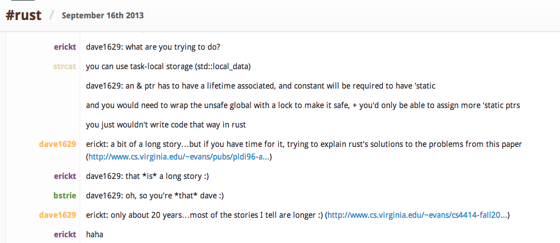
Charge
https://botbot.me/mozilla/rust/
Next class: complexities of memory management
PS2 is due Monday, 30 September

