Slide 1
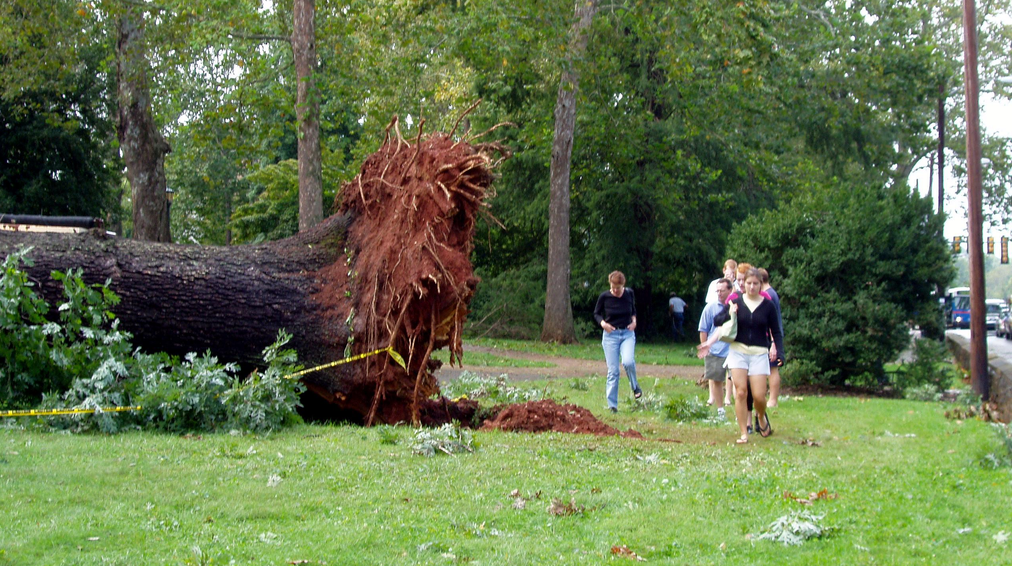
Class 8
Managing Memory
cs4414 Fall 2013
David Evans

Slide 2
Plan for Today
Exam 1
Version control: git
Concurrent Collatz Challenge Winner!
Memory Management

Slide 3
Exam 1
Posted shortly after class today https://docs.google.com/forms/d/1G0OjxCKnHfOWzuazXJ9DO5qwDKGs2J32KUhQcMQdzJk/
6 questions from notes, 2 synthesis questions
Due 11:59pm Thursday (Feb 13)
Open resources:
  use anything you want, other than other humans
  don’t post comments relevant to exam on course site between now and Friday

Slide 4
Any Questions?

Slide 7
Concurrent Collatz Challenge
Last class…
Challenge: Write a substantially better find_collatz program that makes good use of all available cores, and always produces the correct result.

Slide 8
fn find_collatz(k: int) -> int {
let mut n = 1;
let max_tasks = 7; // keep all my cores busy
let mut found_result = false;
let mut result = -1; // need to initialize
while !found_result {
let mut ports = ~[];
for i in range(0, max_tasks) {
let val = n + i;
let (port, chan) : (Port<int>, Chan<int>) = Chan::new();
ports.push(port);
spawn(proc() {
let steps = collatz_steps(val);
println!("Result for {}: {}", val, steps);
chan.send(steps);
});
}
for i in range(0, max_tasks) {
let port = ports.pop();
let steps = port.recv();
if steps > k {
found_result = true;
result = n + i;
}
}
n += max_tasks;
}
assert!(result != -1);
result
}

Slide 9
A Much Better Way
Loren Fryxell

Slide 10
Memory Management

Slide 11
C Memory Management
MALLOC(3) BSD Library Functions Manual
SYNOPSIS
...
void free(void *ptr);
void *malloc(size_t size);
...
DESCRIPTION
The malloc(), calloc(), valloc(), realloc(), and reallocf() functions allocate memory. The allocated memory is aligned such that it can be used for any data type, …. The free() function frees allocations that were created via the preceding allocation functions.

Slide 12
# include <stdlib.h>
# include <stdio.h>
int main(int _argc, char **_argv) {
int *x = (int *) malloc (sizeof(*x));
*x = 4414;
printf("x = %d\n", *x);
return 0;
}
gash> gcc -Wall toofree.c
gash> ./a.out
x = 4414

Slide 13
# include <stdlib.h>
# include <stdio.h>
int main(int _argc, char **_argv) {
int *x = (int *) malloc (sizeof(*x));
*x = 4414;
free(x);
printf("x = %d\n", *x);
return 0;
}
gash> gcc -Wall toofree.c
gash> ./a.out
x = 4414

Slide 14
int main(int _argc, char **_argv) {
int *x = (int *) malloc (sizeof(*x));
*x = 4414;
free(x);
free(x);
printf("x = %d\n", *x);
return 0;
}
Note: this is what happens to happen on my computer, but the C behavior is undefined. It would be “correct” for a C program like this to do absolutely anything!
gash> gcc -Wall toofree.c
gash> ./a.out
a.out(23685) malloc: *** error for object 0x10a1008d0: pointer being freed was not allocated
*** set a breakpoint in malloc_error_break to debug
Abort trap: 6

Slide 15
This gets tricky…
(from locale.h)
struct lconv
{
char *decimal_point;
char *thousands_sep;
char *grouping;
char *int_curr_symbol;
char *currency_symbol;
… } ;
// in my code…
struct lconv *local = localeconv (void);
…
free(local->decimal_point); // ?
free(local); // ?

Slide 16
Should we really care?

Slide 17
/*
* Copyright (c) 1983 The Regents of the University of California.
* All rights reserved.
*
* Redistribution and use in source and binary forms are permitted
* provided that the above copyright notice and this paragraph are
* ...
* THIS SOFTWARE IS PROVIDED ``AS IS'' AND WITHOUT ANY EPRESS OR
* IMPLIED WARRANTIES, INCLUDING, WITHOUT LIMITATION, THE IMPLIED
* WARRANTIES OF MERCHANTIBILITY AND FITNESS FOR A PARTICULAR PURPOSE.
*/
…
main(argc, argv)
int argc;
char *argv[];
{
…
BSD4.3 (1986) fingerd.c

Slide 18
MULTICS
(from Class 4)
Code (carries license)
“Ideas” (no license, possible patent lawsuits)
Unix
BSD
Minix
NextStep
FreeBSD
Linux
Mac OS X
Android
iOS

Slide 19
“So there you have it: The single Greatest Piece of Software Ever, with the broadest impact on the world, was BSD 4.3. Other Unixes were bigger commercial successes. But as the cumulative accomplishment of the BSD systems, 4.3 represented an unmatched peak of innovation. BSD 4.3 represents the single biggest theoretical undergirder of the Internet. Moreover, the passion that surrounds Linux and open source code is a direct offshoot of the ideas that created BSD: a love for the power of computing and a belief that it should be a freely available extension of man's intellectual powers--a force that changes his place in the universe.”
Charles Babcock, What's the Greatest Software Ever
Written?, InformationWeek, 11 August 2006.

Slide 20
main(argc, argv)
int argc;
char *argv[];
{
register char *sp;
char line[512];
struct sockaddr_in sin;
int i, p[2], pid, status;
...
if (gets(line, stdin) == NULL)
exit(1);
...
if ((pid = fork()) == 0) {
…
execv("/usr/ucb/finger", av);
…
BSD4.3 (1986) fingerd.c

Slide 21
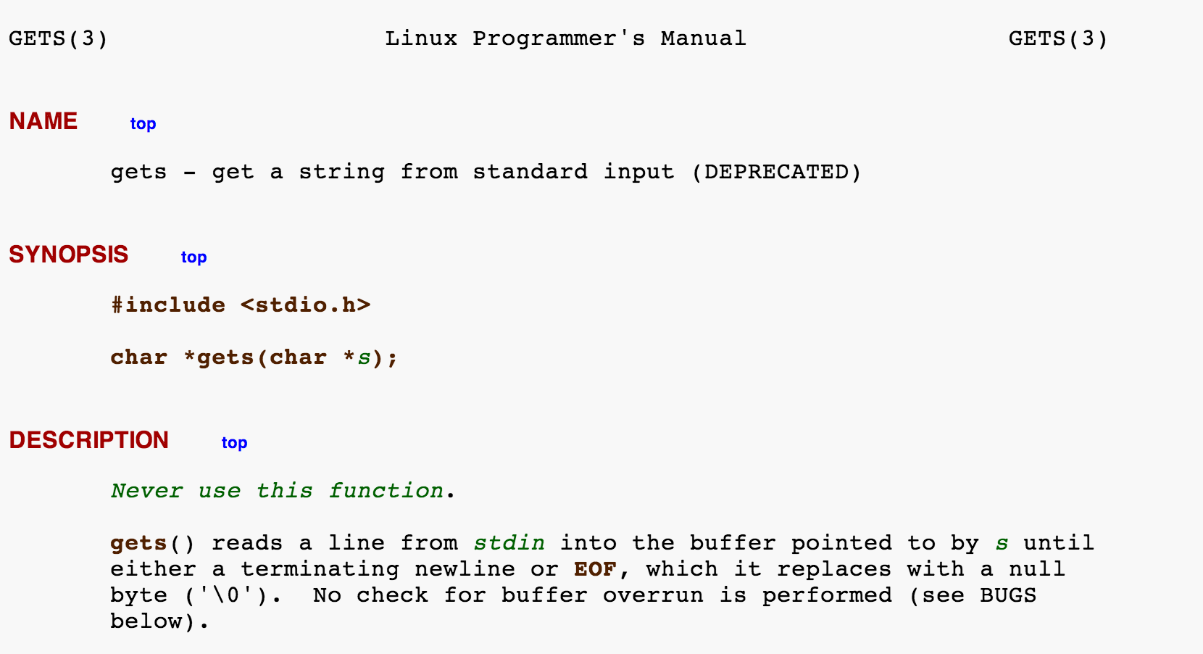
main(argc, argv)
int argc;
char *argv[];
{
register char *sp;
char line[512];
struct sockaddr_in sin;
int i, p[2], pid, status;
...
if (gets(line, stdin) == NULL)
exit(1);
...
if ((pid = fork()) == 0) {
…
execv("/usr/ucb/finger", av);
…
BSD4.3 (1986) fingerd.c

Slide 22
main(argc, argv)
int argc;
char *argv[];
{
register char *sp;
char line[512];
struct sockaddr_in sin;
int i, p[2], pid, status;
...
if (fgets(line, sizeof(line), stdin) == NULL)
exit(1);
...
if ((pid = fork()) == 0) {
…
execv("/usr/ucb/finger", av);
…
BSD4.3 (1986) fingerd.c
(patched)

Slide 23
Exploiting the BSD4.3 version
char buf[536];/* 1084 */
...
for(i = 0; i < 400; i++)
buf[i] = 1;
for(j = 0; j < 28; j++)
buf[i+j] = "\335\217/sh\0\335\217/bin\320^Z\335\0\335\0\335Z\335\003\320^\\
\274;\344\371\344\342\241\256\343\350\357\256\362\351"[j];
l556 = 0x7fffe9fc;/* Rewrite part of the stack frame */
l560 = 0x7fffe8a8;
l564 = 0x7fffe8bc;
l568 = 0x28000000;
l552 = 0x0001c020;
... /* reverse word order for the VAX */
write(s, buf, sizeof(buf));/* sizeof == 536 */
write(s, XS("\n"), 1);
sleep(5);
if (test_connection(s, s, 10)) {
*fd1 = s;
*fd2 = s;
return 1;
}
char line[512];
...
if (gets(line, stdin) == NULL)
exit(1);
...
if ((pid = fork()) == 0) {
…
execv("/usr/ucb/finger", av);
…

Slide 24
’i’
’f’
Stack executing fingerd.c main()
…
’/’
p[1]
’b’
p[0]
’c’
char line[512];
struct sockaddr_in sin;
int i, p[2], pid, status;
FILE *fp;
char *av[4];
...
if (gets(line, stdin) == NULL)
exit(1);
...
if ((pid = fork()) == 0) {
…
execv("/usr/ucb/finger", av);
…
i
’u’
sin
’/’
line[511]
’r’
…
’s’
line[2]
’u’
line[1]
’/’
line[0]
…

Slide 25
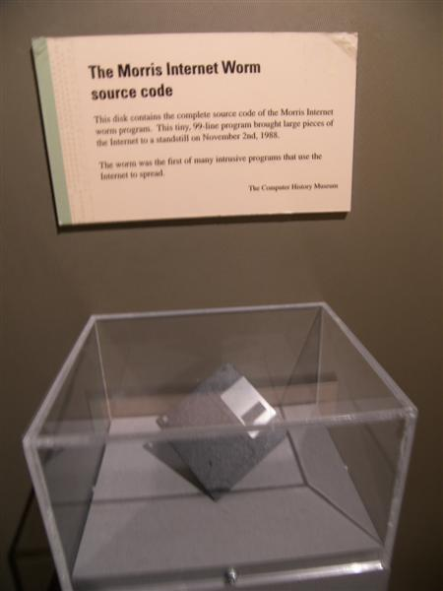
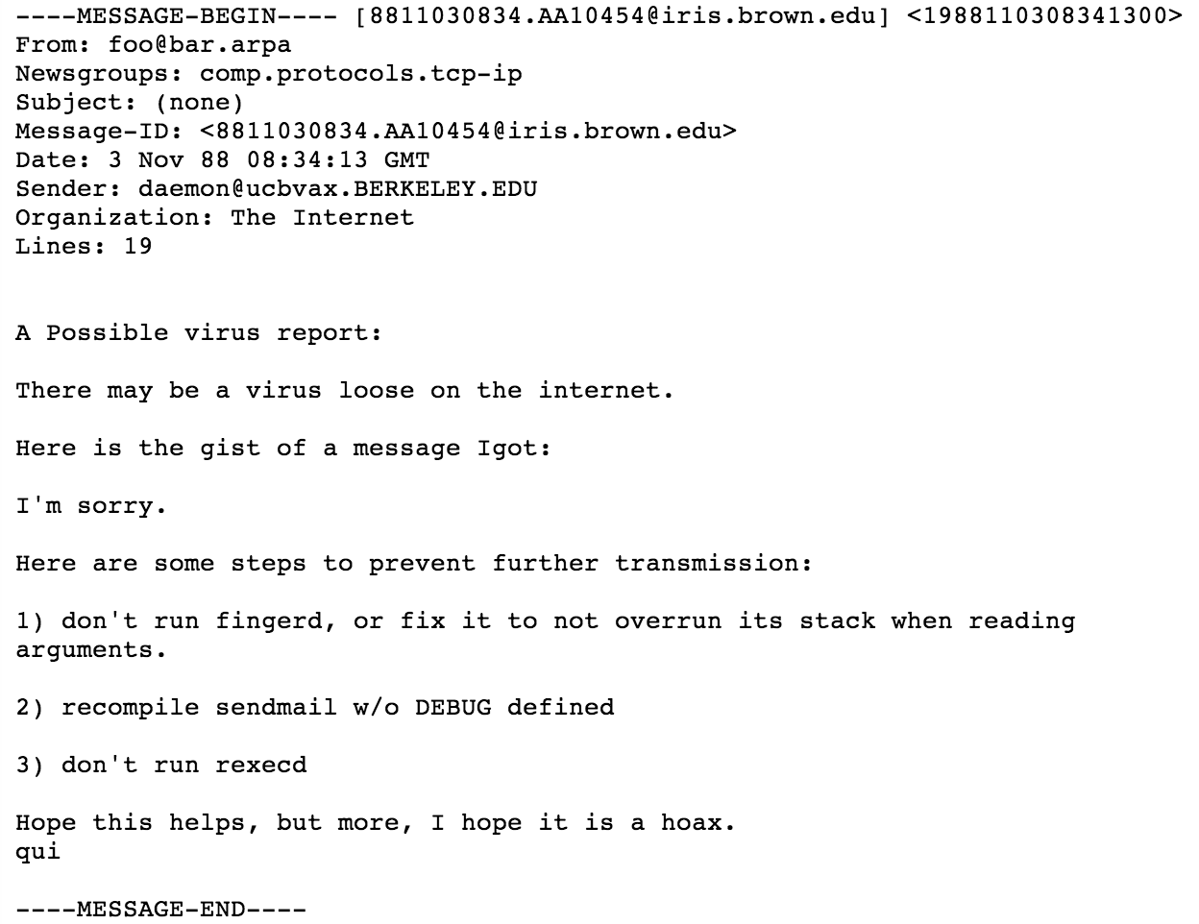
Boston Museum of Science

Slide 26
Paul Graham, Undergraduation
Almost everyone hates their dissertation by the time they're done with it. … But thousands before you have suffered through writing a dissertation. And aside from that, grad school is close to paradise. Many people remember it as the happiest time of their lives. And nearly all the rest, including me, remember it as a period that would have been, if they hadn't had to write a dissertation.
The danger with grad school is that you don't see the scary part upfront. PhD programs start out as college part 2, with several years of classes. So by the time you face the horror of writing a dissertation, you're already several years in. If you quit now, you'll be a grad-school dropout, and you probably won't like that idea. When Robert got kicked out of grad school for writing the Internet worm of 1988, I envied him enormously for finding a way out without the stigma of failure.

Slide 27
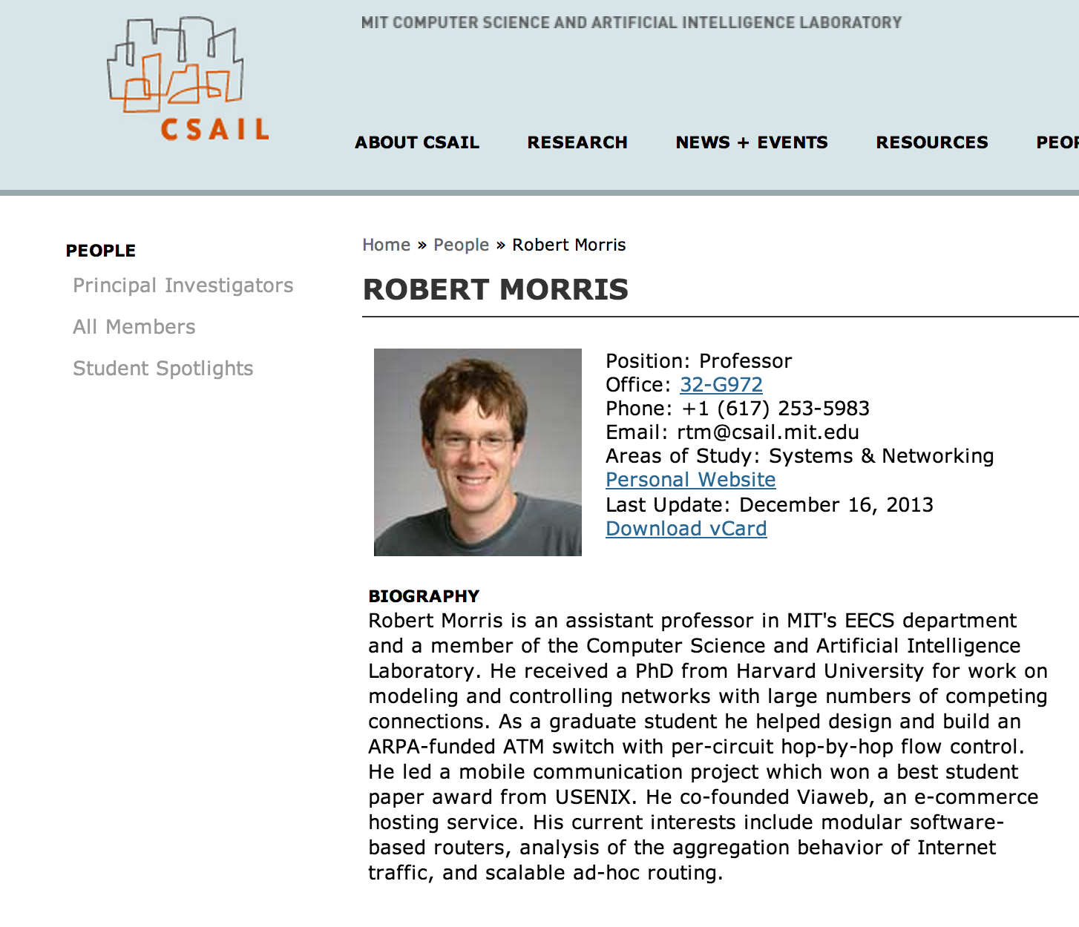

Slide 28
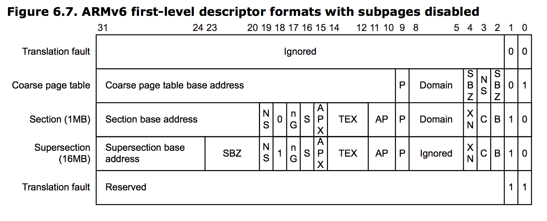
Stack Smashing Defense
Physical Memory
Page Table
addr / flags
Page + Offset
(AMD did this first with AMD64, then Intel copied in Pentium 4, and ARM.)

Slide 29
No-Execute Pages
Attempt to fetch an instruction from a page with NX bit is 1: FAULT
W^X: OS should try to make all pages in memory either writable or executable, but not both!
Would this have prevented the Morris Worm exploit?

Slide 30
Stack Smashing Defense #2
’i’
’f’
…
’/’
p[1]
’b’
p[0]
’c’
i
’u’
sin
’/’
line[511]
’r’
…
’s’
line[2]
’u’
line[1]
’/’
line[0]
…

Slide 31
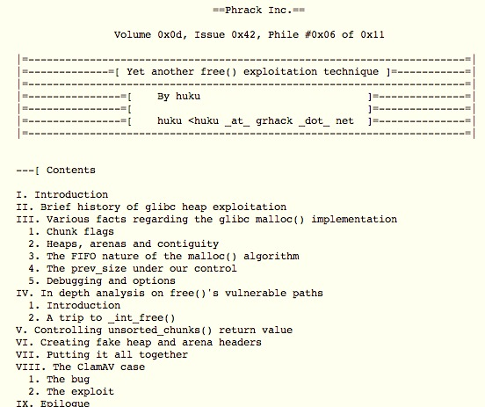
November 2009

Slide 32
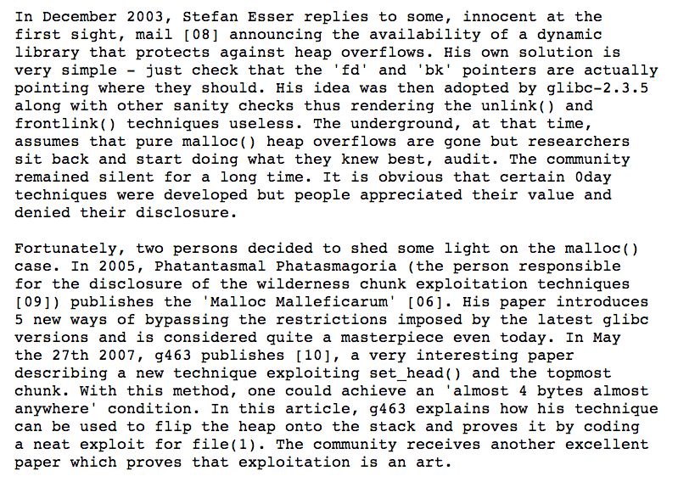

Slide 34
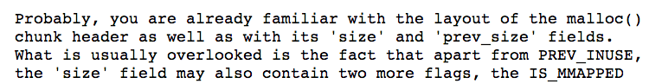
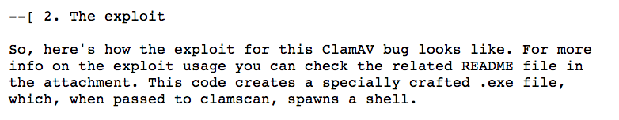
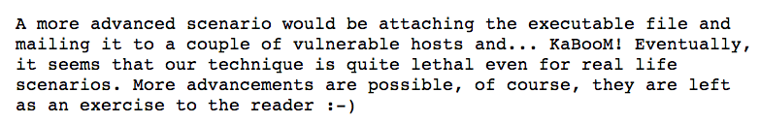

Slide 35
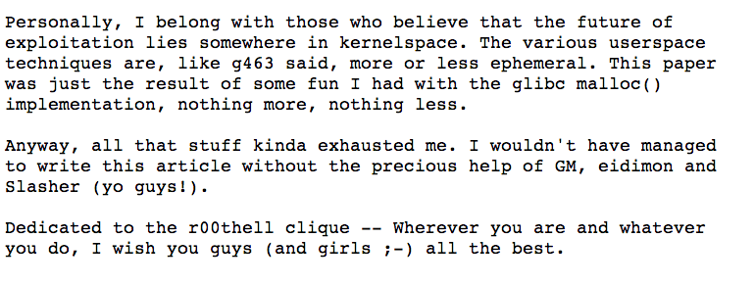
http://www.phrack.org/issues.html?issue=61&id=6

Slide 36
(Why) Doesn’t C++ solve this?
new = malloc
delete = free

Slide 37
Doesn’t Java solve this?

Slide 39
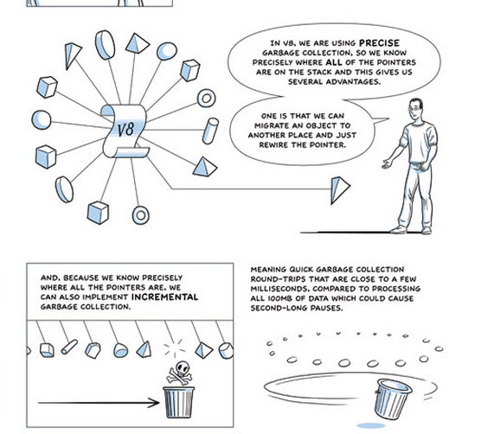
(Advanced “comic book” version of GC)

Slide 40
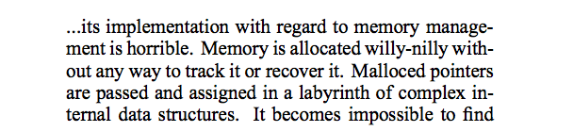
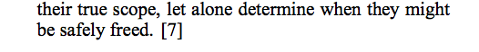
Getting back to my story…
comp.os.linux post, August 1994

Slide 41
“Willy-Nilly” Memory Management
Systematic Memory Management

Slide 42
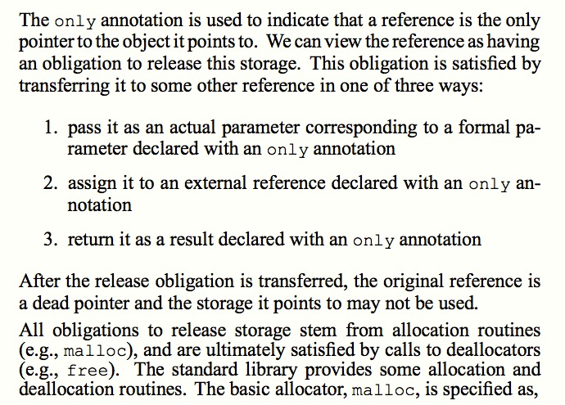
Static Detection of Dynamic Memory Errors, David Evans, PLDI May 1996

Slide 43
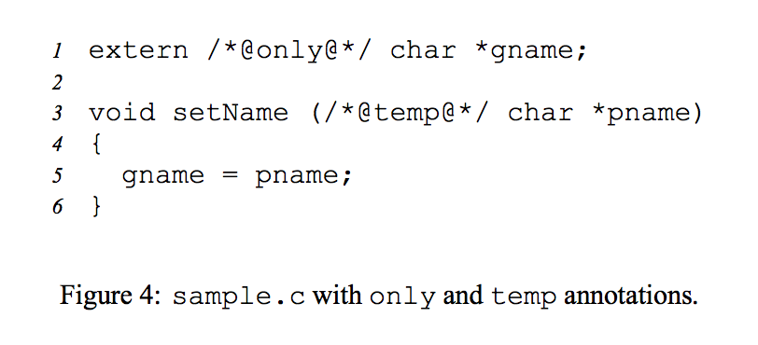
Static Detection of Dynamic Memory Errors, David Evans, PLDI May 1996

Slide 44
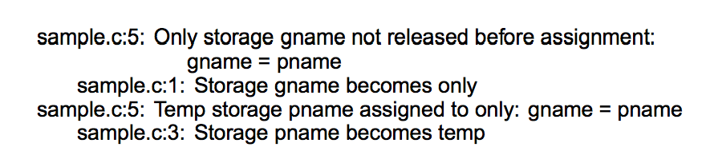
Static Detection of Dynamic Memory Errors, David Evans, PLDI May 1996
Note: these are “compile-time” errors (just produced by a separate tool).

Slide 45

Annotations?
Where we are going, we don’t need annotations!

Slide 46
A box is a reference to a heap allocation holding another value. There are two kinds of boxes: managed boxes and owned boxes.
An owned box type or value is constructed by the prefix tilde sigil ~.
Rust Manual, Section 9.1.4
extern /*@only@*/ char *gname;
void setName(/*@temp@*/ char *pname) {
gname = pname;
}

Slide 47
A box is a reference to a heap allocation holding another value. There are two kinds of boxes: managed boxes and owned boxes.
An owned box type or value is constructed by the prefix tilde sigil ~.
Rust Manual, Section 9.1.4
extern /*@only@*/ char *gname;
void setName(/*@temp@*/ char *pname) {
gname = pname;
}
static gname : ~str = ~"”;
fn set_name(pname : &str) {
gname = pname;
}
[Note: we can’t really have a global, owned string like this in Rust.]

Slide 48
extern /*@only@*/ char *gname;
void setName(/*@temp@*/ char *pname) {
gname = pname;
}
gash> splint sample.c
sample.c:5: Only storage gname not released before assignment:
gname = pname
sample.c:1: Storage gname becomes only
sample.c:5: Temp storage pname assigned to only: gname = pname
sample.c:3: Storage pname becomes temp
static gname : ~str = ~"Where we're going, we don't need roads!”;
fn set_name(pname : &str) {
gname = pname;
}
gash> rustc sample.rs
sample.rs:4:12: 4:17 error: mismatched types: expected `~str` but found `&str`
(str storage differs: expected ~ but found &)
sample.rs:4 gname = pname;

Slide 49
static gname : ~str = ~"annotations";
fn set_name(pname : ~str) {
gname = pname;
}
fn main() {
set_name("roads");
}
gash> rustc sample2.rs
sample2.rs:8:13: 8:20 error: mismatched types: expected `~str` but found `&'static str` (str storage differs: expected ~ but found &'static )
sample2.rs:8 set_name("roads");

Slide 50
fn set_name(gname : &mut ~str, pname : ~str) {
*gname = pname;
}
fn main() {
let mut gname : ~str = ~"annotations";
println(fmt!("gname = %s", gname));
set_name(&mut gname, ~"frees");
println(fmt!("gname = %s", gname));
}
gash> rust run good.rs
gname = annotations
gname = frees

Slide 51
fn set_name(gname : &mut ~str, pname : ~str) {
*gname = pname;
}
Why doesn’t Rust complain about the missing free?

Slide 52
free()s?
Where we are going, we don’t need free()s!

Slide 53
Charge
Managing memory safely and explicitly gets really complicated since we often do want to share objects. We’ll talk about pointer types Rust provides for more complex sharing next class.
PS2 is due Sunday, 9 February
You can use any language you want for this, but if your submission has any double-free vulnerabilities, buffer overflow vulnerabilities, or memory leaks you get a -10 on this assignment.

Slide 54
What Dave was doing when you were being born/learning to crawl…

Slide 55
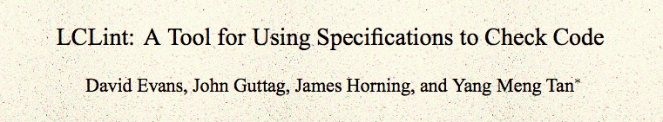
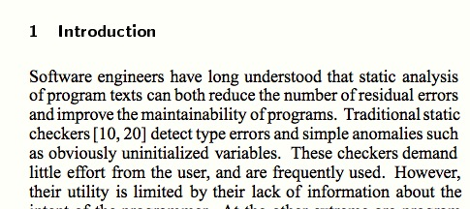
ACM Foundations in Software Engineering, 1994

Slide 56
comp.os.linux post, August 1994

Slide 57
C Memory Management
MALLOC(3) BSD Library Functions Manual
SYNOPSIS
...
void free(void *ptr);
void *malloc(size_t size);
...
DESCRIPTION
The malloc(), calloc(), valloc(), realloc(), and reallocf() functions allocate memory. The allocated memory is aligned such that it can be used for any data type, …. The free() function frees allocations that were created via the preceding allocation functions.

Slide 58
# include <stdlib.h>
# include <stdio.h>
int main(int _argc, char **_argv) {
int *x = (int *) malloc (sizeof(*x));
*x = 4414;
printf("x = %d\n", *x);
return 0;
}
gash> gcc -Wall toofree.c
gash> ./a.out
x = 4414

Slide 59
# include <stdlib.h>
# include <stdio.h>
int main(int _argc, char **_argv) {
int *x = (int *) malloc (sizeof(*x));
*x = 4414;
free(x);
printf("x = %d\n", *x);
return 0;
}
gash> gcc -Wall toofree.c
gash> ./a.out
x = 4414

Slide 60
int main(int _argc, char **_argv) {
int *x = (int *) malloc (sizeof(*x));
*x = 4414;
free(x);
free(x);
printf("x = %d\n", *x);
return 0;
}
Note: this is what happens to happen on my computer, but the C behavior is undefined. It would be “correct” for a C program like this to do absolutely anything!
gash> gcc -Wall toofree.c
gash> ./a.out
a.out(23685) malloc: *** error for object 0x10a1008d0: pointer being freed was not allocated
*** set a breakpoint in malloc_error_break to debug
Abort trap: 6

Slide 61
This gets tricky…
(from locale.h)
struct lconv
{
char *decimal_point;
char *thousands_sep;
char *grouping;
char *int_curr_symbol;
char *currency_symbol;
… } ;
// in my code…
struct lconv *local = localeconv (void);
…
free(local->decimal_point); // ?
free(local); // ?

Slide 62
Should we really care?

Slide 63
November 2009

Slide 67
http://www.phrack.org/issues.html?issue=61&id=6

Slide 68
(Why) Doesn’t C++ solve this?
new = malloc
delete = free

Slide 69
Doesn’t Java solve this?

Slide 71
(Advanced “comic book” version of GC)

Slide 72
What Dave was doing when you were being born/learning to crawl…

Slide 73
ACM Foundations in Software Engineering, 1994

Slide 74
comp.os.linux post, August 1994

Slide 75
“Willy-Nilly” Memory Management
Systematic Memory Management

Slide 76
Static Detection of Dynamic Memory Errors, David Evans, PLDI May 1996

Slide 77
Static Detection of Dynamic Memory Errors, David Evans, PLDI May 1996

Slide 78
Static Detection of Dynamic Memory Errors, David Evans, PLDI May 1996
Note: these are “compile-time” errors (just produced by a separate tool).

Slide 79
Annotations?
Where we are going, we don’t need annotations!

Slide 80
A box is a reference to a heap allocation holding another value. There are two kinds of boxes: managed boxes and owned boxes.
An owned box type or value is constructed by the prefix tilde sigil ~.
Rust Manual, Section 9.1.4
extern /*@only@*/ char *gname;
void setName(/*@temp@*/ char *pname) {
gname = pname;
}

Slide 81
A box is a reference to a heap allocation holding another value. There are two kinds of boxes: managed boxes and owned boxes.
An owned box type or value is constructed by the prefix tilde sigil ~.
Rust Manual, Section 9.1.4
extern /*@only@*/ char *gname;
void setName(/*@temp@*/ char *pname) {
gname = pname;
}
static gname : ~str = ~"";
fn set_name(pname : &str) {
gname = pname;
}
[Note: we can’t really have a global, owned string like this in Rust.]

Slide 82
extern /*@only@*/ char *gname;
void setName(/*@temp@*/ char *pname) {
gname = pname;
}
gash> splint sample.c
sample.c:5: Only storage gname not released before assignment:
gname = pname
sample.c:1: Storage gname becomes only
sample.c:5: Temp storage pname assigned to only: gname = pname
sample.c:3: Storage pname becomes temp
static gname : ~str = ~"Where we're going, we don't need roads!”;
fn set_name(pname : &str) {
gname = pname;
}
gash> rustc sample.rs
sample.rs:4:12: 4:17 error: mismatched types: expected `~str` but found `&str`
(str storage differs: expected ~ but found &)
sample.rs:4 gname = pname;

Slide 83
static gname : ~str = ~"annotations";
fn set_name(pname : ~str) {
gname = pname;
}
fn main() {
set_name("roads");
}
gash> rustc sample2.rs
sample2.rs:8:13: 8:20 error: mismatched types: expected `~str` but found `&'static str` (str storage differs: expected ~ but found &'static )
sample2.rs:8 set_name("roads");

Slide 84
fn set_name(gname : &mut ~str, pname : ~str) {
*gname = pname;
}
fn main() {
let mut gname : ~str = ~"annotations";
println(fmt!("gname = %s", gname));
set_name(&mut gname, ~"frees");
println(fmt!("gname = %s", gname));
}
gash> rust run good.rs
gname = annotations
gname = frees

Slide 85
fn set_name(gname : &mut ~str, pname : ~str) {
*gname = pname;
}
Why doesn’t Rust complain about the missing free?

Slide 86
free()s?
Where we are going, we don’t need free()s!

Slide 87
Managing memory safely and explicitly gets really complicated since we often do want to share objects. We’ll talk about pointer types Rust provides for more complex sharing next class.
PS2 is due Sunday, 9 February
You can use any language you want for this, but if your submission has any double-free vulnerabilities, buffer overflow vulnerabilities, or memory leaks you get a -10 on this assignment.

Slide 88
Charge

Slide 89
Charge

Slide 90
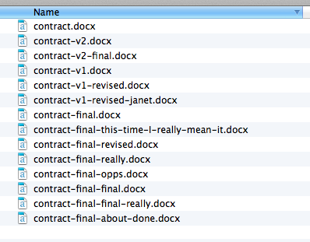
“Smart Lawyer” Version Control

Slide 91
Version Control
How can Alice find the last working version of her code before she broke everything trying to fix a little bug?
How can Alice and Bob work on a program together?
How can 10,000 developers work together on the Linux kernel?
Annual Linux Development Report

Slide 92
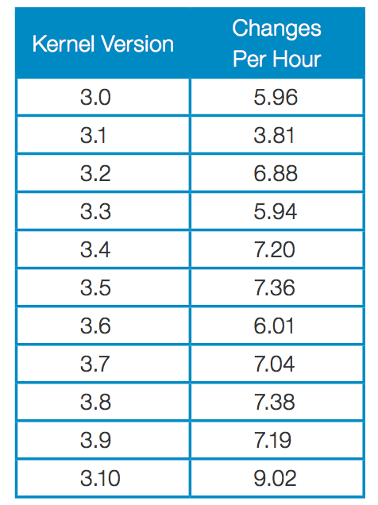
“Since the beginning of the git era (the 2.6.11 release in 2005), a total of 9,784 developers have contributed to the Linux kernel; those developers worked for a minimum of 1,064 companies.”

Slide 93
“Since the beginning of the git era (the 2.6.11 release in 2005), a total of 9,784 developers have contributed to the Linux kernel; those developers worked for a minimum of 1,064 companies.”

Slide 94
Which companies contribute the most changes?

Slide 95
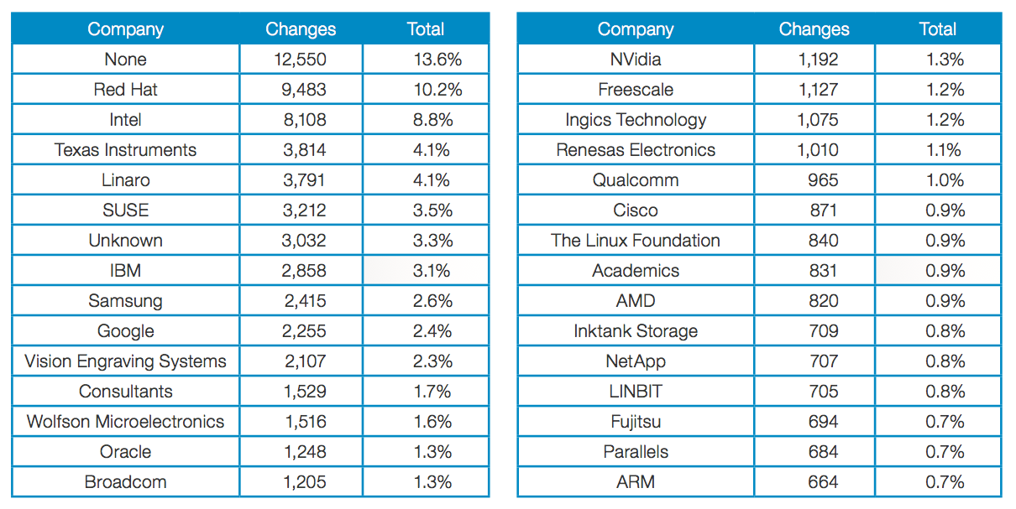

Slide 96
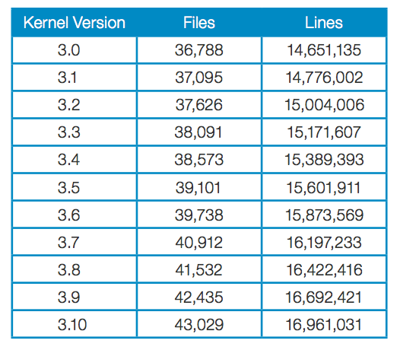
^{July 2011}
^{June 2013}

Slide 97
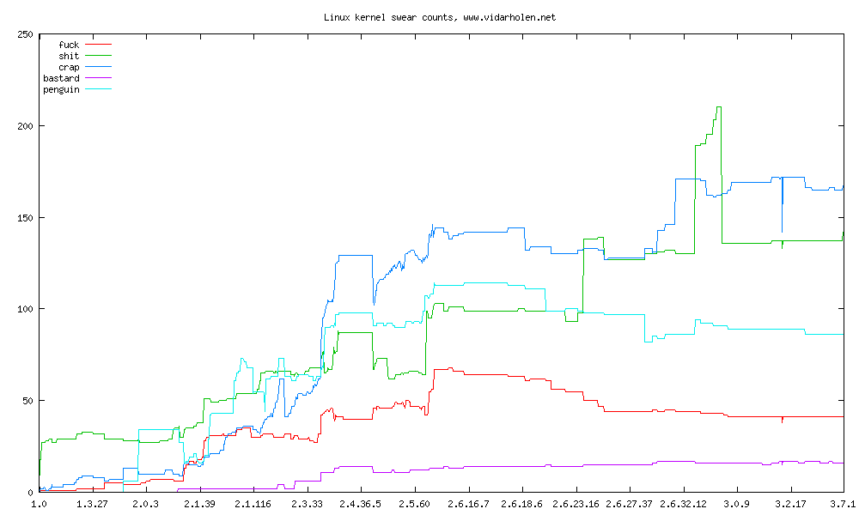
http://www.vidarholen.net/contents/wordcount/

Slide 98
Centralized Version Control
Repository
(cvs, subversion)
update
update
commit
commit
Bob:
gash> svn checkout
gash> svn update
[make changes]
gash> svn commit
Alice:
gash> svn checkout
gash> svn update
[make changes]
gash> svn commit

Slide 99
Distributed Version Control
Main Repository
(git, Mercurial)
clone, pull
clone, pull
Alice’s Local Repository
push
Bob’s Local Repository
push
commit
update
update
commit
[make changes]
[make changes]

Slide 100
Centralized: One Repo
Distributed
Main Repository
(Hg)
Repository
(svn)
clone, pull
clone, pull
update
update
Bob’s Local Repository
Alice’s Local Repository
push
push
commit
commit
update,
commit
update,
commit
[make changes]
[make changes]
[make changes]
[make changes]

Slide 101
What has to happen before Bob sees Alice’s changes?
Main Repository
(Hg)
pull
Alice’s Local Repository
Bob’s Local Repository
push
commit
update
changed gash.rs
see gash.rs
Alice
Bob

Slide 102
git pull = “pull” + “update”
Main Repository
(git)
pull does not correspond to push:
it corresponds to commit + push
pull
Alice’s Local Repository
Bob’s Local Repository
push
commit
update
(I find this asymmetrical and confusing…but not many scenarios where pulling to local without updating is useful.)
changed gash.rs
see gash.rs
Alice
Bob

Slide 103
What if Bob had modified his copy?
Main Repository
(git)
pull
gash> git pull
…
error: Your local changes to the following files would be overwritten by merge:
ps2/gash.rs
Please, commit your changes or stash them before you can merge.
Aborting
Bob’s Local Repository
Alice’s Local Repository
push
commit
changed gash.rs
see gash.rs
Alice
Bob

Slide 104
Okay, let’s commit:
Main Repository
(git)
pull
gash> git commit -a –m "Cleaned up pipes implementation."
[master 1347c1f] Fixed the notorious zombie process bug.
1 files changed, 3 insertions(+), 0 deletions(-)
gash> git pull
Auto-merging ps2/gash.rs
CONFLICT (content): Merge conflict in ps2/gash.rs
Automatic merge failed; fix conflicts and then commit the result.
Alice’s Local Repository
Bob’s Local Repository
push
commit
changed gash.rs
see gash.rs
Alice
Bob

Slide 105
Observing Conflicts
//
// gash.rs
//
// Reference solution for PS2
//
<<<<<<< HEAD
// Note: it would be very unwise to run this server on a machine that is
// on the Internet and contains any sensitive files!
=======
// Warning: this is not a secure server!
>>>>>>> faf7829d3ab38459172b622351d68ac1f47bddd0
//
// University of Virginia - cs4414 Spring 2014
Notes:
HEAD is your repository (master branch); second is the main repository you tried to pull from

Slide 106
Resolving Conflicts (for Luddites)
gash> emacs zhttpto.rs
edit conflicted file manually (removing the <<<< and ====)
gash> git commit -a -m "Updated security message."
[master 1e6e684] Updated security message.
gash> git push
…
To https://github.com/cs4414/Reference-Solutions.git
faf7829..1e6e684 master -> master

Slide 107
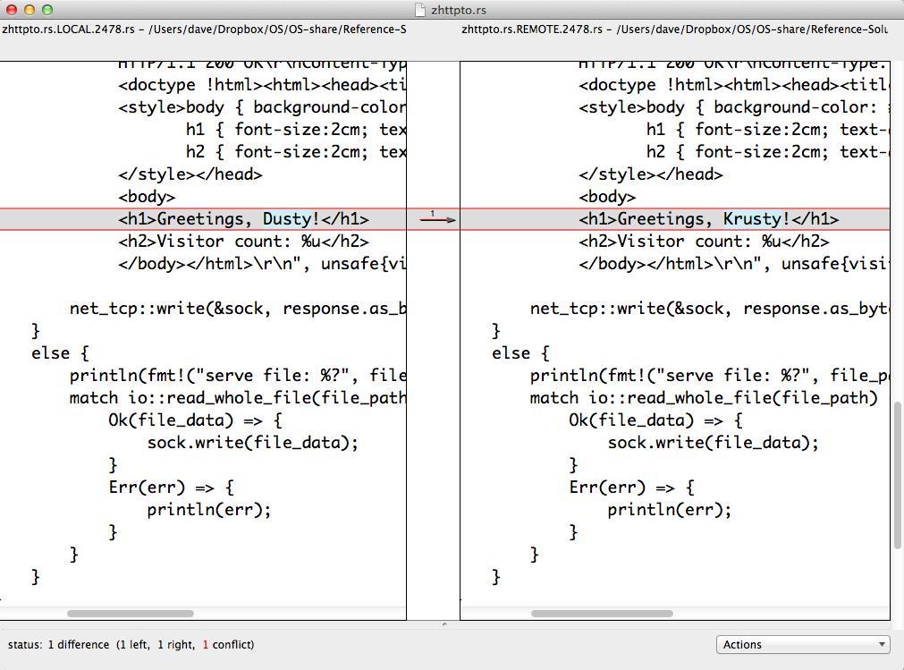
Resolving Conflicts (for Moderns)
git mergetool

Slide 108
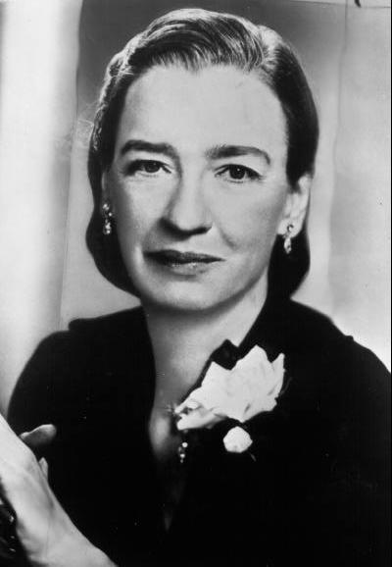
Avoiding Conflicts
It’s easier to ask forgiveness than it is to get permission.
Admiral Grace Hopper
With conflicts, it is better to avoid them than to resolve them!
pull before you start modifying, and often while working
commit early and often, use good messages
push whenever you have something worth sharing (but don’t push junk)
divide your project into small, coherent files
communicate well with your teammates!

Slide 109
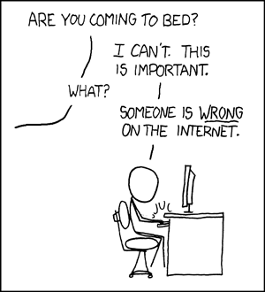
Avoiding Major Conflicts with Teammates
Don’t resolve conflicts by just undoing others’ work!
At least make sure you understand it before replacing their changes with your own.

Slide 110



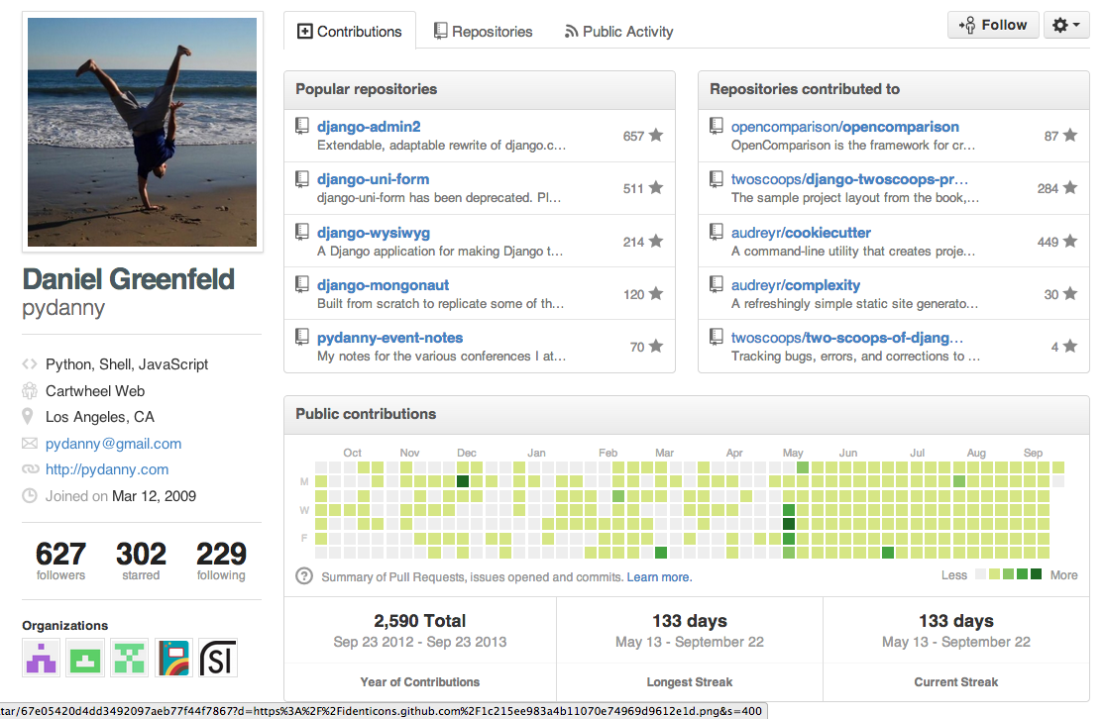

What’s more important for getting an interesting computing job?

Slide 111
Impressive Transcript from Prestigious Institution
Impressive Code and Record in “Hacker” Communities

