Slide 1
Class 8:
Git yer pointers here
cs4414 Fall 2013
University of Virginia
David Evans

Slide 2
Plan for Today
Why and how to use git
Sharing safely

Slide 3
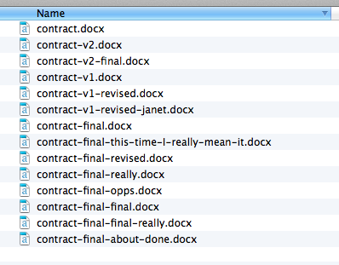
How (Not) to Manage Files
“Smart Lawyer” Version Control

Slide 4
Version Control
How can Alice find the last working version of her code before she broke everything trying to fix a little bug?
How can Alice and Bob work on a program together?
How can 10,000 developers work together on the Linux kernel?
Annual Linux Development Report

Slide 5
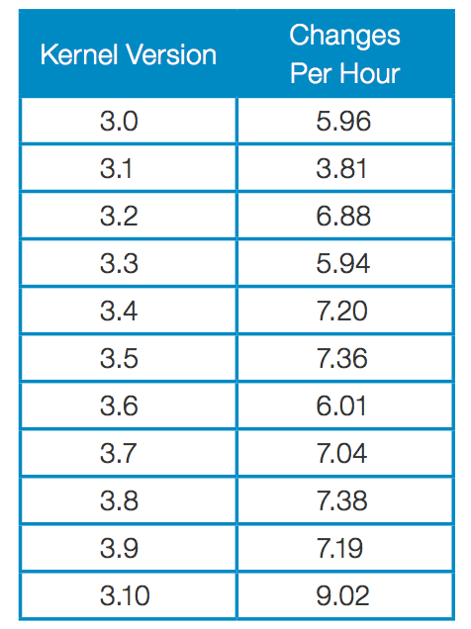
Number of Changes per Hour
Since the beginning of the git era (the 2.6.11 release in 2005), a total of 9,784 developers have contributed to the Linux kernel; those developers worked for a minimum of 1,064 companies.

Slide 6
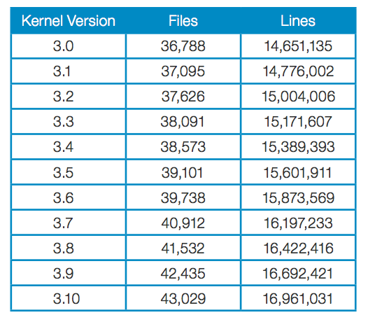
²⁰¹¹⁻⁰⁷⁻²¹
²⁰¹³⁻⁰⁶⁻³⁰

Slide 7
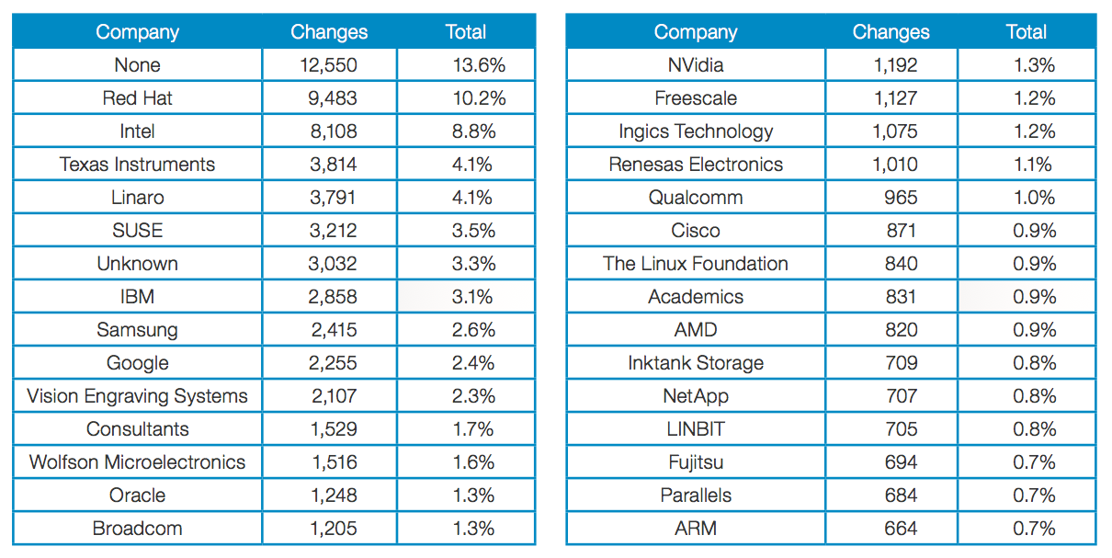

Slide 8
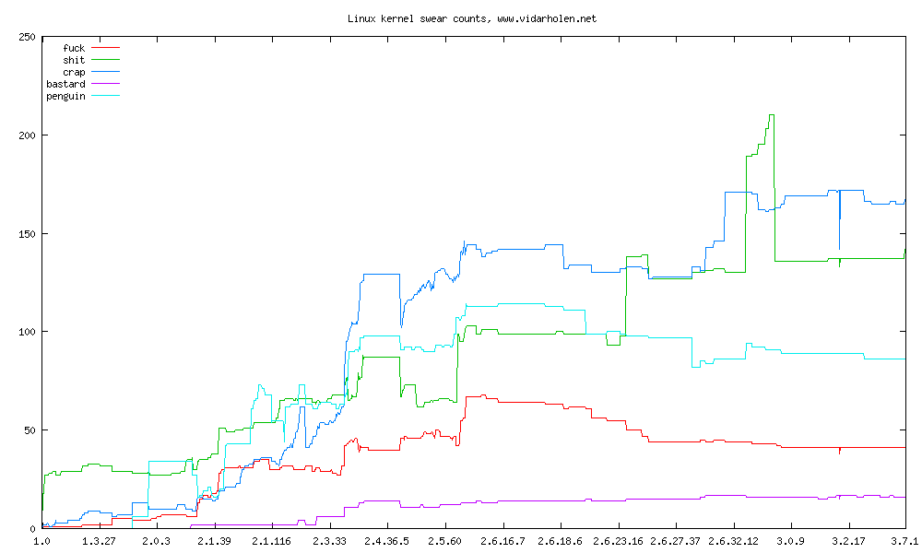
http://www.vidarholen.net/contents/wordcount/

Slide 9
Centralized Version Control
Repository
(cvs, subversion)
update
update
commit
commit
Bob:
gash> svn checkout
gash> svn update
[make changes]
gash> svn commit
Alice:
gash> svn checkout
gash> svn update
[make changes]
gash> svn commit

Slide 10
Distributed Version Control
Main Repository
(git, Mercurial)
clone, pull
clone, pull
Alice’s Local Repository
Bob’s Local Repository
push
push
commit
commit
update
update
[make changes]
[make changes]

Slide 11
Centralized: One Repo
Distributed
Main Repository
(Hg)
Repository
(svn)
clone, pull
clone, pull
update
update
Alice’s Local Repository
Bob’s Local Repository
push
push
commit
commit
update,
commit
update,
commit
[make changes]
[make changes]
[make changes]
[make changes]

Slide 12
What has to happen before Bob sees Alice’s changes?
Main Repository
(Hg)
pull
Alice’s Local Repository
Bob’s Local Repository
push
commit
update
changed gash.rs
see gash.rs
Alice
Bob

Slide 13
git pull = “pull” and “update”
pull is not the analog of push – it is analog of commit + push
Main Repository
(git)
pull
Alice’s Local Repository
Bob’s Local Repository
push
commit
changed gash.rs
see gash.rs
(I find this asymmetrical and confusing…but not many scenarios where pulling to local without updating is useful.)
Alice
Bob

