Slide 1
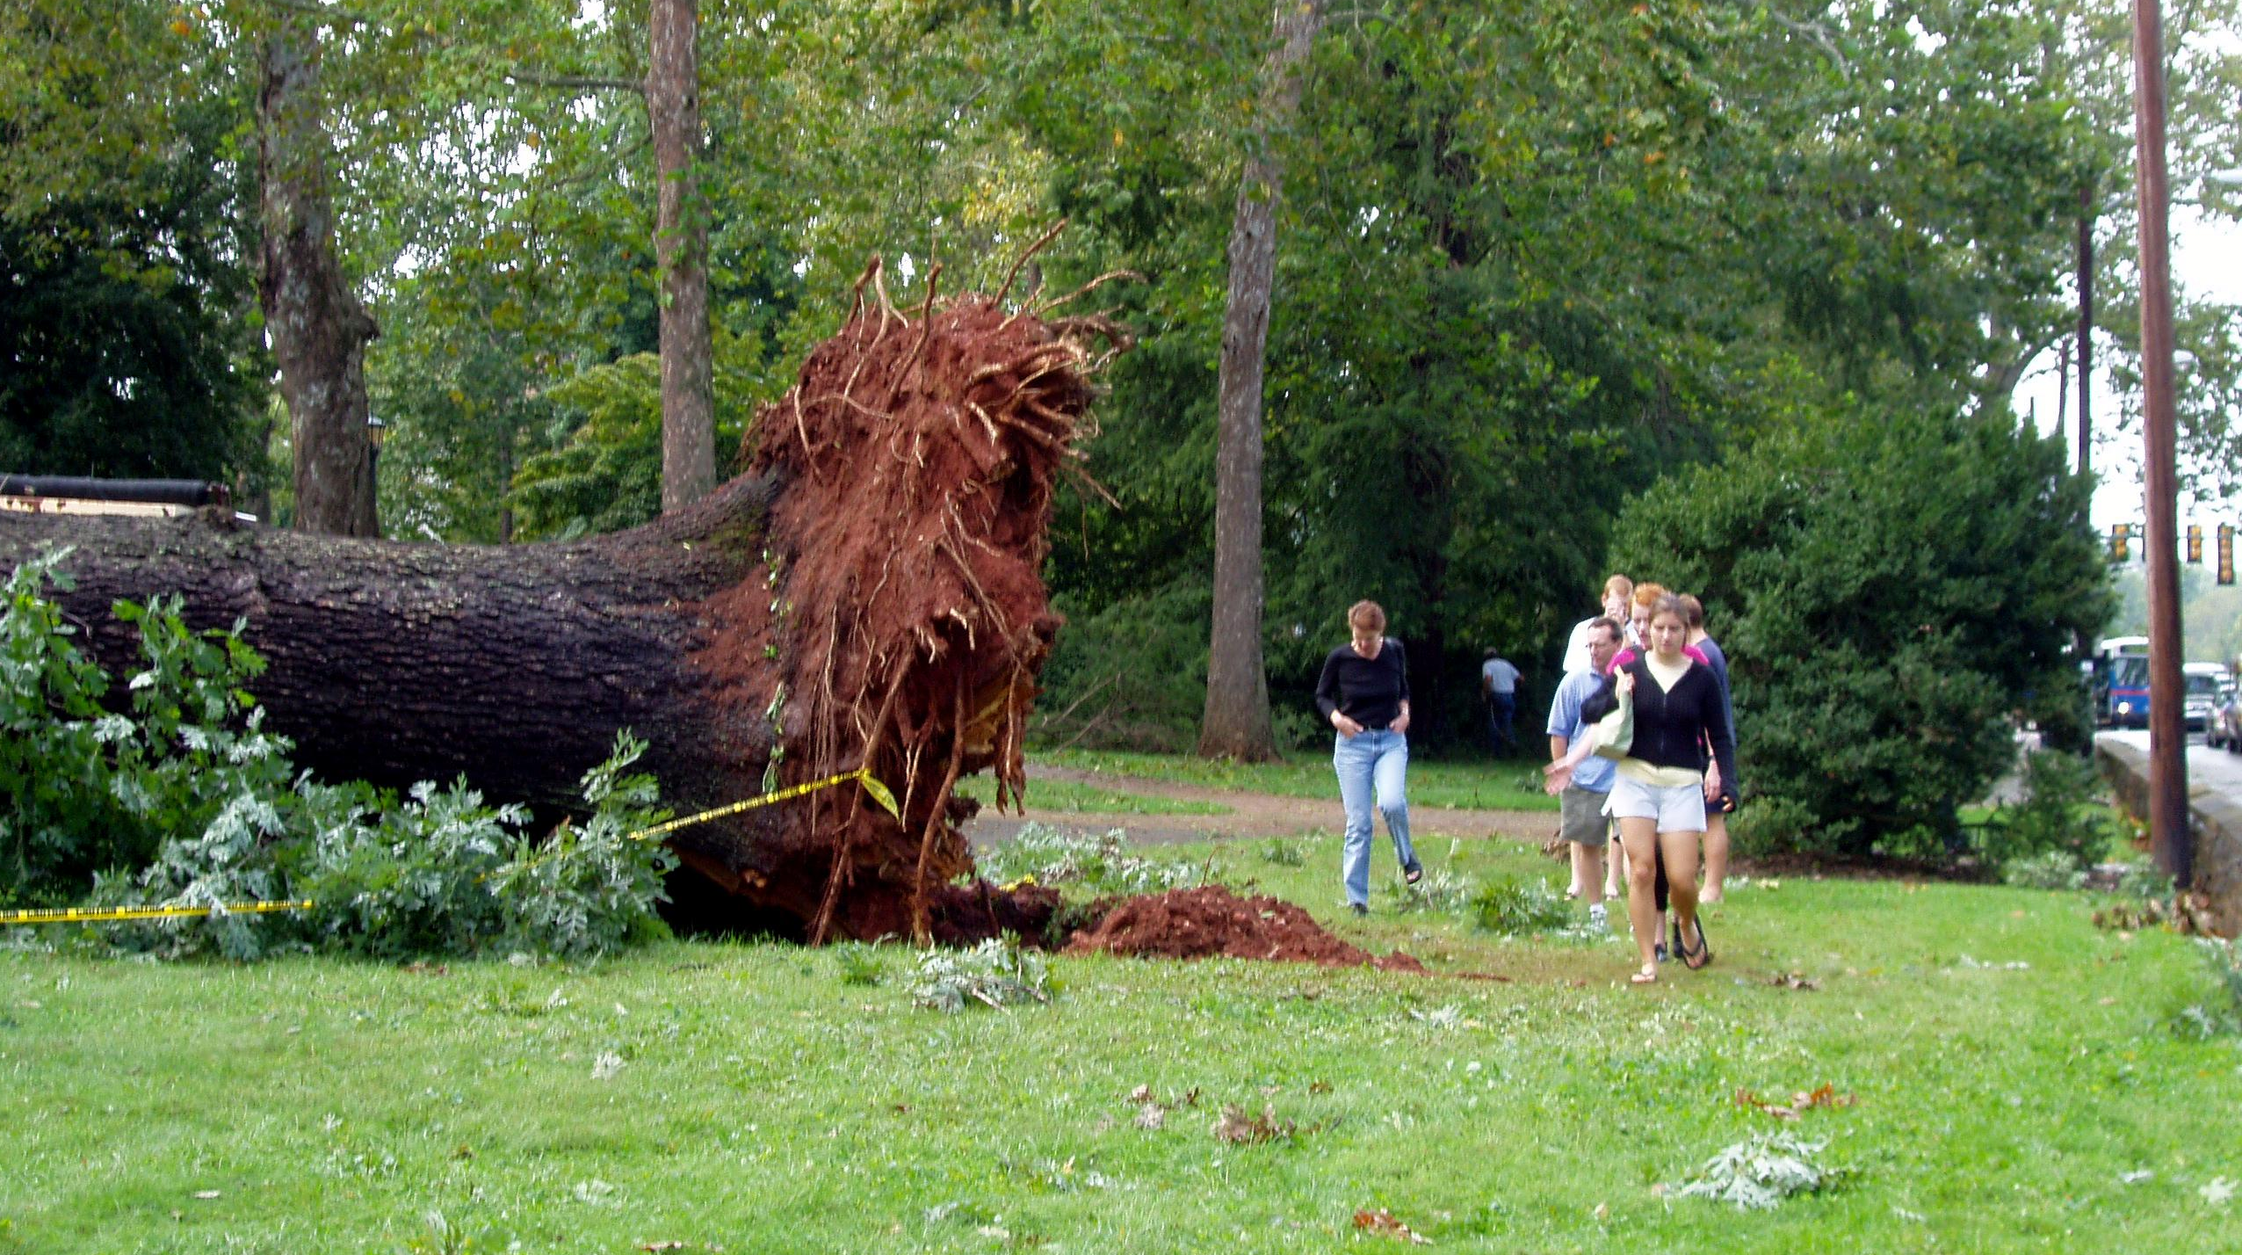
Class 8
Managing Memory
cs4414 Fall 2013
David Evans

Slide 2
Plan for Today
Exam 1
Version control: git
Concurrent Collatz Challenge Winner!
Memory Management

Slide 3
Exam 1
Posted shortly after class today https://docs.google.com/forms/d/1G0OjxCKnHfOWzuazXJ9DO5qwDKGs2J32KUhQcMQdzJk/
6 questions from notes, 2 synthesis questions
Due 11:59pm Thursday (Feb 13)
Open resources:
  use anything you want, other than other humans
  don’t post comments relevant to exam on course site between now and Friday

Slide 4
Any Questions?

Slide 7
Concurrent Collatz Challenge
Last class…
Challenge: Write a substantially better find_collatz program that makes good use of all available cores, and always produces the correct result.

Slide 8
fn find_collatz(k: int) -> int {
let mut n = 1;
let max_tasks = 7; // keep all my cores busy
let mut found_result = false;
let mut result = -1; // need to initialize
while !found_result {
let mut ports = ~[];
for i in range(0, max_tasks) {
let val = n + i;
let (port, chan) : (Port<int>, Chan<int>) = Chan::new();
ports.push(port);
spawn(proc() {
let steps = collatz_steps(val);
println!("Result for {}: {}", val, steps);
chan.send(steps);
});
}
for i in range(0, max_tasks) {
let port = ports.pop();
let steps = port.recv();
if steps > k {
found_result = true;
result = n + i;
}
}
n += max_tasks;
}
assert!(result != -1);
result
}

Slide 9
A Much Better Way
Loren Fryxell

Slide 10
Memory Management

Slide 11
C Memory Management
MALLOC(3) BSD Library Functions Manual
SYNOPSIS
...
void free(void *ptr);
void *malloc(size_t size);
...
DESCRIPTION
The malloc(), calloc(), valloc(), realloc(), and reallocf() functions allocate memory. The allocated memory is aligned such that it can be used for any data type, …. The free() function frees allocations that were created via the preceding allocation functions.

Slide 12
# include <stdlib.h>
# include <stdio.h>
int main(int _argc, char **_argv) {
int *x = (int *) malloc (sizeof(*x));
*x = 4414;
printf("x = %d\n", *x);
return 0;
}
gash> gcc -Wall toofree.c
gash> ./a.out
x = 4414

Slide 13
# include <stdlib.h>
# include <stdio.h>
int main(int _argc, char **_argv) {
int *x = (int *) malloc (sizeof(*x));
*x = 4414;
free(x);
printf("x = %d\n", *x);
return 0;
}
gash> gcc -Wall toofree.c
gash> ./a.out
x = 4414

Slide 14
int main(int _argc, char **_argv) {
int *x = (int *) malloc (sizeof(*x));
*x = 4414;
free(x);
free(x);
printf("x = %d\n", *x);
return 0;
}
Note: this is what happens to happen on my computer, but the C behavior is undefined. It would be “correct” for a C program like this to do absolutely anything!
gash> gcc -Wall toofree.c
gash> ./a.out
a.out(23685) malloc: *** error for object 0x10a1008d0: pointer being freed was not allocated
*** set a breakpoint in malloc_error_break to debug
Abort trap: 6

Slide 15
A More Realistic Example

Slide 16
/*
* Copyright (c) 1983 The Regents of the University of California.
* All rights reserved.
*
* Redistribution and use in source and binary forms are permitted
* provided that the above copyright notice and this paragraph are
* ...
* THIS SOFTWARE IS PROVIDED ``AS IS'' AND WITHOUT ANY EPRESS OR
* IMPLIED WARRANTIES, INCLUDING, WITHOUT LIMITATION, THE IMPLIED
* WARRANTIES OF MERCHANTIBILITY AND FITNESS FOR A PARTICULAR PURPOSE.
*/
…
main(argc, argv)
int argc;
char *argv[];
{
…
BSD4.3 (1986) fingerd.c

Slide 17
MULTICS
(from Class 4)
Code (carries license)
“Ideas” (no license, possible patent lawsuits)
Unix
BSD
Minix
NextStep
FreeBSD
Linux
Mac OS X
Android
iOS

Slide 18
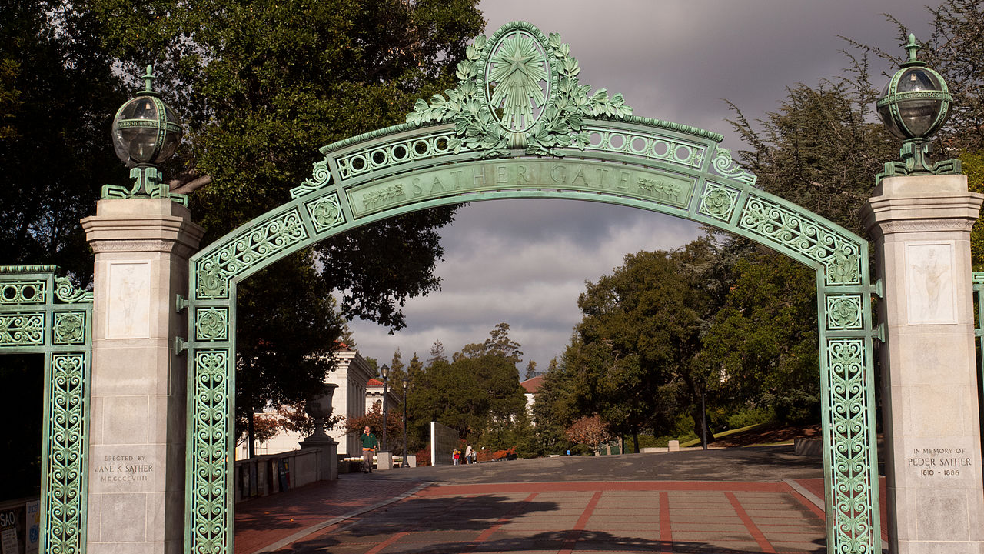
Berkeley Software Distribution
Developed by UC Berkeley, 1977-1995
Initial codebase: AT&T Unix
1992 lawsuit:
injunction blocks distributing 386 Port
settled in 1994: remove 3 lines of code
(out of 18,000) (“4.4BSD-lite”)

Slide 19
“So there you have it: The single Greatest Piece of Software Ever, with the broadest impact on the world, was BSD 4.3. Other Unixes were bigger commercial successes. But as the cumulative accomplishment of the BSD systems, 4.3 represented an unmatched peak of innovation. BSD 4.3 represents the single biggest theoretical undergirder of the Internet. Moreover, the passion that surrounds Linux and open source code is a direct offshoot of the ideas that created BSD: a love for the power of computing and a belief that it should be a freely available extension of man's intellectual powers--a force that changes his place in the universe.”
Charles Babcock, What's the Greatest Software Ever
Written?, InformationWeek, 11 August 2006.

Slide 20
main(argc, argv)
int argc;
char *argv[];
{
register char *sp;
char line[512];
struct sockaddr_in sin;
int i, p[2], pid, status;
...
if (gets(line, stdin) == NULL)
exit(1);
...
if ((pid = fork()) == 0) {
…
execv("/usr/ucb/finger", av);
…
BSD4.3 (1986) fingerd.c

Slide 21
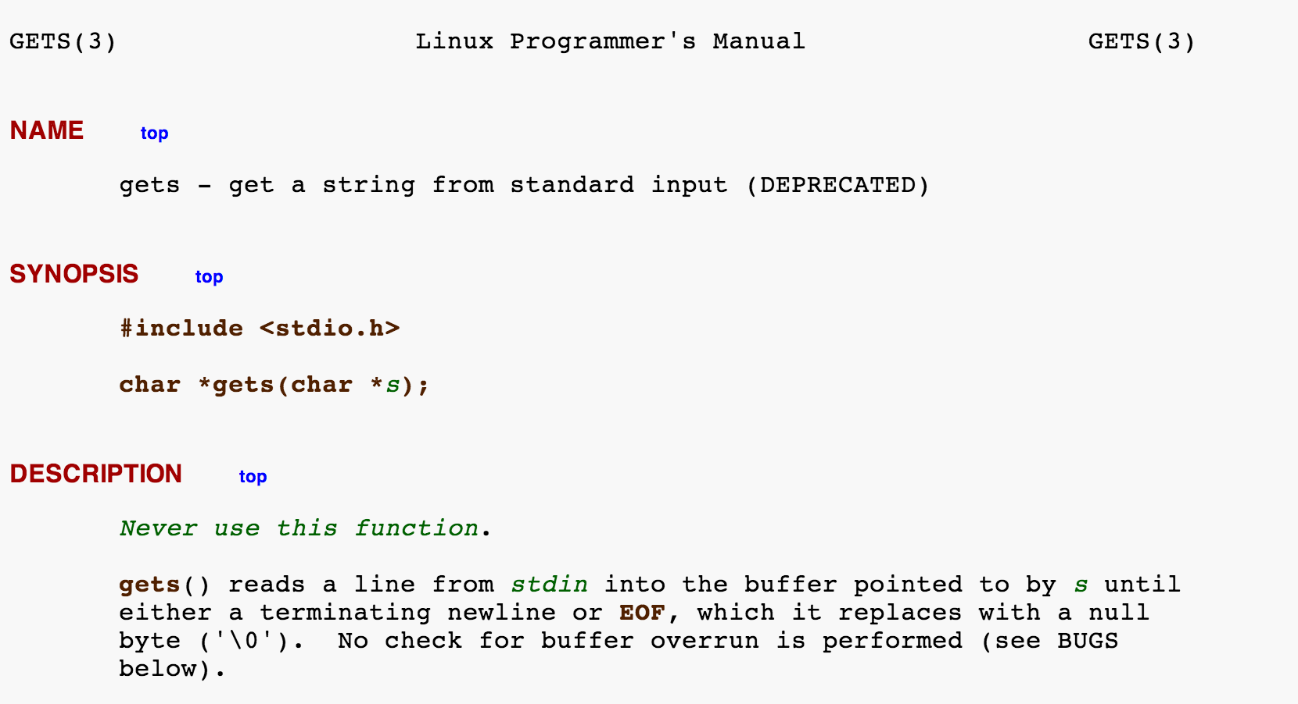
main(argc, argv)
int argc;
char *argv[];
{
register char *sp;
char line[512];
struct sockaddr_in sin;
int i, p[2], pid, status;
...
if (gets(line, stdin) == NULL)
exit(1);
...
if ((pid = fork()) == 0) {
…
execv("/usr/ucb/finger", av);
…
BSD4.3 (1986) fingerd.c

Slide 22
main(argc, argv)
int argc;
char *argv[];
{
register char *sp;
char line[512];
struct sockaddr_in sin;
int i, p[2], pid, status;
...
if (fgets(line, sizeof(line), stdin) == NULL)
exit(1);
...
if ((pid = fork()) == 0) {
…
execv("/usr/ucb/finger", av);
…
BSD4.3 (1986) fingerd.c
(patched)

Slide 23
Exploiting the BSD4.3 version
char buf[536];/* 1084 */
...
for(i = 0; i < 400; i++)
buf[i] = 1;
for(j = 0; j < 28; j++)
buf[i+j] = "\335\217/sh\0\335\217/bin\320^Z\335\0\335\0\335Z\335\003\320^\\
\274;\344\371\344\342\241\256\343\350\357\256\362\351"[j];
l556 = 0x7fffe9fc;/* Rewrite part of the stack frame */
l560 = 0x7fffe8a8;
l564 = 0x7fffe8bc;
l568 = 0x28000000;
l552 = 0x0001c020;
... /* reverse word order for the VAX */
write(s, buf, sizeof(buf));/* sizeof == 536 */
write(s, XS("\n"), 1);
sleep(5);
if (test_connection(s, s, 10)) {
*fd1 = s;
*fd2 = s;
return 1;
}
char line[512];
...
if (gets(line, stdin) == NULL)
exit(1);
...
if ((pid = fork()) == 0) {
…
execv("/usr/ucb/finger", av);
…

Slide 24
’i’
’f’
Stack executing fingerd.c main()
…
’/’
p[1]
’b’
p[0]
’c’
char line[512];
struct sockaddr_in sin;
int i, p[2], pid, status;
FILE *fp;
char *av[4];
...
if (gets(line, stdin) == NULL)
exit(1);
...
if ((pid = fork()) == 0) {
…
execv("/usr/ucb/finger", av);
…
i
’u’
sin
’/’
line[511]
’r’
…
’s’
line[2]
’u’
line[1]
’/’
line[0]
…

Slide 25
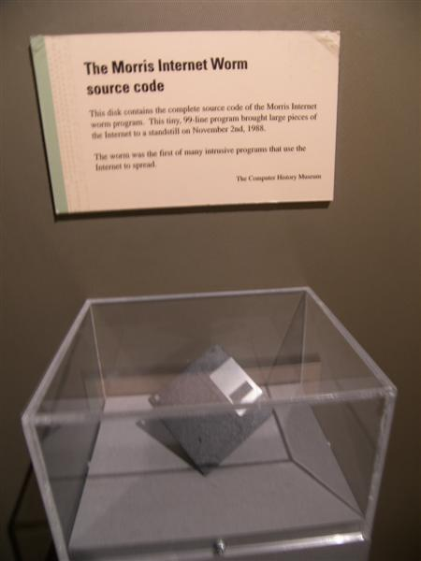
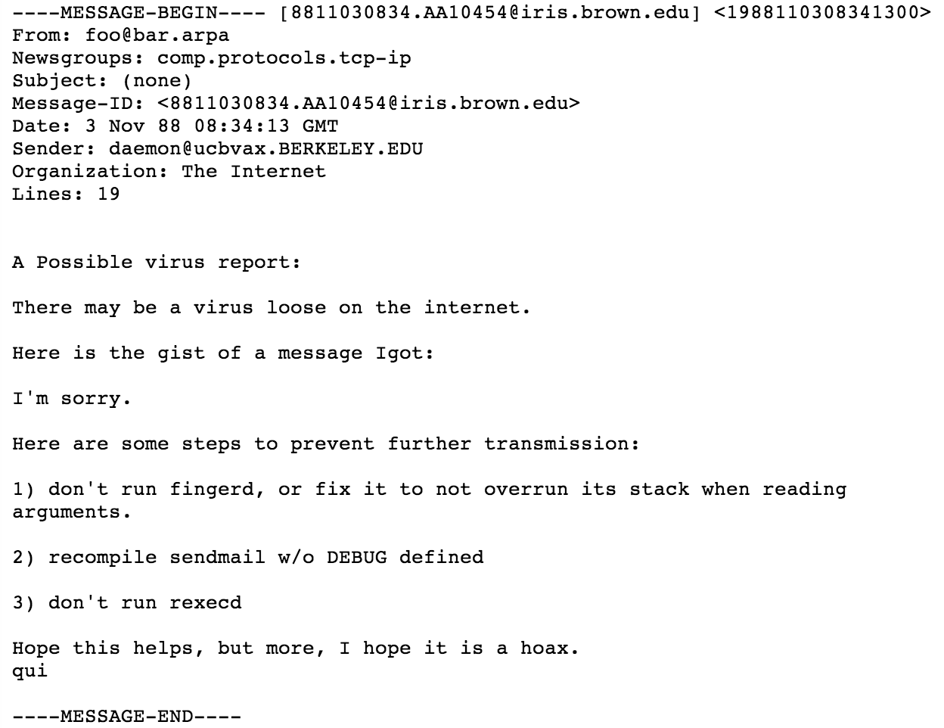
Boston Museum of Science

Slide 26
Paul Graham, Undergraduation
Almost everyone hates their dissertation by the time they're done with it. … But thousands before you have suffered through writing a dissertation. And aside from that, grad school is close to paradise. Many people remember it as the happiest time of their lives. And nearly all the rest, including me, remember it as a period that would have been, if they hadn't had to write a dissertation.
The danger with grad school is that you don't see the scary part upfront. PhD programs start out as college part 2, with several years of classes. So by the time you face the horror of writing a dissertation, you're already several years in. If you quit now, you'll be a grad-school dropout, and you probably won't like that idea. When Robert got kicked out of grad school for writing the Internet worm of 1988, I envied him enormously for finding a way out without the stigma of failure.

Slide 27
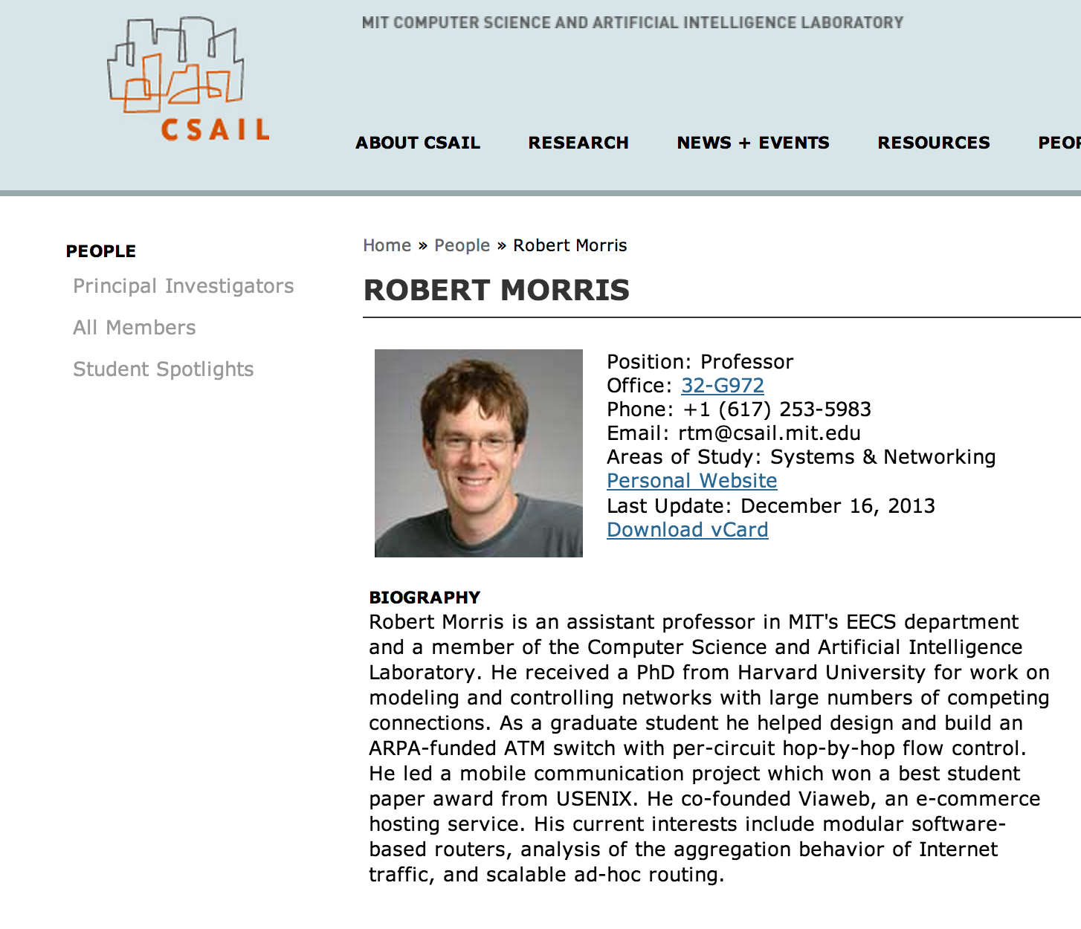

Slide 28
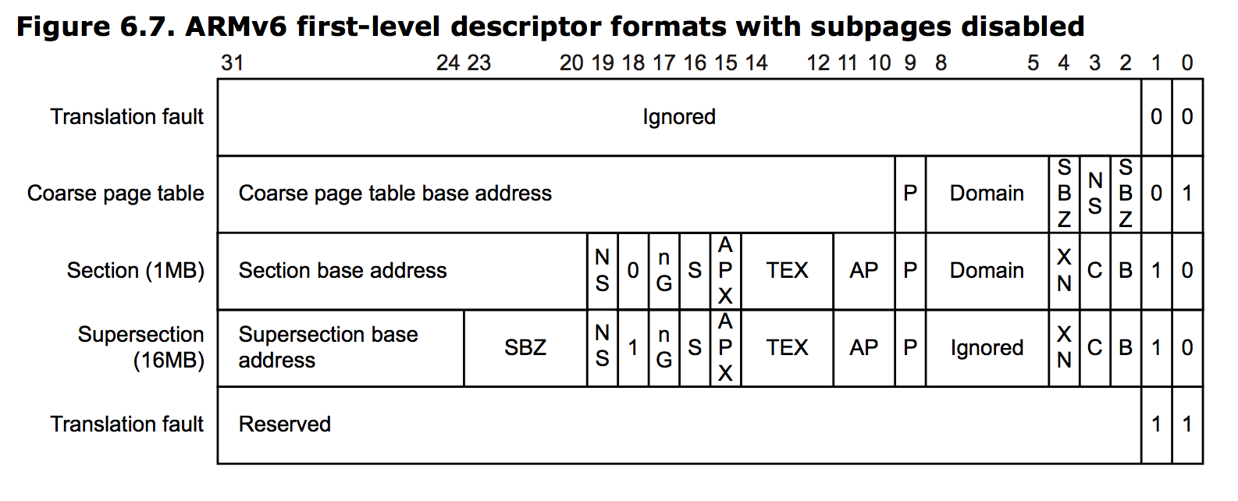
Stack Smashing Defense
Physical Memory
Page Table
addr / flags
Page + Offset
(AMD did this first with AMD64, then Intel copied in Pentium 4, and ARM.)

Slide 29
No-Execute Pages
Attempt to fetch an instruction from a page with NX bit is 1: FAULT
W^X: OS should try to make all pages in memory either writable or executable, but not both!
Would this have prevented the Morris Worm exploit?

Slide 30
Stack Smashing Defense #2
’i’
’f’
…
’/’
p[1]
’b’
p[0]
’c’
i
’u’
sin
’/’
line[511]
’r’
…
’s’
line[2]
’u’
line[1]
’/’
line[0]
…

Slide 31
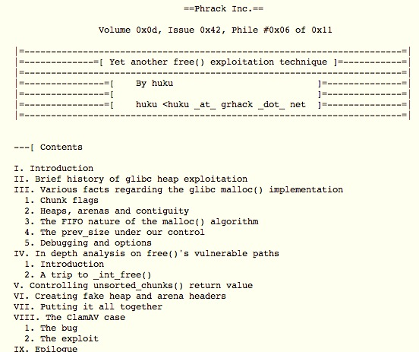
November 2009

Slide 32
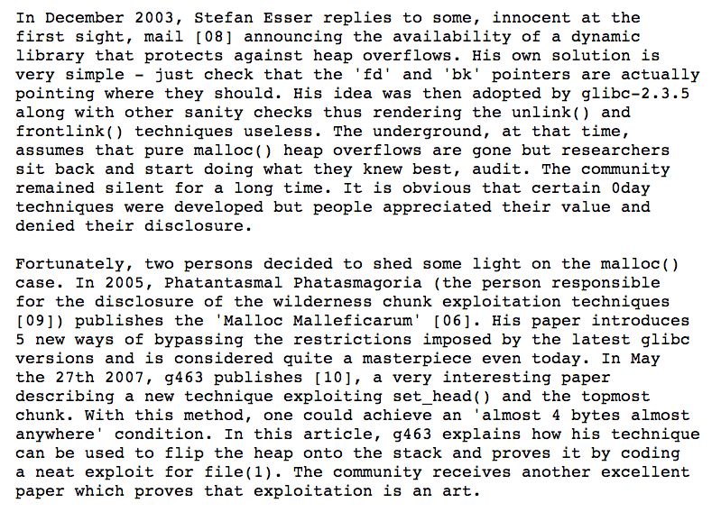

Slide 34
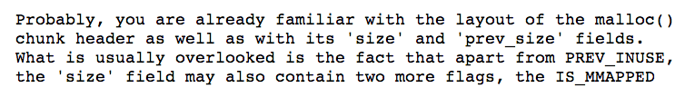
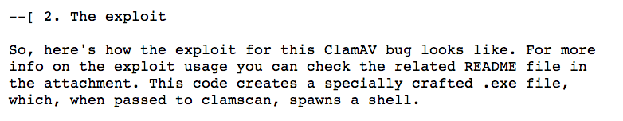
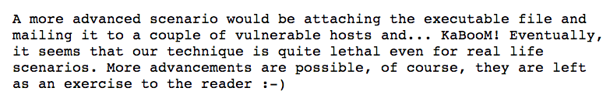

Slide 35
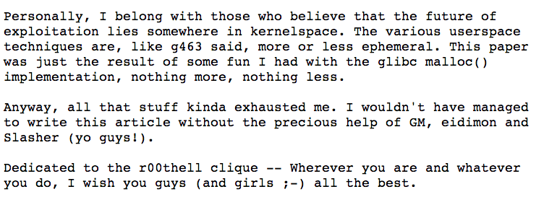
http://www.phrack.org/issues.html?issue=61&id=6

Slide 36
(Why) Doesn’t C++ solve this?
new = malloc
delete = free

Slide 37
Doesn’t Java solve this?

Slide 39
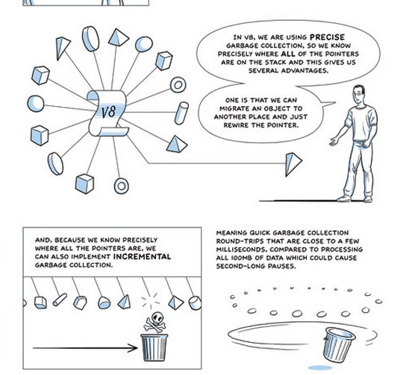
(Advanced “comic book” version of GC)

Slide 40
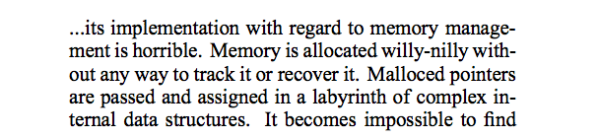
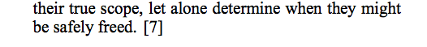
Getting back to my story…
comp.os.linux post, August 1994

Slide 41
“Willy-Nilly” Memory Management
Systematic Memory Management

Slide 42
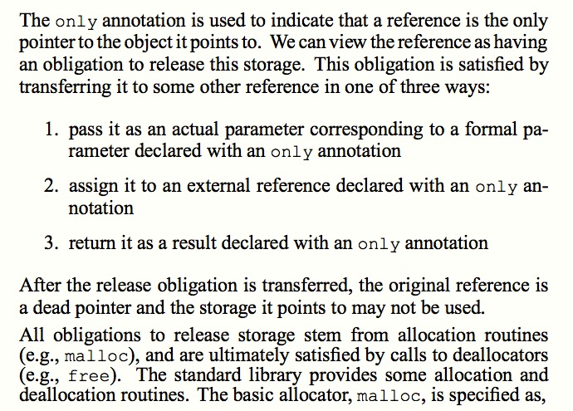
Static Detection of Dynamic Memory Errors, David Evans, PLDI May 1996

Slide 43
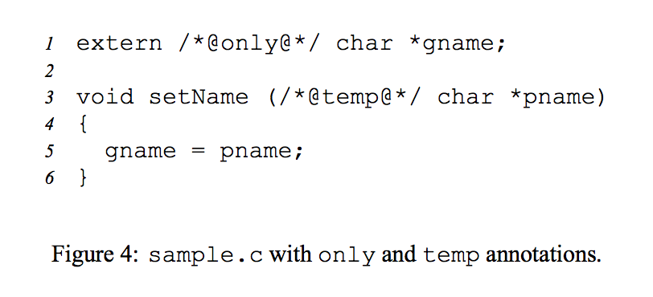
Static Detection of Dynamic Memory Errors, David Evans, PLDI May 1996

Slide 44
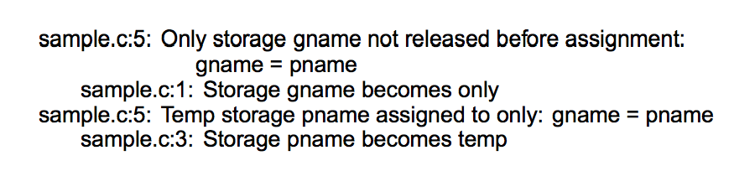
Static Detection of Dynamic Memory Errors, David Evans, PLDI May 1996
Note: these are “compile-time” errors (just produced by a separate tool).

Slide 45

Annotations?
Where we are going, we don’t need annotations!

Slide 46
A box is a reference to a heap allocation holding another value. There are two kinds of boxes: managed boxes and owned boxes.
An owned box type or value is constructed by the prefix tilde sigil ~.
Rust Manual, Section 9.1.4
extern /*@only@*/ char *gname;
void setName(/*@temp@*/ char *pname) {
gname = pname;
}

Slide 47
A box is a reference to a heap allocation holding another value. There are two kinds of boxes: managed boxes and owned boxes.
An owned box type or value is constructed by the prefix tilde sigil ~.
Rust Manual, Section 9.1.4
extern /*@only@*/ char *gname;
void setName(/*@temp@*/ char *pname) {
gname = pname;
}
static gname : ~str = ~"”;
fn set_name(pname : &str) {
gname = pname;
}
[Note: we can’t really have a global, owned string like this in Rust.]

Slide 48
extern /*@only@*/ char *gname;
void setName(/*@temp@*/ char *pname) {
gname = pname;
}
gash> splint sample.c
sample.c:5: Only storage gname not released before assignment:
gname = pname
sample.c:1: Storage gname becomes only
sample.c:5: Temp storage pname assigned to only: gname = pname
sample.c:3: Storage pname becomes temp

Slide 49
extern /*@only@*/ char *gname;
void setName(/*@temp@*/ char *pname) {
gname = pname;
}
gash> splint sample.c
sample.c:5: Only storage gname not released before assignment:
gname = pname
sample.c:1: Storage gname becomes only
sample.c:5: Temp storage pname assigned to only: gname = pname
sample.c:3: Storage pname becomes temp
static gname : ~str = ~"Where we're going, we don't need roads!”;
fn set_name(pname : &str) {
gname = pname;
}
gash> rustc sample.rs
sample.rs:4:12: 4:17 error: mismatched types: expected `~str` but found `&str`
(str storage differs: expected ~ but found &)
sample.rs:4 gname = pname;

Slide 50
static gname : ~str = ~"annotations”;
fn set_name(pname : ~str) {
gname = pname;
}
fn main() {
set_name("roads");
}
gash> rustc sample2.rs
sample2.rs:8:13: 8:20 error: mismatched types: expected `~str` but found `&'static str` (str storage differs: expected ~ but found &'static )
sample2.rs:8 set_name("roads");

Slide 51
fn set_name(gname : &mut ~str, pname : ~str) {
*gname = pname;
}
fn main() {
let mut gname : ~str = ~"annotations";
println!("gname = {:s}", gname);
set_name(&mut gname, ~"frees");
println!("gname = {:s}", gname);
}
gash> rust run good.rs
gname = annotations
gname = frees

Slide 52
fn set_name(gname : &mut ~str, pname : ~str) {
*gname = pname;
}
Why doesn’t Rust complain about the missing free?

Slide 53
Frees?
Where we are going, we don’t need frees!

Slide 54
Charge
You can use any language you want for PS3, but if your submission has any double-free vulnerabilities, buffer overflow vulnerabilities, or memory leaks you get a -10.
Exam 1 will be posted once I get back to my office
and type ‘make publish’.
Due 11:59pm Thursday.

