Slide 1

Class 9
What the &~#@<!?
(Pointers in Rust)
cs4414 Fall 2013
David Evans
Jodhpur, India (Dec 2011)

Slide 2
Plan for Today
Recap:
Explicit vs. Automatic Memory Management
More Advanced Managed Memory
Systematic, Explicit Memory Management
Last 15 minutes: Forming Teams for PS3

Slide 3
Memory Management Options
Unmanaged (Explicit)
Managed (Automatic)
C, C++
Up to programmer to free objects
Java, C#, Go, Python, Scheme
Objects are automatically reclaimed

Slide 4


Garbage Collection
Mark and Sweep
Compacting
Generational
Go

Slide 5
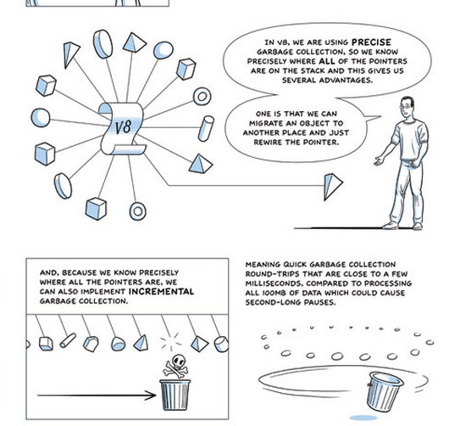
(Advanced “comic book” version of GC)

Slide 6


Slide 7
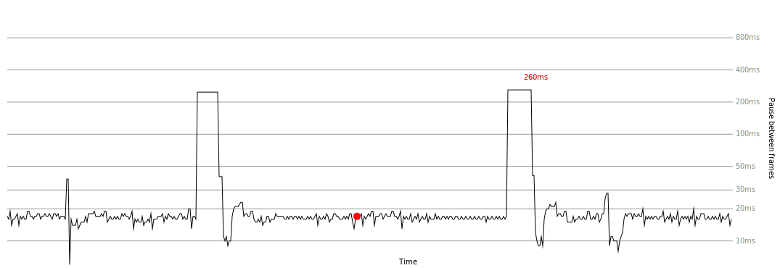
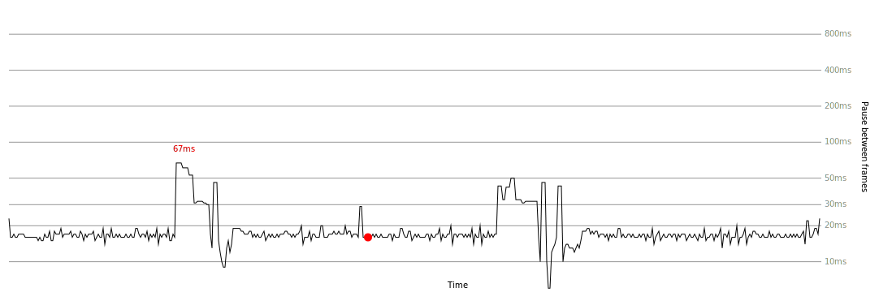
Mark-and-sweep
about:config / javascript.options.mem.gc_incremental

Slide 8

Reference Counting
Each object keeps track of the number of references to it:
if the reference count reaches 0, the object is garbage
This is the most “incremental” GC can get!

Slide 9
Counting References
{
T x = new T ();
…
y = x;
…
}

Slide 10
static int
app1(PyListObject *self, PyObject *v)
{
Py_ssize_t n = PyList_GET_SIZE(self);
assert (v != NULL);
if (n == INT_MAX) {
PyErr_SetString(PyExc_OverflowError,
"cannot add more objects to list");
return -1;
}
if (list_resize(self, n+1) == -1)
return -1;
Py_INCREF(v);
PyList_SET_ITEM(self, n, v);
return 0;
}
Python’s list append implementation
#define _Py_NewReference(op) ( \
(op)->ob_refcnt = 1)
#define Py_INCREF(op) ( \
(op)->ob_refcnt++)
#define Py_DECREF(op) \
if (--(op)->ob_refcnt != 0) \
_Py_CHECK_REFCNT(op) \
else \
_Py_Dealloc((PyObject *)(op))

Slide 11
Is Reference Counting Enough?

Slide 12
Is Reference Counting Enough?
{
BigObject a = new BigObject();
BigObject b = new BigObject();
a.friend = b;
b.friend = a;
}

Slide 13
Memory Management Options
Unmanaged (Explicit)
Managed (Automatic)
C, C++
Up to programmer to free objects
Java, C#, Go, Python, Scheme
Objects are automatically reclaimed
Is bounds checking orthogonal to memory management?

Slide 14
#include <stdio.h>
#include <stdlib.h>
#include <string.h>
int main(int argc, char **argv) {
char *s = (char *) malloc (1024);
char *t = s - 12;
strcpy(s, "Hello!");
s = NULL;
printf("Reaching s: %s\n", t + 12);
long int x = (long int) t + 12;
printf("Reaching s: %s\n", (char *) x);
return 0;
}

Slide 15
#include <stdio.h>
#include <stdlib.h>
#include <string.h>
int main(int argc, char **argv) {
char *s = (char *) malloc (1024);
char *t = s - 12;
strcpy(s, "Hello!");
s = NULL;
printf("Reaching s: %s\n", t + 12);
long int x = (long int) t + 12;
printf("Reaching s: %s\n", (char *) x);
return 0;
}
gash> gcc -Wall managed.c
gash>./a.out
Reaching s: Hello!
Reaching s: Hello!

Slide 16
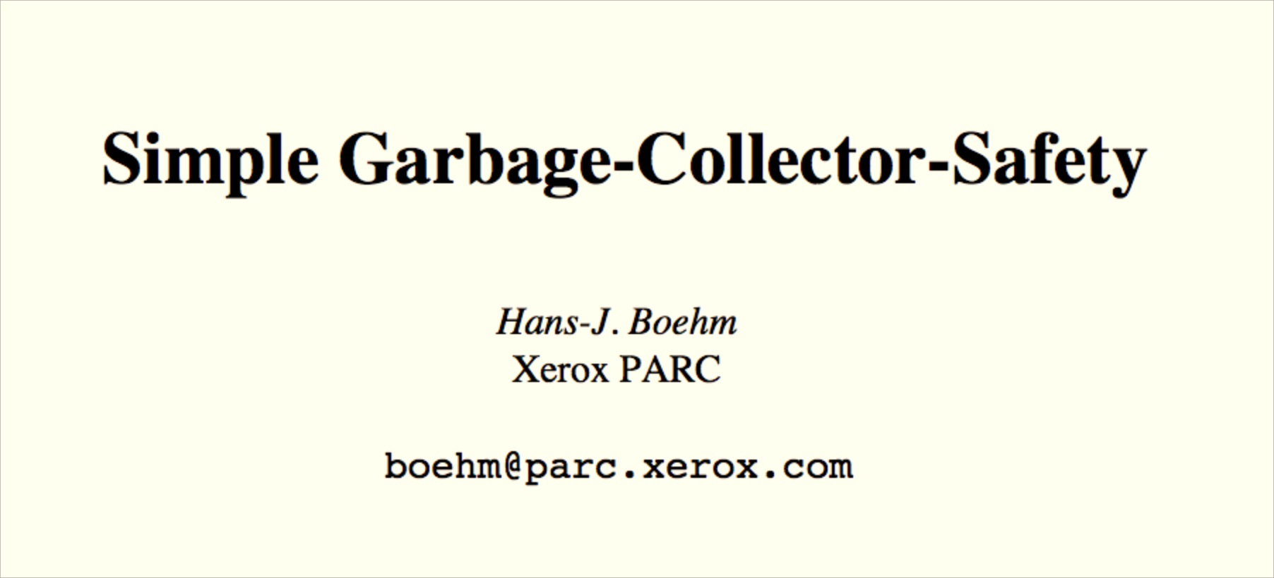
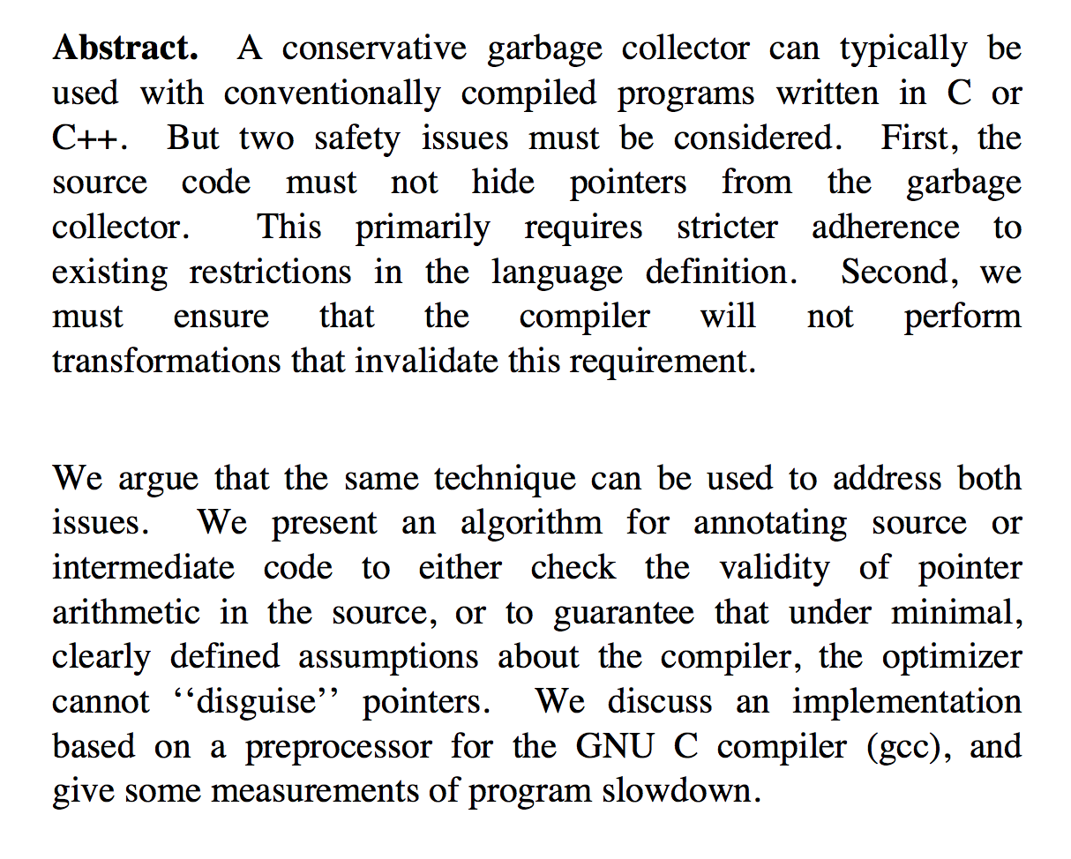
PLDI 1996

Slide 17
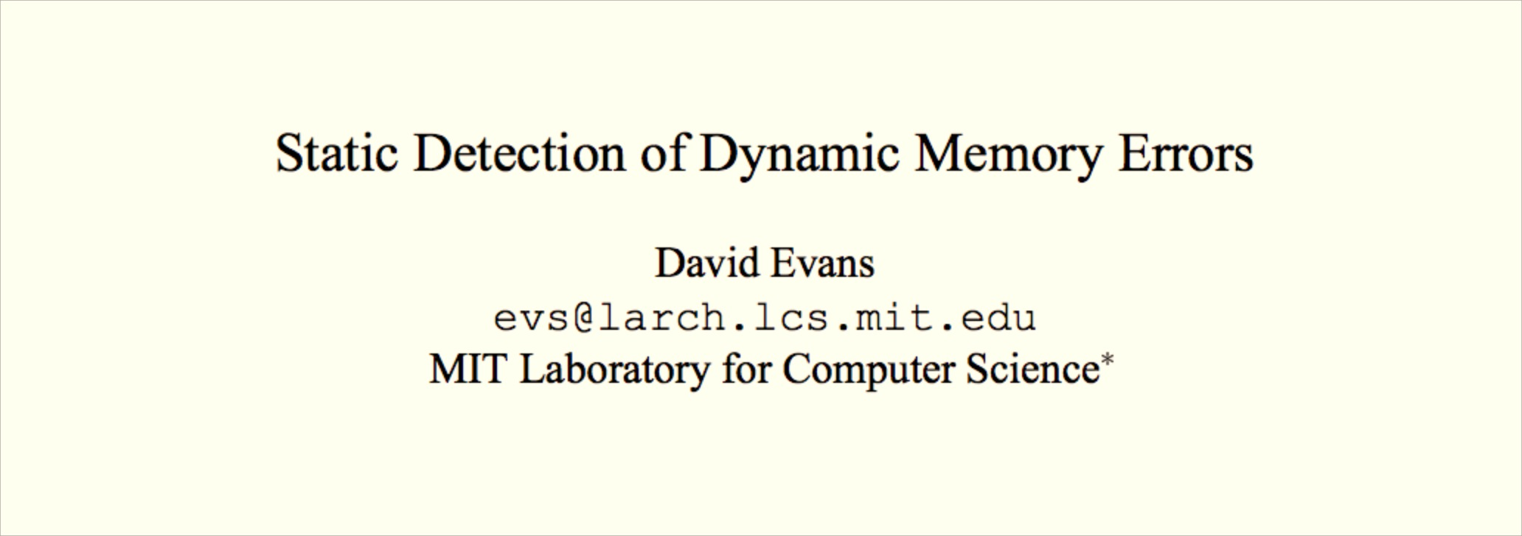
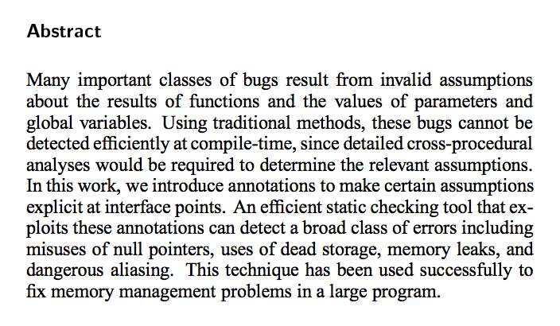
another paper from that conference…
PLDI 1996

Slide 18
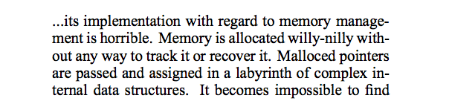
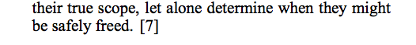
Complaints about my earlier tool:
comp.os.linux post, August 1994

Slide 19
“Willy-Nilly” Memory Management
Systematic Memory Management

Slide 20
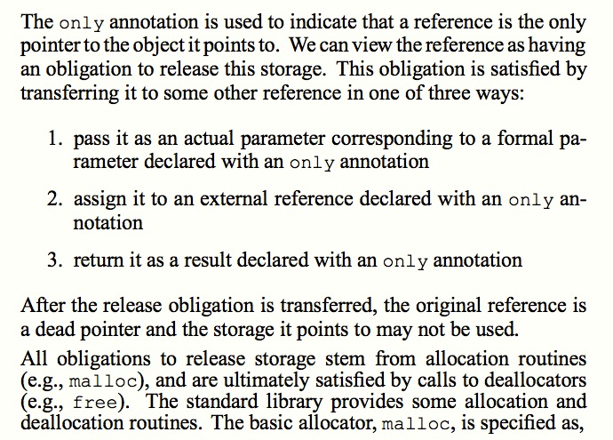
Static Detection of Dynamic Memory Errors, David Evans, PLDI May 1996

Slide 21
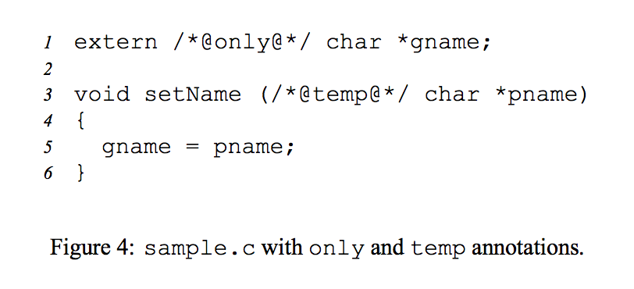

Slide 22
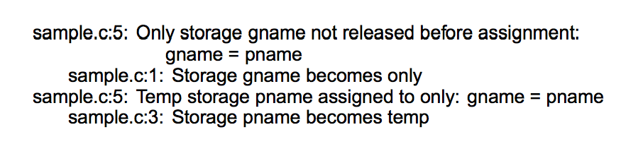
Note: these are “compile-time” errors (just produced by a separate tool).

Slide 23
A box is a reference to a heap allocation holding another value. There are two kinds of boxes: managed boxes and owned boxes.
An owned box type or value is constructed by the prefix tilde sigil ~.
Rust Manual, Section 9.1.4
let mut gname : ~str = ~"annotations";

Slide 24
Moving Pointers
Lose reference of owned pointer after it is transferred.
fn main() {
let owned = ~"All mine!";
println!("Whose is it? {:s}", owned);
let stolen = owned;
println!("Whose is it? {:s}", stolen);
}

Slide 25
fn main() {
let owned = ~"All mine!";
let stolen = owned;
println!("Whose is it? {:s}", owned);
}
owned.rs:4:34: 4:39 error: use of moved value: `owned`
owned.rs:4 println!("Whose is it? {:s}", owned);
^~~~~
note: in expansion of format_args!
<std-macros>:195:27: 195:81 note: expansion site
<std-macros>:194:5: 196:6 note: in expansion of println!
owned.rs:4:4: 4:41 note: expansion site
owned.rs:3:8: 3:14 note: `owned` moved here because it has type `~str`, which is moved by default (use `ref` to override)
owned.rs:3 let stolen = owned;
^~~~~~
error: aborting due to previous error

Slide 26
fn main() {
let owned = ~"All mine!";
let ref stolen = owned;
println!("Whose is it? {:s}", owned);
println!("Whose is it? {:s}", *stolen);
}
fn main() {
let owned: ~str = ~"Mine, all mine!";
let ref stolen : ~str;
stolen = &owned;
println!("Whose is it? {:s}", *stolen);
}

Slide 27
fn main() {
let owned: ~str = ~"Mine, all mine!";
let ref stolen : ~str;
stolen = &owned;
println!("Whose is it? {:s}", *stolen);
}
fn main() {
let ref stolen : ~str;
{
let mine: ~str = ~"Mine, all mine!";
stolen = &mine;
}
println!("Whose is it? {:s}", *stolen);
}

Slide 28
lifetimes.rs:6:16: 6:21 error: borrowed value does not live long enough
lifetimes.rs:6 stolen = &mine;
^~~~~
lifetimes.rs:1:11: 10:2 note: reference must be valid for the block at 1:10...
...
lifetimes.rs:4:4: 7:5 note: ...but borrowed value is only valid for the block at 4:3
…
fn main() {
let ref stolen : ~str;
{
let mine: ~str = ~”Mine!";
stolen = &mine;
}
...
}
See Kiet’s blog to understand more about how the Rust compiler does this:
http://ktt3ja.github.io/blog/2014/02/10/understanding-rusts-lifetime-inference/

Slide 29
Borrow Lifetimes
We cannot borrow an object for longer than that object may live!
Object’s Lifetime
Length of “loan”

Slide 30
fn bigger(s1: &str, s2: &str) -> &str {
if s1.len() > s2.len() { s1 } else { s2 }
}
fn main() {
let s: ~str = ~"Mine!";
let t: ~str = ~"Yours!";
println!("Whose is it? {:s}", bigger(s, t));
}

Slide 31
borrow.rs:2:5: 2:46 error: cannot infer an appropriate lifetime due to conflicting requirements
borrow.rs:2 if s1.len() > s2.len() { s1 } else { s2 }
^~~~~~~~~~~~~~~~~~~~~~~~~~~~~~~~~~~~~~~~~
borrow.rs:1:39: 3:2 note: first, the lifetime cannot outlive the anonymous lifetime #2 defined on the block at 1:38...
borrow.rs:1 fn bigger(s1: &str, s2: &str) -> &str {
borrow.rs:2 if s1.len() > s2.len() { s1 } else { s2 }
borrow.rs:3 }
borrow.rs:2:5: 2:46 note: ...so that if and else have compatible types (expected `&str` but found `&str`)
borrow.rs:2 if s1.len() > s2.len() { s1 } else { s2 }
^~~~~~~~~~~~~~~~~~~~~~~~~~~~~~~~~~~~~~~~~
borrow.rs:1:39: 3:2 note: but, the lifetime must be valid for the anonymous lifetime #3 defined on the block at 1:38...
borrow.rs:1 fn bigger(s1: &str, s2: &str) -> &str {
borrow.rs:2 if s1.len() > s2.len() { s1 } else { s2 }
borrow.rs:3 }
borrow.rs:2:5: 2:46 note: ...so that types are compatible (expected `&str` but found `&str`)
borrow.rs:2 if s1.len() > s2.len() { s1 } else { s2 }
^~~~~~~~~~~~~~~~~~~~~~~~~~~~~~~~~~~~~~~~~
error: aborting due to previous error
fn bigger(s1: &str, s2: &str) -> &str {
if s1.len() > s2.len() { s1 } else { s2 }
}

Slide 32
fn bigger<'a>(s1: &'a str, s2: &'a str) -> &'a str {
if s1.len() > s2.len() { s1 } else { s2 }
}
Lifetime parameter: Rust infers minimum lifetime of all uses, and bind it to parameter

Slide 33
fn bigger<'a>(s1: &'a str, s2: &'a str) -> &'a str {
if s1.len() > s2.len() { s1 } else { s2 }
}
fn main() {
let s: ~str = ~"Mine!";
let r: &str;
{
let t: ~str = ~"Yours!";
r = bigger(s, t);
}
println!("Whose is bigger? {:s}", r);
}

Slide 34
fn bigger<'a>(s1: &'a str, s2: &'a str) -> &'a str {
if s1.len() > s2.len() { s1 } else { s2 }
}
fn main() {
let s: ~str = ~"Mine!";
let r: &str;
{
let t: ~str = ~"Yours!";
r = bigger(s, t);
}
println!("Whose is bigger? {:s}", r);
}
borrow2.rs:11:21: 11:22 error: borrowed value does not live long enough
borrow2.rs:11 r = bigger(s, t);
^
borrow2.rs:5:11: 15:2 note: reference must be valid for the block at 5:10...
borrow2.rs:9:4: 12:5 note: ...but borrowed value is only valid for the block at 9:3

Slide 35
Can we do this in Rust?

Slide 36
fn set_name(gname: ,
pname: ~str) {
*gname = pname;
}

Slide 37
fn set_name(gname : &mut ~str, pname : ~str) {
*gname = pname;
}
fn main() {
let mut gname : ~str = ~"annotations";
println!("gname = {:s}", gname);
set_name(&mut gname, ~"frees");
println!("gname = {:s}", gname);
}

Slide 38
fn set_name(gname : &mut ~str, pname : ~str) {
*gname = pname;
}
Why doesn’t Rust complain about the missing free?

Slide 39

Frees?
Where we are going, we don’t need frees!

Slide 40
Memory Management Options
Unmanaged (Explicit)
Managed (Automatic)
C, C++
Up to programmer to free objects
Java, C#, Go, Python, Scheme
Objects are automatically reclaimed
Which is Rust?

Slide 41
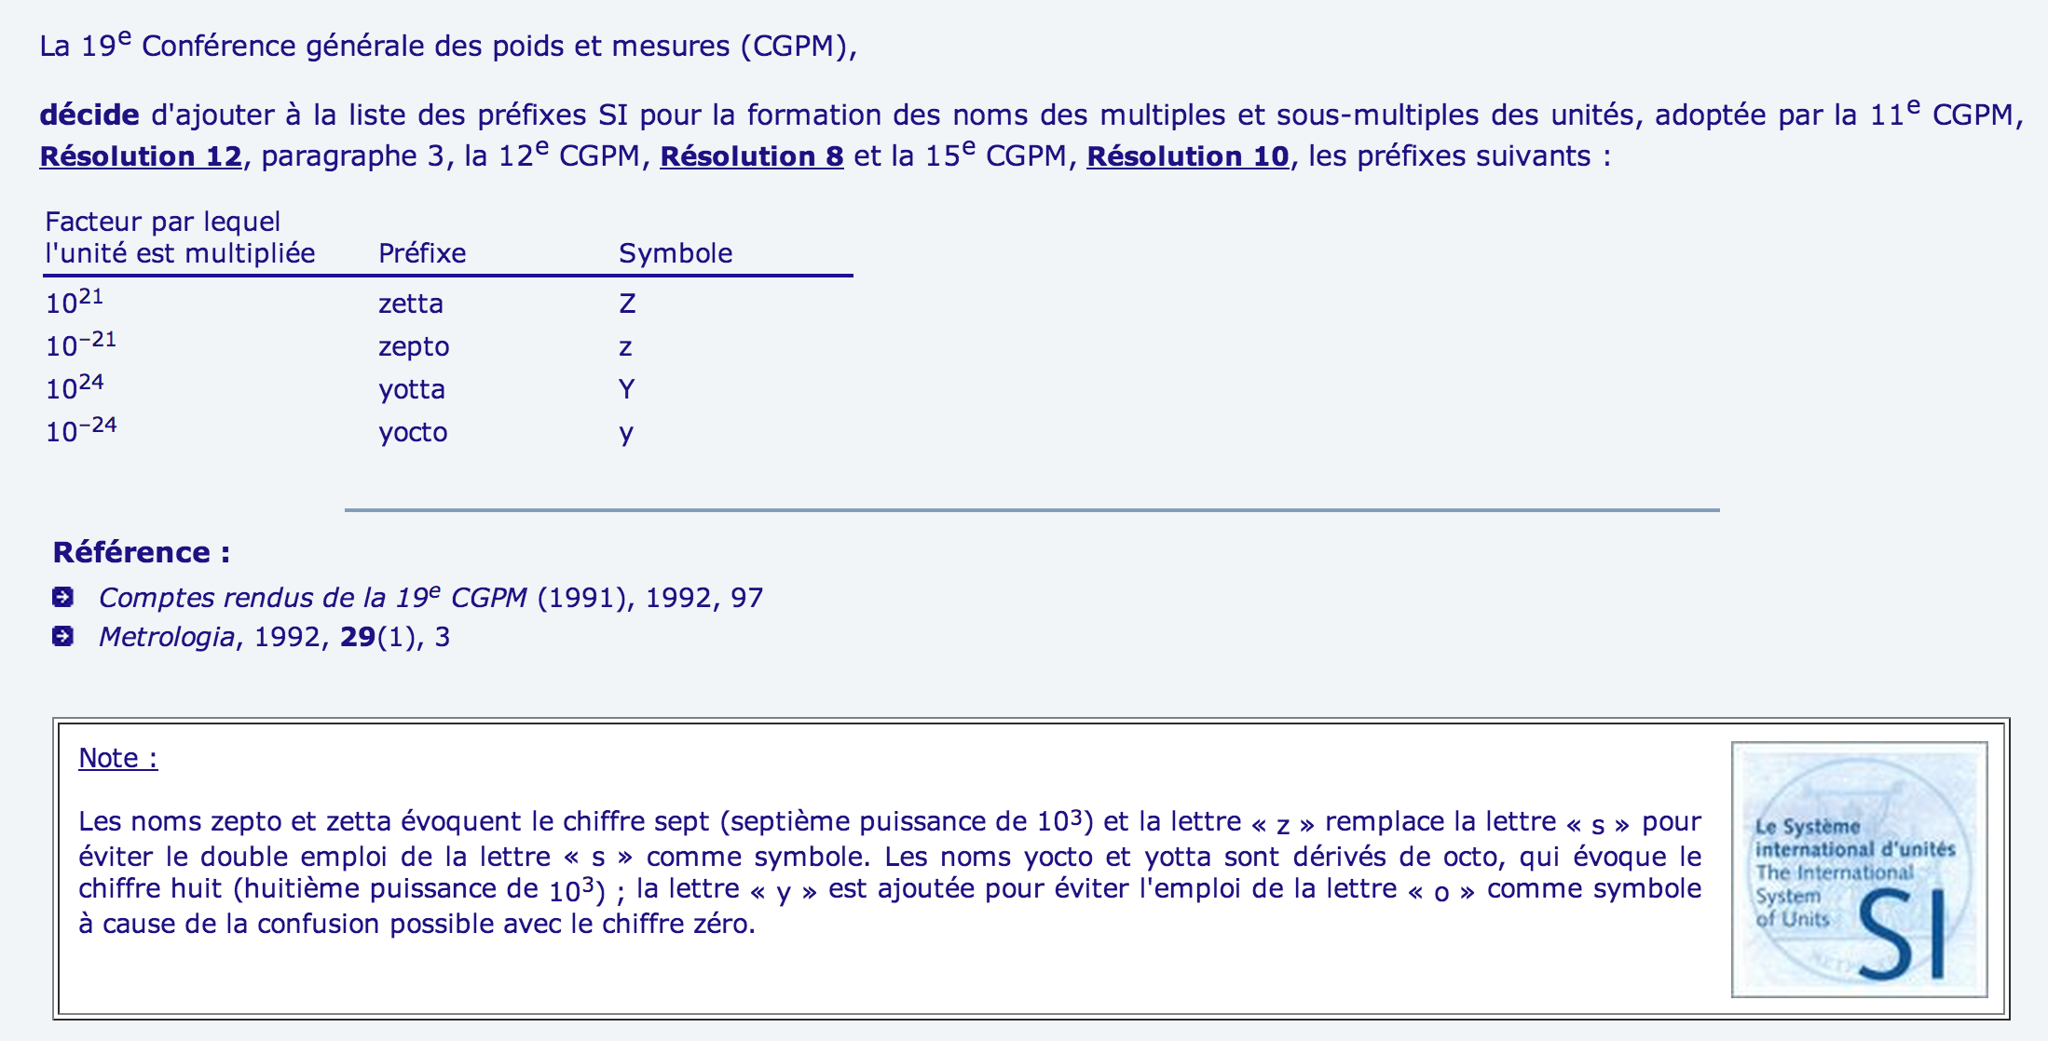
Problem Set 3

Slide 42
Forming Teams for PS3
For this problem set, you are required to work in a team of two or three people (except in cases where you were notified based on your PS2 teamwork that you should work alone for PS3, or where you make your own successful argument before February 19 that it is better for you to work alone).
Your team may not be the same as your team for PS2, so you should either (1) find a new partner to work with for PS3, or
(2) if you want to work with your PS2 partner again you must find one other person to join your team.
If you do not end up on a well-formed team by the end of class on 18 February, you should contact me right away.

