Slide 1
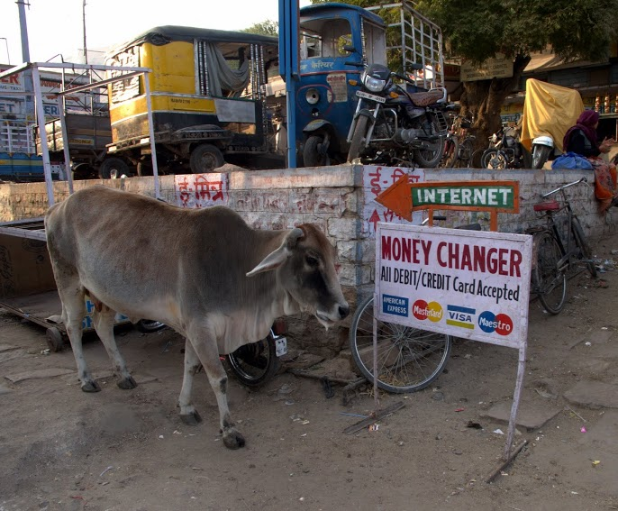
Class 9:
Mapping in Parallel
cs4414 Fall 2013
University of Virginia
David Evans
Jodhpur, India (Dec 2011)

Slide 2
Plan for Today
Recap list map
MapReduce
Tasks in Rust
Multi-threaded map

Slide 3
struct Node {
head : int,
tail : Option<~Node>
}
type List = Option<~Node> ;
trait Map {
fn mapr(&self, &fn(int) -> int) -> List;
}
impl Map for List {
fn mapr(&self, f: &fn(int) -> int) -> List {
match(*self) {
None => None,
Some(ref node) => { Some(~Node{ head: f(node.head),
tail: node.tail.mapr(f) }) },
} } }
You should understand everything in this code.
Ask questions now if there is anything unclear.

Slide 4
Cost of Map
Core 1
What is the running time of p.map(f) using one core where p is a list of N elements and each evaluation of f(x) takes 1ms?

Slide 5
Cost of Multi-Core Map
Core 1
What is the running time of p.map(f) using k cores where p is a list of N elements and each evaluation of f(x) takes 1ms?
Core 2
Core 3
Core 4

Slide 6
How should we parallelize map?
fn mapr(&self, f: &fn(int) -> int) -> List {
match(*self) {
None => None,
Some(ref node) => { Some(~Node{ head: f(node.head),
tail: node.tail.mapr(f) }) },
}
}

Slide 7

OSDI 2004
“MapReduce is a programming model and an associated implementation for processing and generating large data sets. Users specify a map function that processes a key/value pair to generate a set of intermediate key/value pairs, and a reduce function that merges all intermediate values associated with the same intermediate key. Many real world tasks are expressible in this model, as shown in the paper.
Programs written in this functional style are automatically parallelized and executed on a large cluster of commodity machines.”

Slide 8

Did Google invent map?

Slide 9
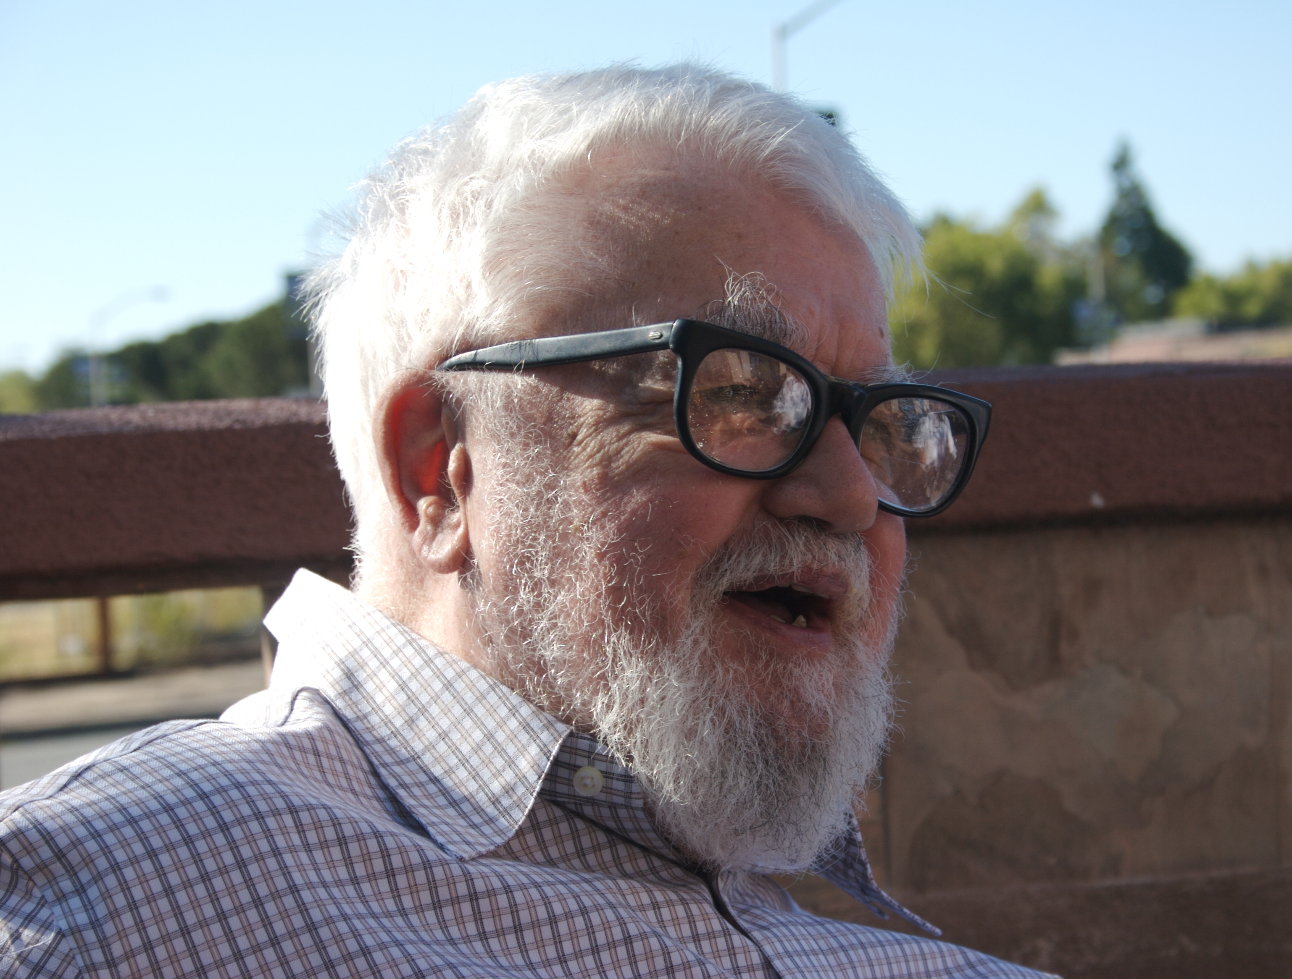
John McCarthy
1927-2011

Slide 10
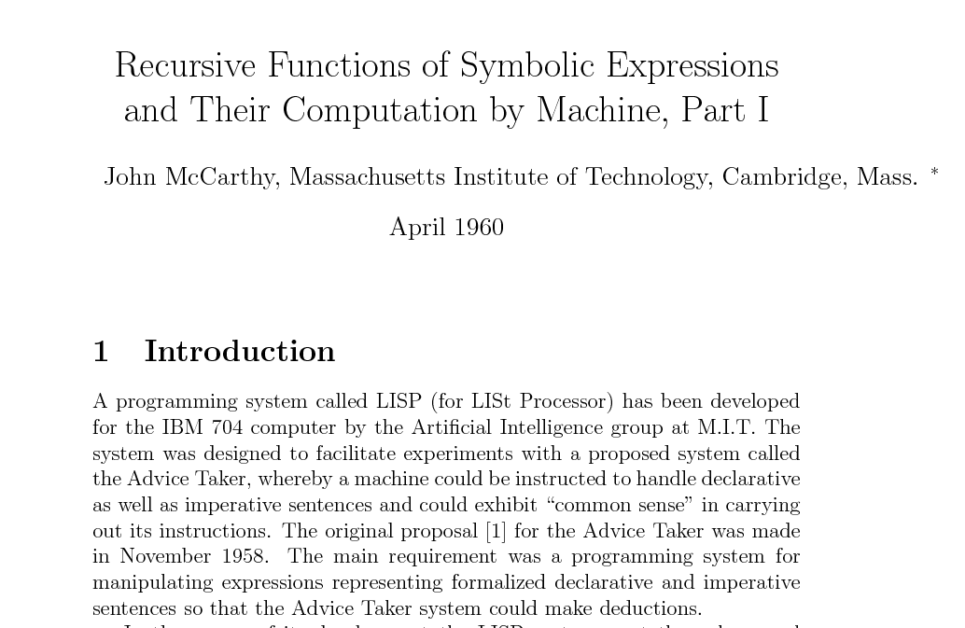

Slide 11
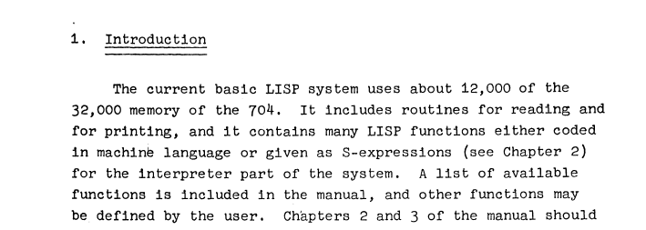
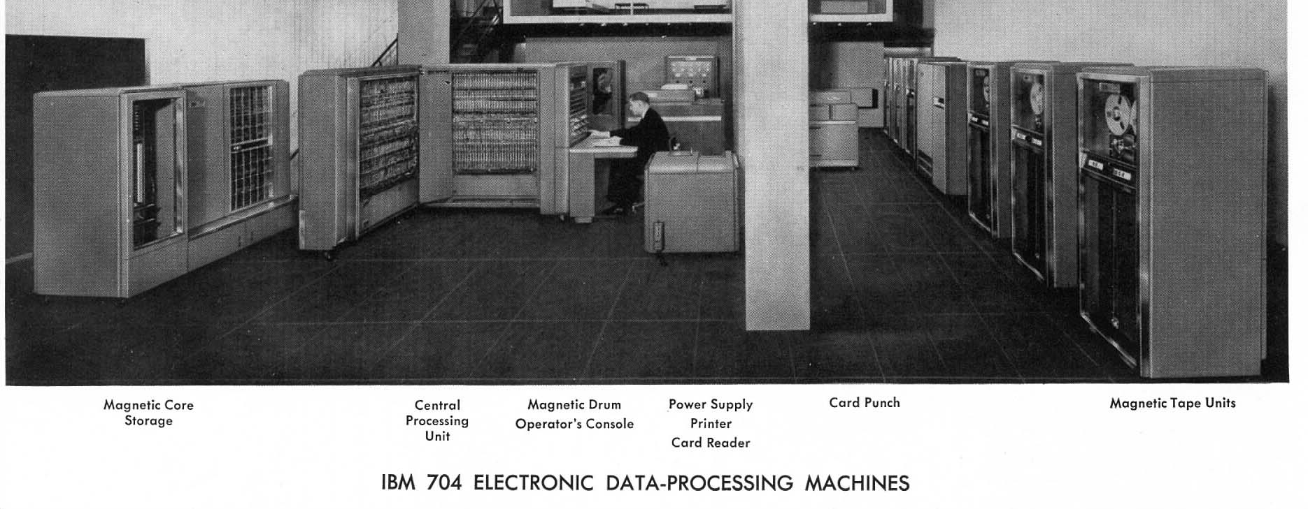
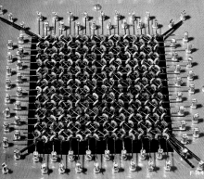
Magentic Core Memory
32,000 36-bit words
40,000 instructions/second
1955-1960: First “mass-produced” computer (sold 123 of them)
1 accumulator register (38 bits), 3 decrement registers (15 bit)
Instructions had 3 bit opcode, 15 bit decrement, 15 bit address

Slide 12
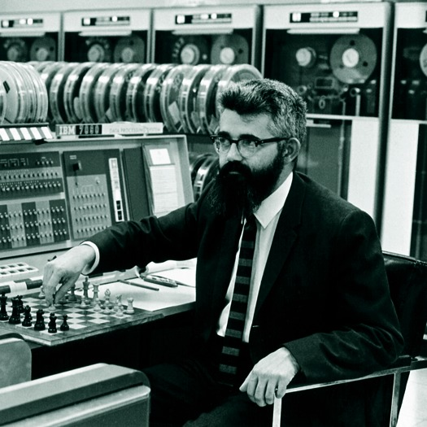
John McCarthy
playing chess with IBM 7090
(1967)

Slide 13
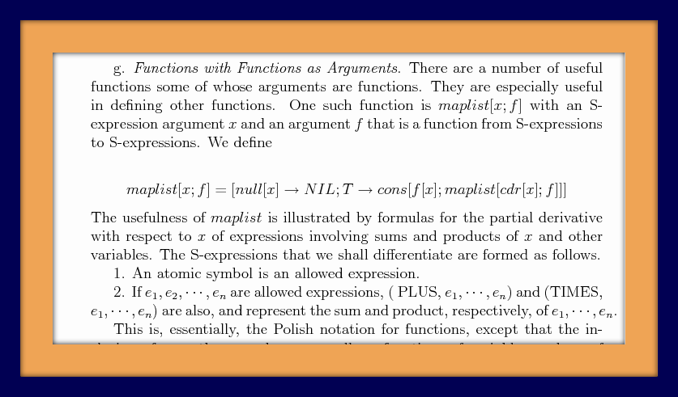
fn mapr(&self, f: &fn(int) -> int) -> List {
match(*self) {
None => None,
Some(ref node) => {
Some(~Node{ head: f(node.head), tail: node.tail.mapr(f) }) },
}
}

Slide 14
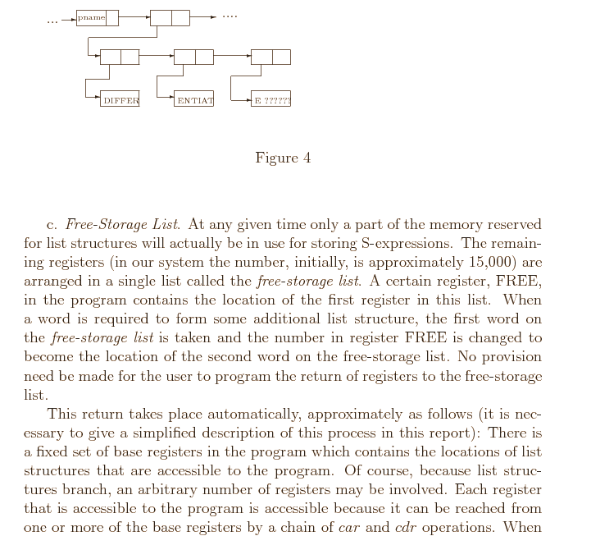

Slide 15
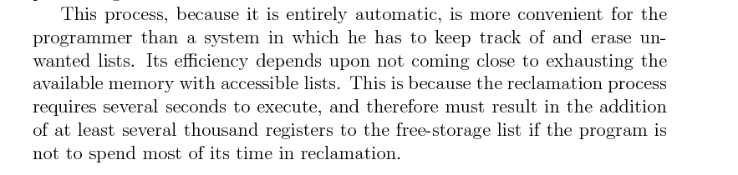
@ pointers (in 1960)

Slide 16
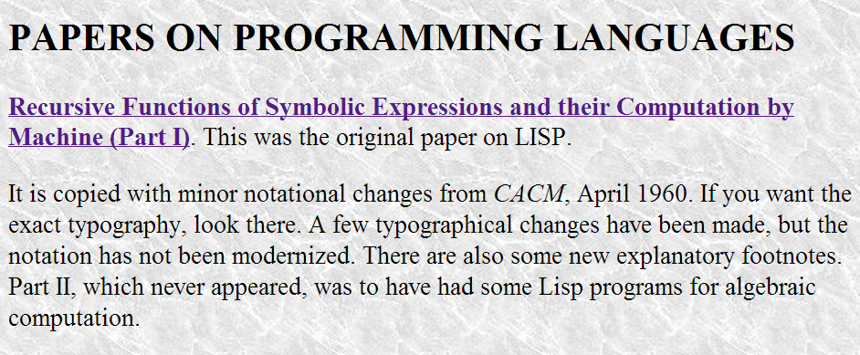

Slide 17
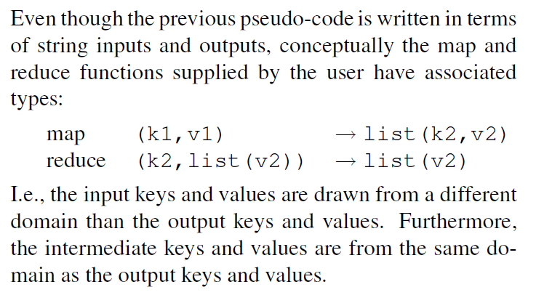
MapReduce
fn mapr(&self, f: &fn(int) -> int) -> List {
match(*self) {
None => None,
Some(ref node) => {
Some(~Node{ head: f(node.head),
tail: node.tail.mapr(f) }) }, } }
Google’s map:

Slide 18
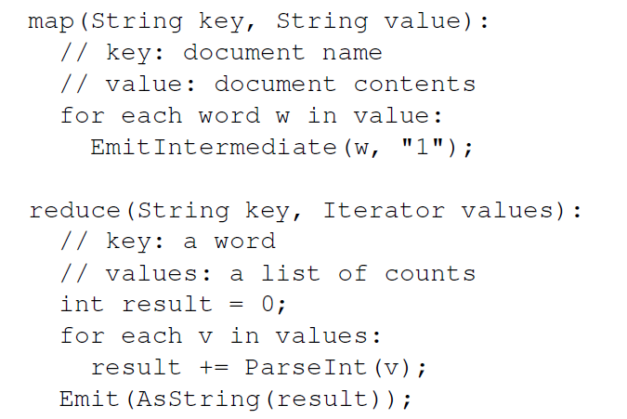

Slide 19
fn mapg<K1, V1, K2, V2>(List<Pair<K1, V1>>,
f: &fn(K1, V1) -> (K2, V2))
-> List<Pair<K2, V2>>
fn reduceg<K, V, R>(K, List<V>) -> List<R>

Slide 20
fn mapg<K1, V1, K2, V2>(List<Pair<K1, V1>>,
f: &fn(K1, V1) -> (K2, V2))
-> List<Pair<K2, V2>>
fn reduceg<K, V, R>(K, List<V>) -> List<R>
fn map_reduce<K1, V1, K2, V2, R>(
List<Pair<K1, V2>>,
mapf: &fn(K1, V1) -> (K2, V2)),
reducef: &fn(K2, List<V2>) -> R))
-> List<R>

Slide 21
fn map_reduce<K1, V1, K2, V2, R>(
data: List<Pair<K1, V2>>,
mapf: &fn(K1, V1) -> (K2, V2)),
reducef: &fn(K2, List<V2>) -> R))
-> List<R> {
}

Slide 22
fn map_reduce<K1, V1, K2, V2, R>(
data: List<Pair<K1, V2>>,
mapf: &fn(K1, V1) -> (K2, V2)),
reducef: &fn(K2, List<V2>) -> R))
-> List<R> {
let ivalues = data.map(mapf)
let mvalues = // merge ivalues by k2
mvalues.map(reducef)
}
Completing the code (with parallel map will finish today) is left as sticker-worthy exercise!

Slide 23
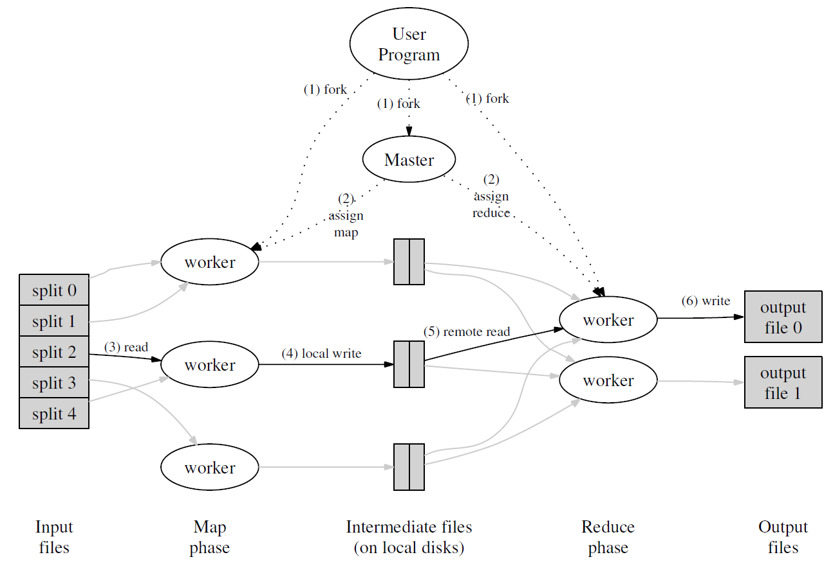
Mapping in Parallel

Slide 24
Processes, Threads, Tasks
Process
Originally: abstraction for owning the whole machine
What do you need:
Thread
(Illusion of) independent sequence of instructions
What do you need:

Slide 25
Processes, Threads, Tasks
Process
Originally: abstraction for owning the whole machine
What do you need:
Thread
(Illusion of) independent sequence of instructions
What do you need:
Own program counter
Own stack, registers
Own memory space
Own program counter
Own stack, registers
Shares memory space

Slide 26
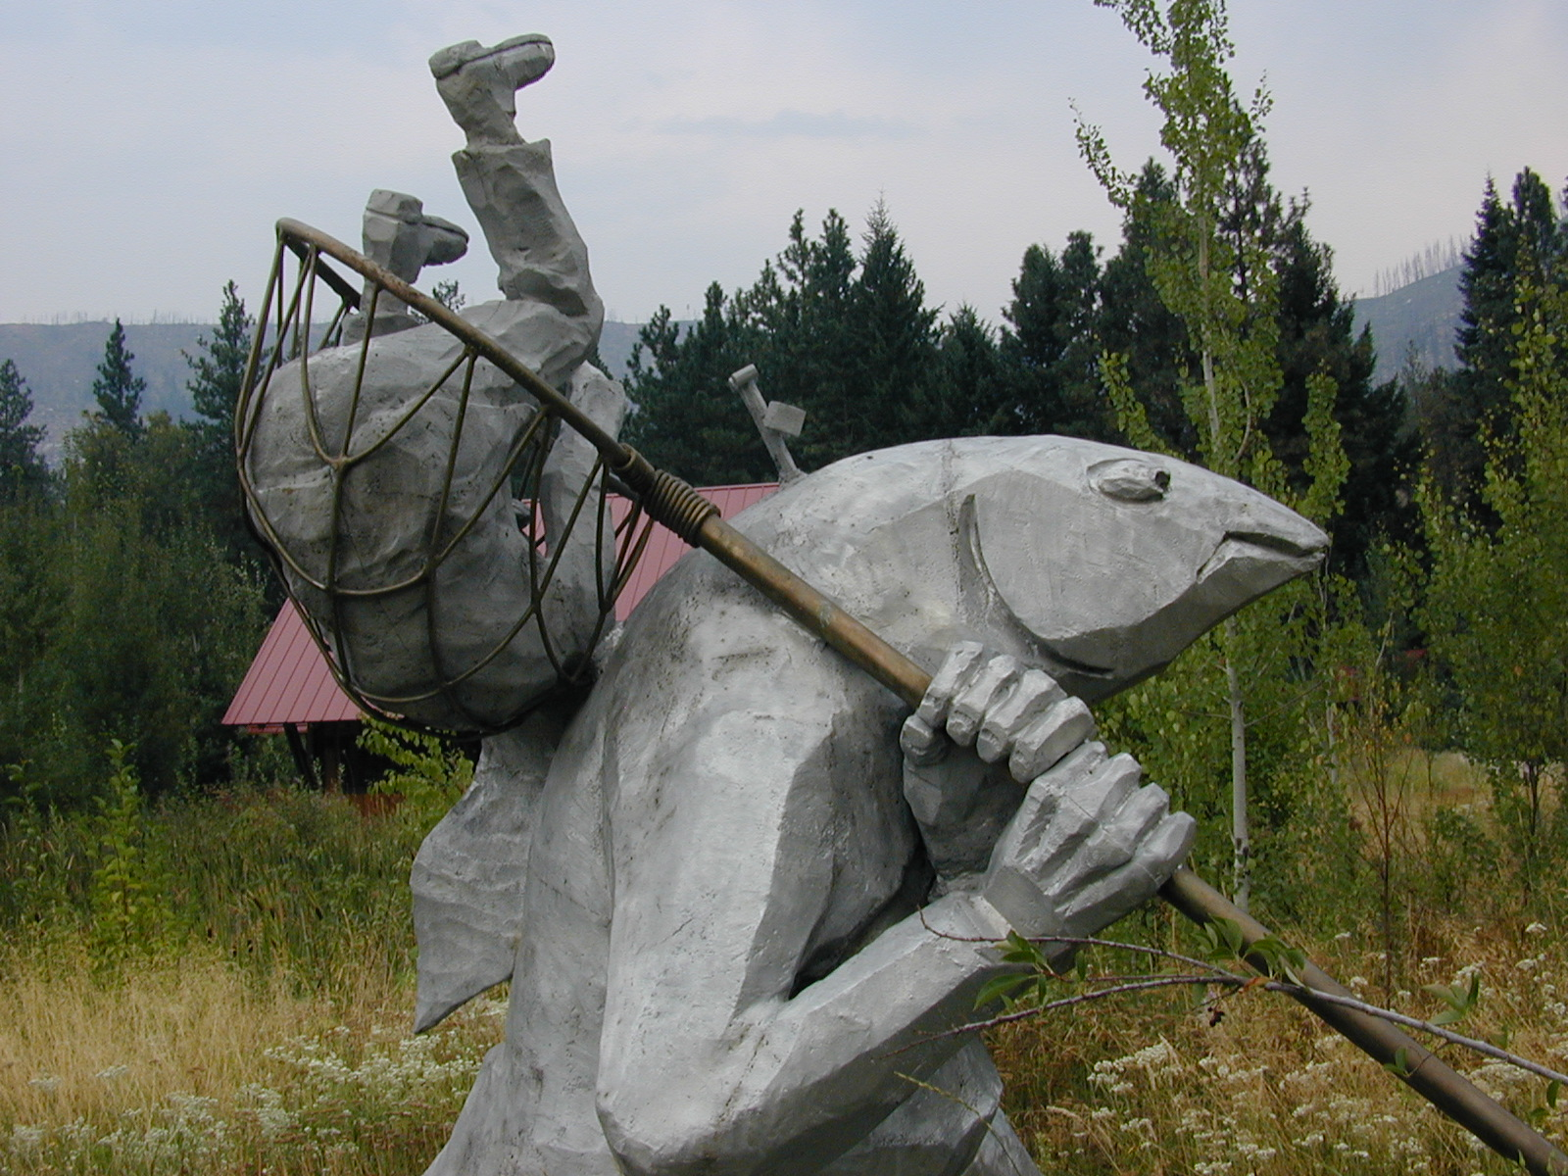
Tasks in Rust

Slide 27
Tasks
fn spawn(f: ~fn())
Own PC
Own stack, registers
Safely shared immutable memory
Safely independent own memory
spawn( | | {
println(“Get back to work!”);
});
syntactic sugar:
do spawn {
println(“Get back to work!”);
}
Task = Thread – unsafe memory sharing
or
Task = Process + safe memory sharing – cost of OS process

Slide 28
impl Map for List {
fn mapr(&self, f: &fn(int) -> int) -> List {
match(*self) {
None => None,
Some(ref node) => {
Some(~Node{ head: f(node.head),
tail: node.tail.mapr(f) })
},
}
}
}
Original single-threaded mapr
fn spawn(f: ~fn())

Slide 29
First attempt
impl Map for List {
fn mapr(&self, f: extern fn(int) -> int) -> List {
match(*self) {
None => None,
Some(ref node) => {
do spawn {
f(node.head)
}
Some(~Node{ head: ?,
tail: node.tail.mapr(f) })
},
}
}
}
Cannot use node here!

Slide 30
impl Map for List {
fn mapr(&self, f: extern fn(int) -> int) -> List {
match(*self) {
None => None,
Some(ref node) => {
let val = node.head;
do spawn {
f(val)
}
Some(~Node{ head: ?,
tail: node.tail.mapr(f) })
},
}
}
}
How can we get results back from a spawned task without shared memory?

Slide 31
Channels
let (port, chan) : (Port<int>, Chan<int>) = stream();
let val = node.head;
do spawn {
chan.send(f(val));
}
let newval = port.recv();

Slide 32
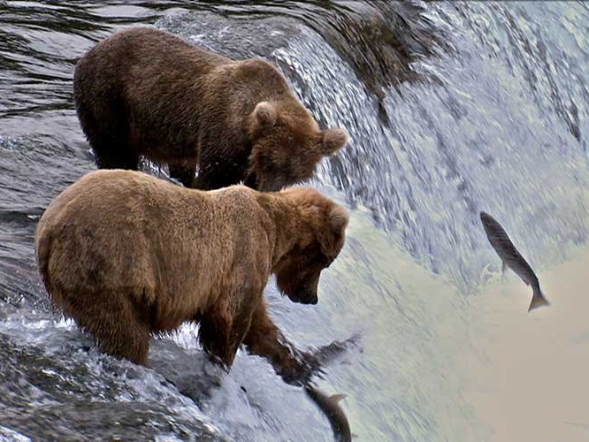
spawning up stream
is tough, but Rust saves you from all the bears!

Slide 33
First attempt
fn mapr(&self, f: extern fn(int) -> int) -> List {
match(*self) {
None => None,
Some(ref node) => {
let (port, chan) : (Port<int>, Chan<int>) = stream();
let newtail = node.tail.mapr(f);
let val = node.head;
do spawn {
chan.send(f(val));
}
Some(~Node{ head: port.recv(), tail: newtail })
}
}
}
}
Compiles are runs fine and produces correct output…
but has a major bug!

Slide 34
Now we’re spawning!
fn mapr(&self, f: extern fn(int) -> int) -> List {
match(*self) {
None => None,
Some(ref node) => {
let (port, chan) : (Port<int>, Chan<int>) = stream();
let val = node.head;
do spawn {
chan.send(f(val));
}
let newtail = node.tail.mapr(f);
Some(~Node{ head: port.recv(), tail: newtail })
}
}
}
}

Slide 35
fn collatz_steps(n: int) -> int {
if n == 1 { 0 } else { 1 + collatz_steps(if n % 2 == 0 { n / 2 } else { 3*n + 1 }) }
}
fn find_collatz(k: int) -> int {
// Returns the minimum value, n, with Collatz stopping time >= k.
let mut n = 1;
while collatz_steps(n) < k { n += 1; }
n
}
fn main() {
let lst0 : List = Some(~Node{head: 400, tail:
Some(~Node{head : 410, tail:
Some(~Node{head: 420, tail:
Some(~Node{head: 430, tail: None})})})});
println(lst0.to_str());
let lst1 = lst0.mapr(find_collatz);
println(lst1.to_str());
let lst2 = lst1.mapr(find_collatz);
println(lst2.to_str());
}

Slide 36
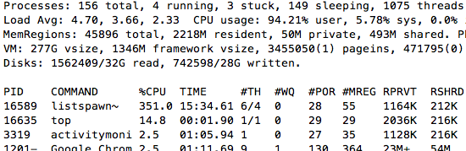
When 350+% of your CPU isn’t fast enough, its time to buy a new computer!

Slide 37



Slide 38
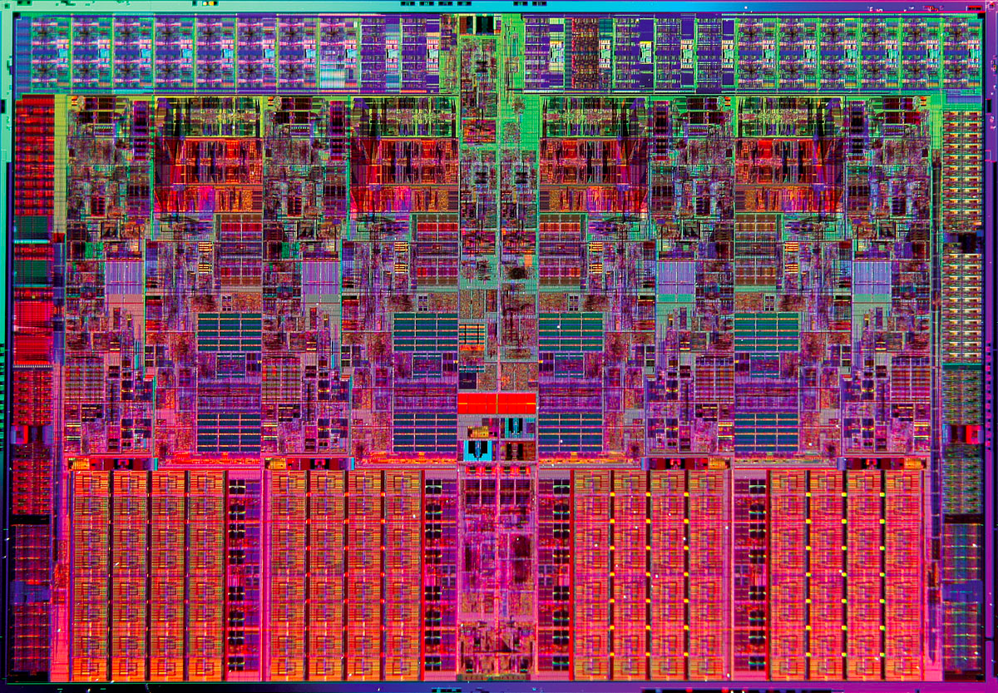
Intel i7 Quad-Core Processor

Slide 39
Intel i7 Quad-Core Processor
Core
Core
Core
Core
Shared Memory Cache (L3 = 6MB)

Slide 40
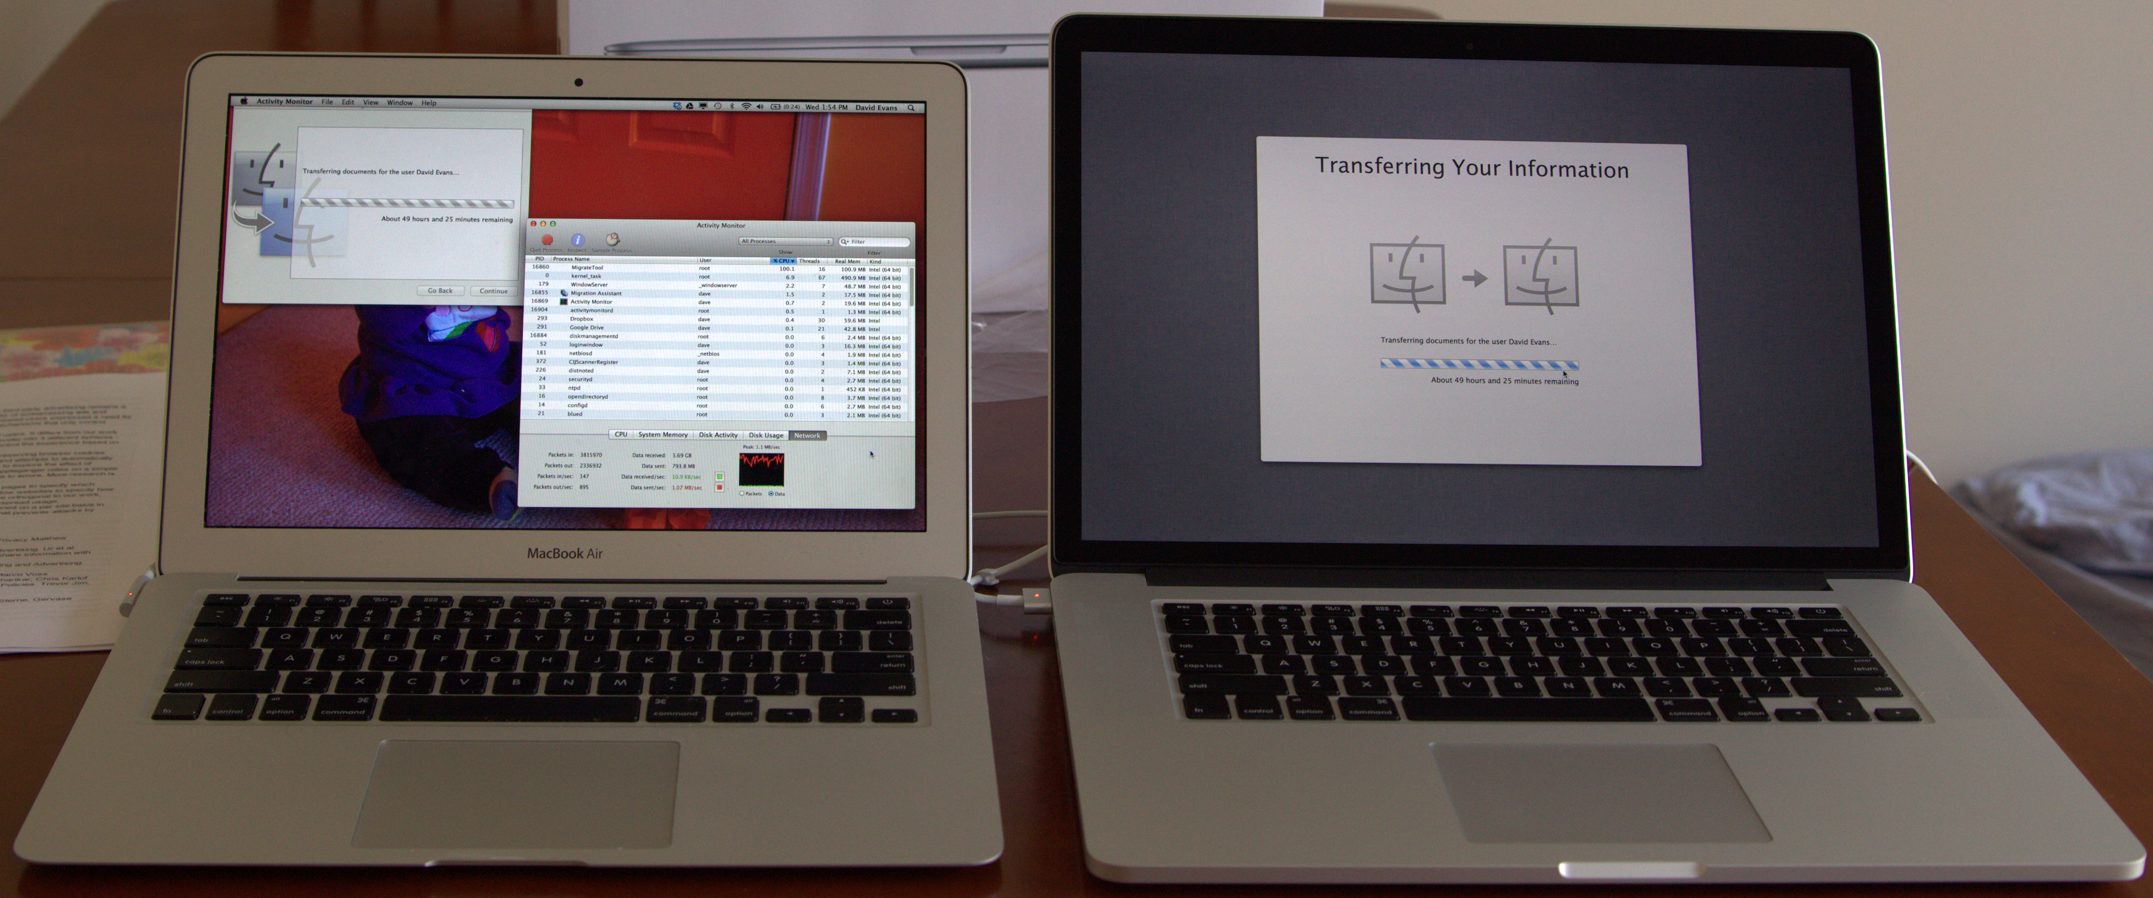
How much faster will my Rust mapping program be on my new machine?
60 seconds
?
2011 MacBook Air
Intel i5-2557M
1.7 GHz, 2 cores (4 threads)
3 MB shared L3 cache
2013 MacBook Pro
Intel i7-3740QM
2.7 GHz, 4 cores (8 threads)
6MB shared L3 cache
both support “hyperthreading” (two threads per core)

Slide 41


Slide 42
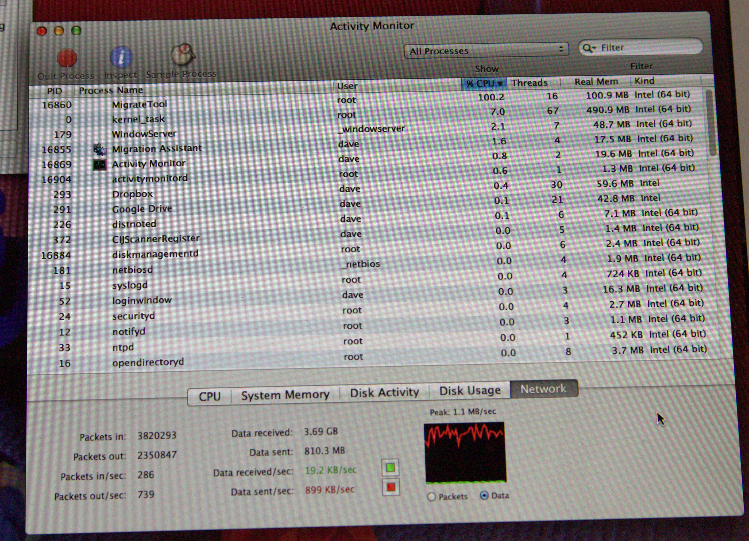
PS2 due by 8”59
Submit your “guesses” and reasoning in course forum….hopefully I will know the actual answer by Tuesday!

Slide 43


